Slide 1
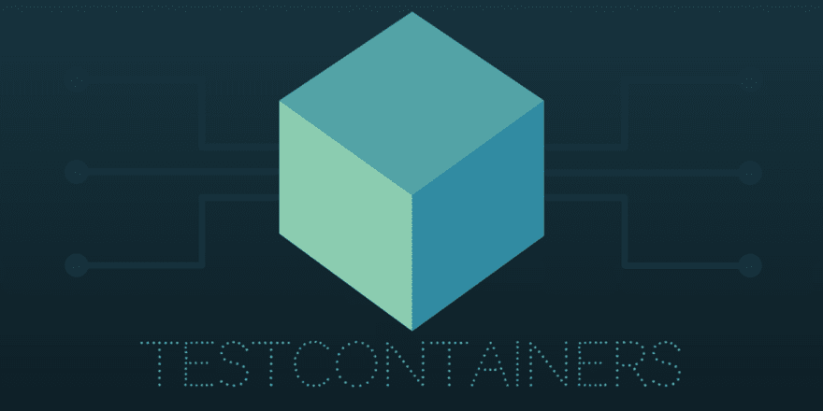
Tescontainers
22 December 2023
Mykahilo Trofimov

Slide 2



Unit tests with real dependencies
HOW IT WORKS
Many languages
Testcontainers is an open source framework for providing throwaway, lightweight instances of databases, message brokers, web browsers, or just about anything that can run in a Docker container.
Test dependencies as code
Run
GenericContainer redis = new GenericContainer("redis:5.0.3-alpine")
.withExposedPorts(6379);
Real
Dependencies
In test

Slide 3













Support for
01
SQL Database: 16 positions
NoSQL Database: 13 positions
Message Broker: 6 positions
Cloud: 6 positions
Web: 5 positions
...n
Other: 10 positions
Custom: ∞ positions

Slide 4
Example...
$ docker -H tcp://174.17.0.1:2376 ps
$ docker build
$ docker cp
$ docker logs -f

Slide 5
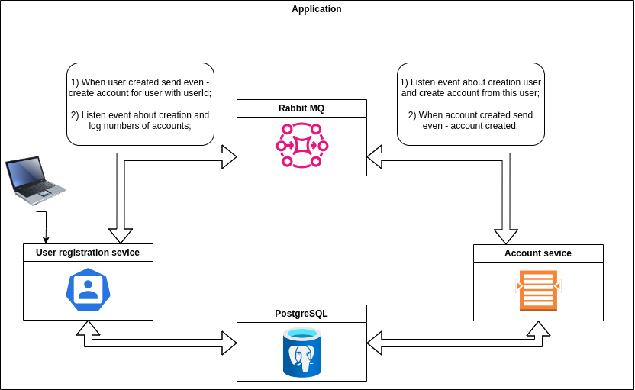
Example
Diagram

Slide 6
Some difficulties
with communication
$ localhost ne host
$ network
$ alias

Slide 7
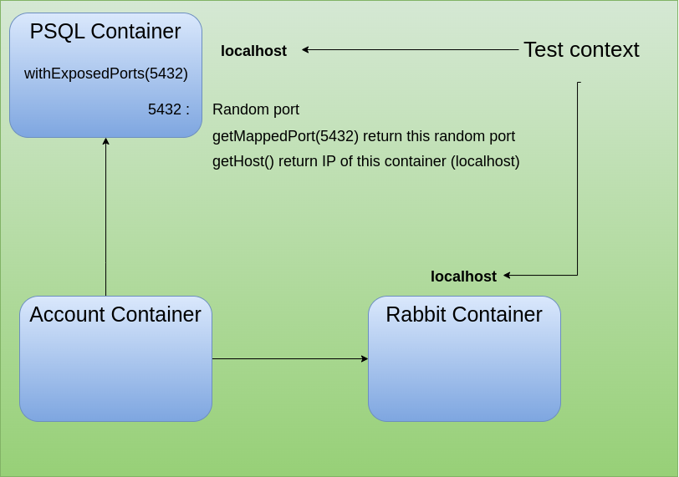

http://localhost:7743
http://rabbit:1901
http://localhost:12991

Slide 8

Conclusions
or
after party.
- Testcontainers help with testing in a near-prod environment.
- On-demand isolated infrastructure
- Consistent experience on both local and CI environments
- Reliable test setup using wait strategies
- Advanced networking capabilities
- Automatic clean up
Need more tests...
curl https://all-web -H “cool-images”

Slide 9
Thank You
$ docker ps
$ docker rm -f 7743bf3

