Slide 1
Group Project Idea - Applied Medical Signal Analysis Detection & Classification of Premature Ventricular Contractions (PVC) in ECG
Abdelmoaty A., Alam J., Bokor P., Eichleitner D., Galle D.

Slide 2
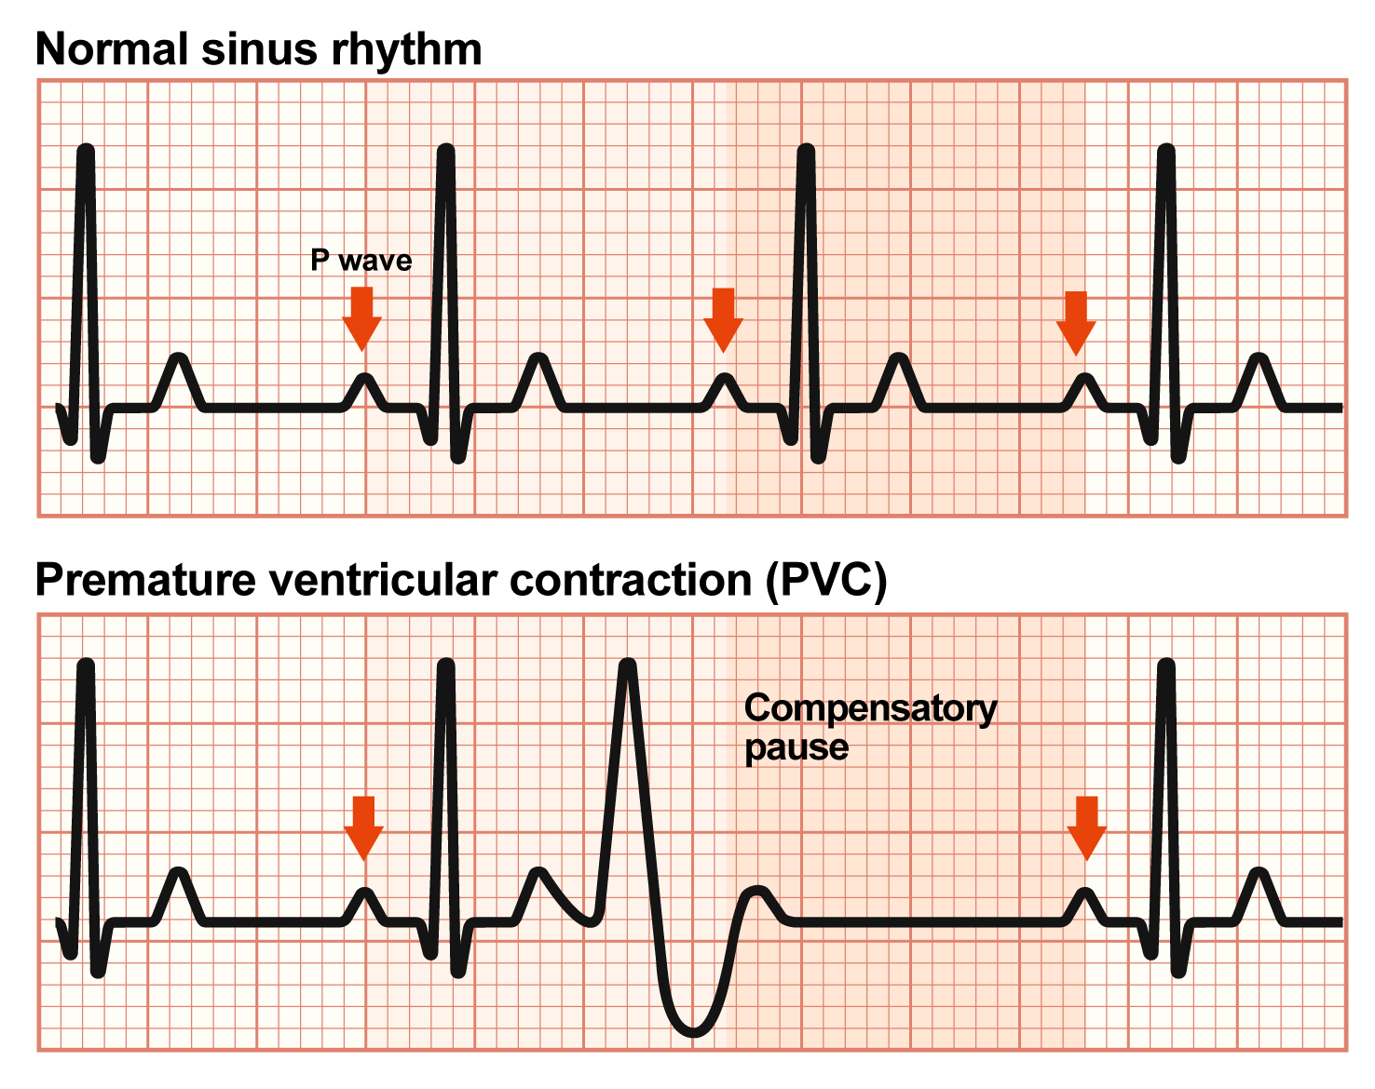
Premature Ventricular Contractions
Premature Ventricular Contractions (PVC) are a form of ectopic heart beat – posing a disturbance in regular heart rhythm
PVC can appear in regular healthy hearts upon (physical and mental) stress, however, they might also be an early warning sign for significant disease of the cardiovascular system
These PVC extra systoles show a distinct pattern in electrocardiograms

Slide 3
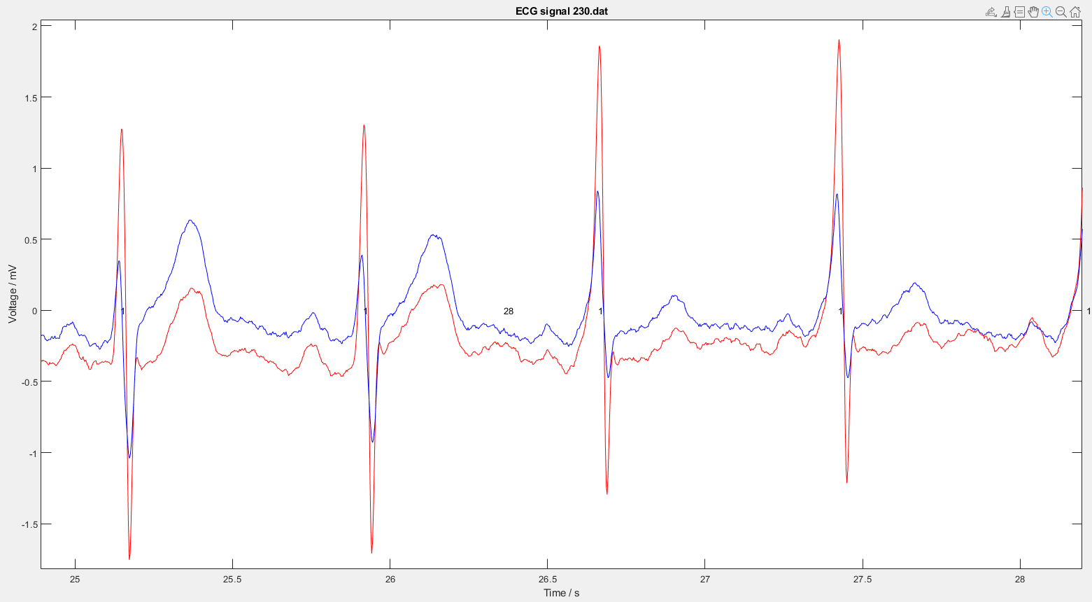
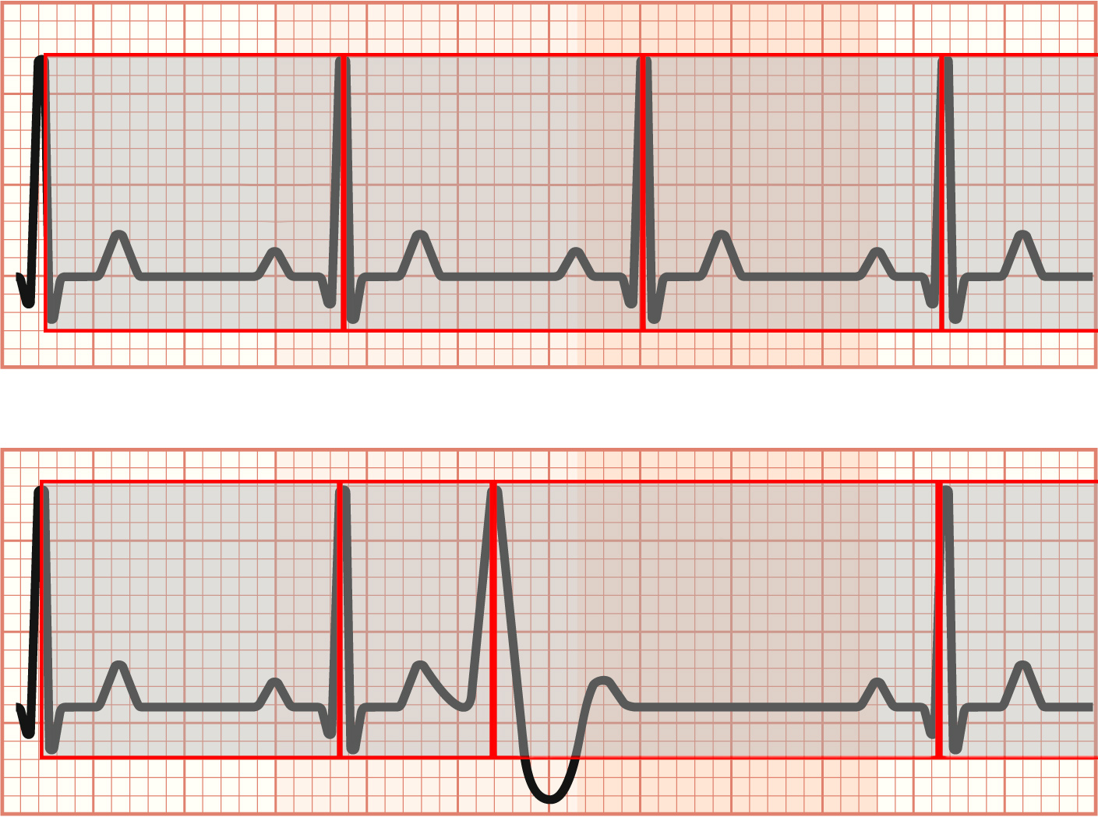
Project Idea Outline
Obtain ECG dataset containing normal sinus heartbeat as well as arrhythmic datasets → https://physionet.org/content/mitdb/1.0.0/
MIT-BIH dataset provides labelled data sufficient for the projects scope
Use Matlab to read in and process the data (high pass filter for baseline normalization)
Classify the highest peaks (QRS complexes) by intensity threshold
Declare windows and size them to span from one QRS complex to the next
Norm the window length to get rid of pulse/bpm influence
Train either a SVM or a CNN with windowed data → to be determined, Matlab offers functionalities for both

Slide 4
MIT-BIH Dataset Massachusetts Institute of Technology – Beth Israel Hospital Arrhythmia Database
Rhythm annotations appear below the level used for beat annotations:
(AB | Atrial bigeminy
(AFIB | Atrial fibrillation
(AFL | Atrial flutter
(B | Ventricular bigeminy
(BII | 2° heart block
(IVR | Idioventricular rhythm
(N | Normal sinus rhythm
(NOD | Nodal (A-V junctional) rhythm
(P | Paced rhythm
(PREX | Pre-excitation (WPW)
(SBR | Sinus bradycardia
(SVTA | Supraventricular tachyarrhythmia
(T | Ventricular trigeminy
(VFL | Ventricular flutter
(VT | Ventricular tachycardia
The MIT-BIH Arrhythmia Database contains 48 half-hour excerpts of two-channel ambulatory ECG recordings, obtained from 47 subjects studied by the BIH Arrhythmia Laboratory between 1975 and 1979.
Twenty-three recordings were chosen at random from a set of 4000 24-hour ambulatory ECG recordings collected from a mixed population of inpatients (about 60%) and outpatients (about 40%) at Boston's Beth Israel Hospital;
the remaining 25 recordings were selected from the same set to include less common but clinically significant arrhythmias that would not be well-represented in a small random sample.
The recordings were digitized at 360 samples per second per channel with 11-bit resolution over a 10 mV range. Two or more cardiologists independently annotated each record; disagreements were resolved to obtain the computer-readable reference annotations for each beat (approximately 110,000 annotations in all) included with the database.

