Slide 1
Group Project Documentation - Applied Medical Signal Analysis Detection & Classification of Premature Ventricular Contractions (PVC) in ECG
Abdelmoaty A., Alam J., Bokor P., Eichleitner D., Galle D.

Slide 2
Introduction

Slide 3
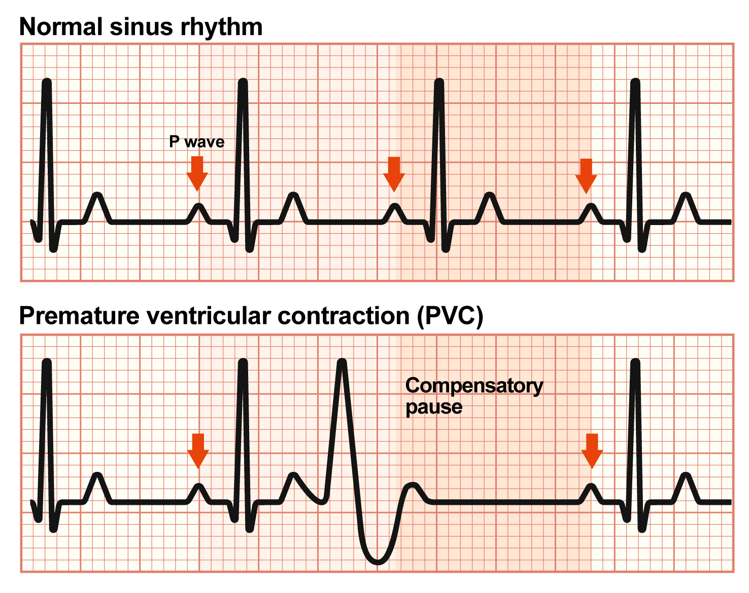
Premature Ventricular Contractions
Premature Ventricular Contractions (PVC) are a form of ectopic heart beat – posing a disturbance in regular heart rhythm
PVC can appear in regular healthy hearts upon (physical and mental) stress, however, they might also be an early warning sign for significant disease of the cardiovascular system
These PVC/ extra systoles show a distinct pattern in electrocardiograms

Slide 4
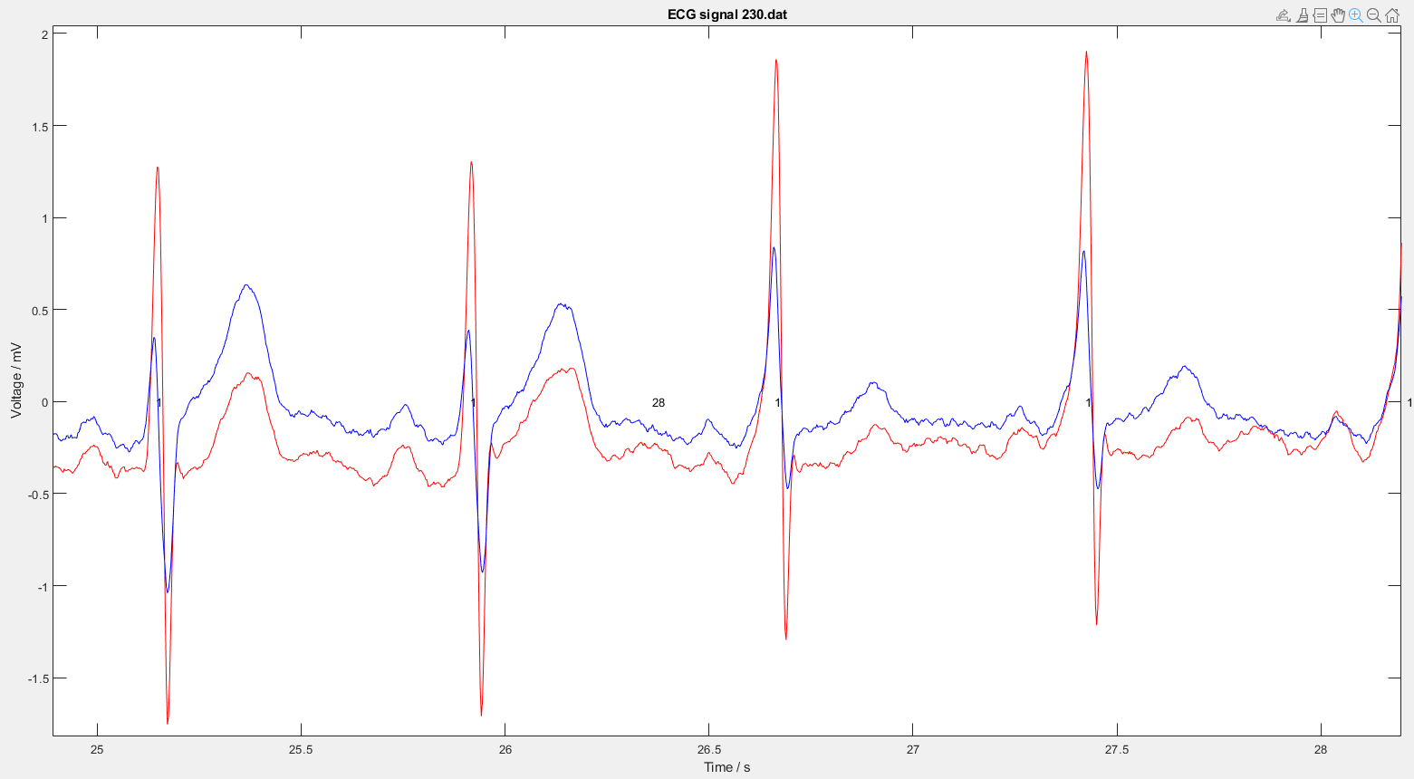
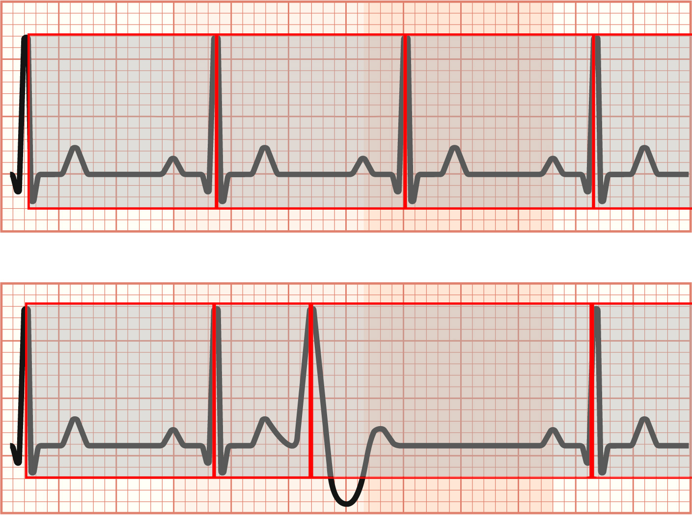
Project Idea Outline
Obtaining ECG dataset containing normal sinus heartbeat as well as arrhythmic datasets → https://physionet.org/content/mitdb/1.0.0/
Matlab usage for visualizing, processing the data (high pass filter for baseline normalization) & neural network training
Classification of R waves(QRS complexes)
Declaration of windows and size them to span from one QRS complex to the next (RR interval)
Norming the window length to get rid of HRV (heart rate variability) influence
NN training with windowed data → patternnet in Matlab

Slide 5
Material & Methods

Slide 6
MIT-BIH Dataset Massachusetts Institute of Technology – Beth Israel Hospital Arrhythmia Database
Rhythm annotations appear below the level used for beat annotations:
AB | Atrial bigeminy
AFIB | Atrial fibrillation
AFL | Atrial flutter
B | Ventricular bigeminy
BII | 2° heart block
IVR | Idioventricular rhythm
N | Normal sinus rhythm
NOD | Nodal (A-V junctional) rhythm
P | Paced rhythm
PREX | Pre-excitation (WPW)
SBR | Sinus bradycardia
SVTA | Supraventricular tachyarrhythmia
T | Ventricular trigeminy
VFL | Ventricular flutter
VT | Ventricular tachycardia
The MIT-BIH Arrhythmia Database contains 48 half-hour excerpts of two-channel ambulatory ECG recordings, obtained from 47 subjects studied by the BIH Arrhythmia Laboratory between 1975 and 1979.
Twenty-three recordings were chosen at random from a set of 4000 24-hour ambulatory ECG recordings collected from a mixed population of inpatients (about 60%) and outpatients (about 40%) at Boston's Beth Israel Hospital;
the remaining 25 recordings were selected from the same set to include less common but clinically significant arrhythmias that would not be well-represented in a small random sample.
The recordings were digitized at 360 samples per second per channel with 11-bit resolution over a 10 mV range. Two or more cardiologists independently annotated each record; disagreements were resolved to obtain the computer-readable reference annotations for each beat (approximately 110,000 annotations in all) included with the database.

Slide 7
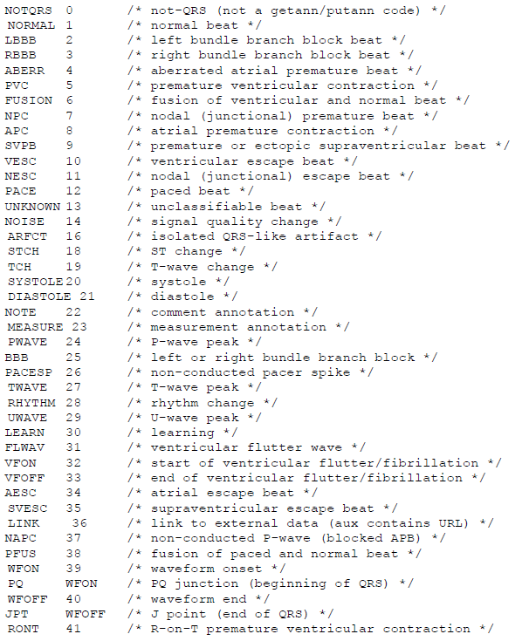
MIT-BIH Dataset Annotations
MIT-BIH Arrhythmia dataset comes with a set of annotations that were performed and checked by multiple medical doctors
Original ECG data annotations used numbering system between 0 and 49 → see reference image
Within the framework of this project, the numbers 0, 1, 12, 20, 21, 38 were considered „normal“ events related to the QRS complex. This approach yields useful labelling for further classification
The remaining annotation numbers were grouped as the collective label „arrhythmia“

Slide 8
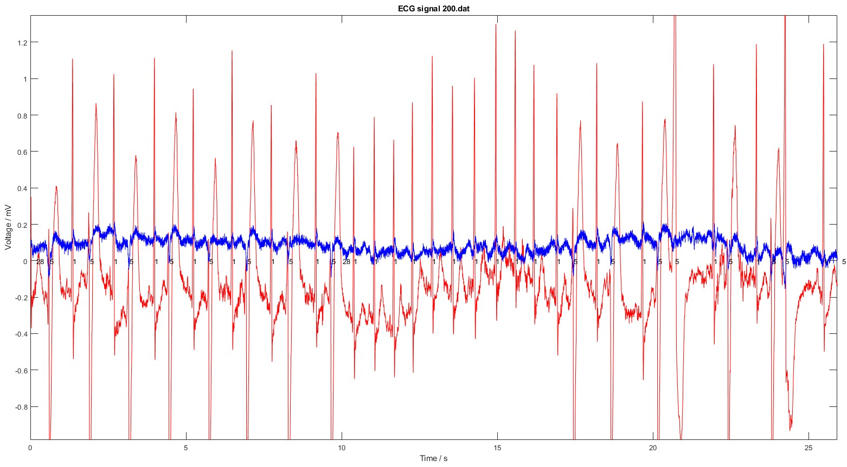
Data Preparation ECG Signal Visualization
Dual channel binary ECG datafiles
Loaded & visualized in Matlab → see right
Channel 1 (red, MLII) used for training and classifcation
Channel 2 (blue, Lead-V1) unused
ECG Signal Channel 1 Preprocessing using
High Pass Filter
Square
Squareroot
Norming [0,1]

Slide 9
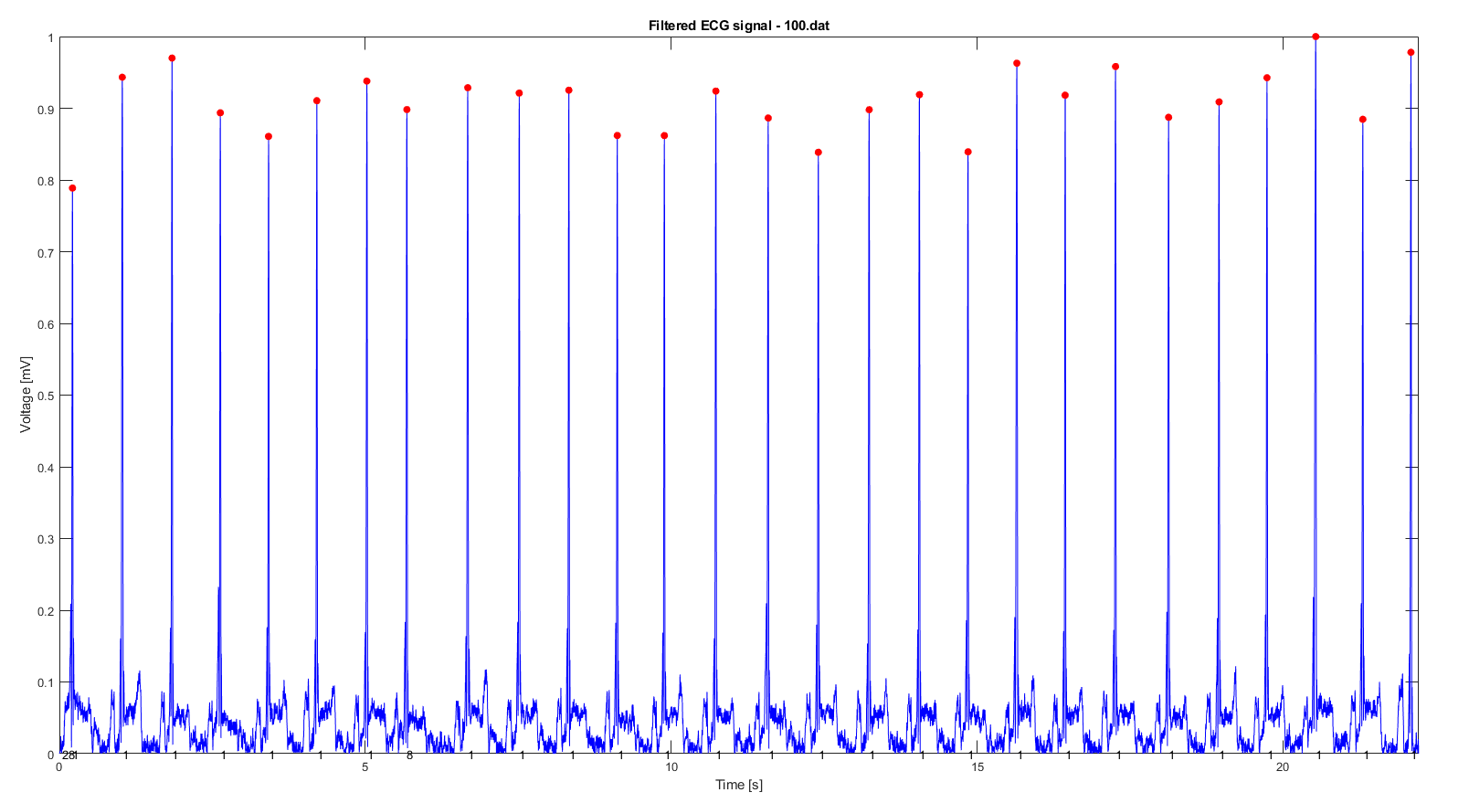
Data Preparation QRS Peak Detection
Threshold based peak detection of QRS complex → Average heart rate calculation & heart rate variability (HRV) calculation
R wave provided with database as label ‚1‘ if no other factor is predominant

Slide 10
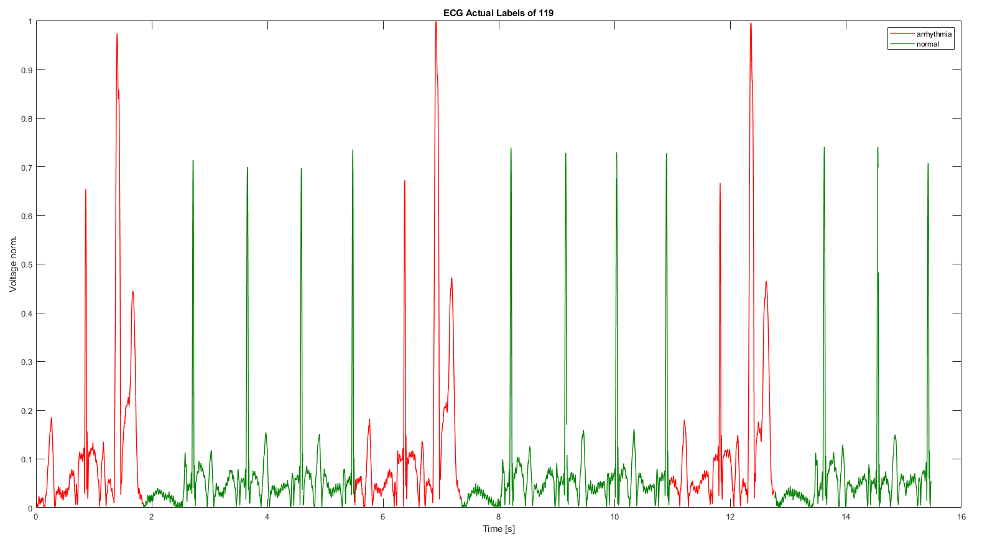
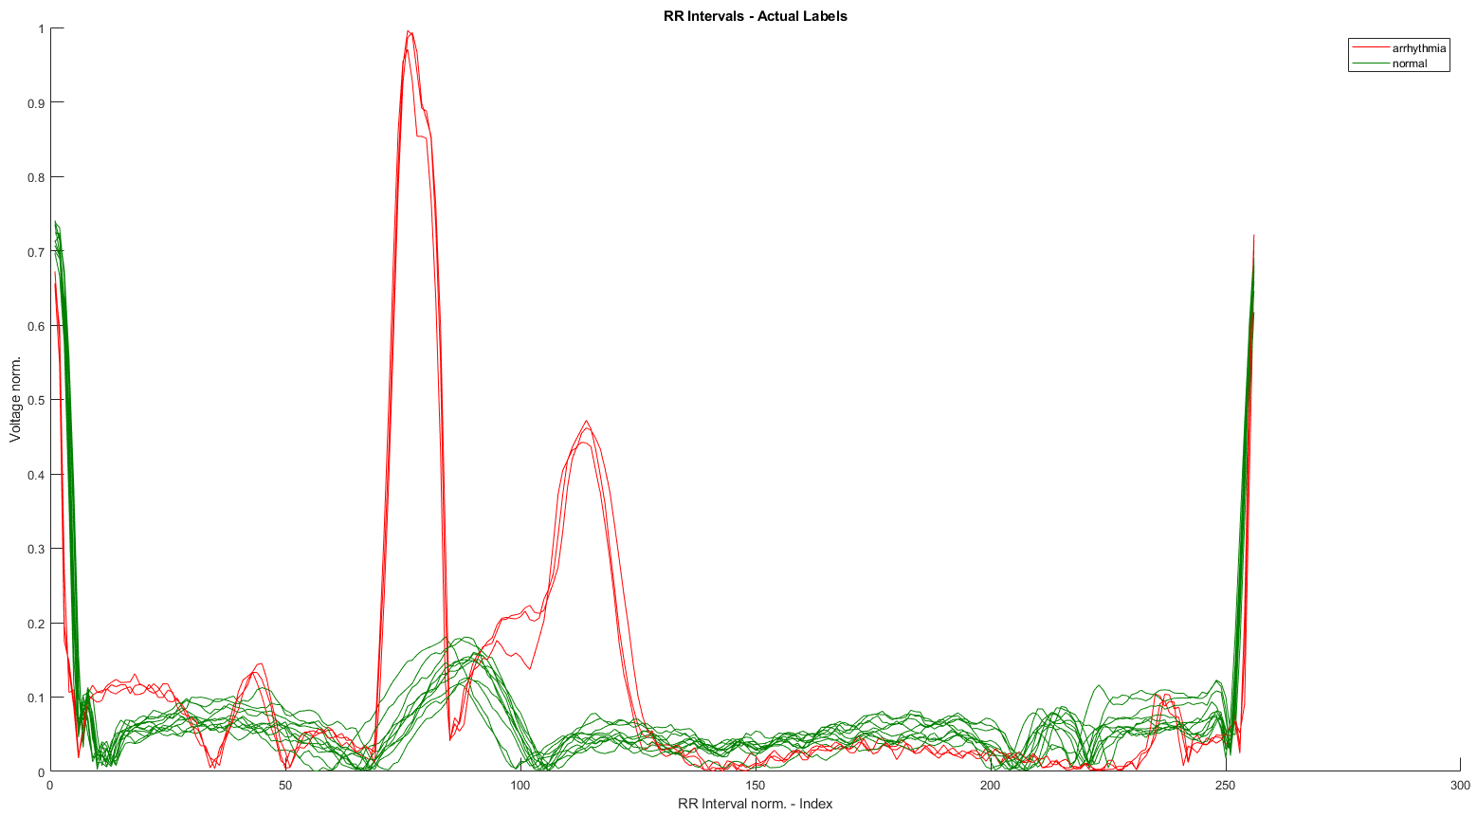
Data Preparation Preprocessing for Neural Network
ECG signal channel 1 preprocessing
High Pass Filter (elimination of offset and low frequency noise)
Square (elimination of negative values)
Square root (scaling to enhance low signals)
Norm y-axis (Voltage max = 1)
Annotations for ECG channel 1 are loaded and QRS complexes labelled
Data between QRS complexes (= RR intervals) are taken into consideration and get individually stored in „windows“ array
Preparation of RR interval „windows“
The windows are normed in the x-axis (time) to be exactly 256 datapoints long. This exterminates the influence of HRV (heart rate variability) and brings the data in shape for the neural network training
Each window is searched for corresponding annotations in the database. If there are annotations present that correspond to arrhythmia the whole window is labelled as ‚arrhythmia‘ (red). If there are none or only regular annotations, the window is labelled as ‚normal‘ (green)

Slide 11
Neural Network Training Samples & Parameters
Patternnet was trained on multiple ECG samples [100, 101, 103, 104, 105, 106, 112, 114, 115, 116, 117, 200, 208, 214, 221]
For each sample the first 200000 datapoints (roughly 550s) were used, resulting in 8034 available RR interval windows for training
Training was done with the Levenberg-Marquardt algorithm for 20 epochs with a learning rate of 0.06 (set by empirical testing)
80% were used for training, 20% for testing/validation

Slide 12
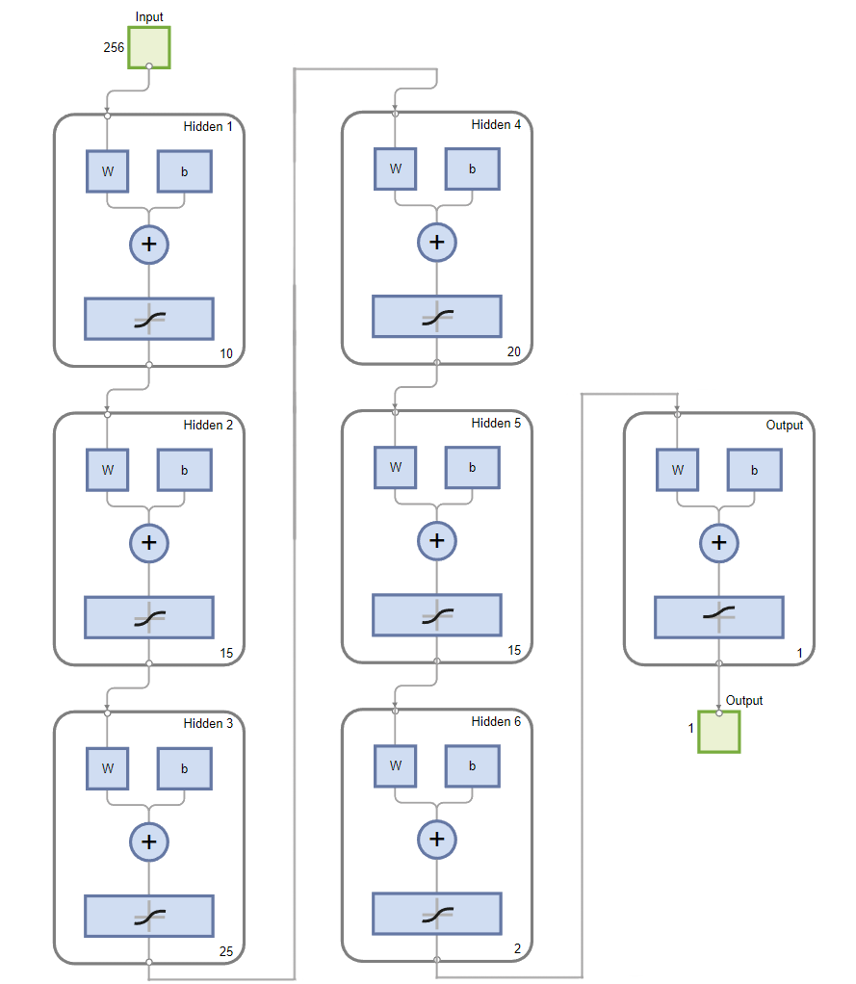
Neural Network Training Patternnet Structure
Input = 256 (RR intervals norm.)
Hidden = [10, 15, 35, 20, 10, 5]
Output = 2 ('1'= 'normal‘, '2'='arrhythmia‘)

Slide 13
Results

Slide 14
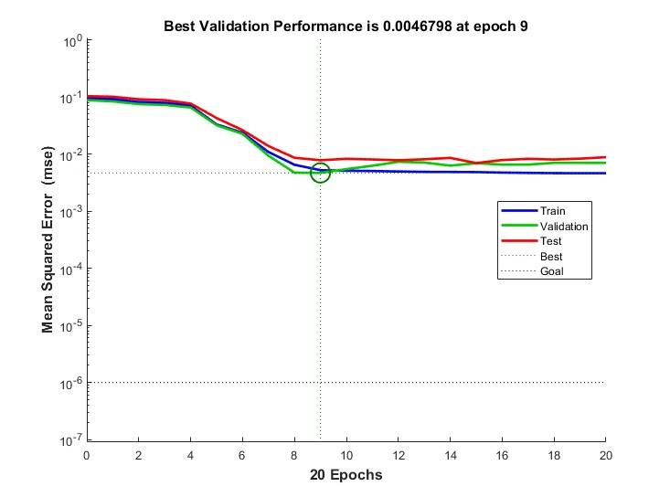
Neural Network Training Performance
Performance in general was very good upon training, yielding accuracy of ~98.69%
However, plateauing of accuracy for test, training and validation partitions was found to form at epoch 9

Slide 15
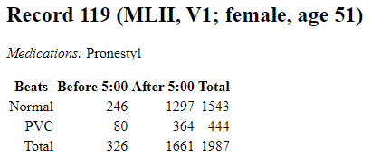
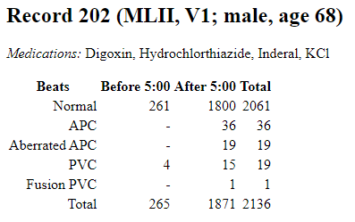
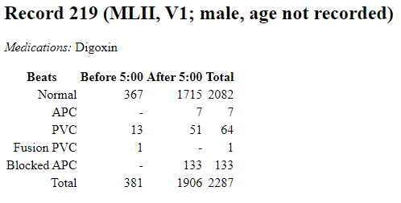
Validation Test Samples
Prediction on ECG signals previously not trained, tested or validated on neural network
ECG files 119, 202, 219 were selected, due to their presence of normal and PVC events
200000 datapoints (~550s) used for validation → 1634 RR interval windows
Confusion Matrix
1467 0
4 163
Accuracy of 99.75% achieved

Slide 16
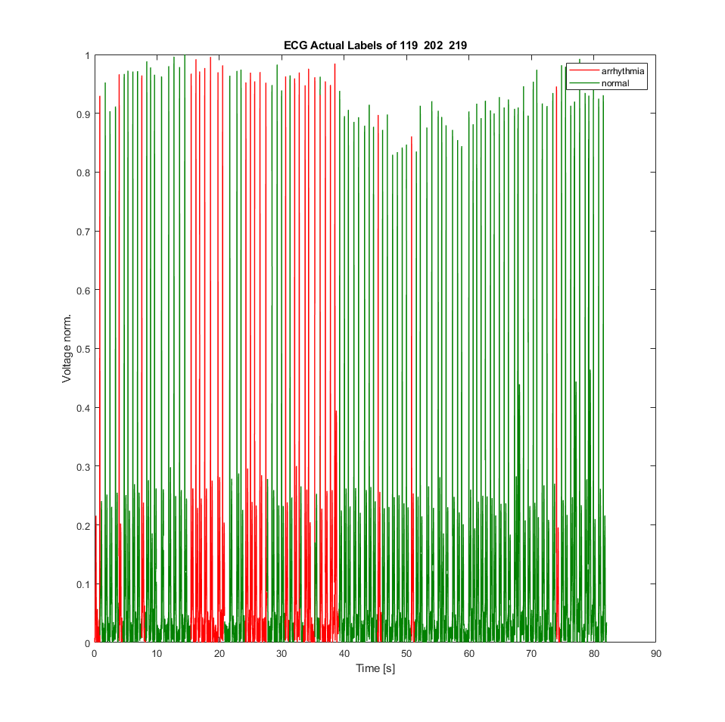

Validation Test Prediction of 119, 202, 219 – ECG norm.

Slide 17
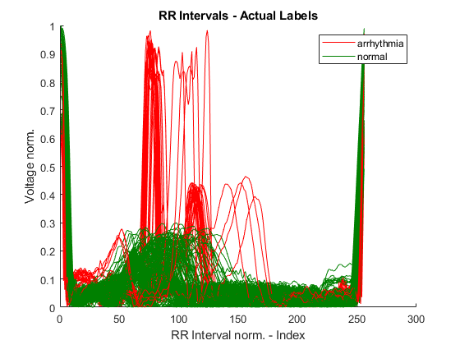
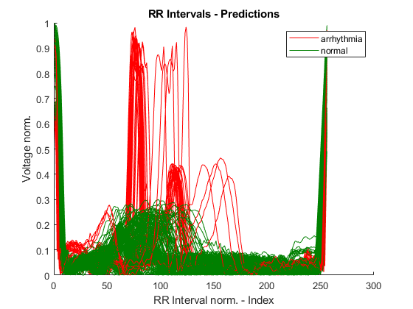
Validation Test Prediction of 119, 202, 219 – RR Intervals

Slide 18
Discussion

Slide 19
Discussion Future Improvement & Development Suggestions
Suggested steps for improvements
Data:
Verify annotation on training dataset
Split into more output classes to differentiate types of arrhythmia
Use 2nd ECG channel for additional features extraction & multidimenional training
Model & Training:
Add more data points and/or other datasets to training
Adaptions to hidden layer structure & amount of nodes
Dropout rates to reduce overfitting
Introduction of batch training to lower noise in loss rate calculation
Other training algorithms (Resilient Backpropagation, Broyden-Fletcher,…)

Slide 20
Thank you for your attention!

