Slide 1

SIGN LANGUAGE Recognition system Group ID: 5
Student Name:
1] Suraj gawade (412)
2] saurabh kumatkar
3] Aditya pise
4] GEET LAKHE
Guide Name : Mrs. Mohini arote
P.E.S Modern College of Engineering, Pune-05. AY: 2021-2022

Slide 2



Introduction
Sign language is a type of language that uses manual communication to convey meaningful messages to other people. This includes simultaneous employing of hand gestures, movement, orientation of the fingers, arms or body, and facial expressions to convey a speaker's ideas.
A real-time sign language translator is required for facilitating communication between the deaf community and the general public.
A real-time sign language translator is required for facilitating communication between the deaf community and the general public. We implemented 27 symbols(A-Z, blank) of American Sign Language in our project.
P.E.S Modern College of Engineering, Pune-05. AY: 2021-2022

Slide 3
Problem Statement
To create a computer application and build a model which when shown a real time video of hand gestures of American Sign Language shows the output for that particular sign in text format on the screen.
P.E.S Modern College of Engineering, Pune-05. AY: 2021-2022

Slide 4
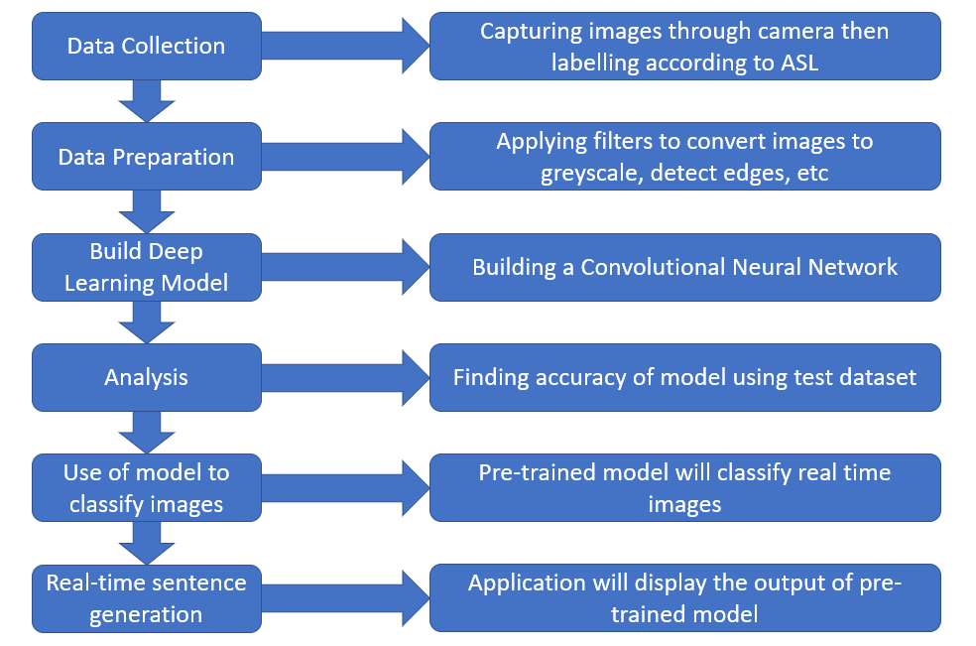
Proposed Solution
Fig. 1. Proposed architecture block diagram.
4
P.E.S Modern College of Engineering, Pune-05. AY: 2021-2022

Slide 5
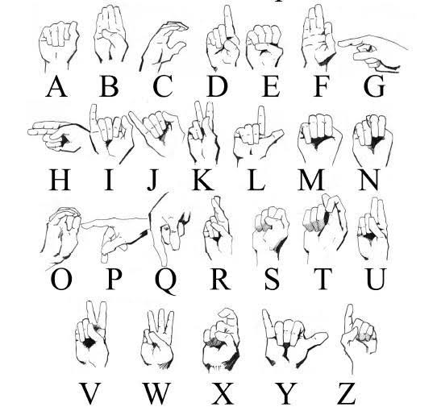
Data Sets
P.E.S Modern College of Engineering, Pune-05. AY: 2021-2022

Slide 6
Conclusions
P.E.S Modern College of Engineering, Pune-05. AY: 2021-2022

