Slide 1

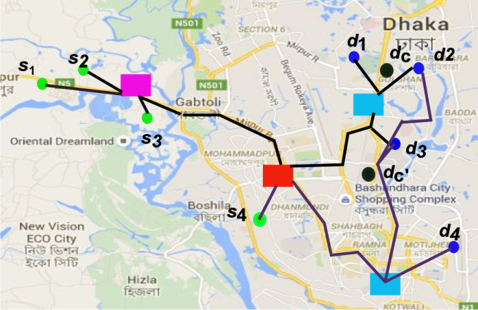
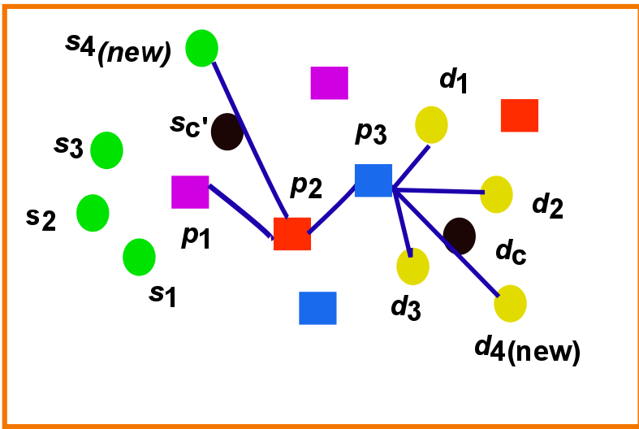
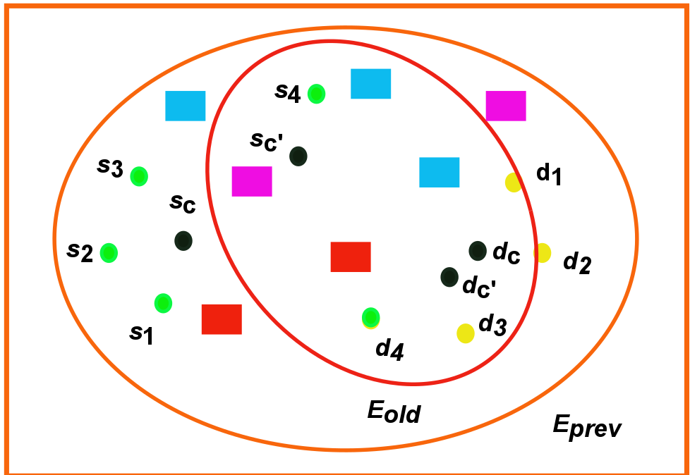
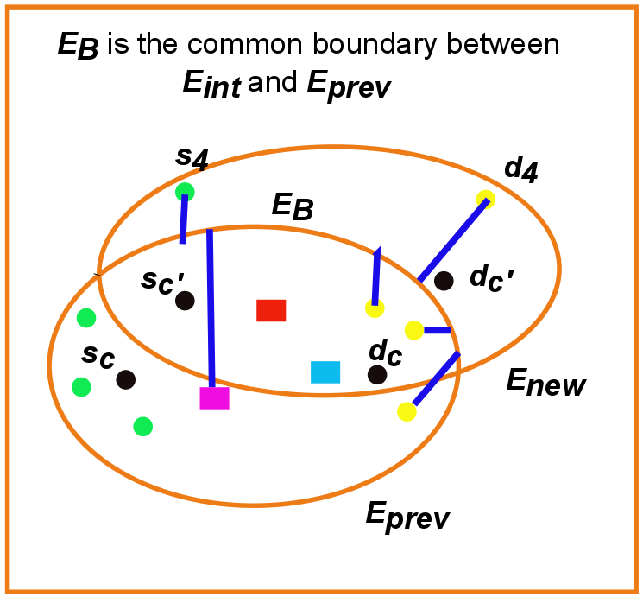
Dynamic Group Trip Planning Queries in Road Network
Tasmin Chowdhury (1005025), Anika Tabassum (1005041)
Introduction
Retrieve POI
Our Approach
The proliferation of location-based social networks allows people to process location-based queries within a group. following scenario is very common when a group of people plans a trip.
Compute answer
We introduced an efficient query processing technique for changeable group
Types and
order of POI
-Source
-Destination
-Centroid
Novelty
Avoid retrieval of same POI
Avoid repeated computation
Ensuring smallest search space by storing necessary data
Fig 2: Computing new major axis
Related Work
We have used elliptical properties to refine search space as existing approaches^{[1]}
Sc and dc is the centroid of current sources and destinations
Major axis length is considered as aggregate trip distance of previous optimal set
Flow chart
DGTP Query
Evaluation
Execution Time
Receive query
from client
Compute GTP
Communication Overhead
yes
Any user join or leave?
no
Compute new ellipse
Visit next POI
Retrieve new POI
yes
Need to retrieve new POI?
no
Complexity analysis
yes
Any possibility of ans change?
no
Computation
Result
Research Challenge
Future Work
Lessen query processing time
Lessen I/O overhead
Lessen communication overhead
dfs
In ordered POI sets
To return k optimal answer sets
Conclusion
we propose an efficient solution that does not need to re-evaluate the GTP query every time. We have also found a technique to know whether new data of the required ellipse are needed to be retrieved or not for the current computation
References
Hashem, S. Barua, M. E. Ali, L. Kulik, E. Tanin Efficient computation of trips with friends and families, 24th ACM International Conference
J. Li, M. L. Yiu, N. Mamoulis. Efficient notification of meeting points for moving groups via independent safe regions in 29th IEEE International Conference on Data Engineering
Department of Computer Science and Engineering (CSE), BUET

