Slide 1



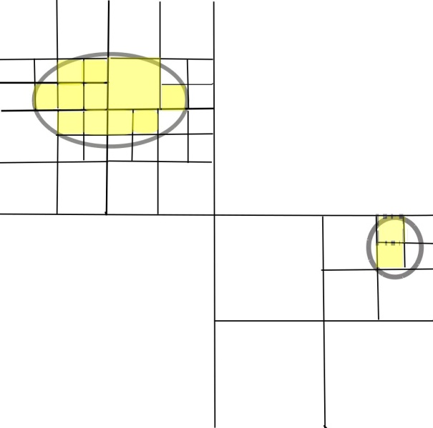
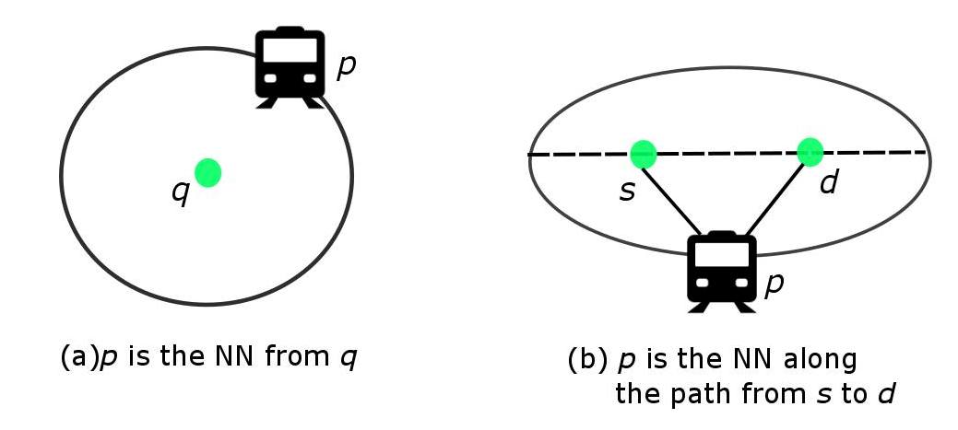
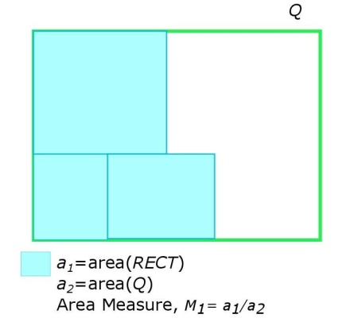
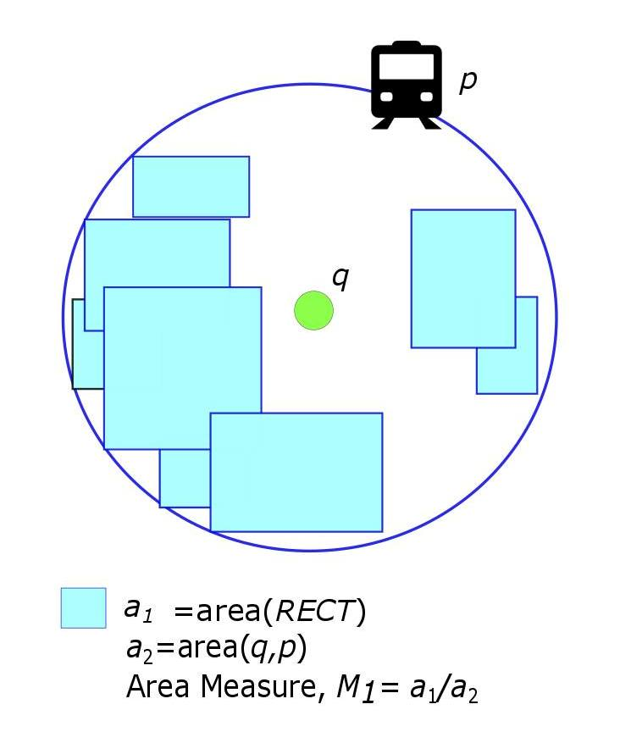
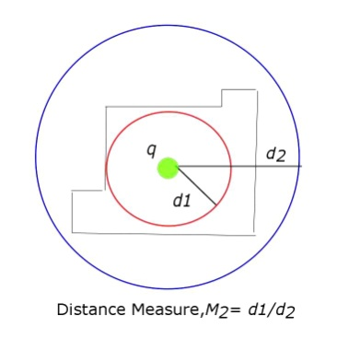
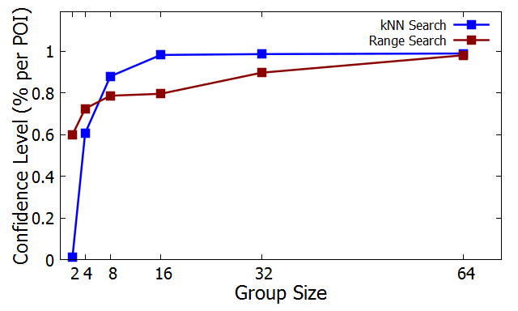
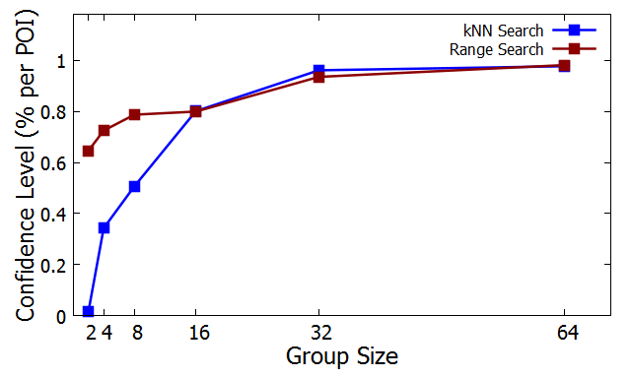
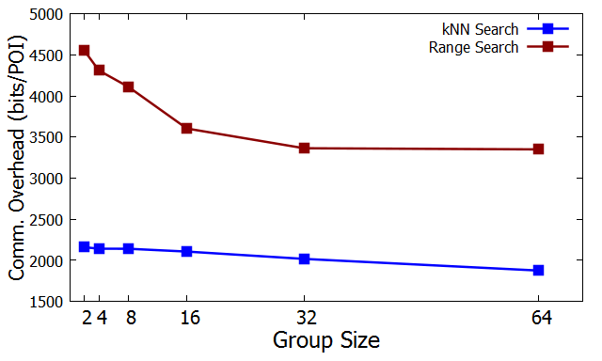
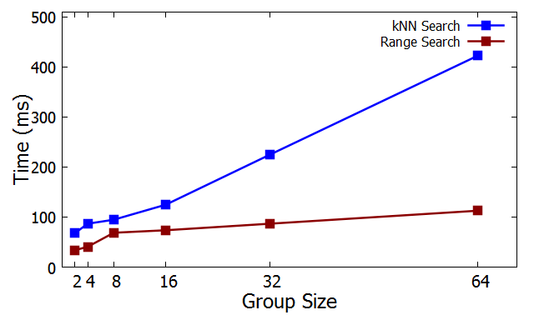
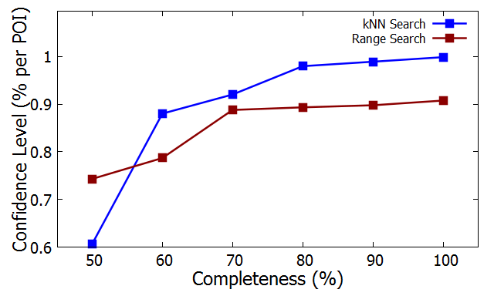
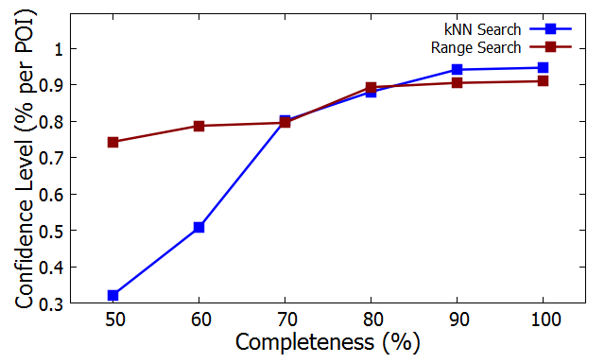
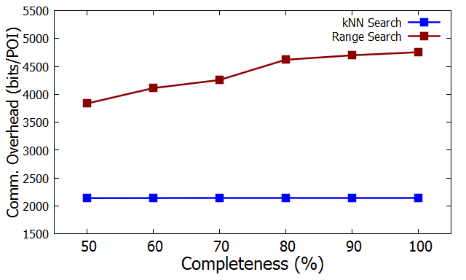
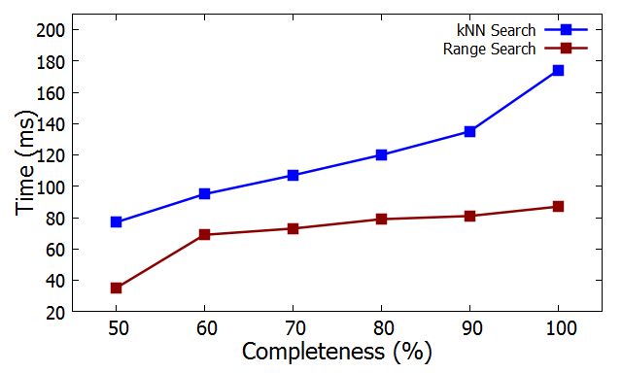
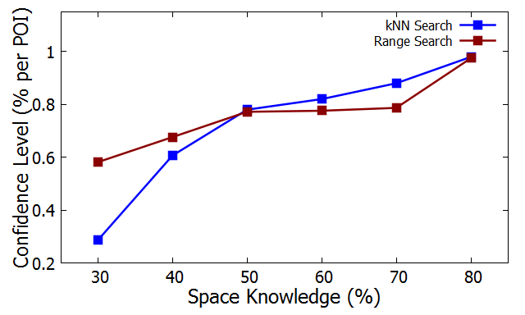
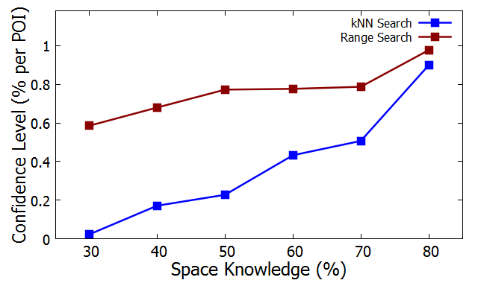
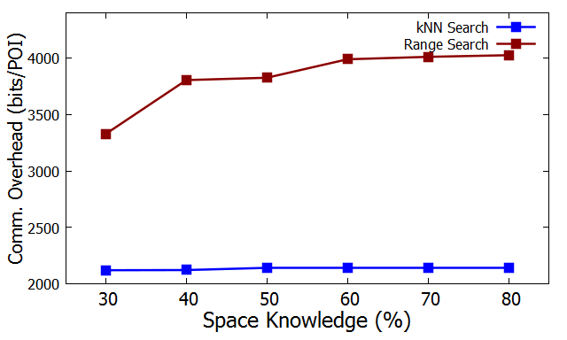
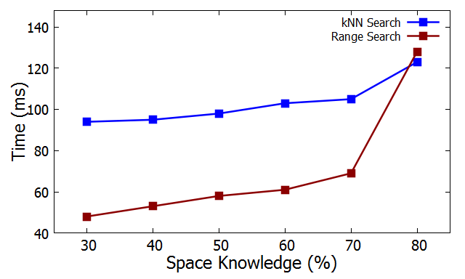
A Crowd-Enabled Approach for Efficient Processing of k Nearest Neighbor and Range Queries in Incomplete Databases
Samia Kabir, Mehnaz Tabassum Mahin
Introduction
Query Types
Uniqueness
Research Challenge
The proliferation of location-based social networks allows people to process location-based queries within a group. We present a crowd-enabled approach to evaluate k-Nearest Neighbor (kNN) and Range queries in incomplete databases of group members. We provide the query-answer with a quality guarantee.
Limitations of traditional Location Service Provider (LSP)
Existing approaches^{[1,2]} are based on the assumption that LSPs have complete space knowledge.
Range Query
Reveals users’ personal information
Biased nature of LSP about nearest POIs
No awareness of a user’s choice and preference
q
How to evaluate spatial queries in incomplete and distributed databases with a quality guarantee?
NN Query
Our approach is to completely eliminate the role of LSP.
Figure 1: NN and Range query
Our Approach
Group Formation
Data Collection and Indexing
Primary Selection
POI Information
Indexing
Formation for a specific time period
Revelation of personal information to some trustworthy people
Users’ knowledge
Shared data by the members of the formed group
POI | R-tree
Space | Quad-tree
Query Time Selection
Space Information
Preference of a query requestor
Available information from a member’s profile
Area knowledge of group members
Previous contribution of a member
Derived data
Geometric
mapping
--Known
Region
--Unknown
Region
Figure 2: Geometrical Mapping of user information
Figure 3: Quad Tree Indexing
Single User Processing
Aggregation
Confidence Level
Receive Query from a query requestor
BFS on POI Tree
Aggregation of query answers from group members
Combination of the sets of MBRs into a set S
Determination of a relevant set of MBRs for POIs
RECT_{i} for kNN p_{i} in kNN query
RECT for Q in Range query
Computation of confidence level
Lower bound of accuracy for a query-answer
Set of POIs
An answer set for kNN query,
N={(p₁,M₁₁,M₁₂ ), (p₂,M₂₁,M₂₂ ),…, (p_{k},M_{k1},M_{k2} )}
An answer set for Range query,
N=(P, M₁, M₂)
Send Answer to the query requestor
POIs with MBRs
Search on Space Tree for relevant area of each POI
(a)
(c)
(b)
(a) → Range query
(b), (c) → kNN query
Evaluation
Future Challenges
Confidence Level (area)
Confidence Level (distance)
Communication Overhead
Execution Time
Different queries like Group Nearest Neighbour and Trip Planning queries
Imprecise location information
Figure 4: Effect of Group Size (x-axis: Group Size, y-axis: Query Performance)
Conclusion
We present the first crowd-enabled approach to process spatial queries in incomplete databases. We introduce an indexing technique for POI and space information and provide the quality guarantee of query-answers.
Figure 5: Effect of POI Knowledge (x-axis: POI Knowledge (%), y-axis: Query Performance)
References
Figure 6: Effect of Space Knowledge (x-axis: Space Knowledge (%), y-axis: Query Performance)
N. Roussopoulos, S. Kelley, and F. Vincent. Nearest neighbor queries. In ACM SIGMOD International Conference,1995.
T. Hashem, M. E. Ali, L. Kulik, E. Tanin, and A. Quattrone. Protecting privacy for group nearest neighbor queries with crowdsourced data and computing. UbiComp, 2013.
Our algorithms
Are scalable even if the group size increases.
Provide high confidence level.
Incur less computational overhead.
Complexity analysis
n₁ = number of nodes in POI tree, n₂ = number of nodes in Space tree, h = height bound of Space tree, m= the maximum number of entries of a node
POI Tree | O(mlog_{m}n₁)
Space Tree | O(n₂+h)
Aggregation | O(|S|)
Department of Computer Science and Engineering (CSE), BUET

