Slide 1
EYEXE

Slide 2
Participant details*
Name: Arnab Das
Institution: Asansol Engineering College (M.A.K.A.U.T)
Contact number: 9547966499
Email: raj713335@gmail.com
Notes:
Additional slides can be added if required.

Slide 3
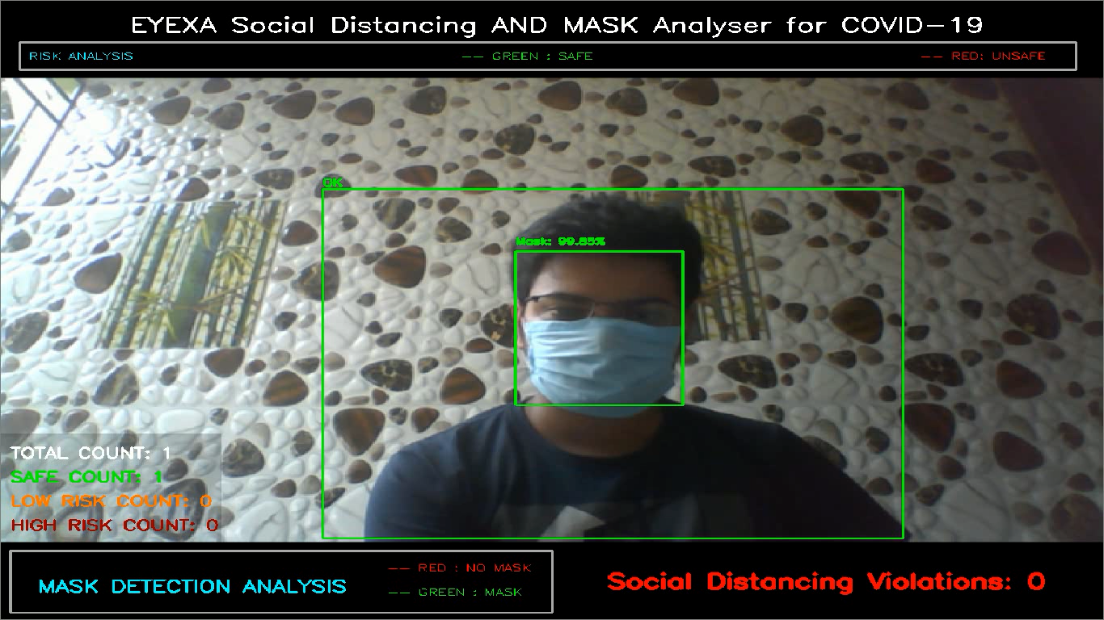
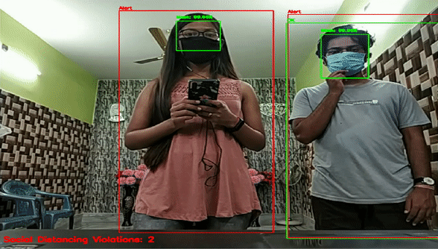
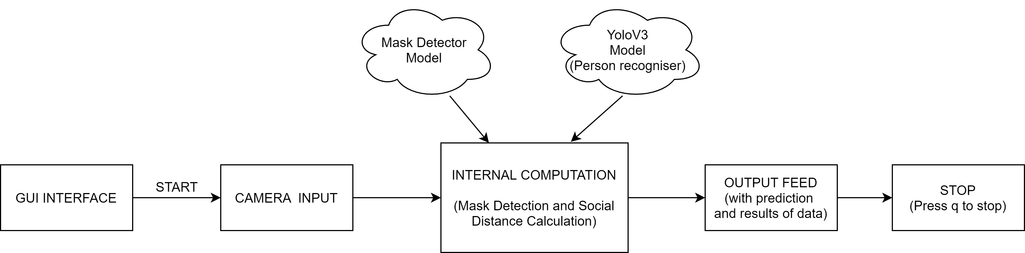
Short Description of the Solution *
EYEXA is a Combined Computer Vision and Machine Learning Application that recognises a person and checks if he is maintaining social distancing or not , and also checks if he is wearing a mask or not simultaneously.
If any of the two above criteria fails then its alerts a user concerned with a warning sound , so the person violating can take necessary steps to minimise the spread of the virus.
Notes:
Additional slides can be added if required.

Slide 4
Detailed Explanation*
EYEXA performs two primary functions using multi threading , OpenCV and ML
EYEXA uses yolov3 model to track a person and then does various internal computations to check all the person in the frame are maintaining a proper social distancing norms or not . and display the number of person violating the social distancing norms.
EYEXA uses an custom trained model based on MobileNetV2 to train on images of person wearing/not_wearing a mask , and predict the person in the camera feed is wearing a mask or not . It also uses a res10_300x300_sad_iter_140000.caffemodel to focus on person face during the prediction.
And all the video capture is saved in the ./output directory, and all the predictions are made in real time from the video capture.
Notes:
Additional slides can be added if required.

Slide 5
Solution to Implementation *
Explain how your solution can be implemented to achieve the benefits.
The solution is made completely using Python 3.0 and comes with a exe file having all the dependencies that are already embedded in the exe file , and once the application in installed in the system it is ready to start running with a beautiful GUI Interface.
EYEXA is a Combined Computer Vision and Machine Learning Application that recognises a person and checks if he is maintaining social distancing or not , and also checks if he is wearing a mask or not simultaneously.
If any of the two above criteria fails then its alerts a user concerned with a warning sound , so the person violating can take necessary steps to minimise the spread of the virus.
Notes:
Additional slides can be added if required.

Slide 6
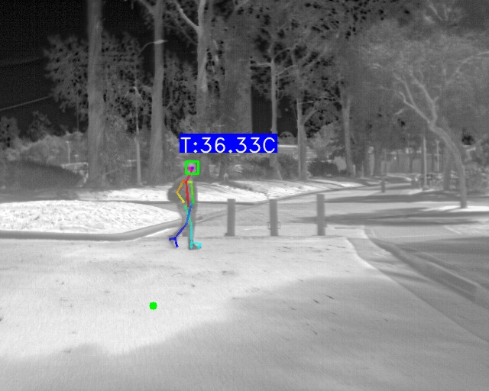
Future State
Give a detailed explanation on the Future State of your solution.
Right Now our EYEXA application can run on desktop or any Linux or Mac based system as it uses raw python programming that is compatible on any Desktop , Laptop or raspberrypi based system .
But in future i would like the system to run on mobile devices like android or IOS using tensorflow lite, and also in browser based system using tensorflow.js or deploy it in cloud using kubernetes so that the application can be used by various sets of people having low hardware capabilities.
In future we will integrate out system with thermal imaging
infrared cameras to detect the temperature of a person
along with existing social distancing and mask detector .
Notes:
Additional slides can be added if required.
*Required.

Slide 7
Pros and Cons *
Enlist all the advantages and Disadvantages of your solution.
Advantages:
Very easy to use and can work on various system and scalable.
Uses low computing power model like yolov3 and MobileNetV2 thus reducing its need for computationally expensive devices like GPU.
Has a smooth GUI based interface making it easier for person to operate and comes with a exe file, thus you don’t require and added dependencies pre installed in the device.
It ran on a system with 2 GB RAM and Intel Dual Core Processor without GPU smoothly.
Disadvantages:
A bit slow in prediction as it don’t uses any advance and powerful computing power like expensive GPU.
Notes:
Additional slides can be added if required.

Slide 8
Essential Links*
Include all your essential links of your codes(GitHub, Google drive, etc.)
Github: https://github.com/raj713335/EYEXA
LinkedIn :https://www.linkedin.com/in/arnab-das-732515143

Slide 9
Summary
References :
https://www.pyimagesearch.com/2020/06/01/opencv-social-distancing-detector/
https://www.pyimagesearch.com/2020/05/04/covid-19-face-mask-detector-with-opencv-keras-tensorflow-and-deep-learning/
https://www.coursera.org/account/accomplishments/specialization/certificate/8C3LD42HQ2J6
https://www.coursera.org/account/accomplishments/specialization/certificate/VM84M4KYXB6Y?utm_medium=certificate&utm_source=link&utm_campaign=copybutton_certificate&utm_term=long
Notes:
Additional slides can be added if required.

