Slide 1




Chapter 1:
New Perspectives on
Marketing in the
Service Economy

Slide 2
Overview of Chapter 1
Why Study Services?
What are Services?
The Marketing Challenges Posed by Services
The Expanded Marketing Mix Required for Services

Slide 3
Why Study Services?

Slide 4
Why Study Services? (1)
Services dominate economy in most nations
Understanding services offers you personal competitive advantages
Importance of service sector in economy is growing rapidly:
  Services account for more than 60 percent of GDP worldwide
  Almost all economies have a substantial service sector
  Most new employment is provided by services
  Strongest growth area for marketing

Slide 5
Services Dominate the U.S. Economy
(Fig 1.1)
Services, 68%
Agriculture, Forestry, Mining, Fishing, 2.3%
Manufacturing and Construction, 17.3%
Government, 12.4% (mostly Services)
Source: Bureau of Economic Analysis, Survey of Current Business, May 2005, Table 1
INSIGHTS
Private sector service industries account for over two-thirds of GDP
Adding government services, total is almost four-fifths of GDP

Slide 6
Estimated Size of Service Sector in
Selected Countries (Fig 1.2—updated 10/06)
Cayman Islands (95%), Jersey (93%)
Bahamas (90%), Bermuda ( 89%)
Luxembourg (83%)
Panama (80%), USA (79%)
Japan (74%), France (73%), U.K. (73%), Canada (71%)
Mexico (69%), Australia (68%), Germany (68%)
Poland (66%), South Africa (65%)
Israel (60%), Russia (58%), S. Korea (56%)
Argentina (53%), Brazil (51%)
India (48%)
China (40%)
Saudi Arabia (33%)
Services as Percent of GDP
10
20
30
40
50
60
70
80
90

Slide 7
Value Added by Service Industry
Categories to U.S. GDP in 2004
Other (except government) 3.6%
Accommodation and food services 4.0%
Arts, entertainment, and recreation 1.5%
Healthcare and social assistance 10.4%
Educational services 1.3%
Professional and business services 17.3%
Real estate and rental and leasing 18.7%
Finance and insurance 12.6%
Information 7.1%
Transportation and warehousing 4.4%
Retail trade 10.3%
Source: Bureau of Economic Analysis,
Survey of Current Business, May 2005, Table 1
Wholesale trade 8.9%

Slide 8
NAICS: A New Way to Classify and
Analyze the Service Economy (RI 1.1)
NAICS—North American Industry Classification System—now used to compile and record economic data by national statistical agencies of the U.S., Canada, Mexico
New classification system replaces old SIC codes in U.S.
Captures huge array of new service industries, each with its own NAICS code
NAPCS—North American Product Classification System—assigns codes to thousands of service products
  Particularly useful for looking at rented goods services
U.S. and Canadian data easily accessible on the Web; information includes number of establishments and employment

Slide 9
Some Newer Service Industries
Profiled by NAICS Codes But Not SIC
Casino Hotels
Continuing Care Retirement Communities
Diagnostic Imaging Centers
Diet and Weight Reducing Centers
Environmental Consulting
Golf Courses, Country Clubs
Hazardous Waste Collection
HMO Medical Centers
Industrial Design Services
Investment Banking and Securities Dealing
Management Consulting Services
Satellite Telecommunications
Telemarketing Bureaus
Temporary Help Services

Slide 10

Why Study Services? (2)
Most new jobs are generated by services
  Fastest growth expected in knowledge-based industries
  Significant training and educational qualifications required, but employees will be more highly compensated
  Will service jobs lost to lower-cost countries? Yes, some service jobs can be exported

Slide 11
Changing Structure of Employment as Economic Development Evolves
Share of
Employment
Agriculture
Services
Industry
Time, per Capita Income
Source: IMF, 1997

Slide 12

Why Study Services? (3)
Powerful forces are transforming service markets
  Government policies, social changes, business trends, advances in IT, internationalization
These forces are reshaping
  Demand
  Supply
  The competitive landscape
  Customers’ choices, power, and decision making

Slide 13
Transformation of the Service Economy
Social
Changes
Business
Trends
Advances in
IT
Government
Policies
Globalization
New markets and product categories
Increase in demand for services
More intense competition
Innovation in service products & delivery systems, stimulated by better technology
Customers have more choices and exercise more power
Success hinges on:
Understanding customers and competitors
Viable business models
Creation of value for customers and firm

Slide 14
Factors Stimulating Transformation of the Service Economy (1)
Social
Changes
Business
Trends
Advances in
IT
Government
Policies
Globalization
Changes in regulations
Privatization
New rules to protect customers, employees, and the environment
New agreement on trade in services

Slide 15
Factors Stimulating Transformation of the Service Economy (2)
Social
Changes
Business
Trends
Advances in
IT
Government
Policies
Globalization
Rising consumer expectations
More affluence
More people short of time
Increased desire for buying experiences versus things
Rising consumer ownership of high tech equipment
Easier access to information
Immigration
Growing but aging population

Slide 16
Factors Stimulating Transformation of the Service Economy (3)
Social
Changes
Business
Trends
Advances in
IT
Government
Policies
Globalization
Push to increase shareholder value
Emphasis on productivity and cost savings
Manufacturers add value through service and sell services
More strategic alliances and outsourcing
Focus on quality and customer satisfaction
Growth of franchising
Marketing emphasis by nonprofits

Slide 17
Factors Stimulating Transformation of the Service Economy (4)
Social
Changes
Business
Trends
Advances in
IT
Government
Policies
Globalization
Growth of the Internet
Greater bandwidth
Compact mobile equipment
Wireless networking
Faster, more powerful software
Digitization of text, graphics, audio, video

Slide 18
Factors Stimulating Transformation of the Service Economy (5)
Social
Changes
Business
Trends
Advances in
IT
Government
Policies
Globalization
More companies operating on transnational basis
Increased international travel
International mergers and alliances
“Offshoring” of customer service
Foreign competitors invade domestic markets

Slide 19
What Are Services?

Slide 20
What Are Services? (1)
The historical view
  Goes back over 200 years to Adam Smith and Jean-Baptiste Say
  Different from goods because they are perishable (Smith 1776)
  Consumption cannot be separated from production, services are intangible (Say 1803)
A fresh perspective: Services involve a form of rental, offering benefits without transfer of ownership
  Include rental of goods
  Marketing tasks for services differ from those involved in selling goods and transferring ownership

Slide 21
What Are Services? (2)
Five broad categories within non-ownership framework:
  Rented goods services
  Defined space and place rentals
  Labor and expertise rentals
  Access to shared physical environments
  Systems and networks: access and usage
Implications of renting versus owning (Service Perspectives 1.1)
  Markets exist for renting durable goods rather than selling them
  Renting portions of larger physical entity (e.g., office space, apartment) can form basis for service
  Customers more closely engaged with service suppliers
  Time plays central role in most services
  Customer choice criteria may differ between rentals and outright purchases
  Services offer opportunities for resource sharing

Slide 22
Defining Services
Services
  Are economic activities offered by one party to another
  Most commonly employ time-based performances to bring about desired results in:
    recipients themselves
    objects or other assets for which purchasers have responsibility
In exchange for their money, time, and effort, service customers expect to obtain value from
  Access to goods, labor, facilities, environments, professional skills, networks, and systems
  But they do not normally take ownership of any of the physical elements involved

Slide 23
Service Products versus Customer Service and After-Sales Service
A firm’s market offerings are divided into core product elements and supplementary service elements
Is everyone in service? Need to distinguish between:
  Marketing of services
  Marketing goods through added-value service
Good service increases the value of a core physical good
After-sales service is as important as pre-sales service for many physical goods
Manufacturing firms are reformulating and enhancing existing added-value services to market them as stand-alone core products

Slide 24
Challenges Posed by Services

Slide 25

Services Pose Distinctive Marketing Challenges
Marketing management tasks in the service sector differ from those in the manufacturing sector
The eight common differences are:
  Most service products cannot be inventoried
  Intangible elements usually dominate value creation
  Services are often difficult to visualize and understand
  Customers may be involved in co-production
  People may be part of the service experience
  Operational inputs and outputs tend to vary more widely
  The time factor often assumes great importance
  Distribution may take place through nonphysical channels
What are marketing implications?

Slide 26
Differences, Implications, and
Marketing-Related Tasks (1) (Table 1.1)
Difference
Most service products
cannot be inventoried
Intangible elements
usually dominate
value creation
Services are often
difficult to visualize
and understand
Customers may be
involved in co-
production
Implications
Customers may be
turned away
Harder to evaluate
service and distinguish
from competitors
Greater risk and
uncertainty perceived
Interaction between
customer and provider;
but poor task execution
could affect satisfaction
Marketing-Related Tasks
Use pricing, promotion, and
reservations to smooth
demand; work with ops to
manage capacity
Emphasize physical clues,
employ metaphors and vivid
images in advertising
Educate customers on
making good choices; offer
guarantees
Develop user-friendly
equipment, facilities, and
systems; train customers,
provide good support

Slide 27
Differences, Implications, and
Marketing-Related Tasks (2) (Table 1.1)
Difference
People may be part of
service experience
Operational inputs and
outputs tend to vary
more widely
Time factor often
assumes great
importance
Distribution may take
place through
nonphysical channels
Implications
Behavior of service
personnel and customers
can affect satisfaction
Hard to maintain quality,
consistency, reliability
Difficult to shield
customers from failures
Time is money;
customers want service
at convenient times
Electronic channels or
voice telecommunications
Marketing-Related Tasks
Recruit, train employees to
reinforce service concept
Shape customer behavior
Redesign for simplicity and
failure proofing
Institute good service
recovery procedures
Find ways to compete on
speed of delivery; offer
extended hours
Create user-friendly,
secure websites and free
access by telephone

Slide 28
Value Added by Physical, Intangible Elements Helps Distinguish Goods and Services (Fig 1.6)
Physical Elements
High
Salt
Detergents
CD Player
Wine
Golf Clubs
New Car
Tailored clothing
Plumbing Repair
Fast-Food Restaurant
Health Club
Airline Flight
Landscape Maintenance
Consulting
Life Insurance
Internet Banking
Low
Intangible Elements
High
Source; Adapted from Lynn Shostack

Slide 29
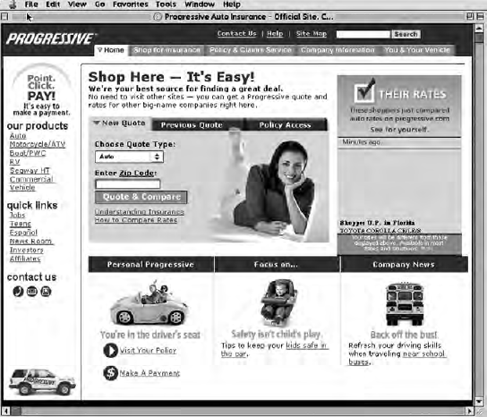
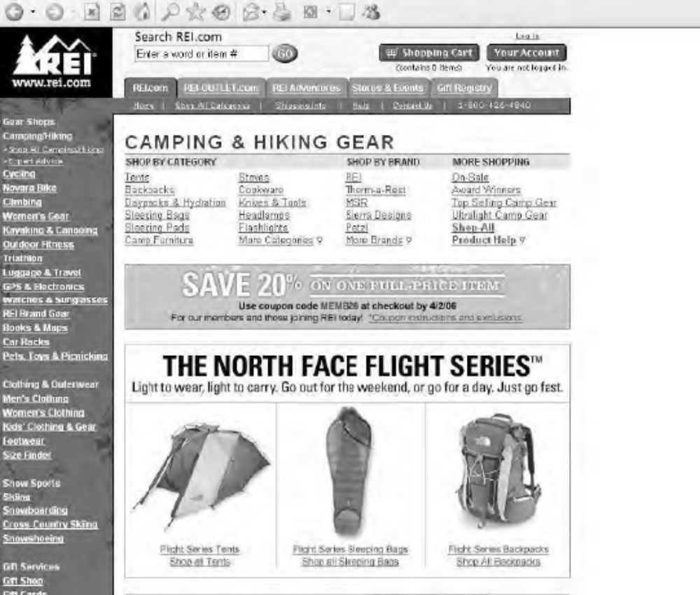
Progressive and REI: Two Types of
Website Reflecting Core Product (Fig 1.8)
Websites can deliver info-based services like Progressive’s car insurance but …
…REI’s camping gear must be delivered through physical channels to customers after they have used the website to make choices, order, and pay

Slide 30
Expanded Marketing Mix
for Services

Slide 31
Services Require
An Expanded Marketing Mix
Marketing can be viewed as:
  A strategic and competitive thrust pursued by top management
  A set of functional activities performed by line managers
  A customer-driven orientation for the entire organization
Marketing is the only function to bring operating revenues into a business; all other functions are cost centers
The “8Ps” of services marketing are needed to create viable strategies for meeting customer needs profitably in a competitive marketplace

Slide 32
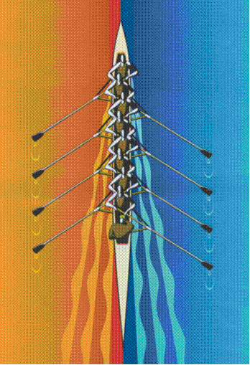
The 8Ps of Services Marketing
Product Elements (Chapter 3)
Place and Time (Chapter 4)
Price and Other User Outlays (Chapter 5)
Promotion and Education (Chapter 6)
Process (Chapter 8)
Physical Environment (Chapter 10)
People (Chapter 11)
Productivity and Quality (Chapter 14)
Fig 1.9 Working in Unison: The 8Ps of Services Marketing

Slide 33
The 8Ps of Services Marketing:
(1) Product Elements
Embrace all aspects of service performance that create value
Core product responds to customer’s primary need
Array of supplementary service elements
  Help customer use core product effectively
  Add value through useful enhancements
Planning marketing mix begins with creating a service concept that:
  Will offer value to target customers
  Satisfy their needs better than competing alternatives

Slide 34

The 8Ps of Services Marketing:
(2) Place and Time
Delivery decisions: Where, When, How
Geographic locations served
Service schedules
Physical channels
Electronic channels
Customer control and convenience
Channel partners/intermediaries

Slide 35
The 8Ps of Services Marketing:
(3) Price and Other User Outlays
Marketers must recognize that customer outlays involve more than price paid to seller
Traditional pricing tasks:
  Selling price, discounts, premiums
  Margins for intermediaries (if any)
  Credit terms
Identify and minimize other costs incurred by users:
  Additional monetary costs associated with service usage (e.g., travel to service location, parking, phone, babysitting, etc.)
  Time expenditures, especially waiting
  Unwanted mental and physical effort
  Negative sensory experiences

Slide 36

The 8Ps of Services Marketing:
(4) Promotion and Education
Informing, educating, persuading, reminding customers
Marketing communication tools
  Media elements (print, broadcast, outdoor, retail, the Internet, etc.)
  Personal selling, customer service
  Sales promotion
  Publicity/PR
Imagery and recognition
  Branding
  Corporate design
Content
  Information, advice
  Persuasive messages
  Customer education/training

Slide 37
The 8Ps of Services Marketing:
(5) Process
How firm does things may be as important as what it does
Customers often actively involved in processes, especially when acting as co-producers of service
Process involves choices of method and sequence in service creation and delivery
  Design of activity flows
  Number and sequence of actions for customers
  Nature of customer involvement
  Role of contact personnel
  Role of technology, degree of automation
Badly designed processes waste time, create poor experiences, and disappoint customers

Slide 38

The 8Ps of Services Marketing:
(6) Physical Environment
Design servicescape and provide tangible evidence of service performances
Create and maintain physical appearances
  Buildings/landscaping
  Interior design/furnishings
  Vehicles/equipment
  Staff grooming/clothing
  Sounds and smells
  Other tangibles
Manage physical cues carefully— can have profound impact on customer impressions

Slide 39

The 8Ps of Services Marketing:
(7) People
Interactions between customers and contact personnel strongly influence customer perceptions of service quality
The right customer-contact employees performing tasks well
  Job design
  Recruiting
  Training
  Motivation
The right customers for firm’s mission
  Contribute positively to experience of other customers
  Possess—or can be trained to have— needed skills (co-production)
  Can shape customer roles and manage customer behavior

Slide 40
The 8Ps of Services Marketing:
(8) Productivity and Quality
Productivity and quality must work hand in hand
Improving productivity key to reducing costs
Improving and maintaining quality essential for building customer satisfaction and loyalty
Ideally, strategies should be sought to improve both productivity and quality simultaneously—technology often the key
  Technology-based innovations have potential to create high payoffs
  But, must be user friendly and deliver valued customer benefits

Slide 41
Marketing Must Be Integrated with
Other Management Functions

Slide 42
Marketing Must Be Integrated with Other Management Functions (Fig 1.10)
Three management functions play central and interrelated roles in meeting needs of service customers
Operations
Management
Marketing
Management
Customers
Human Resources
Management

Slide 43
A Framework for Developing Effective Service Marketing Strategies (Fig 1.11)

Slide 44
A Framework For Developing Effective Service Marketing Strategies: Overview
Understanding Customer Needs, Decision Making, and Behavior in Service Encounters
Chapter 2
Building the Service Model
Part II: Chapters 3-7
Managing the Customer Interface
Part III: Chapters 8-11
Implementing Profitable Service Strategies
Part IV: Chapters 12-15

Slide 45
Framework for Developing Effective
Service Marketing Strategies: Part I
I: Understanding Customer Needs, Decision Making, and Behavior in Service Encounters
(Chapter 2)
Differences among Services Affect Customer Behavior
Three-Stage Model of Service Consumption
Prepurchase Stage: Search, evaluation of alternatives, decision
Service Encounter Stage: Role in high-contact vs. low-contact delivery
Post-Encounter Stage: Evaluation against expectations, future intentions

Slide 46
Framework for Developing Effective
Service Marketing Strategies: Part II
Building The Service Model
Part II: Chapters 3-7
The Value Proposition
Develop service concept: core & supplementary elements
Select physical & electronic channels for service delivery
Value Exchange
Set prices with reference to costs, competition & value
The Business Model
Educate customers & promote the value proposition
Position the value proposition against competing alternatives

Slide 47
Framework for Developing Effective
Service Marketing Strategies: Part III
III: Managing the Customer Interface
(Chapters 8-11)
Design and manage service processes
Balance demand against productivity capacity
Plan the service environment
Manage service employees for competitive advantage

Slide 48
Framework for Developing Effective
Service Marketing Strategies: Part IV
IV: Implementing Profitable Service Strategies
(Chapters 12-15)
Create customer relationship and build loyalty
Plan for service recovery and create customer feedback systems
Continuously improve service quality and productivity
Organize for change management and service leadership

Slide 49
Chapter 1 Summary: New Perspectives on Marketing in the Service Economy
Reasons for studying services:
  Service sector dominates economy in most nations, many new industries
  Most new jobs created by services
  Powerful forces—government policies, social changes, business trends, IT advances, and globalization—are transforming service markets
  Understanding services offers personal competitive advantage
The service concept and its definition:
  Services create benefits without transfer of ownership
  Most employ time-based performances to bring about desired results in recipients or in assets for which they have responsibility
  Customers expect value from access to goods, facilities, labor, professional skills, environments, networks & systems in return for money, time, effort
Services present distinctive marketing challenges relative to goods, requiring:
  Expanded marketing mix comprising 8Ps instead of traditional 4Ps
  Integration of marketing function with operations and human resources

