Slide 1

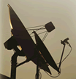


Chapter 2:
Customer Behavior in
Service Encounters

Slide 2
Overview Of Chapter 2
How Differences among Services Affect Customer Behavior
Customer Decision Making: The Three Stage Model of Service Consumption
  Prepurchase Stage
  Service Encounter Stage
  Post-Encounter Stage

Slide 3
A Framework for Developing Effective Service Marketing Strategies
Understanding Customer Needs, Decision Making, and Behavior in Service Encounters
Chapter 2
Building the Service Model
Part II: Chapters 3-7
Managing the Customer Interface
Part III: Chapters 8-11
Implementing Profitable Service Strategies
Part IV: Chapters 12-15

Slide 4
A Framework for Developing Effective Service Marketing Strategies
Two Key Themes in Part I of the
Services Marketing Strategy Framework:
Differences among Services Affect
Customer Behavior
Three-Stage Model of Service Consumption
Prepurchase Stage: Search, evaluation of alternatives, decision
Service Encounter Stage: Role in high-contact vs. low-contact delivery
Post-Encounter Stage: Evaluation against expectations, future intentions

Slide 5
How Differences among Services Affect Customer Behavior

Slide 6
Differences among Services Affect Customer Behavior
Consumers are rarely involved in the manufacture of goods but often participate in service creation and delivery
Challenge for service marketers is to understand how customers interact with service operations
Based on differences in nature of service act (tangible/intangible) and who or what is direct recipient of service (people/possessions), there are four categories of services:
  People processing
  Possession processing
  Mental stimulus processing
  Information processing

Slide 7
Four Categories Of Services (Fig 2.1)
Who or What Is the Direct Recipient of the Service?
Nature of the Service Act
People
Possessions
Tangible Actions
People processing
(services directed at people’s bodies):
Barbers
Health care
Possession processing
(services directed at physical possessions):
Refueling
Disposal/recycling
Intangible Actions
Mental stimulus processing
(services directed at people’s minds):
Education
Advertising/PR
Information processing
(services directed at intangible assets):
Accounting
Banking

Slide 8
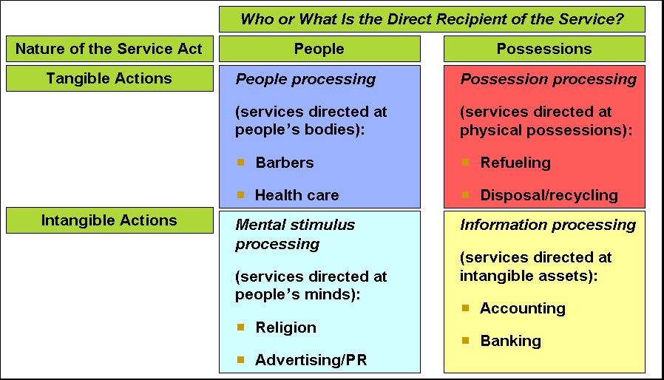
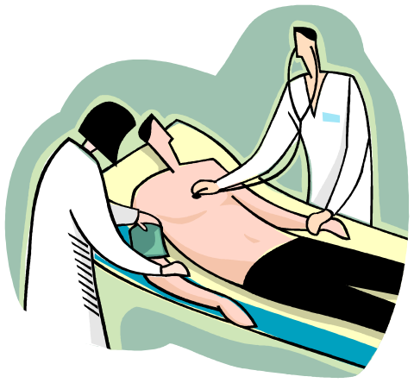
Four Categories Of Services
People Processing
Customers must:
  Physically enter the service factory
  Co-operate actively with the service operation
Managers should think about process and output from customer’s perspective
  To identify benefits created and non-financial costs:
    Time, mental, physical effort

Slide 9
Possession Processing
Possession Processing
Customers are less physically involved compared to people processing services
Involvement is limited
Production and consumption are separable

Slide 10
Mental Stimulus Processing
Mental Stimulus Processing
Ethical standards required when customers who depend on such services can potentially be manipulated by suppliers
Physical presence of recipients not required
Core content of services is information-based
  Can be “inventoried”

Slide 11
Information Processing
Information Processing
Information is the most intangible form of service output
But may be transformed into enduring forms of service output
Line between information processing and mental stimulus processing may be blurred.

Slide 12
Customer Decision Making:
Three-Stage Model of Service Consumption

Slide 13
The Purchase Process for Services
Prepurchase Stage
Service Encounter Stage
Post-Encounter Stage

Slide 14
Prepurchase Stage

Slide 15
Prepurchase Stage: Overview
Customers seek solutions to aroused needs
Evaluating a service may be difficult
Uncertainty about outcomes increases perceived risk
What risk reduction strategies can service suppliers develop?
Understanding customers’ service expectations
Components of customer expectations
Making a service purchase decision
Prepurchase Stage
Service Encounter Stage
Post-Encounter Stage

Slide 16

Customers Seek Solutions to
Aroused Needs
People buy goods and services to meet specific needs/wants
External sources may stimulate the awareness of a need
Companies may seek opportunities by monitoring consumer attitudes and behavior
Figure 2.4
Prudential Financial’s advertising stimulates thinking about retirement needs
Courtesy of Masterfile Corporation

Slide 17
Evaluating a Service May Be Difficult
Search attributes help customers evaluate a product before purchase
  Style, color, texture, taste, sound
Experience attributes cannot be evaluated before purchase—must “experience” product to know it
  Vacations, sporting events, medical procedures
Credence attributes are product characteristics that customers find impossible to evaluate confidently even after purchase and consumption
  Quality of repair and maintenance work

Slide 18
How Product Attributes Affect
Ease of Evaluation
Most Goods
Most Services
Easy
Difficult
to evaluate
to evaluate*
Restaurant meals
Lawn fertilizer
Haircut
Entertainment
Clothing
Chair
Motor vehicle
Foods
Computer repair
Education
Legal services
Complex surgery
High in search
High in experience
High in credence
attributes
attributes
attributes
*NOTE: Difficulty of evaluation tends to decrease with broad exposure
to a service category and frequency of use of a specific supplier
Source:
Adapted from Zeithaml

Slide 19
Perceived Risks in Purchasing and Using Services
Functional—unsatisfactory performance outcomes
Financial—monetary loss, unexpected extra costs
Temporal—wasted time, delays leading to problems
Physical—personal injury, damage to possessions
Psychological—fears and negative emotions
Social—how others may think and react
Sensory—unwanted impact on any of five senses

Slide 20
How Might Consumers Handle Perceived Risk?
Seeking information from respected personal sources
Relying on a firm that has a good reputation
Looking for guarantees and warranties
Visiting service facilities or trying aspects of service before purchasing
Asking knowledgeable employees about competing services
Examining tangible cues or other physical evidence
Using the Internet to compare service offerings and search for independent reviews and ratings

Slide 21
Strategic Responses to Managing Customer Perceptions of Risk
Offer performance warranties, guarantees to protect against fears of monetary loss
For products where customers worry about performance, sensory risks:
  Offer previews, free trials (provides experience)
  Advertising (helps to visualize)
For products where customers perceive physical or psychological risks:
  Institute visible safety procedures
  Deliver automated messages about anticipated problems
  Websites offering FAQs and more detailed background
  Train staff members to be respectful and empathetic

Slide 22
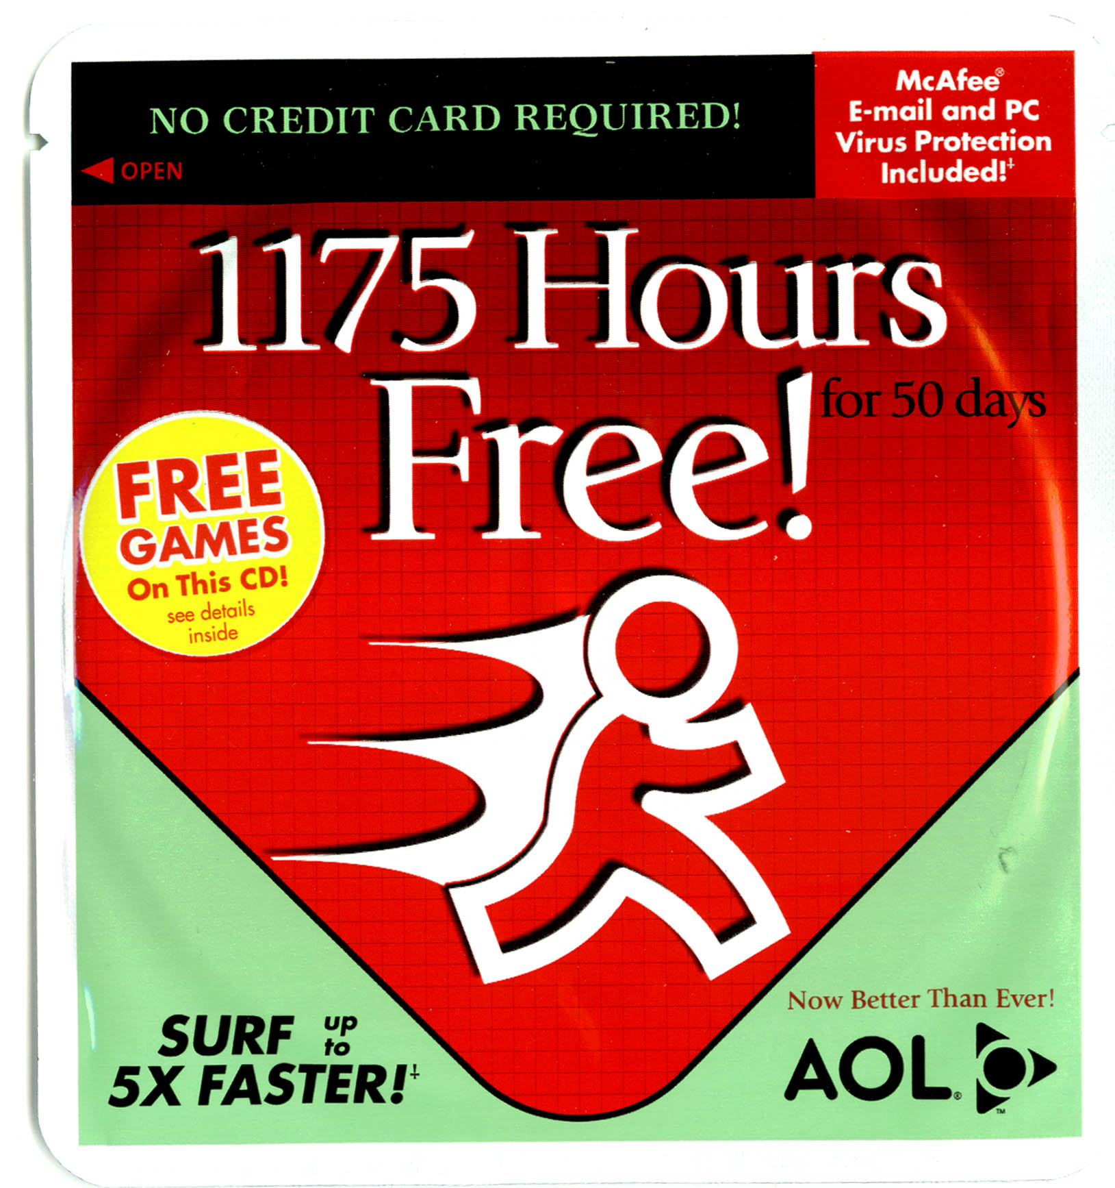
AOL Offers Free Trial Software to Attract Prospective Customers (Fig 2.6)

Slide 23
Understanding Customers’
Service Expectations
Customers evaluate service quality by comparing what they expect against what they perceive
  Situational and personal factors also considered
Expectations of good service vary from one business to another, and among differently positioned service providers in the same industry
Expectations change over time
Example: Service Perspectives 2.1
  Parents wish to participate in decisions relating to their children’s medical treatment for heart problems
  Media coverage, education, the Internet has made this possible

Slide 24
Factors Influencing Customer Expectations of Service (Fig 2.8)
Explicit & Implicit
Personal Needs
Service Promises
Word-of-Mouth
Desired Service
Past Experience
Beliefs about
What Is Possible
ZONE
OF
TOLERANCE
Perceived Service
Alterations
Adequate Service
Predicted Service
Situational Factors
Source: Adapted from Valarie A. Zeithaml, Leonard A. Berry, and A. Parasuraman, “The Nature and Determinants of Customer Expectations of Service,” Journal of the Academy of Marketing Science 21, no. 1 (1993): pp 1–12.

Slide 25
Components of Customer Expectations
Desired Service Level:
  Wished-for level of service quality that customer believes can and should be delivered
Adequate Service Level:
  Minimum acceptable level of service
Predicted Service Level:
  Service level that customer believes firm will actually deliver
Zone of Tolerance:
  Range within which customers are willing to accept variations in service delivery

Slide 26
Service Encounter Stage

Slide 27
Service Encounter Stage: Overview
Service encounters range from high- to low-contact
Understanding the servuction system
Service marketing systems: high-contact and low-contact
Role and script theories
Theater as a metaphor for service delivery: An integrative perspective
Implications for customer participation in service creation and delivery
Prepurchase Stage
Service Encounter Stage
Post-Encounter Stage

Slide 28
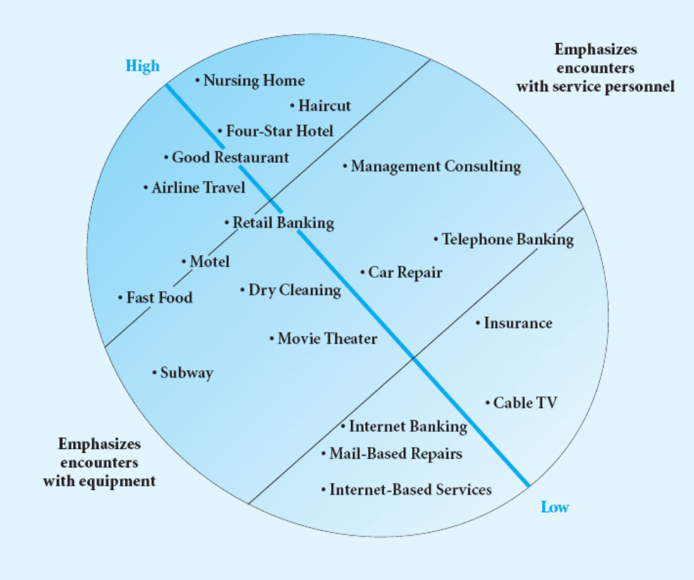
Service Encounters Range from
High-Contact to Low-Contact (Fig 2.9)
Figure 2.9
Levels of Customer Contact with Service Organizations

Slide 29
Distinctions between High-Contact and Low-Contact Services
High-Contact Services
  Customers visit service facility and remain throughout service delivery
  Active contact between customers and service personnel
  Includes most people-processing services
Low-Contact Services
  Little or no physical contact with service personnel
  Contact usually at arm’s length through electronic or physical distribution channels
  New technologies (e.g. the Web) help reduce contact levels
Medium-Contact Services Lie in between These Two

Slide 30
The Servuction System:
Service Production and Delivery
Service Operations (front stage and backstage)
  Where inputs are processed and service elements created
  Includes facilities, equipment, and personnel
Service Delivery (front stage)
  Where “final assembly” of service elements takes place and service is delivered to customers
  Includes customer interactions with operations and other customers
Service Marketing (front stage)
  Includes service delivery (as above) and all other contacts between service firm and customers

Slide 31
Service Marketing System for a
High-Contact Service (Fig 2.10)
SERVICE MARKETING SYSTEM
Service Delivery System
Other Contact Points
Service Operations System
Other
Customers
Advertising
Sales Calls
Market Research Surveys
Billing/Statements
Misc. Mail, Phone Calls,
E-mails, Faxes, etc.
Website
Random Exposure to Facilities/Vehicles
Chance Encounters with Service Personnel
Word of Mouth
Interior & Exterior
Facilities
Technical
Core
The
Customer
Equipment
Service People
Backstage
Front Stage
Other
Customers
(invisible)
(visible)

Slide 32
Service Marketing System for a
Low-Contact Service (Fig 2.11)
Service Operations
System
SERVICE MARKETING SYSTEM
Service Delivery System
Other Contact Points
Mail
Advertising
Market Research Surveys
Billing/Statements
Random Exposure to Facilities/Vehicles
Word of Mouth
The
Technical Core
Self Service Equipment
Customer
Phone, Fax, Web- site, etc.
Front Stage
Backstage
(visible)
(invisible)

Slide 33

Theater as a Metaphor for
Service Delivery
“All the world’s a stage and all the men and women merely players. They have their exits and their entrances and each man in his time plays many parts”
William Shakespeare
As You Like It

Slide 34
Theatrical Metaphor:
An Integrative Perspective
Service dramas unfold on a “stage”—settings may change as performance unfolds
Many service dramas are tightly scripted, others improvised
Front-stage personnel are like members of a cast
Like actors, employees have roles, may wear special costumes, speak required lines, behave in specific ways
Support comes from a backstage production team
Customers are the audience—depending on type of performance, may be passive or active participants

Slide 35
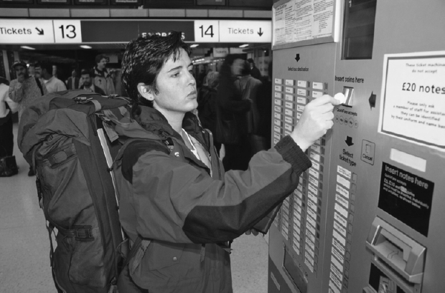
Implications of Customer Participation in Service Delivery
Greater need for information/training to help customers to perform well, get desired results
Customers should be given a realistic service preview in advance of service delivery, so they have a clear picture of their expected role
Figure 2.13: Tourists Appreciate Easy-to-Understand Instructions When Traveling

Slide 36
Post-Encounter Stage

Slide 37
Post-Encounter Stage: Overview
Prepurchase Stage
Evaluation of service performance
Future intentions
Service Encounter Stage
Post-Encounter Stage

Slide 38
Customer Satisfaction Is Central to the Marketing Concept
Satisfaction defined as attitude-like judgment following a service purchase or series of service interactions
Customers have expectations prior to consumption, observe service performance, compare it to expectations
Satisfaction judgments are based on this comparison
  Positive disconfirmation if better than expected
  Confirmation if same as expected
  Negative disconfirmation if worse than expected
Satisfaction reflects perceived service quality, price/quality tradeoffs, personal and situational factors
Research shows links between customer satisfaction and a firm’s financial performance

Slide 39

Customer Delight:
Going Beyond Satisfaction
Research shows that delight is a function of three components:
  Unexpectedly high levels of performance
  Arousal (e.g., surprise, excitement)
  Positive affect (e.g., pleasure, joy, or happiness)
Is it possible for customers to be delighted by very mundane services?
Strategic links exist between customer satisfaction and corporate performance.
Getting feedback during service delivery help to boost customer loyalty
Progressive Insurance seeks to delight customers through exceptional customer service (Best Practice in Action 2.1)

Slide 40
Summary of Chapter 2:
Customer Behavior in Service Encounters (1)
Four broad categories of services
  People processing, possession processing, mental stimulus processing, information processing
  Based on differences in nature of service act (tangible or intangible), and who or what is direct recipient of service (people or possessions)
  Each poses distinctive service management challenges
Three-Stage Model of service consumption helps us to understand and better manage customer behavior

Slide 41
Summary of Chapter 2:
Customer Behavior in Service Encounters (2)
Prepurchase stage
  Customers seek solutions to aroused needs
  Evaluation alternatives are more difficult when a service involves experience and credence attributes
  Customers face a variety of perceived risks in selecting, purchasing and using services
  Steps taken to reduce customers’ risk perceptions, include: (1) guarantees and warranties, (2) previews of service and visits to service facilities, (3) employee training, (4) instituting visible safety procedures, (5) easy access to information, and (6) advance notice of problems or delays
  Customer expectations of service range from “desired” to “adequate” with a zone of tolerance in between; if actual service is perceived as less than adequate, customers will be dissatisfied

Slide 42
Summary of Chapter 2:
Customer Behavior in Service Encounters (3)
Service encounter stage
  Service encounters range from high contact to low contact
  Servuction system differs by level of contact:
    High-contact services: Most parts of operations, service delivery, and marketing systems are exposed to customers
    Low-contact services: Some parts of systems are invisible to customers
  Role and script theories help us understand and manage customer behavior during encounters
  Theatrical view of service delivery offers insights for design, stage-managing performances, and relationships with customer “audience”
Post-encounter stage
  In evaluating service performance, customers can have expectations positively disconfirmed, confirmed, or negatively disconfirmed
  Unexpectedly high levels of performance, arousal and positive affect are likely to lead to delight

