Slide 1
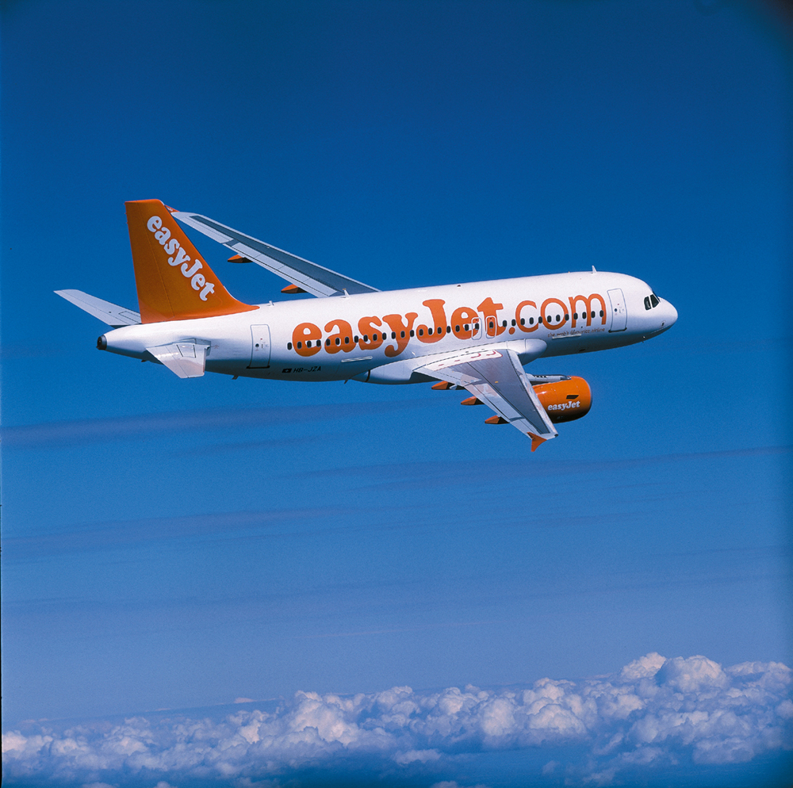



Chapter 3:
Developing
Service Concepts:
Core and
Supplementary Elements

Slide 2
Overview of Chapter 3
Planning and Creating Services
The Flower of Service
Planning and Branding Service Products
Development of New Services

Slide 3
Planning and Creating Services

Slide 4
Planning and Creating Services
A service product comprises all elements of service performance, both tangible and intangible, that create value for customers
The service concept is represented by:
  A core product
  Accompanied by supplementary services

Slide 5

Core Products and Supplementary Services
In mature industries, core products often become commodities
Supplementary services help to differentiate core products and create competitive advantage by:
  Facilitating use of core product (a service or a good)
  Enhancing the value and appeal of the core product

Slide 6
Augmenting the Core Product (Fig 3.1)
Figure 3.1
Shostack’s Molecular Model: Passenger Airline Service
Distribution
Price
Service Frequency
Vehicle
In-flight Service
Transport
Pre- & Postflight Service
Food & Drink
Key
Tangible Elements
Intangible Elements
Marketing Positioning
(weighted toward evidence)
Source: Shostack

Slide 7

Augmenting the Core Product
Are supplementary services needed to facilitate use of core product or simply to add extra appeal?
Should customers be charged separately for each service element?
Or should all elements be bundled at a single price?

Slide 8
Designing a Service Concept
Core Product
  Central component that supplies the principal, problem-solving benefits customers seek
Supplementary Services
  Augment the core product, facilitating its use and enhancing its value and appeal
Delivery Processes
  Used to deliver both the core product and each of the supplementary services

Slide 9
Core and Supplementary Product Design:
An Integrated Perspective (Fig 3.2)
Delivery Concept
for Core Product
Supplementary
services offered
and delivered
Scheduling
Nature of Process
Service Level
Customer
Role

Slide 10
Documenting Delivery Sequence
Over Time
Must address sequence in which customers will use each core and supplementary service
Determine approximate length of time required for each step
  Customers may budget a specific amount of time for an activity
Information should reflect good understanding of customers, especially their:
  Needs
  Habits
  Expectations
Question: Do customers’ expectations change during service delivery in light of perceived quality of each sequential encounter?

Slide 11
Core and Supplementary Services at Luxury Hotel
(Offering Much More than Cheap Motel!)
Reservation
Cashier
Valet
Parking
Business
Center
Reception
A Bed for the Night in an Elegant Private Room with a Bathroom
Room
Service
Baggage
Service
Wake-up
Call
Cocktail
Bar
Internet
Entertainment/ Sports/ Exercise
Restaurant

Slide 12
What Happens, When, in What Sequence?
Time Dimension in Augmented Product (Fig 3.3)
Reservation
internet
Parking
Get car
Check in
Check out
Internet
Internet
Use room
USE GUESTROOM OVERNIGHT
Porter
Pay TV
Meal
Room service
Before Visit
Time Frame of An Overnight Hotel Stay
(Real-time service use)

Slide 13
Flowcharting Service Delivery
Helps to Clarify Product Elements
Offers way to understand totality of customer’s service experience
Useful for distinguishing between core product itself and service elements that supplement core
  Restaurants: Food and beverage (core)
  Reservations (supplementary services)
Shows how nature of customer involvement with service organizations varies by type of service:
  People processing
  Possession processing
  Mental Stimulus processing
  Information processing

Slide 14
Defining Core and Supplementary
Elements of Our Service Product
How is our core product defined and what supplementary elements augment it?
What product benefits create most value for customers?
Is our service package differentiated from competition in meaningful ways for target customers?
What are current levels of service on core product and each supplementary element?
Can we charge more for higher service levels? For example:
  Faster response and execution
  Better physical amenities
  Easier access
  Higher staffing levels
  Superior caliber personnel
Alternatively, should we cut service levels and charge less?

Slide 15
Simple Flowchart for Delivery of a People-Processing Service (Fig 3.4)
People Processing – Stay at Motel
Spend Night in Room
Park Car
Check In
Breakfast
Check Out
Maid Makes up Room
Breakfast Prepared

Slide 16
Simple Flowchart for Delivery of a
Possession-Processing Service (Fig 3.4)
Possession Processing – Repair a DVD Player
Travel to Store
Technician Examines Player, Diagnoses Problem
Leave Store
Return, Pick up Player and Pay
(Later) Play DVDs at Home
Technician Repairs Player

Slide 17
Simple Flowchart for Delivery of Mental
Stimulus-Processing Service (Fig 3.4)
Mental Stimulus Processing – Weather Forecast
Turn on TV, Select Channel
View Presentation of Weather Forecast
Confirm Plans for Picnic
Collect Weather Data
Meteorologists Input Data to Models and Creates Forecast from Output
TV Weatherperson Prepares Local Forecast

Slide 18
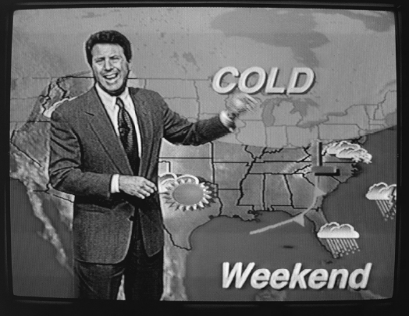
Weather Forecasting Is a Service Directed at Customers’ Minds (Fig 3.5)

Slide 19
Simple Flowchart for Delivery of An
Information-Processing Service (Fig 3.4)
Information Processing – Health Insurance
Learn about Options
Select Plan, Complete Forms
Insurance Coverage Begins
Printed Policy Documents Arrive
Pay
University and Insurance Company Agree on Terms of Coverage
Customer Information Entered in Database

Slide 20
The Flower of Service (Fig 3.6)
Information
Payment
Consultation
Billing
Core
Order Taking
Exceptions
Hospitality
Safekeeping
KEY:
Facilitating elements
Enhancing elements

Slide 21
How to Determine What Supplementary Services Should Be Offered
Not every core product is surrounded by supplementary elements from all eight clusters
Nature of product helps to determine:
  Which supplementary services must be offered
  Which might usefully be added to enhance value and ease of doing business with the organization
People-processing and high-contact services tend to have more supplementary services
Market positioning strategy helps to determine which supplementary services should be included
Firms that offer different levels of service often add extra supplementary services for each upgrade in service level

Slide 22
The Flower of Service:
Facilitating Services—Information
Customers often require information about how to obtain and use a product or service.
Examples of elements:
Directions to service site
Schedule/service hours
Prices
Conditions of sale
Usage instructions
Core

Slide 23
The Flower of Service:
Facilitating Services—Order Taking
Customers need to know what is available and may want to secure commitment to delivery. The process should be fast and smooth.
Examples of elements:
Applications
Order entry
Reservations and check-in
Core

Slide 24
The Flower of Service:
Facilitating Services—Billing
“How much do I owe you?”
Bills should be clear,
Accurate, and intelligible.
Examples of elements:
Periodic statements of
account activity
Machine display of amount
due
Core

Slide 25
The Flower of Service:
Facilitating Services—Payment
Customers may pay faster
and more cheerfully if you
make transactions simple
and convenient for them.
Examples of elements:
Self service payment
Direct to payee or intermediary
Automatic deduction
Core

Slide 26
The Flower of Service:
Enhancing Services—Consultation
Value can be added to goods and services by offering advice and consultation tailored to
each customer’s needs and situation.
Examples of elements:
Customized advice
Personal counseling
Management consulting
Core

Slide 27
The Flower of Service:
Enhancing Services—Hospitality
Customers who invest time and effort in visiting a business and using its services deserve to be
treated as welcome guests—
after all, marketing invited them!
Examples of elements:
Greeting
Waiting facilities and amenities
Food and beverages
Toilets and washrooms
Security
Core

Slide 28
The Flower of Service:
Enhancing Services—Safekeeping
Customers prefer not to worry about looking after the personal possessions that they bring with them to a service site.
Examples of elements:
Looking after possessions
customers bring with them
Caring for goods purchased
(or rented) by customers
Core

Slide 29
The Flower of Service:
Enhancing Services—Exceptions
Customers appreciate some
flexibility when they make special requests and expect responsiveness when things don’t go according to plan.
Examples of elements:
Special requests in advance
Complaints or compliments
Problem solving
Restitution
Core

Slide 30
Managerial Implications
To develop product policy and pricing strategy, managers need to determine:
  Which supplementary services should be offered as a standard package accompanying the core
  Which supplementary elements could be offered as options for an extra charge
In general, firms that compete on a low-cost, no-frills basis needs fewer supplementary elements than those marketing expensive, high-value-added services
Each flower petal must receive consistent care and concern to remain fresh and appealing

Slide 31
Planning and Branding Service Products

Slide 32
Service Products
A product implies a defined and consistent “bundle of output” and also ability of firm to differentiate its bundle of output from competitors’
Service firms can differentiate their products in similar fashion to various “models” offered by manufacturers
Providers of more intangible services also offer a “menu” of products
  Represent an assembly of elements that are built around the core product
  May include certain value-added supplementary services

Slide 33

Product Lines and Brands
Most service organizations offer a line of products rather than just a single product
They may choose among three broad alternatives:
  Single brand to cover all products and services
  A separate, stand-alone brand for each offering
  Some combination of these two extremes

Slide 34
Spectrum of Branding Alternatives
(Fig 3.8)
Corporate Branding
Individual Product Branding
“Branded House”
e.g., Virgin Group
“House of Brands”
e.g., P&G
Sub-brands
e.g., Raffles Class at Singapore Airlines
Endorsed Brands
e.g., Courtyard
by Marriott
Source: Derived from Aaker and Joachimsthaler

Slide 35
Example: British Airways Sub-brands
British Airways offers six distinct air travel products
  Four intercontinental offerings:
    First (deluxe service)
    Club World (business class)
    World Traveller Plus (premier economy class)
    World Traveller (economy class)
  Two intra-European offerings:
    Club Europe
    Euro-Traveller

Slide 36
Offering a Branded Experience (1)
Branding can be employed at both corporate and product levels
Corporate brand:
  Easily recognized
  Holds meaning to customers
  Stands for a particular way of doing business
Product brand:
  Helps firm communicate distinctive experiences and benefits associated with a specific service concept
Moving toward branded customer experience includes:
  Create brand promise
  Shape truly differentiated customer experience
  Give employees skills, tools, and supporting processes to deliver promise
  Measure and monitor

Slide 37
Offering a Branded Experience (2)
“The brand promise or value proposition is not a tag line, an icon, or a color or a graphic element, although all of these may contribute. It is, instead, the heart and soul of the brand….”
Don Schultz

Slide 38
Developing New Services

Slide 39
A Hierarchy of
New Service Categories (1)
Major service innovations
  New core products for previously undefined markets
Major process innovations
  Using new processes to deliver existing products with added benefits
Product-line extensions
  Additions to current product lines
Process-line extensions
  Alternative delivery procedures

Slide 40
A Hierarchy of
New Service Categories (2)
Supplementary service innovations
  Addition of new or improved facilitating or enhancing elements
Service improvements
  Modest changes in the performance of current products
Style changes
  Visible changes in service design or scripts

Slide 41
Reengineering Service Processes
Service processes affect not only customers, but also cost, speed, and productivity with which desired outcome is achieved
Reengineering involves analyzing and redesigning processes to achieve faster and better performance
  Running tasks in parallel instead of sequence can reduce/eliminate dead time
Examination of processes can lead to creation of alternative delivery methods that constitute new service concepts
  Add/eliminate supplementary services
  Resequence delivery of service elements
  Offer self-service options

Slide 42

Physical Goods as a Source Of New Service Ideas
Services can be built around rentals: Alternatives to owning a physical good and/or doing work oneself
  Customers can rent goods—use and return for a fee—instead of purchasing them
  Customers can hire personnel to operate own or rented equipment
Any new durable good may create need for after-sales services now and in future—possession processing
  Shipping
  Installation
  Problem-solving and consulting advice
  Cleaning and maintenance
  Upgrades
  Removal and disposal

Slide 43
Creating Services as Substitutes for
Owning and/or Using Goods (Fig 3.10)
Rent Use of a Physical Good
Own a Physical Good
Perform Work Oneself
Drive Own Car
Use Own Computer
Rent a Car and Drive it
Rent Use of Computer
Hire Someone to Do Work
Hire a Chauffeur to Drive
Hire a Typist to Type
Hire a Taxi or Limousine
Send Work Out to a
Secretarial Service

Slide 44
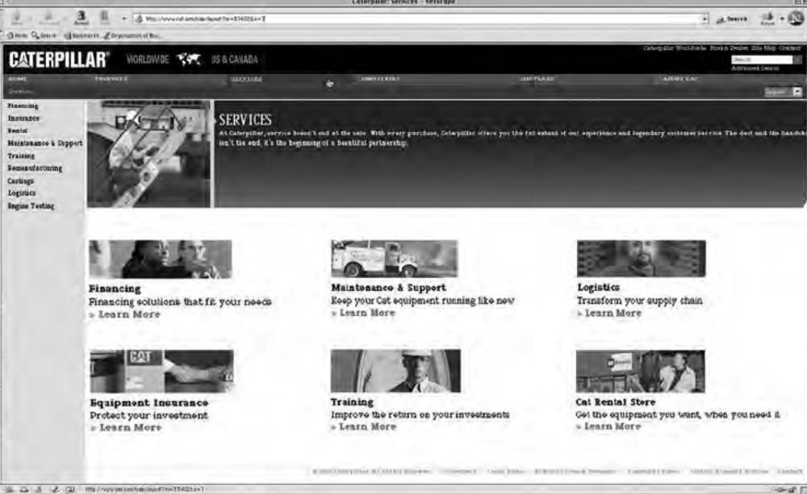
Caterpillar Promotes Its Service Businesses (Fig 3.11)
Reprinted Courtesy of Caterpillar, Inc.

Slide 45

Achieving Success in Developing New Services
Services are not immune to high failure rates that plague new manufactured products
  “dot.com” companies
In developing new services
  Core product is of secondary importance
  Ability to maintain quality of the total service offering is key
  Accompanying marketing support activities are vital
  Market knowledge is of utmost importance

Slide 46
Success Factors in
New Service Development
Market synergy
  Good fit between new product and firm’s image/resources
  Advantage versus competition in meeting customers’ needs
  Strong support from firm during/after launch
  Firm understands customer purchase decision behavior
Organizational factors
  Strong interfunctional cooperation and coordination
  Internal marketing to educate staff on new product and its competition
  Employees understand importance of new services to firm
Market research factors
  Scientific studies conducted early in development process
  Product concept well defined before undertaking field studies

Slide 47
Summary of Chapter 3:
Developing Service Concepts (1)
Planning and creating services involve:
  Augmenting core product
  Designing core product, supplementary services, and delivery process
  Documenting delivery sequence over time with flowcharts
  Gaining insights from flowcharting
Flower of service includes core product and two types of supplementary services: facilitating and enhancing
  Facilitating services include information, order taking, billing, and payment
  Enhancing services include consultation, hospitality, safekeeping, and exceptions
Spectrum of branding alternatives exists for services
  Branded house
  Sub-brands
  Endorsed brands
  House of brands

Slide 48
Summary of Chapter 3:
Developing Service Concepts (2)
Seven categories of new services:
  Major service innovations
  Major process innovations
  Product-line extensions
  Process-line extensions
  Supplementary service innovations
  Service improvements
  Style changes
To develop new services, we can
  Reengineer service processes
  Use physical goods as a source of new service ideas
  Use research to design new services
  Achieve success in developing new services

