Slide 1
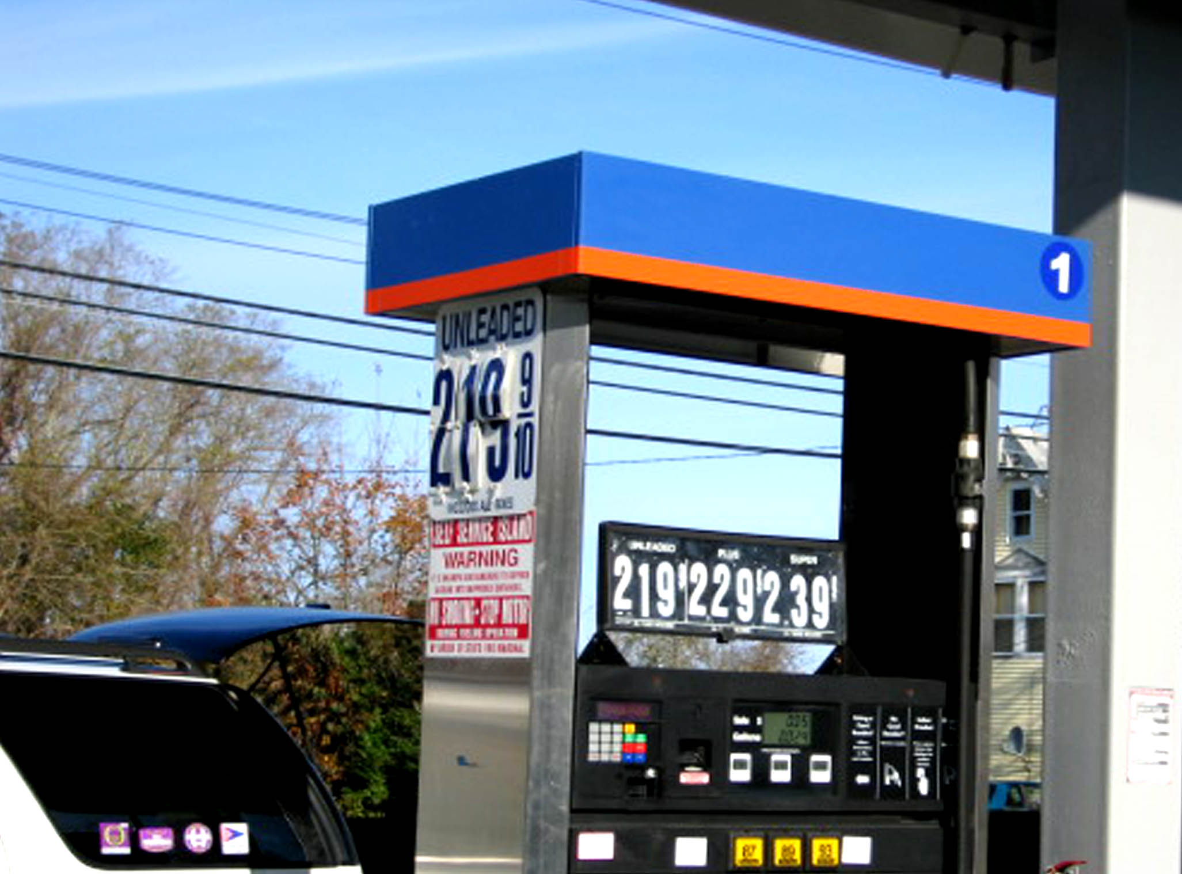



Chapter 5:
Exploring Business Models:
Pricing and Revenue
Management

Slide 2
Overview of Chapter 5
Effective Pricing Is Central to Financial Success
Pricing Strategy Stands on Three Legs
Revenue Management: What It Is and How It Works
Ethical Concerns in Service Pricing
Putting Service Pricing into Practice

Slide 3
Effective Pricing Is Central to Financial Success

Slide 4
What Is a Business Model?
Use of effective pricing mechanism to:
  Transform sales into revenues
  Recover costs
  Create value for owners of business
Must clarify business logic that explains how firm can deliver value to customers at an appropriate cost
Not all business models require end user of specific service to pay full cost—consider third-party payers:
  Advertisers
  Health insurers
  Donors to nonprofit organizations
  Tax subsidies for public services

Slide 5
What Makes Service Pricing Strategy Different and Difficult?
Harder to calculate financial costs of creating a service process or performance than a manufactured good
Variability of inputs and outputs—how can firms define a “unit of service” and establish basis for pricing?
Customers find many services hard to evaluate—what are they getting in return for their money?
Importance of time factor—same service may have more value to customers when delivered faster
Delivery through physical or electronic channels—may create differences in perceived value

Slide 6

Alternative Objectives for Pricing
(Table 5.1)
Revenue and profit objectives
  Seek profit
  Cover costs
Patronage and user-based objectives
  Build demand
    Demand maximization
    Full-capacity utilization
  Build a user base
    Stimulate trial and adoption of new service
    Build market share/large user base

Slide 7
Pricing Strategy Stands on
Three Legs

Slide 8
The Pricing Tripod
Fig 5.1
Pricing
strategy
Competition
Costs
Value to customer

Slide 9
Three Main Approaches to Pricing
Cost-based pricing
  Set prices relative to financial costs (problem: defining costs)
  Activity-based costing
  Pricing implications of cost analysis
Competition-based pricing
  Monitor competitors’ pricing strategy (especially if service lacks differentiation)
  Who is the price leader? Does one firm set the pace?
Value-based pricing
  Relate price to value perceived by customer

Slide 10
Cost-based Pricing:
Traditional vs. Activity-based Costing
Traditional costing approach
  Emphasizes expense categories (arbitrary overhead allocation)
  May result in reducing value generated for customers
ABC management systems
  Link resource expenses to variety and complexity of goods/services produced
  Yields accurate cost information
When looking at prices, customers care about value to themselves, not what service production costs the firm

Slide 11
Value-based Pricing
Understanding Net Value (Fig 5.2)
Value exchange will not take place unless customer sees positive net value in transaction
Net value = Perceived benefits to customer (gross value) minus all Perceived outlays (Money, Time, Mental/Physical effort)
Monetary price is not only perceived outlay in purchasing, using a service
Consumer surplus: difference between price paid and amount customer would have been willing to pay in absence of other options
Effort
Time
e
Perceived
benefits
Perceived
outlays

Slide 12
Value-based Pricing:
Strategies for Enhancing Net Value
Enhance gross value—benefits delivered
  Add benefits to core product
  Enhance supplementary service
  Manage perceptions of benefits delivered
Reduce outlays—costs incurred by customers
  Reduce price and/or other monetary costs of acquisition and usage
  Cut amount of time required to evaluate, buy, use service
  Lower physical and mental effort associated with purchase and use
  Reduce perceptions of amount of cost, time, effort required

Slide 13
Value-based Pricing:
Enhancing Perceptions of Gross Value
Reduce uncertainty
  Service guarantees
  Benefit-driven—pricing aspect(s) of service that create value
  Flat rate (quoting a fixed price in advance)
Relationship pricing
  Nonprice incentives
  Discounts for volume purchases
  Discounts for purchasing multiple services
Low-cost leadership
  Convince customers not to equate price with quality
  Keep economic costs low to ensure profitability at low price

Slide 14

Paying for Service:
The Customer’s Perspective
Customer “expenditures” on service comprise both financial and nonfinancial outlays
Incremental financial outlays
  Price of purchasing service
  Expenses associated with search, purchase activity, usage
Nonmonetary costs
  Time costs
  Physical costs
  Psychological (mental) costs
  Sensory costs (unpleasant sights, sounds,
  feel, tastes, smells)

Slide 15
Determining Total Costs of a Service to Customer (Fig 5.4)
Money
Purchase
Search costs*
Time
Operating costs
Physical effort
Incidental expenses
Purchase and service encounter costs
Psychological burdens
Sensory
burdens
Necessary
follow-up
After costs*
Problem
solving
* Includes all five
cost categories

Slide 16
Trading Off Monetary and Nonmonetary Costs (Fig 5.5)
Which clinic would you patronize if you needed a chest x-ray (assuming all three clinics offer good quality)?
Clinic A
Clinic B
Clinic C
Price $45
Located 1 hour away by car or transit
Next available appointment is in 3 weeks
Hours: Mon-Fri, 9AM-5PM
Estimated wait at clinic is about 2 hours
Price $85
Located 15 mins away by car or transit
Next available appointment is in 1 week
Hours: Mon-Fri, 8AM-10PM
Estimated wait at clinic is about 30 to 45 mins
Price $125
Located next to your office or college
Next appointment is in 1 day
Hours: Mon-Fri, 8AM-10PM
By appointment— estimated wait at clinic is 0 to 15 mins

Slide 17
Increasing Net Value by Reducing
Nonmonetary Costs of Service
Reduce time costs of service at each stage
Minimize unwanted psychological costs of service
  Eliminate/redesign unpleasant/inconvenient procedures
Eliminate unwanted physical costs of service
Decrease unpleasant sensory costs of service
  Unpleasant sights, sounds, smells, feel, tastes

Slide 18
Revenue Management:
What It Is and How It Works

Slide 19
Maximizing Revenue from
Available Capacity at a Given Time
Price customization
  Charge different value segments different prices for same product
Useful in dynamic markets
  Different price buckets based on price sensitivity to different usage times, flexibility, other factors
RM uses mathematical models to examine historical data and real-time information to determine
  What prices to charge within each price bucket
  How many service units to allocate to each bucket
Rate fences deter customers willing to pay more from trading down to lower prices (minimize consumer surplus)

Slide 20
The Strategic Levels of
Revenue (Yield) Management
Price
Fixed
Variable
Quadrant 1
Movies
Stadiums/arenas
Function space
Quadrant 2
Hotel rooms
Airline seats
Rental cars
Cruise lines
Predictable
Duration
Quadrant 3
Restaurants
Golf courses
Quadrant 4
Continuing care
Hospitals
Unpredictable
Source: Fig 1 from Kimes and Chase reading (p. 212)

Slide 21
Dealing with Customer Conflicts Arising from Revenue Management
Customer conflict can arise from:
Marketing tools to reduce customer conflicts:
Perceived unfairness and perceived financial risk associated with multitier pricing and selective inventory availability
Unfulfilled inventory commitment
Unfulfilled demand of regular customers
Unfulfilled price expectation of group customers
Change in nature of service
Fenced pricing
Bundling
Categorizing
High published price
Well-designed customer recovery program for overbooking
Preferred availability policies
Offer lower displacement cost alternatives
Physical segregation and perceptible extra service
Set optimal capacity utilization level
Source: J. Wirtz, S.E. Kimes, J.H.P. Ho and P. Patterson, “Revenue Management: Resolving Potential Customer Conflicts,” Journal of Revenue and Pricing Management, 2003, Vol. 2 (3): 216-228.

Slide 22
Price Elasticity (Fig 5.6)
Price per
unit of
service
D_{i}
D_{e}
Price elasticity =
Percentage change in demand
Percentage change in price
D_{e}
D_{i}
Quantity of units demanded
D_{e} : Demand is price elastic. Small changes in price lead to big changes in demand
D_{i} : Demand for service is price inelastic. Big changes have little impact on demand

Slide 23
Key Categories of Rate Fences (1)
Table 5.2
Rate Fences | Examples
Physical (product-related) Fences
Basic product | Class of travel (business/economy class) Size and furnishing of a hotel room Seat location in a theater
Amenities | Free breakfast at a hotel, airport pickup, etc. Free golf cart at a golf course
Service level | Priority wait-listing Increase in baggage allowances Dedicated service hotlines Dedicated account management team

Slide 24
Key Categories of Rate Fences (2)
Table 5.2
Nonphysical Fences
Transaction Characteristics
Time of booking or reservation | Requirements for advance purchase Must pay full fare two weeks before departure
Location of booking or reservation | Passengers booking air tickets for an identical route in different countries are charged different prices
Flexibility of ticket usage | Fees/penalties for canceling or changing a reservation (up to loss of entire ticket price) Nonrefundable reservation fees

Slide 25

Key Categories of Rate Fences (3)
Table 5.2
Nonphysical Fences (cont’d)
Consumption Characteristics
Time or duration of use | Early-bird special in restaurant before 6PM Must stay over on Saturday for airline, hotel Must stay at least 5 days
Location of consumption | Price depends on departure location, especially in international travel Prices vary by location (between cities, city center versus edges of city)

Slide 26

Key Categories of Rate Fences (4)
Table 5.2
Nonphysical Fences (cont’d)
Buyer Characteristics
Frequency or volume of consumption | Member of certain loyalty tier with the firm get priority pricing, discounts, or loyalty benefits
Group membership | Child, student, senior citizen discounts Affiliation with certain groups (e.g., alumni)
Size of customer group | Group discounts based on size of group

Slide 27
Relating Price Buckets and Fences to
Demand Curve (Fig 5.7)
Price per seat
1st class
Full fare economy (no restrictions)
1 - week advance purchase
1 - week advance purchase, Saturday night stay
3 - week advance purchase, Saturday night stay
3-week advance purchase, Saturday night stay, $100 for changes
Specified flights, book on Internet, no changes/refunds
Late sales through consolidators/Internet, no refunds
Capacity of 1st class cabin
No. of seats demanded
Capacity of aircraft
* Dark areas denote amount of consumer surplus (goal of segmented pricing is to reduce this)

Slide 28
Ethical Concerns in Service Pricing

Slide 29
Ethical Concerns in Pricing
Customers are vulnerable when service is hard to evaluate or they don’t observe performance of work
Many services have complex pricing schedules
  Hard to understand
  Difficult to calculate full costs in advance of service
Unfairness and misrepresentation in price promotions
  Misleading advertising
  Hidden charges
Too many rules and regulations
  Customers feel constrained, exploited
  Customers unfairly penalized when plans change

Slide 30
Designing Fairness into
Revenue Management
Design clear, logical, and fair price schedules and fences
Use high published prices and present fences as opportunities for discounts rather than quoting lower prices and using fence as basis to impose surcharges
Communicate consumer benefits of revenue management
Use bundling to “hide” discounts
Take care of loyal customers
Use service recovery to compensate for overbooking

Slide 31
Putting Service Pricing
into Practice

Slide 32
Pricing Issues:
Putting Strategy into Practice (Table 5.3)
How much to charge?
What basis for pricing?
Who should collect payment?
Where should payment be made?
When should payment be made?
How should payment be made?
How to communicate prices?

Slide 33

Putting Service Pricing into Practice (1)
How much to charge?
  The pricing tripod model provides a useful departure point
  A specific figure must be set for the price
  Need to consider the pros and cons, the ethical issues
What basis for pricing? (How define unit of service?)
  Completing a task
  Admission to a service performance
  Time based
  Monetary value of service delivered (e.g., commission)
  Consumption of physical resources (e.g., food and beverages)

Slide 34

Putting Service Pricing into Practice (2)
Who should collect payment?
  Service provider or specialist intermediaries
  Direct or nondirect channels
Where should payment be made?
  Conveniently located intermediaries
  Mail/bank transfer
When should payment be made?
  In advance
  Once service delivery has been completed

Slide 35

Putting Service Pricing into Practice (3)
How should payment be made?
  Cash
  Token
  Stored value card
  Electronic fund transfer
  Charge card (debit/credit)
  Vouchers
  Third-party payment
How to communicate prices?
  Relate the price to that of competing products
  Ensure price is accurate and intelligible

Slide 36
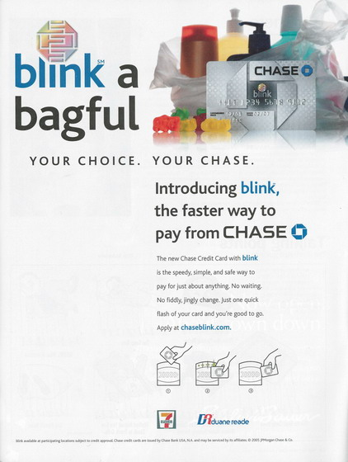
Chase’s Blink Service (Fig 5.10)
Chase advertises its fast new credit card scanning service, “Blink”
“Blink” can be read by a point-of-sale terminal without being physically touched
Simplifies and speeds payment transaction, saves customer time and effort
Courtesy of JP Morgan Chase & Company

Slide 37
Frequency of Health Club Use
Relates to Timing of Payments (RI 6.1)
Annual payment plan
Quarterly payment plan
Frequency of health club visits
Semiannual payment plan
Monthly payment plan
Frequency of health club visits
Time line
Time line
Source: John Gourville and Dilip Soman, “Pricing and the Psychology of Consumption,” Harvard Business Review, September 2002, 90-96.

Slide 38
Summary of Chapter 5:
Exploring Business Models (1)
Pricing objectives can include
  Generating revenues and profit
  Building demand
  Developing user base
Three main foundations to pricing a service
  Cost-based pricing
  Competition-based pricing
  Value-based pricing
Cost-based pricing seeks to recover costs plus a margin for profit; includes both traditional and activity-based costing
Firm must be aware of competitive pricing but may be harder to compare for services than for goods
Value-based pricing should reflect net benefits to customer after deducting all costs

Slide 39
Summary of Chapter 5:
Exploring Business Models (2)
Revenue management
  Maximizes revenue from a given capacity at a point in time
  Helps manage demand and set prices for each segment closer to perceived value
  Involves use of rate fences to deter segments willing to pay more from trading down to lower prices
Ethical issues in pricing
  Customers are vulnerable when service is hard to evaluate
  Many services have deliberately complex pricing schedules
  Unfairness and misrepresentation in price promotions and advertising
  Hidden charges catch customers by surprise
  Too many rules and regulations

Slide 40
Summary of Chapter 5 –
Exploring Business Models (3)
Questions to ask when putting service pricing into practice
  How much to charge?
  What should the specified basis for pricing be?
  Who should collect payment
  Where should payment be made?
  When should payment be made?
  How should payment be made?
  How should prices be communicated to the right target market?

