Slide 1
An Approximation of The Traveling Salesman Problem
A Bug's Life

Slide 2


Slide 3
AntColonyOptimization(Ants, Edges, Start):
minPath = [start]
minCost = sys.maxsize
for all edges:
pheromones(edge) = 1
ant in ant:
path, cost = releaseAnt(Ant)
if cost < minCost
minPath = path
minCost = cost
releaseAnt(ant)
u ← start
for unvisited neighbour of u
u→v = calculateWeightedPathChoice(u) editPheremones(u→v)
calculateWeightedPathChoice(u)
choices = []
for neighbour v of u
for pheromoneLevel of u→v
add v to choices
n = randomElement(choices)
return u→n
editPheremones(u→v)
p = pheremones(u→v)
increase p by 1/w
decrease p
O(A*V)
Given A ants, each completes its path in a multiple of n steps, traversing V vertices.

Slide 4
In Action
AntColonyOptimization(Ants, Edges, Start):
minPath = [start]
minCost = sys.maxsize
for all edges:
pheromones(edge) = 1
ant in ant:
path, cost = releaseAnt(Ant)
if cost < minCost
minPath = path
minCost = cost
releaseAnt(ant)
u ← start
for unvisited neighbour of u
u→v = calculateWeightedPathChoice(u) editPheremones(u→v)
calculateWeightedPathChoice(u)
choices = []
for neighbour v of u
for pheromoneLevel of u→v
add v to choices
n = randomElement(choices)
return u→n
A B 10
A C 11
A D 12
A E 25
B C 20
B D 21
B E 22
C D 30
C E 31
D E 40
F A 14
F B 18
F C 13
F D 25
F E 23
A (Start)
E
B
F
editPheremones(u→v)
p = pheremones(u→v)
increase p by 1/w
decrease p
C
D

Slide 5
Lower Bound Approximation
Given sets number of edges e, corresponding list of weights w and a number of n nodes:
S = {e_{i}←{e₀…e_{n}}| w(e_{i}) == min({edges /\ ~S_{i}}) }
Σ w(path) >= Σ w(S)
But this lower bound does not tell us much:
Effectively this states: "The lower bound from the path cannot be less than a cycle containing the n shortest edges"

Slide 6
Lower Bound Approximation With Kruskal's Algorithm
A
A B 10
A C 11
A D 12
A E 25
B C 20
B D 21
B E 22
C D 30
C E 31
D E 40
F A 14
F B 18
F C 13
F D 25
F E 23
E
B
F
C
D
("TheChalkFace")

Slide 7
Lower Bound Approximation With Kruskal's Algorithm
A
Step 1:
Remove 1 vertex
A B 10
A C 11
A E 25
B C 20
B E 22
C E 31
F A 14
F B 18
F C 13
F E 23
E
B
F
C
D

Slide 8
Lower Bound Approximation With Kruskal's Algorithm
A
Step 2:
Select the shortest edge that does not create a cycle
A B 10
A C 11
A E 25
B C 20
B E 22
C E 31
F A 14
F B 18
F C 13
F E 23
E
B
F
K(V, E): sort E by increasing weight F (V,?) for each vertex v 2 V MS(v) for i 1 to |E| uv ith lightest edge in E if F(u) 6= F(v) U(u, v) add uv to F return F
C
D

Slide 9
Lower Bound Approximation With Kruskal's Algorithm
A
Step 3:
Continue selecting the shortest edge that does not create a cycle until it is not possible anymore
A B 10
A C 11
A E 25
B C 20
B E 22
C E 31
F A 14
F B 18
F C 13
F E 23
E
B
F
C
D

Slide 10
Lower Bound Approximation With Kruskal's Algorithm
A
Step 3:
Continue selecting the shortest edge that does not create a cycle until it is not possible anymore
A B 10
A C 11
A E 25
B C 20
B E 22
C E 31
F A 14
F B 18
F C 13
F E 23
E
B
F
C
D

Slide 11
Lower Bound Approximation With Kruskal's Algorithm
A
Step 3:
Continue selecting the shortest edge that does not create a cycle until it is not possible anymore
A B 10
A C 11
A E 25
B C 20
B E 22
C E 31
F A 14
F B 18
F C 13
F E 23
E
B
F
C
D

Slide 12
Lower Bound Approximation With Kruskal's Algorithm
A
A B 10
A C 11
B E 22
F C 13
A D 12
B D 21
C D 30
D E 40
F D 25
E
Step 4:
Reintroduce the missing vertex, and connect it to the other component with the cheapest weight to form a path between
B
F
C
D
Time complexity:- O(ElogV)

Slide 13
A
E
B
F
A
E
C
D
B
F
C
D

Slide 14
Time Complexity and PseudoCode
LowerBoundApproximation (G, V, E):
r ← randomVertexFrom(G)
V.remove(r)
for neighbor x of r
E.remove x→r
K.append(x→r)
f = Kruskal(V, E) # O(ElogV)
sort K by increasing weight #O(K logK), K < E
f.addEdge(K[0])
f.addEdge(K[1])
Therefore, Complexity is O(E logV + c) where c is an insignificant factor
Kruskal's Algorithm
Time complexity:- O(E logV)
Kruskal(V, E):
sort E by increasing weight
F ← (V, None)
for each vertex v in V
MakeSet(v)
for i ← 1 to |E|
uv ← ith lightest edge in E
if Find(u) =/= Find(v)
Union(u, v)
add uv to F
return F
(Erickson)

Slide 15
How Do Approximations Compare To Exact Solution
Answers:
Minimum edges (Lower Bounds) | 75
Kruskal's (Lower Bound) | 89
Approximation | 102
Actual | 102

Slide 16
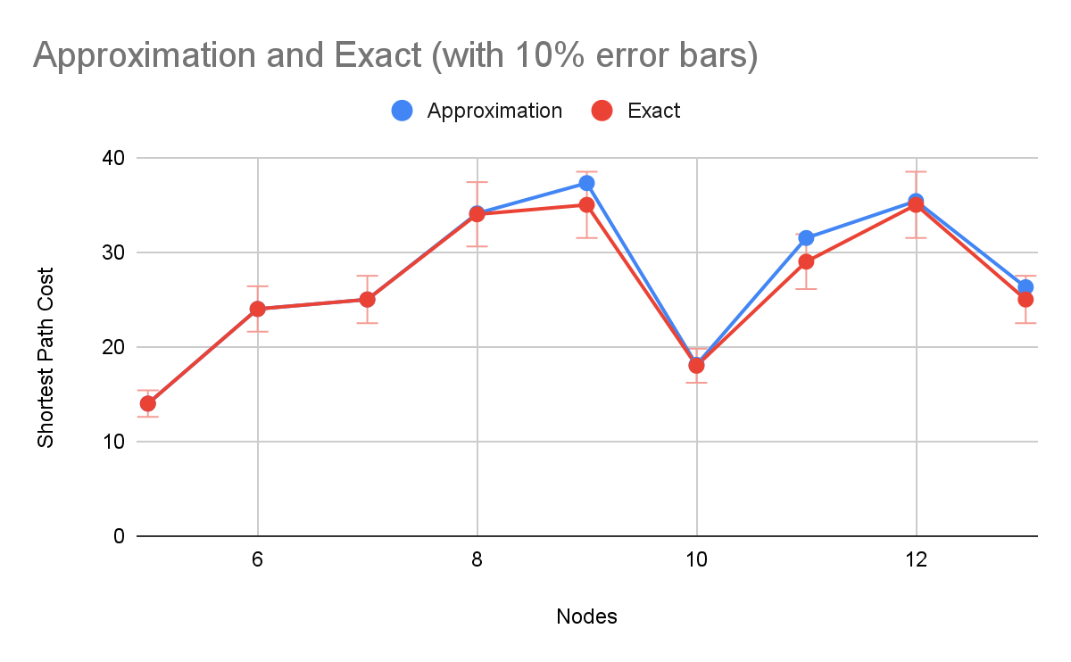
Answers
Nodes | Approximation | Exact
5 | 14 | 14
6 | 24 | 24
7 | 25 | 25
8 | 34.1 | 34
9 | 37.3 | 35
10 | 18.1 | 18
11 | 31.5 | 29
12 | 35.4 | 35
13 | 26.3 | 25
*Approximation Scores are calculated as a mean of 10 trials

Slide 17
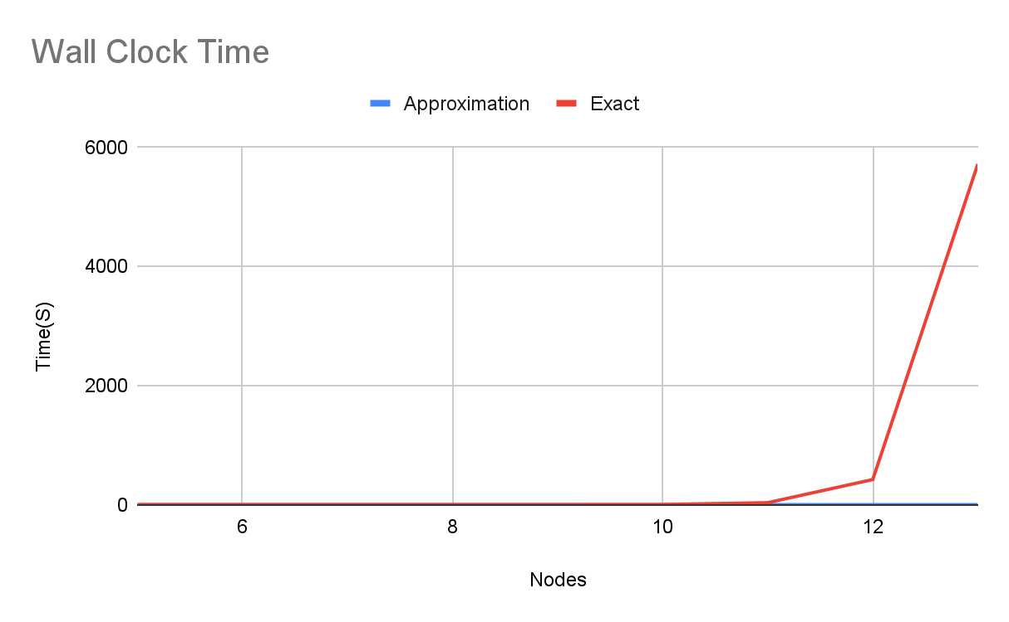
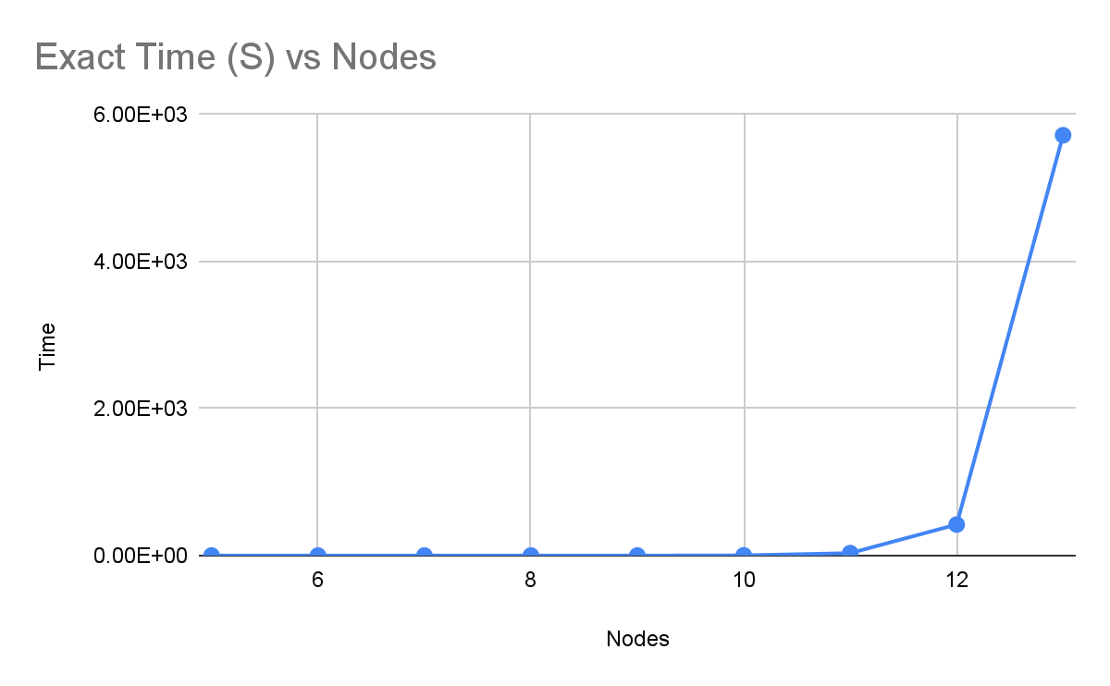
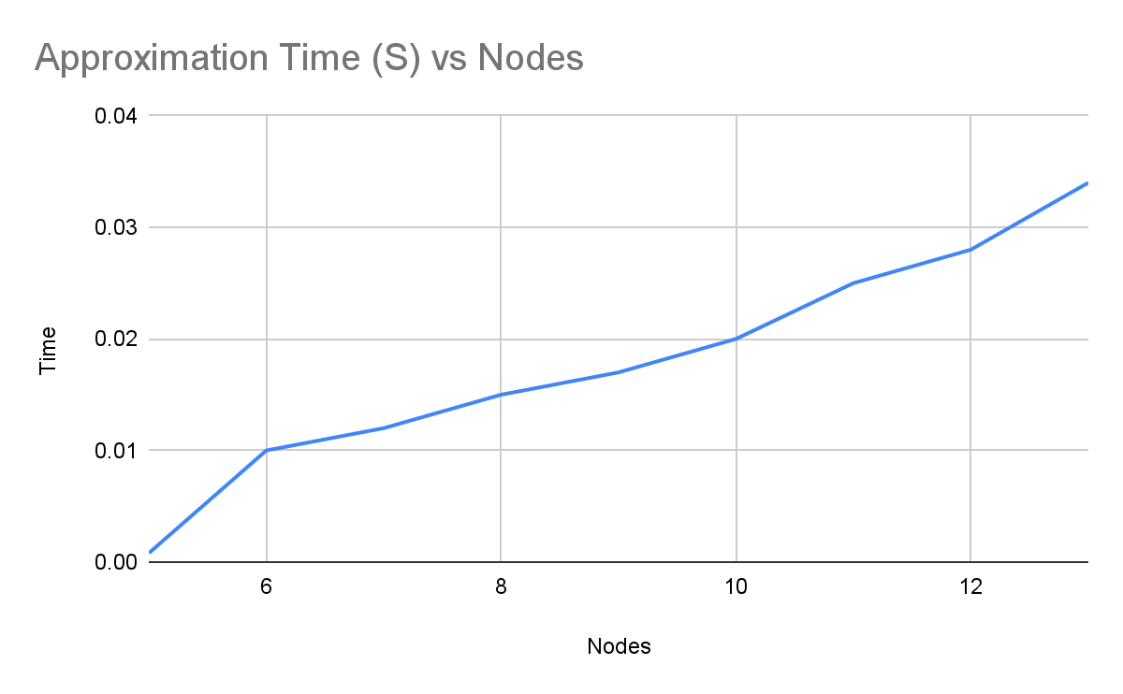
Time (Seconds)
Nodes | Approximation | Exact
5 | 0.0008 | 7.51E-05
6 | 0.01 | 0.0009922981262
7 | 0.012 | 0.004011392593
8 | 0.015 | 0.02692866325
9 | 0.017 | 0.2593269348
10 | 0.02 | 2.653352737
11 | 0.025 | 32.93935084
12 | 0.028 | 421.6014912
13 | 0.034 | 5717.731137

Slide 18
Works Cited
Erickson, Jeff. “Algorithms.” Algorithms by Jeff Erickson, http://jeffe.cs.illinois.edu/teaching/algorithms/.
"TheChalkFace", Anthony. “The Travelling Salesman Problem - the Chalkface.” Https://Www.thechalkface.net/, https://www.thechalkface.net/resources/Travelling_Salesman_England.pdf.

