Slide 1
CHARIOT Webgme
Final Project Presentation
Chinmaya Samal
Avisek Naug

Slide 2
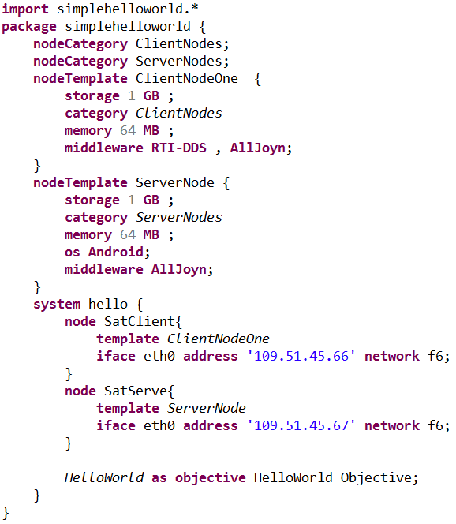


CHARIOT
Cyber-pHysical Application aRchiTecture with Objective-based reconfiguraTion
System model
Interpreter + Design-time analysis tools
System architect
Generated artifacts
Design-time
Runtime
Autonomous
Resilience loop
Distributed Database
Resilience infrastructure
Monitoring infrastructure
Managed system
Management Infrastructure
Notes:
Self-reconfiguration to achieve autonomous resilience

Slide 3
CHARIOT
Cyber-pHysical Application aRchiTecture with Objective-based reconfiguraTion
Configuration space
Initial configuration point
Fault disables part of space
New configuration point
Reconfiguration
Function recovered
Another fault
New configuration point
Reconfiguration
Function recovered
Configuration space generated from models of the system

Slide 4





CHARIOT Implementation
Z3
Xtext
Design-time
Runtime
Zookeeper
Configuration Space

Slide 5

CHARIOT WebGME
Z3
Design-time
Runtime
Zookeeper
Configuration Space

Slide 6
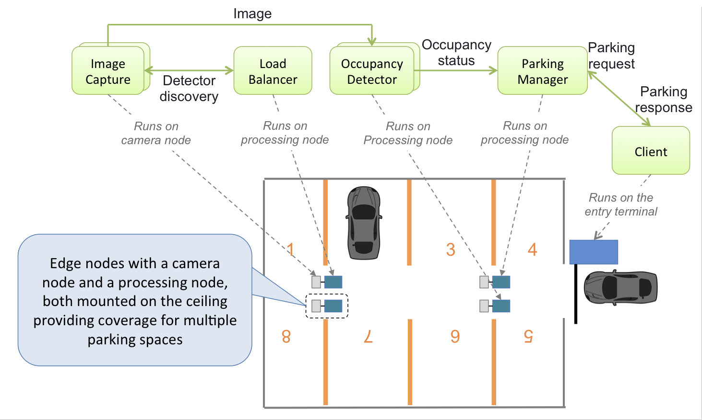
Example: Smart Parking system
Camera Nodes - captures images of parking spaces
Occupancy Detector - checks if there is a parking space or not
Parking Manager - contains occupancy status of all parking spaces
Client - sends a request for a parking space

Slide 7
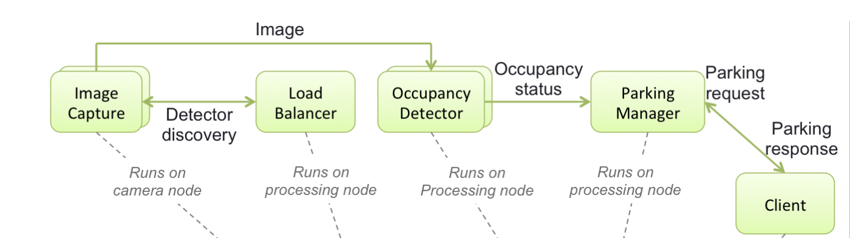
Functionalities & Compositions
Functionality - Entities with one or more input and output ports
Composition - Collection of functionalities and their inter-dependencies

Slide 8
Component Types
Each component type is associated with a functionality.
A component instance therefore only provides a single functionality, whereas a functionality can be provided by component instances of different types.
When a component type is instantiated, the component instance provides the functionality associated with its type.
Each Component Type has :-
Memory - memory it requires for computation
Storage - storage it requires
provided functionality - functionality provided by the component
OS - OS it needs to run on
Middleware - middleware it needs
start script - The script that will start the component
stop script - The script that will stop the component

Slide 9
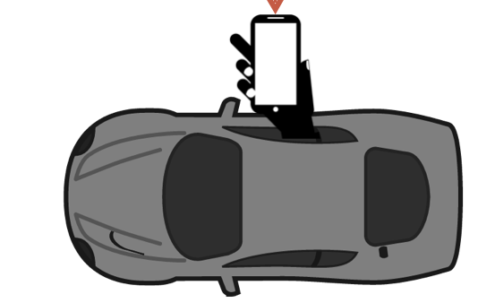
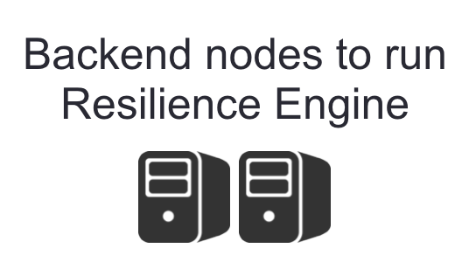
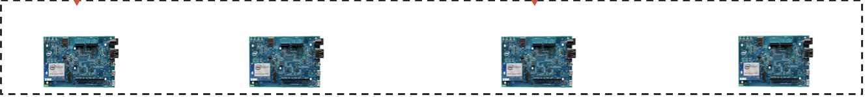
Node Categories
The nodes are not explicitly modeled since the group of nodes comprising a system can change dynamically at runtime.
Node category can be defined as a logical concept used to establish groups of nodes
Node templates represent the kinds of nodes that can belong to a category
Node category is a collection of node templates
Client Node
Occupancy Detector

Slide 10
Goal Description
A system’s goal requires one or more objectives to be satisfied
An objective requires existence of one or more functionalities, where functionalities are provided by components
A component provides exactly one functionality
Multiple components can provide same functionality
Dynamic representation of a system, which doesn’t require systems to be described as a collection of concrete components
Doesn’t matter which component provides a certain functionality as long as it is provided
Live system comprising one or more instances of different components
Redundancy patterns can be applied to functionalities for resilience
Voter, Consensus, Simple cluster patterns
System Model
Goal
Objective ₁
…...
Objective _{n}
Functionality₁
...
Functionality_{n}
Component_{A} (App)
Component_{B} (App)
Notes:
Underlying concept that allows generic system description at design-time.

Slide 11
CHARIOT Meta-Model walkthrough

Slide 12
CHARIOT Runtime walkthrough

Slide 13
Thank You

