Slide 1
GIT Getting Started
Dao Thanh tung

Slide 2
Content
1. About Version Control
2. A Short History of Git
3. Git Basics
4. The Command Line
5. Installing Git
6. First-Time Git Setup
7. Getting Help

Slide 3
1. About Version Control
What is “version control”
Records changes to a file or set of files over time
Recall specific versions later
Benefits
Revert files back to a previous state
Revert the entire project back to a previous state
Compare changes over time
See who last modified something that might be causing a problem
See who introduced an issue and when
Easily recover when screw things up or lose file

Slide 4
1. About Version Control (cont.) - Classification
Local Version Control Systems
Centralized Version Control Systems
Distributed Version Control Systems

Slide 5

1. About Version Control (cont.) - Local Version Control Systems
Figure 1. Local version control.
Notes:
- Copy files into another directory:
Common, simple, error prone
Forget which directory you’re in and accidentally write to the wrong file or copy over files you don’t mean to.
Local VCSs that had a simple database that kept all the changes to files under revision control.
RCS: keeping patch sets (that is, the differences between files) in a special format on disk.

Slide 6
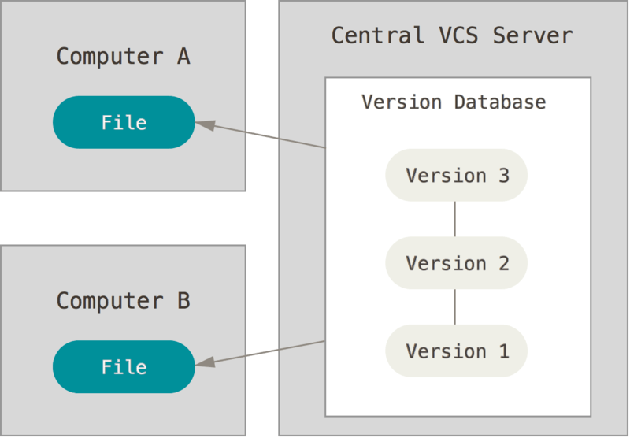
1. About Version Control (cont.) - Centralized Version Control Systems
Figure 2. Centralized version control.
Notes:
Collaborate with developers on other systems
CVS, Subversion, and Perforce, have a single server that contains all the versioned files, and a number of clients that check out files from that central place
Benefits:
Everyone knows to a certain degree what everyone else on the project is doing
Administrators have fine-grained control over who can do what; and it’s far easier to administer a CVCS than it is to deal with local databases on every client.
Profits:
Server goes down => nobody can collaborate at all or save versioned changes to anything they’re working on
Hard disk the central database is on becomes corrupted

Slide 7
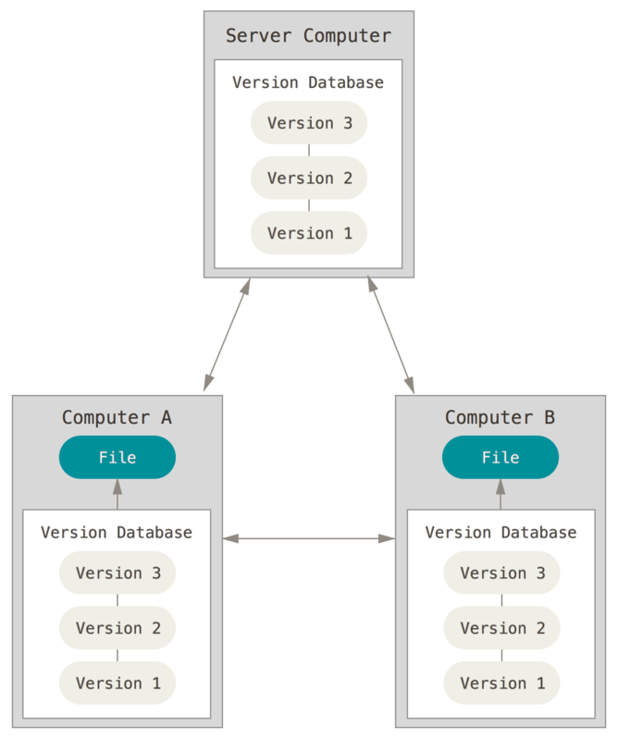
1. About Version Control (cont.) - Distributed Version Control Systems
Figure 3. Distributed version control.
Notes:
clients don’t just check out the latest snapshot of the files: they fully mirror the repository. Thus if any server dies, and these systems were collaborating via it, any of the client repositories can be copied back up to the server to restore it. Every clone is really a full backup of all the data.
can collaborate with different groups of people in different ways simultaneously within the same project

Slide 8
2. A Short History of Git
DVCS for Linux kernel project (since 2005)
Profits
Speed
Simple design
Strong support for non-linear development (thousands of parallel branches)
Fully distributed
Able to handle large projects like the Linux kernel efficiently (speed and data size)

Slide 9
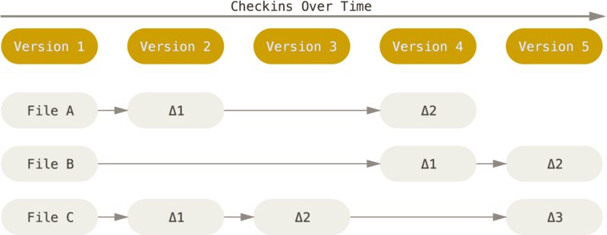
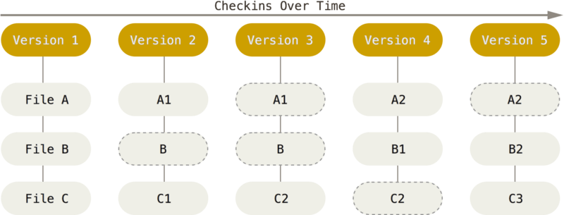
3. Git Basics - Snapshots, Not Differences
Figure 4. Storing data as changes to a base version of each file.
Figure 5. Storing data as snapshots of the project over time.
Notes:
Every time you commit, or save the state of your project in Git, it basically takes a picture of what all your files look like at that moment and stores a reference to that snapshot.
To be efficient, if files have not changed, Git doesn’t store the file again, just a link to the previous identical file it has already stored. Git thinks about its data more like a stream of snapshots.

Slide 10
3. Git Basics (cont.)- Nearly Every Operation Is Local
Perforce => can’t do much when aren’t connected to the server
Subversion and CVS => can edit files but can’t commit changes to your database
GIT => have the entire history of the project right there on your local disk, most operations seem almost instantaneous.

Slide 11
3. Git Basics (cont.)- Git Has Integrity
Everything in Git is check-summed before it is stored and is then referred to by that checksum
It’s impossible to change the contents of any file or directory without Git knowing about it
Ex: SHA-1 hash: 24b9da6552252987aa493b52f8696cd6d3b00373
Notes:
This is a 40-character string composed of hexadecimal characters (0–9 and a–f) and calculated based on the contents of a file or directory structure in Git

Slide 12
3. Git Basics (cont.)- Git Generally Only Adds Data
After you commit a snapshot into Git, it is very difficult to lose, especially if you regularly push your database to another repository.

Slide 13
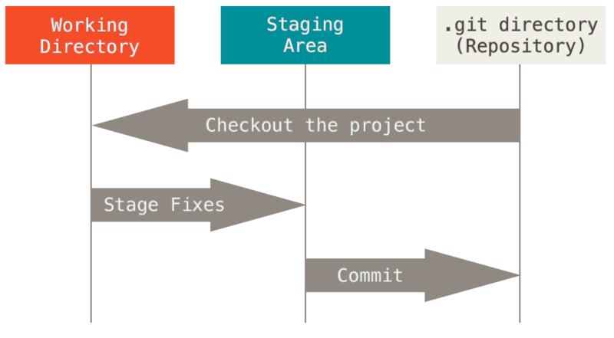
3. Git Basics (cont.)- The Three States
Figure 6. Working tree, staging area, and Git directory.
Notes:
Three main states of files:
Committed: data is safely stored in your local database
Modified: you have changed the file but have not committed it to your database yet
Staged: have marked a modified file in its current version to go into your next commit snapshot.
The working tree is a single checkout of one version of the project. These files are pulled out of the compressed database in the Git directory and placed on disk for you to use or modify.
The basic Git workflow goes something like this:
You modify files in your working tree.
You stage the files, adding snapshots of them to your staging area.
You do a commit, which takes the files as they are in the staging area and stores that snapshot permanently to your Git directory.
If a particular version of a file is in the Git directory, it’s considered committed.
If it has been modified and was added to the staging area, it is staged.
And if it was changed since it was checked out but has not been staged, it is modified

Slide 14
4. The Command Line
Run all Git commands
If you know how to run the command line version, you can probably also figure out how to run the GUI version, while the opposite is not necessarily true
Command Prompt or Powershell in Windows

Slide 15
5. Installing Git
Installing on Linux: http://git-scm.com/download/linux.
Installing on Mac: http://git-scm.com/download/mac.
Installing on Windows: http://git-scm.com/download/win

Slide 16
6. First-Time Git Setup
git config: get and set configuration variables that control all aspects of how Git looks and operates
3 variables:
/etc/gitconfig file: Contains values for every user on the system and all their repositories. If you pass the option --system to git config, it reads and writes from this file specifically.
~/.gitconfig or ~/.config/git/config file: Specific to your user. You can make Git read and write to this file specifically by passing the --global option.
config file in the Git directory (that is, .git/config) of whatever repository you’re currently using: Specific to that single repository.
Each level overrides values in the previous level
On Windows systems:
Git looks for the .gitconfig file in the $HOME directory (C:\Users\$USER for most people)
It also still looks for /etc/gitconfig, although it’s relative to the MSys root, which is wherever you decide to install Git on your Windows system when you run the installer (C:\ProgramData\Git\config). This config file can only be changed by git config -f <file> as an admin.

Slide 17
6. First-Time Git Setup (cont.)
Your Identity
Username: $ git config --global user.name "John Doe“
Email address: $ git config --global user.email johndoe@example.com
Your Editor
Git uses your system’s default editor
On a Windows system, if you want to use a different text editor, you must specify the full path to its executable file. This can be different depending on how your editor is packaged.
Ex: $ git config --global core.editor "'C:/Program Files/Notepad++/notepad++.exe' -multiInst -nosession“
Checking Your Settings
$ git config –list
$ git config <key>
Notes:
Again, you need to do this only once if you pass the --global option, because then Git will always use that information for anything you do on that system. If you want to override this with a different name or email address for specific projects, you can run the command without the --global option when you’re in that project.
Many of the GUI tools will help you do this when you first run them.

Slide 18
7. Getting Help
$ git help <verb>
$ git <verb> --help
$ man git-<verb>

Slide 19
Summary
What is SVC?
What is GIT?
Working tree of GIT
Install & config GIT

Slide 20
Reference
https://git-scm.com/book/en/v2/Getting-Started-About-Version-Control

Slide 21

Q&A

