Slide 1
GIT Basics
Dao Thanh tung

Slide 2
Content
1. Getting a Git Repository
2. Recording Changes to the Repository
3. Viewing the Commit History
5. Working with Remotes
6. Tagging
7. Git Aliases
4. Undoing Things
Notes:
By the end of the chapter, you should be able to configure and initialize a repository, begin and stop tracking files, and stage and commit changes.
We’ll also show you how to set up Git to ignore certain files and file patterns, how to undo mistakes quickly and easily, how to browse the history of your project and view changes between commits, and how to push and pull from remote repositories.

Slide 3
1. Getting a Git Repository
Initializing a Repository in an Existing Directory
$ cd /c/user/your_repository
$ git init
creates a new subdirectory named .git that contains all of your necessary repository files – a Git repository skeleton
Start version-controlling
$ git add *.c
$ git add LICENSE
$ git commit -m 'initial project version‘
Cloning an Existing Repository
Git receives a full copy of nearly all data that the server has
Default:
$ git clone [url]
Clone to 1 directory existence
$ git clone [url] [directory]
Notes:
That creates a directory named “libgit2”, initializes a .git directory inside it, pulls down all the data for that repository, and checks out a working copy of the latest version.

Slide 4
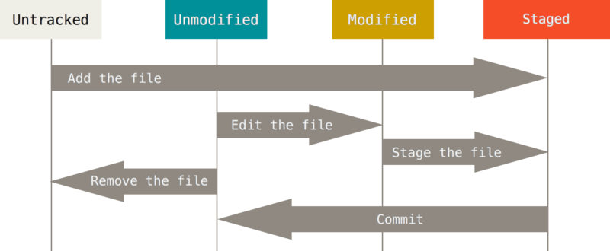
2. Recording Changes to the Repository
Figure 8. The lifecycle of the status of your files.
Notes:
Tracked files are files that were in the last snapshot; they can be unmodified, modified, or staged.
Untracked files are everything else – any files in your working directory that were not in your last snapshot and are not in your staging area.
When you first clone a repository, all of your files will be tracked and unmodified because Git just checked them out and you haven’t edited anything.
As you edit files, Git sees them as modified, because you’ve changed them since your last commit. You stage these modified files and then commit all your staged changes, and the cycle repeats.

Slide 5

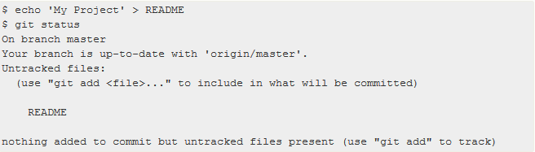
2. Recording Changes to the Repository (cont.)
Checking the Status of Your Files
$ git status
Ex1:
Ex2:

Slide 6
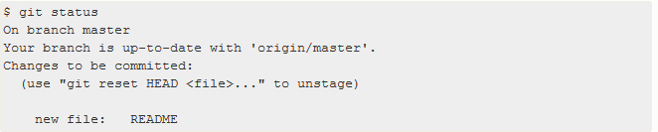
2. Recording Changes to the Repository (cont.)
Tracking New Files
$ git add
Ex:
$ git add README
Notes:
The git add command takes a path name for either a file or a directory; if it’s a directory, the command adds all the files in that directory recursively.

Slide 7
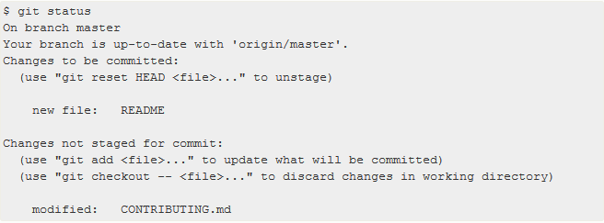
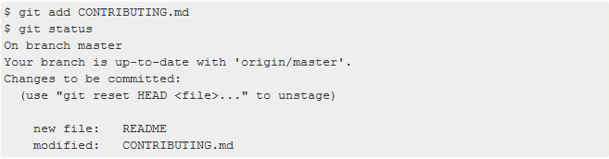
2. Recording Changes to the Repository (cont.)
Staging Modified File
$ git add
Ex:
$ git add CONTRIBUTING.md
Notes:
Git commit only files on stage

Slide 8
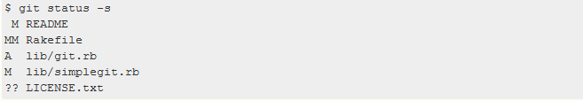
2. Recording Changes to the Repository (cont.)
Short Status
$ git status –s
$ git status --short

Slide 9
2. Recording Changes to the Repository (cont.)
Ignoring Files
a class of files that you don’t want Git to automatically add or even show you as being untracked
create a file listing patterns to match them named .gitignore.
Tips: GitHub maintains a fairly comprehensive list of good .gitignore file examples for dozens of projects and languages at https://github.com/github/gitignore if you want a starting point for your project.
Notes:
The first line tells Git to ignore any files ending in “.o” or “.a” – object and archive files that may be the product of building your code. The second line tells Git to ignore all files whose names end with a tilde (~), which is used by many text editors such as Emacs to mark temporary files. You may also include a log, tmp, or pid directory; automatically generated documentation; and so on.

Slide 10
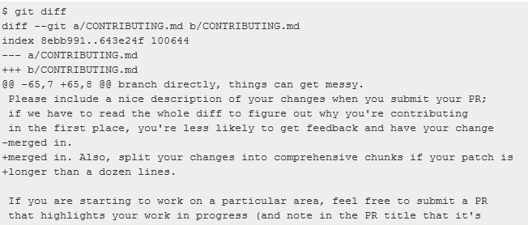
2. Recording Changes to the Repository (cont.)
Viewing Your Staged and Unstaged Changes
Two questions:
What have you changed but not yet staged?
What have you staged that you are about to commit?
$ git diff
To see what you’ve changed but not yet staged, type git diff with no other arguments:

Slide 11
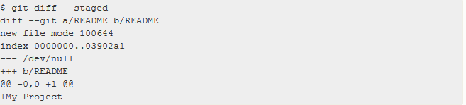
2. Recording Changes to the Repository (cont.)
If you want to see what you’ve staged that will go into your next commit, you can use git diff --staged. This command compares your staged changes to your last commit:

Slide 12
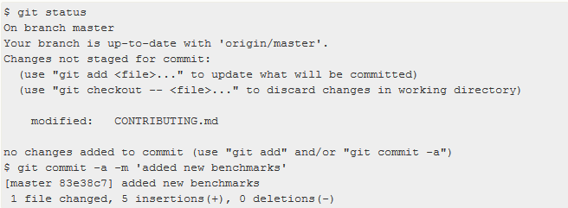
2. Recording Changes to the Repository (cont.)
Committing Your Changes
$ git commit => type comment with chosen editor
$ git commit –m “message”
Skipping the Staging Area
Adding the -a option to the git commit command makes Git automatically stage every file that is already tracked before doing the commit, letting you skip the git add part:
Notes:
Remember that anything that is still unstaged – any files you have created or modified that you haven’t run git add on since you edited them – won’t go into this commit.

Slide 13
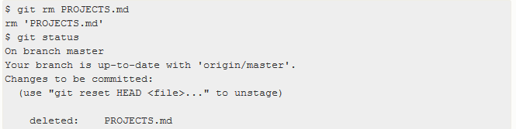
2. Recording Changes to the Repository (cont.)
Removing Files
To remove a file from Git, you have to remove it from your tracked files (more accurately, remove it from your staging area) and then commit.
The git rm command does that, and also removes the file from your working directory so you don’t see it as an untracked file the next time around.

Slide 14
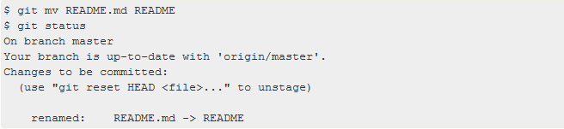
2. Recording Changes to the Repository (cont.)
Moving Files
$ git mv file_from file_to

Slide 15
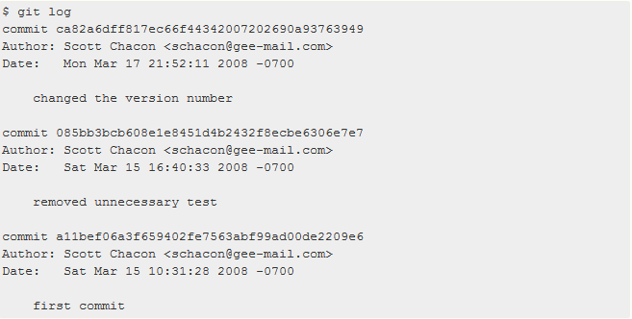
3. Viewing the Commit History
$ git log

Slide 16
3. Viewing the Commit History (cont)
Common options to git log
Option | Description
-p | Show the patch introduced with each commit.
--stat | Show statistics for files modified in each commit.
--shortstat | Display only the changed/insertions/deletions line from the --stat command.
--name-only | Show the list of files modified after the commit information.
--name-status | Show the list of files affected with added/modified/deleted information as well.
--abbrev-commit | Show only the first few characters of the SHA-1 checksum instead of all 40.
--relative-date | Display the date in a relative format (for example, “2 weeks ago”) instead of using the full date format.
--graph | Display an ASCII graph of the branch and merge history beside the log output.
--pretty | Show commits in an alternate format. Options include oneline, short, full, fuller, and format (where you specify your own format).

Slide 17
4. Undoing Things
At any stage, you may want to undo something.
One of the common undos takes place when you commit too early and possibly forget to add some files, or you mess up your commit message. If you want to try that commit again, you can run commit with the --amend option:
$ git commit --amend
This command takes your staging area and uses it for the commit. If you’ve made no changes since your last commit (for instance, you run this command immediately after your previous commit), then your snapshot will look exactly the same, and all you’ll change is your commit message.

Slide 18
4. Undoing Things (cont.)
You end up with a single commit – the second commit replaces the results of the first.

Slide 19
4. Undoing Things (cont.)
Unstaging a Staged File
$ git reset HEAD <file>
Unmodifying a Modified File
$ git checkout -- <file>

Slide 20
5. Working with Remotes
Remote repositories are versions of your project that are hosted on the Internet or network somewhere.
Collaborating with others
Managing these remote repositories
Pushing data to them
Pulling data from them
Managing remote repositories
Add
Remove
Mange various remote branches

Slide 21
5. Working with Remotes (cont.)
Showing Your Remotes
$ git remote –v
Adding Remote Repositories
$ git remote add <shortname> <url>
Fetching and Pulling from Your Remotes
$ git fetch [remote-name]
The command goes out to that remote project and pulls down all the data from that remote project that you don’t have yet. After you do this, you should have references to all the branches from that remote, which you can merge in or inspect at any time.
$ git pull
Running git pull generally fetches data from the server you originally cloned from and automatically tries to merge it into the code you’re currently working on.
Pushing to Your Remotes
$ git push [remote-name] [branch-name]
This command works only if you cloned from a server to which you have write access and if nobody has pushed in the meantime. If you and someone else clone at the same time and they push upstream and then you push upstream, your push will rightly be rejected. You’ll have to fetch their work first and incorporate it into yours before you’ll be allowed to push.

Slide 22
5. Working with Remotes (cont.)
Inspecting a Remote
$ git remote show [remote-name]
Removing and Renaming Remotes
Rename : $ git remote rename [old_remote_name] [new_remote_name]
Remove: $ git remote remove [remote_name]

Slide 23
6. Tagging
Git has the ability to tag specific points in history as being important.
Listing Your Tags
$ git tag
Creating Tags
Lightweight: a branch that doesn’t change – it’s just a pointer to a specific commit.
Command: $ git tag “name”
Annotated tags: stored as full objects in the Git database.
Command: $ git tag -a “name” -m “message“
Tagging Later
$ git tag -a ”name” ”checksum_of_commit”
Sharing Tags
$ git push [remote] [tagname]
$ git push [remote] –tags
Checking out Tags
$ git checkout tagname

Slide 24

7. Git Aliases
Git simply replaces the new command with whatever you alias it for.
This means that, for example, instead of typing git commit, you just need to type git ci.

Slide 25
Summary
Action with local repository
Log
Action with remote repository

Slide 26
Reference
https://git-scm.com/book/en/v2/Git-Basics-Getting-a-Git-Repository

Slide 27

Q&A

