Slide 1
GIT Branching
Dao Thanh tung

Slide 2
Content
1. Branches in a Nutshell
2. Basic Branching and Merging
3. Branch Management
5. Remote Branches
6. Rebasing
4. Branching Workflows
Notes:
By the end of the chapter, you should be able to configure and initialize a repository, begin and stop tracking files, and stage and commit changes.
We’ll also show you how to set up Git to ignore certain files and file patterns, how to undo mistakes quickly and easily, how to browse the history of your project and view changes between commits, and how to push and pull from remote repositories.

Slide 3
1. Branches in a Nutshell
Other VCS tools:
Expensive process
Create a new copy of your source code directory => long time for large projects
GIT
Lightweight
Making branching operations nearly instantaneous
Switching back and forth between branches generally just as fast

Slide 4
1. Branches in a Nutshell (cont.)
Git doesn’t store data as a series of changesets or differences, but instead as a series of snapshots.
Make a commit => Commit object
Pointer to the snapshot of the content you staged
Author’s name and email
Message that you typed
Commit or commits that directly came before this commit (its parent or parents)
Initial commit: zero parents
Normal commit: 1 parent
Commit as results from a merge of 2 or more branches: multiple parents

Slide 5
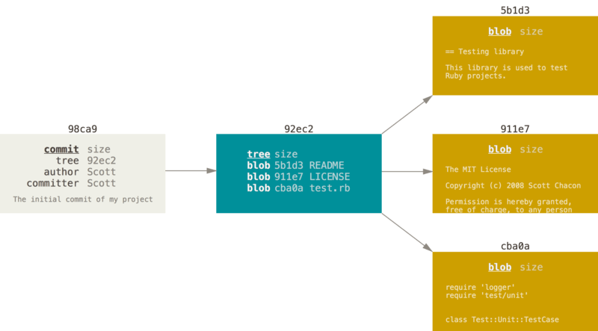
1. Branches in a Nutshell (cont.)
Figure 9. A commit and its tree
Notes:
Staging the files:
computes a checksum for each one
stores that version of the file in the Git repository (Git refers to them as blobs)
adds that checksum to the staging area
Git commit
Git checksums each subdirectory (in this case, just the root project directory) and stores those tree objects in the Git repository.
Git then creates a commit object that has the metadata and a pointer to the root project tree so it can re-create that snapshot when needed.
Your Git repository now contains five objects: one blob for the contents of each of your three files, one tree that lists the contents of the directory and specifies which file names are stored as which blobs, and one commit with the pointer to that root tree and all the commit metadata.

Slide 6
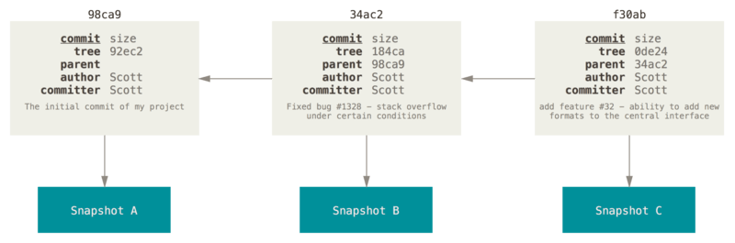
1. Branches in a Nutshell (cont.)
Figure 10. Commits and their parents
Notes:
If you make some changes and commit again, the next commit stores a pointer to the commit that came immediately before it.

Slide 7
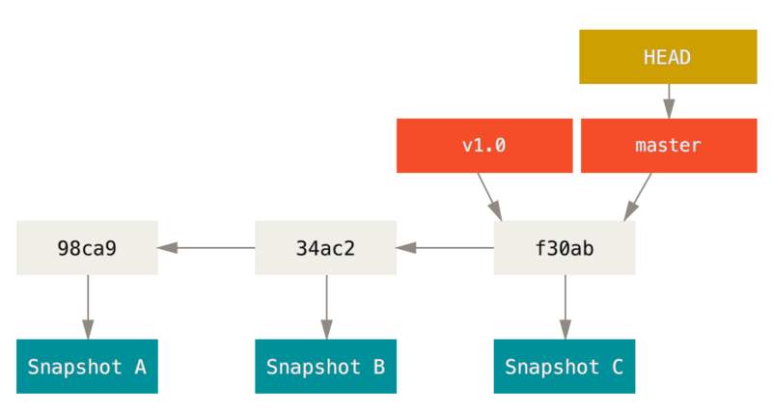
1. Branches in a Nutshell (cont.)
A branch in Git is simply a lightweight movable pointer to one of these commits.
The default branch name in Git is master.
As you start making commits, you’re given a master branch that points to the last commit you made. Every time you commit, it moves forward automatically.
Figure 11. A branch and its commit history
Notes:
The “master” branch in Git is not a special branch. It is exactly like any other branch. The only reason nearly every repository has one is that the git init command creates it by default and most people don’t bother to change it.

Slide 8
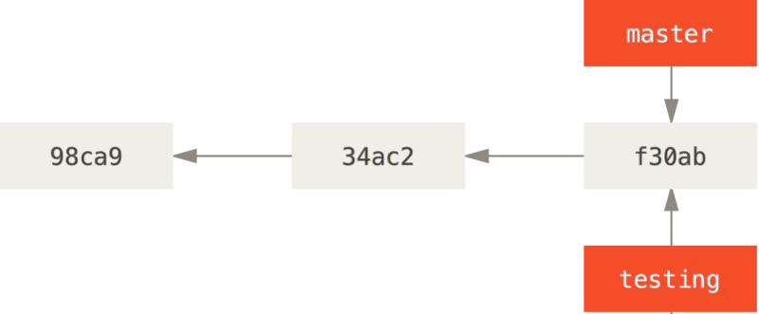
1. Branches in a Nutshell (cont.)
Creating a New Branch
$ git branch testing
Figure 12. Two branches pointing into the same series of commits
Notes:
creates a new pointer for you to move around.

Slide 9
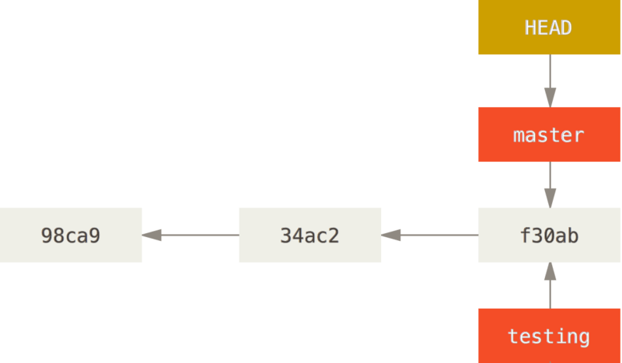
1. Branches in a Nutshell (cont.)
How does Git know what branch you’re currently on?
It keeps a special pointer called HEAD.
Figure 13. HEAD pointing to a branch
Notes:
You can easily see this by running a simple git log command that shows you where the branch pointers are pointing. This option is called --decorate.

Slide 10
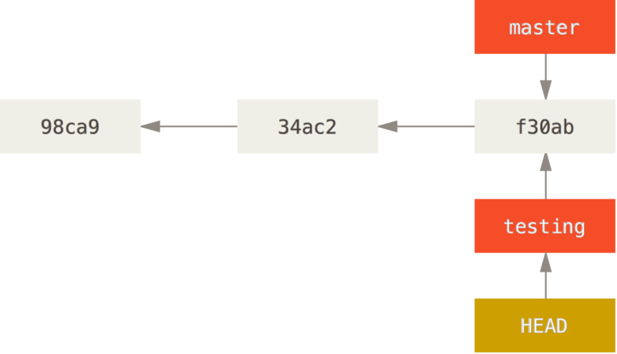
1. Branches in a Nutshell (cont.)
Switching Branches
$ git checkout [branch]
Figure 14. HEAD points to the current branch

Slide 11
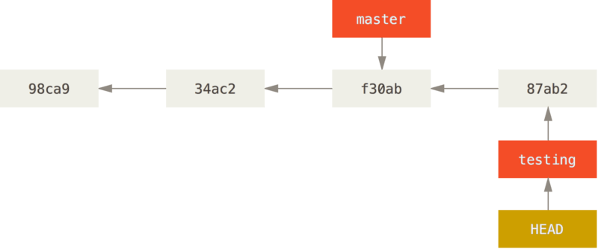
1. Branches in a Nutshell (cont.)
Figure 15. The HEAD branch moves forward when a commit is made

Slide 12
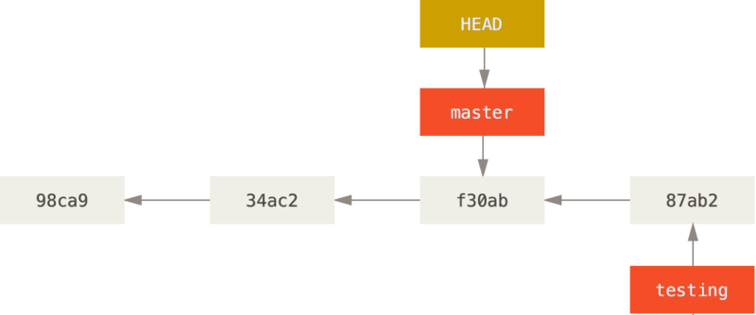
1. Branches in a Nutshell (cont.)
Figure 16. HEAD moves when you checkout
Notes:
That command did two things
It moved the HEAD pointer back to point to the master branch
It reverted the files in your working directory back to the snapshot that master points to

Slide 13
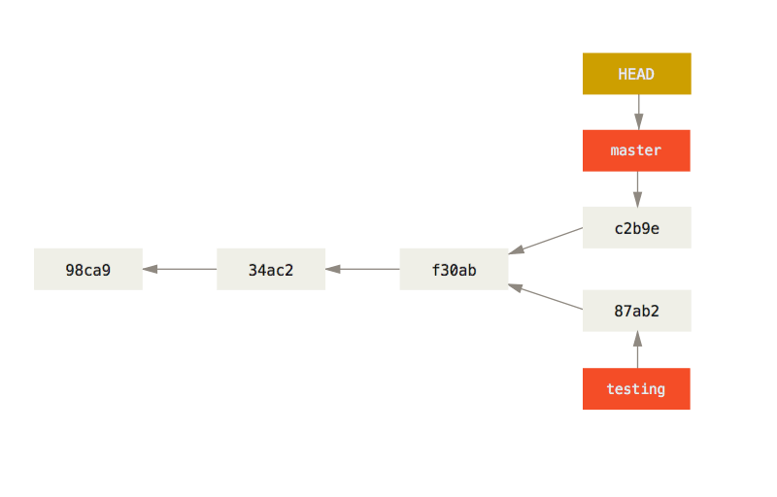
1. Branches in a Nutshell (cont.)
Figure 17. Divergent history
Notes:
You created and switched to a branch, did some work on it, and then switched back to your main branch and did other work.
you can switch back and forth between the branches and merge them together when you’re ready
If you run git log --oneline --decorate --graph --all it will print out the history of your commits, showing where your branch pointers are and how your history has diverged.
Because a branch in Git is actually a simple file that contains the 40 character SHA-1 checksum of the commit it points to, branches are cheap to create and destroy. Creating a new branch is as quick and simple as writing 41 bytes to a file (40 characters and a newline).

Slide 14
2. Basic Branching and Merging
Ex in the real world:
You’ll follow these steps:
Do work on a website.
Create a branch for a new story you’re working on.
Do some work in that branch.
At this stage, you’ll receive a call that another issue is critical and you need a hotfix. You’ll do the following:
Switch to your production branch.
Create a branch to add the hotfix.
After it’s tested, merge the hotfix branch, and push to production.
Switch back to your original story and continue working.

Slide 15
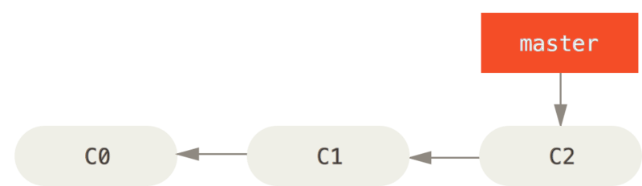
2. Basic Branching and Merging (cont.)
Basic Branching
Figure 18. A simple commit history

Slide 16
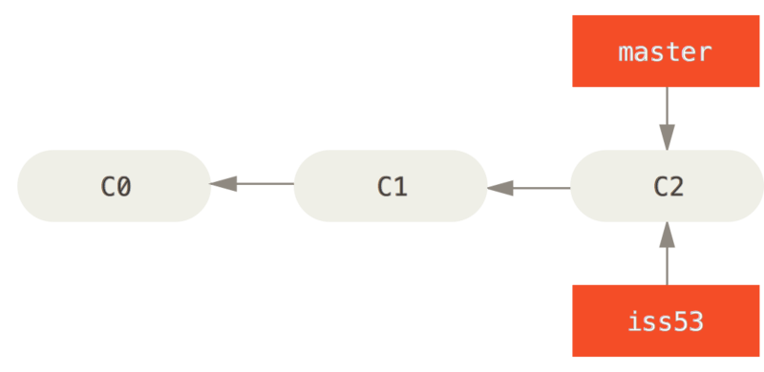
2. Basic Branching and Merging (cont.)
Figure 19. Creating a new branch pointer
Notes:
To create a branch and switch to it at the same time, you can run the git checkout command with the -b switch

Slide 17
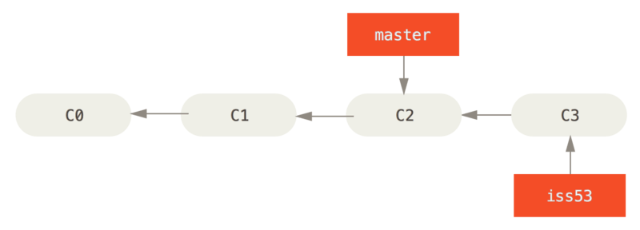
2. Basic Branching and Merging (cont.)
Figure 20. The iss53 branch has moved forward with your work
Notes:
Now you get the call that there is an issue with the website, and you need to fix it immediately. With Git, you don’t have to deploy your fix along with the iss53 changes you’ve made, and you don’t have to put a lot of effort into reverting those changes before you can work on applying your fix to what is in production. All you have to do is switch back to your master branch.
Note that if your working directory or staging area has uncommitted changes that conflict with the branch you’re checking out, Git won’t let you switch branches. It’s best to have a clean working state when you switch branches.

Slide 18
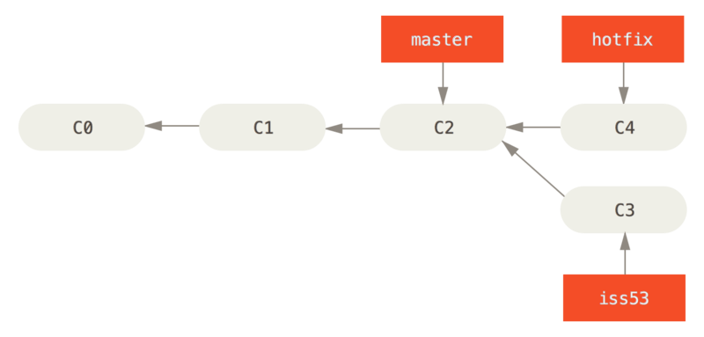
2. Basic Branching and Merging (cont.)
Figure 21. Hotfix branch based on master

Slide 19
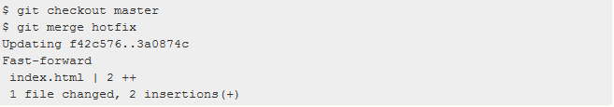
2. Basic Branching and Merging (cont.)
Merge branches
You can run your tests, make sure the hotfix is what you want, and merge it back into your master branch to deploy to production. You do this with the git merge command:
Notes:
You’ll notice the phrase “fast-forward” in that merge. Because the commit C4 pointed to by the branch hotfix you merged in was directly ahead of the commit C2 you’re on, Git simply moves the pointer forward. To phrase that another way, when you try to merge one commit with a commit that can be reached by following the first commit’s history, Git simplifies things by moving the pointer forward because there is no divergent work to merge together – this is called a “fast-forward.”

Slide 20
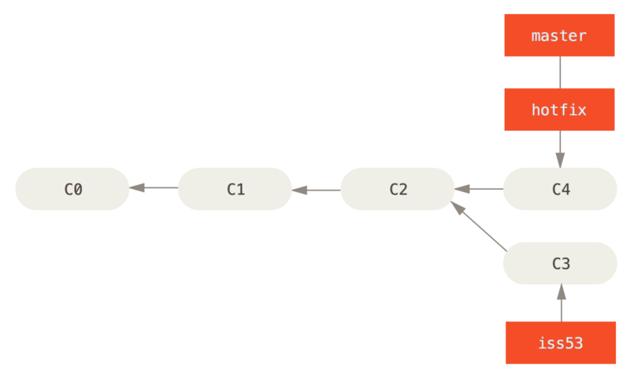
2. Basic Branching and Merging (cont.)
Figure 22. master is fast-forwarded to hotfix
Notes:
Your change is now in the snapshot of the commit pointed to by the master branch, and you can deploy the fix.

Slide 21
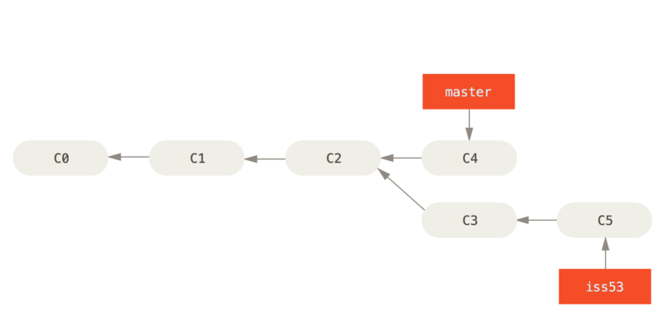
2. Basic Branching and Merging (cont.)
Delete branch
$ git branch –d [branch]
Figure 23. Work continues on iss53

Slide 22
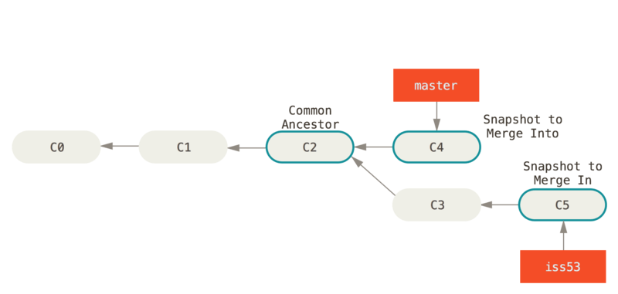
2. Basic Branching and Merging (cont.)
Basic Merging
Basic Merging Mechanism
Figure 24. Three snapshots used in a typical merge
Notes:
All you have to do is check out the branch you wish to merge into and then run the git merge command:
This looks a bit different than the hotfix merge you did earlier. In this case, your development history has diverged from some older point. Because the commit on the branch you’re on isn’t a direct ancestor of the branch you’re merging in, Git has to do some work. In this case, Git does a simple three-way merge, using the two snapshots pointed to by the branch tips and the common ancestor of the two.

Slide 23
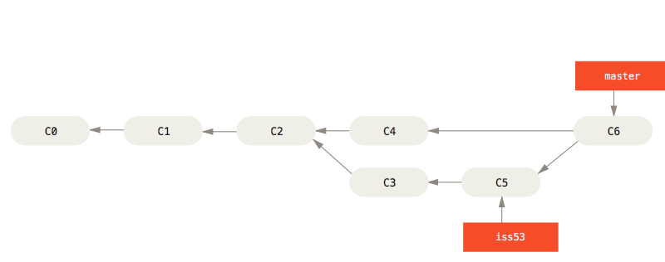
2. Basic Branching and Merging (cont.)
Figure 25. A merge commit
Notes:
Instead of just moving the branch pointer forward, Git creates a new snapshot that results from this three-way merge and automatically creates a new commit that points to it. This is referred to as a merge commit, and is special in that it has more than one parent.

Slide 24

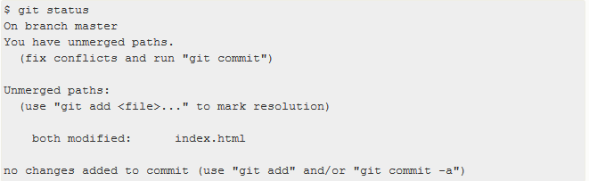

2. Basic Branching and Merging (cont.)
Basic Merge Conflicts
Git hasn’t automatically created a new merge commit. It has paused the process while you resolve the conflict. If you want to see which files are unmerged at any point after a merge conflict, you can run git status:

Slide 25
2. Basic Branching and Merging (cont.)
You have to either choose one side or the other or merge the contents yourself. For instance, you might resolve this conflict by replacing the entire block with this:
After you’ve resolved each of these sections in each conflicted file, run git add on each file to mark it as resolved. Staging the file marks it as resolved in Git.
After you exit the merge tool, Git asks you if the merge was successful. If you tell the script that it was, it stages the file to mark it as resolved for you. You can run git status again to verify that all conflicts have been resolved
If you’re happy with that, and you verify that everything that had conflicts has been staged, you can type git commit to finalize the merge commit. The commit message can be default or you can modify it with details.

Slide 26

3. Branch Management
$ git branch
Notice the * character that prefixes the master branch: it indicates the branch that you currently have checked out
$ git branch –v: To see the last commit on each branch
$ git branch –merged: To see which branches are already merged into the branch you’re on
$ git branch --no-merged: To see all the branches that contain work you haven’t yet merged in
$ git branch –d [branch]: delete branch merged and not be current
$ git branch –D [branch]: delete branch not merged yet

Slide 27
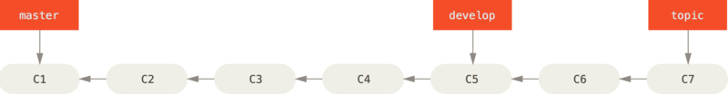
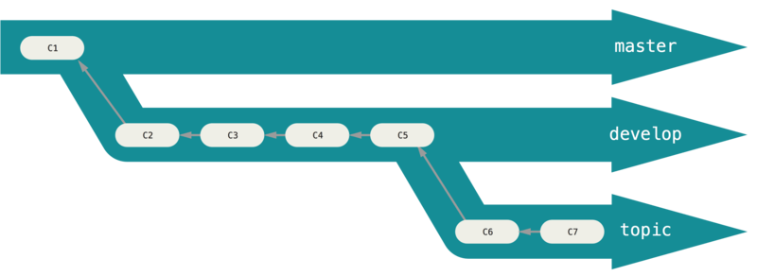
4. Branching Workflows
Long-Running Branches
Figure 26. A linear view of progressive-stability branching
Figure 27. A “silo” view of progressive-stability branching
Notes:
Many Git developers have a workflow that embraces this approach, such as having only code that is entirely stable in their master branch – possibly only code that has been or will be released. They have another parallel branch named develop or next that they work from or use to test stability – it isn’t necessarily always stable, but whenever it gets to a stable state, it can be merged into master. It’s used to pull in topic branches (short-lived branches, like your earlier iss53 branch) when they’re ready, to make sure they pass all the tests and don’t introduce bugs.
In reality, we’re talking about pointers moving up the line of commits you’re making. The stable branches are farther down the line in your commit history, and the bleeding-edge branches are farther up the history.
The idea is that your branches are at various levels of stability; when they reach a more stable level, they’re merged into the branch above them. Again, having multiple long-running branches isn’t necessary, but it’s often helpful, especially when you’re dealing with very large or complex projects.

Slide 28
4. Branching Workflows (cont.)
Topic branches, however, are useful in projects of any size.
A topic branch is a short-lived branch that you create and use for a single particular feature or related work.
You can keep the changes there for minutes, days, or months, and merge them in when they’re ready, regardless of the order in which they were created or worked on.

Slide 29
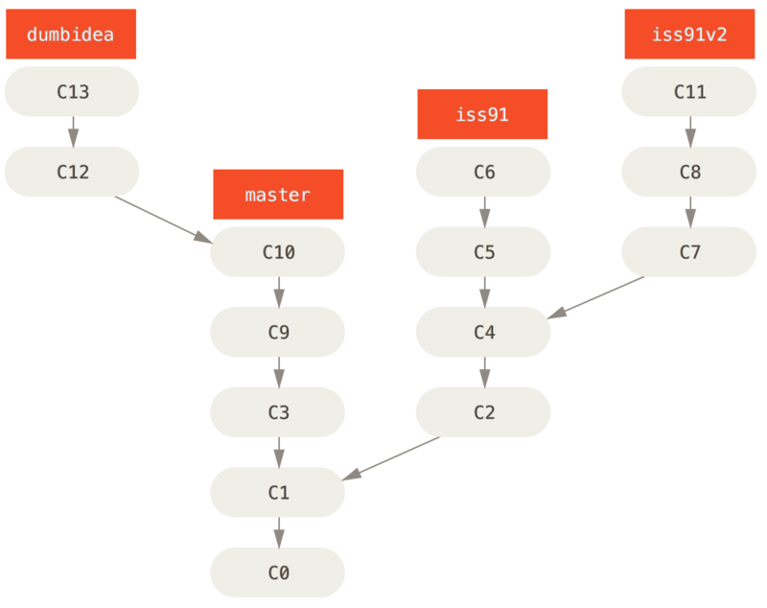
4. Branching Workflows (cont.)
Figure 28. Multiple topic branches
Notes:
Consider an example of doing some work (on master), branching off for an issue (iss91), working on it for a bit, branching off the second branch to try another way of handling the same thing (iss91v2), going back to your master branch and working there for a while, and then branching off there to do some work that you’re not sure is a good idea (dumbidea branch). Your commit history will look something like this:

Slide 30
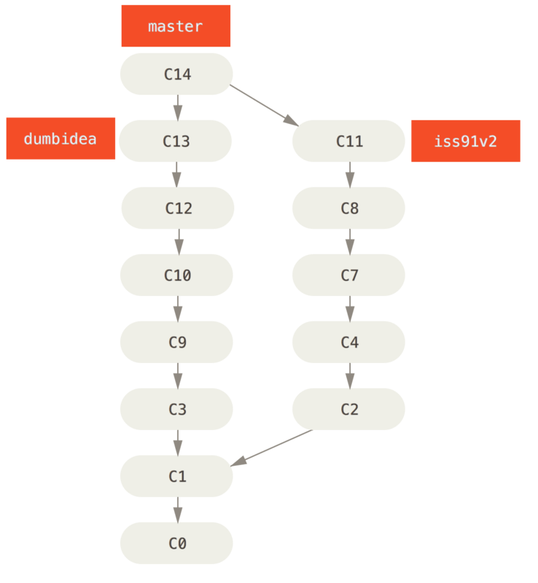
4. Branching Workflows (cont.)
Figure 29. History after merging dumbidea and iss91v2
Notes:
Now, let’s say you decide you like the second solution to your issue best (iss91v2); and you showed the dumbidea branch to your coworkers, and it turns out to be genius. You can throw away the original iss91 branch (losing commits C5 and C6) and merge in the other two.

Slide 31
5. Remote Branches
Remote references are references (pointers) in your remote repositories, including branches, tags, and so on.
Get a full list of remote references
$ git ls-remote [remote]
$ git remote show [remote]
Remote-tracking branches are references to the state of remote branches. They’re local references that you can’t move; they’re moved automatically for you whenever you do any network communication.
Notes:
They take the form (remote)/(branch). For instance, if you wanted to see what the master branch on your origin remote looked like as of the last time you communicated with it, you would check the origin/master branch. If you were working on an issue with a partner and they pushed up an iss53 branch, you might have your own local iss53 branch; but the branch on the server would point to the commit at origin/iss53.

Slide 32
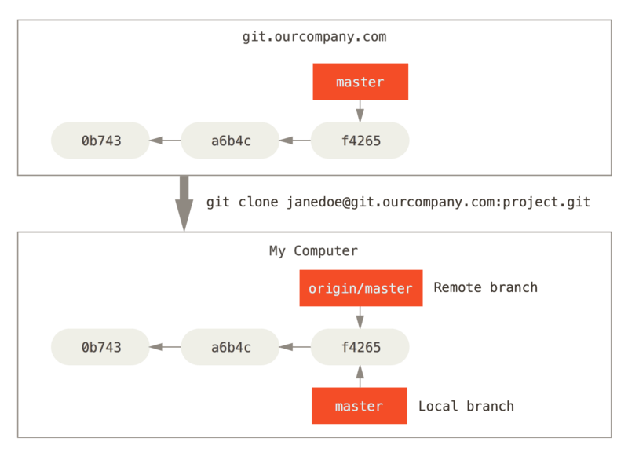
5. Remote Branches (cont.)
Figure 30. Server and local repositories after cloning
Notes:
“origin” is not special
Just like the branch name “master” does not have any special meaning in Git, neither does “origin”. While “master” is the default name for a starting branch when you run git init which is the only reason it’s widely used, “origin” is the default name for a remote when you run git clone. If you run git clone -o booyah instead, then you will have booyah/master as your default remote branch.

Slide 33
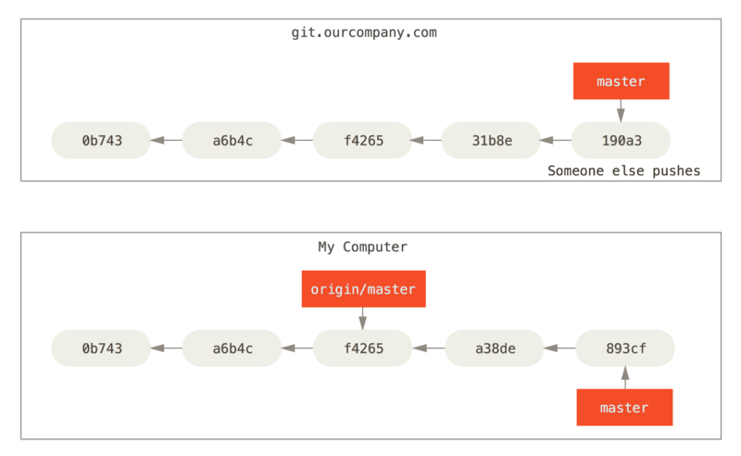
5. Remote Branches (cont.)
Figure 31. Local and remote work can diverge

Slide 34
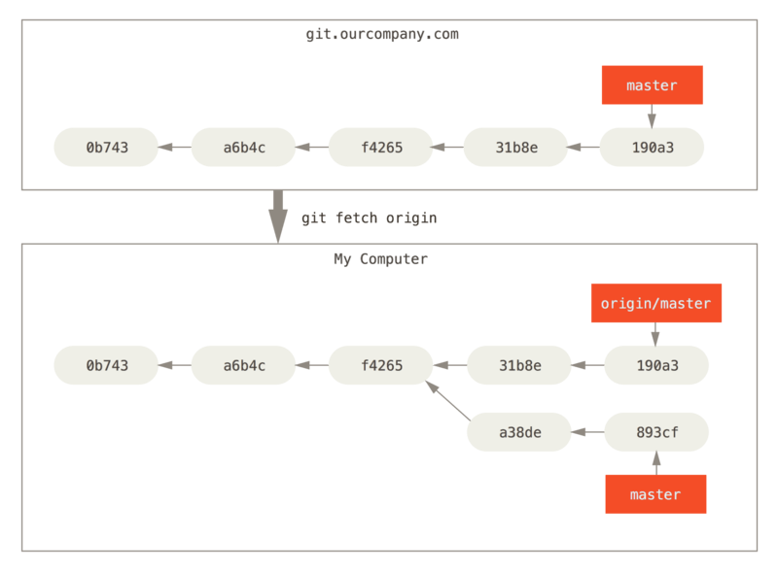
5. Remote Branches (cont.)
Fetching: Synchronize your work
Git fetch [remote branch]
Figure 32. git fetch updates your remote references
Notes:
To synchronize your work, you run a git fetch origin command. This command looks up which server “origin” is (in this case, it’s git.ourcompany.com), fetches any data from it that you don’t yet have, and updates your local database, moving your origin/master pointer to its new, more up-to-date position.

Slide 35
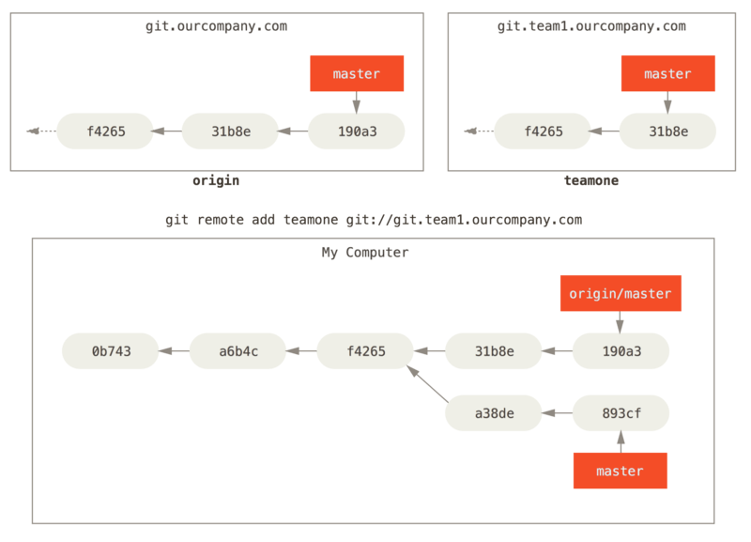
5. Remote Branches (cont.)
Figure 33. Adding another server as a remote

Slide 36
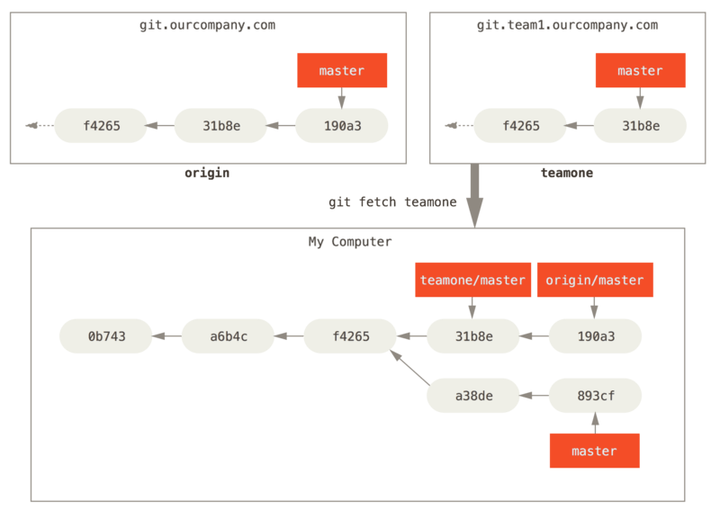
5. Remote Branches (cont.)
Figure 34. Remote tracking branch for teamone/master

Slide 37
5. Remote Branches (cont.)
Pushing
When you want to share a branch with the world, you need to push it up to a remote that you have write access to.
Your local branches aren’t automatically synchronized to the remotes you write to – you have to explicitly push the branches you want to share.
You can use private branches for work you don’t want to share, and push up only the topic branches you want to collaborate on.
$ git push <remote> <branch>
It’s important to note that when you do a fetch that brings down new remote-tracking branches, you don’t automatically have local, editable copies of them. In other words, in this case, you don’t have a new serverfix branch – you only have an origin/serverfix pointer that you can’t modify.
To merge this work into your current working branch, you can run git merge origin/serverfix. If you want your own serverfix branch that you can work on, you can base it off your remote-tracking branch
Notes:
You can use this format to push a local branch into a remote branch that is named differently. If you didn’t want it to be called serverfix on the remote, you could instead run git push origin serverfix:awesomebranch to push your local serverfix branch to the awesomebranch branch on the remote project.
This gives you a local branch that you can work on that starts where origin/serverfix is.

Slide 38
5. Remote Branches (cont.)
Checking out a local branch from a remote-tracking branch automatically creates what is called a “tracking branch” (and the branch it tracks is called an “upstream branch”).
Tracking branches are local branches that have a direct relationship to a remote branch.
If you’re on a tracking branch and type git pull, Git automatically knows which server to fetch from and branch to merge into.
Notes:
When you clone a repository, it generally automatically creates a master branch that tracks origin/master. However, you can set up other tracking branches if you wish – ones that track branches on other remotes, or don’t track the master branch. The simple case is the example you just saw, running git checkout -b [branch] [remotename]/[branch]. This is a common enough operation that Git provides the --track shorthand:

Slide 39
5. Remote Branches (cont.)
$ git checkout -b [branch] [remotename]/[branch]
If the branch name you’re trying to checkout (a) doesn’t exist and (b) exactly matches a name on only one remote, Git will create a tracking branch for you:
To set up a local branch with a different name than the remote branch, you can easily use the first version with a different local branch name:

Slide 40
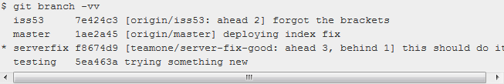
5. Remote Branches (cont.)
If you already have a local branch and want to set it to a remote branch you just pulled down, or want to change the upstream branch you’re tracking, you can use the -u or --set-upstream-to option to git branch to explicitly set it at any time.
If you want to see what tracking branches you have set up, you can use the -vv option to git branch.
If you want totally up to date ahead and behind numbers, you’ll need to fetch from all your remotes right before running this. You could do that like this:
Notes:
So here we can see that our iss53 branch is tracking origin/iss53 and is “ahead” by two, meaning that we have two commits locally that are not pushed to the server. We can also see that our master branch is tracking origin/master and is up to date. Next we can see that our serverfix branch is tracking the server-fix-good branch on our teamone server and is ahead by three and behind by one, meaning that there is one commit on the server we haven’t merged in yet and three commits locally that we haven’t pushed. Finally we can see that our testing branch is not tracking any remote branch.
It’s important to note that these numbers are only since the last time you fetched from each server. This command does not reach out to the servers, it’s telling you about what it has cached from these servers locally.

Slide 41
5. Remote Branches (cont.)
Pulling
While the git fetch command will fetch down all the changes on the server that you don’t have yet, it will not modify your working directory at all. It will simply get the data for you and let you merge it yourself.
git pull which is essentially a git fetch immediately followed by a git merge in most cases.

Slide 42
5. Remote Branches (cont.)
Deleting Remote Branches
$ git push [remote] –delete [remote branch]

Slide 43
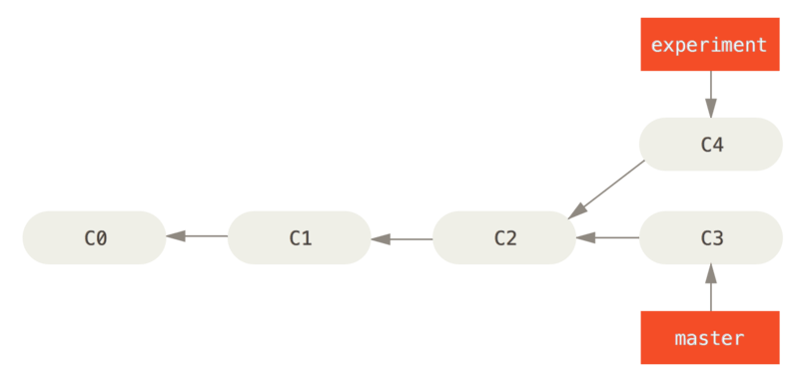
6. Rebasing
2 main ways to integrate changes from one branch into another
merge
rebase
Basic Rebase
Figure 35. Simple divergent history

Slide 44
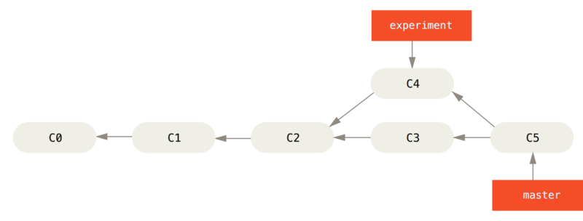
6. Rebasing
Figure 36. Merging to integrate diverged work history
Notes:
The easiest way to integrate the branches, as we’ve already covered, is the merge command. It performs a three-way merge between the two latest branch snapshots (C3 and C4) and the most recent common ancestor of the two (C2), creating a new snapshot (and commit).

Slide 45

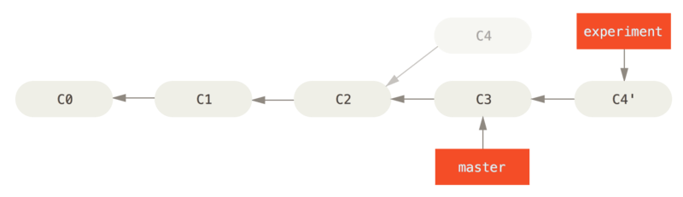
6. Rebasing (cont.)
However, there is another way: you can take the patch of the change that was introduced in C4 and reapply it on top of C3. In Git, this is called rebasing. With the rebase command, you can take all the changes that were committed on one branch and replay them on another one.
Figure 37. Rebasing the change introduced in C4 onto C3
Notes:
It works by going to the common ancestor of the two branches (the one you’re on and the one you’re rebasing onto), getting the diff introduced by each commit of the branch you’re on, saving those diffs to temporary files, resetting the current branch to the same commit as the branch you are rebasing onto, and finally applying each change in turn.

Slide 46
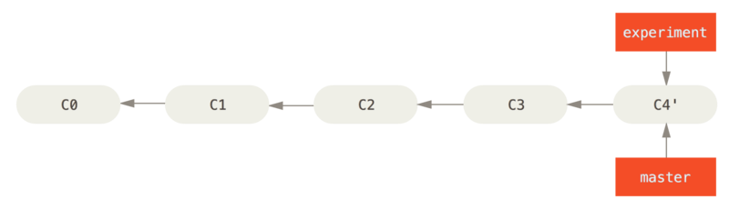
6. Rebasing (cont.)
At this point, you can go back to the master branch and do a fast-forward merge.
Figure 38. Fast-forwarding the master branch
Notes:
Now, the snapshot pointed to by C4' is exactly the same as the one that was pointed to by C5 in the merge example. There is no difference in the end product of the integration, but rebasing makes for a cleaner history. If you examine the log of a rebased branch, it looks like a linear history: it appears that all the work happened in series, even when it originally happened in parallel.
Often, you’ll do this to make sure your commits apply cleanly on a remote branch – perhaps in a project to which you’re trying to contribute but that you don’t maintain. In this case, you’d do your work in a branch and then rebase your work onto origin/master when you were ready to submit your patches to the main project. That way, the maintainer doesn’t have to do any integration work – just a fast-forward or a clean apply.

Slide 47
6. Rebasing (cont.)
Note that the snapshot pointed to by the final commit you end up with, whether it’s the last of the rebased commits for a rebase or the final merge commit after a merge, is the same snapshot – it’s only the history that is different.
Rebasing replays changes from one line of work onto another in the order they were introduced, whereas merging takes the endpoints and merges them together.

Slide 48
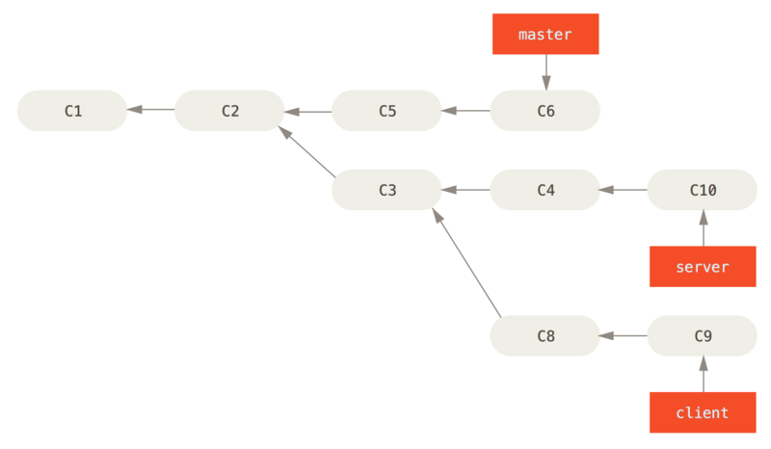
6. Rebasing (cont.)
More Interesting Rebases
Figure 39. A history with a topic branch off another topic branch

Slide 49
6. Rebasing (cont.)
Suppose you decide that you want to merge your client-side changes into your mainline for a release, but you want to hold off on the server-side changes until it’s tested further.
You can take the changes on client that aren’t on server (C8 and C9) and replay them on your master branch by using the --onto option of git rebase: $ git rebase --onto master server client
Notes:
This basically says, “Take the client branch, figure out the patches since it diverged from the server branch, and replay these patches in the client branch as if it was based directly off the master branch instead.” It’s a bit complex, but the result is pretty cool.

Slide 50
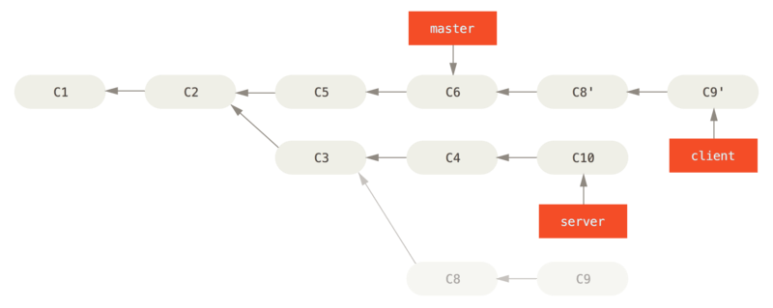
6. Rebasing (cont.)
Figure 40. Rebasing a topic branch off another topic branch

Slide 51
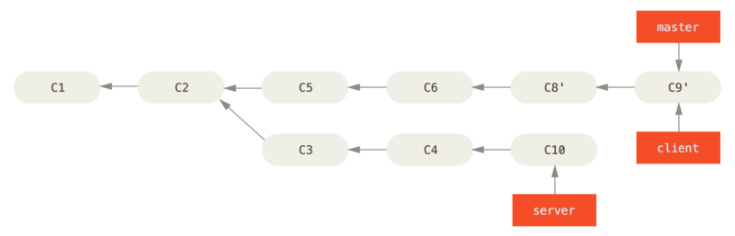
6. Rebasing (cont.)
Figure 41. Fast-forwarding your master branch to include the client branch changes

Slide 52
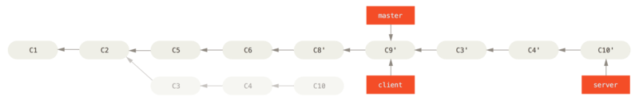
6. Rebasing (cont.)
$ git rebase [basebranch] [topicbranch] – which checks out the topic branch (in this case, server) for you and replays it onto the base branch (master):
Figure 42. Rebasing your server branch on top of your master branch

Slide 53

6. Rebasing (cont.)
Figure 43. Final commit history
Notes:
$ git checkout master
$ git merge server
$ git branch -d client
$ git branch -d server

Slide 54
6. Rebasing (cont.)
The Perils of Rebasing
When you rebase stuff, you’re abandoning existing commits and creating new ones that are similar but different.
If you push commits somewhere and others pull them down and base work on them, and then you rewrite those commits with git rebase and push them up again, your collaborators will have to re-merge their work and things will get messy when you try to pull their work back into yours.

Slide 55
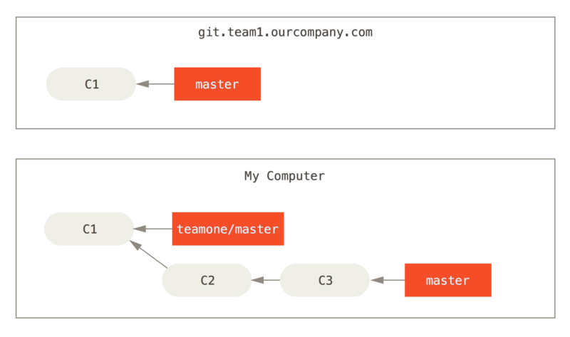
6. Rebasing (cont.)
Figure 44. Clone a repository, and base some work on it

Slide 56
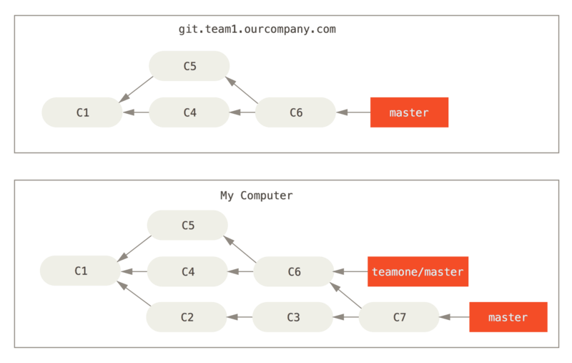
6. Rebasing (cont.)
Figure 45. Fetch more commits, and merge them into your work

Slide 57
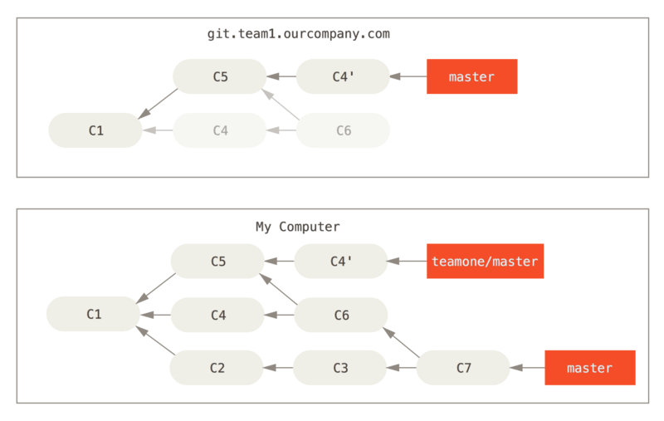
6. Rebasing (cont.)
Figure 46. Someone pushes rebased commits, abandoning commits you’ve based your work on

Slide 58
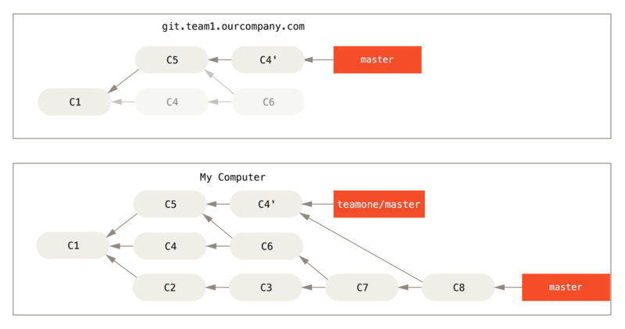
6. Rebasing (cont.)
Figure 47. You merge in the same work again into a new merge commit
Notes:
If you run a git log when your history looks like this, you’ll see two commits that have the same author, date, and message, which will be confusing. Furthermore, if you push this history back up to the server, you’ll reintroduce all those rebased commits to the central server, which can further confuse people. It’s pretty safe to assume that the other developer doesn’t want C4 and C6 to be in the history; that’s why they rebased in the first place. Nếu bạn sử dụng rebase như là cách để dọn dẹp các commit trước khi đẩy chúng lên, và nếu như bạn chỉ rebase commit chưa bao giờ được công khai, thì sẽ không có chuyện gì xảy ra. Nếu bạn rebase các commit đã được công khai và mọi người có thể đã tích hợp (base) nó vào công việc của họ thì bạn có thể gặp phải các vấn đề thực sự khó chịu.

Slide 59
6. Rebasing (cont.)
Rebase When You Rebase
If someone on your team force pushes changes that overwrite work that you’ve based work on, your challenge is to figure out what is yours and what they’ve rewritten.
It turns out that in addition to the commit SHA-1 checksum, Git also calculates a checksum that is based just on the patch introduced with the commit. This is called a “patch-id”.
If you pull down work that was rewritten and rebase it on top of the new commits from your partner, Git can often successfully figure out what is uniquely yours and apply them back on top of the new branch.

Slide 60
6. Rebasing (cont.)
For instance, in the previous scenario, if instead of doing a merge when we’re at Someone pushes rebased commits, abandoning commits you’ve based your work on we run $ git rebase teamone/master, Git will:
Determine what work is unique to our branch (C2, C3, C4, C6, C7)
Determine which are not merge commits (C2, C3, C4)
Determine which have not been rewritten into the target branch (just C2 and C3, since C4 is the same patch as C4')
Apply those commits to the top of teamone/master

Slide 61
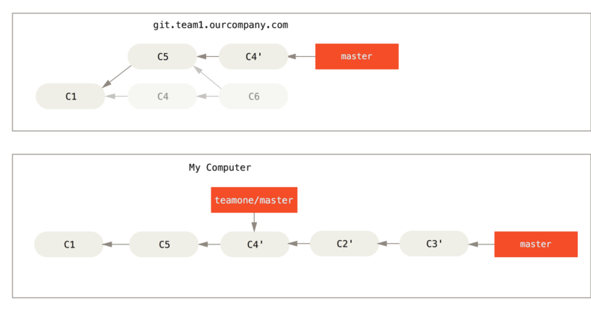
6. Rebasing (cont.)
So instead of the result we see in You merge in the same work again into a new merge commit, we would end up with something more like Rebase on top of force-pushed rebase work..
Figure 48. Rebase on top of force-pushed rebase work.

Slide 62
6. Rebasing (cont.)
If you treat rebasing as a way to clean up and work with commits before you push them, and if you only rebase commits that have never been available publicly, then you’ll be fine. If you rebase commits that have already been pushed publicly, and people may have based work on those commits, then you may be in for some frustrating trouble, and the scorn of your teammates.
If you or a partner does find it necessary at some point, make sure everyone knows to run git pull --rebase to try to make the pain after it happens a little bit simpler.

Slide 63
6. Rebasing (cont.)
Rebase vs. Merge
Your repository’s commit history is a record of what actually happened. It’s a historical document, valuable in its own right, and shouldn’t be tampered with.
Commit history is the story of how your project was made. You wouldn’t publish the first draft of a book, and the manual for how to maintain your software deserves careful editing.
In general the way to get the best of both worlds is to rebase local changes you’ve made but haven’t shared yet before you push them in order to clean up your story, but never rebase anything you’ve pushed somewhere.

Slide 64
Summary
Branching
Merging
Rebasing

Slide 65
Reference
https://git-scm.com/book/en/v2/Git-Branching-Branches-in-a-Nutshell

Slide 66

Q&A

