Slide 1
QML Quick Starter
Dao Thanh tung

Slide 2
Content
1. Qt5
2. QtQuick
3. QML
4. QML Syntqx
5. Basic Elements
6. Compnents
7. Simple Transformations

Slide 3
1. Qt5
Why Qt5?
Stationary PCs → portable notebook → mobile
UX paradigm changes: touch-based UI, UI satisfies customer demands
Qt5 focus
Outstanding Graphics: Qt Quick 2 is based on OpenGL (ES) using a scene graph implementation.
Developer Productivity:
QML + JavaScript: front-end → beautiful UI
C++: back-end → stability, performance, and extending the runtime
Cross-platform portability: Qt Platform Abstraction → port Qt to a wider range of platforms easier and faster
Open Development: qt.io

Slide 4
2. Qt Quick

Slide 5
2. Qt Quick (cont.)
Qt Quick: UI technology used in Qt5
QML – Markup language for UI
JavaScript – the dynamic scripting language
Qt C++ - The highly portable enhanced c++ library
Separate the computing intensive and native operation of your application from the UI part

Slide 6
3. QML
Define:
Similar to HTML, QML is a markup language
It is composed of tags called elements in Qt Quick enclosed in curly brackets Item {}
UI can be enhanced using JavaScript code
Purpose:
Creation of UI
Speed and easier reading for developers

Slide 7
4. QML Syntax
In its simplest way QML is a hierarchy of elements. Child elements inherit the coordinate system from the parent.
A x,y coordinate is always relative to the parent.

Slide 8
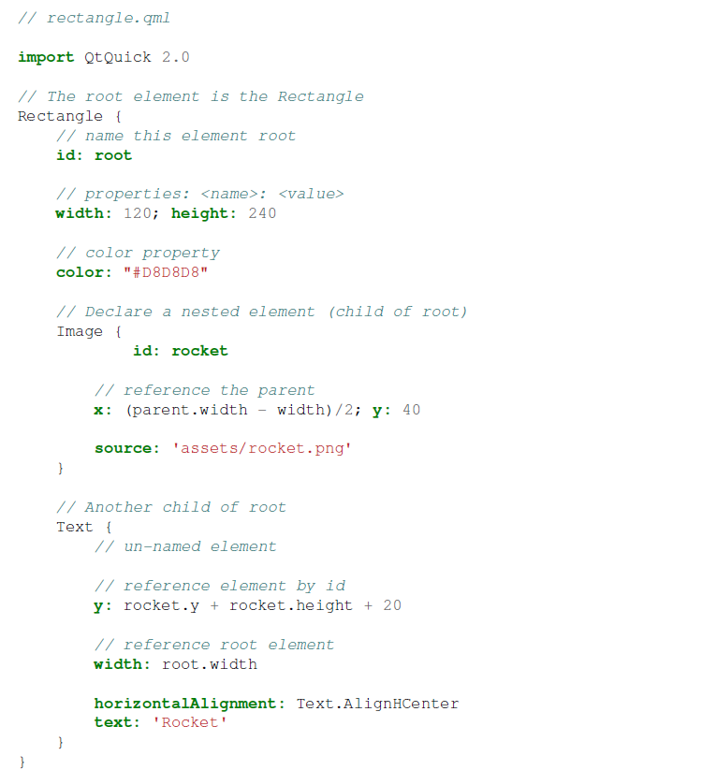
4. QML Syntax (cont.)
Notes:
The import statement imports a module in a specific version. In general you always want to import
QtQuick 2.0 as your initial set of elements
• Comments can be made using // for single line comments or /* */ for multi-line comments. Just like in
C/C++ and JavaScript
• Every QML file needs to have exactly one root element, like HTML
• An element is declared by its type followed by { }
• Elements can have properties, they are in the form name : value
• Arbitrary elements inside a QML document can be accessed by using their id (an unquoted identifier)
• Elements can be nested, means a parent element can have child elements. The parent element can be
accessed using the parent keyword
Tip: Often you want to access a particular element by id or a parent element using the parent keyword. So it’s
good practice to name your root element root using id: root. Then you don’t have to think about how the
root element is named in your QML document.

Slide 9
4. QML Syntax (cont.)
Properties
Elements are declared: Their element name
Elements are defined:
Using their properties
Creating custom properties
A simple key-value pair
Ex: width : 100, text: ‘Greetings’, color: ‘#FF0000’
Well-defined type
An initial value

Slide 10
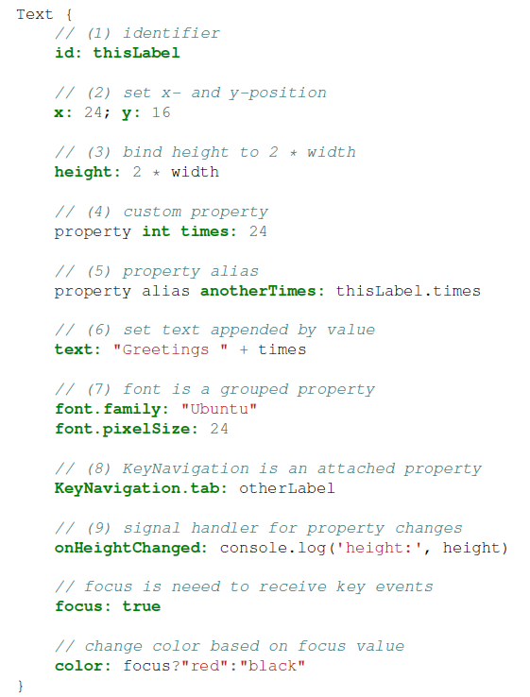
4. QML Syntax (cont.)
Notes:
1. id is a very special property-like value, it is used to reference elements inside a QML file (called document
in QML). The id is not a string type but rather an identifier and part of the QML syntax. An id needs to
be unique inside a document and it can’t be re-set to a different value, neither be queried. (It behaves more
like a pointer in the C++ world.)
2. A property can be set to a value, depending on its type. If no value is given for a property, an initial value
will be chosen. You need to consult the documentation of the particular element for more information about
the initial value of a property.
3. A property can depend on one or many other properties. This is called binding. A bound property is updated,
when its dependent properties change. It works like a contract, in this case the height should always be two times the width.
4. Adding own properties to an element is done using the property qualifier followed by the type, the name
and the optional initial value (property <type> <name> : <value>). If no initial value is given
a system initial value is chosen.
Note: You can also declare one property to be the default property if no property name is given by prepending
the property declaration with the default keyword. This is used for example when you add child
elements, the child elements are added automatically to the default property children of type list if they
are visible elements.
5. Another important way of declaring properties is using the alias keyword (property alias
<name> : <reference>). The alias keyword allows us to forward a property of an object or
an object itself from within the type to an outer scope. We will use this technique later when defining components
to export the inner properties or element ids to the root level. A property alias does not need a type,
it uses the type of the referenced property or object.
6. The text property depends on the custom property times of type int. The int based value is automatically
converted to a string type. The expression itself is another example of binding and results into the
text being updated every time the times property changes.
7. Some properties are grouped properties. This feature is used when a property is more structured and related
properties should be grouped together. Another way of writing grouped properties is font { family:
"Ubuntu"; pixelSize: 24 }.
8. Some properties are attached to the element itself. This is done for global relevant elements which appear
only once in the application (e.g. keyboard input). The writing is <Element>.<property>:
<value>.
9. For every property you can provide an signal handler. This handler is called after the property changes.
For example here we want to be notified whenever the height changes and use the built-in console to log a
message to the system.
Warning: An element id should only be used to reference elements inside your document (e.g. the current
file). QML provides a mechanism called dynamic-scoping where later loaded documents overwrite the element
id’s from earlier loaded documents. This makes it possible to reference element id’s from earlier loaded
documents, if they are not yet overwritten. It’s like creating global variables. Unfortunately this leads normally
to really bad code in practice, where the program depends on the order of execution. Unfortunately this can’t
be turned off. Please only use this with care or even better don’t use this mechanism at all. It’s better to export
the element you want to provide to the outside world using properties on the root element of your document.

Slide 11
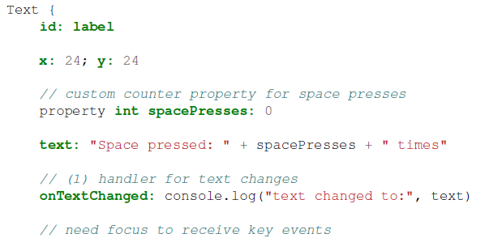
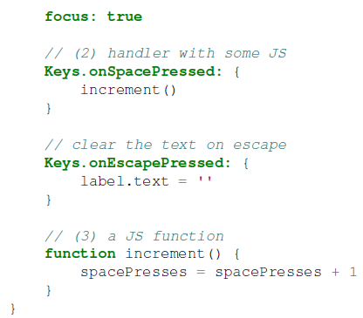
4. QML Syntax (cont.)
Scripting
Notes:
1. The text changed handler onTextChanged prints the current text every-time the text changed due to a
space-bar key pressed
2. When the text element receives the space-bar key (because the user pressed the space-bar on the keyboard)
we call a JavaScript function increment().
3. Definition of a JavaScript function in the form of function <name>(<parameters>) { ... },
which increments our counter spacePressed. Every time spacePressed is incremented bound properties
will also be updated.
Note: The difference between the QML : (binding) and the JavaScript = (assignment) is, that the binding is a
contract and keeps true over the lifetime of the binding, whereas the JavaScript assignment (=) is a one time value
assignment. The lifetime of a binding ends, when a new binding is set to the property or even when a JavaScript
value is assigned is to the property. For example a key handler setting the text property to an empty string would
destroy our increment display:
Keys.onEscapePressed: {
label.text = ''
}
After pressing escape, pressing the space-bar will not update the display anymore as the previous binding of the
text property (text: “Space pressed: ” + spacePresses + ” times”) was destroyed.
When you have conflicting strategies to change a property as in this case (text updated by a change to a property
increment via a binding and text cleared by a JavaScript assignment) then you can’t use binding! You need to use
assignment on both property change paths as the binding will be destroyed by the assignment (broken contract!).

Slide 12
5. Basic Elements
Visual Elements
Ex: Rectangle
A geometry
Present an area on the screen
Non-visual Elements
Ex: Timer
General functionality
Manipulate the visual elements

Slide 13
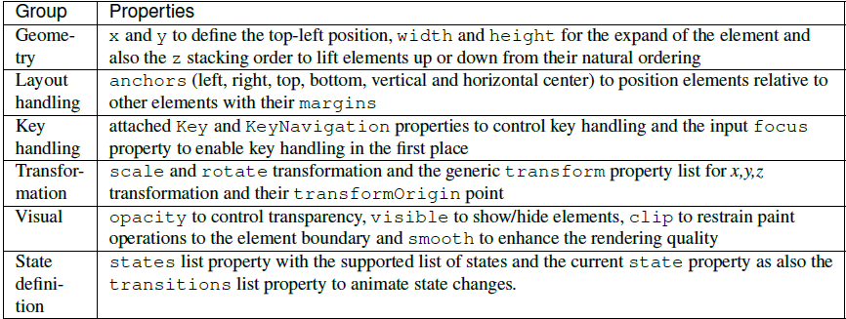
5. Basic Elements (cont.)
Item Element
Item is the base element for all visual elements as such all other visual elements inherit from Item.
It doesn’t paint anything by itself but defines all properties which are common across all visual elements:
Notes:
Note: The Item element is often used as a container for other elements, similar to the div element in HTML.

Slide 14
5. Basic Elements (cont.)
Rectangle Element
The Rectangle extends Item and adds a fill color to it.
supports borders
rounded rectangles
gradient
Notes:
Note: The named colors used are colors from the SVG color names (see http://www.w3.org/TR/css3-color/#svgcolor).
You can provide colors in QML in different ways the most common ways are as RGB string (‘#FF4444’)
or as a color name (e.g. ‘white’).
A gradient is defined by a series of gradient stops. Each stop has a position and a color. The position marks the
position on the y-axis (0 = top, 1 = bottom). The color of the GradientStop marks the color at that position.
Note: A rectangle with no width/height set will not be visible. This happens often when you have several
rectangles width (height) depending on each other and something went wrong in your composition logic. So
watch out!
Note: It is not possible to create an angled gradient. For this it’s better to use predefined images. One possibility
would be to just rotate the rectangle with the gradient, but be aware the geometry of an rotated rectangle will not
change and thus will lead to confusion as the geometry of the element is not the same as the visible area. From
the authors perspective it’s really better to use designed gradient images in that case.

Slide 15
5. Basic Elements (cont.)
Text element
Its most notable property is the text property of type string.
The element calculates its initial width and height based on the given text and the font used.
The font can be influenced using the font property group (e.g. font.family, font.pixelSize, ...).
Aligned by horizontalAlignment and verticalAlignment properties
Notes:
The elide property allows you to set the elide position to the left, right or middle of your text. In case you don’t
want the ‘...’ of the elide mode to appear but still want to see the full text you can also wrap the text using the
wrapMode property (works only when width is explicitly set)
A Text element only displays the given text. It does not render any background decoration. Besides the rendered
text the Text element is transparent. It’s part of your overall design to provide a sensible background to the text
element.
Note: Be aware a Text initial width (height) is depending on the text string and on the font set. A Text element
with no width set and no text will not be visible, as the initial width will be 0.
Note: Often when you want to layout Text elements you need to differentiate between aligning the text inside
the Text element boundary box or to align the element boundary box itself. In the former you want to use the
horizontalAlignment and verticalAlignment properties and in the later case you want to manipulate
the element geometry or use anchors.

Slide 16
5. Basic Elements (cont.)
Image Element
An Image element is able to display images in various formats (e.g. PNG, JPG, GIF, BMP).
Notes:
Besides the obvious source property to provide
the image URL it contains a fillMode which controls the resizing behavior.
Note: Image elements using PreserveAspectCrop should also enable the clipping to avoid image data to
be rendered outside the Image boundaries. By default clipping is disabled (clip : false). You need to
enable clipping (clip : true) to restrain the painting to the elements bounding rectangle. This can be used
on any visual element.

Slide 17
5. Basic Elements (cont.)
MouseArea Element
Its a rectangular invisible item in where you can capture mouse events.
The mouse area is often used together with a visible item to execute commands when the user interacts with the visual part.
Notes:
Note: This is an important aspect of Qt Quick, the input handling is separated from the visual presentation. By
this it allows you to show the user an interface element, but the interaction area can be larger.

Slide 18
6. Components
Reusable element
File based component
Placing a QML element in a file and give the file an element name (e.g. Button.qml) and use like every other element from QtQuick module

Slide 19
7. Simple Transformations
Manipulates the geometry of an object
Translated: via changing the x, y position
Rotated: via rotation property (degree: 0 .. 360)
Scaled: via scale property
value < 1: scaled down
value > 1: scaled up
Rotation and scaling not change geometry (x, y and width/height still the same). Just painting instructions are transformed.
Ex: Qt cadaques : page 38 - 41

Slide 20
Summary

Slide 21
Reference
Qt5_cadaques.pdf

Slide 22

Q&A

