Slide 1
Connections
Dao Thanh tung

Slide 2
Content
1. Signal and Handler Event System
2. Receiving Signals with Signal Handlers
3. Property Change Signal Handlers
4. Using the Connections Type
5. Attached Signal Handlers
6 Adding Signals to Custom QML Types
7. Connecting Signals to Methods and Signal

Slide 3
1. Signal and Handler Event System
Application and UI need to communicate with each other.
Signal and handler mechanism
signal: event
signal handler: respond to signal
When a signal is emitted, the corresponding signal handler is invoked
Notes:
For example, a button needs to know that the user has clicked on it. The button may change colors to indicate its state or perform some logic. As well, application needs to know whether the user is clicking the button.

Slide 4
2. Receiving Signals with Signal Handlers
To receive a notification when a particular signal is emitted to a particular object, the object definition declare a signal handler
on<Signal> where <Signal> is the name of signal with the first letter capitalized
JavaScript code to be executed when the signal handler is invoked
Notes:
<Signal> is the name of the signal, with the first letter capitalized.

Slide 5
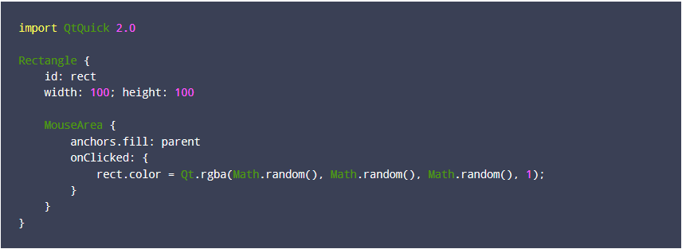
2. Receiving Signals with Signal Handlers (cont.)
Ex:

Slide 6
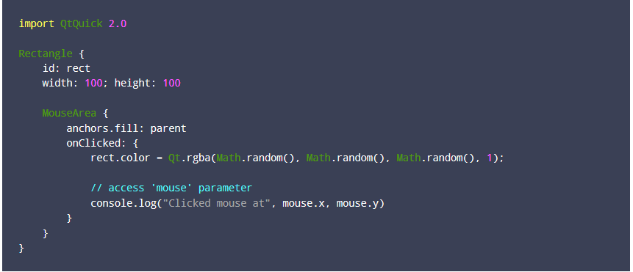
2. Receiving Signals with Signal Handlers (cont.)
Ex: signal with parameter

Slide 7
3. Property Change Signal Handlers
A signal is automatically emitted when the value of a QML property changes.
This type of signal is a property change signal
signal handlers for these signals are written in the form on<Property>Changed where <Property> is the name of the property, with the first letter capitalized.

Slide 8
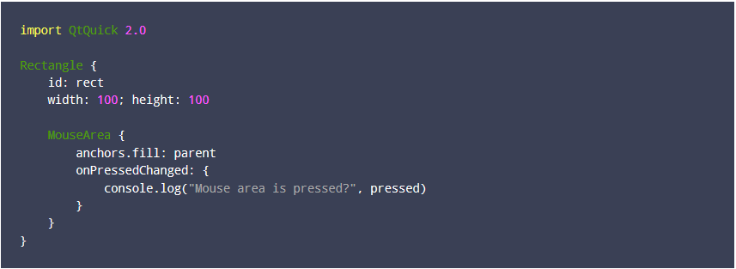
3. Property Change Signal Handlers (cont.)
Ex
Notes:
Even though the MouseArea documentation does not document a signal handler named onPressedChanged, the signal is implicitly provided by the fact that the pressed property exists.

Slide 9
4. Using the Connections Type
Access a signal outside of the object that emits it
Connections type: connect to signals of arbitrary objects
A Connections object can receive any signal from its specified target

Slide 10
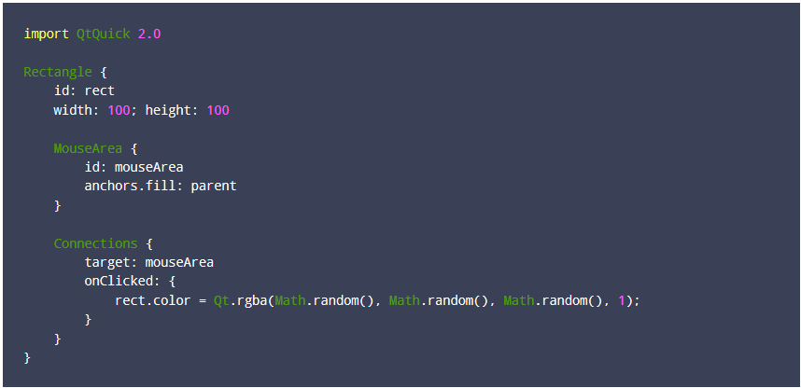
4. Using the Connections Type (cont.)
Ex:

Slide 11
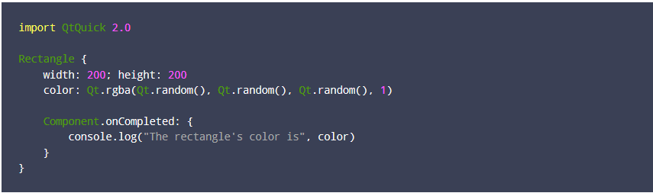
5. Attached Signal Handlers
receives a signal from an attaching type rather than the object within which the handler is declared.
Ex:
Notes:
he onCompleted handler is not responding to some completed signal from the Rectangle type. Instead, an object of the Component attaching type with a completed signal has automatically been attached to the Rectangle object by the QML engine, and the engine emits this signal when the object is fully created, thus triggering the Component.onCompleted signal handler.
Attached signal handlers allow objects to be notified of particular signals that are significant to each individual object. If there was no Component.onCompleted attached signal handler, for example, then an object could not receive this notification without registering for some special signal from some special object. The attached signal handler mechanism enables objects to receive particular signals without these extra processes.

Slide 12
6. Adding Signals to Custom QML Types
Signals can be added to custom QML Types through signal keyword
Syntax:
signal <name>[([<type> <parameter name>[, ...]])]
A signal is emitted by invoking the signal as a method

Slide 13
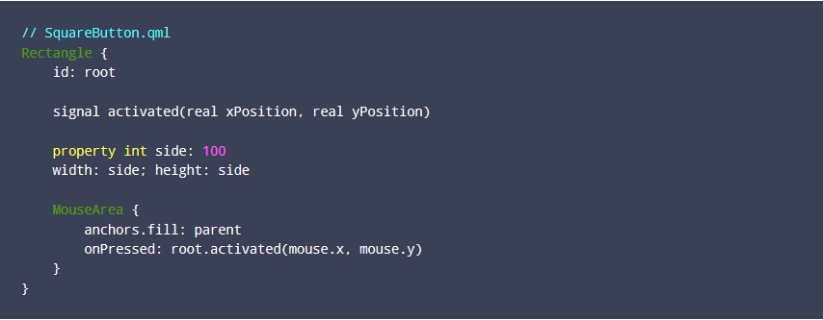
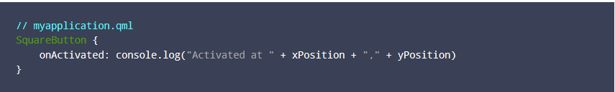
6. Adding Signals to Custom QML Types (cont.)
Ex:

Slide 14
7. Connecting Signals to Methods and Signals
Signal objects have a connect() method to a connect signal either to a method or another signal
When a signal is connected to a method, the method is automatically invoked whenever the signal is emitted.
This mechanism enables a signal to be received by a method instead of a signal handler.

Slide 15
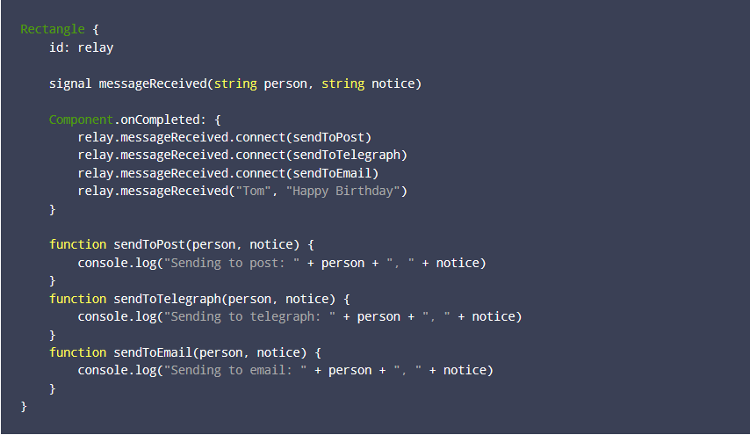
7. Connecting Signals to Methods and Signals (cont)
Ex:

Slide 16
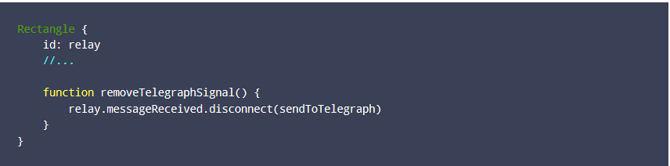
7. Connecting Signals to Methods and Signals (cont)
Benefit:
using the connect method allows a signal to be received by multiple methods
useful when connecting signals to dynamically created objects.
There is a corresponding disconnect() method for removing connected signals:
Notes:
not be possible with signal handlers as they must be uniquely named.

Slide 17
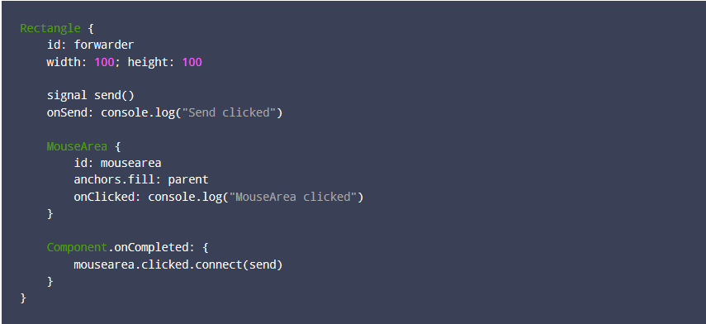

7. Connecting Signals to Methods and Signals (cont)
By connecting signals to other signals, the connect() method can form different signal chains.

Slide 18
Summary

Slide 19
Reference
http://doc.qt.io/qt-5/qtqml-syntax-signals.html

Slide 20

Q&A

