Slide 1
Threading
Dao Thanh tung

Slide 2
Content
1. Detailed Description
2. Property Documentation
3. Signal Documentation
4. Method Documentation

Slide 3
1. Detailed Description
WorkerScript QML Type
run operations in a new thread
useful for running operations in the background so that the main GUI thread is not blocked

Slide 4
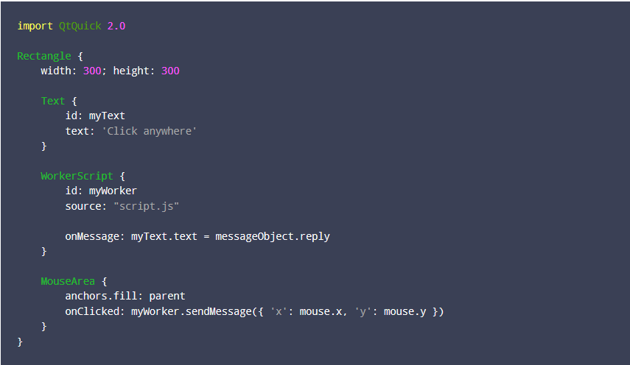
1. Detailed Description (cont.)
Notes:
The above worker script specifies a JavaScript file, "script.js", that handles the operations to be performed in the new thread. Here is script.js:

Slide 5
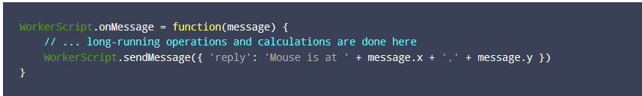
1. Detailed Description (cont.)
Notes:
When the user clicks anywhere within the rectangle, sendMessage() is called, triggering the WorkerScript.onMessage() handler in script.js. This in turn sends a reply message that is then received by the onMessage() handler of myWorker.

Slide 6
1. Detailed Description (cont.)
Restrictions
The JavaScript file is evaluated in a context separate from the main QML engine
cannot access the properties, methods or other attributes of the QML item
cannot access any context properties set on the QML object through QQmlContext
Restrictions on the types of values that can be passed to and from the worker script
Worker script can not use .import syntax

Slide 7
2. Property Documentation
source : url
This holds the url of the JavaScript file that implements the WorkerScript.onMessage() handler for threaded operations.

Slide 8
3. Signal Documentation
message(jsobject msg)
This signal is emitted when a message msg is received from a worker script in another thread through a call to sendMessage().
The corresponding handler is onMessage.

Slide 9
4. Method Documentation
sendMessage(jsobject message)
Sends the given message to a worker script handler in another thread
The other worker script handler can receive this message through the onMessage() handler
The message object may only contain values of the following types
boolean, number, string
JavaScript objects and arrays
ListModel objects (any other type of QObject* is not allowed)
All objects and arrays are copied to the message. With the exception of ListModel objects, any modifications by the other thread to an object passed in message will not be reflected in the original object.

Slide 10
Summary

Slide 11
Reference
http://doc.qt.io/qt-5/qml-workerscript.html

Slide 12

Q&A

