Slide 1
Profiling
Dao Thanh tung

Slide 2
Content
1.Profiling QML Applications
2. Using QML Profiler
3. Specifying Flushing Settings
4. Attaching to Running Qt Quick Applications
5. Analyzing Collected Data
6. Viewing Statistic

Slide 3
1.Profiling QML Applications
QML Profile
Typical performance problems
slowness and unresponsive, stuttering user interfaces
executing too much JavaScript in too few frames
check the frame rate in animations and Scene Graph events
look for gaps
check whether the application behaves as expected
The JavaScript category displays the run time of functions, which you should try to keep below 16 ms per frame.
creating, painting, or updating invisible items, which takes time in the GUI thread
look for dropped frames
not using too many short bindings or signal handlers that are updated per frame
visualize Scene Graph overdraw
check scene layout
find items that are never visible to the users
frames get dropped even though JavaScript is not being run
there are large, unexplained gaps in the timeline
check your custom QQuickItem implementations
Notes:
All JavaScript must return before the GUI thread can proceed, and frames are delayed or dropped if the GUI thread is not ready.
because they are located outside the screen or hidden beneath other, visible elements

Slide 4
2. Using QML Profiler
1. To be able to profile an application, you must set up QML debugging for the project. For more information, see Setting Up QML Debugging.
2. In the Projects mode, select a kit with Qt version 4.7.4 or later.
Note: To profile applications on devices, you must install Qt 4.7.4 or later libraries on them.
3. Select Analyze > QML Profiler to profile the current application.
4. Select the (Start) button to start the application from the QML Profiler.
Note: If data collection does not start automatically, select the (Enable Profiling) button.

Slide 5
2. Using QML Profiler
When you start analyzing an application, the application is launched, and the QML Profiler immediately begins to collect data.
This is indicated by the time running in the Elapsed field.
Data is collected until you select the Enable Profiling button.
Data collection takes time, and therefore, there might be a delay before the data is displayed.
Do not use application commands to exit the application, because data is sent to the QML Profiler when you select the Enable Profiling button.
The application continues to run for some seconds, after which it is stopped automatically.
If you exit the application, the data is not sent.
Select the Disable Profiling button to disable the automatic start of the data collection when an application is launched.
Data collection starts when you select the button again.
To save all the collected data
right-click any QML Profiler view to open the context menu
select Save QML Trace
To view the saved data
select Load QML Trace
You can also deliver the saved data to other developers for examination or load data saved by them

Slide 6
3. Specifying Flushing Settings
specify flushing settings for the QML Profiler
globally for all projects
Tools > Options > Analyzer
separately for each project
Projects > Run
Custom in QML Profiler Settings
To restore the global settings for the project, select Restore Global.
Select the Flush data while profiling check box to flush the data periodically instead of flushing all data when profiling stops.
This saves memory on the target device and shortens the wait between the profiling being stopped and the data being displayed.
flush interval in milliseconds
The shorter the interval, the more often the data is flushed
The longer the interval, the more data has to be buffered in the target application, potentially wasting memory
the flushing itself takes time, which can distort the profiling results.

Slide 7
4. Attaching to Running Qt Quick Applications
To profile Qt Quick applications that are not launched by Qt Creator, select Analyze > QML Profiler (External).
You must enable QML debugging and profiling for the application in the project build settings.
In the QML Profiler dialog, Port field, specify the port to listen to.

Slide 8
5. Analyzing Collected Data
The Timeline view displays graphical representations of QML and JavaScript execution and a condensed view of all recorded events.

Slide 9
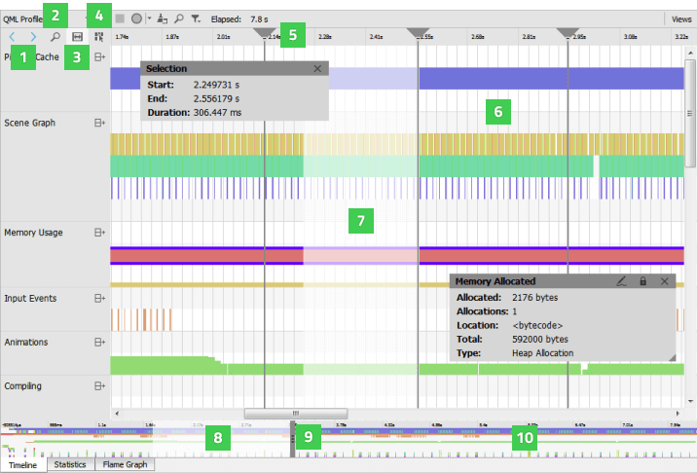
5. Analyzing Collected Data (cont.)
Notes:
Each row in the timeline (6) describes a type of QML events that were recorded. Move the cursor on an event on a row to see how long it takes and where in the source it is being called. To display the information only when an event is selected, disable the View Event Information on Mouseover button (4).
The outline (10) summarizes the period for which data was collected. Drag the zoom range (8) or click the outline to move on the outline. You can also move between events by selecting the Jump to Previous Event and Jump to Next Event buttons (1).
Select the Show Zoom Slider button (2) to open a slider that you can use to set the zoom level. You can also drag the zoom handles (9). To reset the default zoom level, right-click the timeline to open the context menu, and select Reset Zoom.
Click the time ruler to add vertical orientation lines (5) to the timeline.

Slide 10
5. Analyzing Collected Data (cont.)
Selecting Event Ranges
view the frame rate of events and to compare it with the frame rate of similar events.
Select the Select Range button (3) to activate the selection tool.
Then click in the timeline to specify the beginning of the event range.
Drag the selection handle to define the end of the range.
The length of the range indicates the frame rate of the event.
measure delays between two subsequent events
Place a range between the end of the first event and the beginning of the second event.
The Duration field displays the delay between the events in milliseconds.
To zoom into an event range, double-click it.
To remove an event range, close the Selection dialog.
Notes:
event range (7)

Slide 11
5. Analyzing Collected Data (cont.) -Understanding the Data
Generally, events in the timeline view indicate how long QML or JavaScript execution took
Move the mouse over them to see details
For most events, they include location in source code, duration and some relevant parts of the source code itself.
You can click on an event to move the cursor in the code editor to the part of the code the event is associated with.

Slide 12
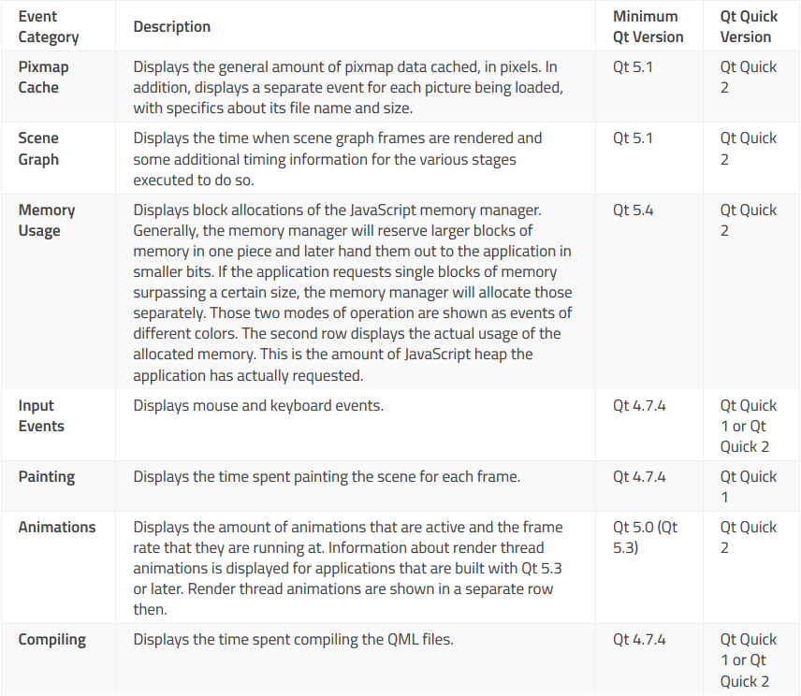
5. Analyzing Collected Data (cont.) -Understanding the Data

Slide 13
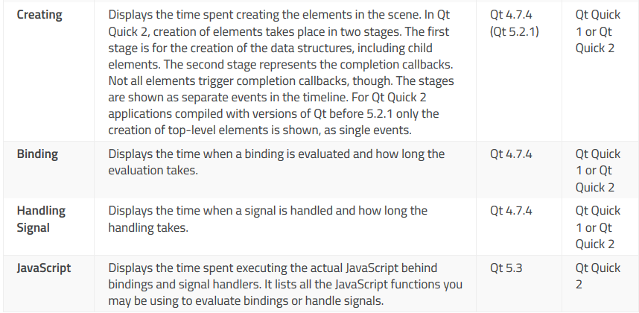
5. Analyzing Collected Data (cont.) -Understanding the Data

Slide 14
6. Viewing Statistics
The Statistics view displays the number of times each binding, create, compile, JavaScript, or signal event is triggered and the average time it takes.
This allows you to examine which events you need to optimize.
A high number of occurrences might indicate that an event is triggered unnecessarily.
To view the median, longest, and shortest time for the occurrences, select Extended Event Statistics in the context menu.

Slide 15
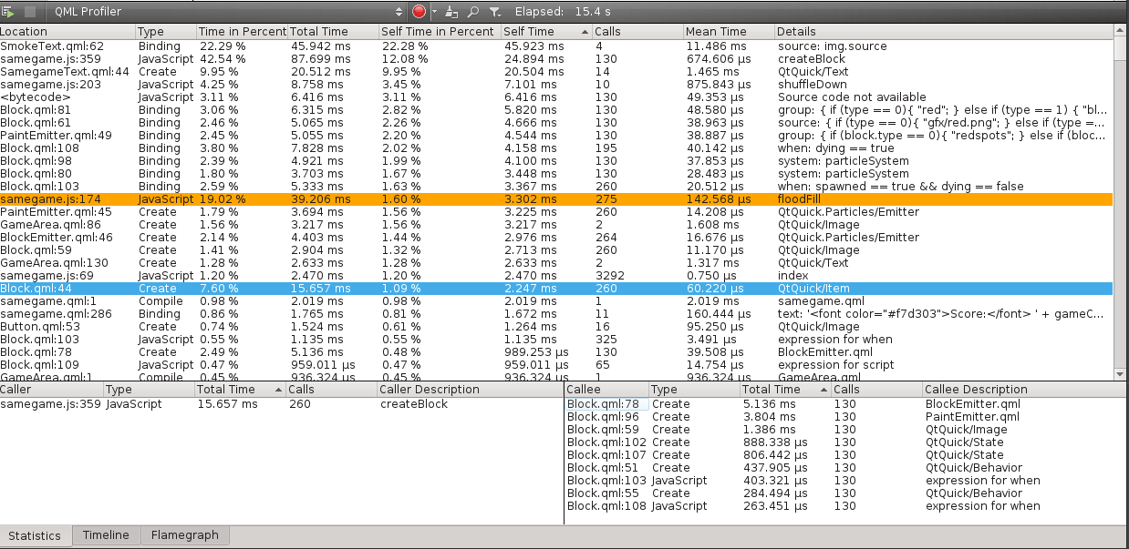
6. Viewing Statistics (cont.)
Notes:
The Callers and Callees panes show dependencies between events. They allow you to examine the internal functions of the application. The Callers pane summarizes the QML events that trigger a binding. This tells you what caused a change in a binding. The Callees pane summarizes the QML events that a binding triggers. This tells you which QML events are affected if you change a binding.
Click on an event to move to it in the source code in the code editor.
When you select an event in the Timeline view, information about it is displayed in the Statistics view. To view an event range in the Statistics view, select Analyze Current Range in the context menu in the Timeline view.
To copy the contents of one view or row to the clipboard, select Copy Table or Copy Row in the context menu.
JavaScript events are shown in the Statistics view only for applications that use Qt Quick 2 and are compiled with Qt 5.3 or later.

Slide 16
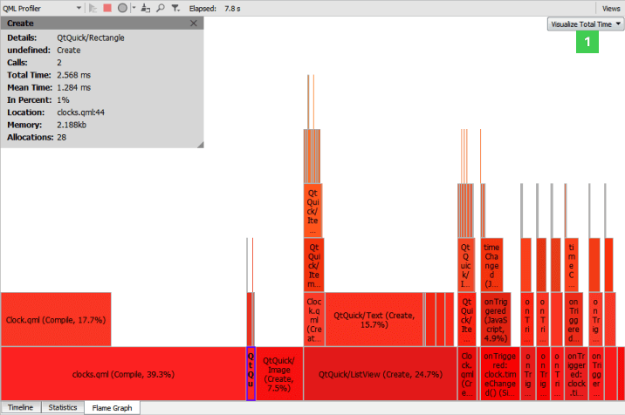
6. Viewing Statistics (cont.)
Visualizing Statistics as Flame Graphs
Notes:
The Flame Graph view shows a more concise statistical overview of QML and JavaScript execution. In the Visualize Total Time view, the horizontal bars show the amount of time all invocations of a certain function took together, relative to the total runtime of all JavaScript and QML events. The nesting shows which functions were called by which other ones.
To view the total amount of memory allocated by the functions in the Visualize Memory view, select Memory in the drop-down menu (1).
To view the the number of memory allocations performed by the functions in the Visualize Allocations view, select Allocations in the drop-down menu.
Unlike the Timeline view, the Flame Graph view does not show the time spans when no QML or JavaScript is running at all. Thus, it is not suitable for analyzing per frame execution times. However, it is very easy to see the total impact of the various QML and JavaScript events there.

Slide 17
Summary

Slide 18
Reference
http://doc.qt.io/qtcreator/creator-qml-performance-monitor.html

Slide 19

Q&A

