Slide 1
Object tracking
Members:
Nguyen Thanh Tung
Nguyen Viet Quy
Nguyen Dinh Thanh
Tran Van Tung
Nguyen Thanh Dong (Interns)
Notes:
1

Slide 2



Agenda
Introduction
Analyzing and solution
Demo

Slide 3
Introduction
Object tracking project using Udoo Neo board, with core A9 running Linux system which took responsibility for image processing and sent control signal to core M4 to control server motor.
Purpose:
Select object to detect: Using computer mouse to select object and press ‘c’ button on the keyboard to take template picture of the object and starting detect.
Sending the object position on the screen to core M4 and starting control server motor to track object.

Slide 4
Analyzing
Analyzing:
Prepare: Udoo board, 2 servo motor, LCD screen and USB camera
To achieve project purpose, we need to find out the efficient solution of image processing and control smoothly servo motor to track the object.

Slide 5

Finding Solution
Worry!!!!

Slide 6
Finding Solution
Which solution?
Cascade Classifier Training
Motion detection algorithm
Color Detection
Template matching algorithm

Slide 7
Template matching algorithm
Introduction:
Template Matching is a method for searching and finding the location of a template image in a larger image.
Notes:
7

Slide 8

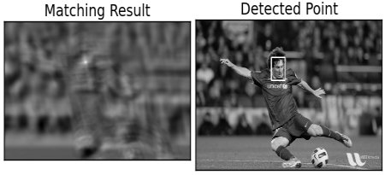
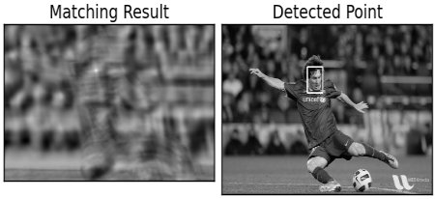
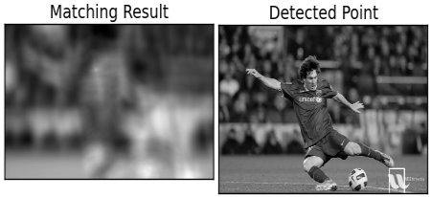
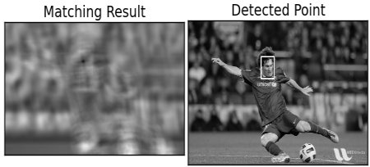
Template matching algorithm
Template image
The result with cv2.TM_CCOEFF method
The result with cv2.TM_CCOEFF_NORMED method
The result with cv2.TM_CCORR method
The result with cv2.TM_SQDIFF method
Notes:
8

Slide 9
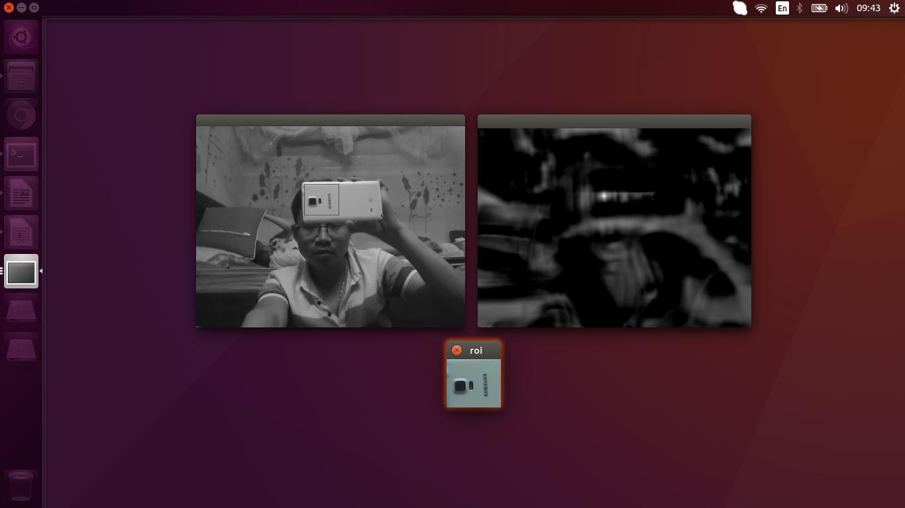
Template matching algorithm
Notes:
9

Slide 10
Template matching algorithm
The advantage:
This is algorithm used much for object detection
Quick and easy method for detecting object
Allowing to select any template picture of
The disadvantage:
When move object father the detection is less efficient.
Can not detect object when object is changed side
Notes:
10

Slide 11

Demo

Slide 12
Reference
http://www.roborealm.com/tutorial/color_object_tracking_2/slide010.php
https://docs.opencv.org/trunk/d4/dc6/tutorial_py_template_matching.html

Slide 13
Thank You!

