Slide 1
Hashing
Lesson Plan - 8

Slide 2
Contents
Evocation
Objective
Introduction
General idea
Hash Tables
Types of Hashing
Hash function
Hashing methods
Hashing algorithm
Mind map
Summary

Slide 3

ANNEXURE-I
Evocation

Slide 4
Objective
To study the basic concept of hashing techniques and algorithm

Slide 5
ANNEXURE-II
Introduction-Hashing
In hashed search, key through algorithmic function determines location of data
Transform key into index that contains data need to locate
Hashing is a key to address mapping process
The implementation of hash tables is called hashing
Hashing is a technique used for performing insertions, deletions and finds in constant average time (i.e.O(1))

Slide 6
General idea
The ideal hash table structure is merely an array of some fixed size,
containing the items
A stored item needs to have a data member, called key, that will be
used in computing the index value for the item
  Key could be an integer, a string, etc
  e.g. a name or Id that is a part of a large employee structure
The size of the array is TableSize
The items that are stored in the hash table are indexed by values
from 0 to TableSize – 1
Each key is mapped into some number in the range 0 to
TableSize – 1
The mapping is called a hash function

Slide 7
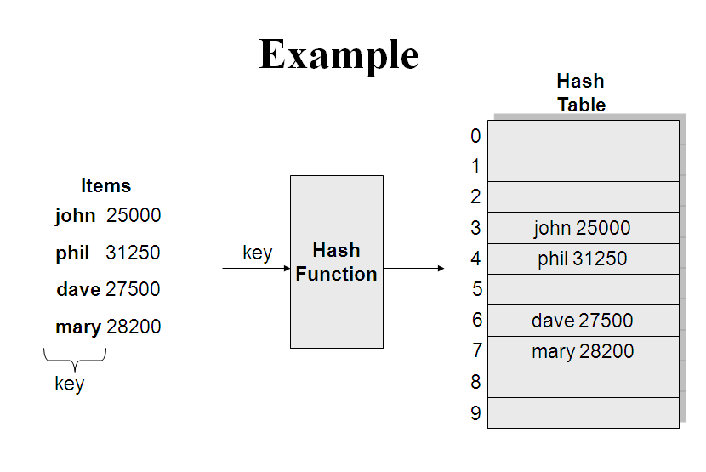
Hashing

Slide 8
Hash Tables
There are two types of Hash Tables: Open-addressed Hash Tables and
Separate-Chained Hash Tables
An Open-addressed Hash Table is a one-dimensional array indexed by
integer values that are computed by an index function called a hash
function
A Separate-Chained Hash Table is a one-dimensional array of linked lists
indexed by integer values that are computed by an index function called a
hash function
Hash tables are sometimes referred to as scatter tables
Typical hash table operations are:
Initialization
Insertion
Searching
Deletion

Slide 9
Types of Hashing
There are two types of hashing :
Static hashing: In static hashing, the hash function maps
search-key values to a fixed set of locations
Dynamic hashing: In dynamic hashing a hash table can grow
to handle more items. The associated hash function must
change as the table grows
The load factor of a hash table is the ratio of the number of
keys in the table to the size of the hash table
Note: The higher the load factor, the slower the retrieval
With open addressing, the load factor cannot exceed 1. With
chaining, the load factor often exceeds 1

Slide 10
Hash Function
Choice of hash function:
  Must be simple to compute
  Must distribute the keys evenly among the cells
  Minimal number of collisions
If a hashing function groups key values together, this is called clustering of the keys
A good hashing function distributes the key values uniformly throughout the range
Problems:
Keys may not be numeric
Number of possible keys is much larger than the space available in table
Different keys may map into same location
Hash function is not one-to-one => collision
If there are too many collisions, the performance of the hash table will suffer dramatically

Slide 11
Collision Resolution
Collision occurs when hashing algorithm produces an address for insertion key and the address is already occupied
Address produced by hash algorithm is home address
Memory contains all home address is prime area
When two keys collide at home address, resolve collision by placing one of keys and data in another location
[0] [4] [8] [16]
B and A
collide at 8
C and B
collide at 16
 |  |  |  | C |  |  |  | A |  |  |  |  |  |  |  | B
hash(A)
hash(B)
3. hash (c)

Slide 12
Hashing Methods
Hashing methods
Direct
Modulo division
Mid square
Rotation
Subtraction
Folding
Digit Extraction
Pseudorandom
generation

Slide 13
Hashing methods
Direct Method
Key is the address without algorithmic manipulation
Data structure contain element for possible key
Example problem
To analyze total monthly sales by days of month
For each sale we need date and amount of sale
To calculate sales record for month, we need day of month
as key for array and add sales amount to accumulator
daily Sales[ sale. day ] = daily Sales[ sale . day ] + sale . amount;

Slide 14
Direct Hashing of Employee numbers
000 | (Not used)
001 | Harry Lee
002 | Sarah Trapp
005 | Vu Nguymen
007 | Ray Black
[001]
[002]
[003]
[004]
[005]
[006]
[007]
[008]
[009]
Address
005
100
002
Hash
Key
[099]
[100]
100 | John Adams

Slide 15
Hashing Methods
Subtraction method
Direct and subtraction hash functions guarantee search effort of one with no collisions
In one to one hashing method only one key hashes to each address
Example
Company have 100 employees, employee number starts from 1001 to 1100
Hashing function subtracts 1000 from key to determine address

Slide 16
ANNEXURE-III
Rapid Eye Movement Exercise
Imagine a huge clock in front of you
Direct your focus on 12 o'clock, slowly move eyes clockwise around the clock without stopping at the reference hours. Do three complete rotations
Focus straight ahead at the horizon and note changes in feelings, body sensations
Repeat as many times as you feel necessary for any inner pacing

Slide 17
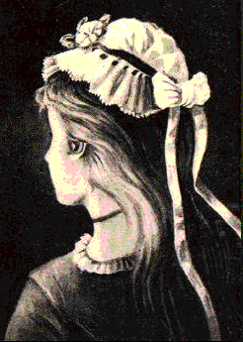
Optical Illusion
What do you see in the image below?

Slide 18
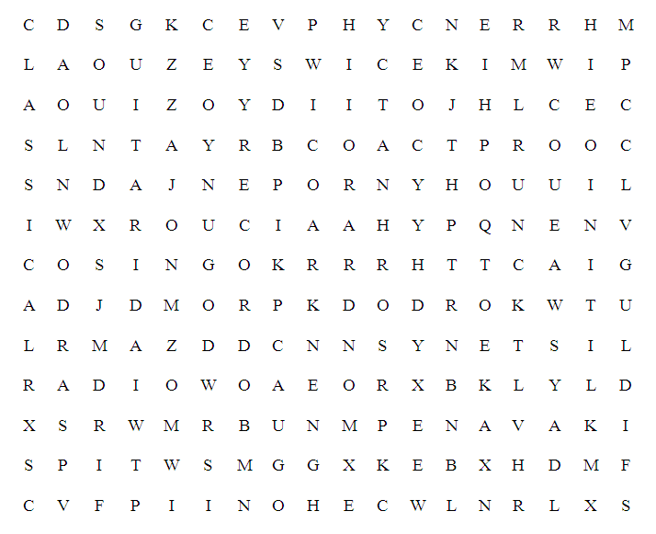
Music Word search

Slide 19
Branches and Descriptions
Anthology
Pomology
Batracology
Petrology
Odontology

Slide 20
Modulo Division Method
Modulo Division Method
Divides the key by array size and use remainder for address
Algorithm works with any list size, but list size is a prime number produces fewer collisions
address = key MODULO list Size

Slide 21
Modulo Division Hashing
[000]
[001]
[002]
[003]
[004]
[005]
[006]
[007]
379452 | Mary Dodd
121267 | Bryan Devaux
378845 | Partrick Linn
160252 | Tuan Ngo
045128 | Feldman
121267
045128
379452
Hash
[008]
[305]
[306]

Slide 22
Digit Extraction Method
Digits are extracted from key and used as address
Example
Six digit employee number is used to hash three digit address
(000-999)
Select first, third and fourth digits use them as address
379452-394
121267-112
378845-388
160252-102
045128-051

Slide 23
Midsquare Method
Key is squared and the address is selected from the middle of the squared number
Example
Given a key of 9452, midsquare address calculation is shown using four digit address (0000-9999)
9452²=89340304: address is 3403
Select first three digits and then use midsquare method
379452 : 379² = 143641 - 364
121267 : 121² = 014641 - 464
378845 : 378² = 142884 - 288
160252 : 160² = 025600 - 560
045128 : 045² = 002025 - 202

Slide 24
Folding Methods
Two folding methods
Fold shift
Fold boundary
Fold shift key value is divided into parts whose size matches size of required address
Left and right parts are shifted and added with middle part
In fold boundary, left and right numbers are folded on a fixed boundary between them and center number

Slide 25
Hash Fold examples
123 321
456 456
789 987
368 764
Fold Shift Fold boundary
123456789
123
789
123
789
Digits reversed
1
1
Discarded

Slide 26
Rotation Method
Rotation is used in combination with folding and pseudorandom hashing
Hashing keys are identical except for last character
Rotating last character to front of key and minimize the effect
Example
Consider case of six digit employee number that is used in large company
600101 600101 160010
600102 600102 260010
600103 600103 360010
600104 600104 460010
600105 600105 560010
Original Key Rotation Rotated Key

Slide 27
Pseudorandom Hashing
Key is used as seed in pseudorandom number generator and the random number is scaled into possible address range using modulo-division
Pseudorandom number generator generate same number of series
A common random number generator is y = ax + c
Example
Assume a=17, c=7, x=121267,Prime number=307
y= ((17*121267) + 7) modulo 307
y= (2061539 + 7) modulo 307
y= 2061546 modulo 307
y= 41

Slide 28
Hashing Algorithm
Algorithm hash (key size, maxAddr, addr)
set looper to 0
set addr to 0
for each character in key
if (character not space)
add character to address
rotate addr 12 bits right
end if
end loop
if (addr < 0)
addr = absolute (addr)
end if
addr = addr modulo maxAddr
end hash

Slide 29
ANNEXURE-IV
Mind Map
General idea
Types
Hash Function
Hashing
Collision resolution
Hashing
Methods
Hashing
Algorithm

Slide 30
ANNEXURE-V
Summary
In hashed search, key through algorithmic function determines location of data
Hashing functions including direct, subtraction, modulo division, digit extraction, midsquare, folding, rotation, pseudorandom generation
In direct hashing, key is address without algorithmic manipulation
In subtraction hashing key is transformed to address by subtracting a fixed number from it
In modulo division hashing key is divided by list size and remainder plus 1 is used as address
In digit extraction hashing select digits are extracted from key and used as address

Slide 31
Summary
In midsquare hashing key is squared and address is selected from middle of result
In fold shift hashing key is divided into parts whose size match size of required address. Then parts are added to obtain address
In fold boundary hashing, key is divided into parts whose size match size of required address. Then left and right parts are reserved and added to middle part to obtain address
In rotation hashing far right digit of key is rotated to left to determine address
In pseudorandom generation hashing, key is used as seed to generate pseudorandom number. Result is scaled to obtain address

