Slide 1
Coding.Waterkant 2020
Challenges:
C06-Predict Ticket Submissions
C07-Prediction of Ticket Processing Times
Tronje - Tim - Sascha - Vipul
Patron: Jesko Zychski from Landeshauptstadt Kiel

Slide 2
Motivation
As the Landeshauptstadt Kiel with more than 5,000 employees we try and do our best for all our citizens each and every day. We want everyone to be able to do their best job and we want our internal processes to run smoothly - so we need a strong team in the background who will have our back in case of problems.
As a help desk, this team works on up to 1,000 different requirements and problems every day. We need your support so that the help desk team can organize themselves even better.
Our goal was to
predict the amount of incoming tickets
predict the lifetime of a ticket.
For the first goal we tried three different approaches, traditional models like ARIMA and Exponential Smoothing as well as modern approaches like LSTM.
For the second goal we used a Random Forest Model.

Slide 3
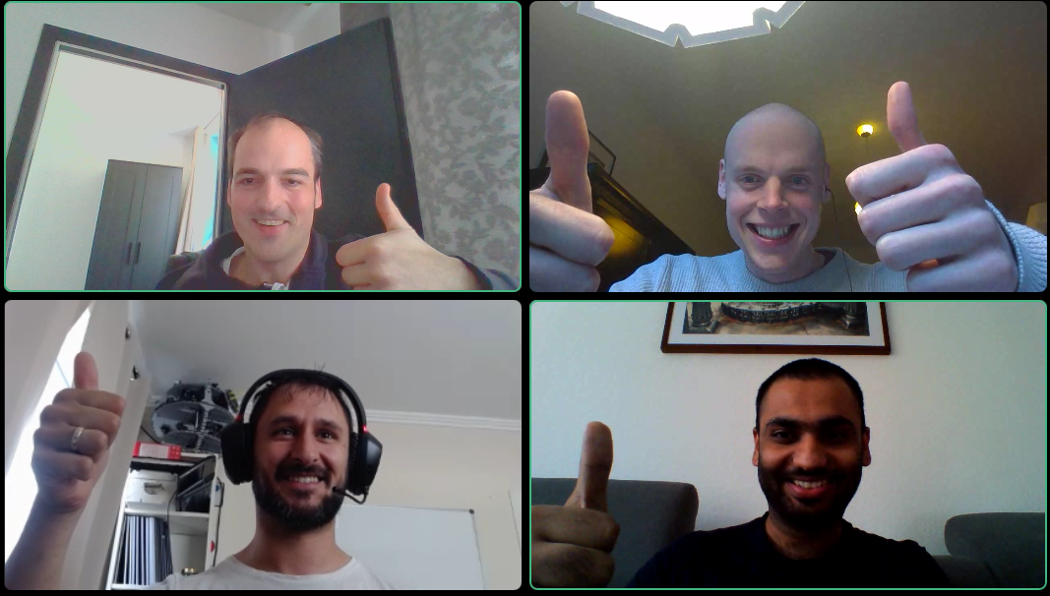
The Team
Tronje
Tim
Vipul
Sascha

Slide 4
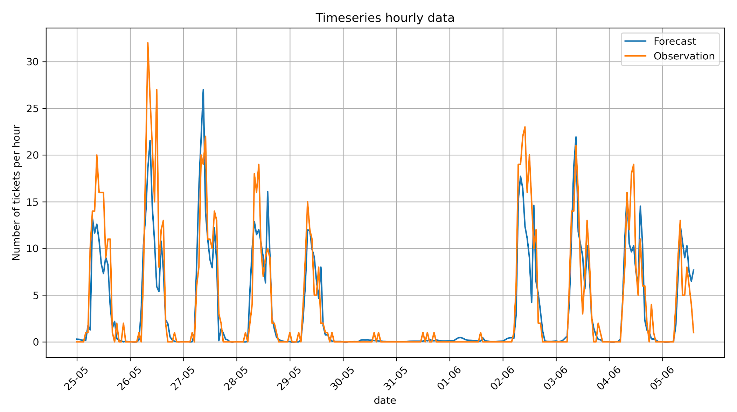
Timeseries Forecasting with LSTMs
Version 1
RMS for daily data -> 36 - RMS for hourly data -> 1.75
Statistical without any feature engineering

Slide 5
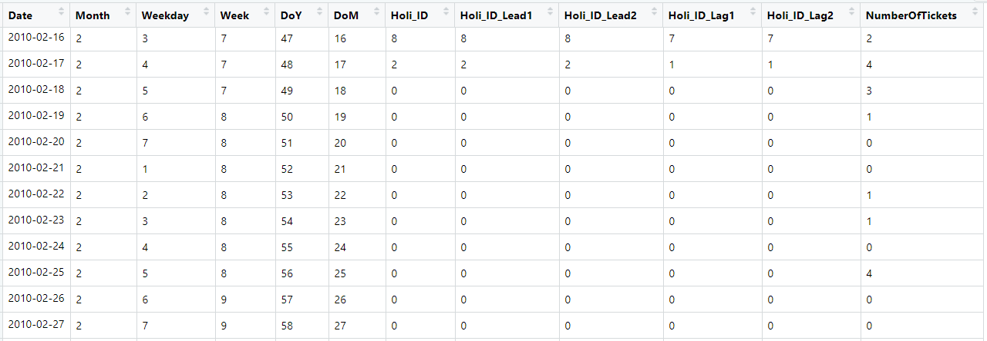
Analysis Dataset with Feature Engineering

Slide 6
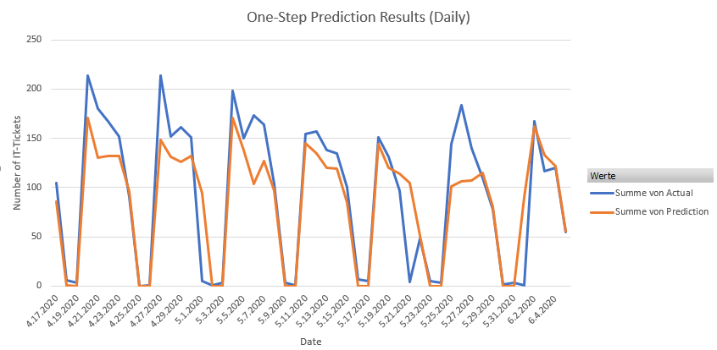
Timeseries Forecasting with LSTMs
Version 2 (with some feature engineering)
RMSE for daily data -> 31.07

Slide 7
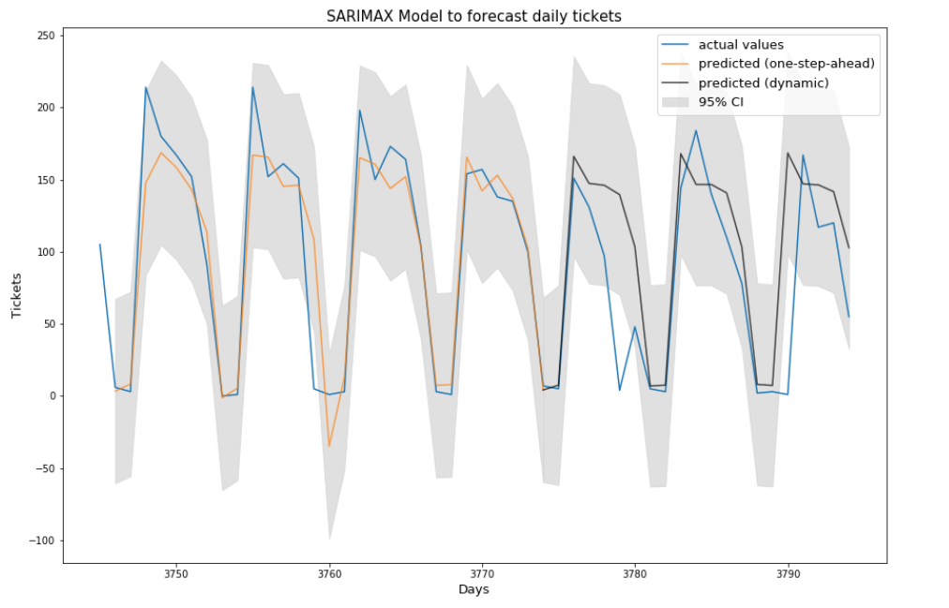
Tentative Results Seasonal ARIMA
RMSE = 32.60

Slide 8
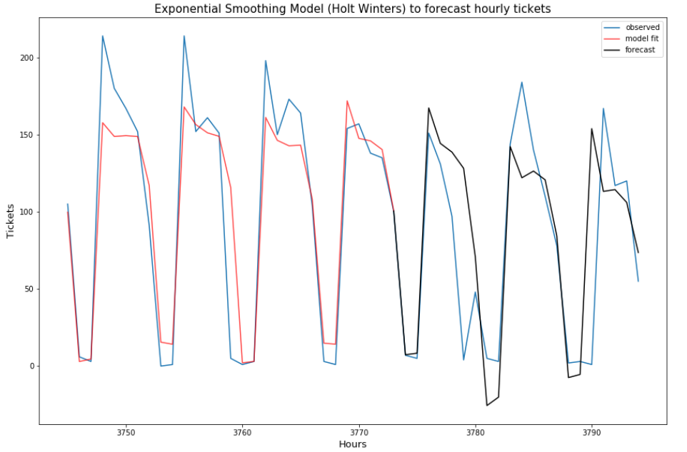
Tentative Results Exponential Smoothing
RMSE = 34.89

Slide 9
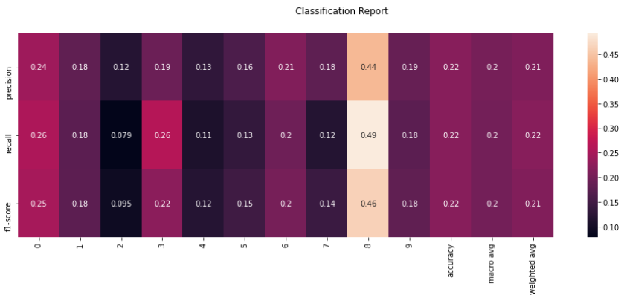
Testative Results Classification
Accuracy Score: ~22%

Slide 10
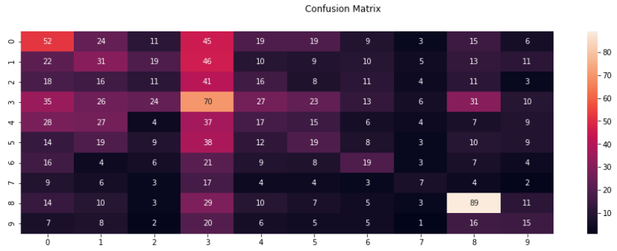
Testative Results Classification
Many wrong predictions :-(

Slide 11
Outlook + Conclusions
Our goal was to
predict the amount of incoming tickets
The LSTM model seems to be the most promising - for daily as well as for hourly data. Further tweaking should improve the results, as well as additional feature engineering
The traditional approaches for daily predictions are nearly as good as the LSTM
predict the lifetime of a ticket.
The Random Forest Model needs more feature engineering in order to improve the results

