Slide 1
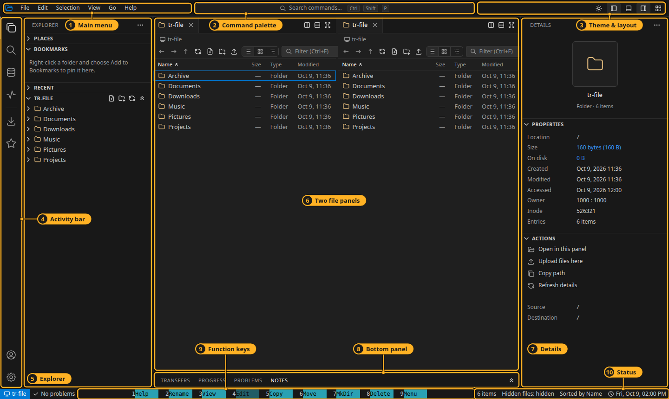
tr-file
A quick tour of the two-panel file manager
VS Code’s look · Midnight Commander’s keys
Notes:
tr-file is a two-panel file manager that runs in the browser or as a desktop app. It looks like VS Code and uses the keys of Midnight Commander. This tour takes about ten minutes. Every key named here can be changed in Settings, and F1 lists them all.

Slide 2




One window, four apps
File Manager
Search
Disk Usage
Task Manager
Two panels, tabs, splits, previews and an editor
Find files by name in the workspace or a folder
See where the space went: pie, table or treemap
Processes and live graphs of the machine
Browser or desktop
Everything has a key
Nothing blinks
The same app on a server, or as one Electron window
And every key can be changed — F1 shows them all
Reloads keep what is on screen until the answer lands
Notes:
The activity bar on the left switches between four sub-applications that share one title bar, status bar and command palette. The file manager comes back exactly as you left it when you switch back.

Slide 3
The window
1
Main menu F9
2
Command palette Ctrl+Shift+P
3
Theme and layout
4
Activity bar switch apps
5
Explorer places, bookmarks, tree
6
Two file panels
7
Details of the entry under the cursor
8
Bottom panel transfers, jobs, notes
9
Function keys F1–F10
10
Status counts, sort, server clock
Notes:
Walk round the window. The active panel is where actions go; the other panel is where copies and moves go. Ctrl+Tab moves the keyboard round the parts. Ctrl+E, Ctrl+D and Ctrl+/ hide the sidebars when you need room.

Slide 4
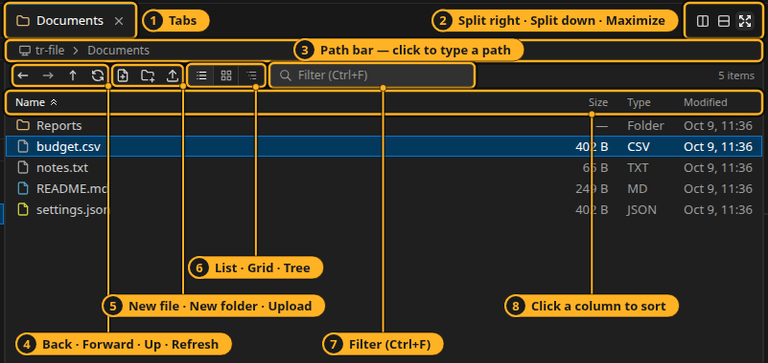
A panel
1
Tabs Ctrl+T · Ctrl+W
2
Split · maximize Ctrl+↑
3
Path bar Ctrl+L to type
4
Back · forward · up · refresh Alt+← → ↑ · Ctrl+R
5
New file · folder · upload F7
6
List · grid · tree per folder
7
Filter Ctrl+F
Ctrl+L
The path bar suggests as you type
↓ ↑ choose · Tab completes · Enter goes. A file’s path opens its folder with the file selected.
8
Sort click a column
Notes:
Each panel has tabs, its own history and its own toolbar. The view and sort order belong to the folder, so a folder looks the same every time you come back. Arrows, Home/End, page keys and typing letters move the cursor; Enter opens.

Slide 5
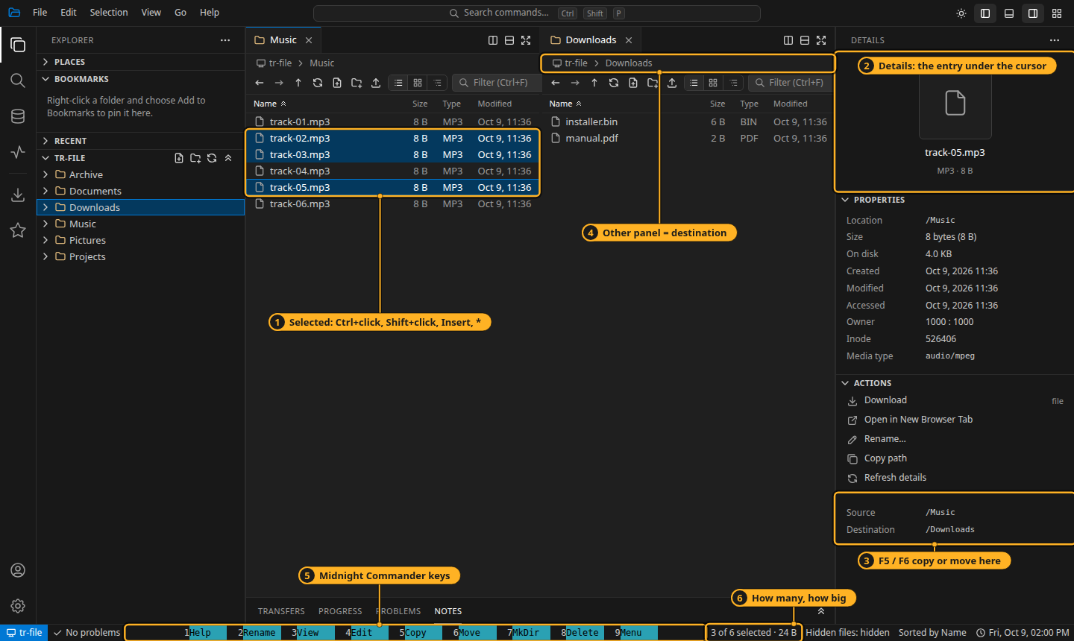
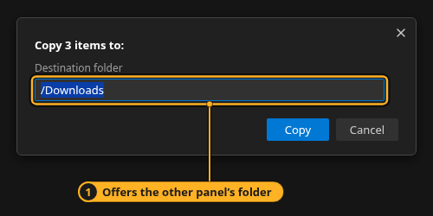
Select, then copy or move
Select
Ins
mark
*
all / none
+
by pattern
Act on the selection
F5
F6
F8
copy
move
delete
Notes:
Ctrl+click and Shift+click select several entries, or use Insert, star and plus. F5 asks where to copy and offers the other panel’s folder. Jobs run in the background with a progress window; an entry that fails asks Skip, Skip All, Retry or Abort. Ctrl+C/X/V and drag and drop do the same. Delete moves to the trash, and Ctrl+Z undoes the last change.

Slide 6
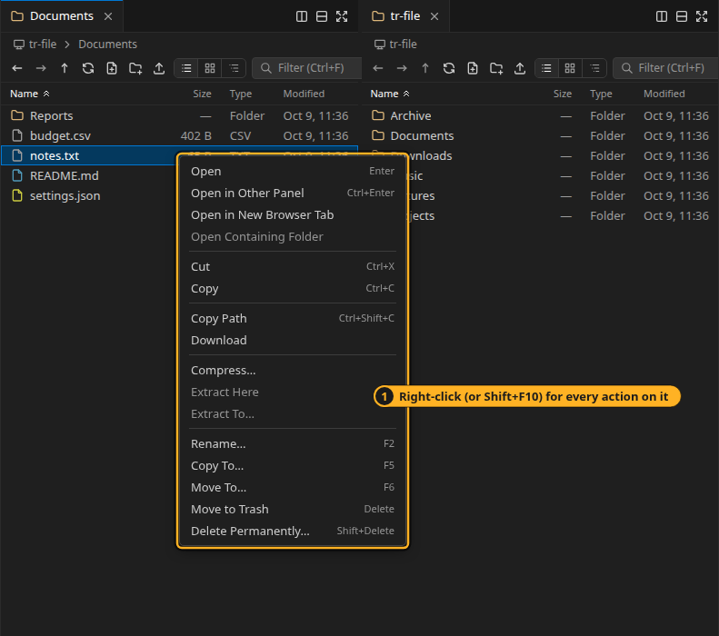




Right-click for everything
Copy Path
Ctrl+Shift+C — twice for a UNIX-style path
Open in Other Panel
Ctrl+Enter, in a new tab over there
Undo
Ctrl+Z: rename, create, copy, move, trash
Trash and restore
Delete asks first; restore from Places
Notes:
Right-click, or Shift+F10, shows every action for what you clicked: an entry, several, blank space, a tab or a tree folder. The same commands are in the main menu and the palette.

Slide 7
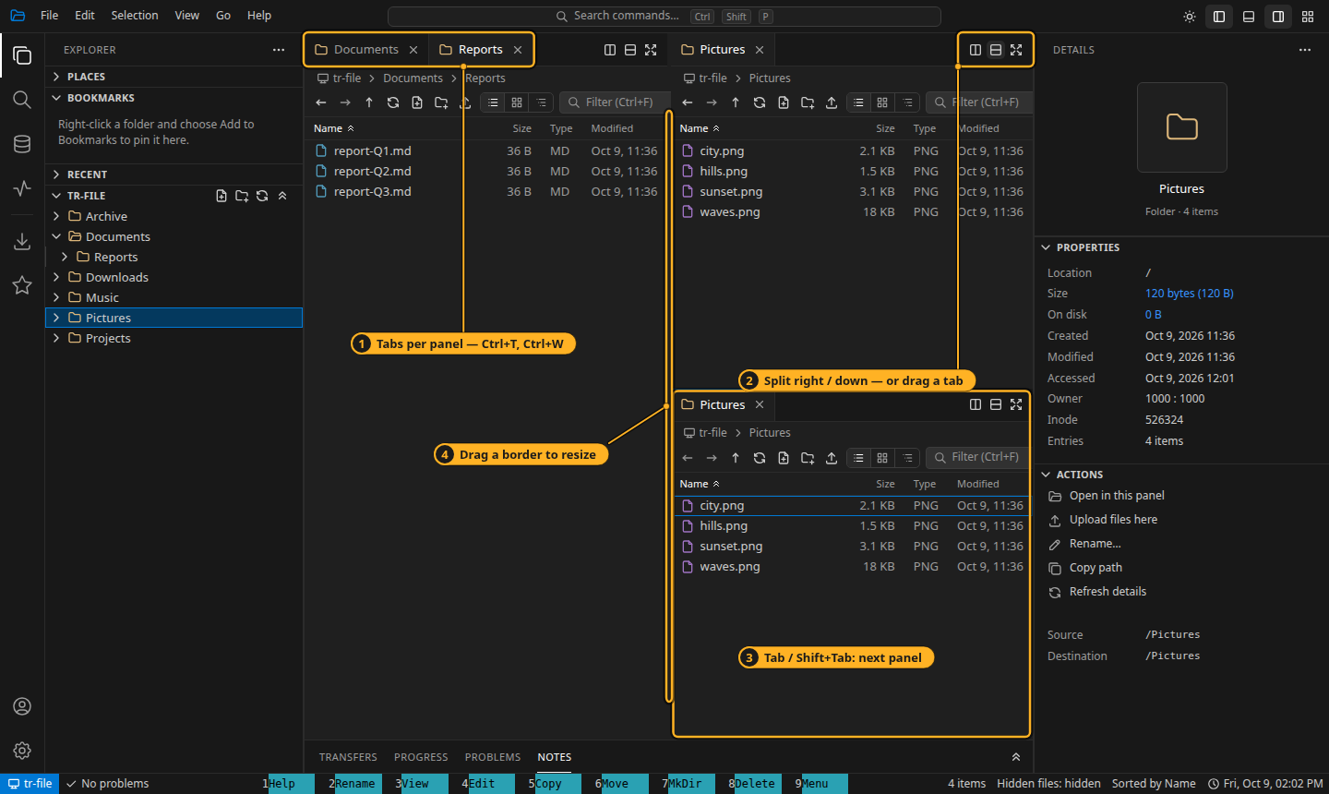
Panels, tabs and layout
1
Tabs per panel Ctrl+PgUp / PgDn
2
Split right or down / splits right; drag a tab across
3
Tab / Shift+Tab move between panels
4
Drag a border to resize
Notes:
Panels split right or down as far as you like, each with its own tabs. Tab moves between panels as in Midnight Commander. The whole layout is restored next time; the gear menu has Reset Layout.

Slide 8
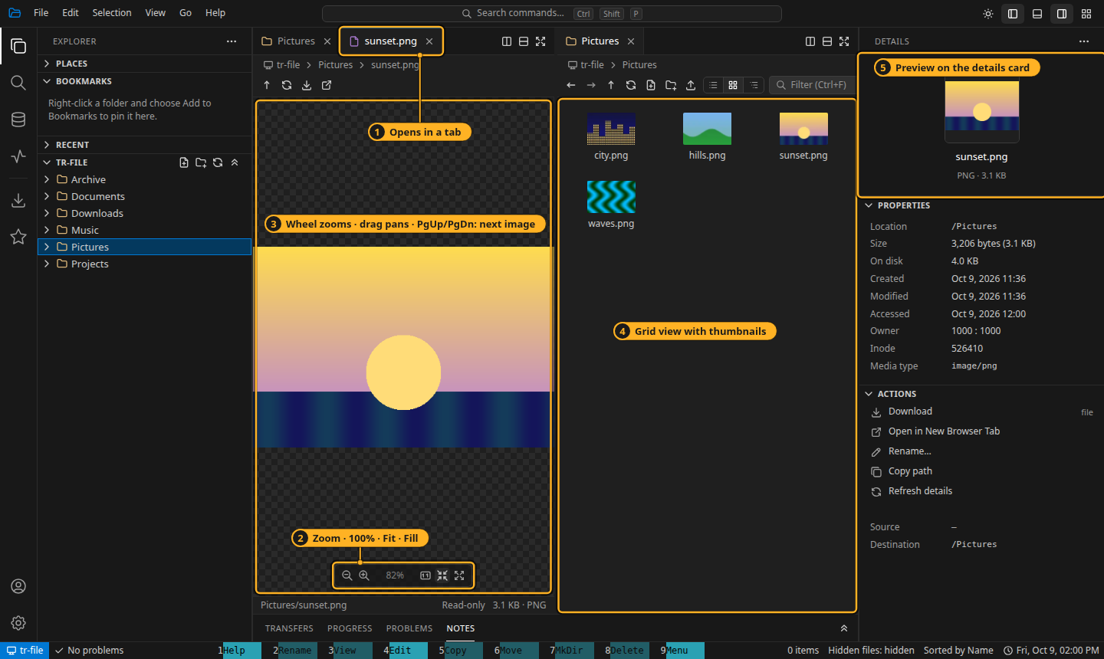
Pictures
1
Opens in a tab Escape closes it
2
Zoom · 100 % · fit · fill + − 1 0
3
Wheel zooms, drag pans PgUp / PgDn: next picture
4
Grid view with thumbnails
5
Details card previews it too
Notes:
Double-click a picture to open it read-only in a tab. PgUp and PgDn step through the folder’s pictures and the listing follows. The grid view draws thumbnails; the details card shows the selected picture.

Slide 9
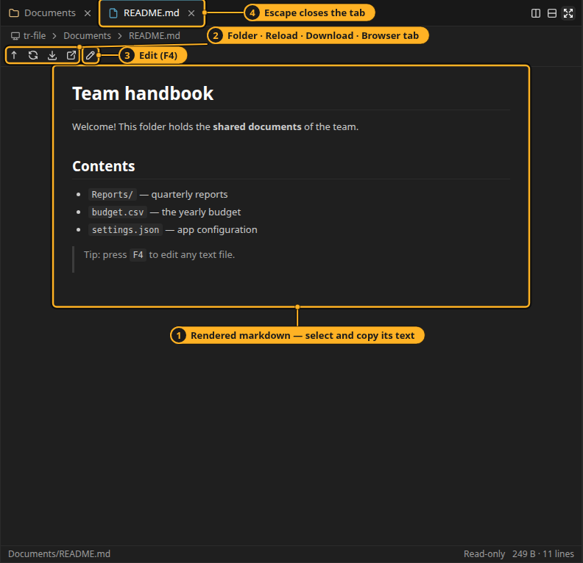
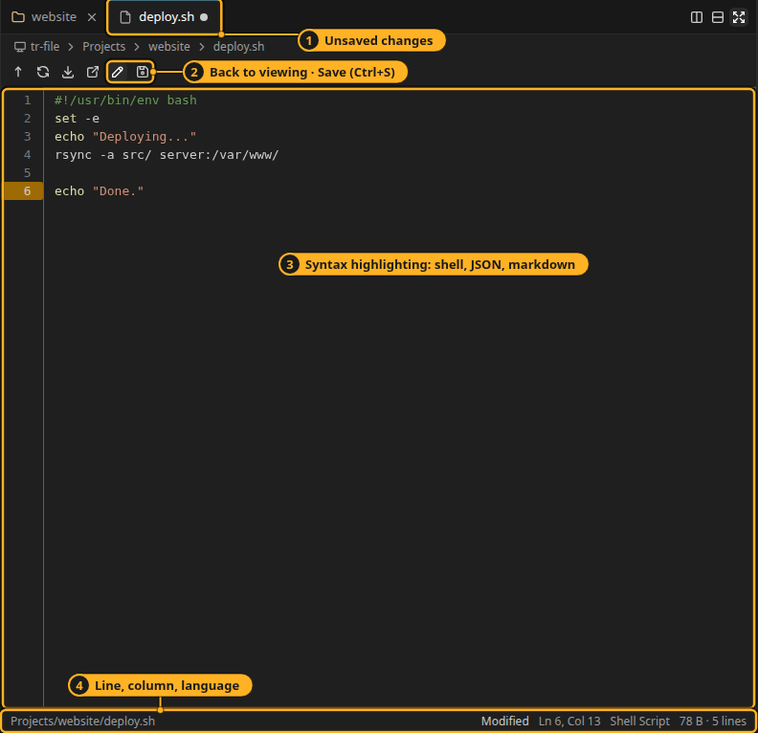
Read, then press F4 to edit
Markdown rendered — select and copy its text
Highlighted editor · dot = unsaved · Ctrl+S saves
Notes:
Text files open in a viewer; markdown is rendered. F4 or the pencil edits in place: markdown, shell and JSON are highlighted, Ctrl+F finds, Tab indents. A dot on the tab means unsaved changes; closing asks first. If the file changed on disk meanwhile, saving asks whether to overwrite.

Slide 10
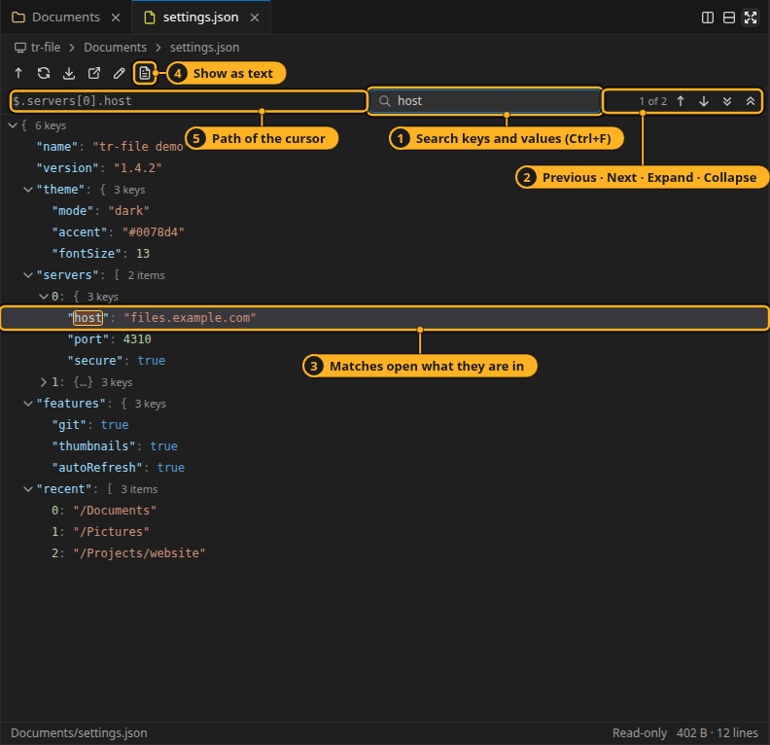
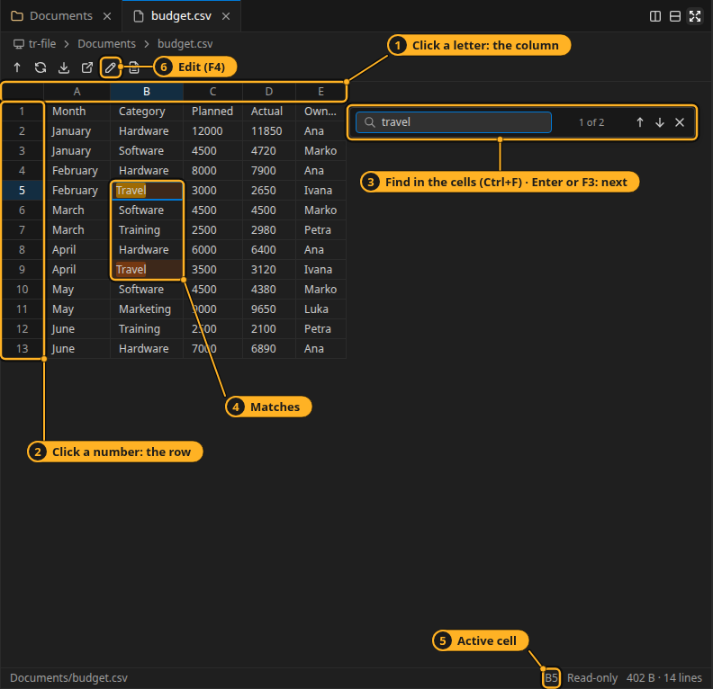
JSON as a tree, CSV as a sheet
Search keys and values · F2 edits in place
Excel’s keys · find · F4 to edit cells
Notes:
JSON opens as a tree: Ctrl+F searches keys and values and opens what each match is in; double-click or F2 changes a value in place and the file keeps its layout. CSV and TSV open as a spreadsheet with Excel’s selection and keys; Ctrl+C copies tab-separated text. F4 makes it editable. A zip opens like a read-only folder.

Slide 11
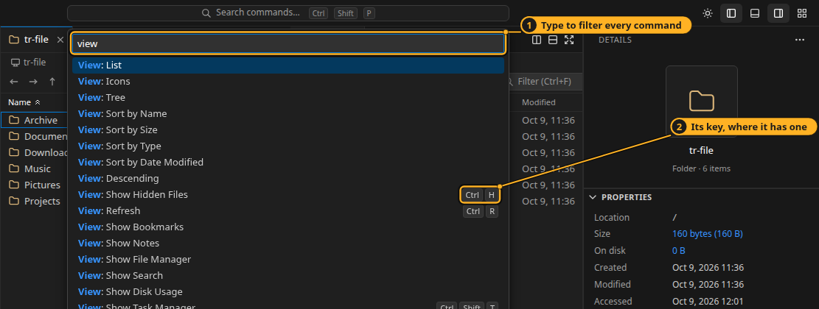
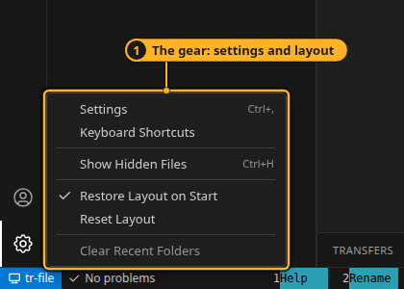
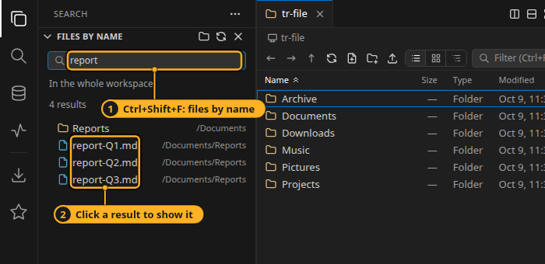
Find anything
Command palette — Ctrl+Shift+P: every command, with its key
Bookmarks
Right-click a folder › Add to Bookmarks. Drag to reorder; Ctrl+1…9 on the desktop.
The gear
Settings, keyboard shortcuts, hidden files (Ctrl+H), layout.
Search by name
Ctrl+Shift+F, in the workspace or the active folder. Click a result to show it.
Notes:
The palette lists every command and filters as you type; some commands ask for a value in the same box, like Go: Jump to Folder. Search finds files by name. Bookmarks live in the Explorer.

Slide 12
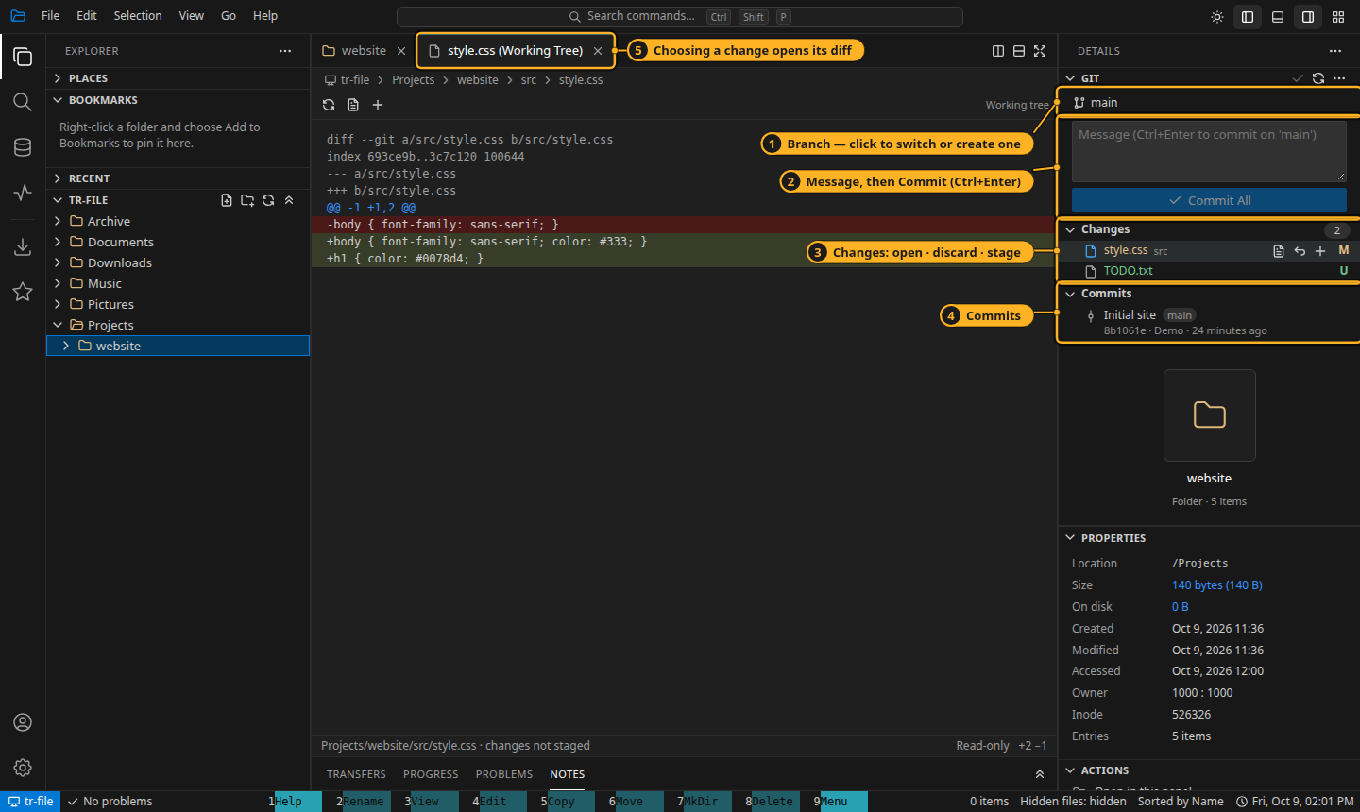
Git, in the Details sidebar
1
Branch switch or create
2
Commit Ctrl+Enter; offers to stage all
3
Changes open · discard · stage
4
Commits recent history
5
A change opens its diff in a tab
Notes:
When the folder shown is in a Git repository, the Git pane appears at the top of Details. Its … menu has pull, push, sync, fetch, stash and pop. A commit made in a terminal shows up by itself.

Slide 13
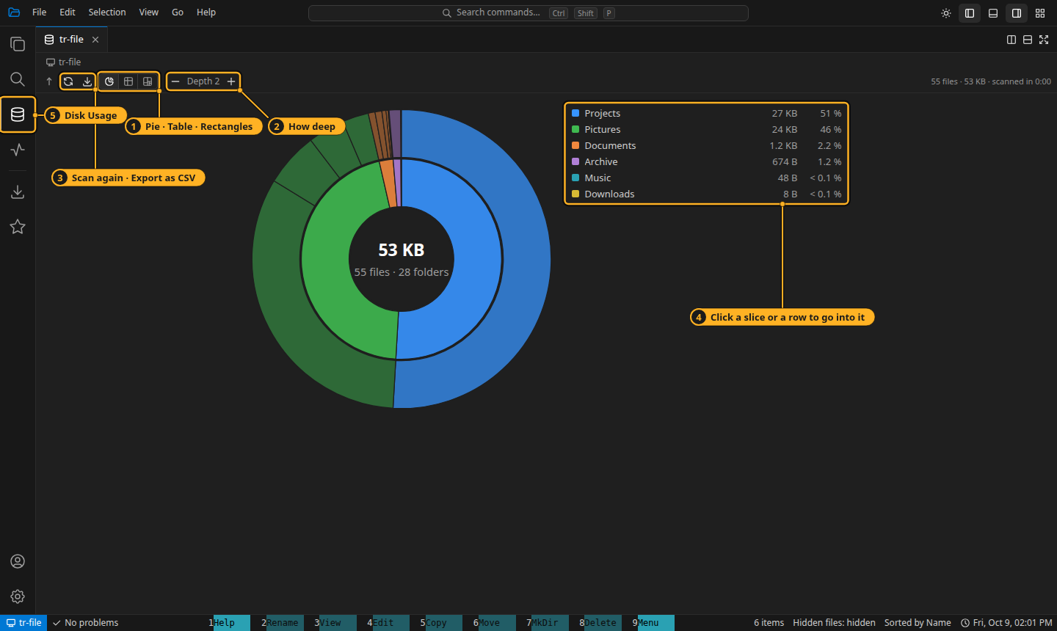
Disk Usage
1
Pie · table · rectangles
2
How deep 1–8 levels
3
Scan again · export CSV
4
Click to go into a folder Escape stops a scan
5
Disk Usage or press a folder’s Size
Notes:
Disk Usage shows where the space went, as a sunburst pie, a table with share bars or a treemap. Click a slice to go into it; the path bar brings you back. Export as CSV saves what is shown, ready for Excel.

Slide 14
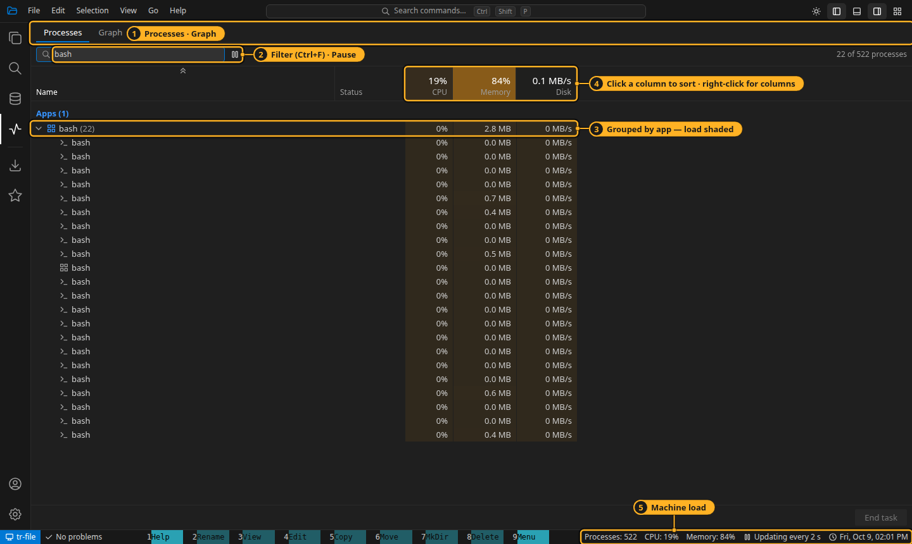
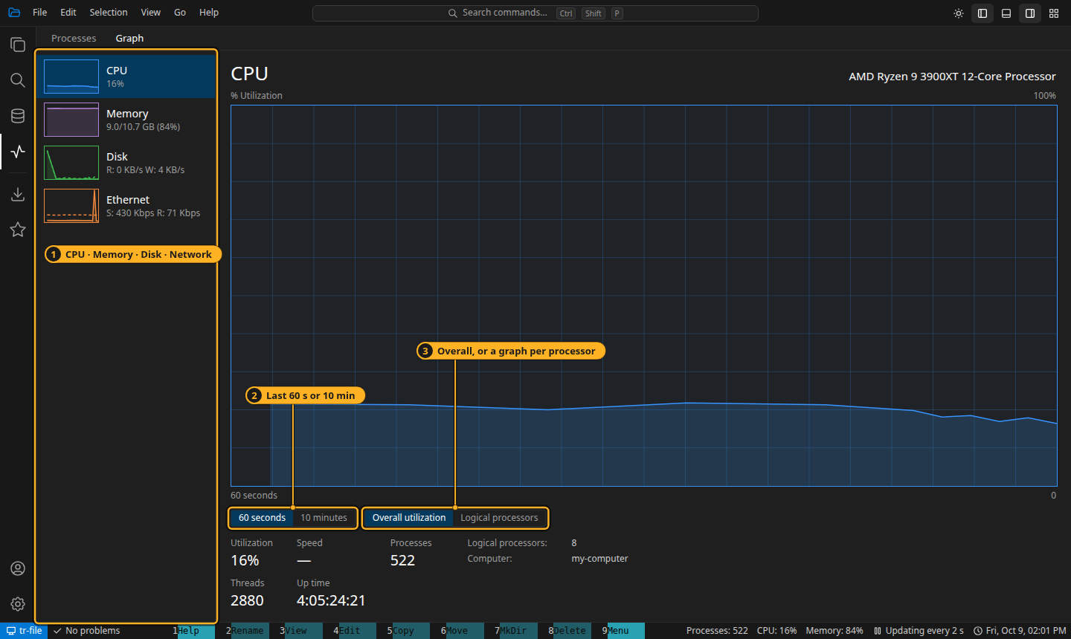
Task Manager
Processes
Grouped by app and shaded by load. Delete ends a task, Shift+Delete the whole tree — both ask first.
Graph
CPU, memory, disk and each network adapter, over 60 seconds or 10 minutes.
Notes:
Like Windows’ own Task Manager, for the machine tr-file runs on — Ctrl+Shift+T on the desktop. Filter with Ctrl+F, sort by clicking a column, right-click the header to choose columns. The status bar shows the load while it is open.

Slide 15
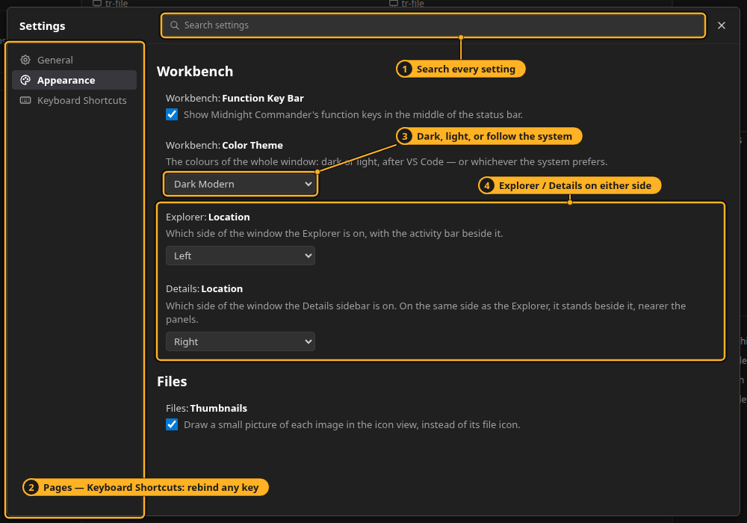
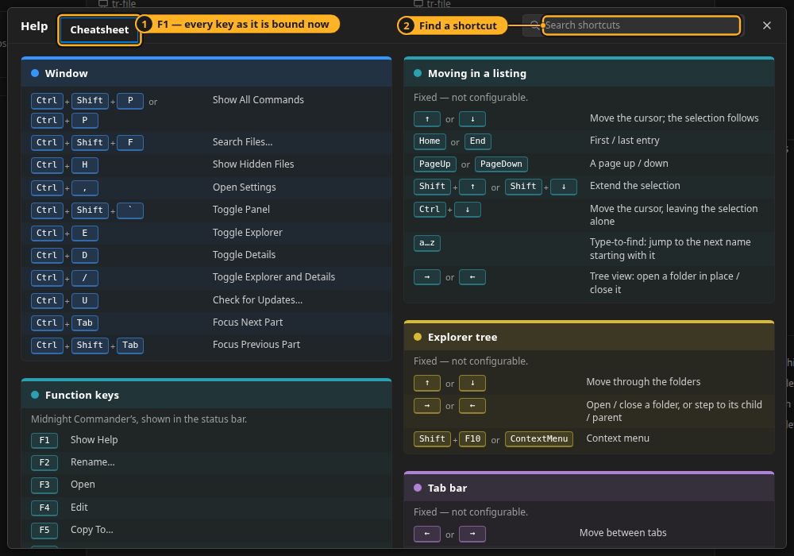
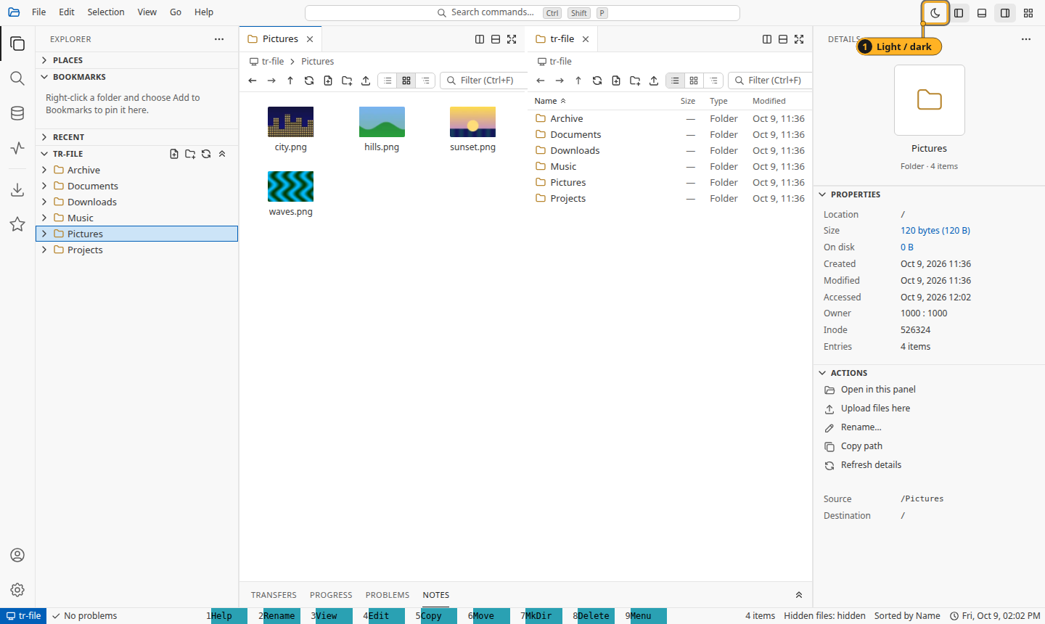
Make it yours
Settings — Ctrl+,
Cheatsheet — F1
Light or dark
Theme, sidebars on either side, and rebinding any key
Every key as it is bound now, searchable
The sun / moon button in the title bar
Notes:
Settings has General, Appearance and Keyboard Shortcuts pages and a search box. Color theme can be dark, light or follow the system; Explorer and Details can sit on either side. F1 opens the cheatsheet with your own key changes included.

Slide 16




In the desktop app
The whole computer
Remote servers
System integration
Every drive on Windows, / elsewhere
Go › Remote Computer… — passwords never saved
Clipboard, trash, drag out, open with the default app
Window zoom
Show / hide anywhere
Updates itself
Ctrl+= / Ctrl+− / Ctrl+0, and the title bar
Ctrl+` from any application
Ctrl+U checks; a blue Upgrade button appears
Notes:
The desktop app runs the whole stack in one window, on Windows, Linux and macOS. Every browser-reserved chord such as Ctrl+T, Ctrl+W and Ctrl+Tab reaches the app there.

Slide 17
Six keys to remember
F1
Ctrl+Shift+P
Help — every key
Command palette
Tab
F5 / F6
Other panel
Copy / move there
Everything else is in F1 — and can be rebound.
F4
Ctrl+L
Edit the file
Type a path
Notes:
If you remember six keys: F1 for help, Ctrl+Shift+P for any command, Tab to the other panel, F5 and F6 to copy or move there, F4 to edit, Ctrl+L to type a path. The full tutorial with annotated screenshots is docs/tutorial/README.md.

