Slide 1
✍ In your workbook · Vocabulary (Act 1–2)
How This Deck Works
Universal Design for Learning · Multi-Tiered System of Supports
EVERY LEARNER · SAME FIRM GOAL
Multiple ways in
Multiple ways to see it
Multiple ways to show it
Every lesson opens with a real question and a clear “I can” goal, so you know why it matters and where you’re headed.
Direct instruction, primary sources, maps, and bilingual key vocabulary — the same ideas shown more than one way.
Model-with-me, sentence frames, and choices in how you respond — you reach the same goal by the route that works for you.
Your teacher checks your progress along the way and gives you another path if you need one — the goal never lowers.
U.S. History Hack · TroopToTeacher Technologies LLC · Aligned to TN Academic Standards & TCAP EOC
1

Slide 2
US.45
Rise and Spread of Fascism, Communism, and Totalitarianism
TN STANDARD
US.45 – Explain the rise and spread of fascism, communism, and totalitarianism internationally.
I CAN
I can explain the rise and spread of fascism, communism, and totalitarianism internationally, including the key characteristics and leaders of each system.
U.S. History Hack · TroopToTeacher Technologies LLC · Aligned to TN Academic Standards & TCAP EOC
1

Slide 3
KEY VOCABULARY · LANGUAGE SUPPORT
✍ In your workbook · Vocabulary (Act 1–2)
US.45
Words you need before we read
Fascism
Totalitarianism
Communism
En español: Fascismo
En español: Totalitarismo
En español: Comunismo
WHAT IT MEANS
WHAT IT MEANS
WHAT IT MEANS
An authoritarian political ideology that emphasizes extreme nationalism, militarism, totalitarian control, and a dictatorial leader. Suppresses opposition and glorifies the state above individual rights.
A system of government where the state controls every aspect of public and private life, using propaganda, secret police, and terror to eliminate opposition.
A political and economic system in which the state owns property and the means of production in the name of the working class; in the 20th century it took the form of one-party dictatorship under leaders like Lenin and Stalin.
U.S. History Hack · TroopToTeacher Technologies LLC · Aligned to TN Academic Standards & TCAP EOC
2

Slide 4
DIRECT INSTRUCTION
US.45
✍ In your workbook · Cornell Notes & Close Read (Act 3–4)
Fascism preached ultranationalism, a single all-powerful dictator (Mussolini's “Il Duce,” Hitler's “Führer”), militarism, and one-party rule — glorifying the nation and blaming scapegoats over individual rights.
KEY POINT
Fascism preached ultranationalism, a single all-powerful dictator (Mussolini's “Il Duce,” Hitler's “Führer”), militarism, and one-party rule — glorifying the nation and blaming scapegoats over individual rights.
US.45 · DI 1 of 4 · Key Characteristics of Fascism
U.S. History Hack · TroopToTeacher Technologies LLC · Aligned to TN Academic Standards & TCAP EOC
3

Slide 5
DIRECT INSTRUCTION
US.45
✍ In your workbook · Cornell Notes & Close Read (Act 3–4)
Communism saw history as class struggle: a workers' revolution overthrows capitalism, property becomes collectively owned under state control, aiming for a classless society (Marx; Lenin and Stalin's USSR).
KEY POINT
Communism saw history as class struggle: a workers' revolution overthrows capitalism, property becomes collectively owned under state control, aiming for a classless society (Marx; Lenin and Stalin's USSR).
US.45 · DI 2 of 4 · Fundamental Tenets of Communism
U.S. History Hack · TroopToTeacher Technologies LLC · Aligned to TN Academic Standards & TCAP EOC
4

Slide 6
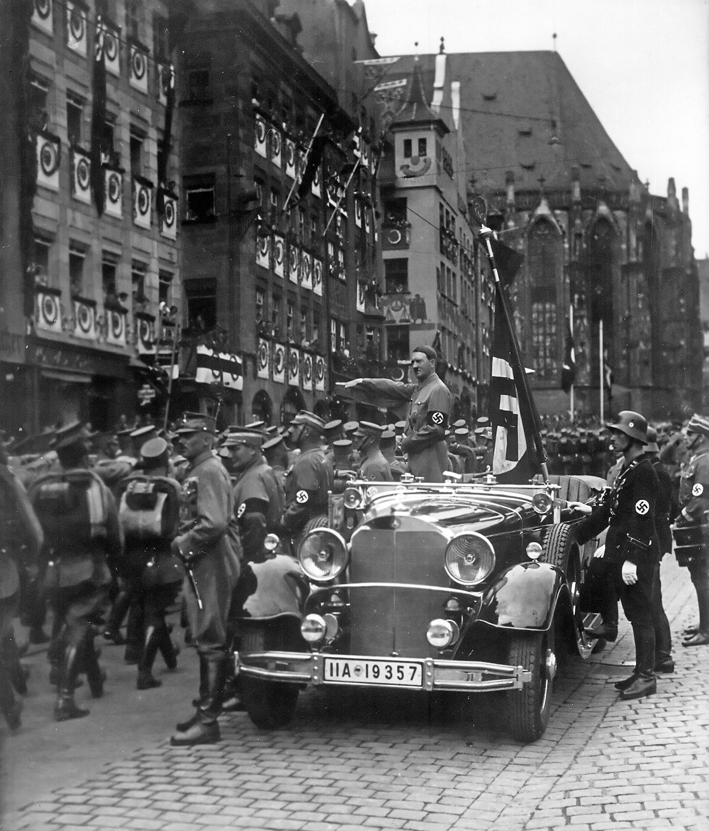
DIRECT INSTRUCTION
US.45
✍ In your workbook · Cornell Notes & Close Read (Act 3–4)
Totalitarian states seized total control of public and private life — Mussolini's Italy, Hitler's Germany, and Stalin's USSR used propaganda, secret police, and terror to crush all opposition.
ZOOM IN
US.45 · DI 3 of 4 · Totalitarianism in Italy, Germany & USSR
U.S. History Hack · TroopToTeacher Technologies LLC · Aligned to TN Academic Standards & TCAP EOC
5

Slide 7
DIRECT INSTRUCTION
US.45
✍ In your workbook · Cornell Notes & Close Read (Act 3–4)
The Great Depression, weak democracies, resentment over the Treaty of Versailles, and fear of communism pushed desperate populations toward radical, authoritarian solutions after WWI.
KEY POINT
The Great Depression, weak democracies, resentment over the Treaty of Versailles, and fear of communism pushed desperate populations toward radical, authoritarian solutions after WWI.
US.45 · DI 4 of 4 · Factors in Its International Spread
U.S. History Hack · TroopToTeacher Technologies LLC · Aligned to TN Academic Standards & TCAP EOC
6

Slide 8
SOURCE IT FIRST
US.45
✍ In your workbook · Primary Source & HIPPO (Act 5)
Read Mussolini’s “The Doctrine of Fascism” — weigh who wrote it and why before you read the words.
WHO
WHEN
WHY
Benito Mussolini
1932
Consider the author's purpose and audience before reading the words.
The Doctrine of Fascism
Benito Mussolini · 1932
"The Fascist State organizes the nation, but leaves a sufficient margin of liberty to the individual; the latter is deprived of all useless and possibly harmful freedom, but retains what is essential; the deciding power in this question cannot be the individual, but the State alone... The Fascist conception of the State is all-embracing; outside of it no human or spiritual values can exist, much less have value."
Internet Archive
U.S. History Hack · TroopToTeacher Technologies LLC · Aligned to TN Academic Standards & TCAP EOC
7

Slide 9
THREE PERSPECTIVES
US.45
✍ In your workbook · Constructed Response (Act 7)
A historian returns to three questions at the end of every reading. Use them to analyze this standard.
Who benefited?
Who bore the costs?
Who decided?
Who gained land, wealth, power, or protection?
Who lost land, labor, freedom, or life — and who was silenced?
Which people, offices, or courts held the authority?
US.45:
US.45:
US.45:
Dictators and their parties who seized total power, and industrialists and elites who backed strongmen to crush labor movements and communism.
Political dissidents, ethnic and religious minorities, and ordinary citizens who lost civil liberties, free press, and eventually their lives under state terror.
Single-party dictatorships that abolished checks on power — Mussolini, Hitler, and Stalin ruling through propaganda, secret police, and force.
Anchor: The Doctrine of Fascism, Benito Mussolini, 1932 (Internet Archive)
U.S. History Hack · TroopToTeacher Technologies LLC · Aligned to TN Academic Standards & TCAP EOC
8

Slide 10
PROGRESS CHECK
✍ In your workbook · Practice Quiz (Act 6)
US.45
Check your understanding
How did economic crisis and political instability enable the rise of totalitarian regimes in Italy, Germany, and the Soviet Union?
A
The Great Depression, post-WWI disappointment, and political chaos created conditions where people accepted radical solutions and strong leaders promising stability
B
Economic prosperity led people to seek stronger government control, although this view has been largely discredited by scholars, which does not align with the documented historical record
C
Totalitarian regimes rose during periods of peace and prosperity, despite the fact that multiple sources contradict this view, which does not align with the documented historical record
D
Democratic governments actively promoted totalitarianism, which does not align with the documented historical record, but the historical evidence paints a more nuanced picture
Confidence: 😟 1 🙂 2 😀 3 — circle where you are; your teacher routes reteach or extension.
U.S. History Hack · TroopToTeacher Technologies LLC · Aligned to TN Academic Standards & TCAP EOC
9

Slide 11
US.46
FDR's Response to World Crises
TN STANDARD
US.46 – Explain President Franklin D. Roosevelt's response to world crises, including: The Quarantine Speech, the Four Freedoms speech, the Atlantic Charter, and the Lend-Lease Act.
I CAN
I can explain President Franklin D. Roosevelt's response to world crises, including the Quarantine Speech, the Four Freedoms speech, the Atlantic Charter, and the Lend-Lease Act.
U.S. History Hack · TroopToTeacher Technologies LLC · Aligned to TN Academic Standards & TCAP EOC
10

Slide 12
KEY VOCABULARY · LANGUAGE SUPPORT
✍ In your workbook · Vocabulary (Act 1–2)
US.46
Words you need before we read
Quarantine Speech
Four Freedoms Speech
Lend-Lease Act (1941)
En español: Discurso de la Cuarentena
En español: Discurso de las Cuatro Libertades
En español: Ley de Préstamo y Arriendo (1941)
WHAT IT MEANS
WHAT IT MEANS
WHAT IT MEANS
FDR's 1937 address proposing that peace-loving nations 'quarantine' aggressor states to halt the spread of international lawlessness.
FDR's 1941 speech defining American war aims: freedom of speech, freedom of worship, freedom from want, and freedom from fear.
U.S. program allowing the President to lend or lease war supplies to any nation deemed vital to American defense, primarily Britain and the Soviet Union.
U.S. History Hack · TroopToTeacher Technologies LLC · Aligned to TN Academic Standards & TCAP EOC
11

Slide 13
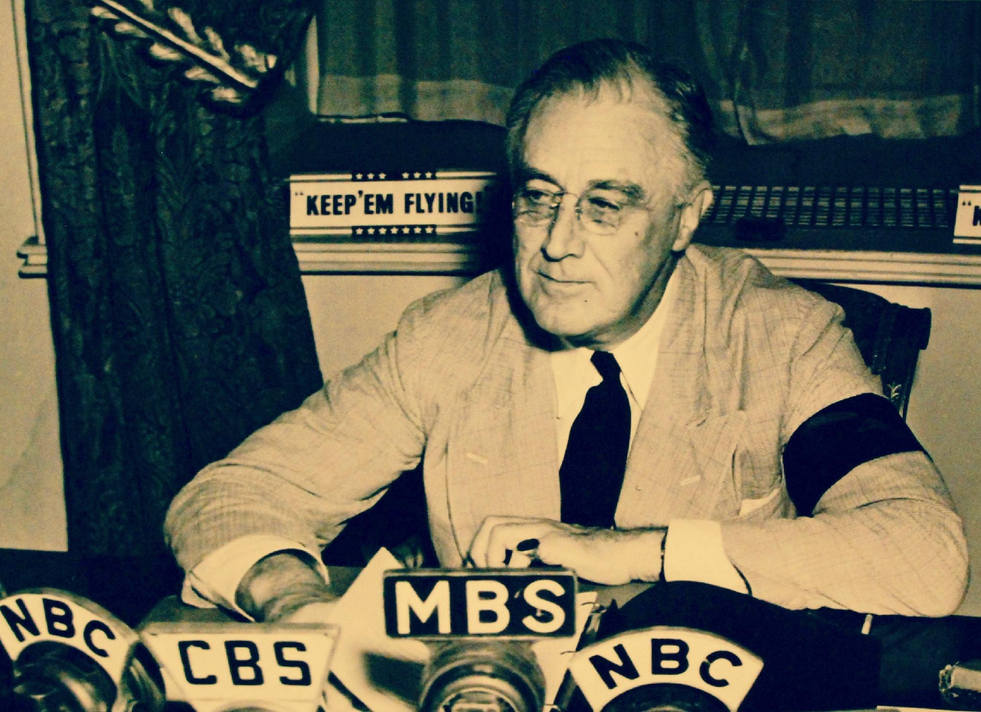
DIRECT INSTRUCTION
US.46
✍ In your workbook · Cornell Notes & Close Read (Act 3–4)
Amid strong isolationism (the Neutrality Acts), FDR's 1937 Quarantine Speech urged democracies to “quarantine” aggressor nations like a disease to stop the spread of war.
ZOOM IN
US.46 · DI 1 of 4 · Quarantine Speech (Oct 5, 1937)
U.S. History Hack · TroopToTeacher Technologies LLC · Aligned to TN Academic Standards & TCAP EOC
12

Slide 14
DIRECT INSTRUCTION
US.46
✍ In your workbook · Cornell Notes & Close Read (Act 3–4)
In January 1941 FDR named four freedoms worth defending everywhere: freedom of speech, freedom of worship, freedom from want, and freedom from fear.
KEY POINT
In January 1941 FDR named four freedoms worth defending everywhere: freedom of speech, freedom of worship, freedom from want, and freedom from fear.
US.46 · DI 2 of 4 · Four Freedoms Speech (Jan 6, 1941)
U.S. History Hack · TroopToTeacher Technologies LLC · Aligned to TN Academic Standards & TCAP EOC
13

Slide 15
DIRECT INSTRUCTION
US.46
✍ In your workbook · Cornell Notes & Close Read (Act 3–4)
Meeting secretly with Churchill off Newfoundland (Aug 1941), FDR set postwar aims: no territorial gains, self-government, and free trade — a blueprint for the Allied cause.
KEY POINT
Meeting secretly with Churchill off Newfoundland (Aug 1941), FDR set postwar aims: no territorial gains, self-government, and free trade — a blueprint for the Allied cause.
US.46 · DI 3 of 4 · Atlantic Charter (Aug 14, 1941)
U.S. History Hack · TroopToTeacher Technologies LLC · Aligned to TN Academic Standards & TCAP EOC
14

Slide 16
DIRECT INSTRUCTION
US.46
✍ In your workbook · Cornell Notes & Close Read (Act 3–4)
The March 1941 Lend-Lease Act let the U.S. supply Britain and the Allies with weapons without immediate payment — making America the “arsenal of democracy” while still officially neutral.
KEY POINT
The March 1941 Lend-Lease Act let the U.S. supply Britain and the Allies with weapons without immediate payment — making America the “arsenal of democracy” while still officially neutral.
US.46 · DI 4 of 4 · Lend-Lease Act (Mar 11, 1941)
U.S. History Hack · TroopToTeacher Technologies LLC · Aligned to TN Academic Standards & TCAP EOC
15

Slide 17
SOURCE IT FIRST
US.46
✍ In your workbook · Primary Source & HIPPO (Act 5)
Read FDR’s Four Freedoms Speech — identify the speaker, date, and purpose before you weigh his words.
WHO
WHEN
WHY
President Franklin D. Roosevelt
January 6, 1941
Consider the author's purpose and audience before reading the words.
The Four Freedoms Speech
President Franklin D. Roosevelt · January 6, 1941
"In the future days, which we seek to make secure, we look forward to a world founded upon four essential human freedoms. The first is freedom of speech and expression—everywhere in the world. The second is freedom of every person to worship God in his own way—everywhere in the world. The third is freedom from want... The fourth is freedom from fear."
National Archives
U.S. History Hack · TroopToTeacher Technologies LLC · Aligned to TN Academic Standards & TCAP EOC
16

Slide 18
THREE PERSPECTIVES
US.46
✍ In your workbook · Constructed Response (Act 7)
A historian returns to three questions at the end of every reading. Use them to analyze this standard.
Who benefited?
Who bore the costs?
Who decided?
Who gained land, wealth, power, or protection?
Who lost land, labor, freedom, or life — and who was silenced?
Which people, offices, or courts held the authority?
US.46:
US.46:
US.46:
Britain and the Allies, kept in the war by American supplies, and U.S. defense industries that expanded under Lend-Lease production.
Isolationists whose influence FDR steadily eroded, and Axis powers whose enemies were now backed by American industrial might.
President Roosevelt, who steered a neutral nation toward the Allies, and Congress, which passed Lend-Lease over isolationist objection.
Anchor: The Four Freedoms Speech, President Franklin D. Roosevelt, January 6, 1941 (National Archives)
U.S. History Hack · TroopToTeacher Technologies LLC · Aligned to TN Academic Standards & TCAP EOC
17

Slide 19
PROGRESS CHECK
✍ In your workbook · Practice Quiz (Act 6)
US.46
Check your understanding
How did the Atlantic Charter establish principles for the post-war international order?
A
It focused only on immediate military strategy, yet the available evidence points to a different conclusion, which contradicts the primary source evidence from this era
B
It established principles including self-determination, free trade, collective security, and disarmament that became the foundation for the United Nations and post-war international law
C
It divided the world into American and British spheres of influence, despite the fact that multiple sources contradict this view, but closer analysis reveals a more complicated historical reality
D
It had no lasting impact on international relations, though this interpretation lacks supporting historical evidence, although historical sources do not support this conclusion
Confidence: 😟 1 🙂 2 😀 3 — circle where you are; your teacher routes reteach or extension.
U.S. History Hack · TroopToTeacher Technologies LLC · Aligned to TN Academic Standards & TCAP EOC
18

Slide 20
US.47
U.S. Response to the Holocaust
TN STANDARD
US.47 – Analyze the response of the U.S. to the plight of European Jews before the start of the war, the U.S. liberation of concentration camps during the war, and the immigration of Holocaust survivors after the war.
I CAN
I can analyze the response of the U.S. to the plight of European Jews before the war, the liberation of concentration camps during the war, and the immigration of Holocaust survivors after the war.
U.S. History Hack · TroopToTeacher Technologies LLC · Aligned to TN Academic Standards & TCAP EOC
19

Slide 21
KEY VOCABULARY · LANGUAGE SUPPORT
✍ In your workbook · Vocabulary (Act 1–2)
US.47
Words you need before we read
Holocaust
Nuremberg Laws (1935)
Adolf Hitler
En español: Holocausto
En español: Leyes de Nuremberg (1935)
En español: Adolf Hitler
WHAT IT MEANS
WHAT IT MEANS
WHAT IT MEANS
Nazi Germany's systematic genocide of 6 million Jews and millions of others (Roma, disabled, homosexuals, political opponents) during World War II.
Nazi racial laws that stripped Jews of German citizenship, banned intermarriage between Jews and non-Jews, and defined "Jewishness" by ancestry. They institutionalized anti-Semitic persecution.
Nazi dictator of Germany (1933-1945) who led Germany into World War II and orchestrated the Holocaust, resulting in the deaths of 6 million Jews and millions of others.
U.S. History Hack · TroopToTeacher Technologies LLC · Aligned to TN Academic Standards & TCAP EOC
20

Slide 22
DIRECT INSTRUCTION
US.47
✍ In your workbook · Cornell Notes & Close Read (Act 3–4)
Before the war, the National Origins Act (1924) quota system sharply limited immigration from where most Jews lived, and the U.S. turned away refugees — famously the ship the St. Louis (1939).
KEY POINT
Before the war, the National Origins Act (1924) quota system sharply limited immigration from where most Jews lived, and the U.S. turned away refugees — famously the ship the St. Louis (1939).
US.47 · DI 1 of 4 · U.S. Response Before the War
U.S. History Hack · TroopToTeacher Technologies LLC · Aligned to TN Academic Standards & TCAP EOC
21

Slide 23
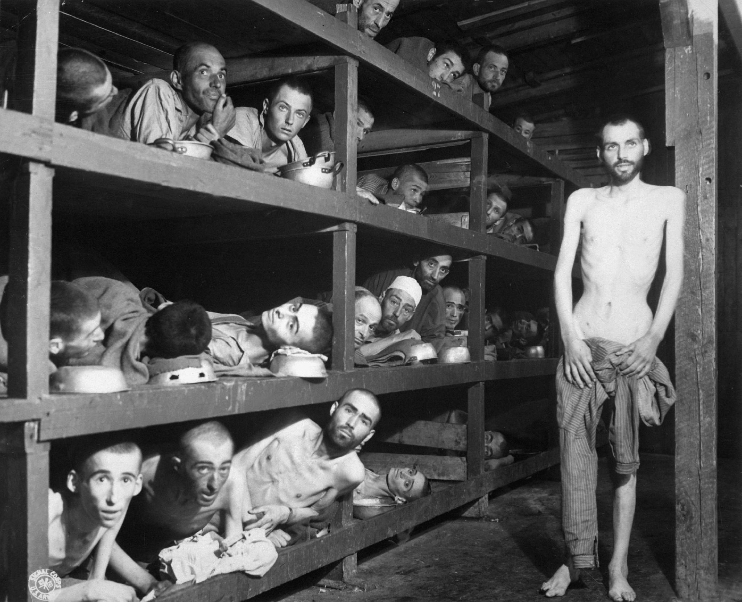
DIRECT INSTRUCTION
US.47
✍ In your workbook · Cornell Notes & Close Read (Act 3–4)
In 1944–45 Allied troops liberated the camps; U.S. forces reached Buchenwald, Dachau, and Mauthausen, finding mass death, disease, and survivors — evidence of the Holocaust's horror.
ZOOM IN
US.47 · DI 2 of 4 · Liberation of the Concentration Camps
U.S. History Hack · TroopToTeacher Technologies LLC · Aligned to TN Academic Standards & TCAP EOC
22

Slide 24
DIRECT INSTRUCTION
US.47
✍ In your workbook · Cornell Notes & Close Read (Act 3–4)
The Displaced Persons Act (1948, expanded 1950) admitted survivors and other displaced persons, though early quotas favored some refugees over Jews.
KEY POINT
The Displaced Persons Act (1948, expanded 1950) admitted survivors and other displaced persons, though early quotas favored some refugees over Jews.
US.47 · DI 3 of 4 · Post-War Immigration of Survivors
U.S. History Hack · TroopToTeacher Technologies LLC · Aligned to TN Academic Standards & TCAP EOC
23

Slide 25
DIRECT INSTRUCTION
US.47
✍ In your workbook · Cornell Notes & Close Read (Act 3–4)
From Kristallnacht (1938) onward, the Holocaust raises lasting questions about the cost of indifference and the responsibility of nations and individuals to intervene.
KEY POINT
From Kristallnacht (1938) onward, the Holocaust raises lasting questions about the cost of indifference and the responsibility of nations and individuals to intervene.
US.47 · DI 4 of 4 · Moral & Ethical Implications
U.S. History Hack · TroopToTeacher Technologies LLC · Aligned to TN Academic Standards & TCAP EOC
24

Slide 26
SOURCE IT FIRST
US.47
✍ In your workbook · Primary Source & HIPPO (Act 5)
Read Elie Wiesel’s testimony of liberation — consider the witness, the moment, and the purpose before you read the account.
WHO
WHEN
WHY
Elie Wiesel
1945 (describing liberation)
Consider the author's purpose and audience before reading the words.
Testimony of Holocaust Survivor
Elie Wiesel · 1945 (describing liberation)
"On April 10, there were still some 20,000 prisoners in the camp, including several hundred children. It was decided to evacuate all of us at once... On April 11, at about six o'clock in the evening, the first American tanks stood at the gates of Buchenwald. Our first act as free men was to throw ourselves onto the provisions. That's all we thought about. Nothing else mattered."
United States Holocaust Memorial Museum
U.S. History Hack · TroopToTeacher Technologies LLC · Aligned to TN Academic Standards & TCAP EOC
25

Slide 27
THREE PERSPECTIVES
US.47
✍ In your workbook · Constructed Response (Act 7)
A historian returns to three questions at the end of every reading. Use them to analyze this standard.
Who benefited?
Who bore the costs?
Who decided?
Who gained land, wealth, power, or protection?
Who lost land, labor, freedom, or life — and who was silenced?
Which people, offices, or courts held the authority?
US.47:
US.47:
US.47:
Survivors eventually admitted after the war, and postwar human-rights and refugee efforts that grew from the world’s reckoning with the Holocaust.
Six million murdered European Jews and millions of other victims, and refugees turned away by restrictive prewar immigration quotas.
Nazi Germany, which carried out genocide; and the U.S. government, whose immigration quotas and wartime priorities shaped a limited response.
Anchor: Testimony of Holocaust Survivor, Elie Wiesel, 1945 (describing liberation) (United States Holocaust Memorial Museum)
U.S. History Hack · TroopToTeacher Technologies LLC · Aligned to TN Academic Standards & TCAP EOC
26

Slide 28
PROGRESS CHECK
✍ In your workbook · Practice Quiz (Act 6)
US.47
Check your understanding
How did U.S. immigration restrictions and public attitudes limit American response to Jewish refugees before WWII?
A
The U.S. welcomed all Jewish refugees without restriction, which ignores key developments that shaped the outcome, but closer analysis reveals a more complicated historical reality
B
Only economic factors affected refugee policy, which does not reflect the consensus among historians and fails to account for key developments in the broader context
C
The National Origins Act quotas, consular obstruction, anti-Semitism, isolationism, and economic fears during the Depression combined to severely limit Jewish immigration
D
The U.S. had no immigration restrictions in the 1930s, but this oversimplifies the complex factors at work, although historical sources do not support this conclusion
Confidence: 😟 1 🙂 2 😀 3 — circle where you are; your teacher routes reteach or extension.
U.S. History Hack · TroopToTeacher Technologies LLC · Aligned to TN Academic Standards & TCAP EOC
27

Slide 29
US.48
American Entry into World War II
TN STANDARD
US.48 – Explain the reasons for American entry into World War II, including the attack on Pearl Harbor.
I CAN
I can explain the reasons for American entry into World War II, including the attack on Pearl Harbor.
U.S. History Hack · TroopToTeacher Technologies LLC · Aligned to TN Academic Standards & TCAP EOC
28

Slide 30
KEY VOCABULARY · LANGUAGE SUPPORT
✍ In your workbook · Vocabulary (Act 1–2)
US.48
Words you need before we read
Pearl Harbor
Hideki Tojo
Axis Powers
En español: Pearl Harbor
En español: Hideki Tojo
En español: Potencias del Eje
WHAT IT MEANS
WHAT IT MEANS
WHAT IT MEANS
Japan's surprise attack on the U.S. naval base in Hawaii on December 7, 1941, killing over 2,400 Americans and bringing the United States into World War II.
Japanese military leader and Prime Minister (1941-1944) who led Japan into World War II and authorized the attack on Pearl Harbor.
Military alliance of Germany, Italy, and Japan during World War II. United by shared goals of territorial expansion, militarism, and opposition to democratic nations.
U.S. History Hack · TroopToTeacher Technologies LLC · Aligned to TN Academic Standards & TCAP EOC
29

Slide 31
DIRECT INSTRUCTION
US.48
✍ In your workbook · Cornell Notes & Close Read (Act 3–4)
German U-boats attacked U.S. ships carrying Lend-Lease supplies, pulling America into an undeclared naval war in the Atlantic before formal entry.
KEY POINT
German U-boats attacked U.S. ships carrying Lend-Lease supplies, pulling America into an undeclared naval war in the Atlantic before formal entry.
US.48 · DI 1 of 4 · Factors in the European Theater
U.S. History Hack · TroopToTeacher Technologies LLC · Aligned to TN Academic Standards & TCAP EOC
30

Slide 32
DIRECT INSTRUCTION
US.48
✍ In your workbook · Cornell Notes & Close Read (Act 3–4)
As Japan conquered China and Southeast Asia, the U.S. answered with economic sanctions — including an oil embargo — raising tensions toward war in the Pacific.
KEY POINT
As Japan conquered China and Southeast Asia, the U.S. answered with economic sanctions — including an oil embargo — raising tensions toward war in the Pacific.
US.48 · DI 2 of 4 · Factors in the Pacific Theater
U.S. History Hack · TroopToTeacher Technologies LLC · Aligned to TN Academic Standards & TCAP EOC
31

Slide 33
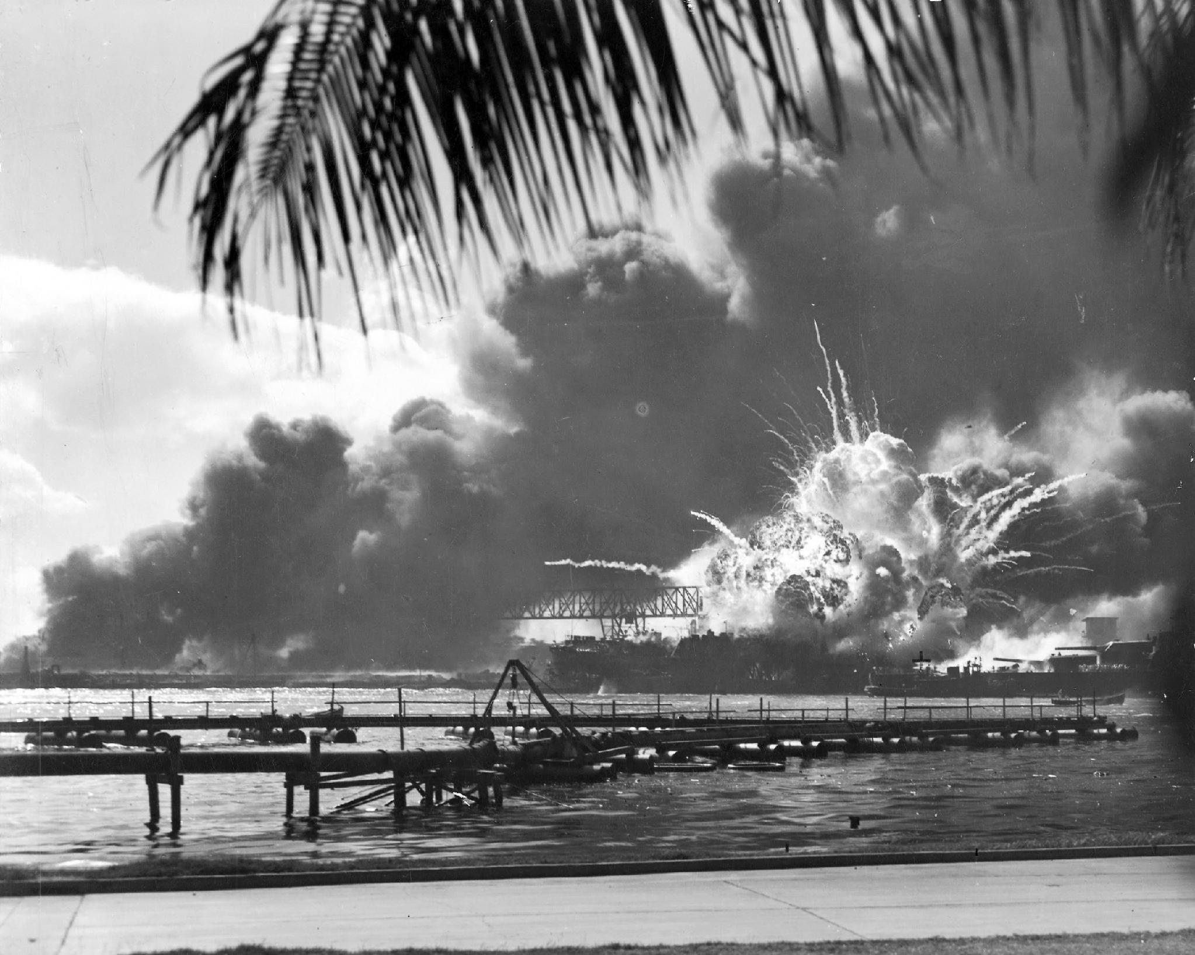
DIRECT INSTRUCTION
US.48
✍ In your workbook · Cornell Notes & Close Read (Act 3–4)
On December 7, 1941, six Japanese carriers launched 353 planes against the U.S. Pacific Fleet at Pearl Harbor; FDR called it “a date which will live in infamy” and the U.S. declared war.
ZOOM IN
US.48 · DI 3 of 4 · Attack on Pearl Harbor (Dec 7, 1941)
U.S. History Hack · TroopToTeacher Technologies LLC · Aligned to TN Academic Standards & TCAP EOC
32

Slide 34
DIRECT INSTRUCTION
US.48
✍ In your workbook · Cornell Notes & Close Read (Act 3–4)
Pearl Harbor ended isolationism and unified the nation; Germany and Italy declared war on Dec 11, making it a true world war and bringing U.S. industry to the Allies.
KEY POINT
Pearl Harbor ended isolationism and unified the nation; Germany and Italy declared war on Dec 11, making it a true world war and bringing U.S. industry to the Allies.
US.48 · DI 4 of 4 · Consequences of American Entry
U.S. History Hack · TroopToTeacher Technologies LLC · Aligned to TN Academic Standards & TCAP EOC
33

Slide 35
SOURCE IT FIRST
US.48
✍ In your workbook · Primary Source & HIPPO (Act 5)
Read FDR’s “Day of Infamy” Speech — note the speaker, date, and purpose before you read his words.
WHO
WHEN
WHY
President Franklin D. Roosevelt
December 8, 1941
Consider the author's purpose and audience before reading the words.
Day of Infamy Speech
President Franklin D. Roosevelt · December 8, 1941
"Yesterday, December 7th, 1941—a date which will live in infamy—the United States of America was suddenly and deliberately attacked by naval and air forces of the Empire of Japan. The United States was at peace with that nation and, at the solicitation of Japan, was still in conversation with its government and its Emperor looking toward the maintenance of peace in the Pacific."
National Archives
U.S. History Hack · TroopToTeacher Technologies LLC · Aligned to TN Academic Standards & TCAP EOC
34

Slide 36
THREE PERSPECTIVES
US.48
✍ In your workbook · Constructed Response (Act 7)
A historian returns to three questions at the end of every reading. Use them to analyze this standard.
Who benefited?
Who bore the costs?
Who decided?
Who gained land, wealth, power, or protection?
Who lost land, labor, freedom, or life — and who was silenced?
Which people, offices, or courts held the authority?
US.48:
US.48:
US.48:
The Allied cause, joined by America’s full industrial and military power, and interventionists whose warnings were vindicated by the attack.
The 2,400 killed at Pearl Harbor, the sailors and civilians of the Pacific Fleet, and the millions of Americans soon sent to war.
Japan’s military leaders, who ordered the attack; and President Roosevelt and Congress, who declared war the next day.
Anchor: Day of Infamy Speech, President Franklin D. Roosevelt, December 8, 1941 (National Archives)
U.S. History Hack · TroopToTeacher Technologies LLC · Aligned to TN Academic Standards & TCAP EOC
35

Slide 37
PROGRESS CHECK
✍ In your workbook · Practice Quiz (Act 6)
US.48
Check your understanding
How did the Pearl Harbor attack unite American public opinion and end isolationism?
A
Public opinion remained divided after Pearl Harbor, which contradicts the primary source evidence from this era, but the historical evidence paints a more nuanced picture
B
Isolationism continued throughout the war, but the historical record tells a more complex story and oversimplifies the complex factors at work during this period
C
Pearl Harbor had no effect on public opinion, but the historical record tells a more complex story and oversimplifies the complex factors at work during this period
D
The surprise attack shocked Americans, Roosevelt's "Date of Infamy" speech galvanized the nation, and Congress declared war with only one dissenting vote, destroying isolationist opposition
Confidence: 😟 1 🙂 2 😀 3 — circle where you are; your teacher routes reteach or extension.
U.S. History Hack · TroopToTeacher Technologies LLC · Aligned to TN Academic Standards & TCAP EOC
36

Slide 38
US.49
WWII Leaders & Key Figures
TN STANDARD
US.49 – Identify the roles and the significant actions of the following individuals in World War II: Winston Churchill, Dwight D. Eisenhower, Adolf Hitler, Douglas MacArthur, George C. Marshall, Benito Mussolini, President Franklin D. Roosevelt, Joseph Stalin, Hideki Tojo, President Harry S. Truman.
I CAN
I can identify the roles and the significant actions of key individuals in World War II, including Churchill, Eisenhower, Hitler, MacArthur, Marshall, Mussolini, FDR, Stalin, Tojo, and Truman.
U.S. History Hack · TroopToTeacher Technologies LLC · Aligned to TN Academic Standards & TCAP EOC
37

Slide 39
KEY VOCABULARY · LANGUAGE SUPPORT
✍ In your workbook · Vocabulary (Act 1–2)
US.49
Words you need before we read
Dwight D. Eisenhower
Adolf Hitler
Joseph Stalin
En español: Dwight D. Eisenhower
En español: Adolf Hitler
En español: Joseph Stalin
WHAT IT MEANS
WHAT IT MEANS
WHAT IT MEANS
Supreme Commander of Allied Forces in Europe who planned and led the D-Day invasion and coordinated Allied victory in Europe. Later became 34th President.
Nazi dictator of Germany (1933-1945) who led Germany into World War II and orchestrated the Holocaust, resulting in the deaths of 6 million Jews and millions of others.
Communist dictator of the Soviet Union (1924-1953) who ruled through terror, forced collectivization, and purges, resulting in millions of deaths.
U.S. History Hack · TroopToTeacher Technologies LLC · Aligned to TN Academic Standards & TCAP EOC
38

Slide 40
DIRECT INSTRUCTION
US.49
✍ In your workbook · Cornell Notes & Close Read (Act 3–4)
Allied political leaders — FDR (U.S.), Churchill (Britain), and Stalin (USSR) — formed the “Big Three” who set strategy and planned the postwar world.
KEY POINT
Allied political leaders — FDR (U.S.), Churchill (Britain), and Stalin (USSR) — formed the “Big Three” who set strategy and planned the postwar world.
US.49 · DI 1 of 4 · Allied Political Leaders
U.S. History Hack · TroopToTeacher Technologies LLC · Aligned to TN Academic Standards & TCAP EOC
39

Slide 41
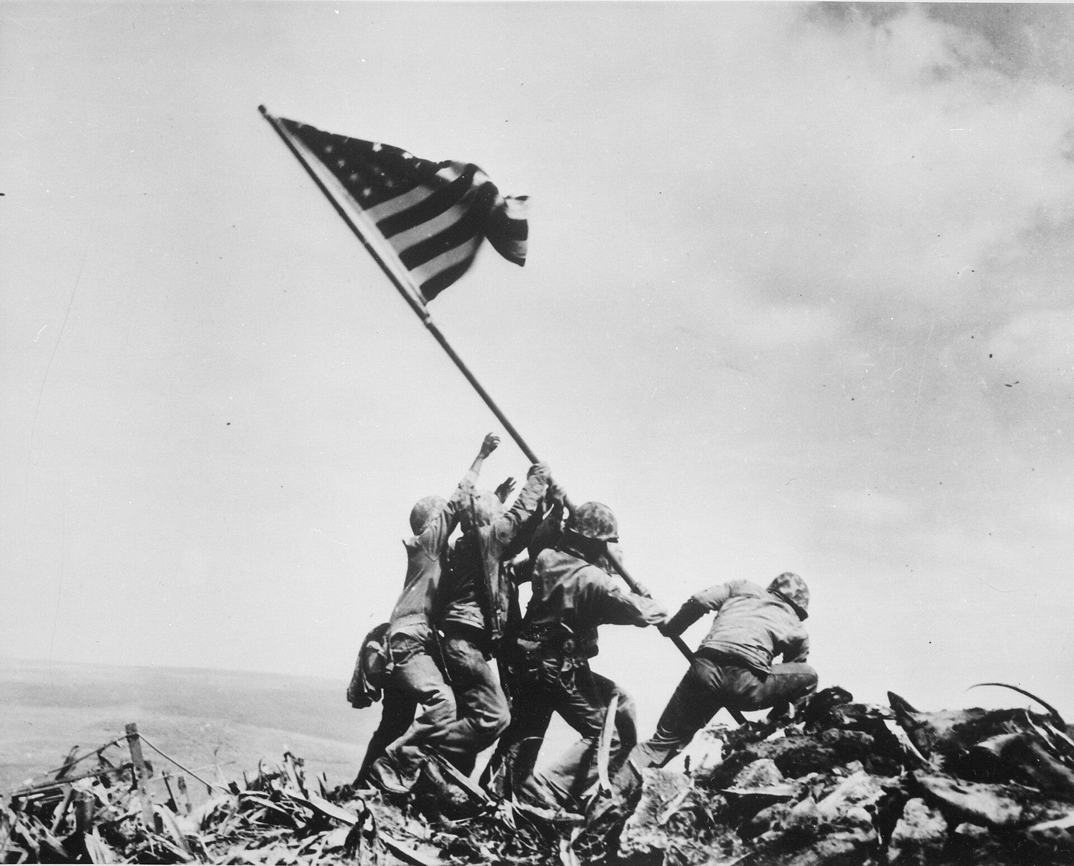
DIRECT INSTRUCTION
US.49
✍ In your workbook · Cornell Notes & Close Read (Act 3–4)
Allied commanders included Dwight D. Eisenhower, Supreme Allied Commander in Europe (D-Day), and Douglas MacArthur and George Patton, who led major campaigns.
ZOOM IN
US.49 · DI 2 of 4 · Allied Military Leaders
U.S. History Hack · TroopToTeacher Technologies LLC · Aligned to TN Academic Standards & TCAP EOC
40

Slide 42
DIRECT INSTRUCTION
US.49
✍ In your workbook · Cornell Notes & Close Read (Act 3–4)
Axis leaders — Hitler (Germany), Mussolini (Italy), and Tojo (Japan) — ruled as dictators, launching aggression and, in Hitler's case, the Holocaust.
KEY POINT
Axis leaders — Hitler (Germany), Mussolini (Italy), and Tojo (Japan) — ruled as dictators, launching aggression and, in Hitler's case, the Holocaust.
US.49 · DI 3 of 4 · Axis Leaders
U.S. History Hack · TroopToTeacher Technologies LLC · Aligned to TN Academic Standards & TCAP EOC
41

Slide 43
DIRECT INSTRUCTION
US.49
✍ In your workbook · Cornell Notes & Close Read (Act 3–4)
Allied leaders mostly headed democracies and managed coalitions; Axis leaders ruled as totalitarian dictators — a contrast in how power was held and used.
KEY POINT
Allied leaders mostly headed democracies and managed coalitions; Axis leaders ruled as totalitarian dictators — a contrast in how power was held and used.
US.49 · DI 4 of 4 · Comparing Leadership Approaches
U.S. History Hack · TroopToTeacher Technologies LLC · Aligned to TN Academic Standards & TCAP EOC
42

Slide 44
SOURCE IT FIRST
US.49
✍ In your workbook · Primary Source & HIPPO (Act 5)
Read Churchill’s “We Shall Fight on the Beaches” Speech — weigh the speaker, moment, and audience before you read the words.
WHO
WHEN
WHY
Winston Churchill
June 4, 1940
Consider the author's purpose and audience before reading the words.
We Shall Fight on the Beaches Speech
Winston Churchill · June 4, 1940
"We shall fight on the beaches, we shall fight on the landing grounds, we shall fight in the fields and in the streets, we shall fight in the hills; we shall never surrender, and even if, which I do not for a moment believe, this Island or a large part of it were subjugated and starving, then our Empire beyond the seas... would carry on the struggle."
International Churchill Society
U.S. History Hack · TroopToTeacher Technologies LLC · Aligned to TN Academic Standards & TCAP EOC
43

Slide 45
THREE PERSPECTIVES
US.49
✍ In your workbook · Constructed Response (Act 7)
A historian returns to three questions at the end of every reading. Use them to analyze this standard.
Who benefited?
Who bore the costs?
Who decided?
Who gained land, wealth, power, or protection?
Who lost land, labor, freedom, or life — and who was silenced?
Which people, offices, or courts held the authority?
US.49:
US.49:
US.49:
The Allied nations and their peoples, freed from Axis conquest, and leaders like Churchill and Eisenhower whose reputations were cemented by victory.
The tens of millions of soldiers and civilians killed worldwide, and the populations subjected to Axis occupation and total war.
The Allied and Axis heads of state and their top commanders, whose strategic decisions directed the movements of entire armies.
Anchor: We Shall Fight on the Beaches Speech, Winston Churchill, June 4, 1940 (International Churchill Society)
U.S. History Hack · TroopToTeacher Technologies LLC · Aligned to TN Academic Standards & TCAP EOC
44

Slide 46
PROGRESS CHECK
✍ In your workbook · Practice Quiz (Act 6)
US.49
Check your understanding
How did Allied leaders like Roosevelt, Churchill, and Stalin coordinate their war efforts despite different goals?
A
Through conferences at Tehran and Yalta, the "Europe First" strategy, and division of responsibilities, they maintained cooperation despite tensions over post-war Europe and different ideological systems
B
They never coordinated their efforts, which does not align with the documented historical record and oversimplifies the complex factors at work during this period despite the fact that multiple contemporary sources contradict this
C
Stalin made all decisions for the alliance, though this interpretation lacks supporting historical evidence, although this overlooks critical economic and social factors involved
D
They fought completely separate wars, although historical sources do not support this conclusion and oversimplifies the complex factors at work during this period when examined alongside the available primary and secondary sources
Confidence: 😟 1 🙂 2 😀 3 — circle where you are; your teacher routes reteach or extension.
U.S. History Hack · TroopToTeacher Technologies LLC · Aligned to TN Academic Standards & TCAP EOC
45

Slide 47
US.50
Major WWII Battles: Midway, Iwo Jima, Okinawa & D-Day
TN STANDARD
US.50 – Explain the role of geographic and military factors on the outcomes of battles in the Pacific and European theaters of war, including the Battles of Midway, Iwo Jima, Okinawa, and D-Day.
I CAN
I can explain the role of geographic and military factors on the outcomes of battles in the Pacific and European theaters, including Midway, Iwo Jima, Okinawa, and D-Day.
U.S. History Hack · TroopToTeacher Technologies LLC · Aligned to TN Academic Standards & TCAP EOC
46

Slide 48
KEY VOCABULARY · LANGUAGE SUPPORT
✍ In your workbook · Vocabulary (Act 1–2)
US.50
Words you need before we read
D-Day (Normandy Invasion)
Battle of Midway
Battle of Iwo Jima
En español: Día D (Invasión de Normandía)
En español: Batalla de Midway
En español: Batalla de Iwo Jima
WHAT IT MEANS
WHAT IT MEANS
WHAT IT MEANS
June 6, 1944 Allied invasion of Nazi-occupied France across the beaches of Normandy, the largest amphibious assault in history, turning point of the war in Europe.
June 1942 decisive U.S. naval victory that stopped Japanese expansion in the Pacific and marked the turning point of the Pacific War.
February-March 1945 brutal battle for a strategic Pacific island, famous for the iconic flag-raising photograph on Mount Suribachi.
U.S. History Hack · TroopToTeacher Technologies LLC · Aligned to TN Academic Standards & TCAP EOC
47

Slide 49
DIRECT INSTRUCTION
US.50
✍ In your workbook · Cornell Notes & Close Read (Act 3–4)
At Midway (June 1942), U.S. codebreakers set an ambush that sank four Japanese carriers — the turning point that shifted the Pacific to the Allies.
KEY POINT
At Midway (June 1942), U.S. codebreakers set an ambush that sank four Japanese carriers — the turning point that shifted the Pacific to the Allies.
US.50 · DI 1 of 4 · Battle of Midway (June 1942)
U.S. History Hack · TroopToTeacher Technologies LLC · Aligned to TN Academic Standards & TCAP EOC
48

Slide 50
DIRECT INSTRUCTION
US.50
✍ In your workbook · Cornell Notes & Close Read (Act 3–4)
Iwo Jima (Feb–Mar 1945) was a costly fight for airfields U.S. bombers needed; its tunnels and defenders made it one of the war's bloodiest battles.
ZOOM IN
US.50 · DI 2 of 4 · Battle of Iwo Jima (Feb–Mar 1945)
U.S. History Hack · TroopToTeacher Technologies LLC · Aligned to TN Academic Standards & TCAP EOC
49

Slide 51
DIRECT INSTRUCTION
US.50
✍ In your workbook · Cornell Notes & Close Read (Act 3–4)
Okinawa (Apr–Jun 1945), just 340 miles from Japan, was the bloodiest Pacific campaign — its scale foreshadowed how deadly invading the home islands would be.
KEY POINT
Okinawa (Apr–Jun 1945), just 340 miles from Japan, was the bloodiest Pacific campaign — its scale foreshadowed how deadly invading the home islands would be.
US.50 · DI 3 of 4 · Battle of Okinawa (Apr–Jun 1945)
U.S. History Hack · TroopToTeacher Technologies LLC · Aligned to TN Academic Standards & TCAP EOC
50

Slide 52
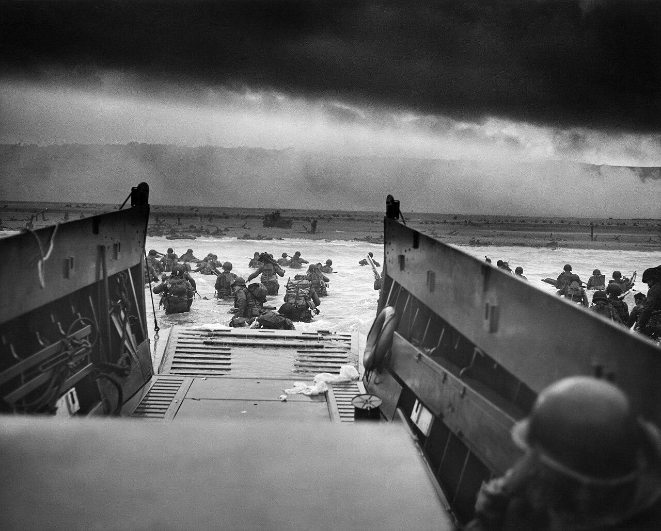
DIRECT INSTRUCTION
US.50
✍ In your workbook · Cornell Notes & Close Read (Act 3–4)
On D-Day (June 6, 1944) Allied forces landed at Normandy, opening the Western Front in Europe and beginning the drive toward Germany.
ZOOM IN
US.50 · DI 4 of 4 · D-Day: Normandy Invasion (June 6, 1944)
U.S. History Hack · TroopToTeacher Technologies LLC · Aligned to TN Academic Standards & TCAP EOC
51

Slide 53
SOURCE IT FIRST
US.50
✍ In your workbook · Primary Source & HIPPO (Act 5)
Read Eisenhower’s D-Day Order of the Day — identify the author, date, and purpose before you analyze the source.
WHO
WHEN
WHY
General Dwight D. Eisenhower
June 6, 1944
Consider the author's purpose and audience before reading the words.
Order of the Day - D-Day
General Dwight D. Eisenhower · June 6, 1944
"Soldiers, Sailors, and Airmen of the Allied Expeditionary Force! You are about to embark upon the Great Crusade, toward which we have striven these many months. The eyes of the world are upon you. The hope and prayers of liberty-loving people everywhere march with you... The tide has turned! The free men of the world are marching together to Victory!"
National Archives
U.S. History Hack · TroopToTeacher Technologies LLC · Aligned to TN Academic Standards & TCAP EOC
52

Slide 54
THREE PERSPECTIVES
US.50
✍ In your workbook · Constructed Response (Act 7)
A historian returns to three questions at the end of every reading. Use them to analyze this standard.
Who benefited?
Who bore the costs?
Who decided?
Who gained land, wealth, power, or protection?
Who lost land, labor, freedom, or life — and who was silenced?
Which people, offices, or courts held the authority?
US.50:
US.50:
US.50:
The Allied cause and liberated peoples of Europe and the Pacific, as each victory brought the defeat of the Axis closer.
The soldiers killed and wounded storming beaches and islands, and civilians caught in some of the deadliest battles of the war.
Allied commanders like Eisenhower and Nimitz, who chose where and when to strike based on geographic and strategic advantage.
Anchor: Order of the Day - D-Day, General Dwight D. Eisenhower, June 6, 1944 (National Archives)
U.S. History Hack · TroopToTeacher Technologies LLC · Aligned to TN Academic Standards & TCAP EOC
53

Slide 55
PROGRESS CHECK
✍ In your workbook · Practice Quiz (Act 6)
US.50
Check your understanding
How did geographic features of the Pacific islands affect American military strategy in battles like Midway and Iwo Jima?
A
Geography had no effect on Pacific strategy, though this interpretation lacks supporting historical evidence, although historical sources do not support this conclusion
B
Midway's central location made it strategically vital, while Iwo Jima's volcanic terrain created natural fortifications requiring costly direct assault to secure airfields needed for bombing Japan
C
All Pacific islands were geographically identical, which does not reflect the consensus among historians, but the historical evidence paints a more nuanced picture and does not reflect the scholarly consensus on this topic
D
American forces avoided geographic challenges entirely, which does not align with the documented historical record, and this view has been largely revised by modern historical research
Confidence: 😟 1 🙂 2 😀 3 — circle where you are; your teacher routes reteach or extension.
U.S. History Hack · TroopToTeacher Technologies LLC · Aligned to TN Academic Standards & TCAP EOC
54

Slide 56
US.51
Special Fighting Forces in WWII
TN STANDARD
US.51 – Identify the roles and sacrifices of individual American soldiers, as well as the unique contributions of special fighting forces such as the Tuskegee Airmen, the 442nd Regimental Combat team, the 101st Airborne, and the Navajo Code Talkers.
I CAN
I can identify the roles and sacrifices of individual American soldiers and the unique contributions of special fighting forces such as the Tuskegee Airmen, the 442nd Regimental Combat Team, the 101st Airborne, and the Navajo Code Talkers.
U.S. History Hack · TroopToTeacher Technologies LLC · Aligned to TN Academic Standards & TCAP EOC
55

Slide 57
KEY VOCABULARY · LANGUAGE SUPPORT
✍ In your workbook · Vocabulary (Act 1–2)
US.51
Words you need before we read
Tuskegee Airmen
442nd Regimental Combat Team
Navajo Code Talkers
En español: Aviadores de Tuskegee
En español: 442º Equipo de Combate Regimental
En español: Descifradores de Código Navajo
WHAT IT MEANS
WHAT IT MEANS
WHAT IT MEANS
First African American military pilots who fought in World War II, proving their skill despite facing racial discrimination and segregation.
All Japanese-American unit that became the most decorated unit in U.S. military history, fighting in Europe while their families were interned at home.
Navajo Marines who used their native language to create an unbreakable code for military communications in the Pacific theater.
U.S. History Hack · TroopToTeacher Technologies LLC · Aligned to TN Academic Standards & TCAP EOC
56

Slide 58
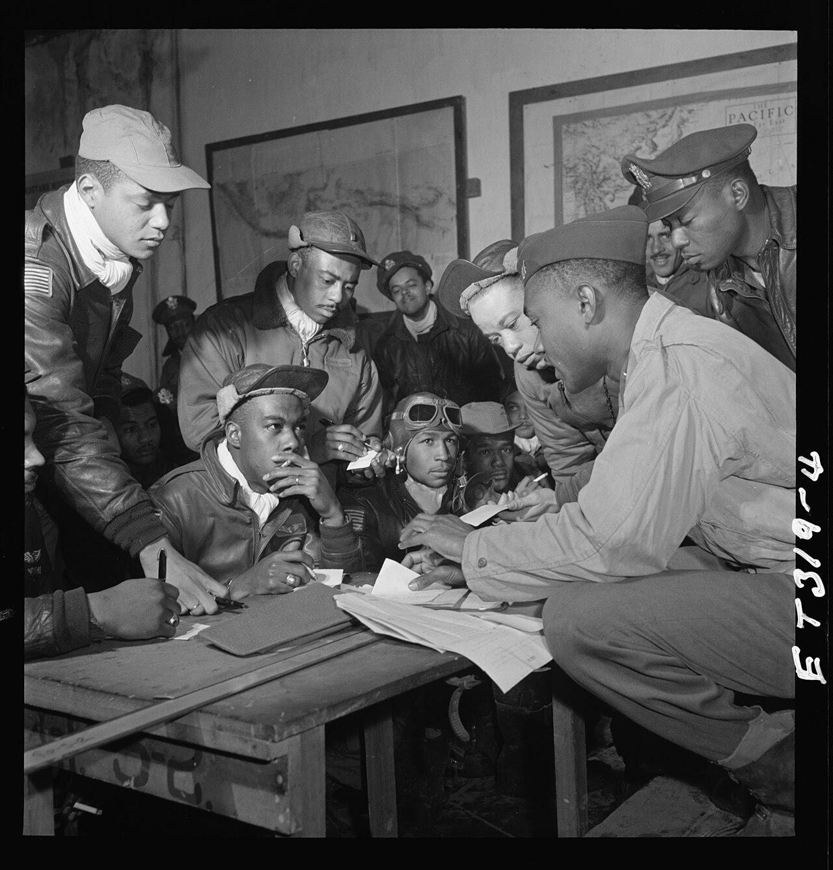
DIRECT INSTRUCTION
US.51
✍ In your workbook · Cornell Notes & Close Read (Act 3–4)
The Tuskegee Airmen were the first African American military aviators, trained in Alabama; their bomber-escort record proved Black pilots' skill and courage.
ZOOM IN
US.51 · DI 1 of 5 · Tuskegee Airmen
U.S. History Hack · TroopToTeacher Technologies LLC · Aligned to TN Academic Standards & TCAP EOC
57

Slide 59
DIRECT INSTRUCTION
US.51
✍ In your workbook · Cornell Notes & Close Read (Act 3–4)
The 442nd Regimental Combat Team, mostly Japanese American volunteers (many with families in internment camps), became the most decorated unit of its size in U.S. history.
KEY POINT
The 442nd Regimental Combat Team, mostly Japanese American volunteers (many with families in internment camps), became the most decorated unit of its size in U.S. history.
US.51 · DI 2 of 5 · 442nd Regimental Combat Team
U.S. History Hack · TroopToTeacher Technologies LLC · Aligned to TN Academic Standards & TCAP EOC
58

Slide 60
DIRECT INSTRUCTION
US.51
✍ In your workbook · Cornell Notes & Close Read (Act 3–4)
The “Screaming Eagles” of the 101st Airborne parachuted into Normandy on D-Day, securing bridges and crossroads behind enemy lines.
KEY POINT
The “Screaming Eagles” of the 101st Airborne parachuted into Normandy on D-Day, securing bridges and crossroads behind enemy lines.
US.51 · DI 3 of 5 · 101st Airborne Division
U.S. History Hack · TroopToTeacher Technologies LLC · Aligned to TN Academic Standards & TCAP EOC
59

Slide 61
DIRECT INSTRUCTION
US.51
✍ In your workbook · Cornell Notes & Close Read (Act 3–4)
Navajo Code Talkers built an unbreakable code from their native language — unknown outside their nation — that protected U.S. communications in the Pacific.
KEY POINT
Navajo Code Talkers built an unbreakable code from their native language — unknown outside their nation — that protected U.S. communications in the Pacific.
US.51 · DI 4 of 5 · Navajo Code Talkers
U.S. History Hack · TroopToTeacher Technologies LLC · Aligned to TN Academic Standards & TCAP EOC
60

Slide 62
DIRECT INSTRUCTION
US.51
✍ In your workbook · Cornell Notes & Close Read (Act 3–4)
These units showed extraordinary courage while often fighting two wars — against foreign enemies and against discrimination at home — advancing the push for civil rights.
KEY POINT
These units showed extraordinary courage while often fighting two wars — against foreign enemies and against discrimination at home — advancing the push for civil rights.
US.51 · DI 5 of 5 · Individual Sacrifice & Legacy
U.S. History Hack · TroopToTeacher Technologies LLC · Aligned to TN Academic Standards & TCAP EOC
61

Slide 63
SOURCE IT FIRST
US.51
✍ In your workbook · Primary Source & HIPPO (Act 5)
Read the Tuskegee Airmen Commendation — consider who issued it and why before you weigh its words.
WHO
WHEN
WHY
U.S. Army Air Forces
1945
Consider the author's purpose and audience before reading the words.
Tuskegee Airmen Commendation
U.S. Army Air Forces · 1945
"The 332nd Fighter Group has established an outstanding record by continuously outstanding performance of duty... Your formation has not lost a single bomber to enemy fighters. The determination, technique, and courage shown by your group in engaging enemy aircraft has been outstanding."
National Archives
U.S. History Hack · TroopToTeacher Technologies LLC · Aligned to TN Academic Standards & TCAP EOC
62

Slide 64
THREE PERSPECTIVES
US.51
✍ In your workbook · Constructed Response (Act 7)
A historian returns to three questions at the end of every reading. Use them to analyze this standard.
Who benefited?
Who bore the costs?
Who decided?
Who gained land, wealth, power, or protection?
Who lost land, labor, freedom, or life — and who was silenced?
Which people, offices, or courts held the authority?
US.51:
US.51:
US.51:
The Allied war effort, strengthened by these forces’ skill, and the later civil-rights cause, which drew on their proven service and sacrifice.
Soldiers of color who fought and died while facing discrimination, and Japanese American troops whose families were interned at home.
The War Department and military commanders who deployed these units, and the soldiers themselves who volunteered despite injustice.
Anchor: Tuskegee Airmen Commendation, U.S. Army Air Forces, 1945 (National Archives)
U.S. History Hack · TroopToTeacher Technologies LLC · Aligned to TN Academic Standards & TCAP EOC
63

Slide 65
PROGRESS CHECK
✍ In your workbook · Practice Quiz (Act 6)
US.51
Check your understanding
Why is the service of the 442nd Regimental Combat Team particularly significant given the internment of Japanese Americans?
A
Their service had no connection to internment policies, but the historical record tells a more complex story, and this view has been largely revised by modern historical research
B
The 442nd was composed of non-Japanese American soldiers, but this fails to account for the broader historical context, but the historical evidence paints a more nuanced picture
C
Japanese American soldiers volunteered to fight for a country that imprisoned their families, becoming the most decorated unit of their size while proving their loyalty despite profound injustice
D
They served only in the Pacific theater, but this fails to account for the broader historical context and does not reflect the scholarly consensus on this topic, which contradicts the primary source evidence from this era
Confidence: 😟 1 🙂 2 😀 3 — circle where you are; your teacher routes reteach or extension.
U.S. History Hack · TroopToTeacher Technologies LLC · Aligned to TN Academic Standards & TCAP EOC
64

Slide 66
US.52
Women in World War II
TN STANDARD
US.52 – Examine and explain the entry of large numbers of women into the workforce and armed forces during World War II and the subsequent impact on American society.
I CAN
I can examine and explain the entry of large numbers of women into the workforce and armed forces during World War II and the subsequent impact on American society.
U.S. History Hack · TroopToTeacher Technologies LLC · Aligned to TN Academic Standards & TCAP EOC
65

Slide 67
KEY VOCABULARY · LANGUAGE SUPPORT
✍ In your workbook · Vocabulary (Act 1–2)
US.52
Words you need before we read
Rosie the Riveter
Tuskegee Airmen
Rationing
En español: Rosie la Remachadora
En español: Aviadores de Tuskegee
En español: Racionamiento
WHAT IT MEANS
WHAT IT MEANS
WHAT IT MEANS
Cultural icon representing millions of American women who worked in factories and shipyards during World War II, filling jobs left by men who went to war.
First African American military pilots who fought in World War II, proving their skill despite facing racial discrimination and segregation.
Government-controlled limits on consumer goods during WWII to ensure adequate supplies for the military, requiring ration books and coupons.
U.S. History Hack · TroopToTeacher Technologies LLC · Aligned to TN Academic Standards & TCAP EOC
66

Slide 68
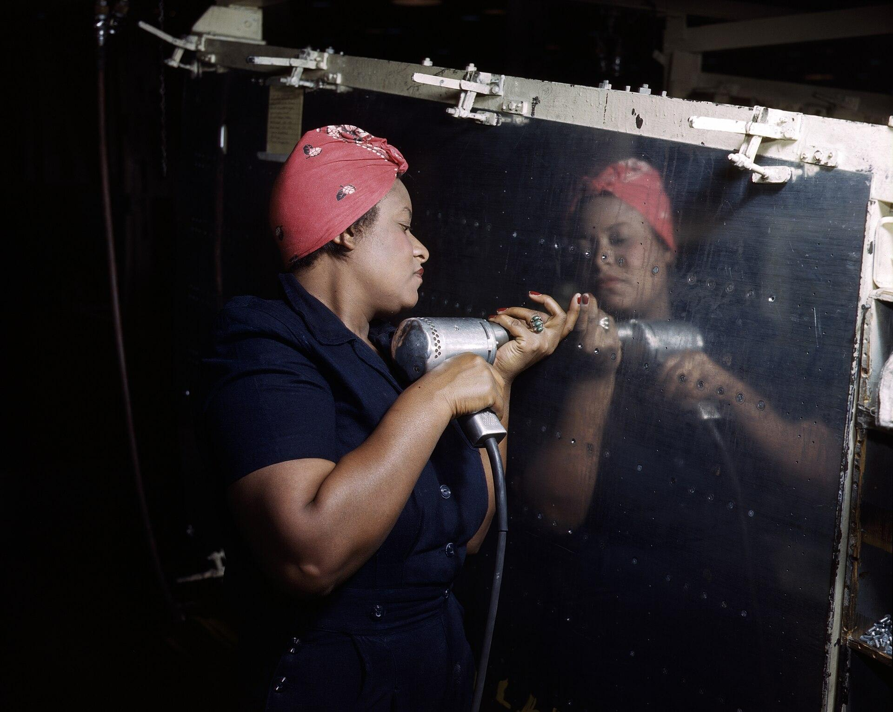
DIRECT INSTRUCTION
US.52
✍ In your workbook · Cornell Notes & Close Read (Act 3–4)
With 16 million men in uniform, a huge labor shortage opened factory jobs to women; government campaigns recruited them to war production.
ZOOM IN
US.52 · DI 1 of 4 · Factors Leading to Participation
U.S. History Hack · TroopToTeacher Technologies LLC · Aligned to TN Academic Standards & TCAP EOC
67

Slide 69
DIRECT INSTRUCTION
US.52
✍ In your workbook · Cornell Notes & Close Read (Act 3–4)
Women faced lower pay (about 65% of men's wages), hard conditions, and doubts about their ability — yet gained new opportunities and skills.
KEY POINT
Women faced lower pay (about 65% of men's wages), hard conditions, and doubts about their ability — yet gained new opportunities and skills.
US.52 · DI 2 of 4 · Challenges & Opportunities
U.S. History Hack · TroopToTeacher Technologies LLC · Aligned to TN Academic Standards & TCAP EOC
68

Slide 70
DIRECT INSTRUCTION
US.52
✍ In your workbook · Cornell Notes & Close Read (Act 3–4)
Women built bombers, fighters, and Liberty ships and made ammunition, radar, and radios — “Rosie the Riveter” symbolized their vital output.
KEY POINT
Women built bombers, fighters, and Liberty ships and made ammunition, radar, and radios — “Rosie the Riveter” symbolized their vital output.
US.52 · DI 3 of 4 · Impact on Production & Economy
U.S. History Hack · TroopToTeacher Technologies LLC · Aligned to TN Academic Standards & TCAP EOC
69

Slide 71
DIRECT INSTRUCTION
US.52
✍ In your workbook · Cornell Notes & Close Read (Act 3–4)
Many women were laid off for returning veterans and pushed toward homemaking, but wartime work reshaped expectations and seeded later gains.
KEY POINT
Many women were laid off for returning veterans and pushed toward homemaking, but wartime work reshaped expectations and seeded later gains.
US.52 · DI 4 of 4 · Long-term Effects on Society
U.S. History Hack · TroopToTeacher Technologies LLC · Aligned to TN Academic Standards & TCAP EOC
70

Slide 72
SOURCE IT FIRST
US.52
✍ In your workbook · Primary Source & HIPPO (Act 5)
Read the War Production Board poster text — weigh who produced it and why before you read the message.
WHO
WHEN
WHY
U.S. War Production Board
1943
Consider the author's purpose and audience before reading the words.
War Production Board Poster Text
U.S. War Production Board · 1943
"Do the job HE left behind. Women workers are needed in aircraft plants, shipyards, and munitions factories. Apply at your nearest U.S. Employment Service office. Every woman who takes a war job brings Victory closer. The more women at work—the sooner we win!"
Library of Congress
U.S. History Hack · TroopToTeacher Technologies LLC · Aligned to TN Academic Standards & TCAP EOC
71

Slide 73
THREE PERSPECTIVES
US.52
✍ In your workbook · Constructed Response (Act 7)
A historian returns to three questions at the end of every reading. Use them to analyze this standard.
Who benefited?
Who bore the costs?
Who decided?
Who gained land, wealth, power, or protection?
Who lost land, labor, freedom, or life — and who was silenced?
Which people, offices, or courts held the authority?
US.52:
US.52:
US.52:
The war economy, powered by women’s labor, and women who gained new skills, wages, and a lasting sense of capability.
Women paid less than men in hazardous jobs, then laid off after the war, and those pressured to abandon the workforce for returning veterans.
Government and industry that recruited women for the duration, then employers and social pressure that pushed them out at war’s end.
Anchor: War Production Board Poster Text, U.S. War Production Board, 1943 (Library of Congress)
U.S. History Hack · TroopToTeacher Technologies LLC · Aligned to TN Academic Standards & TCAP EOC
72

Slide 74
PROGRESS CHECK
✍ In your workbook · Practice Quiz (Act 6)
US.52
Check your understanding
How did "Rosie the Riveter" symbolize both opportunities and challenges facing working women?
A
Rosie only represented challenges women faced, despite limited evidence supporting this interpretation, which does not align with the documented historical record
B
Rosie represented only wealthy women, which does not reflect the consensus among historians despite the fact that multiple contemporary sources contradict this and does not reflect the scholarly consensus on this topic
C
The symbol had no cultural significance, which contradicts the primary source evidence from this era, but closer analysis reveals a more complicated historical reality
D
Rosie symbolized women's capability and patriotic duty while obscuring challenges like lower pay, discrimination, inadequate childcare, and expectations to maintain domestic responsibilities
Confidence: 😟 1 🙂 2 😀 3 — circle where you are; your teacher routes reteach or extension.
U.S. History Hack · TroopToTeacher Technologies LLC · Aligned to TN Academic Standards & TCAP EOC
73

Slide 75
US.53
African Americans in WWII
TN STANDARD
US.53 – Examine the impact of World War II on economic and social conditions for African Americans, including the Fair Employment Practices Committee and the eventual integration of the armed forces by President Harry S. Truman. (TCA)
I CAN
I can examine the impact of World War II on economic and social conditions for African Americans, including the Fair Employment Practices Committee and the eventual integration of the armed forces by President Truman.
U.S. History Hack · TroopToTeacher Technologies LLC · Aligned to TN Academic Standards & TCAP EOC
74

Slide 76
KEY VOCABULARY · LANGUAGE SUPPORT
✍ In your workbook · Vocabulary (Act 1–2)
US.53
Words you need before we read
Executive Order 8802
Double V Campaign
Tuskegee Airmen
En español: Orden Ejecutiva 8802
En español: Campaña de la Doble V
En español: Aviadores de Tuskegee
WHAT IT MEANS
WHAT IT MEANS
WHAT IT MEANS
The June 1941 order signed by President Roosevelt banning racial discrimination in the defense industry and creating the Fair Employment Practices Committee.
A World War II campaign led by the Black press calling for a 'Double Victory' - over fascism abroad and racial discrimination at home.
First African American military pilots who fought in World War II, proving their skill despite facing racial discrimination and segregation.
U.S. History Hack · TroopToTeacher Technologies LLC · Aligned to TN Academic Standards & TCAP EOC
75

Slide 77
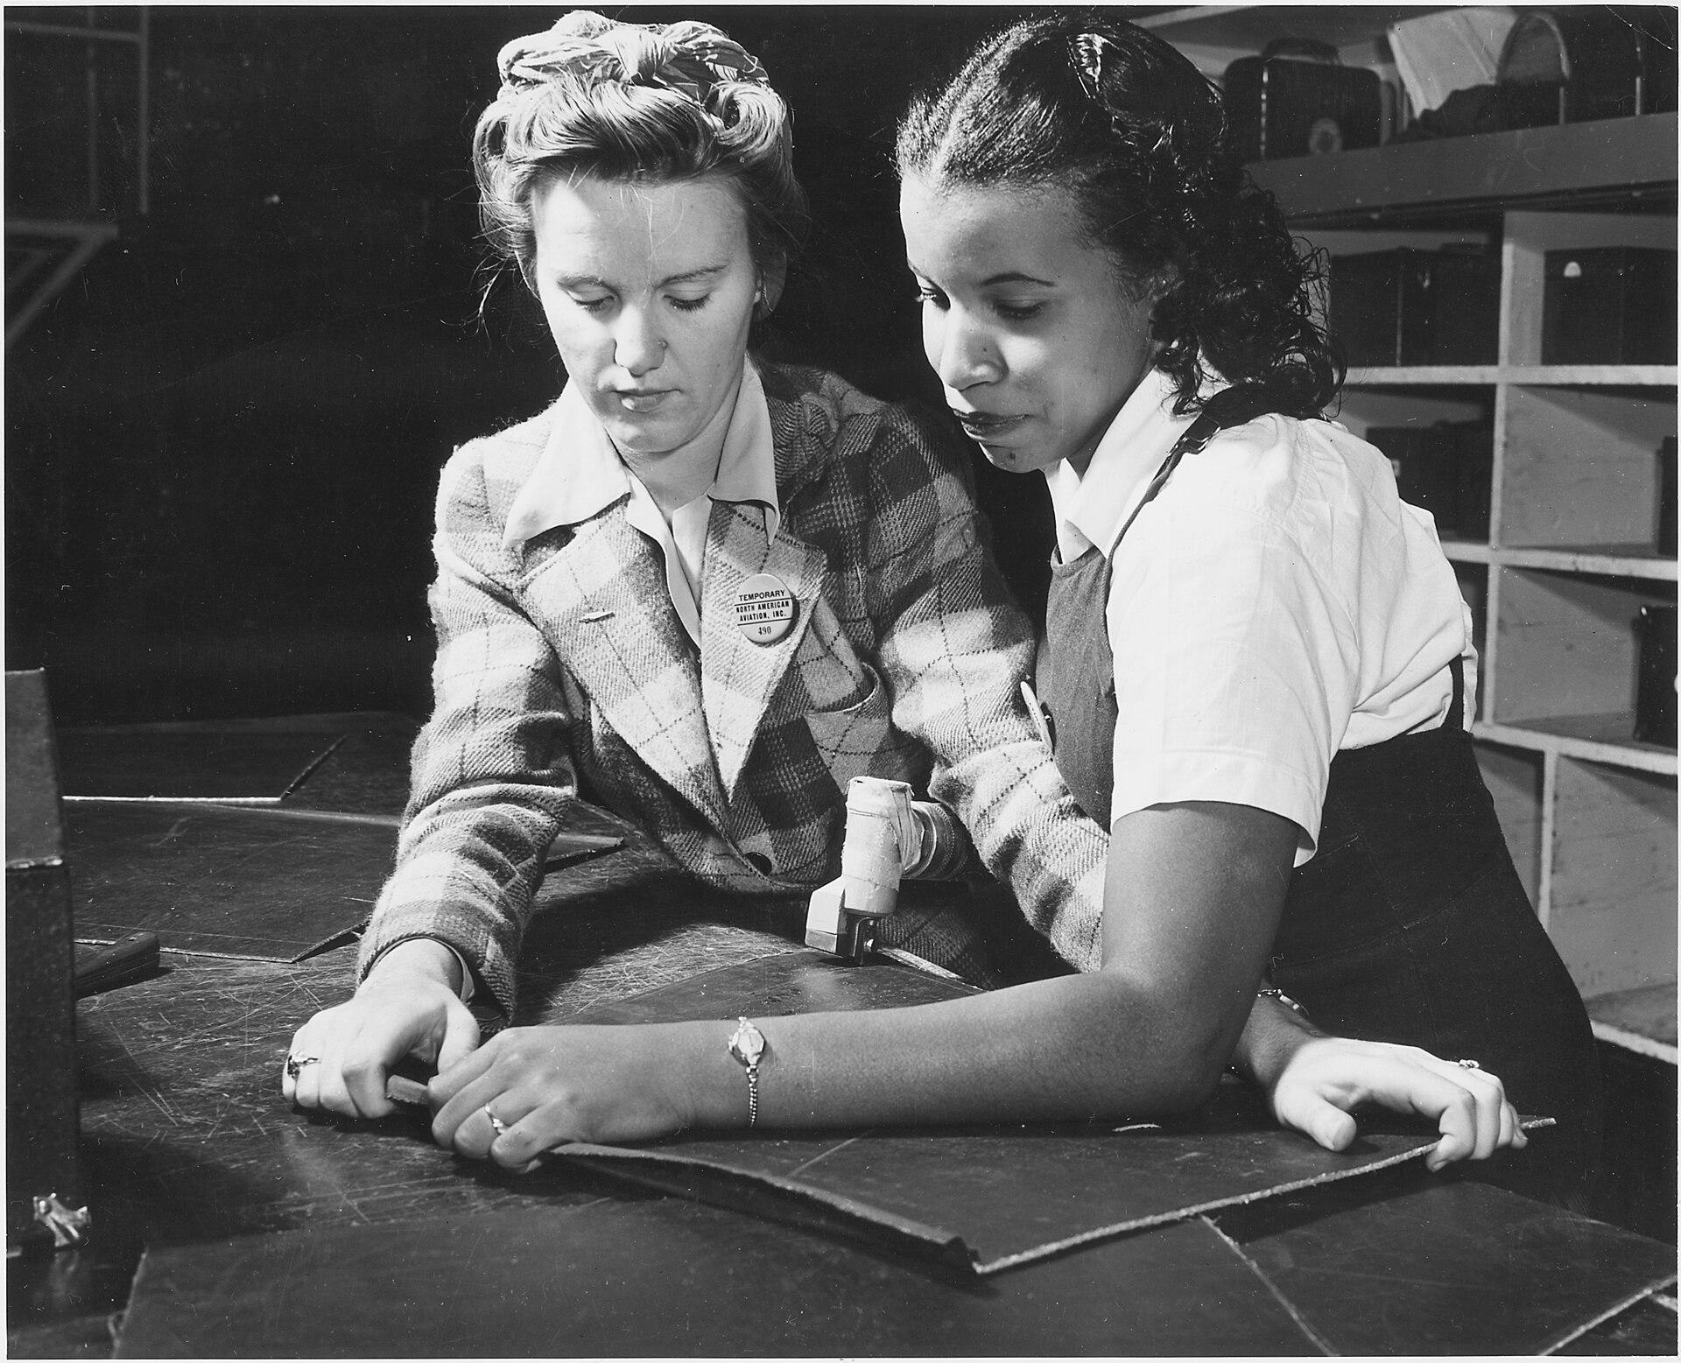
DIRECT INSTRUCTION
US.53
✍ In your workbook · Cornell Notes & Close Read (Act 3–4)
In the Second Great Migration, about 1.5 million African Americans moved North and West in the 1940s to cities like Detroit, Chicago, and Los Angeles for defense jobs.
ZOOM IN
US.53 · DI 1 of 4 · Second Great Migration & Opportunity
U.S. History Hack · TroopToTeacher Technologies LLC · Aligned to TN Academic Standards & TCAP EOC
76

Slide 78
DIRECT INSTRUCTION
US.53
✍ In your workbook · Cornell Notes & Close Read (Act 3–4)
The Pittsburgh Courier's “Double V” campaign demanded victory over fascism abroad and racism at home; a million Black Americans served, mostly in segregated units.
KEY POINT
The Pittsburgh Courier's “Double V” campaign demanded victory over fascism abroad and racism at home; a million Black Americans served, mostly in segregated units.
US.53 · DI 2 of 4 · Double V Campaign
U.S. History Hack · TroopToTeacher Technologies LLC · Aligned to TN Academic Standards & TCAP EOC
77

Slide 79
DIRECT INSTRUCTION
US.53
✍ In your workbook · Cornell Notes & Close Read (Act 3–4)
A. Philip Randolph's threatened march on Washington pressured FDR to issue Executive Order 8802 (1941), creating the FEPC to bar racial discrimination in defense jobs.
KEY POINT
A. Philip Randolph's threatened march on Washington pressured FDR to issue Executive Order 8802 (1941), creating the FEPC to bar racial discrimination in defense jobs.
US.53 · DI 3 of 4 · Fair Employment Practices Committee
U.S. History Hack · TroopToTeacher Technologies LLC · Aligned to TN Academic Standards & TCAP EOC
78

Slide 80
DIRECT INSTRUCTION
US.53
✍ In your workbook · Cornell Notes & Close Read (Act 3–4)
Executive Order 9981 (1948) ordered desegregation of the armed forces — gradual to implement, but a landmark toward integration.
KEY POINT
Executive Order 9981 (1948) ordered desegregation of the armed forces — gradual to implement, but a landmark toward integration.
US.53 · DI 4 of 4 · Integration of the Armed Forces
U.S. History Hack · TroopToTeacher Technologies LLC · Aligned to TN Academic Standards & TCAP EOC
79

Slide 81
SOURCE IT FIRST
US.53
✍ In your workbook · Primary Source & HIPPO (Act 5)
Read Executive Order 8802 — identify who issued it, when, and why before you analyze the source.
WHO
WHEN
WHY
President Franklin D. Roosevelt
June 25, 1941
Consider the author's purpose and audience before reading the words.
Executive Order 8802
President Franklin D. Roosevelt · June 25, 1941
"There shall be no discrimination in the employment of workers in defense industries or Government because of race, creed, color, or national origin... It is the duty of employers and of labor organizations... to provide for the full and equitable participation of all workers in defense industries."
National Archives
U.S. History Hack · TroopToTeacher Technologies LLC · Aligned to TN Academic Standards & TCAP EOC
80

Slide 82
THREE PERSPECTIVES
US.53
✍ In your workbook · Constructed Response (Act 7)
A historian returns to three questions at the end of every reading. Use them to analyze this standard.
Who benefited?
Who bore the costs?
Who decided?
Who gained land, wealth, power, or protection?
Who lost land, labor, freedom, or life — and who was silenced?
Which people, offices, or courts held the authority?
US.53:
US.53:
US.53:
African American workers who gained defense jobs, and the emerging civil-rights movement, energized by wartime demands for equality.
Black Americans who still faced segregation, violence, and discrimination even in war industries and a still-segregated military.
President Roosevelt, pressured by A. Philip Randolph, who issued EO 8802; and President Truman, who ordered military desegregation.
Anchor: Executive Order 8802, President Franklin D. Roosevelt, June 25, 1941 (National Archives)
U.S. History Hack · TroopToTeacher Technologies LLC · Aligned to TN Academic Standards & TCAP EOC
81

Slide 83
PROGRESS CHECK
✍ In your workbook · Practice Quiz (Act 6)
US.53
Check your understanding
What was the "Double V" campaign, and how did it connect the fight against fascism abroad with civil rights at home?
A
The Pittsburgh Courier's campaign demanded victory over fascism abroad and over racism at home, arguing that fighting for democracy overseas exposed the contradiction of denying democracy to Black Americans
B
It focused only on military victory, although this view has been largely discredited by scholars, which does not align with the documented historical record, which represents a common misconception about this historical period
C
It supported segregation, though this interpretation lacks supporting historical evidence, though this interpretation lacks supporting historical evidence, but closer analysis reveals a more complicated historical reality
D
It had no connection to civil rights, which ignores key developments that shaped the outcome, which represents a common misconception about this historical period, although historical sources do not support this conclusion
Confidence: 😟 1 🙂 2 😀 3 — circle where you are; your teacher routes reteach or extension.
U.S. History Hack · TroopToTeacher Technologies LLC · Aligned to TN Academic Standards & TCAP EOC
82

Slide 84
US.54
Japanese American Internment & Korematsu
TN STANDARD
US.54 – Describe the constitutional issues and impact of the internment of Japanese Americans on the U.S., including the Fred Korematsu v. United States of America decision.
I CAN
I can describe the constitutional issues and impact of the internment of Japanese Americans on the U.S., including the Fred Korematsu v. United States of America decision.
U.S. History Hack · TroopToTeacher Technologies LLC · Aligned to TN Academic Standards & TCAP EOC
83

Slide 85
KEY VOCABULARY · LANGUAGE SUPPORT
✍ In your workbook · Vocabulary (Act 1–2)
US.54
Words you need before we read
Japanese Internment
Korematsu v. United States
Executive Order 9066
En español: Internamiento Japonés
En español: Korematsu contra Estados Unidos
En español: Orden Ejecutiva 9066
WHAT IT MEANS
WHAT IT MEANS
WHAT IT MEANS
The forced relocation and incarceration of 120,000 Japanese Americans (two-thirds U.S. citizens) in concentration camps during WWII, based on racial prejudice, not evidence of disloyalty.
1944 Supreme Court decision upholding Japanese internment as a wartime necessity, later widely condemned as one of the Court's worst decisions.
The February 1942 order signed by President Roosevelt authorizing the military to exclude and relocate Japanese Americans from the West Coast.
U.S. History Hack · TroopToTeacher Technologies LLC · Aligned to TN Academic Standards & TCAP EOC
84

Slide 86
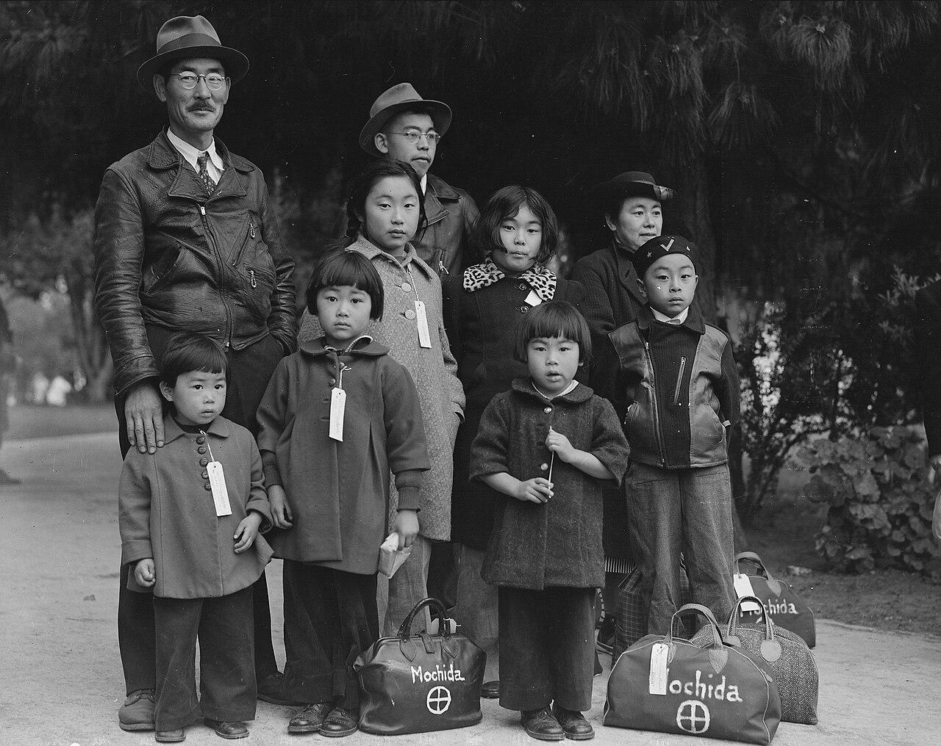
DIRECT INSTRUCTION
US.54
✍ In your workbook · Cornell Notes & Close Read (Act 3–4)
After Pearl Harbor, Executive Order 9066 (Feb 1942) authorized removal from military areas, leading to the incarceration of about 120,000 Japanese Americans in camps.
ZOOM IN
US.54 · DI 1 of 4 · Executive Order 9066 & Internment
U.S. History Hack · TroopToTeacher Technologies LLC · Aligned to TN Academic Standards & TCAP EOC
85

Slide 87
DIRECT INSTRUCTION
US.54
✍ In your workbook · Cornell Notes & Close Read (Act 3–4)
Internment violated due process (no hearings or evidence of disloyalty) and equal protection — punishing people for ancestry, not acts.
KEY POINT
Internment violated due process (no hearings or evidence of disloyalty) and equal protection — punishing people for ancestry, not acts.
US.54 · DI 2 of 4 · Constitutional Issues
U.S. History Hack · TroopToTeacher Technologies LLC · Aligned to TN Academic Standards & TCAP EOC
86

Slide 88
DIRECT INSTRUCTION
US.54
✍ In your workbook · Cornell Notes & Close Read (Act 3–4)
Fred Korematsu refused internment; in Korematsu v. United States (1944) the Supreme Court upheld the exclusion 6–3 on “wartime necessity” — a ruling later condemned.
KEY POINT
Fred Korematsu refused internment; in Korematsu v. United States (1944) the Supreme Court upheld the exclusion 6–3 on “wartime necessity” — a ruling later condemned.
US.54 · DI 3 of 4 · Korematsu v. United States (1944)
U.S. History Hack · TroopToTeacher Technologies LLC · Aligned to TN Academic Standards & TCAP EOC
87

Slide 89
DIRECT INSTRUCTION
US.54
✍ In your workbook · Cornell Notes & Close Read (Act 3–4)
Internees lost an estimated $400 million and suffered lasting trauma; the Civil Liberties Act of 1988 formally apologized and paid redress.
KEY POINT
Internees lost an estimated $400 million and suffered lasting trauma; the Civil Liberties Act of 1988 formally apologized and paid redress.
US.54 · DI 4 of 4 · Impact & Historical Lessons
U.S. History Hack · TroopToTeacher Technologies LLC · Aligned to TN Academic Standards & TCAP EOC
88

Slide 90
SOURCE IT FIRST
US.54
✍ In your workbook · Primary Source & HIPPO (Act 5)
Read Executive Order 9066 — note who issued it, when, and why before you weigh its words.
WHO
WHEN
WHY
President Franklin D. Roosevelt
February 19, 1942
Consider the author's purpose and audience before reading the words.
Executive Order 9066
President Franklin D. Roosevelt · February 19, 1942
"I hereby authorize and direct the Secretary of War, and the Military Commanders whom he may from time to time designate... to prescribe military areas in such places and of such extent as he or the appropriate Military Commander may determine, from which any or all persons may be excluded."
National Archives
U.S. History Hack · TroopToTeacher Technologies LLC · Aligned to TN Academic Standards & TCAP EOC
89

Slide 91
THREE PERSPECTIVES
US.54
✍ In your workbook · Constructed Response (Act 7)
A historian returns to three questions at the end of every reading. Use them to analyze this standard.
Who benefited?
Who bore the costs?
Who decided?
Who gained land, wealth, power, or protection?
Who lost land, labor, freedom, or life — and who was silenced?
Which people, offices, or courts held the authority?
US.54:
US.54:
US.54:
Wartime officials who claimed security justification, and some who acquired the property Japanese Americans were forced to abandon.
120,000 interned Japanese Americans who lost homes, businesses, and freedom — an estimated $400 million in property and lasting trauma.
President Roosevelt, who signed EO 9066; the military, which carried out removal; and the Supreme Court, which upheld it in Korematsu.
Anchor: Executive Order 9066, President Franklin D. Roosevelt, February 19, 1942 (National Archives)
U.S. History Hack · TroopToTeacher Technologies LLC · Aligned to TN Academic Standards & TCAP EOC
90

Slide 92
PROGRESS CHECK
✍ In your workbook · Practice Quiz (Act 6)
US.54
Check your understanding
How did Executive Order 9066 violate constitutional principles of due process and equal protection?
A
It followed all constitutional procedures, although historical sources do not support this conclusion, though this interpretation lacks supporting historical evidence, but the historical evidence paints a more nuanced picture
B
It denied due process by detaining people without individual hearings or evidence, and violated equal protection by targeting Japanese Americans while not similarly treating German or Italian Americans
C
It only affected non-citizens, but the historical record tells a more complex story, but closer analysis reveals a more complicated historical reality, although historical sources do not support this conclusion
D
The Constitution does not protect against internment, which does not align with the documented historical record, which ignores significant political and cultural developments of the era
Confidence: 😟 1 🙂 2 😀 3 — circle where you are; your teacher routes reteach or extension.
U.S. History Hack · TroopToTeacher Technologies LLC · Aligned to TN Academic Standards & TCAP EOC
91

Slide 93
US.55
Home Front Mobilization
TN STANDARD
US.55 – Describe the war's impact on the home front, including: rationing, bond drives, propaganda, movement to cities and industrial centers, Bracero program, conversion of factories for wartime production, location of prisoner of war camps in Tennessee.
I CAN
I can describe the war's impact on the home front, including rationing, bond drives, propaganda, movement to cities, the Bracero program, conversion of factories, and prisoner of war camps in Tennessee.
U.S. History Hack · TroopToTeacher Technologies LLC · Aligned to TN Academic Standards & TCAP EOC
92

Slide 94
KEY VOCABULARY · LANGUAGE SUPPORT
✍ In your workbook · Vocabulary (Act 1–2)
US.55
Words you need before we read
Rationing
War Bonds
Rosie the Riveter
En español: Racionamiento
En español: Bonos de Guerra
En español: Rosie la Remachadora
WHAT IT MEANS
WHAT IT MEANS
WHAT IT MEANS
Government-controlled limits on consumer goods during WWII to ensure adequate supplies for the military, requiring ration books and coupons.
Government bonds sold to citizens to finance the war effort, promoted through massive publicity campaigns featuring celebrities and patriotic appeals.
Cultural icon representing millions of American women who worked in factories and shipyards during World War II, filling jobs left by men who went to war.
U.S. History Hack · TroopToTeacher Technologies LLC · Aligned to TN Academic Standards & TCAP EOC
93

Slide 95
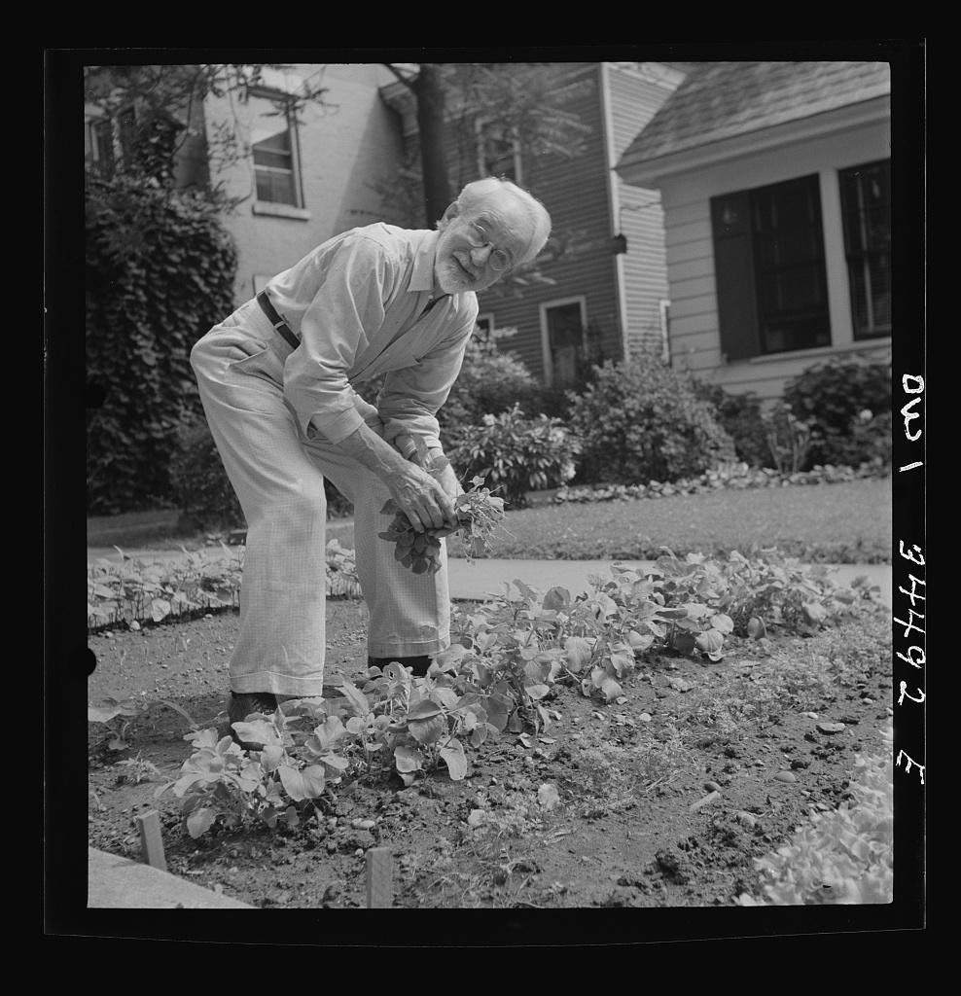
DIRECT INSTRUCTION
US.55
✍ In your workbook · Cornell Notes & Close Read (Act 3–4)
Ration books with coupons controlled gasoline, tires, sugar, meat, and coffee so the military had enough — reshaping everyday civilian life.
ZOOM IN
US.55 · DI 1 of 4 · Rationing & Conservation
U.S. History Hack · TroopToTeacher Technologies LLC · Aligned to TN Academic Standards & TCAP EOC
94

Slide 96
DIRECT INSTRUCTION
US.55
✍ In your workbook · Cornell Notes & Close Read (Act 3–4)
Liberty and Victory bonds financed the war and gave civilians a stake in victory; bond drives used celebrities, posters, and patriotic appeals.
KEY POINT
Liberty and Victory bonds financed the war and gave civilians a stake in victory; bond drives used celebrities, posters, and patriotic appeals.
US.55 · DI 2 of 4 · War Bonds & Propaganda
U.S. History Hack · TroopToTeacher Technologies LLC · Aligned to TN Academic Standards & TCAP EOC
95

Slide 97
DIRECT INSTRUCTION
US.55
✍ In your workbook · Cornell Notes & Close Read (Act 3–4)
Millions moved to defense centers as auto plants converted to war production; the Bracero Program brought Mexican laborers to fill farm labor shortages.
KEY POINT
Millions moved to defense centers as auto plants converted to war production; the Bracero Program brought Mexican laborers to fill farm labor shortages.
US.55 · DI 3 of 4 · Migration, Factory Conversion & Bracero
U.S. History Hack · TroopToTeacher Technologies LLC · Aligned to TN Academic Standards & TCAP EOC
96

Slide 98
DIRECT INSTRUCTION
US.55
✍ In your workbook · Cornell Notes & Close Read (Act 3–4)
Tennessee hosted war plants, POW camps, and — powered by TVA electricity — major facilities like Oak Ridge, making the state central to the war effort.
KEY POINT
Tennessee hosted war plants, POW camps, and — powered by TVA electricity — major facilities like Oak Ridge, making the state central to the war effort.
US.55 · DI 4 of 4 · Tennessee's Wartime Role
U.S. History Hack · TroopToTeacher Technologies LLC · Aligned to TN Academic Standards & TCAP EOC
97

Slide 99
SOURCE IT FIRST
US.55
✍ In your workbook · Primary Source & HIPPO (Act 5)
Read the War Ration Book instructions — identify the issuing office and its purpose before you read the text.
WHO
WHEN
WHY
Office of Price Administration
1943
Consider the author's purpose and audience before reading the words.
War Ration Book Instructions
Office of Price Administration · 1943
"This book is your Government's guarantee of your fair share of goods made scarce by war. Price ceilings and rationing are the most fair way to distribute scarce goods. Misuse of rationing stamps is a crime punishable by fine or imprisonment. Your Government needs your compliance."
National Archives
U.S. History Hack · TroopToTeacher Technologies LLC · Aligned to TN Academic Standards & TCAP EOC
98

Slide 100
THREE PERSPECTIVES
US.55
✍ In your workbook · Constructed Response (Act 7)
A historian returns to three questions at the end of every reading. Use them to analyze this standard.
Who benefited?
Who bore the costs?
Who decided?
Who gained land, wealth, power, or protection?
Who lost land, labor, freedom, or life — and who was silenced?
Which people, offices, or courts held the authority?
US.55:
US.55:
US.55:
The war effort, financed and supplied by home-front sacrifice, and regions like Tennessee that gained industry, bases, and jobs.
Civilians who gave up goods to rationing, families separated by wartime migration, and communities strained by rapid, crowded growth.
Federal agencies like the Office of Price Administration and War Production Board that set rationing, bond, and production policy.
Anchor: War Ration Book Instructions, Office of Price Administration, 1943 (National Archives)
U.S. History Hack · TroopToTeacher Technologies LLC · Aligned to TN Academic Standards & TCAP EOC
99

Slide 101
PROGRESS CHECK
✍ In your workbook · Practice Quiz (Act 6)
US.55
Check your understanding
What role did propaganda play in maintaining civilian morale and support for the war effort?
A
Propaganda was not used during WWII, but this fails to account for the broader historical context, but contemporary accounts and primary sources suggest otherwise
B
Propaganda only targeted military personnel, yet the available evidence points to a different conclusion, but the historical evidence paints a more nuanced picture
C
The Office of War Information used films, posters, and radio to demonize enemies, celebrate American values, recruit workers, and build national unity through shared purpose and sacrifice
D
Propaganda undermined the war effort, but this fails to account for the broader historical context, but contemporary accounts and primary sources suggest otherwise
Confidence: 😟 1 🙂 2 😀 3 — circle where you are; your teacher routes reteach or extension.
U.S. History Hack · TroopToTeacher Technologies LLC · Aligned to TN Academic Standards & TCAP EOC
100

Slide 102
US.56
Manhattan Project & Atomic Bomb
TN STANDARD
US.56 – Describe the Manhattan Project and explain the rationale for using the atomic bomb to end the war.
I CAN
I can describe the Manhattan Project and explain the rationale for using the atomic bomb to end the war.
U.S. History Hack · TroopToTeacher Technologies LLC · Aligned to TN Academic Standards & TCAP EOC
101

Slide 103
KEY VOCABULARY · LANGUAGE SUPPORT
✍ In your workbook · Vocabulary (Act 1–2)
US.56
Words you need before we read
Manhattan Project
Atomic Bomb
Battle of Iwo Jima
En español: Proyecto Manhattan
En español: Bomba Atómica
En español: Batalla de Iwo Jima
WHAT IT MEANS
WHAT IT MEANS
WHAT IT MEANS
Top-secret U.S. program to develop the atomic bomb, involving sites at Oak Ridge (Tennessee), Los Alamos (New Mexico), and Hanford (Washington).
Nuclear weapons dropped on Hiroshima (August 6) and Nagasaki (August 9, 1945), killing over 200,000 people and forcing Japan's surrender, ending World War II.
February-March 1945 brutal battle for a strategic Pacific island, famous for the iconic flag-raising photograph on Mount Suribachi.
U.S. History Hack · TroopToTeacher Technologies LLC · Aligned to TN Academic Standards & TCAP EOC
102

Slide 104
DIRECT INSTRUCTION
US.56
✍ In your workbook · Cornell Notes & Close Read (Act 3–4)
Oak Ridge, TN was chosen to enrich uranium for its remote security, abundant TVA electric power, and good transportation — a secret city built almost overnight.
KEY POINT
Oak Ridge, TN was chosen to enrich uranium for its remote security, abundant TVA electric power, and good transportation — a secret city built almost overnight.
US.56 · DI 1 of 4 · Oak Ridge, Tennessee Selection
U.S. History Hack · TroopToTeacher Technologies LLC · Aligned to TN Academic Standards & TCAP EOC
103

Slide 105
DIRECT INSTRUCTION
US.56
✍ In your workbook · Cornell Notes & Close Read (Act 3–4)
The Manhattan Project was a secret, multi-site program — Los Alamos (design), Oak Ridge (uranium), Hanford (plutonium) — led by Gen. Groves and physicist Oppenheimer.
KEY POINT
The Manhattan Project was a secret, multi-site program — Los Alamos (design), Oak Ridge (uranium), Hanford (plutonium) — led by Gen. Groves and physicist Oppenheimer.
US.56 · DI 2 of 4 · Manhattan Project Overview
U.S. History Hack · TroopToTeacher Technologies LLC · Aligned to TN Academic Standards & TCAP EOC
104

Slide 106
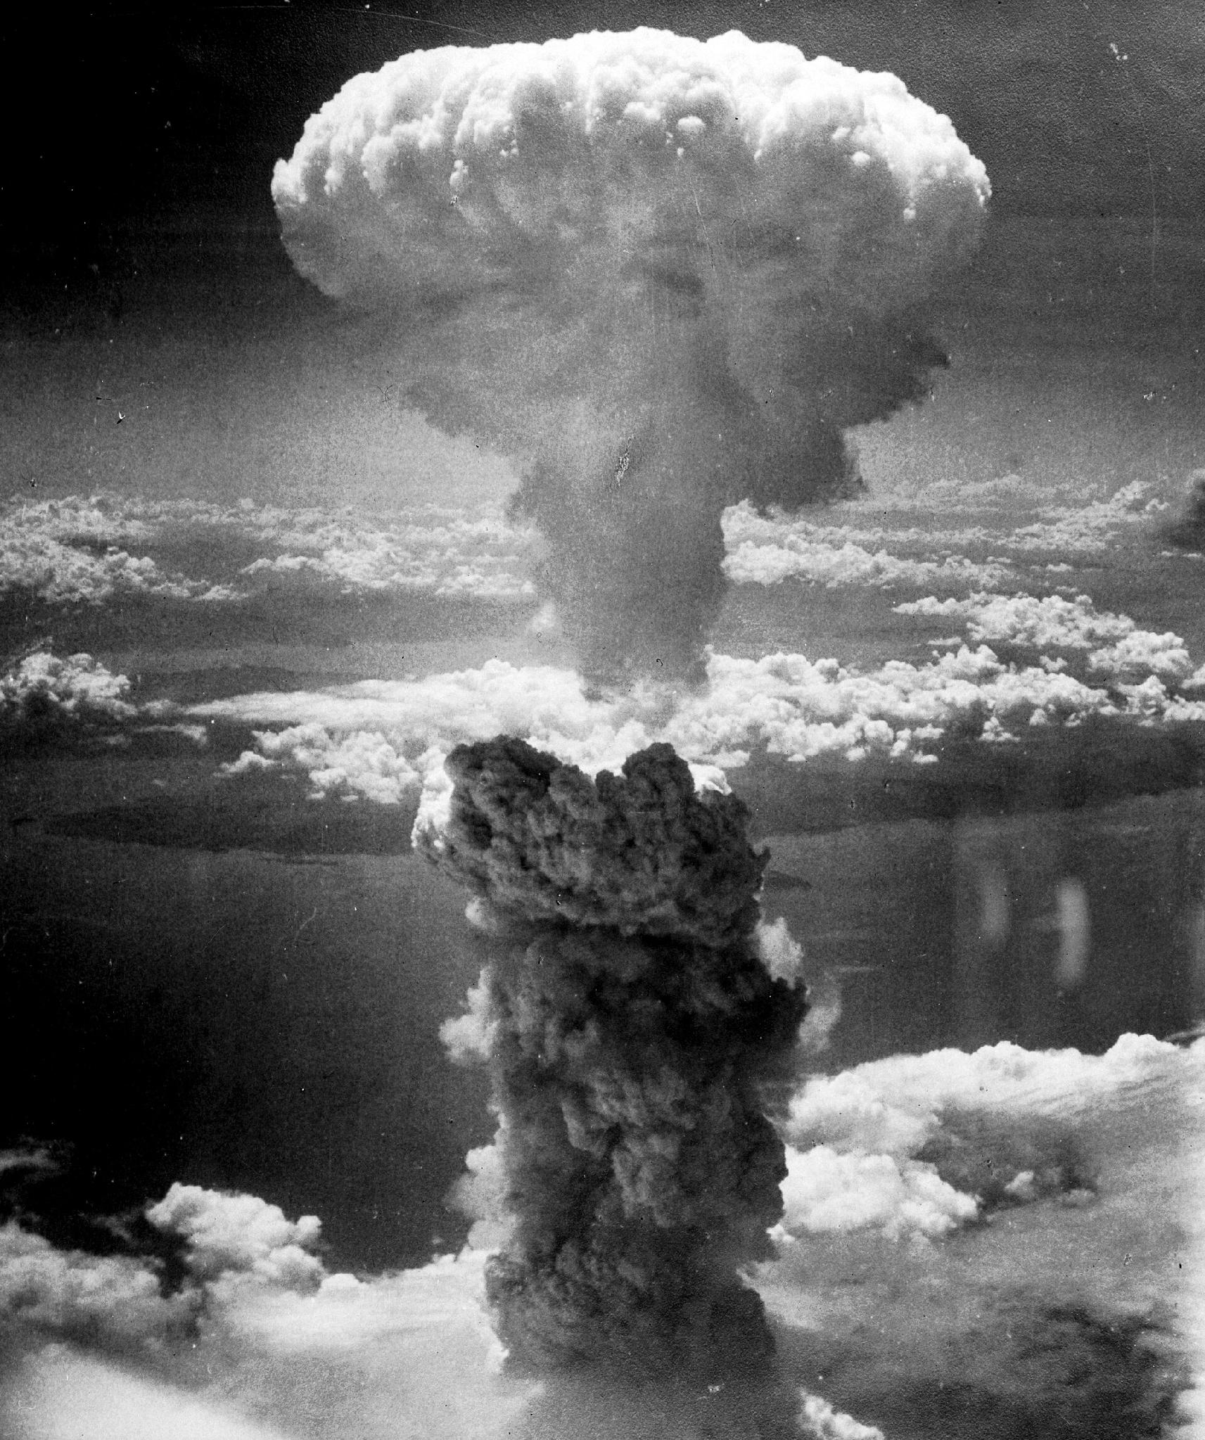
DIRECT INSTRUCTION
US.56
✍ In your workbook · Cornell Notes & Close Read (Act 3–4)
President Truman authorized the atomic bombs to end the war quickly and avoid a costly invasion of Japan projected to cost hundreds of thousands of lives.
ZOOM IN
US.56 · DI 3 of 4 · Rationale for Using Atomic Weapons
U.S. History Hack · TroopToTeacher Technologies LLC · Aligned to TN Academic Standards & TCAP EOC
105

Slide 107
DIRECT INSTRUCTION
US.56
✍ In your workbook · Cornell Notes & Close Read (Act 3–4)
The debate weighs ending the war fast and saving invasion casualties against the mass civilian deaths at Hiroshima and Nagasaki — a lasting ethical question.
KEY POINT
The debate weighs ending the war fast and saving invasion casualties against the mass civilian deaths at Hiroshima and Nagasaki — a lasting ethical question.
US.56 · DI 4 of 4 · The Ethical Debate
U.S. History Hack · TroopToTeacher Technologies LLC · Aligned to TN Academic Standards & TCAP EOC
106

Slide 108
SOURCE IT FIRST
US.56
✍ In your workbook · Primary Source & HIPPO (Act 5)
Read Truman’s Statement on the Atomic Bomb — note the speaker, date, and purpose before you read his words.
WHO
WHEN
WHY
President Harry S. Truman
August 6, 1945
Consider the author's purpose and audience before reading the words.
Statement on the Atomic Bomb
President Harry S. Truman · August 6, 1945
"Sixteen hours ago an American airplane dropped one bomb on Hiroshima, an important Japanese Army base. That bomb had more power than 20,000 tons of T.N.T... We are now prepared to obliterate more rapidly and completely every productive enterprise the Japanese have above ground in any city... If they do not now accept our terms they may expect a rain of ruin from the air."
Harry S. Truman Presidential Library
U.S. History Hack · TroopToTeacher Technologies LLC · Aligned to TN Academic Standards & TCAP EOC
107

Slide 109
THREE PERSPECTIVES
US.56
✍ In your workbook · Constructed Response (Act 7)
A historian returns to three questions at the end of every reading. Use them to analyze this standard.
Who benefited?
Who bore the costs?
Who decided?
Who gained land, wealth, power, or protection?
Who lost land, labor, freedom, or life — and who was silenced?
Which people, offices, or courts held the authority?
US.56:
US.56:
US.56:
The United States, which ended the war and emerged as a nuclear superpower, and Oak Ridge, Tennessee, transformed by the project.
The tens of thousands of Japanese civilians killed and injured at Hiroshima and Nagasaki, and survivors who suffered lasting effects.
President Truman, who authorized the bombings, and the scientists and military leaders of the Manhattan Project who built the weapon.
Anchor: Statement on the Atomic Bomb, President Harry S. Truman, August 6, 1945 (Harry S. Truman Presidential Library)
U.S. History Hack · TroopToTeacher Technologies LLC · Aligned to TN Academic Standards & TCAP EOC
108

Slide 110
PROGRESS CHECK
✍ In your workbook · Practice Quiz (Act 6)
US.56
Check your understanding
What factors influenced President Truman's decision to use atomic weapons against Japan?
A
Truman made the decision without considering alternatives, which does not align with the documented historical record, although historical sources do not support this conclusion
B
Only military factors were considered, but this fails to account for the broader historical context, which represents a common misconception about this historical period
C
Truman opposed using the bombs, but this fails to account for the broader historical context, which does not align with the documented historical record
D
Projected invasion casualties based on Okinawa, desire to end the war quickly, demonstrating power to the Soviet Union, and Japanese refusal to surrender all influenced the decision
Confidence: 😟 1 🙂 2 😀 3 — circle where you are; your teacher routes reteach or extension.
U.S. History Hack · TroopToTeacher Technologies LLC · Aligned to TN Academic Standards & TCAP EOC
109

Slide 111
US.57
Yalta and Potsdam Conferences
TN STANDARD
US.57 – Explain the major outcomes of the Yalta and Potsdam Conferences.
I CAN
I can explain the major outcomes of the Yalta and Potsdam Conferences.
U.S. History Hack · TroopToTeacher Technologies LLC · Aligned to TN Academic Standards & TCAP EOC
110

Slide 112
KEY VOCABULARY · LANGUAGE SUPPORT
✍ In your workbook · Vocabulary (Act 1–2)
US.57
Words you need before we read
Yalta Conference
Potsdam Conference
Joseph Stalin
En español: Conferencia de Yalta
En español: Conferencia de Potsdam
En español: Joseph Stalin
WHAT IT MEANS
WHAT IT MEANS
WHAT IT MEANS
February 1945 meeting of Roosevelt, Churchill, and Stalin to plan post-war Europe, dividing Germany and establishing spheres of influence.
July-August 1945 meeting of Truman, Churchill/Attlee, and Stalin finalizing plans for occupied Germany and issuing surrender terms to Japan.
Communist dictator of the Soviet Union (1924-1953) who ruled through terror, forced collectivization, and purges, resulting in millions of deaths.
U.S. History Hack · TroopToTeacher Technologies LLC · Aligned to TN Academic Standards & TCAP EOC
111

Slide 113
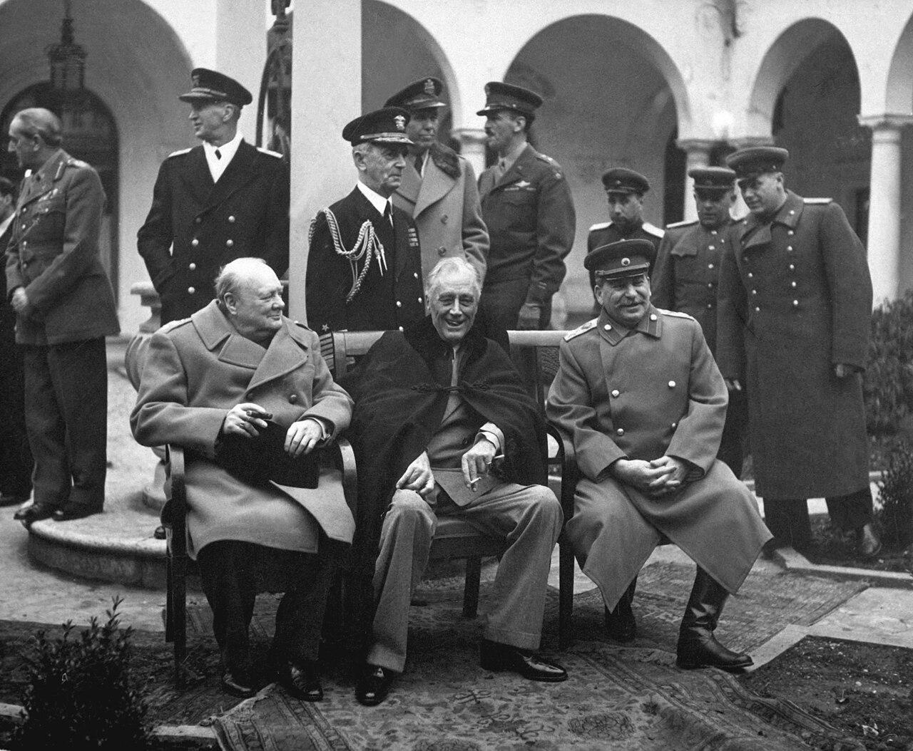
DIRECT INSTRUCTION
US.57
✍ In your workbook · Cornell Notes & Close Read (Act 3–4)
At Yalta (Feb 1945), FDR, Churchill, and Stalin planned the UN, the division of Germany into occupation zones, and “free elections” in Eastern Europe — a promise Stalin broke.
ZOOM IN
US.57 · DI 1 of 4 · Yalta Conference (Feb 1945)
U.S. History Hack · TroopToTeacher Technologies LLC · Aligned to TN Academic Standards & TCAP EOC
112

Slide 114
DIRECT INSTRUCTION
US.57
✍ In your workbook · Cornell Notes & Close Read (Act 3–4)
At Potsdam (Jul–Aug 1945), Truman, Stalin, and Churchill (then Attlee) met as Germany surrendered; disputes over Eastern Europe deepened distrust.
KEY POINT
At Potsdam (Jul–Aug 1945), Truman, Stalin, and Churchill (then Attlee) met as Germany surrendered; disputes over Eastern Europe deepened distrust.
US.57 · DI 2 of 4 · Potsdam Conference (Jul–Aug 1945)
U.S. History Hack · TroopToTeacher Technologies LLC · Aligned to TN Academic Standards & TCAP EOC
113

Slide 115
DIRECT INSTRUCTION
US.57
✍ In your workbook · Cornell Notes & Close Read (Act 3–4)
Disagreement over Eastern Europe proved irreconcilable — Stalin's “free elections” meant communist governments — seeding the U.S.–Soviet Cold War.
KEY POINT
Disagreement over Eastern Europe proved irreconcilable — Stalin's “free elections” meant communist governments — seeding the U.S.–Soviet Cold War.
US.57 · DI 3 of 4 · Cold War Origins
U.S. History Hack · TroopToTeacher Technologies LLC · Aligned to TN Academic Standards & TCAP EOC
114

Slide 116
DIRECT INSTRUCTION
US.57
✍ In your workbook · Cornell Notes & Close Read (Act 3–4)
Critics say FDR conceded too much to Stalin at Yalta; defenders note Soviet armies already held Eastern Europe — Allied diplomacy won the war but left Europe divided.
KEY POINT
Critics say FDR conceded too much to Stalin at Yalta; defenders note Soviet armies already held Eastern Europe — Allied diplomacy won the war but left Europe divided.
US.57 · DI 4 of 4 · Assessing Allied Diplomacy
U.S. History Hack · TroopToTeacher Technologies LLC · Aligned to TN Academic Standards & TCAP EOC
115

Slide 117
SOURCE IT FIRST
US.57
✍ In your workbook · Primary Source & HIPPO (Act 5)
Read the Yalta Conference Communiqué — weigh who issued it and why before you read the agreements.
WHO
WHEN
WHY
Roosevelt, Churchill, and Stalin
February 1945
Consider the author's purpose and audience before reading the words.
Yalta Conference Communiqué
Roosevelt, Churchill, and Stalin · February 1945
"We have agreed on common policies and plans for enforcing the unconditional surrender terms which we shall impose together on Nazi Germany... It is our inflexible purpose to destroy German militarism and Nazism and to ensure that Germany will never again be able to disturb the peace of the world."
Avalon Project, Yale Law School
U.S. History Hack · TroopToTeacher Technologies LLC · Aligned to TN Academic Standards & TCAP EOC
116

Slide 118
THREE PERSPECTIVES
US.57
✍ In your workbook · Constructed Response (Act 7)
A historian returns to three questions at the end of every reading. Use them to analyze this standard.
Who benefited?
Who bore the costs?
Who decided?
Who gained land, wealth, power, or protection?
Who lost land, labor, freedom, or life — and who was silenced?
Which people, offices, or courts held the authority?
US.57:
US.57:
US.57:
The Soviet Union, which secured influence over Eastern Europe, and the Allies who set up the UN and postwar occupation zones.
The nations of Eastern Europe subjected to Soviet-backed communist governments despite promises of free elections.
The “Big Three” — Roosevelt (later Truman), Churchill (later Attlee), and Stalin — who negotiated the postwar settlement.
Anchor: Yalta Conference Communiqué, Roosevelt, Churchill, and Stalin, February 1945 (Avalon Project, Yale Law School)
U.S. History Hack · TroopToTeacher Technologies LLC · Aligned to TN Academic Standards & TCAP EOC
117

Slide 119
PROGRESS CHECK
✍ In your workbook · Practice Quiz (Act 6)
US.57
Check your understanding
How did the Potsdam Conference reveal growing tensions between the United States and Soviet Union?
A
Disputes over Eastern European governments, German reparations, and differing visions for post-war Europe revealed fundamental disagreements that would define the Cold War
B
Potsdam showed complete Allied unity, though this interpretation lacks supporting historical evidence, which ignores significant political and cultural developments of the era
C
Only minor disagreements emerged, despite the fact that multiple sources contradict this view, which represents a common misconception about this historical period
D
The Soviet Union was excluded from Potsdam, though this interpretation lacks supporting historical evidence, though this interpretation lacks supporting historical evidence
Confidence: 😟 1 🙂 2 😀 3 — circle where you are; your teacher routes reteach or extension.
U.S. History Hack · TroopToTeacher Technologies LLC · Aligned to TN Academic Standards & TCAP EOC
118

Slide 120
US.58
Founding of the United Nations & Cordell Hull
TN STANDARD
US.58 – Identify and explain the reasons for the founding of the United Nations, including the role of Cordell Hull.
I CAN
I can identify and explain the reasons for the founding of the United Nations, including the role of Cordell Hull.
U.S. History Hack · TroopToTeacher Technologies LLC · Aligned to TN Academic Standards & TCAP EOC
119

Slide 121
KEY VOCABULARY · LANGUAGE SUPPORT
✍ In your workbook · Vocabulary (Act 1–2)
US.58
Words you need before we read
United Nations
Cordell Hull
Yalta Conference
En español: United Nations
En español: Cordell Hull
En español: Conferencia de Yalta
WHAT IT MEANS
WHAT IT MEANS
WHAT IT MEANS
An international organization founded in 1945 by 50 nations to maintain global peace, security, and cooperation and to prevent another world war through collective diplomacy.
U.S. Secretary of State under Franklin D. Roosevelt (1933-1944), awarded the 1945 Nobel Peace Prize for his role in creating the United Nations.
February 1945 meeting of Roosevelt, Churchill, and Stalin to plan post-war Europe, dividing Germany and establishing spheres of influence.
U.S. History Hack · TroopToTeacher Technologies LLC · Aligned to TN Academic Standards & TCAP EOC
120

Slide 122
DIRECT INSTRUCTION
US.58
✍ In your workbook · Cornell Notes & Close Read (Act 3–4)
The League of Nations failed because the U.S. never joined, it lacked enforcement, and major powers could ignore it — lessons the UN's designers aimed to fix.
KEY POINT
The League of Nations failed because the U.S. never joined, it lacked enforcement, and major powers could ignore it — lessons the UN's designers aimed to fix.
US.58 · DI 1 of 4 · Lessons from the League's Failure
U.S. History Hack · TroopToTeacher Technologies LLC · Aligned to TN Academic Standards & TCAP EOC
121

Slide 123
DIRECT INSTRUCTION
US.58
✍ In your workbook · Cornell Notes & Close Read (Act 3–4)
Cordell Hull, FDR's Secretary of State and a Tennessean, was key to planning the UN and is called its “Father”; he won the 1945 Nobel Peace Prize.
KEY POINT
Cordell Hull, FDR's Secretary of State and a Tennessean, was key to planning the UN and is called its “Father”; he won the 1945 Nobel Peace Prize.
US.58 · DI 2 of 4 · Cordell Hull's Role
U.S. History Hack · TroopToTeacher Technologies LLC · Aligned to TN Academic Standards & TCAP EOC
122

Slide 124
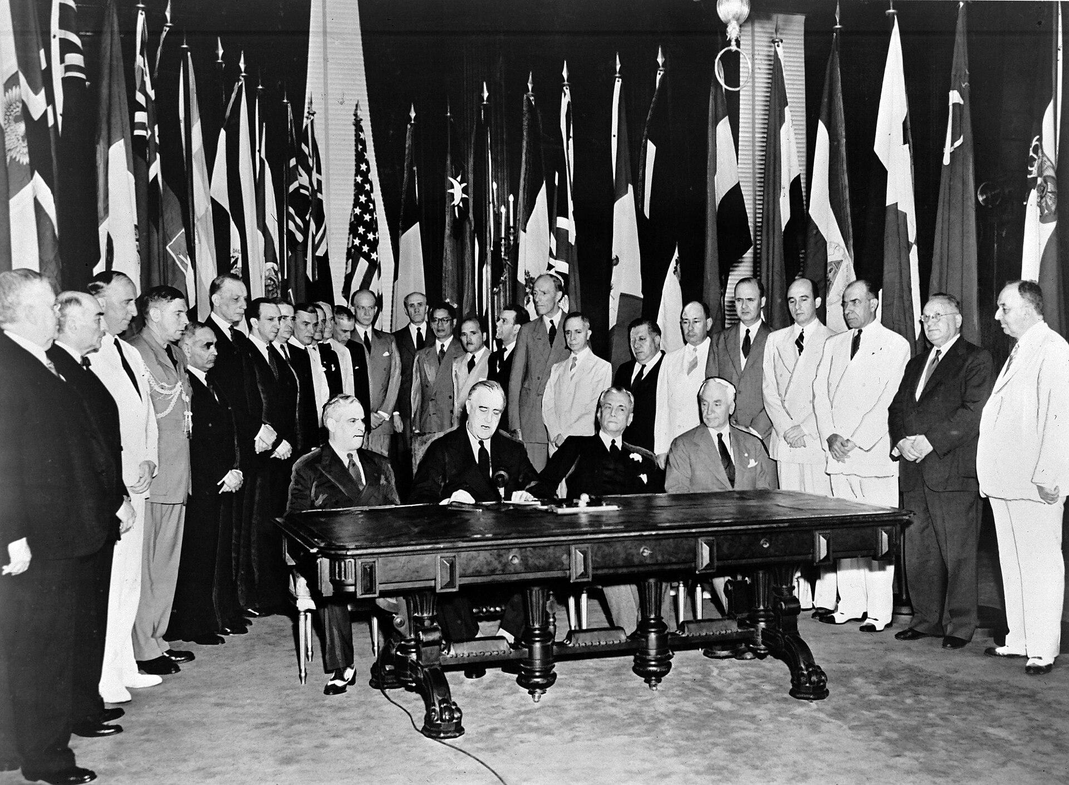
DIRECT INSTRUCTION
US.58
✍ In your workbook · Cornell Notes & Close Read (Act 3–4)
The UN was built to keep international peace through collective action, using a General Assembly and a Security Council, and to promote cooperation among nations.
ZOOM IN
US.58 · DI 3 of 4 · UN Goals & Structure
U.S. History Hack · TroopToTeacher Technologies LLC · Aligned to TN Academic Standards & TCAP EOC
123

Slide 125
DIRECT INSTRUCTION
US.58
✍ In your workbook · Cornell Notes & Close Read (Act 3–4)
Unlike the League, the UN secured U.S. membership and endured — though Cold War rivalry and the Security Council veto often limited its action.
KEY POINT
Unlike the League, the UN secured U.S. membership and endured — though Cold War rivalry and the Security Council veto often limited its action.
US.58 · DI 4 of 4 · UN Legacy & Limitations
U.S. History Hack · TroopToTeacher Technologies LLC · Aligned to TN Academic Standards & TCAP EOC
124

Slide 126
SOURCE IT FIRST
US.58
✍ In your workbook · Primary Source & HIPPO (Act 5)
Read the United Nations Charter Preamble — identify who wrote it and why before you analyze its aims.
WHO
WHEN
WHY
United Nations
June 26, 1945
Consider the author's purpose and audience before reading the words.
United Nations Charter Preamble
United Nations · June 26, 1945
"We the peoples of the United Nations determined to save succeeding generations from the scourge of war, which twice in our lifetime has brought untold sorrow to mankind, and to reaffirm faith in fundamental human rights, in the dignity and worth of the human person, in the equal rights of men and women and of nations large and small."
United Nations
U.S. History Hack · TroopToTeacher Technologies LLC · Aligned to TN Academic Standards & TCAP EOC
125

Slide 127
THREE PERSPECTIVES
US.58
✍ In your workbook · Constructed Response (Act 7)
A historian returns to three questions at the end of every reading. Use them to analyze this standard.
Who benefited?
Who bore the costs?
Who decided?
Who gained land, wealth, power, or protection?
Who lost land, labor, freedom, or life — and who was silenced?
Which people, offices, or courts held the authority?
US.58:
US.58:
US.58:
The postwar world order and the U.S., now a leading member of a permanent peace organization, and Cordell Hull, honored with the Nobel Peace Prize.
Smaller nations whose interests could be overridden by great-power vetoes in the Security Council.
The founding Allied powers and diplomats like Cordell Hull who designed the UN, and the U.S. Senate, which this time approved membership.
Anchor: United Nations Charter Preamble, United Nations, June 26, 1945 (United Nations)
U.S. History Hack · TroopToTeacher Technologies LLC · Aligned to TN Academic Standards & TCAP EOC
126

Slide 128
PROGRESS CHECK
✍ In your workbook · Practice Quiz (Act 6)
US.58
Check your understanding
What were the main goals of the United Nations, and how did they reflect wartime experiences?
A
The UN had no connection to WWII experiences, although this view has been largely discredited by scholars, but closer analysis reveals a more complicated historical reality, but the historical evidence paints a more nuanced picture
B
Goals of maintaining peace, promoting human rights, enabling self-determination, and fostering cooperation directly addressed the failures that led to WWII—aggression, human rights violations, and economic nationalism
C
The UN focused only on trade issues, although this view has been largely discredited by scholars and does not reflect the scholarly consensus on this topic, which ignores significant political and cultural developments of the era
D
Wartime experiences were irrelevant to UN design, but this fails to account for the broader historical context, which represents a common misconception about this historical period, which contradicts the primary source evidence from this era
Confidence: 😟 1 🙂 2 😀 3 — circle where you are; your teacher routes reteach or extension.
U.S. History Hack · TroopToTeacher Technologies LLC · Aligned to TN Academic Standards & TCAP EOC
127

