Slide 1
How This Deck Works
Universal Design for Learning · Multi-Tiered System of Supports
EVERY LEARNER · SAME FIRM GOAL
Multiple ways in
Multiple ways to see it
Multiple ways to show it
Every lesson opens with a real question and a clear “I can” goal, so you know why it matters and where you’re headed.
Direct instruction, primary sources, maps, and bilingual key vocabulary — the same ideas shown more than one way.
Model-with-me, sentence frames, and choices in how you respond — you reach the same goal by the route that works for you.
Your teacher checks your progress along the way and gives you another path if you need one — the goal never lowers.
U.S. History Hack · TroopToTeacher Technologies LLC · Aligned to TN Academic Standards & TCAP EOC
1

Slide 2
US.83
Johnson's Great Society Programs
TN STANDARD
US.83 – Evaluate the impact of President Lyndon Johnson's Great Society programs, including: Medicare, urban renewal, and the War on Poverty.
I CAN
I can evaluate the impact of President Lyndon Johnson's Great Society programs, including Medicare, urban renewal, and the War on Poverty.
U.S. History Hack · TroopToTeacher Technologies LLC · Aligned to TN Academic Standards & TCAP EOC
1

Slide 3
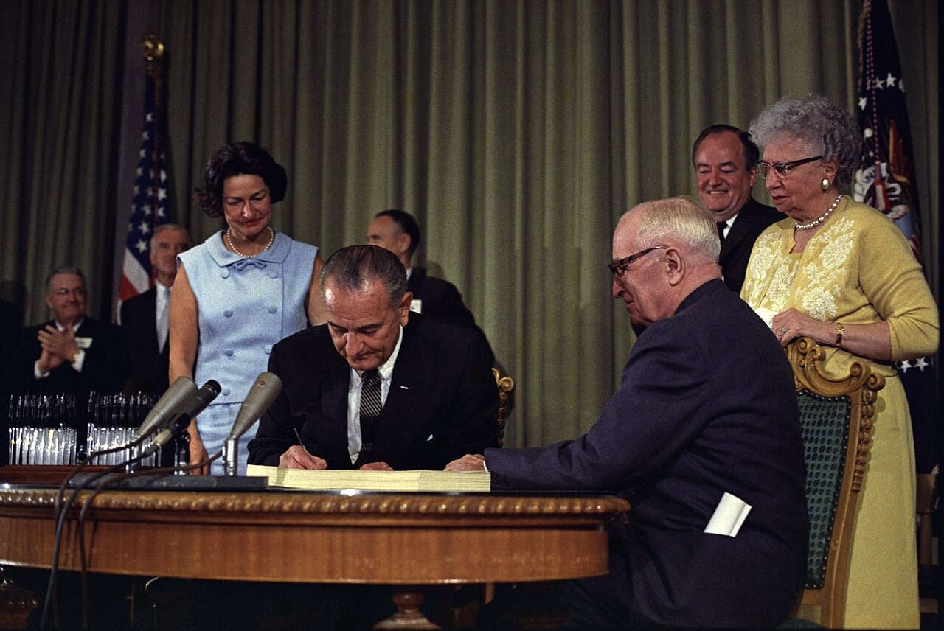
DIRECT INSTRUCTION
US.83
The Great Society aimed to end poverty and injustice — Johnson’s 1964-1969 agenda created Medicare, Medicaid, Head Start, VISTA, the Elementary and Secondary Education Act, urban renewal, and the War on Poverty to expand opportunity through federal power.
ZOOM IN
US.83 · Great Society Overview
U.S. History Hack · TroopToTeacher Technologies LLC · Aligned to TN Academic Standards & TCAP EOC
2

Slide 4
DIRECT INSTRUCTION
US.83
Medicare reshaped healthcare but strained budgets — it guaranteed health insurance to Americans over 65 who had faced age and pre-existing-condition discrimination, cutting senior medical bankruptcies, though costs soon rose beyond projections.
KEY POINT
Medicare reshaped healthcare but strained budgets — it guaranteed health insurance to Americans over 65 who had faced age and pre-existing-condition discrimination, cutting senior medical bankruptcies, though costs soon rose beyond projections.
US.83 · Medicare & Its Costs
U.S. History Hack · TroopToTeacher Technologies LLC · Aligned to TN Academic Standards & TCAP EOC
3

Slide 5
DIRECT INSTRUCTION
US.83
Results were real but mixed — poverty fell from 22.4% (1959) to 12.6% (1970) and Head Start and food stamps helped, yet urban renewal displaced minority neighborhoods and poverty plateaued in the 1970s, fueling lasting debate.
KEY POINT
Results were real but mixed — poverty fell from 22.4% (1959) to 12.6% (1970) and Head Start and food stamps helped, yet urban renewal displaced minority neighborhoods and poverty plateaued in the 1970s, fueling lasting debate.
US.83 · Impact & Debate
U.S. History Hack · TroopToTeacher Technologies LLC · Aligned to TN Academic Standards & TCAP EOC
4

Slide 6
SOURCE IT FIRST
US.83
Read Johnson’s Great Society Speech — weigh who spoke and why before you read the words.
WHO
WHEN
WHY
President Lyndon B. Johnson
May 22, 1964
Consider the author's purpose and audience before you interpret the words.
Great Society Speech
President Lyndon B. Johnson · May 22, 1964
"The Great Society rests on abundance and liberty for all. It demands an end to poverty and racial injustice, to which we are totally committed in our time. But that is just the beginning. The Great Society is a place where every child can find knowledge to enrich his mind and to enlarge his talents."
Miller Center, University of Virginia
U.S. History Hack · TroopToTeacher Technologies LLC · Aligned to TN Academic Standards & TCAP EOC
5

Slide 7
THREE PERSPECTIVES
US.83
A historian returns to three questions at the end of every reading. Use them to analyze this standard.
Who benefited?
Who bore the costs?
Who decided?
Who gained land, wealth, power, or protection?
Who lost land, labor, freedom, or life — and who was silenced?
Which people, offices, or courts held the authority?
US.83:
US.83:
US.83:
Elderly Americans who gained Medicare, poor families who gained Medicaid and food stamps, and children served by Head Start and new school funding.
Minority neighborhoods displaced by urban renewal, and taxpayers facing rising long-term program costs and debates over welfare dependency.
President Johnson, who set the agenda, and Congress, which funded and passed the Great Society programs into law.
Anchor: Great Society Speech, President Lyndon B. Johnson, May 22, 1964 (Miller Center, University of Virginia)
U.S. History Hack · TroopToTeacher Technologies LLC · Aligned to TN Academic Standards & TCAP EOC
6

Slide 8
KEY VOCABULARY · LANGUAGE SUPPORT
US.83
Words you need before we read
Great Society
War on Poverty
Medicare and Medicaid
En español: Gran Sociedad
En español: Guerra contra la Pobreza
En español: Medicare y Medicaid
WHAT IT MEANS
WHAT IT MEANS
WHAT IT MEANS
President Lyndon B. Johnson's 1960s domestic program to end poverty and racial injustice and expand education, health care, and civil rights.
LBJ's set of Great Society programs — including Head Start and Job Corps — created in 1964 to reduce poverty in the United States.
Federal health-insurance programs created in 1965: Medicare for Americans 65 and older, Medicaid for low-income families.
U.S. History Hack · TroopToTeacher Technologies LLC · Aligned to TN Academic Standards & TCAP EOC
2

Slide 9
PROGRESS CHECK
US.83
Check your understanding
How did Medicare transform healthcare access for elderly Americans, and what challenges did it create?
A
It provided health insurance for seniors who previously faced discrimination, reducing bankruptcies, but costs escalated beyond projections, creating fiscal challenges
B
Medicare had no significant impact on elderly healthcare, although this overlooks critical economic and social factors when examined alongside the available primary and secondary sources
C
Medicare only covered wealthy Americans, which contradicts the primary source evidence from this era, which does not align with the documented historical record
D
The program was eliminated after one year due to lack of support, which contradicts the primary source evidence from this era, but closer analysis reveals a more complicated historical reality
Confidence: 😟 1 🙂 2 😀 3 — circle where you are; your teacher routes reteach or extension.
U.S. History Hack · TroopToTeacher Technologies LLC · Aligned to TN Academic Standards & TCAP EOC
3

Slide 10
US.84
Social Activism and Counterculture
TN STANDARD
US.84 – Analyze different points of view that reflect the rise of social activism and the growth of counterculture, including generation gap, hippies, and Woodstock.
I CAN
I can analyze different points of view that reflect the rise of social activism and the growth of counterculture, including the generation gap, hippies, and Woodstock.
U.S. History Hack · TroopToTeacher Technologies LLC · Aligned to TN Academic Standards & TCAP EOC
7

Slide 11
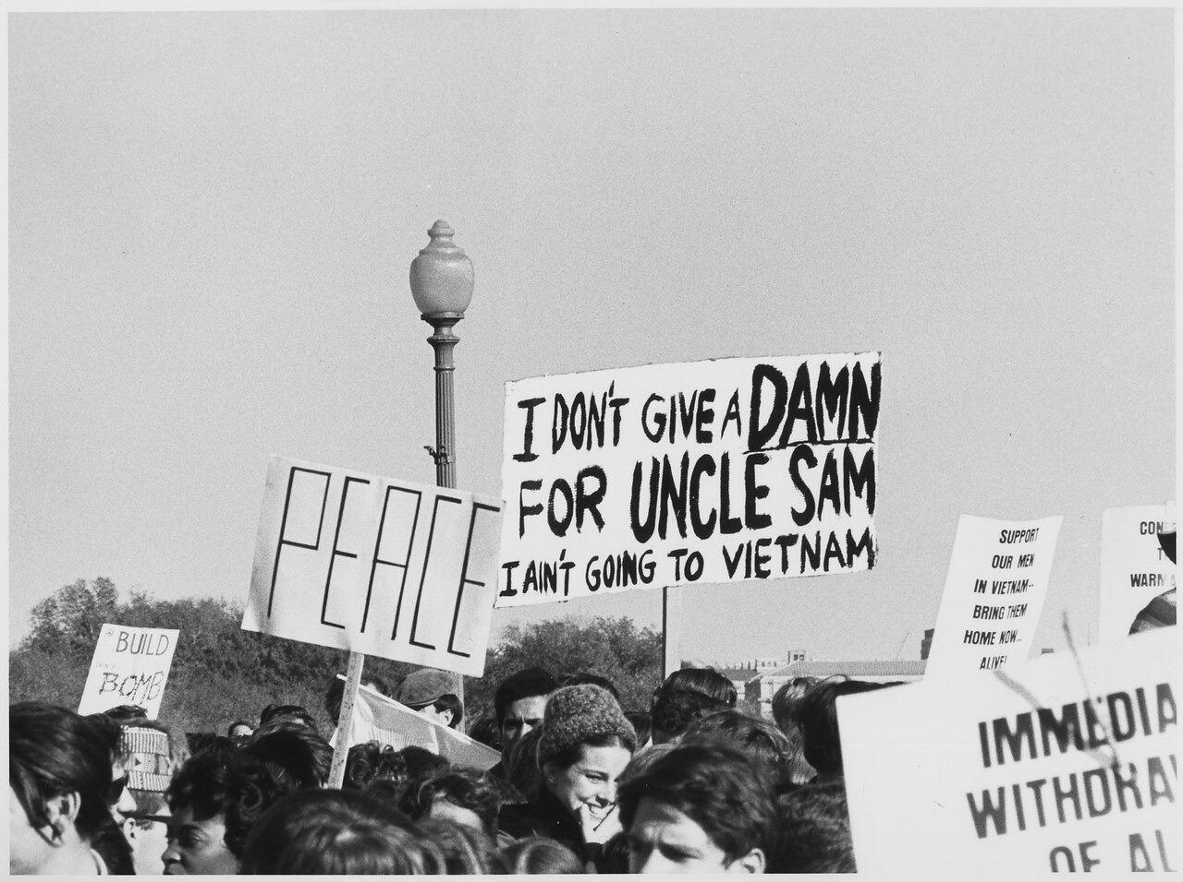
DIRECT INSTRUCTION
US.84
Americans split over protest and patriotism — supporters saw activism as democratic participation against injustice, war, and poverty, while critics viewed protesters as unpatriotic radicals undermining institutions and military morale.
ZOOM IN
US.84 · Divided Viewpoints
U.S. History Hack · TroopToTeacher Technologies LLC · Aligned to TN Academic Standards & TCAP EOC
8

Slide 12
DIRECT INSTRUCTION
US.84
A generation gap divided old and young — Americans shaped by the Depression and World War II clashed with a younger generation raised in postwar prosperity that questioned authority, traditional values, and foreign policy.
KEY POINT
A generation gap divided old and young — Americans shaped by the Depression and World War II clashed with a younger generation raised in postwar prosperity that questioned authority, traditional values, and foreign policy.
US.84 · The Generation Gap
U.S. History Hack · TroopToTeacher Technologies LLC · Aligned to TN Academic Standards & TCAP EOC
9

Slide 13
DIRECT INSTRUCTION
US.84
The counterculture challenged mainstream life — hippies rejected materialism, embraced peace and drugs, and opposed the Vietnam War; Woodstock (1969) symbolized their idealism even as the decade’s optimism faded into disillusionment.
KEY POINT
The counterculture challenged mainstream life — hippies rejected materialism, embraced peace and drugs, and opposed the Vietnam War; Woodstock (1969) symbolized their idealism even as the decade’s optimism faded into disillusionment.
US.84 · Hippies & Woodstock
U.S. History Hack · TroopToTeacher Technologies LLC · Aligned to TN Academic Standards & TCAP EOC
10

Slide 14
SOURCE IT FIRST
US.84
Read the Gulf of Tonkin Resolution — note who issued it and why before you read the text.
WHO
WHEN
WHY
U.S. Congress
August 7, 1964
Consider who wrote this and why before you decide what power it really granted.
Gulf of Tonkin Resolution
U.S. Congress · August 7, 1964
"The Congress approves and supports the determination of the President, as Commander in Chief, to take all necessary measures to repel any armed attack against the forces of the United States and to prevent further aggression... The United States is, therefore, prepared, as the President determines, to take all necessary steps, including the use of armed force."
National Archives
U.S. History Hack · TroopToTeacher Technologies LLC · Aligned to TN Academic Standards & TCAP EOC
11

Slide 15
THREE PERSPECTIVES
US.84
A historian returns to three questions at the end of every reading. Use them to analyze this standard.
Who benefited?
Who bore the costs?
Who decided?
Who gained land, wealth, power, or protection?
Who lost land, labor, freedom, or life — and who was silenced?
Which people, offices, or courts held the authority?
US.84:
US.84:
US.84:
Young activists who found a voice, and movements for civil rights, peace, and the environment that gained energy from the counterculture.
Soldiers and families divided by the war, and a society strained by generational conflict, drug use, and the collapse of 1960s optimism.
Congress and the president, who set war policy through measures like the Gulf of Tonkin Resolution, and the activists who chose to protest it.
Anchor: Gulf of Tonkin Resolution, U.S. Congress, August 7, 1964 (National Archives)
U.S. History Hack · TroopToTeacher Technologies LLC · Aligned to TN Academic Standards & TCAP EOC
12

Slide 16
KEY VOCABULARY · LANGUAGE SUPPORT
US.84
Words you need before we read
Counterculture
Generation Gap
Hippie Movement
En español: Contracultura
En español: Brecha Generacional
En español: Movimiento Hippie
WHAT IT MEANS
WHAT IT MEANS
WHAT IT MEANS
A 1960s youth movement that rejected mainstream values, embracing new music, dress, and views on peace, freedom, and social change.
The sharp differences in values, politics, and culture between 1960s youth and their parents' generation.
A counterculture group of the 1960s that promoted peace, love, communal living, and opposition to the Vietnam War.
U.S. History Hack · TroopToTeacher Technologies LLC · Aligned to TN Academic Standards & TCAP EOC
4

Slide 17
PROGRESS CHECK
US.84
Check your understanding
How did the hippie movement challenge mainstream American values?
A
Hippies supported traditional American values, which contradicts the primary source evidence from this era, but the historical evidence paints a more nuanced picture
B
They rejected materialism, conformity, and militarism while embracing alternative lifestyles, peace, environmental awareness, and communal living
C
The hippie movement had no significant cultural impact, which does not align with the documented historical record
D
Hippies focused exclusively on political reform, although this view has been largely discredited by scholars
Confidence: 😟 1 🙂 2 😀 3 — circle where you are; your teacher routes reteach or extension.
U.S. History Hack · TroopToTeacher Technologies LLC · Aligned to TN Academic Standards & TCAP EOC
5

Slide 18
US.85
Nixon Administration Achievements
TN STANDARD
US.85 – Explain significant achievements of President Richard Nixon's administration, including his appeal to the "silent majority" and his major foreign policy actions.
I CAN
I can explain significant achievements of President Richard Nixon's administration, including his appeal to the "silent majority" and his major foreign policy actions.
U.S. History Hack · TroopToTeacher Technologies LLC · Aligned to TN Academic Standards & TCAP EOC
13

Slide 19
DIRECT INSTRUCTION
US.85
Nixon posted broad achievements — he pursued detente and SALT I with the USSR, created the EPA, saw Title IX and the 26th Amendment (voting age 18) enacted, enforced desegregation, and imposed temporary wage and price controls.
KEY POINT
Nixon posted broad achievements — he pursued detente and SALT I with the USSR, created the EPA, saw Title IX and the 26th Amendment (voting age 18) enacted, enforced desegregation, and imposed temporary wage and price controls.
US.85 · Significant Achievements
U.S. History Hack · TroopToTeacher Technologies LLC · Aligned to TN Academic Standards & TCAP EOC
14

Slide 20
DIRECT INSTRUCTION
US.85
The "silent majority" reshaped politics — Nixon appealed to Americans who did not protest but backed law and order and traditional values, winning working-class Democrats and building a coalition that reshaped Republican strategy.
KEY POINT
The "silent majority" reshaped politics — Nixon appealed to Americans who did not protest but backed law and order and traditional values, winning working-class Democrats and building a coalition that reshaped Republican strategy.
US.85 · The Silent Majority
U.S. History Hack · TroopToTeacher Technologies LLC · Aligned to TN Academic Standards & TCAP EOC
15

Slide 21
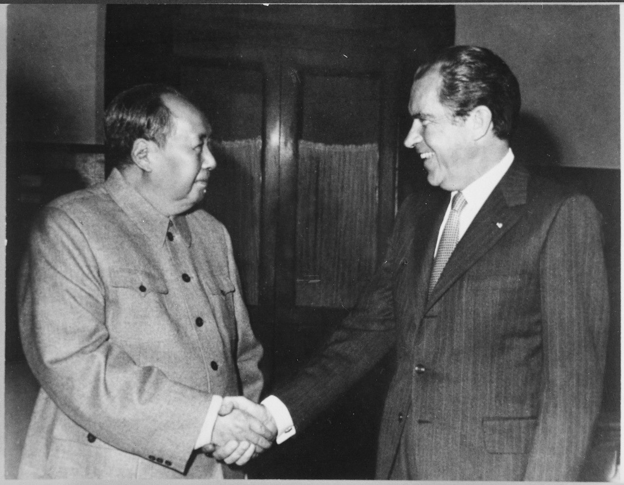
DIRECT INSTRUCTION
US.85
Nixon opened China and eased Cold War tension — secret diplomacy led to his historic 1972 China visit, detente reduced friction with the USSR through arms control, and Vietnamization gradually withdrew U.S. troops before Saigon fell in 1975.
ZOOM IN
US.85 · Foreign Policy
U.S. History Hack · TroopToTeacher Technologies LLC · Aligned to TN Academic Standards & TCAP EOC
16

Slide 22
SOURCE IT FIRST
US.85
Read Nixon’s Silent Majority Speech — identify the speaker and his audience before you weigh the words.
WHO
WHEN
WHY
President Richard Nixon
November 3, 1969
Consider who Nixon is addressing and why before you judge the speech.
Silent Majority Speech
President Richard Nixon · November 3, 1969
"And so tonight — to you, the great silent majority of my fellow Americans — I ask for your support. I pledged in my campaign for the Presidency to end the war in a way that we could win the peace. I have initiated a plan of action which will enable me to keep that pledge."
Richard Nixon Presidential Library
U.S. History Hack · TroopToTeacher Technologies LLC · Aligned to TN Academic Standards & TCAP EOC
17

Slide 23
THREE PERSPECTIVES
US.85
A historian returns to three questions at the end of every reading. Use them to analyze this standard.
Who benefited?
Who bore the costs?
Who decided?
Who gained land, wealth, power, or protection?
Who lost land, labor, freedom, or life — and who was silenced?
Which people, offices, or courts held the authority?
US.85:
US.85:
US.85:
The U.S. strategically, through the opening to China and arms control, and Republicans who gained a durable working-class coalition.
South Vietnam, which fell in 1975 after U.S. withdrawal, and protest movements framed as outside Nixon’s ’silent majority.’
President Nixon and his advisers, who drove foreign policy and domestic strategy, and Congress, which enacted measures like Title IX and the 26th Amendment.
Anchor: Silent Majority Speech, President Richard Nixon, November 3, 1969 (Richard Nixon Presidential Library)
U.S. History Hack · TroopToTeacher Technologies LLC · Aligned to TN Academic Standards & TCAP EOC
18

Slide 24
KEY VOCABULARY · LANGUAGE SUPPORT
US.85
Words you need before we read
Silent Majority
Détente
Nixon Visits China
En español: Mayoría Silenciosa
En español: Distensión
En español: Visita de Nixon a China
WHAT IT MEANS
WHAT IT MEANS
WHAT IT MEANS
President Nixon's term for the many Americans who quietly supported his policies but did not join loud public protests.
Nixon's policy of easing Cold War tensions with the Soviet Union and China through diplomacy and treaties.
Nixon's historic 1972 trip that reopened U.S. relations with Communist China after more than 20 years of hostility.
U.S. History Hack · TroopToTeacher Technologies LLC · Aligned to TN Academic Standards & TCAP EOC
6

Slide 25
PROGRESS CHECK
US.85
Check your understanding
How did Nixon's "Silent Majority" strategy reshape American political campaigns and voter appeals?
A
The Silent Majority strategy had no lasting political impact, which represents a common misconception about the period despite the fact that multiple contemporary sources contradict this
B
Nixon only appealed to wealthy voters, which ignores key developments that shaped the outcome and does not reflect the scholarly consensus on this topic
C
It appealed to middle-class voters frustrated with protests and counterculture, winning working-class Democrats and reshaping Republican electoral strategy for decades
D
The strategy focused exclusively on young voters, though this interpretation lacks supporting historical evidence when examined alongside the available primary and secondary sources
Confidence: 😟 1 🙂 2 😀 3 — circle where you are; your teacher routes reteach or extension.
U.S. History Hack · TroopToTeacher Technologies LLC · Aligned to TN Academic Standards & TCAP EOC
7

Slide 26
US.86
Watergate Scandal
TN STANDARD
US.86 – Examine the Watergate scandal, including: Background of the break-in, Changing role of media and journalism, Controversy surrounding President Gerald Ford's pardon, Legacy of distrust, United States v. Nixon.
I CAN
I can examine the Watergate scandal, including the background of the break-in, the changing role of media, President Ford's pardon controversy, the legacy of distrust, and United States v. Nixon.
U.S. History Hack · TroopToTeacher Technologies LLC · Aligned to TN Academic Standards & TCAP EOC
19

Slide 27
DIRECT INSTRUCTION
US.86
A break-in became a constitutional crisis — the June 1972 burglary of Democratic headquarters at the Watergate complex was tied to Nixon’s reelection campaign (CREEP) and the White House; the cover-up proved more damaging than the crime.
KEY POINT
A break-in became a constitutional crisis — the June 1972 burglary of Democratic headquarters at the Watergate complex was tied to Nixon’s reelection campaign (CREEP) and the White House; the cover-up proved more damaging than the crime.
US.86 · The Break-in
U.S. History Hack · TroopToTeacher Technologies LLC · Aligned to TN Academic Standards & TCAP EOC
20

Slide 28
DIRECT INSTRUCTION
US.86
The press held power accountable — Washington Post reporters Woodward and Bernstein followed the money and cultivated sources like "Deep Throat" (Mark Felt), while televised hearings established investigative journalism as a democratic check.
KEY POINT
The press held power accountable — Washington Post reporters Woodward and Bernstein followed the money and cultivated sources like "Deep Throat" (Mark Felt), while televised hearings established investigative journalism as a democratic check.
US.86 · The Media’s Role
U.S. History Hack · TroopToTeacher Technologies LLC · Aligned to TN Academic Standards & TCAP EOC
21

Slide 29
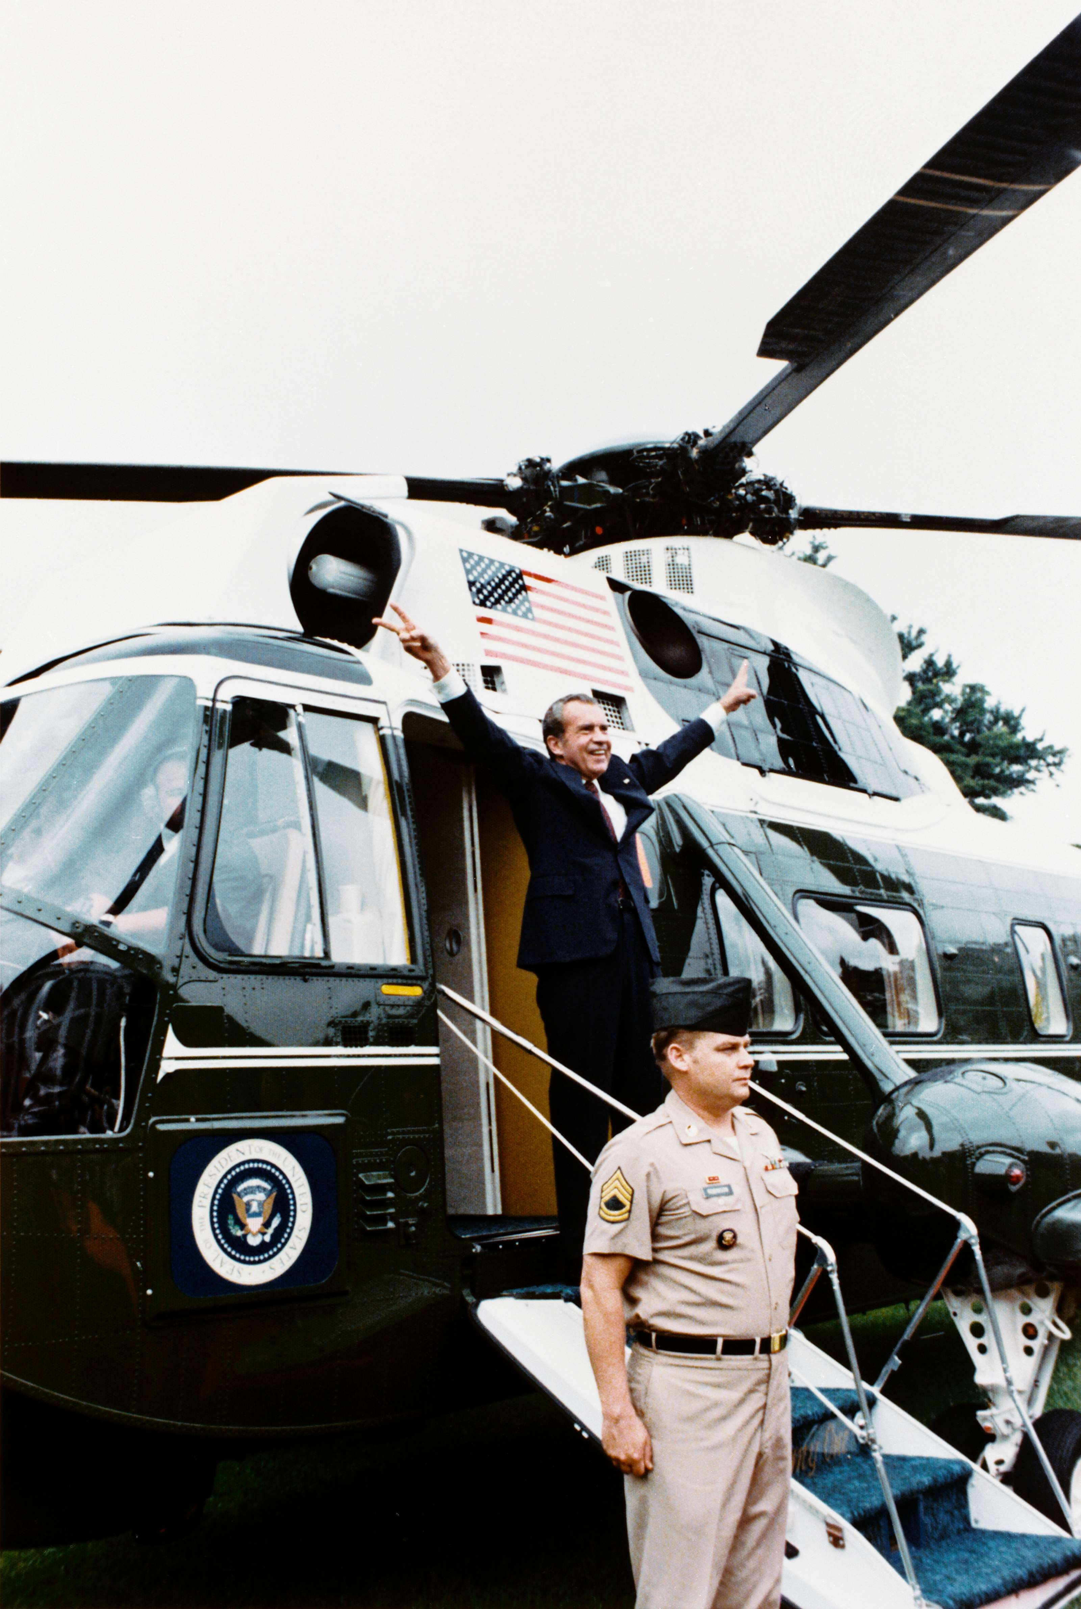
DIRECT INSTRUCTION
US.86
The Court affirmed no one is above the law — in United States v. Nixon the justices unanimously ruled executive privilege could not block a criminal subpoena; Nixon surrendered the tapes and resigned, and Ford’s pardon deepened public distrust.
ZOOM IN
US.86 · U.S. v. Nixon & Resignation
U.S. History Hack · TroopToTeacher Technologies LLC · Aligned to TN Academic Standards & TCAP EOC
22

Slide 30
SOURCE IT FIRST
US.86
Read Nixon’s Resignation Speech — weigh who wrote it and why before you read the words.
WHO
WHEN
WHY
President Richard Nixon
August 8, 1974
Consider the author's purpose — a resignation speech is meant to shape how history remembers him.
Resignation Speech
President Richard Nixon · August 8, 1974
"I have never been a quitter. To leave office before my term is completed is abhorrent to every instinct in my body. But as President, I must put the interest of America first... Therefore, I shall resign the Presidency effective at noon tomorrow. Vice President Ford will be sworn in as President."
National Archives
U.S. History Hack · TroopToTeacher Technologies LLC · Aligned to TN Academic Standards & TCAP EOC
23

Slide 31
THREE PERSPECTIVES
US.86
A historian returns to three questions at the end of every reading. Use them to analyze this standard.
Who benefited?
Who bore the costs?
Who decided?
Who gained land, wealth, power, or protection?
Who lost land, labor, freedom, or life — and who was silenced?
Which people, offices, or courts held the authority?
US.86:
US.86:
US.86:
The rule of law and the press, which proved they could check a president, and the courts, which affirmed limits on executive power.
Public trust in government, which fell from 73% (1958) to 36% (1974), and Americans left cynical by the cover-up and Ford’s pardon.
The Supreme Court, which ordered the tapes released, Congress, which pursued impeachment, and President Ford, who chose to pardon Nixon.
Anchor: Resignation Speech, President Richard Nixon, August 8, 1974 (National Archives)
U.S. History Hack · TroopToTeacher Technologies LLC · Aligned to TN Academic Standards & TCAP EOC
24

Slide 32
KEY VOCABULARY · LANGUAGE SUPPORT
US.86
Words you need before we read
Watergate Scandal
United States v. Nixon
Executive Privilege
En español: Escándalo de Watergate
En español: Estados Unidos vs. Nixon
En español: Privilegio Ejecutivo
WHAT IT MEANS
WHAT IT MEANS
WHAT IT MEANS
A political scandal beginning with a 1972 break-in at Democratic headquarters that exposed abuses of power and forced Nixon to resign in 1974.
A 1974 Supreme Court ruling that the president is not above the law and must release the Watergate tapes.
A president's claimed right to keep some communications secret — rejected by the Court in the Watergate tapes case.
U.S. History Hack · TroopToTeacher Technologies LLC · Aligned to TN Academic Standards & TCAP EOC
8

Slide 33
PROGRESS CHECK
US.86
Check your understanding
How did investigative journalism during Watergate change the relationship between media and government?
A
Media coverage had no significant impact on Watergate, which ignores key developments that shaped the outcome and fails to account for key developments in the broader context
B
The media supported Nixon throughout the scandal, but the historical record tells a more complex story when examined alongside the available primary and secondary sources
C
Journalism became less important after Watergate, which does not align with the documented historical record despite the fact that multiple contemporary sources contradict this
D
Woodward and Bernstein's persistent investigation demonstrated media's power to hold government accountable, establishing investigative journalism as crucial to democracy
Confidence: 😟 1 🙂 2 😀 3 — circle where you are; your teacher routes reteach or extension.
U.S. History Hack · TroopToTeacher Technologies LLC · Aligned to TN Academic Standards & TCAP EOC
9

Slide 34
US.87
Emergence of Environmentalism
TN STANDARD
US.87 – Explain the emergence of environmentalism, including the creation of the Environmental Protection Agency and disasters such as Love Canal and Three Mile Island.
I CAN
I can explain the emergence of environmentalism, including the creation of the Environmental Protection Agency and disasters such as Love Canal and Three Mile Island.
U.S. History Hack · TroopToTeacher Technologies LLC · Aligned to TN Academic Standards & TCAP EOC
25

Slide 35
DIRECT INSTRUCTION
US.87
Rising alarm launched the environmental movement — Rachel Carson’s Silent Spring (1962) exposed pesticide dangers, visible smog and polluted rivers spread concern, and Earth Day 1970 brought massive demonstrations for environmental protection.
KEY POINT
Rising alarm launched the environmental movement — Rachel Carson’s Silent Spring (1962) exposed pesticide dangers, visible smog and polluted rivers spread concern, and Earth Day 1970 brought massive demonstrations for environmental protection.
US.87 · Roots of the Movement
U.S. History Hack · TroopToTeacher Technologies LLC · Aligned to TN Academic Standards & TCAP EOC
26

Slide 36
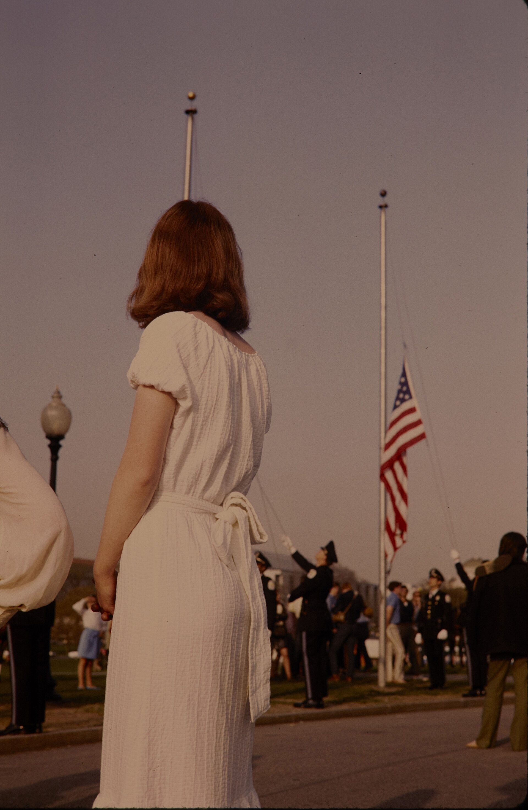
DIRECT INSTRUCTION
US.87
The EPA made protection a federal priority — created in 1970, it consolidated federal environmental duties — setting pollution standards, enforcing laws, funding research, and regulating toxic substances — building America’s framework for environmental regulation.
ZOOM IN
US.87 · Creating the EPA
U.S. History Hack · TroopToTeacher Technologies LLC · Aligned to TN Academic Standards & TCAP EOC
27

Slide 37
DIRECT INSTRUCTION
US.87
Disasters proved the stakes were real — at Love Canal (NY) toxic waste under homes and a school forced 239 families to relocate and spurred the Superfund program; the 1979 Three Mile Island meltdown scare largely halted new U.S. nuclear plants.
KEY POINT
Disasters proved the stakes were real — at Love Canal (NY) toxic waste under homes and a school forced 239 families to relocate and spurred the Superfund program; the 1979 Three Mile Island meltdown scare largely halted new U.S. nuclear plants.
US.87 · Love Canal & Three Mile Island
U.S. History Hack · TroopToTeacher Technologies LLC · Aligned to TN Academic Standards & TCAP EOC
28

Slide 38
SOURCE IT FIRST
US.87
Read Nixon’s EPA Establishment Message — note who issued it and why before you read the words.
WHO
WHEN
WHY
President Richard Nixon
July 9, 1970
Consider that Nixon is announcing a new federal agency to Congress — how does that official purpose shape what the message emphasizes?
EPA Establishment Message
President Richard Nixon · July 9, 1970
"Our national government today is not structured to make a coordinated attack on the pollutants which debase the air we breathe, the water we drink, and the land that grows our food... The Environmental Protection Agency would be charged with protecting and enhancing the physical environment of the Nation."
Richard Nixon Presidential Library
U.S. History Hack · TroopToTeacher Technologies LLC · Aligned to TN Academic Standards & TCAP EOC
29

Slide 39
THREE PERSPECTIVES
US.87
A historian returns to three questions at the end of every reading. Use them to analyze this standard.
Who benefited?
Who bore the costs?
Who decided?
Who gained land, wealth, power, or protection?
Who lost land, labor, freedom, or life — and who was silenced?
Which people, offices, or courts held the authority?
US.87:
US.87:
US.87:
The public, who gained cleaner air and water and a federal agency to enforce it, and future generations protected by new environmental laws.
Families harmed at Love Canal and communities near polluters, and industries newly bound by regulation and cleanup responsibility.
President Nixon and Congress, who created the EPA and passed environmental laws, and the agency itself, which set and enforced standards.
Anchor: EPA Establishment Message, President Richard Nixon, July 9, 1970 (Richard Nixon Presidential Library)
U.S. History Hack · TroopToTeacher Technologies LLC · Aligned to TN Academic Standards & TCAP EOC
30

Slide 40
KEY VOCABULARY · LANGUAGE SUPPORT
US.87
Words you need before we read
Environmentalism
Environmental Protection Agency (EPA)
Earth Day
En español: Ambientalismo
En español: Agencia de Protección Ambiental
En español: Día de la Tierra
WHAT IT MEANS
WHAT IT MEANS
WHAT IT MEANS
A movement that grew in the 1960s-70s to protect nature and public health from pollution and industrial harm.
The federal agency created in 1970 to set and enforce standards for clean air, water, and land.
First held April 22, 1970, a nationwide event that raised public awareness and support for protecting the environment.
U.S. History Hack · TroopToTeacher Technologies LLC · Aligned to TN Academic Standards & TCAP EOC
10

Slide 41
PROGRESS CHECK
US.87
Check your understanding
What lessons did Love Canal and Three Mile Island teach Americans about industrial and nuclear safety?
A
Love Canal showed toxic waste dangers leading to Superfund, while Three Mile Island raised nuclear safety fears that halted reactor construction
B
These incidents had no lasting policy impact, but this oversimplifies the complex factors at work and oversimplifies the complex factors at work during this period
C
Both incidents proved industrial practices were completely safe, which does not align with the documented historical record
D
Only Love Canal affected environmental policy, although this overlooks critical economic and social factors
Confidence: 😟 1 🙂 2 😀 3 — circle where you are; your teacher routes reteach or extension.
U.S. History Hack · TroopToTeacher Technologies LLC · Aligned to TN Academic Standards & TCAP EOC
11

Slide 42
US.88
Carter Administration Events
TN STANDARD
US.88 – Identify and explain the significant events of President Jimmy Carter's administration, including: Poor economy, Panama Canal Treaty, Camp David Accords, Energy crisis, Iran Hostage Crisis.
I CAN
I can identify and explain the significant events of President Jimmy Carter's administration, including the poor economy, Panama Canal Treaty, Camp David Accords, energy crisis, and Iran Hostage Crisis.
U.S. History Hack · TroopToTeacher Technologies LLC · Aligned to TN Academic Standards & TCAP EOC
31

Slide 43
DIRECT INSTRUCTION
US.88
"Stagflation" gripped the economy — Carter faced high inflation (13.5% by 1980) and unemployment (7.6%) at once, with soaring energy costs and 20% interest rates; his wage-price guidelines and monetary tightening proved insufficient.
KEY POINT
"Stagflation" gripped the economy — Carter faced high inflation (13.5% by 1980) and unemployment (7.6%) at once, with soaring energy costs and 20% interest rates; his wage-price guidelines and monetary tightening proved insufficient.
US.88 · Economic Difficulties
U.S. History Hack · TroopToTeacher Technologies LLC · Aligned to TN Academic Standards & TCAP EOC
32

Slide 44
DIRECT INSTRUCTION
US.88
Energy and diplomacy tested his presidency — two oil crises brought gas lines and the new Department of Energy; the 1977 Panama Canal treaties transferred canal control to Panama by 1999, drawing fierce conservative opposition.
KEY POINT
Energy and diplomacy tested his presidency — two oil crises brought gas lines and the new Department of Energy; the 1977 Panama Canal treaties transferred canal control to Panama by 1999, drawing fierce conservative opposition.
US.88 · Energy & Panama Canal
U.S. History Hack · TroopToTeacher Technologies LLC · Aligned to TN Academic Standards & TCAP EOC
33

Slide 45
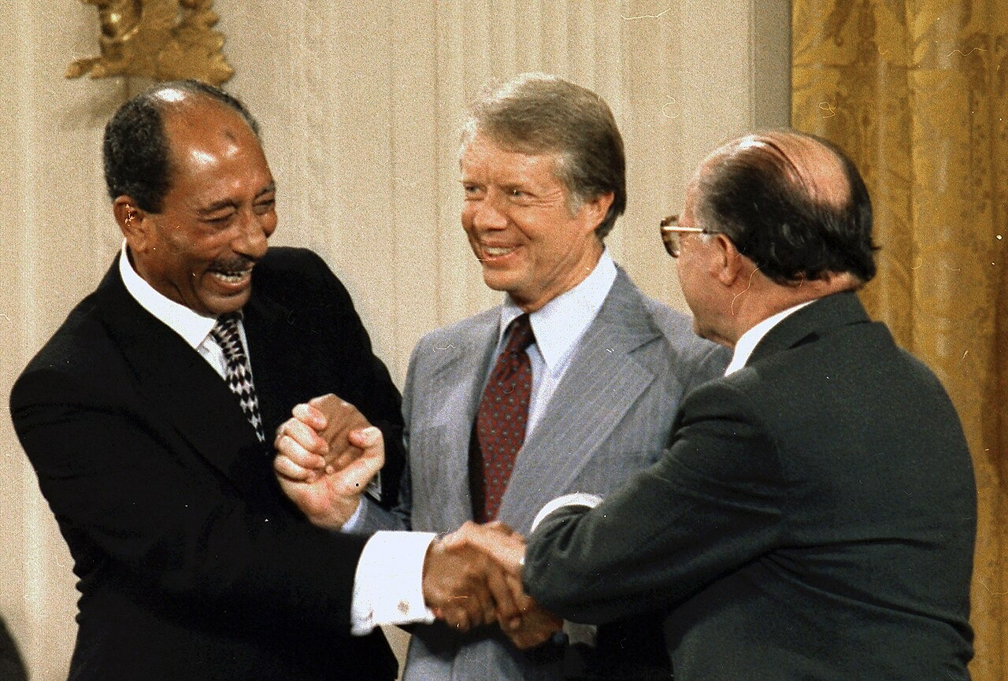
DIRECT INSTRUCTION
US.88
Peace at Camp David, crisis in Iran — Carter mediated 13 days between Sadat and Begin, producing the first Arab-Israeli peace framework; but Iranian revolutionaries held 52 Americans hostage for 444 days, dooming his 1980 reelection.
ZOOM IN
US.88 · Camp David & Iran
U.S. History Hack · TroopToTeacher Technologies LLC · Aligned to TN Academic Standards & TCAP EOC
34

Slide 46
SOURCE IT FIRST
US.88
Read Carter’s Camp David Accords Signing Statement — weigh who spoke and why before you read the words.
WHO
WHEN
WHY
President Jimmy Carter
September 17, 1978
Consider the setting — a signing ceremony is meant to celebrate and frame an achievement.
Camp David Accords Signing Statement
President Jimmy Carter · September 17, 1978
"During the last two weeks, the members of all three delegations have spent endless hours, day and night, talking, negotiating, grappling with problems that have divided their people for 30 years. Whenever there was a deadlock, they found new ways to break the barrier."
Jimmy Carter Presidential Library
U.S. History Hack · TroopToTeacher Technologies LLC · Aligned to TN Academic Standards & TCAP EOC
35

Slide 47
THREE PERSPECTIVES
US.88
A historian returns to three questions at the end of every reading. Use them to analyze this standard.
Who benefited?
Who bore the costs?
Who decided?
Who gained land, wealth, power, or protection?
Who lost land, labor, freedom, or life — and who was silenced?
Which people, offices, or courts held the authority?
US.88:
US.88:
US.88:
Egypt and Israel, who gained a peace framework and the Sinai’s return, and Panama, which regained control of the canal.
American families squeezed by stagflation and gas lines, and the 52 hostages held in Iran for 444 days.
President Carter, who mediated Camp David and set energy policy, and the Senate, which ratified the Panama Canal treaties.
Anchor: Camp David Accords Signing Statement, President Jimmy Carter, September 17, 1978 (Jimmy Carter Presidential Library)
U.S. History Hack · TroopToTeacher Technologies LLC · Aligned to TN Academic Standards & TCAP EOC
36

Slide 48
KEY VOCABULARY · LANGUAGE SUPPORT
US.88
Words you need before we read
Stagflation
Energy Crisis
Camp David Accords
En español: Estanflación
En español: Crisis Energética
En español: Acuerdos de Camp David
WHAT IT MEANS
WHAT IT MEANS
WHAT IT MEANS
An unusual 1970s economy combining high inflation, high unemployment, and slow growth at the same time.
1970s fuel shortages and soaring gas prices, worsened by an OPEC oil embargo, that strained the U.S. economy.
A 1978 peace agreement between Egypt and Israel brokered by President Carter, a major diplomatic success.
U.S. History Hack · TroopToTeacher Technologies LLC · Aligned to TN Academic Standards & TCAP EOC
12

Slide 49
PROGRESS CHECK
US.88
Check your understanding
What economic challenges did President Carter face, and why were his solutions unsuccessful?
A
Carter faced no significant economic challenges, although this overlooks critical economic and social factors, and this view has been largely revised by modern historical research
B
Stagflation combined high inflation and unemployment; his voluntary guidelines and monetary tightening proved insufficient against these complex, interconnected problems
C
The economy thrived during Carter's presidency, although historical sources do not support this conclusion and oversimplifies the complex factors at work during this period
D
Carter's policies immediately solved all economic problems, although this overlooks critical economic and social factors, which ignores significant political and cultural developments of the era
Confidence: 😟 1 🙂 2 😀 3 — circle where you are; your teacher routes reteach or extension.
U.S. History Hack · TroopToTeacher Technologies LLC · Aligned to TN Academic Standards & TCAP EOC
13

Slide 50
US.89
Reagan Administration Significance
TN STANDARD
US.89 – Analyze the significance of President Ronald Reagan's administration, including: Revitalization of national pride, Reaganomics, Iran-Contra affair, "War on Drugs", Strategic Defense Initiative, AIDS epidemic.
I CAN
I can analyze the significance of President Ronald Reagan's administration, including the revitalization of national pride, Reaganomics, Iran-Contra affair, "War on Drugs," Strategic Defense Initiative, and the AIDS epidemic.
U.S. History Hack · TroopToTeacher Technologies LLC · Aligned to TN Academic Standards & TCAP EOC
37

Slide 51
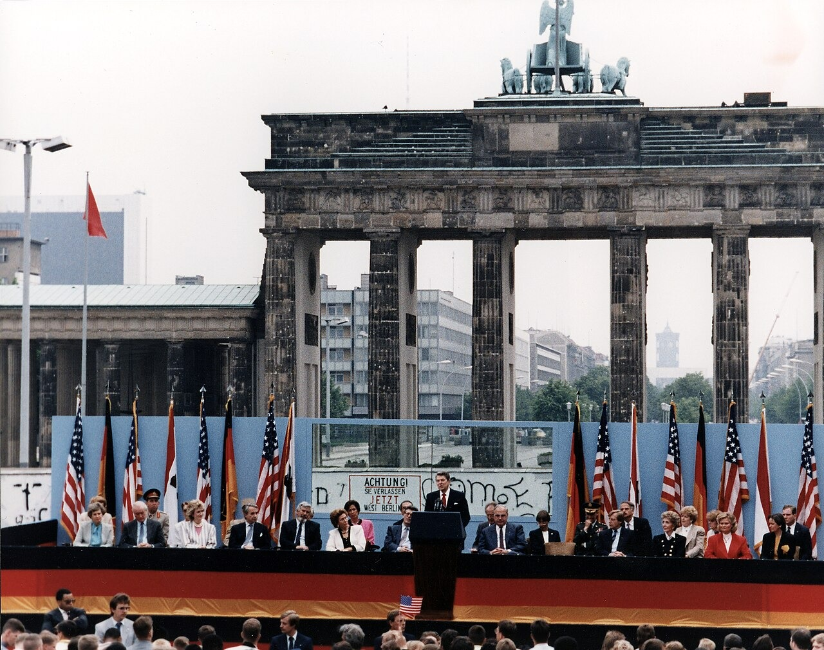
DIRECT INSTRUCTION
US.89
Reagan restored national confidence — through optimistic "Morning in America" rhetoric, a large military buildup, and interventions like Grenada, he helped Americans feel proud again after Vietnam, Watergate, and the Iran hostage crisis.
ZOOM IN
US.89 · Reviving National Pride
U.S. History Hack · TroopToTeacher Technologies LLC · Aligned to TN Academic Standards & TCAP EOC
38

Slide 52
DIRECT INSTRUCTION
US.89
"Reaganomics" reshaped the economy — supply-side tax cuts, deregulation, and spending cuts (except defense) renewed growth and lowered inflation, but income inequality and federal deficits rose, sparking lasting fairness debates.
KEY POINT
"Reaganomics" reshaped the economy — supply-side tax cuts, deregulation, and spending cuts (except defense) renewed growth and lowered inflation, but income inequality and federal deficits rose, sparking lasting fairness debates.
US.89 · Reaganomics
U.S. History Hack · TroopToTeacher Technologies LLC · Aligned to TN Academic Standards & TCAP EOC
39

Slide 53
DIRECT INSTRUCTION
US.89
SDI, Iran-Contra, and AIDS marked his record — his "Star Wars" missile-defense plan pressured the USSR; the secret Iran-Contra arms deal broke the law and damaged his credibility; and his slow AIDS response drew lasting criticism.
KEY POINT
SDI, Iran-Contra, and AIDS marked his record — his "Star Wars" missile-defense plan pressured the USSR; the secret Iran-Contra arms deal broke the law and damaged his credibility; and his slow AIDS response drew lasting criticism.
US.89 · SDI, Iran-Contra & AIDS
U.S. History Hack · TroopToTeacher Technologies LLC · Aligned to TN Academic Standards & TCAP EOC
40

Slide 54
SOURCE IT FIRST
US.89
Read Reagan’s First Inaugural Address — note the speaker and moment before you weigh the words.
WHO
WHEN
WHY
President Ronald Reagan
January 20, 1981
Consider that an inaugural address is designed to set the tone and philosophy for a whole presidency.
First Inaugural Address
President Ronald Reagan · January 20, 1981
"In this present crisis, government is not the solution to our problem; government is the problem. From time to time we've been tempted to believe that society has become too complex to be managed by self-rule... But if no one among us is capable of governing himself, then who among us has the capacity to govern someone else?"
Ronald Reagan Presidential Library
U.S. History Hack · TroopToTeacher Technologies LLC · Aligned to TN Academic Standards & TCAP EOC
41

Slide 55
THREE PERSPECTIVES
US.89
A historian returns to three questions at the end of every reading. Use them to analyze this standard.
Who benefited?
Who bore the costs?
Who decided?
Who gained land, wealth, power, or protection?
Who lost land, labor, freedom, or life — and who was silenced?
Which people, offices, or courts held the authority?
US.89:
US.89:
US.89:
Higher-income Americans who gained from tax cuts and growth, and a nation whose confidence and standing rose as the Cold War wound down.
Poorer Americans hit by social-program cuts and rising inequality, and people with AIDS harmed by the administration’s delayed response.
President Reagan and his officials, who set economic and defense policy, and Congress, which passed his budgets and later investigated Iran-Contra.
Anchor: First Inaugural Address, President Ronald Reagan, January 20, 1981 (Ronald Reagan Presidential Library)
U.S. History Hack · TroopToTeacher Technologies LLC · Aligned to TN Academic Standards & TCAP EOC
42

Slide 56
KEY VOCABULARY · LANGUAGE SUPPORT
US.89
Words you need before we read
Reaganomics
Supply-Side Economics
Strategic Defense Initiative
En español: Reaganomía
En español: Economía de la Oferta
En español: Iniciativa de Defensa Estratégica
WHAT IT MEANS
WHAT IT MEANS
WHAT IT MEANS
President Reagan's economic plan of tax cuts, reduced regulation, and lower domestic spending to spur growth (supply-side economics).
The theory behind Reaganomics that cutting taxes on businesses and the wealthy encourages investment and benefits the whole economy.
Reagan's proposed 1983 space-based missile-defense system, nicknamed 'Star Wars,' to intercept Soviet nuclear attacks.
U.S. History Hack · TroopToTeacher Technologies LLC · Aligned to TN Academic Standards & TCAP EOC
14

Slide 57
PROGRESS CHECK
US.89
Check your understanding
Analyze the economic principles of Reaganomics and evaluate their impact on different groups of Americans.
A
Reaganomics affected all Americans equally, which does not align with the documented historical record, but contemporary accounts and primary sources suggest otherwise
B
Reaganomics eliminated all economic inequality, although historical sources do not support this conclusion and does not reflect the scholarly consensus on this topic
C
Supply-side tax cuts and deregulation promoted growth but increased inequality—wealthy Americans benefited most while social program cuts affected the poor
D
Only poor Americans benefited from Reagan's policies, but this fails to account for the broader historical context, which does not align with the documented historical record
Confidence: 😟 1 🙂 2 😀 3 — circle where you are; your teacher routes reteach or extension.
U.S. History Hack · TroopToTeacher Technologies LLC · Aligned to TN Academic Standards & TCAP EOC
15

Slide 58
US.90
George H.W. Bush Administration
TN STANDARD
US.90 – Describe the significant events of President George H.W. Bush's administration, including the invasion of Panama and the Gulf War.
I CAN
I can describe the significant events of President George H.W. Bush's administration, including the invasion of Panama and the Gulf War.
U.S. History Hack · TroopToTeacher Technologies LLC · Aligned to TN Academic Standards & TCAP EOC
43

Slide 59
DIRECT INSTRUCTION
US.90
Panama tested post-Cold War force — Operation Just Cause (1989) removed dictator Manuel Noriega, indicted for drug trafficking, showing American willingness to use military power for law enforcement and setting precedents for future interventions.
KEY POINT
Panama tested post-Cold War force — Operation Just Cause (1989) removed dictator Manuel Noriega, indicted for drug trafficking, showing American willingness to use military power for law enforcement and setting precedents for future interventions.
US.90 · Invasion of Panama
U.S. History Hack · TroopToTeacher Technologies LLC · Aligned to TN Academic Standards & TCAP EOC
44

Slide 60
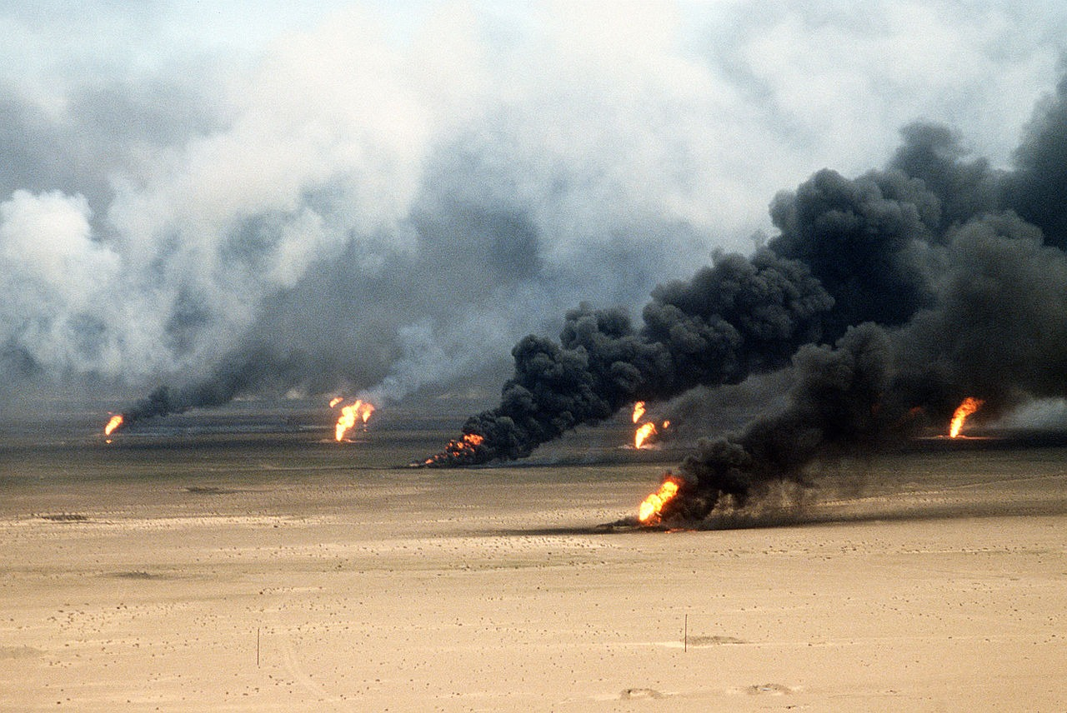
DIRECT INSTRUCTION
US.90
The Gulf War showcased coalition power — after Iraq invaded Kuwait (1990), Bush built an international coalition with UN authorization; Operation Desert Storm (1991) quickly freed Kuwait with few coalition casualties, proving multilateral action possible.
ZOOM IN
US.90 · The Gulf War
U.S. History Hack · TroopToTeacher Technologies LLC · Aligned to TN Academic Standards & TCAP EOC
45

Slide 61
DIRECT INSTRUCTION
US.90
The Cold War ended on Bush’s watch — the Berlin Wall fell (1989) and the USSR dissolved (1991); Bush managed the transition carefully, avoided triumphalism, and supported German reunification, leaving the U.S. the sole superpower.
KEY POINT
The Cold War ended on Bush’s watch — the Berlin Wall fell (1989) and the USSR dissolved (1991); Bush managed the transition carefully, avoided triumphalism, and supported German reunification, leaving the U.S. the sole superpower.
US.90 · End of the Cold War
U.S. History Hack · TroopToTeacher Technologies LLC · Aligned to TN Academic Standards & TCAP EOC
46

Slide 62
SOURCE IT FIRST
US.90
Read Bush’s Address on the Gulf War — weigh who spoke and why before you read the words.
WHO
WHEN
WHY
President George H.W. Bush
January 16, 1991
Consider that a wartime address is meant to justify military action and rally the public.
Address on the Gulf War
President George H.W. Bush · January 16, 1991
"Five months ago, Saddam Hussein started this cruel war against Kuwait. Tonight, the battle has been joined... Our objectives are clear: Saddam Hussein's forces will leave Kuwait. The legitimate government of Kuwait will be restored to its rightful place, and Kuwait will once again be free."
Miller Center, University of Virginia
U.S. History Hack · TroopToTeacher Technologies LLC · Aligned to TN Academic Standards & TCAP EOC
47

Slide 63
THREE PERSPECTIVES
US.90
A historian returns to three questions at the end of every reading. Use them to analyze this standard.
Who benefited?
Who bore the costs?
Who decided?
Who gained land, wealth, power, or protection?
Who lost land, labor, freedom, or life — and who was silenced?
Which people, offices, or courts held the authority?
US.90:
US.90:
US.90:
Kuwait, freed from Iraqi occupation, and the U.S., which emerged as the world’s sole superpower after the Cold War’s peaceful end.
Iraqi and Panamanian civilians and soldiers caught in the fighting, and a region left unstable after the Gulf War.
President Bush, who ordered the interventions, the UN, which authorized force in the Gulf, and the coalition partners who joined.
Anchor: Address on the Gulf War, President George H.W. Bush, January 16, 1991 (Miller Center, University of Virginia)
U.S. History Hack · TroopToTeacher Technologies LLC · Aligned to TN Academic Standards & TCAP EOC
48

Slide 64
KEY VOCABULARY · LANGUAGE SUPPORT
US.90
Words you need before we read
Persian Gulf War
Operation Desert Storm
Fall of the Berlin Wall
En español: Guerra del Golfo Pérsico
En español: Operación Tormenta del Desierto
En español: Caída del Muro de Berlín
WHAT IT MEANS
WHAT IT MEANS
WHAT IT MEANS
A 1991 U.S.-led coalition war that drove Iraqi forces out of Kuwait after Iraq's 1990 invasion.
The 1991 military campaign that quickly liberated Kuwait from Iraqi occupation.
The 1989 opening of the wall dividing East and West Berlin, a symbol of the Cold War's end.
U.S. History Hack · TroopToTeacher Technologies LLC · Aligned to TN Academic Standards & TCAP EOC
16

Slide 65
PROGRESS CHECK
US.90
Check your understanding
How did Bush build international support for the Gulf War, and why was the military campaign successful?
A
The U.S. acted alone without international support, although this overlooks critical economic and social factors, which represents a common misconception about this historical period
B
The Gulf War lasted several years, despite limited evidence supporting this interpretation despite the fact that multiple contemporary sources contradict this
C
Coalition forces suffered heavy casualties, but this fails to account for the broader historical context, which represents a common misconception about this historical period
D
Bush assembled a UN-authorized coalition that quickly liberated Kuwait, demonstrating effective diplomacy, military superiority, and successful multilateral action
Confidence: 😟 1 🙂 2 😀 3 — circle where you are; your teacher routes reteach or extension.
U.S. History Hack · TroopToTeacher Technologies LLC · Aligned to TN Academic Standards & TCAP EOC
17

Slide 66
US.91
Clinton Administration Events
TN STANDARD
US.91 – Summarize the events of President Bill Clinton's administration, including: Welfare-to-work, Balanced budget, NAFTA, Scandals and subsequent impeachment hearings.
I CAN
I can summarize the events of President Bill Clinton's administration, including welfare-to-work, balanced budget, NAFTA, and scandals and subsequent impeachment hearings.
U.S. History Hack · TroopToTeacher Technologies LLC · Aligned to TN Academic Standards & TCAP EOC
49

Slide 67
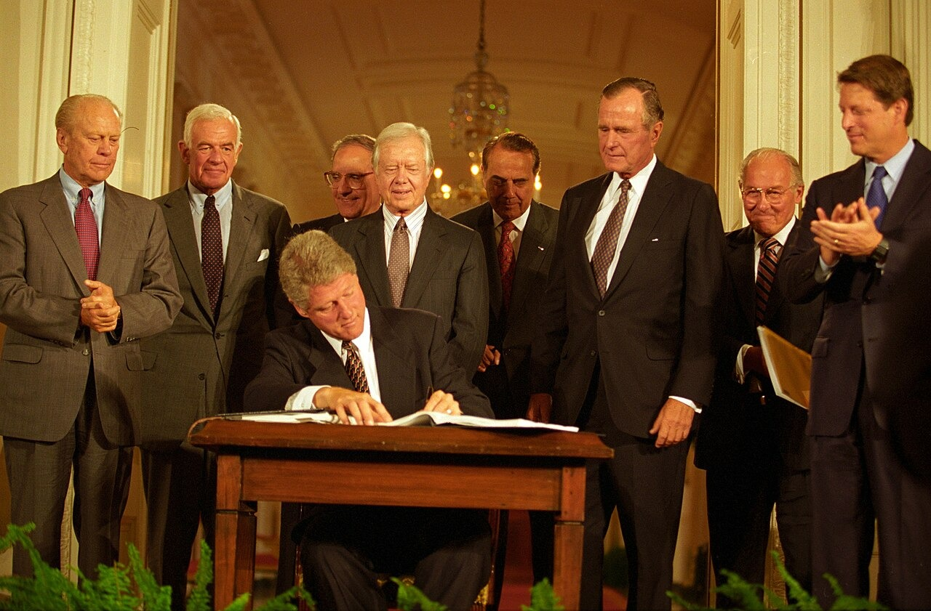
DIRECT INSTRUCTION
US.91
NAFTA opened North American trade — the 1994 agreement ended trade barriers among the U.S., Canada, and Mexico; supporters expected growth while critics feared lost jobs, and results were mixed as trade rose but manufacturing moved to Mexico.
ZOOM IN
US.91 · NAFTA
U.S. History Hack · TroopToTeacher Technologies LLC · Aligned to TN Academic Standards & TCAP EOC
50

Slide 68
DIRECT INSTRUCTION
US.91
Welfare reform and a balanced budget defined domestic policy — the 1996 welfare-to-work law replaced AFDC with TANF, requiring work and time limits; Clinton also reached the first balanced federal budget since 1969, briefly reducing the debt.
KEY POINT
Welfare reform and a balanced budget defined domestic policy — the 1996 welfare-to-work law replaced AFDC with TANF, requiring work and time limits; Clinton also reached the first balanced federal budget since 1969, briefly reducing the debt.
US.91 · Welfare Reform & Budget
U.S. History Hack · TroopToTeacher Technologies LLC · Aligned to TN Academic Standards & TCAP EOC
51

Slide 69
DIRECT INSTRUCTION
US.91
Scandal led to impeachment — facing Whitewater and the Monica Lewinsky affair, Clinton was impeached by the House for perjury and obstruction, but the Senate acquitted him amid deep partisan division over personal conduct and politics.
KEY POINT
Scandal led to impeachment — facing Whitewater and the Monica Lewinsky affair, Clinton was impeached by the House for perjury and obstruction, but the Senate acquitted him amid deep partisan division over personal conduct and politics.
US.91 · Scandals & Impeachment
U.S. History Hack · TroopToTeacher Technologies LLC · Aligned to TN Academic Standards & TCAP EOC
52

Slide 70
SOURCE IT FIRST
US.91
Read Clinton’s NAFTA Signing Statement — note who spoke and why before you read the words.
WHO
WHEN
WHY
President Bill Clinton
December 8, 1993
Consider the author's purpose — a signing statement is meant to sell the benefits of a policy.
NAFTA Signing Statement
President Bill Clinton · December 8, 1993
"NAFTA means jobs. American jobs, and good-paying American jobs. If I didn't believe that, I wouldn't support this agreement... NAFTA will generate these jobs by opening the largest, richest market in the world — right in our own hemisphere, right next door."
Library of Congress
U.S. History Hack · TroopToTeacher Technologies LLC · Aligned to TN Academic Standards & TCAP EOC
53

Slide 71
THREE PERSPECTIVES
US.91
A historian returns to three questions at the end of every reading. Use them to analyze this standard.
Who benefited?
Who bore the costs?
Who decided?
Who gained land, wealth, power, or protection?
Who lost land, labor, freedom, or life — and who was silenced?
Which people, offices, or courts held the authority?
US.91:
US.91:
US.91:
Consumers and exporters who gained from expanded trade, and a government that reached a balanced budget and briefly cut the debt.
American manufacturing workers whose jobs moved to Mexico, and families who left welfare without escaping poverty under TANF.
President Clinton and Congress, who set trade and welfare policy, and the House and Senate, which impeached and then acquitted him.
Anchor: NAFTA Signing Statement, President Bill Clinton, December 8, 1993 (Library of Congress)
U.S. History Hack · TroopToTeacher Technologies LLC · Aligned to TN Academic Standards & TCAP EOC
54

Slide 72
KEY VOCABULARY · LANGUAGE SUPPORT
US.91
Words you need before we read
NAFTA
Welfare-to-Work Reform
Balanced Budget
En español: TLCAN
En español: Reforma de Asistencia Social
En español: Presupuesto Equilibrado
WHAT IT MEANS
WHAT IT MEANS
WHAT IT MEANS
The 1994 North American Free Trade Agreement removing most trade barriers among the U.S., Canada, and Mexico.
A 1996 Clinton-era law that limited welfare benefits and required recipients to find work.
A federal budget in which spending does not exceed revenue; achieved in the late 1990s under Clinton.
U.S. History Hack · TroopToTeacher Technologies LLC · Aligned to TN Academic Standards & TCAP EOC
18

Slide 73
PROGRESS CHECK
US.91
Check your understanding
What were the goals of NAFTA, and how did it affect American workers and the economy?
A
It eliminated trade barriers to boost economic growth, but while trade increased, manufacturing job losses to Mexico created ongoing debates about globalization's costs
B
NAFTA had no significant economic effects, but this fails to account for the broader historical context, but contemporary accounts and primary sources suggest otherwise
C
NAFTA only affected agricultural trade, yet the available evidence points to a different conclusion despite the fact that multiple contemporary sources contradict this
D
All American workers benefited equally from NAFTA, which ignores key developments that shaped the outcome, but contemporary accounts and primary sources suggest otherwise
Confidence: 😟 1 🙂 2 😀 3 — circle where you are; your teacher routes reteach or extension.
U.S. History Hack · TroopToTeacher Technologies LLC · Aligned to TN Academic Standards & TCAP EOC
19

Slide 74
US.92
September 11th Impact
TN STANDARD
US.92 – Describe the impact of the September 11, 2001 terrorist attacks on the World Trade Center and the Pentagon, including: the response of President George W. Bush, wars in Afghanistan and Iraq, and continued efforts to combat terrorism globally.
I CAN
I can describe the impact of the September 11, 2001 terrorist attacks on the World Trade Center and the Pentagon, including the response of President George W. Bush, wars in Afghanistan and Iraq, and continued efforts to combat terrorism globally.
U.S. History Hack · TroopToTeacher Technologies LLC · Aligned to TN Academic Standards & TCAP EOC
55

Slide 75
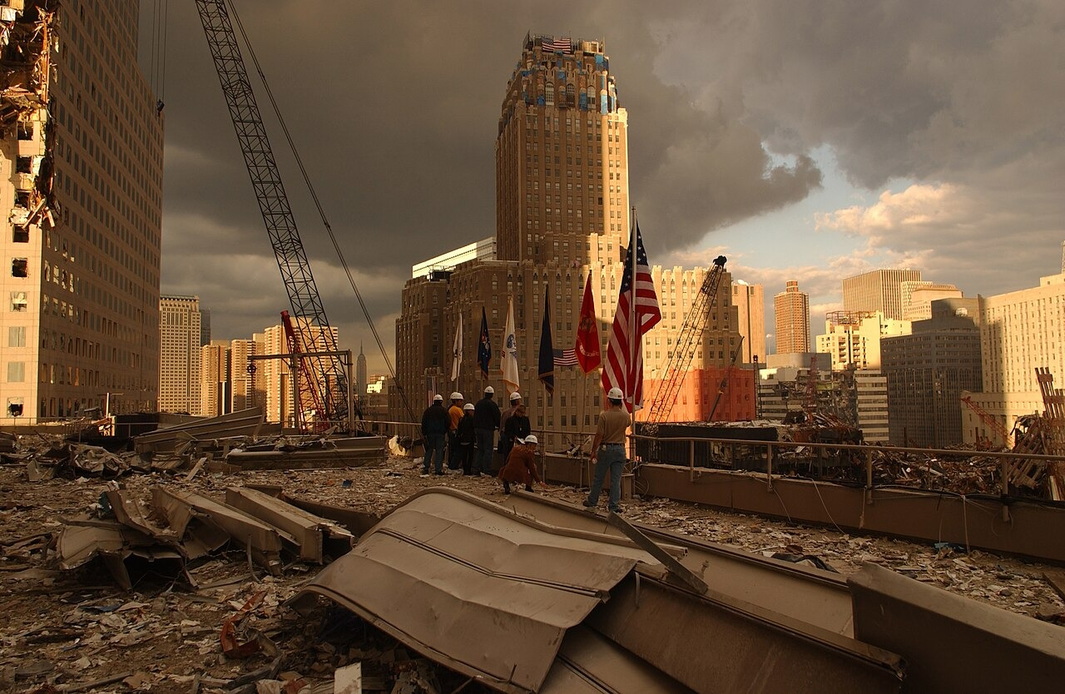
DIRECT INSTRUCTION
US.92
9/11 reshaped security at home — Bush created the Department of Homeland Security, signed the USA PATRIOT Act expanding surveillance, and tightened airport security, declaring a global "War on Terror" after the attacks.
ZOOM IN
US.92 · Bush’s Response
U.S. History Hack · TroopToTeacher Technologies LLC · Aligned to TN Academic Standards & TCAP EOC
56

Slide 76
DIRECT INSTRUCTION
US.92
Two wars followed the attacks — the Afghanistan invasion removed the Taliban but became America’s longest war; the Iraq War toppled Saddam Hussein but bred instability and lost credibility when the claimed weapons of mass destruction proved false.
KEY POINT
Two wars followed the attacks — the Afghanistan invasion removed the Taliban but became America’s longest war; the Iraq War toppled Saddam Hussein but bred instability and lost credibility when the claimed weapons of mass destruction proved false.
US.92 · Afghanistan & Iraq
U.S. History Hack · TroopToTeacher Technologies LLC · Aligned to TN Academic Standards & TCAP EOC
57

Slide 77
DIRECT INSTRUCTION
US.92
Counter-terrorism reached worldwide — the War on Terror combined military operations, intelligence sharing, financial tracking, and diplomatic pressure; it prevented major U.S. attacks but raised concerns over civil liberties and root causes.
KEY POINT
Counter-terrorism reached worldwide — the War on Terror combined military operations, intelligence sharing, financial tracking, and diplomatic pressure; it prevented major U.S. attacks but raised concerns over civil liberties and root causes.
US.92 · Global Counter-terrorism
U.S. History Hack · TroopToTeacher Technologies LLC · Aligned to TN Academic Standards & TCAP EOC
58

Slide 78
SOURCE IT FIRST
US.92
Read Bush’s Address to the Nation (9/11) — weigh who spoke and why before you read the words.
WHO
WHEN
WHY
President George W. Bush
September 11, 2001
Consider that a president speaking hours after a tragedy is trying to reassure and unite a frightened nation.
Address to the Nation
President George W. Bush · September 11, 2001
"Today, our fellow citizens, our way of life, our very freedom came under attack in a series of deliberate and deadly terrorist acts... Thousands of lives were suddenly ended by evil, despicable acts of terror. The pictures of airplanes flying into buildings, fires burning, huge structures collapsing, have filled us with disbelief, terrible sadness, and a quiet, unyielding anger."
Library of Congress
U.S. History Hack · TroopToTeacher Technologies LLC · Aligned to TN Academic Standards & TCAP EOC
59

Slide 79
THREE PERSPECTIVES
US.92
A historian returns to three questions at the end of every reading. Use them to analyze this standard.
Who benefited?
Who bore the costs?
Who decided?
Who gained land, wealth, power, or protection?
Who lost land, labor, freedom, or life — and who was silenced?
Which people, offices, or courts held the authority?
US.92:
US.92:
US.92:
Americans protected from further major attacks, and a national-security apparatus that gained new agencies and expanded surveillance powers.
9/11 victims and their families, soldiers and civilians in Afghanistan and Iraq, and Americans whose civil liberties were curtailed.
President Bush, who launched the War on Terror, and Congress, which authorized force and passed the PATRIOT Act.
Anchor: Address to the Nation, President George W. Bush, September 11, 2001 (Library of Congress)
U.S. History Hack · TroopToTeacher Technologies LLC · Aligned to TN Academic Standards & TCAP EOC
60

Slide 80
KEY VOCABULARY · LANGUAGE SUPPORT
US.92
Words you need before we read
September 11, 2001 Attacks
War on Terror
USA PATRIOT Act
En español: Ataques del 11 de Septiembre
En español: Guerra contra el Terrorismo
En español: Ley Patriota
WHAT IT MEANS
WHAT IT MEANS
WHAT IT MEANS
Coordinated al-Qaeda terrorist attacks that destroyed the World Trade Center and struck the Pentagon, killing nearly 3,000 people.
The U.S. global campaign after 9/11 to defeat terrorist groups and the nations that harbored them.
A 2001 law expanding government surveillance powers to prevent terrorism, criticized by some as a threat to civil liberties.
U.S. History Hack · TroopToTeacher Technologies LLC · Aligned to TN Academic Standards & TCAP EOC
20

Slide 81
PROGRESS CHECK
US.92
Check your understanding
What were the reasons for military action in Afghanistan and Iraq, and what were the consequences of each war?
A
Both wars achieved their stated objectives quickly, yet the available evidence points to a different conclusion and oversimplifies the complex factors at work during this period
B
Afghanistan targeted al-Qaeda and Taliban with initial success but became America's longest war; Iraq was based on WMD claims that proved false, creating instability
C
Neither war had significant consequences, which does not reflect the consensus among historians, which represents a common misconception about this historical period
D
Both wars were completed within one year, although this view has been largely discredited by scholars when examined alongside the available primary and secondary sources
Confidence: 😟 1 🙂 2 😀 3 — circle where you are; your teacher routes reteach or extension.
U.S. History Hack · TroopToTeacher Technologies LLC · Aligned to TN Academic Standards & TCAP EOC
21

Slide 82
US.93
Increasing Role of Women and Minorities
TN STANDARD
US.93 – Describe the increasing role of women and minorities in the American military, politics, and economy, including: Hillary Clinton, Sandra Day O'Connor, Nancy Pelosi, Colin Powell, Condoleezza Rice. (TCA)
I CAN
I can describe the increasing role of women and minorities in the American military, politics, and economy, including Hillary Clinton, Sandra Day O'Connor, Nancy Pelosi, Colin Powell, and Condoleezza Rice.
U.S. History Hack · TroopToTeacher Technologies LLC · Aligned to TN Academic Standards & TCAP EOC
61

Slide 83
DIRECT INSTRUCTION
US.93
Women reached the top of government — Hillary Clinton served as First Lady, senator, and Secretary of State and became the first woman nominated for president by a major party (2016); Nancy Pelosi became the first woman Speaker of the House.
KEY POINT
Women reached the top of government — Hillary Clinton served as First Lady, senator, and Secretary of State and became the first woman nominated for president by a major party (2016); Nancy Pelosi became the first woman Speaker of the House.
US.93 · Women in Politics
U.S. History Hack · TroopToTeacher Technologies LLC · Aligned to TN Academic Standards & TCAP EOC
62

Slide 84
DIRECT INSTRUCTION
US.93
Minorities led national security — Colin Powell became the first Black Chairman of the Joint Chiefs and later Secretary of State; Condoleezza Rice became the first Black woman National Security Advisor and then Secretary of State.
KEY POINT
Minorities led national security — Colin Powell became the first Black Chairman of the Joint Chiefs and later Secretary of State; Condoleezza Rice became the first Black woman National Security Advisor and then Secretary of State.
US.93 · Minorities in Leadership
U.S. History Hack · TroopToTeacher Technologies LLC · Aligned to TN Academic Standards & TCAP EOC
63

Slide 85
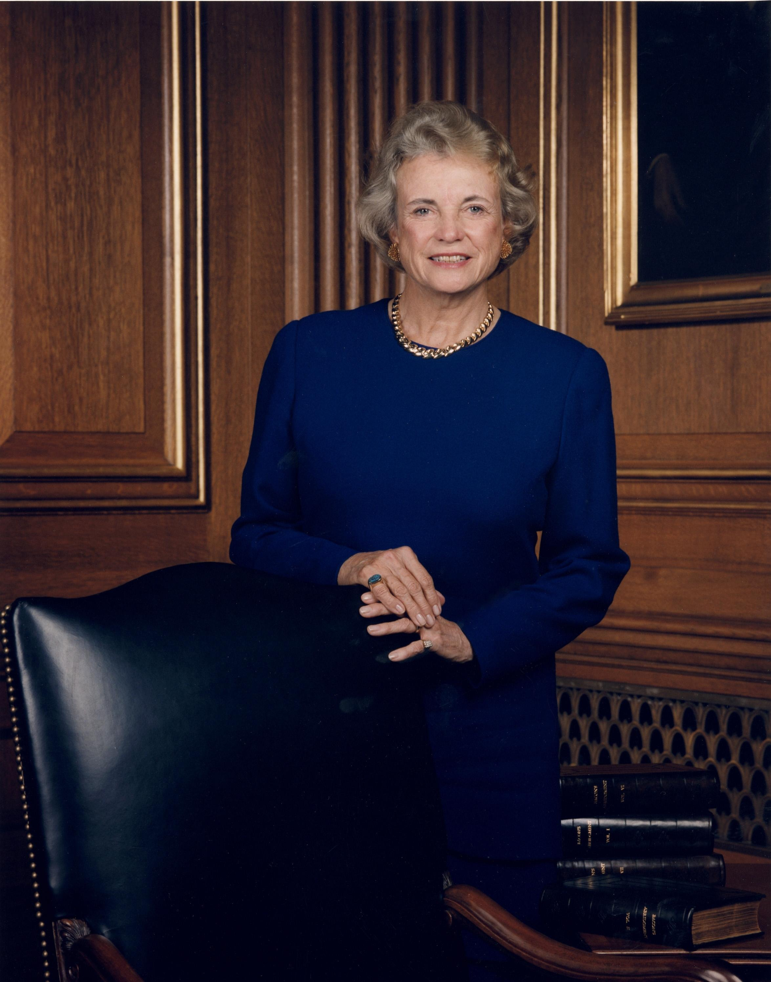
DIRECT INSTRUCTION
US.93
O’Connor broke the Court’s gender barrier — appointed by Reagan in 1981, Sandra Day O’Connor became the first woman Supreme Court Justice, often casting moderate swing votes and opening the profession’s highest office to women.
ZOOM IN
US.93 · Breaking Barriers
U.S. History Hack · TroopToTeacher Technologies LLC · Aligned to TN Academic Standards & TCAP EOC
64

Slide 86
SOURCE IT FIRST
US.93
Read O’Connor’s Confirmation Statement — note who spoke and why before you read the words.
WHO
WHEN
WHY
Sandra Day O'Connor
September 1981
Consider that O'Connor is speaking as a barrier-breaker aware her words will be heard by women nationwide.
Sandra Day O'Connor Confirmation Statement
Sandra Day O'Connor · September 1981
"It is a great honor for me to be the first woman to be nominated for a place on the Supreme Court. It is an honor to be selected by the President of the United States and an honor to be confirmed by the Senate... I hope that my appointment will serve to inspire other women to aspire to positions of leadership."
Library of Congress
U.S. History Hack · TroopToTeacher Technologies LLC · Aligned to TN Academic Standards & TCAP EOC
65

Slide 87
THREE PERSPECTIVES
US.93
A historian returns to three questions at the end of every reading. Use them to analyze this standard.
Who benefited?
Who bore the costs?
Who decided?
Who gained land, wealth, power, or protection?
Who lost land, labor, freedom, or life — and who was silenced?
Which people, offices, or courts held the authority?
US.93:
US.93:
US.93:
Women and minorities who saw leaders reach the highest offices, and a government made more representative of the nation it served.
Groups still underrepresented despite these firsts, and leaders who faced added scrutiny and barriers as pioneers in their fields.
Presidents who nominated these leaders, the Senate that confirmed them, and voters who elected women and minorities to office.
Anchor: Sandra Day O'Connor Confirmation Statement, Sandra Day O'Connor, September 1981 (Library of Congress)
U.S. History Hack · TroopToTeacher Technologies LLC · Aligned to TN Academic Standards & TCAP EOC
66

Slide 88
KEY VOCABULARY · LANGUAGE SUPPORT
US.93
Words you need before we read
Sandra Day O'Connor
Colin Powell
Condoleezza Rice
En español: Sandra Day O'Connor
En español: Colin Powell
En español: Condoleezza Rice
WHAT IT MEANS
WHAT IT MEANS
WHAT IT MEANS
The first woman to serve on the U.S. Supreme Court, appointed in 1981.
The first African American U.S. Secretary of State (2001) and Chairman of the Joint Chiefs of Staff.
The first African American woman U.S. Secretary of State (2005), a key foreign-policy leader.
U.S. History Hack · TroopToTeacher Technologies LLC · Aligned to TN Academic Standards & TCAP EOC
22

Slide 89
PROGRESS CHECK
US.93
Check your understanding
Analyze how these leaders' achievements reflected broader changes in American society regarding gender and racial equality.
A
These individual achievements had no broader social significance, despite limited evidence supporting this interpretation, which does not align with the documented historical record
B
Racial and gender equality was fully achieved through their service, despite the fact that multiple sources contradict this view
C
Their success in previously exclusive positions demonstrated expanding opportunities while also revealing continuing barriers and debates about representation
D
Only one of these leaders faced discrimination, despite limited evidence supporting this interpretation when examined alongside the available primary and secondary sources
Confidence: 😟 1 🙂 2 😀 3 — circle where you are; your teacher routes reteach or extension.
U.S. History Hack · TroopToTeacher Technologies LLC · Aligned to TN Academic Standards & TCAP EOC
23

Slide 90
US.94
Communication Methods Evolution
TN STANDARD
US.94 – Compare and contrast commonly used methods of communication from 1970 to today, and analyze the impact they have had on society.
I CAN
I can compare and contrast commonly used methods of communication from 1970 to today, and analyze the impact they have had on society.
U.S. History Hack · TroopToTeacher Technologies LLC · Aligned to TN Academic Standards & TCAP EOC
67

Slide 91
DIRECT INSTRUCTION
US.94
1970s communication was slow and local — landline phones carried voice, three networks dominated TV news, radio and newspapers shaped information, and mail was standard for writing — communication was deliberate and geographically constrained.
KEY POINT
1970s communication was slow and local — landline phones carried voice, three networks dominated TV news, radio and newspapers shaped information, and mail was standard for writing — communication was deliberate and geographically constrained.
US.94 · Communication in the 1970s
U.S. History Hack · TroopToTeacher Technologies LLC · Aligned to TN Academic Standards & TCAP EOC
68

Slide 92

DIRECT INSTRUCTION
US.94
Digital tools made communication instant — smartphones now merge voice, text, internet, and media; social media enables instant global contact, email drives business, video calls connect people remotely, and streaming has replaced traditional TV.
ZOOM IN
US.94 · Communication Today
U.S. History Hack · TroopToTeacher Technologies LLC · Aligned to TN Academic Standards & TCAP EOC
69

Slide 93
DIRECT INSTRUCTION
US.94
The shift reshaped society — instant global connection and unlimited information brought e-commerce, remote work, and digital democracy, but also information overload, privacy concerns, shorter attention spans, and reduced face-to-face interaction.
KEY POINT
The shift reshaped society — instant global connection and unlimited information brought e-commerce, remote work, and digital democracy, but also information overload, privacy concerns, shorter attention spans, and reduced face-to-face interaction.
US.94 · Societal Impact
U.S. History Hack · TroopToTeacher Technologies LLC · Aligned to TN Academic Standards & TCAP EOC
70

Slide 94
SOURCE IT FIRST
US.94
Read the Pew Research report on the Internet — note who produced it and why before you read the words.
WHO
WHEN
WHY
Pew Research Center
2005
Consider that a research organization aims to describe trends with evidence, not to sell a product.
The Internet and Society
Pew Research Center · 2005
"The internet has fundamentally changed how Americans communicate, work, and access information. Email has largely replaced letter writing for personal and business correspondence. Social networking sites allow people to maintain hundreds of relationships simultaneously."
Library of Congress
U.S. History Hack · TroopToTeacher Technologies LLC · Aligned to TN Academic Standards & TCAP EOC
71

Slide 95
THREE PERSPECTIVES
US.94
A historian returns to three questions at the end of every reading. Use them to analyze this standard.
Who benefited?
Who bore the costs?
Who decided?
Who gained land, wealth, power, or protection?
Who lost land, labor, freedom, or life — and who was silenced?
Which people, offices, or courts held the authority?
US.94:
US.94:
US.94:
People and businesses gaining instant global connection, unlimited information, e-commerce, and the flexibility of remote work.
Those facing information overload, lost privacy, cybersecurity threats, and reduced face-to-face connection and rising isolation.
Technology companies and inventors who built the platforms, and the users whose adoption drove how the tools reshaped daily life.
Anchor: The Internet and Society, Pew Research Center, 2005 (Library of Congress)
U.S. History Hack · TroopToTeacher Technologies LLC · Aligned to TN Academic Standards & TCAP EOC
72

Slide 96
KEY VOCABULARY · LANGUAGE SUPPORT
US.94
Words you need before we read
Internet Revolution
World Wide Web
Personal Computer
En español: Revolución de Internet
En español: Red Informática Mundial
En español: Computadora Personal
WHAT IT MEANS
WHAT IT MEANS
WHAT IT MEANS
The rapid late-20th-century spread of the internet, transforming how people communicate, work, and access information.
A system of linked web pages, opened to the public in the 1990s, that made the internet easy to use.
An affordable home computer that became common in the 1980s-90s, changing work, school, and daily life.
U.S. History Hack · TroopToTeacher Technologies LLC · Aligned to TN Academic Standards & TCAP EOC
24

Slide 97
PROGRESS CHECK
US.94
Check your understanding
How have modern communication technologies changed the way Americans interact with each other and their government?
A
Modern technology has not changed communication patterns, which does not align with the documented historical record
B
Americans communicate less today than in the 1970s, which does not reflect the consensus among historians and does not reflect the scholarly consensus on this topic
C
Only young people use modern communication technology, which represents a common misconception about the period
D
Smartphones, social media, and internet enable instant global communication, transforming how citizens engage with politics, news, and each other
Confidence: 😟 1 🙂 2 😀 3 — circle where you are; your teacher routes reteach or extension.
U.S. History Hack · TroopToTeacher Technologies LLC · Aligned to TN Academic Standards & TCAP EOC
25

Slide 98
US.95
Obama Administration Achievements and Setbacks
TN STANDARD
US.95 – Describe the achievements and setbacks of President Barack Obama's administration.
I CAN
I can describe the achievements and setbacks of President Barack Obama's administration.
U.S. History Hack · TroopToTeacher Technologies LLC · Aligned to TN Academic Standards & TCAP EOC
73

Slide 99
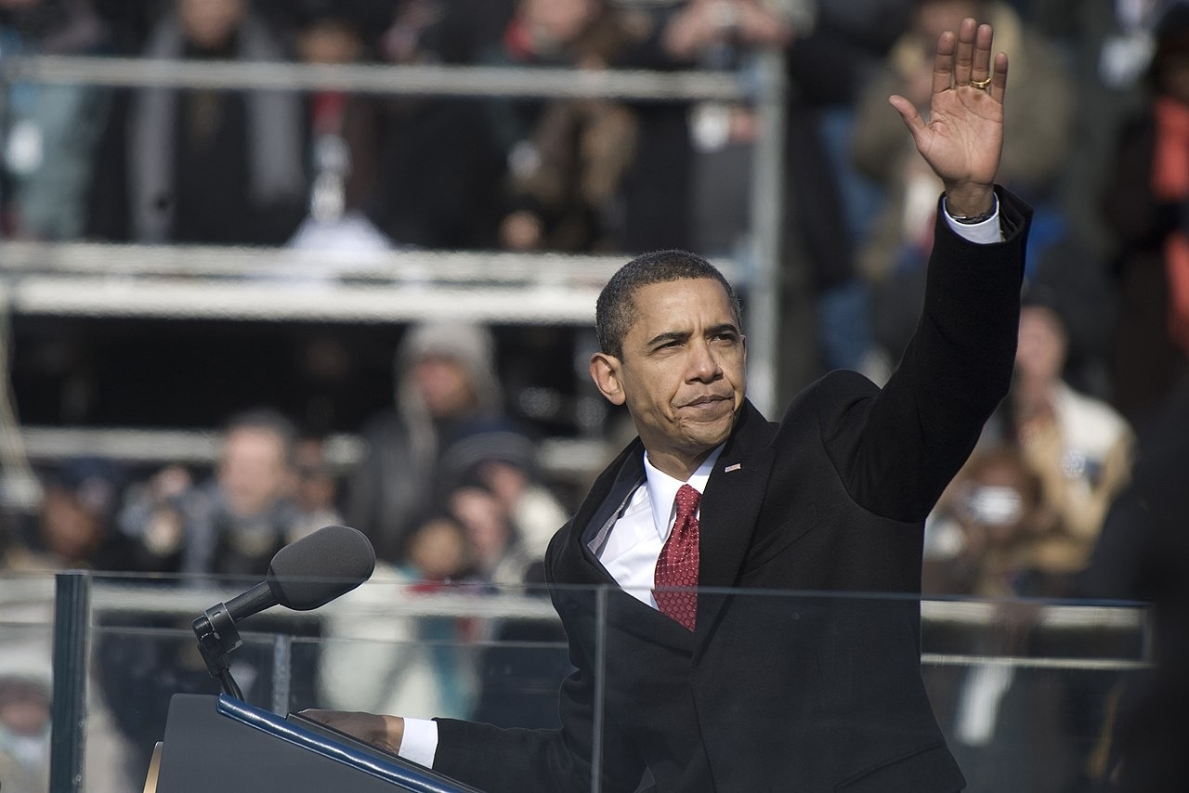
DIRECT INSTRUCTION
US.95
Obama posted major achievements — the Affordable Care Act expanded coverage to millions, the Recovery Act helped end the Great Recession (unemployment fell from 10% to 4.7%), and foreign wins included the Iran deal, Cuba, and the killing of Osama bin Laden.
ZOOM IN
US.95 · Major Achievements
U.S. History Hack · TroopToTeacher Technologies LLC · Aligned to TN Academic Standards & TCAP EOC
74

Slide 100
DIRECT INSTRUCTION
US.95
Serious setbacks tested his presidency — after 2010 midterm losses, Republican opposition brought government shutdowns and debt-ceiling crises, while the Syrian civil war, the rise of ISIS, Russian aggression in Ukraine, and Benghazi posed hard challenges.
KEY POINT
Serious setbacks tested his presidency — after 2010 midterm losses, Republican opposition brought government shutdowns and debt-ceiling crises, while the Syrian civil war, the rise of ISIS, Russian aggression in Ukraine, and Benghazi posed hard challenges.
US.95 · Significant Setbacks
U.S. History Hack · TroopToTeacher Technologies LLC · Aligned to TN Academic Standards & TCAP EOC
75

Slide 101
DIRECT INSTRUCTION
US.95
Partisan conflict defined the era — Obama faced unprecedented obstruction, including the year-long blockade of his Supreme Court nominee Merrick Garland; his presidency showed both the possibilities and limits of power in a polarized nation.
KEY POINT
Partisan conflict defined the era — Obama faced unprecedented obstruction, including the year-long blockade of his Supreme Court nominee Merrick Garland; his presidency showed both the possibilities and limits of power in a polarized nation.
US.95 · Partisan Conflict
U.S. History Hack · TroopToTeacher Technologies LLC · Aligned to TN Academic Standards & TCAP EOC
76

Slide 102
SOURCE IT FIRST
US.95
Read Obama’s First Inaugural Address — weigh who spoke and why before you read the words.
WHO
WHEN
WHY
President Barack Obama
January 20, 2009
Consider that an inaugural address is meant to set the tone and priorities for a new presidency at a moment of national crisis.
First Inaugural Address
President Barack Obama · January 20, 2009
"That we are in the midst of crisis is now well understood. Our nation is at war, against a far-reaching network of violence and hatred. Our economy is badly weakened, a consequence of greed and irresponsibility on the part of some... Today I say to you that the challenges we face are real."
National Archives
U.S. History Hack · TroopToTeacher Technologies LLC · Aligned to TN Academic Standards & TCAP EOC
77

Slide 103
THREE PERSPECTIVES
US.95
A historian returns to three questions at the end of every reading. Use them to analyze this standard.
Who benefited?
Who bore the costs?
Who decided?
Who gained land, wealth, power, or protection?
Who lost land, labor, freedom, or life — and who was silenced?
Which people, offices, or courts held the authority?
US.95:
US.95:
US.95:
Millions who gained health coverage under the ACA, workers as the economy recovered, and groups advanced by marriage equality and DACA.
Americans caught in shutdowns and debt-ceiling crises, and people affected by unresolved conflicts in Syria, Ukraine, and against ISIS.
President Obama, who set the agenda, and a divided Congress, whose obstruction shaped what he could and could not achieve.
Anchor: First Inaugural Address, President Barack Obama, January 20, 2009 (National Archives)
U.S. History Hack · TroopToTeacher Technologies LLC · Aligned to TN Academic Standards & TCAP EOC
78

Slide 104
KEY VOCABULARY · LANGUAGE SUPPORT
US.95
Words you need before we read
Affordable Care Act
Great Recession
American Recovery and Reinvestment Act
En español: Ley de Cuidado de Salud Asequible
En español: Gran Recesión
En español: Ley de Recuperación y Reinversión
WHAT IT MEANS
WHAT IT MEANS
WHAT IT MEANS
President Obama's 2010 health-care law ('Obamacare') expanding insurance coverage to millions of Americans.
The severe 2007-09 economic downturn — the worst since the Great Depression — marked by a housing and banking crisis.
A 2009 stimulus law that used federal spending and tax cuts to fight the Great Recession.
U.S. History Hack · TroopToTeacher Technologies LLC · Aligned to TN Academic Standards & TCAP EOC
26

Slide 105
PROGRESS CHECK
US.95
Check your understanding
How did Republican opposition limit Obama's ability to implement his agenda after 2010?
A
After 2010 midterm losses, Republican control of Congress led to legislative gridlock, government shutdowns, and blocking of Supreme Court nominations
B
Republicans fully supported Obama's agenda, which represents a common misconception about the period, though this interpretation lacks supporting historical evidence
C
Obama's agenda was unaffected by opposition, but this oversimplifies the complex factors at work, which represents a common misconception about this historical period
D
Democrats controlled Congress throughout his presidency, but this oversimplifies the complex factors at work, although historical sources do not support this conclusion
Confidence: 😟 1 🙂 2 😀 3 — circle where you are; your teacher routes reteach or extension.
U.S. History Hack · TroopToTeacher Technologies LLC · Aligned to TN Academic Standards & TCAP EOC
27

