Slide 1
U.S. HISTORY HACK
Unit 10
The Modern Era
The Great Society · Vietnam-Era Activism · Watergate · The Reagan Era & the End of the Cold War · 9/11 · The Digital Revolution · 1964–2016
Standards US.83 – US.95
US.83
US.84
US.85
US.86
US.87
US.88
US.89
US.90
US.91
US.92
US.93
US.94
US.95
TCAP EOC LECTURE DECK · Tennessee Academic Standards for U.S. History
TroopToTeacher Technologies LLC
Notes:
Unit 10 TCAP EOC lecture deck. Each standard runs as a full lesson: divider (standard + I Can), hook, direct instruction with a verified primary-source image, key figures, vocabulary, a student activity (paired to a printable worksheet), a TCAP-style check (question slide, then click to the reveal/answer-key slide), and a wrap-up with a teacher answer key in the speaker notes. All images are public-domain, captioned, and linked to the Library of Congress / National Archives.

Slide 2
UNIT ROADMAP
Where We Are Headed
Unit 10 · The Modern Era (1964–2016) — from Johnson's Great Society, the social activism and counterculture of the 1960s, and Nixon and Watergate, through environmentalism, the Reagan era and the end of the Cold War, to Clinton and the 1990s, September 11th, the digital revolution, and the Obama years
US.83
Johnson's Great Society Programs
then
US.90
George H.W. Bush Administration
US.84
Social Activism and Counterculture
US.91
Clinton Administration Events
US.85
Nixon Administration Achievements
US.92
September 11th Impact
US.86
Watergate Scandal
US.93
Increasing Role of Women and Minorities
US.87
Emergence of Environmentalism
US.94
Communication Methods Evolution
US.88
Carter Administration Events
US.95
Obama Administration Achievements and Setbacks
US.89
Reagan Administration Significance
U.S. History Hack · TroopToTeacher Technologies LLC · Aligned to TN Academic Standards & TCAP EOC
2

Slide 3
BELL RINGER · HOOK
In 1964, President Johnson promised to build a "Great Society" that would end poverty and racial injustice.
Over the next half century, the nation moved through the turmoil of Vietnam and Watergate, the end of the Cold War, the shock of September 11th, a digital revolution, and the election of its first Black president.
How did the United States move from the confidence of the Great Society in 1964 to the challenges and transformations of the twenty-first century — and what forces reshaped American life along the way?
TURN & TALK
With a partner, list three ways American life today — how people communicate, who holds power, and the role of government — is different from the way it was in 1964. Then predict which event in this unit did the most to create each change. Keep your list; we will return to it at the end of the unit.
U.S. History Hack · TroopToTeacher Technologies LLC · Aligned to TN Academic Standards & TCAP EOC
3
Notes:
Bell ringer (5 min). Changes students may name: instant digital communication (the personal computer, the Internet, cell phones, social media); a broader sharing of power (the first woman on the Supreme Court, the first Black president, more women and minorities in high office); and a larger, more contested role for the federal government (Medicare and the Great Society, environmental regulation, the Affordable Care Act). Push students to connect each change to a specific event or figure in this unit. Collect lists; revisit on the closing slide after students can answer with evidence — from the Great Society, through Vietnam-era activism, Watergate, environmentalism, the Reagan era and the end of the Cold War, to 9/11, the digital revolution, and the Obama presidency.

Slide 4
STANDARD
SOCIAL STUDIES PRACTICES
US.83
SSP.01
Collect sources
SSP.05
Historical awareness
SSP.06
Geographic awareness
Johnson's Great Society Programs
TN ACADEMIC STANDARD
Evaluate the impact of President Lyndon Johnson's Great Society programs, including: Medicare, urban renewal, and the War on Poverty.
I CAN
I can evaluate the impact of President Lyndon Johnson's Great Society programs, including Medicare, urban renewal, and the War on Poverty.
U.S. History Hack · TroopToTeacher Technologies LLC · Aligned to TN Academic Standards & TCAP EOC
4

Slide 5
US.83 · QUICK REVIEW
Do You Remember?
Before we start, retrieve what we have already learned. Answer from memory first — no notes.
1
Unit 9 We just finished Unit 9 on the Civil Rights Movement. What did major laws like the Civil Rights Act of 1964 and the Voting Rights Act of 1965 accomplish?
2
Unit Hook Look back at our unit hook. What big question about the modern era are we going to keep returning to?
U.S. History Hack · TroopToTeacher Technologies LLC · Aligned to TN Academic Standards & TCAP EOC
5
Notes:
SPACED RETRIEVAL (US.83). Cold-call or whiteboards, 3-4 min, low stakes. Answers — 1) The Civil Rights Act of 1964 banned segregation and discrimination in public places, schools, and jobs; the Voting Rights Act of 1965 protected the right to vote by banning literacy tests and adding federal oversight. Together they dismantled legal segregation and opened the door to fuller participation — setting the stage for the Great Society's broader push against poverty and inequality. 2) How the federal government's role expanded to address poverty, health care, civil rights, and the economy — and how presidents from Johnson to Obama each shaped that role in different ways.

Slide 6
US.83 · CONFIDENCE CHECK
Warm-Up — Quick Recall
DOK 1
LOW STAKES
Everyone can answer this. Thumbs / whiteboards — no notes.
What was President Johnson's name for his set of anti-poverty and social programs?
✓ ANSWER
The Great Society.
COMMIT FIRST: have everyone answer before the reveal — this is the DOK 1 floor; the graded check later in this lesson moves up to DOK 2–3.
U.S. History Hack · TroopToTeacher Technologies LLC · Aligned to TN Academic Standards & TCAP EOC
6
Notes:
CONFIDENCE CHECK (US.83, DOK 1). 60-90 seconds. Have EVERY student commit (thumbs / whiteboard / choral) before revealing — this secures an early win and surfaces who is shaky before new content. Answer: The Great Society. Key term to listen for: Great Society. This is the low-floor entry; the graded Check for Understanding later in the standard rises to DOK 2–3.

Slide 7
US.83 · HOOK
Think About It
In just a few years, President Lyndon Johnson pushed Congress to create Medicare, Medicaid, Head Start, and a “War on Poverty” — the largest expansion of government help since the New Deal, all under one banner: the Great Society.
DISCUSS
TIMING: Turn & Talk 60 sec → cold-call 2 pairs
Should the federal government be responsible for fighting poverty and providing health care — or should that be left to states, charities, and families? What did the Great Society decide?
U.S. History Hack · TroopToTeacher Technologies LLC · Aligned to TN Academic Standards & TCAP EOC
7
Notes:
HOOK (US.83). Run tight: pose the provocation, give a silent 10-second think, then Turn & Talk 60 seconds. Cold-call 2–3 pairs (not volunteers) for a sentence-starter answer — "One force was ___ because ___" — then bridge to the standard. Keep total to ~4 minutes; do not let it sprawl. Return to this question at the unit close for an evidence-based answer.

Slide 8
US.83 · DIRECT INSTRUCTION
1 of 4
Great Society Programs Overview
President Johnson's Great Society (1964-1969) created an ambitious domestic agenda aimed at eliminating poverty and racial injustice.
Key programs included: Medicare (health insurance for Americans over 65), Medicaid (health coverage for low-income families), Head Start (early childhood education for disadvantaged children), VISTA (Volunteers in Service to America — domestic Peace Corps), the Elementary and Secondary Education Act (federal funding for schools), Urban Renewal (federal programs to rebuild inner cities), and the War on Poverty (a comprehensive anti-poverty initiative).
SENTENCE FRAME (EL & writing support)
The Great Society created ___ in order to ___, which expanded the federal government's role in ___.
U.S. History Hack · TroopToTeacher Technologies LLC · Aligned to TN Academic Standards & TCAP EOC
8
Notes:
FACILITATION (US.83). Ask: can the government end poverty by passing laws and funding programs? What evidence would tell us if it worked? Teach in small steps; pause and check for understanding before the next chunk (aim 80%+ before moving on).

Slide 9
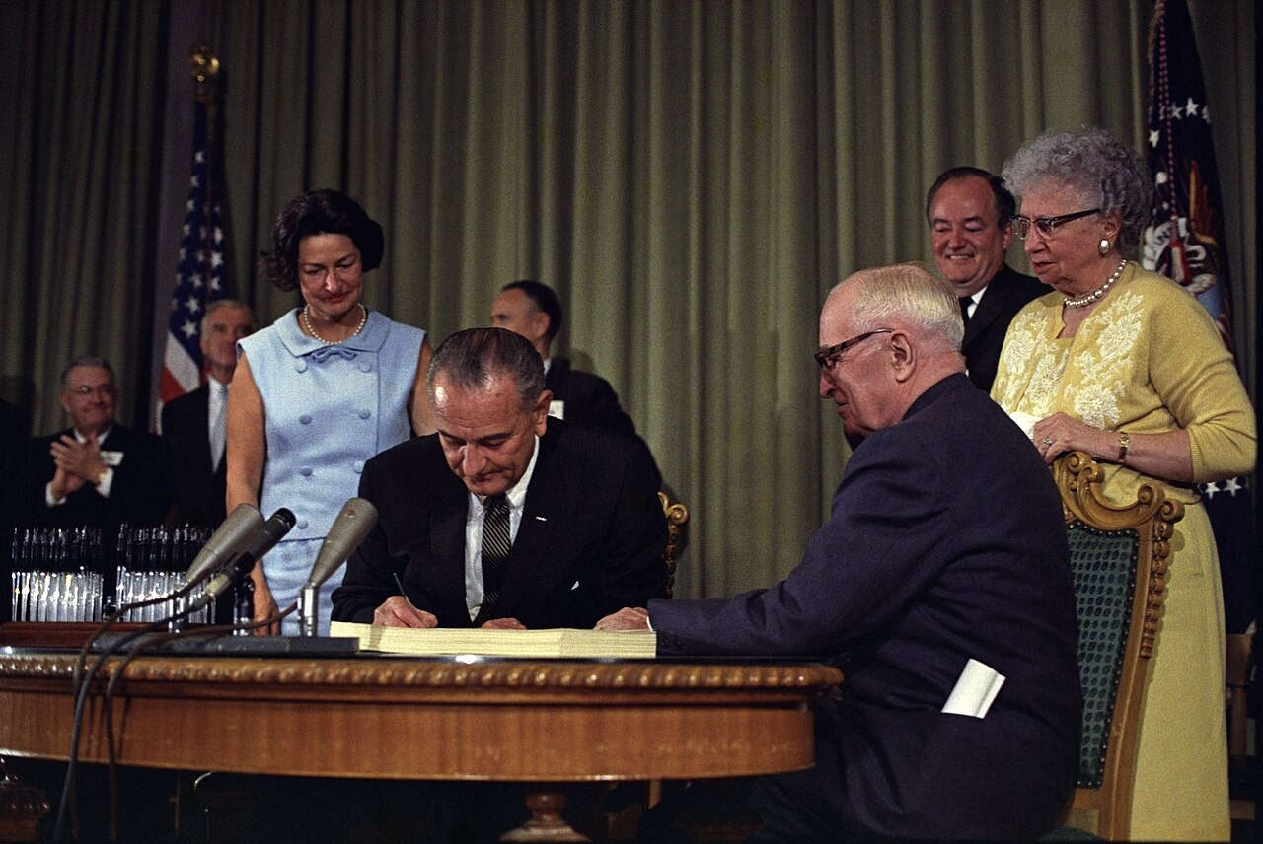
US.83 · DIRECT INSTRUCTION
2 of 4
Medicare's Effect on Healthcare
Medicare dramatically improved healthcare access for elderly Americans, who previously faced insurance discrimination due to age and pre-existing conditions.
It reduced medical bankruptcies among seniors and established the principle of government-guaranteed healthcare.
However, costs escalated beyond projections, creating long-term fiscal challenges and debates about healthcare spending that continue today.
White House Press Office, 1965 LBJ Presidential Library (Austin
U.S. History Hack · TroopToTeacher Technologies LLC · Aligned to TN Academic Standards & TCAP EOC
9

Slide 10
US.83 · DIRECT INSTRUCTION
3 of 4
Urban Renewal Consequences
Urban renewal projects often displaced low-income, predominantly minority communities to build highways, shopping centers, and middle-class housing.
While intended to eliminate "slums," these programs frequently destroyed established neighborhoods, disrupted social networks, and contributed to racial segregation by concentrating displaced residents in public housing projects.
U.S. History Hack · TroopToTeacher Technologies LLC · Aligned to TN Academic Standards & TCAP EOC
10

Slide 11
US.83 · DIRECT INSTRUCTION
4 of 4
War on Poverty Effectiveness
The poverty rate fell from 22.4% in 1959 to 12.6% in 1970, suggesting initial success.
Programs like Head Start and food stamps provided crucial support.
However, poverty rates plateaued in the 1970s, and critics argued that welfare dependency increased.
The initiative's mixed results sparked ongoing debates about government's role in addressing inequality.
U.S. History Hack · TroopToTeacher Technologies LLC · Aligned to TN Academic Standards & TCAP EOC
11

Slide 12
US.83 · PEOPLE WHO SHAPED THE ERA
Key Figure
President Lyndon B. Johnson
36th President of the United States
Launched the Great Society and the War on Poverty (1964)
Signed Medicare and Medicaid into law (1965)
STRATEGY Legislative reform (federal social programs)
U.S. History Hack · TroopToTeacher Technologies LLC · Aligned to TN Academic Standards & TCAP EOC
12

Slide 13
US.83 · PRIMARY SOURCE ANALYSIS
Great Society Speech
Close Reading
President Lyndon B. Johnson · May 22, 1964
"The Great Society rests on abundance and liberty for all. It demands an end to poverty and racial injustice, to which we are totally committed in our time. But that is just the beginning. The Great Society is a place where every child can find knowledge to enrich his mind and to enlarge his talents."
CONTEXT
In May 1964, President Johnson used a commencement address at the University of Michigan to unveil his vision of a "Great Society." Coming just months after taking office following Kennedy's assassination, Johnson laid out an ambitious agenda to use federal power to end poverty and racial injustice and to expand education and opportunity for all Americans.
ANALYZE
What were the goals of Johnson's Great Society?
READ CLOSELY Underline the exact words that answer the ANALYZE question — be ready to read them aloud.
SOURCE IT
WHO made it?
WHEN?
WHY does it matter?
FIRST
President Lyndon B. Johnson
May 22, 1964
Consider the author's purpose and audience before you interpret the words.
SSP.02 · before you interpret
Source: National Archives
U.S. History Hack · TroopToTeacher Technologies LLC · Aligned to TN Academic Standards & TCAP EOC
13
Notes:
Primary-source analysis. SOURCE IT FIRST (SSP.02) — model the sourcing routine aloud before students interpret: WHO made this source? (President Lyndon B. Johnson) WHEN? (May 22, 1964) WHY does that matter? (Consider the author's purpose and audience before you interpret the words.) Only then move to the ANALYZE question. Suggested answer: Johnson states the Great Society "demands an end to poverty and racial injustice" and envisions a place "where every child can find knowledge to enrich his mind." Practice skill: Close Reading.

Slide 14
US.83 · KEY VOCABULARY
Word Wall
Great Society
Gran Sociedad
War on Poverty
Guerra contra la Pobreza
say: grayt soh-SY-eh-tee
say: wor on POV-er-tee
GS
President Lyndon B. Johnson's 1960s domestic program to end poverty and racial injustice and expand education, health care, and civil rights.
WO
LBJ's set of Great Society programs — including Head Start and Job Corps — created in 1964 to reduce poverty in the United States.
Medicare and Medicaid
Medicare y Medicaid
Head Start
Head Start (Programa Preescolar)
say: MED-ih-kair and MED-ih-kaid
say: hed START
MA
Federal health-insurance programs created in 1965: Medicare for Americans 65 and older, Medicaid for low-income families.
HS
A 1965 Great Society program providing early childhood education, health, and nutrition services to low-income children.
Urban Renewal
Renovación Urbana
Voting Rights Act of 1965
Ley de Derecho al Voto de 1965
say: UR-bin ree-NOO-ul
say: VOH-ting ryts akt
UR
Federal programs that cleared and rebuilt city neighborhoods; often displaced poor and minority residents despite new housing and highways.
VR
A Great Society law that banned literacy tests and other barriers used to deny African Americans the right to vote.
"say:" pronunciation guide (stressed syllable in CAPS) and a per-term visual anchor support newcomer English learners. Spanish term + full bilingual Frayer models are in the unit vocabulary set.
U.S. History Hack · TroopToTeacher Technologies LLC · Aligned to TN Academic Standards & TCAP EOC
1

Slide 15
US.83 · GUIDED PRACTICE — WE DO IT TOGETHER
Let’s Work One Together
Evaluate the impact of a government program
MODEL PROMPT: Read Johnson's Great Society speech. What outcome does he promise, and how would we measure whether it worked?
WORKED EXAMPLE (teacher models this aloud)
Johnson promises "an end to poverty and racial injustice" and opportunity for "every child."
THINK ALOUD
To evaluate impact, I would look for evidence — like the poverty rate falling from 22.4% to 12.6% — and also for unintended consequences, like urban renewal displacing communities.
→ Now you try: Now you: name one Great Society program and one measurable result (positive or negative) that lets us judge its impact.
U.S. History Hack · TroopToTeacher Technologies LLC · Aligned to TN Academic Standards & TCAP EOC
15
Notes:
GUIDED PRACTICE / WE DO (US.83). Skill modeled: Evaluate the impact of a government program. Model the worked example aloud using the THINK ALOUD as your script, then release students to the activity ("Now you: name one Great Society program and one measurable result (positive or negative) that lets us judge its impact."). This is the I Do → We Do → You Do bridge — do not skip it; aim for 80%+ success before independent work.

Slide 16
US.83 · STUDENT ACTIVITY
The Great Society — Causes & Consequences Chart
Pairs
15 min
YOUR TASK
Using your Cornell notes and Johnson's “Great Society” speech excerpt, complete the Causes & Consequences organizer. In the CAUSES column, list the conditions Johnson wanted to fix (poverty, lack of health care for the elderly, unequal education). In the CONSEQUENCES column, trace the programs that followed — Medicare, Medicaid, the War on Poverty, Head Start, and federal education aid — and what each one did. Finish with a one-sentence claim about whether the Great Society succeeded in building Johnson's vision.
DELIVERABLE
DIFFERENTIATION
Completed Causes & Consequences organizer (3+ causes, 3+ consequences) plus a one-sentence evidence-based claim on the Great Society's lasting impact.
Entry: Organizer pre-seeded with a word bank (Medicare, Medicaid, War on Poverty, Head Start, Great Society) to sort into Causes vs. Consequences. Honors: Evaluate the long-term significance of the Great Society — which program most changed American life, and does it still matter today? Defend with evidence.
Companion printable: printables/unit-10/unit-10-cause-effect.html
U.S. History Hack · TroopToTeacher Technologies LLC · Aligned to TN Academic Standards & TCAP EOC
16
Notes:
Student activity for US.83. Pair with the printable: printables/unit-10/unit-10-cause-effect.html. Timing: 15. Deliverable: Completed Causes & Consequences organizer (3+ causes, 3+ consequences) plus a one-sentence evidence-based claim on the Great Society's lasting impact.

Slide 17
US.83 · CHECK FOR UNDERSTANDING
TCAP-Style Question
DOK 3
EOC PRACTICE
How did Johnson describe his approach to fighting poverty?
Simply expanding existing charity programs
A
Leaving poverty reduction to state governments
B
A new approach that strikes at the causes of poverty, not just consequences
C
Reducing government involvement in social programs
D
ANSWER FIRST: students commit — then click / advance to reveal the correct answer and explanation.
U.S. History Hack · TroopToTeacher Technologies LLC · Aligned to TN Academic Standards & TCAP EOC
17
Notes:
CHECK FOR UNDERSTANDING (US.83, DOK 3). Have students commit to an answer (whiteboards, hand signal, or turn-and-talk) BEFORE advancing. Correct answer: C. The next slide reveals it. Why: Johnson emphasizes that the Act "charts a new course" and "strikes at the causes, not just the consequences of poverty," distinguishing it from previous programs.

Slide 18
US.83 · ANSWER REVEAL
TCAP-Style Question
✓ ANSWER KEY
How did Johnson describe his approach to fighting poverty?
A
Simply expanding existing charity programs
B
Leaving poverty reduction to state governments
C
A new approach that strikes at the causes of poverty, not just consequences
✓
D
Reducing government involvement in social programs
Correct answer: C. Why: Johnson emphasizes that the Act "charts a new course" and "strikes at the causes, not just the consequences of poverty," distinguishing it from previous programs.
U.S. History Hack · TroopToTeacher Technologies LLC · Aligned to TN Academic Standards & TCAP EOC
18
Notes:
ANSWER KEY (US.83). Correct: C. Johnson emphasizes that the Act "charts a new course" and "strikes at the causes, not just the consequences of poverty," distinguishing it from previous programs.

Slide 19
US.83 · WRAP-UP
What You Need to Know for TCAP
KEY TAKEAWAYS
EXIT TICKET
DOK 2
Great Society Programs Overview
Medicare's Effect on Healthcare
Urban Renewal Consequences
War on Poverty Effectiveness
Explain what the Great Society was and describe two programs it created. Why is it considered a major expansion of the federal government?
★ HONORS / EXTENSION DOK 3 · SSP.04 Argumentation
Evaluate the long-term significance of the Great Society. Which program most changed American life, and does it still matter today? Defend your answer with evidence.
U.S. History Hack · TroopToTeacher Technologies LLC · Aligned to TN Academic Standards & TCAP EOC
19
Notes:
WRAP-UP / EXIT-TICKET KEY (US.83, DOK 2). Prompt: Explain what the Great Society was and describe two programs it created. Why is it considered a major expansion of the federal government? Model answer: The Great Society was President Johnson's set of programs to fight poverty and improve life for all Americans. Two examples: Medicare gave health insurance to Americans 65 and older, and Medicaid provided health care for low-income families (others include Head Start and the War on Poverty). It was a major expansion because the federal government took direct responsibility for health care, poverty, and education — roles states, charities, and families had mostly handled before. RETEACH TRIGGER — if a student misses this exit ticket: (1) <50% of class miss → spiral it into the next standard’s Quick Review opener (see the US.83 review prompts). (2) Individual/small group → reteach with the "Great Society Programs Overview" direct-instruction slide + re-run the SOURCE IT FIRST routine on the US.83 primary source, then assign the paired printable: printables/unit-10/unit-10-cause-effect.html. (3) Re-assess with the US.83 check-for-understanding reveal slide as a do-now the next day. Reteach anchors (this standard’s sections): Great Society Programs Overview; Medicare's Effect on Healthcare; Urban Renewal Consequences; War on Poverty Effectiveness. I Can objective: I can evaluate the impact of President Lyndon Johnson's Great Society programs, including Medicare, urban renewal, and the War on Poverty. HONORS / EXTENSION (DOK 3, for early finishers or advanced learners): Evaluate the long-term significance of the Great Society. Which program most changed American life, and does it still matter today? Defend your answer with evidence. — look for a clear claim plus two specific pieces of evidence.

Slide 20
STANDARD
SOCIAL STUDIES PRACTICES
US.84
SSP.01
Collect sources
SSP.04
Build an argument
SSP.05
Historical awareness
Social Activism and Counterculture
TN ACADEMIC STANDARD
Analyze different points of view that reflect the rise of social activism and the growth of counterculture, including generation gap, hippies, and Woodstock.
I CAN
I can analyze different points of view that reflect the rise of social activism and the growth of counterculture, including the generation gap, hippies, and Woodstock.
U.S. History Hack · TroopToTeacher Technologies LLC · Aligned to TN Academic Standards & TCAP EOC
20

Slide 21
US.84 · QUICK REVIEW
Do You Remember?
Before we start, retrieve what we have already learned. Answer from memory first — no notes.
1
US.83 In the last standard we studied Johnson's Great Society. Name two programs it created and what they did.
U.S. History Hack · TroopToTeacher Technologies LLC · Aligned to TN Academic Standards & TCAP EOC
21
Notes:
SPACED RETRIEVAL (US.84). Cold-call or whiteboards, 3-4 min, low stakes. Answers — 1) Medicare (health insurance for Americans 65+), Medicaid (health care for low-income families), Head Start (early education), and the War on Poverty. They dramatically expanded the federal government's role in fighting poverty and providing health care.

Slide 22
US.84 · CONFIDENCE CHECK
Warm-Up — Quick Recall
DOK 1
LOW STAKES
Everyone can answer this. Thumbs / whiteboards — no notes.
What war did most 1960s youth protests oppose?
✓ ANSWER
The Vietnam War.
COMMIT FIRST: have everyone answer before the reveal — this is the DOK 1 floor; the graded check later in this lesson moves up to DOK 2–3.
U.S. History Hack · TroopToTeacher Technologies LLC · Aligned to TN Academic Standards & TCAP EOC
22
Notes:
CONFIDENCE CHECK (US.84, DOK 1). 60-90 seconds. Have EVERY student commit (thumbs / whiteboard / choral) before revealing — this secures an early win and surfaces who is shaky before new content. Answer: The Vietnam War. Key term to listen for: counterculture. This is the low-floor entry; the graded Check for Understanding later in the standard rises to DOK 2–3.

Slide 23
US.84 · HOOK
Think About It
While their parents celebrated 1950s prosperity, millions of young Americans in the 1960s marched against the Vietnam War, questioned authority, and built a “counterculture” — opening a “generation gap” that split families and the nation.
DISCUSS
TIMING: Turn & Talk 60 sec → cold-call 2 pairs
When a whole generation rejects the values of the one before it, is that a sign of a society breaking down — or of a society changing and growing?
U.S. History Hack · TroopToTeacher Technologies LLC · Aligned to TN Academic Standards & TCAP EOC
23
Notes:
HOOK (US.84). Run tight: pose the provocation, give a silent 10-second think, then Turn & Talk 60 seconds. Cold-call 2–3 pairs (not volunteers) for a sentence-starter answer — "One force was ___ because ___" — then bridge to the standard. Keep total to ~4 minutes; do not let it sprawl. Return to this question at the unit close for an evidence-based answer.

Slide 24
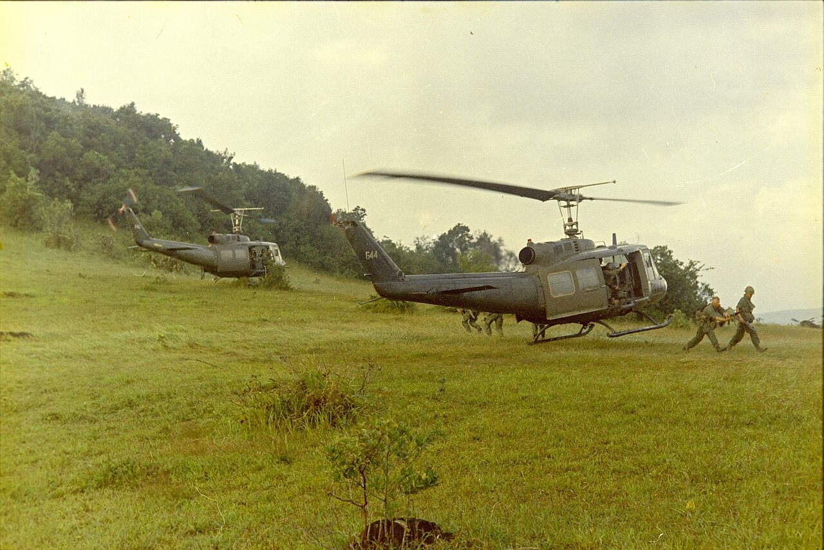
US.84 · DIRECT INSTRUCTION
1 of 4
Different Viewpoints on Social Activism
Supporters saw activism as necessary democratic participation addressing social injustices like civil rights, poverty, and unjust wars.
Critics viewed protesters as unpatriotic radicals undermining American institutions, values, and military morale.
This divide reflected fundamental disagreements about patriotism, authority, and social change.
SENTENCE FRAME (EL & writing support)
SP5 Robert C. Lafoon, Department of the Army Special Photo Office (DASPO), 1967 National Archives and Records Administration (NARA)
In the 1960s, young Americans in the counterculture protested ___ by ___, which caused older Americans to ___.
TEACHER CUE Chunk → cold-call → confirm before advancing.
U.S. History Hack · TroopToTeacher Technologies LLC · Aligned to TN Academic Standards & TCAP EOC
24
Notes:
FACILITATION (US.84). Ask: when young Americans challenged their parents' values in the 1960s, was that patriotism or rebellion? Can it be both? Teach in small steps; pause and check for understanding before the next chunk (aim 80%+ before moving on).

Slide 25
US.84 · DIRECT INSTRUCTION
2 of 4
The Generation Gap
The gap reflected fundamental differences between older Americans who experienced the Depression and World War II and younger Americans questioning authority, traditional values, and foreign policy.
Younger Americans who had grown up in postwar prosperity felt freer to challenge the establishment their parents had built and defended.
U.S. History Hack · TroopToTeacher Technologies LLC · Aligned to TN Academic Standards & TCAP EOC
25

Slide 26
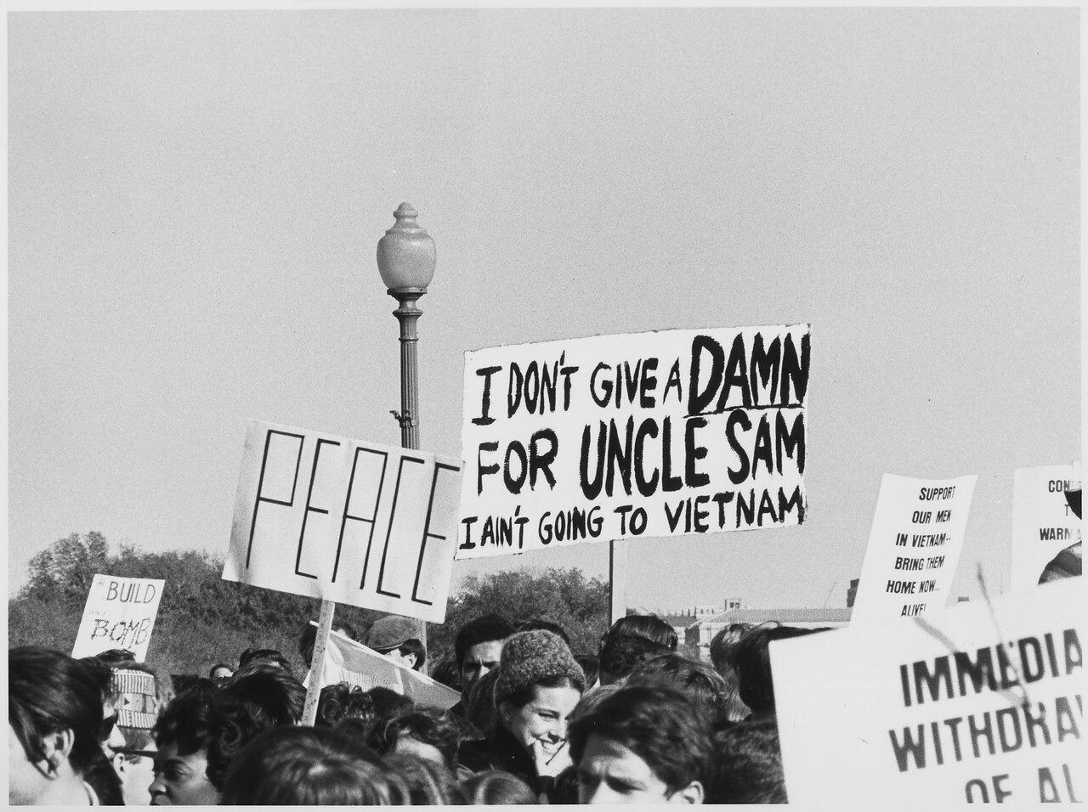
US.84 · DIRECT INSTRUCTION
3 of 4
The Hippie Movement
Hippies rejected materialism, embraced peace and love, experimented with drugs, and created alternative communities.
They opposed the Vietnam War and promoted environmental awareness, influencing music, fashion, and social attitudes.
Their lifestyle challenged middle-class conformity and sparked both admiration and outrage.
Johnson White House Photo Office, October 21, 1967 National Archives and Records Administration (NARA)
U.S. History Hack · TroopToTeacher Technologies LLC · Aligned to TN Academic Standards & TCAP EOC
26

Slide 27
US.84 · DIRECT INSTRUCTION
4 of 4
Woodstock's Significance
The 1969 music festival symbolized counterculture values of peace, music, and community.
Despite logistical problems — rain, inadequate facilities, massive crowds — it demonstrated young Americans' desire for alternative social arrangements.
Woodstock became an iconic moment of 1960s idealism, even as the decade's optimism soon gave way to disillusionment.
U.S. History Hack · TroopToTeacher Technologies LLC · Aligned to TN Academic Standards & TCAP EOC
27

Slide 28
US.84 · PEOPLE WHO SHAPED THE ERA
Key Figure
Dr. Martin Luther King Jr.
Civil rights leader and anti-war voice
Publicly opposed the Vietnam War in his 1967 "Beyond Vietnam" speech
Linked the struggle against poverty at home to the cost of war abroad
STRATEGY Moral persuasion (nonviolent protest)
U.S. History Hack · TroopToTeacher Technologies LLC · Aligned to TN Academic Standards & TCAP EOC
28

Slide 29
US.84 · PRIMARY SOURCE ANALYSIS
Gulf of Tonkin Resolution
Close Reading
U.S. Congress · August 7, 1964
"The Congress approves and supports the determination of the President, as Commander in Chief, to take all necessary measures to repel any armed attack against the forces of the United States and to prevent further aggression... The United States is, therefore, prepared, as the President determines, to take all necessary steps, including the use of armed force."
CONTEXT
After reported attacks on U.S. Navy ships in the Gulf of Tonkin, Congress passed this resolution in August 1964. It gave President Johnson broad authority to expand American military involvement in Vietnam without a formal declaration of war — fueling the anti-war activism that helped define the counterculture era.
ANALYZE
What power did the Gulf of Tonkin Resolution grant to the President?
READ CLOSELY Underline the exact words that answer the ANALYZE question — be ready to read them aloud.
SOURCE IT
WHO made it?
WHEN?
WHY does it matter?
FIRST
U.S. Congress
August 7, 1964
Consider who wrote this and why before you decide what power it really granted.
SSP.02 · before you interpret
Source: National Archives
U.S. History Hack · TroopToTeacher Technologies LLC · Aligned to TN Academic Standards & TCAP EOC
29
Notes:
Primary-source analysis. SOURCE IT FIRST (SSP.02) — model the sourcing routine aloud before students interpret: WHO made this source? (U.S. Congress) WHEN? (August 7, 1964) WHY does that matter? (Consider who wrote this and why before you decide what power it really granted.) Only then move to the ANALYZE question. Suggested answer: The resolution authorized the President "to take all necessary measures" and "all necessary steps, including the use of armed force" without a formal declaration of war. Practice skill: Close Reading.

Slide 30
US.84 · KEY VOCABULARY
Word Wall
Counterculture
Contracultura
Generation Gap
Brecha Generacional
say: KOWN-ter-kul-cher
say: jen-er-AY-shun gap
CO
A 1960s youth movement that rejected mainstream values, embracing new music, dress, and views on peace, freedom, and social change.
GG
The sharp differences in values, politics, and culture between 1960s youth and their parents' generation.
Hippie Movement
Movimiento Hippie
Woodstock
Woodstock
say: HIP-ee MOOV-ment
say: WOOD-stok
HM
A counterculture group of the 1960s that promoted peace, love, communal living, and opposition to the Vietnam War.
WO
A 1969 music festival in New York that drew 400,000 people and became a symbol of the counterculture and antiwar spirit.
Antiwar Movement
Movimiento contra la Guerra
New Left
Nueva Izquierda
say: AN-tee-wor MOOV-ment
say: noo LEFT
AM
Widespread 1960s-70s protests, especially on college campuses, against U.S. involvement in the Vietnam War.
NL
A 1960s political movement of young activists who pushed for civil rights, free speech, and an end to the Vietnam War.
"say:" pronunciation guide (stressed syllable in CAPS) and a per-term visual anchor support newcomer English learners. Spanish term + full bilingual Frayer models are in the unit vocabulary set.
U.S. History Hack · TroopToTeacher Technologies LLC · Aligned to TN Academic Standards & TCAP EOC
2

Slide 31
US.84 · GUIDED PRACTICE — WE DO IT TOGETHER
Let’s Work One Together
Analyze competing points of view
MODEL PROMPT: Two Americans watch the same anti-war march in 1967. One sees patriots; one sees traitors. How do I analyze both views fairly?
WORKED EXAMPLE (teacher models this aloud)
Supporters framed protest as democratic participation; critics framed it as undermining the country and the troops.
THINK ALOUD
To analyze a point of view, I ask what experiences and values shape it — Depression-and-WWII elders valued authority and sacrifice, while postwar youth felt free to question it.
→ Now you try: Now you: pick one counterculture symbol (hippies, Woodstock, or protest) and explain how a supporter and a critic would each describe it.
U.S. History Hack · TroopToTeacher Technologies LLC · Aligned to TN Academic Standards & TCAP EOC
30
Notes:
GUIDED PRACTICE / WE DO (US.84). Skill modeled: Analyze competing points of view. Model the worked example aloud using the THINK ALOUD as your script, then release students to the activity ("Now you: pick one counterculture symbol (hippies, Woodstock, or protest) and explain how a supporter and a critic would each describe it."). This is the I Do → We Do → You Do bridge — do not skip it; aim for 80%+ success before independent work.

Slide 32
US.84 · STUDENT ACTIVITY
Protest & Counterculture — SAPA Chart
Groups of 3
18 min
YOUR TASK
Using your Cornell notes, complete the SAPA chart (Situation — Action — Problem — Action) for THREE forms of 1960s activism: the anti-war movement, the student movement, and the counterculture. For each, identify the Situation (what they opposed), the Action taken (the tactic — marches, teach-ins, sit-ins), the Problem/backlash it met, and the further Action or outcome. Note how the “silent majority” reacted to these movements.
DELIVERABLE
DIFFERENTIATION
Completed SAPA chart for three movements, each with all four columns filled, plus one sentence on which movement had the biggest effect on public opinion about Vietnam.
Entry: SAPA chart with one movement pre-filled as a model and a word bank of tactics (teach-in, march, draft-card burning, sit-in). Honors: Analyze how the counterculture and anti-war movements reshaped American culture and politics — what did they change permanently, and what backlash did they trigger?
Companion printable: printables/unit-10/unit-10-sapa.html
U.S. History Hack · TroopToTeacher Technologies LLC · Aligned to TN Academic Standards & TCAP EOC
31
Notes:
Student activity for US.84. Pair with the printable: printables/unit-10/unit-10-sapa.html. Timing: 18. Deliverable: Completed SAPA chart for three movements, each with all four columns filled, plus one sentence on which movement had the biggest effect on public opinion about Vietnam.

Slide 33
US.84 · CHECK FOR UNDERSTANDING
TCAP-Style Question
DOK 3
EOC PRACTICE
What conclusion did Walter Cronkite reach about the Vietnam War?
America was winning and should continue fighting
A
America was losing and should surrender immediately
B
The war was a stalemate and the only way out was negotiation
C
The war would be over within weeks
D
ANSWER FIRST: students commit — then click / advance to reveal the correct answer and explanation.
U.S. History Hack · TroopToTeacher Technologies LLC · Aligned to TN Academic Standards & TCAP EOC
32
Notes:
CHECK FOR UNDERSTANDING (US.84, DOK 3). Have students commit to an answer (whiteboards, hand signal, or turn-and-talk) BEFORE advancing. Correct answer: C. The next slide reveals it. Why: Cronkite concluded the war was "mired in stalemate" and that "the only rational way out then will be to negotiate" — a turning point in public opinion.

Slide 34
US.84 · ANSWER REVEAL
TCAP-Style Question
✓ ANSWER KEY
What conclusion did Walter Cronkite reach about the Vietnam War?
A
America was winning and should continue fighting
B
America was losing and should surrender immediately
C
The war was a stalemate and the only way out was negotiation
✓
D
The war would be over within weeks
Correct answer: C. Why: Cronkite concluded the war was "mired in stalemate" and that "the only rational way out then will be to negotiate" — a turning point in public opinion.
U.S. History Hack · TroopToTeacher Technologies LLC · Aligned to TN Academic Standards & TCAP EOC
33
Notes:
ANSWER KEY (US.84). Correct: C. Cronkite concluded the war was "mired in stalemate" and that "the only rational way out then will be to negotiate" — a turning point in public opinion.

Slide 35
US.84 · WRAP-UP
What You Need to Know for TCAP
KEY TAKEAWAYS
EXIT TICKET
DOK 2
Different Viewpoints on Social Activism
The Generation Gap
The Hippie Movement
Woodstock's Significance
Describe the counterculture and the “generation gap” of the 1960s. What did young Americans protest, and how did older Americans react?
★ HONORS / EXTENSION DOK 3 · SSP.04 Argumentation
Analyze how the counterculture and anti-war movements changed American society. What did they change permanently, and what backlash did they trigger? Argue with evidence.
U.S. History Hack · TroopToTeacher Technologies LLC · Aligned to TN Academic Standards & TCAP EOC
34
Notes:
WRAP-UP / EXIT-TICKET KEY (US.84, DOK 2). Prompt: Describe the counterculture and the “generation gap” of the 1960s. What did young Americans protest, and how did older Americans react? Model answer: The counterculture was a 1960s youth movement that rejected traditional values and embraced new music, styles, and ideas. The “generation gap” was the deep divide between these youth and their parents. Young Americans protested the Vietnam War, racial injustice, and conformity. Many older Americans — the “silent majority” — saw the protests and counterculture as a threat to law, order, and traditional values. RETEACH TRIGGER — if a student misses this exit ticket: (1) <50% of class miss → spiral it into the next standard’s Quick Review opener (see the US.84 review prompts). (2) Individual/small group → reteach with the "Different Viewpoints on Social Activism" direct-instruction slide + re-run the SOURCE IT FIRST routine on the US.84 primary source, then assign the paired printable: printables/unit-10/unit-10-sapa.html. (3) Re-assess with the US.84 check-for-understanding reveal slide as a do-now the next day. Reteach anchors (this standard’s sections): Different Viewpoints on Social Activism; The Generation Gap; The Hippie Movement; Woodstock's Significance. I Can objective: I can analyze different points of view that reflect the rise of social activism and the growth of counterculture, including the generation gap, hippies, and Woodstock. HONORS / EXTENSION (DOK 3, for early finishers or advanced learners): Analyze how the counterculture and anti-war movements changed American society. What did they change permanently, and what backlash did they trigger? Argue with evidence. — look for a clear claim plus two specific pieces of evidence.

Slide 36
STANDARD
SOCIAL STUDIES PRACTICES
US.85
SSP.01
Collect sources
SSP.05
Historical awareness
SSP.06
Geographic awareness
Nixon Administration Achievements
TN ACADEMIC STANDARD
Explain significant achievements of President Richard Nixon's administration, including his appeal to the "silent majority" and his major foreign policy actions.
I CAN
I can explain significant achievements of President Richard Nixon's administration, including his appeal to the "silent majority" and his major foreign policy actions.
U.S. History Hack · TroopToTeacher Technologies LLC · Aligned to TN Academic Standards & TCAP EOC
35

Slide 37
US.85 · QUICK REVIEW
Do You Remember?
Before we start, retrieve what we have already learned. Answer from memory first — no notes.
1
US.84 We just studied 1960s social activism and the counterculture. What was the “generation gap,” and what did young protesters oppose?
U.S. History Hack · TroopToTeacher Technologies LLC · Aligned to TN Academic Standards & TCAP EOC
36
Notes:
SPACED RETRIEVAL (US.85). Cold-call or whiteboards, 3-4 min, low stakes. Answers — 1) The generation gap was the sharp divide in values between 1960s youth and their parents. Young Americans protested the Vietnam War, questioned authority, and embraced a counterculture of new music, styles, and ideas — clashing with older, more traditional Americans.

Slide 38
US.85 · CONFIDENCE CHECK
Warm-Up — Quick Recall
DOK 1
LOW STAKES
Everyone can answer this. Thumbs / whiteboards — no notes.
Which communist country did Nixon famously visit in 1972?
✓ ANSWER
China.
COMMIT FIRST: have everyone answer before the reveal — this is the DOK 1 floor; the graded check later in this lesson moves up to DOK 2–3.
U.S. History Hack · TroopToTeacher Technologies LLC · Aligned to TN Academic Standards & TCAP EOC
37
Notes:
CONFIDENCE CHECK (US.85, DOK 1). 60-90 seconds. Have EVERY student commit (thumbs / whiteboard / choral) before revealing — this secures an early win and surfaces who is shaky before new content. Answer: China. Key term to listen for: Silent Majority. This is the low-floor entry; the graded Check for Understanding later in the standard rises to DOK 2–3.

Slide 39
US.85 · HOOK
Think About It
The same president who was forced to resign in disgrace also opened relations with communist China, eased tensions with the Soviet Union, and won a landslide by appealing to what he called the “silent majority.”
DISCUSS
TIMING: Turn & Talk 60 sec → cold-call 2 pairs
Nixon appealed to the “silent majority” — Americans who did not protest but felt unheard. Why can the people who stay quiet sometimes matter more in an election than the ones in the streets?
U.S. History Hack · TroopToTeacher Technologies LLC · Aligned to TN Academic Standards & TCAP EOC
38
Notes:
HOOK (US.85). Run tight: pose the provocation, give a silent 10-second think, then Turn & Talk 60 seconds. Cold-call 2–3 pairs (not volunteers) for a sentence-starter answer — "One force was ___ because ___" — then bridge to the standard. Keep total to ~4 minutes; do not let it sprawl. Return to this question at the unit close for an evidence-based answer.

Slide 40
US.85 · DIRECT INSTRUCTION
1 of 3
Significant Achievements
Nixon's achievements spanned multiple areas.
In foreign policy, he pursued détente with the Soviet Union, opened relations with China, and signed the SALT I Treaty.
In domestic policy, he created the Environmental Protection Agency, saw Title IX passed for gender equality in education, and enforced desegregation.
In economic policy, he imposed temporary wage and price controls and ended the gold standard.
In social policy, the 26th Amendment lowered the voting age to 18.
SENTENCE FRAME (EL & writing support)
President Nixon appealed to the “silent majority” by ___, and in foreign policy he ___ in order to ___.
U.S. History Hack · TroopToTeacher Technologies LLC · Aligned to TN Academic Standards & TCAP EOC
39
Notes:
FACILITATION (US.85). Ask: how could a president known for creating the EPA and opening China also become the center of a scandal that forced him to resign? What does that tell us about judging a presidency? Teach in small steps; pause and check for understanding before the next chunk (aim 80%+ before moving on).

Slide 41
US.85 · DIRECT INSTRUCTION
2 of 3
The "Silent Majority" Concept
Nixon appealed to Americans who didn't participate in protests but supported traditional values and law and order.
This strategy targeted middle-class voters frustrated with civil rights demonstrations, antiwar protests, and counterculture movements.
It helped Nixon win working-class Democratic voters and reshape Republican electoral strategy for decades, creating a coalition that would dominate American politics.
U.S. History Hack · TroopToTeacher Technologies LLC · Aligned to TN Academic Standards & TCAP EOC
40

Slide 42
US.85 · DIRECT INSTRUCTION
3 of 3
Major Foreign Policy Initiatives
China Opening: Secret diplomacy led to Nixon's historic 1972 China visit, establishing diplomatic relations and strategically isolating the Soviet Union.
Détente: Reduced tensions with the USSR through arms control negotiations and increased trade.
Vietnam: The Vietnamization policy gradually withdrew American troops while maintaining support for South Vietnam, though the country ultimately fell in 1975.
U.S. History Hack · TroopToTeacher Technologies LLC · Aligned to TN Academic Standards & TCAP EOC
41

Slide 43
US.85 · PEOPLE WHO SHAPED THE ERA
Key Figure
President Richard Nixon
37th President of the United States
Opened diplomatic relations with China with his historic 1972 visit
Pursued détente and signed the SALT I arms-control treaty with the USSR
STRATEGY Diplomacy (Cold War realpolitik)
U.S. History Hack · TroopToTeacher Technologies LLC · Aligned to TN Academic Standards & TCAP EOC
42

Slide 44
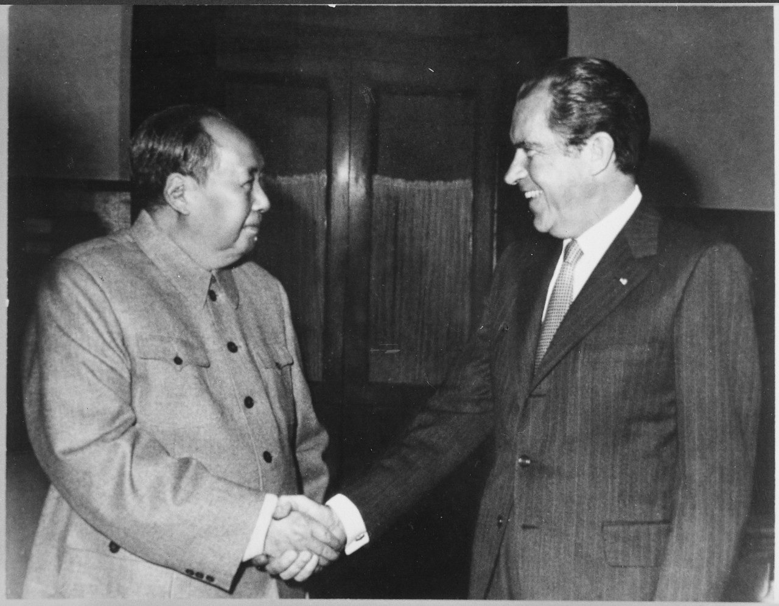
US.85 · PRIMARY SOURCE ANALYSIS
Silent Majority Speech
Argumentation
President Richard Nixon · November 3, 1969
ZOOM IN Find ONE detail that surprises you — be ready to name it.
"And so tonight — to you, the great silent majority of my fellow Americans — I ask for your support. I pledged in my campaign for the Presidency to end the war in a way that we could win the peace. I have initiated a plan of action which will enable me to keep that pledge."
CONTEXT
In November 1969, with anti-war protests growing, Nixon addressed the nation to defend his Vietnam policy. Rather than speak to the protesters, he appealed to what he called the "great silent majority" — ordinary Americans who did not march but, he claimed, quietly supported him.
ANALYZE
Who was Nixon appealing to in this speech?
Nixon White House Photographic Office, February 21, 1972 National Archives and Records Administration (NARA 194759); via Wikimedia Commons
SOURCE IT
WHO made it?
WHEN?
WHY does it matter?
FIRST
President Richard Nixon
November 3, 1969
Consider who Nixon is addressing and why before you judge the speech.
SSP.02 · before you interpret
Source: National Archives
U.S. History Hack · TroopToTeacher Technologies LLC · Aligned to TN Academic Standards & TCAP EOC
43
Notes:
Primary-source analysis. SOURCE IT FIRST (SSP.02) — model the sourcing routine aloud before students interpret: WHO made this source? (President Richard Nixon) WHEN? (November 3, 1969) WHY does that matter? (Consider who Nixon is addressing and why before you judge the speech.) Only then move to the ANALYZE question. Suggested answer: Nixon directly addresses "the great silent majority of my fellow Americans," seeking support from those who did not join vocal protests but supported his approach. Practice skill: Argumentation.

Slide 45
US.85 · KEY VOCABULARY
Word Wall
Silent Majority
Mayoría Silenciosa
Détente
Distensión
say: SY-lent muh-JOR-ih-tee
say: day-TAHNT
SM
President Nixon's term for the many Americans who quietly supported his policies but did not join loud public protests.
DT
Nixon's policy of easing Cold War tensions with the Soviet Union and China through diplomacy and treaties.
Nixon Visits China
Visita de Nixon a China
SALT I
SALT I (Tratado de Armas)
say: NIK-sun VIZ-its CHY-nuh
say: salt WUN
NV
Nixon's historic 1972 trip that reopened U.S. relations with Communist China after more than 20 years of hostility.
SI
The 1972 Strategic Arms Limitation Talks treaty that limited U.S. and Soviet nuclear missiles, a key result of détente.
Revenue Sharing
Distribución de Ingresos Federales
Environmental Protection Agency (EPA)
Agencia de Protección Ambiental
say: REV-en-yoo SHAIR-ing
say: en-vy-run-MEN-tul pro-TEK-shun
RS
A Nixon program returning federal tax money to state and local governments to spend on their own priorities.
EP
A federal agency created under Nixon in 1970 to write and enforce laws protecting air, water, and land.
"say:" pronunciation guide (stressed syllable in CAPS) and a per-term visual anchor support newcomer English learners. Spanish term + full bilingual Frayer models are in the unit vocabulary set.
U.S. History Hack · TroopToTeacher Technologies LLC · Aligned to TN Academic Standards & TCAP EOC
3

Slide 46
US.85 · GUIDED PRACTICE — WE DO IT TOGETHER
Let’s Work One Together
Explain a leader's political strategy
MODEL PROMPT: Nixon says he speaks for a "silent majority." How do I explain what that strategy was and why it worked?
WORKED EXAMPLE (teacher models this aloud)
Nixon appealed to Americans who did not protest but valued law, order, and tradition.
THINK ALOUD
To explain a strategy, I identify the audience Nixon targeted (frustrated middle-class voters) and the goal (winning support without answering the protesters directly).
→ Now you try: Now you: explain in one sentence how the "silent majority" appeal helped Nixon build a lasting political coalition.
U.S. History Hack · TroopToTeacher Technologies LLC · Aligned to TN Academic Standards & TCAP EOC
45
Notes:
GUIDED PRACTICE / WE DO (US.85). Skill modeled: Explain a leader's political strategy. Model the worked example aloud using the THINK ALOUD as your script, then release students to the activity ("Now you: explain in one sentence how the "silent majority" appeal helped Nixon build a lasting political coalition."). This is the I Do → We Do → You Do bridge — do not skip it; aim for 80%+ success before independent work.

Slide 47
US.85 · STUDENT ACTIVITY
Nixon's Foreign Policy — Cause & Effect Chart
Pairs
15 min
YOUR TASK
Using your Cornell notes and Nixon's Silent Majority speech excerpt, complete the Cause & Effect organizer for Nixon's major foreign-policy moves. In CAUSES, list the Cold War problems Nixon faced (the Vietnam War, tension with the USSR, an isolated China). In EFFECTS, trace his responses — the 1972 opening to China, détente and SALT I with the Soviets, and Vietnamization. Finish with a claim about how Nixon used one communist power against another.
DELIVERABLE
DIFFERENTIATION
Completed Cause & Effect organizer (3+ causes, 3+ effects) plus a one-sentence claim on how Nixon's China opening changed the balance of the Cold War.
Entry: Organizer with a word bank (détente, SALT I, China visit, Vietnamization, silent majority) to place. Honors: Evaluate whether Nixon's foreign policy achievements outweigh the damage of Watergate. Argue with evidence.
Companion printable: printables/unit-10/unit-10-cause-effect.html
U.S. History Hack · TroopToTeacher Technologies LLC · Aligned to TN Academic Standards & TCAP EOC
46
Notes:
Student activity for US.85. Pair with the printable: printables/unit-10/unit-10-cause-effect.html. Timing: 15. Deliverable: Completed Cause & Effect organizer (3+ causes, 3+ effects) plus a one-sentence claim on how Nixon's China opening changed the balance of the Cold War.

Slide 48
US.85 · CHECK FOR UNDERSTANDING
TCAP-Style Question
DOK 3
EOC PRACTICE
Who was Nixon appealing to in this speech?
Anti-war protestors
A
Military leaders only
B
Ordinary Americans who quietly supported his Vietnam policies
C
Foreign governments
D
ANSWER FIRST: students commit — then click / advance to reveal the correct answer and explanation.
U.S. History Hack · TroopToTeacher Technologies LLC · Aligned to TN Academic Standards & TCAP EOC
47
Notes:
CHECK FOR UNDERSTANDING (US.85, DOK 3). Have students commit to an answer (whiteboards, hand signal, or turn-and-talk) BEFORE advancing. Correct answer: C. The next slide reveals it. Why: Nixon directly addresses "the great silent majority of my fellow Americans," seeking support from those who did not join vocal protests but supported his approach.

Slide 49
US.85 · ANSWER REVEAL
TCAP-Style Question
✓ ANSWER KEY
Who was Nixon appealing to in this speech?
A
Anti-war protestors
B
Military leaders only
C
Ordinary Americans who quietly supported his Vietnam policies
✓
D
Foreign governments
Correct answer: C. Why: Nixon directly addresses "the great silent majority of my fellow Americans," seeking support from those who did not join vocal protests but supported his approach.
U.S. History Hack · TroopToTeacher Technologies LLC · Aligned to TN Academic Standards & TCAP EOC
48
Notes:
ANSWER KEY (US.85). Correct: C. Nixon directly addresses "the great silent majority of my fellow Americans," seeking support from those who did not join vocal protests but supported his approach.

Slide 50
US.85 · WRAP-UP
What You Need to Know for TCAP
KEY TAKEAWAYS
EXIT TICKET
DOK 3
Significant Achievements
The "Silent Majority" Concept
Major Foreign Policy Initiatives
Explain who Nixon meant by the “silent majority,” and describe his two major foreign-policy achievements.
★ HONORS / EXTENSION DOK 3 · SSP.04 Argumentation
Evaluate whether Nixon's foreign-policy achievements outweigh the damage of Watergate to his legacy. Defend your position with evidence.
U.S. History Hack · TroopToTeacher Technologies LLC · Aligned to TN Academic Standards & TCAP EOC
49
Notes:
WRAP-UP / EXIT-TICKET KEY (US.85, DOK 3). Prompt: Explain who Nixon meant by the “silent majority,” and describe his two major foreign-policy achievements. Model answer: The “silent majority” meant the many Americans who did not protest but, Nixon argued, quietly supported him and traditional values. His two biggest foreign-policy achievements were opening relations with communist China (his 1972 visit) and pursuing détente with the Soviet Union, including the SALT I arms-control treaty. Together these eased Cold War tensions by playing the two communist powers against each other. RETEACH TRIGGER — if a student misses this exit ticket: (1) <50% of class miss → spiral it into the next standard’s Quick Review opener (see the US.85 review prompts). (2) Individual/small group → reteach with the "Significant Achievements" direct-instruction slide + re-run the SOURCE IT FIRST routine on the US.85 primary source, then assign the paired printable: printables/unit-10/unit-10-cause-effect.html. (3) Re-assess with the US.85 check-for-understanding reveal slide as a do-now the next day. Reteach anchors (this standard’s sections): Significant Achievements; The "Silent Majority" Concept; Major Foreign Policy Initiatives. I Can objective: I can explain significant achievements of President Richard Nixon's administration, including his appeal to the "silent majority" and his major foreign policy actions. HONORS / EXTENSION (DOK 3, for early finishers or advanced learners): Evaluate whether Nixon's foreign-policy achievements outweigh the damage of Watergate to his legacy. Defend your position with evidence. — look for a clear claim plus two specific pieces of evidence.

Slide 51
STANDARD
SOCIAL STUDIES PRACTICES
US.86
SSP.01
Collect sources
SSP.02
Examine a source
SSP.06
Geographic awareness
Watergate Scandal
TN ACADEMIC STANDARD
Examine the Watergate scandal, including: Background of the break-in, Changing role of media and journalism, Controversy surrounding President Gerald Ford's pardon, Legacy of distrust, United States v. Nixon.
I CAN
I can examine the Watergate scandal, including the background of the break-in, the changing role of media, President Ford's pardon controversy, the legacy of distrust, and United States v. Nixon.
U.S. History Hack · TroopToTeacher Technologies LLC · Aligned to TN Academic Standards & TCAP EOC
50

Slide 52
US.86 · QUICK REVIEW
Do You Remember?
Before we start, retrieve what we have already learned. Answer from memory first — no notes.
1
US.85 In the last standard we studied Nixon's achievements. What were his two biggest foreign-policy moves?
U.S. History Hack · TroopToTeacher Technologies LLC · Aligned to TN Academic Standards & TCAP EOC
51
Notes:
SPACED RETRIEVAL (US.86). Cold-call or whiteboards, 3-4 min, low stakes. Answers — 1) Nixon opened relations with communist China with his historic 1972 visit and pursued détente with the Soviet Union, signing the SALT I arms-control treaty — easing Cold War tensions by playing the two communist powers against each other.

Slide 53
US.86 · CONFIDENCE CHECK
Warm-Up — Quick Recall
DOK 1
LOW STAKES
Everyone can answer this. Thumbs / whiteboards — no notes.
What scandal forced President Nixon to resign in 1974?
✓ ANSWER
The Watergate scandal.
COMMIT FIRST: have everyone answer before the reveal — this is the DOK 1 floor; the graded check later in this lesson moves up to DOK 2–3.
U.S. History Hack · TroopToTeacher Technologies LLC · Aligned to TN Academic Standards & TCAP EOC
52
Notes:
CONFIDENCE CHECK (US.86, DOK 1). 60-90 seconds. Have EVERY student commit (thumbs / whiteboard / choral) before revealing — this secures an early win and surfaces who is shaky before new content. Answer: The Watergate scandal. Key term to listen for: Watergate Scandal. This is the low-floor entry; the graded Check for Understanding later in the standard rises to DOK 2–3.

Slide 54
US.86 · HOOK
Think About It
A break-in at an office building led, step by step, to the only resignation of a U.S. president in history — and proved that in America, not even the president is above the law.
DISCUSS
TIMING: Turn & Talk 60 sec → cold-call 2 pairs
When a president breaks the law, who is powerful enough to hold him accountable — the courts, Congress, the press, or the voters? Watergate tested all four.
U.S. History Hack · TroopToTeacher Technologies LLC · Aligned to TN Academic Standards & TCAP EOC
53
Notes:
HOOK (US.86). Run tight: pose the provocation, give a silent 10-second think, then Turn & Talk 60 seconds. Cold-call 2–3 pairs (not volunteers) for a sentence-starter answer — "One force was ___ because ___" — then bridge to the standard. Keep total to ~4 minutes; do not let it sprawl. Return to this question at the unit close for an evidence-based answer.

Slide 55
US.86 · DIRECT INSTRUCTION
1 of 4
The Break-in Circumstances
On June 17, 1972, five men were arrested breaking into Democratic National Committee headquarters at the Watergate complex.
Initial investigations revealed connections to Nixon's reelection campaign (CREEP) and White House officials, suggesting political espionage rather than a simple burglary.
The cover-up that followed would prove more damaging than the original crime.
SENTENCE FRAME (EL & writing support)
The Watergate scandal began when ___, and it ended Nixon's presidency because ___.
U.S. History Hack · TroopToTeacher Technologies LLC · Aligned to TN Academic Standards & TCAP EOC
54
Notes:
FACILITATION (US.86). Ask: the phrase "no one is above the law" comes from Watergate. Why does that idea still matter for how we judge presidents today? Teach in small steps; pause and check for understanding before the next chunk (aim 80%+ before moving on).

Slide 56
US.86 · DIRECT INSTRUCTION
2 of 4
Media's Changing Role
Washington Post reporters Bob Woodward and Carl Bernstein conducted persistent investigative journalism, following money trails and cultivating sources (including "Deep Throat," later revealed as FBI Deputy Director Mark Felt).
Television coverage brought congressional hearings into American homes, demonstrating the media's power to hold government accountable and establishing investigative journalism as a crucial democratic institution.
U.S. History Hack · TroopToTeacher Technologies LLC · Aligned to TN Academic Standards & TCAP EOC
55

Slide 57
US.86 · DIRECT INSTRUCTION
3 of 4
United States v. Nixon
The Supreme Court unanimously ruled that executive privilege couldn't override judicial subpoenas for criminal proceedings.
Nixon had to surrender White House tapes to prosecutors.
This landmark decision established limits on presidential power and affirmed that no one, including the president, is above the law — a fundamental principle of American constitutional government.
U.S. History Hack · TroopToTeacher Technologies LLC · Aligned to TN Academic Standards & TCAP EOC
56

Slide 58
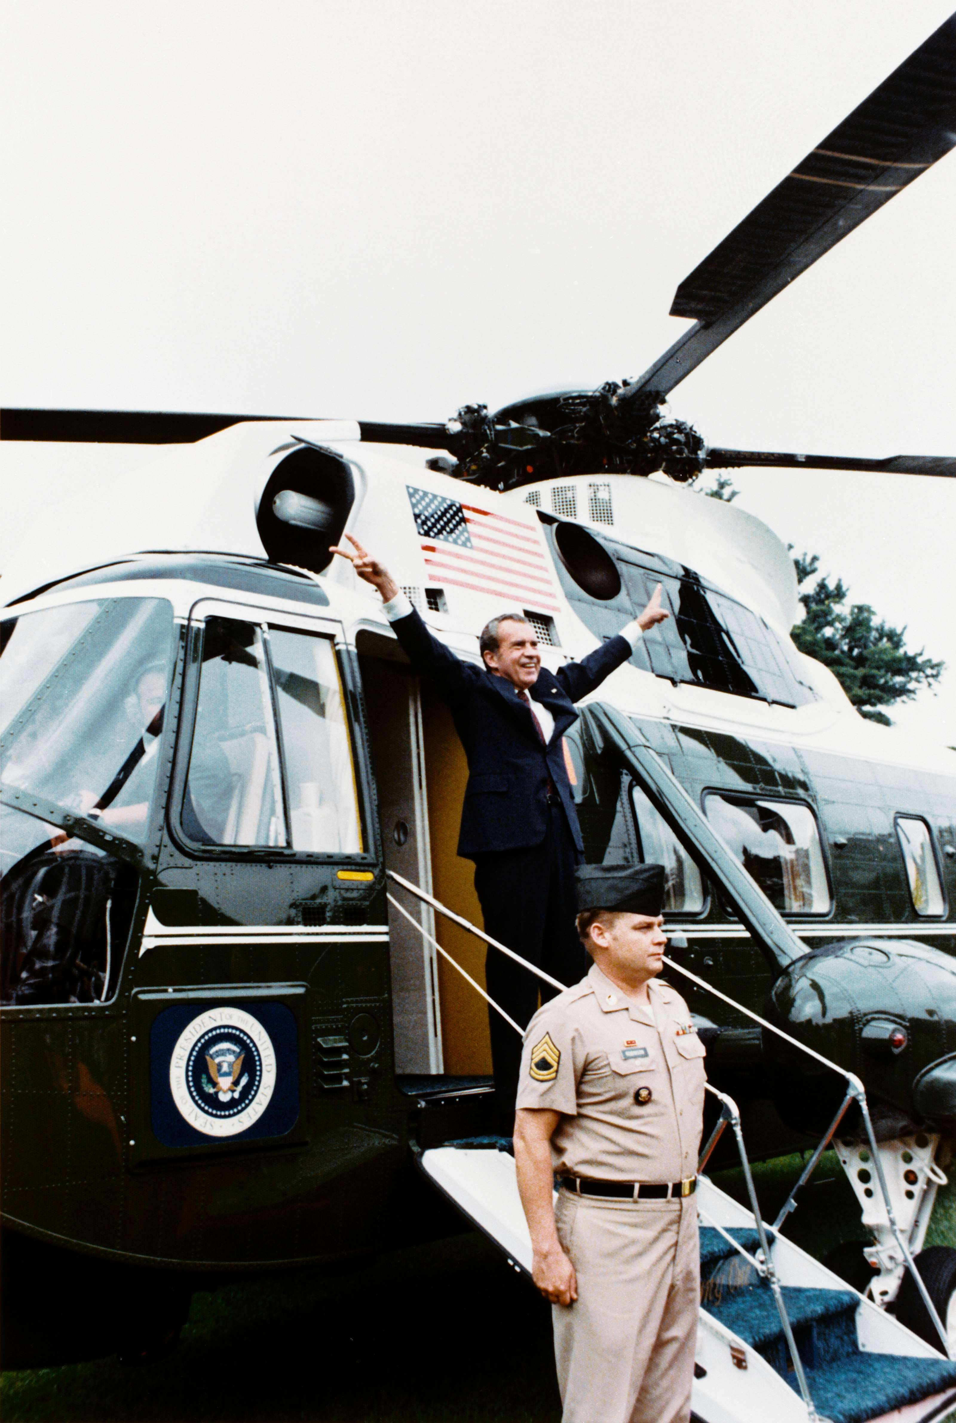
US.86 · DIRECT INSTRUCTION
4 of 4
Ford's Pardon and Legacy of Distrust
President Ford's unconditional pardon of Nixon (September 1974) sparked outrage among Americans seeking accountability.
Supporters argued it was necessary to heal the nation; critics claimed it established double standards of justice.
Watergate fundamentally altered Americans' relationship with government, creating lasting cynicism.
Public trust fell from 73% in 1958 to 36% by 1974, influencing political culture for generations.
Ollie Atkins, White House Chief Photographer, August 9, 1974 Executive Office of the President of the United States
U.S. History Hack · TroopToTeacher Technologies LLC · Aligned to TN Academic Standards & TCAP EOC
57

Slide 59
US.86 · PEOPLE WHO SHAPED THE ERA
Key Figure
Bob Woodward and Carl Bernstein
Washington Post investigative reporters
Exposed the Watergate cover-up through persistent investigative reporting
Cultivated the secret source "Deep Throat" (FBI official Mark Felt)
STRATEGY Investigative journalism (accountability reporting)
U.S. History Hack · TroopToTeacher Technologies LLC · Aligned to TN Academic Standards & TCAP EOC
58

Slide 60
US.86 · PRIMARY SOURCE ANALYSIS
Resignation Speech
Sourcing
President Richard Nixon · August 8, 1974
"I have never been a quitter. To leave office before my term is completed is abhorrent to every instinct in my body. But as President, I must put the interest of America first... Therefore, I shall resign the Presidency effective at noon tomorrow. Vice President Ford will be sworn in as President."
CONTEXT
Facing near-certain impeachment after the release of the "smoking gun" tape, Nixon became the first U.S. president to resign. In this televised address, he explained his decision to the nation while insisting he had acted in the country's interest.
ANALYZE
Why does Nixon say he is resigning?
READ CLOSELY Underline the exact words that answer the ANALYZE question — be ready to read them aloud.
SOURCE IT
WHO made it?
WHEN?
WHY does it matter?
FIRST
President Richard Nixon
August 8, 1974
Consider the author's purpose — a resignation speech is meant to shape how history remembers him.
SSP.02 · before you interpret
Source: National Archives
U.S. History Hack · TroopToTeacher Technologies LLC · Aligned to TN Academic Standards & TCAP EOC
59
Notes:
Primary-source analysis. SOURCE IT FIRST (SSP.02) — model the sourcing routine aloud before students interpret: WHO made this source? (President Richard Nixon) WHEN? (August 8, 1974) WHY does that matter? (Consider the author's purpose — a resignation speech is meant to shape how history remembers him.) Only then move to the ANALYZE question. Suggested answer: Nixon states he "must put the interest of America first" as his reason for resigning, framing it as a sacrifice despite it being "abhorrent" to him. Practice skill: Sourcing.

Slide 61
US.86 · KEY VOCABULARY
Word Wall
Watergate Scandal
Escándalo de Watergate
United States v. Nixon
Estados Unidos vs. Nixon
say: WAW-ter-gayt SKAN-dul
say: yoo-NY-ted stayts VER-sus NIK-sun
WS
A political scandal beginning with a 1972 break-in at Democratic headquarters that exposed abuses of power and forced Nixon to resign in 1974.
US
A 1974 Supreme Court ruling that the president is not above the law and must release the Watergate tapes.
Executive Privilege
Privilegio Ejecutivo
Ford's Pardon of Nixon
Indulto de Ford a Nixon
say: eg-ZEK-yoo-tiv PRIV-ul-ij
say: fordz PAR-dun
EP
A president's claimed right to keep some communications secret — rejected by the Court in the Watergate tapes case.
FS
President Gerald Ford's 1974 decision to pardon Nixon for any crimes, a choice that deepened public distrust of government.
Impeachment
Juicio Político
Investigative Journalism
Periodismo de Investigación
say: im-PEECH-ment
say: in-VES-tih-gay-tiv JUR-nul-izm
IM
The constitutional process for charging a president with serious wrongdoing; Nixon resigned before the House could impeach him.
IJ
In-depth reporting — like the Washington Post's Watergate coverage — that uncovers hidden wrongdoing by those in power.
"say:" pronunciation guide (stressed syllable in CAPS) and a per-term visual anchor support newcomer English learners. Spanish term + full bilingual Frayer models are in the unit vocabulary set.
U.S. History Hack · TroopToTeacher Technologies LLC · Aligned to TN Academic Standards & TCAP EOC
4

Slide 62
US.86 · GUIDED PRACTICE — WE DO IT TOGETHER
Let’s Work One Together
Corroborate evidence across sources
MODEL PROMPT: One source is Nixon's resignation speech; another is the "smoking gun" tape. How do I use both to judge his guilt?
WORKED EXAMPLE (teacher models this aloud)
The speech says he acted for America's good; the tape shows him directing a cover-up.
THINK ALOUD
To corroborate, I compare what different sources say — when the tape contradicts the speech, the tape is stronger evidence because it was recorded at the time and not meant to be public.
→ Now you try: Now you: explain which source better reveals Nixon's actual role in Watergate, and why.
U.S. History Hack · TroopToTeacher Technologies LLC · Aligned to TN Academic Standards & TCAP EOC
61
Notes:
GUIDED PRACTICE / WE DO (US.86). Skill modeled: Corroborate evidence across sources. Model the worked example aloud using the THINK ALOUD as your script, then release students to the activity ("Now you: explain which source better reveals Nixon's actual role in Watergate, and why."). This is the I Do → We Do → You Do bridge — do not skip it; aim for 80%+ success before independent work.

Slide 63
US.86 · STUDENT ACTIVITY
Watergate — Timeline of a Constitutional Crisis
Pairs
15 min
YOUR TASK
Using your Cornell notes and the primary source excerpts, build a timeline of the Watergate scandal in order: the 1972 break-in at the Democratic headquarters, the cover-up, the Senate hearings and discovery of the White House tapes, United States v. Nixon (1974), and Nixon's resignation on August 9, 1974. For each event, add one sentence on why it mattered. Finish with a claim about what Watergate proved about the rule of law and the phrase “no one is above the law.”
DELIVERABLE
DIFFERENTIATION
Completed timeline (5+ ordered events, each with a why-it-mattered note) plus a one-sentence claim on how the system of checks and balances responded to a president who broke the law.
Entry: Timeline with events pre-listed to place in order and a word bank (break-in, cover-up, tapes, United States v. Nixon, resignation). Honors: Analyze which branch of government did the most to hold Nixon accountable — the courts, Congress, the press, or public opinion? Defend with evidence.
Companion printable: printables/unit-10/unit-10-timeline.html
U.S. History Hack · TroopToTeacher Technologies LLC · Aligned to TN Academic Standards & TCAP EOC
62
Notes:
Student activity for US.86. Pair with the printable: printables/unit-10/unit-10-timeline.html. Timing: 15. Deliverable: Completed timeline (5+ ordered events, each with a why-it-mattered note) plus a one-sentence claim on how the system of checks and balances responded to a president who broke the law.

Slide 64
US.86 · CHECK FOR UNDERSTANDING
TCAP-Style Question
DOK 3
EOC PRACTICE
Why does Nixon say he is resigning?
He was found guilty of crimes in court
A
He wants to spend more time with his family
B
He was forced out by the military
C
He believes it is in the best interest of America
D
ANSWER FIRST: students commit — then click / advance to reveal the correct answer and explanation.
U.S. History Hack · TroopToTeacher Technologies LLC · Aligned to TN Academic Standards & TCAP EOC
63
Notes:
CHECK FOR UNDERSTANDING (US.86, DOK 3). Have students commit to an answer (whiteboards, hand signal, or turn-and-talk) BEFORE advancing. Correct answer: D. The next slide reveals it. Why: Nixon states he "must put the interest of America first" as his reason for resigning, framing it as a sacrifice despite it being "abhorrent" to him.

Slide 65
US.86 · ANSWER REVEAL
TCAP-Style Question
✓ ANSWER KEY
Why does Nixon say he is resigning?
A
He was found guilty of crimes in court
B
He wants to spend more time with his family
C
He was forced out by the military
D
He believes it is in the best interest of America
✓
Correct answer: D. Why: Nixon states he "must put the interest of America first" as his reason for resigning, framing it as a sacrifice despite it being "abhorrent" to him.
U.S. History Hack · TroopToTeacher Technologies LLC · Aligned to TN Academic Standards & TCAP EOC
64
Notes:
ANSWER KEY (US.86). Correct: D. Nixon states he "must put the interest of America first" as his reason for resigning, framing it as a sacrifice despite it being "abhorrent" to him.

Slide 66
US.86 · WRAP-UP
What You Need to Know for TCAP
KEY TAKEAWAYS
EXIT TICKET
DOK 2
The Break-in Circumstances
Media's Changing Role
United States v. Nixon
Ford's Pardon and Legacy of Distrust
Explain the Watergate scandal and why it led to Nixon's resignation. What did United States v. Nixon establish?
★ HONORS / EXTENSION DOK 3 · SSP.04 Argumentation
Analyze which check on power did the most to hold Nixon accountable — the courts, Congress, the press, or public opinion? Defend your answer with evidence.
U.S. History Hack · TroopToTeacher Technologies LLC · Aligned to TN Academic Standards & TCAP EOC
65
Notes:
WRAP-UP / EXIT-TICKET KEY (US.86, DOK 2). Prompt: Explain the Watergate scandal and why it led to Nixon's resignation. What did United States v. Nixon establish? Model answer: Watergate began with a 1972 break-in at the Democratic Party headquarters, which the Nixon White House then tried to cover up. Investigations and secret tapes revealed Nixon's involvement in the cover-up. In United States v. Nixon (1974), the Supreme Court ruled unanimously that he had to hand over the tapes, rejecting his claim of executive privilege. Facing certain impeachment, Nixon resigned on August 9, 1974. The case established that not even the president is above the law. RETEACH TRIGGER — if a student misses this exit ticket: (1) <50% of class miss → spiral it into the next standard’s Quick Review opener (see the US.86 review prompts). (2) Individual/small group → reteach with the "The Break-in Circumstances" direct-instruction slide + re-run the SOURCE IT FIRST routine on the US.86 primary source, then assign the paired printable: printables/unit-10/unit-10-timeline.html. (3) Re-assess with the US.86 check-for-understanding reveal slide as a do-now the next day. Reteach anchors (this standard’s sections): The Break-in Circumstances; Media's Changing Role; United States v. Nixon; Ford's Pardon and Legacy of Distrust. I Can objective: I can examine the Watergate scandal, including the background of the break-in, the changing role of media, President Ford's pardon controversy, the legacy of distrust, and United States v. Nixon. HONORS / EXTENSION (DOK 3, for early finishers or advanced learners): Analyze which check on power did the most to hold Nixon accountable — the courts, Congress, the press, or public opinion? Defend your answer with evidence. — look for a clear claim plus two specific pieces of evidence.

Slide 67
STANDARD
SOCIAL STUDIES PRACTICES
US.87
SSP.01
Collect sources
SSP.05
Historical awareness
SSP.06
Geographic awareness
Emergence of Environmentalism
TN ACADEMIC STANDARD
Explain the emergence of environmentalism, including the creation of the Environmental Protection Agency and disasters such as Love Canal and Three Mile Island.
I CAN
I can explain the emergence of environmentalism, including the creation of the Environmental Protection Agency and disasters such as Love Canal and Three Mile Island.
U.S. History Hack · TroopToTeacher Technologies LLC · Aligned to TN Academic Standards & TCAP EOC
66

Slide 68
US.87 · QUICK REVIEW
Do You Remember?
Before we start, retrieve what we have already learned. Answer from memory first — no notes.
1
US.86 We just studied Watergate. Why did President Nixon resign, and what did the Supreme Court decide in United States v. Nixon?
U.S. History Hack · TroopToTeacher Technologies LLC · Aligned to TN Academic Standards & TCAP EOC
67
Notes:
SPACED RETRIEVAL (US.87). Cold-call or whiteboards, 3-4 min, low stakes. Answers — 1) Nixon resigned in 1974 to avoid impeachment after evidence tied him to covering up the Watergate break-in. In United States v. Nixon (1974), the Court ruled unanimously that he had to turn over the White House tapes — proving no one, not even the president, is above the law.

Slide 69
US.87 · CONFIDENCE CHECK
Warm-Up — Quick Recall
DOK 1
LOW STAKES
Everyone can answer this. Thumbs / whiteboards — no notes.
What federal agency was created in 1970 to protect the environment?
✓ ANSWER
The Environmental Protection Agency (EPA).
COMMIT FIRST: have everyone answer before the reveal — this is the DOK 1 floor; the graded check later in this lesson moves up to DOK 2–3.
U.S. History Hack · TroopToTeacher Technologies LLC · Aligned to TN Academic Standards & TCAP EOC
68
Notes:
CONFIDENCE CHECK (US.87, DOK 1). 60-90 seconds. Have EVERY student commit (thumbs / whiteboard / choral) before revealing — this secures an early win and surfaces who is shaky before new content. Answer: The Environmental Protection Agency (EPA). Key term to listen for: Environmental Protection Agency (EPA). This is the low-floor entry; the graded Check for Understanding later in the standard rises to DOK 2–3.

Slide 70
US.87 · HOOK
Think About It
A single book about pesticides, rivers so polluted they caught fire, and 20 million Americans marching on the first Earth Day — within a few years the United States created the EPA and passed sweeping laws to protect the air, water, and wildlife.
DISCUSS
TIMING: Turn & Talk 60 sec → cold-call 2 pairs
How does a nation go from ignoring pollution to passing major environmental laws in just a few years? What has to change first — the science, or the public's attention?
U.S. History Hack · TroopToTeacher Technologies LLC · Aligned to TN Academic Standards & TCAP EOC
69
Notes:
HOOK (US.87). Run tight: pose the provocation, give a silent 10-second think, then Turn & Talk 60 seconds. Cold-call 2–3 pairs (not volunteers) for a sentence-starter answer — "One force was ___ because ___" — then bridge to the standard. Keep total to ~4 minutes; do not let it sprawl. Return to this question at the unit close for an evidence-based answer.

Slide 71
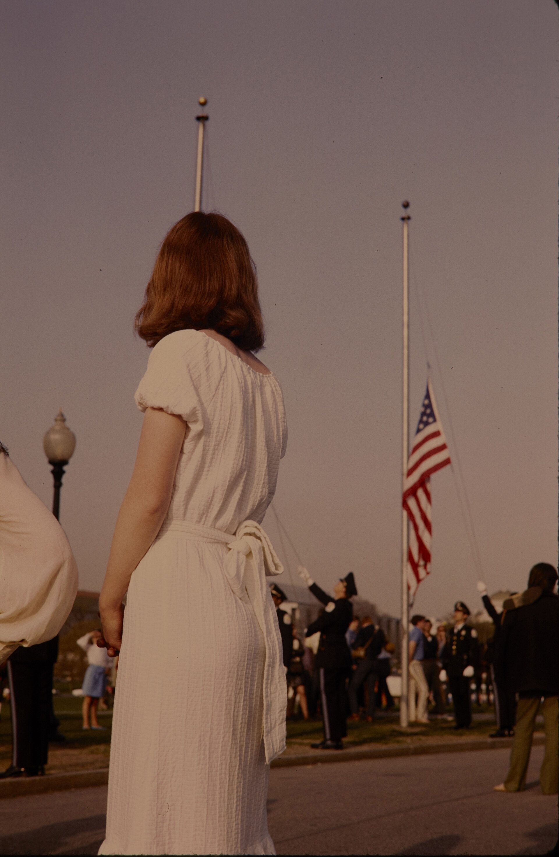
US.87 · DIRECT INSTRUCTION
1 of 4
Factors Leading to the Environmental Movement
Several factors sparked environmental awareness: Rachel Carson's "Silent Spring" (1962) exposed pesticide dangers and their ecological impact.
Visible pollution plagued cities with smog, rivers with contamination, and coastlines with oil spills.
Earth Day 1970 brought massive public demonstrations supporting environmental protection.
Growing scientific understanding of ecological interconnections raised alarm about long-term consequences.
SENTENCE FRAME (EL & writing support)
Cecil W. Stoughton, U.S. National Park Service, April 22, 1970 U.S. National Park Service (NPGallery); via Wikimedia Commons
The environmental movement grew because ___, which led the government to ___.
TEACHER CUE Chunk → cold-call → confirm before advancing.
U.S. History Hack · TroopToTeacher Technologies LLC · Aligned to TN Academic Standards & TCAP EOC
70
Notes:
FACILITATION (US.87). Ask: why did it take disasters like Love Canal and Three Mile Island to convince Americans that pollution was a serious national problem? Teach in small steps; pause and check for understanding before the next chunk (aim 80%+ before moving on).

Slide 72
US.87 · DIRECT INSTRUCTION
2 of 4
EPA's Purpose and Functions
Created in 1970, the Environmental Protection Agency consolidated federal environmental responsibilities.
Its functions include setting pollution standards, enforcing environmental laws, conducting research, and regulating toxic substances.
The EPA marked the federal government's commitment to environmental protection as a national priority, establishing America's framework for environmental regulation.
U.S. History Hack · TroopToTeacher Technologies LLC · Aligned to TN Academic Standards & TCAP EOC
71

Slide 73
US.87 · DIRECT INSTRUCTION
3 of 4
Love Canal Disaster
In Niagara Falls, New York, a school and homes were built on a former chemical waste dump.
By the 1970s, residents experienced high rates of birth defects and cancer.
The federal government relocated 239 families and declared the area uninhabitable.
This disaster led to the Superfund program for cleaning up toxic waste sites, demonstrating the long-term consequences of industrial pollution.
U.S. History Hack · TroopToTeacher Technologies LLC · Aligned to TN Academic Standards & TCAP EOC
72

Slide 74
US.87 · DIRECT INSTRUCTION
4 of 4
Three Mile Island Accident
The 1979 nuclear accident in Pennsylvania involved a partial reactor meltdown, radiation release, and evacuation recommendations.
While health impacts were limited, the incident heightened public fears about nuclear power safety, effectively ending nuclear plant construction in the United States for decades and strengthening arguments for alternative energy sources.
U.S. History Hack · TroopToTeacher Technologies LLC · Aligned to TN Academic Standards & TCAP EOC
73

Slide 75
US.87 · PEOPLE WHO SHAPED THE ERA
Key Figure
Rachel Carson
Marine biologist and author of "Silent Spring"
Published "Silent Spring" (1962), exposing the dangers of pesticides like DDT
Helped launch the modern environmental movement
STRATEGY Public awareness (science writing)
U.S. History Hack · TroopToTeacher Technologies LLC · Aligned to TN Academic Standards & TCAP EOC
74

Slide 76
US.87 · PRIMARY SOURCE ANALYSIS
EPA Establishment Message
Close Reading
President Richard Nixon · July 9, 1970
"Our national government today is not structured to make a coordinated attack on the pollutants which debase the air we breathe, the water we drink, and the land that grows our food... The Environmental Protection Agency would be charged with protecting and enhancing the physical environment of the Nation."
CONTEXT
In July 1970, President Nixon sent Congress a message proposing a new Environmental Protection Agency to pull together pollution-control programs scattered across the federal government. It reflected the surging public demand for environmental action seen at the first Earth Day that April.
ANALYZE
What problem was the EPA created to address?
READ CLOSELY Underline the exact words that answer the ANALYZE question — be ready to read them aloud.
SOURCE IT
WHO made it?
WHEN?
WHY does it matter?
FIRST
President Richard Nixon
July 9, 1970
Consider that Nixon is announcing a new federal agency to Congress — how does that official purpose shape what the message emphasizes?
SSP.02 · before you interpret
Source: National Archives
U.S. History Hack · TroopToTeacher Technologies LLC · Aligned to TN Academic Standards & TCAP EOC
75
Notes:
Primary-source analysis. SOURCE IT FIRST (SSP.02) — model the sourcing routine aloud before students interpret: WHO made this source? (President Richard Nixon) WHEN? (July 9, 1970) WHY does that matter? (Consider that Nixon is announcing a new federal agency to Congress — how does that official purpose shape what the message emphasizes?) Only then move to the ANALYZE question. Suggested answer: Nixon identifies the need for "a coordinated attack on the pollutants which debase the air we breathe, the water we drink, and the land that grows our food." Practice skill: Close Reading.

Slide 77
US.87 · KEY VOCABULARY
Word Wall
Environmentalism
Ambientalismo
Environmental Protection Agency (EPA)
Agencia de Protección Ambiental
say: en-vy-run-MEN-tul-izm
say: en-vy-run-MEN-tul pro-TEK-shun
EN
A movement that grew in the 1960s-70s to protect nature and public health from pollution and industrial harm.
EP
The federal agency created in 1970 to set and enforce standards for clean air, water, and land.
Earth Day
Día de la Tierra
Love Canal
Love Canal
say: URTH day
say: luv kuh-NAL
ED
First held April 22, 1970, a nationwide event that raised public awareness and support for protecting the environment.
LC
A New York neighborhood built on buried toxic waste; its 1978 health crisis spurred federal cleanup laws like Superfund.
Three Mile Island
Three Mile Island
Clean Air Act
Ley de Aire Limpio
say: three myl EYE-lund
say: kleen AIR akt
TM
A 1979 partial nuclear meltdown in Pennsylvania that heightened fears about nuclear power safety.
CA
A landmark law (expanded 1970) authorizing the federal government to limit air pollution from industry and vehicles.
"say:" pronunciation guide (stressed syllable in CAPS) and a per-term visual anchor support newcomer English learners. Spanish term + full bilingual Frayer models are in the unit vocabulary set.
U.S. History Hack · TroopToTeacher Technologies LLC · Aligned to TN Academic Standards & TCAP EOC
5

Slide 78
US.87 · GUIDED PRACTICE — WE DO IT TOGETHER
Let’s Work One Together
Explain cause and effect in a movement
MODEL PROMPT: Rachel Carson writes about vanishing birds. How do I connect that book to the creation of the EPA in 1970?
WORKED EXAMPLE (teacher models this aloud)
"Silent Spring" raised public alarm about pollution, which built pressure for government action.
THINK ALOUD
To explain cause and effect, I trace the chain: a warning book raised awareness, awareness created public demand (Earth Day), and demand pushed government to act (the EPA).
→ Now you try: Now you: name one cause of the environmental movement and one effect it produced, and connect them.
U.S. History Hack · TroopToTeacher Technologies LLC · Aligned to TN Academic Standards & TCAP EOC
77
Notes:
GUIDED PRACTICE / WE DO (US.87). Skill modeled: Explain cause and effect in a movement. Model the worked example aloud using the THINK ALOUD as your script, then release students to the activity ("Now you: name one cause of the environmental movement and one effect it produced, and connect them."). This is the I Do → We Do → You Do bridge — do not skip it; aim for 80%+ success before independent work.

Slide 79
US.87 · STUDENT ACTIVITY
The Rise of Environmentalism — Cause & Effect Chart
Pairs
15 min
YOUR TASK
Using your Cornell notes and the primary source excerpt, complete the Cause & Effect organizer for the modern environmental movement. In CAUSES, list what raised alarm (Rachel Carson's Silent Spring, polluted rivers and air, oil spills). In EFFECTS, trace the response — the first Earth Day in 1970, the creation of the EPA, the Clean Air Act and Clean Water Act, and the Endangered Species Act. Finish with a claim about how public awareness led to federal action.
DELIVERABLE
DIFFERENTIATION
Completed Cause & Effect organizer (3+ causes, 3+ effects) plus a one-sentence claim on why the environmental movement grew into national law so quickly.
Entry: Organizer with a word bank (Silent Spring, Earth Day, EPA, Clean Air Act, Endangered Species Act) to sort. Honors: Evaluate whether public pressure or government action did more to protect the environment in the 1970s. Argue with evidence.
Companion printable: printables/unit-10/unit-10-cause-effect.html
U.S. History Hack · TroopToTeacher Technologies LLC · Aligned to TN Academic Standards & TCAP EOC
78
Notes:
Student activity for US.87. Pair with the printable: printables/unit-10/unit-10-cause-effect.html. Timing: 15. Deliverable: Completed Cause & Effect organizer (3+ causes, 3+ effects) plus a one-sentence claim on why the environmental movement grew into national law so quickly.

Slide 80
US.87 · CHECK FOR UNDERSTANDING
TCAP-Style Question
DOK 3
EOC PRACTICE
How did Senator Nelson describe the significance of Earth Day?
A one-time event with limited impact
A
Evidence of a broad new national concern cutting across generations
B
A movement only for young people
C
A political event for one party only
D
ANSWER FIRST: students commit — then click / advance to reveal the correct answer and explanation.
U.S. History Hack · TroopToTeacher Technologies LLC · Aligned to TN Academic Standards & TCAP EOC
79
Notes:
CHECK FOR UNDERSTANDING (US.87, DOK 3). Have students commit to an answer (whiteboards, hand signal, or turn-and-talk) BEFORE advancing. Correct answer: B. The next slide reveals it. Why: Nelson described Earth Day as "dramatic evidence of a broad new national concern that cuts across generations and ideologies," uniting diverse Americans.

Slide 81
US.87 · ANSWER REVEAL
TCAP-Style Question
✓ ANSWER KEY
How did Senator Nelson describe the significance of Earth Day?
A
A one-time event with limited impact
B
Evidence of a broad new national concern cutting across generations
✓
C
A movement only for young people
D
A political event for one party only
Correct answer: B. Why: Nelson described Earth Day as "dramatic evidence of a broad new national concern that cuts across generations and ideologies," uniting diverse Americans.
U.S. History Hack · TroopToTeacher Technologies LLC · Aligned to TN Academic Standards & TCAP EOC
80
Notes:
ANSWER KEY (US.87). Correct: B. Nelson described Earth Day as "dramatic evidence of a broad new national concern that cuts across generations and ideologies," uniting diverse Americans.

Slide 82
US.87 · WRAP-UP
What You Need to Know for TCAP
KEY TAKEAWAYS
EXIT TICKET
DOK 2
Factors Leading to the Environmental Movement
EPA's Purpose and Functions
Love Canal Disaster
Three Mile Island Accident
Explain what caused the modern environmental movement and describe two government responses to it.
★ HONORS / EXTENSION DOK 3 · SSP.04 Argumentation
Evaluate whether public pressure or government action did more to protect the environment in the 1970s. Argue with evidence.
U.S. History Hack · TroopToTeacher Technologies LLC · Aligned to TN Academic Standards & TCAP EOC
81
Notes:
WRAP-UP / EXIT-TICKET KEY (US.87, DOK 2). Prompt: Explain what caused the modern environmental movement and describe two government responses to it. Model answer: Causes included Rachel Carson's book Silent Spring (1962), which warned about pesticides, plus visible pollution, oil spills, and burning rivers. Government responses included the first Earth Day (1970), the creation of the Environmental Protection Agency (EPA), and laws like the Clean Air Act, Clean Water Act, and Endangered Species Act. Public awareness pushed the federal government to act. RETEACH TRIGGER — if a student misses this exit ticket: (1) <50% of class miss → spiral it into the next standard’s Quick Review opener (see the US.87 review prompts). (2) Individual/small group → reteach with the "Factors Leading to the Environmental Movement" direct-instruction slide + re-run the SOURCE IT FIRST routine on the US.87 primary source, then assign the paired printable: printables/unit-10/unit-10-cause-effect.html. (3) Re-assess with the US.87 check-for-understanding reveal slide as a do-now the next day. Reteach anchors (this standard’s sections): Factors Leading to the Environmental Movement; EPA's Purpose and Functions; Love Canal Disaster; Three Mile Island Accident. I Can objective: I can explain the emergence of environmentalism, including the creation of the Environmental Protection Agency and disasters such as Love Canal and Three Mile Island. HONORS / EXTENSION (DOK 3, for early finishers or advanced learners): Evaluate whether public pressure or government action did more to protect the environment in the 1970s. Argue with evidence. — look for a clear claim plus two specific pieces of evidence.

Slide 83
STANDARD
SOCIAL STUDIES PRACTICES
US.88
SSP.01
Collect sources
SSP.05
Historical awareness
SSP.06
Geographic awareness
Carter Administration Events
TN ACADEMIC STANDARD
Identify and explain the significant events of President Jimmy Carter's administration, including: Poor economy, Panama Canal Treaty, Camp David Accords, Energy crisis, Iran Hostage Crisis.
I CAN
I can identify and explain the significant events of President Jimmy Carter's administration, including the poor economy, Panama Canal Treaty, Camp David Accords, energy crisis, and Iran Hostage Crisis.
U.S. History Hack · TroopToTeacher Technologies LLC · Aligned to TN Academic Standards & TCAP EOC
82

Slide 84
US.88 · QUICK REVIEW
Do You Remember?
Before we start, retrieve what we have already learned. Answer from memory first — no notes.
1
US.87 In the last standard we studied the rise of environmentalism. What agency and what event helped launch the movement?
U.S. History Hack · TroopToTeacher Technologies LLC · Aligned to TN Academic Standards & TCAP EOC
83
Notes:
SPACED RETRIEVAL (US.88). Cold-call or whiteboards, 3-4 min, low stakes. Answers — 1) The first Earth Day in 1970 drew about 20 million Americans, and the Environmental Protection Agency (EPA) was created that year to enforce new anti-pollution laws like the Clean Air Act and Clean Water Act. Rachel Carson's book Silent Spring had helped spark public concern.

Slide 85
US.88 · CONFIDENCE CHECK
Warm-Up — Quick Recall
DOK 1
LOW STAKES
Everyone can answer this. Thumbs / whiteboards — no notes.
What 1978 agreement, brokered by Carter, made peace between Egypt and Israel?
✓ ANSWER
The Camp David Accords.
COMMIT FIRST: have everyone answer before the reveal — this is the DOK 1 floor; the graded check later in this lesson moves up to DOK 2–3.
U.S. History Hack · TroopToTeacher Technologies LLC · Aligned to TN Academic Standards & TCAP EOC
84
Notes:
CONFIDENCE CHECK (US.88, DOK 1). 60-90 seconds. Have EVERY student commit (thumbs / whiteboard / choral) before revealing — this secures an early win and surfaces who is shaky before new content. Answer: The Camp David Accords. Key term to listen for: Camp David Accords. This is the low-floor entry; the graded Check for Understanding later in the standard rises to DOK 2–3.

Slide 86
US.88 · HOOK
Think About It
President Carter brokered a historic peace between Egypt and Israel at Camp David — yet is often remembered for gas lines, high inflation, and 444 days in which 52 Americans were held hostage in Iran.
DISCUSS
TIMING: Turn & Talk 60 sec → cold-call 2 pairs
Can a president achieve a great foreign-policy success and still lose the public's confidence? What matters more to voters — events abroad, or problems they feel at home?
U.S. History Hack · TroopToTeacher Technologies LLC · Aligned to TN Academic Standards & TCAP EOC
85
Notes:
HOOK (US.88). Run tight: pose the provocation, give a silent 10-second think, then Turn & Talk 60 seconds. Cold-call 2–3 pairs (not volunteers) for a sentence-starter answer — "One force was ___ because ___" — then bridge to the standard. Keep total to ~4 minutes; do not let it sprawl. Return to this question at the unit close for an evidence-based answer.

Slide 87
US.88 · DIRECT INSTRUCTION
1 of 5
Economic Difficulties
Carter faced "stagflation" — simultaneous high inflation (13.5% by 1980) and unemployment (7.6%).
Energy costs soared, interest rates reached 20%, and economic growth stagnated.
Carter's response included voluntary wage-price guidelines and Federal Reserve monetary tightening, but these measures proved insufficient to solve the complex economic crisis.
SENTENCE FRAME (EL & writing support)
President Carter's greatest success was ___, but his presidency was damaged by ___.
U.S. History Hack · TroopToTeacher Technologies LLC · Aligned to TN Academic Standards & TCAP EOC
86
Notes:
FACILITATION (US.88). Ask: is it fair that a president who achieved a historic peace treaty is often remembered mainly for a hostage crisis he could not control? Teach in small steps; pause and check for understanding before the next chunk (aim 80%+ before moving on).

Slide 88
US.88 · DIRECT INSTRUCTION
2 of 5
Energy Crisis Implications
Two oil crises (1973-74, 1979) created gas shortages, long lines at stations, and economic disruption.
Carter promoted energy conservation, created the Department of Energy, and called for reduced dependence on foreign oil.
However, public frustration with gas lines and heating oil costs damaged his political standing and raised questions about American vulnerability to foreign energy suppliers.
U.S. History Hack · TroopToTeacher Technologies LLC · Aligned to TN Academic Standards & TCAP EOC
87

Slide 89
US.88 · DIRECT INSTRUCTION
3 of 5
Panama Canal Treaty
The 1977 treaties gradually transferred canal control to Panama by 1999, ending the American colonial presence in Central America.
While strategically sound (the canal was becoming militarily obsolete), the treaties faced fierce domestic opposition from conservatives who viewed them as signs of American weakness and retreat from global commitments.
U.S. History Hack · TroopToTeacher Technologies LLC · Aligned to TN Academic Standards & TCAP EOC
88

Slide 90
US.88 · DIRECT INSTRUCTION
4 of 5
Iran Hostage Crisis
After the Shah's overthrow in 1979, Iranian revolutionaries seized the U.S. Embassy, holding 52 Americans hostage for 444 days.
Carter's failed rescue mission and inability to secure release dominated his presidency's final year, contributing to perceptions of American weakness and his 1980 electoral defeat to Ronald Reagan.
U.S. History Hack · TroopToTeacher Technologies LLC · Aligned to TN Academic Standards & TCAP EOC
89

Slide 91
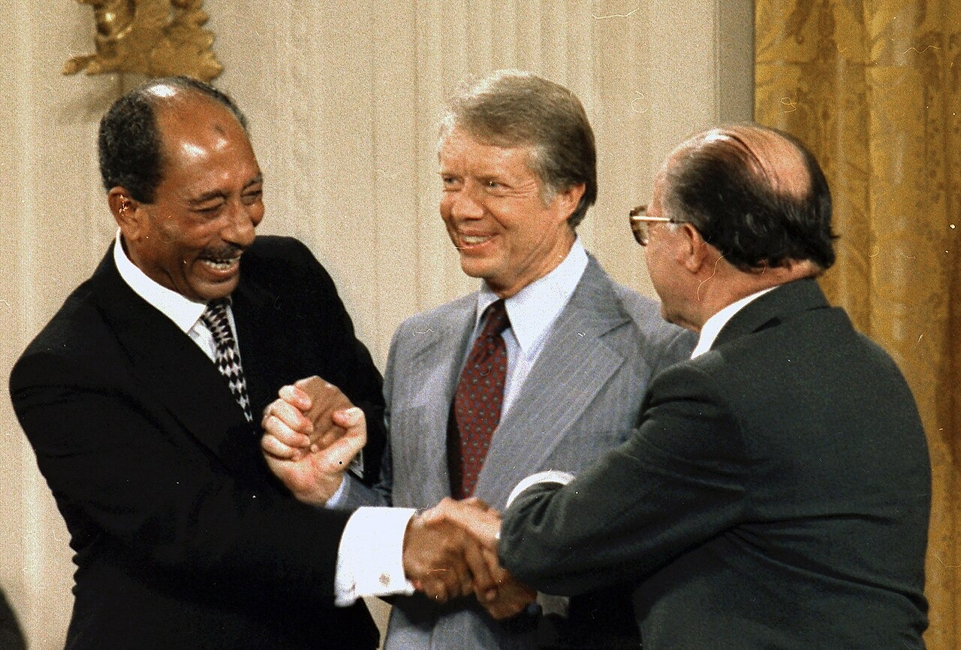
US.88 · DIRECT INSTRUCTION
5 of 5
Camp David Accords
Carter mediated 13 days of negotiations between Egypt's Sadat and Israel's Begin, producing a framework for Middle East peace.
Egypt recognized Israel and regained the Sinai Peninsula, while Israel withdrew from occupied Egyptian territory.
This represented the first Arab-Israeli peace agreement and Carter's greatest foreign policy achievement.
Unknown; U.S. National Archives and Records Administration, September 17, 1978 National Archives and Records Administration (NARA); via Wikimedia Commons
U.S. History Hack · TroopToTeacher Technologies LLC · Aligned to TN Academic Standards & TCAP EOC
90

Slide 92
US.88 · PEOPLE WHO SHAPED THE ERA
Key Figure
President Jimmy Carter
39th President of the United States
Brokered the 1978 Camp David Accords between Egypt and Israel
Created the Department of Energy and promoted energy conservation
STRATEGY Diplomacy (personal mediation)
U.S. History Hack · TroopToTeacher Technologies LLC · Aligned to TN Academic Standards & TCAP EOC
91

Slide 93
US.88 · PRIMARY SOURCE ANALYSIS
Camp David Accords Signing Statement
Contextualization
President Jimmy Carter · September 17, 1978
"During the last two weeks, the members of all three delegations have spent endless hours, day and night, talking, negotiating, grappling with problems that have divided their people for 30 years. Whenever there was a deadlock, they found new ways to break the barrier."
CONTEXT
In September 1978, Carter invited Egyptian President Anwar Sadat and Israeli Prime Minister Menachem Begin to the presidential retreat at Camp David for 13 days of intense, secret negotiations. The resulting framework led to the first peace treaty between Israel and an Arab nation.
ANALYZE
What did the Camp David Accords achieve?
READ CLOSELY Underline the exact words that answer the ANALYZE question — be ready to read them aloud.
SOURCE IT
WHO made it?
WHEN?
WHY does it matter?
FIRST
President Jimmy Carter
September 17, 1978
Consider the setting — a signing ceremony is meant to celebrate and frame an achievement.
SSP.02 · before you interpret
Source: National Archives
U.S. History Hack · TroopToTeacher Technologies LLC · Aligned to TN Academic Standards & TCAP EOC
92
Notes:
Primary-source analysis. SOURCE IT FIRST (SSP.02) — model the sourcing routine aloud before students interpret: WHO made this source? (President Jimmy Carter) WHEN? (September 17, 1978) WHY does that matter? (Consider the setting — a signing ceremony is meant to celebrate and frame an achievement.) Only then move to the ANALYZE question. Suggested answer: Carter describes resolving "problems that have divided their people for 30 years" and achieving "a framework for peace" between Israel and Egypt. Practice skill: Contextualization.

Slide 94
US.88 · KEY VOCABULARY
Word Wall
Stagflation
Estanflación
Energy Crisis
Crisis Energética
say: stag-FLAY-shun
say: EN-er-jee KRY-sis
ST
An unusual 1970s economy combining high inflation, high unemployment, and slow growth at the same time.
EC
1970s fuel shortages and soaring gas prices, worsened by an OPEC oil embargo, that strained the U.S. economy.
Camp David Accords
Acuerdos de Camp David
Panama Canal Treaty
Tratado del Canal de Panamá
say: kamp DAY-vid uh-KORDZ
say: PAN-uh-mah kuh-NAL
CD
A 1978 peace agreement between Egypt and Israel brokered by President Carter, a major diplomatic success.
PC
Carter-era treaties (1977) agreeing to hand control of the Panama Canal over to Panama by the year 2000.
Iran Hostage Crisis
Crisis de los Rehenes en Irán
Human Rights Diplomacy
Diplomacia de Derechos Humanos
say: ih-RAN HOS-tij KRY-sis
say: HYOO-mun ryts dih-PLOH-muh-see
IH
The 1979-81 seizure of 52 Americans at the U.S. embassy in Iran for 444 days, which damaged Carter's presidency.
HR
Carter's foreign policy of pressuring other nations to respect their citizens' basic rights.
"say:" pronunciation guide (stressed syllable in CAPS) and a per-term visual anchor support newcomer English learners. Spanish term + full bilingual Frayer models are in the unit vocabulary set.
U.S. History Hack · TroopToTeacher Technologies LLC · Aligned to TN Academic Standards & TCAP EOC
6

Slide 95
US.88 · GUIDED PRACTICE — WE DO IT TOGETHER
Let’s Work One Together
Weigh successes against setbacks
MODEL PROMPT: Carter brokered the Camp David Accords but was hurt by the Iran Hostage Crisis. How do I weigh these against each other?
WORKED EXAMPLE (teacher models this aloud)
Camp David was a historic diplomatic success; the hostage crisis was a prolonged failure that made him look weak.
THINK ALOUD
To weigh events, I judge each by its impact and how long it lasted — a lasting peace treaty versus a 444-day crisis that helped cost him reelection.
→ Now you try: Now you: name Carter's biggest success and biggest setback, and explain which mattered more for his presidency.
U.S. History Hack · TroopToTeacher Technologies LLC · Aligned to TN Academic Standards & TCAP EOC
94
Notes:
GUIDED PRACTICE / WE DO (US.88). Skill modeled: Weigh successes against setbacks. Model the worked example aloud using the THINK ALOUD as your script, then release students to the activity ("Now you: name Carter's biggest success and biggest setback, and explain which mattered more for his presidency."). This is the I Do → We Do → You Do bridge — do not skip it; aim for 80%+ success before independent work.

Slide 96
US.88 · STUDENT ACTIVITY
The Carter Years — HIPP[O] Source Analysis
Pairs
15 min
YOUR TASK
Using your Cornell notes and a Carter-era primary source, complete the HIPP[O] organizer: Historical context, Intended audience, Purpose, Point of view, and Overall significance. Then list the major events of Carter's presidency — the Camp David Accords (1978), the energy crisis and “malaise,” and the Iran Hostage Crisis — and note whether each was a success or a setback. Finish with a claim on how the hostage crisis affected Americans' confidence.
DELIVERABLE
DIFFERENTIATION
Completed HIPP[O] organizer for one source, a labeled list of Carter's key events (success vs. setback), and a one-sentence claim on why the Camp David Accords are remembered as his greatest achievement.
Entry: HIPP[O] organizer with guiding questions and a matching activity linking each event to success or setback. Honors: Evaluate whether Carter should be judged more by his foreign-policy successes or his domestic struggles. Defend with evidence.
Companion printable: printables/unit-10/hippo-primary-source-organizer.html
U.S. History Hack · TroopToTeacher Technologies LLC · Aligned to TN Academic Standards & TCAP EOC
95
Notes:
Student activity for US.88. Pair with the printable: printables/unit-10/hippo-primary-source-organizer.html. Timing: 15. Deliverable: Completed HIPP[O] organizer for one source, a labeled list of Carter's key events (success vs. setback), and a one-sentence claim on why the Camp David Accords are remembered as his greatest achievement.

Slide 97
US.88 · CHECK FOR UNDERSTANDING
TCAP-Style Question
DOK 3
EOC PRACTICE
What crisis does Carter identify as threatening America?
A military threat from the Soviet Union
A
A crisis of confidence and loss of national unity and purpose
B
An economic depression
C
A constitutional crisis
D
ANSWER FIRST: students commit — then click / advance to reveal the correct answer and explanation.
U.S. History Hack · TroopToTeacher Technologies LLC · Aligned to TN Academic Standards & TCAP EOC
96
Notes:
CHECK FOR UNDERSTANDING (US.88, DOK 3). Have students commit to an answer (whiteboards, hand signal, or turn-and-talk) BEFORE advancing. Correct answer: B. The next slide reveals it. Why: Carter describes "a crisis of confidence" that "strikes at the very heart and soul and spirit of our national will" and a "loss of a unity of purpose."

Slide 98
US.88 · ANSWER REVEAL
TCAP-Style Question
✓ ANSWER KEY
What crisis does Carter identify as threatening America?
A
A military threat from the Soviet Union
B
A crisis of confidence and loss of national unity and purpose
✓
C
An economic depression
D
A constitutional crisis
Correct answer: B. Why: Carter describes "a crisis of confidence" that "strikes at the very heart and soul and spirit of our national will" and a "loss of a unity of purpose."
U.S. History Hack · TroopToTeacher Technologies LLC · Aligned to TN Academic Standards & TCAP EOC
97
Notes:
ANSWER KEY (US.88). Correct: B. Carter describes "a crisis of confidence" that "strikes at the very heart and soul and spirit of our national will" and a "loss of a unity of purpose."

Slide 99
US.88 · WRAP-UP
What You Need to Know for TCAP
KEY TAKEAWAYS
EXIT TICKET
DOK 2
Economic Difficulties
Energy Crisis Implications
Panama Canal Treaty
Iran Hostage Crisis
Camp David Accords
Describe Carter's greatest foreign-policy success and the crisis that most damaged his presidency.
★ HONORS / EXTENSION DOK 3 · SSP.04 Argumentation
Evaluate whether Carter should be judged more by his foreign-policy successes or his domestic struggles. Defend with evidence.
U.S. History Hack · TroopToTeacher Technologies LLC · Aligned to TN Academic Standards & TCAP EOC
98
Notes:
WRAP-UP / EXIT-TICKET KEY (US.88, DOK 2). Prompt: Describe Carter's greatest foreign-policy success and the crisis that most damaged his presidency. Model answer: Carter's greatest success was the Camp David Accords (1978), a historic peace agreement between Egypt and Israel that he personally brokered. The Iran Hostage Crisis — in which 52 Americans were held for 444 days after Iranian revolutionaries seized the U.S. embassy — most damaged his presidency, along with high inflation, gas shortages, and a sense of national “malaise.” RETEACH TRIGGER — if a student misses this exit ticket: (1) <50% of class miss → spiral it into the next standard’s Quick Review opener (see the US.88 review prompts). (2) Individual/small group → reteach with the "Economic Difficulties" direct-instruction slide + re-run the SOURCE IT FIRST routine on the US.88 primary source, then assign the paired printable: printables/unit-10/hippo-primary-source-organizer.html. (3) Re-assess with the US.88 check-for-understanding reveal slide as a do-now the next day. Reteach anchors (this standard’s sections): Economic Difficulties; Energy Crisis Implications; Panama Canal Treaty; Iran Hostage Crisis; Camp David Accords. I Can objective: I can identify and explain the significant events of President Jimmy Carter's administration, including the poor economy, Panama Canal Treaty, Camp David Accords, energy crisis, and Iran Hostage Crisis. HONORS / EXTENSION (DOK 3, for early finishers or advanced learners): Evaluate whether Carter should be judged more by his foreign-policy successes or his domestic struggles. Defend with evidence. — look for a clear claim plus two specific pieces of evidence.

Slide 100
STANDARD
SOCIAL STUDIES PRACTICES
US.89
SSP.01
Collect sources
SSP.04
Build an argument
SSP.06
Geographic awareness
Reagan Administration Significance
TN ACADEMIC STANDARD
Analyze the significance of President Ronald Reagan's administration, including: Revitalization of national pride, Reaganomics, Iran-Contra affair, "War on Drugs", Strategic Defense Initiative, AIDS epidemic.
I CAN
I can analyze the significance of President Ronald Reagan's administration, including the revitalization of national pride, Reaganomics, Iran-Contra affair, "War on Drugs," Strategic Defense Initiative, and the AIDS epidemic.
U.S. History Hack · TroopToTeacher Technologies LLC · Aligned to TN Academic Standards & TCAP EOC
99

Slide 101
US.89 · QUICK REVIEW
Do You Remember?
Before we start, retrieve what we have already learned. Answer from memory first — no notes.
1
US.88 We just studied the Carter years. What was his greatest foreign-policy success, and what crisis hurt his presidency?
U.S. History Hack · TroopToTeacher Technologies LLC · Aligned to TN Academic Standards & TCAP EOC
100
Notes:
SPACED RETRIEVAL (US.89). Cold-call or whiteboards, 3-4 min, low stakes. Answers — 1) His greatest success was the Camp David Accords (1978), a peace agreement between Egypt and Israel. The Iran Hostage Crisis — in which 52 Americans were held for 444 days — along with high inflation and gas shortages, badly damaged his presidency.

Slide 102
US.89 · CONFIDENCE CHECK
Warm-Up — Quick Recall
DOK 1
LOW STAKES
Everyone can answer this. Thumbs / whiteboards — no notes.
What was the name for Reagan's tax-cutting, supply-side economic policy?
✓ ANSWER
Reaganomics.
COMMIT FIRST: have everyone answer before the reveal — this is the DOK 1 floor; the graded check later in this lesson moves up to DOK 2–3.
U.S. History Hack · TroopToTeacher Technologies LLC · Aligned to TN Academic Standards & TCAP EOC
101
Notes:
CONFIDENCE CHECK (US.89, DOK 1). 60-90 seconds. Have EVERY student commit (thumbs / whiteboard / choral) before revealing — this secures an early win and surfaces who is shaky before new content. Answer: Reaganomics. Key term to listen for: Reaganomics. This is the low-floor entry; the graded Check for Understanding later in the standard rises to DOK 2–3.

Slide 103
US.89 · HOOK
Think About It
Standing at the Berlin Wall, President Reagan demanded, “Mr. Gorbachev, tear down this wall!” — two years later it fell. Reagan cut taxes, built up the military, and restored a sense of national confidence, while critics pointed to deficits and the Iran-Contra affair.
DISCUSS
TIMING: Turn & Talk 60 sec → cold-call 2 pairs
Reagan believed lower taxes and a stronger military would revive America. How do you judge whether a president's economic and foreign policies actually worked — by the results at the time, or years later?
U.S. History Hack · TroopToTeacher Technologies LLC · Aligned to TN Academic Standards & TCAP EOC
102
Notes:
HOOK (US.89). Run tight: pose the provocation, give a silent 10-second think, then Turn & Talk 60 seconds. Cold-call 2–3 pairs (not volunteers) for a sentence-starter answer — "One force was ___ because ___" — then bridge to the standard. Keep total to ~4 minutes; do not let it sprawl. Return to this question at the unit close for an evidence-based answer.

Slide 104
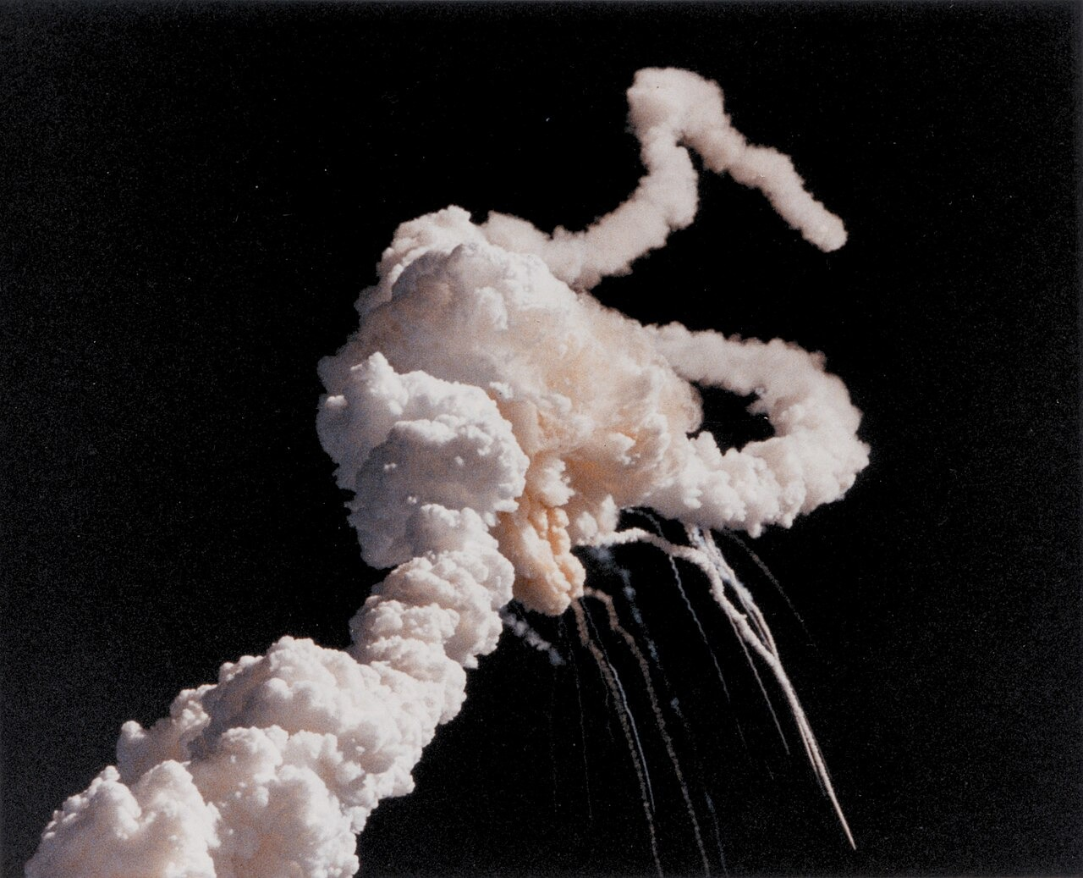
US.89 · DIRECT INSTRUCTION
1 of 5
Strategies for Enhancing National Pride
Reagan restored American confidence through optimistic rhetoric ("Morning in America"), a military buildup demonstrating strength, and successful foreign interventions (Grenada).
His communication skills and personal charisma helped Americans feel proud of their country again after Vietnam, Watergate, and the Iran hostage crisis had damaged national morale.
SENTENCE FRAME (EL & writing support)
Kennedy Space Center, NASA, January 28, 1986 NASA (Photo GPN-2004-00012); via Wikimedia Commons
Reaganomics tried to help the economy by ___, while Reagan pressured the Soviet Union by ___.
TEACHER CUE Chunk → cold-call → confirm before advancing.
U.S. History Hack · TroopToTeacher Technologies LLC · Aligned to TN Academic Standards & TCAP EOC
103
Notes:
FACILITATION (US.89). Ask: Reagan is one of the most admired and most criticized modern presidents. How can historians hold both views at once? Teach in small steps; pause and check for understanding before the next chunk (aim 80%+ before moving on).

Slide 105
US.89 · DIRECT INSTRUCTION
2 of 5
Reaganomics Principles and Impacts
Principles: Supply-side economics emphasizing tax cuts, deregulation, and reduced government spending (except defense).
Impacts: Economic growth resumed and inflation fell, but income inequality increased and federal deficits soared.
Tax cuts primarily benefited wealthy Americans, while social program cuts affected the poor, creating debates about fairness that continue today.
U.S. History Hack · TroopToTeacher Technologies LLC · Aligned to TN Academic Standards & TCAP EOC
104

Slide 106
US.89 · DIRECT INSTRUCTION
3 of 5
Strategic Defense Initiative
"Star Wars" proposed a space-based missile defense system to protect against nuclear attack.
Reagan believed this would make nuclear weapons "impotent and obsolete" while demonstrating American technological superiority.
Critics argued it was technologically unfeasible and destabilizing to arms control, though some credit it with pressuring the Soviet Union.
U.S. History Hack · TroopToTeacher Technologies LLC · Aligned to TN Academic Standards & TCAP EOC
105

Slide 107
US.89 · DIRECT INSTRUCTION
4 of 5
Iran-Contra Affair
The Reagan administration secretly sold arms to Iran to fund Nicaraguan Contras, violating congressional prohibitions.
When exposed, it revealed illegal activities, damaged Reagan's credibility, and led to criminal convictions of several officials.
The scandal raised questions about presidential knowledge and adherence to constitutional limits on executive power.
U.S. History Hack · TroopToTeacher Technologies LLC · Aligned to TN Academic Standards & TCAP EOC
106

Slide 108
US.89 · DIRECT INSTRUCTION
5 of 5
AIDS Epidemic Response
Reagan's delayed and inadequate response to AIDS reflected social prejudices and conservative values.
The administration initially ignored the crisis, providing minimal funding for research or prevention.
This delayed response contributed to the epidemic's spread and thousands of preventable deaths, creating lasting criticism of Reagan's public health leadership.
U.S. History Hack · TroopToTeacher Technologies LLC · Aligned to TN Academic Standards & TCAP EOC
107

Slide 109
US.89 · PEOPLE WHO SHAPED THE ERA
Key Figure
President Ronald Reagan
40th President of the United States
Cut taxes and increased military spending under "Reaganomics"
Challenged Soviet leader Gorbachev to "tear down this wall" (1987)
STRATEGY Communication ("the Great Communicator")
U.S. History Hack · TroopToTeacher Technologies LLC · Aligned to TN Academic Standards & TCAP EOC
108

Slide 110
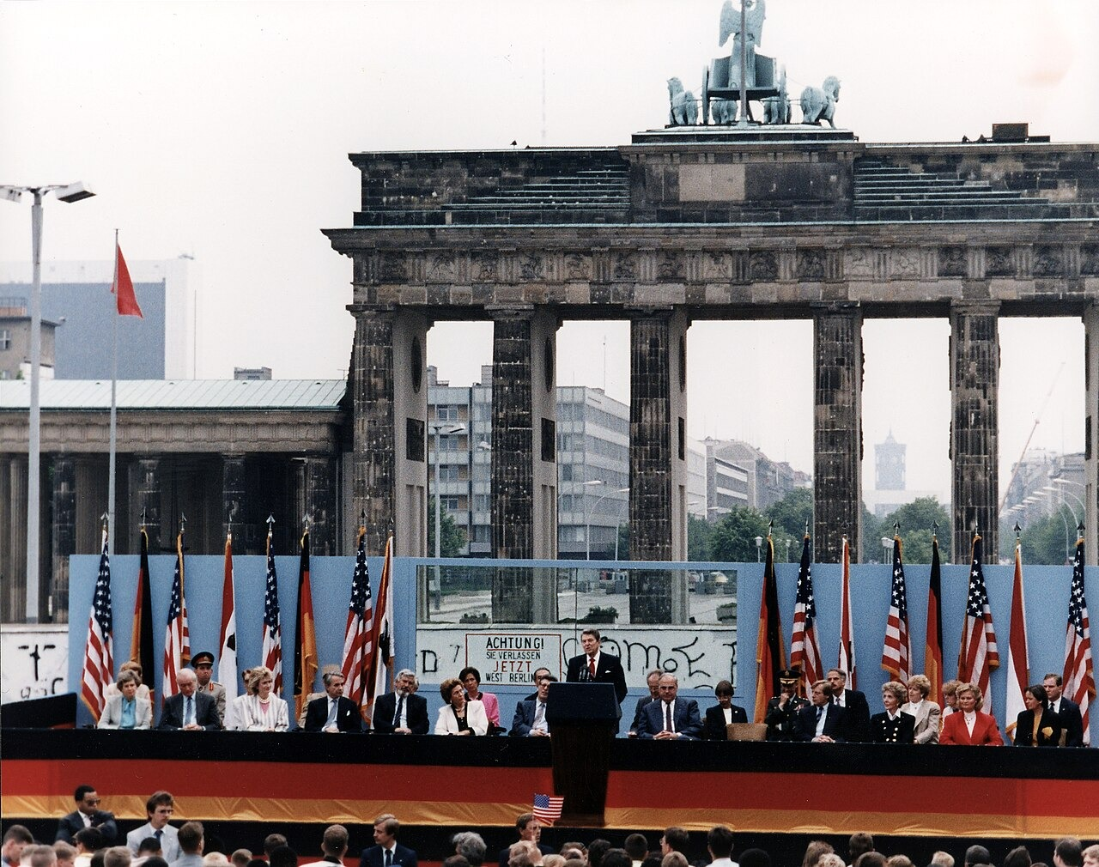
US.89 · PRIMARY SOURCE ANALYSIS
First Inaugural Address
Argumentation
President Ronald Reagan · January 20, 1981
ZOOM IN Find ONE detail that surprises you — be ready to name it.
"In this present crisis, government is not the solution to our problem; government is the problem. From time to time we've been tempted to believe that society has become too complex to be managed by self-rule... But if no one among us is capable of governing himself, then who among us has the capacity to govern someone else?"
CONTEXT
Reagan took office in January 1981 during high inflation and unemployment. His inaugural address announced a sharp turn away from the New Deal and Great Society tradition of activist government, summarizing his conservative philosophy in a single famous line.
ANALYZE
What is Reagan's view of government according to this speech?
Reagan White House Photographic Office, June 12, 1987 National Archives and Records Administration (NARA)
SOURCE IT
WHO made it?
WHEN?
WHY does it matter?
FIRST
President Ronald Reagan
January 20, 1981
Consider that an inaugural address is designed to set the tone and philosophy for a whole presidency.
SSP.02 · before you interpret
Source: National Archives
U.S. History Hack · TroopToTeacher Technologies LLC · Aligned to TN Academic Standards & TCAP EOC
109
Notes:
Primary-source analysis. SOURCE IT FIRST (SSP.02) — model the sourcing routine aloud before students interpret: WHO made this source? (President Ronald Reagan) WHEN? (January 20, 1981) WHY does that matter? (Consider that an inaugural address is designed to set the tone and philosophy for a whole presidency.) Only then move to the ANALYZE question. Suggested answer: Reagan explicitly states "government is not the solution to our problem; government is the problem," expressing his conservative philosophy of limited government. Practice skill: Argumentation.

Slide 111
US.89 · KEY VOCABULARY
Word Wall
Reaganomics
Reaganomía
Supply-Side Economics
Economía de la Oferta
say: ray-gun-OM-iks
say: suh-PLY syd ee-kuh-NOM-iks
RE
President Reagan's economic plan of tax cuts, reduced regulation, and lower domestic spending to spur growth (supply-side economics).
SS
The theory behind Reaganomics that cutting taxes on businesses and the wealthy encourages investment and benefits the whole economy.
Strategic Defense Initiative
Iniciativa de Defensa Estratégica
Iran-Contra Affair
Caso Irán-Contra
say: struh-TEE-jik dee-FENS
say: ih-RAN KON-truh uh-FAIR
SD
Reagan's proposed 1983 space-based missile-defense system, nicknamed 'Star Wars,' to intercept Soviet nuclear attacks.
IC
A 1980s scandal in which officials secretly sold arms to Iran and used the money to fund rebels in Nicaragua.
War on Drugs
Guerra contra las Drogas
AIDS Epidemic
Epidemia del SIDA
say: wor on DRUGZ
say: aydz ep-ih-DEM-ik
WO
Expanded 1980s federal efforts to stop drug use and trafficking through tougher laws and enforcement.
AE
The public-health crisis of the 1980s from a deadly new disease; the government's slow response drew wide criticism.
"say:" pronunciation guide (stressed syllable in CAPS) and a per-term visual anchor support newcomer English learners. Spanish term + full bilingual Frayer models are in the unit vocabulary set.
U.S. History Hack · TroopToTeacher Technologies LLC · Aligned to TN Academic Standards & TCAP EOC
7

Slide 112
US.89 · GUIDED PRACTICE — WE DO IT TOGETHER
Let’s Work One Together
Analyze significance from multiple angles
MODEL PROMPT: Reagan is praised for national pride and criticized for the AIDS response. How do I analyze his significance fairly?
WORKED EXAMPLE (teacher models this aloud)
Reagan restored confidence and pressured the USSR, but his AIDS and Iran-Contra records drew serious criticism.
THINK ALOUD
To analyze significance, I look at both achievements and failures rather than picking only one side — a president can be transformative and flawed at the same time.
→ Now you try: Now you: name one Reagan achievement and one criticism, and explain how both shape his historical significance.
U.S. History Hack · TroopToTeacher Technologies LLC · Aligned to TN Academic Standards & TCAP EOC
111
Notes:
GUIDED PRACTICE / WE DO (US.89). Skill modeled: Analyze significance from multiple angles. Model the worked example aloud using the THINK ALOUD as your script, then release students to the activity ("Now you: name one Reagan achievement and one criticism, and explain how both shape his historical significance."). This is the I Do → We Do → You Do bridge — do not skip it; aim for 80%+ success before independent work.

Slide 113
US.89 · STUDENT ACTIVITY
The Reagan Era — Cause & Effect Chart
Groups of 3
18 min
YOUR TASK
Using your Cornell notes and Reagan's “Tear Down This Wall” speech excerpt, complete the Cause & Effect organizer. In CAUSES, list the conditions Reagan responded to (high inflation and unemployment, the ongoing Cold War). In EFFECTS, trace his policies and their results — Reaganomics and tax cuts, the military buildup, and increased pressure on the Soviet Union that helped bring the Cold War toward its end. Finish with a claim about how Reagan's policies reshaped the economy and the Cold War.
DELIVERABLE
DIFFERENTIATION
Completed Cause & Effect organizer (3+ causes, 3+ effects) plus a one-sentence claim on Reagan's most significant legacy.
Entry: Organizer with a word bank (Reaganomics, tax cuts, military buildup, Cold War pressure, Berlin Wall) to place. Honors: Evaluate whether Reagan's economic policy or his Cold War strategy had the greater long-term impact. Argue with evidence.
Companion printable: printables/unit-10/unit-10-cause-effect.html
U.S. History Hack · TroopToTeacher Technologies LLC · Aligned to TN Academic Standards & TCAP EOC
112
Notes:
Student activity for US.89. Pair with the printable: printables/unit-10/unit-10-cause-effect.html. Timing: 18. Deliverable: Completed Cause & Effect organizer (3+ causes, 3+ effects) plus a one-sentence claim on Reagan's most significant legacy.

Slide 114
US.89 · CHECK FOR UNDERSTANDING
TCAP-Style Question
DOK 3
EOC PRACTICE
What is Reagan's view of government according to this speech?
Government should expand its role in society
A
Government and business should be partners
B
Government expertise is needed for complex problems
C
Government itself is the problem, not the solution
D
ANSWER FIRST: students commit — then click / advance to reveal the correct answer and explanation.
U.S. History Hack · TroopToTeacher Technologies LLC · Aligned to TN Academic Standards & TCAP EOC
113
Notes:
CHECK FOR UNDERSTANDING (US.89, DOK 3). Have students commit to an answer (whiteboards, hand signal, or turn-and-talk) BEFORE advancing. Correct answer: D. The next slide reveals it. Why: Reagan explicitly states "government is not the solution to our problem; government is the problem," expressing his conservative philosophy of limited government.

Slide 115
US.89 · ANSWER REVEAL
TCAP-Style Question
✓ ANSWER KEY
What is Reagan's view of government according to this speech?
A
Government should expand its role in society
B
Government and business should be partners
C
Government expertise is needed for complex problems
D
Government itself is the problem, not the solution
✓
Correct answer: D. Why: Reagan explicitly states "government is not the solution to our problem; government is the problem," expressing his conservative philosophy of limited government.
U.S. History Hack · TroopToTeacher Technologies LLC · Aligned to TN Academic Standards & TCAP EOC
114
Notes:
ANSWER KEY (US.89). Correct: D. Reagan explicitly states "government is not the solution to our problem; government is the problem," expressing his conservative philosophy of limited government.

Slide 116
US.89 · WRAP-UP
What You Need to Know for TCAP
KEY TAKEAWAYS
EXIT TICKET
DOK 3
Strategies for Enhancing National Pride
Reaganomics Principles and Impacts
Strategic Defense Initiative
Iran-Contra Affair
AIDS Epidemic Response
Explain the main ideas of Reaganomics and describe how Reagan approached the Cold War.
★ HONORS / EXTENSION DOK 3 · SSP.04 Argumentation
Evaluate whether Reagan's economic policy or his Cold War strategy had the greater long-term impact on the United States. Argue with evidence.
U.S. History Hack · TroopToTeacher Technologies LLC · Aligned to TN Academic Standards & TCAP EOC
115
Notes:
WRAP-UP / EXIT-TICKET KEY (US.89, DOK 3). Prompt: Explain the main ideas of Reaganomics and describe how Reagan approached the Cold War. Model answer: Reaganomics was a supply-side policy: cut taxes and regulations to encourage investment and growth, while increasing military spending. Toward the Cold War, Reagan built up the military, funded new defense programs (the Strategic Defense Initiative), and publicly pressured the Soviet Union — famously demanding at the Berlin Wall, “Mr. Gorbachev, tear down this wall!” This pressure, combined with Soviet weakness, helped bring the Cold War toward its end. RETEACH TRIGGER — if a student misses this exit ticket: (1) <50% of class miss → spiral it into the next standard’s Quick Review opener (see the US.89 review prompts). (2) Individual/small group → reteach with the "Strategies for Enhancing National Pride" direct-instruction slide + re-run the SOURCE IT FIRST routine on the US.89 primary source, then assign the paired printable: printables/unit-10/unit-10-cause-effect.html. (3) Re-assess with the US.89 check-for-understanding reveal slide as a do-now the next day. Reteach anchors (this standard’s sections): Strategies for Enhancing National Pride; Reaganomics Principles and Impacts; Strategic Defense Initiative; Iran-Contra Affair; AIDS Epidemic Response. I Can objective: I can analyze the significance of President Ronald Reagan's administration, including the revitalization of national pride, Reaganomics, Iran-Contra affair, "War on Drugs," Strategic Defense Initiative, and the AIDS epidemic. HONORS / EXTENSION (DOK 3, for early finishers or advanced learners): Evaluate whether Reagan's economic policy or his Cold War strategy had the greater long-term impact on the United States. Argue with evidence. — look for a clear claim plus two specific pieces of evidence.

Slide 117
STANDARD
SOCIAL STUDIES PRACTICES
US.90
SSP.01
Collect sources
SSP.05
Historical awareness
SSP.06
Geographic awareness
George H.W. Bush Administration
TN ACADEMIC STANDARD
Describe the significant events of President George H.W. Bush's administration, including the invasion of Panama and the Gulf War.
I CAN
I can describe the significant events of President George H.W. Bush's administration, including the invasion of Panama and the Gulf War.
U.S. History Hack · TroopToTeacher Technologies LLC · Aligned to TN Academic Standards & TCAP EOC
116

Slide 118
US.90 · QUICK REVIEW
Do You Remember?
Before we start, retrieve what we have already learned. Answer from memory first — no notes.
1
US.89 In the last standard we studied the Reagan era. What was “Reaganomics,” and how did Reagan pressure the Soviet Union?
U.S. History Hack · TroopToTeacher Technologies LLC · Aligned to TN Academic Standards & TCAP EOC
117
Notes:
SPACED RETRIEVAL (US.90). Cold-call or whiteboards, 3-4 min, low stakes. Answers — 1) Reaganomics cut taxes and regulations to spur economic growth (supply-side economics). Reagan also built up the U.S. military and challenged the Soviets directly — as in his “Tear down this wall” speech — adding pressure that helped bring the Cold War toward its end.

Slide 119
US.90 · CONFIDENCE CHECK
Warm-Up — Quick Recall
DOK 1
LOW STAKES
Everyone can answer this. Thumbs / whiteboards — no notes.
What 1991 war did George H.W. Bush lead a coalition to win?
✓ ANSWER
The Persian Gulf War (Operation Desert Storm).
COMMIT FIRST: have everyone answer before the reveal — this is the DOK 1 floor; the graded check later in this lesson moves up to DOK 2–3.
U.S. History Hack · TroopToTeacher Technologies LLC · Aligned to TN Academic Standards & TCAP EOC
118
Notes:
CONFIDENCE CHECK (US.90, DOK 1). 60-90 seconds. Have EVERY student commit (thumbs / whiteboard / choral) before revealing — this secures an early win and surfaces who is shaky before new content. Answer: The Persian Gulf War (Operation Desert Storm). Key term to listen for: Gulf War (1991). This is the low-floor entry; the graded Check for Understanding later in the standard rises to DOK 2–3.

Slide 120
US.90 · HOOK
Think About It
In a single presidency, George H.W. Bush watched the Berlin Wall fall, the Soviet Union collapse, and led a global coalition to victory in the Persian Gulf War — leaving the United States as the world's only superpower.
DISCUSS
TIMING: Turn & Talk 60 sec → cold-call 2 pairs
When the Cold War ended and America became the world's only superpower, what new responsibilities — and new dangers — came with standing alone at the top?
U.S. History Hack · TroopToTeacher Technologies LLC · Aligned to TN Academic Standards & TCAP EOC
119
Notes:
HOOK (US.90). Run tight: pose the provocation, give a silent 10-second think, then Turn & Talk 60 seconds. Cold-call 2–3 pairs (not volunteers) for a sentence-starter answer — "One force was ___ because ___" — then bridge to the standard. Keep total to ~4 minutes; do not let it sprawl. Return to this question at the unit close for an evidence-based answer.

Slide 121
US.90 · DIRECT INSTRUCTION
1 of 3
Panama Invasion
Operation Just Cause (1989) removed dictator Manuel Noriega, who had been indicted for drug trafficking and was threatening American citizens.
The invasion demonstrated post-Cold War American willingness to use military force for law enforcement and humanitarian purposes, establishing precedents for future interventions.
SENTENCE FRAME (EL & writing support)
During the Bush presidency, ___ happened, which meant that the United States ___.
U.S. History Hack · TroopToTeacher Technologies LLC · Aligned to TN Academic Standards & TCAP EOC
120
Notes:
FACILITATION (US.90). Ask: Bush chose to push Iraq out of Kuwait but not remove Saddam Hussein. Was that restraint wise, or a missed chance? Why is it still debated? Teach in small steps; pause and check for understanding before the next chunk (aim 80%+ before moving on).

Slide 122
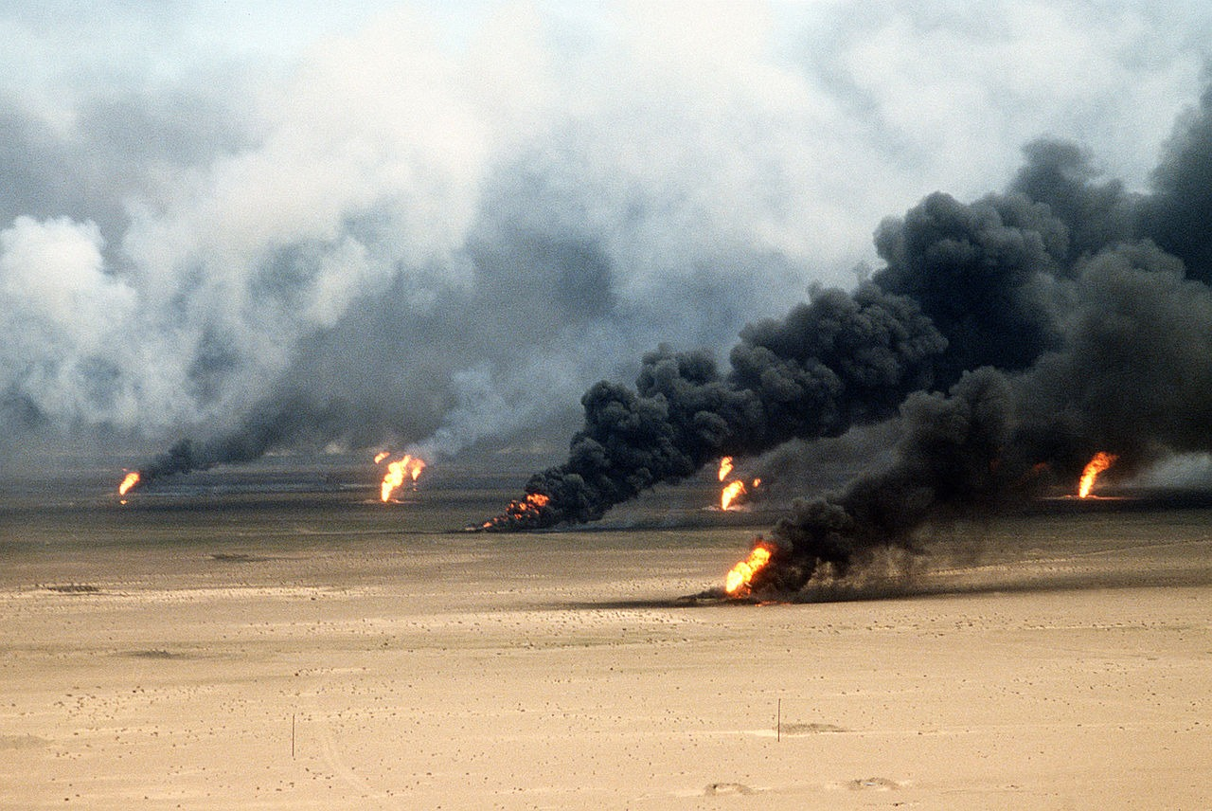
US.90 · DIRECT INSTRUCTION
2 of 3
Gulf War Context and Outcomes
When Iraq invaded Kuwait (1990), Bush assembled an international coalition and obtained UN authorization for military action.
Operation Desert Storm (1991) quickly liberated Kuwait with minimal coalition casualties, demonstrating American military superiority, effective international diplomacy, and the potential for multilateral action in the post-Cold War world.
Tech. Sgt. David McLeod, U.S. Air Force, 1991 U.S. Department of Defense
U.S. History Hack · TroopToTeacher Technologies LLC · Aligned to TN Academic Standards & TCAP EOC
121

Slide 123
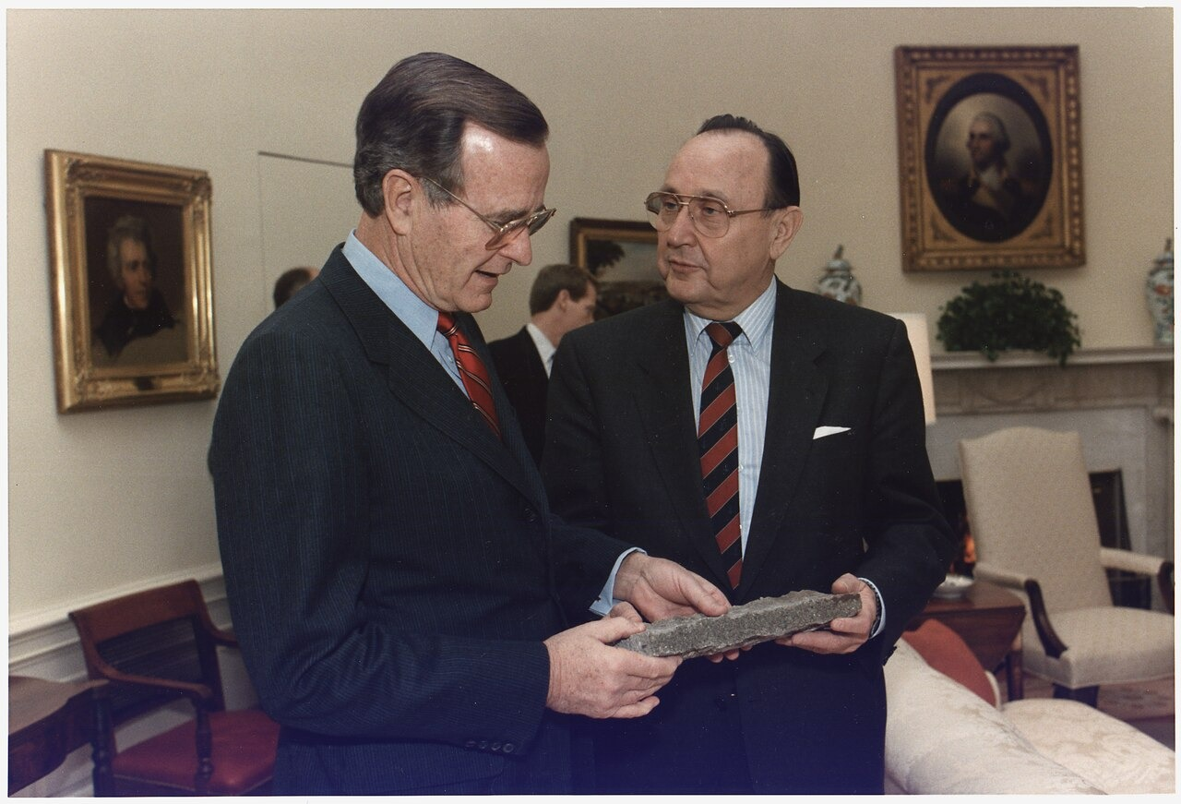
US.90 · DIRECT INSTRUCTION
3 of 3
Fall of Berlin Wall and Soviet Collapse (Honors)
The Berlin Wall's fall (1989) symbolized communism's collapse and the Cold War's end.
Bush managed this transition carefully, avoiding triumphalism that might provoke Soviet hardliners while supporting German reunification.
The Soviet Union's dissolution (1991) left America as the world's sole superpower, creating new global responsibilities and challenges for American foreign policy.
Bush White House Photographic Office, November 21, 1989 National Archives and Records Administration (NARA 186404); via Wikimedia Commons
U.S. History Hack · TroopToTeacher Technologies LLC · Aligned to TN Academic Standards & TCAP EOC
122

Slide 124
US.90 · PEOPLE WHO SHAPED THE ERA
Key Figure
President George H.W. Bush
41st President of the United States
Assembled an international coalition to liberate Kuwait in the Gulf War (1991)
Guided U.S. policy through the fall of the Berlin Wall and Soviet collapse
STRATEGY Coalition-building (multilateral diplomacy)
U.S. History Hack · TroopToTeacher Technologies LLC · Aligned to TN Academic Standards & TCAP EOC
123

Slide 125
US.90 · PRIMARY SOURCE ANALYSIS
Address on the Gulf War
Contextualization
President George H.W. Bush · January 16, 1991
"Five months ago, Saddam Hussein started this cruel war against Kuwait. Tonight, the battle has been joined... Our objectives are clear: Saddam Hussein's forces will leave Kuwait. The legitimate government of Kuwait will be restored to its rightful place, and Kuwait will once again be free."
CONTEXT
After Iraq invaded Kuwait in August 1990, Bush built a broad international coalition and secured UN backing. On January 16, 1991, as Operation Desert Storm began, he addressed the nation to explain the war's limited and specific goals.
ANALYZE
What were the stated objectives of the Gulf War?
READ CLOSELY Underline the exact words that answer the ANALYZE question — be ready to read them aloud.
SOURCE IT
WHO made it?
WHEN?
WHY does it matter?
FIRST
President George H.W. Bush
January 16, 1991
Consider that a wartime address is meant to justify military action and rally the public.
SSP.02 · before you interpret
Source: National Archives
U.S. History Hack · TroopToTeacher Technologies LLC · Aligned to TN Academic Standards & TCAP EOC
124
Notes:
Primary-source analysis. SOURCE IT FIRST (SSP.02) — model the sourcing routine aloud before students interpret: WHO made this source? (President George H.W. Bush) WHEN? (January 16, 1991) WHY does that matter? (Consider that a wartime address is meant to justify military action and rally the public.) Only then move to the ANALYZE question. Suggested answer: Bush states the objectives: "Saddam Hussein's forces will leave Kuwait" and "The legitimate government of Kuwait will be restored." Practice skill: Contextualization.

Slide 126
US.90 · KEY VOCABULARY
Word Wall
Persian Gulf War
Guerra del Golfo Pérsico
Operation Desert Storm
Operación Tormenta del Desierto
say: PER-zhun gulf WOR
say: op-er-AY-shun DEZ-ert storm
PG
A 1991 U.S.-led coalition war that drove Iraqi forces out of Kuwait after Iraq's 1990 invasion.
OD
The 1991 military campaign that quickly liberated Kuwait from Iraqi occupation.
Fall of the Berlin Wall
Caída del Muro de Berlín
Collapse of the Soviet Union
Colapso de la Unión Soviética
say: fawl of ber-LIN WAWL
say: kuh-LAPS of SOH-vee-et
FO
The 1989 opening of the wall dividing East and West Berlin, a symbol of the Cold War's end.
CO
The 1991 breakup of the USSR into independent nations, ending the Cold War.
Panama Invasion
Invasión de Panamá
Americans with Disabilities Act
Ley de Estadounidenses con Discapacidades
say: PAN-uh-mah in-VAY-zhun
say: uh-MER-ih-kunz with dis-uh-BIL-ih-teez
PI
The 1989 U.S. military action that removed Panamanian dictator Manuel Noriega from power.
AW
A 1990 law signed by President Bush banning discrimination against people with disabilities.
"say:" pronunciation guide (stressed syllable in CAPS) and a per-term visual anchor support newcomer English learners. Spanish term + full bilingual Frayer models are in the unit vocabulary set.
U.S. History Hack · TroopToTeacher Technologies LLC · Aligned to TN Academic Standards & TCAP EOC
8

Slide 127
US.90 · GUIDED PRACTICE — WE DO IT TOGETHER
Let’s Work One Together
Place events in historical context
MODEL PROMPT: The Gulf War and the Soviet collapse both happened under Bush. How do I explain why they mark a new era?
WORKED EXAMPLE (teacher models this aloud)
Both events came right after the Cold War ended, leaving the U.S. as the world's only superpower.
THINK ALOUD
To place events in context, I ask what came before — the Cold War shaped 40 years, so its end changed how America used its power abroad.
→ Now you try: Now you: explain how the end of the Cold War changed America's role in the world during Bush's presidency.
U.S. History Hack · TroopToTeacher Technologies LLC · Aligned to TN Academic Standards & TCAP EOC
126
Notes:
GUIDED PRACTICE / WE DO (US.90). Skill modeled: Place events in historical context. Model the worked example aloud using the THINK ALOUD as your script, then release students to the activity ("Now you: explain how the end of the Cold War changed America's role in the world during Bush's presidency."). This is the I Do → We Do → You Do bridge — do not skip it; aim for 80%+ success before independent work.

Slide 128
US.90 · STUDENT ACTIVITY
The End of the Cold War — Timeline
Pairs
15 min
YOUR TASK
Using your Cornell notes, build a timeline of the George H.W. Bush years in order: the fall of the Berlin Wall (1989), the reunification of Germany, the collapse of the Soviet Union (1991), and the Persian Gulf War / Operation Desert Storm (1991). For each event, add one sentence on its significance. Finish with a claim about what it meant for the United States to become the world's only superpower.
DELIVERABLE
DIFFERENTIATION
Completed timeline (4+ ordered events, each with a significance note) plus a one-sentence claim on how the end of the Cold War changed America's role in the world.
Entry: Timeline with events pre-listed to place in order and a word bank (Berlin Wall, German reunification, Soviet collapse, Desert Storm). Honors: Analyze whether the peaceful end of the Cold War or the swift victory in the Gulf War did more to define Bush's presidency. Defend with evidence.
Companion printable: printables/unit-10/unit-10-timeline.html
U.S. History Hack · TroopToTeacher Technologies LLC · Aligned to TN Academic Standards & TCAP EOC
127
Notes:
Student activity for US.90. Pair with the printable: printables/unit-10/unit-10-timeline.html. Timing: 15. Deliverable: Completed timeline (4+ ordered events, each with a significance note) plus a one-sentence claim on how the end of the Cold War changed America's role in the world.

Slide 129
US.90 · CHECK FOR UNDERSTANDING
TCAP-Style Question
DOK 3
EOC PRACTICE
How did Bush describe the end of the Soviet Union?
As a dangerous development for the world
A
As a victory for democracy, freedom, and American values
B
As having no significance for America
C
As the beginning of a new war
D
ANSWER FIRST: students commit — then click / advance to reveal the correct answer and explanation.
U.S. History Hack · TroopToTeacher Technologies LLC · Aligned to TN Academic Standards & TCAP EOC
128
Notes:
CHECK FOR UNDERSTANDING (US.90, DOK 3). Have students commit to an answer (whiteboards, hand signal, or turn-and-talk) BEFORE advancing. Correct answer: B. The next slide reveals it. Why: Bush called it "a victory for democracy and freedom" and "a victory for the moral force of our values" that every American should take pride in.

Slide 130
US.90 · ANSWER REVEAL
TCAP-Style Question
✓ ANSWER KEY
How did Bush describe the end of the Soviet Union?
A
As a dangerous development for the world
B
As a victory for democracy, freedom, and American values
✓
C
As having no significance for America
D
As the beginning of a new war
Correct answer: B. Why: Bush called it "a victory for democracy and freedom" and "a victory for the moral force of our values" that every American should take pride in.
U.S. History Hack · TroopToTeacher Technologies LLC · Aligned to TN Academic Standards & TCAP EOC
129
Notes:
ANSWER KEY (US.90). Correct: B. Bush called it "a victory for democracy and freedom" and "a victory for the moral force of our values" that every American should take pride in.

Slide 131
US.90 · WRAP-UP
What You Need to Know for TCAP
KEY TAKEAWAYS
EXIT TICKET
DOK 2
Panama Invasion
Gulf War Context and Outcomes
Fall of Berlin Wall and Soviet Collapse (Honors)
Describe two major events of the George H.W. Bush presidency and explain their significance.
★ HONORS / EXTENSION DOK 3 · SSP.04 Argumentation
Analyze whether the peaceful end of the Cold War or the swift Gulf War victory did more to define Bush's presidency. Defend with evidence.
U.S. History Hack · TroopToTeacher Technologies LLC · Aligned to TN Academic Standards & TCAP EOC
130
Notes:
WRAP-UP / EXIT-TICKET KEY (US.90, DOK 2). Prompt: Describe two major events of the George H.W. Bush presidency and explain their significance. Model answer: First, the Cold War ended — the Berlin Wall fell in 1989 and the Soviet Union collapsed in 1991 — leaving the United States as the world's only superpower. Second, Bush led an international coalition to victory in the Persian Gulf War (Operation Desert Storm, 1991), driving Iraq out of Kuwait. Both events reshaped America's role and responsibilities in the world. RETEACH TRIGGER — if a student misses this exit ticket: (1) <50% of class miss → spiral it into the next standard’s Quick Review opener (see the US.90 review prompts). (2) Individual/small group → reteach with the "Panama Invasion" direct-instruction slide + re-run the SOURCE IT FIRST routine on the US.90 primary source, then assign the paired printable: printables/unit-10/unit-10-timeline.html. (3) Re-assess with the US.90 check-for-understanding reveal slide as a do-now the next day. Reteach anchors (this standard’s sections): Panama Invasion; Gulf War Context and Outcomes; Fall of Berlin Wall and Soviet Collapse (Honors). I Can objective: I can describe the significant events of President George H.W. Bush's administration, including the invasion of Panama and the Gulf War. HONORS / EXTENSION (DOK 3, for early finishers or advanced learners): Analyze whether the peaceful end of the Cold War or the swift Gulf War victory did more to define Bush's presidency. Defend with evidence. — look for a clear claim plus two specific pieces of evidence.

Slide 132
STANDARD
SOCIAL STUDIES PRACTICES
US.91
SSP.01
Collect sources
SSP.05
Historical awareness
SSP.06
Geographic awareness
Clinton Administration Events
TN ACADEMIC STANDARD
Summarize the events of President Bill Clinton's administration, including: Welfare-to-work, Balanced budget, NAFTA, Scandals and subsequent impeachment hearings.
I CAN
I can summarize the events of President Bill Clinton's administration, including welfare-to-work, balanced budget, NAFTA, and scandals and subsequent impeachment hearings.
U.S. History Hack · TroopToTeacher Technologies LLC · Aligned to TN Academic Standards & TCAP EOC
131

Slide 133
US.91 · QUICK REVIEW
Do You Remember?
Before we start, retrieve what we have already learned. Answer from memory first — no notes.
1
US.90 We just studied George H.W. Bush. What two world-changing events happened during his presidency?
U.S. History Hack · TroopToTeacher Technologies LLC · Aligned to TN Academic Standards & TCAP EOC
132
Notes:
SPACED RETRIEVAL (US.91). Cold-call or whiteboards, 3-4 min, low stakes. Answers — 1) The Cold War ended — the Berlin Wall fell (1989) and the Soviet Union collapsed (1991) — and the United States led a coalition to victory in the Persian Gulf War (Operation Desert Storm, 1991), leaving America as the world's only superpower.

Slide 134
US.91 · CONFIDENCE CHECK
Warm-Up — Quick Recall
DOK 1
LOW STAKES
Everyone can answer this. Thumbs / whiteboards — no notes.
What 1993 free-trade agreement linked the U.S., Canada, and Mexico?
✓ ANSWER
NAFTA (the North American Free Trade Agreement).
COMMIT FIRST: have everyone answer before the reveal — this is the DOK 1 floor; the graded check later in this lesson moves up to DOK 2–3.
U.S. History Hack · TroopToTeacher Technologies LLC · Aligned to TN Academic Standards & TCAP EOC
133
Notes:
CONFIDENCE CHECK (US.91, DOK 1). 60-90 seconds. Have EVERY student commit (thumbs / whiteboard / choral) before revealing — this secures an early win and surfaces who is shaky before new content. Answer: NAFTA (the North American Free Trade Agreement). Key term to listen for: NAFTA. This is the low-floor entry; the graded Check for Understanding later in the standard rises to DOK 2–3.

Slide 135
US.91 · HOOK
Think About It
The 1990s brought a booming economy, a balanced budget, and free-trade deals like NAFTA — alongside welfare reform and only the second presidential impeachment in American history.
DISCUSS
TIMING: Turn & Talk 60 sec → cold-call 2 pairs
Free-trade agreements like NAFTA promised cheaper goods and new markets, but also sent some jobs overseas. When a policy helps the country as a whole but hurts some workers, is it worth it?
U.S. History Hack · TroopToTeacher Technologies LLC · Aligned to TN Academic Standards & TCAP EOC
134
Notes:
HOOK (US.91). Run tight: pose the provocation, give a silent 10-second think, then Turn & Talk 60 seconds. Cold-call 2–3 pairs (not volunteers) for a sentence-starter answer — "One force was ___ because ___" — then bridge to the standard. Keep total to ~4 minutes; do not let it sprawl. Return to this question at the unit close for an evidence-based answer.

Slide 136
US.91 · DIRECT INSTRUCTION
1 of 4
NAFTA Goals and Outcomes
The North American Free Trade Agreement (1994) eliminated trade barriers between the U.S., Canada, and Mexico.
Supporters argued it would increase trade and economic growth.
Critics claimed it would cost American jobs and exploit Mexican workers.
Results were mixed — trade increased significantly, but manufacturing jobs moved to Mexico, intensifying debates about globalization.
SENTENCE FRAME (EL & writing support)
NAFTA was created to ___, and in the 1990s the U.S. economy ___.
U.S. History Hack · TroopToTeacher Technologies LLC · Aligned to TN Academic Standards & TCAP EOC
135
Notes:
FACILITATION (US.91). Ask: Clinton remained popular even after being impeached. What does that tell us about how Americans separate a leader's personal conduct from their job performance? Teach in small steps; pause and check for understanding before the next chunk (aim 80%+ before moving on).

Slide 137
US.91 · DIRECT INSTRUCTION
2 of 4
Welfare-to-Work Transition
The 1996 Personal Responsibility and Work Opportunity Act replaced Aid to Families with Dependent Children (AFDC) with Temporary Assistance for Needy Families (TANF).
The new system required work or job training and imposed time limits on benefits.
Welfare rolls declined dramatically, but poverty reduction was limited, raising questions about whether people left poverty or just left welfare.
U.S. History Hack · TroopToTeacher Technologies LLC · Aligned to TN Academic Standards & TCAP EOC
136

Slide 138
US.91 · DIRECT INSTRUCTION
3 of 4
Scandals and Impeachment
Clinton faced multiple scandals, including Whitewater real estate investments and sexual harassment allegations.
The Monica Lewinsky affair led to impeachment charges for perjury and obstruction of justice.
The House impeached Clinton, but the Senate acquitted him, reflecting partisan divisions and debates about whether personal conduct should determine political consequences.
U.S. History Hack · TroopToTeacher Technologies LLC · Aligned to TN Academic Standards & TCAP EOC
137

Slide 139
US.91 · DIRECT INSTRUCTION
4 of 4
Balanced Budget Significance
Clinton achieved the first balanced federal budget since 1969, aided by economic growth, tax increases on high earners, and spending restraint.
Budget surpluses in the late 1990s reduced national debt and demonstrated fiscal responsibility, though this achievement proved temporary as surpluses disappeared under subsequent administrations.
U.S. History Hack · TroopToTeacher Technologies LLC · Aligned to TN Academic Standards & TCAP EOC
138

Slide 140
US.91 · PEOPLE WHO SHAPED THE ERA
Key Figure
President Bill Clinton
42nd President of the United States
Signed NAFTA and achieved the first balanced federal budget since 1969
Was impeached by the House but acquitted by the Senate (1998-1999)
STRATEGY Centrist politics ("triangulation")
U.S. History Hack · TroopToTeacher Technologies LLC · Aligned to TN Academic Standards & TCAP EOC
139

Slide 141
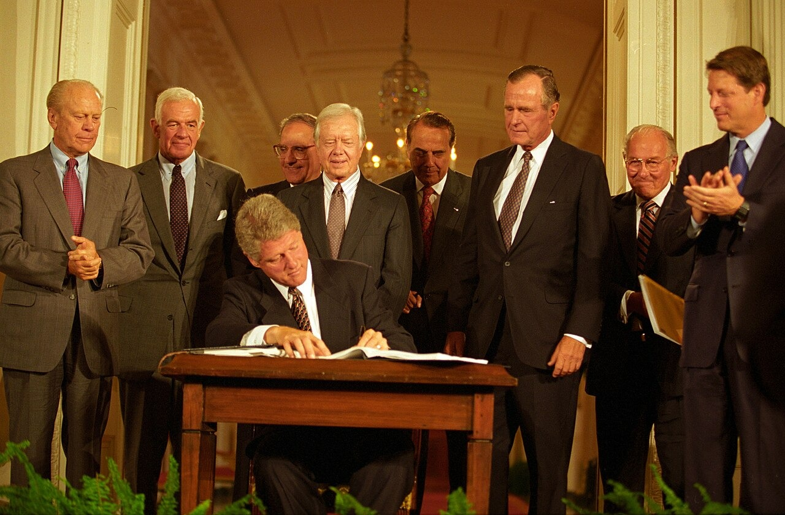
US.91 · PRIMARY SOURCE ANALYSIS
NAFTA Signing Statement
Sourcing
President Bill Clinton · December 8, 1993
ZOOM IN Find ONE detail that surprises you — be ready to name it.
"NAFTA means jobs. American jobs, and good-paying American jobs. If I didn't believe that, I wouldn't support this agreement... NAFTA will generate these jobs by opening the largest, richest market in the world — right in our own hemisphere, right next door."
CONTEXT
In December 1993, Clinton signed legislation implementing NAFTA, a free-trade agreement that had divided both parties. He argued the deal would create American jobs by opening new markets, though critics warned it would send manufacturing jobs abroad.
ANALYZE
How did Clinton justify supporting NAFTA?
Ralph Alswang, White House Photographic Office, September 14, 1993 Clinton White House
SOURCE IT
WHO made it?
WHEN?
WHY does it matter?
FIRST
President Bill Clinton
December 8, 1993
Consider the author's purpose — a signing statement is meant to sell the benefits of a policy.
SSP.02 · before you interpret
Source: National Archives
U.S. History Hack · TroopToTeacher Technologies LLC · Aligned to TN Academic Standards & TCAP EOC
140
Notes:
Primary-source analysis. SOURCE IT FIRST (SSP.02) — model the sourcing routine aloud before students interpret: WHO made this source? (President Bill Clinton) WHEN? (December 8, 1993) WHY does that matter? (Consider the author's purpose — a signing statement is meant to sell the benefits of a policy.) Only then move to the ANALYZE question. Suggested answer: Clinton states "NAFTA means jobs. American jobs, and good-paying American jobs" and that it "will generate these jobs by opening the largest, richest market." Practice skill: Sourcing.

Slide 142
US.91 · KEY VOCABULARY
Word Wall
NAFTA
TLCAN
Welfare-to-Work Reform
Reforma de Asistencia Social
say: NAF-tuh
say: WEL-fair to wurk ree-FORM
NA
The 1994 North American Free Trade Agreement removing most trade barriers among the U.S., Canada, and Mexico.
WT
A 1996 Clinton-era law that limited welfare benefits and required recipients to find work.
Balanced Budget
Presupuesto Equilibrado
Clinton Impeachment
Juicio Político a Clinton
say: BAL-unst BUJ-it
say: KLIN-tun im-PEECH-ment
BB
A federal budget in which spending does not exceed revenue; achieved in the late 1990s under Clinton.
CI
The 1998 House impeachment of President Clinton for perjury and obstruction; the Senate acquitted him in 1999.
Contract with America
Contrato con América
Dot-com Boom
Auge de las Puntocom
say: KON-trakt with uh-MER-ih-kuh
say: dot-KOM boom
CW
A 1994 Republican campaign plan led by Newt Gingrich promising smaller government and balanced budgets.
DC
The late-1990s surge in internet-based businesses and stock values, which later crashed in 2000-01.
"say:" pronunciation guide (stressed syllable in CAPS) and a per-term visual anchor support newcomer English learners. Spanish term + full bilingual Frayer models are in the unit vocabulary set.
U.S. History Hack · TroopToTeacher Technologies LLC · Aligned to TN Academic Standards & TCAP EOC
9

Slide 143
US.91 · GUIDED PRACTICE — WE DO IT TOGETHER
Let’s Work One Together
Summarize a presidency's key events
MODEL PROMPT: Clinton's years included a balanced budget, NAFTA, and impeachment. How do I summarize them clearly?
WORKED EXAMPLE (teacher models this aloud)
Clinton oversaw prosperity and a balanced budget, expanded free trade, and was impeached but acquitted.
THINK ALOUD
To summarize, I group events by theme — economic policy (budget, NAFTA, welfare) and political controversy (scandals, impeachment) — instead of just listing them.
→ Now you try: Now you: write a one-sentence summary of the Clinton presidency that includes both an achievement and a controversy.
U.S. History Hack · TroopToTeacher Technologies LLC · Aligned to TN Academic Standards & TCAP EOC
142
Notes:
GUIDED PRACTICE / WE DO (US.91). Skill modeled: Summarize a presidency's key events. Model the worked example aloud using the THINK ALOUD as your script, then release students to the activity ("Now you: write a one-sentence summary of the Clinton presidency that includes both an achievement and a controversy."). This is the I Do → We Do → You Do bridge — do not skip it; aim for 80%+ success before independent work.

Slide 144
US.91 · STUDENT ACTIVITY
The Clinton Years — Cause & Effect Chart
Pairs
15 min
YOUR TASK
Using your Cornell notes and the NAFTA primary source, complete the Cause & Effect organizer for the Clinton presidency. In CAUSES, list the issues Clinton faced (a globalizing economy, budget deficits, debate over trade). In EFFECTS, trace the results — NAFTA and expanded free trade, the 1990s economic boom and budget surplus, welfare reform, and the political conflict that led to impeachment. Finish with a claim about globalization's effect on American workers.
DELIVERABLE
DIFFERENTIATION
Completed Cause & Effect organizer (3+ causes, 3+ effects) plus a one-sentence claim on whether free trade helped or hurt American workers in the 1990s.
Entry: Organizer with a word bank (NAFTA, free trade, budget surplus, welfare reform, globalization) to sort. Honors: Evaluate whether the economic prosperity of the 1990s or the political battles of the era better defines the Clinton presidency. Argue with evidence.
Companion printable: printables/unit-10/unit-10-cause-effect.html
U.S. History Hack · TroopToTeacher Technologies LLC · Aligned to TN Academic Standards & TCAP EOC
143
Notes:
Student activity for US.91. Pair with the printable: printables/unit-10/unit-10-cause-effect.html. Timing: 15. Deliverable: Completed Cause & Effect organizer (3+ causes, 3+ effects) plus a one-sentence claim on whether free trade helped or hurt American workers in the 1990s.

Slide 145
US.91 · CHECK FOR UNDERSTANDING
TCAP-Style Question
DOK 3
EOC PRACTICE
How did Clinton justify supporting NAFTA?
It would reduce immigration from Mexico
A
It would weaken Canada economically
B
It would create American jobs by opening new markets
C
It would eliminate all trade barriers worldwide
D
ANSWER FIRST: students commit — then click / advance to reveal the correct answer and explanation.
U.S. History Hack · TroopToTeacher Technologies LLC · Aligned to TN Academic Standards & TCAP EOC
144
Notes:
CHECK FOR UNDERSTANDING (US.91, DOK 3). Have students commit to an answer (whiteboards, hand signal, or turn-and-talk) BEFORE advancing. Correct answer: C. The next slide reveals it. Why: Clinton states "NAFTA means jobs. American jobs, and good-paying American jobs" and that it "will generate these jobs by opening the largest, richest market."

Slide 146
US.91 · ANSWER REVEAL
TCAP-Style Question
✓ ANSWER KEY
How did Clinton justify supporting NAFTA?
A
It would reduce immigration from Mexico
B
It would weaken Canada economically
C
It would create American jobs by opening new markets
✓
D
It would eliminate all trade barriers worldwide
Correct answer: C. Why: Clinton states "NAFTA means jobs. American jobs, and good-paying American jobs" and that it "will generate these jobs by opening the largest, richest market."
U.S. History Hack · TroopToTeacher Technologies LLC · Aligned to TN Academic Standards & TCAP EOC
145
Notes:
ANSWER KEY (US.91). Correct: C. Clinton states "NAFTA means jobs. American jobs, and good-paying American jobs" and that it "will generate these jobs by opening the largest, richest market."

Slide 147
US.91 · WRAP-UP
What You Need to Know for TCAP
KEY TAKEAWAYS
EXIT TICKET
DOK 2
NAFTA Goals and Outcomes
Welfare-to-Work Transition
Scandals and Impeachment
Balanced Budget Significance
Explain what NAFTA was and describe the state of the U.S. economy in the 1990s under Clinton.
★ HONORS / EXTENSION DOK 3 · SSP.04 Argumentation
Evaluate whether the prosperity of the 1990s or the political battles of the era better defines the Clinton presidency. Argue with evidence.
U.S. History Hack · TroopToTeacher Technologies LLC · Aligned to TN Academic Standards & TCAP EOC
146
Notes:
WRAP-UP / EXIT-TICKET KEY (US.91, DOK 2). Prompt: Explain what NAFTA was and describe the state of the U.S. economy in the 1990s under Clinton. Model answer: NAFTA (the North American Free Trade Agreement, 1993) removed most trade barriers among the United States, Canada, and Mexico. Under Clinton the 1990s economy boomed — with low unemployment, strong growth, and a balanced federal budget that produced a surplus. The era also included welfare reform and Clinton's impeachment (from which he was acquitted). RETEACH TRIGGER — if a student misses this exit ticket: (1) <50% of class miss → spiral it into the next standard’s Quick Review opener (see the US.91 review prompts). (2) Individual/small group → reteach with the "NAFTA Goals and Outcomes" direct-instruction slide + re-run the SOURCE IT FIRST routine on the US.91 primary source, then assign the paired printable: printables/unit-10/unit-10-cause-effect.html. (3) Re-assess with the US.91 check-for-understanding reveal slide as a do-now the next day. Reteach anchors (this standard’s sections): NAFTA Goals and Outcomes; Welfare-to-Work Transition; Scandals and Impeachment; Balanced Budget Significance. I Can objective: I can summarize the events of President Bill Clinton's administration, including welfare-to-work, balanced budget, NAFTA, and scandals and subsequent impeachment hearings. HONORS / EXTENSION (DOK 3, for early finishers or advanced learners): Evaluate whether the prosperity of the 1990s or the political battles of the era better defines the Clinton presidency. Argue with evidence. — look for a clear claim plus two specific pieces of evidence.

Slide 148
STANDARD
SOCIAL STUDIES PRACTICES
US.92
SSP.01
Collect sources
SSP.05
Historical awareness
SSP.06
Geographic awareness
September 11th Impact
TN ACADEMIC STANDARD
Describe the impact of the September 11, 2001 terrorist attacks on the World Trade Center and the Pentagon, including: the response of President George W. Bush, wars in Afghanistan and Iraq, and continued efforts to combat terrorism globally.
I CAN
I can describe the impact of the September 11, 2001 terrorist attacks on the World Trade Center and the Pentagon, including the response of President George W. Bush, wars in Afghanistan and Iraq, and continued efforts to combat terrorism globally.
U.S. History Hack · TroopToTeacher Technologies LLC · Aligned to TN Academic Standards & TCAP EOC
147

Slide 149
US.92 · QUICK REVIEW
Do You Remember?
Before we start, retrieve what we have already learned. Answer from memory first — no notes.
1
US.91 In the last standard we studied the Clinton years. What was NAFTA, and what economic milestone did the 1990s reach?
U.S. History Hack · TroopToTeacher Technologies LLC · Aligned to TN Academic Standards & TCAP EOC
148
Notes:
SPACED RETRIEVAL (US.92). Cold-call or whiteboards, 3-4 min, low stakes. Answers — 1) NAFTA (1993) was a free-trade agreement linking the U.S., Canada, and Mexico. The 1990s saw a strong economy, low unemployment, and a balanced federal budget with a surplus — alongside welfare reform and Clinton's impeachment.

Slide 150
US.92 · CONFIDENCE CHECK
Warm-Up — Quick Recall
DOK 1
LOW STAKES
Everyone can answer this. Thumbs / whiteboards — no notes.
On what date did terrorists attack the World Trade Center and the Pentagon?
✓ ANSWER
September 11, 2001.
COMMIT FIRST: have everyone answer before the reveal — this is the DOK 1 floor; the graded check later in this lesson moves up to DOK 2–3.
U.S. History Hack · TroopToTeacher Technologies LLC · Aligned to TN Academic Standards & TCAP EOC
149
Notes:
CONFIDENCE CHECK (US.92, DOK 1). 60-90 seconds. Have EVERY student commit (thumbs / whiteboard / choral) before revealing — this secures an early win and surfaces who is shaky before new content. Answer: September 11, 2001. Key term to listen for: September 11, 2001 Attacks. This is the low-floor entry; the graded Check for Understanding later in the standard rises to DOK 2–3.

Slide 151
US.92 · HOOK
Think About It
On the morning of September 11, 2001, hijacked planes struck the World Trade Center and the Pentagon, killing nearly 3,000 people — and changing American security, foreign policy, and daily life in ways that still shape the country today.
DISCUSS
TIMING: Turn & Talk 60 sec → cold-call 2 pairs
After 9/11, Americans accepted new security measures — airport screening, the Patriot Act, expanded surveillance. How does a free society decide how much liberty to trade for safety?
U.S. History Hack · TroopToTeacher Technologies LLC · Aligned to TN Academic Standards & TCAP EOC
150
Notes:
HOOK (US.92). Run tight: pose the provocation, give a silent 10-second think, then Turn & Talk 60 seconds. Cold-call 2–3 pairs (not volunteers) for a sentence-starter answer — "One force was ___ because ___" — then bridge to the standard. Keep total to ~4 minutes; do not let it sprawl. Return to this question at the unit close for an evidence-based answer.

Slide 152
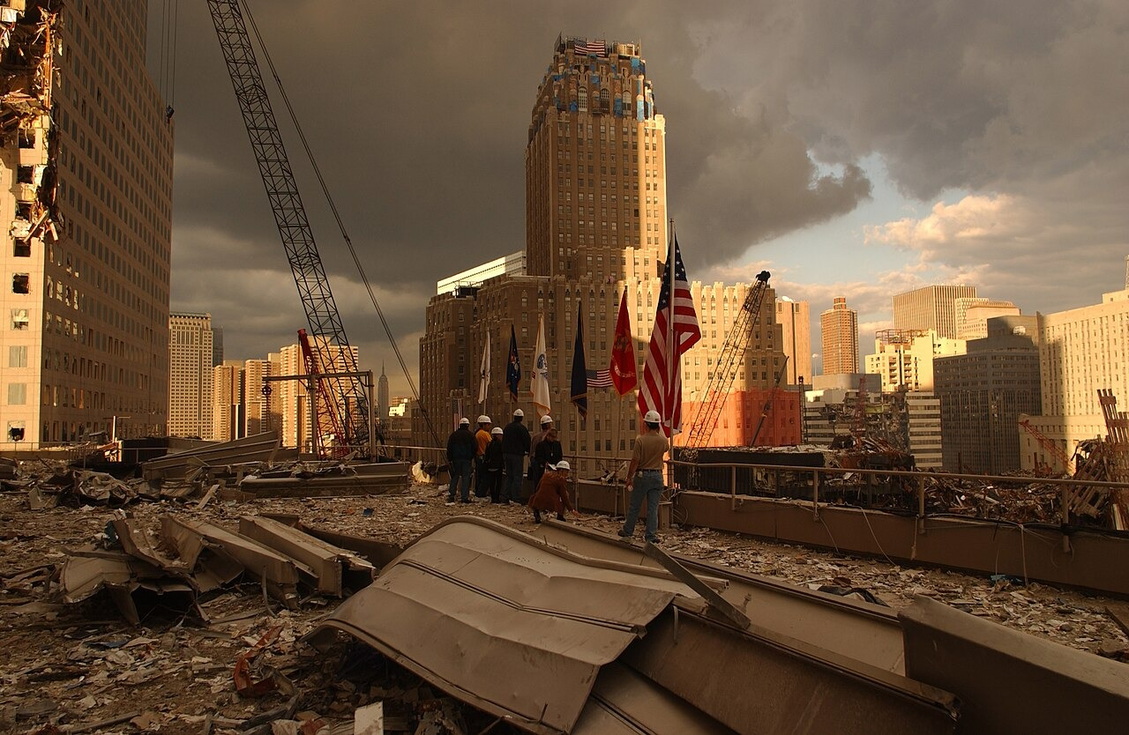
US.92 · DIRECT INSTRUCTION
1 of 4
Bush's Domestic and International Response
Domestically, Bush created the Department of Homeland Security, signed the USA PATRIOT Act expanding surveillance powers, increased airport security, and launched domestic surveillance programs.
Internationally, he declared a "War on Terror," demanded the Taliban surrender Osama bin Laden, and assembled an international coalition for the Afghanistan invasion to destroy al-Qaeda and remove the Taliban.
SENTENCE FRAME (EL & writing support)
Andrea Booher, FEMA News Photo, September 28, 2001 Federal Emergency Management Agency (FEMA)
After the September 11th attacks, the United States responded by ___, in order to ___.
TEACHER CUE Chunk → cold-call → confirm before advancing.
U.S. History Hack · TroopToTeacher Technologies LLC · Aligned to TN Academic Standards & TCAP EOC
151
Notes:
FACILITATION (US.92). Ask: after 9/11, the government expanded surveillance to improve security. How should a democracy balance safety against civil liberties? Teach in small steps; pause and check for understanding before the next chunk (aim 80%+ before moving on).

Slide 153
US.92 · DIRECT INSTRUCTION
2 of 4
Afghanistan War
Justified as self-defense against al-Qaeda and the Taliban harboring terrorists, the Afghanistan invasion initially succeeded in removing the Taliban from power.
However, it evolved into the longest war in American history with limited success in nation-building.
Questions persisted about exit strategies and whether military force could transform Afghan society.
U.S. History Hack · TroopToTeacher Technologies LLC · Aligned to TN Academic Standards & TCAP EOC
152

Slide 154
US.92 · DIRECT INSTRUCTION
3 of 4
Iraq War
Bush claimed Saddam Hussein possessed weapons of mass destruction and supported terrorism.
The invasion succeeded militarily but created regional instability, sectarian violence, and damaged American credibility when the WMD claims proved false.
The war raised fundamental questions about intelligence, justification for preemptive war, and occupation strategies.
U.S. History Hack · TroopToTeacher Technologies LLC · Aligned to TN Academic Standards & TCAP EOC
153

Slide 155
US.92 · DIRECT INSTRUCTION
4 of 4
Global Counter-terrorism Efforts
The "War on Terror" included military operations in multiple countries, intelligence sharing with allies, financial tracking of terrorist organizations, and diplomatic pressure on nations supporting terrorism.
Success in preventing major attacks on American soil was offset by concerns about civil liberties, international law violations, and whether military approaches address terrorism's root causes.
U.S. History Hack · TroopToTeacher Technologies LLC · Aligned to TN Academic Standards & TCAP EOC
154

Slide 156
US.92 · PEOPLE WHO SHAPED THE ERA
Key Figure
President George W. Bush
43rd President of the United States
Led the U.S. response to the September 11, 2001 terrorist attacks
Launched the "War on Terror" and wars in Afghanistan and Iraq
STRATEGY Assertive foreign policy (War on Terror)
U.S. History Hack · TroopToTeacher Technologies LLC · Aligned to TN Academic Standards & TCAP EOC
155

Slide 157
US.92 · PRIMARY SOURCE ANALYSIS
Address to the Nation
Contextualization
President George W. Bush · September 11, 2001
"Today, our fellow citizens, our way of life, our very freedom came under attack in a series of deliberate and deadly terrorist acts... Thousands of lives were suddenly ended by evil, despicable acts of terror. The pictures of airplanes flying into buildings, fires burning, huge structures collapsing, have filled us with disbelief, terrible sadness, and a quiet, unyielding anger."
CONTEXT
On the evening of September 11, 2001, hours after hijacked planes destroyed the World Trade Center and struck the Pentagon, Bush addressed a shaken nation from the Oval Office. His words framed the attacks as an assault on American freedom itself.
ANALYZE
How does Bush describe the September 11 attacks?
READ CLOSELY Underline the exact words that answer the ANALYZE question — be ready to read them aloud.
SOURCE IT
WHO made it?
WHEN?
WHY does it matter?
FIRST
President George W. Bush
September 11, 2001
Consider that a president speaking hours after a tragedy is trying to reassure and unite a frightened nation.
SSP.02 · before you interpret
Source: National Archives
U.S. History Hack · TroopToTeacher Technologies LLC · Aligned to TN Academic Standards & TCAP EOC
156
Notes:
Primary-source analysis. SOURCE IT FIRST (SSP.02) — model the sourcing routine aloud before students interpret: WHO made this source? (President George W. Bush) WHEN? (September 11, 2001) WHY does that matter? (Consider that a president speaking hours after a tragedy is trying to reassure and unite a frightened nation.) Only then move to the ANALYZE question. Suggested answer: Bush describes "deliberate and deadly terrorist acts" where "our very freedom came under attack," causing "terrible sadness, and a quiet, unyielding anger." Practice skill: Contextualization.

Slide 158
US.92 · KEY VOCABULARY
Word Wall
September 11, 2001 Attacks
Ataques del 11 de Septiembre
War on Terror
Guerra contra el Terrorismo
say: sep-TEM-ber ee-LEV-en uh-TAKS
say: wor on TER-er
SA
Coordinated al-Qaeda terrorist attacks that destroyed the World Trade Center and struck the Pentagon, killing nearly 3,000 people.
WO
The U.S. global campaign after 9/11 to defeat terrorist groups and the nations that harbored them.
USA PATRIOT Act
Ley Patriota
Department of Homeland Security
Departamento de Seguridad Nacional
say: yoo-es-AY PAY-tree-ut akt
say: dee-PART-ment of HOHM-land
UP
A 2001 law expanding government surveillance powers to prevent terrorism, criticized by some as a threat to civil liberties.
DO
A federal department created in 2002 to coordinate protection of the U.S. against terrorism and disasters.
War in Afghanistan
Guerra en Afganistán
Iraq War
Guerra de Irak
say: wor in af-GAN-ih-stan
say: ih-RAK wor
WI
The U.S. war begun in 2001 to remove the Taliban and destroy al-Qaeda bases after the 9/11 attacks.
IW
The 2003 U.S.-led invasion that toppled Saddam Hussein, launched on claims of weapons of mass destruction.
"say:" pronunciation guide (stressed syllable in CAPS) and a per-term visual anchor support newcomer English learners. Spanish term + full bilingual Frayer models are in the unit vocabulary set.
U.S. History Hack · TroopToTeacher Technologies LLC · Aligned to TN Academic Standards & TCAP EOC
10

Slide 159
US.92 · GUIDED PRACTICE — WE DO IT TOGETHER
Let’s Work One Together
Trace the impact of a single event
MODEL PROMPT: 9/11 was one day. How do I trace its impact across security, wars, and civil liberties?
WORKED EXAMPLE (teacher models this aloud)
9/11 led to new security agencies, the PATRIOT Act, and wars in Afghanistan and Iraq.
THINK ALOUD
To trace impact, I follow the consequences outward from the event — one attack reshaped domestic security, foreign policy, and debates over privacy.
→ Now you try: Now you: name one domestic and one international way 9/11 changed the United States.
U.S. History Hack · TroopToTeacher Technologies LLC · Aligned to TN Academic Standards & TCAP EOC
158
Notes:
GUIDED PRACTICE / WE DO (US.92). Skill modeled: Trace the impact of a single event. Model the worked example aloud using the THINK ALOUD as your script, then release students to the activity ("Now you: name one domestic and one international way 9/11 changed the United States."). This is the I Do → We Do → You Do bridge — do not skip it; aim for 80%+ success before independent work.

Slide 160
US.92 · STUDENT ACTIVITY
September 11th — Pre-9/11 vs. Post-9/11 America Venn
Pairs
18 min
YOUR TASK
Using your Cornell notes and the primary source, complete the Venn diagram comparing America BEFORE and AFTER September 11, 2001. In the outer circles, record what was distinct to each period (open airports and looser security before; the Department of Homeland Security, the Patriot Act, airport screening, and the War on Terror after). In the overlap, record what stayed the same (American resilience, national unity). Finish with a claim about how 9/11 changed the balance between security and civil liberties.
DELIVERABLE
DIFFERENTIATION
Completed Venn diagram (2+ items per section, including the shared overlap) plus a one-sentence claim on the biggest lasting change 9/11 brought to daily American life.
Entry: Venn diagram with sentence stems and a word bank (Homeland Security, Patriot Act, airport security, War on Terror, national unity) to place. Honors: Analyze whether the security measures adopted after 9/11 protected Americans or went too far in limiting freedoms. Defend with evidence.
Companion printable: printables/unit-10/venn-pre-9-11-vs-post-9-11-america.html
U.S. History Hack · TroopToTeacher Technologies LLC · Aligned to TN Academic Standards & TCAP EOC
159
Notes:
Student activity for US.92. Pair with the printable: printables/unit-10/venn-pre-9-11-vs-post-9-11-america.html. Timing: 18. Deliverable: Completed Venn diagram (2+ items per section, including the shared overlap) plus a one-sentence claim on the biggest lasting change 9/11 brought to daily American life.

Slide 161
US.92 · CHECK FOR UNDERSTANDING
TCAP-Style Question
DOK 2
EOC PRACTICE
How does Bush describe the September 11 attacks?
As deliberate attacks on American freedom that caused sadness and anger
A
As accidents caused by mechanical failures
B
As minor incidents requiring limited response
C
As actions by a specific foreign government
D
ANSWER FIRST: students commit — then click / advance to reveal the correct answer and explanation.
U.S. History Hack · TroopToTeacher Technologies LLC · Aligned to TN Academic Standards & TCAP EOC
160
Notes:
CHECK FOR UNDERSTANDING (US.92, DOK 2). Have students commit to an answer (whiteboards, hand signal, or turn-and-talk) BEFORE advancing. Correct answer: A. The next slide reveals it. Why: Bush describes "deliberate and deadly terrorist acts" where "our very freedom came under attack," causing "terrible sadness, and a quiet, unyielding anger."

Slide 162
US.92 · ANSWER REVEAL
TCAP-Style Question
✓ ANSWER KEY
How does Bush describe the September 11 attacks?
A
As deliberate attacks on American freedom that caused sadness and anger
✓
B
As accidents caused by mechanical failures
C
As minor incidents requiring limited response
D
As actions by a specific foreign government
Correct answer: A. Why: Bush describes "deliberate and deadly terrorist acts" where "our very freedom came under attack," causing "terrible sadness, and a quiet, unyielding anger."
U.S. History Hack · TroopToTeacher Technologies LLC · Aligned to TN Academic Standards & TCAP EOC
161
Notes:
ANSWER KEY (US.92). Correct: A. Bush describes "deliberate and deadly terrorist acts" where "our very freedom came under attack," causing "terrible sadness, and a quiet, unyielding anger."

Slide 163
US.92 · WRAP-UP
What You Need to Know for TCAP
KEY TAKEAWAYS
EXIT TICKET
DOK 3
Bush's Domestic and International Response
Afghanistan War
Iraq War
Global Counter-terrorism Efforts
Explain how the September 11th attacks changed American security and foreign policy. Give at least two specific changes.
★ HONORS / EXTENSION DOK 3 · SSP.04 Argumentation
Analyze whether the security measures adopted after 9/11 protected Americans or went too far in limiting freedoms. Defend your position with evidence.
U.S. History Hack · TroopToTeacher Technologies LLC · Aligned to TN Academic Standards & TCAP EOC
162
Notes:
WRAP-UP / EXIT-TICKET KEY (US.92, DOK 3). Prompt: Explain how the September 11th attacks changed American security and foreign policy. Give at least two specific changes. Model answer: After 9/11, the United States created the Department of Homeland Security and passed the Patriot Act, expanding surveillance and law-enforcement powers. It launched the War on Terror, including wars in Afghanistan and Iraq, and greatly increased airport and border security. These changes reshaped daily life and raised lasting debate over the balance between security and civil liberties. RETEACH TRIGGER — if a student misses this exit ticket: (1) <50% of class miss → spiral it into the next standard’s Quick Review opener (see the US.92 review prompts). (2) Individual/small group → reteach with the "Bush's Domestic and International Response" direct-instruction slide + re-run the SOURCE IT FIRST routine on the US.92 primary source, then assign the paired printable: printables/unit-10/venn-pre-9-11-vs-post-9-11-america.html. (3) Re-assess with the US.92 check-for-understanding reveal slide as a do-now the next day. Reteach anchors (this standard’s sections): Bush's Domestic and International Response; Afghanistan War; Iraq War; Global Counter-terrorism Efforts. I Can objective: I can describe the impact of the September 11, 2001 terrorist attacks on the World Trade Center and the Pentagon, including the response of President George W. Bush, wars in Afghanistan and Iraq, and continued efforts to combat terrorism globally. HONORS / EXTENSION (DOK 3, for early finishers or advanced learners): Analyze whether the security measures adopted after 9/11 protected Americans or went too far in limiting freedoms. Defend your position with evidence. — look for a clear claim plus two specific pieces of evidence.

Slide 164
STANDARD
SOCIAL STUDIES PRACTICES
US.93
SSP.01
Collect sources
SSP.05
Historical awareness
SSP.06
Geographic awareness
Increasing Role of Women and Minorities
TN ACADEMIC STANDARD
Describe the increasing role of women and minorities in the American military, politics, and economy, including: Hillary Clinton, Sandra Day O'Connor, Nancy Pelosi, Colin Powell, Condoleezza Rice. (TCA)
I CAN
I can describe the increasing role of women and minorities in the American military, politics, and economy, including Hillary Clinton, Sandra Day O'Connor, Nancy Pelosi, Colin Powell, and Condoleezza Rice.
U.S. History Hack · TroopToTeacher Technologies LLC · Aligned to TN Academic Standards & TCAP EOC
163

Slide 165
US.93 · QUICK REVIEW
Do You Remember?
Before we start, retrieve what we have already learned. Answer from memory first — no notes.
1
US.92 We just studied the September 11th attacks. Name two ways the U.S. government responded.
U.S. History Hack · TroopToTeacher Technologies LLC · Aligned to TN Academic Standards & TCAP EOC
164
Notes:
SPACED RETRIEVAL (US.93). Cold-call or whiteboards, 3-4 min, low stakes. Answers — 1) The U.S. created the Department of Homeland Security and passed the Patriot Act, launched the War on Terror with wars in Afghanistan and Iraq, and greatly increased airport and border security — reshaping the balance between security and civil liberties.

Slide 166
US.93 · CONFIDENCE CHECK
Warm-Up — Quick Recall
DOK 1
LOW STAKES
Everyone can answer this. Thumbs / whiteboards — no notes.
Who was the first woman appointed to the U.S. Supreme Court?
✓ ANSWER
Sandra Day O'Connor (1981).
COMMIT FIRST: have everyone answer before the reveal — this is the DOK 1 floor; the graded check later in this lesson moves up to DOK 2–3.
U.S. History Hack · TroopToTeacher Technologies LLC · Aligned to TN Academic Standards & TCAP EOC
165
Notes:
CONFIDENCE CHECK (US.93, DOK 1). 60-90 seconds. Have EVERY student commit (thumbs / whiteboard / choral) before revealing — this secures an early win and surfaces who is shaky before new content. Answer: Sandra Day O'Connor (1981). Key term to listen for: Sandra Day O'Connor. This is the low-floor entry; the graded Check for Understanding later in the standard rises to DOK 2–3.

Slide 167
US.93 · HOOK
Think About It
Sandra Day O'Connor became the first woman on the Supreme Court, Colin Powell and Condoleezza Rice led American foreign policy, and Nancy Pelosi became the first woman Speaker of the House — breaking barriers that had stood for the entire history of the republic.
DISCUSS
TIMING: Turn & Talk 60 sec → cold-call 2 pairs
When someone becomes the “first” to hold a powerful office, why does that matter beyond just one person's career? What does it change for everyone who comes after?
U.S. History Hack · TroopToTeacher Technologies LLC · Aligned to TN Academic Standards & TCAP EOC
166
Notes:
HOOK (US.93). Run tight: pose the provocation, give a silent 10-second think, then Turn & Talk 60 seconds. Cold-call 2–3 pairs (not volunteers) for a sentence-starter answer — "One force was ___ because ___" — then bridge to the standard. Keep total to ~4 minutes; do not let it sprawl. Return to this question at the unit close for an evidence-based answer.

Slide 168
US.93 · DIRECT INSTRUCTION
1 of 5
Hillary Clinton's Contributions
First Lady (1993-2001), U.S. Senator from New York (2001-2009), Secretary of State (2009-2013), and the first woman nominated for president by a major party (2016).
She advocated for healthcare reform, women's rights, and children's issues while breaking gender barriers in American politics at the highest levels.
SENTENCE FRAME (EL & writing support)
___ broke a barrier by becoming the first ___ to ___, which was significant because ___.
U.S. History Hack · TroopToTeacher Technologies LLC · Aligned to TN Academic Standards & TCAP EOC
167
Notes:
FACILITATION (US.93). Ask: why do "firsts" like the first woman on the Supreme Court matter for people who will never hold that job themselves? Teach in small steps; pause and check for understanding before the next chunk (aim 80%+ before moving on).

Slide 169
US.93 · DIRECT INSTRUCTION
2 of 5
Colin Powell's Leadership
First Black Chairman of the Joint Chiefs of Staff (1989-1993), he oversaw Gulf War success and served as Secretary of State (2001-2005).
His military leadership and diplomatic service demonstrated minority advancement in national security positions while maintaining broad public respect across political lines.
U.S. History Hack · TroopToTeacher Technologies LLC · Aligned to TN Academic Standards & TCAP EOC
168

Slide 170
US.93 · DIRECT INSTRUCTION
3 of 5
Sandra Day O'Connor's Pioneering Impact
First woman Supreme Court Justice (1981-2006), appointed by Reagan.
Her moderate conservative positions often provided swing votes on crucial cases.
She opened the door for women in the legal profession's highest position and demonstrated that gender need not determine judicial philosophy.
U.S. History Hack · TroopToTeacher Technologies LLC · Aligned to TN Academic Standards & TCAP EOC
169

Slide 171
US.93 · DIRECT INSTRUCTION
4 of 5
Condoleezza Rice's Foreign Policy Role
First Black woman National Security Advisor (2001-2005) and Secretary of State (2005-2009).
Her expertise in Soviet/Russian affairs and close relationship with President Bush made her influential in post-9/11 foreign policy, particularly regarding Iraq and democracy promotion.
U.S. History Hack · TroopToTeacher Technologies LLC · Aligned to TN Academic Standards & TCAP EOC
170

Slide 172
US.93 · DIRECT INSTRUCTION
5 of 5
Nancy Pelosi's Political Leadership
First woman Speaker of the House (2007-2011, 2019-2023), the highest-ranking woman in American government.
She led Democratic opposition to Bush policies, shepherded Obama's legislative agenda including healthcare reform, and managed Trump's impeachment proceedings, demonstrating women's leadership in legislative politics.
U.S. History Hack · TroopToTeacher Technologies LLC · Aligned to TN Academic Standards & TCAP EOC
171

Slide 173
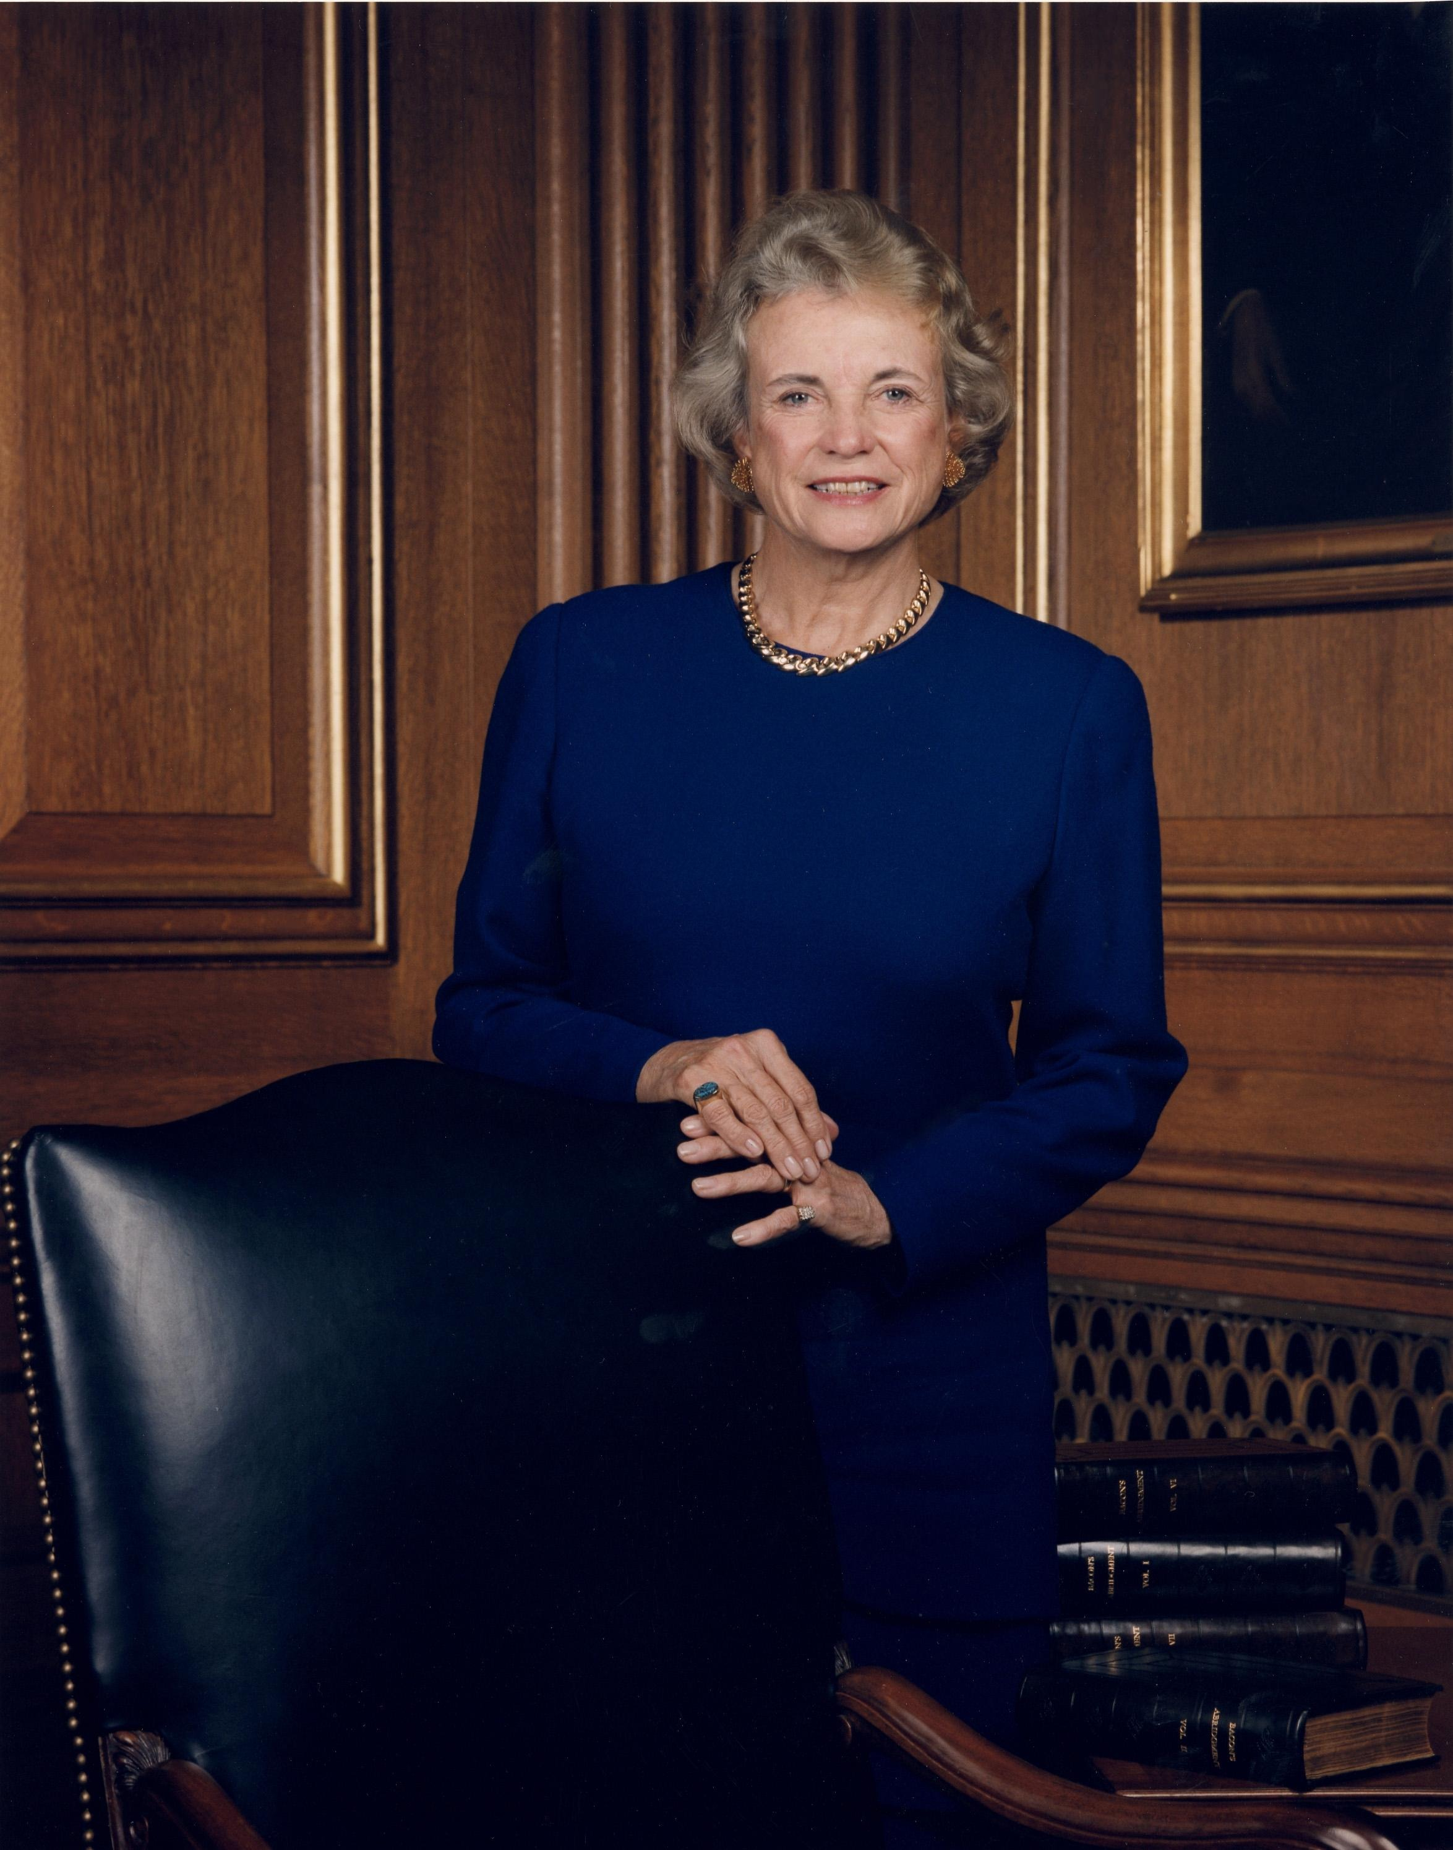
US.93 · PEOPLE WHO SHAPED THE ERA
Key Figures
Sandra Day O'Connor
Colin Powell
First woman U.S. Supreme Court Justice
First Black Chairman of the Joint Chiefs and Secretary of State
Became the first woman appointed to the Supreme Court (1981)
Often cast the deciding swing vote on major cases
First African American Chairman of the Joint Chiefs of Staff (1989)
First African American Secretary of State (2001)
Unknown; U.S. federal government, 1994 U.S. Supreme Court
STRATEGY Institutional leadership (breaking barriers)
STRATEGY Public service (military and diplomacy)
U.S. History Hack · TroopToTeacher Technologies LLC · Aligned to TN Academic Standards & TCAP EOC
172

Slide 174
US.93 · PRIMARY SOURCE ANALYSIS
Sandra Day O'Connor Confirmation Statement
Argumentation
Sandra Day O'Connor · September 1981
"It is a great honor for me to be the first woman to be nominated for a place on the Supreme Court. It is an honor to be selected by the President of the United States and an honor to be confirmed by the Senate... I hope that my appointment will serve to inspire other women to aspire to positions of leadership."
CONTEXT
When President Reagan nominated Sandra Day O'Connor in 1981, she became the first woman ever named to the Supreme Court. In her confirmation statement she reflected on the meaning of the milestone for women across the country.
ANALYZE
What significance did O'Connor attach to her appointment?
READ CLOSELY Underline the exact words that answer the ANALYZE question — be ready to read them aloud.
SOURCE IT
WHO made it?
WHEN?
WHY does it matter?
FIRST
Sandra Day O'Connor
September 1981
Consider that O'Connor is speaking as a barrier-breaker aware her words will be heard by women nationwide.
SSP.02 · before you interpret
Source: National Archives
U.S. History Hack · TroopToTeacher Technologies LLC · Aligned to TN Academic Standards & TCAP EOC
173
Notes:
Primary-source analysis. SOURCE IT FIRST (SSP.02) — model the sourcing routine aloud before students interpret: WHO made this source? (Sandra Day O'Connor) WHEN? (September 1981) WHY does that matter? (Consider that O'Connor is speaking as a barrier-breaker aware her words will be heard by women nationwide.) Only then move to the ANALYZE question. Suggested answer: O'Connor states "I hope that my appointment will serve to inspire other women to aspire to positions of leadership." Practice skill: Argumentation.

Slide 175
US.93 · KEY VOCABULARY
Word Wall
Sandra Day O'Connor
Sandra Day O'Connor
Colin Powell
Colin Powell
say: SAN-druh day oh-KON-er
say: KOH-lin POW-ul
SD
The first woman to serve on the U.S. Supreme Court, appointed in 1981.
CP
The first African American U.S. Secretary of State (2001) and Chairman of the Joint Chiefs of Staff.
Condoleezza Rice
Condoleezza Rice
Hillary Clinton
Hillary Clinton
say: kon-duh-LEE-zuh RYS
say: HIL-uh-ree KLIN-tun
CR
The first African American woman U.S. Secretary of State (2005), a key foreign-policy leader.
HC
U.S. Senator, Secretary of State, and the first woman to win a major party's presidential nomination (2016).
Nancy Pelosi
Nancy Pelosi
Glass Ceiling
Techo de Cristal
say: NAN-see puh-LOH-see
say: glas SEE-ling
NP
The first woman elected Speaker of the U.S. House of Representatives (2007).
GC
An invisible barrier that has kept women and minorities from reaching the highest positions in business and government.
"say:" pronunciation guide (stressed syllable in CAPS) and a per-term visual anchor support newcomer English learners. Spanish term + full bilingual Frayer models are in the unit vocabulary set.
U.S. History Hack · TroopToTeacher Technologies LLC · Aligned to TN Academic Standards & TCAP EOC
11

Slide 176
US.93 · GUIDED PRACTICE — WE DO IT TOGETHER
Let’s Work One Together
Explain historical significance of individuals
MODEL PROMPT: O'Connor, Powell, and Rice all achieved "firsts." How do I explain why these firsts matter?
WORKED EXAMPLE (teacher models this aloud)
Each broke a barrier — first woman on the Court, first Black Secretary of State — opening doors for others.
THINK ALOUD
To explain significance, I ask what changed because of the person — a "first" matters because it proves a role is open to groups once excluded.
→ Now you try: Now you: pick one leader from this standard and explain what barrier they broke and why it mattered.
U.S. History Hack · TroopToTeacher Technologies LLC · Aligned to TN Academic Standards & TCAP EOC
175
Notes:
GUIDED PRACTICE / WE DO (US.93). Skill modeled: Explain historical significance of individuals. Model the worked example aloud using the THINK ALOUD as your script, then release students to the activity ("Now you: pick one leader from this standard and explain what barrier they broke and why it mattered."). This is the I Do → We Do → You Do bridge — do not skip it; aim for 80%+ success before independent work.

Slide 177
US.93 · STUDENT ACTIVITY
Expanding Opportunity — Women & Minorities Cause & Effect
Groups of 3
18 min
YOUR TASK
Using your Cornell notes, complete the Cause & Effect organizer for the expanding roles of women and minorities. In CAUSES, list the barriers and the movements that challenged them (Title IX, affirmative action, the women's and civil-rights movements). In EFFECTS, trace the breakthroughs — Sandra Day O'Connor as the first woman on the Supreme Court, Colin Powell and other minority leaders, and rising participation in politics, business, and the professions. Finish with a claim about how these breakthroughs changed who holds power in America.
DELIVERABLE
DIFFERENTIATION
Completed Cause & Effect organizer (3+ causes, 3+ effects) plus a one-sentence claim on the most significant breakthrough for women and minorities in this era.
Entry: Organizer with a word bank (Title IX, affirmative action, Sandra Day O'Connor, Colin Powell, glass ceiling) to sort. Honors: Evaluate whether laws or individual trailblazers did more to expand opportunity for women and minorities. Argue with evidence.
Companion printable: printables/unit-10/unit-10-cause-effect.html
U.S. History Hack · TroopToTeacher Technologies LLC · Aligned to TN Academic Standards & TCAP EOC
176
Notes:
Student activity for US.93. Pair with the printable: printables/unit-10/unit-10-cause-effect.html. Timing: 18. Deliverable: Completed Cause & Effect organizer (3+ causes, 3+ effects) plus a one-sentence claim on the most significant breakthrough for women and minorities in this era.

Slide 178
US.93 · CHECK FOR UNDERSTANDING
TCAP-Style Question
DOK 3
EOC PRACTICE
What significance did O'Connor attach to her appointment?
It would change the court's political balance
A
It could inspire other women to seek leadership positions
B
It would lead to more conservative rulings
C
It was purely a personal achievement
D
ANSWER FIRST: students commit — then click / advance to reveal the correct answer and explanation.
U.S. History Hack · TroopToTeacher Technologies LLC · Aligned to TN Academic Standards & TCAP EOC
177
Notes:
CHECK FOR UNDERSTANDING (US.93, DOK 3). Have students commit to an answer (whiteboards, hand signal, or turn-and-talk) BEFORE advancing. Correct answer: B. The next slide reveals it. Why: O'Connor states "I hope that my appointment will serve to inspire other women to aspire to positions of leadership."

Slide 179
US.93 · ANSWER REVEAL
TCAP-Style Question
✓ ANSWER KEY
What significance did O'Connor attach to her appointment?
A
It would change the court's political balance
B
It could inspire other women to seek leadership positions
✓
C
It would lead to more conservative rulings
D
It was purely a personal achievement
Correct answer: B. Why: O'Connor states "I hope that my appointment will serve to inspire other women to aspire to positions of leadership."
U.S. History Hack · TroopToTeacher Technologies LLC · Aligned to TN Academic Standards & TCAP EOC
178
Notes:
ANSWER KEY (US.93). Correct: B. O'Connor states "I hope that my appointment will serve to inspire other women to aspire to positions of leadership."

Slide 180
US.93 · WRAP-UP
What You Need to Know for TCAP
KEY TAKEAWAYS
EXIT TICKET
DOK 2
Hillary Clinton's Contributions
Colin Powell's Leadership
Sandra Day O'Connor's Pioneering Impact
Condoleezza Rice's Foreign Policy Role
Nancy Pelosi's Political Leadership
Describe two women or minority leaders from this era and explain why their achievements were significant.
★ HONORS / EXTENSION DOK 3 · SSP.04 Argumentation
Evaluate whether laws (like Title IX and affirmative action) or individual trailblazers did more to expand opportunity for women and minorities. Argue with evidence.
U.S. History Hack · TroopToTeacher Technologies LLC · Aligned to TN Academic Standards & TCAP EOC
179
Notes:
WRAP-UP / EXIT-TICKET KEY (US.93, DOK 2). Prompt: Describe two women or minority leaders from this era and explain why their achievements were significant. Model answer: Sandra Day O'Connor became the first woman on the U.S. Supreme Court (1981); Colin Powell became the first African American Secretary of State (and earlier Chairman of the Joint Chiefs). Others include Condoleezza Rice and Nancy Pelosi. Their achievements were significant because they broke barriers that had stood for the nation's entire history, opening top offices to groups long excluded from them. RETEACH TRIGGER — if a student misses this exit ticket: (1) <50% of class miss → spiral it into the next standard’s Quick Review opener (see the US.93 review prompts). (2) Individual/small group → reteach with the "Hillary Clinton's Contributions" direct-instruction slide + re-run the SOURCE IT FIRST routine on the US.93 primary source, then assign the paired printable: printables/unit-10/unit-10-cause-effect.html. (3) Re-assess with the US.93 check-for-understanding reveal slide as a do-now the next day. Reteach anchors (this standard’s sections): Hillary Clinton's Contributions; Colin Powell's Leadership; Sandra Day O'Connor's Pioneering Impact; Condoleezza Rice's Foreign Policy Role; Nancy Pelosi's Political Leadership. I Can objective: I can describe the increasing role of women and minorities in the American military, politics, and economy, including Hillary Clinton, Sandra Day O'Connor, Nancy Pelosi, Colin Powell, and Condoleezza Rice. HONORS / EXTENSION (DOK 3, for early finishers or advanced learners): Evaluate whether laws (like Title IX and affirmative action) or individual trailblazers did more to expand opportunity for women and minorities. Argue with evidence. — look for a clear claim plus two specific pieces of evidence.

Slide 181
STANDARD
SOCIAL STUDIES PRACTICES
US.94
SSP.01
Collect sources
SSP.05
Historical awareness
SSP.06
Geographic awareness
Communication Methods Evolution
TN ACADEMIC STANDARD
Compare and contrast commonly used methods of communication from 1970 to today, and analyze the impact they have had on society.
I CAN
I can compare and contrast commonly used methods of communication from 1970 to today, and analyze the impact they have had on society.
U.S. History Hack · TroopToTeacher Technologies LLC · Aligned to TN Academic Standards & TCAP EOC
180

Slide 182
US.94 · QUICK REVIEW
Do You Remember?
Before we start, retrieve what we have already learned. Answer from memory first — no notes.
1
US.93 In the last standard we studied expanding roles for women and minorities. Name one barrier-breaking leader and what office they held.
U.S. History Hack · TroopToTeacher Technologies LLC · Aligned to TN Academic Standards & TCAP EOC
181
Notes:
SPACED RETRIEVAL (US.94). Cold-call or whiteboards, 3-4 min, low stakes. Answers — 1) Sandra Day O'Connor (first woman on the Supreme Court), Colin Powell and Condoleezza Rice (Secretaries of State), or Nancy Pelosi (first woman Speaker of the House). Each broke a barrier that had stood for the nation's entire history.

Slide 183
US.94 · CONFIDENCE CHECK
Warm-Up — Quick Recall
DOK 1
LOW STAKES
Everyone can answer this. Thumbs / whiteboards — no notes.
What global computer network transformed communication starting in the 1990s?
✓ ANSWER
The Internet.
COMMIT FIRST: have everyone answer before the reveal — this is the DOK 1 floor; the graded check later in this lesson moves up to DOK 2–3.
U.S. History Hack · TroopToTeacher Technologies LLC · Aligned to TN Academic Standards & TCAP EOC
182
Notes:
CONFIDENCE CHECK (US.94, DOK 1). 60-90 seconds. Have EVERY student commit (thumbs / whiteboard / choral) before revealing — this secures an early win and surfaces who is shaky before new content. Answer: The Internet. Key term to listen for: Internet Revolution. This is the low-floor entry; the graded Check for Understanding later in the standard rises to DOK 2–3.

Slide 184
US.94 · HOOK
Think About It
In the 1970s, Americans communicated by letters, landline phones, and printed newspapers. Within a generation, the personal computer, the Internet, email, cell phones, and social media transformed how people talk, work, shop, and share information.
DISCUSS
TIMING: Turn & Talk 60 sec → cold-call 2 pairs
The digital revolution made communication instant and global. What did society gain from that speed — and what, like privacy or face-to-face connection, might it have lost?
U.S. History Hack · TroopToTeacher Technologies LLC · Aligned to TN Academic Standards & TCAP EOC
183
Notes:
HOOK (US.94). Run tight: pose the provocation, give a silent 10-second think, then Turn & Talk 60 seconds. Cold-call 2–3 pairs (not volunteers) for a sentence-starter answer — "One force was ___ because ___" — then bridge to the standard. Keep total to ~4 minutes; do not let it sprawl. Return to this question at the unit close for an evidence-based answer.

Slide 185

US.94 · DIRECT INSTRUCTION
1 of 4
1970s Communication Technologies
Landline telephones were the primary voice communication method.
Television, dominated by three major networks, provided news and entertainment.
Radio remained important for music and local news.
Newspapers were the primary source for detailed news coverage.
Mail served as the standard written communication method.
Communication was slower, more deliberate, and geographically constrained.
SENTENCE FRAME (EL & writing support)
FA2010 (photographer); rights holder released into public domain, 1981 (photographed c. 2011) Museum für Angewandte Kunst
In the 1970s Americans communicated by ___, but today they use ___, which changed society by ___.
TEACHER CUE Chunk → cold-call → confirm before advancing.
U.S. History Hack · TroopToTeacher Technologies LLC · Aligned to TN Academic Standards & TCAP EOC
184
Notes:
FACILITATION (US.94). Ask: we can now reach anyone instantly, yet many people feel more isolated. How can communication improve and harm relationships at the same time? Teach in small steps; pause and check for understanding before the next chunk (aim 80%+ before moving on).

Slide 186
US.94 · DIRECT INSTRUCTION
2 of 4
Present-Day Communication Methods
Smartphones integrate voice, text, internet, and multimedia capabilities.
Social media platforms like Facebook, Twitter, and Instagram enable instant global communication.
Email is the primary business and formal communication method.
Video conferencing through Zoom and similar platforms allows face-to-face remote communication.
Streaming services have replaced traditional television viewing patterns.
U.S. History Hack · TroopToTeacher Technologies LLC · Aligned to TN Academic Standards & TCAP EOC
185

Slide 187
US.94 · DIRECT INSTRUCTION
3 of 4
Comparing Characteristics and Limitations
1970s advantages: more face-to-face interaction, deeper news analysis, less information overload. 1970s limitations: slower communication, limited information access, geographic barriers.
Present advantages: instant global communication, unlimited information access, multimedia capabilities.
Present limitations: information overload, privacy concerns, reduced attention spans, and cybersecurity threats.
U.S. History Hack · TroopToTeacher Technologies LLC · Aligned to TN Academic Standards & TCAP EOC
186

Slide 188
US.94 · DIRECT INSTRUCTION
4 of 4
Societal Impact
Communication evolution has transformed culture (global connectivity, viral content), the economy (e-commerce, remote work), governance (social media campaigns, digital democracy), and relationships (online dating, long-distance connections, but also reduced face-to-face interaction and increased isolation).
These changes continue to reshape American society in profound ways.
U.S. History Hack · TroopToTeacher Technologies LLC · Aligned to TN Academic Standards & TCAP EOC
187

Slide 189
US.94 · PRIMARY SOURCE ANALYSIS
The Internet and Society
Close Reading
Pew Research Center · 2005
"The internet has fundamentally changed how Americans communicate, work, and access information. Email has largely replaced letter writing for personal and business correspondence. Social networking sites allow people to maintain hundreds of relationships simultaneously."
CONTEXT
By 2005, the internet had moved from novelty to necessity for many Americans. Research organizations like the Pew Research Center began documenting how digital tools were reshaping the way people communicated, worked, and found information.
ANALYZE
According to this source, how has the internet changed American life?
READ CLOSELY Underline the exact words that answer the ANALYZE question — be ready to read them aloud.
SOURCE IT
WHO made it?
WHEN?
WHY does it matter?
FIRST
Pew Research Center
2005
Consider that a research organization aims to describe trends with evidence, not to sell a product.
SSP.02 · before you interpret
Source: National Archives
U.S. History Hack · TroopToTeacher Technologies LLC · Aligned to TN Academic Standards & TCAP EOC
188
Notes:
Primary-source analysis. SOURCE IT FIRST (SSP.02) — model the sourcing routine aloud before students interpret: WHO made this source? (Pew Research Center) WHEN? (2005) WHY does that matter? (Consider that a research organization aims to describe trends with evidence, not to sell a product.) Only then move to the ANALYZE question. Suggested answer: The source states "The internet has fundamentally changed how Americans communicate, work, and access information" and "has transformed everything from commerce to politics." Practice skill: Close Reading.

Slide 190
US.94 · KEY VOCABULARY
Word Wall
Internet Revolution
Revolución de Internet
World Wide Web
Red Informática Mundial
say: IN-ter-net rev-uh-LOO-shun
say: wurld wyd WEB
IR
The rapid late-20th-century spread of the internet, transforming how people communicate, work, and access information.
WW
A system of linked web pages, opened to the public in the 1990s, that made the internet easy to use.
Personal Computer
Computadora Personal
Social Media
Redes Sociales
say: PER-sun-ul kum-PYOO-ter
say: SOH-shul MEE-dee-uh
PC
An affordable home computer that became common in the 1980s-90s, changing work, school, and daily life.
SM
Online platforms of the 2000s that let people share content and connect instantly around the world.
Smartphone
Teléfono Inteligente
Digital Divide
Brecha Digital
say: SMART-fohn
say: DIJ-ih-tul dih-VYD
SM
A mobile phone with internet and computer features, widespread after 2007, that put communication in every pocket.
DD
The gap between those who have reliable access to computers and the internet and those who do not.
"say:" pronunciation guide (stressed syllable in CAPS) and a per-term visual anchor support newcomer English learners. Spanish term + full bilingual Frayer models are in the unit vocabulary set.
U.S. History Hack · TroopToTeacher Technologies LLC · Aligned to TN Academic Standards & TCAP EOC
12

Slide 191
US.94 · GUIDED PRACTICE — WE DO IT TOGETHER
Let’s Work One Together
Compare and contrast across time
MODEL PROMPT: How do I compare how a 1975 teenager and a teenager today would stay in touch with a friend?
WORKED EXAMPLE (teacher models this aloud)
In 1975 they wrote letters and made rare phone calls; today they text and use social media instantly.
THINK ALOUD
To compare and contrast, I identify what is similar (both want to connect) and what is different (speed, cost, and how personal it feels).
→ Now you try: Now you: name one advantage and one drawback of today's communication compared with the 1970s.
U.S. History Hack · TroopToTeacher Technologies LLC · Aligned to TN Academic Standards & TCAP EOC
190
Notes:
GUIDED PRACTICE / WE DO (US.94). Skill modeled: Compare and contrast across time. Model the worked example aloud using the THINK ALOUD as your script, then release students to the activity ("Now you: name one advantage and one drawback of today's communication compared with the 1970s."). This is the I Do → We Do → You Do bridge — do not skip it; aim for 80%+ success before independent work.

Slide 192
US.94 · STUDENT ACTIVITY
The Digital Revolution — Then vs. Now Venn
Pairs
15 min
YOUR TASK
Using your Cornell notes, complete the Venn diagram comparing communication BEFORE and AFTER the digital revolution. In the outer circles, record what was distinct to each era (letters, landline phones, and printed newspapers before; the personal computer, the Internet, email, cell phones, and social media after). In the overlap, record what stayed the same (people's need to connect and share information). Finish with a claim about how faster communication changed everyday life and the economy.
DELIVERABLE
DIFFERENTIATION
Completed Venn diagram (2+ items per section, including the shared overlap) plus a one-sentence claim on the single technology that changed communication the most.
Entry: Venn diagram with sentence stems and a word bank (personal computer, Internet, email, cell phone, social media) to place. Honors: Analyze how the digital revolution changed not just communication but also work, politics, and privacy. Defend with evidence.
Companion printable: printables/unit-10/unit-10-venn.html
U.S. History Hack · TroopToTeacher Technologies LLC · Aligned to TN Academic Standards & TCAP EOC
191
Notes:
Student activity for US.94. Pair with the printable: printables/unit-10/unit-10-venn.html. Timing: 15. Deliverable: Completed Venn diagram (2+ items per section, including the shared overlap) plus a one-sentence claim on the single technology that changed communication the most.

Slide 193
US.94 · CHECK FOR UNDERSTANDING
TCAP-Style Question
DOK 3
EOC PRACTICE
What benefits and concerns does this source identify about modern communication?
Only benefits — instant global connection with no drawbacks
A
Only concerns — technology has made communication worse
B
Global connection and instant communication, but also privacy concerns, misinformation, and less face-to-face interaction
C
No significant changes from earlier communication methods
D
ANSWER FIRST: students commit — then click / advance to reveal the correct answer and explanation.
U.S. History Hack · TroopToTeacher Technologies LLC · Aligned to TN Academic Standards & TCAP EOC
192
Notes:
CHECK FOR UNDERSTANDING (US.94, DOK 3). Have students commit to an answer (whiteboards, hand signal, or turn-and-talk) BEFORE advancing. Correct answer: C. The next slide reveals it. Why: The testimony notes benefits like "instant communication across continents" but also "concerns about privacy, misinformation, and the decline of face-to-face interaction."

Slide 194
US.94 · ANSWER REVEAL
TCAP-Style Question
✓ ANSWER KEY
What benefits and concerns does this source identify about modern communication?
A
Only benefits — instant global connection with no drawbacks
B
Only concerns — technology has made communication worse
C
Global connection and instant communication, but also privacy concerns, misinformation, and less face-to-face interaction
✓
D
No significant changes from earlier communication methods
Correct answer: C. Why: The testimony notes benefits like "instant communication across continents" but also "concerns about privacy, misinformation, and the decline of face-to-face interaction."
U.S. History Hack · TroopToTeacher Technologies LLC · Aligned to TN Academic Standards & TCAP EOC
193
Notes:
ANSWER KEY (US.94). Correct: C. The testimony notes benefits like "instant communication across continents" but also "concerns about privacy, misinformation, and the decline of face-to-face interaction."

Slide 195
US.94 · WRAP-UP
What You Need to Know for TCAP
KEY TAKEAWAYS
EXIT TICKET
DOK 2
1970s Communication Technologies
Present-Day Communication Methods
Comparing Characteristics and Limitations
Societal Impact
Compare how Americans communicated in the 1970s with how they communicate today. Name at least two changes and one effect on society.
★ HONORS / EXTENSION DOK 3 · SSP.04 Argumentation
Analyze how the digital revolution changed not just communication but also work, politics, and privacy. Defend your answer with evidence.
U.S. History Hack · TroopToTeacher Technologies LLC · Aligned to TN Academic Standards & TCAP EOC
194
Notes:
WRAP-UP / EXIT-TICKET KEY (US.94, DOK 2). Prompt: Compare how Americans communicated in the 1970s with how they communicate today. Name at least two changes and one effect on society. Model answer: In the 1970s, Americans relied on letters, landline telephones, and printed newspapers. Today they use the Internet, email, cell phones, and social media, making communication instant, global, and constant. Effects include faster access to information and new ways to work and organize — but also concerns about privacy, misinformation, and less face-to-face contact. RETEACH TRIGGER — if a student misses this exit ticket: (1) <50% of class miss → spiral it into the next standard’s Quick Review opener (see the US.94 review prompts). (2) Individual/small group → reteach with the "1970s Communication Technologies" direct-instruction slide + re-run the SOURCE IT FIRST routine on the US.94 primary source, then assign the paired printable: printables/unit-10/unit-10-venn.html. (3) Re-assess with the US.94 check-for-understanding reveal slide as a do-now the next day. Reteach anchors (this standard’s sections): 1970s Communication Technologies; Present-Day Communication Methods; Comparing Characteristics and Limitations; Societal Impact. I Can objective: I can compare and contrast commonly used methods of communication from 1970 to today, and analyze the impact they have had on society. HONORS / EXTENSION (DOK 3, for early finishers or advanced learners): Analyze how the digital revolution changed not just communication but also work, politics, and privacy. Defend your answer with evidence. — look for a clear claim plus two specific pieces of evidence.

Slide 196
STANDARD
SOCIAL STUDIES PRACTICES
US.95
SSP.01
Collect sources
SSP.05
Historical awareness
SSP.06
Geographic awareness
Obama Administration Achievements and Setbacks
TN ACADEMIC STANDARD
Describe the achievements and setbacks of President Barack Obama's administration.
I CAN
I can describe the achievements and setbacks of President Barack Obama's administration.
U.S. History Hack · TroopToTeacher Technologies LLC · Aligned to TN Academic Standards & TCAP EOC
195

Slide 197
US.95 · QUICK REVIEW
Do You Remember?
Before we start, retrieve what we have already learned. Answer from memory first — no notes.
1
US.94 We just studied the evolution of communication. How did communication change from the 1970s to today?
U.S. History Hack · TroopToTeacher Technologies LLC · Aligned to TN Academic Standards & TCAP EOC
196
Notes:
SPACED RETRIEVAL (US.95). Cold-call or whiteboards, 3-4 min, low stakes. Answers — 1) In the 1970s people relied on letters, landline phones, and printed news. The personal computer, the Internet, email, cell phones, and social media made communication instant, global, and constant — transforming work, politics, and everyday life.

Slide 198
US.95 · CONFIDENCE CHECK
Warm-Up — Quick Recall
DOK 1
LOW STAKES
Everyone can answer this. Thumbs / whiteboards — no notes.
Who became the first African American president of the United States, in 2009?
✓ ANSWER
Barack Obama.
COMMIT FIRST: have everyone answer before the reveal — this is the DOK 1 floor; the graded check later in this lesson moves up to DOK 2–3.
U.S. History Hack · TroopToTeacher Technologies LLC · Aligned to TN Academic Standards & TCAP EOC
197
Notes:
CONFIDENCE CHECK (US.95, DOK 1). 60-90 seconds. Have EVERY student commit (thumbs / whiteboard / choral) before revealing — this secures an early win and surfaces who is shaky before new content. Answer: Barack Obama. Key term to listen for: Affordable Care Act (Obamacare). This is the low-floor entry; the graded Check for Understanding later in the standard rises to DOK 2–3.

Slide 199
US.95 · HOOK
Think About It
In 2009, Barack Obama took office as the first African American president — facing the worst economic crisis since the Great Depression, two wars, and a health-care system he set out to reform, all amid deep political division.
DISCUSS
TIMING: Turn & Talk 60 sec → cold-call 2 pairs
Obama entered office promising “hope” and “change” during a national crisis. When a leader inherits enormous problems, how should we measure success — by what they fixed, or by what they attempted?
U.S. History Hack · TroopToTeacher Technologies LLC · Aligned to TN Academic Standards & TCAP EOC
198
Notes:
HOOK (US.95). Run tight: pose the provocation, give a silent 10-second think, then Turn & Talk 60 seconds. Cold-call 2–3 pairs (not volunteers) for a sentence-starter answer — "One force was ___ because ___" — then bridge to the standard. Keep total to ~4 minutes; do not let it sprawl. Return to this question at the unit close for an evidence-based answer.

Slide 200
US.95 · DIRECT INSTRUCTION
1 of 3
Major Achievements
Healthcare: The Affordable Care Act (Obamacare) expanded health insurance to millions of uninsured Americans.
Economic Recovery: The American Recovery and Reinvestment Act helped end the Great Recession, with unemployment falling from 10% to 4.7%.
Foreign Policy: the Paris Climate Agreement, the Iran nuclear deal, normalized relations with Cuba, and the killing of Osama bin Laden.
Social Progress: marriage equality advancement and the DACA program for young immigrants.
SENTENCE FRAME (EL & writing support)
The Obama administration achieved ___, but faced the setback of ___, because ___.
U.S. History Hack · TroopToTeacher Technologies LLC · Aligned to TN Academic Standards & TCAP EOC
199
Notes:
FACILITATION (US.95). Ask: Unit 10 ends with the first Black president. Looking back across all of U.S. History, what does Obama's election show about how far the country had come — and what challenges remained? Teach in small steps; pause and check for understanding before the next chunk (aim 80%+ before moving on).

Slide 201
US.95 · DIRECT INSTRUCTION
2 of 3
Significant Setbacks
Legislative battles: Republican opposition limited Obama's agenda after 2010 midterm losses, leading to government shutdowns and debt ceiling crises.
Foreign policy challenges: the Syrian civil war response, ISIS emergence, Russian aggression in Ukraine, and the Benghazi attack created difficult situations without clear solutions.
U.S. History Hack · TroopToTeacher Technologies LLC · Aligned to TN Academic Standards & TCAP EOC
200

Slide 202
US.95 · DIRECT INSTRUCTION
3 of 3
Partisan Conflicts
Obama faced unprecedented Republican obstruction, including blocking his Supreme Court nomination of Merrick Garland for nearly a year.
Racial tensions persisted despite — and sometimes because of — having the first Black president.
His presidency demonstrated both the possibilities and limitations of presidential power in an increasingly polarized political environment.
U.S. History Hack · TroopToTeacher Technologies LLC · Aligned to TN Academic Standards & TCAP EOC
201

Slide 203
US.95 · PEOPLE WHO SHAPED THE ERA
Key Figure
President Barack Obama
44th President of the United States
First African American president of the United States (2009)
Signed the Affordable Care Act (2010) and ordered the operation that killed Osama bin Laden (2011)
STRATEGY Coalition politics ("hope and change")
U.S. History Hack · TroopToTeacher Technologies LLC · Aligned to TN Academic Standards & TCAP EOC
202

Slide 204
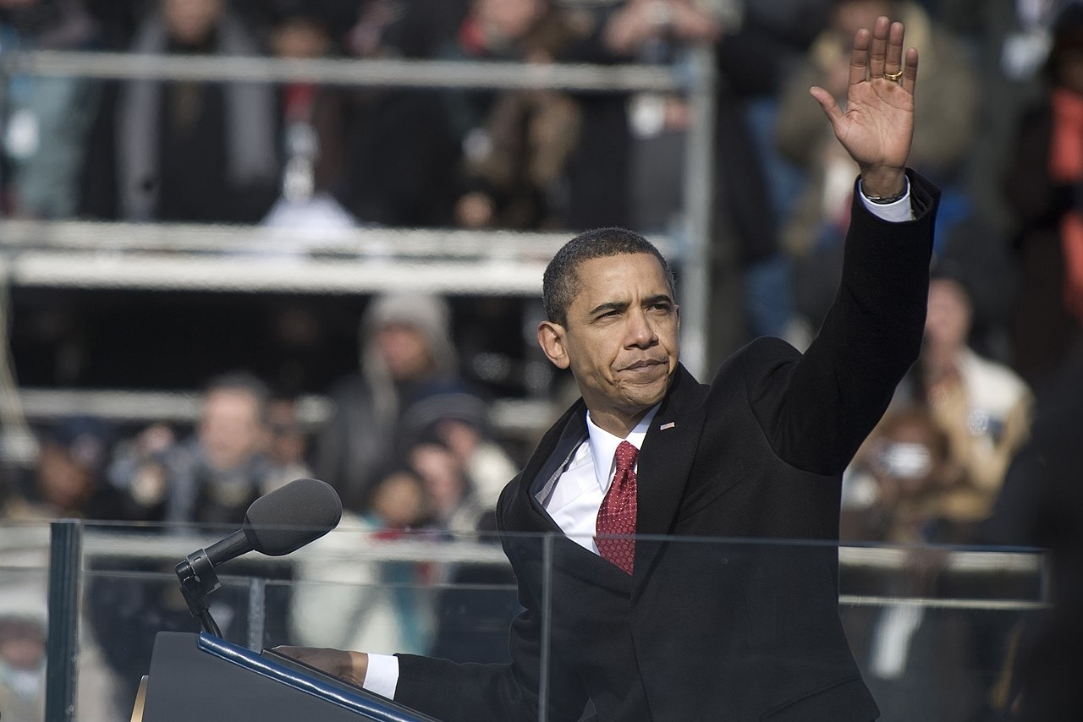
US.95 · PRIMARY SOURCE ANALYSIS
First Inaugural Address
Contextualization
President Barack Obama · January 20, 2009
ZOOM IN Find ONE detail that surprises you — be ready to name it.
"That we are in the midst of crisis is now well understood. Our nation is at war, against a far-reaching network of violence and hatred. Our economy is badly weakened, a consequence of greed and irresponsibility on the part of some... Today I say to you that the challenges we face are real."
CONTEXT
Barack Obama took office in January 2009 as the first African American president, amid the worst economic crisis since the Great Depression and two ongoing wars. His inaugural address candidly named the crises the nation faced.
ANALYZE
What challenges does Obama acknowledge America faces?
U.S. Navy (photo 090120-N-0696M-327), January 20, 2009 U.S. Department of Defense
SOURCE IT
WHO made it?
WHEN?
WHY does it matter?
FIRST
President Barack Obama
January 20, 2009
Consider that an inaugural address is meant to set the tone and priorities for a new presidency at a moment of national crisis.
SSP.02 · before you interpret
Source: National Archives
U.S. History Hack · TroopToTeacher Technologies LLC · Aligned to TN Academic Standards & TCAP EOC
203
Notes:
Primary-source analysis. SOURCE IT FIRST (SSP.02) — model the sourcing routine aloud before students interpret: WHO made this source? (President Barack Obama) WHEN? (January 20, 2009) WHY does that matter? (Consider that an inaugural address is meant to set the tone and priorities for a new presidency at a moment of national crisis.) Only then move to the ANALYZE question. Suggested answer: Obama identifies being "at war, against a far-reaching network of violence and hatred" and that "Our economy is badly weakened" as the major challenges. Practice skill: Contextualization.

Slide 205
US.95 · KEY VOCABULARY
Word Wall
Affordable Care Act
Ley de Cuidado de Salud Asequible
Great Recession
Gran Recesión
say: uh-FOR-duh-bul KAIR akt
say: grayt ree-SESH-un
AC
President Obama's 2010 health-care law ('Obamacare') expanding insurance coverage to millions of Americans.
GR
The severe 2007-09 economic downturn — the worst since the Great Depression — marked by a housing and banking crisis.
American Recovery and Reinvestment Act
Ley de Recuperación y Reinversión
First African American President
Primer Presidente Afroamericano
say: uh-MER-ih-kun ree-KUV-er-ee
say: furst AF-rih-kun uh-MER-ih-kun
AR
A 2009 stimulus law that used federal spending and tax cuts to fight the Great Recession.
FA
Barack Obama, elected in 2008, whose presidency was a historic milestone in U.S. history.
Death of Osama bin Laden
Muerte de Osama bin Laden
Partisan Gridlock
Estancamiento Partidista
say: deth of oh-SAH-muh bin LAH-den
say: PAR-tih-zun GRID-lok
DO
The 2011 U.S. special-forces raid that killed the al-Qaeda leader behind the 9/11 attacks.
PG
Sharp division between Democrats and Republicans that blocked lawmaking during much of Obama's presidency.
"say:" pronunciation guide (stressed syllable in CAPS) and a per-term visual anchor support newcomer English learners. Spanish term + full bilingual Frayer models are in the unit vocabulary set.
U.S. History Hack · TroopToTeacher Technologies LLC · Aligned to TN Academic Standards & TCAP EOC
13

Slide 206
US.95 · GUIDED PRACTICE — WE DO IT TOGETHER
Let’s Work One Together
Balance achievements against setbacks
MODEL PROMPT: Obama passed the ACA but faced heavy opposition. How do I describe both his achievements and setbacks?
WORKED EXAMPLE (teacher models this aloud)
He expanded healthcare and led an economic recovery, but faced gridlock and foreign-policy challenges.
THINK ALOUD
To balance a record, I list achievements and setbacks side by side and judge each on its lasting impact, rather than deciding he only succeeded or only failed.
→ Now you try: Now you: name one Obama achievement and one setback, and explain why both belong in a fair description of his presidency.
U.S. History Hack · TroopToTeacher Technologies LLC · Aligned to TN Academic Standards & TCAP EOC
205
Notes:
GUIDED PRACTICE / WE DO (US.95). Skill modeled: Balance achievements against setbacks. Model the worked example aloud using the THINK ALOUD as your script, then release students to the activity ("Now you: name one Obama achievement and one setback, and explain why both belong in a fair description of his presidency."). This is the I Do → We Do → You Do bridge — do not skip it; aim for 80%+ success before independent work.

Slide 207
US.95 · STUDENT ACTIVITY
The Obama Years — Achievements & Setbacks Chart
Pairs
15 min
YOUR TASK
Using your Cornell notes and Obama's inaugural address excerpt, complete the Cause & Effect organizer for the Obama presidency. In CAUSES, list the challenges he inherited (the 2008 Great Recession, wars abroad, a divided health-care system). In EFFECTS, trace the responses — the economic stimulus and auto rescue, the Affordable Care Act, the killing of Osama bin Laden, and being the first African American president — along with the setbacks of political gridlock and a slow recovery. Finish with a claim about Obama's most significant achievement.
DELIVERABLE
DIFFERENTIATION
Completed Cause & Effect organizer (3+ causes, 3+ effects, labeled achievement or setback) plus a one-sentence claim on Obama's most lasting legacy.
Entry: Organizer with a word bank (Great Recession, stimulus, Affordable Care Act, bin Laden, first Black president) to sort into achievements vs. setbacks. Honors: Evaluate whether Obama should be judged more by his response to the Great Recession or by the Affordable Care Act. Argue with evidence.
Companion printable: printables/unit-10/unit-10-cause-effect.html
U.S. History Hack · TroopToTeacher Technologies LLC · Aligned to TN Academic Standards & TCAP EOC
206
Notes:
Student activity for US.95. Pair with the printable: printables/unit-10/unit-10-cause-effect.html. Timing: 15. Deliverable: Completed Cause & Effect organizer (3+ causes, 3+ effects, labeled achievement or setback) plus a one-sentence claim on Obama's most lasting legacy.

Slide 208
US.95 · CHECK FOR UNDERSTANDING
TCAP-Style Question
DOK 3
EOC PRACTICE
How does Obama describe the significance of the Affordable Care Act?
As a minor adjustment to existing healthcare laws
A
As a temporary measure until a better solution was found
B
As a compromise that satisfied no one
C
As a historic achievement ensuring basic health security for all Americans
D
ANSWER FIRST: students commit — then click / advance to reveal the correct answer and explanation.
U.S. History Hack · TroopToTeacher Technologies LLC · Aligned to TN Academic Standards & TCAP EOC
207
Notes:
CHECK FOR UNDERSTANDING (US.95, DOK 3). Have students commit to an answer (whiteboards, hand signal, or turn-and-talk) BEFORE advancing. Correct answer: D. The next slide reveals it. Why: Obama describes it as coming "after almost a century of trying" and establishing "the core principle that everybody should have some basic security when it comes to their health care."

Slide 209
US.95 · ANSWER REVEAL
TCAP-Style Question
✓ ANSWER KEY
How does Obama describe the significance of the Affordable Care Act?
A
As a minor adjustment to existing healthcare laws
B
As a temporary measure until a better solution was found
C
As a compromise that satisfied no one
D
As a historic achievement ensuring basic health security for all Americans
✓
Correct answer: D. Why: Obama describes it as coming "after almost a century of trying" and establishing "the core principle that everybody should have some basic security when it comes to their health care."
U.S. History Hack · TroopToTeacher Technologies LLC · Aligned to TN Academic Standards & TCAP EOC
208
Notes:
ANSWER KEY (US.95). Correct: D. Obama describes it as coming "after almost a century of trying" and establishing "the core principle that everybody should have some basic security when it comes to their health care."

Slide 210
US.95 · WRAP-UP
What You Need to Know for TCAP
KEY TAKEAWAYS
EXIT TICKET
DOK 3
Major Achievements
Significant Setbacks
Partisan Conflicts
Describe two achievements and one setback of the Obama administration. Why is his presidency historically significant?
★ HONORS / EXTENSION DOK 3 · SSP.04 Argumentation
Evaluate whether Obama should be judged more by his response to the Great Recession or by the Affordable Care Act. Argue with evidence.
U.S. History Hack · TroopToTeacher Technologies LLC · Aligned to TN Academic Standards & TCAP EOC
209
Notes:
WRAP-UP / EXIT-TICKET KEY (US.95, DOK 3). Prompt: Describe two achievements and one setback of the Obama administration. Why is his presidency historically significant? Model answer: Achievements included the Affordable Care Act (which expanded health coverage), the economic stimulus and auto rescue that helped end the Great Recession, and the operation that killed Osama bin Laden. A major setback was persistent political gridlock and a slow economic recovery. His presidency is historically significant above all because he was the first African American president of the United States. RETEACH TRIGGER — if a student misses this exit ticket: (1) <50% of class miss → spiral it into the next standard’s Quick Review opener (see the US.95 review prompts). (2) Individual/small group → reteach with the "Major Achievements" direct-instruction slide + re-run the SOURCE IT FIRST routine on the US.95 primary source, then assign the paired printable: printables/unit-10/unit-10-cause-effect.html. (3) Re-assess with the US.95 check-for-understanding reveal slide as a do-now the next day. Reteach anchors (this standard’s sections): Major Achievements; Significant Setbacks; Partisan Conflicts. I Can objective: I can describe the achievements and setbacks of President Barack Obama's administration. HONORS / EXTENSION (DOK 3, for early finishers or advanced learners): Evaluate whether Obama should be judged more by his response to the Great Recession or by the Affordable Care Act. Argue with evidence. — look for a clear claim plus two specific pieces of evidence.

Slide 211
Unit 10 Complete
The Modern Era (1964–2016) · from the Great Society and 1960s activism, through Watergate and the end of the Cold War, to 9/11, the digital revolution, and the Obama years.
Revisit your unit hook: How did the United States move from the confidence of the Great Society in 1964 to the challenges and transformations of the twenty-first century? You can now answer with evidence — from Medicare and the War on Poverty, through Vietnam-era protest and Watergate, Reagan and the fall of the Berlin Wall, 9/11 and the digital revolution, to the election of the first African American president.
U.S. History Hack · The complete TCAP EOC course, Units 1–10
U.S. History Hack · TroopToTeacher Technologies LLC · All primary sources verified against National Archives, Library of Congress, and U.S. Senate records. All images public domain.

