Slide 1
How This Deck Works
Universal Design for Learning · Multi-Tiered System of Supports
EVERY LEARNER · SAME FIRM GOAL
Multiple ways in
Multiple ways to see it
Multiple ways to show it
Every lesson opens with a real question and a clear “I can” goal, so you know why it matters and where you’re headed.
Direct instruction, primary sources, maps, and bilingual key vocabulary — the same ideas shown more than one way.
Model-with-me, sentence frames, and choices in how you respond — you reach the same goal by the route that works for you.
Your teacher checks your progress along the way and gives you another path if you need one — the goal never lowers.
U.S. History Hack · TroopToTeacher Technologies LLC · Aligned to TN Academic Standards & TCAP EOC
1

Slide 2
US.08
Social Darwinism & Social Gospel
TN STANDARD
US.08 – Explain the concepts of Social Darwinism and the Social Gospel.
I CAN
I can explain the concepts of Social Darwinism and the Social Gospel and how they shaped debates over government's role in addressing social problems.
U.S. History Hack · TroopToTeacher Technologies LLC · Aligned to TN Academic Standards & TCAP EOC
1

Slide 3
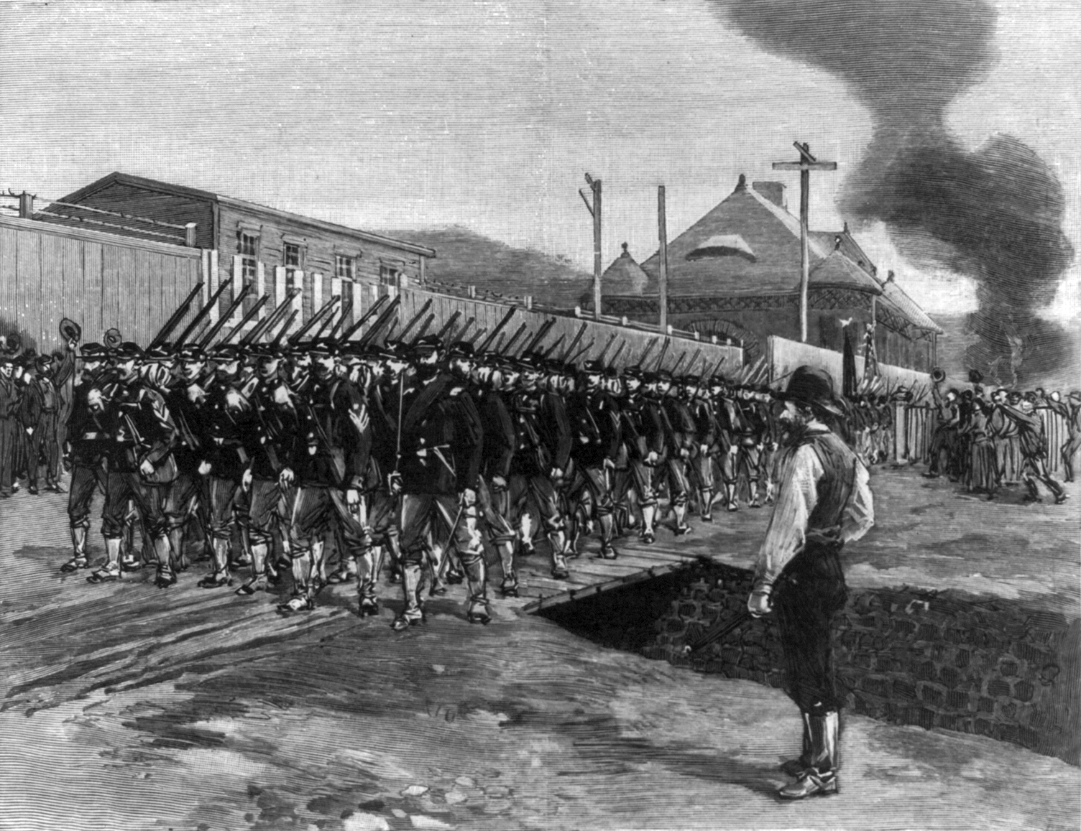
DIRECT INSTRUCTION
US.08
Social Darwinism applied “survival of the fittest” to society — Spencer and Sumner used it to defend industrial wealth and oppose helping the poor.
ZOOM IN
US.08 · Social Darwinism Explained
U.S. History Hack · TroopToTeacher Technologies LLC · Aligned to TN Academic Standards & TCAP EOC
2

Slide 4
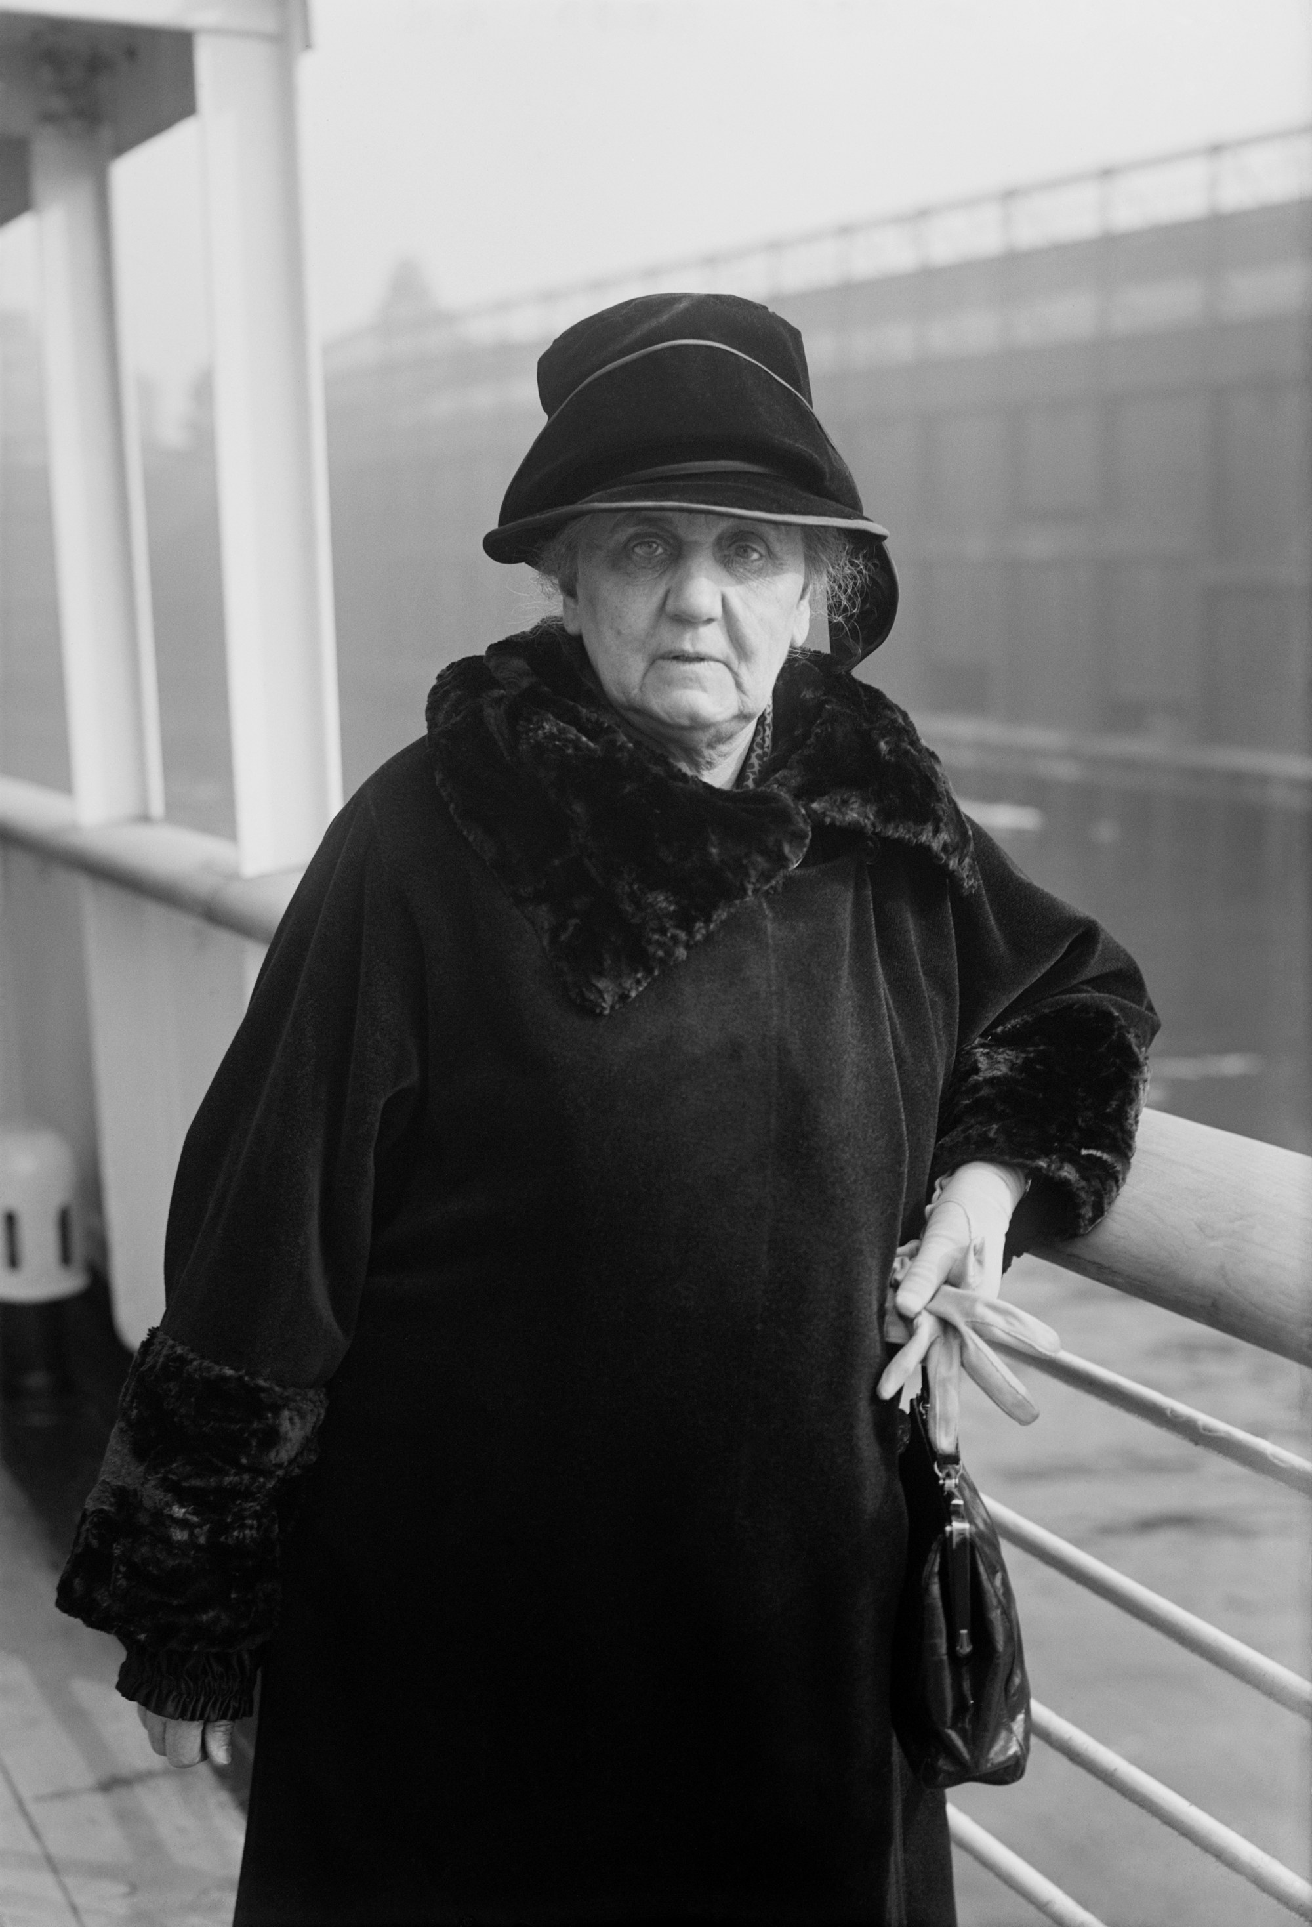
DIRECT INSTRUCTION
US.08
The Social Gospel answered back — reformers like Rauschenbusch argued Christian ethics demanded fighting poverty and improving working conditions.
ZOOM IN
US.08 · The Social Gospel Movement
U.S. History Hack · TroopToTeacher Technologies LLC · Aligned to TN Academic Standards & TCAP EOC
3

Slide 5
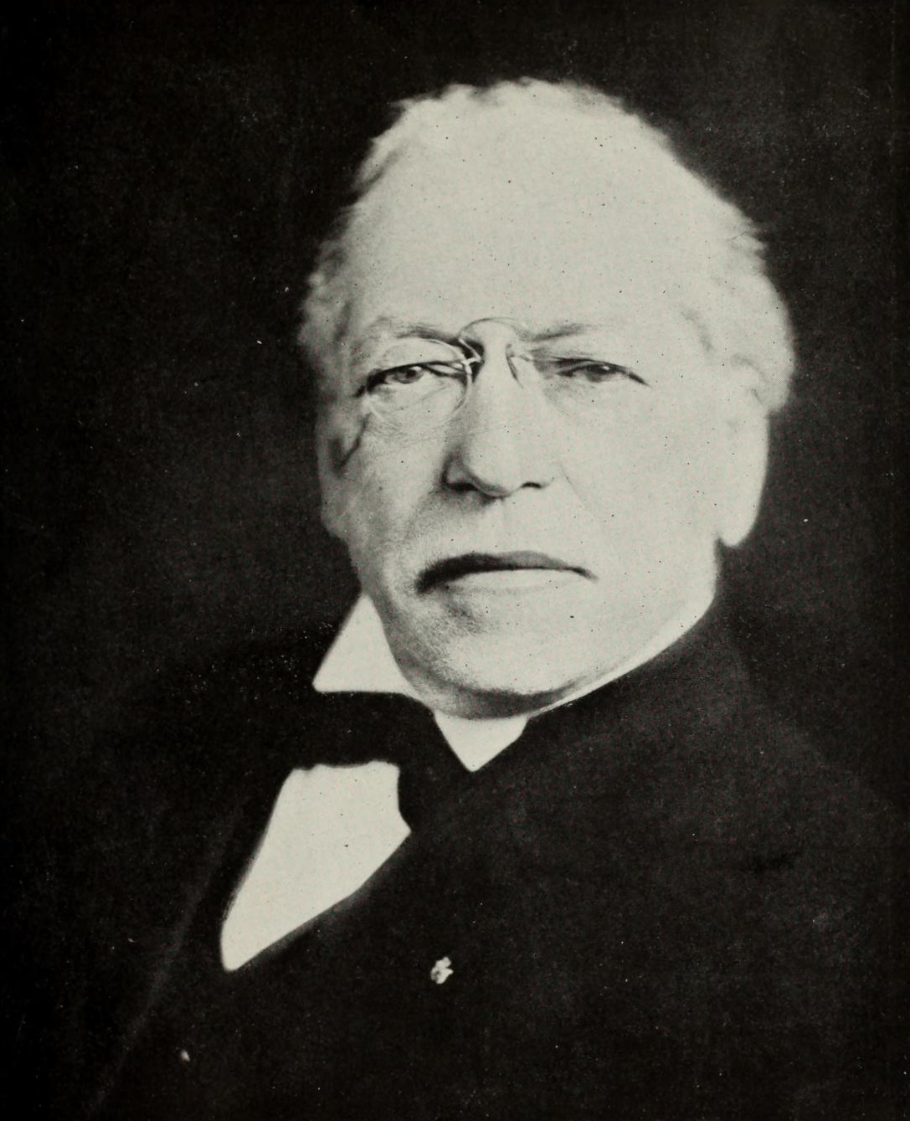
DIRECT INSTRUCTION
US.08
These rival philosophies framed the era’s central debate: should government stay out of social problems, or act to reduce inequality?
ZOOM IN
US.08 · Cultural & Economic Impact
U.S. History Hack · TroopToTeacher Technologies LLC · Aligned to TN Academic Standards & TCAP EOC
4

Slide 6
SOURCE IT FIRST
US.08
Carnegie explained how the rich should use their fortunes — read “The Gospel of Wealth” and weigh who he thinks deserves help.
WHO
WHEN
WHY
Andrew Carnegie, America's wealthiest steel manufacturer.
1889, at the height of the Gilded Age and rising labor unrest.
A wealthy author writing about wealth reveals assumptions about who deserves help — and who does not.
The Gospel of Wealth
Andrew Carnegie · 1889
"The problem of our age is the proper administration of wealth, so that the ties of brotherhood may still bind together the rich and poor in harmonious relationship. The conditions of human life have not only been changed, but revolutionized, within the past few hundred years... The contrast between the palace of the millionaire and the cottage of the laborer... measures the change which has come with civilization."
Carnegie Corporation of New York
U.S. History Hack · TroopToTeacher Technologies LLC · Aligned to TN Academic Standards & TCAP EOC
5

Slide 7
THREE PERSPECTIVES
US.08
A historian returns to three questions at the end of every reading. Use them to analyze this standard.
Who benefited?
Who bore the costs?
Who decided?
Who gained land, wealth, power, or protection?
Who lost land, labor, freedom, or life — and who was silenced?
Which people, offices, or courts held the authority?
US.08:
US.08:
US.08:
Industrialists and defenders of laissez-faire, who used Social Darwinism to justify vast fortunes and resist regulation or relief.
The urban poor and working class, dismissed as “unfit” by Social Darwinists — the very people the Social Gospel and settlement houses tried to aid.
Private thinkers and philanthropists (Spencer, Sumner, Carnegie, Rauschenbusch) shaping public opinion — government had not yet claimed a role in social welfare.
Anchor: Carnegie, “The Gospel of Wealth,” 1889 (Carnegie Corporation of New York)
U.S. History Hack · TroopToTeacher Technologies LLC · Aligned to TN Academic Standards & TCAP EOC
6

Slide 8
KEY VOCABULARY · LANGUAGE SUPPORT
US.08
Words you need before we read
Social Darwinism
Social Gospel
Settlement House
En español: Darwinismo Social
En español: Evangelio Social
En español: Casa de Asentamiento
WHAT IT MEANS
WHAT IT MEANS
WHAT IT MEANS
The belief that Darwin's theory of natural selection applies to human society — the wealthy are 'fit' and the poor are 'weak,' justifying laissez-faire capitalism and opposing government aid.
A religious movement that emphasized Christians' duty to address poverty, unsafe conditions, and inequality — providing moral foundation for Progressive Era reform.
Community centers in poor urban neighborhoods staffed by reformers who provided services such as childcare, education, and job training to immigrants and the poor.
U.S. History Hack · TroopToTeacher Technologies LLC · Aligned to TN Academic Standards & TCAP EOC
2

Slide 9
PROGRESS CHECK
US.08
Check your understanding
Analyze how these competing philosophies shaped debates over government's role in addressing social and economic problems.
A
Social Darwinism argued government should not interfere while Social Gospel supported intervention, creating a fundamental tension about whether society should address inequality that continues today
B
Both philosophies supported the same policies, but this fails to account for the broader historical context, and this view has been largely revised by modern historical research
C
Neither philosophy influenced government policy, despite the fact that multiple sources contradict this view, but the historical evidence paints a more nuanced picture and does not reflect the scholarly consensus on this topic
D
Government ignored both viewpoints, although this view has been largely discredited by scholars when examined alongside the available primary and secondary sources, although historical sources do not support this conclusion
Confidence: 😟 1 🙂 2 😀 3 — circle where you are; your teacher routes reteach or extension.
U.S. History Hack · TroopToTeacher Technologies LLC · Aligned to TN Academic Standards & TCAP EOC
3

Slide 10
US.09
Booker T. Washington vs W.E.B. Du Bois
TN STANDARD
US.09 – Compare and contrast the ideas and philosophies of Booker T. Washington and W.E.B. Du Bois. (TCA)
I CAN
I can compare and contrast the ideas and philosophies of Booker T. Washington and W.E.B. Du Bois regarding education, civil rights, and strategies for African American advancement.
U.S. History Hack · TroopToTeacher Technologies LLC · Aligned to TN Academic Standards & TCAP EOC
7

Slide 11
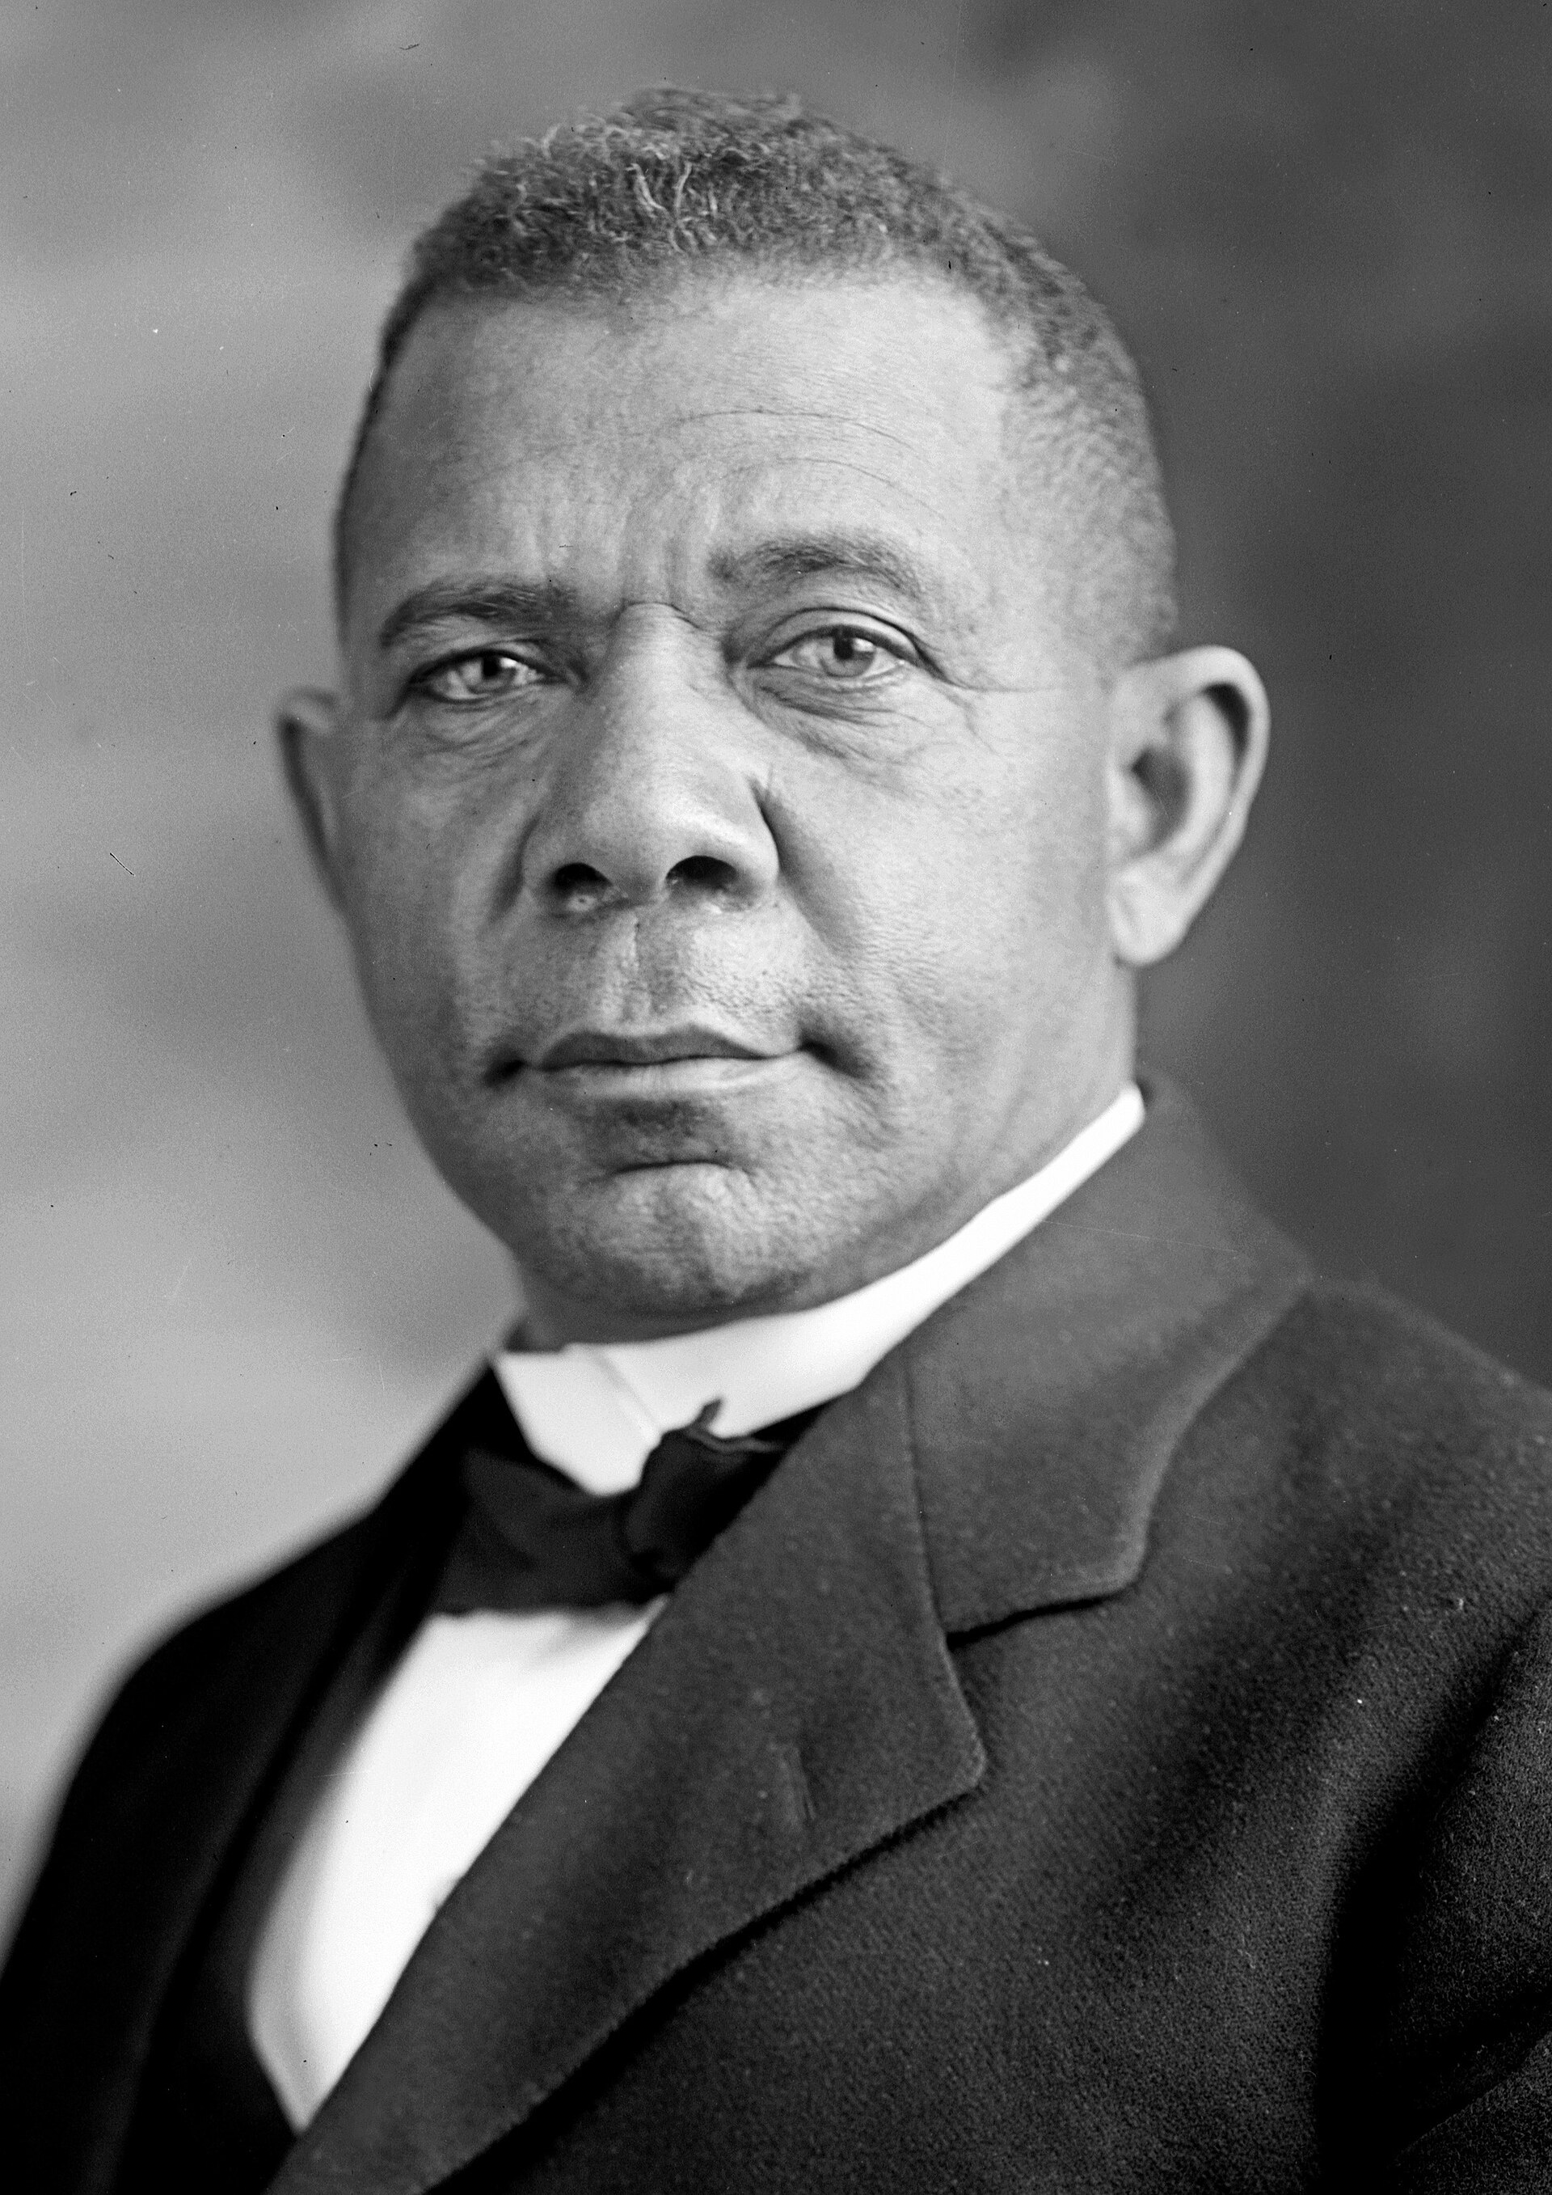
DIRECT INSTRUCTION
US.09
Booker T. Washington — born enslaved, founder of Tuskegee — became the most prominent Black leader after his 1895 Atlanta Compromise speech.
ZOOM IN
US.09 · Background & Origins
U.S. History Hack · TroopToTeacher Technologies LLC · Aligned to TN Academic Standards & TCAP EOC
8

Slide 12
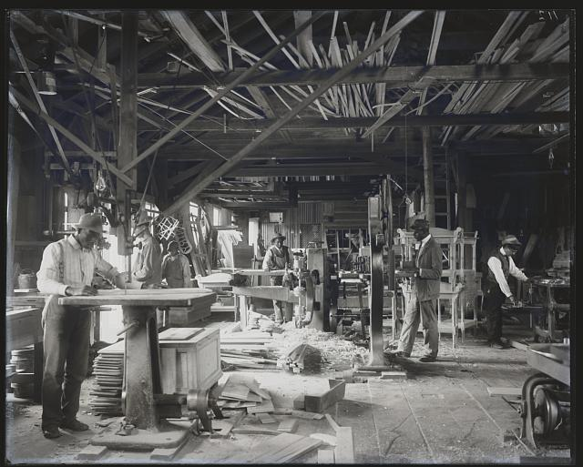
DIRECT INSTRUCTION
US.09
Washington emphasized vocational training and economic self-sufficiency; Du Bois demanded a liberal-arts education for a “Talented Tenth” of leaders.
ZOOM IN
US.09 · Educational Philosophy
U.S. History Hack · TroopToTeacher Technologies LLC · Aligned to TN Academic Standards & TCAP EOC
9

Slide 13
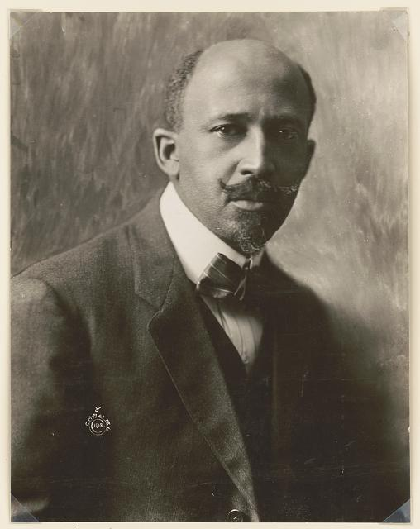
DIRECT INSTRUCTION
US.09
Washington favored accommodation and gradualism; Du Bois rejected it, co-founding the NAACP to demand full civil and political rights now.
ZOOM IN
US.09 · Rights, Equality & Strategy
U.S. History Hack · TroopToTeacher Technologies LLC · Aligned to TN Academic Standards & TCAP EOC
10

Slide 14
SOURCE IT FIRST
US.09
Read Washington’s own words at Atlanta — then ask what he accepted, and why his audience mattered.
WHO
WHEN
WHY
Booker T. Washington — formerly enslaved educator, founder of Tuskegee Institute.
1895, thirty years after the Civil War, in the era of Jim Crow laws and rising racial violence.
Context matters — his audience included Southern white leaders who controlled access to Black economic opportunity.
Atlanta Compromise Speech
Booker T. Washington · 1895
"In all things that are purely social we can be as separate as the fingers, yet one as the hand in all things essential to mutual progress. There is no defense or security for any of us except in the highest intelligence and development of all... The wisest among my race understand that the agitation of questions of social equality is the extremest folly."
History Matters, George Mason University
U.S. History Hack · TroopToTeacher Technologies LLC · Aligned to TN Academic Standards & TCAP EOC
11

Slide 15
THREE PERSPECTIVES
US.09
A historian returns to three questions at the end of every reading. Use them to analyze this standard.
Who benefited?
Who bore the costs?
Who decided?
Who gained land, wealth, power, or protection?
Who lost land, labor, freedom, or life — and who was silenced?
Which people, offices, or courts held the authority?
US.09:
US.09:
US.09:
Southern white leaders reassured by Washington’s accommodation; and Black communities who gained trade skills and institutions like Tuskegee.
African Americans denied full political and civil rights under Jim Crow — the delay Du Bois warned accommodation would prolong.
Two Black leaders defining rival strategies — Washington through Tuskegee and public accommodation, Du Bois through the NAACP and protest.
Anchor: Washington, Atlanta Compromise Speech, 1895 (History Matters, GMU)
U.S. History Hack · TroopToTeacher Technologies LLC · Aligned to TN Academic Standards & TCAP EOC
12

Slide 16
KEY VOCABULARY · LANGUAGE SUPPORT
US.09
Words you need before we read
Booker T. Washington
W.E.B. Du Bois
Atlanta Compromise
En español: Booker T. Washington
En español: W.E.B. Du Bois
En español: Compromiso de Atlanta
WHAT IT MEANS
WHAT IT MEANS
WHAT IT MEANS
African American educator who founded Tuskegee Institute and advocated vocational training and economic self-sufficiency as the path to African American advancement, accepting temporary segregation.
African American scholar who demanded immediate civil and political rights, co-founded the NAACP, and advocated classical education for the 'Talented Tenth' of African American leaders.
Booker T. Washington's 1895 speech accepting racial segregation in exchange for economic opportunity, arguing African Americans should focus on industrial skills rather than political rights.
U.S. History Hack · TroopToTeacher Technologies LLC · Aligned to TN Academic Standards & TCAP EOC
4

Slide 17
PROGRESS CHECK
US.09
Check your understanding
Evaluate which approach was more effective for advancing African American progress during this era.
A
Washington's approach completely succeeded, yet the available evidence points to a different conclusion and oversimplifies the complex factors at work during this period and fails to account for key developments in the broader context
B
Both contributed: Washington built institutions and economic opportunity while Du Bois established organizations like the NAACP that would lead later civil rights victories—different strategies served different needs
C
Neither approach had any impact, but this oversimplifies the complex factors at work, which ignores significant political and cultural developments of the era, which represents a common misconception about this historical period
D
Du Bois's approach achieved everything during his lifetime, which contradicts the primary source evidence from this era and does not reflect the scholarly consensus on this topic, which contradicts the primary source evidence from this era
Confidence: 😟 1 🙂 2 😀 3 — circle where you are; your teacher routes reteach or extension.
U.S. History Hack · TroopToTeacher Technologies LLC · Aligned to TN Academic Standards & TCAP EOC
5

Slide 18
US.10
Populism & Granger Movement
TN STANDARD
US.10 – Explain the characteristics and impact of the Granger movement and populism, emphasizing the conflicts between farmers and the railroads.
I CAN
I can explain the characteristics and impact of the Granger movement and populism, emphasizing the conflicts between farmers and the railroads.
U.S. History Hack · TroopToTeacher Technologies LLC · Aligned to TN Academic Standards & TCAP EOC
13

Slide 19
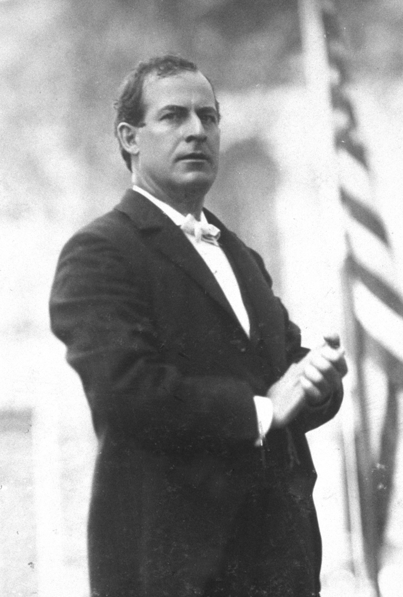
DIRECT INSTRUCTION
US.10
Populism gave farmers and rural workers a political voice against banks, railroads, and eastern financial power.
ZOOM IN
US.10 · Understanding Populism
U.S. History Hack · TroopToTeacher Technologies LLC · Aligned to TN Academic Standards & TCAP EOC
14

Slide 20
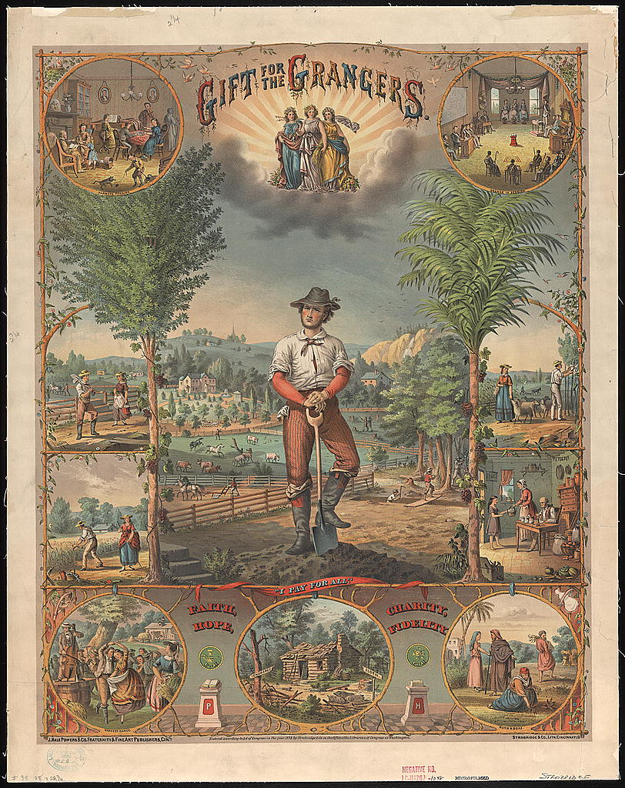
DIRECT INSTRUCTION
US.10
The Grange (1867) and the Farmers’ Alliance organized farmers socially and politically — lobbying for railroad regulation.
ZOOM IN
US.10 · Granger Movement & Farmers’ Alliance
U.S. History Hack · TroopToTeacher Technologies LLC · Aligned to TN Academic Standards & TCAP EOC
15

Slide 21
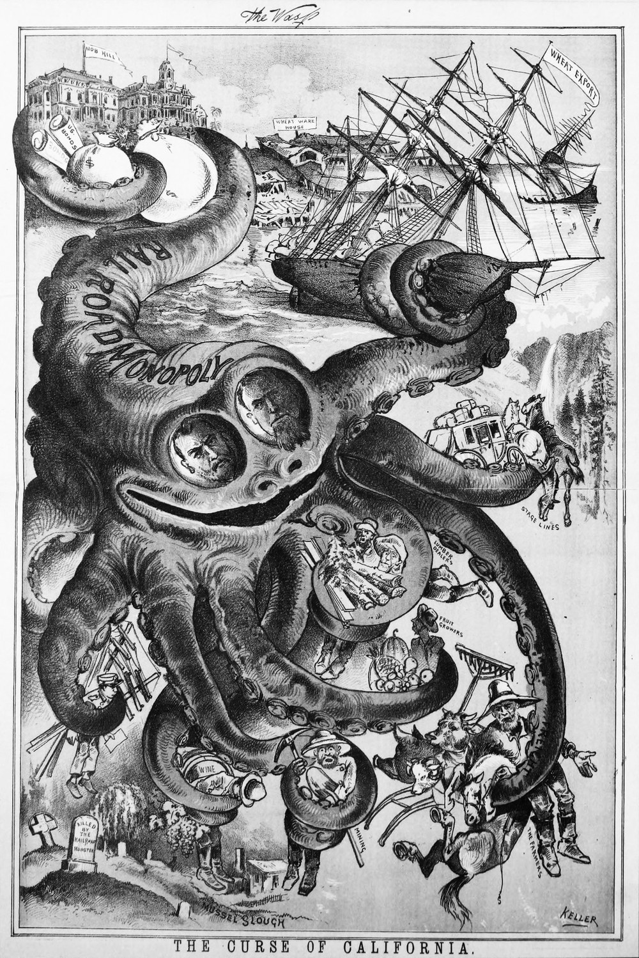
DIRECT INSTRUCTION
US.10
Railroads squeezed farmers with high, discriminatory freight rates, rebates to big shippers, and control of grain elevators.
ZOOM IN
US.10 · Farmer vs. Railroad Conflicts
U.S. History Hack · TroopToTeacher Technologies LLC · Aligned to TN Academic Standards & TCAP EOC
16

Slide 22
SOURCE IT FIRST
US.10
Read the 1892 Populist Platform — its demands reveal what farmers thought was broken and how they wanted to fix it.
WHO
WHEN
WHY
The People's Party — delegates representing millions of American farmers from the South and Midwest.
1892, during a severe agricultural depression with falling crop prices and rising railroad costs.
Political platforms reveal what a group believes is wrong and what power they want to use to fix it.
Populist Party Platform
People's Party National Convention · 1892
"We demand free and unlimited coinage of silver and gold at the present legal ratio of 16 to 1... We demand a graduated income tax... We believe that the power of government—in other words, of the people—should be expanded... to the end that oppression, injustice, and poverty shall eventually cease in the land."
Library of Congress
U.S. History Hack · TroopToTeacher Technologies LLC · Aligned to TN Academic Standards & TCAP EOC
17

Slide 23
THREE PERSPECTIVES
US.10
A historian returns to three questions at the end of every reading. Use them to analyze this standard.
Who benefited?
Who bore the costs?
Who decided?
Who gained land, wealth, power, or protection?
Who lost land, labor, freedom, or life — and who was silenced?
Which people, offices, or courts held the authority?
US.10:
US.10:
US.10:
Railroads, banks, and eastern financiers who profited from high rates, tight money, and the gold standard.
Farmers crushed by falling crop prices, debt, and freight charges — the constituency Populism organized to defend.
The People’s Party and Farmers’ Alliance building a mass movement, and the courts and Congress that would later address railroad regulation.
Anchor: Populist Party Platform, 1892 (Library of Congress)
U.S. History Hack · TroopToTeacher Technologies LLC · Aligned to TN Academic Standards & TCAP EOC
18

Slide 24
KEY VOCABULARY · LANGUAGE SUPPORT
US.10
Words you need before we read
Populism
Granger Movement
Farmers' Alliance
En español: Populismo
En español: Movimiento Granger
En español: Alianza de Agricultores
WHAT IT MEANS
WHAT IT MEANS
WHAT IT MEANS
A political movement representing the interests of ordinary farmers and workers against the power of banks, railroads, and wealthy eastern interests in the late 19th century.
A farmers' organization founded in the 1860s–1870s that provided social support and lobbied for railroad regulation; won early 'Granger laws' capping freight rates.
A coalition of farmers' organizations in the 1870s–1890s that created cooperatives, lobbied for government credit, and laid the groundwork for the Populist Party.
U.S. History Hack · TroopToTeacher Technologies LLC · Aligned to TN Academic Standards & TCAP EOC
6

Slide 25
PROGRESS CHECK
US.10
Check your understanding
Analyze why the Populist movement ultimately failed but influenced later Progressive reforms.
A
Populism had no lasting influence, but contemporary accounts suggest a different explanation despite the fact that multiple contemporary sources contradict this, and this view has been largely revised by modern historical research
B
Populism succeeded in all its goals immediately, although historical sources do not support this conclusion, but contemporary accounts and primary sources suggest otherwise and fails to account for key developments in the broader context
C
The movement failed electorally when Bryan lost in 1896, but its ideas—income tax, direct election of senators, railroad regulation—were adopted by Progressives, showing how failed movements can shape future reform
D
Progressive reforms were unrelated to Populism, although historical sources do not support this conclusion, which ignores significant political and cultural developments of the era, although historical sources do not support this conclusion
Confidence: 😟 1 🙂 2 😀 3 — circle where you are; your teacher routes reteach or extension.
U.S. History Hack · TroopToTeacher Technologies LLC · Aligned to TN Academic Standards & TCAP EOC
7

Slide 26
US.11
Rise of the Labor Movement
TN STANDARD
US.11 – Explain the rise of the labor movement, union tactics (e.g. strikes), the role of leaders (e.g. Eugene Debs and Samuel Gompers), the unjust use of prison labor (e.g. Coal Creek labor saga), and the responses of management and government.
I CAN
I can explain the rise of the labor movement, union tactics such as strikes, the role of leaders such as Eugene Debs and Samuel Gompers, the unjust use of prison labor (Coal Creek), and the responses of management and government.
U.S. History Hack · TroopToTeacher Technologies LLC · Aligned to TN Academic Standards & TCAP EOC
19

Slide 27
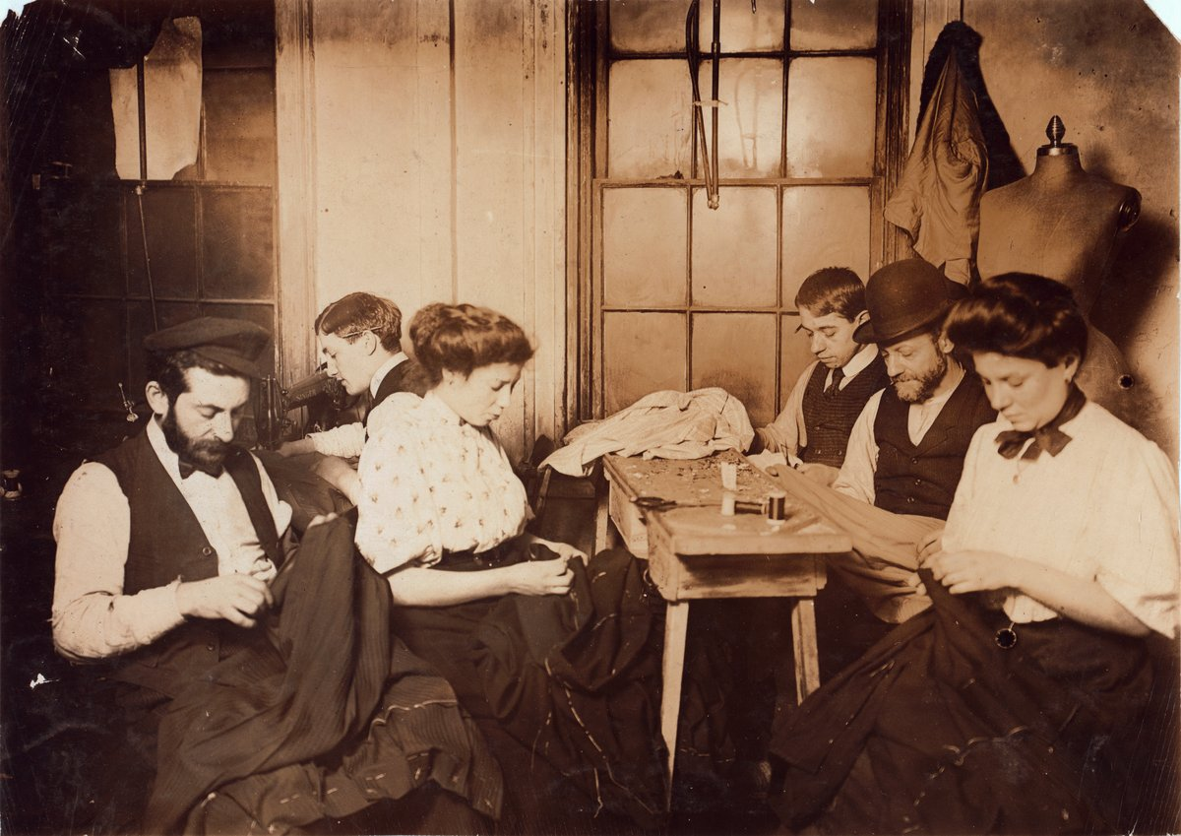
DIRECT INSTRUCTION
US.11
Brutal conditions — 12–16 hour days, dangerous work, child labor, and wages cut at will — drove industrial workers to organize.
ZOOM IN
US.11 · Factors Leading to Organization
U.S. History Hack · TroopToTeacher Technologies LLC · Aligned to TN Academic Standards & TCAP EOC
20

Slide 28
DIRECT INSTRUCTION
US.11
Unions bargained collectively and used strikes to force negotiation; leaders included AFL’s Samuel Gompers and socialist Eugene Debs.
ZOOM IN
US.11 · Union Tactics & Key Leaders
U.S. History Hack · TroopToTeacher Technologies LLC · Aligned to TN Academic Standards & TCAP EOC
21

Slide 29
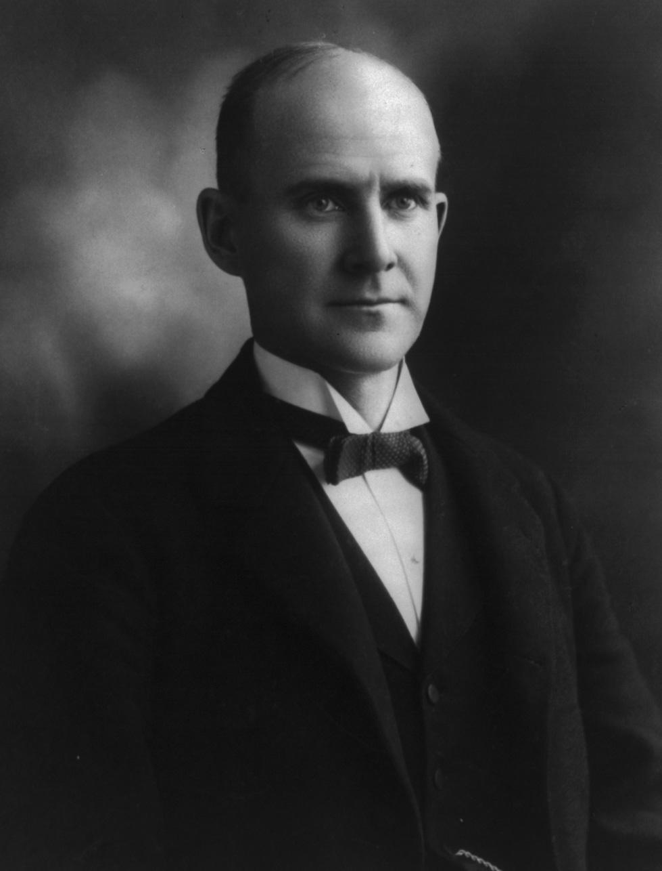
DIRECT INSTRUCTION
US.11
In Tennessee’s Coal Creek saga (1891), miners revolted against convict-lease labor — prisoners leased as unpaid forced workers.
ZOOM IN
US.11 · Coal Creek & Prison Labor
U.S. History Hack · TroopToTeacher Technologies LLC · Aligned to TN Academic Standards & TCAP EOC
22

Slide 30
DIRECT INSTRUCTION
US.11
Management fought back with lockouts, Pinkertons, blacklisting, and court injunctions — often with government backing.
ZOOM IN
US.11 · Management & Government Responses
U.S. History Hack · TroopToTeacher Technologies LLC · Aligned to TN Academic Standards & TCAP EOC
23

Slide 31
SOURCE IT FIRST
US.11
Read Gompers’s “What Does Labor Want?” — his words reveal what the movement believed the country owed its workers.
WHO
WHEN
WHY
Samuel Gompers, AFL president and chief voice of organized labor in America.
1893, during the worst economic depression of the 19th century (the Panic of 1893).
A labor leader's public speech reveals what workers needed — and what the movement believed the country owed its workers.
Samuel Gompers Address
Samuel Gompers, AFL President · 1893
"What does labor want? We want more schoolhouses and less jails; more books and less arsenals; more learning and less vice; more leisure and less greed; more justice and less revenge; in fact, more of the opportunities to cultivate our better natures, to make manhood more noble, womanhood more beautiful, and childhood more happy and bright."
Library of Congress
U.S. History Hack · TroopToTeacher Technologies LLC · Aligned to TN Academic Standards & TCAP EOC
24

Slide 32
THREE PERSPECTIVES
US.11
A historian returns to three questions at the end of every reading. Use them to analyze this standard.
Who benefited?
Who bore the costs?
Who decided?
Who gained land, wealth, power, or protection?
Who lost land, labor, freedom, or life — and who was silenced?
Which people, offices, or courts held the authority?
US.11:
US.11:
US.11:
Industrialists who kept wages low and used lockouts, strikebreakers, and convict labor to blunt worker organizing.
Workers facing dangerous conditions and cut wages; leased convicts forced into unpaid mine labor at Coal Creek.
Union leaders like Gompers and Debs; employers and Pinkertons; and courts and government that often intervened on management’s side.
Anchor: Gompers, “What Does Labor Want?” 1893 (Library of Congress)
U.S. History Hack · TroopToTeacher Technologies LLC · Aligned to TN Academic Standards & TCAP EOC
25

Slide 33
KEY VOCABULARY · LANGUAGE SUPPORT
US.11
Words you need before we read
Labor Union
Strike
Collective Bargaining
En español: Sindicato Laboral
En español: Huelga
En español: Negociación Colectiva
WHAT IT MEANS
WHAT IT MEANS
WHAT IT MEANS
An organization of workers formed to protect their rights and improve wages, hours, and working conditions through collective bargaining and, if necessary, strikes.
A work stoppage organized by union workers to pressure management to meet their demands for better wages, hours, or working conditions.
The process where union representatives negotiate wages, hours, and conditions on behalf of all workers, giving workers more power than they would have bargaining individually.
U.S. History Hack · TroopToTeacher Technologies LLC · Aligned to TN Academic Standards & TCAP EOC
8

Slide 34
PROGRESS CHECK
US.11
Check your understanding
Analyze why government and business leaders often opposed labor unions and used force to break strikes.
A
Business and government supported all union activities, but this fails to account for the broader historical context, which does not align with the documented historical record, but contemporary accounts and primary sources suggest otherwise
B
Government remained neutral in all labor disputes, but the historical record tells a more complex story, although this overlooks critical economic and social factors involved, which represents a common misconception about this historical period
C
Unions never faced any opposition, despite the fact that multiple sources contradict this view despite the fact that multiple contemporary sources contradict this, although historical sources do not support this conclusion
D
Unions threatened corporate profits and control, so owners used strikebreakers and private security while government deployed troops and injunctions, viewing organized labor as dangerous to economic and social order
Confidence: 😟 1 🙂 2 😀 3 — circle where you are; your teacher routes reteach or extension.
U.S. History Hack · TroopToTeacher Technologies LLC · Aligned to TN Academic Standards & TCAP EOC
9

Slide 35
US.12
Trusts, Monopolies & Antitrust
TN STANDARD
US.12 – Describe the rise of trusts and monopolies, their impact on consumers and workers, and the government's response, including the Sherman Antitrust Act of 1890 and the Clayton Antitrust Act of 1914.
I CAN
I can describe the rise of trusts and monopolies, their impact on consumers and workers, and the government's response including the Sherman Antitrust Act (1890) and the Clayton Antitrust Act (1914).
U.S. History Hack · TroopToTeacher Technologies LLC · Aligned to TN Academic Standards & TCAP EOC
26

Slide 36
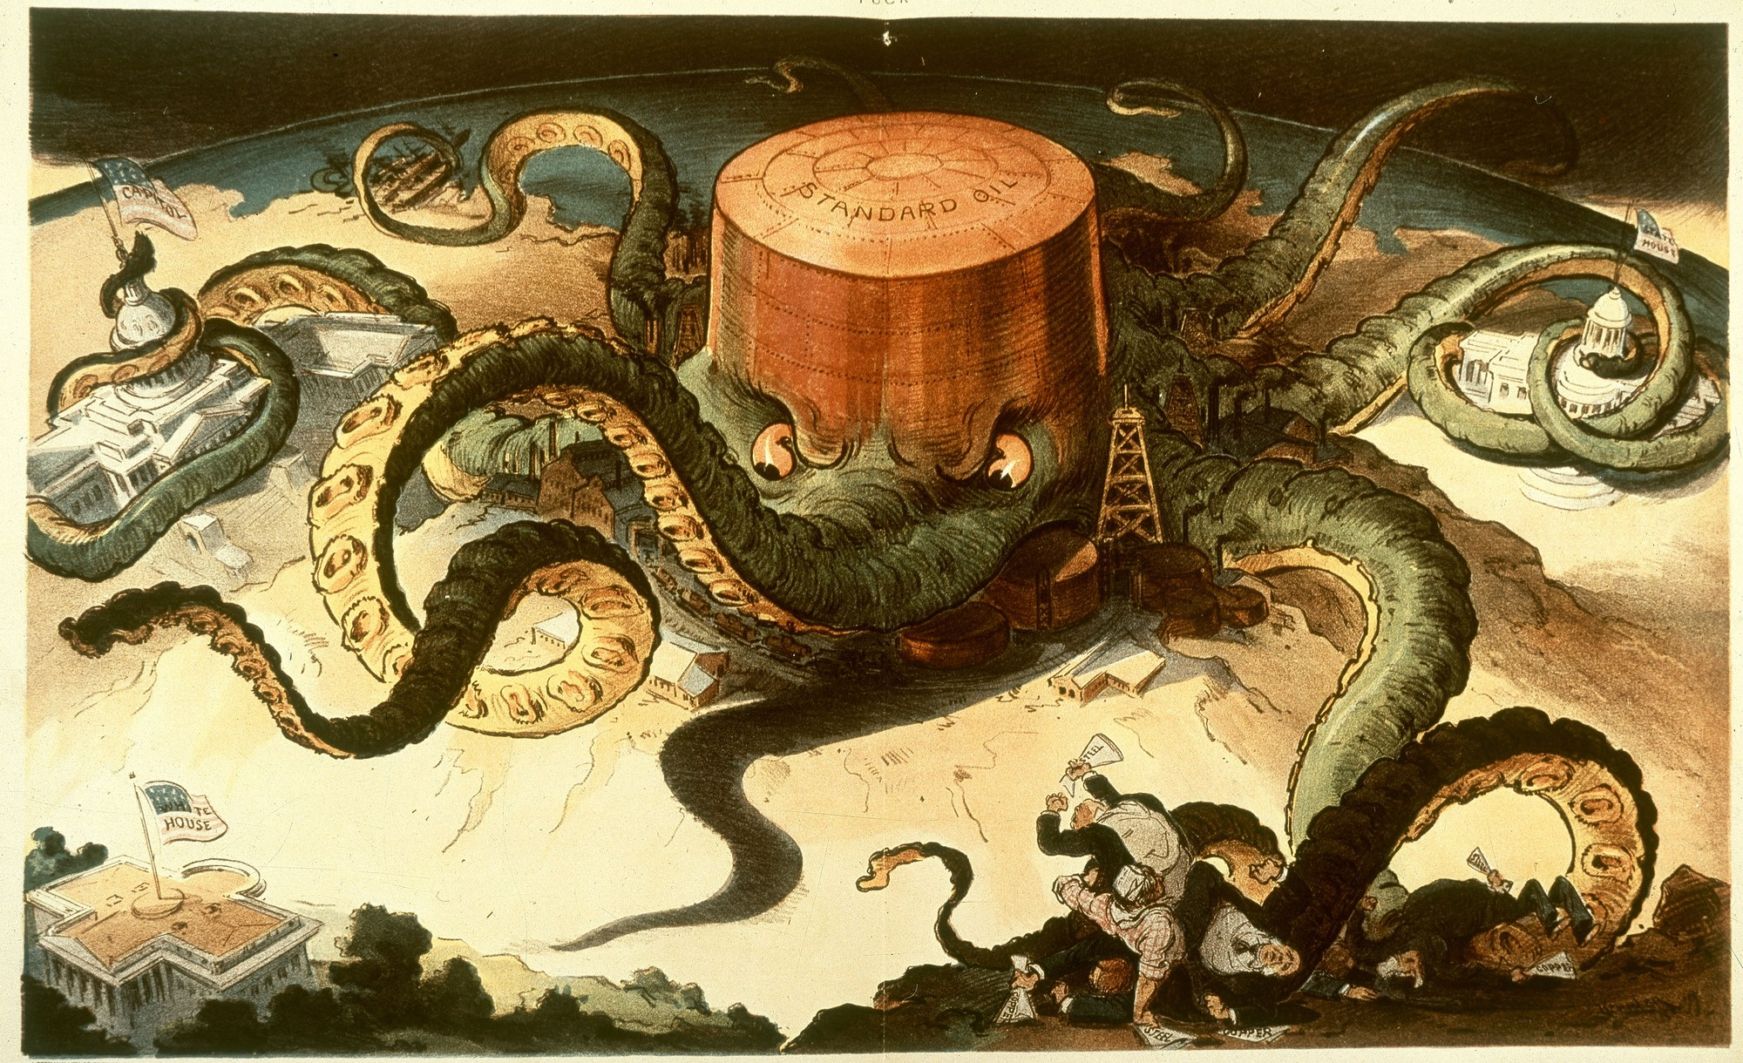
DIRECT INSTRUCTION
US.12
Trusts let a board of trustees control an entire industry — Rockefeller’s Standard Oil refined 90% of America’s oil.
ZOOM IN
US.12 · Rise of Trusts & Monopolies
U.S. History Hack · TroopToTeacher Technologies LLC · Aligned to TN Academic Standards & TCAP EOC
27

Slide 37
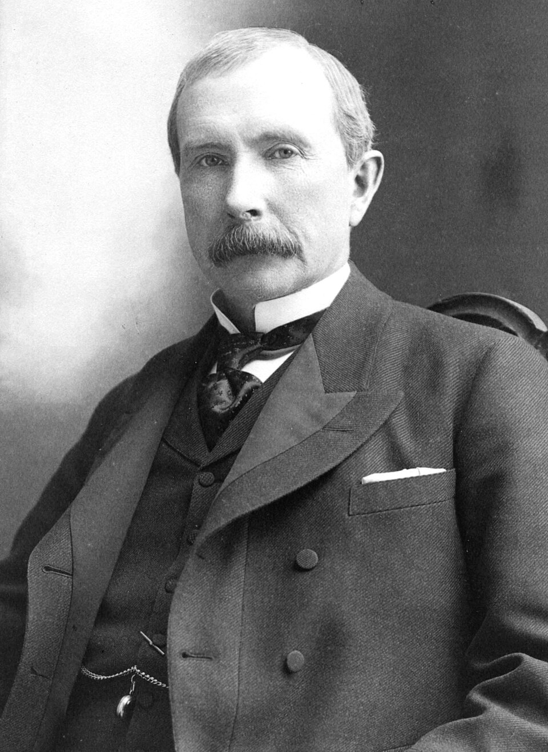
DIRECT INSTRUCTION
US.12
Monopolies raised consumer prices and used predatory pricing to crush smaller competitors and suppress wages.
ZOOM IN
US.12 · Impact on Consumers, Workers & Competition
U.S. History Hack · TroopToTeacher Technologies LLC · Aligned to TN Academic Standards & TCAP EOC
28

Slide 38
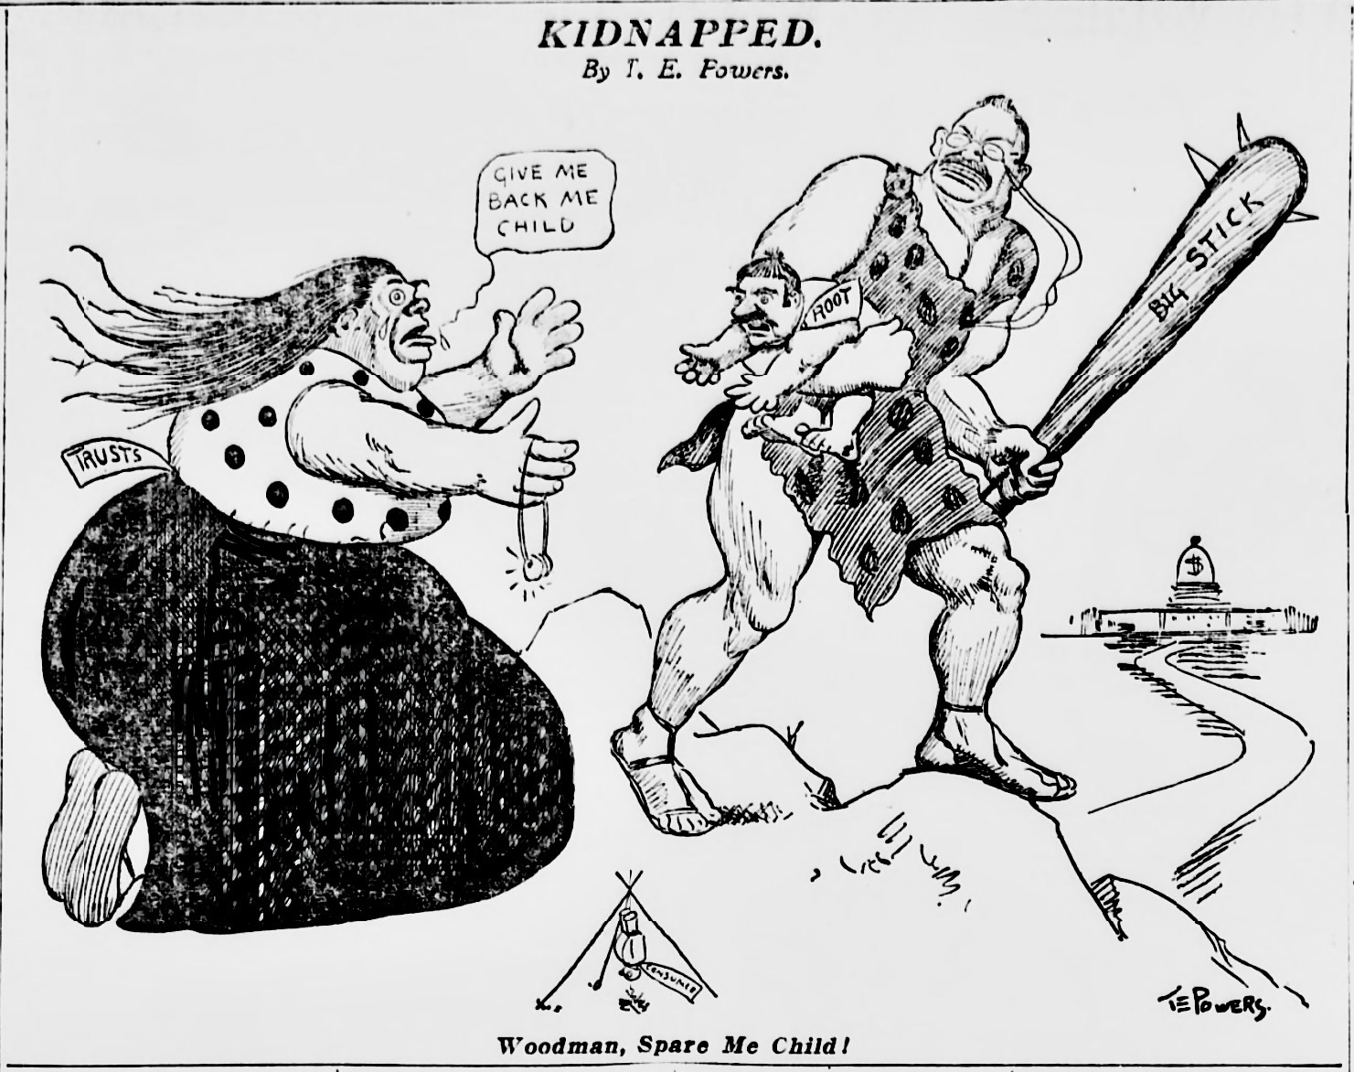
DIRECT INSTRUCTION
US.12
The Sherman Antitrust Act (1890) outlawed “restraint of trade,” and the Clayton Act (1914) closed loopholes — banning price discrimination and protecting unions.
ZOOM IN
US.12 · Sherman (1890) & Clayton (1914)
U.S. History Hack · TroopToTeacher Technologies LLC · Aligned to TN Academic Standards & TCAP EOC
29

Slide 39
SOURCE IT FIRST
US.12
Read the Sherman Antitrust Act itself — the law’s wording reveals what Congress believed monopolies were doing to America.
WHO
WHEN
WHY
U.S. Congress — a federal statute signed into law by President Harrison.
1890, as Standard Oil controlled 90% of American oil refining and trusts dominated steel, sugar, and tobacco.
Federal laws reveal what Congress believed needed government protection — ask what harm they were trying to prevent.
Sherman Antitrust Act
U.S. Congress · 1890
"Every contract, combination in the form of trust or otherwise, or conspiracy, in restraint of trade or commerce among the several States, or with foreign nations, is declared to be illegal... Every person who shall monopolize, or attempt to monopolize... any part of the trade or commerce among the several States... shall be deemed guilty of a felony."
National Archives
U.S. History Hack · TroopToTeacher Technologies LLC · Aligned to TN Academic Standards & TCAP EOC
30

Slide 40
THREE PERSPECTIVES
US.12
A historian returns to three questions at the end of every reading. Use them to analyze this standard.
Who benefited?
Who bore the costs?
Who decided?
Who gained land, wealth, power, or protection?
Who lost land, labor, freedom, or life — and who was silenced?
Which people, offices, or courts held the authority?
US.12:
US.12:
US.12:
Trust owners like Rockefeller who dominated industries and drove out rivals before regulation caught up.
Consumers paying monopoly prices, workers with suppressed wages, and small competitors destroyed by predatory pricing.
The U.S. Congress, which passed the Sherman (1890) and Clayton (1914) Acts, and courts that interpreted “restraint of trade.”
Anchor: Sherman Antitrust Act, 1890 (National Archives)
U.S. History Hack · TroopToTeacher Technologies LLC · Aligned to TN Academic Standards & TCAP EOC
31

Slide 41
KEY VOCABULARY · LANGUAGE SUPPORT
US.12
Words you need before we read
Trust
Monopoly
Sherman Antitrust Act
En español: Trust (Fideicomiso)
En español: Monopolio
En español: Ley Sherman Antimonopolio
WHAT IT MEANS
WHAT IT MEANS
WHAT IT MEANS
A legal arrangement where stockholders in several companies transfer their shares to a central board, creating a single entity that controls an entire industry and eliminates competition.
Complete control of a product or service by a single company, allowing it to set prices without competition — harmful to consumers, workers, and smaller businesses.
An 1890 federal law that made it illegal to form trusts, monopolies, or conspiracies that restrained trade — the first federal law to regulate corporate power.
U.S. History Hack · TroopToTeacher Technologies LLC · Aligned to TN Academic Standards & TCAP EOC
10

Slide 42
PROGRESS CHECK
US.12
Check your understanding
Evaluate whether the Clayton Antitrust Act of 1914 successfully addressed the limitations of earlier antitrust legislation.
A
By specifying illegal practices, exempting labor unions, and creating the FTC for enforcement, the Clayton Act improved antitrust effectiveness, though success still depended on political will to enforce it
B
The Clayton Act was identical to the Sherman Act, which represents a common misconception about the period and fails to account for key developments in the broader context, but contemporary accounts and primary sources suggest otherwise
C
The Clayton Act weakened antitrust enforcement, which represents a common misconception about the period, which represents a common misconception about this historical period and does not reflect the scholarly consensus on this topic
D
Antitrust laws had no impact on business practices, but the historical record tells a more complex story, and this view has been largely revised by modern historical research, but the historical evidence paints a more nuanced picture
Confidence: 😟 1 🙂 2 😀 3 — circle where you are; your teacher routes reteach or extension.
U.S. History Hack · TroopToTeacher Technologies LLC · Aligned to TN Academic Standards & TCAP EOC
11

Slide 43
US.13
Working Conditions, Women & Child Labor
TN STANDARD
US.13 – Describe working conditions in industries during this era, including the use of labor by women and children.
I CAN
I can describe working conditions in industries during this era, including the use of labor by women and children.
U.S. History Hack · TroopToTeacher Technologies LLC · Aligned to TN Academic Standards & TCAP EOC
32

Slide 44
DIRECT INSTRUCTION
US.13
Industrial workers endured 10–16 hour days, six or seven days a week, with no overtime, sick leave, or compensation for injury.
ZOOM IN
US.13 · Industrial Working Conditions
U.S. History Hack · TroopToTeacher Technologies LLC · Aligned to TN Academic Standards & TCAP EOC
33

Slide 45
DIRECT INSTRUCTION
US.13
Women filled garment, textile, and food-processing jobs — paid far less than men for the same work.
KEY POINT
Women filled garment, textile, and food-processing jobs — paid far less than men for the same work.
US.13 · Women in the Industrial Workforce
U.S. History Hack · TroopToTeacher Technologies LLC · Aligned to TN Academic Standards & TCAP EOC
34

Slide 46
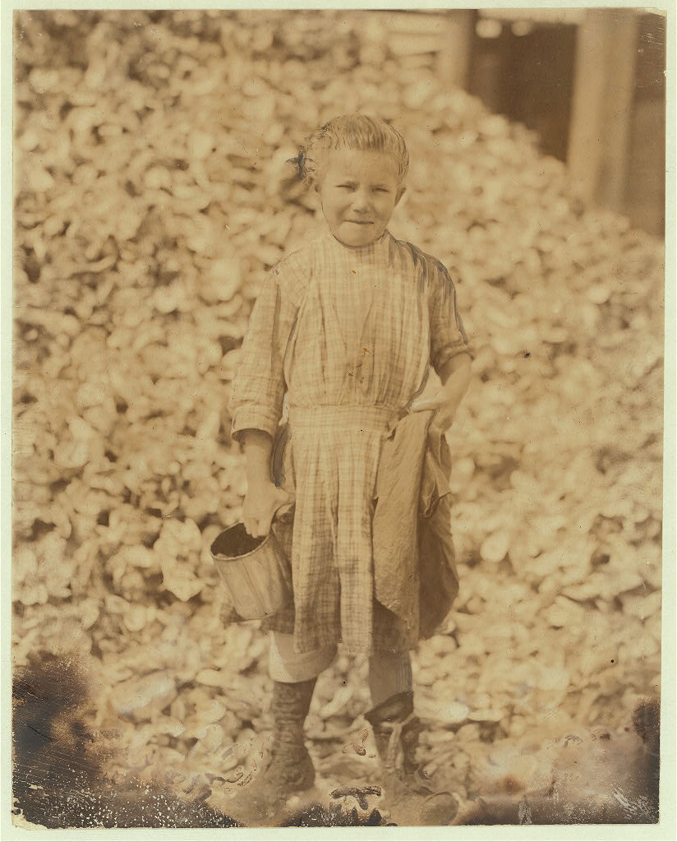
DIRECT INSTRUCTION
US.13
An estimated 1.75 million children under 15 worked in mines, mills, and factories — losing schooling and safety.
ZOOM IN
US.13 · Child Labor Practices
U.S. History Hack · TroopToTeacher Technologies LLC · Aligned to TN Academic Standards & TCAP EOC
35

Slide 47
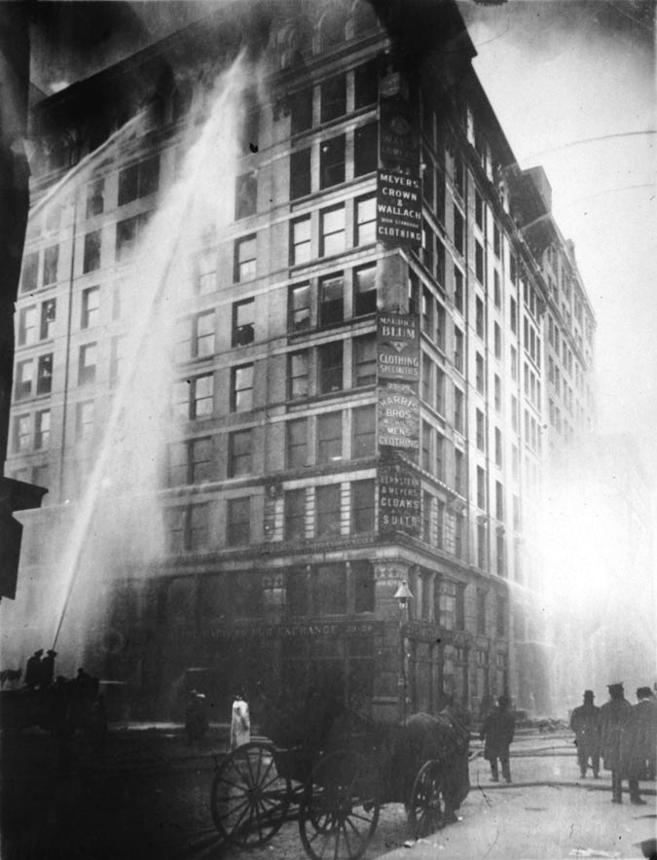
DIRECT INSTRUCTION
US.13
The Triangle Shirtwaist fire (1911) killed 146 workers — mostly young immigrant women — behind locked exits, forcing safety reform.
ZOOM IN
US.13 · The Triangle Shirtwaist Fire
U.S. History Hack · TroopToTeacher Technologies LLC · Aligned to TN Academic Standards & TCAP EOC
36

Slide 48
SOURCE IT FIRST
US.13
Read survivor Rose Safran’s account of the fire — then ask what a witness could see, and what she could not know.
WHO
WHEN
WHY
Rose Safran — a young immigrant worker who survived the Triangle fire.
1911, weeks after the fire; she is testifying about what she witnessed firsthand.
Survivor testimony is powerful primary evidence — but always ask: what could this witness see, and what might they not know?
Triangle Shirtwaist Factory Fire Survivor Account
Rose Safran · 1911
"The door was locked and immediately there was a great jam of girls behind me... I stood there crying and praying while some girls jumped from the window ledge. They went through the air like bundles. I knew that if the door was not opened I would die on the window ledge or be pushed off. The whole thing was over in seven minutes."
Cornell University ILR School
U.S. History Hack · TroopToTeacher Technologies LLC · Aligned to TN Academic Standards & TCAP EOC
37

Slide 49
THREE PERSPECTIVES
US.13
A historian returns to three questions at the end of every reading. Use them to analyze this standard.
Who benefited?
Who bore the costs?
Who decided?
Who gained land, wealth, power, or protection?
Who lost land, labor, freedom, or life — and who was silenced?
Which people, offices, or courts held the authority?
US.13:
US.13:
US.13:
Factory owners who cut costs through cheap female and child labor and minimal safety spending.
Women paid less than men, children denied schooling, and the 146 Triangle workers who died behind locked doors.
Employers who set conditions; and, after the fire, city and state governments that enacted new factory-safety laws.
Anchor: Rose Safran, Triangle fire survivor account, 1911 (Cornell ILR)
U.S. History Hack · TroopToTeacher Technologies LLC · Aligned to TN Academic Standards & TCAP EOC
38

Slide 50
KEY VOCABULARY · LANGUAGE SUPPORT
US.13
Words you need before we read
Sweatshop
Child Labor
Triangle Shirtwaist Fire
En español: Taller de Explotación
En español: Trabajo Infantil
En español: Incendio de la Fábrica Triangle
WHAT IT MEANS
WHAT IT MEANS
WHAT IT MEANS
A factory or workshop where workers faced long hours, low wages, and dangerous or unhealthy conditions — common in the garment industry employing immigrant women.
The employment of children — sometimes as young as 5 or 6 — in factories, mines, and mills; an estimated 1.75 million children worked in American industry by 1900.
A 1911 factory fire in New York City that killed 146 workers — mostly young immigrant women — trapped by locked exits, becoming a catalyst for worker safety reform.
U.S. History Hack · TroopToTeacher Technologies LLC · Aligned to TN Academic Standards & TCAP EOC
12

Slide 51
PROGRESS CHECK
US.13
Check your understanding
Analyze how tragedies like the Triangle Shirtwaist Factory Fire led to workplace safety reforms.
A
The fire had no impact on workplace safety, although this view has been largely discredited by scholars despite the fact that multiple contemporary sources contradict this
B
The deaths of 146 workers from locked exits, inadequate fire safety, and collapsed fire escapes shocked the public and led to fire codes, factory inspections, and workers' compensation laws
C
Workplace safety was already adequate before the fire, but contemporary accounts suggest a different explanation, which represents a common misconception about this historical period
D
Reforms only affected the garment industry, despite limited evidence supporting this interpretation, although historical sources do not support this conclusion
Confidence: 😟 1 🙂 2 😀 3 — circle where you are; your teacher routes reteach or extension.
U.S. History Hack · TroopToTeacher Technologies LLC · Aligned to TN Academic Standards & TCAP EOC
13

Slide 52
US.14
Muckrakers & Progressive Idealists
TN STANDARD
US.14 – Explain the roles played by muckrakers and progressive idealists, including: Robert M. La Follette, Sr., President Theodore Roosevelt, Upton Sinclair, Lincoln Steffens, Ida Tarbell.
I CAN
I can explain the roles played by muckrakers and progressive idealists, including Robert M. La Follette Sr., President Theodore Roosevelt, Upton Sinclair, Lincoln Steffens, and Ida Tarbell.
U.S. History Hack · TroopToTeacher Technologies LLC · Aligned to TN Academic Standards & TCAP EOC
39

Slide 53
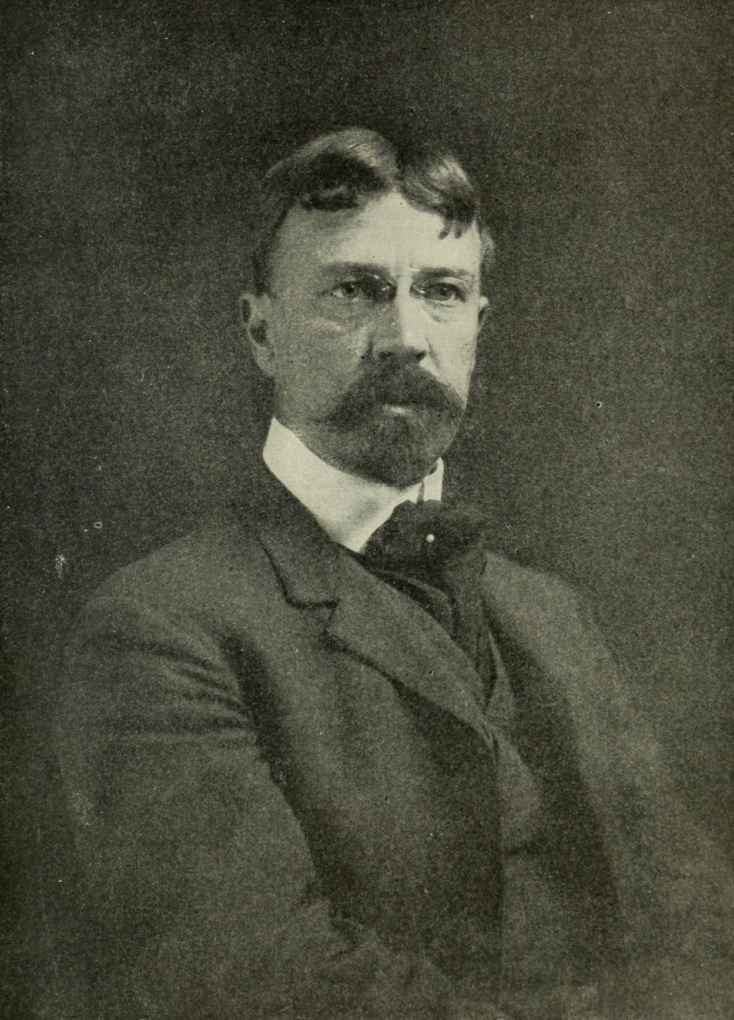
DIRECT INSTRUCTION
US.14
Muckrakers — named by Roosevelt — were investigative journalists who exposed corruption, corporate abuse, and social injustice.
ZOOM IN
US.14 · The Muckrakers
U.S. History Hack · TroopToTeacher Technologies LLC · Aligned to TN Academic Standards & TCAP EOC
40

Slide 54
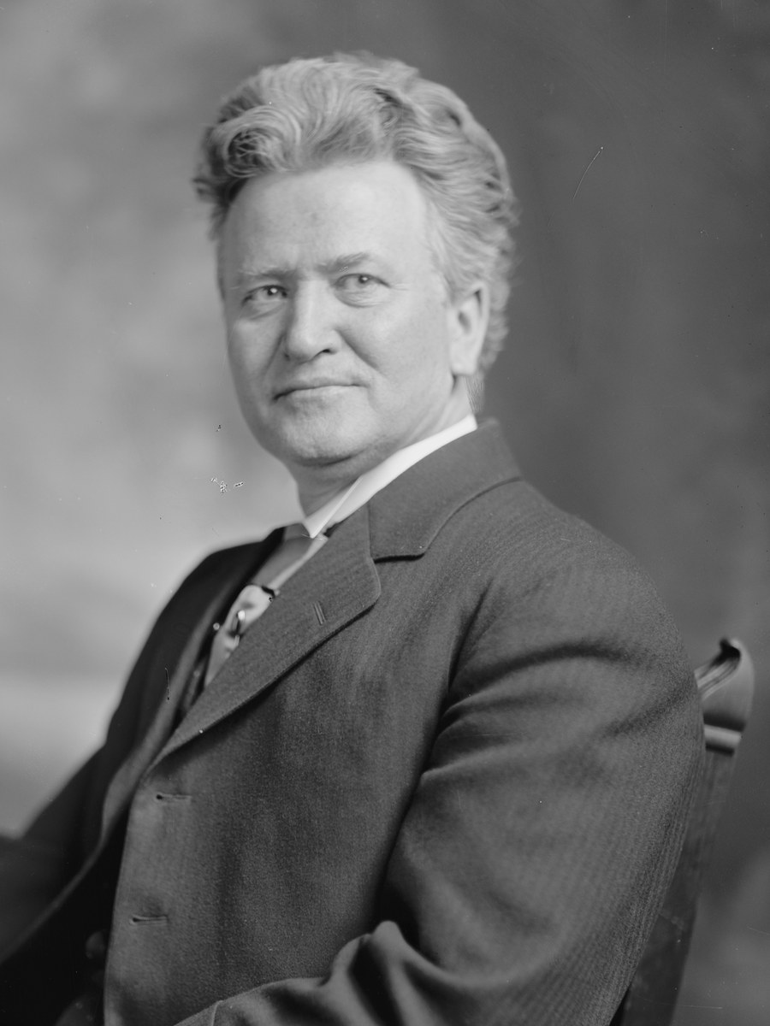
DIRECT INSTRUCTION
US.14
“Fighting Bob” La Follette made Wisconsin the “laboratory of democracy,” pioneering primaries, regulation, and expert governance.
ZOOM IN
US.14 · La Follette & the Wisconsin Idea
U.S. History Hack · TroopToTeacher Technologies LLC · Aligned to TN Academic Standards & TCAP EOC
41

Slide 55
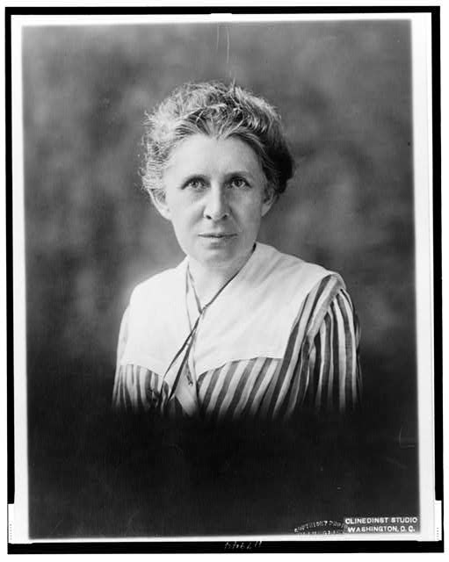
DIRECT INSTRUCTION
US.14
Steffens’s “Shame of the Cities” exposed machine corruption; Tarbell’s Standard Oil series documented Rockefeller’s ruthless tactics.
ZOOM IN
US.14 · Steffens & Tarbell
U.S. History Hack · TroopToTeacher Technologies LLC · Aligned to TN Academic Standards & TCAP EOC
42

Slide 56
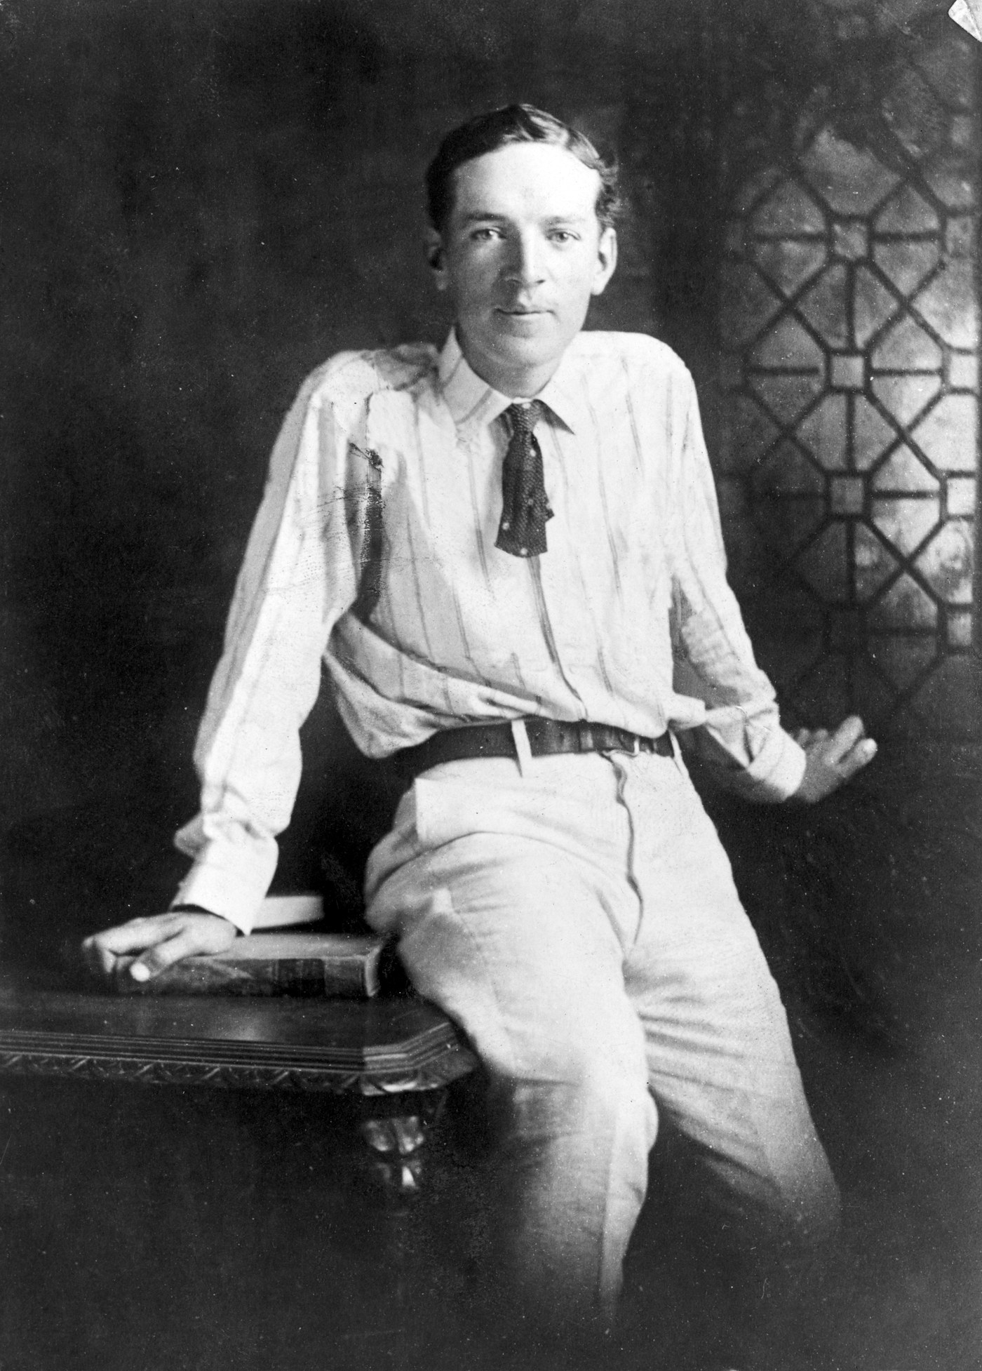
DIRECT INSTRUCTION
US.14
Sinclair’s “The Jungle” (1906) exposed meatpacking horrors — prompting Roosevelt to back federal food-safety laws.
ZOOM IN
US.14 · Sinclair & Roosevelt
U.S. History Hack · TroopToTeacher Technologies LLC · Aligned to TN Academic Standards & TCAP EOC
43

Slide 57
SOURCE IT FIRST
US.14
Read Tarbell on Standard Oil — then weigh her direct evidence against the fact that Rockefeller ruined her father’s business.
WHO
WHEN
WHY
Ida Tarbell — investigative journalist, daughter of a Pennsylvania oil producer destroyed by Standard Oil.
1904, after two years of documentary investigation; Standard Oil was at the height of its power.
The author's personal connection to the subject raises both credibility (direct experience) and a question: does her family's loss make her biased? A good historian acknowledges both.
The History of the Standard Oil Company
Ida Tarbell · 1904
"Mr. Rockefeller has systematically played with loaded dice, and it is doubtful if there has ever been a time since 1872 when he has run a race with a competitor and started fair. Business played in this way loses all its sportmanlike qualities. It is fit only for tricksters."
Library of Congress
U.S. History Hack · TroopToTeacher Technologies LLC · Aligned to TN Academic Standards & TCAP EOC
44

Slide 58
THREE PERSPECTIVES
US.14
A historian returns to three questions at the end of every reading. Use them to analyze this standard.
Who benefited?
Who bore the costs?
Who decided?
Who gained land, wealth, power, or protection?
Who lost land, labor, freedom, or life — and who was silenced?
Which people, offices, or courts held the authority?
US.14:
US.14:
US.14:
The reading public, who gained hard evidence of abuse; reformers who used muckraking exposes to build support for regulation.
Corrupt bosses and trusts exposed by name — Standard Oil, municipal machines, and meatpackers forced into the public eye.
Journalists (Tarbell, Steffens, Sinclair) and reform leaders (La Follette, Roosevelt) who turned exposure into policy.
Anchor: Tarbell, The History of the Standard Oil Company, 1904 (Library of Congress)
U.S. History Hack · TroopToTeacher Technologies LLC · Aligned to TN Academic Standards & TCAP EOC
45

Slide 59
KEY VOCABULARY · LANGUAGE SUPPORT
US.14
Words you need before we read
Muckraker
Progressive Movement
Wisconsin Idea
En español: Periodista de Investigación
En español: Movimiento Progresivo
En español: Idea de Wisconsin
WHAT IT MEANS
WHAT IT MEANS
WHAT IT MEANS
Investigative journalists and authors who exposed corporate abuse, government corruption, and social injustice in the Progressive Era, building public pressure for reform.
A broad reform effort (1890s–1920s) that used journalism, legislation, and political organizing to address the social and economic harms of industrialization.
Robert La Follette's model of Progressive reform using university experts to design legislation and regulate corporations, making Wisconsin 'the laboratory of democracy.'
U.S. History Hack · TroopToTeacher Technologies LLC · Aligned to TN Academic Standards & TCAP EOC
14

Slide 60
PROGRESS CHECK
US.14
Check your understanding
Evaluate Theodore Roosevelt's complex relationship with muckrakers and his role in progressive reform.
A
Roosevelt completely supported all muckrakers, which does not reflect the consensus among historians, which does not align with the documented historical record and fails to account for key developments in the broader context
B
Roosevelt opposed all muckraking journalism, which represents a common misconception about the period, although this overlooks critical economic and social factors involved, but the historical evidence paints a more nuanced picture
C
Roosevelt used muckraker exposés to build support for reforms like consumer protection and trust-busting, but also criticized excessive negativity—showing how reform leaders balance media pressure with political strategy
D
Muckrakers and Roosevelt had no connection, despite limited evidence supporting this interpretation, but closer analysis reveals a more complicated historical reality, which represents a common misconception about this historical period
Confidence: 😟 1 🙂 2 😀 3 — circle where you are; your teacher routes reteach or extension.
U.S. History Hack · TroopToTeacher Technologies LLC · Aligned to TN Academic Standards & TCAP EOC
15

Slide 61
US.15
Progressive Movement Goals & Achievements
TN STANDARD
US.15 – Analyze the goals and achievements of the Progressive movement, including: Adoption of the initiative, referendum, and recall, Adoption of the primary system, 16th Amendment, 17th Amendment, 18th Amendment.
I CAN
I can analyze the goals and achievements of the Progressive movement, including the initiative, referendum, recall, direct primary, 16th Amendment, 17th Amendment, and 18th Amendment.
U.S. History Hack · TroopToTeacher Technologies LLC · Aligned to TN Academic Standards & TCAP EOC
46

Slide 62
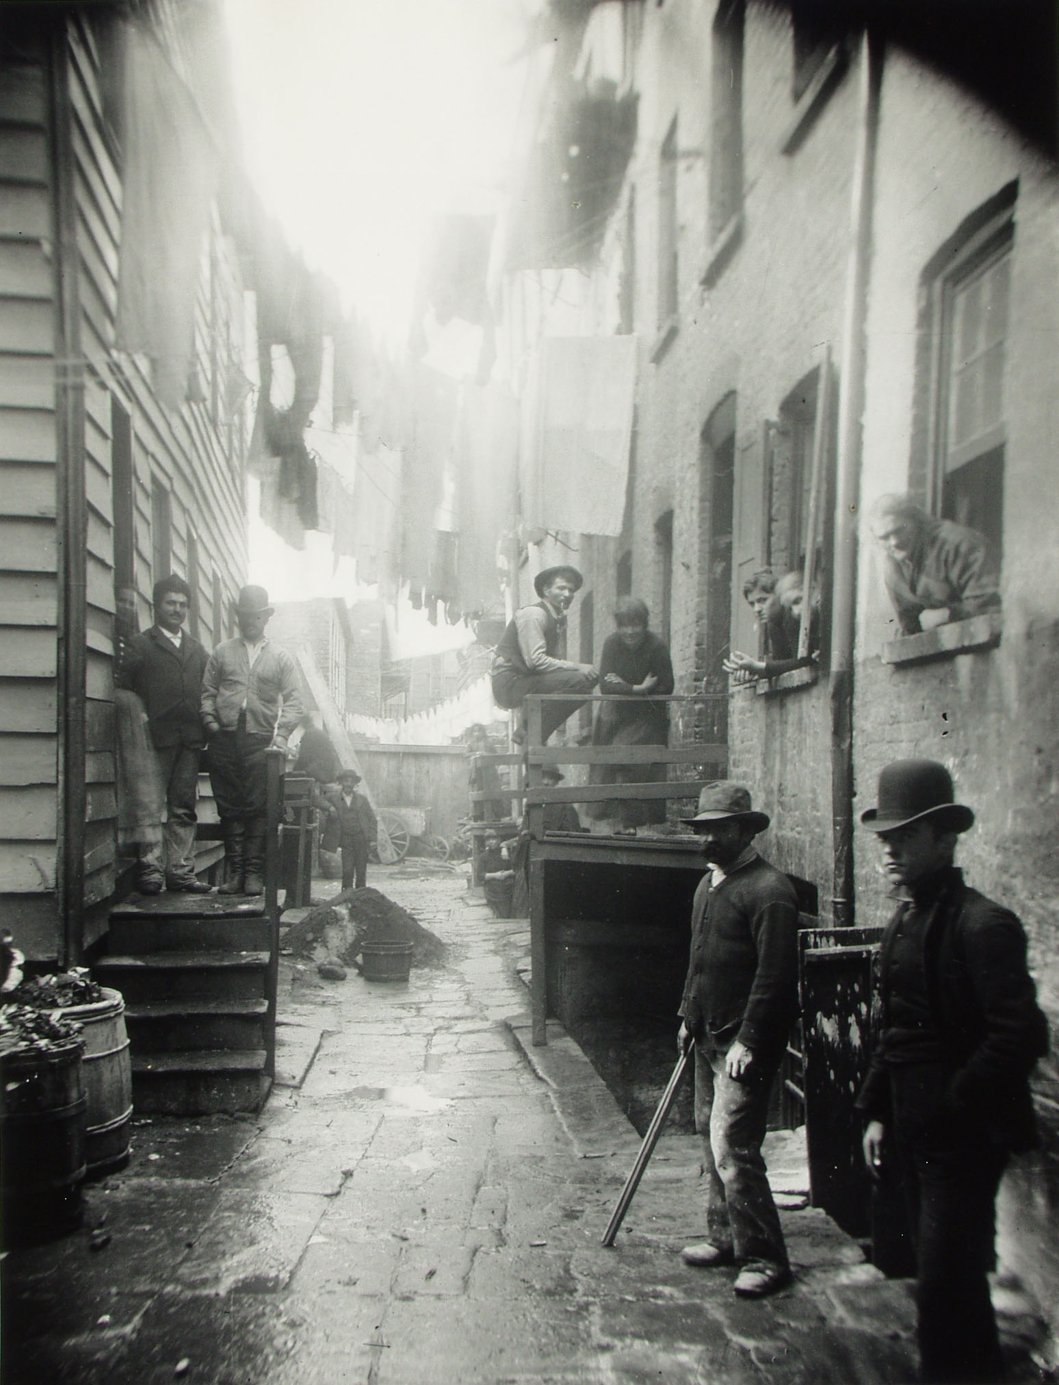
DIRECT INSTRUCTION
US.15
Progressives sought to use government power to curb corporate trusts, protect workers and consumers, and clean up politics.
ZOOM IN
US.15 · Goals of the Progressive Movement
U.S. History Hack · TroopToTeacher Technologies LLC · Aligned to TN Academic Standards & TCAP EOC
47

Slide 63
DIRECT INSTRUCTION
US.15
Initiative, referendum, and recall gave voters direct power to propose laws, approve them, and remove officials.
ZOOM IN
US.15 · Initiative, Referendum & Recall
U.S. History Hack · TroopToTeacher Technologies LLC · Aligned to TN Academic Standards & TCAP EOC
48

Slide 64
DIRECT INSTRUCTION
US.15
The direct primary took candidate selection away from party bosses and gave it to voters.
ZOOM IN
US.15 · The Primary System
U.S. History Hack · TroopToTeacher Technologies LLC · Aligned to TN Academic Standards & TCAP EOC
49

Slide 65
DIRECT INSTRUCTION
US.15
Three amendments: the 16th (income tax), 17th (direct election of senators), and 18th (Prohibition) enshrined Progressive goals.
KEY POINT
Three amendments: the 16th (income tax), 17th (direct election of senators), and 18th (Prohibition) enshrined Progressive goals.
US.15 · 16th, 17th & 18th Amendments
U.S. History Hack · TroopToTeacher Technologies LLC · Aligned to TN Academic Standards & TCAP EOC
50

Slide 66
SOURCE IT FIRST
US.15
Read the 16th Amendment — a single sentence that reshaped federal power. Ask what problem the income tax was solving.
WHO
WHEN
WHY
The U.S. Congress and state ratifying conventions — the constitutional amendment process.
1913, after decades of Progressive lobbying for a federal income tax.
Constitutional amendments reveal what a society agreed was important enough to change the fundamental law — ask what problem it was solving.
16th Amendment
U.S. Constitution · 1913
"The Congress shall have power to lay and collect taxes on incomes, from whatever source derived, without apportionment among the several States, and without regard to any census or enumeration."
Constitution Annotated, Library of Congress
U.S. History Hack · TroopToTeacher Technologies LLC · Aligned to TN Academic Standards & TCAP EOC
51

Slide 67
THREE PERSPECTIVES
US.15
A historian returns to three questions at the end of every reading. Use them to analyze this standard.
Who benefited?
Who bore the costs?
Who decided?
Who gained land, wealth, power, or protection?
Who lost land, labor, freedom, or life — and who was silenced?
Which people, offices, or courts held the authority?
US.15:
US.15:
US.15:
Ordinary voters gaining direct democratic tools; the federal government gaining a stable income-tax revenue base.
Party bosses who lost control of nominations; wealthy interests newly subject to a federal income tax.
State legislatures and Congress, which adopted direct-democracy reforms and ratified the 16th, 17th, and 18th Amendments.
Anchor: 16th Amendment, 1913 (Constitution Annotated, Library of Congress)
U.S. History Hack · TroopToTeacher Technologies LLC · Aligned to TN Academic Standards & TCAP EOC
52

Slide 68
KEY VOCABULARY · LANGUAGE SUPPORT
US.15
Words you need before we read
Initiative
Referendum
Recall
En español: Iniciativa
En español: Referéndum
En español: Revocación
WHAT IT MEANS
WHAT IT MEANS
WHAT IT MEANS
A Progressive reform allowing citizens to propose new laws by collecting enough voter signatures to put the proposal directly on the ballot.
A Progressive reform allowing voters to approve or reject laws passed by the state legislature — giving citizens a direct check on legislative power.
A Progressive reform allowing voters to remove elected officials from office before their terms expire — a direct accountability tool against corrupt or unresponsive officials.
U.S. History Hack · TroopToTeacher Technologies LLC · Aligned to TN Academic Standards & TCAP EOC
16

Slide 69
PROGRESS CHECK
US.15
Check your understanding
Analyze which Progressive reforms had the most lasting impact on American democracy.
A
No Progressive reforms survived, which represents a common misconception about the period, which contradicts the primary source evidence from this era and fails to account for key developments in the broader context
B
Only Prohibition had lasting impact, although this view has been largely discredited by scholars and oversimplifies the complex factors at work during this period
C
Progressive reforms were all reversed, but this oversimplifies the complex factors at work when examined alongside the available primary and secondary sources
D
Direct primaries, direct election of senators, and the income tax fundamentally reshaped American politics and remain in effect, while Prohibition demonstrated that not all reforms succeed
Confidence: 😟 1 🙂 2 😀 3 — circle where you are; your teacher routes reteach or extension.
U.S. History Hack · TroopToTeacher Technologies LLC · Aligned to TN Academic Standards & TCAP EOC
17

Slide 70
US.16
Theodore Roosevelt's Progressive Achievements
TN STANDARD
US.16 – Analyze the significant progressive achievements during President Theodore Roosevelt's administration, including: Square Deal, 'Trust-busting', Pure Food and Drug Act, Meat Inspection Act, Support for conservation.
I CAN
I can analyze the significant progressive achievements during President Theodore Roosevelt's administration, including the Square Deal, trust-busting, Pure Food and Drug Act, Meat Inspection Act, and conservation efforts.
U.S. History Hack · TroopToTeacher Technologies LLC · Aligned to TN Academic Standards & TCAP EOC
53

Slide 71
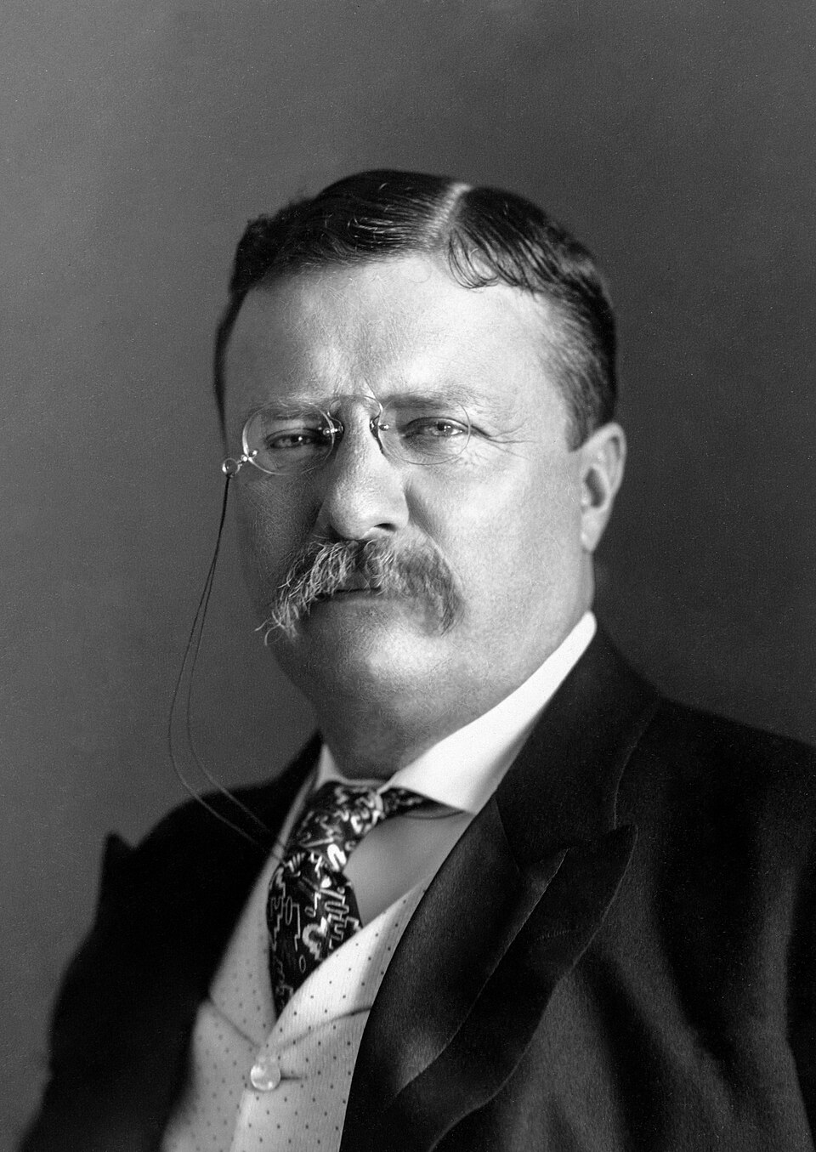
DIRECT INSTRUCTION
US.16
Roosevelt’s “Square Deal” promised fair treatment for labor, business, and consumers alike.
ZOOM IN
US.16 · The Square Deal
U.S. History Hack · TroopToTeacher Technologies LLC · Aligned to TN Academic Standards & TCAP EOC
54

Slide 72
DIRECT INSTRUCTION
US.16
After “The Jungle,” Roosevelt backed the Pure Food and Drug Act and Meat Inspection Act (1906) to protect consumers.
ZOOM IN
US.16 · Pure Food & Meat Inspection Acts
U.S. History Hack · TroopToTeacher Technologies LLC · Aligned to TN Academic Standards & TCAP EOC
55

Slide 73
DIRECT INSTRUCTION
US.16
As a “trust-buster,” Roosevelt filed 44 antitrust suits — including against Standard Oil — to check corporate power.
ZOOM IN
US.16 · Trust-Busting
U.S. History Hack · TroopToTeacher Technologies LLC · Aligned to TN Academic Standards & TCAP EOC
56

Slide 74
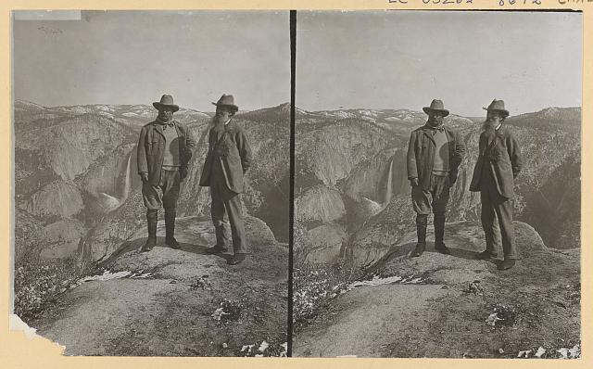
DIRECT INSTRUCTION
US.16
The first environmentalist president, Roosevelt protected some 230 million acres — 150 national forests and 5 national parks.
ZOOM IN
US.16 · Conservation
U.S. History Hack · TroopToTeacher Technologies LLC · Aligned to TN Academic Standards & TCAP EOC
57

Slide 75
SOURCE IT FIRST
US.16
Read Roosevelt’s “Square Deal” speech — ask which group he reassures and which he challenges.
WHO
WHEN
WHY
Theodore Roosevelt — 26th President of the United States, speaking as commander in chief.
1903, in the middle of a national coal strike and rising public anger at corporate trusts.
A president's public speech defines policy for millions of people — ask what group he is trying to reassure, and what group he may be challenging.
Square Deal Speech
President Theodore Roosevelt · 1903
"When I say I believe in a square deal I do not mean... to give every man the best hand. If the cards do not come to any man, or if they do come, and he has not got the power to play them, that is his affair. All I mean is that there shall be no crookedness in the dealing."
Library of Congress
U.S. History Hack · TroopToTeacher Technologies LLC · Aligned to TN Academic Standards & TCAP EOC
58

Slide 76
THREE PERSPECTIVES
US.16
A historian returns to three questions at the end of every reading. Use them to analyze this standard.
Who benefited?
Who bore the costs?
Who decided?
Who gained land, wealth, power, or protection?
Who lost land, labor, freedom, or life — and who was silenced?
Which people, offices, or courts held the authority?
US.16:
US.16:
US.16:
Consumers protected by food-safety laws; the public whose lands were conserved; workers given a fairer hearing under the Square Deal.
Monopoly trusts targeted by 44 antitrust suits; meatpackers and industries newly subject to federal inspection and regulation.
President Theodore Roosevelt and his administration, using executive power, antitrust suits, and Congress to enact reform.
Anchor: Roosevelt, Square Deal Speech, 1903 (Library of Congress)
U.S. History Hack · TroopToTeacher Technologies LLC · Aligned to TN Academic Standards & TCAP EOC
59

Slide 77
KEY VOCABULARY · LANGUAGE SUPPORT
US.16
Words you need before we read
Square Deal
Trust-Busting
Conservation
En español: Trato Justo
En español: Disolución de Trusts
En español: Conservación
WHAT IT MEANS
WHAT IT MEANS
WHAT IT MEANS
Theodore Roosevelt's domestic policy promising fair treatment for all Americans — balancing the interests of consumers, workers, and businesses through federal regulation.
Roosevelt's aggressive use of the Sherman Antitrust Act to break up monopolistic corporations — he filed 44 antitrust suits, earning the nickname 'trust-buster.'
The protection and sustainable management of natural resources; Roosevelt established 150 national forests and 5 national parks, protecting 230 million acres of public land.
U.S. History Hack · TroopToTeacher Technologies LLC · Aligned to TN Academic Standards & TCAP EOC
18

Slide 78
PROGRESS CHECK
US.16
Check your understanding
Evaluate Roosevelt's conservation legacy and its impact on environmental policy.
A
By creating national parks, forests, and wildlife refuges while balancing development with preservation, Roosevelt established conservation as a federal responsibility with lasting impact on American environmental policy
B
Roosevelt opposed conservation, but the historical record tells a more complex story, although historical sources do not support this conclusion, and this view has been largely revised by modern historical research
C
Conservation was unimportant to Roosevelt, which represents a common misconception about the period and fails to account for key developments in the broader context and oversimplifies the complex factors at work during this period
D
His conservation policies were all reversed, but the historical record tells a more complex story and fails to account for key developments in the broader context and oversimplifies the complex factors at work during this period
Confidence: 😟 1 🙂 2 😀 3 — circle where you are; your teacher routes reteach or extension.
U.S. History Hack · TroopToTeacher Technologies LLC · Aligned to TN Academic Standards & TCAP EOC
19

Slide 79
US.17
Woodrow Wilson's Progressive Achievements
TN STANDARD
US.17 – Analyze the significant progressive achievements during President Woodrow Wilson's administration, including: the New Freedom, the Federal Reserve Act, and the creation of the National Park Service.
I CAN
I can analyze the significant progressive achievements during President Woodrow Wilson's administration, including the New Freedom, the Federal Reserve Act, and the creation of the National Park Service.
U.S. History Hack · TroopToTeacher Technologies LLC · Aligned to TN Academic Standards & TCAP EOC
60

Slide 80
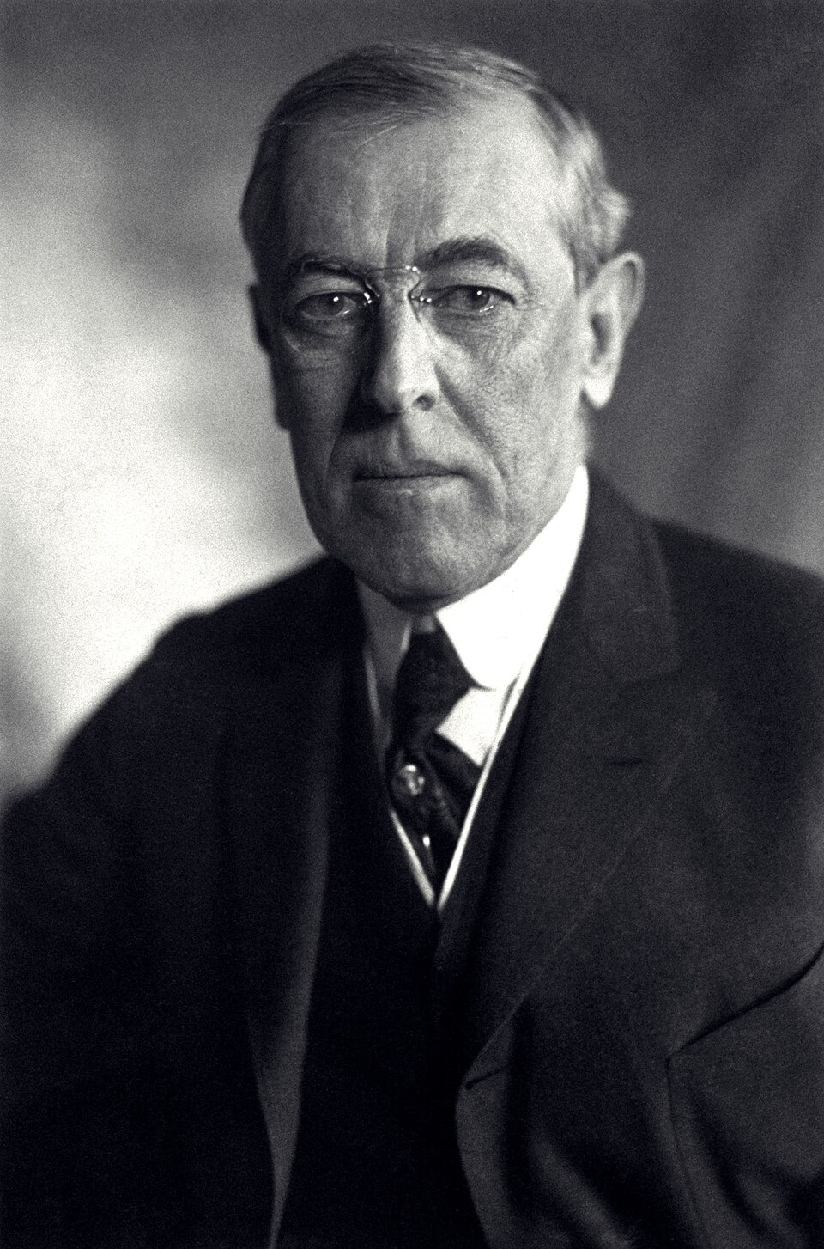
DIRECT INSTRUCTION
US.17
Wilson won the 1912 three-way race and pushed his “New Freedom” — attacking trusts, tariffs, and high finance.
ZOOM IN
US.17 · The New Freedom Platform
U.S. History Hack · TroopToTeacher Technologies LLC · Aligned to TN Academic Standards & TCAP EOC
61

Slide 81
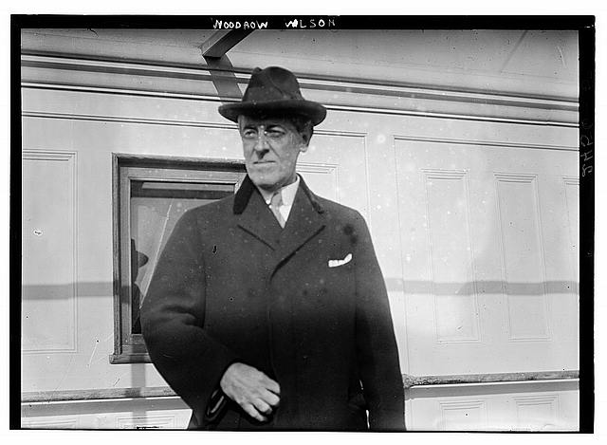
DIRECT INSTRUCTION
US.17
The Federal Reserve Act (1913) created a central banking system to stabilize money and prevent panics like 1907.
ZOOM IN
US.17 · Federal Reserve Act
U.S. History Hack · TroopToTeacher Technologies LLC · Aligned to TN Academic Standards & TCAP EOC
62

Slide 82
DIRECT INSTRUCTION
US.17
The National Park Service (1916) unified management of the nation’s parks under one federal agency.
ZOOM IN
US.17 · National Park Service
U.S. History Hack · TroopToTeacher Technologies LLC · Aligned to TN Academic Standards & TCAP EOC
63

Slide 83
SOURCE IT FIRST
US.17
Read Wilson’s message on the Federal Reserve — ask what problem he responds to and who his solution serves.
WHO
WHEN
WHY
Woodrow Wilson — 28th President, speaking to Congress as the chief executive proposing legislation.
June 1913, as the Federal Reserve bill was being debated — six years after the Panic of 1907.
Presidential messages to Congress are public arguments for policy — ask: what problem is he responding to, and who benefits from his proposed solution?
Federal Reserve Act Message
President Woodrow Wilson · 1913
"We shall deal with our economic system as it is and as it may be modified, not as it might be if we had a clean sheet of paper to write upon... We must effect our reforms with a minimum of disturbance to business. The control of the system of banking and of issue should be vested in the Government itself, so that the banks may be the instruments, not the masters, of business."
Library of Congress
U.S. History Hack · TroopToTeacher Technologies LLC · Aligned to TN Academic Standards & TCAP EOC
64

Slide 84
THREE PERSPECTIVES
US.17
A historian returns to three questions at the end of every reading. Use them to analyze this standard.
Who benefited?
Who bore the costs?
Who decided?
Who gained land, wealth, power, or protection?
Who lost land, labor, freedom, or life — and who was silenced?
Which people, offices, or courts held the authority?
US.17:
US.17:
US.17:
The broader economy gained a more stable banking system; the public gained coordinated stewardship of national parks.
Private bankers who lost sole control of money and credit; trusts and tariff-protected industries targeted by the New Freedom.
President Woodrow Wilson working with Congress to pass the Federal Reserve Act and create the National Park Service.
Anchor: Wilson, Federal Reserve Act message, 1913 (Library of Congress)
U.S. History Hack · TroopToTeacher Technologies LLC · Aligned to TN Academic Standards & TCAP EOC
65

Slide 85
KEY VOCABULARY · LANGUAGE SUPPORT
US.17
Words you need before we read
New Freedom
Federal Reserve System
Underwood Tariff
En español: Nueva Libertad
En español: Sistema de la Reserva Federal
En español: Arancel Underwood
WHAT IT MEANS
WHAT IT MEANS
WHAT IT MEANS
Woodrow Wilson's Progressive program that targeted the 'triple wall of privilege' — high tariffs, monopolistic banks, and industrial trusts — seeking to restore competition rather than just regulate big business.
The central banking system created by the Federal Reserve Act (1913) — 12 regional banks under a government-appointed board that manages the money supply and stabilizes the financial system.
Wilson's 1913 tariff reduction that significantly lowered import taxes, making goods cheaper for consumers, while the new income tax (16th Amendment) replaced the lost revenue.
U.S. History Hack · TroopToTeacher Technologies LLC · Aligned to TN Academic Standards & TCAP EOC
20

Slide 86
PROGRESS CHECK
US.17
Check your understanding
Analyze how Wilson's reforms created institutional frameworks that continue to influence American economic policy.
A
Wilson's reforms were all temporary, which does not align with the documented historical record when examined alongside the available primary and secondary sources and oversimplifies the complex factors at work during this period
B
The Federal Reserve manages monetary policy, the FTC enforces consumer protection, and the NPS protects natural resources—institutions created over a century ago that remain central to American government today
C
None of Wilson's institutions survived, which represents a common misconception about the period, and this view has been largely revised by modern historical research and fails to account for key developments in the broader context
D
Only the income tax remained from Wilson's era, which does not reflect the consensus among historians when examined alongside the available primary and secondary sources and fails to account for key developments in the broader context
Confidence: 😟 1 🙂 2 😀 3 — circle where you are; your teacher routes reteach or extension.
U.S. History Hack · TroopToTeacher Technologies LLC · Aligned to TN Academic Standards & TCAP EOC
21

Slide 87
US.18
Women's Suffrage Movement
TN STANDARD
US.18 – Describe the movement to achieve suffrage for women, including: the significance of leaders such as Carrie Chapman Catt, Anne Dallas Dudley, and Alice Paul, the activities of suffragettes, the passage of the 19th Amendment, and the role of Tennessee as the 'Perfect 36.'
I CAN
I can describe the movement to achieve suffrage for women, including the significance of leaders such as Carrie Chapman Catt, Anne Dallas Dudley, and Alice Paul, the activities of suffragettes, the passage of the 19th Amendment, and the role of Tennessee as the 'Perfect 36.'
U.S. History Hack · TroopToTeacher Technologies LLC · Aligned to TN Academic Standards & TCAP EOC
66

Slide 88
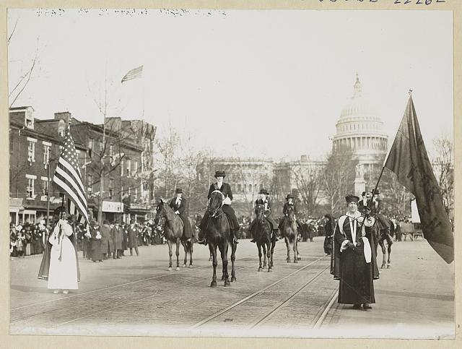
DIRECT INSTRUCTION
US.18
Women had demanded the vote since Seneca Falls (1848); the movement gained new urgency in the Progressive Era.
ZOOM IN
US.18 · Historical Context & Motivations
U.S. History Hack · TroopToTeacher Technologies LLC · Aligned to TN Academic Standards & TCAP EOC
67

Slide 89
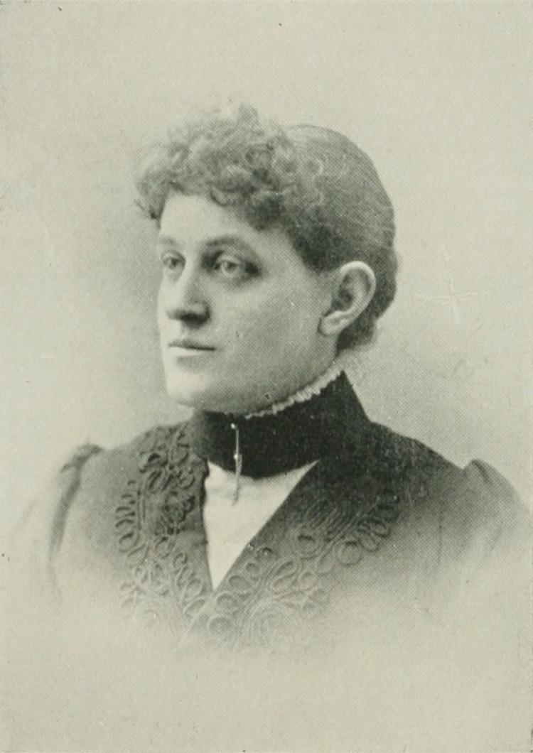
DIRECT INSTRUCTION
US.18
Carrie Chapman Catt led NAWSA’s state-by-state “Winning Plan”; Alice Paul pushed militant national tactics; Anne Dallas Dudley organized Tennessee.
ZOOM IN
US.18 · Key Leaders & Strategies
U.S. History Hack · TroopToTeacher Technologies LLC · Aligned to TN Academic Standards & TCAP EOC
68

Slide 90
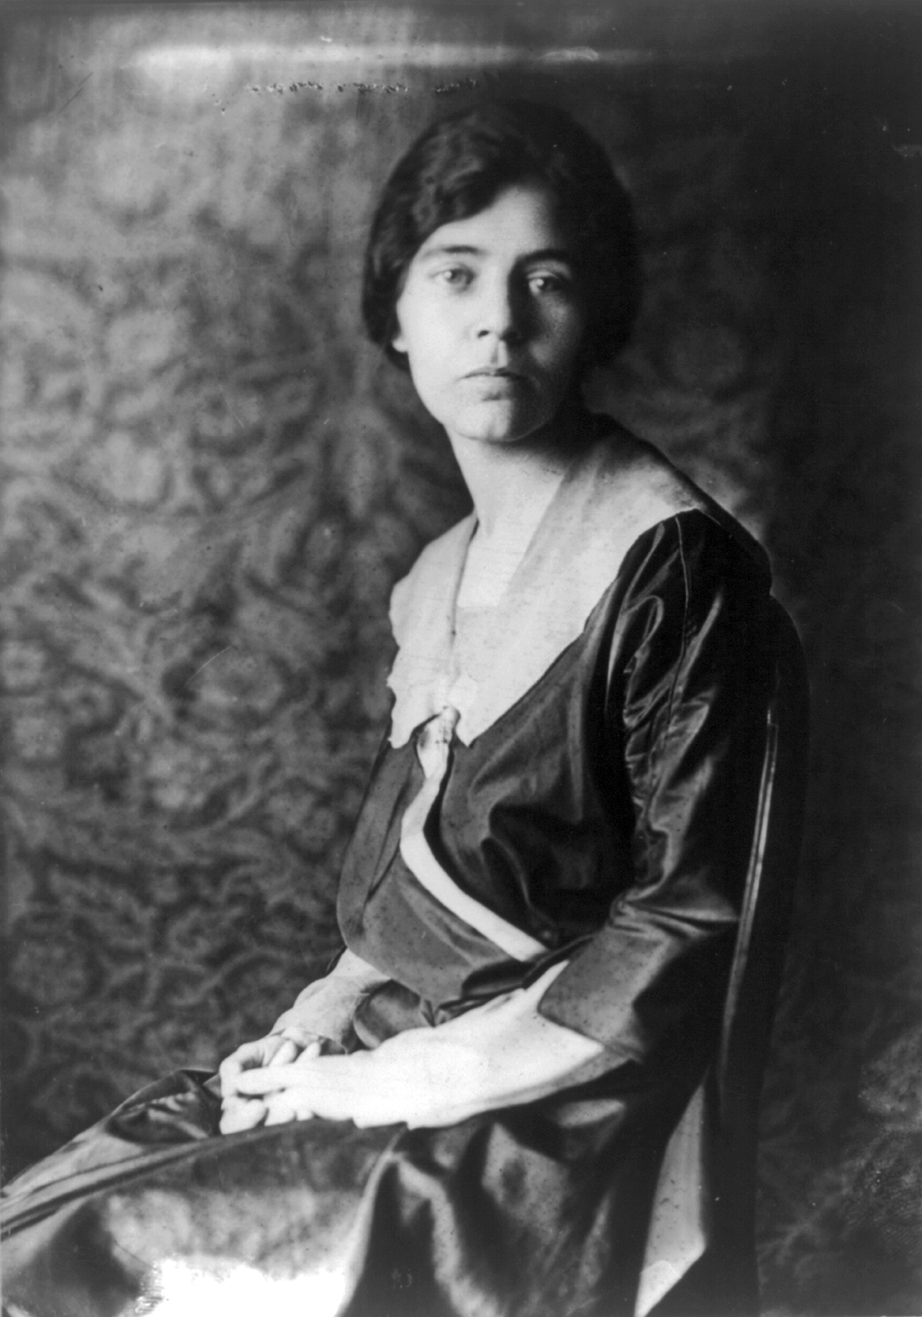
DIRECT INSTRUCTION
US.18
Suffragists escalated from petitions and lectures to mass parades, picketing the White House, and hunger strikes.
ZOOM IN
US.18 · Suffragette Activities & Tactics
U.S. History Hack · TroopToTeacher Technologies LLC · Aligned to TN Academic Standards & TCAP EOC
69

Slide 91
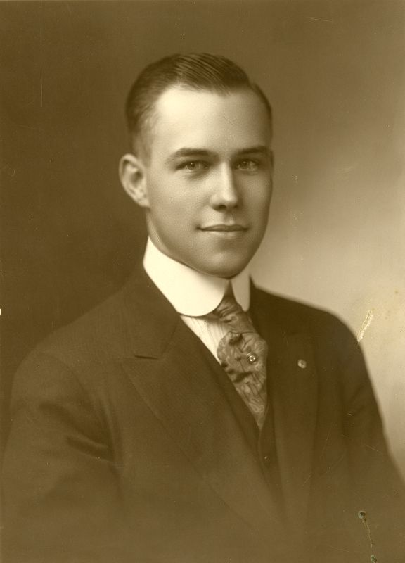
DIRECT INSTRUCTION
US.18
The 19th Amendment passed Congress in 1919; Tennessee’s decisive ratification in August 1920 made it the “Perfect 36.”
ZOOM IN
US.18 · 19th Amendment & the ‘Perfect 36’
U.S. History Hack · TroopToTeacher Technologies LLC · Aligned to TN Academic Standards & TCAP EOC
70

Slide 92
SOURCE IT FIRST
US.18
Read the 19th Amendment — one sentence that enfranchised millions. Ask who fought for it and what values it enshrined.
WHO
WHEN
WHY
The U.S. Congress and 36 state ratifying bodies — ratified after 70 years of organized suffrage campaigning.
August 18, 1920 — the Tennessee vote made it official; it was the final constitutional act of the Progressive Era.
Constitutional amendments are the highest form of democratic change — understanding who fought for them and why reveals the values a society chose to enshrine in its fundamental law.
19th Amendment
U.S. Constitution · 1920
"The right of citizens of the United States to vote shall not be denied or abridged by the United States or by any State on account of sex. Congress shall have power to enforce this article by appropriate legislation."
National Archives
U.S. History Hack · TroopToTeacher Technologies LLC · Aligned to TN Academic Standards & TCAP EOC
71

Slide 93
THREE PERSPECTIVES
US.18
A historian returns to three questions at the end of every reading. Use them to analyze this standard.
Who benefited?
Who bore the costs?
Who decided?
Who gained land, wealth, power, or protection?
Who lost land, labor, freedom, or life — and who was silenced?
Which people, offices, or courts held the authority?
US.18:
US.18:
US.18:
American women, who gained the constitutional right to vote after more than seven decades of organized campaigning.
Suffragists who endured arrest, hunger strikes, and force-feeding; and many women of color still blocked from voting by Jim Crow after 1920.
Congress and 36 state legislatures — with Tennessee, the ‘Perfect 36,’ casting the deciding ratification vote in August 1920.
Anchor: 19th Amendment, 1920 (National Archives)
U.S. History Hack · TroopToTeacher Technologies LLC · Aligned to TN Academic Standards & TCAP EOC
72

Slide 94
KEY VOCABULARY · LANGUAGE SUPPORT
US.18
Words you need before we read
Women's Suffrage
19th Amendment
Carrie Chapman Catt
En español: Sufragio Femenino
En español: 19ª Enmienda
En español: Carrie Chapman Catt
WHAT IT MEANS
WHAT IT MEANS
WHAT IT MEANS
The movement to secure voting rights for women, culminating in the 19th Amendment (1920) after more than 70 years of organized activism.
Ratified on August 18, 1920, this amendment prohibits denying any citizen the right to vote based on sex — extending the vote to women across the United States.
NAWSA president who developed the 'Winning Plan' — a coordinated state-level and federal strategy that led to the 19th Amendment's ratification.
U.S. History Hack · TroopToTeacher Technologies LLC · Aligned to TN Academic Standards & TCAP EOC
22

Slide 95
PROGRESS CHECK
US.18
Check your understanding
Analyze the immediate and long-term impacts of women's suffrage on American politics and society.
A
Women's suffrage had no lasting impact, but the historical record tells a more complex story, but the historical evidence paints a more nuanced picture, which contradicts the primary source evidence from this era
B
Women stopped participating in politics after 1920, though this interpretation lacks supporting historical evidence, which ignores significant political and cultural developments of the era
C
Suffrage immediately enfranchised 26 million women, challenged gender roles, supported reforms in education and health, and laid the foundation for later women's rights movements and gender equality advances
D
Only electoral politics was affected, but contemporary accounts suggest a different explanation when examined alongside the available primary and secondary sources, but the historical evidence paints a more nuanced picture
Confidence: 😟 1 🙂 2 😀 3 — circle where you are; your teacher routes reteach or extension.
U.S. History Hack · TroopToTeacher Technologies LLC · Aligned to TN Academic Standards & TCAP EOC
23

