Slide 1
U.S. HISTORY HACK
Unit 2
The Progressive Era
Reform · Labor · Trusts · Suffrage · 1877–1920
Standards US.08 – US.18
US.08
US.09
US.10
US.11
US.12
US.13
US.14
US.15
US.16
US.17
US.18
TCAP EOC LECTURE DECK · Tennessee Academic Standards for U.S. History
TroopToTeacher Technologies LLC
Notes:
Unit 2 TCAP EOC lecture deck. Each standard runs as a full lesson: divider (standard + I Can), hook, direct instruction with a verified primary-source image, key figures, vocabulary, a student activity (paired to a printable worksheet), a TCAP-style check (question slide, then click to the reveal/answer-key slide), and a wrap-up with a teacher answer key in the speaker notes. All images are public-domain, captioned, and linked to the Library of Congress / National Archives.

Slide 2
UNIT ROADMAP
Where We Are Headed
Unit 2 · The Progressive Era (1877–1920) — Reform, Labor, Trusts & Women’s Suffrage
US.08
Social Darwinism & Social Gospel
then
US.14
Muckrakers & Progressive Idealists
US.09
Booker T. Washington vs W.E.B. Du Bois
US.15
Progressive Movement Goals & Achievements
US.10
Populism & Granger Movement
US.16
Theodore Roosevelt's Progressive Achievements
US.11
Rise of the Labor Movement
US.17
Woodrow Wilson's Progressive Achievements
US.12
Trusts, Monopolies & Antitrust
US.18
Women's Suffrage Movement
US.13
Working Conditions, Women & Child Labor
U.S. History Hack · TroopToTeacher Technologies LLC · Aligned to TN Academic Standards & TCAP EOC
2

Slide 3
BELL RINGER · HOOK
In 1865, most Americans lived on farms.
By 1920, most lived in cities.
What forces could move an entire nation off the land and into the factory in just 55 years?
TURN & TALK
With a partner, list three things that might pull people toward cities — and three things that might push them off the farm. Keep your list; we will return to it at the end of the unit.
U.S. History Hack · TroopToTeacher Technologies LLC · Aligned to TN Academic Standards & TCAP EOC
3
Notes:
Bell ringer (5 min). Push factors: drought/crop failure, falling crop prices, farm debt/mechanization, lack of land. Pull factors: factory jobs, higher wages, electricity, entertainment, immigrant communities. Collect lists; revisit on the closing slide.

Slide 4
STANDARD
SOCIAL STUDIES PRACTICES
US.08
SSP.02
Examine a source
SSP.04
Build an argument
SSP.05
Historical awareness
Social Darwinism & Social Gospel
TN ACADEMIC STANDARD
Explain the concepts of Social Darwinism and the Social Gospel.
I CAN
I can explain the concepts of Social Darwinism and the Social Gospel and how they shaped debates over government's role in addressing social problems.
U.S. History Hack · TroopToTeacher Technologies LLC · Aligned to TN Academic Standards & TCAP EOC
4

Slide 5
How This Deck Works — UDL 3.0 & MTSS
Teacher reference · CAST UDL 3.0 guidelines designed into every standard
EVERY LEARNER · SAME FIRM GOAL
ENGAGEMENT
REPRESENTATION
ACTION & EXPRESSION
Multiple means of the “why”
Multiple means of the “what”
Multiple means of the “how”
Welcoming Interests & Identities
Sustaining Effort & Persistence
Emotional Capacity
Perception
Language & Symbols
Building Knowledge
Interaction
Expression & Communication
Strategy Development
MTSS decision cycle: Tier 1 core for all → the Progress Check yields evidence → below mastery routes to targeted reteach (Tier 2, Teacher Guide §16); at/above mastery routes to extension. The goal never lowers.
U.S. History Hack · TEACHER DECK · Aligned to TN Academic Standards & TCAP EOC
1

Slide 6
US.08 · QUICK REVIEW
Do You Remember?
Before we start, retrieve what we have already learned. Answer from memory first — no notes.
1
US.07 What economic philosophy, dominant in the Gilded Age, argued that government should NOT interfere in business or the economy?
2
Unit Hook What era are we entering in Unit 2, and what is its general goal?
U.S. History Hack · TroopToTeacher Technologies LLC · Aligned to TN Academic Standards & TCAP EOC
5
Notes:
SPACED RETRIEVAL (US.08). Cold-call or whiteboards, 3-4 min, low stakes. Answers — 1) Laissez-faire — the idea that the free market, left alone, would produce the best economic outcomes. 2) The Progressive Era (roughly 1890–1920) — a period of reform movements aimed at addressing the social and economic problems created by industrialization.

Slide 7
US.08 · CONFIDENCE CHECK
Warm-Up — Quick Recall
DOK 1
LOW STAKES
Everyone can answer this. Thumbs / whiteboards — no notes.
Name the belief that poverty is 'natural' because only the strongest survive in society.
✓ ANSWER
Social Darwinism — the application of Darwin's 'survival of the fittest' idea to human society, used to justify inequality and oppose government help for the poor.
COMMIT FIRST: have everyone answer before the reveal — this is the DOK 1 floor; the graded check later in this lesson moves up to DOK 2–3.
U.S. History Hack · TroopToTeacher Technologies LLC · Aligned to TN Academic Standards & TCAP EOC
6
Notes:
CONFIDENCE CHECK (US.08, DOK 1). 60-90 seconds. Have EVERY student commit (thumbs / whiteboard / choral) before revealing — this secures an early win and surfaces who is shaky before new content. Answer: Social Darwinism — the application of Darwin's 'survival of the fittest' idea to human society, used to justify inequality and oppose government help for the poor. Key term to listen for: Social Darwinism. This is the low-floor entry; the graded Check for Understanding later in the standard rises to DOK 2–3.

Slide 8
US.08 · HOOK
Think About It
In 1889, Jane Addams opened Hull House in Chicago to serve 50,000 neighborhood immigrants per week — all while being told by Social Darwinists that poverty was simply 'nature's way.'
DISCUSS
TIMING: Turn & Talk 60 sec → cold-call 2 pairs
If survival of the fittest justified letting the poor struggle alone, why did thousands of volunteers rush to settlement houses to help them? What does that tension tell us about what Americans actually believed?
U.S. History Hack · TroopToTeacher Technologies LLC · Aligned to TN Academic Standards & TCAP EOC
7
Notes:
HOOK (US.08). Run tight: pose the provocation, give a silent 10-second think, then Turn & Talk 60 seconds. Cold-call 2–3 pairs (not volunteers) for a sentence-starter answer — "One force was ___ because ___" — then bridge to the standard. Keep total to ~4 minutes; do not let it sprawl. Return to this question at the unit close for an evidence-based answer.

Slide 9
US.08 · DIRECT INSTRUCTION
1 of 3
Social Darwinism Explained
Social Darwinism applied Charles Darwin's theory of 'survival of the fittest' to human society and economics.
Proponents like Herbert Spencer and William Graham Sumner argued that wealth and success indicated natural superiority, while poverty indicated weakness.
Business leaders used these ideas to defend monopolies, low wages, and opposition to labor reform, arguing that government intervention would interfere with natural economic selection.
SENTENCE FRAME (EL & writing support)
Social Darwinism argued that ________ was natural, while the Social Gospel argued that ________ had a duty to address poverty through ________.
U.S. History Hack · TroopToTeacher Technologies LLC · Aligned to TN Academic Standards & TCAP EOC
8
Notes:
FACILITATION (US.08). 10-second silent look at the Carnegie quote, then Turn & Talk: 'Is this Social Darwinism, Social Gospel, or something in between?' Cold-call 2–3 pairs — push them to use evidence from the text. Teach in small steps; pause and check for understanding before the next chunk (aim 80%+ before moving on).

Slide 10
US.08 · DIRECT INSTRUCTION
2 of 3
The Social Gospel Movement
The Social Gospel was a Protestant reform movement that applied Christian ethics to social problems.
Leaders like Walter Rauschenbusch argued that Christians had a duty to address poverty, unsafe working conditions, and urban inequality.
Advocates supported settlement houses like Jane Addams' Hull House, labor reforms, and government intervention.
Tennessee roots: Nashville's Fisk University and Vanderbilt's School of Religion promoted Social Gospel theology; minister Edgar Gardner Murphy advocated for child labor reform as a Social Gospel cause.
★ TENNESSEE CONNECTION
Nashville's Fisk University and Vanderbilt's School of Religion promoted Social Gospel theology, and Tennessee minister Edgar Gardner Murphy championed child-labor reform as a Social Gospel cause.
U.S. History Hack · TroopToTeacher Technologies LLC · Aligned to TN Academic Standards & TCAP EOC
9

Slide 11
US.08 · DIRECT INSTRUCTION
3 of 3
Cultural and Economic Impact
These competing philosophies shaped debates over government's role in addressing inequality.
Social Darwinism defended the status quo of industrial capitalism, arguing that helping the poor was futile or even harmful.
The Social Gospel provided moral justification for Progressive Era reforms, arguing that Christians must work for a more just society.
The tension between these viewpoints continues to shape debates about welfare, regulation, and the proper role of government.
★ TENNESSEE CONNECTION
The Social Darwinism vs. Social Gospel debate over government's role reached Tennessee pulpits and campuses, framing how Tennesseans argued about poverty and reform in the Progressive Era.
U.S. History Hack · TroopToTeacher Technologies LLC · Aligned to TN Academic Standards & TCAP EOC
10

Slide 12
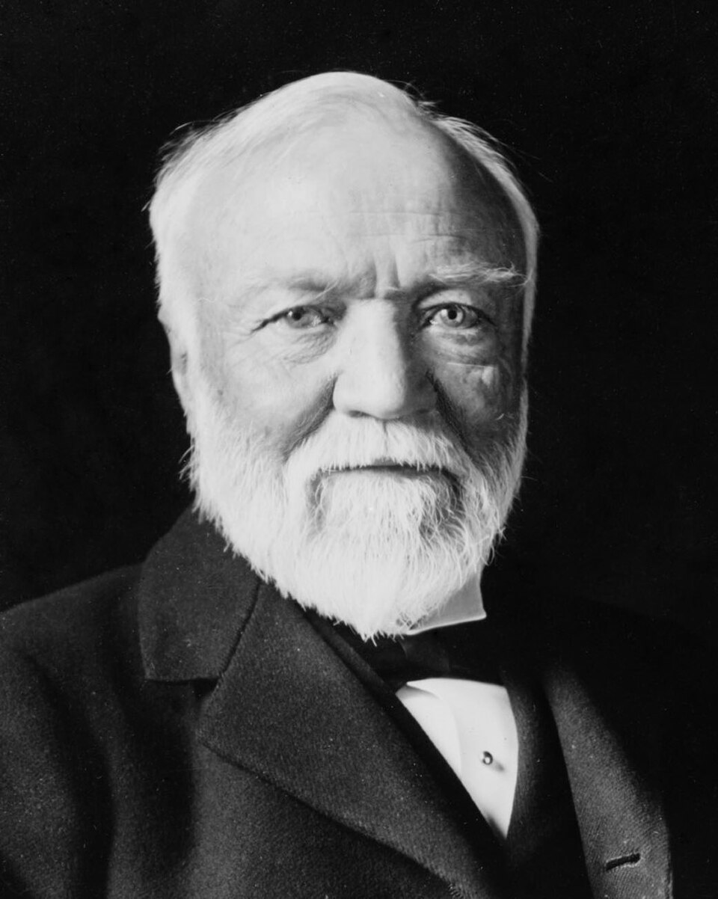
US.08 · PRIMARY SOURCE ANALYSIS
The Gospel of Wealth
Close Reading
Andrew Carnegie · 1889
ZOOM IN Find ONE detail that surprises you — be ready to name it.
"The problem of our age is the proper administration of wealth, so that the ties of brotherhood may still bind together the rich and poor in harmonious relationship. The conditions of human life have not only been changed, but revolutionized, within the past few hundred years... The contrast between the palace of the millionaire and the cottage of the laborer... measures the change which has come with civilization."
CONTEXT
By 1889, industrialization had created a level of inequality in America that had never existed before. Andrew Carnegie, John D. Rockefeller, and other 'robber barons' had accumulated fortunes worth hundreds of millions of dollars, while the workers in their factories earned barely enough to survive. This extreme concentration of wealth sparked public anger and demands for reform. In response, Carnegie wrote 'The Gospel of Wealth,' arguing that rich men had a moral duty to use their wealth for public benefit — framing philanthropy as the solution to inequality while defending the free-market system that had made him rich.
ANALYZE
What does Carnegie identify as "the problem of our age"?
Theodore C. Marceau, 1913 Library of Congress
SOURCE IT
WHO made it?
WHEN?
WHY does it matter?
FIRST
Andrew Carnegie, America's wealthiest steel manufacturer.
1889, at the height of the Gilded Age and rising labor unrest.
A wealthy author writing about wealth reveals assumptions about who deserves help — and who does not.
SSP.02 · before you interpret
Source: Carnegie Corporation of New York
U.S. History Hack · TroopToTeacher Technologies LLC · Aligned to TN Academic Standards & TCAP EOC
11
Notes:
Primary-source analysis. SOURCE IT FIRST (SSP.02) — model the sourcing routine aloud before students interpret: WHO made this source? (Andrew Carnegie, America's wealthiest steel manufacturer.) WHEN? (1889, at the height of the Gilded Age and rising labor unrest.) WHY does that matter? (A wealthy author writing about wealth reveals assumptions about who deserves help — and who does not.) Only then move to the ANALYZE question. Suggested answer: Carnegie explicitly states "The problem of our age is the proper administration of wealth, so that the ties of brotherhood may still bind together the rich and poor." Practice skill: Close Reading.

Slide 13
US.08 · KEY VOCABULARY
Word Wall
Social Darwinism
Darwinismo Social
Social Gospel
Evangelio Social
say: SO-shul DAR-win-iz-um
SD
The belief that Darwin's theory of natural selection applies to human society — the wealthy are 'fit' and the poor are 'weak,' justifying laissez-faire capitalism and opposing government aid.
SG
A religious movement that emphasized Christians' duty to address poverty, unsafe conditions, and inequality — providing moral foundation for Progressive Era reform.
Settlement House
Casa de Asentamiento
Progressive Movement
Movimiento Progresivo
say: SET-ul-ment HOWSS
say: pruh-GRES-iv MOO-vment
SH
Community centers in poor urban neighborhoods staffed by reformers who provided services such as childcare, education, and job training to immigrants and the poor.
PM
A reform movement (1890s–1920s) that sought to address social and economic problems caused by industrialization, including corruption, poverty, and unsafe working conditions.
Laissez-Faire
Laissez-Faire
Muckraker
Periodista de Investigación
say: LEH-say FAIR
say: MUK-ray-ker
L
The economic policy that government should not interfere in business; Social Darwinists used this principle to oppose worker protections and anti-poverty programs.
M
Investigative journalists who exposed corruption, corporate abuse, and social injustice, helping fuel public demand for Progressive Era reform.
"say:" pronunciation guide (stressed syllable in CAPS) and a per-term visual anchor support newcomer English learners. Spanish term + full bilingual Frayer models are in the unit vocabulary set.
U.S. History Hack · TroopToTeacher Technologies LLC · Aligned to TN Academic Standards & TCAP EOC
12

Slide 14
US.08 · GUIDED PRACTICE — WE DO IT TOGETHER
Let’s Work One Together
Compare-and-contrast reasoning
MODEL PROMPT: Compare how a Social Darwinist and a Social Gospel advocate would each respond to a family living in poverty.
WORKED EXAMPLE (teacher models this aloud)
SOCIAL DARWINIST: Poverty proves the family is unfit — helping them interferes with natural selection and weakens society. Government should stay out. SOCIAL GOSPEL ADVOCATE: Poverty is a social problem that Christians are morally obligated to address — through settlement houses, labor reform, and government action.
THINK ALOUD
I start by identifying what each philosophy says about the CAUSE of poverty, then trace how that cause leads to a different POLICY conclusion. The contrast isn't just about ideas — it's about what government should DO.
→ Now you try: Now apply both lenses to child labor in your activity: what would each philosophy say about outlawing it?
U.S. History Hack · TroopToTeacher Technologies LLC · Aligned to TN Academic Standards & TCAP EOC
13
Notes:
GUIDED PRACTICE / WE DO (US.08). Skill modeled: Compare-and-contrast reasoning. Model the worked example aloud using the THINK ALOUD as your script, then release students to the activity ("Now apply both lenses to child labor in your activity: what would each philosophy say about outlawing it?"). This is the I Do → We Do → You Do bridge — do not skip it; aim for 80%+ success before independent work.

Slide 15
US.08 · STUDENT ACTIVITY
Social Darwinism vs. Social Gospel — Philosophical Debate Organizer
Pairs
12 min
YOUR TASK
Using your notes and the Carnegie excerpt, complete a T-chart comparing Social Darwinism and the Social Gospel on three dimensions: (1) What causes poverty? (2) What should government do about it? (3) What is the role of the wealthy? Then write a one-sentence claim: which philosophy provided a stronger moral justification for Progressive Era reform — and cite one piece of evidence from the primary source or Direct Instruction to support your claim.
DELIVERABLE
DIFFERENTIATION
Completed T-chart with three filled rows AND a one-sentence evidence-based claim identifying which philosophy better supported Progressive reform.
Entry: T-chart sentence starters provided: 'Social Darwinism argues that poverty is caused by ___, while the Social Gospel argues ___.' Complete the T-chart only (no written claim required). Honors: Write a paragraph arguing that the tension between Social Darwinism and the Social Gospel is still visible in modern debates about government welfare programs. Cite one historical example and one present-day parallel.
Companion printable: cornell-notes/unit-2/us08-social-darwinism-social-gospel.pdf
U.S. History Hack · TroopToTeacher Technologies LLC · Aligned to TN Academic Standards & TCAP EOC
14
Notes:
Student activity for US.08. Pair with the printable: cornell-notes/unit-2/us08-social-darwinism-social-gospel.pdf. Timing: 12. Deliverable: Completed T-chart with three filled rows AND a one-sentence evidence-based claim identifying which philosophy better supported Progressive reform.

Slide 16
US.08 · CHECK FOR UNDERSTANDING
TCAP-Style Question
DOK 2
EOC PRACTICE
What does Carnegie identify as "the problem of our age"?
How to properly manage wealth to maintain harmony between rich and poor
A
The lack of wealthy individuals in society
B
The need for government to take over businesses
C
The decline of industrial production
D
ANSWER FIRST: students commit — then click / advance to reveal the correct answer and explanation.
U.S. History Hack · TroopToTeacher Technologies LLC · Aligned to TN Academic Standards & TCAP EOC
15
Notes:
CHECK FOR UNDERSTANDING (US.08, DOK 2). Have students commit to an answer (whiteboards, hand signal, or turn-and-talk) BEFORE advancing. Correct answer: A. The next slide reveals it. Why: Carnegie explicitly states "The problem of our age is the proper administration of wealth, so that the ties of brotherhood may still bind together the rich and poor."

Slide 17
US.08 · ANSWER REVEAL
TCAP-Style Question
✓ ANSWER KEY
What does Carnegie identify as "the problem of our age"?
A
How to properly manage wealth to maintain harmony between rich and poor
✓
B
The lack of wealthy individuals in society
C
The need for government to take over businesses
D
The decline of industrial production
Correct answer: A. Why: Carnegie explicitly states "The problem of our age is the proper administration of wealth, so that the ties of brotherhood may still bind together the rich and poor."
U.S. History Hack · TroopToTeacher Technologies LLC · Aligned to TN Academic Standards & TCAP EOC
16
Notes:
ANSWER KEY (US.08). Correct: A. Carnegie explicitly states "The problem of our age is the proper administration of wealth, so that the ties of brotherhood may still bind together the rich and poor."

Slide 18
US.08 · WRAP-UP
What You Need to Know for TCAP
KEY TAKEAWAYS
EXIT TICKET
DOK 2
Social Darwinism Explained
The Social Gospel Movement
Cultural and Economic Impact
Explain how Social Darwinism and the Social Gospel responded differently to poverty. Which argument do you think was more persuasive to Americans in the 1890s, and why?
★ HONORS / EXTENSION DOK 3 · SSP.04 Argumentation
Evaluate: Did Social Darwinism primarily reflect scientific thinking or economic interest? Using at least two pieces of evidence, argue whether the wealthy who endorsed Social Darwinism did so because they believed it was true or because it justified their own position. (SSP.04)
U.S. History Hack · TroopToTeacher Technologies LLC · Aligned to TN Academic Standards & TCAP EOC
17
Notes:
WRAP-UP / EXIT-TICKET KEY (US.08, DOK 2). Prompt: Explain how Social Darwinism and the Social Gospel responded differently to poverty. Which argument do you think was more persuasive to Americans in the 1890s, and why? Model answer: Social Darwinism argued poverty was natural — the poor simply lacked the fitness to compete — so government intervention would be counterproductive. The Social Gospel argued poverty was a social sin that Christians had a moral duty to correct through settlement houses and reform. The Social Gospel proved more persuasive to many Americans because it offered practical action (Hull House served 50,000/week) and framed helping the poor as religious duty rather than weakness. RETEACH TRIGGER — if a student misses this exit ticket: (1) <50% of class miss → spiral it into the next standard’s Quick Review opener (see the US.08 review prompts). (2) Individual/small group → reteach with the "Social Darwinism Explained" direct-instruction slide + re-run the SOURCE IT FIRST routine on the US.08 primary source, then assign the paired printable: cornell-notes/unit-2/us08-social-darwinism-social-gospel.pdf. (3) Re-assess with the US.08 check-for-understanding reveal slide as a do-now the next day. Reteach anchors (this standard’s sections): Social Darwinism Explained; The Social Gospel Movement; Cultural and Economic Impact. I Can objective: I can explain the concepts of Social Darwinism and the Social Gospel and how they shaped debates over government's role in addressing social problems. HONORS / EXTENSION (DOK 3, for early finishers or advanced learners): Evaluate: Did Social Darwinism primarily reflect scientific thinking or economic interest? Using at least two pieces of evidence, argue whether the wealthy who endorsed Social Darwinism did so because they believed it was true or because it justified their own position. (SSP.04) — look for a clear claim plus two specific pieces of evidence.

Slide 19
STANDARD
SOCIAL STUDIES PRACTICES
US.09
SSP.02
Examine a source
SSP.03
Synthesize sources
SSP.04
Build an argument
SSP.05
Historical awareness
Booker T. Washington vs W.E.B. Du Bois
TN ACADEMIC STANDARD
Compare and contrast the ideas and philosophies of Booker T. Washington and W.E.B. Du Bois. (TCA)
I CAN
I can compare and contrast the ideas and philosophies of Booker T. Washington and W.E.B. Du Bois regarding education, civil rights, and strategies for African American advancement.
U.S. History Hack · TroopToTeacher Technologies LLC · Aligned to TN Academic Standards & TCAP EOC
18

Slide 20
KEY VOCABULARY · LANGUAGE SUPPORT
US.08
Words you need before we read
Social Darwinism
Social Gospel
Settlement House
En español: Darwinismo Social
En español: Evangelio Social
En español: Casa de Asentamiento
WHAT IT MEANS
WHAT IT MEANS
WHAT IT MEANS
The belief that Darwin's theory of natural selection applies to human society — the wealthy are 'fit' and the poor are 'weak,' justifying laissez-faire capitalism and opposing government aid.
A religious movement that emphasized Christians' duty to address poverty, unsafe conditions, and inequality — providing moral foundation for Progressive Era reform.
Community centers in poor urban neighborhoods staffed by reformers who provided services such as childcare, education, and job training to immigrants and the poor.
UDL · REPRESENTATION → LANGUAGE & SYMBOLS
U.S. History Hack · TEACHER DECK · Aligned to TN Academic Standards & TCAP EOC
2

Slide 21
PROGRESS CHECK
US.08
Check your understanding
Analyze how these competing philosophies shaped debates over government's role in addressing social and economic problems.
A
Social Darwinism argued government should not interfere while Social Gospel supported intervention, creating a fundamental tension about whether society should address inequality that continues today
✓ KEY
B
Both philosophies supported the same policies, but this fails to account for the broader historical context, and this view has been largely revised by modern historical research
C
Neither philosophy influenced government policy, despite the fact that multiple sources contradict this view, but the historical evidence paints a more nuanced picture and does not reflect the scholarly consensus on this topic
D
Government ignored both viewpoints, although this view has been largely discredited by scholars when examined alongside the available primary and secondary sources, although historical sources do not support this conclusion
UDL · ACTION & EXPRESSION → STRATEGY DEVELOPMENT
MTSS: below mastery → targeted reteach (Tier 2); at/above → extension. The goal never lowers.
U.S. History Hack · TEACHER DECK · Aligned to TN Academic Standards & TCAP EOC
3

Slide 22
US.09 · QUICK REVIEW
Do You Remember?
Before we start, retrieve what we have already learned. Answer from memory first — no notes.
1
US.08 How did the Social Gospel movement respond to poverty differently than Social Darwinism?
2
US.08 What was a settlement house, and name the most famous one and its founder.
U.S. History Hack · TroopToTeacher Technologies LLC · Aligned to TN Academic Standards & TCAP EOC
19
Notes:
SPACED RETRIEVAL (US.09). Cold-call or whiteboards, 3-4 min, low stakes. Answers — 1) Social Gospel argued that Christians had a moral duty to address poverty through settlement houses and reform; Social Darwinism argued poverty was natural and helping the poor interfered with 'survival of the fittest.' 2) A settlement house was a community center in poor urban neighborhoods; Hull House in Chicago, founded by Jane Addams in 1889.

Slide 23
US.09 · CONFIDENCE CHECK
Warm-Up — Quick Recall
DOK 1
LOW STAKES
Everyone can answer this. Thumbs / whiteboards — no notes.
What does 'accommodation' mean in the context of Booker T. Washington's strategy?
✓ ANSWER
Accepting existing segregation and political inequality in the short term while focusing on economic self-improvement through vocational education.
COMMIT FIRST: have everyone answer before the reveal — this is the DOK 1 floor; the graded check later in this lesson moves up to DOK 2–3.
U.S. History Hack · TroopToTeacher Technologies LLC · Aligned to TN Academic Standards & TCAP EOC
20
Notes:
CONFIDENCE CHECK (US.09, DOK 1). 60-90 seconds. Have EVERY student commit (thumbs / whiteboard / choral) before revealing — this secures an early win and surfaces who is shaky before new content. Answer: Accepting existing segregation and political inequality in the short term while focusing on economic self-improvement through vocational education. Key term to listen for: Accommodation. This is the low-floor entry; the graded Check for Understanding later in the standard rises to DOK 2–3.

Slide 24
US.09 · HOOK
Think About It
In 1895, Booker T. Washington addressed a mostly white audience in Atlanta and said African Americans should 'cast down your bucket where you are' — accept economic work first, civil rights later. Five miles away, W.E.B. Du Bois called that speech 'a submission.'
DISCUSS
TIMING: Turn & Talk 60 sec → cold-call 2 pairs
Two brilliant men, both fighting the same racism — but with completely opposite strategies. Which approach would you choose, and why? Hold that question as we dig into one of history's great debates.
U.S. History Hack · TroopToTeacher Technologies LLC · Aligned to TN Academic Standards & TCAP EOC
21
Notes:
HOOK (US.09). Run tight: pose the provocation, give a silent 10-second think, then Turn & Talk 60 seconds. Cold-call 2–3 pairs (not volunteers) for a sentence-starter answer — "One force was ___ because ___" — then bridge to the standard. Keep total to ~4 minutes; do not let it sprawl. Return to this question at the unit close for an evidence-based answer.

Slide 25
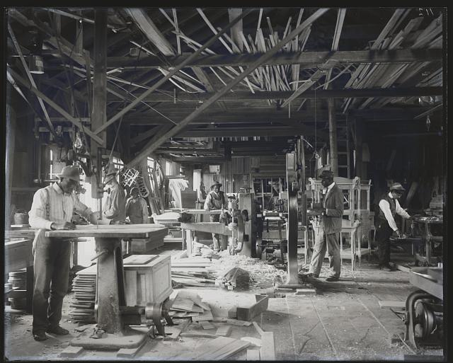
US.09 · DIRECT INSTRUCTION
1 of 4
Background and Origins
Booker T. Washington (1856–1915) was born into slavery in Virginia and founded Tuskegee Institute in Alabama.
His 1895 Atlanta Compromise speech made him the most prominent African American leader of his era.
W.E.B. Du Bois (1868–1963) was born free in Massachusetts and became the first African American to earn a Ph.D. from Harvard.
He authored 'The Souls of Black Folk' (1903) and co-founded the NAACP in 1909.
Their different origins shaped fundamentally different philosophies about how to advance African American equality.
SENTENCE FRAME (EL & writing support)
Frances Benjamin Johnston, 1902 Library of Congress
Booker T. Washington believed African Americans should focus on ________ first, while W.E.B. Du Bois demanded ________ and founded ________ to fight for full equality.
TEACHER CUE Chunk → cold-call → confirm before advancing.
U.S. History Hack · TroopToTeacher Technologies LLC · Aligned to TN Academic Standards & TCAP EOC
22
Notes:
FACILITATION (US.09). Show the quote before revealing who wrote it. Ask: 'Who do you think said this — and what does it tell us about their strategy?' Cold-call 2–3 pairs; then reveal Washington's name and ask: 'Does knowing the author change how you read it?' Teach in small steps; pause and check for understanding before the next chunk (aim 80%+ before moving on).

Slide 26
US.09 · DIRECT INSTRUCTION
2 of 4
Educational Philosophy
Washington emphasized vocational and industrial training, believing economic self-sufficiency would gradually earn respect and equal rights.
Du Bois advocated for classical liberal arts education, especially for the 'Talented Tenth' — the educated elite who would lead the race forward.
Du Bois argued that limiting education to vocational training would permanently consign African Americans to second-class status, while Washington saw immediate practical skills as the realistic path forward in the hostile post-Reconstruction South.
U.S. History Hack · TroopToTeacher Technologies LLC · Aligned to TN Academic Standards & TCAP EOC
23

Slide 27
US.09 · DIRECT INSTRUCTION
3 of 4
Approach to Rights and Equality
Washington favored accommodation and gradualism, publicly accepting segregation temporarily while quietly working for change through economic development and relationships with white philanthropists.
He built the 'Tuskegee Machine' — a powerful network that influenced patronage and funding across the country.
Du Bois demanded immediate civil and political rights, opposing accommodation and founding the Niagara Movement (1905) and later the NAACP to fight segregation through political and legal means.
U.S. History Hack · TroopToTeacher Technologies LLC · Aligned to TN Academic Standards & TCAP EOC
24

Slide 28
US.09 · DIRECT INSTRUCTION
4 of 4
Political Strategies Compared
Washington discouraged political agitation, preferring to build economic power first and trust that social equality would follow.
Du Bois called Washington's approach a capitulation that sacrificed voting rights, civil equality, and higher education.
He argued that no people could advance economically without the political power to protect their gains.
These competing strategies reflect a fundamental historical debate about how oppressed groups should pursue justice — and both left lasting legacies: Tuskegee's industrial education and the NAACP's legal civil rights victories.
U.S. History Hack · TroopToTeacher Technologies LLC · Aligned to TN Academic Standards & TCAP EOC
25

Slide 29
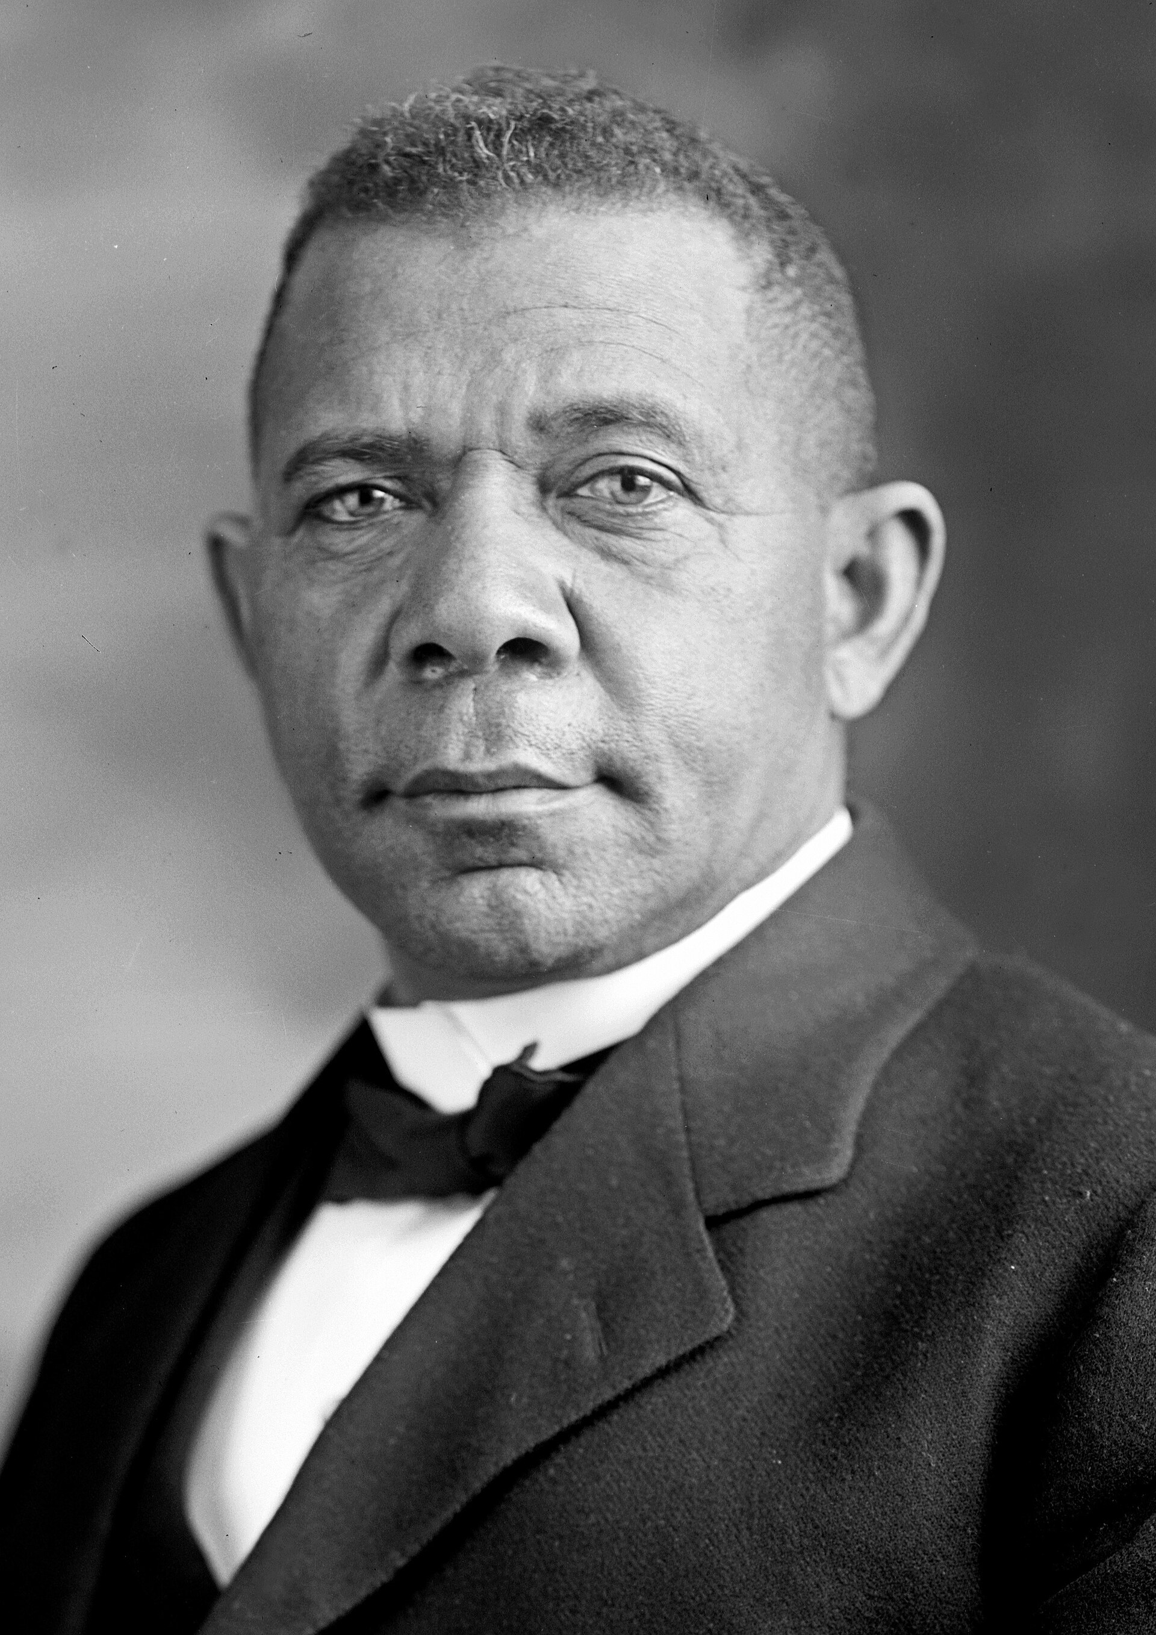
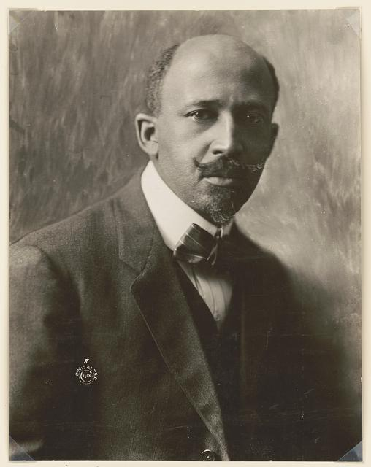
US.09 · PEOPLE WHO SHAPED THE ERA
Key Figures
Booker T. Washington
W.E.B. Du Bois
Educator & Industrial Education Advocate
Civil Rights Leader & Scholar
Founded Tuskegee Normal and Industrial Institute (1881); grew it to 1,500 students by 1900
Delivered Atlanta Compromise speech (1895); became most influential African American leader of the era
Published autobiography 'Up From Slavery' (1901); advised Presidents Roosevelt and Taft on African American appointments
First African American Ph.D. from Harvard (1895); authored 'The Souls of Black Folk' (1903)
Co-founded the NAACP (1909); edited The Crisis magazine for 24 years
Founded the Niagara Movement (1905) — first organization to demand full civil rights
Harris & Ewing, c. 1905-1915 Wikimedia Commons (Library of Congress)
Unknown, 1919 Library of Congress
STRATEGY Accommodationism / Gradualism
STRATEGY Immediate political rights / legal action
U.S. History Hack · TroopToTeacher Technologies LLC · Aligned to TN Academic Standards & TCAP EOC
26

Slide 30
US.09 · PRIMARY SOURCE ANALYSIS
Atlanta Compromise Speech
Sourcing
Booker T. Washington · 1895
"In all things that are purely social we can be as separate as the fingers, yet one as the hand in all things essential to mutual progress. There is no defense or security for any of us except in the highest intelligence and development of all... The wisest among my race understand that the agitation of questions of social equality is the extremest folly."
CONTEXT
Booker T. Washington gave this speech at the Atlanta Cotton States Exposition on September 18, 1895 — just six months before the Supreme Court's Plessy v. Ferguson decision endorsed segregation. Washington was the most prominent Black leader of his era, founder of the Tuskegee Institute, and his speech was received with enormous praise by white Southerners and many northern whites. He proposed that African Americans should focus on vocational education and economic self-improvement rather than demanding immediate political and civil rights — a strategy designed to make racial progress acceptable to white America during the most dangerous era of racial violence since the Civil War.
ANALYZE
What approach to racial progress did Booker T. Washington advocate in this speech?
READ CLOSELY Underline the exact words that answer the ANALYZE question — be ready to read them aloud.
SOURCE IT
WHO made it?
WHEN?
WHY does it matter?
FIRST
Booker T. Washington — formerly enslaved educator, founder of Tuskegee Institute.
1895, thirty years after the Civil War, in the era of Jim Crow laws and rising racial violence.
Context matters — his audience included Southern white leaders who controlled access to Black economic opportunity.
SSP.02 · before you interpret
Source: History Matters, George Mason University
U.S. History Hack · TroopToTeacher Technologies LLC · Aligned to TN Academic Standards & TCAP EOC
27
Notes:
Primary-source analysis. SOURCE IT FIRST (SSP.02) — model the sourcing routine aloud before students interpret: WHO made this source? (Booker T. Washington — formerly enslaved educator, founder of Tuskegee Institute.) WHEN? (1895, thirty years after the Civil War, in the era of Jim Crow laws and rising racial violence.) WHY does that matter? (Context matters — his audience included Southern white leaders who controlled access to Black economic opportunity.) Only then move to the ANALYZE question. Suggested answer: Washington suggests being "separate as the fingers" socially while united in "mutual progress," and calls agitation for social equality "the extremest folly." Practice skill: Sourcing.

Slide 31
US.09 · KEY VOCABULARY
Word Wall
Booker T. Washington
Booker T. Washington
W.E.B. Du Bois
W.E.B. Du Bois
say: doo-BOYSS
BT
African American educator who founded Tuskegee Institute and advocated vocational training and economic self-sufficiency as the path to African American advancement, accepting temporary segregation.
WD
African American scholar who demanded immediate civil and political rights, co-founded the NAACP, and advocated classical education for the 'Talented Tenth' of African American leaders.
Atlanta Compromise
Compromiso de Atlanta
Talented Tenth
El Décimo Talentoso
say: at-LAN-tuh KOM-pruh-myz
say: TAL-en-tid TENTH
AC
Booker T. Washington's 1895 speech accepting racial segregation in exchange for economic opportunity, arguing African Americans should focus on industrial skills rather than political rights.
TT
W.E.B. Du Bois's concept that the top ten percent of educated African Americans should receive classical education and lead the broader community toward full equality.
NAACP
NAACP
Accommodation
Acomodación
say: uh-KOM-uh-DAY-shun
N
National Association for the Advancement of Colored People — founded 1909 by Du Bois and others to fight racial inequality through legal challenges, lobbying, and public education.
A
Washington's strategy of accepting some racial restrictions temporarily to build economic strength, contrasted with Du Bois's demand for immediate full equality.
"say:" pronunciation guide (stressed syllable in CAPS) and a per-term visual anchor support newcomer English learners. Spanish term + full bilingual Frayer models are in the unit vocabulary set.
U.S. History Hack · TroopToTeacher Technologies LLC · Aligned to TN Academic Standards & TCAP EOC
28

Slide 32
US.09 · GUIDED PRACTICE — WE DO IT TOGETHER
Let’s Work One Together
Perspective-taking / argument analysis
MODEL PROMPT: Washington said African Americans should focus on economic progress first. Du Bois said that was wrong. Who makes the stronger argument — and why?
WORKED EXAMPLE (teacher models this aloud)
I'll read Washington: he argues economics → respect → rights. That's a logical chain. But then I read Du Bois: without political rights, any economic gains can be stripped away by Jim Crow law. He has a point — economic progress without legal protection is fragile. I'd say Du Bois's argument is historically stronger because he identifies a real vulnerability in Washington's plan.
THINK ALOUD
Notice how I identify EACH argument's logic, then test it against historical evidence before deciding. I don't just pick the one I agree with — I ask: which logic holds up when you check what actually happened?
→ Now you try: Now you write: one sentence supporting Washington's position and one sentence supporting Du Bois's position, then underline the one you think history proved more correct — and be ready to explain why.
U.S. History Hack · TroopToTeacher Technologies LLC · Aligned to TN Academic Standards & TCAP EOC
29
Notes:
GUIDED PRACTICE / WE DO (US.09). Skill modeled: Perspective-taking / argument analysis. Model the worked example aloud using the THINK ALOUD as your script, then release students to the activity ("Now you write: one sentence supporting Washington's position and one sentence supporting Du Bois's position, then underline the one you think history proved more correct — and be ready to explain why."). This is the I Do → We Do → You Do bridge — do not skip it; aim for 80%+ success before independent work.

Slide 33
US.09 · STUDENT ACTIVITY
Washington vs. Du Bois — Strategy Comparison Chart
Pairs, then whole-class share
15 min
YOUR TASK
Complete a side-by-side comparison chart for Booker T. Washington and W.E.B. Du Bois across four categories: (1) Educational philosophy, (2) Approach to segregation, (3) Political strategy, (4) Long-term legacy. Then answer in writing: In your view, whose strategy was more realistic given the conditions of the 1890s–1910s? Cite at least one specific piece of evidence (from the primary source, Direct Instruction, or Key Figures) to defend your answer.
DELIVERABLE
DIFFERENTIATION
Completed four-row comparison chart AND a written claim (2–4 sentences) with cited evidence defending one strategy as more realistic given the historical context.
Entry: Sentence frame provided: '___ was more realistic because ___. One piece of evidence is ___.' Focus on completing the chart only; teacher provides the written-claim sentence frame for guided completion. Honors: Write a short essay (one paragraph) evaluating BOTH strategies: identify one way Washington's approach succeeded and one way Du Bois's approach succeeded, then explain why the debate between them remains historically important. Must cite the Atlanta Compromise excerpt and one additional source.
Companion printable: cornell-notes/unit-2/us09-washington-dubois.pdf
U.S. History Hack · TroopToTeacher Technologies LLC · Aligned to TN Academic Standards & TCAP EOC
30
Notes:
Student activity for US.09. Pair with the printable: cornell-notes/unit-2/us09-washington-dubois.pdf. Timing: 15. Deliverable: Completed four-row comparison chart AND a written claim (2–4 sentences) with cited evidence defending one strategy as more realistic given the historical context.

Slide 34
US.09 · CHECK FOR UNDERSTANDING
TCAP-Style Question
DOK 2
EOC PRACTICE
What approach to racial progress did Booker T. Washington advocate in this speech?
Immediate demand for full social and political equality
A
Armed resistance against discrimination
B
Acceptance of social separation while focusing on economic advancement
C
Mass migration back to Africa
D
ANSWER FIRST: students commit — then click / advance to reveal the correct answer and explanation.
U.S. History Hack · TroopToTeacher Technologies LLC · Aligned to TN Academic Standards & TCAP EOC
31
Notes:
CHECK FOR UNDERSTANDING (US.09, DOK 2). Have students commit to an answer (whiteboards, hand signal, or turn-and-talk) BEFORE advancing. Correct answer: C. The next slide reveals it. Why: Washington suggests being "separate as the fingers" socially while united in "mutual progress," and calls agitation for social equality "the extremest folly."

Slide 35
US.09 · ANSWER REVEAL
TCAP-Style Question
✓ ANSWER KEY
What approach to racial progress did Booker T. Washington advocate in this speech?
A
Immediate demand for full social and political equality
B
Armed resistance against discrimination
C
Acceptance of social separation while focusing on economic advancement
✓
D
Mass migration back to Africa
Correct answer: C. Why: Washington suggests being "separate as the fingers" socially while united in "mutual progress," and calls agitation for social equality "the extremest folly."
U.S. History Hack · TroopToTeacher Technologies LLC · Aligned to TN Academic Standards & TCAP EOC
32
Notes:
ANSWER KEY (US.09). Correct: C. Washington suggests being "separate as the fingers" socially while united in "mutual progress," and calls agitation for social equality "the extremest folly."

Slide 36
US.09 · WRAP-UP
What You Need to Know for TCAP
KEY TAKEAWAYS
EXIT TICKET
DOK 3
Background and Origins
Educational Philosophy
Approach to Rights and Equality
Political Strategies Compared
Take a position: was Booker T. Washington's strategy of 'accommodation' a pragmatic path to survival in the post-Reconstruction South, or did it ultimately harm the cause of civil rights? Defend your answer with at least one specific piece of evidence.
★ HONORS / EXTENSION DOK 3 · SSP.04 Argumentation
Du Bois argued that Washington's acceptance of the status quo 'practically accepts the alleged inferiority of the Negro races.' Washington countered that agitation without economic power was futile. Using both men's actual arguments, evaluate: which strategy was more likely to produce lasting equality in early-20th-century America? Defend with evidence. (SSP.04)
U.S. History Hack · TroopToTeacher Technologies LLC · Aligned to TN Academic Standards & TCAP EOC
33
Notes:
WRAP-UP / EXIT-TICKET KEY (US.09, DOK 3). Prompt: Take a position: was Booker T. Washington's strategy of 'accommodation' a pragmatic path to survival in the post-Reconstruction South, or did it ultimately harm the cause of civil rights? Defend your answer with at least one specific piece of evidence. Model answer: Defensible either way. Pro-accommodation: Washington operated in the post-Reconstruction South where Black men were being lynched and disenfranchised; economic independence at Tuskegee built real community power that survived violent white supremacy. Anti-accommodation: The Atlanta Compromise effectively conceded civil and political rights and gave white Southerners cover to entrench Jim Crow. Du Bois was right that without voting rights, economic gains could be stripped away. Strong answers cite the Atlanta Compromise speech (1895) and/or Plessy v. Ferguson (1896). RETEACH TRIGGER — if a student misses this exit ticket: (1) <50% of class miss → spiral it into the next standard’s Quick Review opener (see the US.09 review prompts). (2) Individual/small group → reteach with the "Background and Origins" direct-instruction slide + re-run the SOURCE IT FIRST routine on the US.09 primary source, then assign the paired printable: cornell-notes/unit-2/us09-washington-dubois.pdf. (3) Re-assess with the US.09 check-for-understanding reveal slide as a do-now the next day. Reteach anchors (this standard’s sections): Background and Origins; Educational Philosophy; Approach to Rights and Equality; Political Strategies Compared. I Can objective: I can compare and contrast the ideas and philosophies of Booker T. Washington and W.E.B. Du Bois regarding education, civil rights, and strategies for African American advancement. HONORS / EXTENSION (DOK 3, for early finishers or advanced learners): Du Bois argued that Washington's acceptance of the status quo 'practically accepts the alleged inferiority of the Negro races.' Washington countered that agitation without economic power was futile. Using both men's actual arguments, evaluate: which strategy was more likely to produce lasting equality in early-20th-century America? Defend with evidence. (SSP.04) — look for a clear claim plus two specific pieces of evidence.

Slide 37
STANDARD
SOCIAL STUDIES PRACTICES
US.10
SSP.01
Collect sources
SSP.04
Build an argument
SSP.05
Historical awareness
SSP.06
Geographic awareness
Populism & Granger Movement
TN ACADEMIC STANDARD
Explain the characteristics and impact of the Granger movement and populism, emphasizing the conflicts between farmers and the railroads.
I CAN
I can explain the characteristics and impact of the Granger movement and populism, emphasizing the conflicts between farmers and the railroads.
U.S. History Hack · TroopToTeacher Technologies LLC · Aligned to TN Academic Standards & TCAP EOC
34

Slide 38
KEY VOCABULARY · LANGUAGE SUPPORT
US.09
Words you need before we read
Booker T. Washington
W.E.B. Du Bois
Atlanta Compromise
En español: Booker T. Washington
En español: W.E.B. Du Bois
En español: Compromiso de Atlanta
WHAT IT MEANS
WHAT IT MEANS
WHAT IT MEANS
African American educator who founded Tuskegee Institute and advocated vocational training and economic self-sufficiency as the path to African American advancement, accepting temporary segregation.
African American scholar who demanded immediate civil and political rights, co-founded the NAACP, and advocated classical education for the 'Talented Tenth' of African American leaders.
Booker T. Washington's 1895 speech accepting racial segregation in exchange for economic opportunity, arguing African Americans should focus on industrial skills rather than political rights.
UDL · REPRESENTATION → LANGUAGE & SYMBOLS
U.S. History Hack · TEACHER DECK · Aligned to TN Academic Standards & TCAP EOC
4

Slide 39
PROGRESS CHECK
US.09
Check your understanding
Evaluate which approach was more effective for advancing African American progress during this era.
A
Washington's approach completely succeeded, yet the available evidence points to a different conclusion and oversimplifies the complex factors at work during this period and fails to account for key developments in the broader context
B
Both contributed: Washington built institutions and economic opportunity while Du Bois established organizations like the NAACP that would lead later civil rights victories—different strategies served different needs
✓ KEY
C
Neither approach had any impact, but this oversimplifies the complex factors at work, which ignores significant political and cultural developments of the era, which represents a common misconception about this historical period
D
Du Bois's approach achieved everything during his lifetime, which contradicts the primary source evidence from this era and does not reflect the scholarly consensus on this topic, which contradicts the primary source evidence from this era
UDL · ACTION & EXPRESSION → STRATEGY DEVELOPMENT
MTSS: below mastery → targeted reteach (Tier 2); at/above → extension. The goal never lowers.
U.S. History Hack · TEACHER DECK · Aligned to TN Academic Standards & TCAP EOC
5

Slide 40
US.10 · QUICK REVIEW
Do You Remember?
Before we start, retrieve what we have already learned. Answer from memory first — no notes.
1
US.09 What was the NAACP, and which intellectual leader was most associated with founding it?
2
US.09 What did Booker T. Washington mean by 'accommodation'?
U.S. History Hack · TroopToTeacher Technologies LLC · Aligned to TN Academic Standards & TCAP EOC
35
Notes:
SPACED RETRIEVAL (US.10). Cold-call or whiteboards, 3-4 min, low stakes. Answers — 1) The National Association for the Advancement of Colored People (1909), founded with significant leadership from W.E.B. Du Bois, to fight racial discrimination through legal and political means. 2) Accepting segregation and political inequality in the short term, focusing instead on vocational education and economic self-sufficiency as the path to eventual equality.

Slide 41
US.10 · CONFIDENCE CHECK
Warm-Up — Quick Recall
DOK 1
LOW STAKES
Everyone can answer this. Thumbs / whiteboards — no notes.
In one word, what political movement spoke for struggling farmers against railroads and banks in the 1880s–1890s?
✓ ANSWER
Populism — the People's Party movement that demanded railroad regulation, a graduated income tax, and silver coinage to help debt-ridden farmers.
COMMIT FIRST: have everyone answer before the reveal — this is the DOK 1 floor; the graded check later in this lesson moves up to DOK 2–3.
U.S. History Hack · TroopToTeacher Technologies LLC · Aligned to TN Academic Standards & TCAP EOC
36
Notes:
CONFIDENCE CHECK (US.10, DOK 1). 60-90 seconds. Have EVERY student commit (thumbs / whiteboard / choral) before revealing — this secures an early win and surfaces who is shaky before new content. Answer: Populism — the People's Party movement that demanded railroad regulation, a graduated income tax, and silver coinage to help debt-ridden farmers. Key term to listen for: Populism. This is the low-floor entry; the graded Check for Understanding later in the standard rises to DOK 2–3.

Slide 42
US.10 · HOOK
Think About It
By 1890, American railroads charged farmers so much to ship grain that a bushel of wheat grown in Kansas sometimes cost MORE to ship than it was worth at market.
DISCUSS
TIMING: Turn & Talk 60 sec → cold-call 2 pairs
If the companies that carried your product could charge you anything they wanted — and there was no competition — what would you do? Think about how farmers organized to fight back, and what tactics might actually work.
U.S. History Hack · TroopToTeacher Technologies LLC · Aligned to TN Academic Standards & TCAP EOC
37
Notes:
HOOK (US.10). Run tight: pose the provocation, give a silent 10-second think, then Turn & Talk 60 seconds. Cold-call 2–3 pairs (not volunteers) for a sentence-starter answer — "One force was ___ because ___" — then bridge to the standard. Keep total to ~4 minutes; do not let it sprawl. Return to this question at the unit close for an evidence-based answer.

Slide 43
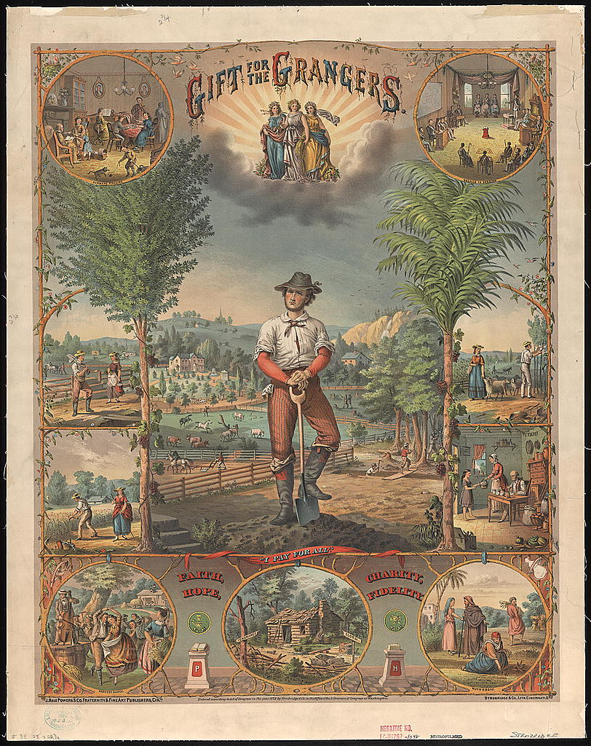
US.10 · DIRECT INSTRUCTION
1 of 4
Understanding Populism
Populism was a political movement representing the interests of farmers and rural workers against the power of banks, railroads, and eastern financial interests in the late 19th century.
Farmers faced falling crop prices, rising railroad freight rates, tight money supply, and mounting debt.
The People's Party (Populist Party), founded in 1892, called for government ownership of railroads, a graduated income tax, direct election of senators, and expansion of the money supply (Free Silver) to help debtors.
SENTENCE FRAME (EL & writing support)
Strobridge & Co. Lith., 1873 Library of Congress
Farmers joined the ________ movement to fight back against ________ discrimination by railroads, demanding reforms such as ________.
TEACHER CUE Chunk → cold-call → confirm before advancing.
U.S. History Hack · TroopToTeacher Technologies LLC · Aligned to TN Academic Standards & TCAP EOC
38
Notes:
FACILITATION (US.10). Show students the 'Cross of Gold' quote: 'You shall not crucify mankind upon a cross of gold.' Silent read → Turn & Talk: 'What economic problem is Bryan describing in dramatic terms?' Cold-call 2 pairs; push for specific economic evidence, not just emotional reaction. Teach in small steps; pause and check for understanding before the next chunk (aim 80%+ before moving on).

Slide 44
US.10 · DIRECT INSTRUCTION
2 of 4
The Granger Movement and Farmers' Alliance
The Patrons of Husbandry (Grange), founded in 1867, was the first major farmers' organization.
It provided social support and lobbied for railroad regulation.
By the 1870s, Grangers had won state laws ('Granger laws') capping railroad rates.
The Farmers' Alliance of the 1880s built on this, creating cooperatives that cut out middlemen and lobbying for government credit programs.
These organizations laid the groundwork for the Populist Party.
★ TENNESSEE CONNECTION
Tennessee farmers joined the Grange and Farmers' Alliance, organizing cooperatives and pressing for railroad regulation — grassroots roots of the Populist movement in the state.
U.S. History Hack · TroopToTeacher Technologies LLC · Aligned to TN Academic Standards & TCAP EOC
39

Slide 45
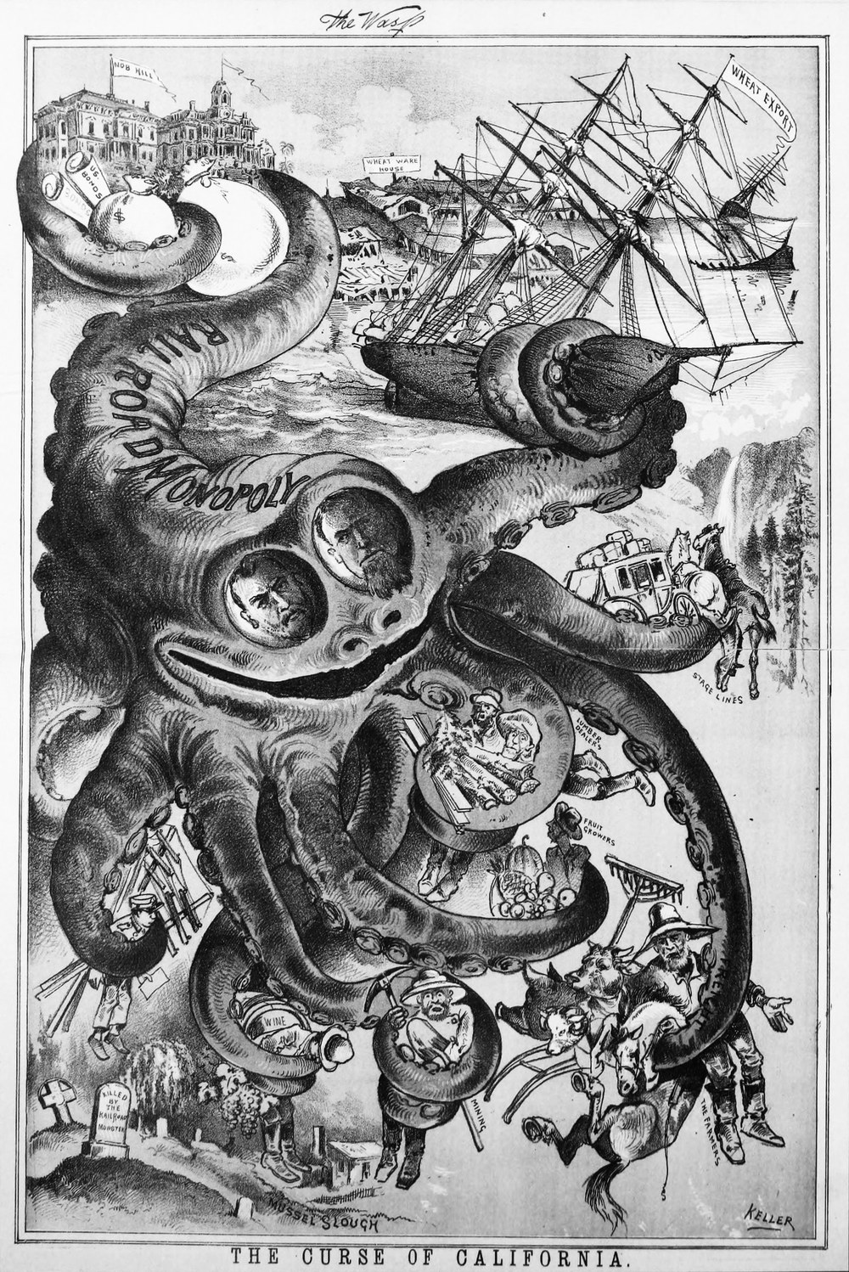
US.10 · DIRECT INSTRUCTION
3 of 4
Farmer vs. Railroad Conflicts
Railroads exercised monopoly power over farmers by charging high and discriminatory freight rates, offering rebates to large shippers, and controlling grain elevator pricing.
A farmer in Kansas might pay more to ship wheat 100 miles than an eastern manufacturer paid to ship goods 1,000 miles.
The Supreme Court initially blocked state regulation (Wabash v. Illinois, 1886), but Congress responded with the Interstate Commerce Act (1887), creating the Interstate Commerce Commission — the first federal regulatory agency.
George Frederick Keller, 1882 Wikimedia Commons
U.S. History Hack · TroopToTeacher Technologies LLC · Aligned to TN Academic Standards & TCAP EOC
40

Slide 46
US.10 · DIRECT INSTRUCTION
4 of 4
Populist Reform Demands
The 1892 Populist Platform demanded government ownership of railroads and telegraphs, a graduated income tax, direct election of senators, the secret ballot, and Free Silver — unlimited coinage of silver to inflate the money supply and ease farmers' debts.
William Jennings Bryan electrified the 1896 Democratic Convention with his 'Cross of Gold' speech, warning that workers and farmers must not be 'crucified upon a cross of gold.' Though Bryan lost to McKinley, many Populist ideas were later adopted by Progressive Era reformers.
U.S. History Hack · TroopToTeacher Technologies LLC · Aligned to TN Academic Standards & TCAP EOC
41

Slide 47
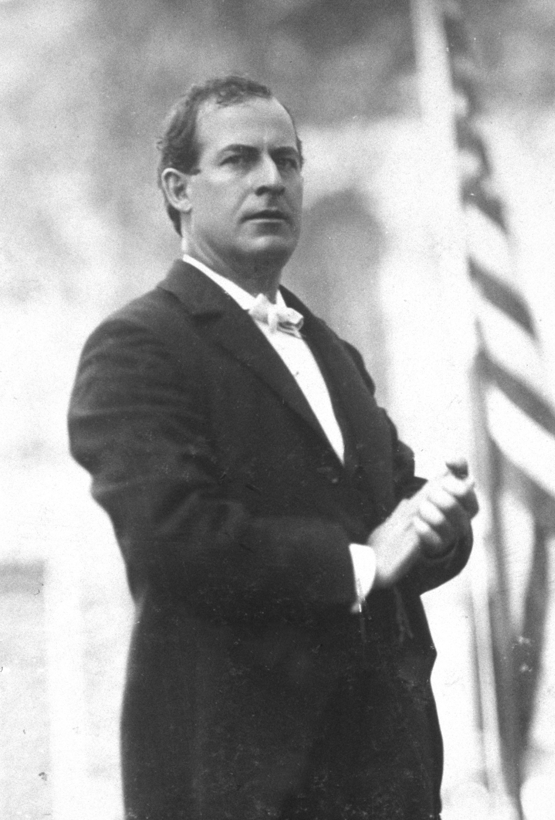
US.10 · PEOPLE WHO SHAPED THE ERA
Key Figure
William Jennings Bryan
Populist Leader & Democratic Presidential Nominee
Delivered the 'Cross of Gold' speech at the 1896 Democratic National Convention; won nomination at age 36
Ran as Democratic presidential nominee three times (1896, 1900, 1908), championing farmers and debtors
Served as Secretary of State under President Wilson (1913–1915)
Unknown, c. 1896 Library of Congress
STRATEGY Agrarian populism / anti-gold standard
U.S. History Hack · TroopToTeacher Technologies LLC · Aligned to TN Academic Standards & TCAP EOC
42

Slide 48
US.10 · PRIMARY SOURCE ANALYSIS
Populist Party Platform
Close Reading
People's Party National Convention · 1892
"We demand free and unlimited coinage of silver and gold at the present legal ratio of 16 to 1... We demand a graduated income tax... We believe that the power of government—in other words, of the people—should be expanded... to the end that oppression, injustice, and poverty shall eventually cease in the land."
CONTEXT
The late 19th century was devastating for American farmers. Falling crop prices, high railroad freight rates, crushing debt, and the deflationary effects of the gold standard squeezed farmers while industrial profits soared. Farmers organized first through the Grange movement and then the Farmers' Alliances before launching the People's (Populist) Party in 1892. At their founding convention in Omaha, Nebraska, the Populists adopted a bold platform calling for government control of railroads, a graduated income tax, direct election of senators, and the free coinage of silver to expand the money supply and help debtors. The Populist movement represented the most significant challenge to Gilded Age capitalism from below.
ANALYZE
What role did the Populist Party believe government should play?
READ CLOSELY Underline the exact words that answer the ANALYZE question — be ready to read them aloud.
SOURCE IT
WHO made it?
WHEN?
WHY does it matter?
FIRST
The People's Party — delegates representing millions of American farmers from the South and Midwest.
1892, during a severe agricultural depression with falling crop prices and rising railroad costs.
Political platforms reveal what a group believes is wrong and what power they want to use to fix it.
SSP.02 · before you interpret
Source: Library of Congress
U.S. History Hack · TroopToTeacher Technologies LLC · Aligned to TN Academic Standards & TCAP EOC
43
Notes:
Primary-source analysis. SOURCE IT FIRST (SSP.02) — model the sourcing routine aloud before students interpret: WHO made this source? (The People's Party — delegates representing millions of American farmers from the South and Midwest.) WHEN? (1892, during a severe agricultural depression with falling crop prices and rising railroad costs.) WHY does that matter? (Political platforms reveal what a group believes is wrong and what power they want to use to fix it.) Only then move to the ANALYZE question. Suggested answer: The platform states "the power of government... should be expanded" to end "oppression, injustice, and poverty." Practice skill: Close Reading.

Slide 49
US.10 · KEY VOCABULARY
Word Wall
Populism
Populismo
Granger Movement
Movimiento Granger
say: POP-yuh-liz-um
say: GRAYN-jer MOO-vment
P
A political movement representing the interests of ordinary farmers and workers against the power of banks, railroads, and wealthy eastern interests in the late 19th century.
GM
A farmers' organization founded in the 1860s–1870s that provided social support and lobbied for railroad regulation; won early 'Granger laws' capping freight rates.
Farmers' Alliance
Alianza de Agricultores
Railroad Discrimination
Discriminación Ferroviaria
say: FAR-merz uh-LY-unts
FA
A coalition of farmers' organizations in the 1870s–1890s that created cooperatives, lobbied for government credit, and laid the groundwork for the Populist Party.
RD
Unfair railroad practices including higher freight rates for farmers than for large businesses and charging more for short hauls than for long hauls on the same lines.
Free Silver
Plata Libre
Cross of Gold
Cruz de Oro
say: FREE SIL-ver
FS
The Populist demand for unlimited coinage of silver to increase the money supply, raise prices, and reduce the debt burden on farmers — opposed by eastern banking interests.
CO
William Jennings Bryan's famous 1896 speech denouncing the gold standard as an economic burden on farmers and workers, winning him the Democratic presidential nomination.
"say:" pronunciation guide (stressed syllable in CAPS) and a per-term visual anchor support newcomer English learners. Spanish term + full bilingual Frayer models are in the unit vocabulary set.
U.S. History Hack · TroopToTeacher Technologies LLC · Aligned to TN Academic Standards & TCAP EOC
44

Slide 50
US.10 · GUIDED PRACTICE — WE DO IT TOGETHER
Let’s Work One Together
Evidence-based argument
MODEL PROMPT: A farmer in 1892 says: 'The railroads are robbing us.' Is that a claim or a fact? How do we test it?
WORKED EXAMPLE (teacher models this aloud)
First I distinguish: 'The railroads are robbing us' is a CLAIM — a strong opinion. To test it, I look for evidence: Did railroads charge farmers more than manufacturers? Yes — historical records show farmers paid 2–3x more per mile than large shippers. Does that make it 'robbery'? That's the interpretation question. I'd say it's documented exploitation — whether it's 'robbery' depends on moral framing, but the economic fact is documented.
THINK ALOUD
Notice I separated the CLAIM from the EVIDENCE, then asked whether the evidence supports the claim. This is what historians do — and what TCAP asks you to do with primary sources.
→ Now you try: Find one piece of evidence from the Populist Platform that supports the claim that railroads were treating farmers unfairly. Write one sentence connecting the evidence to the claim.
U.S. History Hack · TroopToTeacher Technologies LLC · Aligned to TN Academic Standards & TCAP EOC
45
Notes:
GUIDED PRACTICE / WE DO (US.10). Skill modeled: Evidence-based argument. Model the worked example aloud using the THINK ALOUD as your script, then release students to the activity ("Find one piece of evidence from the Populist Platform that supports the claim that railroads were treating farmers unfairly. Write one sentence connecting the evidence to the claim."). This is the I Do → We Do → You Do bridge — do not skip it; aim for 80%+ success before independent work.

Slide 51
US.10 · STUDENT ACTIVITY
Populist Demands — Cause, Grievance, and Reform Tracker
Pairs
12 min
YOUR TASK
Using your notes and the Populist Platform excerpt, complete a three-column tracker: Column 1: Farmer Grievance (what problem?), Column 2: Who or what caused it?, Column 3: Populist Solution (what did they demand?). Fill in at least four grievance rows. Then write one sentence: Was the Populist Party asking the government to do MORE or LESS — and how does that connect to the Social Darwinism vs. Social Gospel debate from US.08?
DELIVERABLE
DIFFERENTIATION
Completed four-row grievance tracker AND a one-sentence connection to the Social Darwinism / Social Gospel debate from US.08.
Entry: Grievance rows pre-filled with the first column (farmer problem stated); student fills in columns 2 and 3. Connection sentence frame: 'The Populist Party asked the government to do ___ because ___.' Honors: Evaluate: Did Populism succeed or fail? Write two sentences — one piece of evidence that it failed (Bryan lost in 1896) and one piece of evidence that it succeeded (name a Populist idea later adopted by Progressives). Then explain why ideas can succeed even when a political party loses.
Companion printable: cornell-notes/unit-2/us10-populism-granger.pdf
U.S. History Hack · TroopToTeacher Technologies LLC · Aligned to TN Academic Standards & TCAP EOC
46
Notes:
Student activity for US.10. Pair with the printable: cornell-notes/unit-2/us10-populism-granger.pdf. Timing: 12. Deliverable: Completed four-row grievance tracker AND a one-sentence connection to the Social Darwinism / Social Gospel debate from US.08.

Slide 52
US.10 · CHECK FOR UNDERSTANDING
TCAP-Style Question
DOK 2
EOC PRACTICE
What role did the Populist Party believe government should play?
Government should be limited and avoid economic intervention
A
Government power should expand to address economic inequality
B
Government should be controlled by business leaders
C
Government should focus only on military defense
D
ANSWER FIRST: students commit — then click / advance to reveal the correct answer and explanation.
U.S. History Hack · TroopToTeacher Technologies LLC · Aligned to TN Academic Standards & TCAP EOC
47
Notes:
CHECK FOR UNDERSTANDING (US.10, DOK 2). Have students commit to an answer (whiteboards, hand signal, or turn-and-talk) BEFORE advancing. Correct answer: B. The next slide reveals it. Why: The platform states "the power of government... should be expanded" to end "oppression, injustice, and poverty."

Slide 53
US.10 · ANSWER REVEAL
TCAP-Style Question
✓ ANSWER KEY
What role did the Populist Party believe government should play?
A
Government should be limited and avoid economic intervention
B
Government power should expand to address economic inequality
✓
C
Government should be controlled by business leaders
D
Government should focus only on military defense
Correct answer: B. Why: The platform states "the power of government... should be expanded" to end "oppression, injustice, and poverty."
U.S. History Hack · TroopToTeacher Technologies LLC · Aligned to TN Academic Standards & TCAP EOC
48
Notes:
ANSWER KEY (US.10). Correct: B. The platform states "the power of government... should be expanded" to end "oppression, injustice, and poverty."

Slide 54
US.10 · WRAP-UP
What You Need to Know for TCAP
KEY TAKEAWAYS
EXIT TICKET
DOK 2
Understanding Populism
The Granger Movement and Farmers' Alliance
Farmer vs. Railroad Conflicts
Populist Reform Demands
Identify TWO specific demands of the Populist Party platform and explain how each demand was meant to help farmers.
★ HONORS / EXTENSION DOK 3 · SSP.04 Argumentation
The Populist Party collapsed after 1896 but many of its platform demands became law within 20 years (income tax via 16th Amendment, direct elections via 17th Amendment). Argue: Was Populism a failure or a delayed success? Use at least two specific examples of Populist demands that were later enacted. (SSP.04)
U.S. History Hack · TroopToTeacher Technologies LLC · Aligned to TN Academic Standards & TCAP EOC
49
Notes:
WRAP-UP / EXIT-TICKET KEY (US.10, DOK 2). Prompt: Identify TWO specific demands of the Populist Party platform and explain how each demand was meant to help farmers. Model answer: 1. Free silver coinage at 16:1 — inflating the money supply would make it easier for debt-ridden farmers to repay loans in cheaper dollars. 2. Federal regulation of railroads (or government ownership) — ending discriminatory rate-setting that charged small farmers more than large shippers. Also acceptable: graduated income tax (would shift the tax burden from farmers to wealthy industrialists), direct election of senators (break corporate control of Congress). RETEACH TRIGGER — if a student misses this exit ticket: (1) <50% of class miss → spiral it into the next standard’s Quick Review opener (see the US.10 review prompts). (2) Individual/small group → reteach with the "Understanding Populism" direct-instruction slide + re-run the SOURCE IT FIRST routine on the US.10 primary source, then assign the paired printable: cornell-notes/unit-2/us10-populism-granger.pdf. (3) Re-assess with the US.10 check-for-understanding reveal slide as a do-now the next day. Reteach anchors (this standard’s sections): Understanding Populism; The Granger Movement and Farmers' Alliance; Farmer vs. Railroad Conflicts; Populist Reform Demands. I Can objective: I can explain the characteristics and impact of the Granger movement and populism, emphasizing the conflicts between farmers and the railroads. HONORS / EXTENSION (DOK 3, for early finishers or advanced learners): The Populist Party collapsed after 1896 but many of its platform demands became law within 20 years (income tax via 16th Amendment, direct elections via 17th Amendment). Argue: Was Populism a failure or a delayed success? Use at least two specific examples of Populist demands that were later enacted. (SSP.04) — look for a clear claim plus two specific pieces of evidence.

Slide 55
STANDARD
SOCIAL STUDIES PRACTICES
US.11
SSP.01
Collect sources
SSP.02
Examine a source
SSP.04
Build an argument
SSP.05
Historical awareness
Rise of the Labor Movement
TN ACADEMIC STANDARD
Explain the rise of the labor movement, union tactics (e.g. strikes), the role of leaders (e.g. Eugene Debs and Samuel Gompers), the unjust use of prison labor (e.g. Coal Creek labor saga), and the responses of management and government.
I CAN
I can explain the rise of the labor movement, union tactics such as strikes, the role of leaders such as Eugene Debs and Samuel Gompers, the unjust use of prison labor (Coal Creek), and the responses of management and government.
U.S. History Hack · TroopToTeacher Technologies LLC · Aligned to TN Academic Standards & TCAP EOC
50

Slide 56
KEY VOCABULARY · LANGUAGE SUPPORT
US.10
Words you need before we read
Populism
Granger Movement
Farmers' Alliance
En español: Populismo
En español: Movimiento Granger
En español: Alianza de Agricultores
WHAT IT MEANS
WHAT IT MEANS
WHAT IT MEANS
A political movement representing the interests of ordinary farmers and workers against the power of banks, railroads, and wealthy eastern interests in the late 19th century.
A farmers' organization founded in the 1860s–1870s that provided social support and lobbied for railroad regulation; won early 'Granger laws' capping freight rates.
A coalition of farmers' organizations in the 1870s–1890s that created cooperatives, lobbied for government credit, and laid the groundwork for the Populist Party.
UDL · REPRESENTATION → LANGUAGE & SYMBOLS
U.S. History Hack · TEACHER DECK · Aligned to TN Academic Standards & TCAP EOC
6

Slide 57
PROGRESS CHECK
US.10
Check your understanding
Analyze why the Populist movement ultimately failed but influenced later Progressive reforms.
A
Populism had no lasting influence, but contemporary accounts suggest a different explanation despite the fact that multiple contemporary sources contradict this, and this view has been largely revised by modern historical research
B
Populism succeeded in all its goals immediately, although historical sources do not support this conclusion, but contemporary accounts and primary sources suggest otherwise and fails to account for key developments in the broader context
C
The movement failed electorally when Bryan lost in 1896, but its ideas—income tax, direct election of senators, railroad regulation—were adopted by Progressives, showing how failed movements can shape future reform
✓ KEY
D
Progressive reforms were unrelated to Populism, although historical sources do not support this conclusion, which ignores significant political and cultural developments of the era, although historical sources do not support this conclusion
UDL · ACTION & EXPRESSION → STRATEGY DEVELOPMENT
MTSS: below mastery → targeted reteach (Tier 2); at/above → extension. The goal never lowers.
U.S. History Hack · TEACHER DECK · Aligned to TN Academic Standards & TCAP EOC
7

Slide 58
US.11 · QUICK REVIEW
Do You Remember?
Before we start, retrieve what we have already learned. Answer from memory first — no notes.
1
US.10 What was the 'Cross of Gold' speech, and what monetary policy did it demand?
2
US.10 What was the main grievance farmers had against railroads?
U.S. History Hack · TroopToTeacher Technologies LLC · Aligned to TN Academic Standards & TCAP EOC
51
Notes:
SPACED RETRIEVAL (US.11). Cold-call or whiteboards, 3-4 min, low stakes. Answers — 1) William Jennings Bryan's 1896 Democratic National Convention speech demanding the free coinage of silver at a 16:1 ratio to gold, which Populists believed would expand the money supply and help debt-ridden farmers. 2) Railroads charged discriminatory rates — higher rates for small farmers than for large shippers — and controlled grain storage, leaving farmers with little economic power.

Slide 59
US.11 · CONFIDENCE CHECK
Warm-Up — Quick Recall
DOK 1
LOW STAKES
Everyone can answer this. Thumbs / whiteboards — no notes.
What is the one word for a union's most powerful tactic — stopping work to force management to negotiate?
✓ ANSWER
Strike — a collective work stoppage by employees to pressure employers to meet their demands for better wages, hours, or conditions.
COMMIT FIRST: have everyone answer before the reveal — this is the DOK 1 floor; the graded check later in this lesson moves up to DOK 2–3.
U.S. History Hack · TroopToTeacher Technologies LLC · Aligned to TN Academic Standards & TCAP EOC
52
Notes:
CONFIDENCE CHECK (US.11, DOK 1). 60-90 seconds. Have EVERY student commit (thumbs / whiteboard / choral) before revealing — this secures an early win and surfaces who is shaky before new content. Answer: Strike — a collective work stoppage by employees to pressure employers to meet their demands for better wages, hours, or conditions. Key term to listen for: Strike. This is the low-floor entry; the graded Check for Understanding later in the standard rises to DOK 2–3.

Slide 60
US.11 · HOOK
Think About It
In 1892, Carnegie Steel locked out its workers at Homestead, Pennsylvania, then hired 300 armed Pinkerton guards to break the strike. Seven workers and three Pinkertons were killed in the battle that followed.
DISCUSS
TIMING: Turn & Talk 60 sec → cold-call 2 pairs
When a company hires a private army to suppress its workers, is that a labor dispute or something more? What responsibility does government have in that situation — and whose side did it take?
U.S. History Hack · TroopToTeacher Technologies LLC · Aligned to TN Academic Standards & TCAP EOC
53
Notes:
HOOK (US.11). Run tight: pose the provocation, give a silent 10-second think, then Turn & Talk 60 seconds. Cold-call 2–3 pairs (not volunteers) for a sentence-starter answer — "One force was ___ because ___" — then bridge to the standard. Keep total to ~4 minutes; do not let it sprawl. Return to this question at the unit close for an evidence-based answer.

Slide 61
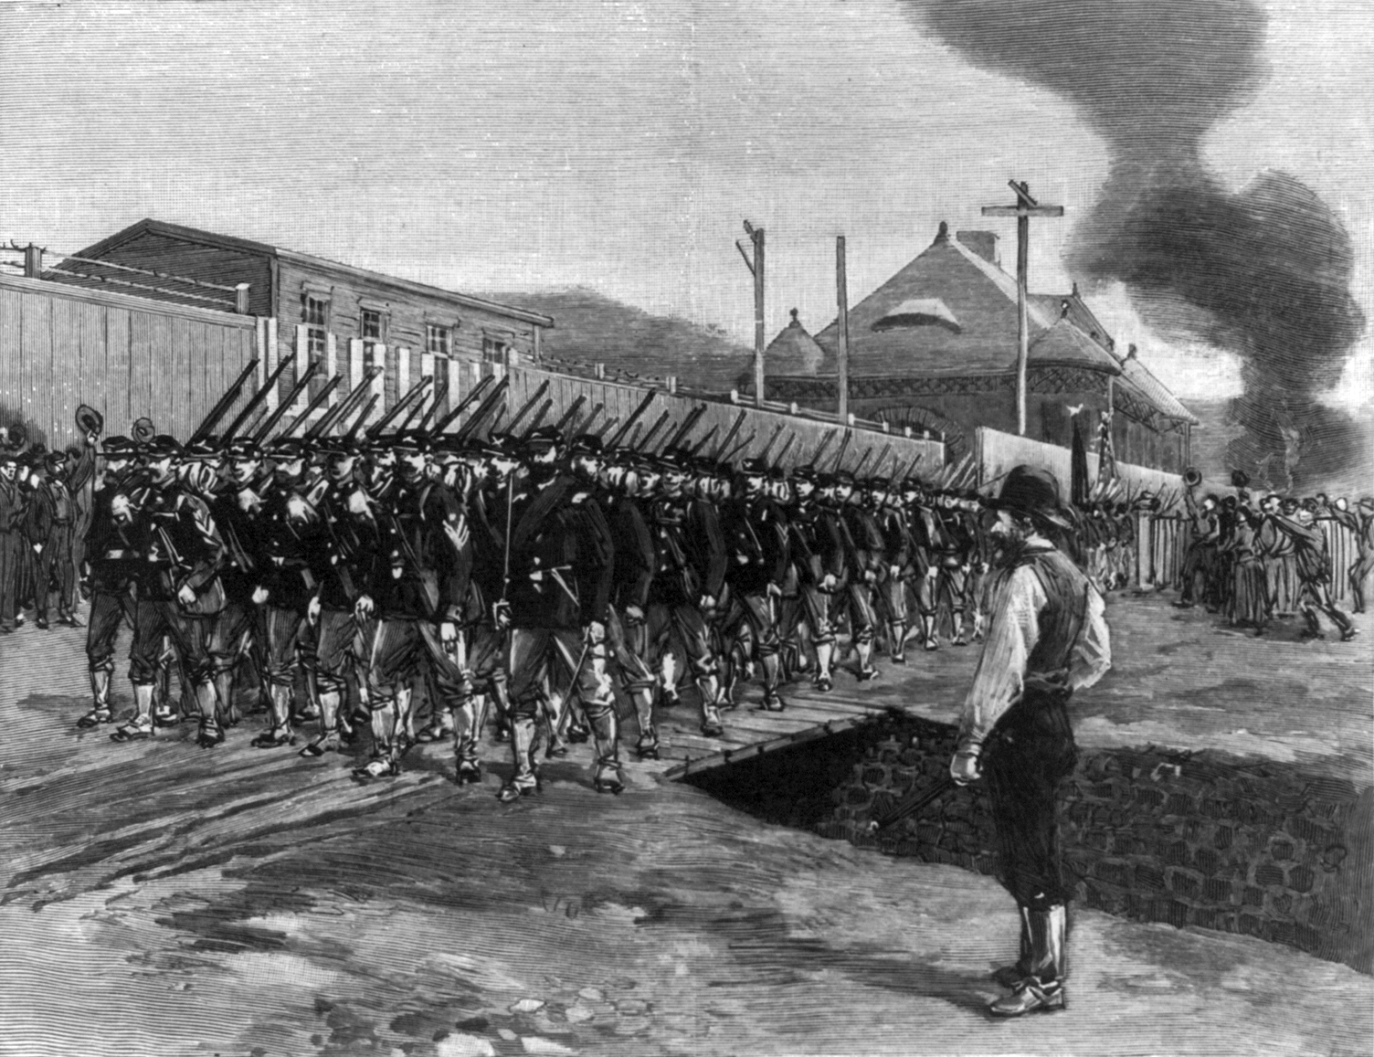
US.11 · DIRECT INSTRUCTION
1 of 5
Factors Leading to Labor Organization
Industrial workers in the late 19th century faced 12–16 hour days, seven-day weeks, dangerous conditions, child labor, and wages that could be cut at the employer's whim.
Workers had no legal protections, no union contracts, and no recourse when injured.
The rise of large corporations — Standard Oil, Carnegie Steel, Pullman — concentrated economic power in the hands of a few while workers remained easily replaceable.
These conditions drove workers to organize for collective protection.
SENTENCE FRAME (EL & writing support)
Unknown, 1892 Library of Congress
Workers organized ________ and used tactics like ________ to pressure employers, while management and government responded with ________ to break strikes.
TEACHER CUE Chunk → cold-call → confirm before advancing.
U.S. History Hack · TroopToTeacher Technologies LLC · Aligned to TN Academic Standards & TCAP EOC
54
Notes:
FACILITATION (US.11). Show the Coal Creek headline before the lesson: 'Tennessee Miners Free 400 Convicts.' Silent think — Turn & Talk: 'Who are the miners fighting against — and why?' Cold-call pairs to name the injustice; then connect to the national labor story. Teach in small steps; pause and check for understanding before the next chunk (aim 80%+ before moving on).

Slide 62
US.11 · DIRECT INSTRUCTION
2 of 5
Union Tactics and Strategies
Labor unions organized workers to bargain collectively for wages, hours, and safety.
Primary tactics included strikes — work stoppages to force management to negotiate — as well as boycotts and picket lines.
The American Federation of Labor (AFL), founded by Samuel Gompers in 1886, focused on skilled trade workers and pursued 'pure and simple' goals: higher wages, shorter hours, better conditions — not socialist revolution.
The more radical American Railway Union (ARU), led by Eugene V. Debs, organized all railroad workers regardless of craft.
U.S. History Hack · TroopToTeacher Technologies LLC · Aligned to TN Academic Standards & TCAP EOC
55

Slide 63
US.11 · DIRECT INSTRUCTION
3 of 5
Key Labor Leaders
Samuel Gompers (1850–1924) founded and dominated the AFL for nearly four decades.
His pragmatic approach secured real gains — including the eight-hour workday movement — without challenging capitalism itself.
Eugene V. Debs (1855–1926) founded the ARU and led the Pullman Strike of 1894.
When the federal government obtained an injunction to break the strike, Debs was jailed for six months, radicalizing him into socialism.
He ran for president five times on the Socialist ticket.
Both men left lasting marks on American labor law and culture.
U.S. History Hack · TroopToTeacher Technologies LLC · Aligned to TN Academic Standards & TCAP EOC
56

Slide 64
US.11 · DIRECT INSTRUCTION
4 of 5
Tennessee's Coal Creek Saga and Prison Labor
In 1891, Tennessee mine operators replaced their paid workers with state convict lease laborers — prisoners leased to private companies as forced, unpaid labor.
Miners in Coal Creek (now Lake City), Tennessee armed themselves and freed nearly 400 convicts, loading them onto trains to Knoxville.
The rebellion continued for over a year, with miners repeatedly freeing convict laborers.
The state ultimately abolished the convict lease system in 1896.
The Coal Creek War is a pivotal Tennessee connection to the national labor story and the injustice of convict leasing.
★ TENNESSEE CONNECTION
In the 1891–92 Coal Creek War, armed Tennessee miners freed nearly 400 leased convicts near Coal Creek (now Lake City); the uprising helped end Tennessee's convict-lease system in 1896.
U.S. History Hack · TroopToTeacher Technologies LLC · Aligned to TN Academic Standards & TCAP EOC
57

Slide 65
US.11 · DIRECT INSTRUCTION
5 of 5
Management and Government Responses
Management responded to strikes with lockouts, Pinkerton detective agencies hired as strikebreakers, blacklisting union members, and court injunctions under the Sherman Antitrust Act.
The Homestead Strike (1892) — Carnegie Steel vs. steelworkers — ended when Pennsylvania Governor Pattison sent the National Guard after Pinkerton agents clashed with strikers.
The Pullman Strike (1894) was broken when President Cleveland used a federal injunction and federal troops over the objections of Illinois Governor Altgeld.
Government generally sided with business in this era, using courts and armies to suppress strikes.
U.S. History Hack · TroopToTeacher Technologies LLC · Aligned to TN Academic Standards & TCAP EOC
58

Slide 66
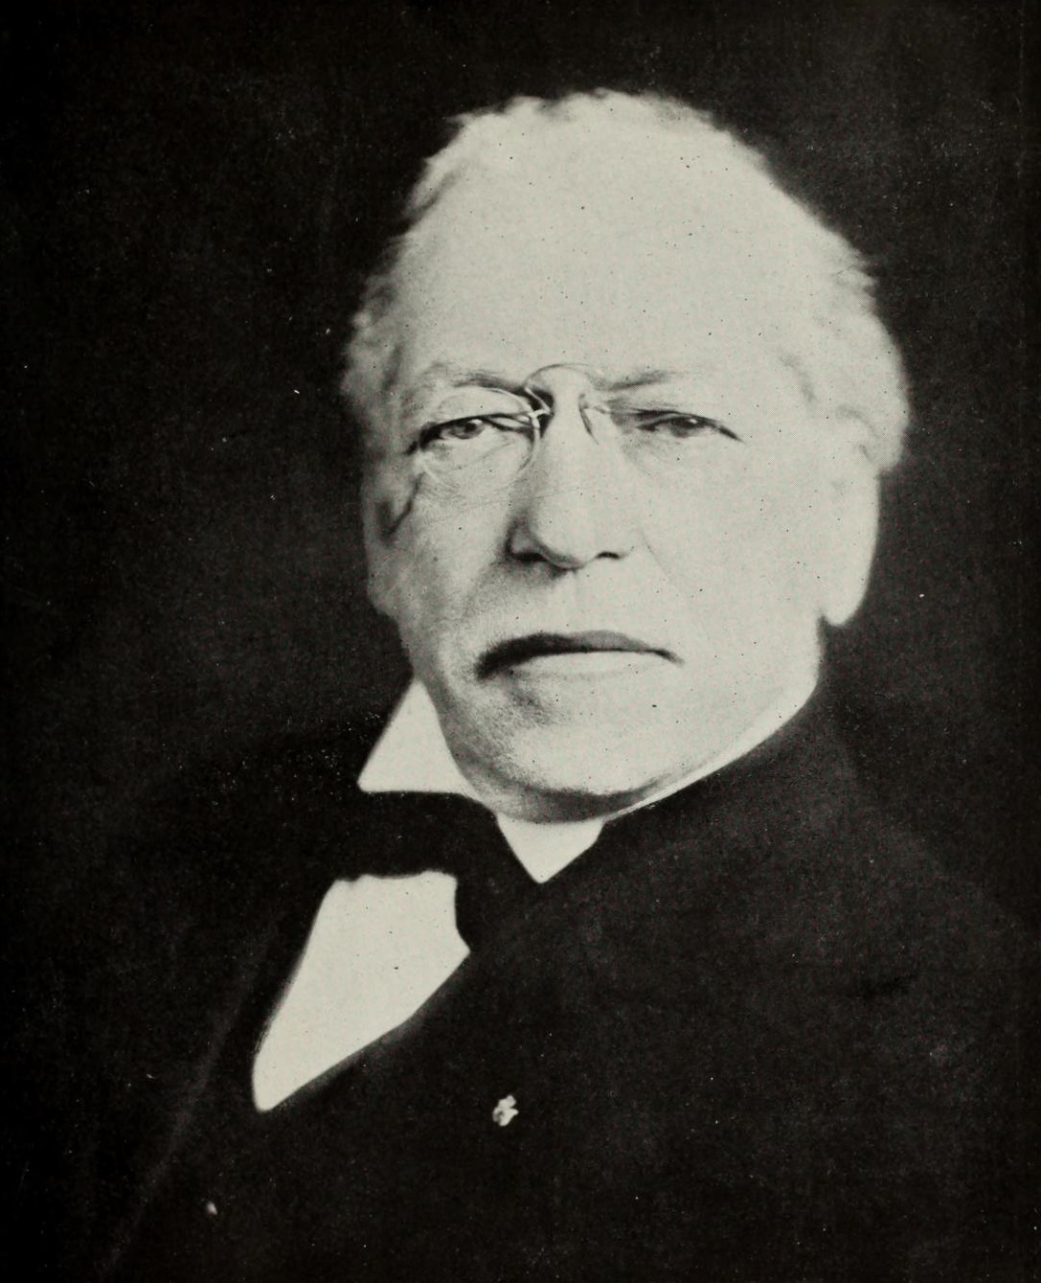
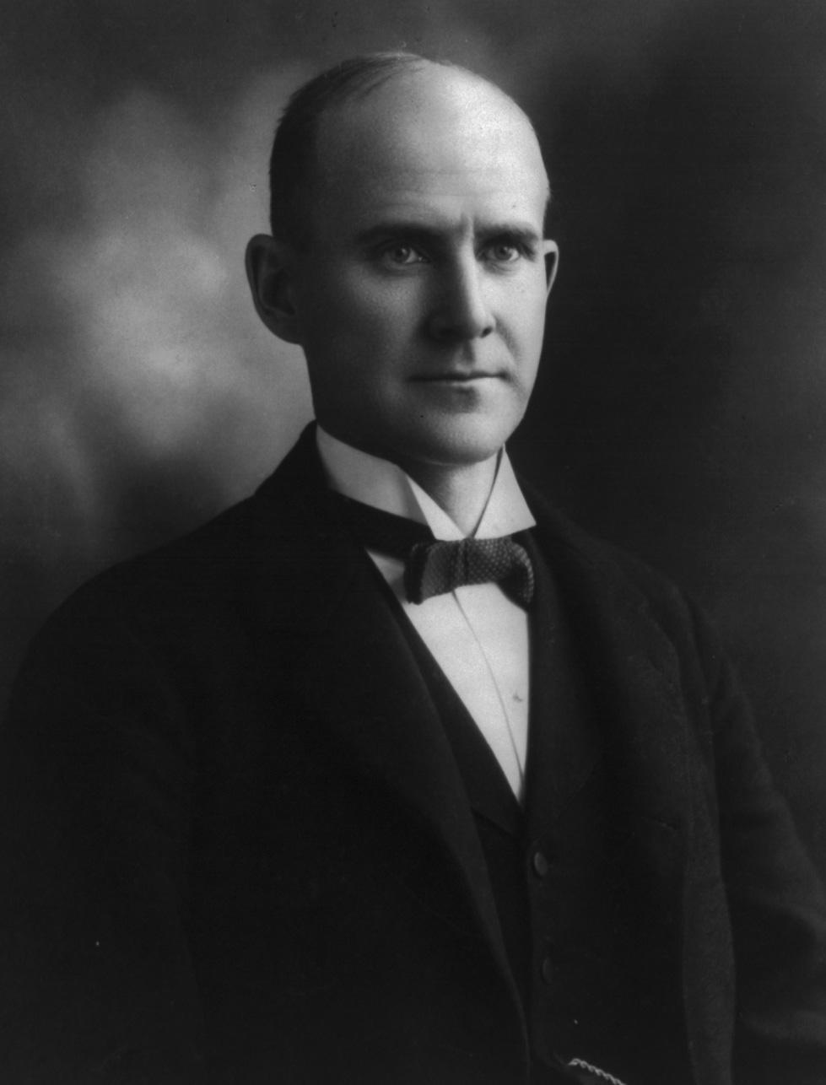
US.11 · PEOPLE WHO SHAPED THE ERA
Key Figures
Samuel Gompers
Eugene V. Debs
Labor Leader & AFL Founder
Labor Leader & Socialist Presidential Candidate
Founded and led the American Federation of Labor (AFL) for nearly 40 years — grew it to over 1 million members
Championed the eight-hour workday, collective bargaining, and 'pure and simple' unionism
Helped establish Labor Day as a national holiday and shaped U.S. labor law through political lobbying
Founded the American Railway Union (1893) — first industrial union to organize all railroad workers
Led the Pullman Strike (1894); jailed for six months after federal injunction — became a socialist
Ran for president five times on the Socialist ticket; received 6% of votes in 1912 from prison
Unknown, c. 1900s–1910s Library of Congress
Unknown, c. 1897 Wikimedia Commons
STRATEGY Pure and simple unionism / pragmatic reform
STRATEGY Industrial unionism / socialism
U.S. History Hack · TroopToTeacher Technologies LLC · Aligned to TN Academic Standards & TCAP EOC
59

Slide 67
US.11 · PRIMARY SOURCE ANALYSIS
Samuel Gompers Address
Close Reading
Samuel Gompers, AFL President · 1893
"What does labor want? We want more schoolhouses and less jails; more books and less arsenals; more learning and less vice; more leisure and less greed; more justice and less revenge; in fact, more of the opportunities to cultivate our better natures, to make manhood more noble, womanhood more beautiful, and childhood more happy and bright."
CONTEXT
The 1880s and 1890s were a period of intense conflict between industrial workers and the corporations that employed them. Workers in steel mills, coal mines, and factories faced 12-hour workdays, dangerous conditions, child labor, and poverty wages. Samuel Gompers founded the American Federation of Labor (AFL) in 1886 and led it for nearly 40 years, building the most powerful labor organization in American history. Unlike more radical unions, the AFL focused on 'bread and butter' issues — wages, hours, and working conditions — for skilled workers. This 1893 speech showed that Gompers articulated a broader vision of what working people deserved beyond just economic gains.
ANALYZE
According to Gompers, what were the broader goals of the labor movement?
READ CLOSELY Underline the exact words that answer the ANALYZE question — be ready to read them aloud.
SOURCE IT
WHO made it?
WHEN?
WHY does it matter?
FIRST
Samuel Gompers, AFL president and chief voice of organized labor in America.
1893, during the worst economic depression of the 19th century (the Panic of 1893).
A labor leader's public speech reveals what workers needed — and what the movement believed the country owed its workers.
SSP.02 · before you interpret
Source: Library of Congress
U.S. History Hack · TroopToTeacher Technologies LLC · Aligned to TN Academic Standards & TCAP EOC
60
Notes:
Primary-source analysis. SOURCE IT FIRST (SSP.02) — model the sourcing routine aloud before students interpret: WHO made this source? (Samuel Gompers, AFL president and chief voice of organized labor in America.) WHEN? (1893, during the worst economic depression of the 19th century (the Panic of 1893).) WHY does that matter? (A labor leader's public speech reveals what workers needed — and what the movement believed the country owed its workers.) Only then move to the ANALYZE question. Suggested answer: Gompers describes wanting "more schoolhouses," "more learning," "more leisure," and "more justice"—broad social improvements beyond just wages. Practice skill: Close Reading.

Slide 68
US.11 · KEY VOCABULARY
Word Wall
Labor Union
Sindicato Laboral
Strike
Huelga
LU
An organization of workers formed to protect their rights and improve wages, hours, and working conditions through collective bargaining and, if necessary, strikes.
S
A work stoppage organized by union workers to pressure management to meet their demands for better wages, hours, or working conditions.
Collective Bargaining
Negociación Colectiva
American Federation of Labor
Federación Americana del Trabajo
say: kuh-LEK-tiv BAR-gun-ing
say: uh-MAIR-ih-kun fed-er-AY-shun uv LAY-ber
CB
The process where union representatives negotiate wages, hours, and conditions on behalf of all workers, giving workers more power than they would have bargaining individually.
AF
Trade union federation founded by Samuel Gompers in 1886, representing skilled workers and pursuing practical goals of higher wages and shorter hours within the capitalist system.
Convict Lease
Arrendamiento de Convictos
Injunction
Orden Judicial
say: KON-vikt LEES
say: in-JUNK-shun
CL
A post-Civil War system in Southern states where prisoners were leased to private companies as forced labor — often replacing paid workers, as in Tennessee's Coal Creek crisis of 1891.
I
A court order requiring someone to stop a specific action; during the Pullman Strike, the federal government used an injunction to break the strike and imprison Eugene Debs.
"say:" pronunciation guide (stressed syllable in CAPS) and a per-term visual anchor support newcomer English learners. Spanish term + full bilingual Frayer models are in the unit vocabulary set.
U.S. History Hack · TroopToTeacher Technologies LLC · Aligned to TN Academic Standards & TCAP EOC
61

Slide 69
US.11 · GUIDED PRACTICE — WE DO IT TOGETHER
Let’s Work One Together
Cause and effect / historical empathy
MODEL PROMPT: A Coal Creek miner in 1891 sees convict laborers replacing him. What does he do — and why does it matter to us?
WORKED EXAMPLE (teacher models this aloud)
CAUSE: Tennessee leases convicts to the mine — miner loses his job with no recourse. EFFECT: Miner joins armed rebellion, frees convicts, puts them on a train. SIGNIFICANCE: This isn't just a Tennessee story — it shows how ordinary people resisted economic injustice when legal options were closed. The state eventually abolished convict leasing — collective action worked.
THINK ALOUD
I'm asking three questions: What happened? Why did it happen? Why does it matter? The third question is the hardest — it requires connecting 1891 Tennessee to the bigger story of labor rights.
→ Now you try: Now trace one cause and one effect of the Pullman Strike (1894). Then write one sentence explaining why government used troops against workers rather than against the company.
U.S. History Hack · TroopToTeacher Technologies LLC · Aligned to TN Academic Standards & TCAP EOC
62
Notes:
GUIDED PRACTICE / WE DO (US.11). Skill modeled: Cause and effect / historical empathy. Model the worked example aloud using the THINK ALOUD as your script, then release students to the activity ("Now trace one cause and one effect of the Pullman Strike (1894). Then write one sentence explaining why government used troops against workers rather than against the company."). This is the I Do → We Do → You Do bridge — do not skip it; aim for 80%+ success before independent work.

Slide 70
US.11 · STUDENT ACTIVITY
Labor Tactics and Tennessee Connection — Case Study Analysis
Groups of 3
15 min
YOUR TASK
You will analyze two labor events: (A) the Pullman Strike of 1894 and (B) Tennessee's Coal Creek Rebellion of 1891. For each event, complete a four-part case study: (1) What was the workers' grievance? (2) What tactic did workers use? (3) How did management and/or government respond? (4) What was the outcome? Then compare: How were the two events similar, and what was different about the role of state vs. federal government in each response?
DELIVERABLE
DIFFERENTIATION
Two completed four-part case studies AND two written sentences comparing the role of government in the Pullman Strike vs. the Coal Creek Rebellion.
Entry: Case study frame pre-filled with event names and dates; students complete the four boxes using their Cornell Notes. Comparison sentence frame: 'In the Pullman Strike, the federal government ___, while in Coal Creek, the state government ___.' Honors: Write a paragraph: Compare Gompers's 'pure and simple' unionism with Debs's socialist approach. Which strategy built longer-lasting protections for workers — and what evidence from the historical record supports your argument? Must reference at least one specific law or policy outcome.
Companion printable: cornell-notes/unit-2/us11-labor-movement.pdf
U.S. History Hack · TroopToTeacher Technologies LLC · Aligned to TN Academic Standards & TCAP EOC
63
Notes:
Student activity for US.11. Pair with the printable: cornell-notes/unit-2/us11-labor-movement.pdf. Timing: 15. Deliverable: Two completed four-part case studies AND two written sentences comparing the role of government in the Pullman Strike vs. the Coal Creek Rebellion.

Slide 71
US.11 · CHECK FOR UNDERSTANDING
TCAP-Style Question
DOK 2
EOC PRACTICE
According to Gompers, what were the broader goals of the labor movement?
A better society with education, justice, and improved quality of life
A
Only higher wages and shorter hours
B
The overthrow of the capitalist system
C
Control of the federal government
D
ANSWER FIRST: students commit — then click / advance to reveal the correct answer and explanation.
U.S. History Hack · TroopToTeacher Technologies LLC · Aligned to TN Academic Standards & TCAP EOC
64
Notes:
CHECK FOR UNDERSTANDING (US.11, DOK 2). Have students commit to an answer (whiteboards, hand signal, or turn-and-talk) BEFORE advancing. Correct answer: A. The next slide reveals it. Why: Gompers describes wanting "more schoolhouses," "more learning," "more leisure," and "more justice"—broad social improvements beyond just wages.

Slide 72
US.11 · ANSWER REVEAL
TCAP-Style Question
✓ ANSWER KEY
According to Gompers, what were the broader goals of the labor movement?
A
A better society with education, justice, and improved quality of life
✓
B
Only higher wages and shorter hours
C
The overthrow of the capitalist system
D
Control of the federal government
Correct answer: A. Why: Gompers describes wanting "more schoolhouses," "more learning," "more leisure," and "more justice"—broad social improvements beyond just wages.
U.S. History Hack · TroopToTeacher Technologies LLC · Aligned to TN Academic Standards & TCAP EOC
65
Notes:
ANSWER KEY (US.11). Correct: A. Gompers describes wanting "more schoolhouses," "more learning," "more leisure," and "more justice"—broad social improvements beyond just wages.

Slide 73
US.11 · WRAP-UP
What You Need to Know for TCAP
KEY TAKEAWAYS
EXIT TICKET
DOK 2
Factors Leading to Labor Organization
Union Tactics and Strategies
Key Labor Leaders
Tennessee's Coal Creek Saga and Prison Labor
Management and Government Responses
Explain how the Coal Creek War (1891–1892) was both a labor dispute AND a Tennessee story about the convict lease system. What did miners do, and what was the outcome?
★ HONORS / EXTENSION DOK 3 · SSP.04 Argumentation
The convict lease system at Coal Creek shows how race and class intersected in the labor movement. Argue: Did white Tennessee miners oppose the convict lease primarily because it was unjust to Black prisoners, or primarily because it threatened their own wages? Use evidence to support your judgment. (SSP.04)
U.S. History Hack · TroopToTeacher Technologies LLC · Aligned to TN Academic Standards & TCAP EOC
66
Notes:
WRAP-UP / EXIT-TICKET KEY (US.11, DOK 2). Prompt: Explain how the Coal Creek War (1891–1892) was both a labor dispute AND a Tennessee story about the convict lease system. What did miners do, and what was the outcome? Model answer: Tennessee mine operators used the convict lease system — renting prisoners (disproportionately Black men convicted under convict labor laws) from the state — to replace striking free miners, who would be undersold and starved out. Anderson County miners twice seized and freed the convicts, burning the stockades. The TN state militia was called out against the miners. Ultimately the convict lease system in Tennessee's mines was abolished by 1896, and the episode pushed Tennessee toward labor reform earlier than most Southern states. RETEACH TRIGGER — if a student misses this exit ticket: (1) <50% of class miss → spiral it into the next standard’s Quick Review opener (see the US.11 review prompts). (2) Individual/small group → reteach with the "Factors Leading to Labor Organization" direct-instruction slide + re-run the SOURCE IT FIRST routine on the US.11 primary source, then assign the paired printable: cornell-notes/unit-2/us11-labor-movement.pdf. (3) Re-assess with the US.11 check-for-understanding reveal slide as a do-now the next day. Reteach anchors (this standard’s sections): Factors Leading to Labor Organization; Union Tactics and Strategies; Key Labor Leaders; Tennessee's Coal Creek Saga and Prison Labor; Management and Government Responses. I Can objective: I can explain the rise of the labor movement, union tactics such as strikes, the role of leaders such as Eugene Debs and Samuel Gompers, the unjust use of prison labor (Coal Creek), and the responses of management and government. HONORS / EXTENSION (DOK 3, for early finishers or advanced learners): The convict lease system at Coal Creek shows how race and class intersected in the labor movement. Argue: Did white Tennessee miners oppose the convict lease primarily because it was unjust to Black prisoners, or primarily because it threatened their own wages? Use evidence to support your judgment. (SSP.04) — look for a clear claim plus two specific pieces of evidence.

Slide 74
STANDARD
SOCIAL STUDIES PRACTICES
US.12
SSP.01
Collect sources
SSP.02
Examine a source
SSP.04
Build an argument
SSP.05
Historical awareness
Trusts, Monopolies & Antitrust
TN ACADEMIC STANDARD
Describe the rise of trusts and monopolies, their impact on consumers and workers, and the government's response, including the Sherman Antitrust Act of 1890 and the Clayton Antitrust Act of 1914.
I CAN
I can describe the rise of trusts and monopolies, their impact on consumers and workers, and the government's response including the Sherman Antitrust Act (1890) and the Clayton Antitrust Act (1914).
U.S. History Hack · TroopToTeacher Technologies LLC · Aligned to TN Academic Standards & TCAP EOC
67

Slide 75
KEY VOCABULARY · LANGUAGE SUPPORT
US.11
Words you need before we read
Labor Union
Strike
Collective Bargaining
En español: Sindicato Laboral
En español: Huelga
En español: Negociación Colectiva
WHAT IT MEANS
WHAT IT MEANS
WHAT IT MEANS
An organization of workers formed to protect their rights and improve wages, hours, and working conditions through collective bargaining and, if necessary, strikes.
A work stoppage organized by union workers to pressure management to meet their demands for better wages, hours, or working conditions.
The process where union representatives negotiate wages, hours, and conditions on behalf of all workers, giving workers more power than they would have bargaining individually.
UDL · REPRESENTATION → LANGUAGE & SYMBOLS
U.S. History Hack · TEACHER DECK · Aligned to TN Academic Standards & TCAP EOC
8

Slide 76
PROGRESS CHECK
US.11
Check your understanding
Analyze why government and business leaders often opposed labor unions and used force to break strikes.
A
Business and government supported all union activities, but this fails to account for the broader historical context, which does not align with the documented historical record, but contemporary accounts and primary sources suggest otherwise
B
Government remained neutral in all labor disputes, but the historical record tells a more complex story, although this overlooks critical economic and social factors involved, which represents a common misconception about this historical period
C
Unions never faced any opposition, despite the fact that multiple sources contradict this view despite the fact that multiple contemporary sources contradict this, although historical sources do not support this conclusion
D
Unions threatened corporate profits and control, so owners used strikebreakers and private security while government deployed troops and injunctions, viewing organized labor as dangerous to economic and social order
✓ KEY
UDL · ACTION & EXPRESSION → STRATEGY DEVELOPMENT
MTSS: below mastery → targeted reteach (Tier 2); at/above → extension. The goal never lowers.
U.S. History Hack · TEACHER DECK · Aligned to TN Academic Standards & TCAP EOC
9

Slide 77
US.12 · QUICK REVIEW
Do You Remember?
Before we start, retrieve what we have already learned. Answer from memory first — no notes.
1
US.11 What is collective bargaining, and why did workers pursue it?
2
US.11 What was an injunction, and how did courts use it against labor unions?
U.S. History Hack · TroopToTeacher Technologies LLC · Aligned to TN Academic Standards & TCAP EOC
68
Notes:
SPACED RETRIEVAL (US.12). Cold-call or whiteboards, 3-4 min, low stakes. Answers — 1) Collective bargaining is the process by which a union negotiates wages, hours, and conditions on behalf of all workers together — giving them more leverage than any individual worker alone. 2) An injunction is a court order commanding someone to stop an action; judges issued injunctions ordering unions to end strikes, threatening leaders with jail if they disobeyed.

Slide 78
US.12 · CONFIDENCE CHECK
Warm-Up — Quick Recall
DOK 1
LOW STAKES
Everyone can answer this. Thumbs / whiteboards — no notes.
What term describes a combination of companies that eliminates competition and controls an entire market?
✓ ANSWER
Monopoly — when one company (or a group acting as one) controls supply and prices in a market with no effective competition.
COMMIT FIRST: have everyone answer before the reveal — this is the DOK 1 floor; the graded check later in this lesson moves up to DOK 2–3.
U.S. History Hack · TroopToTeacher Technologies LLC · Aligned to TN Academic Standards & TCAP EOC
69
Notes:
CONFIDENCE CHECK (US.12, DOK 1). 60-90 seconds. Have EVERY student commit (thumbs / whiteboard / choral) before revealing — this secures an early win and surfaces who is shaky before new content. Answer: Monopoly — when one company (or a group acting as one) controls supply and prices in a market with no effective competition. Key term to listen for: Monopoly. This is the low-floor entry; the graded Check for Understanding later in the standard rises to DOK 2–3.

Slide 79
US.12 · HOOK
Think About It
At its peak, John D. Rockefeller's Standard Oil controlled 90% of U.S. oil refining and secretly negotiated railroad rebates that made it impossible for any competitor to survive.
DISCUSS
TIMING: Turn & Talk 60 sec → cold-call 2 pairs
Is total market domination ever good for a country? Think about lower prices versus no competition — and who should decide where that line is. We'll see what Congress and the courts concluded.
U.S. History Hack · TroopToTeacher Technologies LLC · Aligned to TN Academic Standards & TCAP EOC
70
Notes:
HOOK (US.12). Run tight: pose the provocation, give a silent 10-second think, then Turn & Talk 60 seconds. Cold-call 2–3 pairs (not volunteers) for a sentence-starter answer — "One force was ___ because ___" — then bridge to the standard. Keep total to ~4 minutes; do not let it sprawl. Return to this question at the unit close for an evidence-based answer.

Slide 80
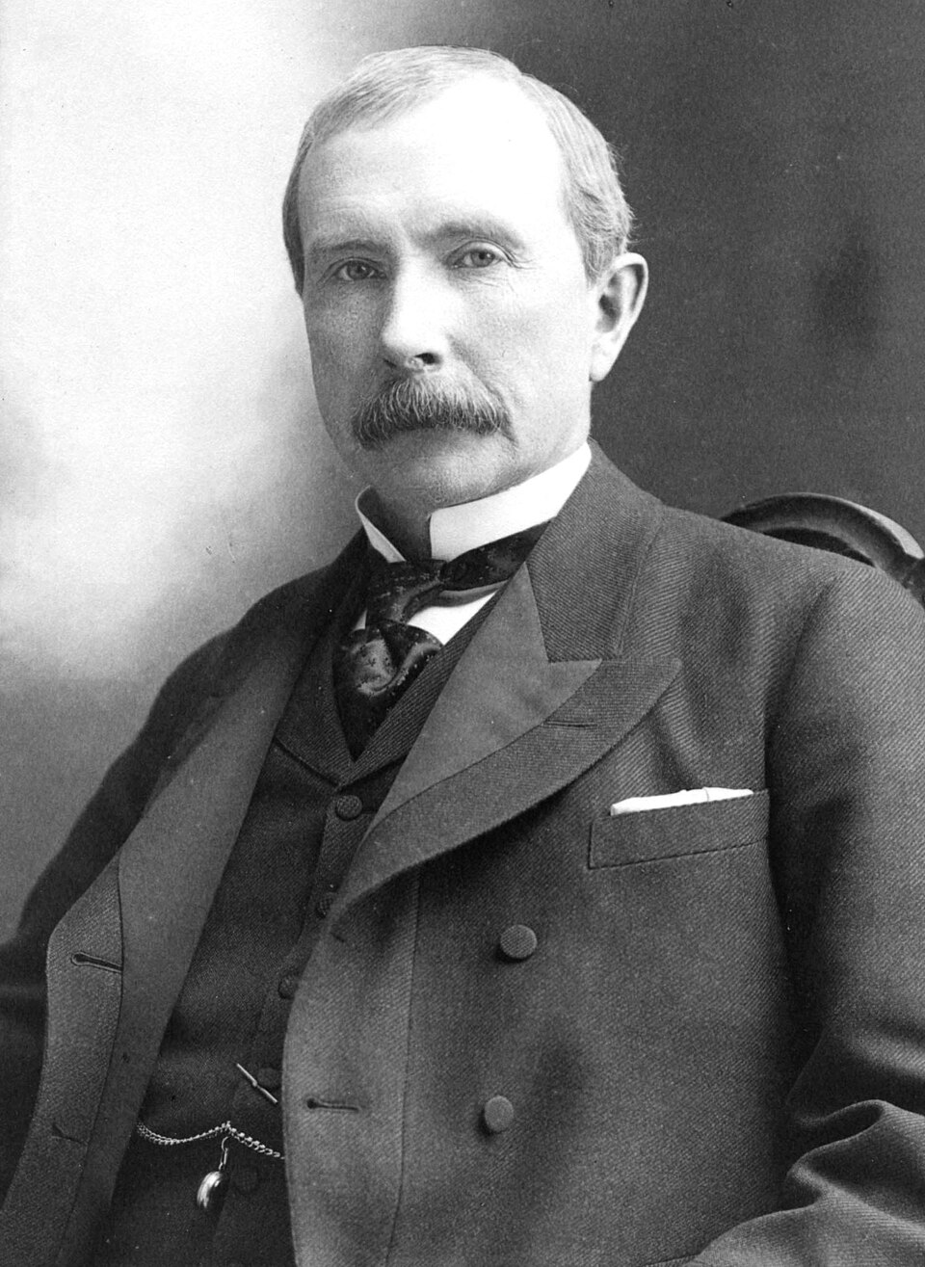
US.12 · DIRECT INSTRUCTION
1 of 4
Rise of Trusts and Monopolies
A trust is a legal arrangement where stockholders in multiple companies transfer their shares to a board of trustees that controls the entire industry.
John D. Rockefeller's Standard Oil used trusts to control 90% of U.S. oil refining by 1880 through horizontal integration — buying out competitors.
Andrew Carnegie used vertical integration in steel, controlling every step from iron ore mines to retail.
These structures eliminated competition and allowed corporations to set prices, cut wages, and dictate terms to suppliers and customers alike.
SENTENCE FRAME (EL & writing support)
Unknown, c. 1900 Wikimedia Commons
Companies like Standard Oil used ________ integration to control entire industries, leading Congress to pass the ________ to restore ________ competition.
TEACHER CUE Chunk → cold-call → confirm before advancing.
U.S. History Hack · TroopToTeacher Technologies LLC · Aligned to TN Academic Standards & TCAP EOC
71
Notes:
FACILITATION (US.12). Show the Standard Oil octopus cartoon (from _images.json). Silent look — Turn & Talk: 'What is this cartoon claiming about Standard Oil? What evidence in the text supports or challenges this claim?' Cold-call 2 pairs before moving to the Sherman Act excerpt. Teach in small steps; pause and check for understanding before the next chunk (aim 80%+ before moving on).

Slide 81
US.12 · DIRECT INSTRUCTION
2 of 4
Impact on Consumers, Workers, and Competition
Monopolies raised prices for consumers by eliminating competition.
Trusts could drive out smaller competitors through predatory pricing — temporarily selling below cost until rivals went bankrupt, then raising prices again.
Workers faced worse conditions because single-employer dominance eliminated labor market competition.
Small business owners could not compete against the economies of scale available to trusts.
The concentration of wealth in the hands of a few 'robber barons' threatened democratic equality and economic opportunity.
U.S. History Hack · TroopToTeacher Technologies LLC · Aligned to TN Academic Standards & TCAP EOC
72

Slide 82
US.12 · DIRECT INSTRUCTION
3 of 4
Sherman Antitrust Act (1890)
Congress passed the Sherman Antitrust Act in 1890, declaring illegal 'every contract, combination in the form of trust or otherwise, or conspiracy, in restraint of trade or commerce.' It was the first federal law to regulate corporate power.
However, early enforcement was weak — courts often applied it against labor unions rather than corporations.
Theodore Roosevelt later used it aggressively against trusts, filing 44 antitrust suits and earning the nickname 'trust-buster.'
U.S. History Hack · TroopToTeacher Technologies LLC · Aligned to TN Academic Standards & TCAP EOC
73

Slide 83
US.12 · DIRECT INSTRUCTION
4 of 4
Clayton Antitrust Act (1914)
The Clayton Antitrust Act of 1914, passed under Woodrow Wilson, strengthened the Sherman Act by specifically prohibiting price discrimination, exclusive dealing contracts, and interlocking directorates (the same people controlling competing companies).
Critically, it exempted labor unions from antitrust prosecution, recognizing workers' right to organize.
Labor leader Samuel Gompers called it 'labor's Magna Carta.' Together, the Sherman and Clayton Acts established the framework for federal antitrust enforcement that still governs U.S. business today.
U.S. History Hack · TroopToTeacher Technologies LLC · Aligned to TN Academic Standards & TCAP EOC
74

Slide 84
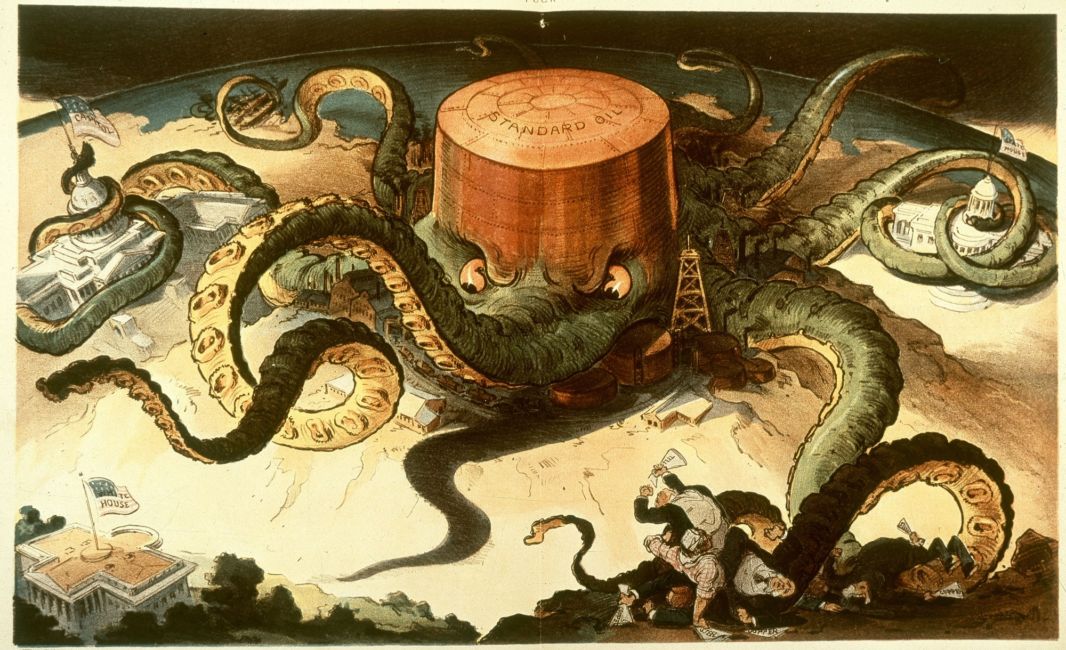
US.12 · PRIMARY SOURCE ANALYSIS
Sherman Antitrust Act
Close Reading
U.S. Congress · 1890
ZOOM IN Find ONE detail that surprises you — be ready to name it.
"Every contract, combination in the form of trust or otherwise, or conspiracy, in restraint of trade or commerce among the several States, or with foreign nations, is declared to be illegal... Every person who shall monopolize, or attempt to monopolize... any part of the trade or commerce among the several States... shall be deemed guilty of a felony."
CONTEXT
By 1890, a small number of giant corporations — called trusts — dominated entire industries in the United States. John D. Rockefeller's Standard Oil controlled 90% of the country's oil refining. Carnegie Steel dominated the steel industry. These monopolies crushed competitors, fixed prices, and exercised enormous political power. Public outrage over the trusts pushed Congress to act. The Sherman Antitrust Act of 1890 was the first federal law to restrict monopolistic business practices, though it was initially used more against labor unions than corporations. Theodore Roosevelt later used it aggressively to break up trusts in the early 1900s.
ANALYZE
What did the Sherman Antitrust Act make illegal?
Udo J. Keppler, 1904 Library of Congress
SOURCE IT
WHO made it?
WHEN?
WHY does it matter?
FIRST
U.S. Congress — a federal statute signed into law by President Harrison.
1890, as Standard Oil controlled 90% of American oil refining and trusts dominated steel, sugar, and tobacco.
Federal laws reveal what Congress believed needed government protection — ask what harm they were trying to prevent.
SSP.02 · before you interpret
Source: National Archives
U.S. History Hack · TroopToTeacher Technologies LLC · Aligned to TN Academic Standards & TCAP EOC
75
Notes:
Primary-source analysis. SOURCE IT FIRST (SSP.02) — model the sourcing routine aloud before students interpret: WHO made this source? (U.S. Congress — a federal statute signed into law by President Harrison.) WHEN? (1890, as Standard Oil controlled 90% of American oil refining and trusts dominated steel, sugar, and tobacco.) WHY does that matter? (Federal laws reveal what Congress believed needed government protection — ask what harm they were trying to prevent.) Only then move to the ANALYZE question. Suggested answer: The Act declares illegal any "contract, combination in the form of trust... or conspiracy, in restraint of trade" and criminalizes monopolization. Practice skill: Close Reading.

Slide 85
US.12 · KEY VOCABULARY
Word Wall
Trust
Trust (Fideicomiso)
Monopoly
Monopolio
say: muh-NOP-uh-lee
T
A legal arrangement where stockholders in several companies transfer their shares to a central board, creating a single entity that controls an entire industry and eliminates competition.
M
Complete control of a product or service by a single company, allowing it to set prices without competition — harmful to consumers, workers, and smaller businesses.
Sherman Antitrust Act
Ley Sherman Antimonopolio
Clayton Antitrust Act
Ley Clayton Antimonopolio
say: SHER-mun AN-tee-trust AKT
say: KLAY-tun AN-tee-trust AKT
SA
An 1890 federal law that made it illegal to form trusts, monopolies, or conspiracies that restrained trade — the first federal law to regulate corporate power.
CA
A 1914 law that strengthened the Sherman Act by prohibiting specific monopolistic practices and exempting labor unions from antitrust prosecution.
Vertical Integration
Integración Vertical
Horizontal Integration
Integración Horizontal
say: VER-tih-kul in-teh-GRAY-shun
say: hor-ih-ZON-tul in-teh-GRAY-shun
VI
A business strategy of controlling every stage of production — from raw materials to retail — used by Carnegie Steel to dominate the steel industry.
HI
A business strategy of buying out competitors in the same industry to eliminate competition — used by Rockefeller to control 90% of U.S. oil refining.
"say:" pronunciation guide (stressed syllable in CAPS) and a per-term visual anchor support newcomer English learners. Spanish term + full bilingual Frayer models are in the unit vocabulary set.
U.S. History Hack · TroopToTeacher Technologies LLC · Aligned to TN Academic Standards & TCAP EOC
76

Slide 86
US.12 · GUIDED PRACTICE — WE DO IT TOGETHER
Let’s Work One Together
Cause and effect / legislative reasoning
MODEL PROMPT: Standard Oil controls 90% of U.S. oil refining. What happens to prices, workers, and competitors — and why does Congress act?
WORKED EXAMPLE (teacher models this aloud)
CAUSE: Rockefeller eliminates competition through buyouts and predatory pricing. EFFECT ON PRICES: No competitors → Standard Oil sets any price it wants. EFFECT ON WORKERS: Single employer dominance → take low wages or don't work. EFFECT ON COMPETITORS: They're bankrupt or bought out. WHY CONGRESS ACTS: Democratic societies can't tolerate one private company controlling basic economic resources — that's economic tyranny, not free market.
THINK ALOUD
I'm connecting economic facts to political response. The law doesn't appear from nowhere — it's a reaction to documented harms. When you see a law on TCAP, ask: what problem was it solving?
→ Now you try: Write two sentences: one explaining what the Sherman Act prohibited, and one explaining why the Clayton Act was needed even after the Sherman Act existed.
U.S. History Hack · TroopToTeacher Technologies LLC · Aligned to TN Academic Standards & TCAP EOC
77
Notes:
GUIDED PRACTICE / WE DO (US.12). Skill modeled: Cause and effect / legislative reasoning. Model the worked example aloud using the THINK ALOUD as your script, then release students to the activity ("Write two sentences: one explaining what the Sherman Act prohibited, and one explaining why the Clayton Act was needed even after the Sherman Act existed."). This is the I Do → We Do → You Do bridge — do not skip it; aim for 80%+ success before independent work.

Slide 87
US.12 · STUDENT ACTIVITY
Antitrust Law Analysis — Before and After
Pairs
12 min
YOUR TASK
Using the Standard Oil octopus cartoon and the Sherman Antitrust Act excerpt, complete a Before/After organizer: (Before) Describe one way Standard Oil harmed consumers, one way it harmed workers, and one way it eliminated competition. (After) Describe one thing the Sherman Act prohibited, one weakness in early enforcement, and one way the Clayton Act (1914) strengthened it. Then write one sentence: Why did Congress need TWO separate antitrust laws — what did the second one fix that the first one missed?
DELIVERABLE
DIFFERENTIATION
Completed Before/After organizer (three rows each side) AND a one-sentence explanation of why the Clayton Act was needed after the Sherman Act already existed.
Entry: Before/After organizer pre-filled with one example in each section; students complete the remaining two rows per section. Final sentence frame: 'The Clayton Act was needed because the Sherman Act ___.' Honors: Evaluate the Standard Oil case (1911): The Supreme Court broke Standard Oil into 34 companies. Was this an effective solution to the monopoly problem? Write two sentences — one arguing yes (with evidence) and one identifying a limitation of the breakup. Then explain which side of the argument you find more historically compelling.
Companion printable: cornell-notes/unit-2/us12-trusts-antitrust.pdf
U.S. History Hack · TroopToTeacher Technologies LLC · Aligned to TN Academic Standards & TCAP EOC
78
Notes:
Student activity for US.12. Pair with the printable: cornell-notes/unit-2/us12-trusts-antitrust.pdf. Timing: 12. Deliverable: Completed Before/After organizer (three rows each side) AND a one-sentence explanation of why the Clayton Act was needed after the Sherman Act already existed.

Slide 88
US.12 · CHECK FOR UNDERSTANDING
TCAP-Style Question
DOK 2
EOC PRACTICE
What did the Sherman Antitrust Act make illegal?
All large businesses and corporations
A
Interstate commerce of any kind
B
Trusts, monopolies, and conspiracies that restrain trade
C
Labor unions and worker organizations
D
ANSWER FIRST: students commit — then click / advance to reveal the correct answer and explanation.
U.S. History Hack · TroopToTeacher Technologies LLC · Aligned to TN Academic Standards & TCAP EOC
79
Notes:
CHECK FOR UNDERSTANDING (US.12, DOK 2). Have students commit to an answer (whiteboards, hand signal, or turn-and-talk) BEFORE advancing. Correct answer: C. The next slide reveals it. Why: The Act declares illegal any "contract, combination in the form of trust... or conspiracy, in restraint of trade" and criminalizes monopolization.

Slide 89
US.12 · ANSWER REVEAL
TCAP-Style Question
✓ ANSWER KEY
What did the Sherman Antitrust Act make illegal?
A
All large businesses and corporations
B
Interstate commerce of any kind
C
Trusts, monopolies, and conspiracies that restrain trade
✓
D
Labor unions and worker organizations
Correct answer: C. Why: The Act declares illegal any "contract, combination in the form of trust... or conspiracy, in restraint of trade" and criminalizes monopolization.
U.S. History Hack · TroopToTeacher Technologies LLC · Aligned to TN Academic Standards & TCAP EOC
80
Notes:
ANSWER KEY (US.12). Correct: C. The Act declares illegal any "contract, combination in the form of trust... or conspiracy, in restraint of trade" and criminalizes monopolization.

Slide 90
US.12 · WRAP-UP
What You Need to Know for TCAP
KEY TAKEAWAYS
EXIT TICKET
DOK 2
Rise of Trusts and Monopolies
Impact on Consumers, Workers, and Competition
Sherman Antitrust Act (1890)
Clayton Antitrust Act (1914)
Explain the difference between the Sherman Antitrust Act (1890) and the Clayton Antitrust Act (1914). Why was the second law necessary?
★ HONORS / EXTENSION DOK 3 · SSP.04 Argumentation
The Supreme Court's 'rule of reason' in Standard Oil Co. v. United States (1911) held that only 'unreasonable' restraints of trade were illegal. Argue: Did this decision strengthen or weaken antitrust enforcement? Was breaking up Standard Oil a genuine victory for consumers, or did it just create new concentrated markets? (SSP.04)
U.S. History Hack · TroopToTeacher Technologies LLC · Aligned to TN Academic Standards & TCAP EOC
81
Notes:
WRAP-UP / EXIT-TICKET KEY (US.12, DOK 2). Prompt: Explain the difference between the Sherman Antitrust Act (1890) and the Clayton Antitrust Act (1914). Why was the second law necessary? Model answer: The Sherman Act (1890) broadly banned combinations 'in restraint of trade' but used vague language that courts often interpreted narrowly, and it was initially used against labor unions as much as corporations. The Clayton Act (1914) strengthened the law by specifically banning price discrimination, exclusive dealing contracts, and interlocking directorates; it also explicitly exempted labor unions from antitrust law. The second law was needed because the Sherman Act alone proved insufficient to effectively break corporate power. RETEACH TRIGGER — if a student misses this exit ticket: (1) <50% of class miss → spiral it into the next standard’s Quick Review opener (see the US.12 review prompts). (2) Individual/small group → reteach with the "Rise of Trusts and Monopolies" direct-instruction slide + re-run the SOURCE IT FIRST routine on the US.12 primary source, then assign the paired printable: cornell-notes/unit-2/us12-trusts-antitrust.pdf. (3) Re-assess with the US.12 check-for-understanding reveal slide as a do-now the next day. Reteach anchors (this standard’s sections): Rise of Trusts and Monopolies; Impact on Consumers, Workers, and Competition; Sherman Antitrust Act (1890); Clayton Antitrust Act (1914). I Can objective: I can describe the rise of trusts and monopolies, their impact on consumers and workers, and the government's response including the Sherman Antitrust Act (1890) and the Clayton Antitrust Act (1914). HONORS / EXTENSION (DOK 3, for early finishers or advanced learners): The Supreme Court's 'rule of reason' in Standard Oil Co. v. United States (1911) held that only 'unreasonable' restraints of trade were illegal. Argue: Did this decision strengthen or weaken antitrust enforcement? Was breaking up Standard Oil a genuine victory for consumers, or did it just create new concentrated markets? (SSP.04) — look for a clear claim plus two specific pieces of evidence.

Slide 91
STANDARD
SOCIAL STUDIES PRACTICES
US.13
SSP.01
Collect sources
SSP.02
Examine a source
SSP.04
Build an argument
SSP.05
Historical awareness
Working Conditions, Women & Child Labor
TN ACADEMIC STANDARD
Describe working conditions in industries during this era, including the use of labor by women and children.
I CAN
I can describe working conditions in industries during this era, including the use of labor by women and children.
U.S. History Hack · TroopToTeacher Technologies LLC · Aligned to TN Academic Standards & TCAP EOC
82

Slide 92
KEY VOCABULARY · LANGUAGE SUPPORT
US.12
Words you need before we read
Trust
Monopoly
Sherman Antitrust Act
En español: Trust (Fideicomiso)
En español: Monopolio
En español: Ley Sherman Antimonopolio
WHAT IT MEANS
WHAT IT MEANS
WHAT IT MEANS
A legal arrangement where stockholders in several companies transfer their shares to a central board, creating a single entity that controls an entire industry and eliminates competition.
Complete control of a product or service by a single company, allowing it to set prices without competition — harmful to consumers, workers, and smaller businesses.
An 1890 federal law that made it illegal to form trusts, monopolies, or conspiracies that restrained trade — the first federal law to regulate corporate power.
UDL · REPRESENTATION → LANGUAGE & SYMBOLS
U.S. History Hack · TEACHER DECK · Aligned to TN Academic Standards & TCAP EOC
10

Slide 93
PROGRESS CHECK
US.12
Check your understanding
Evaluate whether the Clayton Antitrust Act of 1914 successfully addressed the limitations of earlier antitrust legislation.
A
By specifying illegal practices, exempting labor unions, and creating the FTC for enforcement, the Clayton Act improved antitrust effectiveness, though success still depended on political will to enforce it
✓ KEY
B
The Clayton Act was identical to the Sherman Act, which represents a common misconception about the period and fails to account for key developments in the broader context, but contemporary accounts and primary sources suggest otherwise
C
The Clayton Act weakened antitrust enforcement, which represents a common misconception about the period, which represents a common misconception about this historical period and does not reflect the scholarly consensus on this topic
D
Antitrust laws had no impact on business practices, but the historical record tells a more complex story, and this view has been largely revised by modern historical research, but the historical evidence paints a more nuanced picture
UDL · ACTION & EXPRESSION → STRATEGY DEVELOPMENT
MTSS: below mastery → targeted reteach (Tier 2); at/above → extension. The goal never lowers.
U.S. History Hack · TEACHER DECK · Aligned to TN Academic Standards & TCAP EOC
11

Slide 94
US.13 · QUICK REVIEW
Do You Remember?
Before we start, retrieve what we have already learned. Answer from memory first — no notes.
1
US.12 What was the Sherman Antitrust Act, and what did it prohibit?
2
US.12 What is the difference between vertical and horizontal integration?
U.S. History Hack · TroopToTeacher Technologies LLC · Aligned to TN Academic Standards & TCAP EOC
83
Notes:
SPACED RETRIEVAL (US.13). Cold-call or whiteboards, 3-4 min, low stakes. Answers — 1) The Sherman Antitrust Act (1890) was the first federal law to ban monopolistic combinations 'in restraint of trade,' giving the government authority to break up trusts. 2) Horizontal integration means buying up competitors in the same industry (Rockefeller buying rival refineries); vertical integration means controlling all stages of production from raw material to final product (Carnegie owning mines, railroads, and steel mills).

Slide 95
US.13 · CONFIDENCE CHECK
Warm-Up — Quick Recall
DOK 1
LOW STAKES
Everyone can answer this. Thumbs / whiteboards — no notes.
What one word names a crowded, unsafe, poorly paid factory where workers — often women and children — worked long hours for low wages?
✓ ANSWER
Sweatshop — a factory where workers, typically immigrants, worked under dangerous conditions for minimal pay, often in the garment industry.
COMMIT FIRST: have everyone answer before the reveal — this is the DOK 1 floor; the graded check later in this lesson moves up to DOK 2–3.
U.S. History Hack · TroopToTeacher Technologies LLC · Aligned to TN Academic Standards & TCAP EOC
84
Notes:
CONFIDENCE CHECK (US.13, DOK 1). 60-90 seconds. Have EVERY student commit (thumbs / whiteboard / choral) before revealing — this secures an early win and surfaces who is shaky before new content. Answer: Sweatshop — a factory where workers, typically immigrants, worked under dangerous conditions for minimal pay, often in the garment industry. Key term to listen for: Sweatshop. This is the low-floor entry; the graded Check for Understanding later in the standard rises to DOK 2–3.

Slide 96
US.13 · HOOK
Think About It
On March 25, 1911, 146 workers — mostly young immigrant women — died at the Triangle Shirtwaist Factory fire in New York City. The exit doors had been locked by management to prevent theft.
DISCUSS
TIMING: Turn & Talk 60 sec → cold-call 2 pairs
When a workplace is so dangerous that locked doors become death traps, who bears responsibility — the employer, the government, the consumer, or all three? This tragedy changed American law forever.
U.S. History Hack · TroopToTeacher Technologies LLC · Aligned to TN Academic Standards & TCAP EOC
85
Notes:
HOOK (US.13). Run tight: pose the provocation, give a silent 10-second think, then Turn & Talk 60 seconds. Cold-call 2–3 pairs (not volunteers) for a sentence-starter answer — "One force was ___ because ___" — then bridge to the standard. Keep total to ~4 minutes; do not let it sprawl. Return to this question at the unit close for an evidence-based answer.

Slide 97
US.13 · DIRECT INSTRUCTION
1 of 4
Industrial Working Conditions
Factory workers in the Progressive Era faced 10–16 hour days, six or seven days per week, with no overtime pay, no sick leave, no workers' compensation for injuries, and no job security.
Factories were often dangerous: unguarded machinery, toxic fumes, extreme heat, and falling objects caused thousands of deaths and injuries each year.
Employers could dismiss workers at will.
The Triangle Shirtwaist Factory fire of 1911 in New York City — killing 146 workers trapped behind locked doors — became the defining symbol of the era's labor abuses.
SENTENCE FRAME (EL & writing support)
In the early 1900s, workers in ________ faced dangerous conditions including ________, which the ________ tragedy made impossible to ignore.
U.S. History Hack · TroopToTeacher Technologies LLC · Aligned to TN Academic Standards & TCAP EOC
86
Notes:
FACILITATION (US.13). Show the Hine child labor photograph before the lesson. Silent look — 'What do you notice? What do you wonder?' Turn & Talk — cold-call 2 pairs. Then connect: 'This photographer was doing exactly what you're doing right now — looking closely at evidence.' Teach in small steps; pause and check for understanding before the next chunk (aim 80%+ before moving on).

Slide 98
US.13 · DIRECT INSTRUCTION
2 of 4
Women in the Industrial Workforce
Women made up a large portion of the industrial workforce, concentrated in garment factories, textile mills, food processing, and domestic service.
They were paid significantly less than men for the same work — often half or less.
They faced sexual harassment, limited advancement, and dismissal if they married or became pregnant.
Many immigrant women worked in sweatshops — small workshops with especially poor pay and conditions.
Despite these obstacles, women workers also led some of the most significant labor actions of the era, including the 1909 'Uprising of the 20,000' garment workers strike in New York.
U.S. History Hack · TroopToTeacher Technologies LLC · Aligned to TN Academic Standards & TCAP EOC
87

Slide 99
US.13 · DIRECT INSTRUCTION
3 of 4
Child Labor Practices
Children as young as 5 or 6 worked in coal mines, textile mills, canneries, and glass factories.
An estimated 1.75 million children under age 15 worked in American industry by 1900.
They received the lowest wages, performed the most dangerous small-space work in mines, and were exposed to toxic materials without protection.
Reformer and photographer Lewis Hine documented child labor conditions in powerful photographs that helped build public support for reform.
The National Child Labor Committee lobbied for protective legislation, which many Southern states resisted.
U.S. History Hack · TroopToTeacher Technologies LLC · Aligned to TN Academic Standards & TCAP EOC
88

Slide 100
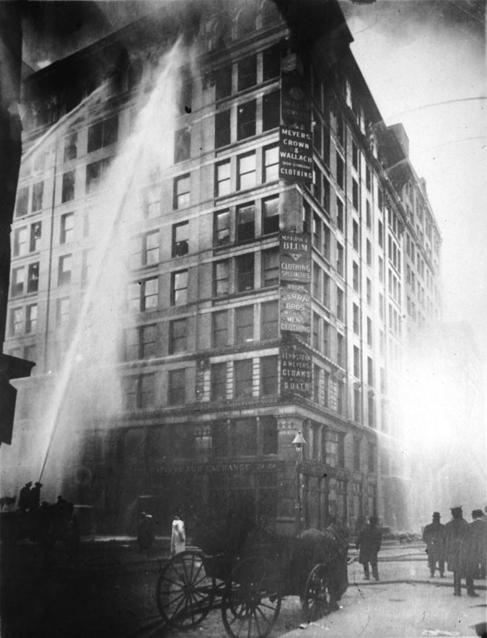
US.13 · DIRECT INSTRUCTION
4 of 4
The Triangle Shirtwaist Fire
On March 25, 1911, fire broke out at the Triangle Shirtwaist Factory in New York City.
The building's exits were locked to prevent theft and unauthorized breaks.
Workers — mostly young immigrant women — were trapped on upper floors. 146 workers died, either burned or jumping from windows.
The outrage that followed drove New York State to pass 36 new worker safety laws within three years and prompted national demands for factory safety standards.
Tennessee garment workers shared these dangerous conditions, and the fire directly accelerated reform efforts across the country.
★ TENNESSEE CONNECTION
Tennessee garment workers labored under the same unsafe conditions as Triangle's victims; the 1911 fire accelerated demands for factory-safety laws across the South, Tennessee included.
Unknown, 1911 Library of Congress
U.S. History Hack · TroopToTeacher Technologies LLC · Aligned to TN Academic Standards & TCAP EOC
89

Slide 101
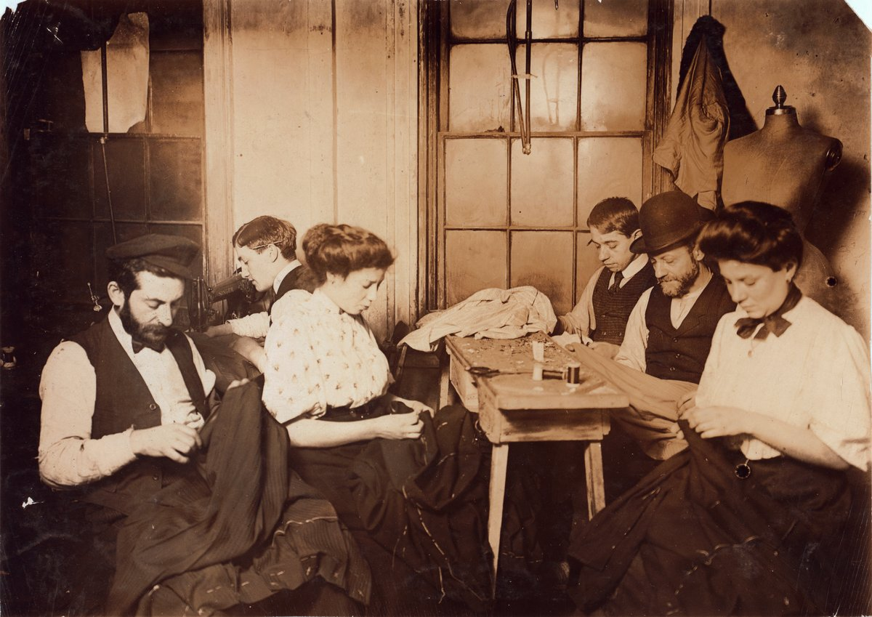
US.13 · PRIMARY SOURCE ANALYSIS
Triangle Shirtwaist Factory Fire Survivor Account
Sourcing
Rose Safran · 1911
ZOOM IN Find ONE detail that surprises you — be ready to name it.
"The door was locked and immediately there was a great jam of girls behind me... I stood there crying and praying while some girls jumped from the window ledge. They went through the air like bundles. I knew that if the door was not opened I would die on the window ledge or be pushed off. The whole thing was over in seven minutes."
CONTEXT
The Triangle Shirtwaist Factory fire of March 25, 1911 was one of the deadliest industrial disasters in American history. The fire killed 146 garment workers — mostly young immigrant women — because the factory owners had locked the exit doors to prevent theft and unauthorized breaks. Workers were trapped on the upper floors of a Greenwich Village building, and many jumped to their deaths rather than burn. The disaster shocked the nation and catalyzed the labor reform movement, leading to major improvements in New York State's factory safety laws and fueling the growth of the International Ladies' Garment Workers' Union (ILGWU).
ANALYZE
What does this account reveal about working conditions at the Triangle Factory?
Unknown, 1908 Library of Congress
SOURCE IT
WHO made it?
WHEN?
WHY does it matter?
FIRST
Rose Safran — a young immigrant worker who survived the Triangle fire.
1911, weeks after the fire; she is testifying about what she witnessed firsthand.
Survivor testimony is powerful primary evidence — but always ask: what could this witness see, and what might they not know?
SSP.02 · before you interpret
Source: Cornell University ILR School
U.S. History Hack · TroopToTeacher Technologies LLC · Aligned to TN Academic Standards & TCAP EOC
90
Notes:
Primary-source analysis. SOURCE IT FIRST (SSP.02) — model the sourcing routine aloud before students interpret: WHO made this source? (Rose Safran — a young immigrant worker who survived the Triangle fire.) WHEN? (1911, weeks after the fire; she is testifying about what she witnessed firsthand.) WHY does that matter? (Survivor testimony is powerful primary evidence — but always ask: what could this witness see, and what might they not know?) Only then move to the ANALYZE question. Suggested answer: The survivor explicitly states "The door was locked," causing girls to jam behind it and others to jump from windows, revealing deadly safety violations. Practice skill: Sourcing.

Slide 102
US.13 · KEY VOCABULARY
Word Wall
Sweatshop
Taller de Explotación
Child Labor
Trabajo Infantil
S
A factory or workshop where workers faced long hours, low wages, and dangerous or unhealthy conditions — common in the garment industry employing immigrant women.
CL
The employment of children — sometimes as young as 5 or 6 — in factories, mines, and mills; an estimated 1.75 million children worked in American industry by 1900.
Triangle Shirtwaist Fire
Incendio de la Fábrica Triangle
Lewis Hine
Lewis Hine
say: TRY-ang-gul SHERT-wayst FYR
TS
A 1911 factory fire in New York City that killed 146 workers — mostly young immigrant women — trapped by locked exits, becoming a catalyst for worker safety reform.
LH
Progressive Era photographer whose documentation of child labor in mines, mills, and canneries helped build public support for child labor laws.
Workers' Compensation
Compensación Laboral
National Child Labor Committee
Comité Nacional de Trabajo Infantil
say: WER-kerz kom-pen-SAY-shun
WC
A system requiring employers to pay workers injured on the job — did not exist in most states before Progressive Era reform; injured workers had no recourse.
NC
Reform organization founded in 1904 that used photography, lobbying, and public campaigns to expose child labor and push for protective legislation.
"say:" pronunciation guide (stressed syllable in CAPS) and a per-term visual anchor support newcomer English learners. Spanish term + full bilingual Frayer models are in the unit vocabulary set.
U.S. History Hack · TroopToTeacher Technologies LLC · Aligned to TN Academic Standards & TCAP EOC
91

Slide 103
US.13 · GUIDED PRACTICE — WE DO IT TOGETHER
Let’s Work One Together
Primary source analysis / sourcing
MODEL PROMPT: Before reading Rose Safran's testimony, let's SOURCE IT FIRST: Who is she, when did she speak, and why does that matter?
WORKED EXAMPLE (teacher models this aloud)
WHO: Rose Safran is a survivor — she was there. That gives her testimony first-hand authority. WHEN: 1911, immediately after the fire — fresh memory, high emotion. WHY IT MATTERS: A survivor's account is powerful evidence because she experienced it. BUT — she may also be traumatized and have reasons to emphasize certain details. We read carefully, not just emotionally.
THINK ALOUD
Sourcing doesn't mean doubting the witness — it means understanding the lens through which they speak. Safran's testimony is reliable evidence of what she experienced. The question is: what can we conclude from her experience about POLICY?
→ Now you try: Write one sentence: what policy change does Safran's testimony provide evidence for? (Hint: what physical condition caused the deaths?)
U.S. History Hack · TroopToTeacher Technologies LLC · Aligned to TN Academic Standards & TCAP EOC
92
Notes:
GUIDED PRACTICE / WE DO (US.13). Skill modeled: Primary source analysis / sourcing. Model the worked example aloud using the THINK ALOUD as your script, then release students to the activity ("Write one sentence: what policy change does Safran's testimony provide evidence for? (Hint: what physical condition caused the deaths?)"). This is the I Do → We Do → You Do bridge — do not skip it; aim for 80%+ success before independent work.

Slide 104
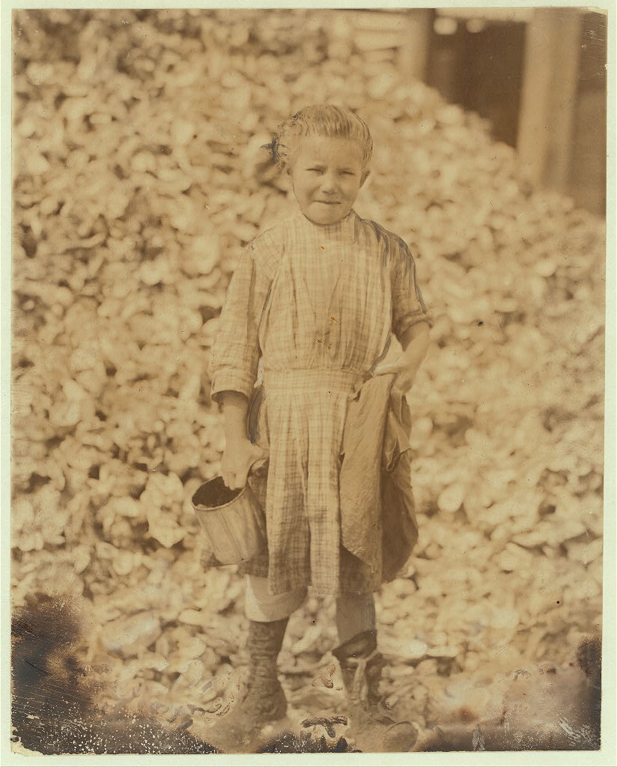
US.13 · STUDENT ACTIVITY
Triangle Fire — Evidence to Policy Reform Argument
Pairs
15 min
YOUR TASK
Using Rose Safran's testimony and the Lewis Hine photograph, build an evidence-to-policy argument in three steps: Step 1 — List two specific working conditions Safran's testimony documents as dangerous. Step 2 — Identify which condition directly caused the most deaths (cite the testimony). Step 3 — Write a one-paragraph policy recommendation (3–5 sentences): What specific law would you propose to prevent this from happening again, and what evidence from the primary source justifies each element of your law? Your paragraph must use at least two pieces of evidence.
Lewis Hine, 1908 Library of Congress
DELIVERABLE
DIFFERENTIATION
Completed Steps 1–2 (listed evidence) PLUS a one-paragraph policy recommendation that cites at least two pieces of evidence from the primary sources.
Entry: Steps 1–2 pre-started with one condition identified; students complete Step 2 and write a policy recommendation using a sentence frame: 'A law should require ___ because the primary source shows ___.' Honors: Research extension: New York passed 36 worker safety laws within three years of the Triangle fire. Write two sentences identifying what interest groups would SUPPORT these laws and what interest groups would OPPOSE them — and explain why the fire shifted the balance of political power toward reform.
Companion printable: cornell-notes/unit-2/us13-working-conditions.pdf
U.S. History Hack · TroopToTeacher Technologies LLC · Aligned to TN Academic Standards & TCAP EOC
93
Notes:
Student activity for US.13. Pair with the printable: cornell-notes/unit-2/us13-working-conditions.pdf. Timing: 15. Deliverable: Completed Steps 1–2 (listed evidence) PLUS a one-paragraph policy recommendation that cites at least two pieces of evidence from the primary sources.

Slide 105
US.13 · CHECK FOR UNDERSTANDING
TCAP-Style Question
DOK 2
EOC PRACTICE
What does this account reveal about working conditions at the Triangle Factory?
Doors were locked, trapping workers inside during the fire
A
Fire escapes and exits were well-maintained
B
Workers had adequate time to evacuate safely
C
Fire drills had prepared workers for emergencies
D
ANSWER FIRST: students commit — then click / advance to reveal the correct answer and explanation.
U.S. History Hack · TroopToTeacher Technologies LLC · Aligned to TN Academic Standards & TCAP EOC
94
Notes:
CHECK FOR UNDERSTANDING (US.13, DOK 2). Have students commit to an answer (whiteboards, hand signal, or turn-and-talk) BEFORE advancing. Correct answer: A. The next slide reveals it. Why: The survivor explicitly states "The door was locked," causing girls to jam behind it and others to jump from windows, revealing deadly safety violations.

Slide 106
US.13 · ANSWER REVEAL
TCAP-Style Question
✓ ANSWER KEY
What does this account reveal about working conditions at the Triangle Factory?
A
Doors were locked, trapping workers inside during the fire
✓
B
Fire escapes and exits were well-maintained
C
Workers had adequate time to evacuate safely
D
Fire drills had prepared workers for emergencies
Correct answer: A. Why: The survivor explicitly states "The door was locked," causing girls to jam behind it and others to jump from windows, revealing deadly safety violations.
U.S. History Hack · TroopToTeacher Technologies LLC · Aligned to TN Academic Standards & TCAP EOC
95
Notes:
ANSWER KEY (US.13). Correct: A. The survivor explicitly states "The door was locked," causing girls to jam behind it and others to jump from windows, revealing deadly safety violations.

Slide 107
US.13 · WRAP-UP
What You Need to Know for TCAP
KEY TAKEAWAYS
EXIT TICKET
DOK 2
Industrial Working Conditions
Women in the Industrial Workforce
Child Labor Practices
The Triangle Shirtwaist Fire
Describe TWO specific working conditions in early 20th-century industries that reformers targeted, and explain what reform or law addressed each.
★ HONORS / EXTENSION DOK 3 · SSP.04 Argumentation
The Triangle fire owners were acquitted of manslaughter in 1911. Argue: Was the legal system the right mechanism for holding employers accountable for workplace deaths, or were legislative reforms (factory laws, workers' comp) more effective? Support with evidence. (SSP.04)
U.S. History Hack · TroopToTeacher Technologies LLC · Aligned to TN Academic Standards & TCAP EOC
96
Notes:
WRAP-UP / EXIT-TICKET KEY (US.13, DOK 2). Prompt: Describe TWO specific working conditions in early 20th-century industries that reformers targeted, and explain what reform or law addressed each. Model answer: 1. Child labor — children as young as 8 worked in mines and mills for pennies; Lewis Hine's photographs built public support; the Keating-Owen Child Labor Act (1916) restricted interstate commerce in goods made with child labor. 2. Unsafe factory conditions — locked exits and fire hazards (Triangle fire 1911) killed workers; New York responded with a Factory Investigating Commission that led to 36 new labor laws including mandatory fire escapes and fire drills. Also acceptable: long hours addressed by state maximum-hours laws, no workers' compensation addressed by state comp laws. RETEACH TRIGGER — if a student misses this exit ticket: (1) <50% of class miss → spiral it into the next standard’s Quick Review opener (see the US.13 review prompts). (2) Individual/small group → reteach with the "Industrial Working Conditions" direct-instruction slide + re-run the SOURCE IT FIRST routine on the US.13 primary source, then assign the paired printable: cornell-notes/unit-2/us13-working-conditions.pdf. (3) Re-assess with the US.13 check-for-understanding reveal slide as a do-now the next day. Reteach anchors (this standard’s sections): Industrial Working Conditions; Women in the Industrial Workforce; Child Labor Practices; The Triangle Shirtwaist Fire. I Can objective: I can describe working conditions in industries during this era, including the use of labor by women and children. HONORS / EXTENSION (DOK 3, for early finishers or advanced learners): The Triangle fire owners were acquitted of manslaughter in 1911. Argue: Was the legal system the right mechanism for holding employers accountable for workplace deaths, or were legislative reforms (factory laws, workers' comp) more effective? Support with evidence. (SSP.04) — look for a clear claim plus two specific pieces of evidence.

Slide 108
STANDARD
SOCIAL STUDIES PRACTICES
US.14
SSP.01
Collect sources
SSP.02
Examine a source
SSP.03
Synthesize sources
SSP.04
Build an argument
Muckrakers & Progressive Idealists
TN ACADEMIC STANDARD
Explain the roles played by muckrakers and progressive idealists, including: Robert M. La Follette, Sr., President Theodore Roosevelt, Upton Sinclair, Lincoln Steffens, Ida Tarbell.
I CAN
I can explain the roles played by muckrakers and progressive idealists, including Robert M. La Follette Sr., President Theodore Roosevelt, Upton Sinclair, Lincoln Steffens, and Ida Tarbell.
U.S. History Hack · TroopToTeacher Technologies LLC · Aligned to TN Academic Standards & TCAP EOC
97

Slide 109
KEY VOCABULARY · LANGUAGE SUPPORT
US.13
Words you need before we read
Sweatshop
Child Labor
Triangle Shirtwaist Fire
En español: Taller de Explotación
En español: Trabajo Infantil
En español: Incendio de la Fábrica Triangle
WHAT IT MEANS
WHAT IT MEANS
WHAT IT MEANS
A factory or workshop where workers faced long hours, low wages, and dangerous or unhealthy conditions — common in the garment industry employing immigrant women.
The employment of children — sometimes as young as 5 or 6 — in factories, mines, and mills; an estimated 1.75 million children worked in American industry by 1900.
A 1911 factory fire in New York City that killed 146 workers — mostly young immigrant women — trapped by locked exits, becoming a catalyst for worker safety reform.
UDL · REPRESENTATION → LANGUAGE & SYMBOLS
U.S. History Hack · TEACHER DECK · Aligned to TN Academic Standards & TCAP EOC
12

Slide 110
PROGRESS CHECK
US.13
Check your understanding
Analyze how tragedies like the Triangle Shirtwaist Factory Fire led to workplace safety reforms.
A
The fire had no impact on workplace safety, although this view has been largely discredited by scholars despite the fact that multiple contemporary sources contradict this
B
The deaths of 146 workers from locked exits, inadequate fire safety, and collapsed fire escapes shocked the public and led to fire codes, factory inspections, and workers' compensation laws
✓ KEY
C
Workplace safety was already adequate before the fire, but contemporary accounts suggest a different explanation, which represents a common misconception about this historical period
D
Reforms only affected the garment industry, despite limited evidence supporting this interpretation, although historical sources do not support this conclusion
UDL · ACTION & EXPRESSION → STRATEGY DEVELOPMENT
MTSS: below mastery → targeted reteach (Tier 2); at/above → extension. The goal never lowers.
U.S. History Hack · TEACHER DECK · Aligned to TN Academic Standards & TCAP EOC
13

Slide 111
US.14 · QUICK REVIEW
Do You Remember?
Before we start, retrieve what we have already learned. Answer from memory first — no notes.
1
US.13 What was the Triangle Shirtwaist Fire and what reform did it most directly trigger?
2
US.13 Who was Lewis Hine, and how did his work contribute to reform?
U.S. History Hack · TroopToTeacher Technologies LLC · Aligned to TN Academic Standards & TCAP EOC
98
Notes:
SPACED RETRIEVAL (US.14). Cold-call or whiteboards, 3-4 min, low stakes. Answers — 1) The 1911 fire killed 146 workers (mostly young immigrant women) in a locked factory; it directly triggered fire safety codes, workers' compensation laws, and factory inspection requirements in New York and eventually nationwide. 2) Lewis Hine was a photographer who documented child labor conditions in factories and mines; his images were used by the National Child Labor Committee to build public support for child labor laws.

Slide 112
US.14 · CONFIDENCE CHECK
Warm-Up — Quick Recall
DOK 1
LOW STAKES
Everyone can answer this. Thumbs / whiteboards — no notes.
What is the nickname for the investigative journalists who exposed corruption, unsafe conditions, and corporate abuse in the Progressive Era?
✓ ANSWER
Muckrakers — journalists like Ida Tarbell, Upton Sinclair, and Lincoln Steffens who investigated and exposed wrongdoing to build public pressure for reform.
COMMIT FIRST: have everyone answer before the reveal — this is the DOK 1 floor; the graded check later in this lesson moves up to DOK 2–3.
U.S. History Hack · TroopToTeacher Technologies LLC · Aligned to TN Academic Standards & TCAP EOC
99
Notes:
CONFIDENCE CHECK (US.14, DOK 1). 60-90 seconds. Have EVERY student commit (thumbs / whiteboard / choral) before revealing — this secures an early win and surfaces who is shaky before new content. Answer: Muckrakers — journalists like Ida Tarbell, Upton Sinclair, and Lincoln Steffens who investigated and exposed wrongdoing to build public pressure for reform. Key term to listen for: Muckraker. This is the low-floor entry; the graded Check for Understanding later in the standard rises to DOK 2–3.

Slide 113
US.14 · HOOK
Think About It
In 1906, Upton Sinclair published 'The Jungle' — a novel exposing Chicago meatpacking plants so graphically that President Roosevelt reportedly threw his sausage out the window after reading it at breakfast.
DISCUSS
TIMING: Turn & Talk 60 sec → cold-call 2 pairs
Can one book change a nation's laws? Sinclair wanted to expose worker exploitation — but what Americans responded to most was the food safety crisis. Does that say something about what moves people to demand reform?
U.S. History Hack · TroopToTeacher Technologies LLC · Aligned to TN Academic Standards & TCAP EOC
100
Notes:
HOOK (US.14). Run tight: pose the provocation, give a silent 10-second think, then Turn & Talk 60 seconds. Cold-call 2–3 pairs (not volunteers) for a sentence-starter answer — "One force was ___ because ___" — then bridge to the standard. Keep total to ~4 minutes; do not let it sprawl. Return to this question at the unit close for an evidence-based answer.

Slide 114
US.14 · DIRECT INSTRUCTION
1 of 4
The Muckrakers
Muckrakers were investigative journalists and authors who exposed corruption, corporate abuse, and social injustice.
President Roosevelt coined the term from Bunyan's 'Pilgrim's Progress' — a man so focused on raking muck he could not look up.
McClure's Magazine (founded 1893) became the leading platform for muckraking, publishing Tarbell's Standard Oil investigation and Steffens's city corruption exposés simultaneously in 1902.
Their evidence-based journalism shaped public opinion, built pressure for reform, and demonstrated the power of a free press to hold power accountable.
SENTENCE FRAME (EL & writing support)
Muckrakers like ________ exposed the problem of ________ through investigative journalism, which helped lead to the passage of ________.
U.S. History Hack · TroopToTeacher Technologies LLC · Aligned to TN Academic Standards & TCAP EOC
101
Notes:
FACILITATION (US.14). Present the Tarbell quote without context: 'It's business — Loss of Liberty.' Turn & Talk: 'What is she calling out? Is this journalism or opinion?' Cold-call 2 pairs; push them to distinguish between a documented claim and an editorial judgment — then reveal she had both kinds of evidence. Teach in small steps; pause and check for understanding before the next chunk (aim 80%+ before moving on).

Slide 115
US.14 · DIRECT INSTRUCTION
2 of 4
Robert M. La Follette and the Wisconsin Idea
Robert M. La Follette Sr. ('Fighting Bob') transformed Wisconsin into 'the laboratory of democracy.' As governor (1901–1906) and U.S. Senator, he pioneered the direct primary, railroad regulation, and the 'Wisconsin Idea' — using university experts to draft and administer legislation.
La Follette demonstrated that Progressive reform could work through existing government structures.
His model was emulated by reformers across the country and anticipated the policy-expert approach that would define 20th-century government.
U.S. History Hack · TroopToTeacher Technologies LLC · Aligned to TN Academic Standards & TCAP EOC
102

Slide 116
US.14 · DIRECT INSTRUCTION
3 of 4
Lincoln Steffens and Ida Tarbell
Lincoln Steffens's 'The Shame of the Cities' (1904) exposed systematic municipal corruption — showing how city governments across America were controlled by political bosses working for business interests.
Ida Tarbell's two-year investigation of Standard Oil (1902–1904) drew on court records, company documents, and interviews to show how Rockefeller used secret railroad rebates and predatory pricing to eliminate competition.
Born in the Pennsylvania oil region, she witnessed firsthand how Standard Oil destroyed her father's independent business.
Her work helped bring about the Supreme Court's 1911 breakup of Standard Oil.
U.S. History Hack · TroopToTeacher Technologies LLC · Aligned to TN Academic Standards & TCAP EOC
103

Slide 117
US.14 · DIRECT INSTRUCTION
4 of 4
Upton Sinclair and Theodore Roosevelt
Upton Sinclair spent seven weeks undercover in Chicago's meatpacking plants and published 'The Jungle' (1906) — a fictional account depicting diseased meat, rat infestations, and worker exploitation.
He aimed for workers' hearts but hit Americans in the stomach: the book drove the Pure Food and Drug Act and Meat Inspection Act of 1906.
President Roosevelt, a Progressive Republican, used the power of the presidency to translate muckrakers' findings into law.
He read 'The Jungle,' ordered his own investigation, and drove the food safety legislation through Congress.
As Roosevelt said: 'No muckraking without results.'
U.S. History Hack · TroopToTeacher Technologies LLC · Aligned to TN Academic Standards & TCAP EOC
104

Slide 118
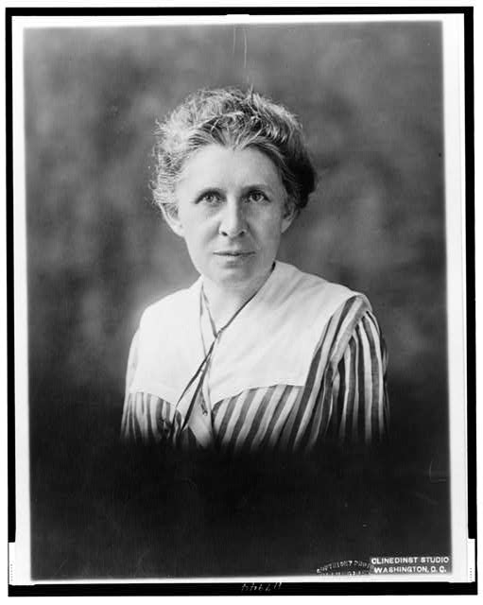
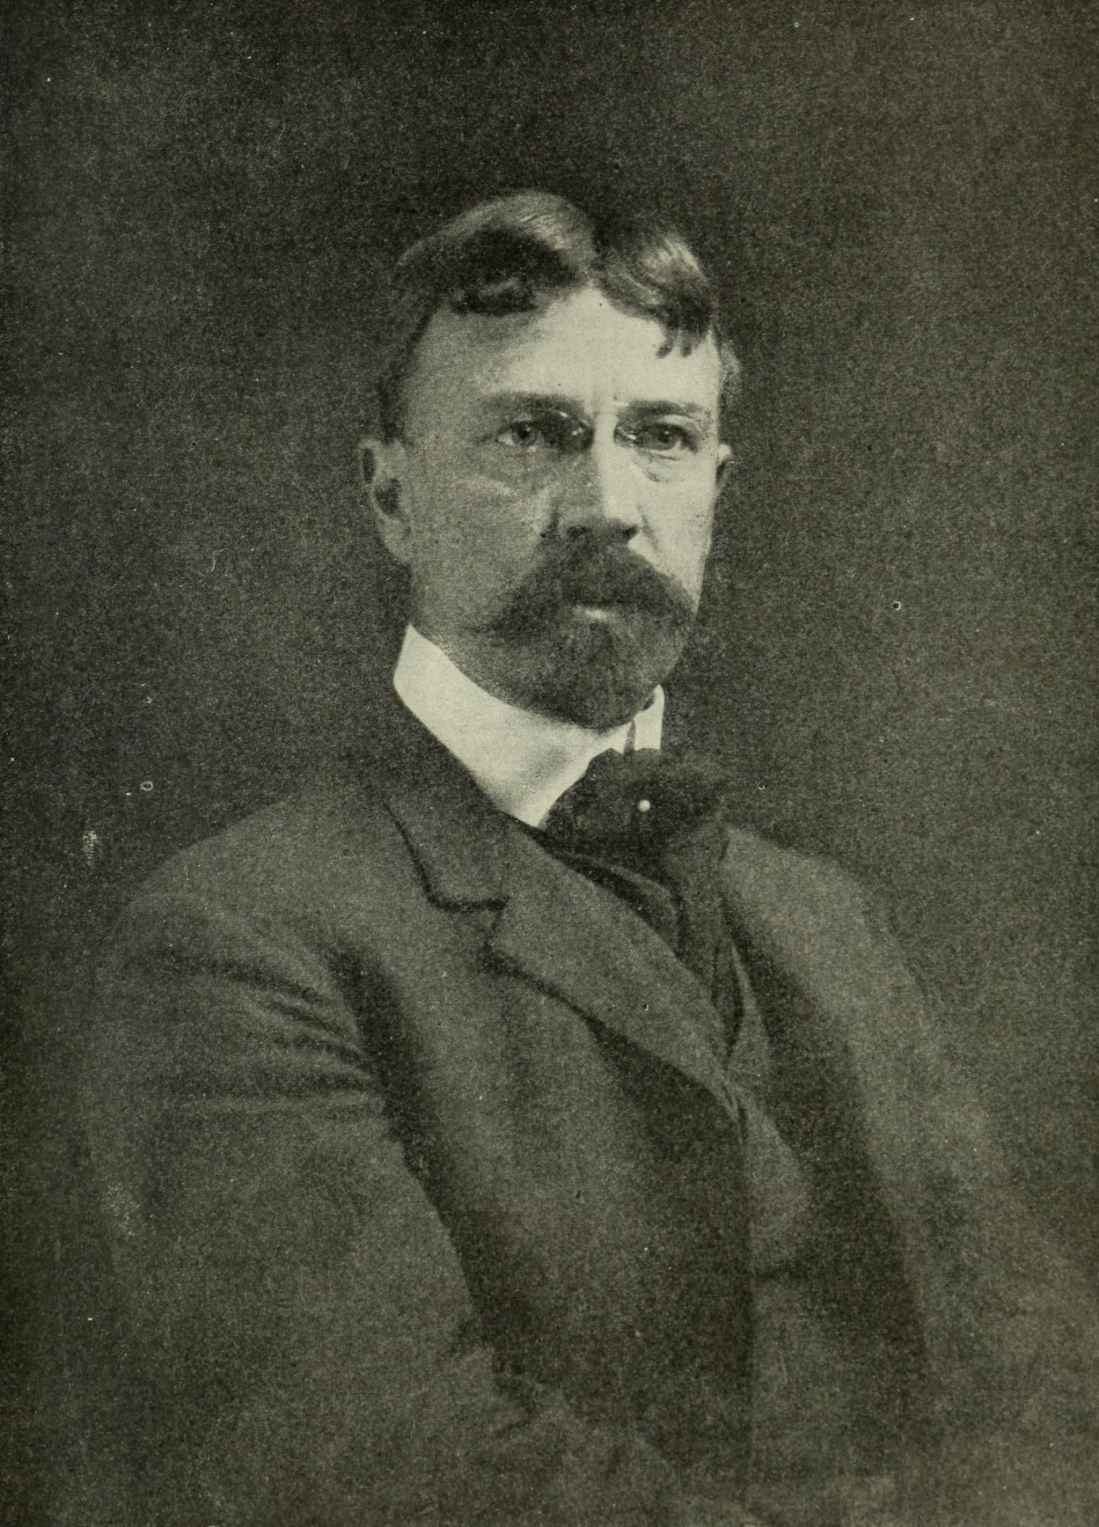
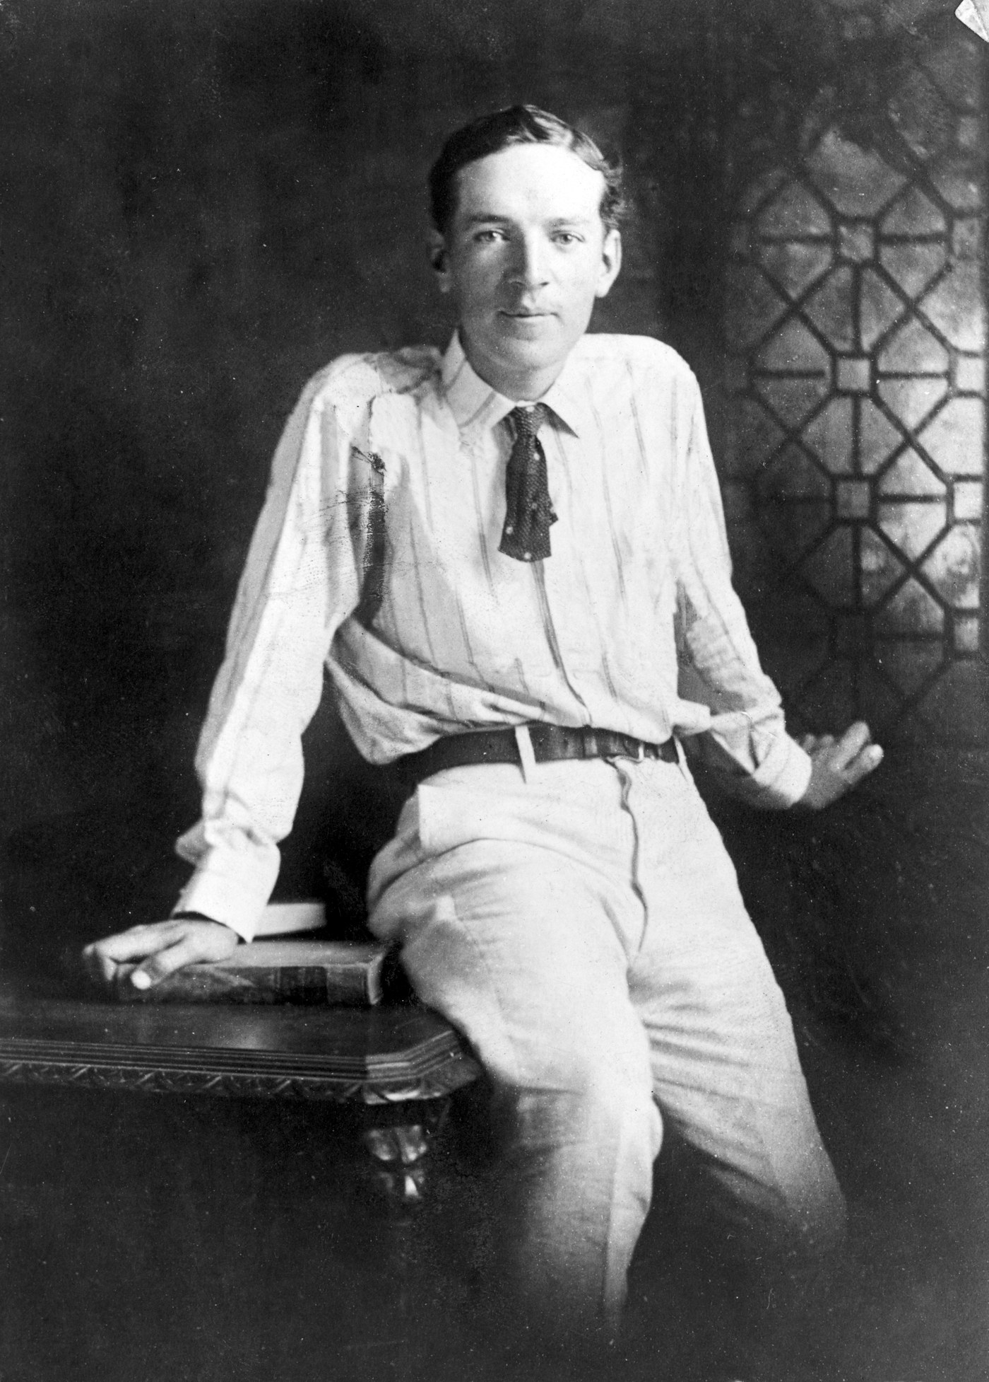
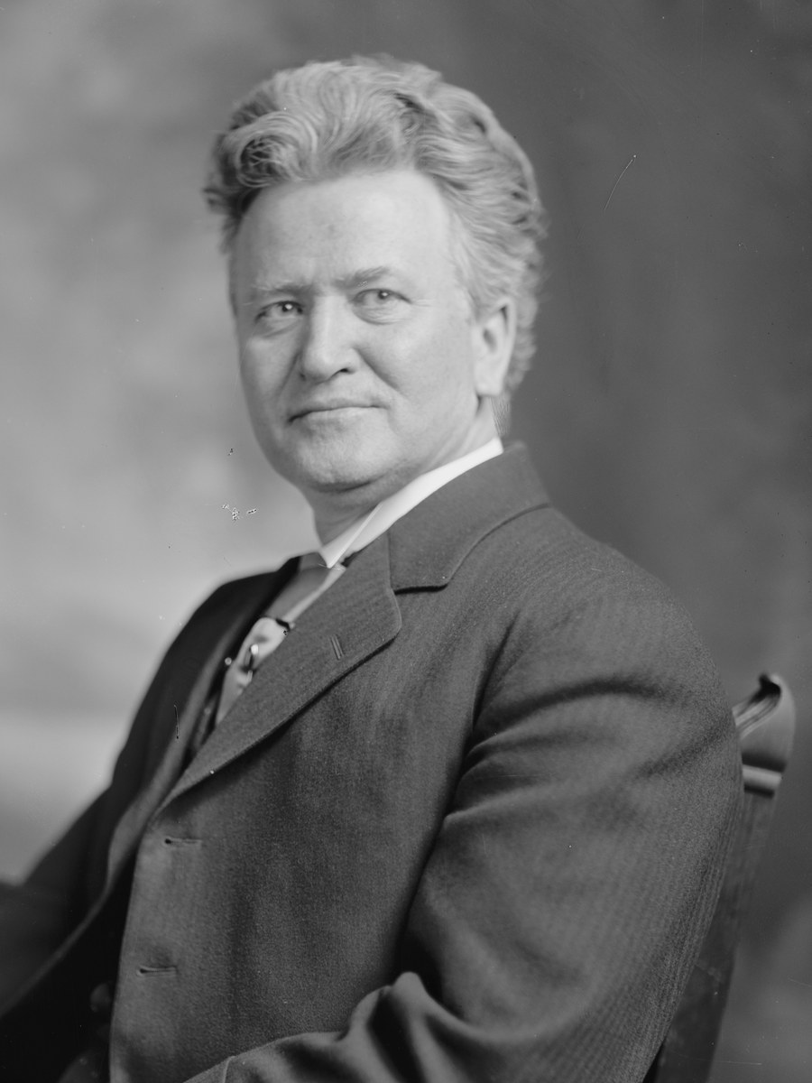
US.14 · PEOPLE WHO SHAPED THE ERA
Key Figures
Ida Tarbell
Muckraking Journalist
Lincoln Steffens
Muckraking Journalist
Two-year investigation of Standard Oil serialized in McClure's (1902–1904) exposed Rockefeller's secret rebates and predatory tactics
Pioneered investigative journalism techniques — court records, document analysis, interviews — still used today
'The Shame of the Cities' (1904) exposed systematic corruption in St. Louis, Minneapolis, Pittsburgh, Philadelphia, Chicago, and New York
Revolutionized investigative journalism at McClure's Magazine; mentored a generation of reform journalists
Library of Congress
Wikimedia Commons
STRATEGY Documentary investigative journalism
STRATEGY Urban political corruption exposure
Upton Sinclair
Muckraking Author & Socialist
Robert La Follette
Progressive Politician
'The Jungle' (1906) described Chicago meatpacking conditions; Roosevelt ordered independent investigation confirming findings
Directly influenced the Pure Food and Drug Act and Meat Inspection Act (1906)
As Wisconsin governor, created the 'Wisconsin Idea' — university experts advising government on legislation and regulation
Pioneered the direct primary system adopted nationally; regulated railroads and utilities in Wisconsin
Wikimedia Commons (Library of Congress)
Library of Congress
STRATEGY Literary journalism / socialistic reform
STRATEGY State-level laboratory democracy
U.S. History Hack · TroopToTeacher Technologies LLC · Aligned to TN Academic Standards & TCAP EOC
105

Slide 119
US.14 · PRIMARY SOURCE ANALYSIS
The History of the Standard Oil Company
Close Reading
Ida Tarbell · 1904
ZOOM IN Find ONE detail that surprises you — be ready to name it.
"Mr. Rockefeller has systematically played with loaded dice, and it is doubtful if there has ever been a time since 1872 when he has run a race with a competitor and started fair. Business played in this way loses all its sportmanlike qualities. It is fit only for tricksters."
CONTEXT
Ida Tarbell was one of the most important investigative journalists in American history. From 1902 to 1904, she published a 19-part series in McClure's Magazine meticulously documenting how John D. Rockefeller's Standard Oil Company had used secret railroad rebates, industrial espionage, and economic intimidation to crush competitors and build a monopoly controlling 90% of American oil refining. Tarbell's research was devastating — she had personally suffered when Standard Oil destroyed her father's independent oil business. Her series was published as a book in 1904 and directly led to the Supreme Court's 1911 decision breaking up Standard Oil into 34 separate companies.
ANALYZE
What accusation does Ida Tarbell make against Rockefeller's business practices?
Udo J. Keppler, 1904 Library of Congress
SOURCE IT
WHO made it?
WHEN?
WHY does it matter?
FIRST
Ida Tarbell — investigative journalist, daughter of a Pennsylvania oil producer destroyed by Standard Oil.
1904, after two years of documentary investigation; Standard Oil was at the height of its power.
The author's personal connection to the subject raises both credibility (direct experience) and a question: does her family's loss make her biased? A good historian acknowledges both.
SSP.02 · before you interpret
Source: Library of Congress
U.S. History Hack · TroopToTeacher Technologies LLC · Aligned to TN Academic Standards & TCAP EOC
106
Notes:
Primary-source analysis. SOURCE IT FIRST (SSP.02) — model the sourcing routine aloud before students interpret: WHO made this source? (Ida Tarbell — investigative journalist, daughter of a Pennsylvania oil producer destroyed by Standard Oil.) WHEN? (1904, after two years of documentary investigation; Standard Oil was at the height of its power.) WHY does that matter? (The author's personal connection to the subject raises both credibility (direct experience) and a question: does her family's loss make her biased? A good historian acknowledges both.) Only then move to the ANALYZE question. Suggested answer: Tarbell accuses Rockefeller of playing "with loaded dice" and states "it is doubtful if there has ever been a time... when he has run a race with a competitor and started fair." Practice skill: Close Reading.

Slide 120
US.14 · KEY VOCABULARY
Word Wall
Muckraker
Periodista de Investigación
Progressive Movement
Movimiento Progresivo
say: MUK-ray-ker
say: pruh-GRES-iv MOO-vment
M
Investigative journalists and authors who exposed corporate abuse, government corruption, and social injustice in the Progressive Era, building public pressure for reform.
PM
A broad reform effort (1890s–1920s) that used journalism, legislation, and political organizing to address the social and economic harms of industrialization.
Wisconsin Idea
Idea de Wisconsin
The Jungle
La Jungla
say: wis-KON-sin eye-DEE-uh
WI
Robert La Follette's model of Progressive reform using university experts to design legislation and regulate corporations, making Wisconsin 'the laboratory of democracy.'
TJ
Upton Sinclair's 1906 novel exposing unsanitary meatpacking conditions; it outraged consumers and drove passage of the Pure Food and Drug Act and Meat Inspection Act.
The Shame of the Cities
La Vergüenza de las Ciudades
History of Standard Oil
Historia de la Standard Oil
TS
Lincoln Steffens's 1904 book exposing systematic political corruption across America's major cities — how business interests controlled city governments through bribery and political machines.
HO
Ida Tarbell's landmark 1904 investigative work documenting how Rockefeller used secret railroad rebates and predatory pricing to build his monopoly — contributing to Standard Oil's 1911 breakup.
"say:" pronunciation guide (stressed syllable in CAPS) and a per-term visual anchor support newcomer English learners. Spanish term + full bilingual Frayer models are in the unit vocabulary set.
U.S. History Hack · TroopToTeacher Technologies LLC · Aligned to TN Academic Standards & TCAP EOC
107

Slide 121
US.14 · GUIDED PRACTICE — WE DO IT TOGETHER
Let’s Work One Together
Argument evaluation / sourcing
MODEL PROMPT: Tarbell says Rockefeller used 'force and fraud.' That's a strong claim. How does an investigative journalist prove it?
WORKED EXAMPLE (teacher models this aloud)
CLAIM: Rockefeller used force and fraud. EVIDENCE TARBELL USED: 1) Court records showing secret railroad rebates Rockefeller received that competitors didn't. 2) Company documents showing predatory pricing to drive out rivals. 3) Interviews with independent oil producers whose businesses were destroyed. That's three types of evidence — documents, records, testimony. The claim holds because the evidence converges.
THINK ALOUD
Strong historical arguments don't rely on one source — they triangulate. When three independent types of evidence point to the same conclusion, historians gain confidence. Tarbell's method became the model for investigative journalism.
→ Now you try: List two types of evidence Tarbell would need to prove that Standard Oil used secret railroad rebates to crush competitors. Then write one sentence explaining how that evidence connects to her claim about 'Loss of Liberty.'
U.S. History Hack · TroopToTeacher Technologies LLC · Aligned to TN Academic Standards & TCAP EOC
108
Notes:
GUIDED PRACTICE / WE DO (US.14). Skill modeled: Argument evaluation / sourcing. Model the worked example aloud using the THINK ALOUD as your script, then release students to the activity ("List two types of evidence Tarbell would need to prove that Standard Oil used secret railroad rebates to crush competitors. Then write one sentence explaining how that evidence connects to her claim about 'Loss of Liberty.'"). This is the I Do → We Do → You Do bridge — do not skip it; aim for 80%+ success before independent work.

Slide 122
US.14 · STUDENT ACTIVITY
Muckraker Profile — Impact and Method
Jigsaw — each group takes one muckraker, then shares
15 min
YOUR TASK
Each group is assigned one muckraker or progressive idealist (Tarbell, Sinclair, Steffens, La Follette, or Roosevelt). Complete a four-part profile card: (1) What problem did this person expose or address? (2) What method did they use (journalism, legislation, lawsuits, etc.)? (3) What was the specific outcome or reform they achieved? (4) What historical-thinking STRATEGY does their work exemplify (e.g., 'Documentary evidence to drive policy', 'State-level laboratory reform', 'Executive power as reform tool')? Then share your profile with the class in a 60-second report-out.
DELIVERABLE
DIFFERENTIATION
Completed four-part profile card for one assigned figure PLUS participation in class report-out sharing key findings.
Entry: Profile card pre-filled with the person's name, the problem they addressed, and two sentence starters for fields 2 and 3. Student completes fields 3 and 4 only. Honors: After the jigsaw, write a synthesis paragraph: Which of the five figures had the greatest long-term impact on American society — and why? Must compare at least two figures and cite specific outcomes (laws passed, institutions created, cases won) to support the claim.
Companion printable: cornell-notes/unit-2/us14-muckrakers-progressives.pdf
U.S. History Hack · TroopToTeacher Technologies LLC · Aligned to TN Academic Standards & TCAP EOC
109
Notes:
Student activity for US.14. Pair with the printable: cornell-notes/unit-2/us14-muckrakers-progressives.pdf. Timing: 15. Deliverable: Completed four-part profile card for one assigned figure PLUS participation in class report-out sharing key findings.

Slide 123
US.14 · CHECK FOR UNDERSTANDING
TCAP-Style Question
DOK 2
EOC PRACTICE
What accusation does Ida Tarbell make against Rockefeller's business practices?
He was a fair competitor who succeeded through hard work
A
He was too generous with his competitors
B
He used unfair tactics and never competed fairly
C
He focused too much on charity work
D
ANSWER FIRST: students commit — then click / advance to reveal the correct answer and explanation.
U.S. History Hack · TroopToTeacher Technologies LLC · Aligned to TN Academic Standards & TCAP EOC
110
Notes:
CHECK FOR UNDERSTANDING (US.14, DOK 2). Have students commit to an answer (whiteboards, hand signal, or turn-and-talk) BEFORE advancing. Correct answer: C. The next slide reveals it. Why: Tarbell accuses Rockefeller of playing "with loaded dice" and states "it is doubtful if there has ever been a time... when he has run a race with a competitor and started fair."

Slide 124
US.14 · ANSWER REVEAL
TCAP-Style Question
✓ ANSWER KEY
What accusation does Ida Tarbell make against Rockefeller's business practices?
A
He was a fair competitor who succeeded through hard work
B
He was too generous with his competitors
C
He used unfair tactics and never competed fairly
✓
D
He focused too much on charity work
Correct answer: C. Why: Tarbell accuses Rockefeller of playing "with loaded dice" and states "it is doubtful if there has ever been a time... when he has run a race with a competitor and started fair."
U.S. History Hack · TroopToTeacher Technologies LLC · Aligned to TN Academic Standards & TCAP EOC
111
Notes:
ANSWER KEY (US.14). Correct: C. Tarbell accuses Rockefeller of playing "with loaded dice" and states "it is doubtful if there has ever been a time... when he has run a race with a competitor and started fair."

Slide 125
US.14 · WRAP-UP
What You Need to Know for TCAP
KEY TAKEAWAYS
EXIT TICKET
DOK 2
The Muckrakers
Robert M. La Follette and the Wisconsin Idea
Lincoln Steffens and Ida Tarbell
Upton Sinclair and Theodore Roosevelt
Choose ONE muckraker (Ida Tarbell, Upton Sinclair, or Lincoln Steffens) and explain: (a) what problem they exposed, (b) how they gathered their evidence, and (c) what law or reform their work helped produce.
★ HONORS / EXTENSION DOK 3 · SSP.04 Argumentation
Upton Sinclair famously said he 'aimed at the public's heart and by accident hit it in the stomach' — Americans responded to food safety, not to worker exploitation. Argue: Does this suggest muckraking journalism was more effective at producing consumer protection than worker protection? What does that tell us about what motivates Americans to demand reform? (SSP.04)
U.S. History Hack · TroopToTeacher Technologies LLC · Aligned to TN Academic Standards & TCAP EOC
112
Notes:
WRAP-UP / EXIT-TICKET KEY (US.14, DOK 2). Prompt: Choose ONE muckraker (Ida Tarbell, Upton Sinclair, or Lincoln Steffens) and explain: (a) what problem they exposed, (b) how they gathered their evidence, and (c) what law or reform their work helped produce. Model answer: Ida Tarbell: exposed Standard Oil's secret railroad rebates and predatory pricing through 19 years of company records and interviews; her 'History of Standard Oil' (1904) built public support for antitrust enforcement, contributing to the Supreme Court's break-up of Standard Oil in 1911. Upton Sinclair: embedded himself in Chicago meatpacking plants; 'The Jungle' (1906) triggered the Pure Food and Drug Act and Meat Inspection Act the same year. Lincoln Steffens: investigated city government records and interviewed officials; 'Shame of the Cities' (1904) exposed machine politics and helped fuel demands for direct primaries and city commission government. RETEACH TRIGGER — if a student misses this exit ticket: (1) <50% of class miss → spiral it into the next standard’s Quick Review opener (see the US.14 review prompts). (2) Individual/small group → reteach with the "The Muckrakers" direct-instruction slide + re-run the SOURCE IT FIRST routine on the US.14 primary source, then assign the paired printable: cornell-notes/unit-2/us14-muckrakers-progressives.pdf. (3) Re-assess with the US.14 check-for-understanding reveal slide as a do-now the next day. Reteach anchors (this standard’s sections): The Muckrakers; Robert M. La Follette and the Wisconsin Idea; Lincoln Steffens and Ida Tarbell; Upton Sinclair and Theodore Roosevelt. I Can objective: I can explain the roles played by muckrakers and progressive idealists, including Robert M. La Follette Sr., President Theodore Roosevelt, Upton Sinclair, Lincoln Steffens, and Ida Tarbell. HONORS / EXTENSION (DOK 3, for early finishers or advanced learners): Upton Sinclair famously said he 'aimed at the public's heart and by accident hit it in the stomach' — Americans responded to food safety, not to worker exploitation. Argue: Does this suggest muckraking journalism was more effective at producing consumer protection than worker protection? What does that tell us about what motivates Americans to demand reform? (SSP.04) — look for a clear claim plus two specific pieces of evidence.

Slide 126
STANDARD
SOCIAL STUDIES PRACTICES
US.15
SSP.01
Collect sources
SSP.04
Build an argument
SSP.05
Historical awareness
Progressive Movement Goals & Achievements
TN ACADEMIC STANDARD
Analyze the goals and achievements of the Progressive movement, including: Adoption of the initiative, referendum, and recall, Adoption of the primary system, 16th Amendment, 17th Amendment, 18th Amendment.
I CAN
I can analyze the goals and achievements of the Progressive movement, including the initiative, referendum, recall, direct primary, 16th Amendment, 17th Amendment, and 18th Amendment.
U.S. History Hack · TroopToTeacher Technologies LLC · Aligned to TN Academic Standards & TCAP EOC
113

Slide 127
KEY VOCABULARY · LANGUAGE SUPPORT
US.14
Words you need before we read
Muckraker
Progressive Movement
Wisconsin Idea
En español: Periodista de Investigación
En español: Movimiento Progresivo
En español: Idea de Wisconsin
WHAT IT MEANS
WHAT IT MEANS
WHAT IT MEANS
Investigative journalists and authors who exposed corporate abuse, government corruption, and social injustice in the Progressive Era, building public pressure for reform.
A broad reform effort (1890s–1920s) that used journalism, legislation, and political organizing to address the social and economic harms of industrialization.
Robert La Follette's model of Progressive reform using university experts to design legislation and regulate corporations, making Wisconsin 'the laboratory of democracy.'
UDL · REPRESENTATION → LANGUAGE & SYMBOLS
U.S. History Hack · TEACHER DECK · Aligned to TN Academic Standards & TCAP EOC
14

Slide 128
PROGRESS CHECK
US.14
Check your understanding
Evaluate Theodore Roosevelt's complex relationship with muckrakers and his role in progressive reform.
A
Roosevelt completely supported all muckrakers, which does not reflect the consensus among historians, which does not align with the documented historical record and fails to account for key developments in the broader context
B
Roosevelt opposed all muckraking journalism, which represents a common misconception about the period, although this overlooks critical economic and social factors involved, but the historical evidence paints a more nuanced picture
C
Roosevelt used muckraker exposés to build support for reforms like consumer protection and trust-busting, but also criticized excessive negativity—showing how reform leaders balance media pressure with political strategy
✓ KEY
D
Muckrakers and Roosevelt had no connection, despite limited evidence supporting this interpretation, but closer analysis reveals a more complicated historical reality, which represents a common misconception about this historical period
UDL · ACTION & EXPRESSION → STRATEGY DEVELOPMENT
MTSS: below mastery → targeted reteach (Tier 2); at/above → extension. The goal never lowers.
U.S. History Hack · TEACHER DECK · Aligned to TN Academic Standards & TCAP EOC
15

Slide 129
US.15 · QUICK REVIEW
Do You Remember?
Before we start, retrieve what we have already learned. Answer from memory first — no notes.
1
US.14 What was the 'Wisconsin Idea' associated with Robert La Follette?
2
US.14 Name one muckraker and the specific problem their work exposed.
U.S. History Hack · TroopToTeacher Technologies LLC · Aligned to TN Academic Standards & TCAP EOC
114
Notes:
SPACED RETRIEVAL (US.15). Cold-call or whiteboards, 3-4 min, low stakes. Answers — 1) The Wisconsin Idea was La Follette's model of using university experts and data to write scientific, expert-driven legislation — making Wisconsin a national laboratory for progressive reform. 2) Ida Tarbell — exposed Standard Oil's monopolistic practices and secret railroad rebates in 'The History of Standard Oil' (1904); or Upton Sinclair — exposed unsanitary meatpacking in 'The Jungle' (1906); or Lincoln Steffens — exposed urban machine corruption in 'The Shame of the Cities' (1904).

Slide 130
US.15 · CONFIDENCE CHECK
Warm-Up — Quick Recall
DOK 1
LOW STAKES
Everyone can answer this. Thumbs / whiteboards — no notes.
Name the Progressive reform that allows citizens to propose a new law directly by collecting signatures — bypassing the legislature.
✓ ANSWER
Initiative — citizens gather signatures to place a proposed law directly on the ballot for voters to decide, removing the need for legislative approval.
COMMIT FIRST: have everyone answer before the reveal — this is the DOK 1 floor; the graded check later in this lesson moves up to DOK 2–3.
U.S. History Hack · TroopToTeacher Technologies LLC · Aligned to TN Academic Standards & TCAP EOC
115
Notes:
CONFIDENCE CHECK (US.15, DOK 1). 60-90 seconds. Have EVERY student commit (thumbs / whiteboard / choral) before revealing — this secures an early win and surfaces who is shaky before new content. Answer: Initiative — citizens gather signatures to place a proposed law directly on the ballot for voters to decide, removing the need for legislative approval. Key term to listen for: Initiative. This is the low-floor entry; the graded Check for Understanding later in the standard rises to DOK 2–3.

Slide 131
US.15 · HOOK
Think About It
Before 1913, U.S. senators were not elected by voters — they were chosen by state legislatures, which were notoriously corrupt and often bribed by railroad and corporate interests.
DISCUSS
TIMING: Turn & Talk 60 sec → cold-call 2 pairs
If the people elected to represent you were actually chosen by wealthy corporations, what would you do? The Progressives had a list of specific reforms to fix democracy itself — let's see what they built.
U.S. History Hack · TroopToTeacher Technologies LLC · Aligned to TN Academic Standards & TCAP EOC
116
Notes:
HOOK (US.15). Run tight: pose the provocation, give a silent 10-second think, then Turn & Talk 60 seconds. Cold-call 2–3 pairs (not volunteers) for a sentence-starter answer — "One force was ___ because ___" — then bridge to the standard. Keep total to ~4 minutes; do not let it sprawl. Return to this question at the unit close for an evidence-based answer.

Slide 132
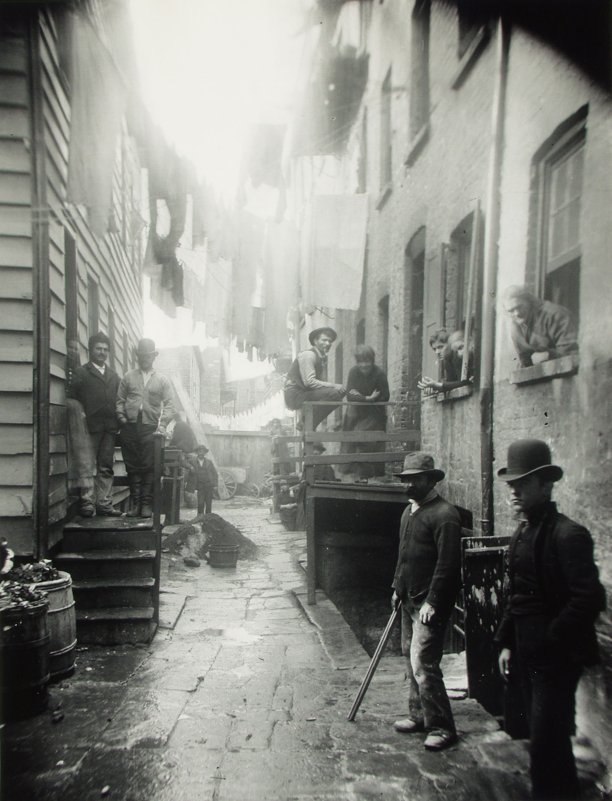
US.15 · DIRECT INSTRUCTION
1 of 4
Goals of the Progressive Movement
Progressives sought to use government power to address the economic and social harms of industrialization — reducing the power of corporate trusts, protecting workers and consumers, cleaning up political corruption, and expanding democratic participation.
They believed that scientific expertise and democratic accountability could make government work for ordinary people.
Their achievements remade American democracy: by 1920, the federal income tax, direct election of senators, and women's suffrage had all become law through constitutional amendment.
SENTENCE FRAME (EL & writing support)
Jacob Riis, 1888 Museum of the City of New York
Progressives reformed democracy by adopting the ________ and ________ so citizens could participate more directly, and ratified the ________ Amendment to address ________.
TEACHER CUE Chunk → cold-call → confirm before advancing.
U.S. History Hack · TroopToTeacher Technologies LLC · Aligned to TN Academic Standards & TCAP EOC
117
Notes:
FACILITATION (US.15). Write on the board: 'INITIATIVE / REFERENDUM / RECALL / DIRECT PRIMARY.' Silent think — Turn & Talk: 'What do all four of these have in common?' Push for 'they all give voters more direct power.' Cold-call 2 pairs; then ask: 'Who had that power before?' Teach in small steps; pause and check for understanding before the next chunk (aim 80%+ before moving on).

Slide 133
US.15 · DIRECT INSTRUCTION
2 of 4
Initiative, Referendum, and Recall
Progressive reformers developed tools to give voters more direct control over government.
The initiative allows citizens to propose laws by collecting signatures.
The referendum allows voters to approve or reject laws passed by the legislature.
The recall allows voters to remove elected officials from office before their terms expire.
Together, these reforms reduced the power of political machines and party bosses who had long controlled nominations and legislation.
By 1914, over twenty states had adopted at least one of these direct democracy tools.
U.S. History Hack · TroopToTeacher Technologies LLC · Aligned to TN Academic Standards & TCAP EOC
118

Slide 134
US.15 · DIRECT INSTRUCTION
3 of 4
The Primary System
Before the Progressive Era, party bosses selected candidates in closed caucuses and conventions — voters had no direct say in who appeared on the ballot.
Robert La Follette pioneered the direct primary in Wisconsin (1905), allowing voters to choose their party's candidates directly.
The direct primary spread rapidly across the nation, reducing the power of party machines and making American politics more responsive to ordinary voters.
By 1916, most states had adopted some form of direct primary for major offices.
U.S. History Hack · TroopToTeacher Technologies LLC · Aligned to TN Academic Standards & TCAP EOC
119

Slide 135
US.15 · DIRECT INSTRUCTION
4 of 4
Constitutional Amendments (16th, 17th, 18th)
Three constitutional amendments reflect Progressive Era achievement.
The 16th Amendment (1913) gave Congress power to levy an income tax — making the tax system more progressive by taxing wealth rather than consumption.
The 17th Amendment (1913) required direct election of U.S. senators, removing the power of state legislatures (often controlled by corporate interests) to choose senators.
The 18th Amendment (1919) prohibited the manufacture and sale of alcohol (Prohibition) — a Progressive and temperance reform that proved impossible to enforce and was repealed in 1933 by the 21st Amendment.
★ TENNESSEE CONNECTION
Tennessee ratified the 16th and 17th Amendments as part of the national Progressive wave, joining the reforms that created the federal income tax and direct election of U.S. senators.
U.S. History Hack · TroopToTeacher Technologies LLC · Aligned to TN Academic Standards & TCAP EOC
120

Slide 136
US.15 · PEOPLE WHO SHAPED THE ERA
Key Figure
Robert La Follette
Progressive Politician
Created the 'Wisconsin Idea' model — university experts advising state government; pioneered the direct primary (Wisconsin, 1905)
As U.S. Senator, fought railroad monopolies and led Progressive reform legislation in Washington
Won nearly 5 million votes as Progressive Party presidential candidate in 1924 — 17% of the popular vote
Harris & Ewing, c. 1910s Library of Congress
STRATEGY State-level reform / direct democracy
U.S. History Hack · TroopToTeacher Technologies LLC · Aligned to TN Academic Standards & TCAP EOC
121

Slide 137
US.15 · PRIMARY SOURCE ANALYSIS
16th Amendment
Close Reading
U.S. Constitution · 1913
"The Congress shall have power to lay and collect taxes on incomes, from whatever source derived, without apportionment among the several States, and without regard to any census or enumeration."
CONTEXT
Before the 16th Amendment (1913), the federal government relied primarily on tariffs (taxes on imported goods) to raise revenue, which placed the tax burden disproportionately on consumers and protected big business. During the Civil War, Congress had briefly imposed an income tax, but the Supreme Court ruled a later income tax unconstitutional in 1895 (Pollock v. Farmers' Loan and Trust Co.) because it was not apportioned among states by population. Progressive Era reformers argued that a graduated income tax — where the wealthy paid a higher percentage — was the fairest way to fund the growing federal government. After years of campaigning, the 16th Amendment was ratified in February 1913.
ANALYZE
What power did the 16th Amendment grant to Congress?
READ CLOSELY Underline the exact words that answer the ANALYZE question — be ready to read them aloud.
SOURCE IT
WHO made it?
WHEN?
WHY does it matter?
FIRST
The U.S. Congress and state ratifying conventions — the constitutional amendment process.
1913, after decades of Progressive lobbying for a federal income tax.
Constitutional amendments reveal what a society agreed was important enough to change the fundamental law — ask what problem it was solving.
SSP.02 · before you interpret
Source: Constitution Annotated, Library of Congress
U.S. History Hack · TroopToTeacher Technologies LLC · Aligned to TN Academic Standards & TCAP EOC
122
Notes:
Primary-source analysis. SOURCE IT FIRST (SSP.02) — model the sourcing routine aloud before students interpret: WHO made this source? (The U.S. Congress and state ratifying conventions — the constitutional amendment process.) WHEN? (1913, after decades of Progressive lobbying for a federal income tax.) WHY does that matter? (Constitutional amendments reveal what a society agreed was important enough to change the fundamental law — ask what problem it was solving.) Only then move to the ANALYZE question. Suggested answer: The amendment explicitly grants Congress "power to lay and collect taxes on incomes, from whatever source derived." Practice skill: Close Reading.

Slide 138
US.15 · KEY VOCABULARY
Word Wall
Initiative
Iniciativa
Referendum
Referéndum
say: ih-NISH-ee-uh-tiv
say: ref-er-EN-dum
I
A Progressive reform allowing citizens to propose new laws by collecting enough voter signatures to put the proposal directly on the ballot.
R
A Progressive reform allowing voters to approve or reject laws passed by the state legislature — giving citizens a direct check on legislative power.
Recall
Revocación
Direct Primary
Primarias Directas
say: duh-REKT PRY-mair-ee
R
A Progressive reform allowing voters to remove elected officials from office before their terms expire — a direct accountability tool against corrupt or unresponsive officials.
DP
A Progressive reform replacing party boss selection with a public vote allowing registered party members to choose their party's candidates directly.
16th Amendment
16ª Enmienda
17th Amendment
17ª Enmienda
1A
Ratified in 1913, this amendment gave Congress the power to levy a federal income tax — enabling a more progressive tax system that taxed wealth rather than only consumption.
1A
Ratified in 1913, this amendment established direct election of U.S. senators by voters — removing the power of state legislatures (often controlled by corporate interests) to choose senators.
"say:" pronunciation guide (stressed syllable in CAPS) and a per-term visual anchor support newcomer English learners. Spanish term + full bilingual Frayer models are in the unit vocabulary set.
U.S. History Hack · TroopToTeacher Technologies LLC · Aligned to TN Academic Standards & TCAP EOC
123

Slide 139
US.15 · GUIDED PRACTICE — WE DO IT TOGETHER
Let’s Work One Together
Compare reform goals to outcomes
MODEL PROMPT: Progressives wanted to reduce the power of wealthy interests over government. Look at the 16th and 17th Amendments — how does each one do that?
WORKED EXAMPLE (teacher models this aloud)
16th Amendment: Before it, the federal government relied on tariffs (taxes on goods) — which hurt poor consumers more than wealthy corporations. An income tax shifts the burden upward — those with more income pay more. That's a direct hit on concentrated wealth. 17th Amendment: Before it, state legislatures chose senators — and corporations could buy state legislatures. Direct election takes senators out of the hands of political machines paid by business.
THINK ALOUD
Each reform is a specific solution to a specific problem. I'm asking: what power did this change shift, and from whom to whom? That's the analytical move TCAP rewards.
→ Now you try: Pick ONE Progressive reform (initiative, referendum, recall, or direct primary) and write two sentences: what problem was it designed to fix, and how did it fix it?
U.S. History Hack · TroopToTeacher Technologies LLC · Aligned to TN Academic Standards & TCAP EOC
124
Notes:
GUIDED PRACTICE / WE DO (US.15). Skill modeled: Compare reform goals to outcomes. Model the worked example aloud using the THINK ALOUD as your script, then release students to the activity ("Pick ONE Progressive reform (initiative, referendum, recall, or direct primary) and write two sentences: what problem was it designed to fix, and how did it fix it?"). This is the I Do → We Do → You Do bridge — do not skip it; aim for 80%+ success before independent work.

Slide 140
US.15 · STUDENT ACTIVITY
Progressive Reforms — Problem, Solution, Outcome Tracker
Pairs
12 min
YOUR TASK
Complete a three-column tracker for five Progressive Era reforms: initiative, referendum, recall, 16th Amendment, 17th Amendment. For each reform: Column 1 — What problem was it designed to solve? Column 2 — How did it solve it (what power shifted, and from whom to whom)? Column 3 — Who would have OPPOSED this reform and why? Then write one sentence: Which one of these five reforms made American democracy most democratic — and what is your evidence?
DELIVERABLE
DIFFERENTIATION
Completed five-row tracker AND a one-sentence claim identifying the most democratizing reform with supporting evidence.
Entry: First two rows of the tracker pre-completed (initiative and 16th Amendment) as models. Student completes remaining three rows. Final sentence frame: 'The ___ was the most democratizing reform because ___.' Honors: The 18th Amendment (Prohibition) is also a Progressive Era achievement. Write two sentences: one argument for why Prohibition fits the Progressive pattern (what problem was it solving?) and one argument for why it was a failure of Progressive logic. Then explain what this case teaches us about the limits of using government to change behavior.
Companion printable: cornell-notes/unit-2/us15-progressive-goals.pdf
U.S. History Hack · TroopToTeacher Technologies LLC · Aligned to TN Academic Standards & TCAP EOC
125
Notes:
Student activity for US.15. Pair with the printable: cornell-notes/unit-2/us15-progressive-goals.pdf. Timing: 12. Deliverable: Completed five-row tracker AND a one-sentence claim identifying the most democratizing reform with supporting evidence.

Slide 141
US.15 · CHECK FOR UNDERSTANDING
TCAP-Style Question
DOK 2
EOC PRACTICE
What power did the 16th Amendment grant to Congress?
The power to regulate interstate commerce
A
The power to establish a national bank
B
The power to limit corporate profits
C
The power to collect income taxes directly
D
ANSWER FIRST: students commit — then click / advance to reveal the correct answer and explanation.
U.S. History Hack · TroopToTeacher Technologies LLC · Aligned to TN Academic Standards & TCAP EOC
126
Notes:
CHECK FOR UNDERSTANDING (US.15, DOK 2). Have students commit to an answer (whiteboards, hand signal, or turn-and-talk) BEFORE advancing. Correct answer: D. The next slide reveals it. Why: The amendment explicitly grants Congress "power to lay and collect taxes on incomes, from whatever source derived."

Slide 142
US.15 · ANSWER REVEAL
TCAP-Style Question
✓ ANSWER KEY
What power did the 16th Amendment grant to Congress?
A
The power to regulate interstate commerce
B
The power to establish a national bank
C
The power to limit corporate profits
D
The power to collect income taxes directly
✓
Correct answer: D. Why: The amendment explicitly grants Congress "power to lay and collect taxes on incomes, from whatever source derived."
U.S. History Hack · TroopToTeacher Technologies LLC · Aligned to TN Academic Standards & TCAP EOC
127
Notes:
ANSWER KEY (US.15). Correct: D. The amendment explicitly grants Congress "power to lay and collect taxes on incomes, from whatever source derived."

Slide 143
US.15 · WRAP-UP
What You Need to Know for TCAP
KEY TAKEAWAYS
EXIT TICKET
DOK 2
Goals of the Progressive Movement
Initiative, Referendum, and Recall
The Primary System
Constitutional Amendments (16th, 17th, 18th)
Explain what the 16th, 17th, and 18th Amendments each did and connect each to a specific Progressive Era problem it was meant to solve.
★ HONORS / EXTENSION DOK 3 · SSP.04 Argumentation
The 18th Amendment (Prohibition) was repealed by the 21st Amendment in 1933 — the only constitutional amendment ever repealed. Argue: Was Prohibition a legitimate Progressive reform or a moralistic overreach? Does its repeal tell us something about the limits of using constitutional amendments to change social behavior? (SSP.04)
U.S. History Hack · TroopToTeacher Technologies LLC · Aligned to TN Academic Standards & TCAP EOC
128
Notes:
WRAP-UP / EXIT-TICKET KEY (US.15, DOK 2). Prompt: Explain what the 16th, 17th, and 18th Amendments each did and connect each to a specific Progressive Era problem it was meant to solve. Model answer: 16th Amendment (1913): authorized a federal income tax — solved the problem that the federal government relied on regressive tariffs; a progressive income tax shifted the burden to those with higher incomes. 17th Amendment (1913): direct election of U.S. senators — solved the problem that corporate interests bribed state legislatures to choose pro-business senators. 18th Amendment (1919): prohibited manufacture and sale of alcohol (Prohibition) — Progressives argued alcohol was linked to poverty, domestic violence, and political corruption in urban machine politics. RETEACH TRIGGER — if a student misses this exit ticket: (1) <50% of class miss → spiral it into the next standard’s Quick Review opener (see the US.15 review prompts). (2) Individual/small group → reteach with the "Goals of the Progressive Movement" direct-instruction slide + re-run the SOURCE IT FIRST routine on the US.15 primary source, then assign the paired printable: cornell-notes/unit-2/us15-progressive-goals.pdf. (3) Re-assess with the US.15 check-for-understanding reveal slide as a do-now the next day. Reteach anchors (this standard’s sections): Goals of the Progressive Movement; Initiative, Referendum, and Recall; The Primary System; Constitutional Amendments (16th, 17th, 18th). I Can objective: I can analyze the goals and achievements of the Progressive movement, including the initiative, referendum, recall, direct primary, 16th Amendment, 17th Amendment, and 18th Amendment. HONORS / EXTENSION (DOK 3, for early finishers or advanced learners): The 18th Amendment (Prohibition) was repealed by the 21st Amendment in 1933 — the only constitutional amendment ever repealed. Argue: Was Prohibition a legitimate Progressive reform or a moralistic overreach? Does its repeal tell us something about the limits of using constitutional amendments to change social behavior? (SSP.04) — look for a clear claim plus two specific pieces of evidence.

Slide 144
STANDARD
SOCIAL STUDIES PRACTICES
US.16
SSP.01
Collect sources
SSP.04
Build an argument
SSP.05
Historical awareness
Theodore Roosevelt's Progressive Achievements
TN ACADEMIC STANDARD
Analyze the significant progressive achievements during President Theodore Roosevelt's administration, including: Square Deal, 'Trust-busting', Pure Food and Drug Act, Meat Inspection Act, Support for conservation.
I CAN
I can analyze the significant progressive achievements during President Theodore Roosevelt's administration, including the Square Deal, trust-busting, Pure Food and Drug Act, Meat Inspection Act, and conservation efforts.
U.S. History Hack · TroopToTeacher Technologies LLC · Aligned to TN Academic Standards & TCAP EOC
129

Slide 145
KEY VOCABULARY · LANGUAGE SUPPORT
US.15
Words you need before we read
Initiative
Referendum
Recall
En español: Iniciativa
En español: Referéndum
En español: Revocación
WHAT IT MEANS
WHAT IT MEANS
WHAT IT MEANS
A Progressive reform allowing citizens to propose new laws by collecting enough voter signatures to put the proposal directly on the ballot.
A Progressive reform allowing voters to approve or reject laws passed by the state legislature — giving citizens a direct check on legislative power.
A Progressive reform allowing voters to remove elected officials from office before their terms expire — a direct accountability tool against corrupt or unresponsive officials.
UDL · REPRESENTATION → LANGUAGE & SYMBOLS
U.S. History Hack · TEACHER DECK · Aligned to TN Academic Standards & TCAP EOC
16

Slide 146
PROGRESS CHECK
US.15
Check your understanding
Analyze which Progressive reforms had the most lasting impact on American democracy.
A
No Progressive reforms survived, which represents a common misconception about the period, which contradicts the primary source evidence from this era and fails to account for key developments in the broader context
B
Only Prohibition had lasting impact, although this view has been largely discredited by scholars and oversimplifies the complex factors at work during this period
C
Progressive reforms were all reversed, but this oversimplifies the complex factors at work when examined alongside the available primary and secondary sources
D
Direct primaries, direct election of senators, and the income tax fundamentally reshaped American politics and remain in effect, while Prohibition demonstrated that not all reforms succeed
✓ KEY
UDL · ACTION & EXPRESSION → STRATEGY DEVELOPMENT
MTSS: below mastery → targeted reteach (Tier 2); at/above → extension. The goal never lowers.
U.S. History Hack · TEACHER DECK · Aligned to TN Academic Standards & TCAP EOC
17

Slide 147
US.16 · QUICK REVIEW
Do You Remember?
Before we start, retrieve what we have already learned. Answer from memory first — no notes.
1
US.15 What did the 17th Amendment change about how U.S. senators are chosen?
2
US.15 What is the difference between an initiative and a referendum?
U.S. History Hack · TroopToTeacher Technologies LLC · Aligned to TN Academic Standards & TCAP EOC
130
Notes:
SPACED RETRIEVAL (US.16). Cold-call or whiteboards, 3-4 min, low stakes. Answers — 1) The 17th Amendment (1913) provided for the direct popular election of U.S. senators by voters, replacing selection by state legislatures which were frequently corrupted by corporate interests. 2) An initiative allows citizens to propose new laws by gathering signatures; a referendum allows citizens to vote to approve or reject a law passed by the legislature.

Slide 148
US.16 · CONFIDENCE CHECK
Warm-Up — Quick Recall
DOK 1
LOW STAKES
Everyone can answer this. Thumbs / whiteboards — no notes.
What was Theodore Roosevelt's domestic policy agenda called — the three-word phrase promising fair treatment for labor, consumers, and business?
✓ ANSWER
The Square Deal — Roosevelt's promise that all three groups (workers, consumers, businesses) would be treated fairly, not just wealthy corporations.
COMMIT FIRST: have everyone answer before the reveal — this is the DOK 1 floor; the graded check later in this lesson moves up to DOK 2–3.
U.S. History Hack · TroopToTeacher Technologies LLC · Aligned to TN Academic Standards & TCAP EOC
131
Notes:
CONFIDENCE CHECK (US.16, DOK 1). 60-90 seconds. Have EVERY student commit (thumbs / whiteboard / choral) before revealing — this secures an early win and surfaces who is shaky before new content. Answer: The Square Deal — Roosevelt's promise that all three groups (workers, consumers, businesses) would be treated fairly, not just wealthy corporations. Key term to listen for: Square Deal. This is the low-floor entry; the graded Check for Understanding later in the standard rises to DOK 2–3.

Slide 149
US.16 · HOOK
Think About It
Theodore Roosevelt became president in 1901 after an assassin's bullet — he was not supposed to be in the White House. Within two years he had sued the largest railroad trust in American history.
DISCUSS
TIMING: Turn & Talk 60 sec → cold-call 2 pairs
What does it mean for a president to use the power of the federal government to protect ordinary citizens from giant corporations? Is that the government's job? Roosevelt had a very specific answer.
U.S. History Hack · TroopToTeacher Technologies LLC · Aligned to TN Academic Standards & TCAP EOC
132
Notes:
HOOK (US.16). Run tight: pose the provocation, give a silent 10-second think, then Turn & Talk 60 seconds. Cold-call 2–3 pairs (not volunteers) for a sentence-starter answer — "One force was ___ because ___" — then bridge to the standard. Keep total to ~4 minutes; do not let it sprawl. Return to this question at the unit close for an evidence-based answer.

Slide 150
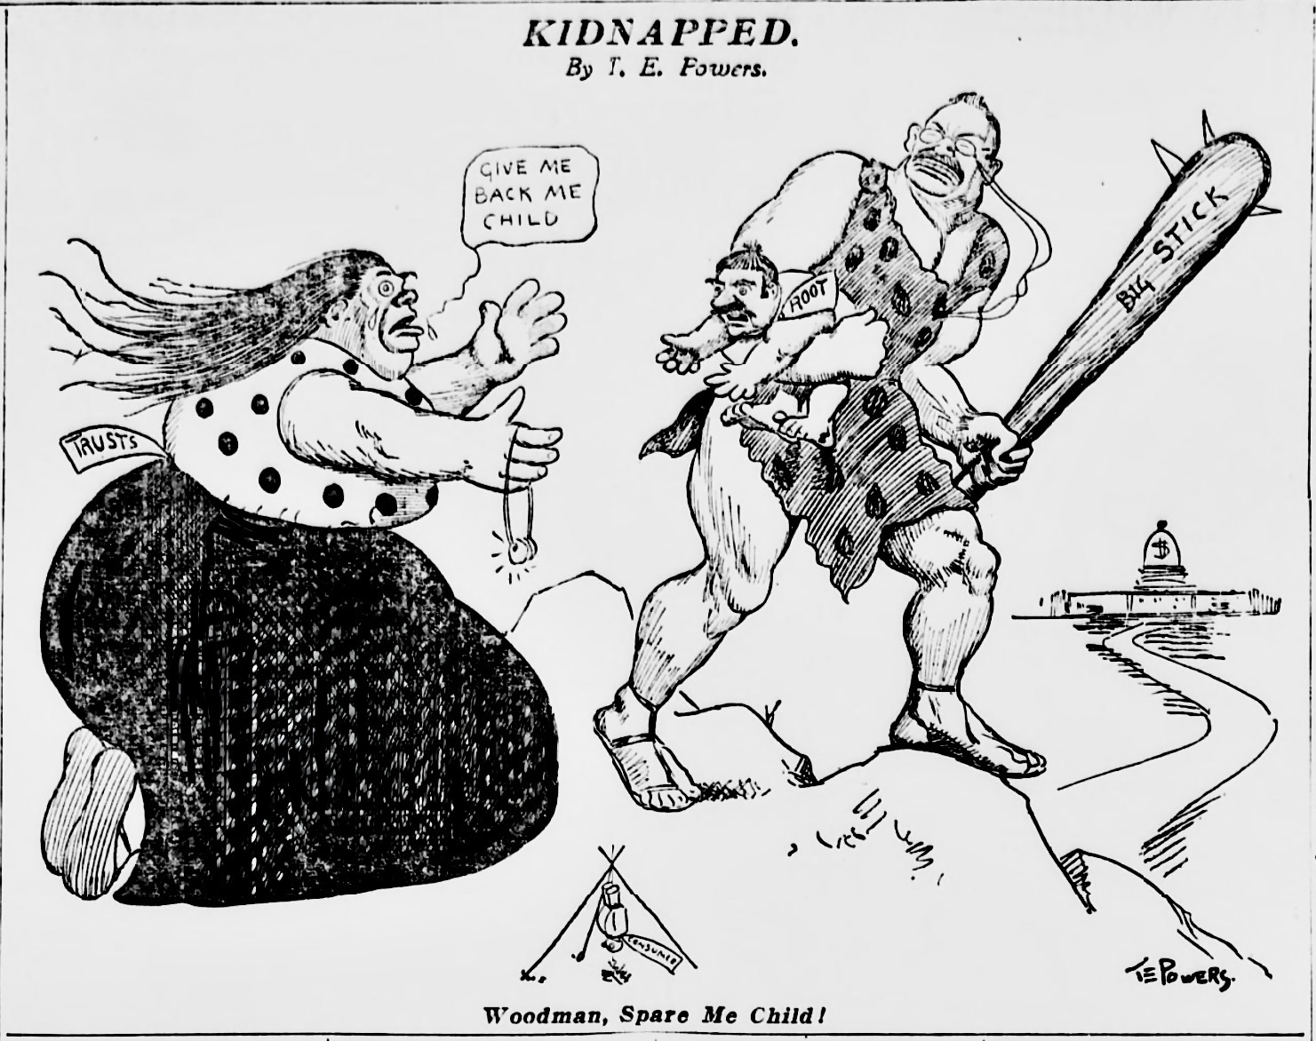
US.16 · DIRECT INSTRUCTION
1 of 4
The Square Deal
Theodore Roosevelt became the 26th president in 1901 after the assassination of William McKinley.
His domestic program, the 'Square Deal,' promised fair treatment for all Americans — consumers, workers, and business — without favoring any one class.
The Square Deal had three core components: conservation of natural resources, control of corporations, and consumer protection.
Roosevelt believed the president had a duty to use federal power to balance competing interests and protect the public good — a dramatic expansion of executive power over the laissez-faire tradition.
SENTENCE FRAME (EL & writing support)
T. E. Powers, 1905 Wikimedia Commons
President Roosevelt's ________ promised fair treatment for workers, consumers, and businesses, and he used ________ to break up monopolies like ________.
TEACHER CUE Chunk → cold-call → confirm before advancing.
U.S. History Hack · TroopToTeacher Technologies LLC · Aligned to TN Academic Standards & TCAP EOC
133
Notes:
FACILITATION (US.16). Show the Roosevelt/Muir photograph at Glacier Point. Silent look — Turn & Talk: 'What does a president camping in the wilderness tell us about his priorities?' Cold-call 2 pairs. Then connect to the conservation achievement statistics — 230 million acres is larger than the entire state of Texas. Teach in small steps; pause and check for understanding before the next chunk (aim 80%+ before moving on).

Slide 151
US.16 · DIRECT INSTRUCTION
2 of 4
Pure Food and Drug Act and Meat Inspection Act
After reading Upton Sinclair's 'The Jungle,' Roosevelt ordered an independent investigation of meatpacking conditions.
The Neill-Reynolds Report (1906) confirmed Sinclair's findings: diseased meat, unsanitary conditions, and falsely labeled products.
Roosevelt used the outrage to push Congress to pass both the Pure Food and Drug Act and the Meat Inspection Act in 1906.
These laws created federal standards for food safety, required inspection of meat sold across state lines, and prohibited false labeling — establishing the principle of federal consumer protection that produced today's FDA.
U.S. History Hack · TroopToTeacher Technologies LLC · Aligned to TN Academic Standards & TCAP EOC
134

Slide 152
US.16 · DIRECT INSTRUCTION
3 of 4
Trust-Busting Approach
Roosevelt viewed the Sherman Antitrust Act as an underused tool for public protection.
He filed 44 antitrust suits against corporations including Standard Oil, American Tobacco, and Northern Securities (a railroad holding company).
His suit against Northern Securities (won in 1904) established that the president could use the Sherman Act against even the most powerful corporations.
Unlike previous presidents who had allowed trusts to operate unchecked, Roosevelt distinguished between 'good trusts' (large but fair) and 'bad trusts' (abusive monopolies) — targeting the latter aggressively.
U.S. History Hack · TroopToTeacher Technologies LLC · Aligned to TN Academic Standards & TCAP EOC
135

Slide 153
US.16 · DIRECT INSTRUCTION
4 of 4
Conservation Efforts
Roosevelt was the first environmentalist president.
He established 150 national forests, 51 federal bird reservations, 4 national game preserves, 5 national parks, and 18 national monuments — protecting 230 million acres of public land.
He worked with conservationist Gifford Pinchot, chief of the U.S. Forest Service, to manage public land for sustainable use rather than unlimited private exploitation.
In 1903, Roosevelt camped with naturalist John Muir at Yosemite Valley, returning determined to expand national park protections.
Tennessee's Great Smoky Mountains National Park was later established with a conservation philosophy Roosevelt helped create.
★ TENNESSEE CONNECTION
Tennessee's Great Smoky Mountains National Park (established 1934) grew directly from the conservation philosophy Theodore Roosevelt pioneered protecting 230 million acres of public land.
U.S. History Hack · TroopToTeacher Technologies LLC · Aligned to TN Academic Standards & TCAP EOC
136

Slide 154
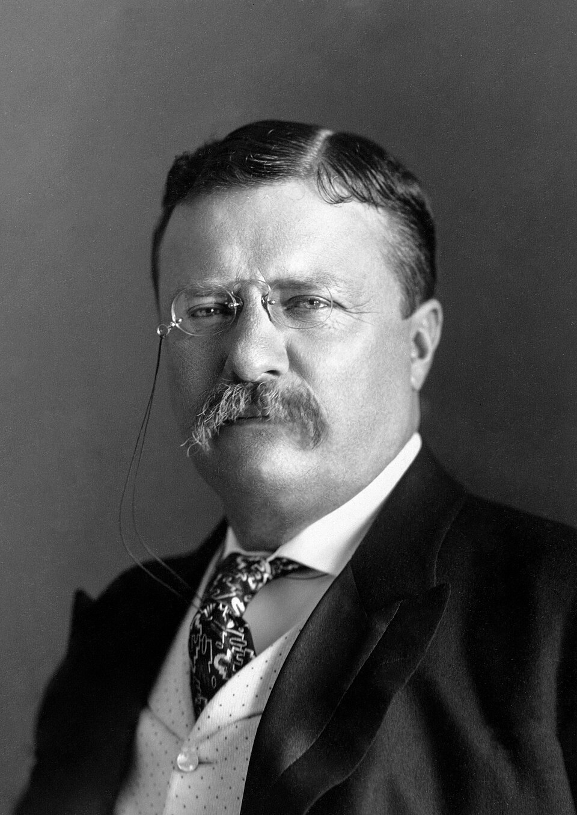
US.16 · PEOPLE WHO SHAPED THE ERA
Key Figure
Theodore Roosevelt
26th President & Progressive Leader
Busted 44+ corporate trusts; won the Northern Securities case (1904) establishing federal antitrust authority
Passed Pure Food and Drug Act and Meat Inspection Act (1906); established 230 million acres of protected public land
Won the Nobel Peace Prize (1906); built the Panama Canal; transformed the American presidency into an activist institution
Pach Brothers, 1904 Library of Congress
STRATEGY Executive power / balanced public interest
U.S. History Hack · TroopToTeacher Technologies LLC · Aligned to TN Academic Standards & TCAP EOC
137

Slide 155
US.16 · PRIMARY SOURCE ANALYSIS
Square Deal Speech
Close Reading
President Theodore Roosevelt · 1903
"When I say I believe in a square deal I do not mean... to give every man the best hand. If the cards do not come to any man, or if they do come, and he has not got the power to play them, that is his affair. All I mean is that there shall be no crookedness in the dealing."
CONTEXT
Theodore Roosevelt became president in September 1901 after the assassination of William McKinley and quickly established himself as the most active, energetic president since Lincoln. Roosevelt believed that the federal government had a responsibility to regulate corporations, protect natural resources, and ensure fair treatment for workers and consumers. His 'Square Deal' domestic program included trust-busting, conservation, and consumer protection. This 1903 speech articulated his political philosophy — not socialist redistribution, but fair rules enforced by a strong government umpire. Roosevelt won the 1904 election in a landslide and remained one of the most popular presidents in American history.
ANALYZE
According to Roosevelt, what did a "Square Deal" mean?
READ CLOSELY Underline the exact words that answer the ANALYZE question — be ready to read them aloud.
SOURCE IT
WHO made it?
WHEN?
WHY does it matter?
FIRST
Theodore Roosevelt — 26th President of the United States, speaking as commander in chief.
1903, in the middle of a national coal strike and rising public anger at corporate trusts.
A president's public speech defines policy for millions of people — ask what group he is trying to reassure, and what group he may be challenging.
SSP.02 · before you interpret
Source: Library of Congress
U.S. History Hack · TroopToTeacher Technologies LLC · Aligned to TN Academic Standards & TCAP EOC
138
Notes:
Primary-source analysis. SOURCE IT FIRST (SSP.02) — model the sourcing routine aloud before students interpret: WHO made this source? (Theodore Roosevelt — 26th President of the United States, speaking as commander in chief.) WHEN? (1903, in the middle of a national coal strike and rising public anger at corporate trusts.) WHY does that matter? (A president's public speech defines policy for millions of people — ask what group he is trying to reassure, and what group he may be challenging.) Only then move to the ANALYZE question. Suggested answer: Roosevelt clarifies he doesn't mean giving everyone "the best hand" but ensuring "no crookedness in the dealing"—fair rules, not equal outcomes. Practice skill: Close Reading.

Slide 156
US.16 · KEY VOCABULARY
Word Wall
Square Deal
Trato Justo
Trust-Busting
Disolución de Trusts
SD
Theodore Roosevelt's domestic policy promising fair treatment for all Americans — balancing the interests of consumers, workers, and businesses through federal regulation.
T
Roosevelt's aggressive use of the Sherman Antitrust Act to break up monopolistic corporations — he filed 44 antitrust suits, earning the nickname 'trust-buster.'
Conservation
Conservación
Pure Food and Drug Act
Ley de Alimentos y Medicamentos Puros
say: PYOOR FOOD and DRUG AKT
C
The protection and sustainable management of natural resources; Roosevelt established 150 national forests and 5 national parks, protecting 230 million acres of public land.
PF
A 1906 law requiring truthful labeling and prohibiting adulterated or misbranded food and drugs — establishing the principle of federal consumer protection that produced today's FDA.
Meat Inspection Act
Ley de Inspección de Carnes
Northern Securities Case
Caso Northern Securities
say: MEET in-SPEK-shun AKT
say: NOR-thern seh-KYOOR-ih-teez KAYSS
MI
A 1906 law requiring federal inspection of meat processing plants after Upton Sinclair's 'The Jungle' exposed unsanitary conditions in Chicago meatpacking plants.
NS
Roosevelt's 1902 antitrust suit against a railroad monopoly; the Supreme Court's 1904 ruling in his favor established presidential authority to use the Sherman Act against powerful corporations.
"say:" pronunciation guide (stressed syllable in CAPS) and a per-term visual anchor support newcomer English learners. Spanish term + full bilingual Frayer models are in the unit vocabulary set.
U.S. History Hack · TroopToTeacher Technologies LLC · Aligned to TN Academic Standards & TCAP EOC
139

Slide 157
US.16 · GUIDED PRACTICE — WE DO IT TOGETHER
Let’s Work One Together
Evidence → conclusion
MODEL PROMPT: Roosevelt filed 44 antitrust suits. Does that make him a 'trust-buster' — or just a president doing his job? Does the label matter?
WORKED EXAMPLE (teacher models this aloud)
EVIDENCE: 44 suits, including Northern Securities (the most powerful railroad monopoly). He won key cases. COMPARISON: Previous presidents filed almost none. CONCLUSION: Relative to his predecessors and to the era's expectation of laissez-faire, 44 suits is genuinely activist. The label 'trust-buster' is historically defensible — but it doesn't mean he wanted to end big business, just control its abuses.
THINK ALOUD
Historical labels like 'trust-buster' or 'muckraker' are analytical shortcuts. A good historian asks: what evidence supports the label, and what does it leave out? That's DOK 3 thinking.
→ Now you try: Write two sentences: one piece of evidence that supports calling Roosevelt a 'trust-buster,' and one limitation of that label — something important about his approach it doesn't capture.
U.S. History Hack · TroopToTeacher Technologies LLC · Aligned to TN Academic Standards & TCAP EOC
140
Notes:
GUIDED PRACTICE / WE DO (US.16). Skill modeled: Evidence → conclusion. Model the worked example aloud using the THINK ALOUD as your script, then release students to the activity ("Write two sentences: one piece of evidence that supports calling Roosevelt a 'trust-buster,' and one limitation of that label — something important about his approach it doesn't capture."). This is the I Do → We Do → You Do bridge — do not skip it; aim for 80%+ success before independent work.

Slide 158
US.16 · STUDENT ACTIVITY
Square Deal in Action — Policy Evidence Chart
Pairs
12 min
YOUR TASK
Roosevelt's Square Deal had three pillars: (1) Conservation of natural resources, (2) Control of corporations, (3) Consumer protection. Using your notes and the Square Deal speech excerpt, fill in a three-pillar evidence chart: for each pillar, identify one specific law or action Roosevelt took AND explain how it fulfilled that pillar of the Square Deal. Then write one sentence: Based on the evidence, do you think Roosevelt was a friend to business, a friend to workers, or a referee between them — and what is your evidence?
DELIVERABLE
DIFFERENTIATION
Completed three-pillar chart with one law/action and one explanation per pillar PLUS a one-sentence claim about Roosevelt's role with supporting evidence.
Entry: First pillar (Conservation) pre-completed as a model. Student completes the Corporation Control and Consumer Protection pillars. Final sentence frame: 'Roosevelt was a ___ because ___.' Honors: Compare Roosevelt's trust-busting approach to Wilson's New Freedom approach (previewing US.17): Roosevelt wanted to REGULATE trusts while Wilson wanted to BREAK them UP. Write two sentences: one argument that Roosevelt's approach was more practical, and one argument that Wilson's approach was more thorough. Then decide which you find more persuasive — and defend it.
Companion printable: cornell-notes/unit-2/us16-roosevelt-progressive.pdf
U.S. History Hack · TroopToTeacher Technologies LLC · Aligned to TN Academic Standards & TCAP EOC
141
Notes:
Student activity for US.16. Pair with the printable: cornell-notes/unit-2/us16-roosevelt-progressive.pdf. Timing: 12. Deliverable: Completed three-pillar chart with one law/action and one explanation per pillar PLUS a one-sentence claim about Roosevelt's role with supporting evidence.

Slide 159
US.16 · CHECK FOR UNDERSTANDING
TCAP-Style Question
DOK 2
EOC PRACTICE
According to Roosevelt, what did a "Square Deal" mean?
Everyone should have a fair chance without unfair advantages
A
Government should guarantee equal outcomes for everyone
B
The wealthy should share their money equally
C
Government should control all business decisions
D
ANSWER FIRST: students commit — then click / advance to reveal the correct answer and explanation.
U.S. History Hack · TroopToTeacher Technologies LLC · Aligned to TN Academic Standards & TCAP EOC
142
Notes:
CHECK FOR UNDERSTANDING (US.16, DOK 2). Have students commit to an answer (whiteboards, hand signal, or turn-and-talk) BEFORE advancing. Correct answer: A. The next slide reveals it. Why: Roosevelt clarifies he doesn't mean giving everyone "the best hand" but ensuring "no crookedness in the dealing"—fair rules, not equal outcomes.

Slide 160
US.16 · ANSWER REVEAL
TCAP-Style Question
✓ ANSWER KEY
According to Roosevelt, what did a "Square Deal" mean?
A
Everyone should have a fair chance without unfair advantages
✓
B
Government should guarantee equal outcomes for everyone
C
The wealthy should share their money equally
D
Government should control all business decisions
Correct answer: A. Why: Roosevelt clarifies he doesn't mean giving everyone "the best hand" but ensuring "no crookedness in the dealing"—fair rules, not equal outcomes.
U.S. History Hack · TroopToTeacher Technologies LLC · Aligned to TN Academic Standards & TCAP EOC
143
Notes:
ANSWER KEY (US.16). Correct: A. Roosevelt clarifies he doesn't mean giving everyone "the best hand" but ensuring "no crookedness in the dealing"—fair rules, not equal outcomes.

Slide 161
US.16 · WRAP-UP
What You Need to Know for TCAP
KEY TAKEAWAYS
EXIT TICKET
DOK 2
The Square Deal
Pure Food and Drug Act and Meat Inspection Act
Trust-Busting Approach
Conservation Efforts
Explain how Theodore Roosevelt's approach to trusts differed from a policy of laissez-faire. Use the Northern Securities Case as a specific example.
★ HONORS / EXTENSION DOK 3 · SSP.04 Argumentation
Roosevelt said he distinguished between 'good trusts' (large but fair) and 'bad trusts' (predatory). Argue: Is this a coherent legal principle, or does it give the executive branch too much power to decide which corporations survive? How does this tension between regulatory discretion and rule of law appear in later American history? (SSP.04)
U.S. History Hack · TroopToTeacher Technologies LLC · Aligned to TN Academic Standards & TCAP EOC
144
Notes:
WRAP-UP / EXIT-TICKET KEY (US.16, DOK 2). Prompt: Explain how Theodore Roosevelt's approach to trusts differed from a policy of laissez-faire. Use the Northern Securities Case as a specific example. Model answer: Laissez-faire meant leaving businesses entirely alone; Roosevelt's 'trust-busting' used the Sherman Antitrust Act to sue corporations that restrained competition. Northern Securities Company (1902) was a railroad holding company formed by J.P. Morgan and railroad barons to control Northwestern rail routes. Roosevelt sued; the Supreme Court ordered it dissolved in 1904. This was the first major federal trust-bust, signaling that even the largest corporations were subject to federal law — a direct reversal of the Gilded Age laissez-faire approach. RETEACH TRIGGER — if a student misses this exit ticket: (1) <50% of class miss → spiral it into the next standard’s Quick Review opener (see the US.16 review prompts). (2) Individual/small group → reteach with the "The Square Deal" direct-instruction slide + re-run the SOURCE IT FIRST routine on the US.16 primary source, then assign the paired printable: cornell-notes/unit-2/us16-roosevelt-progressive.pdf. (3) Re-assess with the US.16 check-for-understanding reveal slide as a do-now the next day. Reteach anchors (this standard’s sections): The Square Deal; Pure Food and Drug Act and Meat Inspection Act; Trust-Busting Approach; Conservation Efforts. I Can objective: I can analyze the significant progressive achievements during President Theodore Roosevelt's administration, including the Square Deal, trust-busting, Pure Food and Drug Act, Meat Inspection Act, and conservation efforts. HONORS / EXTENSION (DOK 3, for early finishers or advanced learners): Roosevelt said he distinguished between 'good trusts' (large but fair) and 'bad trusts' (predatory). Argue: Is this a coherent legal principle, or does it give the executive branch too much power to decide which corporations survive? How does this tension between regulatory discretion and rule of law appear in later American history? (SSP.04) — look for a clear claim plus two specific pieces of evidence.

Slide 162
STANDARD
SOCIAL STUDIES PRACTICES
US.17
SSP.01
Collect sources
SSP.04
Build an argument
SSP.05
Historical awareness
Woodrow Wilson's Progressive Achievements
TN ACADEMIC STANDARD
Analyze the significant progressive achievements during President Woodrow Wilson's administration, including: the New Freedom, the Federal Reserve Act, and the creation of the National Park Service.
I CAN
I can analyze the significant progressive achievements during President Woodrow Wilson's administration, including the New Freedom, the Federal Reserve Act, and the creation of the National Park Service.
U.S. History Hack · TroopToTeacher Technologies LLC · Aligned to TN Academic Standards & TCAP EOC
145

Slide 163
KEY VOCABULARY · LANGUAGE SUPPORT
US.16
Words you need before we read
Square Deal
Trust-Busting
Conservation
En español: Trato Justo
En español: Disolución de Trusts
En español: Conservación
WHAT IT MEANS
WHAT IT MEANS
WHAT IT MEANS
Theodore Roosevelt's domestic policy promising fair treatment for all Americans — balancing the interests of consumers, workers, and businesses through federal regulation.
Roosevelt's aggressive use of the Sherman Antitrust Act to break up monopolistic corporations — he filed 44 antitrust suits, earning the nickname 'trust-buster.'
The protection and sustainable management of natural resources; Roosevelt established 150 national forests and 5 national parks, protecting 230 million acres of public land.
UDL · REPRESENTATION → LANGUAGE & SYMBOLS
U.S. History Hack · TEACHER DECK · Aligned to TN Academic Standards & TCAP EOC
18

Slide 164
PROGRESS CHECK
US.16
Check your understanding
Evaluate Roosevelt's conservation legacy and its impact on environmental policy.
A
By creating national parks, forests, and wildlife refuges while balancing development with preservation, Roosevelt established conservation as a federal responsibility with lasting impact on American environmental policy
✓ KEY
B
Roosevelt opposed conservation, but the historical record tells a more complex story, although historical sources do not support this conclusion, and this view has been largely revised by modern historical research
C
Conservation was unimportant to Roosevelt, which represents a common misconception about the period and fails to account for key developments in the broader context and oversimplifies the complex factors at work during this period
D
His conservation policies were all reversed, but the historical record tells a more complex story and fails to account for key developments in the broader context and oversimplifies the complex factors at work during this period
UDL · ACTION & EXPRESSION → STRATEGY DEVELOPMENT
MTSS: below mastery → targeted reteach (Tier 2); at/above → extension. The goal never lowers.
U.S. History Hack · TEACHER DECK · Aligned to TN Academic Standards & TCAP EOC
19

Slide 165
US.17 · QUICK REVIEW
Do You Remember?
Before we start, retrieve what we have already learned. Answer from memory first — no notes.
1
US.16 What was the Square Deal and what three groups did Roosevelt say it protected?
2
US.16 What did the Meat Inspection Act and Pure Food and Drug Act (both 1906) require?
U.S. History Hack · TroopToTeacher Technologies LLC · Aligned to TN Academic Standards & TCAP EOC
146
Notes:
SPACED RETRIEVAL (US.17). Cold-call or whiteboards, 3-4 min, low stakes. Answers — 1) Roosevelt's Square Deal promised fair treatment for labor, consumers, and businesses — his domestic policy aimed at balancing these three interests rather than favoring corporations as previous administrations had done. 2) The Meat Inspection Act required federal inspection of meatpacking plants; the Pure Food and Drug Act banned the sale of adulterated or mislabeled food and drugs, creating the foundation for the modern FDA.

Slide 166
US.17 · CONFIDENCE CHECK
Warm-Up — Quick Recall
DOK 1
LOW STAKES
Everyone can answer this. Thumbs / whiteboards — no notes.
What banking system, created in 1913, still controls U.S. interest rates and monetary policy today?
✓ ANSWER
The Federal Reserve System — established by the Federal Reserve Act (1913) to regulate the money supply, set interest rates, and stabilize the nation's banks.
COMMIT FIRST: have everyone answer before the reveal — this is the DOK 1 floor; the graded check later in this lesson moves up to DOK 2–3.
U.S. History Hack · TroopToTeacher Technologies LLC · Aligned to TN Academic Standards & TCAP EOC
147
Notes:
CONFIDENCE CHECK (US.17, DOK 1). 60-90 seconds. Have EVERY student commit (thumbs / whiteboard / choral) before revealing — this secures an early win and surfaces who is shaky before new content. Answer: The Federal Reserve System — established by the Federal Reserve Act (1913) to regulate the money supply, set interest rates, and stabilize the nation's banks. Key term to listen for: Federal Reserve System. This is the low-floor entry; the graded Check for Understanding later in the standard rises to DOK 2–3.

Slide 167
US.17 · HOOK
Think About It
Woodrow Wilson won the 1912 election promising a 'New Freedom' — the idea that big government regulating big business was actually LESS free than breaking up monopolies and restoring open competition.
DISCUSS
TIMING: Turn & Talk 60 sec → cold-call 2 pairs
Two progressives — Roosevelt and Wilson — disagreed about the best way to help ordinary Americans. Roosevelt said 'regulate the trusts'; Wilson said 'break them up.' Which philosophy do you think was right, and does it still matter today?
U.S. History Hack · TroopToTeacher Technologies LLC · Aligned to TN Academic Standards & TCAP EOC
148
Notes:
HOOK (US.17). Run tight: pose the provocation, give a silent 10-second think, then Turn & Talk 60 seconds. Cold-call 2–3 pairs (not volunteers) for a sentence-starter answer — "One force was ___ because ___" — then bridge to the standard. Keep total to ~4 minutes; do not let it sprawl. Return to this question at the unit close for an evidence-based answer.

Slide 168
US.17 · DIRECT INSTRUCTION
1 of 4
The New Freedom Platform
Woodrow Wilson won the 1912 presidential election in a three-way race against both Republican incumbent William Howard Taft and Progressive Party candidate Theodore Roosevelt.
Wilson's 'New Freedom' program attacked what he called the 'triple wall of privilege' — high tariffs, monopolistic banks, and industrial trusts.
Unlike Roosevelt, who wanted to regulate large corporations, Wilson wanted to break them up and restore competition.
The Underwood Tariff Act (1913) lowered tariffs significantly and, combined with the new income tax from the 16th Amendment, shifted federal revenue away from consumption taxes toward wealth.
SENTENCE FRAME (EL & writing support)
Wilson's ________ platform favored ________ over regulation, leading to the creation of the ________ to control the money supply.
U.S. History Hack · TroopToTeacher Technologies LLC · Aligned to TN Academic Standards & TCAP EOC
149
Notes:
FACILITATION (US.17). Show the Wilson portrait. Turn & Talk: 'Wilson won the 1912 election against BOTH Taft and Roosevelt. What does that tell us about what voters wanted?' Cold-call 2 pairs; push for 'voters wanted Progressive reform — but disagreed on approach.' Then lay out the New Freedom vs. Square Deal distinction. Teach in small steps; pause and check for understanding before the next chunk (aim 80%+ before moving on).

Slide 169
US.17 · DIRECT INSTRUCTION
2 of 4
Federal Reserve Act (1913)
Before 1913, the United States had no central banking system.
Financial panics — especially the Panic of 1907 — revealed the fragility of a banking system controlled entirely by private interests.
The Federal Reserve Act (1913) created 12 regional Federal Reserve banks under a presidentially appointed Federal Reserve Board.
The system could adjust the money supply, set interest rates, and serve as a lender of last resort during financial crises.
Wilson ensured that while banks had input, ultimate control rested with a government-appointed board — making banking 'public, not private,' as he stated.
U.S. History Hack · TroopToTeacher Technologies LLC · Aligned to TN Academic Standards & TCAP EOC
150

Slide 170
US.17 · DIRECT INSTRUCTION
3 of 4
National Park Service (1916)
Although Roosevelt had dramatically expanded protected lands, they were administered by multiple agencies with no coordinating policy.
The National Park Service Organic Act (1916), signed by Wilson, created a single agency — the National Park Service — to manage parks 'in such manner and by such means as will leave them unimpaired for the enjoyment of future generations.' Tennessee's Great Smoky Mountains National Park, established in 1934, operates under the framework Wilson signed into law.
The NPS today manages over 400 sites covering 85 million acres.
★ TENNESSEE CONNECTION
Tennessee's Great Smoky Mountains National Park, established 1934, operates under the National Park Service framework Woodrow Wilson signed into law with the 1916 Organic Act.
U.S. History Hack · TroopToTeacher Technologies LLC · Aligned to TN Academic Standards & TCAP EOC
151

Slide 171
US.17 · DIRECT INSTRUCTION
4 of 4
Additional Wilson Reforms
Wilson's progressive achievements extended beyond the three major reforms.
The Clayton Antitrust Act (1914) strengthened antitrust enforcement and exempted labor unions from prosecution.
The Federal Trade Commission Act (1914) created a regulatory agency to prevent unfair business practices.
The Adamson Act (1916) established the eight-hour workday for railroad workers — the first federal hours regulation.
Wilson's presidency brought the Progressive movement to its legislative peak, transforming the federal government into an active regulator of economic life.
U.S. History Hack · TroopToTeacher Technologies LLC · Aligned to TN Academic Standards & TCAP EOC
152

Slide 172
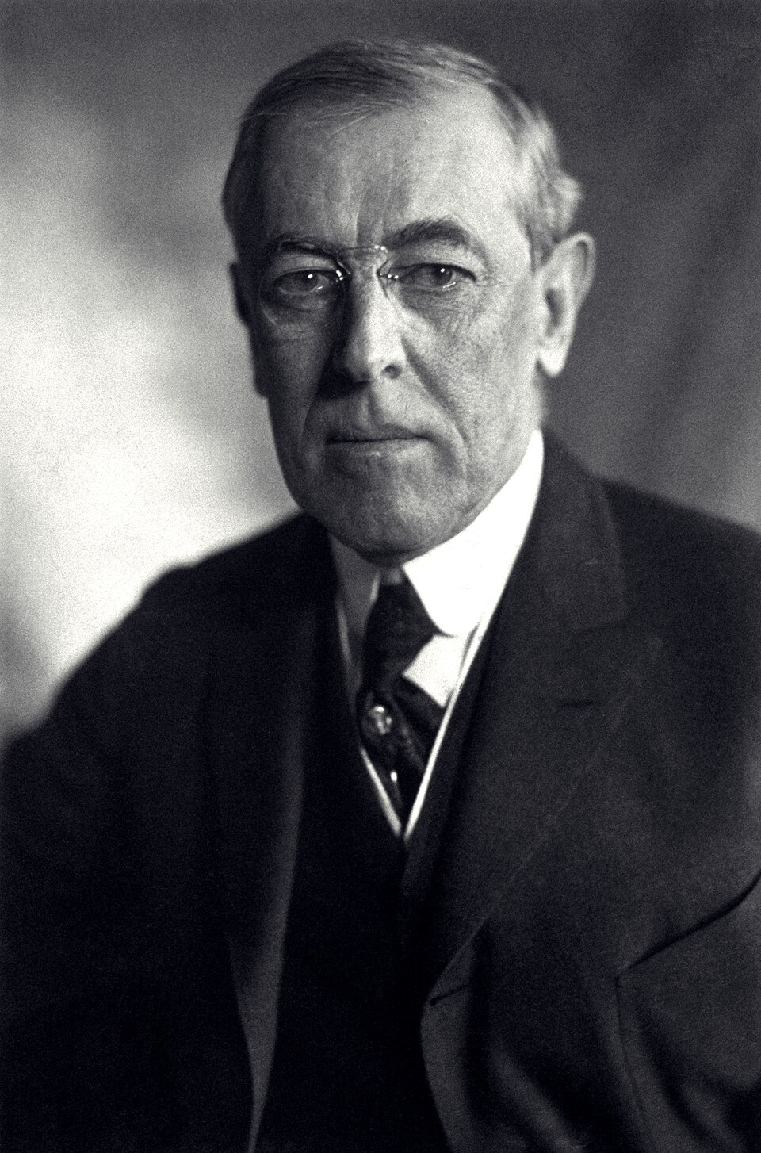
US.17 · PEOPLE WHO SHAPED THE ERA
Key Figure
Woodrow Wilson
28th President & Progressive Reformer
Created the Federal Reserve System (1913) to stabilize American banking — it remains the foundation of U.S. monetary policy
Signed the Clayton Antitrust Act (1914) and created the Federal Trade Commission; lowered tariffs with the Underwood Act
Signed the National Park Service Act (1916); led America through World War I; proposed the League of Nations
Harris & Ewing, 1919 Library of Congress
STRATEGY Restoring competition / institutional regulation
U.S. History Hack · TroopToTeacher Technologies LLC · Aligned to TN Academic Standards & TCAP EOC
153

Slide 173
US.17 · PRIMARY SOURCE ANALYSIS
Federal Reserve Act Message
Close Reading
President Woodrow Wilson · 1913
"We shall deal with our economic system as it is and as it may be modified, not as it might be if we had a clean sheet of paper to write upon... We must effect our reforms with a minimum of disturbance to business. The control of the system of banking and of issue should be vested in the Government itself, so that the banks may be the instruments, not the masters, of business."
CONTEXT
By 1913, banking and monetary policy had become central issues in American politics. The Panic of 1907 had revealed how vulnerable the economy was to bank failures and financial panics — J.P. Morgan personally had to step in with his own money to stabilize the banking system. Populists and progressives argued that the country needed a central banking system controlled by the government, not private bankers. Woodrow Wilson's Federal Reserve Act (1913) created a decentralized federal banking system — the Federal Reserve — that could regulate the money supply and serve as a lender of last resort, placing monetary policy under democratic oversight rather than leaving it to Wall Street.
ANALYZE
What was Wilson's goal for banking reform according to this excerpt?
READ CLOSELY Underline the exact words that answer the ANALYZE question — be ready to read them aloud.
SOURCE IT
WHO made it?
WHEN?
WHY does it matter?
FIRST
Woodrow Wilson — 28th President, speaking to Congress as the chief executive proposing legislation.
June 1913, as the Federal Reserve bill was being debated — six years after the Panic of 1907.
Presidential messages to Congress are public arguments for policy — ask: what problem is he responding to, and who benefits from his proposed solution?
SSP.02 · before you interpret
Source: Library of Congress
U.S. History Hack · TroopToTeacher Technologies LLC · Aligned to TN Academic Standards & TCAP EOC
154
Notes:
Primary-source analysis. SOURCE IT FIRST (SSP.02) — model the sourcing routine aloud before students interpret: WHO made this source? (Woodrow Wilson — 28th President, speaking to Congress as the chief executive proposing legislation.) WHEN? (June 1913, as the Federal Reserve bill was being debated — six years after the Panic of 1907.) WHY does that matter? (Presidential messages to Congress are public arguments for policy — ask: what problem is he responding to, and who benefits from his proposed solution?) Only then move to the ANALYZE question. Suggested answer: Wilson states "The control of the system of banking... should be vested in the Government itself, so that the banks may be the instruments, not the masters, of business." Practice skill: Close Reading.

Slide 174
US.17 · KEY VOCABULARY
Word Wall
New Freedom
Nueva Libertad
Federal Reserve System
Sistema de la Reserva Federal
say: FED-er-ul reh-ZERV SIS-tem
NF
Woodrow Wilson's Progressive program that targeted the 'triple wall of privilege' — high tariffs, monopolistic banks, and industrial trusts — seeking to restore competition rather than just regulate big business.
FR
The central banking system created by the Federal Reserve Act (1913) — 12 regional banks under a government-appointed board that manages the money supply and stabilizes the financial system.
Underwood Tariff
Arancel Underwood
Federal Trade Commission
Comisión Federal de Comercio
say: UN-der-wood TAIR-if
say: FED-er-ul TRAYD kuh-MISH-un
UT
Wilson's 1913 tariff reduction that significantly lowered import taxes, making goods cheaper for consumers, while the new income tax (16th Amendment) replaced the lost revenue.
FT
A regulatory agency created in 1914 to investigate and prevent unfair business practices — a permanent institutional watchdog that supplemented the antitrust laws.
Clayton Antitrust Act
Ley Clayton Antimonopolio
National Park Service
Servicio de Parques Nacionales
say: KLAY-tun AN-tee-trust AKT
CA
A 1914 law that strengthened the Sherman Antitrust Act by prohibiting specific monopolistic practices and explicitly exempting labor unions from antitrust prosecution.
NP
Federal agency created in 1916 to manage and protect national parks 'unimpaired for future generations' — Tennessee's Great Smoky Mountains National Park operates under its framework.
"say:" pronunciation guide (stressed syllable in CAPS) and a per-term visual anchor support newcomer English learners. Spanish term + full bilingual Frayer models are in the unit vocabulary set.
U.S. History Hack · TroopToTeacher Technologies LLC · Aligned to TN Academic Standards & TCAP EOC
155

Slide 175
US.17 · GUIDED PRACTICE — WE DO IT TOGETHER
Let’s Work One Together
Comparing progressive presidencies
MODEL PROMPT: Roosevelt said 'regulate the trusts.' Wilson said 'break them up.' What's the difference — and does it matter?
WORKED EXAMPLE (teacher models this aloud)
ROOSEVELT'S VIEW: Big corporations are here to stay — some are efficient, some are abusive. Use government to control the bad ones. WILSON'S VIEW: Monopoly itself is the problem — even a well-regulated Standard Oil has too much power. Break it up and restore real competition. DIFFERENCE: Regulation vs. restoration of competition. It matters because it shapes what government does: watch and manage, or restructure the market itself.
THINK ALOUD
Both are Progressive, but they disagree about the diagnosis. Roosevelt says monopoly + regulation = OK. Wilson says monopoly = problem, even regulated. On TCAP, you need to know BOTH policies and what distinguishes them.
→ Now you try: Write one sentence each: what was Roosevelt's approach to trusts, and what was Wilson's approach? Then circle which one went further in changing market structure — and explain why in one sentence.
U.S. History Hack · TroopToTeacher Technologies LLC · Aligned to TN Academic Standards & TCAP EOC
156
Notes:
GUIDED PRACTICE / WE DO (US.17). Skill modeled: Comparing progressive presidencies. Model the worked example aloud using the THINK ALOUD as your script, then release students to the activity ("Write one sentence each: what was Roosevelt's approach to trusts, and what was Wilson's approach? Then circle which one went further in changing market structure — and explain why in one sentence."). This is the I Do → We Do → You Do bridge — do not skip it; aim for 80%+ success before independent work.

Slide 176
US.17 · STUDENT ACTIVITY
Wilson's New Freedom — Reform Impact Analysis
Pairs
12 min
YOUR TASK
Wilson said he was attacking the 'triple wall of privilege' — high tariffs, monopolistic banks, and industrial trusts. Using your notes and the Wilson Federal Reserve message, match each wall to one Wilson reform that attacked it: (1) High tariffs → ?, (2) Monopolistic banks → ?, (3) Industrial trusts → ? For each, write one sentence explaining how that reform addressed the problem Wilson identified. Then answer: How does Wilson's New Freedom compare to Roosevelt's Square Deal — use one similarity and one difference.
DELIVERABLE
DIFFERENTIATION
Three matched Wall-to-Reform pairs each with a one-sentence explanation PLUS a two-sentence Roosevelt/Wilson comparison (one similarity, one difference).
Entry: First wall (high tariffs → Underwood Tariff) pre-matched and explained as a model. Student completes the remaining two matches and writes the comparison using a sentence frame: 'Like Roosevelt, Wilson ___. Unlike Roosevelt, Wilson ___.' Honors: Wilson's legacy is complicated: he was a Progressive reformer who also re-segregated the federal civil service and showed the Birth of a Nation at the White House. Write two sentences: one documenting a Progressive achievement and one documenting a failure or harm. Then explain what this complexity means for how we should evaluate historical figures — can someone be both a Progressive and a defender of inequality at the same time?
Companion printable: cornell-notes/unit-2/us17-wilson-progressive.pdf
U.S. History Hack · TroopToTeacher Technologies LLC · Aligned to TN Academic Standards & TCAP EOC
157
Notes:
Student activity for US.17. Pair with the printable: cornell-notes/unit-2/us17-wilson-progressive.pdf. Timing: 12. Deliverable: Three matched Wall-to-Reform pairs each with a one-sentence explanation PLUS a two-sentence Roosevelt/Wilson comparison (one similarity, one difference).

Slide 177
US.17 · CHECK FOR UNDERSTANDING
TCAP-Style Question
DOK 2
EOC PRACTICE
What was Wilson's goal for banking reform according to this excerpt?
To eliminate all private banks
A
To allow banks to regulate themselves completely
B
To place banking control in government hands so banks serve business
C
To return to the gold standard exclusively
D
ANSWER FIRST: students commit — then click / advance to reveal the correct answer and explanation.
U.S. History Hack · TroopToTeacher Technologies LLC · Aligned to TN Academic Standards & TCAP EOC
158
Notes:
CHECK FOR UNDERSTANDING (US.17, DOK 2). Have students commit to an answer (whiteboards, hand signal, or turn-and-talk) BEFORE advancing. Correct answer: C. The next slide reveals it. Why: Wilson states "The control of the system of banking... should be vested in the Government itself, so that the banks may be the instruments, not the masters, of business."

Slide 178
US.17 · ANSWER REVEAL
TCAP-Style Question
✓ ANSWER KEY
What was Wilson's goal for banking reform according to this excerpt?
A
To eliminate all private banks
B
To allow banks to regulate themselves completely
C
To place banking control in government hands so banks serve business
✓
D
To return to the gold standard exclusively
Correct answer: C. Why: Wilson states "The control of the system of banking... should be vested in the Government itself, so that the banks may be the instruments, not the masters, of business."
U.S. History Hack · TroopToTeacher Technologies LLC · Aligned to TN Academic Standards & TCAP EOC
159
Notes:
ANSWER KEY (US.17). Correct: C. Wilson states "The control of the system of banking... should be vested in the Government itself, so that the banks may be the instruments, not the masters, of business."

Slide 179
US.17 · WRAP-UP
What You Need to Know for TCAP
KEY TAKEAWAYS
EXIT TICKET
DOK 2
The New Freedom Platform
Federal Reserve Act (1913)
National Park Service (1916)
Additional Wilson Reforms
Describe Wilson's 'New Freedom' and identify TWO specific laws passed during his administration that reflected this philosophy.
★ HONORS / EXTENSION DOK 3 · SSP.04 Argumentation
Historians debate whether Wilson's New Freedom was more genuinely progressive than Roosevelt's New Nationalism, or whether both men ultimately served the interests of large corporate capital. Argue: Did Wilson's administration fulfill the promise of his 'New Freedom' platform, or did his actual legislative record represent a compromise that left corporate power largely intact? (SSP.04)
U.S. History Hack · TroopToTeacher Technologies LLC · Aligned to TN Academic Standards & TCAP EOC
160
Notes:
WRAP-UP / EXIT-TICKET KEY (US.17, DOK 2). Prompt: Describe Wilson's 'New Freedom' and identify TWO specific laws passed during his administration that reflected this philosophy. Model answer: The New Freedom was Wilson's platform that federal power should be used to break up monopolies and restore genuine market competition — different from Roosevelt's New Nationalism which wanted to regulate (not break up) big business. Laws: (1) Underwood Tariff Act (1913) — reduced tariffs and included a graduated income tax (implementing the 16th Amendment). (2) Federal Reserve Act (1913) — created the central bank, giving government control over monetary policy. Also acceptable: Clayton Antitrust Act (1914) — strengthened antitrust law and protected unions; Federal Trade Commission Act (1914) — created the FTC to investigate and stop unfair business practices. RETEACH TRIGGER — if a student misses this exit ticket: (1) <50% of class miss → spiral it into the next standard’s Quick Review opener (see the US.17 review prompts). (2) Individual/small group → reteach with the "The New Freedom Platform" direct-instruction slide + re-run the SOURCE IT FIRST routine on the US.17 primary source, then assign the paired printable: cornell-notes/unit-2/us17-wilson-progressive.pdf. (3) Re-assess with the US.17 check-for-understanding reveal slide as a do-now the next day. Reteach anchors (this standard’s sections): The New Freedom Platform; Federal Reserve Act (1913); National Park Service (1916); Additional Wilson Reforms. I Can objective: I can analyze the significant progressive achievements during President Woodrow Wilson's administration, including the New Freedom, the Federal Reserve Act, and the creation of the National Park Service. HONORS / EXTENSION (DOK 3, for early finishers or advanced learners): Historians debate whether Wilson's New Freedom was more genuinely progressive than Roosevelt's New Nationalism, or whether both men ultimately served the interests of large corporate capital. Argue: Did Wilson's administration fulfill the promise of his 'New Freedom' platform, or did his actual legislative record represent a compromise that left corporate power largely intact? (SSP.04) — look for a clear claim plus two specific pieces of evidence.

Slide 180
STANDARD
SOCIAL STUDIES PRACTICES
US.18
SSP.01
Collect sources
SSP.02
Examine a source
SSP.04
Build an argument
SSP.05
Historical awareness
Women's Suffrage Movement
TN ACADEMIC STANDARD
Describe the movement to achieve suffrage for women, including: the significance of leaders such as Carrie Chapman Catt, Anne Dallas Dudley, and Alice Paul, the activities of suffragettes, the passage of the 19th Amendment, and the role of Tennessee as the 'Perfect 36.'
I CAN
I can describe the movement to achieve suffrage for women, including the significance of leaders such as Carrie Chapman Catt, Anne Dallas Dudley, and Alice Paul, the activities of suffragettes, the passage of the 19th Amendment, and the role of Tennessee as the 'Perfect 36.'
U.S. History Hack · TroopToTeacher Technologies LLC · Aligned to TN Academic Standards & TCAP EOC
161

Slide 181
KEY VOCABULARY · LANGUAGE SUPPORT
US.17
Words you need before we read
New Freedom
Federal Reserve System
Underwood Tariff
En español: Nueva Libertad
En español: Sistema de la Reserva Federal
En español: Arancel Underwood
WHAT IT MEANS
WHAT IT MEANS
WHAT IT MEANS
Woodrow Wilson's Progressive program that targeted the 'triple wall of privilege' — high tariffs, monopolistic banks, and industrial trusts — seeking to restore competition rather than just regulate big business.
The central banking system created by the Federal Reserve Act (1913) — 12 regional banks under a government-appointed board that manages the money supply and stabilizes the financial system.
Wilson's 1913 tariff reduction that significantly lowered import taxes, making goods cheaper for consumers, while the new income tax (16th Amendment) replaced the lost revenue.
UDL · REPRESENTATION → LANGUAGE & SYMBOLS
U.S. History Hack · TEACHER DECK · Aligned to TN Academic Standards & TCAP EOC
20

Slide 182
PROGRESS CHECK
US.17
Check your understanding
Analyze how Wilson's reforms created institutional frameworks that continue to influence American economic policy.
A
Wilson's reforms were all temporary, which does not align with the documented historical record when examined alongside the available primary and secondary sources and oversimplifies the complex factors at work during this period
B
The Federal Reserve manages monetary policy, the FTC enforces consumer protection, and the NPS protects natural resources—institutions created over a century ago that remain central to American government today
✓ KEY
C
None of Wilson's institutions survived, which represents a common misconception about the period, and this view has been largely revised by modern historical research and fails to account for key developments in the broader context
D
Only the income tax remained from Wilson's era, which does not reflect the consensus among historians when examined alongside the available primary and secondary sources and fails to account for key developments in the broader context
UDL · ACTION & EXPRESSION → STRATEGY DEVELOPMENT
MTSS: below mastery → targeted reteach (Tier 2); at/above → extension. The goal never lowers.
U.S. History Hack · TEACHER DECK · Aligned to TN Academic Standards & TCAP EOC
21

Slide 183
US.18 · QUICK REVIEW
Do You Remember?
Before we start, retrieve what we have already learned. Answer from memory first — no notes.
1
US.17 What was Woodrow Wilson's 'New Freedom' and how did it differ from Roosevelt's 'New Nationalism'?
2
US.17 What did the Federal Reserve Act (1913) create, and why was it significant?
U.S. History Hack · TroopToTeacher Technologies LLC · Aligned to TN Academic Standards & TCAP EOC
162
Notes:
SPACED RETRIEVAL (US.18). Cold-call or whiteboards, 3-4 min, low stakes. Answers — 1) Wilson's New Freedom favored breaking up monopolies to restore competition; Roosevelt's New Nationalism favored keeping big corporations but regulating them through a powerful federal government. 2) It created the Federal Reserve System — the central banking system of the United States — giving the government the ability to regulate the money supply, set interest rates, and stabilize the banking system.

Slide 184
US.18 · CONFIDENCE CHECK
Warm-Up — Quick Recall
DOK 1
LOW STAKES
Everyone can answer this. Thumbs / whiteboards — no notes.
What amendment to the U.S. Constitution gave women the right to vote, and in what year was it ratified?
✓ ANSWER
The 19th Amendment, ratified in 1920 — it prohibited denying the right to vote based on sex.
COMMIT FIRST: have everyone answer before the reveal — this is the DOK 1 floor; the graded check later in this lesson moves up to DOK 2–3.
U.S. History Hack · TroopToTeacher Technologies LLC · Aligned to TN Academic Standards & TCAP EOC
163
Notes:
CONFIDENCE CHECK (US.18, DOK 1). 60-90 seconds. Have EVERY student commit (thumbs / whiteboard / choral) before revealing — this secures an early win and surfaces who is shaky before new content. Answer: The 19th Amendment, ratified in 1920 — it prohibited denying the right to vote based on sex. Key term to listen for: 19th Amendment. This is the low-floor entry; the graded Check for Understanding later in the standard rises to DOK 2–3.

Slide 185
US.18 · HOOK
Think About It
On August 18, 1920, the Tennessee state legislature cast the deciding vote to ratify the 19th Amendment — and the entire outcome hinged on one 24-year-old representative named Harry T. Burn, who changed his vote because of a note his mother slipped him that morning.
DISCUSS
TIMING: Turn & Talk 60 sec → cold-call 2 pairs
Tennessee was the 36th and final state needed to ratify — the 'Perfect 36.' What does it mean that a national amendment granting half the population the right to vote came down to one young man's mother in Nashville? Let's trace how suffragists built 72 years of organizing to that single moment.
U.S. History Hack · TroopToTeacher Technologies LLC · Aligned to TN Academic Standards & TCAP EOC
164
Notes:
HOOK (US.18). Run tight: pose the provocation, give a silent 10-second think, then Turn & Talk 60 seconds. Cold-call 2–3 pairs (not volunteers) for a sentence-starter answer — "One force was ___ because ___" — then bridge to the standard. Keep total to ~4 minutes; do not let it sprawl. Return to this question at the unit close for an evidence-based answer.

Slide 186
US.18 · DIRECT INSTRUCTION
1 of 4
Historical Context and Motivations
Women had been demanding voting rights since the Seneca Falls Convention of 1848, where Elizabeth Cady Stanton and Frederick Douglass led the first women's rights convention in American history.
After 70 years of activism, women still could not vote in federal elections.
The suffrage movement drew from multiple motivations: natural rights arguments that democracy required equal representation; Progressive arguments that women voters would support reform legislation; and civil rights arguments that exclusion from the franchise violated American democratic principles.
SENTENCE FRAME (EL & writing support)
Leaders like ________ and ________ organized suffragettes to demand the right to vote, and Tennessee became the '________' when it ratified the 19th Amendment.
U.S. History Hack · TroopToTeacher Technologies LLC · Aligned to TN Academic Standards & TCAP EOC
165
Notes:
FACILITATION (US.18). Show the suffrage parade image (1913). Silent look — 'What do you notice about the scale? What risks were these women taking?' Turn & Talk → cold-call 2 pairs. Then pivot: 'This was 1913. The 19th Amendment didn't pass until 1920. What took so long — and what finally changed?' Teach in small steps; pause and check for understanding before the next chunk (aim 80%+ before moving on).

Slide 187
US.18 · DIRECT INSTRUCTION
2 of 4
Key Leaders and Their Strategies
Carrie Chapman Catt led the National American Woman Suffrage Association (NAWSA) and developed the 'Winning Plan' — a coordinated strategy of simultaneous state-level campaigns and federal lobbying.
She was a disciplined organizer who built NAWSA into a political force with millions of members.
Alice Paul founded the National Woman's Party and pursued more militant tactics inspired by British suffragettes: parades, White House picketing, hunger strikes, and civil disobedience.
Anne Dallas Dudley organized Tennessee's suffrage movement, building statewide support that made the 'Perfect 36' possible.
Their different strategies were complementary — Catt's mass organization built the foundation while Paul's radicalism maintained public attention.
★ TENNESSEE CONNECTION
Anne Dallas Dudley of Nashville organized Tennessee's suffrage movement, building the statewide support that later made Tennessee's decisive 'Perfect 36' ratification vote possible.
U.S. History Hack · TroopToTeacher Technologies LLC · Aligned to TN Academic Standards & TCAP EOC
166

Slide 188
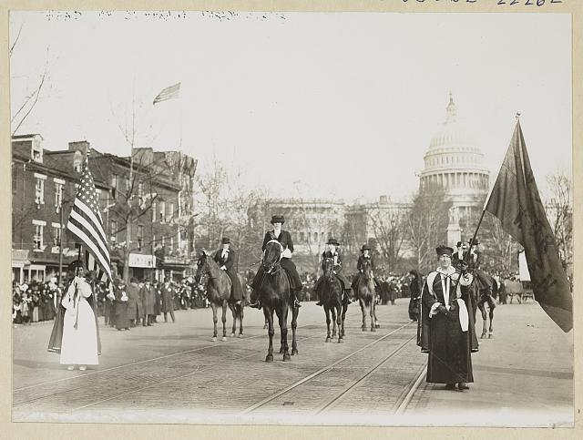
US.18 · DIRECT INSTRUCTION
3 of 4
Suffragette Activities and Tactics
Suffragists used a wide range of tactics over seven decades.
Early campaigns focused on petitions and public lectures.
By the 1910s, the movement organized massive parades — Alice Paul organized a parade of 8,000 women in Washington D.C. the day before Wilson's 1913 inauguration, which was met with mob violence while police stood by.
Paul's 'Silent Sentinels' picketed the White House daily from January 1917 forward — the first sustained picket of the White House in American history.
When picketers were arrested and imprisoned, they went on hunger strikes and endured forced feeding, generating enormous public sympathy.
Harris & Ewing, 1913 Library of Congress
U.S. History Hack · TroopToTeacher Technologies LLC · Aligned to TN Academic Standards & TCAP EOC
167

Slide 189
US.18 · DIRECT INSTRUCTION
4 of 4
The 19th Amendment and Tennessee as the 'Perfect 36'
The 19th Amendment, granting women the right to vote regardless of sex, passed Congress in June 1919.
Ratification required 36 of 48 states.
By August 1920, 35 states had ratified — one short.
Tennessee became the decisive 36th state.
The Tennessee General Assembly voted on August 18, 1920.
The deciding vote was cast by 24-year-old State Representative Harry T. Burn of Niota, Tennessee.
Burn initially planned to vote against ratification, but his mother Phoebe wrote him a letter: 'Hurrah and vote for Suffrage and don't keep them in doubt!' He changed his vote to 'Aye.' That single vote gave millions of American women the constitutional right to vote.
★ TENNESSEE CONNECTION
Tennessee cast the deciding 36th ratification vote on Aug. 18, 1920; 24-year-old Rep. Harry T. Burn of Niota changed his vote to 'Aye' after his mother Phoebe urged him to 'vote for Suffrage.'
U.S. History Hack · TroopToTeacher Technologies LLC · Aligned to TN Academic Standards & TCAP EOC
168

Slide 190
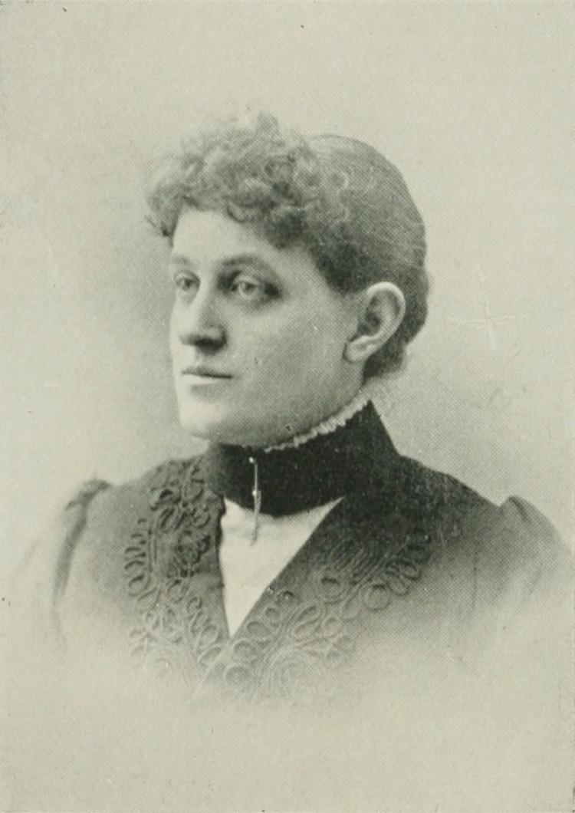
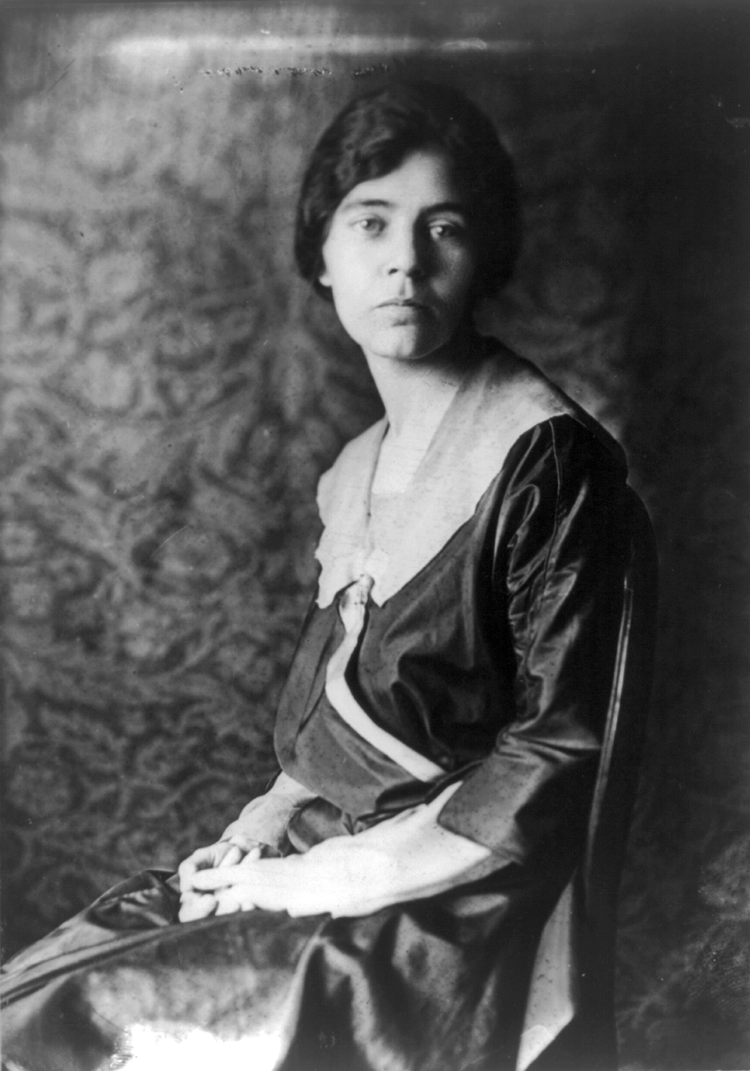
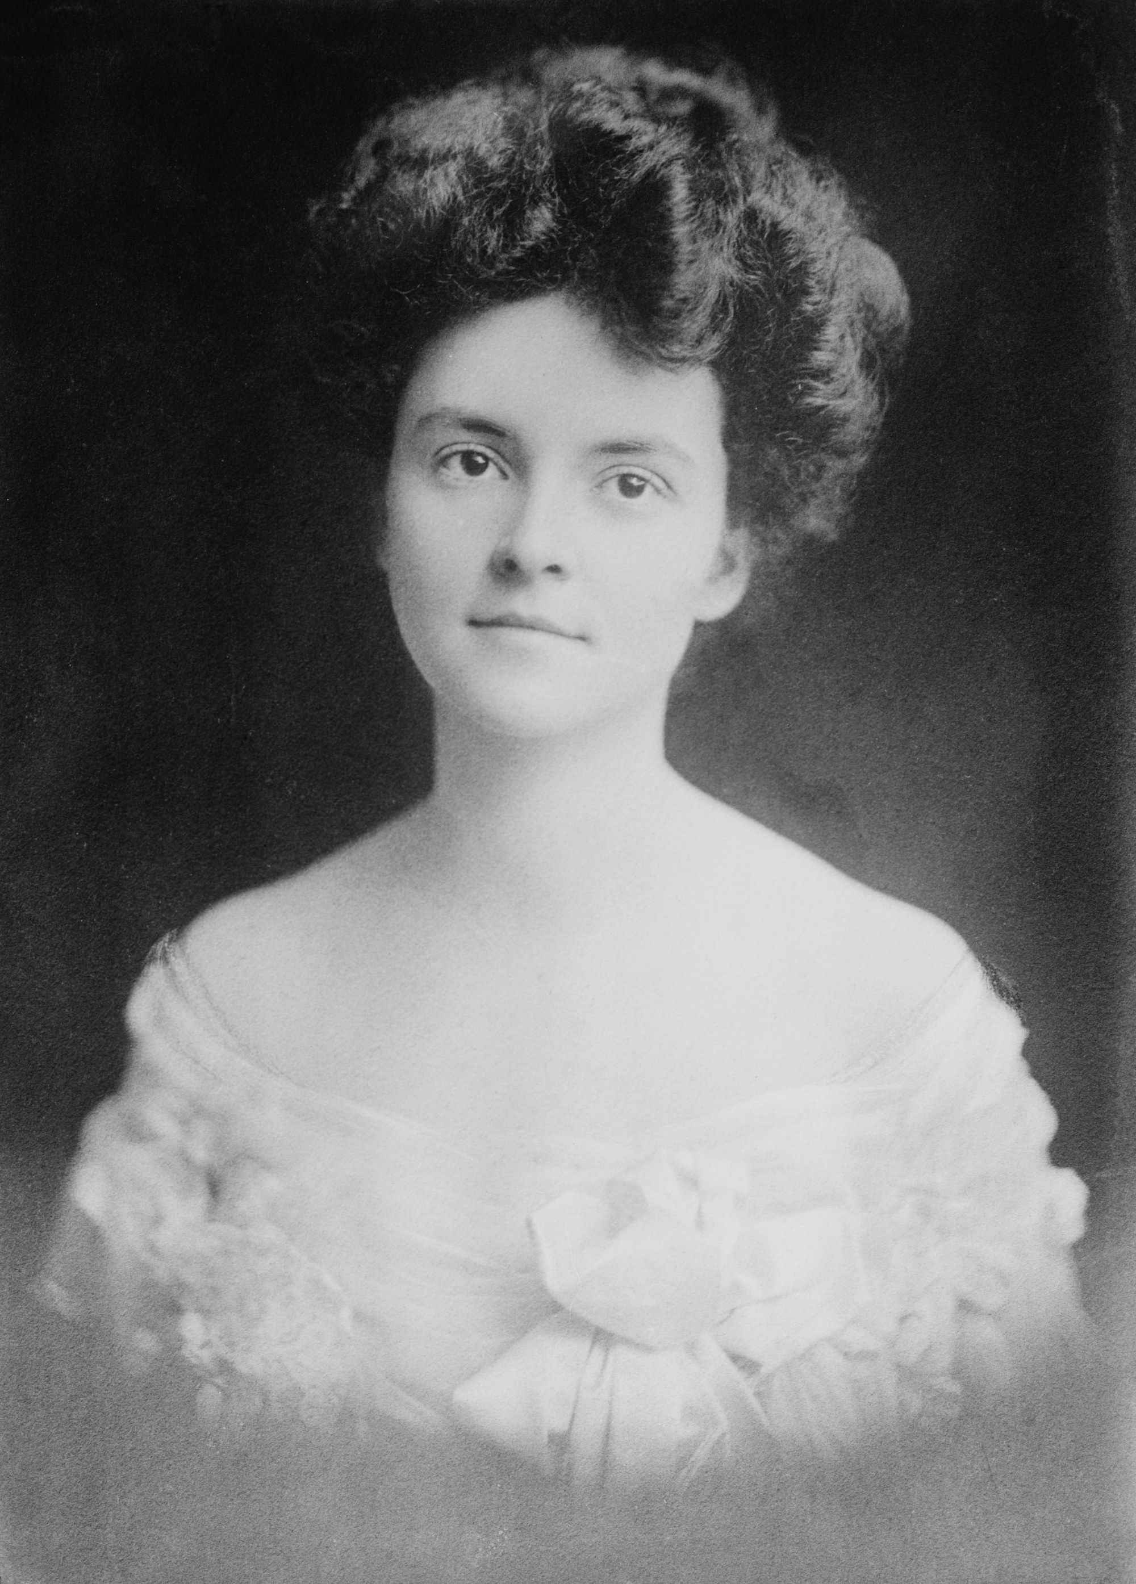
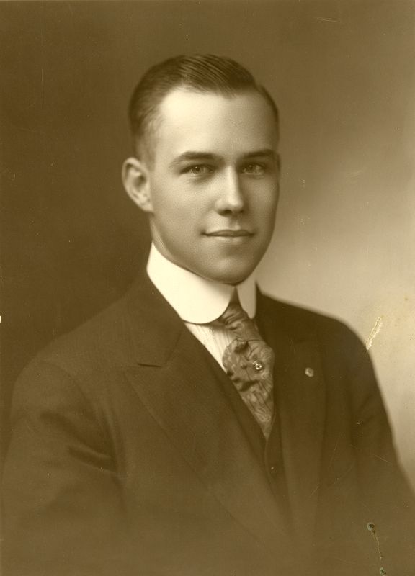
US.18 · PEOPLE WHO SHAPED THE ERA
Key Figures
Carrie Chapman Catt
Suffrage Leader
Alice Paul
Militant Suffragist
Led NAWSA to develop the 'Winning Plan' — coordinating state and federal campaigns; grew organization to 2 million members
Secured ratification of the 19th Amendment (1920) after decades of organizing across 26 countries
Organized 8,000-woman Washington parade (March 1913) — day before Wilson's inauguration, met with mob violence
Led first sustained White House picket line (1917); endured imprisonment and force-feeding at Occoquan Workhouse
Wikimedia Commons
Library of Congress
STRATEGY Mass organization / coordinated legislative strategy
STRATEGY Civil disobedience / militant protest
Anne Dallas Dudley
Southern Suffrage Leader
Harry T. Burn
Tennessee State Legislator & Deciding Vote
Founded Nashville Equal Suffrage League; built Tennessee's statewide suffrage network from the ground up
Served as third vice president of NAWSA; helped persuade Harry T. Burn's mother to write the decisive letter
Youngest member of the Tennessee General Assembly, elected at age 22 in 1918
Cast the deciding 'Aye' vote for ratification on August 18, 1920, making Tennessee the 'Perfect 36'
Library of Congress
Tennessee State Library and Archives
STRATEGY Southern coalition-building / state-level organizing
STRATEGY Conscience vote / family influence
U.S. History Hack · TroopToTeacher Technologies LLC · Aligned to TN Academic Standards & TCAP EOC
169

Slide 191
US.18 · PRIMARY SOURCE ANALYSIS
19th Amendment
Close Reading
U.S. Constitution · 1920
"The right of citizens of the United States to vote shall not be denied or abridged by the United States or by any State on account of sex. Congress shall have power to enforce this article by appropriate legislation."
CONTEXT
American women had been fighting for the right to vote since the Seneca Falls Convention of 1848. The suffrage movement suffered setbacks after the Civil War, when the 15th Amendment gave Black men the right to vote but excluded women. By the early 20th century, the movement had revived under leaders like Susan B. Anthony, Elizabeth Cady Stanton, Carrie Chapman Catt, and Alice Paul, who used tactics ranging from state-by-state campaigns to hunger strikes and White House pickets. Tennessee became the crucial 36th state to ratify the 19th Amendment on August 18, 1920 — providing the necessary three-fourths of states — after a dramatic last-minute vote in the state legislature.
ANALYZE
What did the 19th Amendment guarantee?
READ CLOSELY Underline the exact words that answer the ANALYZE question — be ready to read them aloud.
SOURCE IT
WHO made it?
WHEN?
WHY does it matter?
FIRST
The U.S. Congress and 36 state ratifying bodies — ratified after 70 years of organized suffrage campaigning.
August 18, 1920 — the Tennessee vote made it official; it was the final constitutional act of the Progressive Era.
Constitutional amendments are the highest form of democratic change — understanding who fought for them and why reveals the values a society chose to enshrine in its fundamental law.
SSP.02 · before you interpret
Source: National Archives
U.S. History Hack · TroopToTeacher Technologies LLC · Aligned to TN Academic Standards & TCAP EOC
170
Notes:
Primary-source analysis. SOURCE IT FIRST (SSP.02) — model the sourcing routine aloud before students interpret: WHO made this source? (The U.S. Congress and 36 state ratifying bodies — ratified after 70 years of organized suffrage campaigning.) WHEN? (August 18, 1920 — the Tennessee vote made it official; it was the final constitutional act of the Progressive Era.) WHY does that matter? (Constitutional amendments are the highest form of democratic change — understanding who fought for them and why reveals the values a society chose to enshrine in its fundamental law.) Only then move to the ANALYZE question. Suggested answer: The amendment clearly states voting rights "shall not be denied or abridged... on account of sex." Practice skill: Close Reading.

Slide 192
US.18 · KEY VOCABULARY
Word Wall
Women's Suffrage
Sufragio Femenino
19th Amendment
19ª Enmienda
say: WIM-enz SUF-rij
say: NYNE-teenth uh-MEND-ment
WS
The movement to secure voting rights for women, culminating in the 19th Amendment (1920) after more than 70 years of organized activism.
1A
Ratified on August 18, 1920, this amendment prohibits denying any citizen the right to vote based on sex — extending the vote to women across the United States.
Carrie Chapman Catt
Carrie Chapman Catt
Alice Paul
Alice Paul
say: KAIR-ee CHAP-mun KAT
say: AL-iss PAWL
CC
NAWSA president who developed the 'Winning Plan' — a coordinated state-level and federal strategy that led to the 19th Amendment's ratification.
AP
Militant suffragist who founded the National Woman's Party, organized the 1913 Washington parade, led White House picketing, and endured imprisonment and force-feeding for the cause.
Anne Dallas Dudley
Anne Dallas Dudley
Perfect 36
El Perfecto 36
say: AN DAL-us DUD-lee
say: PER-fikt THUR-tee-siks
AD
Tennessee suffragist who founded the Nashville Equal Suffrage League and built statewide organizing that made Tennessee the decisive 'Perfect 36' for ratification.
P3
The nickname for Tennessee's decisive role as the 36th and final state to ratify the 19th Amendment on August 18, 1920 — secured by Harry T. Burn's deciding vote.
"say:" pronunciation guide (stressed syllable in CAPS) and a per-term visual anchor support newcomer English learners. Spanish term + full bilingual Frayer models are in the unit vocabulary set.
U.S. History Hack · TroopToTeacher Technologies LLC · Aligned to TN Academic Standards & TCAP EOC
171

Slide 193
US.18 · GUIDED PRACTICE — WE DO IT TOGETHER
Let’s Work One Together
Narrative analysis / significance of a single action
MODEL PROMPT: Harry Burn changed one vote. How significant was that — and what does it tell us about how change happens?
WORKED EXAMPLE (teacher models this aloud)
SCALE: One vote among 99 Tennessee legislators. But those 99 votes determined whether 36 million women across America could vote. Scale is deceptive — a single action can be world-changing. CAUSE: His mother's letter. Does that make it trivial? No — it shows that personal moral influence, even in private, can redirect history. LESSON: Big structural change often depends on individual choices made under pressure. Historians study both the structure (the 70-year movement) AND the contingency (what if Burn had voted differently?).
THINK ALOUD
Historical causation works at multiple levels simultaneously: the long-term movement created the conditions, but Burn's individual choice sealed the outcome. TCAP rewards students who can connect both levels.
→ Now you try: Write two sentences: one explaining the long-term causes of the 19th Amendment (the movement), and one explaining the immediate cause (what happened in Tennessee on August 18, 1920). Then underline which one a historian would call more important — and defend your choice.
U.S. History Hack · TroopToTeacher Technologies LLC · Aligned to TN Academic Standards & TCAP EOC
172
Notes:
GUIDED PRACTICE / WE DO (US.18). Skill modeled: Narrative analysis / significance of a single action. Model the worked example aloud using the THINK ALOUD as your script, then release students to the activity ("Write two sentences: one explaining the long-term causes of the 19th Amendment (the movement), and one explaining the immediate cause (what happened in Tennessee on August 18, 1920). Then underline which one a historian would call more important — and defend your choice."). This is the I Do → We Do → You Do bridge — do not skip it; aim for 80%+ success before independent work.

Slide 194
US.18 · STUDENT ACTIVITY
Suffrage Movement — Strategy, Evidence, and Tennessee's Role
Groups of 3
15 min
YOUR TASK
The women's suffrage movement used multiple strategies over 70+ years. Using your notes, the 19th Amendment excerpt, and the Key Figures section, complete a strategy analysis for three leaders: Carrie Chapman Catt, Alice Paul, and Anne Dallas Dudley. For each: (1) What was her strategy? (2) What was her most significant action? (3) What was the outcome of her work? Then write a two-sentence Tennessee Connection: explain the role of Harry T. Burn's vote and Anne Dallas Dudley's organizing in making Tennessee the 'Perfect 36.' Be specific — name the date, the vote, and the letter.
DELIVERABLE
DIFFERENTIATION
Three completed leader strategy analyses PLUS a two-sentence Tennessee Connection that names Harry T. Burn, the vote date (August 18, 1920), and Anne Dallas Dudley's organizing role.
Entry: Catt's row pre-completed as a model. Students complete Paul and Dudley rows only. Tennessee Connection sentence frame: 'Anne Dallas Dudley ___, and Harry T. Burn cast the deciding vote on ___ after ___.' Honors: Compare the suffrage movement to one other reform movement studied in Unit 2 (labor, Populism, or Progressivism). Write one paragraph: What did the suffrage movement have in common with your chosen movement (tactics, obstacles, goals), and what was different? Your paragraph must cite at least one primary source from each movement.
Companion printable: cornell-notes/unit-2/us18-womens-suffrage.pdf
U.S. History Hack · TroopToTeacher Technologies LLC · Aligned to TN Academic Standards & TCAP EOC
173
Notes:
Student activity for US.18. Pair with the printable: cornell-notes/unit-2/us18-womens-suffrage.pdf. Timing: 15. Deliverable: Three completed leader strategy analyses PLUS a two-sentence Tennessee Connection that names Harry T. Burn, the vote date (August 18, 1920), and Anne Dallas Dudley's organizing role.

Slide 195
US.18 · CHECK FOR UNDERSTANDING
TCAP-Style Question
DOK 2
EOC PRACTICE
What did the 19th Amendment guarantee?
Equal pay for women in all jobs
A
The right to vote could not be denied based on sex
B
Women could hold any elected office
C
Married women could own property
D
ANSWER FIRST: students commit — then click / advance to reveal the correct answer and explanation.
U.S. History Hack · TroopToTeacher Technologies LLC · Aligned to TN Academic Standards & TCAP EOC
174
Notes:
CHECK FOR UNDERSTANDING (US.18, DOK 2). Have students commit to an answer (whiteboards, hand signal, or turn-and-talk) BEFORE advancing. Correct answer: B. The next slide reveals it. Why: The amendment clearly states voting rights "shall not be denied or abridged... on account of sex."

Slide 196
US.18 · ANSWER REVEAL
TCAP-Style Question
✓ ANSWER KEY
What did the 19th Amendment guarantee?
A
Equal pay for women in all jobs
B
The right to vote could not be denied based on sex
✓
C
Women could hold any elected office
D
Married women could own property
Correct answer: B. Why: The amendment clearly states voting rights "shall not be denied or abridged... on account of sex."
U.S. History Hack · TroopToTeacher Technologies LLC · Aligned to TN Academic Standards & TCAP EOC
175
Notes:
ANSWER KEY (US.18). Correct: B. The amendment clearly states voting rights "shall not be denied or abridged... on account of sex."

Slide 197
US.18 · WRAP-UP
What You Need to Know for TCAP
KEY TAKEAWAYS
EXIT TICKET
DOK 2
Historical Context and Motivations
Key Leaders and Their Strategies
Suffragette Activities and Tactics
The 19th Amendment and Tennessee as the 'Perfect 36'
Explain the role of Tennessee as the 'Perfect 36' in ratifying the 19th Amendment. Why was the outcome uncertain, and what ultimately decided it?
★ HONORS / EXTENSION DOK 3 · SSP.04 Argumentation
The 19th Amendment did not end women's disenfranchisement — Black women in the South were immediately subjected to the same poll taxes, literacy tests, and violence used to suppress Black male voters. Argue: Was the 19th Amendment a genuine achievement of equal suffrage, or did its failure to address racial barriers make it an incomplete victory? (SSP.04)
U.S. History Hack · TroopToTeacher Technologies LLC · Aligned to TN Academic Standards & TCAP EOC
176
Notes:
WRAP-UP / EXIT-TICKET KEY (US.18, DOK 2). Prompt: Explain the role of Tennessee as the 'Perfect 36' in ratifying the 19th Amendment. Why was the outcome uncertain, and what ultimately decided it? Model answer: Thirty-five states had ratified the 19th Amendment — one short of the required three-fourths. Tennessee's legislature was the last chance in 1920; if it failed, ratification would be delayed years. The vote was tied; Harry T. Burn, a 24-year-old Republican legislator initially opposed, switched his vote after receiving a letter from his mother urging him to 'be a good boy' and support suffrage. Tennessee became the 36th ('Perfect 36') and final state needed, and the amendment was certified on August 26, 1920. RETEACH TRIGGER — if a student misses this exit ticket: (1) <50% of class miss → spiral it into the next standard’s Quick Review opener (see the US.18 review prompts). (2) Individual/small group → reteach with the "Historical Context and Motivations" direct-instruction slide + re-run the SOURCE IT FIRST routine on the US.18 primary source, then assign the paired printable: cornell-notes/unit-2/us18-womens-suffrage.pdf. (3) Re-assess with the US.18 check-for-understanding reveal slide as a do-now the next day. Reteach anchors (this standard’s sections): Historical Context and Motivations; Key Leaders and Their Strategies; Suffragette Activities and Tactics; The 19th Amendment and Tennessee as the 'Perfect 36'. I Can objective: I can describe the movement to achieve suffrage for women, including the significance of leaders such as Carrie Chapman Catt, Anne Dallas Dudley, and Alice Paul, the activities of suffragettes, the passage of the 19th Amendment, and the role of Tennessee as the 'Perfect 36.' HONORS / EXTENSION (DOK 3, for early finishers or advanced learners): The 19th Amendment did not end women's disenfranchisement — Black women in the South were immediately subjected to the same poll taxes, literacy tests, and violence used to suppress Black male voters. Argue: Was the 19th Amendment a genuine achievement of equal suffrage, or did its failure to address racial barriers make it an incomplete victory? (SSP.04) — look for a clear claim plus two specific pieces of evidence.

Slide 198
Unit 2 Complete
The Progressive Era · Reform · Labor · Trusts · Suffrage
Revisit your unit hook: Return to the unit hook — answer it now with evidence from the unit.
Next: Unit 3 — American Imperialism & World War I
U.S. History Hack · TroopToTeacher Technologies LLC · All primary sources verified against National Archives, Library of Congress, and U.S. Senate records. All images public domain.

Slide 199
KEY VOCABULARY · LANGUAGE SUPPORT
US.18
Words you need before we read
Women's Suffrage
19th Amendment
Carrie Chapman Catt
En español: Sufragio Femenino
En español: 19ª Enmienda
En español: Carrie Chapman Catt
WHAT IT MEANS
WHAT IT MEANS
WHAT IT MEANS
The movement to secure voting rights for women, culminating in the 19th Amendment (1920) after more than 70 years of organized activism.
Ratified on August 18, 1920, this amendment prohibits denying any citizen the right to vote based on sex — extending the vote to women across the United States.
NAWSA president who developed the 'Winning Plan' — a coordinated state-level and federal strategy that led to the 19th Amendment's ratification.
UDL · REPRESENTATION → LANGUAGE & SYMBOLS
U.S. History Hack · TEACHER DECK · Aligned to TN Academic Standards & TCAP EOC
22

Slide 200
PROGRESS CHECK
US.18
Check your understanding
Analyze the immediate and long-term impacts of women's suffrage on American politics and society.
A
Women's suffrage had no lasting impact, but the historical record tells a more complex story, but the historical evidence paints a more nuanced picture, which contradicts the primary source evidence from this era
B
Women stopped participating in politics after 1920, though this interpretation lacks supporting historical evidence, which ignores significant political and cultural developments of the era
C
Suffrage immediately enfranchised 26 million women, challenged gender roles, supported reforms in education and health, and laid the foundation for later women's rights movements and gender equality advances
✓ KEY
D
Only electoral politics was affected, but contemporary accounts suggest a different explanation when examined alongside the available primary and secondary sources, but the historical evidence paints a more nuanced picture
UDL · ACTION & EXPRESSION → STRATEGY DEVELOPMENT
MTSS: below mastery → targeted reteach (Tier 2); at/above → extension. The goal never lowers.
U.S. History Hack · TEACHER DECK · Aligned to TN Academic Standards & TCAP EOC
23

