Slide 1
How This Deck Works
Universal Design for Learning · Multi-Tiered System of Supports
EVERY LEARNER · SAME FIRM GOAL
Multiple ways in
Multiple ways to see it
Multiple ways to show it
Every lesson opens with a real question and a clear “I can” goal, so you know why it matters and where you’re headed.
Direct instruction, primary sources, maps, and bilingual key vocabulary — the same ideas shown more than one way.
Model-with-me, sentence frames, and choices in how you respond — you reach the same goal by the route that works for you.
Your teacher checks your progress along the way and gives you another path if you need one — the goal never lowers.
U.S. History Hack · TroopToTeacher Technologies LLC · Aligned to TN Academic Standards & TCAP EOC
1

Slide 2
US.28
The Great Migration
TN STANDARD
US.28 – Analyze the impact of the Great Migration of African Americans that began in the post-World War I era from the rural South to the industrial regions of the Northeast and Midwest. (TCA)
I CAN
I can analyze the impact of the Great Migration of African Americans from the rural South to the industrial regions of the Northeast and Midwest in the post-World War I era.
U.S. History Hack · TroopToTeacher Technologies LLC · Aligned to TN Academic Standards & TCAP EOC
1

Slide 3
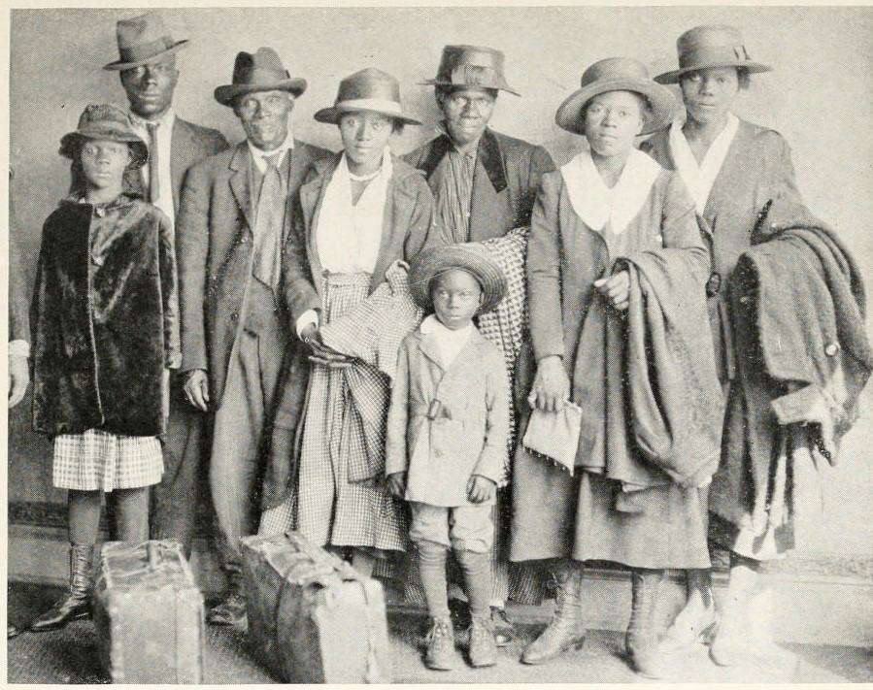
DIRECT INSTRUCTION
US.28
Push factors drove them out — Jim Crow segregation, disenfranchisement, sharecropping debt, and racial violence pushed African Americans out of the rural South.
ZOOM IN
US.28 · Push Factors: Reasons to Leave the South
U.S. History Hack · TroopToTeacher Technologies LLC · Aligned to TN Academic Standards & TCAP EOC
2

Slide 4
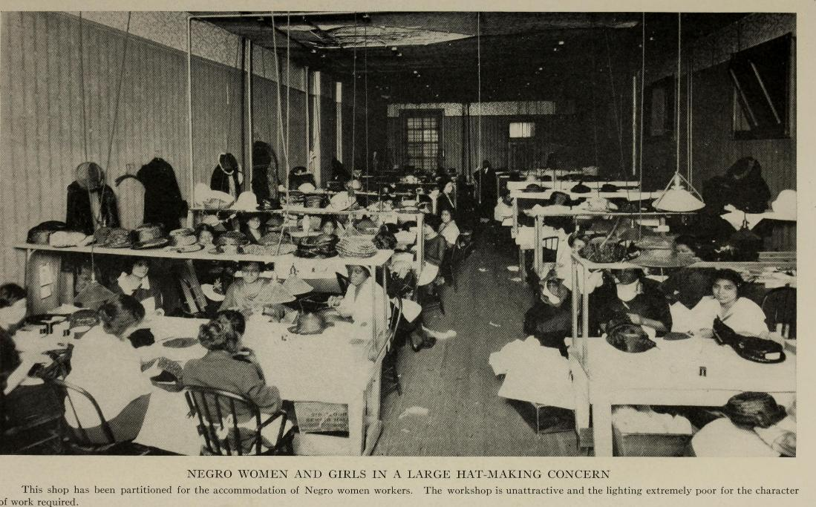
DIRECT INSTRUCTION
US.28
Pull factors drew them north — World War I labor shortages opened Northern factory jobs at far higher wages, and the Chicago Defender urged migration to a freer, more urban life.
ZOOM IN
US.28 · Pull Factors: Attractions of the North
U.S. History Hack · TroopToTeacher Technologies LLC · Aligned to TN Academic Standards & TCAP EOC
3

Slide 5
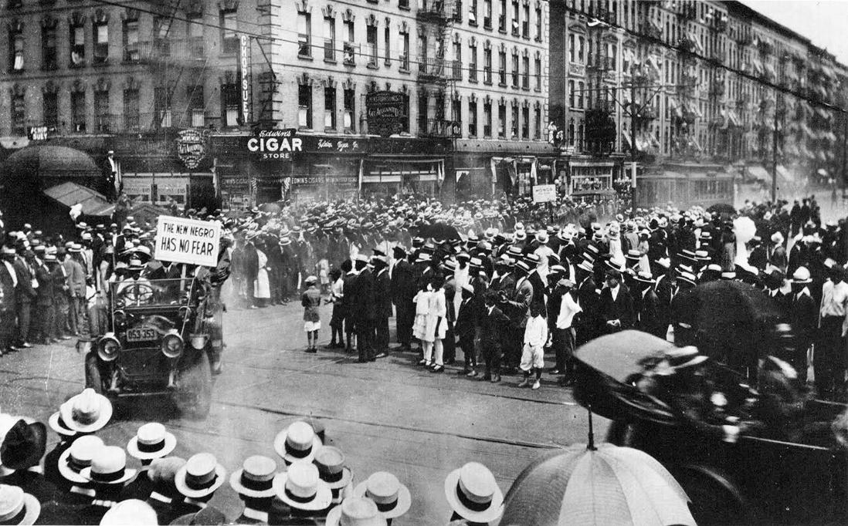
DIRECT INSTRUCTION
US.28
The migration reshaped America — it moved the nation from rural to urban, built concentrated Black voting power and culture in Northern cities, and fueled the Harlem Renaissance.
ZOOM IN
US.28 · Social & Long-term Implications
U.S. History Hack · TroopToTeacher Technologies LLC · Aligned to TN Academic Standards & TCAP EOC
4

Slide 6
SOURCE IT FIRST
US.28
Read a Southern migrant’s letter to the Chicago Defender — weigh the writer’s purpose and audience before you read the words.
WHO
WHEN
WHY
Anonymous Southern Migrant
1917
Consider the author's purpose and audience before reading the words.
Letter from African American Migrant to Chicago Defender
Anonymous Southern Migrant · 1917
"I am in the darkness of the south and I am trying my best to get out. Oh please help me to get out of this low down country. I am counted no more than a dog here. I can do any kind of work from a shoe shine to farming. I would like to get my family out of this cursed place. Please sir help me and my family and God will bless you."
Library of Congress
U.S. History Hack · TroopToTeacher Technologies LLC · Aligned to TN Academic Standards & TCAP EOC
5

Slide 7
THREE PERSPECTIVES
US.28
A historian returns to three questions at the end of every reading. Use them to analyze this standard.
Who benefited?
Who bore the costs?
Who decided?
Who gained land, wealth, power, or protection?
Who lost land, labor, freedom, or life — and who was silenced?
Which people, offices, or courts held the authority?
US.28:
US.28:
US.28:
Migrating families who found higher wages and greater freedom, and Northern industries that gained a needed wartime labor force.
Migrants who faced crowded housing, discrimination, and hostility in the North, and Southern communities drained of working-age population.
Ordinary African American families making individual choices to leave, encouraged by Black newspapers like the Chicago Defender.
Anchor: Letter from African American Migrant to the Chicago Defender, 1917 (Chicago Defender / archive)
U.S. History Hack · TroopToTeacher Technologies LLC · Aligned to TN Academic Standards & TCAP EOC
6

Slide 8
KEY VOCABULARY · LANGUAGE SUPPORT
US.28
Words you need before we read
Great Migration
First Red Scare
Radio Broadcasting
En español: Gran Migración
En español: Primer Susto Rojo
En español: Radiodifusión
WHAT IT MEANS
WHAT IT MEANS
WHAT IT MEANS
The mass movement of over 6 million African Americans from the rural South to urban areas in the North and Midwest between 1916 and 1970, driven by economic opportunity and escape from Jim Crow segregation.
A period of intense fear of communism and radical political activity following World War I (1919-1920), leading to deportations, arrests, and violations of civil liberties.
The transmission of audio content over radio waves that revolutionized communication in the 1920s, creating mass media, national advertising, and shared popular culture.
U.S. History Hack · TroopToTeacher Technologies LLC · Aligned to TN Academic Standards & TCAP EOC
2

Slide 9
PROGRESS CHECK
US.28
Check your understanding
What social and cultural changes occurred in both Southern communities that lost population and Northern cities that gained it?
A
Southern communities lost population and economic vitality while Northern cities saw neighborhood formation, business district growth, cultural flowering like the Harlem Renaissance, but also new racial tensions
B
Neither region experienced significant changes, but contemporary accounts suggest a different explanation, though this interpretation lacks supporting historical evidence, although this overlooks critical economic and social factors involved
C
Only Northern cities experienced changes, yet the available evidence points to a different conclusion, which contradicts the primary source evidence from this era despite the fact that multiple contemporary sources contradict this
D
Southern communities grew stronger after migration, although historical sources do not support this conclusion and oversimplifies the complex factors at work during this period, though this interpretation lacks supporting historical evidence
Confidence: 😟 1 🙂 2 😀 3 — circle where you are; your teacher routes reteach or extension.
U.S. History Hack · TroopToTeacher Technologies LLC · Aligned to TN Academic Standards & TCAP EOC
3

Slide 10
US.29
Radio, Movies, and Popular Culture
TN STANDARD
US.29 – Describe the growth and effects that radio and movies played in the emergence of popular culture, such as advertising, celebrities, news, and entertainment.
I CAN
I can describe the growth and effects that radio and movies played in the emergence of popular culture, such as advertising, celebrities, news, and entertainment.
U.S. History Hack · TroopToTeacher Technologies LLC · Aligned to TN Academic Standards & TCAP EOC
7

Slide 11
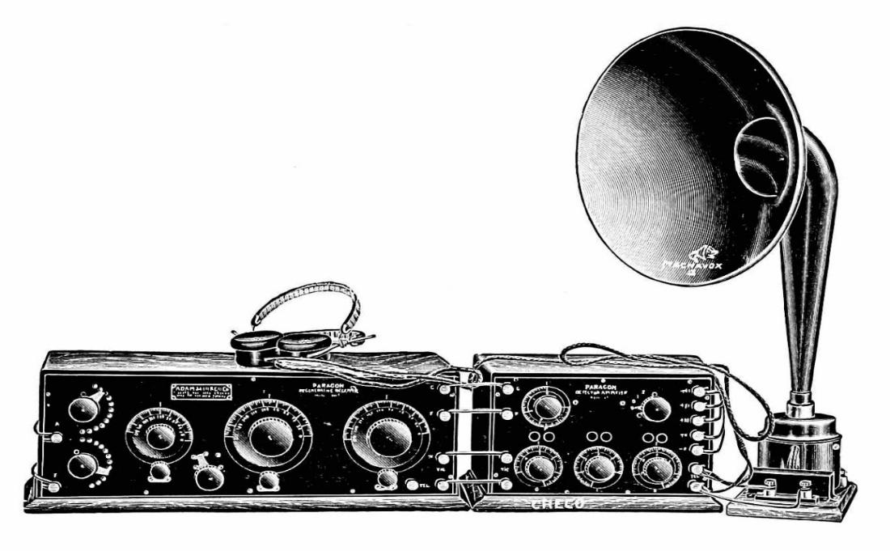
DIRECT INSTRUCTION
US.29
Radio unified the nation — the first medium to reach the whole country at once, radio ownership exploded in the 1920s and created a shared national culture of news, music, and sports.
ZOOM IN
US.29 · Radio’s Impact on Popular Culture
U.S. History Hack · TroopToTeacher Technologies LLC · Aligned to TN Academic Standards & TCAP EOC
8

Slide 12
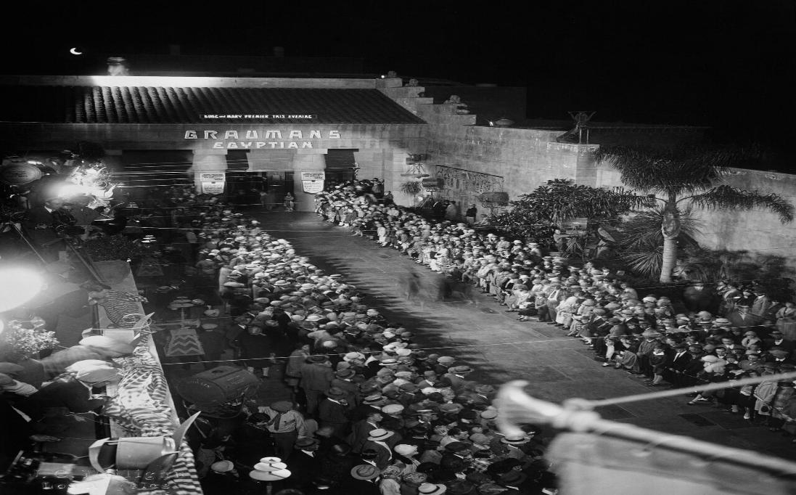
DIRECT INSTRUCTION
US.29
Movies made mass celebrities — silent film turned Charlie Chaplin and others into global stars, and elaborate movie palaces made film the dominant new entertainment industry.
ZOOM IN
US.29 · Film Industry Growth
U.S. History Hack · TroopToTeacher Technologies LLC · Aligned to TN Academic Standards & TCAP EOC
9

Slide 13
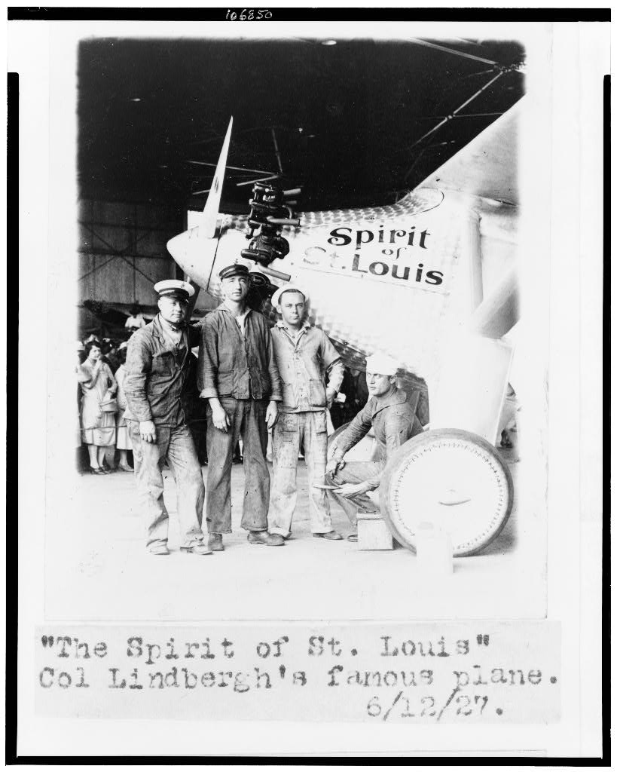
DIRECT INSTRUCTION
US.29
New heroes defined the decade — Chaplin’s “Tramp,” Lindbergh’s 1927 solo flight, and Babe Ruth’s 60 home runs made entertainers and athletes into national icons.
ZOOM IN
US.29 · Chaplin, Lindbergh & Babe Ruth
U.S. History Hack · TroopToTeacher Technologies LLC · Aligned to TN Academic Standards & TCAP EOC
10

Slide 14
SOURCE IT FIRST
US.29
Read a 1925 Photoplay magazine article — identify who published it and why before you read the words.
WHO
WHEN
WHY
Photoplay Magazine
1925
Consider the author's purpose and audience before reading the words.
Motion Picture Magazine Article
Photoplay Magazine · 1925
"The motion picture has become the most democratic of all the arts. It speaks a universal language that all may understand. The immigrant from Europe, the farmer from Kansas, the society matron from New York—all sit side by side in the darkness of the theater, laughing at the same jokes, crying at the same sorrows, thrilling to the same adventures."
Library of Congress
U.S. History Hack · TroopToTeacher Technologies LLC · Aligned to TN Academic Standards & TCAP EOC
11

Slide 15
THREE PERSPECTIVES
US.29
A historian returns to three questions at the end of every reading. Use them to analyze this standard.
Who benefited?
Who bore the costs?
Who decided?
Who gained land, wealth, power, or protection?
Who lost land, labor, freedom, or life — and who was silenced?
Which people, offices, or courts held the authority?
US.29:
US.29:
US.29:
Radio networks, film studios, advertisers, and celebrities who profited from a national mass audience for the first time.
Local and regional cultures overshadowed by a single, commercialized national culture built around big-city media.
Studios, radio networks, and advertisers who chose what the nation watched and heard, shaping public taste and values.
Anchor: Photoplay Magazine article on the film industry, 1925 (magazine archive)
U.S. History Hack · TroopToTeacher Technologies LLC · Aligned to TN Academic Standards & TCAP EOC
12

Slide 16
KEY VOCABULARY · LANGUAGE SUPPORT
US.29
Words you need before we read
Radio Broadcasting
Motion Pictures
Commercial Aviation
En español: Radiodifusión
En español: Imágenes en Movimiento
En español: Aviación Comercial
WHAT IT MEANS
WHAT IT MEANS
WHAT IT MEANS
The transmission of audio content over radio waves that revolutionized communication in the 1920s, creating mass media, national advertising, and shared popular culture.
Silent and "talkie" films that became America's most popular entertainment in the 1920s, creating celebrity culture and Hollywood as the film capital of the world.
The development of airplane technology and air travel in the 1920s, highlighted by Charles Lindbergh's 1927 solo transatlantic flight, which captured public imagination and demonstrated aviation's potential.
U.S. History Hack · TroopToTeacher Technologies LLC · Aligned to TN Academic Standards & TCAP EOC
4

Slide 17
PROGRESS CHECK
US.29
Check your understanding
Analyze how mass media in the 1920s created modern American popular culture and consumer society.
A
Mass media had no impact on consumption patterns, which does not reflect the consensus among historians, although historical sources do not support this conclusion
B
Radio and film advertising promoted consumer products to millions, celebrities modeled lifestyles and endorsed products, and shared entertainment created national markets for standardized goods
C
Consumer culture existed before mass media, although historical sources do not support this conclusion, though this interpretation lacks supporting historical evidence
D
Only wealthy Americans participated in consumer culture, although this overlooks critical economic and social factors, which does not align with the documented historical record
Confidence: 😟 1 🙂 2 😀 3 — circle where you are; your teacher routes reteach or extension.
U.S. History Hack · TroopToTeacher Technologies LLC · Aligned to TN Academic Standards & TCAP EOC
5

Slide 18
US.30
Grand Ole Opry, Blues & Country Music
TN STANDARD
US.30 – Examine how the use of the radio helped grow the popularity of country and blues music, including the rise of the Grand Ole Opry, W.C. Handy, and Bessie Smith. (TCA)
I CAN
I can examine how the use of the radio helped grow the popularity of country and blues music, including the rise of the Grand Ole Opry, W.C. Handy, and Bessie Smith.
U.S. History Hack · TroopToTeacher Technologies LLC · Aligned to TN Academic Standards & TCAP EOC
13

Slide 19
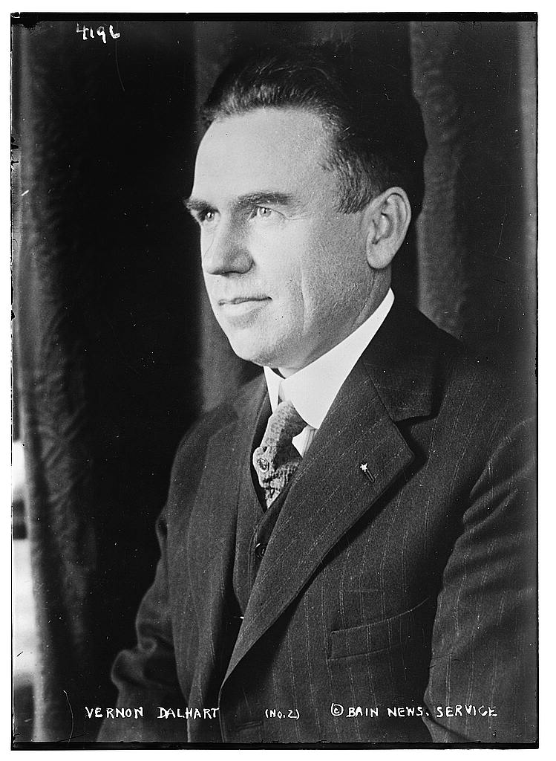
DIRECT INSTRUCTION
US.30
Country music grew from Southern folk roots — Scottish-Irish ballads, gospel, and fiddle-and-banjo traditions produced a new commercial genre of rural white America.
ZOOM IN
US.30 · Country Music Roots
U.S. History Hack · TroopToTeacher Technologies LLC · Aligned to TN Academic Standards & TCAP EOC
14

Slide 20
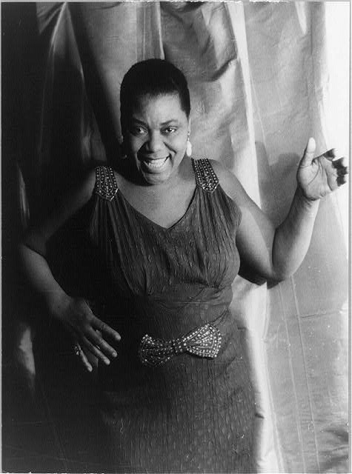
DIRECT INSTRUCTION
US.30
The blues carried African American experience — rooted in work songs, field hollers, and spirituals, the Mississippi Delta blues gave voice to Black life and shaped all later American music.
ZOOM IN
US.30 · Blues Music Evolution
U.S. History Hack · TroopToTeacher Technologies LLC · Aligned to TN Academic Standards & TCAP EOC
15

Slide 21
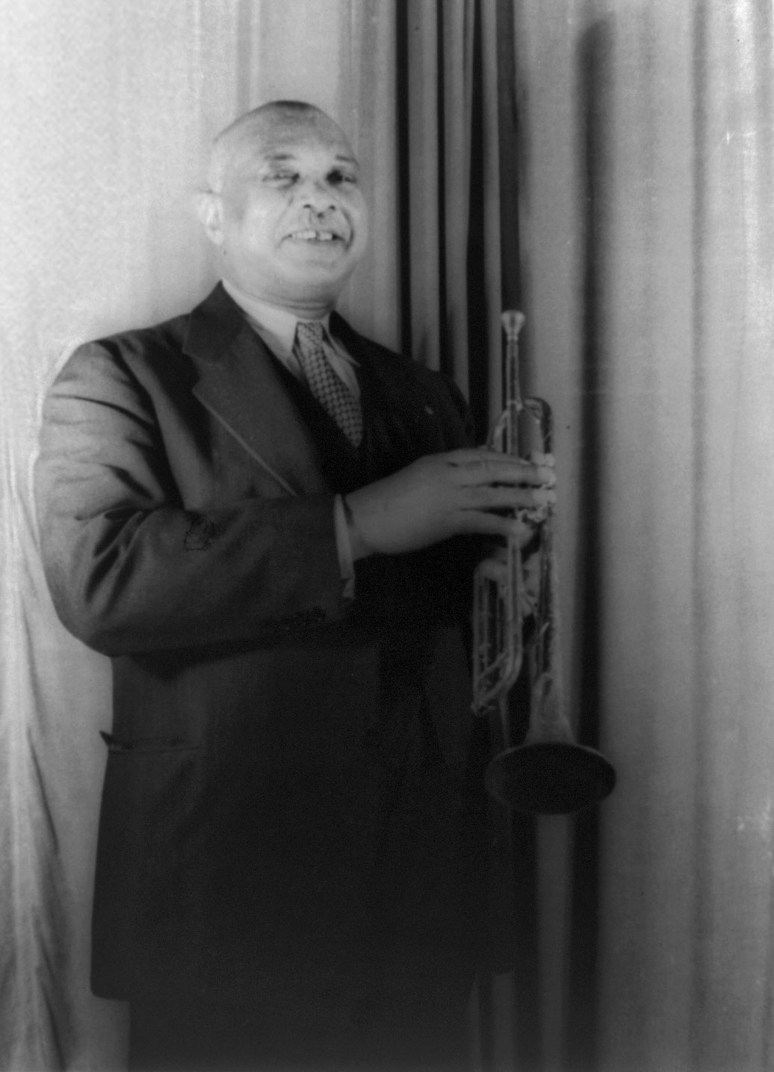
DIRECT INSTRUCTION
US.30
Nashville became a music capital — the Grand Ole Opry began as WSM’s “Barn Dance” on Nov. 28, 1925, while W.C. Handy published the blues and Bessie Smith became its “Empress.”
ZOOM IN
US.30 · The Grand Ole Opry, Handy & Smith
U.S. History Hack · TroopToTeacher Technologies LLC · Aligned to TN Academic Standards & TCAP EOC
16

Slide 22
SOURCE IT FIRST
US.30
Read W.C. Handy’s autobiography — note who is writing and when before you weigh his account.
WHO
WHEN
WHY
W.C. Handy
1941
Consider the author's purpose and audience before reading the words.
W.C. Handy Autobiography Excerpt
W.C. Handy · 1941
"I wrote "Memphis Blues" in 1912 and "St. Louis Blues" in 1914. These were the first blues to be written down and published. Before this, the blues was folk music, passed along by ear. I wanted to capture on paper the sounds I heard in the cotton fields and on Beale Street. The sorrow songs of my people deserved to be preserved and heard by the world."
Library of Congress
U.S. History Hack · TroopToTeacher Technologies LLC · Aligned to TN Academic Standards & TCAP EOC
17

Slide 23
THREE PERSPECTIVES
US.30
A historian returns to three questions at the end of every reading. Use them to analyze this standard.
Who benefited?
Who bore the costs?
Who decided?
Who gained land, wealth, power, or protection?
Who lost land, labor, freedom, or life — and who was silenced?
Which people, offices, or courts held the authority?
US.30:
US.30:
US.30:
Black and white Southern musicians who found new audiences and income, and Nashville, which grew into a national music center.
Black blues artists who often received little pay or credit while their music was borrowed and profited from by others.
Record companies, radio stations like WSM, and pioneering artists such as Handy and Smith who defined the new genres.
Anchor: W.C. Handy, Father of the Blues (autobiography), 1941 (published archive)
U.S. History Hack · TroopToTeacher Technologies LLC · Aligned to TN Academic Standards & TCAP EOC
18

Slide 24
KEY VOCABULARY · LANGUAGE SUPPORT
US.30
Words you need before we read
Grand Ole Opry
W.C. Handy
Bessie Smith
En español: Grand Ole Opry
En español: W.C. Handy
En español: Bessie Smith
WHAT IT MEANS
WHAT IT MEANS
WHAT IT MEANS
A weekly country music radio show that began in Nashville in 1925, becoming the longest-running radio broadcast in U.S. history and establishing Nashville as country music's capital.
Known as the "Father of the Blues," a musician and composer who published the first blues compositions and helped bring blues music from rural areas to mainstream audiences.
The "Empress of the Blues," the most popular female blues singer of the 1920s whose powerful voice and emotional performances influenced generations of musicians.
U.S. History Hack · TroopToTeacher Technologies LLC · Aligned to TN Academic Standards & TCAP EOC
6

Slide 25
PROGRESS CHECK
US.30
Check your understanding
Analyze how country and blues music reflected and influenced American cultural values and regional identity.
A
Music had no connection to cultural values, which represents a common misconception about the period, but the historical evidence paints a more nuanced picture and oversimplifies the complex factors at work during this period
B
Only wealthy Americans appreciated these genres, although historical sources do not support this conclusion, though this interpretation lacks supporting historical evidence and oversimplifies the complex factors at work during this period
C
Country celebrated rural, traditional, and religious values while blues expressed resilience and emotional depth; both preserved regional heritage, provided cultural identity for marginalized communities, and influenced mainstream American music
D
Country and blues had identical cultural messages, which does not reflect the consensus among historians and oversimplifies the complex factors at work during this period despite the fact that multiple contemporary sources contradict this
Confidence: 😟 1 🙂 2 😀 3 — circle where you are; your teacher routes reteach or extension.
U.S. History Hack · TroopToTeacher Technologies LLC · Aligned to TN Academic Standards & TCAP EOC
7

Slide 26
US.31
New Technologies: Air Travel and Electricity
TN STANDARD
US.31 – Describe the impact of new technologies of the era, including the advent of air travel and spread of electricity.
I CAN
I can describe the impact of new technologies of the era, including the advent of air travel and spread of electricity.
U.S. History Hack · TroopToTeacher Technologies LLC · Aligned to TN Academic Standards & TCAP EOC
19

Slide 27
DIRECT INSTRUCTION
US.31
Aviation shrank the nation — from the Wright Brothers’ 1903 flight through WWI advances, air travel cut cross-country trips from days to hours and connected isolated regions.
ZOOM IN
US.31 · Early Aviation & Its Impact
U.S. History Hack · TroopToTeacher Technologies LLC · Aligned to TN Academic Standards & TCAP EOC
20

Slide 28
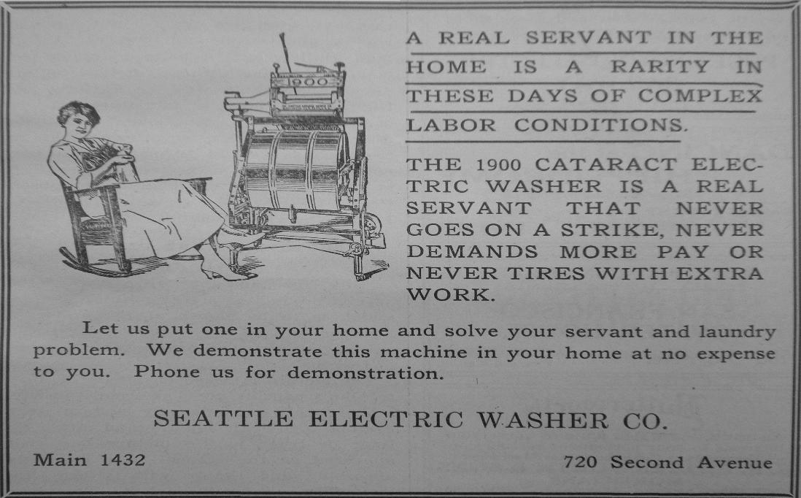
DIRECT INSTRUCTION
US.31
Electricity transformed the cities — by 1930, 85% of urban homes had power, and appliances like vacuums, washing machines, and refrigerators reshaped daily household life.
ZOOM IN
US.31 · Spread of Electricity & the Home
U.S. History Hack · TroopToTeacher Technologies LLC · Aligned to TN Academic Standards & TCAP EOC
21

Slide 29
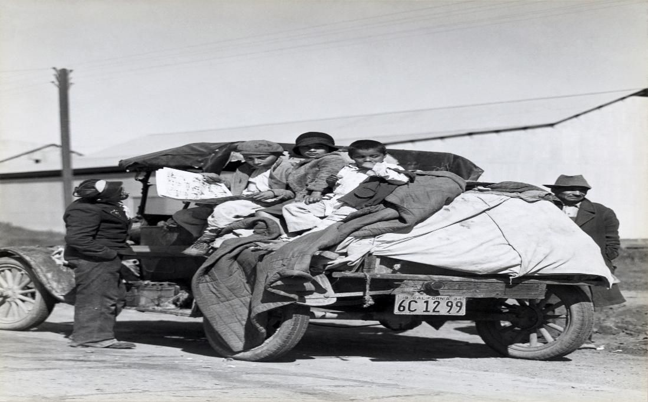
DIRECT INSTRUCTION
US.31
A rural gap remained — only 10% of rural homes had electricity by 1930 because of cost and distance, deepening the divide between modern cities and the countryside.
ZOOM IN
US.31 · The Rural Electrification Gap
U.S. History Hack · TroopToTeacher Technologies LLC · Aligned to TN Academic Standards & TCAP EOC
22

Slide 30
SOURCE IT FIRST
US.31
Read the New York Times report of Lindbergh’s flight — fix its source and date before analyzing it.
WHO
WHEN
WHY
New York Times
May 22, 1927
Consider the author's purpose and audience before reading the words.
Lindbergh Transatlantic Flight News Report
New York Times · May 22, 1927
"LINDBERGH DOES IT! TO PARIS IN 33½ HOURS. Flies 1,000 Miles Through Snow and Sleet; Cheering French Ones Carry Him Off Field. Captain Charles A. Lindbergh accomplished the greatest feat of a solitary man in the records of the human race yesterday when he landed his airplane, the Spirit of St. Louis, at Le Bourget Aerodrome."
Library of Congress
U.S. History Hack · TroopToTeacher Technologies LLC · Aligned to TN Academic Standards & TCAP EOC
23

Slide 31
THREE PERSPECTIVES
US.31
A historian returns to three questions at the end of every reading. Use them to analyze this standard.
Who benefited?
Who bore the costs?
Who decided?
Who gained land, wealth, power, or protection?
Who lost land, labor, freedom, or life — and who was silenced?
Which people, offices, or courts held the authority?
US.31:
US.31:
US.31:
Urban Americans, manufacturers of appliances and aircraft, and businesses connected by faster travel and cheap electric power.
Rural Americans left without electricity, falling further behind cities in convenience, productivity, and modern living.
Private power companies and manufacturers who decided where to build lines and sell goods, prioritizing profitable urban markets.
Anchor: New York Times, Lindbergh Transatlantic Flight report, May 22, 1927 (newspaper archive)
U.S. History Hack · TroopToTeacher Technologies LLC · Aligned to TN Academic Standards & TCAP EOC
24

Slide 32
KEY VOCABULARY · LANGUAGE SUPPORT
US.31
Words you need before we read
Commercial Aviation
Electrification
Automobile Impact
En español: Aviación Comercial
En español: Electrificación
En español: Impacto del Automóvil
WHAT IT MEANS
WHAT IT MEANS
WHAT IT MEANS
The development of airplane technology and air travel in the 1920s, highlighted by Charles Lindbergh's 1927 solo transatlantic flight, which captured public imagination and demonstrated aviation's potential.
The spread of electrical power throughout America in the 1920s, transforming daily life with electric appliances, lighting, and machinery in homes and factories.
The widespread adoption of cars in the 1920s transformed American society, creating suburbs, highways, tourism, and related industries like gas stations, motels, and drive-in restaurants.
U.S. History Hack · TroopToTeacher Technologies LLC · Aligned to TN Academic Standards & TCAP EOC
8

Slide 33
PROGRESS CHECK
US.31
Check your understanding
Evaluate whether technological innovations of the 1920s improved quality of life for all Americans or primarily benefited certain groups.
A
All Americans benefited equally from new technologies, but this fails to account for the broader historical context when examined alongside the available primary and secondary sources
B
Technology only benefited the wealthy, despite the fact that multiple sources contradict this view, although historical sources do not support this conclusion
C
Rural Americans benefited more than urban residents, which does not align with the documented historical record, although historical sources do not support this conclusion
D
Urban, middle-class Americans benefited most from electricity and appliances, while rural areas lacked electrification and many workers faced job displacement from mechanization
Confidence: 😟 1 🙂 2 😀 3 — circle where you are; your teacher routes reteach or extension.
U.S. History Hack · TroopToTeacher Technologies LLC · Aligned to TN Academic Standards & TCAP EOC
9

Slide 34
US.32
Henry Ford, the Automobile & Mass Production
TN STANDARD
US.32 – Describe the impact of Henry T. Ford, the automobile, and the mass production of automobiles on the American economy and society.
I CAN
I can describe the impact of Henry Ford, the automobile, and the mass production of automobiles on the American economy and society.
U.S. History Hack · TroopToTeacher Technologies LLC · Aligned to TN Academic Standards & TCAP EOC
25

Slide 35
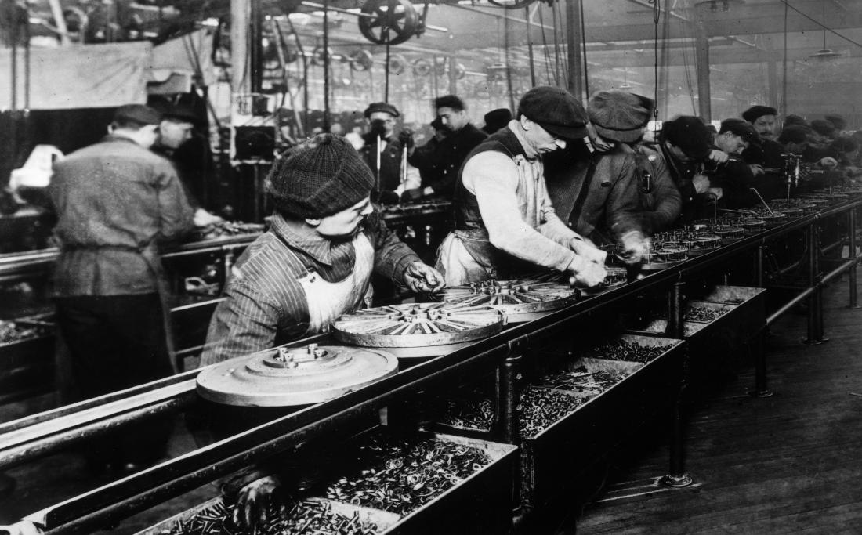
DIRECT INSTRUCTION
US.32
Ford built cars for the masses — founding Ford Motor Company in 1903, he used the Model T and the moving assembly line to make automobiles affordable for average Americans.
ZOOM IN
US.32 · Ford’s Role & Mass Production
U.S. History Hack · TroopToTeacher Technologies LLC · Aligned to TN Academic Standards & TCAP EOC
26

Slide 36
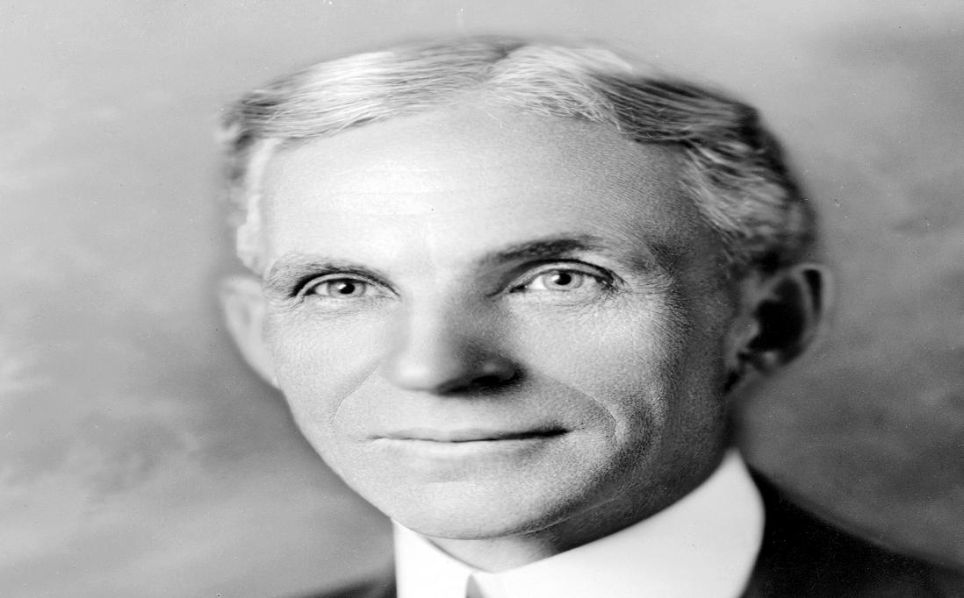
DIRECT INSTRUCTION
US.32
He remade labor and wages — Ford’s $5 Day (1914) doubled industrial pay and cut the workday to eight hours to reduce turnover, trading repetitive assembly-line work for higher wages.
ZOOM IN
US.32 · Impact on Labor Practices
U.S. History Hack · TroopToTeacher Technologies LLC · Aligned to TN Academic Standards & TCAP EOC
27

Slide 37
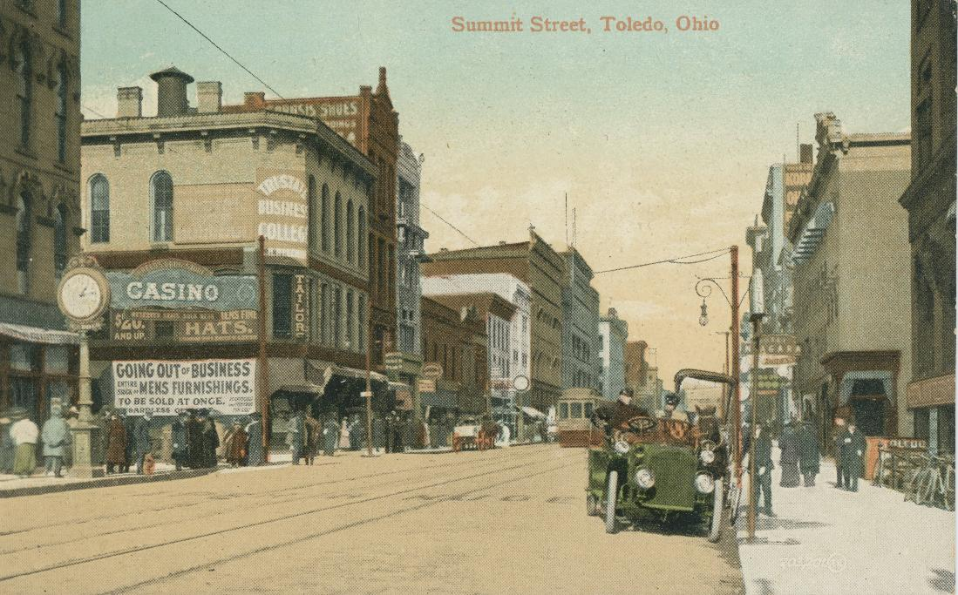
DIRECT INSTRUCTION
US.32
The car transformed society — automobiles ended rural isolation, enabled suburbs, and drove the steel, rubber, glass, and oil industries plus gas stations and motels.
ZOOM IN
US.32 · Societal & Industrial Transformation
U.S. History Hack · TroopToTeacher Technologies LLC · Aligned to TN Academic Standards & TCAP EOC
28

Slide 38
SOURCE IT FIRST
US.32
Read Ford’s $5 Day announcement — identify its author, date, and purpose before you read the words.
WHO
WHEN
WHY
Henry Ford
January 5, 1914
Consider the author's purpose and audience before reading the words.
Ford $5 Day Announcement
Henry Ford · January 5, 1914
"The Ford Motor Company, the greatest and most successful automobile manufacturing company in the world, will, on January 12, inaugurate the greatest revolution in the matter of rewards for its workers ever known to the industrial world. At one stroke it will reduce the hours of labor from nine to eight, and add to every man's pay a share of the profits of the house. The smallest amount to be received by a man 22 years old and upwards will be $5 per day."
The Henry Ford
U.S. History Hack · TroopToTeacher Technologies LLC · Aligned to TN Academic Standards & TCAP EOC
29

Slide 39
THREE PERSPECTIVES
US.32
A historian returns to three questions at the end of every reading. Use them to analyze this standard.
Who benefited?
Who bore the costs?
Who decided?
Who gained land, wealth, power, or protection?
Who lost land, labor, freedom, or life — and who was silenced?
Which people, offices, or courts held the authority?
US.32:
US.32:
US.32:
Ford and the auto industry, workers earning the $5 Day, and the many industries and businesses the automobile created.
Assembly-line workers who faced monotonous, tightly controlled labor, and craftsmen displaced by standardized mass production.
Henry Ford, whose decisions on production, pricing, and wages set the pattern for modern American industry.
Anchor: Henry Ford, $5 Day Announcement, January 5, 1914 (archive)
U.S. History Hack · TroopToTeacher Technologies LLC · Aligned to TN Academic Standards & TCAP EOC
30

Slide 40
KEY VOCABULARY · LANGUAGE SUPPORT
US.32
Words you need before we read
Henry Ford
Assembly Line
Automobile Impact
En español: Henry Ford
En español: Línea de Ensamblaje
En español: Impacto del Automóvil
WHAT IT MEANS
WHAT IT MEANS
WHAT IT MEANS
Automobile manufacturer who revolutionized production with the assembly line, making the Model T affordable for average Americans and transforming society.
A manufacturing method where workers remain stationary while products move past them on a conveyor belt, with each worker performing one specific task, dramatically increasing efficiency.
The widespread adoption of cars in the 1920s transformed American society, creating suburbs, highways, tourism, and related industries like gas stations, motels, and drive-in restaurants.
U.S. History Hack · TroopToTeacher Technologies LLC · Aligned to TN Academic Standards & TCAP EOC
10

Slide 41
PROGRESS CHECK
US.32
Check your understanding
Analyze whether Ford's contributions to American economy and society were more positive or negative overall.
A
Ford's innovations brought affordable transportation, higher wages, and economic growth, but also repetitive assembly work, anti-union policies, and American dependence on fossil fuels and automobile infrastructure
B
Ford's contributions were entirely positive, yet the available evidence points to a different conclusion, but closer analysis reveals a more complicated historical reality, although historical sources do not support this conclusion
C
Ford's contributions were entirely negative, but this oversimplifies the complex factors at work, although this overlooks critical economic and social factors involved, which ignores significant political and cultural developments of the era
D
Ford had no significant impact on American society, yet the available evidence points to a different conclusion, but the historical evidence paints a more nuanced picture despite the fact that multiple contemporary sources contradict this
Confidence: 😟 1 🙂 2 😀 3 — circle where you are; your teacher routes reteach or extension.
U.S. History Hack · TroopToTeacher Technologies LLC · Aligned to TN Academic Standards & TCAP EOC
11

Slide 42
US.33
The Harlem Renaissance
TN STANDARD
US.33 – Analyze the impact of the Harlem Renaissance and its important figures on American culture, including: Louis Armstrong, Duke Ellington, Langston Hughes, Zora Neale Hurston, James Weldon Johnson. (TCA)
I CAN
I can analyze the impact of the Harlem Renaissance and its important figures on American culture, including Louis Armstrong, Duke Ellington, Langston Hughes, Zora Neale Hurston, and James Weldon Johnson.
U.S. History Hack · TroopToTeacher Technologies LLC · Aligned to TN Academic Standards & TCAP EOC
31

Slide 43
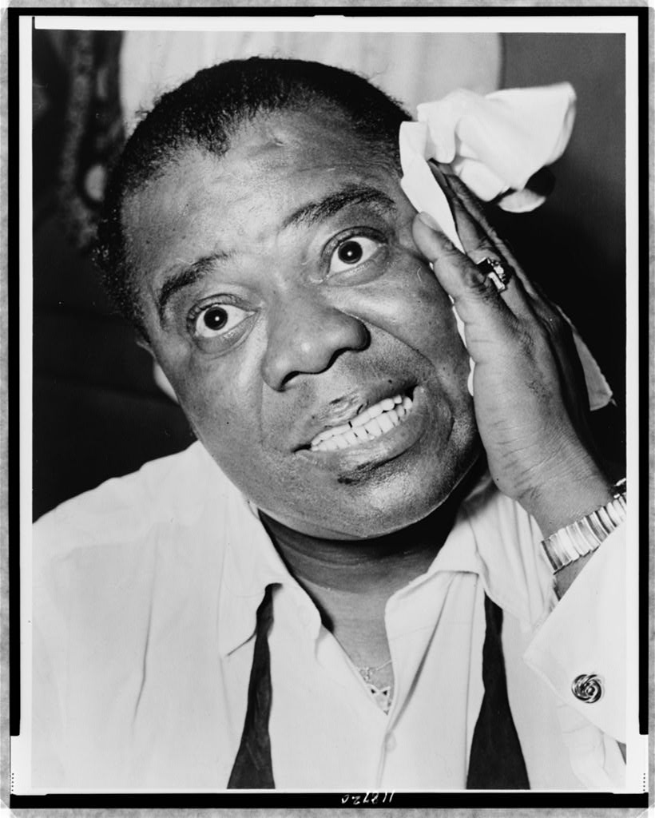
DIRECT INSTRUCTION
US.33
Harlem became a cultural capital — the Great Migration concentrated African Americans in Harlem, sparking a 1920s flowering of Black literature, music, art, and theater.
ZOOM IN
US.33 · Historical Context & the Arts
U.S. History Hack · TroopToTeacher Technologies LLC · Aligned to TN Academic Standards & TCAP EOC
32

Slide 44
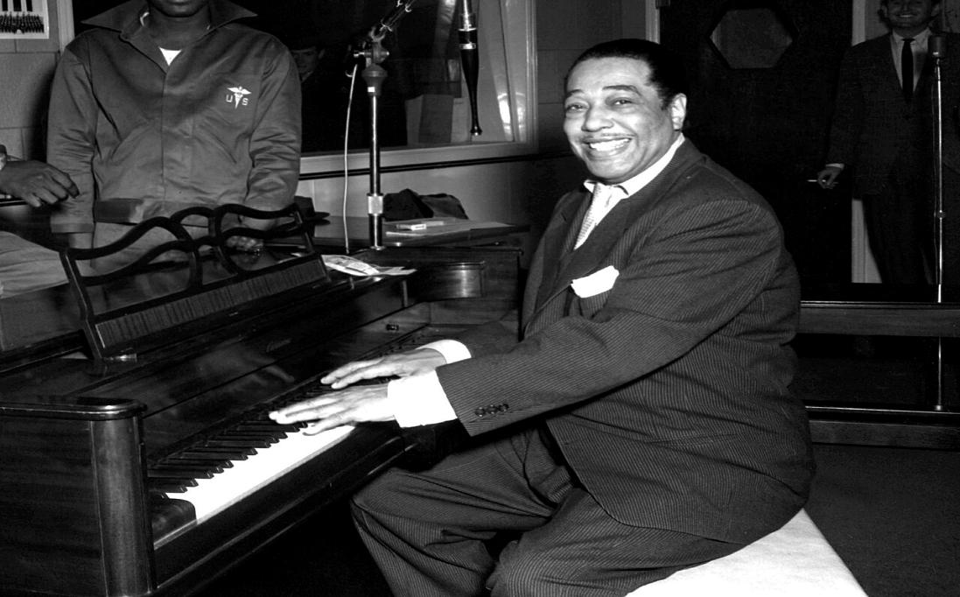
DIRECT INSTRUCTION
US.33
Jazz masters redefined American music — Louis Armstrong turned jazz into a soloist’s art, and Duke Ellington led a sophisticated orchestra that made the Cotton Club famous.
ZOOM IN
US.33 · Armstrong & Ellington
U.S. History Hack · TroopToTeacher Technologies LLC · Aligned to TN Academic Standards & TCAP EOC
33

Slide 45
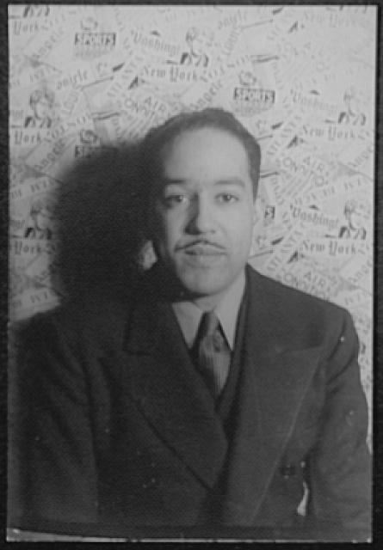
DIRECT INSTRUCTION
US.33
Writers gave the era its voice — Langston Hughes wove jazz rhythms and Black vernacular into poetry, while Zora Neale Hurston preserved African American folklore and stories.
ZOOM IN
US.33 · Hughes & Hurston
U.S. History Hack · TroopToTeacher Technologies LLC · Aligned to TN Academic Standards & TCAP EOC
34

Slide 46
SOURCE IT FIRST
US.33
Read Langston Hughes’ “The Negro Artist and the Racial Mountain” — note his purpose before you read his words.
WHO
WHEN
WHY
Langston Hughes
1926
Consider the author's purpose and audience before reading the words.
The Negro Artist and the Racial Mountain
Langston Hughes · 1926
"We younger Negro artists who create now intend to express our individual dark-skinned selves without fear or shame. If white people are pleased we are glad. If they are not, it doesn't matter. We know we are beautiful. And ugly too. The tom-tom cries and the tom-tom laughs. If colored people are pleased we are glad. If they are not, their displeasure doesn't matter either."
Library of Congress
U.S. History Hack · TroopToTeacher Technologies LLC · Aligned to TN Academic Standards & TCAP EOC
35

Slide 47
THREE PERSPECTIVES
US.33
A historian returns to three questions at the end of every reading. Use them to analyze this standard.
Who benefited?
Who bore the costs?
Who decided?
Who gained land, wealth, power, or protection?
Who lost land, labor, freedom, or life — and who was silenced?
Which people, offices, or courts held the authority?
US.33:
US.33:
US.33:
African American artists who gained recognition and voice, and American culture, permanently enriched by their work.
Black artists who still faced segregation and had to perform for white audiences at venues like the Cotton Club that barred Black patrons.
The artists themselves — Hughes, Hurston, Armstrong, Ellington — who defined a new, self-confident African American cultural identity.
Anchor: Langston Hughes, The Negro Artist and the Racial Mountain, 1926 (published archive)
U.S. History Hack · TroopToTeacher Technologies LLC · Aligned to TN Academic Standards & TCAP EOC
36

Slide 48
KEY VOCABULARY · LANGUAGE SUPPORT
US.33
Words you need before we read
Harlem Renaissance
Louis Armstrong
Duke Ellington
En español: Renacimiento de Harlem
En español: Louis Armstrong
En español: Duke Ellington
WHAT IT MEANS
WHAT IT MEANS
WHAT IT MEANS
A 1920s cultural movement centered in Harlem, New York, where African American artists, writers, musicians, and intellectuals celebrated Black culture and identity through art, literature, and music.
A revolutionary jazz trumpeter and singer from New Orleans who became one of the most influential musicians of the 20th century, pioneering improvisational jazz and scat singing.
A prolific jazz composer, pianist, and bandleader who led his orchestra for nearly 50 years, creating sophisticated jazz compositions that elevated the genre to high art.
U.S. History Hack · TroopToTeacher Technologies LLC · Aligned to TN Academic Standards & TCAP EOC
12

Slide 49
PROGRESS CHECK
US.33
Check your understanding
Analyze how the Harlem Renaissance challenged racial stereotypes and influenced American culture beyond the 1920s.
A
The Renaissance had no lasting cultural impact, though this interpretation lacks supporting historical evidence and does not reflect the scholarly consensus on this topic, though this interpretation lacks supporting historical evidence
B
The Renaissance demonstrated African American intellectual and artistic capabilities, challenged stereotypes through achievement, established jazz as American art, influenced the Civil Rights Movement, and continues to inspire artists today
C
The Renaissance ended racism in America, although this overlooks critical economic and social factors, although this overlooks critical economic and social factors involved, although historical sources do not support this conclusion
D
Its influence was limited to Harlem, although this overlooks critical economic and social factors, but contemporary accounts and primary sources suggest otherwise, which contradicts the primary source evidence from this era
Confidence: 😟 1 🙂 2 😀 3 — circle where you are; your teacher routes reteach or extension.
U.S. History Hack · TroopToTeacher Technologies LLC · Aligned to TN Academic Standards & TCAP EOC
13

Slide 50
US.34
Women in the 1920s: Flappers & Social Changes
TN STANDARD
US.34 – Describe changes and limitations in the social and economic status of women during this era, including flappers, birth control, clerical and office jobs, and the rise of women's colleges.
I CAN
I can describe changes and limitations in the social and economic status of women during this era, including flappers, birth control, clerical and office jobs, and the rise of women's colleges.
U.S. History Hack · TroopToTeacher Technologies LLC · Aligned to TN Academic Standards & TCAP EOC
37

Slide 51
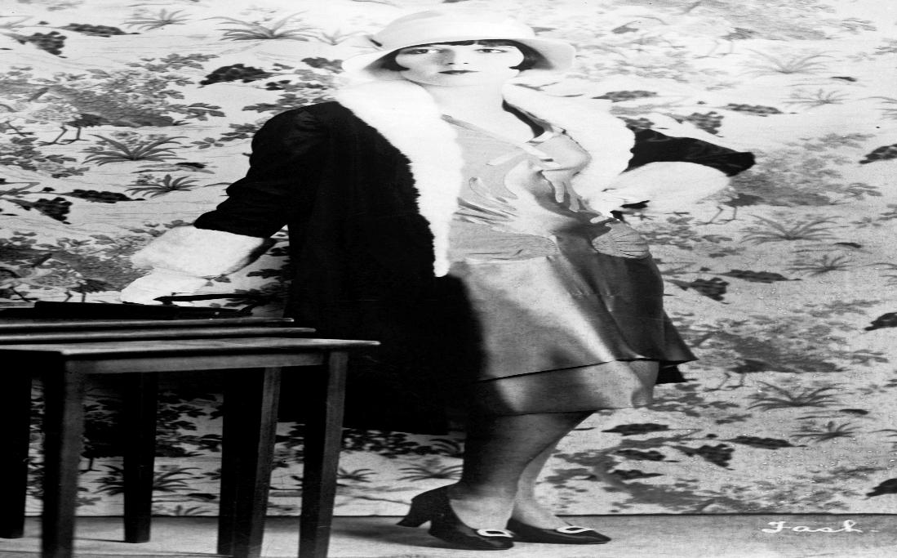
DIRECT INSTRUCTION
US.34
Flappers challenged Victorian norms — young modern women adopted bobbed hair, shorter skirts, makeup, and new public freedoms, symbolizing a break with old expectations.
ZOOM IN
US.34 · Flappers & Cultural Significance
U.S. History Hack · TroopToTeacher Technologies LLC · Aligned to TN Academic Standards & TCAP EOC
38

Slide 52
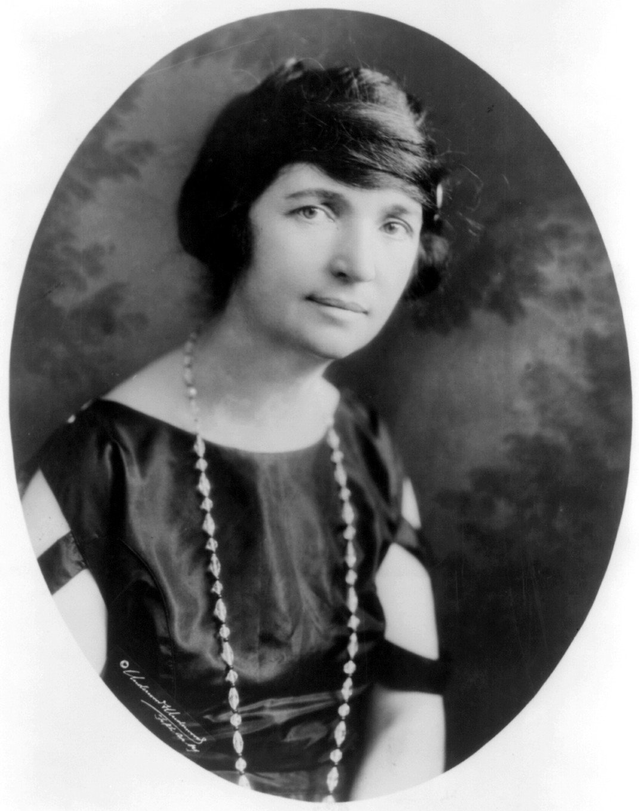
DIRECT INSTRUCTION
US.34
New rights and new work — Margaret Sanger championed birth control, while clerical and office jobs for women grew from 75,000 (1900) to 1.4 million (1930).
ZOOM IN
US.34 · Birth Control & Clerical Jobs
U.S. History Hack · TroopToTeacher Technologies LLC · Aligned to TN Academic Standards & TCAP EOC
39

Slide 53
DIRECT INSTRUCTION
US.34
Change had real limits — women’s colleges expanded opportunity, but most women stayed in traditional roles behind a glass ceiling, and pay inequality persisted.
ZOOM IN
US.34 · Women’s Colleges & Limitations
U.S. History Hack · TroopToTeacher Technologies LLC · Aligned to TN Academic Standards & TCAP EOC
40

Slide 54
SOURCE IT FIRST
US.34
Read Margaret Sanger on birth control — identify who is speaking and why before you weigh her argument.
WHO
WHEN
WHY
Margaret Sanger
1920
Consider the author's purpose and audience before reading the words.
Margaret Sanger on Birth Control
Margaret Sanger · 1920
"No woman can call herself free who does not own and control her body. No woman can call herself free until she can choose consciously whether she will or will not be a mother. Birth control is woman's problem. The quicker she accepts it as hers and hers alone, the quicker will society respect motherhood."
Library of Congress
U.S. History Hack · TroopToTeacher Technologies LLC · Aligned to TN Academic Standards & TCAP EOC
41

Slide 55
THREE PERSPECTIVES
US.34
A historian returns to three questions at the end of every reading. Use them to analyze this standard.
Who benefited?
Who bore the costs?
Who decided?
Who gained land, wealth, power, or protection?
Who lost land, labor, freedom, or life — and who was silenced?
Which people, offices, or courts held the authority?
US.34:
US.34:
US.34:
Younger, often urban and middle-class women who gained new freedoms, education, and clerical jobs in the postwar economy.
Most women — especially poor, rural, and minority women — who stayed in traditional roles, faced a glass ceiling, and were paid less.
Reformers like Sanger, women themselves reshaping social expectations, and the male-controlled institutions that still limited advancement.
Anchor: Margaret Sanger on Birth Control, 1920 (archive)
U.S. History Hack · TroopToTeacher Technologies LLC · Aligned to TN Academic Standards & TCAP EOC
42

Slide 56
KEY VOCABULARY · LANGUAGE SUPPORT
US.34
Words you need before we read
Flappers
Birth Control Movement
Women in the Workforce
En español: Flappers
En español: Movimiento de Control de Natalidad
En español: Mujeres en la Fuerza Laboral
WHAT IT MEANS
WHAT IT MEANS
WHAT IT MEANS
Young women in the 1920s who challenged traditional gender norms by wearing short skirts and bobbed hair, dancing, drinking, smoking, and asserting independence.
Led by Margaret Sanger, the campaign to legalize contraception and provide women reproductive choice, facing opposition from religious and conservative groups.
The 1920s saw increased female employment in clerical and office jobs, though women still faced discrimination, lower wages, and were often expected to leave work upon marriage.
U.S. History Hack · TroopToTeacher Technologies LLC · Aligned to TN Academic Standards & TCAP EOC
14

Slide 57
PROGRESS CHECK
US.34
Check your understanding
Evaluate whether the social and economic changes of the 1920s fundamentally improved women's status or were primarily superficial.
A
Changes completely transformed women's status, although historical sources do not support this conclusion, although this overlooks critical economic and social factors involved, which does not align with the documented historical record
B
No meaningful changes occurred for women, although historical sources do not support this conclusion and does not reflect the scholarly consensus on this topic, which does not align with the documented historical record
C
While voting rights, education access, and work opportunities expanded, persistent pay inequality, limited advancement, marriage bars, and traditional expectations meant fundamental gender inequality continued
D
Only rural women experienced significant changes, although this overlooks critical economic and social factors, but contemporary accounts and primary sources suggest otherwise and fails to account for key developments in the broader context
Confidence: 😟 1 🙂 2 😀 3 — circle where you are; your teacher routes reteach or extension.
U.S. History Hack · TroopToTeacher Technologies LLC · Aligned to TN Academic Standards & TCAP EOC
15

Slide 58
US.35
Civil Liberties: Red Scare, KKK & NAACP
TN STANDARD
US.35 – Examine challenges and advancements related to the push for civil liberties, including: First Red Scare, Immigration Quota Acts of the 1920s, Resurgence of the Ku Klux Klan, Black Wall Street and Tulsa Massacre, Rise of the NAACP, Efforts of Ida B. Wells-Barnett, Emergence of Garveyism. (TCA)
I CAN
I can examine challenges and advancements related to the push for civil liberties, including the First Red Scare, Immigration Quota Acts, resurgence of the KKK, Black Wall Street and Tulsa Massacre, rise of the NAACP, Ida B. Wells-Barnett, and Garveyism.
U.S. History Hack · TroopToTeacher Technologies LLC · Aligned to TN Academic Standards & TCAP EOC
43

Slide 59
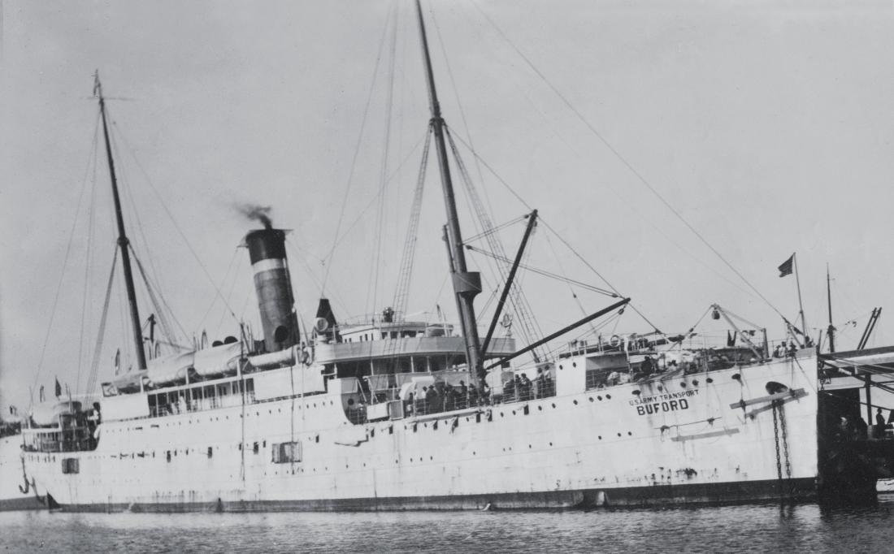
DIRECT INSTRUCTION
US.35
The First Red Scare bred fear — dread of a Russian-style revolution, strikes, and bombings triggered the Palmer Raids and immigration quota laws that cut newcomers to a fraction of earlier levels.
ZOOM IN
US.35 · Red Scare & Immigration Quotas
U.S. History Hack · TroopToTeacher Technologies LLC · Aligned to TN Academic Standards & TCAP EOC
44

Slide 60
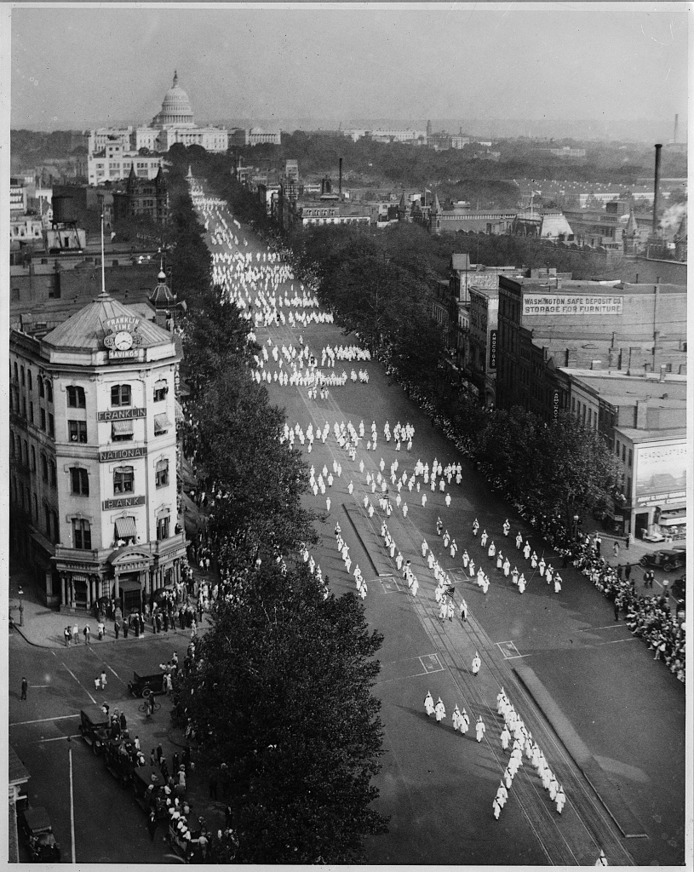
DIRECT INSTRUCTION
US.35
A revived Klan spread hatred — inspired by the film “Birth of a Nation,” the new KKK targeted Catholics, Jews, and immigrants along with African Americans, gaining millions of members.
ZOOM IN
US.35 · Resurgence of the Ku Klux Klan
U.S. History Hack · TroopToTeacher Technologies LLC · Aligned to TN Academic Standards & TCAP EOC
45

Slide 61
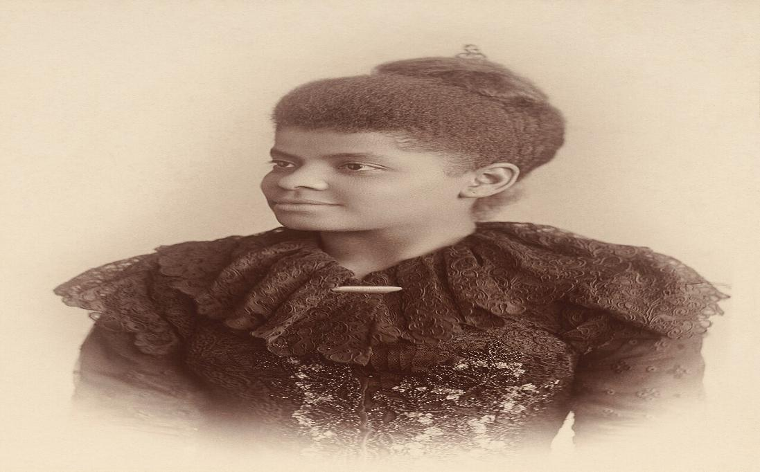
DIRECT INSTRUCTION
US.35
Black leaders fought back — Ida B. Wells exposed lynching with hard data, Marcus Garvey preached Black nationalism through the UNIA, and the NAACP pressed for civil rights and anti-lynching law.
ZOOM IN
US.35 · Ida B. Wells, Garveyism & the NAACP
U.S. History Hack · TroopToTeacher Technologies LLC · Aligned to TN Academic Standards & TCAP EOC
46

Slide 62
SOURCE IT FIRST
US.35
Read Ida B. Wells’ anti-lynching pamphlet — note the author’s purpose and evidence before you read her words.
WHO
WHEN
WHY
Ida B. Wells-Barnett
1909
Consider the author's purpose and audience before reading the words.
Ida B. Wells Anti-Lynching Pamphlet
Ida B. Wells-Barnett · 1909
"The student of American sociology will find the year 1894 marked by a pronounced increase in the number of lynchings. The statistics compiled show that more than ten thousand Negroes have been killed... The alleged causes of lynching do not explain it. It is an excuse to get rid of Negroes who are acquiring wealth and property and thus keep the race terrorized."
Library of Congress
U.S. History Hack · TroopToTeacher Technologies LLC · Aligned to TN Academic Standards & TCAP EOC
47

Slide 63
THREE PERSPECTIVES
US.35
A historian returns to three questions at the end of every reading. Use them to analyze this standard.
Who benefited?
Who bore the costs?
Who decided?
Who gained land, wealth, power, or protection?
Who lost land, labor, freedom, or life — and who was silenced?
Which people, offices, or courts held the authority?
US.35:
US.35:
US.35:
Nativists and the revived Klan who gained political power, and immigration restrictionists who reshaped who could enter the country.
African Americans, Catholics, Jews, immigrants, and suspected radicals targeted by violence, deportation, and legal discrimination.
Attorney General Palmer and Congress’s quota laws on one side; civil-rights leaders like Wells, Garvey, and the NAACP resisting on the other.
Anchor: Ida B. Wells-Barnett, Anti-Lynching Pamphlet, 1909 (archive)
U.S. History Hack · TroopToTeacher Technologies LLC · Aligned to TN Academic Standards & TCAP EOC
48

Slide 64
KEY VOCABULARY · LANGUAGE SUPPORT
US.35
Words you need before we read
First Red Scare
Immigration Quota Acts
KKK Resurgence
En español: Primer Susto Rojo
En español: Leyes de Cuotas de Inmigración
En español: Resurgimiento del KKK
WHAT IT MEANS
WHAT IT MEANS
WHAT IT MEANS
A period of intense fear of communism and radical political activity following World War I (1919-1920), leading to deportations, arrests, and violations of civil liberties.
The 1921 and 1924 laws that drastically limited immigration, especially from Southern and Eastern Europe, Asia, and Africa, based on racist national origins formulas.
The Ku Klux Klan's revival in the 1920s, expanding beyond the South to target not just African Americans but also Catholics, Jews, immigrants, and others, reaching 4-5 million members.
U.S. History Hack · TroopToTeacher Technologies LLC · Aligned to TN Academic Standards & TCAP EOC
16

Slide 65
PROGRESS CHECK
US.35
Check your understanding
Compare the different approaches of Ida B. Wells, Marcus Garvey, and the NAACP in fighting for African American rights.
A
All three used identical approaches, which does not align with the documented historical record, but contemporary accounts and primary sources suggest otherwise and does not reflect the scholarly consensus on this topic, which does not align with the documented historical record
B
None of these figures had significant impact, but this oversimplifies the complex factors at work, which does not align with the documented historical record, but contemporary accounts and primary sources suggest otherwise, which represents a common misconception about this historical period
C
They all opposed civil rights, but this oversimplifies the complex factors at work when examined alongside the available primary and secondary sources, which represents a common misconception about this historical period and fails to account for key developments in the broader context
D
Wells used investigative journalism to expose lynching; Garvey promoted Black nationalism, economic self-sufficiency, and separatism; NAACP pursued integration through legal challenges—representing diverse strategies from documentation to separation to integration
Confidence: 😟 1 🙂 2 😀 3 — circle where you are; your teacher routes reteach or extension.
U.S. History Hack · TroopToTeacher Technologies LLC · Aligned to TN Academic Standards & TCAP EOC
17

Slide 66
US.36
The Scopes Trial
TN STANDARD
US.36 – Describe the Scopes Trial of 1925, including the major figures (i.e., John Scopes, William Jennings Bryan, and Clarence Darrow), two sides of the controversy (i.e., fundamentalism and modernism), the outcome, and the legacy.
I CAN
I can describe the Scopes Trial of 1925, including the major figures, the two sides of the controversy (fundamentalism and modernism), the outcome, and the legacy.
U.S. History Hack · TroopToTeacher Technologies LLC · Aligned to TN Academic Standards & TCAP EOC
49

Slide 67
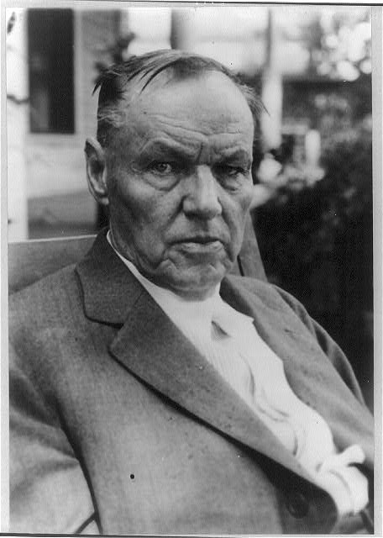
DIRECT INSTRUCTION
US.36
A Tennessee test case drew the nation — teacher John Scopes challenged the Butler Act, pitting William Jennings Bryan for the prosecution against Clarence Darrow for the defense in Dayton, 1925.
ZOOM IN
US.36 · Major Figures & Their Roles
U.S. History Hack · TroopToTeacher Technologies LLC · Aligned to TN Academic Standards & TCAP EOC
50

Slide 68
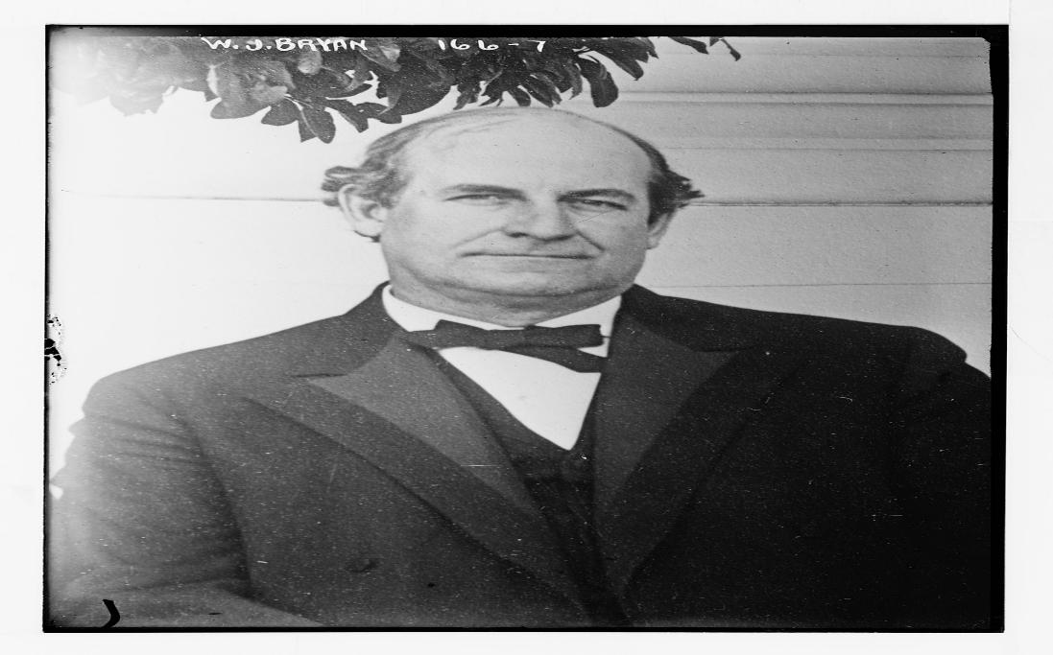
DIRECT INSTRUCTION
US.36
Two worldviews clashed — the prosecution defended the Bible as literal truth and moral order, while the defense argued evolution’s scientific evidence and teachers’ academic freedom.
ZOOM IN
US.36 · Arguments For & Against Evolution
U.S. History Hack · TroopToTeacher Technologies LLC · Aligned to TN Academic Standards & TCAP EOC
51

Slide 69
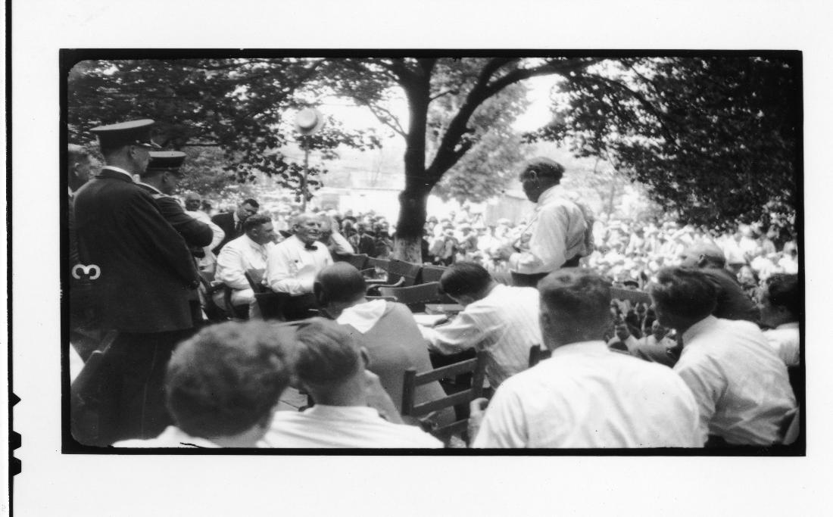
DIRECT INSTRUCTION
US.36
The verdict outlived the trial — Scopes was convicted and fined $100 (later overturned on a technicality), but the case became the enduring symbol of the science-versus-religion debate.
ZOOM IN
US.36 · Outcome & Long-term Legacy
U.S. History Hack · TroopToTeacher Technologies LLC · Aligned to TN Academic Standards & TCAP EOC
52

Slide 70
SOURCE IT FIRST
US.36
Read the transcript of Darrow’s cross-examination of Bryan — note the setting and stakes before you analyze it.
WHO
WHEN
WHY
Trial Transcript
1925
Consider the author's purpose and audience before reading the words.
Clarence Darrow Cross-Examination of Bryan
Trial Transcript · 1925
"DARROW: Do you think the earth was made in six days? BRYAN: Not six days of twenty-four hours... My impression is they were periods. DARROW: Now, if you call those periods, they might have been a very long time? BRYAN: They might have been. DARROW: The creation might have been going on for a very long time? BRYAN: It might have continued for millions of years."
Library of Congress
U.S. History Hack · TroopToTeacher Technologies LLC · Aligned to TN Academic Standards & TCAP EOC
53

Slide 71
THREE PERSPECTIVES
US.36
A historian returns to three questions at the end of every reading. Use them to analyze this standard.
Who benefited?
Who bore the costs?
Who decided?
Who gained land, wealth, power, or protection?
Who lost land, labor, freedom, or life — and who was silenced?
Which people, offices, or courts held the authority?
US.36:
US.36:
US.36:
Both sides claimed a kind of victory: the prosecution won the verdict, while the defense won national attention for evolution and academic freedom.
Tennessee’s teachers, bound by the Butler Act until 1967, and Bryan, whose reputation suffered after Darrow’s cross-examination.
The Tennessee legislature (Butler Act), the Dayton court and jury, and the two famous attorneys who framed the national debate.
Anchor: Clarence Darrow, Cross-Examination of Bryan (trial transcript), 1925 (archive)
U.S. History Hack · TroopToTeacher Technologies LLC · Aligned to TN Academic Standards & TCAP EOC
54

Slide 72
KEY VOCABULARY · LANGUAGE SUPPORT
US.36
Words you need before we read
Scopes Trial
Fundamentalism
Modernism
En español: Juicio de Scopes
En español: Fundamentalismo
En español: Modernismo
WHAT IT MEANS
WHAT IT MEANS
WHAT IT MEANS
The 1925 "Monkey Trial" in Dayton, Tennessee, where teacher John Scopes was prosecuted for teaching evolution, symbolizing the clash between modernism and fundamentalism.
A religious movement emphasizing literal interpretation of the Bible, traditional values, and opposition to modernist ideas like evolution, gaining strength in the 1920s.
A cultural movement embracing science, reason, and social change, including acceptance of evolution, urban lifestyles, and challenges to traditional religious and moral values.
U.S. History Hack · TroopToTeacher Technologies LLC · Aligned to TN Academic Standards & TCAP EOC
18

Slide 73
PROGRESS CHECK
US.36
Check your understanding
How did the confrontation between William Jennings Bryan and Clarence Darrow symbolize broader cultural conflicts in 1920s America?
A
Bryan represented traditional, rural, religious America defending Biblical authority while Darrow represented modern, urban, secular America promoting scientific thinking—symbolizing the era's urban-rural and tradition-modernity divides
B
Bryan and Darrow had similar viewpoints, which ignores key developments that shaped the outcome and oversimplifies the complex factors at work during this period despite the fact that multiple contemporary sources contradict this
C
The confrontation was purely legal, not cultural, but the historical record tells a more complex story, though this interpretation lacks supporting historical evidence, but contemporary accounts and primary sources suggest otherwise
D
Neither figure was significant to the trial, although this overlooks critical economic and social factors, which does not align with the documented historical record, and this view has been largely revised by modern historical research
Confidence: 😟 1 🙂 2 😀 3 — circle where you are; your teacher routes reteach or extension.
U.S. History Hack · TroopToTeacher Technologies LLC · Aligned to TN Academic Standards & TCAP EOC
19

Slide 74
US.37
Prohibition & Its Impact on American Society
TN STANDARD
US.37 – Describe the impacts of Prohibition on American society, including: the rise of organized crime, bootlegging, and speakeasies.
I CAN
I can describe the impacts of Prohibition on American society, including the rise of organized crime, bootlegging, and speakeasies.
U.S. History Hack · TroopToTeacher Technologies LLC · Aligned to TN Academic Standards & TCAP EOC
55

Slide 75
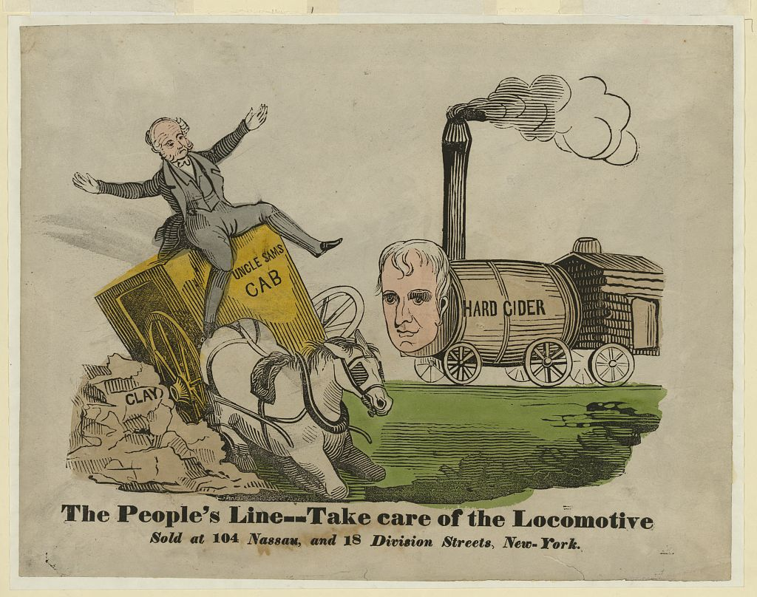
DIRECT INSTRUCTION
US.37
The nation banned alcohol — the 18th Amendment (1919) and the Volstead Act prohibited making, selling, and transporting liquor, aiming to reduce crime, poverty, and family harm.
ZOOM IN
US.37 · Implementation & Intended Effects
U.S. History Hack · TroopToTeacher Technologies LLC · Aligned to TN Academic Standards & TCAP EOC
56

Slide 76
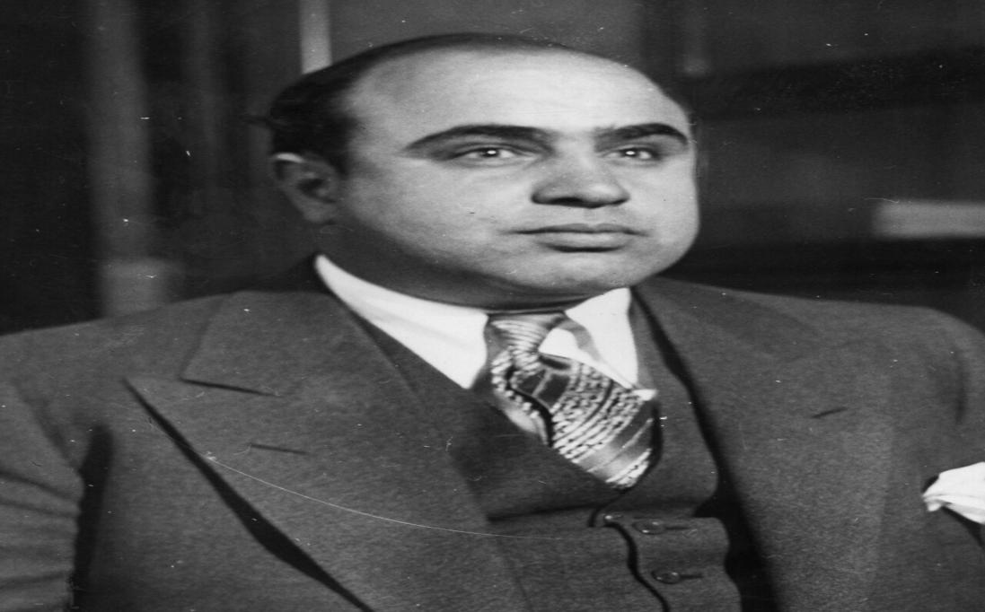
DIRECT INSTRUCTION
US.37
Prohibition fueled organized crime — illegal alcohol brought huge profits, and gangsters like Al Capone built violent criminal empires — Capone earned an estimated $60 million a year in Chicago.
ZOOM IN
US.37 · Organized Crime & Bootlegging
U.S. History Hack · TroopToTeacher Technologies LLC · Aligned to TN Academic Standards & TCAP EOC
57

Slide 77
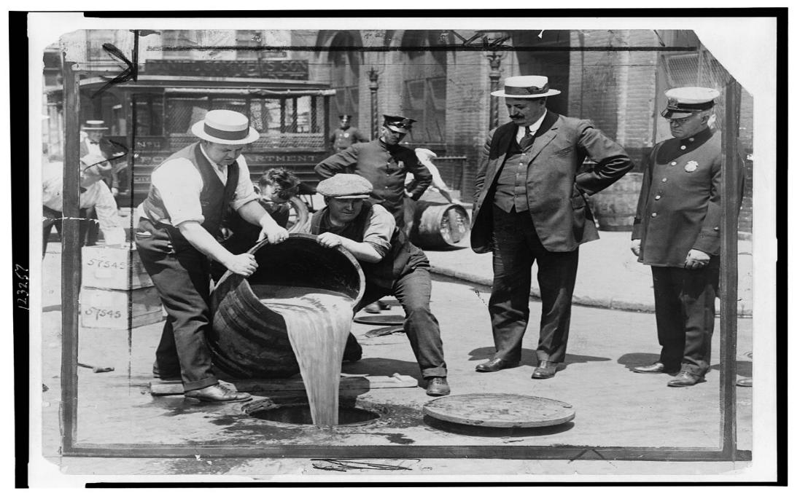
DIRECT INSTRUCTION
US.37
Speakeasies thrived, then the ban ended — secret bars spread jazz and defiance of the law; the Depression, lost tax revenue, and enforcement failure led to repeal by the 21st Amendment (1933).
ZOOM IN
US.37 · Speakeasies & the End of Prohibition
U.S. History Hack · TroopToTeacher Technologies LLC · Aligned to TN Academic Standards & TCAP EOC
58

Slide 78
SOURCE IT FIRST
US.37
Read a 1930 newspaper interview of Al Capone — weigh who is speaking and why before you read the words.
WHO
WHEN
WHY
Al Capone (as quoted in newspaper)
1930
Consider the author's purpose and audience before reading the words.
Al Capone Interview
Al Capone (as quoted in newspaper) · 1930
"I make my money by supplying a public demand. If I break the law, my customers, who number hundreds of the best people in Chicago, are as guilty as I am. The only difference between us is that I sell and they buy. Everybody calls me a racketeer. I call myself a businessman. When I sell liquor, it's bootlegging. When my patrons serve it on silver trays on Lake Shore Drive, it's hospitality."
Library of Congress
U.S. History Hack · TroopToTeacher Technologies LLC · Aligned to TN Academic Standards & TCAP EOC
59

Slide 79
THREE PERSPECTIVES
US.37
A historian returns to three questions at the end of every reading. Use them to analyze this standard.
Who benefited?
Who bore the costs?
Who decided?
Who gained land, wealth, power, or protection?
Who lost land, labor, freedom, or life — and who was silenced?
Which people, offices, or courts held the authority?
US.37:
US.37:
US.37:
Bootleggers and organized crime bosses like Al Capone who reaped enormous profits from illegal alcohol.
Communities plagued by gang violence and corruption, and a public whose respect for law eroded as enforcement failed.
Congress and the states that passed the 18th Amendment and Volstead Act, then reversed course with the 21st Amendment in 1933.
Anchor: Al Capone Interview (as quoted in newspaper), 1930 (newspaper archive)
U.S. History Hack · TroopToTeacher Technologies LLC · Aligned to TN Academic Standards & TCAP EOC
60

Slide 80
KEY VOCABULARY · LANGUAGE SUPPORT
US.37
Words you need before we read
Prohibition
Organized Crime
Bootlegging
En español: Prohibición
En español: Crimen Organizado
En español: Contrabando de Alcohol
WHAT IT MEANS
WHAT IT MEANS
WHAT IT MEANS
The nationwide constitutional ban on the manufacture, sale, and transport of alcoholic beverages, in effect from 1920 to 1933 under the 18th Amendment.
Structured criminal enterprises that expanded dramatically during Prohibition by controlling the illegal liquor trade, led by figures such as Al Capone in Chicago.
The illegal production, smuggling, and distribution of alcohol during Prohibition.
U.S. History Hack · TroopToTeacher Technologies LLC · Aligned to TN Academic Standards & TCAP EOC
20

Slide 81
PROGRESS CHECK
US.37
Check your understanding
Evaluate whether Prohibition caused more harm than good to American society.
A
Prohibition was clearly beneficial overall, despite the fact that multiple sources contradict this view, although this overlooks critical economic and social factors involved, which represents a common misconception about this historical period
B
Prohibition created organized crime, caused deaths from poisonous alcohol, corrupted officials, overwhelmed law enforcement, and undermined respect for law while failing to stop drinking—its harms far outweighed any benefits
C
Prohibition had no significant effects, which represents a common misconception about the period, which contradicts the primary source evidence from this era, though this interpretation lacks supporting historical evidence
D
Prohibition successfully reduced alcohol consumption, though this interpretation lacks supporting historical evidence, though this interpretation lacks supporting historical evidence, and this view has been largely revised by modern historical research
Confidence: 😟 1 🙂 2 😀 3 — circle where you are; your teacher routes reteach or extension.
U.S. History Hack · TroopToTeacher Technologies LLC · Aligned to TN Academic Standards & TCAP EOC
21

Slide 82
US.38
Credit, Consumerism & Financial Speculation
TN STANDARD
US.38 – Analyze the changes in the economy and culture of the U.S. as a result of credit expansion, consumerism, and financial speculation.
I CAN
I can analyze the changes in the economy and culture of the United States as a result of credit expansion, consumerism, and financial speculation.
U.S. History Hack · TroopToTeacher Technologies LLC · Aligned to TN Academic Standards & TCAP EOC
61

Slide 83
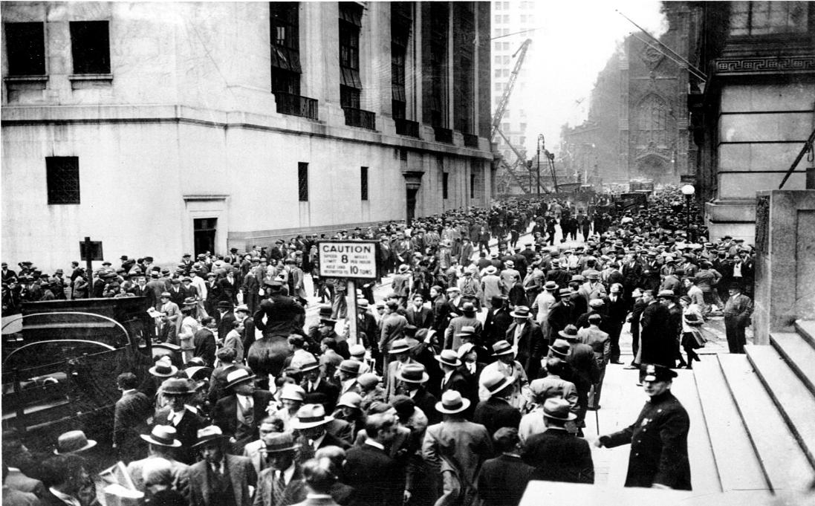
DIRECT INSTRUCTION
US.38
Buy now, pay later reshaped spending — installment credit made cars and appliances affordable, and consumer debt more than doubled from $3.3 billion (1920) to $7.6 billion (1929).
ZOOM IN
US.38 · Credit Expansion & Consumerism
U.S. History Hack · TroopToTeacher Technologies LLC · Aligned to TN Academic Standards & TCAP EOC
62

Slide 84
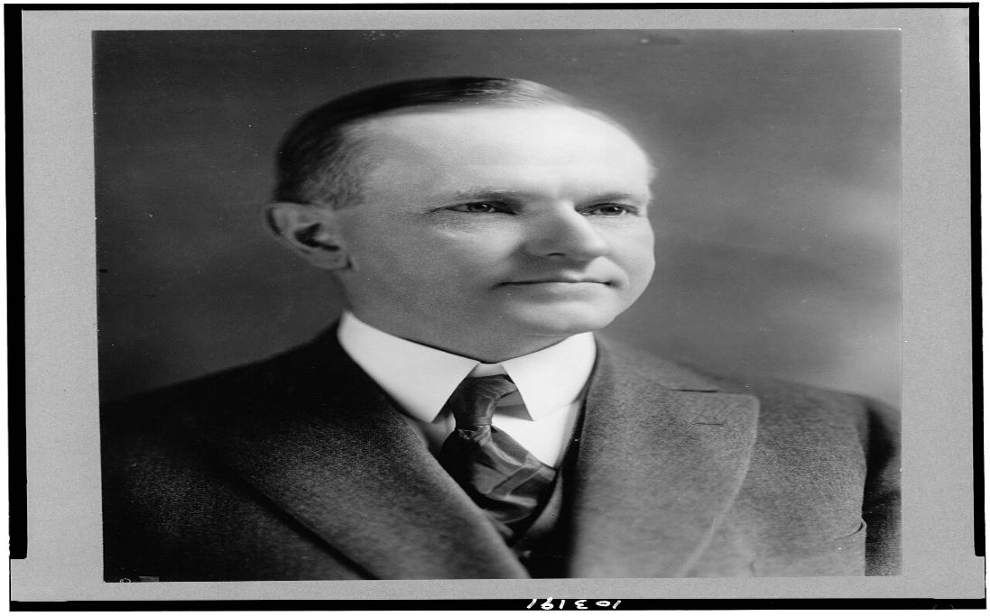
DIRECT INSTRUCTION
US.38
Speculation gripped the market — investors bought stocks on margin with as little as 10% down, and ordinary Americans poured savings into a soaring, overheated stock market.
ZOOM IN
US.38 · Financial Speculation
U.S. History Hack · TroopToTeacher Technologies LLC · Aligned to TN Academic Standards & TCAP EOC
63

Slide 85
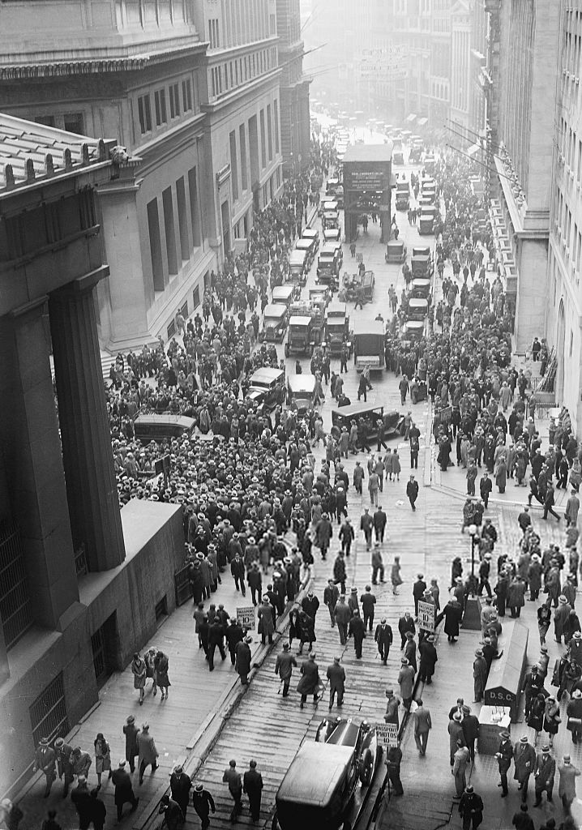
DIRECT INSTRUCTION
US.38
The boom hid deep fragility — credit, margin buying, and rising asset values reinforced one another, so a downturn in any one could trigger collapse — as it did in 1929.
ZOOM IN
US.38 · Interconnections Creating Vulnerability
U.S. History Hack · TroopToTeacher Technologies LLC · Aligned to TN Academic Standards & TCAP EOC
64

Slide 86
SOURCE IT FIRST
US.38
Read a 1926 General Motors installment-plan advertisement — identify who made it and why before you read the words.
WHO
WHEN
WHY
General Motors Acceptance Corporation
1926
Consider the author's purpose and audience before reading the words.
General Motors Installment Plan Advertisement
General Motors Acceptance Corporation · 1926
"Why wait? Drive the car you want NOW and pay for it as you ride. GMAC Time Payment Plan makes it possible for every family to enjoy the benefits of automobile ownership. A small down payment puts you behind the wheel today. Easy monthly payments fit your budget. Don't deny yourself the pleasure and convenience of a new car."
Library of Congress
U.S. History Hack · TroopToTeacher Technologies LLC · Aligned to TN Academic Standards & TCAP EOC
65

Slide 87
THREE PERSPECTIVES
US.38
A historian returns to three questions at the end of every reading. Use them to analyze this standard.
Who benefited?
Who bore the costs?
Who decided?
Who gained land, wealth, power, or protection?
Who lost land, labor, freedom, or life — and who was silenced?
Which people, offices, or courts held the authority?
US.38:
US.38:
US.38:
Manufacturers, retailers, lenders, and brokers who profited from a credit-fueled consumer boom and rising stock prices.
Ordinary Americans buried in debt and margin loans, who lost savings, homes, and jobs when the market crashed in 1929.
Corporations extending credit, advertisers driving demand, and brokers enabling margin buying — with little government regulation.
Anchor: General Motors Installment Plan Advertisement (GMAC), 1926 (archive)
U.S. History Hack · TroopToTeacher Technologies LLC · Aligned to TN Academic Standards & TCAP EOC
66

Slide 88
KEY VOCABULARY · LANGUAGE SUPPORT
US.38
Words you need before we read
Buying on Credit
Consumerism
Stock Speculation
En español: Compra a Crédito
En español: Consumismo
En español: Especulación Bursátil
WHAT IT MEANS
WHAT IT MEANS
WHAT IT MEANS
The practice of purchasing goods with borrowed money repaid over time in installments, which fueled 1920s consumer spending.
A culture of increased purchasing of consumer goods, driven in the 1920s by mass production, national advertising, and installment credit.
The practice of buying stocks - frequently on margin with borrowed money - in the hope of selling at a higher price for quick profit.
U.S. History Hack · TroopToTeacher Technologies LLC · Aligned to TN Academic Standards & TCAP EOC
22

Slide 89
PROGRESS CHECK
US.38
Check your understanding
Analyze how credit expansion, consumerism, and speculation worked together to create both prosperity and economic vulnerability.
A
These factors were unrelated, although this overlooks critical economic and social factors, but the historical evidence paints a more nuanced picture and oversimplifies the complex factors at work during this period
B
These factors created only prosperity, not vulnerability, but the historical record tells a more complex story and fails to account for key developments in the broader context, although historical sources do not support this conclusion
C
Credit enabled consumption and speculation, which drove production and stock prices higher, encouraging more lending in a cycle that created apparent prosperity while building unsustainable debt and inflated asset values that would collapse
D
Economic vulnerability came from foreign sources, which ignores key developments that shaped the outcome and does not reflect the scholarly consensus on this topic, which does not align with the documented historical record
Confidence: 😟 1 🙂 2 😀 3 — circle where you are; your teacher routes reteach or extension.
U.S. History Hack · TroopToTeacher Technologies LLC · Aligned to TN Academic Standards & TCAP EOC
23

