Slide 1
UNIVERSAL DESIGN FOR LEARNING · MTSS
How This Unit Supports Every Learner
CORE PATH
SUPPORT OPTION
The grade-level lesson every student does — same TN standard, same rigor, same ceiling.
An optional scaffold that lowers a barrier, not the goal. Available to anyone.
LANGUAGE SUPPORT
RESPONSE CHOICE
Vocabulary, pronunciation, Spanish, and sentence frames for multilingual learners — open to all.
Show what you know your way: write it · say & record it · diagram & label it. Same learning target.
PROGRESS CHECK
EXTENSION
A quick DOK-2 check and confidence rating so you and your teacher see the next step.
An optional deeper challenge (higher DOK). The standard stays the same.
Options are available by design and support access without lowering the learning goal. Supports work alongside, never in place of, required IEP or 504 accommodations.
U.S. History Hack · TroopToTeacher Technologies LLC · Aligned to TN Academic Standards & TCAP EOC
1

Slide 2
US.39
Causes of the Great Depression
TN STANDARD
US.39 – Analyze the causes of the Great Depression, including: bank failures, buying on margin, crash of the stock market, excess consumerism, high tariffs, laissez-faire politics, overextension of credit, overproduction in agriculture & manufacturing, rising unemployment.
I CAN
I can analyze the causes of the Great Depression, including bank failures, buying on margin, the stock market crash, overproduction, high tariffs, laissez-faire politics, and rising unemployment.
U.S. History Hack · TroopToTeacher Technologies LLC · Aligned to TN Academic Standards & TCAP EOC
2

Slide 3
US.39 · KEY VOCABULARY / LANGUAGE SUPPORT
Key Vocabulary — Language Support
Great Depression
Stock Market Crash of 1929
Buying on Margin
Gran Depresión
Crash del Mercado de Valores
Comprar con Margen
say: grayt dee-PRESH-un
say: stok MAR-ket krash
say: BY-ing on MAR-jin
The worst economic downturn in U.S. history (1929–early 1940s): mass unemployment, bank failures, and widespread poverty.
The sudden collapse of stock prices in October 1929 ("Black Tuesday") that signaled the start of the Depression.
Buying stocks with mostly borrowed money (about 10% down); the bubble burst when prices fell and loans could not be repaid.
LANGUAGE SUPPORT Spanish term, a "say:" pronunciation guide, and a plain-language definition support multilingual learners and are available to everyone. Full bilingual Frayer models are in the unit vocabulary set.
U.S. History Hack · TroopToTeacher Technologies LLC · Aligned to TN Academic Standards & TCAP EOC
3

Slide 4
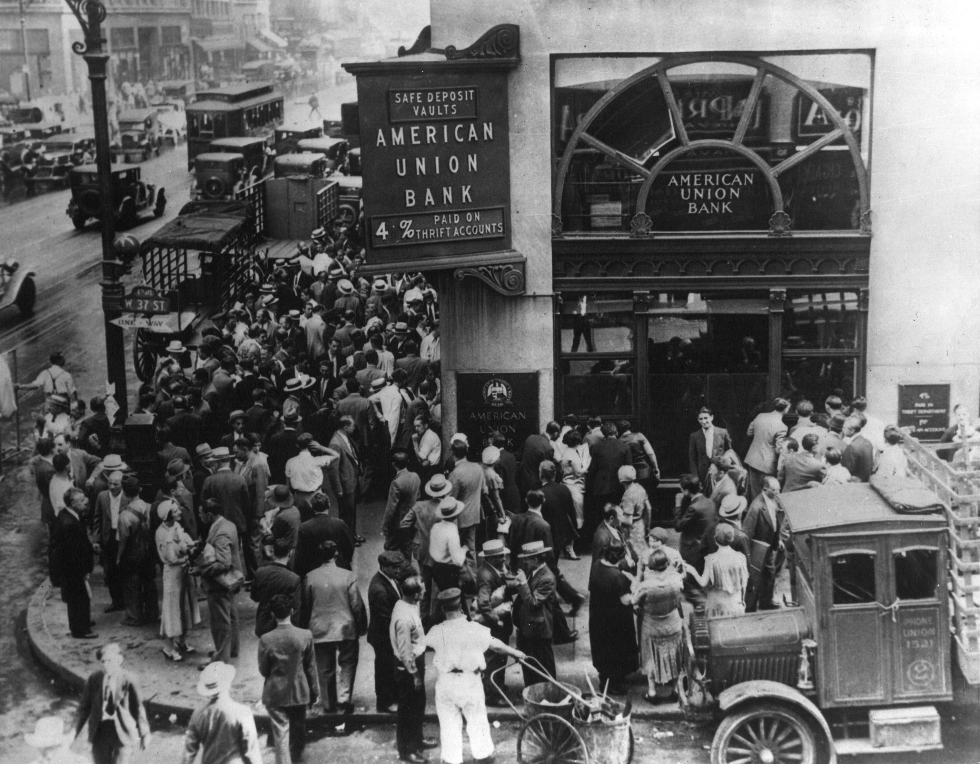
DIRECT INSTRUCTION
US.39
Banks failed and confidence collapsed — bank runs and over 9,000 failed banks between 1929-1933 wiped out uninsured savings and contracted the money supply by a third.
ZOOM IN
US.39 · Bank Failures & the Banking Crisis
Source: 1931 — National Archives (NARA) / Wikimedia Commons
U.S. History Hack · TroopToTeacher Technologies LLC · Aligned to TN Academic Standards & TCAP EOC
4

Slide 5
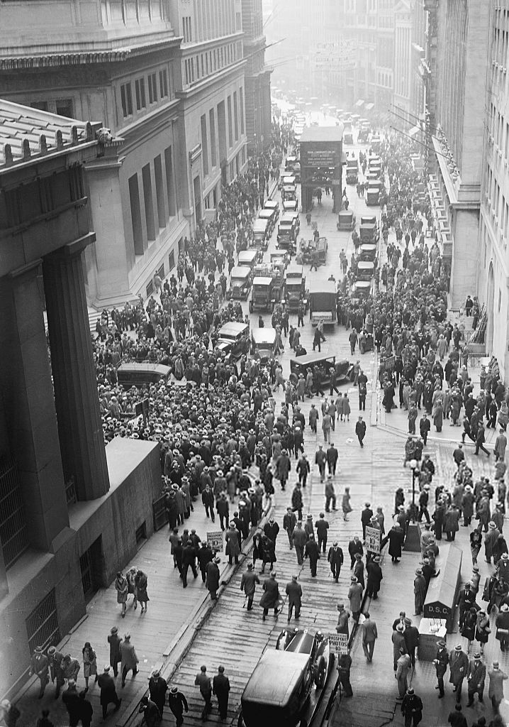
DIRECT INSTRUCTION
US.39
Margin buying inflated a fragile market — stocks bought with only 10% down inflated prices, then the October 1929 crash erased $30 billion in a week as margin calls forced panic selling.
ZOOM IN
US.39 · Buying on Margin & the Crash
Source: U.S. Government, Oct 29 1929 — Wikimedia Commons
U.S. History Hack · TroopToTeacher Technologies LLC · Aligned to TN Academic Standards & TCAP EOC
5

Slide 6
DIRECT INSTRUCTION
US.39
Structural weakness deepened the crisis — overproduction, income inequality, easy credit, laissez-faire government, and the Smoot-Hawley Tariff pushed unemployment from 3.2% to 23.6%.
KEY POINT
Even before the 1929 crash, the boom rested on shaky supports — too many goods, too much debt, and too little regulation — so joblessness climbed from 3.2% to 23.6%.
US.39 · Overproduction, Tariffs & Unemployment
U.S. History Hack · TroopToTeacher Technologies LLC · Aligned to TN Academic Standards & TCAP EOC
6

Slide 7
SOURCE IT FIRST
US.39
Read the New York Times crash report — weigh the author’s purpose and audience before you read the words.
WHO
WHEN
WHY
New York Times
October 30, 1929
Consider the author's purpose and audience before reading the words.
Stock Market Crash Newspaper Report
New York Times · October 30, 1929
"STOCKS COLLAPSE IN 16,410,030-SHARE DAY. The most disastrous decline in the biggest and broadest stock market of history rocked the financial district yesterday. Billions of dollars in open market values were wiped out as prices crumbled under the pressure of liquidation of securities which had to be sold at any price."
Library of Congress
U.S. History Hack · TroopToTeacher Technologies LLC · Aligned to TN Academic Standards & TCAP EOC
7

Slide 8
THREE PERSPECTIVES
US.39
A historian returns to three questions at the end of every reading. Use them to analyze this standard.
Who benefited?
Who bore the costs?
Who decided?
Who gained land, wealth, power, or protection?
Who lost land, labor, freedom, or life — and who was silenced?
Which people, offices, or courts held the authority?
US.39:
US.39:
US.39:
Speculators and insiders who sold before the collapse, and, later, reformers who used the crash to justify federal regulation of banking and securities.
Ordinary depositors who lost uninsured savings, investors ruined by margin calls, and the 12-15 million Americans thrown out of work.
Banks and brokers extending credit and margin, and laissez-faire Republican administrations that chose not to intervene as the crisis spread.
Anchor: Stock Market Crash Newspaper Report, New York Times, October 30, 1929 (Library of Congress)
U.S. History Hack · TroopToTeacher Technologies LLC · Aligned to TN Academic Standards & TCAP EOC
8

Slide 9
US.39 · PROGRESS CHECK
Progress Check
DOK 2 · SELF-CHECK
What role did "buying on margin" and overextension of credit play in creating economic instability?
A
Margin buying had no connection to the crash.
B
Credit was carefully regulated in the 1920s.
C
Margin buying inflated stock prices artificially, and when prices fell, margin calls forced panic selling that accelerated the collapse while widespread consumer debt created defaults.
D
Only wealthy investors bought on margin.
Commit your answer first — then discuss. Your teacher has the answer key. How sure are you? I’ve got this · Mostly · Still shaky · Lost
U.S. History Hack · TroopToTeacher Technologies LLC · Aligned to TN Academic Standards & TCAP EOC
9

Slide 10
US.40
The Dust Bowl
TN STANDARD
US.40 – Analyze the causes of the Dust Bowl, and explain the social, geographic, and economic impacts.
I CAN
I can analyze the causes of the Dust Bowl, and explain the social, geographic, and economic impacts.
U.S. History Hack · TroopToTeacher Technologies LLC · Aligned to TN Academic Standards & TCAP EOC
10

Slide 11
US.40 · KEY VOCABULARY / LANGUAGE SUPPORT
Key Vocabulary — Language Support
Dust Bowl
Okies
Cuenca de Polvo
Okies
say: dust bohl
say: OH-keez
A 1930s drought-and-dust-storm disaster on the Great Plains, caused by severe drought plus over-plowing of the native grassland.
A label — often used as an insult — for migrant farmers from Oklahoma, Texas, Arkansas, and Missouri who fled the Dust Bowl to California, facing discrimination and poverty.
LANGUAGE SUPPORT Spanish term, a "say:" pronunciation guide, and a plain-language definition support multilingual learners and are available to everyone. Full bilingual Frayer models are in the unit vocabulary set.
U.S. History Hack · TroopToTeacher Technologies LLC · Aligned to TN Academic Standards & TCAP EOC
11

Slide 12
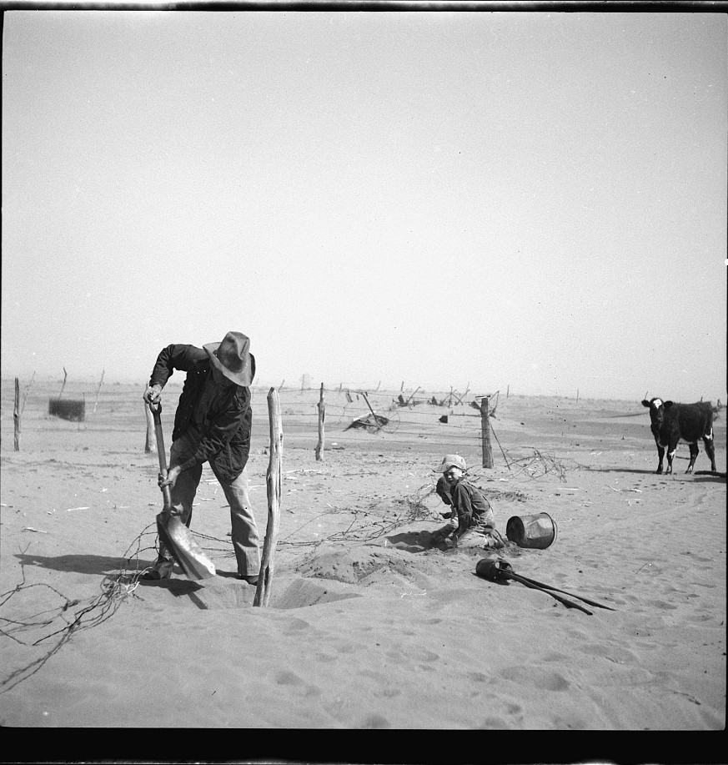
DIRECT INSTRUCTION
US.40
Over-farming stripped the land’s defenses — plowing up native prairie grasses, WWI-era wheat expansion, tractors, and monoculture left Plains soil exposed with no crop rotation or conservation.
ZOOM IN
US.40 · Causes: Over-farming
Source: Arthur Rothstein / FSA, 1936 — Library of Congress
U.S. History Hack · TroopToTeacher Technologies LLC · Aligned to TN Academic Standards & TCAP EOC
12

Slide 13
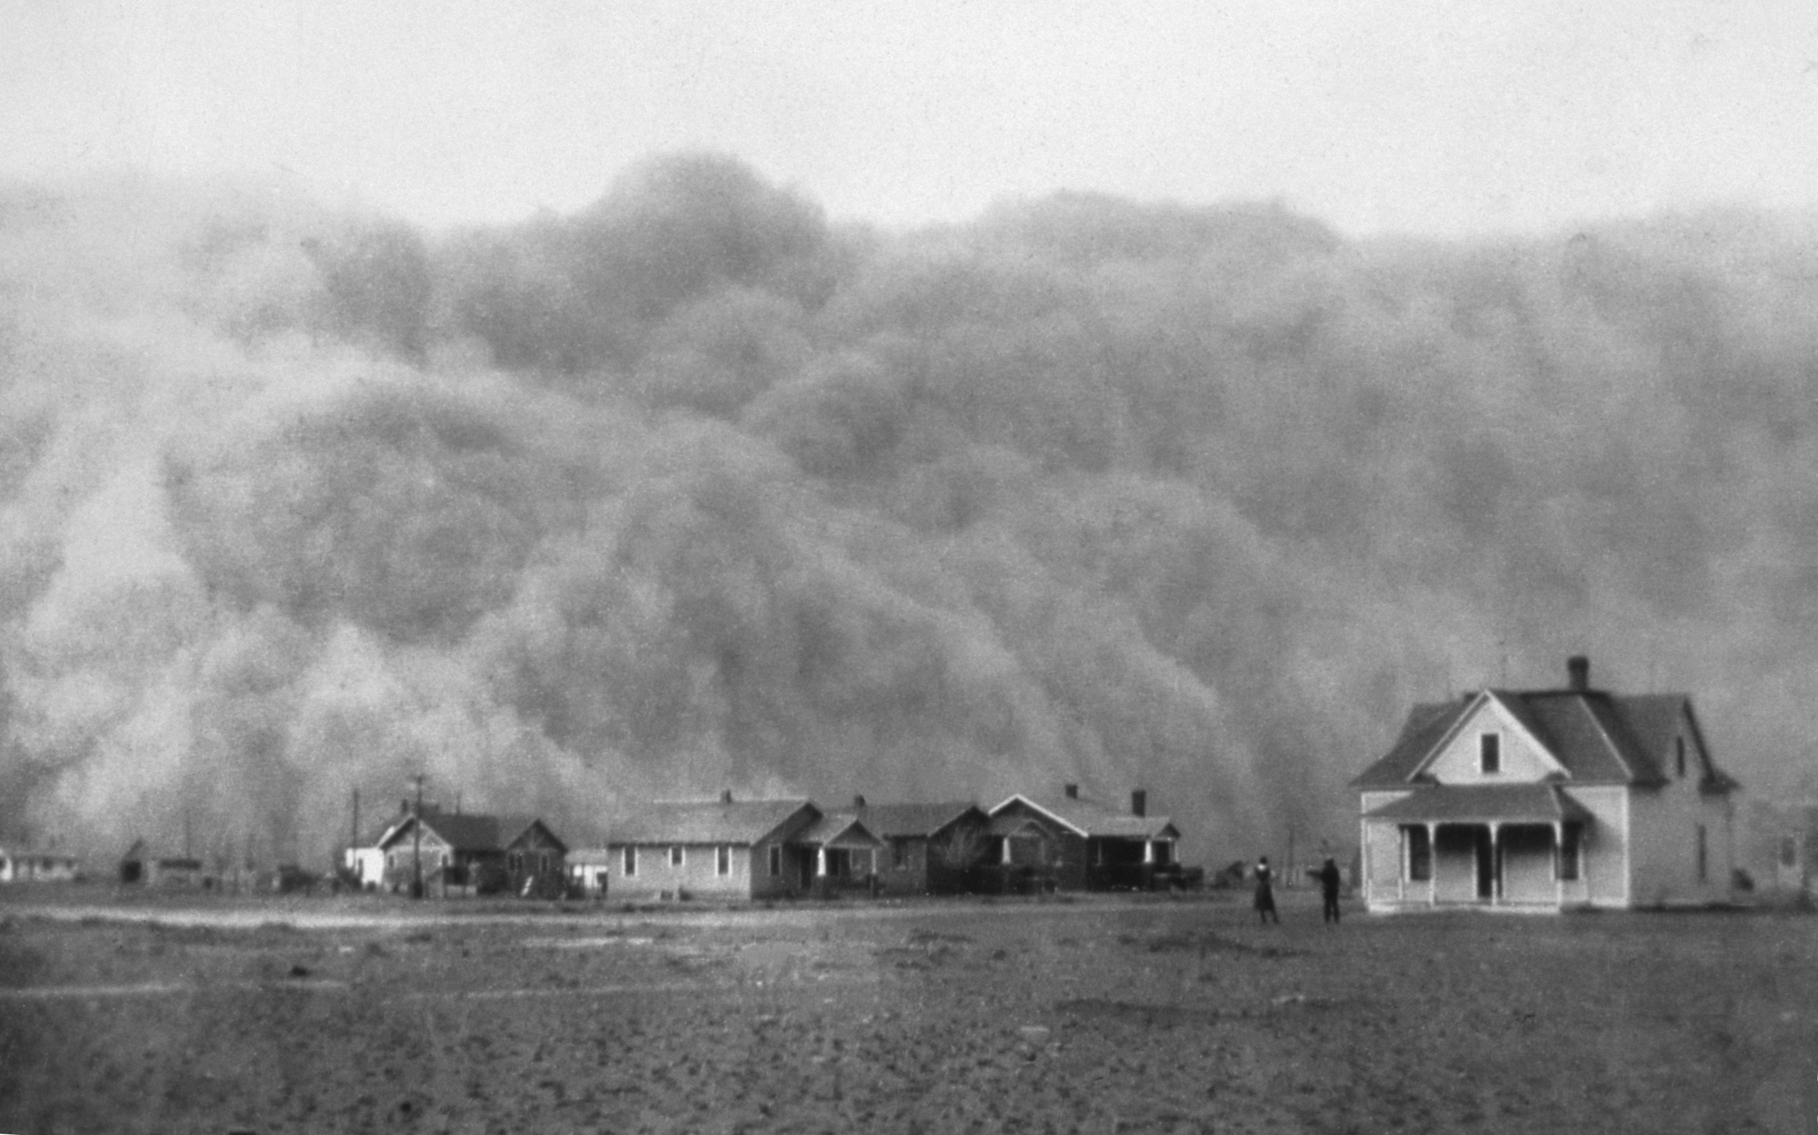
DIRECT INSTRUCTION
US.40
Drought and wind created “black blizzards” — a 1931-1939 drought dropped rainfall 40% below normal, and strong winds blew away 75% of topsoil, darkening skies as far as Washington, D.C.
KEY POINT
A 1931–1939 drought dropped rainfall about 40% below normal, and strong winds stripped up to 75% of the topsoil, creating "black blizzards" that darkened skies as far east as Washington, D.C.
US.40 · Causes: Severe Drought
U.S. History Hack · TroopToTeacher Technologies LLC · Aligned to TN Academic Standards & TCAP EOC
13

Slide 14
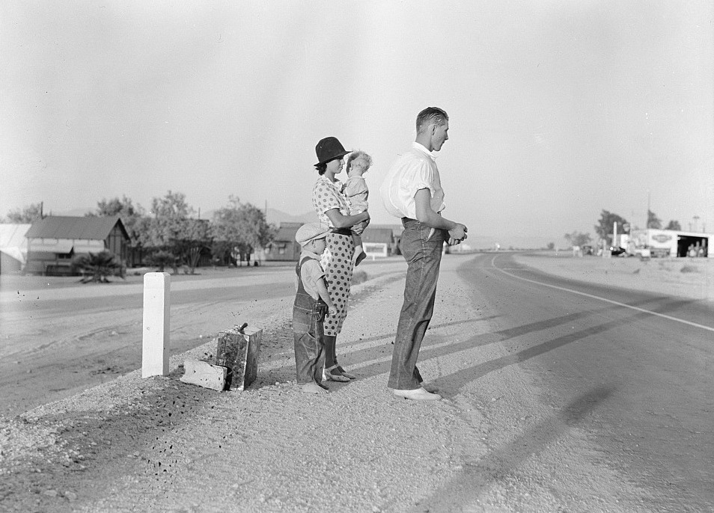
DIRECT INSTRUCTION
US.40
Displacement uprooted millions — 3.5 million left the Plains as “Okies,” over 200,000 heading to California on Route 66, as farm income fell 60% and banks foreclosed on thousands of farms.
KEY POINT
Displacement uprooted millions: about 3.5 million people left the Plains as "Okies," over 200,000 heading to California, as farm income fell roughly 60% and banks foreclosed on thousands of farms.
US.40 · Social & Economic Impacts
U.S. History Hack · TroopToTeacher Technologies LLC · Aligned to TN Academic Standards & TCAP EOC
14

Slide 15
SOURCE IT FIRST
US.40
Read Caroline Henderson’s letter from a Kansas farm — identify who is writing and when before you weigh her account.
WHO
WHEN
WHY
Caroline Henderson
June 1935
Consider the author's purpose and audience before reading the words.
Letter from Kansas Farm Woman
Caroline Henderson · June 1935
"Wearing our shade hats, with handkerchiefs tied over our faces and vaseline in our nostrils, we have been trying to rescue our home from the accumulations of wind-blown dust which penetrates wherever air can go. It is almost a hopeless task, for those gritty, grayish clouds of dust seem never to end. The whole world seems to be one vast dust heap."
Library of Congress
U.S. History Hack · TroopToTeacher Technologies LLC · Aligned to TN Academic Standards & TCAP EOC
15

Slide 16
THREE PERSPECTIVES
US.40
A historian returns to three questions at the end of every reading. Use them to analyze this standard.
Who benefited?
Who bore the costs?
Who decided?
Who gained land, wealth, power, or protection?
Who lost land, labor, freedom, or life — and who was silenced?
Which people, offices, or courts held the authority?
US.40:
US.40:
US.40:
Little benefit came from the disaster itself; later, New Deal soil-conservation programs and California agribusiness gained from cheap migrant labor.
Plains farm families who lost land and homes, “Okie” migrants who faced discrimination, and rural communities drained of population.
Farmers and land policies that encouraged over-plowing, and nature’s drought cycle — later, the federal government stepped in with conservation programs.
Anchor: Letter from Kansas Farm Woman, Caroline Henderson, June 1935 (Library of Congress)
U.S. History Hack · TroopToTeacher Technologies LLC · Aligned to TN Academic Standards & TCAP EOC
16

Slide 17
US.40 · PROGRESS CHECK
Progress Check
DOK 2 · SELF-CHECK
What combination of human farming practices and natural weather patterns created the Dust Bowl?
A
Farmers plowed up native grasses, practiced monoculture without conservation, and severe drought combined with strong winds eroded the exposed topsoil.
B
The Dust Bowl was entirely caused by natural drought.
C
Modern farming techniques prevented soil erosion.
D
The Dust Bowl only affected a small local area.
Commit your answer first — then discuss. Your teacher has the answer key. How sure are you? I’ve got this · Mostly · Still shaky · Lost
U.S. History Hack · TroopToTeacher Technologies LLC · Aligned to TN Academic Standards & TCAP EOC
17

Slide 18
US.41
Impact of the Great Depression on the American People
TN STANDARD
US.41 – Describe the impact of the Great Depression on the American people, including mass unemployment, migration, and Hoovervilles.
I CAN
I can describe the impact of the Great Depression on the American people, including mass unemployment, migration, and Hoovervilles.
U.S. History Hack · TroopToTeacher Technologies LLC · Aligned to TN Academic Standards & TCAP EOC
18

Slide 19
US.41 · KEY VOCABULARY / LANGUAGE SUPPORT
Key Vocabulary — Language Support
Mass Unemployment
Hoovervilles
Desempleo Masivo
Hoovervilles
say: mass un-em-PLOY-ment
say: HOO-ver-vilz
Joblessness reached about 25% (roughly 15 million people) at its 1933 peak, creating widespread poverty and desperation.
Shantytown settlements of homeless people during the Depression, named mockingly after President Herbert Hoover.
LANGUAGE SUPPORT Spanish term, a "say:" pronunciation guide, and a plain-language definition support multilingual learners and are available to everyone. Full bilingual Frayer models are in the unit vocabulary set.
U.S. History Hack · TroopToTeacher Technologies LLC · Aligned to TN Academic Standards & TCAP EOC
19

Slide 20
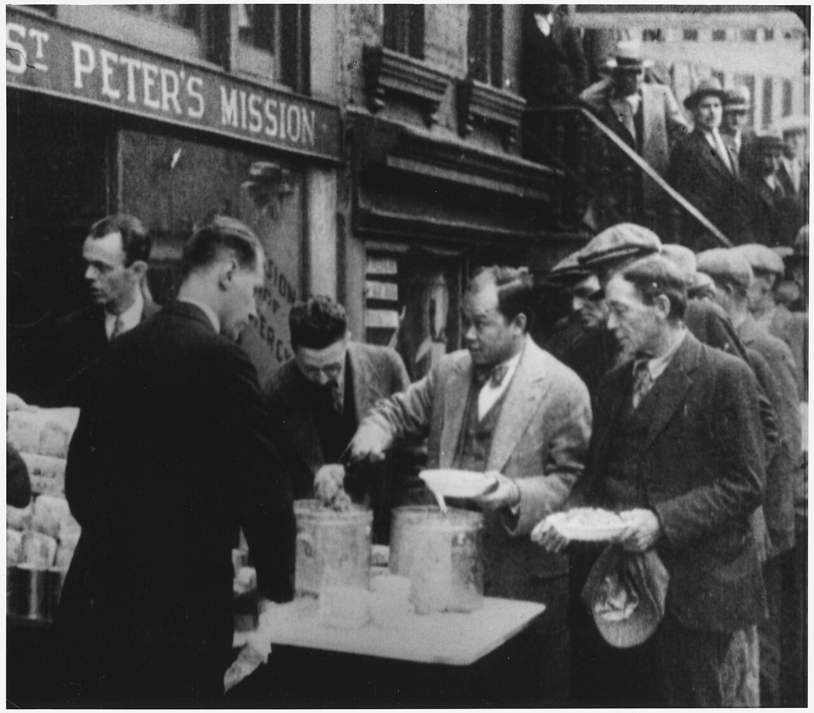
DIRECT INSTRUCTION
US.41
Mass unemployment scarred a generation — joblessness peaked at 25% in 1933 (50% among youth), lasting years and forcing role reversals as women and children became breadwinners.
ZOOM IN
US.41 · Mass Unemployment
Source: c. 1930–1935 — National Archives (NARA) / Wikimedia Commons
U.S. History Hack · TroopToTeacher Technologies LLC · Aligned to TN Academic Standards & TCAP EOC
20

Slide 21
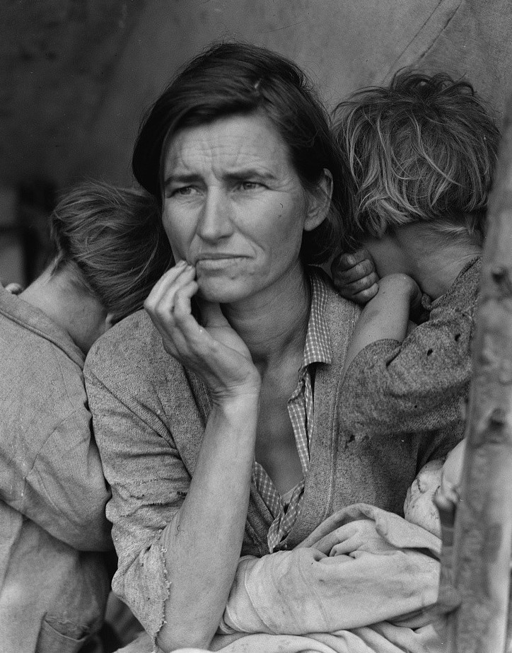
DIRECT INSTRUCTION
US.41
Families and communities strained — divorce, desertion, and delayed marriage rose; families doubled up, gardened, bartered, and leaned on churches while shame drove social withdrawal.
ZOOM IN
US.41 · Effects on Families & Migration
Source: Dorothea Lange / FSA, 1936 — Library of Congress
U.S. History Hack · TroopToTeacher Technologies LLC · Aligned to TN Academic Standards & TCAP EOC
21

Slide 22
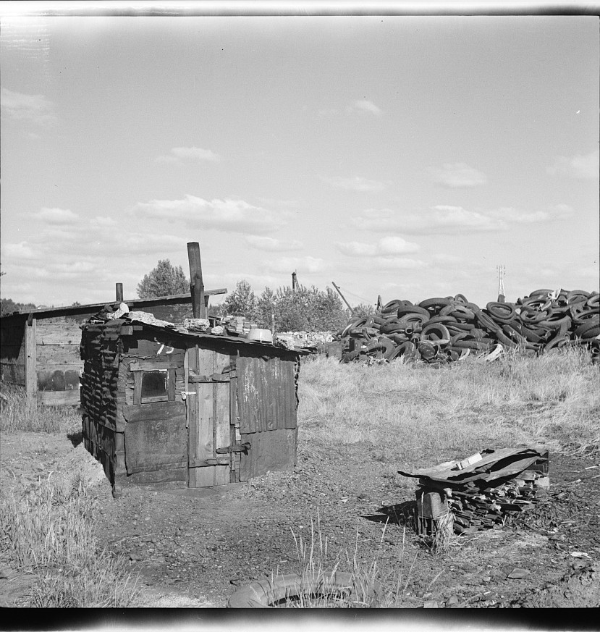
DIRECT INSTRUCTION
US.41
Hoovervilles marked the human cost — homeless Americans built shanty towns of cardboard, tin, and scrap on city outskirts, sarcastically named for the president many blamed.
ZOOM IN
US.41 · Hoovervilles & Social Change
Source: Arthur Rothstein, 1936 — Library of Congress
U.S. History Hack · TroopToTeacher Technologies LLC · Aligned to TN Academic Standards & TCAP EOC
22

Slide 23
SOURCE IT FIRST
US.41
Read a Hooverville resident’s account — consider the writer’s purpose and audience before you read the words.
WHO
WHEN
WHY
Unemployed Factory Worker
1932
Consider the author's purpose and audience before reading the words.
Hooverville Resident Account
Unemployed Factory Worker · 1932
"We built our shack out of old packing crates and flattened tin cans. There must be a thousand families living here in this camp by the river. We call it Hooverville after the president who promised us prosperity. Men who used to have good jobs stand in bread lines for hours just to get a bowl of soup. I never thought I'd see Americans living like this."
Library of Congress
U.S. History Hack · TroopToTeacher Technologies LLC · Aligned to TN Academic Standards & TCAP EOC
23

Slide 24
THREE PERSPECTIVES
US.41
A historian returns to three questions at the end of every reading. Use them to analyze this standard.
Who benefited?
Who bore the costs?
Who decided?
Who gained land, wealth, power, or protection?
Who lost land, labor, freedom, or life — and who was silenced?
Which people, offices, or courts held the authority?
US.41:
US.41:
US.41:
Few benefited; the shared suffering later fueled demand for a federal safety net that the New Deal would build.
The unemployed, homeless Hooverville residents, displaced migrants, and middle-class families who fell into poverty and lost faith in the American Dream.
Ordinary Americans making survival choices, and a federal government whose limited response left communities to rely on mutual aid and charity.
Anchor: Hooverville Resident Account, Unemployed Factory Worker, 1932 (Library of Congress)
U.S. History Hack · TroopToTeacher Technologies LLC · Aligned to TN Academic Standards & TCAP EOC
24

Slide 25
US.41 · PROGRESS CHECK
Progress Check
DOK 2 · SELF-CHECK
How did mass unemployment during the Great Depression affect individuals, families, and communities?
A
Unemployment had limited social effects.
B
Government programs immediately solved unemployment.
C
Only industrial workers experienced unemployment.
D
With 25% unemployment, families faced psychological trauma, role reversals, increased divorce, child labor, and relied on mutual aid while communities experienced population loss and service decline.
Commit your answer first — then discuss. Your teacher has the answer key. How sure are you? I’ve got this · Mostly · Still shaky · Lost
U.S. History Hack · TroopToTeacher Technologies LLC · Aligned to TN Academic Standards & TCAP EOC
25

Slide 26
US.42
Herbert Hoover's Response
TN STANDARD
US.42 – Describe the steps taken by President Herbert Hoover to address the depression, including his: philosophy of "Rugged Individualism", public works projects, the Reconstruction Finance Corporation, and response to the "Bonus Army".
I CAN
I can describe the steps taken by President Herbert Hoover to address the depression, including his philosophy of "Rugged Individualism," public works projects, the Reconstruction Finance Corporation, and response to the "Bonus Army."
U.S. History Hack · TroopToTeacher Technologies LLC · Aligned to TN Academic Standards & TCAP EOC
26

Slide 27
US.42 · KEY VOCABULARY / LANGUAGE SUPPORT
Key Vocabulary — Language Support
Rugged Individualism
Bonus Army
Reconstruction Finance Corp. (RFC)
Individualismo Robusto
Ejército del Bono
Corporación Financiera de Reconstrucción
say: RUG-ed in-dih-VIJ-oo-uh-liz-um
say: BOH-nus AR-mee
say: ree-kun-STRUK-shun fy-NANS
Hoover’s belief that people should succeed through their own efforts and private charity rather than direct federal aid.
WWI veterans who marched on Washington in 1932 demanding early bonus payment; the Army dispersed them by force.
A 1932 federal agency that lent money to banks, railroads, and businesses to prevent further collapse.
LANGUAGE SUPPORT Spanish term, a "say:" pronunciation guide, and a plain-language definition support multilingual learners and are available to everyone. Full bilingual Frayer models are in the unit vocabulary set.
U.S. History Hack · TroopToTeacher Technologies LLC · Aligned to TN Academic Standards & TCAP EOC
27

Slide 28
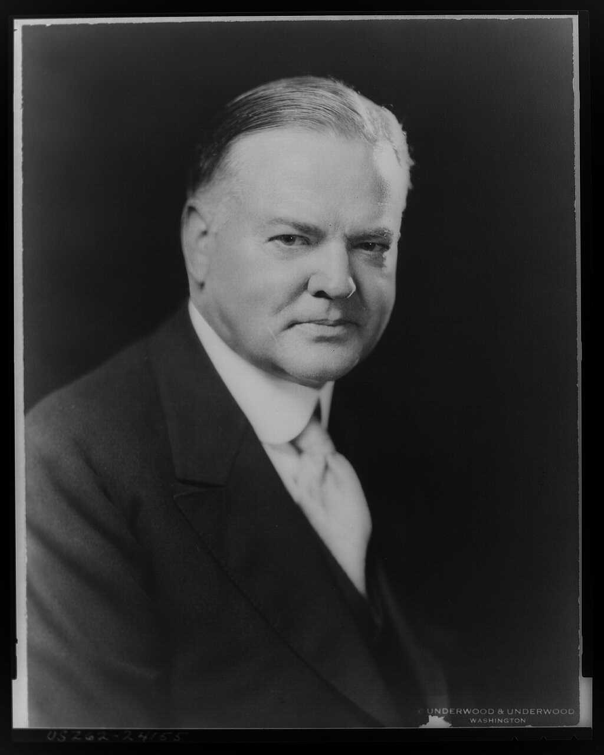
DIRECT INSTRUCTION
US.42
“Rugged individualism” limited his response — Hoover believed people should solve their own problems and that direct federal relief would destroy initiative and violate constitutional principles.
ZOOM IN
US.42 · Philosophy of “Rugged Individualism”
Source: Underwood & Underwood, 1928 — Library of Congress
U.S. History Hack · TroopToTeacher Technologies LLC · Aligned to TN Academic Standards & TCAP EOC
28

Slide 29
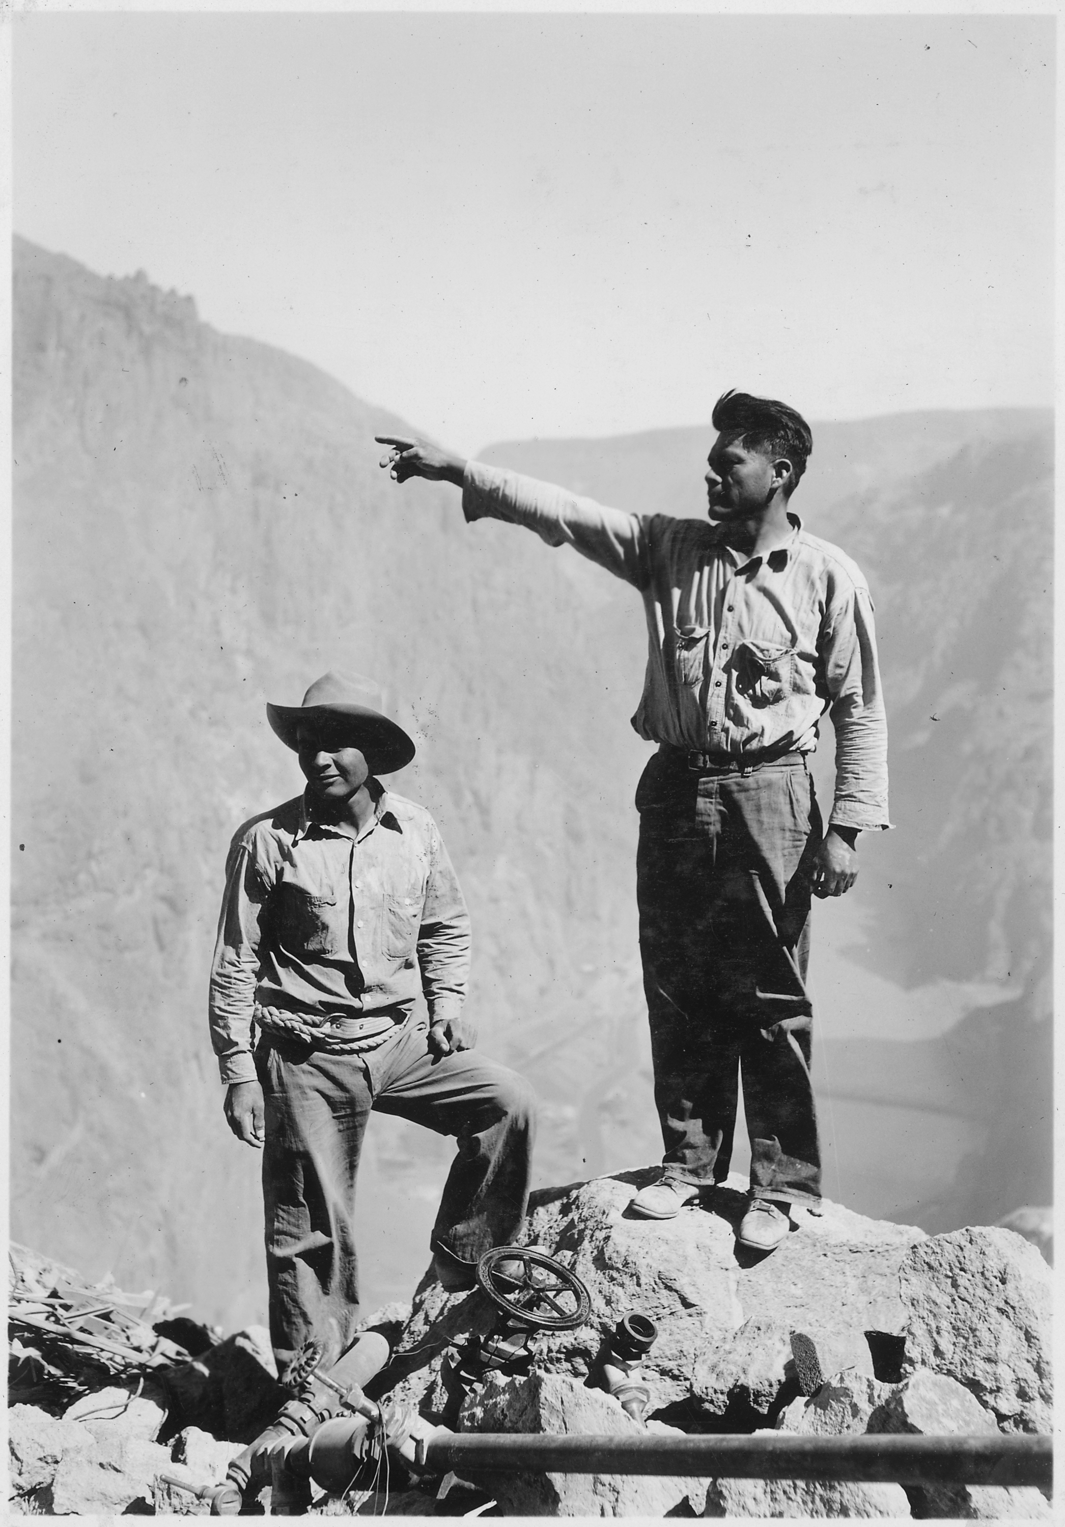
DIRECT INSTRUCTION
US.42
Public works and the RFC came too small — the Hoover Dam and a $2 billion RFC lent to banks and businesses on “trickle-down” theory, but the scale was inadequate for the crisis.
ZOOM IN
US.42 · Public Works & the RFC
Source: U.S. Bureau of Reclamation, c. 1932–1934 — National Archives
U.S. History Hack · TroopToTeacher Technologies LLC · Aligned to TN Academic Standards & TCAP EOC
29

Slide 30
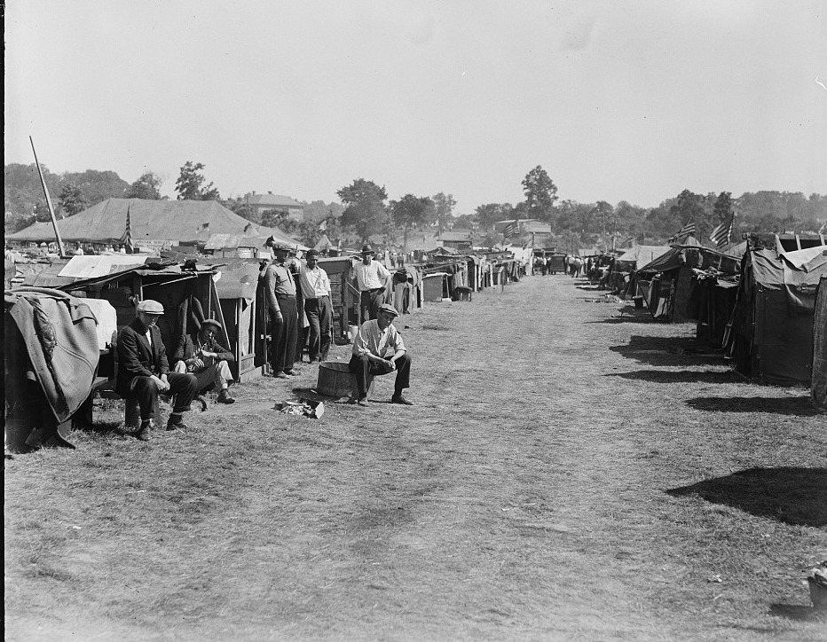
DIRECT INSTRUCTION
US.42
The Bonus Army destroyed his reputation — when 17,000 WWI veterans camped in Washington in 1932, the Army under MacArthur used tanks and tear gas, and images of the attack doomed Hoover’s 1932 campaign.
ZOOM IN
US.42 · Bonus Army & Political Consequences
Source: Harris & Ewing, 1932 — Library of Congress
U.S. History Hack · TroopToTeacher Technologies LLC · Aligned to TN Academic Standards & TCAP EOC
30

Slide 31
SOURCE IT FIRST
US.42
Read Hoover’s 1928 “Rugged Individualism” speech — note the speaker, date, and purpose before you read his words.
WHO
WHEN
WHY
President Herbert Hoover
1928
Consider the author's purpose and audience before reading the words.
Rugged Individualism Speech
President Herbert Hoover · 1928
"During the war we necessarily turned to the Government to solve every difficult economic problem... However justified in time of war, if continued in peacetime it would destroy not only our American system but with it our progress and freedom as well. When the Federal Government undertakes to go into commercial business, it must at once set up the organization and administration of that business."
Miller Center, University of Virginia
U.S. History Hack · TroopToTeacher Technologies LLC · Aligned to TN Academic Standards & TCAP EOC
31

Slide 32
THREE PERSPECTIVES
US.42
A historian returns to three questions at the end of every reading. Use them to analyze this standard.
Who benefited?
Who bore the costs?
Who decided?
Who gained land, wealth, power, or protection?
Who lost land, labor, freedom, or life — and who was silenced?
Which people, offices, or courts held the authority?
US.42:
US.42:
US.42:
Banks and large corporations that received RFC loans, and FDR, who won a landslide by defining himself against Hoover’s limited response.
The unemployed who received little direct relief, and the WWI veterans of the Bonus Army driven out of Washington by force.
President Hoover, bound by his philosophy; Congress, which rejected the bonus bill; and General MacArthur, who exceeded orders against the veterans.
Anchor: Rugged Individualism Speech, President Herbert Hoover, 1928 (Miller Center, University of Virginia)
U.S. History Hack · TroopToTeacher Technologies LLC · Aligned to TN Academic Standards & TCAP EOC
32

Slide 33
US.42 · PROGRESS CHECK
Progress Check
DOK 2 · SELF-CHECK
How did President Hoover’s philosophy of "Rugged Individualism" shape his response to the Great Depression?
A
It led to aggressive government intervention.
B
His belief that individuals should solve problems without government help led to limited federal response, reliance on voluntary cooperation, and opposition to direct relief programs.
C
He immediately provided direct payments to unemployed workers.
D
Rugged individualism had no impact on his policies.
Commit your answer first — then discuss. Your teacher has the answer key. How sure are you? I’ve got this · Mostly · Still shaky · Lost
U.S. History Hack · TroopToTeacher Technologies LLC · Aligned to TN Academic Standards & TCAP EOC
33

Slide 34
US.43
FDR's New Deal Programs
TN STANDARD
US.43 – Analyze the impact of the relief, recovery, and reform efforts of President Franklin D. Roosevelt's New Deal programs, including: Agricultural Adjustment Act, Civilian Conservation Corps, Fair Labor Standards Act, FDIC, National Recovery Administration, Securities and Exchange Commission, Social Security, TVA, Works Progress Administration.
I CAN
I can analyze the impact of the relief, recovery, and reform efforts of FDR's New Deal programs, including the AAA, CCC, Fair Labor Standards Act, FDIC, NRA, SEC, Social Security, TVA, and WPA.
U.S. History Hack · TroopToTeacher Technologies LLC · Aligned to TN Academic Standards & TCAP EOC
34

Slide 35
US.43 · KEY VOCABULARY / LANGUAGE SUPPORT
Key Vocabulary — Language Support
New Deal
Tennessee Valley Authority (TVA)
Social Security Act (1935)
New Deal
Autoridad del Valle de Tennessee
Ley de Seguridad Social
say: noo deel
say: ten-eh-SEE VAL-ee aw-THOR-ih-tee
say: SOH-shul sih-KYOOR-ih-tee
FDR’s relief, recovery, and reform programs that expanded federal power and established the social safety net.
Federal agency that built dams for flood control, cheap electricity, and development in the Tennessee Valley.
Landmark law creating old-age pensions, unemployment insurance, and aid for dependent and disabled Americans.
LANGUAGE SUPPORT Spanish term, a "say:" pronunciation guide, and a plain-language definition support multilingual learners and are available to everyone. Full bilingual Frayer models are in the unit vocabulary set.
U.S. History Hack · TroopToTeacher Technologies LLC · Aligned to TN Academic Standards & TCAP EOC
35

Slide 36
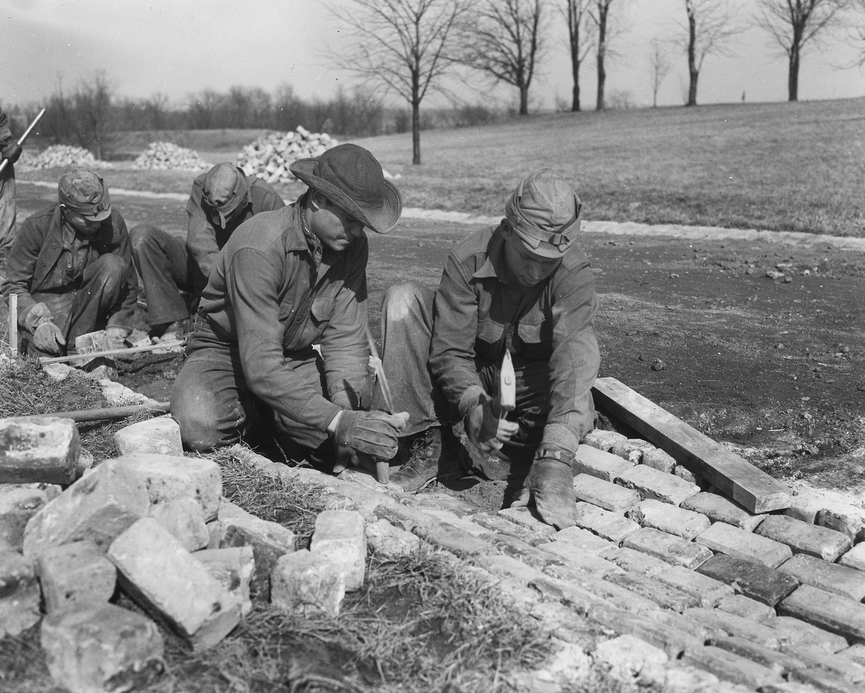
DIRECT INSTRUCTION
US.43
Relief put millions back to work — the CCC (1933) employed young men planting 3 billion trees, and the WPA (1935) put 8.5 million Americans to work building roads, schools, and airports.
ZOOM IN
US.43 · Relief: CCC & WPA
Source: c. 1933 — National Archives (NARA) / Wikimedia Commons
U.S. History Hack · TroopToTeacher Technologies LLC · Aligned to TN Academic Standards & TCAP EOC
36

Slide 37
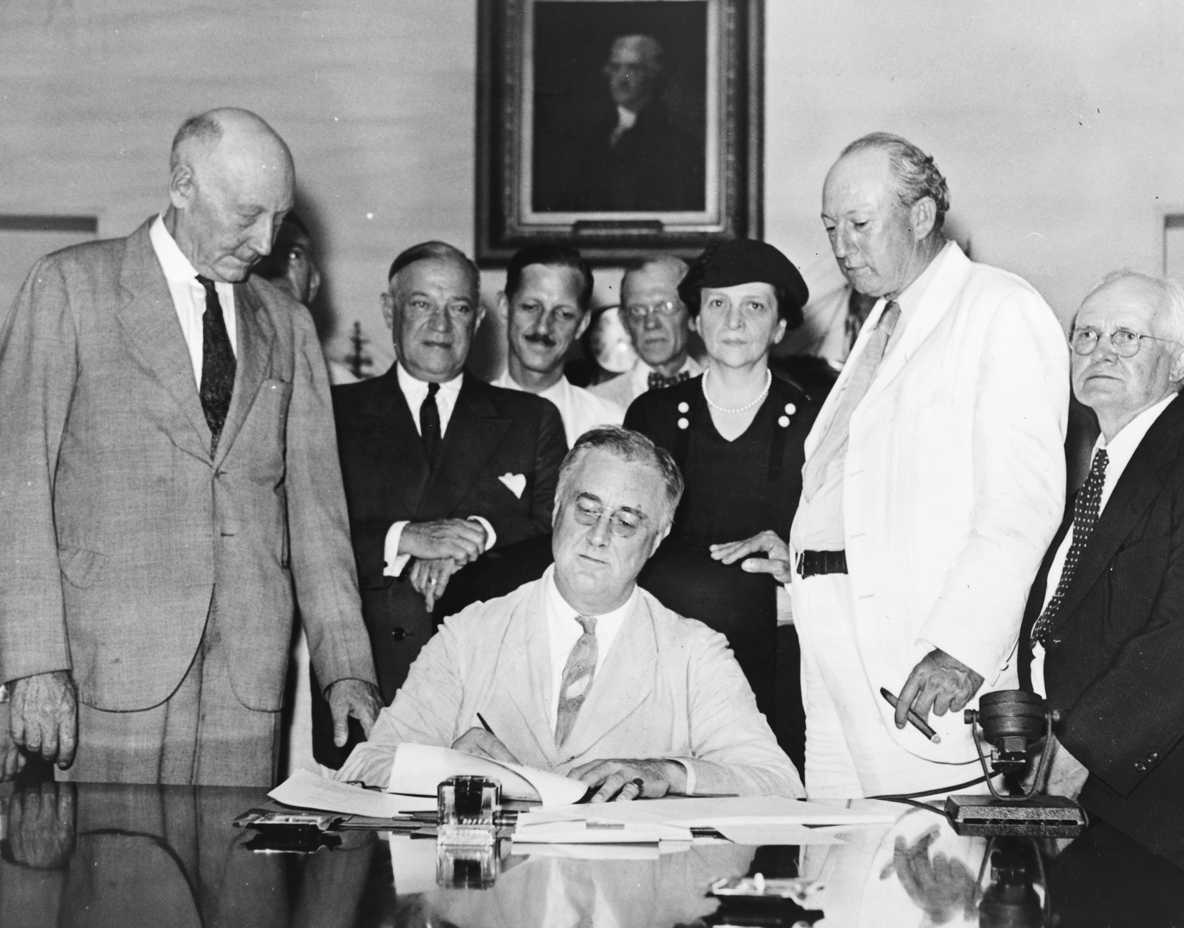
DIRECT INSTRUCTION
US.43
Recovery and reform reshaped the economy — the AAA and NRA raised prices and set labor codes (both later struck down), while the FDIC, SEC, FLSA, and Social Security built a permanent safety net.
KEY POINT
The AAA and NRA raised prices and set labor codes (both later struck down by the Supreme Court), while the FDIC, SEC, the Fair Labor Standards Act, and the Social Security Act built a permanent safety net that outlasted the Depression.
US.43 · Recovery & Reform Programs
U.S. History Hack · TroopToTeacher Technologies LLC · Aligned to TN Academic Standards & TCAP EOC
37

Slide 38
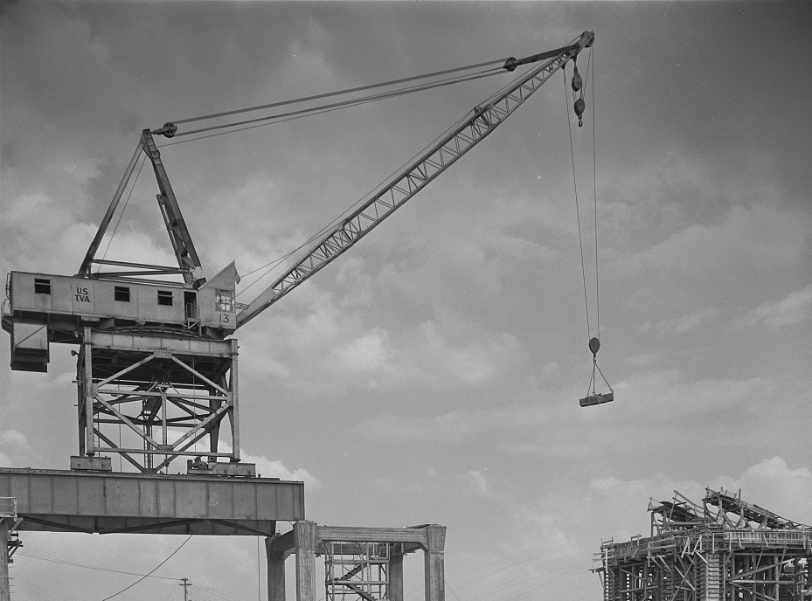
DIRECT INSTRUCTION
US.43
The TVA transformed Tennessee — the Tennessee Valley Authority (1933) built 16 dams for flood control, cheap electricity, and navigation, electrifying one of America’s poorest regions and still operating today.
ZOOM IN
US.43 · Tennessee Valley Authority (TN)
Source: FSA/OWI, 1942 — Library of Congress
U.S. History Hack · TroopToTeacher Technologies LLC · Aligned to TN Academic Standards & TCAP EOC
38

Slide 39
SOURCE IT FIRST
US.43
Read FDR’s description of the TVA — identify the author and date before you analyze the source.
WHO
WHEN
WHY
Franklin D. Roosevelt
1933
Consider the author's purpose and audience before reading the words.
TVA (Tennessee Valley Authority) Description
Franklin D. Roosevelt · 1933
"It is clear that the Muscle Shoals development is but a small part of the potential public usefulness of the entire Tennessee River. Such use, if envisioned in its entirety, transcends mere power development: it enters the wide fields of flood control, soil erosion, afforestation, elimination from agricultural use of marginal lands, and distribution and diversification of industry."
National Archives
U.S. History Hack · TroopToTeacher Technologies LLC · Aligned to TN Academic Standards & TCAP EOC
39

Slide 40
THREE PERSPECTIVES
US.43
A historian returns to three questions at the end of every reading. Use them to analyze this standard.
Who benefited?
Who bore the costs?
Who decided?
Who gained land, wealth, power, or protection?
Who lost land, labor, freedom, or life — and who was silenced?
Which people, offices, or courts held the authority?
US.43:
US.43:
US.43:
Unemployed workers who found jobs, farmers and depositors protected by new programs, and the Tennessee Valley, transformed by cheap TVA power.
Sharecroppers displaced by the AAA, taxpayers funding the programs, and families relocated for TVA dams and reservoirs.
FDR and Congress, who created the alphabet agencies, and the Supreme Court, which struck down the AAA and NRA as unconstitutional.
Anchor: TVA (Tennessee Valley Authority) Description, Franklin D. Roosevelt, 1933 (National Archives)
U.S. History Hack · TroopToTeacher Technologies LLC · Aligned to TN Academic Standards & TCAP EOC
40

Slide 41
US.43 · PROGRESS CHECK
Progress Check
DOK 2 · SELF-CHECK
How did the "Three R’s" (Relief, Recovery, Reform) organize Roosevelt’s approach to ending the Great Depression?
A
Relief provided immediate help to unemployed (CCC, WPA), Recovery programs restored economic activity (AAA, NRA), and Reform programs fixed underlying problems (FDIC, SEC, Social Security).
B
FDR used only one approach throughout the New Deal.
C
The Three R’s were unrelated programs.
D
Roosevelt opposed the Three R’s approach.
Commit your answer first — then discuss. Your teacher has the answer key. How sure are you? I’ve got this · Mostly · Still shaky · Lost
U.S. History Hack · TroopToTeacher Technologies LLC · Aligned to TN Academic Standards & TCAP EOC
41

Slide 42
US.44
Effects and Controversies of New Deal Policies
TN STANDARD
US.44 – Analyze the effects of and the controversies arising from New Deal economic policies, including charges of socialism and President Franklin D. Roosevelt's "court packing" attempt.
I CAN
I can analyze the effects of and the controversies arising from New Deal economic policies, including charges of socialism and FDR's "court packing" attempt.
U.S. History Hack · TroopToTeacher Technologies LLC · Aligned to TN Academic Standards & TCAP EOC
42

Slide 43
US.44 · KEY VOCABULARY / LANGUAGE SUPPORT
Key Vocabulary — Language Support
Court Packing Plan
Socialism Accusations
FDIC
Plan de Empaquetar la Corte
Acusaciones de Socialismo
Corp. Federal de Seguro de Depósitos
say: kort PAK-ing plan
say: SOH-shuh-liz-um
say: FED-er-ul dee-POZ-it
FDR’s 1937 plan to add up to six Supreme Court justices after it struck down New Deal laws; seen as a threat to judicial independence.
Critics charged that the New Deal was socialist for expanding government power, though it preserved private ownership.
New Deal agency that insures bank deposits, preventing bank runs by guaranteeing savers will not lose their money.
LANGUAGE SUPPORT Spanish term, a "say:" pronunciation guide, and a plain-language definition support multilingual learners and are available to everyone. Full bilingual Frayer models are in the unit vocabulary set.
U.S. History Hack · TroopToTeacher Technologies LLC · Aligned to TN Academic Standards & TCAP EOC
43

Slide 44
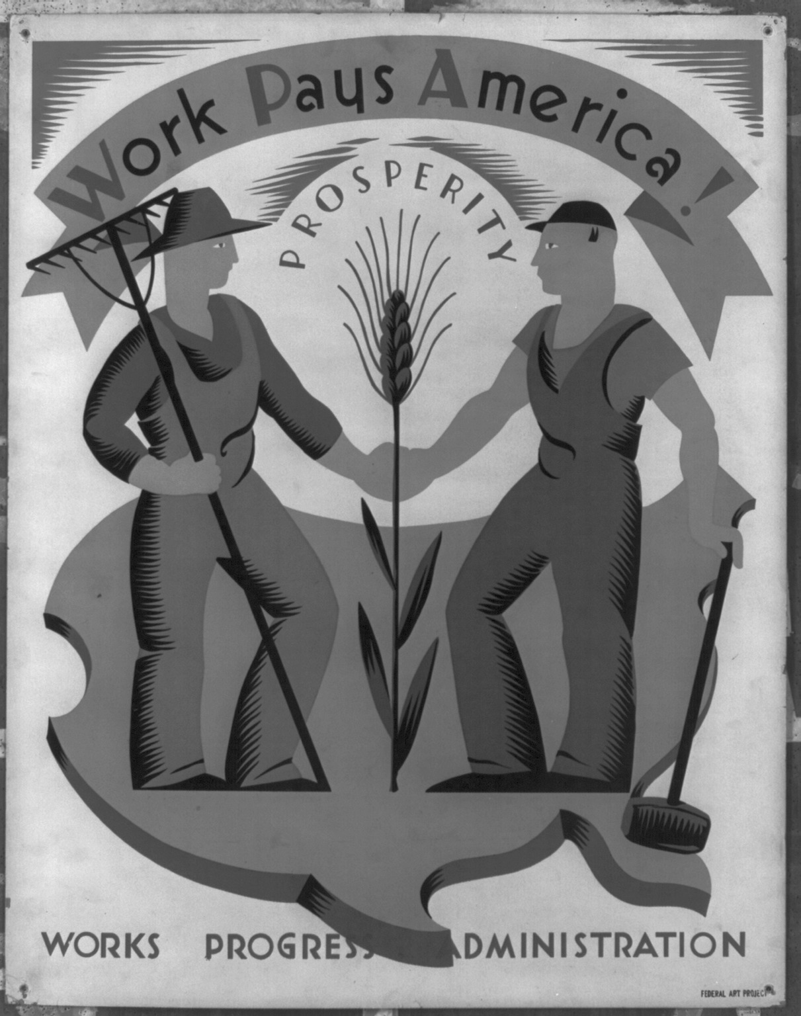
DIRECT INSTRUCTION
US.44
The New Deal reshaped government’s role — unemployment fell from 25% to 14%, manufacturing rose 60%, and federal spending grew from 3% to 10% of GDP, permanently expanding Washington’s reach.
ZOOM IN
US.44 · Economic & Structural Effects
Source: Federal Art Project / WPA, c. 1936 — Library of Congress
U.S. History Hack · TroopToTeacher Technologies LLC · Aligned to TN Academic Standards & TCAP EOC
44

Slide 45
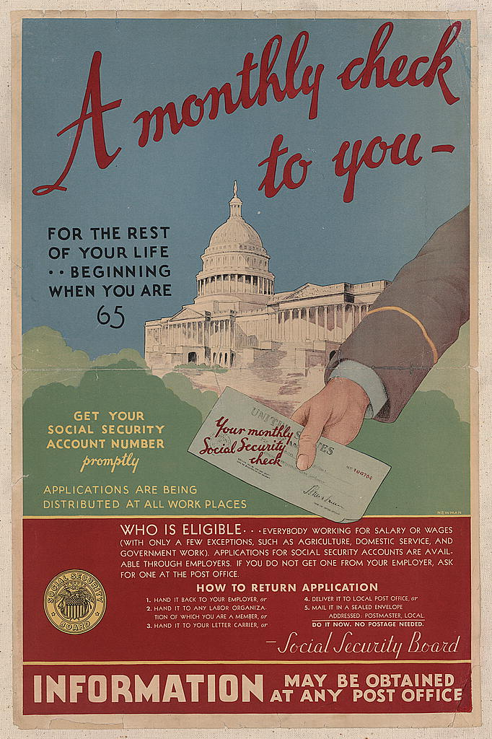
DIRECT INSTRUCTION
US.44
Critics charged socialism and overreach — business leaders said the New Deal regulated enterprise and redistributed income like socialism, though it preserved private ownership rather than nationalizing industry.
ZOOM IN
US.44 · Charges of Socialism
Source: Newman (artist), 1935 — Library of Congress
U.S. History Hack · TroopToTeacher Technologies LLC · Aligned to TN Academic Standards & TCAP EOC
45

Slide 46
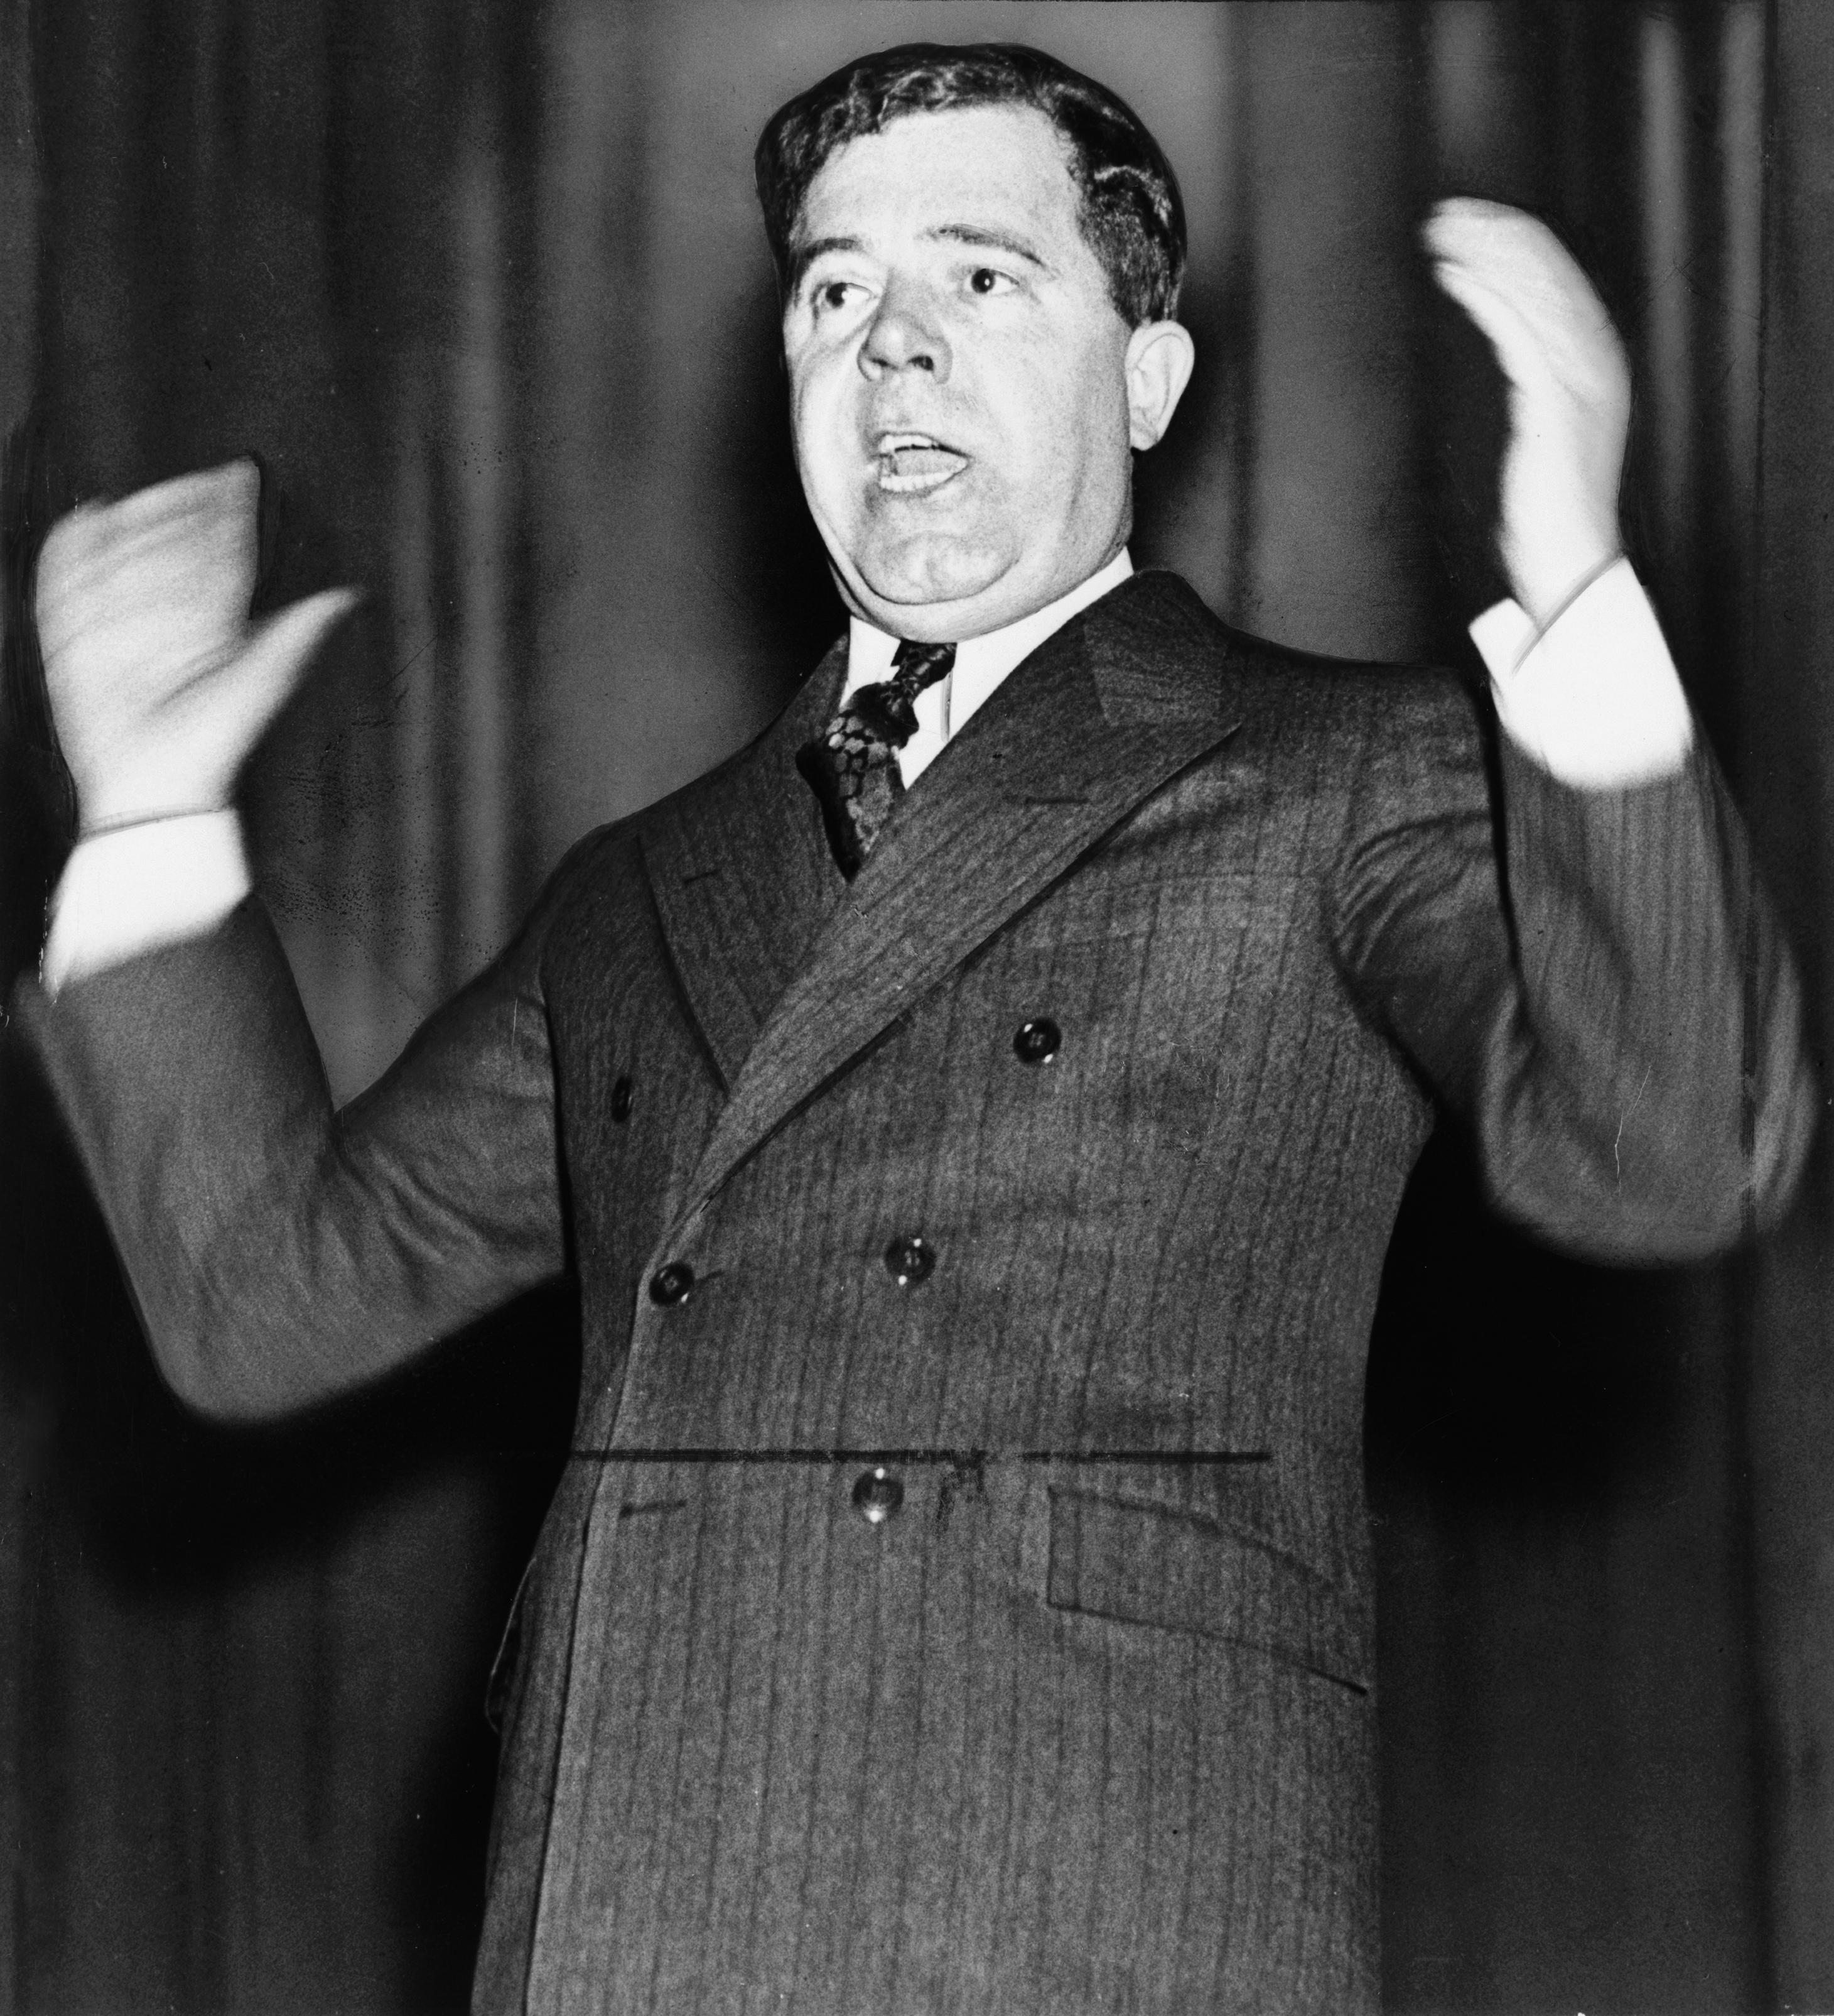
DIRECT INSTRUCTION
US.44
Court-packing split the nation — after the Court struck down the AAA and NRA, FDR’s 1937 plan to add up to six justices failed in Congress and cost him political capital, though it pressured the Court.
KEY POINT
After the Supreme Court struck down the AAA and NRA, FDR’s 1937 plan to add up to six justices — attacked as "court packing" — failed in Congress and cost him political capital, even among allies. Yet the pressure helped shift the Court toward upholding later New Deal laws ("the switch in time that saved nine").
US.44 · Court-Packing & Differing Perspectives
U.S. History Hack · TroopToTeacher Technologies LLC · Aligned to TN Academic Standards & TCAP EOC
46

Slide 47
SOURCE IT FIRST
US.44
Read Huey Long’s “Share Our Wealth” program — weigh who is speaking and why before you read the words.
WHO
WHEN
WHY
Senator Huey Long
1934
Consider the author's purpose and audience before reading the words.
Share Our Wealth Program
Senator Huey Long · 1934
"We propose to limit the size of each fortune. No person shall own more than 3 or 4 million dollars. We will guarantee every family in America an annual income of $2,000 to $2,500 and a home worth $5,000. Every child shall have a free education from kindergarten through college. The hours of labor will be limited so as to give the masses more time for recreation."
U.S. Senate Historical Office
U.S. History Hack · TroopToTeacher Technologies LLC · Aligned to TN Academic Standards & TCAP EOC
47

Slide 48
THREE PERSPECTIVES
US.44
A historian returns to three questions at the end of every reading. Use them to analyze this standard.
Who benefited?
Who bore the costs?
Who decided?
Who gained land, wealth, power, or protection?
Who lost land, labor, freedom, or life — and who was silenced?
Which people, offices, or courts held the authority?
US.44:
US.44:
US.44:
Workers, the elderly, and depositors protected by lasting programs like Social Security and the FDIC, and the new Democratic political coalition.
Business owners who faced new regulation, states that lost power to Washington, and critics who warned of expanded federal and executive authority.
FDR and the Democratic Congress who passed the programs, the Supreme Court that limited them, and critics like Huey Long who pushed from the left.
Anchor: Share Our Wealth Program, Senator Huey Long, 1934 (U.S. Senate Historical Office)
U.S. History Hack · TroopToTeacher Technologies LLC · Aligned to TN Academic Standards & TCAP EOC
48

Slide 49
US.44 · PROGRESS CHECK
Progress Check
DOK 2 · SELF-CHECK
What were the main economic effects of New Deal policies on employment, banking, and government spending?
A
New Deal policies had no measurable economic impact.
B
The economy worsened under New Deal policies.
C
Unemployment fell from 25% to 14%, bank runs ended with FDIC, manufacturing increased 60%, and government spending grew from 3% to 10% of GDP.
D
Only banking was affected by New Deal programs.
Commit your answer first — then discuss. Your teacher has the answer key. How sure are you? I’ve got this · Mostly · Still shaky · Lost
U.S. History Hack · TroopToTeacher Technologies LLC · Aligned to TN Academic Standards & TCAP EOC
49

Slide 50
US.41 & US.43 · WHOSE STORY THE NEW DEAL REACHED
Reached — and Left Out
Black Americans
Mexican Americans
Indigenous Peoples
The AAA’s crop-reduction payments went to landowners, pushing many Black sharecroppers and tenant farmers off the land, and Social Security (1935) at first excluded farm and domestic workers — jobs held by most Black workers. Yet FDR’s informal “Black Cabinet,” including Mary McLeod Bethune and Robert Weaver, advised the administration, and Black voters shifted toward the Democratic Party.
Amid Depression job competition, “Mexican Repatriation” (about 1929–1936) pressured an estimated 400,000 to more than one million people of Mexican descent — many of them U.S.-born citizens — to leave for Mexico. Mexican and Filipino farmworkers in California often faced lower pay and worse conditions than white “Okie” migrants.
The Indian Reorganization Act of 1934 (the “Indian New Deal”), led by John Collier, ended the Dawes-era allotment policy, restored some tribal self-government and land, and supported Native culture — a major reversal, though its results were mixed and debated. A CCC Indian Division employed thousands.
History Hack-authored instructional synthesis grounded in the standard historical record — not a primary source. Verified public-domain images and primary sources for these histories are a pending content addition.
U.S. History Hack · TroopToTeacher Technologies LLC · Aligned to TN Academic Standards & TCAP EOC
50

