Slide 1
How This Deck Works
Universal Design for Learning · Multi-Tiered System of Supports
EVERY LEARNER · SAME FIRM GOAL
Multiple ways in
Multiple ways to see it
Multiple ways to show it
Every lesson opens with a real question and a clear “I can” goal, so you know why it matters and where you’re headed.
Direct instruction, primary sources, maps, and bilingual key vocabulary — the same ideas shown more than one way.
Model-with-me, sentence frames, and choices in how you respond — you reach the same goal by the route that works for you.
Your teacher checks your progress along the way and gives you another path if you need one — the goal never lowers.
U.S. History Hack · TroopToTeacher Technologies LLC · Aligned to TN Academic Standards & TCAP EOC
1

Slide 2
US.71
1950s Prosperity & Consumerism
TN STANDARD
US.71 – Analyze the impact of prosperity and consumerism in the 1950s, including: the growth of white-collar jobs, the "suburban ideal", the impact of the G.I. Bill, and the increased reliance on foreign oil.
I CAN
I can analyze the impact of prosperity and consumerism in the 1950s, including the growth of white-collar jobs, the "suburban ideal," the impact of the G.I. Bill, and the increased reliance on foreign oil.
U.S. History Hack · TroopToTeacher Technologies LLC · Aligned to TN Academic Standards & TCAP EOC
1

Slide 3
DIRECT INSTRUCTION
US.71
Postwar prosperity remade daily life — in the 1950s U.S. GDP surged from $200 billion to $500 billion, and low unemployment, rising wages, and consumer spending built a broad new middle class.
KEY POINT
Postwar prosperity remade daily life — in the 1950s U.S. GDP surged from $200 billion to $500 billion, and low unemployment, rising wages, and consumer spending built a broad new middle class.
US.71 · Post-War Economic Boom
U.S. History Hack · TroopToTeacher Technologies LLC · Aligned to TN Academic Standards & TCAP EOC
2

Slide 4
DIRECT INSTRUCTION
US.71
The economy shifted from factories to offices — white-collar workers—managers, professionals, clerks, and salespeople—outnumbered blue-collar factory workers for the first time, signaling a service-and-management economy.
KEY POINT
The economy shifted from factories to offices — white-collar workers—managers, professionals, clerks, and salespeople—outnumbered blue-collar factory workers for the first time, signaling a service-and-management economy.
US.71 · Growth of White-Collar Jobs
U.S. History Hack · TroopToTeacher Technologies LLC · Aligned to TN Academic Standards & TCAP EOC
3

Slide 5
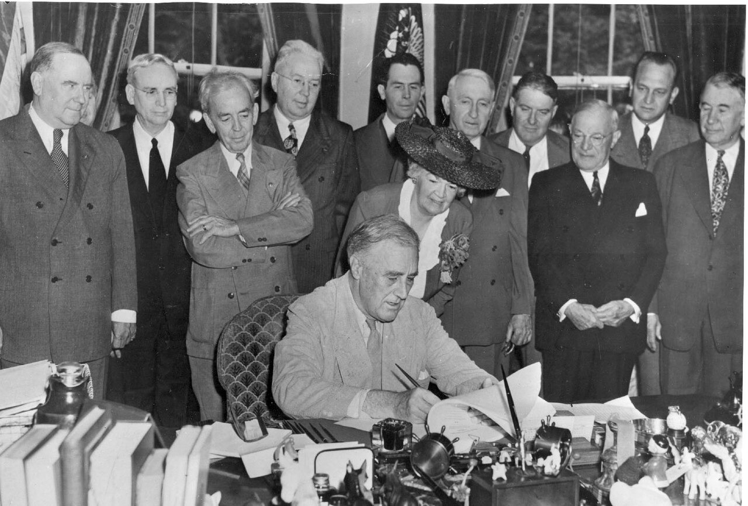
DIRECT INSTRUCTION
US.71
The G.I. Bill and Levittown built the suburbs — the 1944 Servicemen’s Readjustment Act gave veterans tuition and low-interest home loans, and developers like William Levitt mass-produced affordable suburban homes.
ZOOM IN
US.71 · The G.I. Bill & the Suburban Ideal
U.S. History Hack · TroopToTeacher Technologies LLC · Aligned to TN Academic Standards & TCAP EOC
4

Slide 6
SOURCE IT FIRST
US.71
Read the G.I. Bill — weigh who wrote it and why before you read the words.
WHO
WHEN
WHY
U.S. Congress
1944
Consider the author’s purpose and audience before reading the words.
Servicemen’s Readjustment Act (G.I. Bill)
U.S. Congress · 1944
"Any person who served in the active military or naval service... shall be entitled to vocational rehabilitation... The Administrator shall pay the educational institution... tuition, fees, books, and supplies. Each eligible person shall be entitled to a subsistence allowance... while pursuing a full-time course of education."
National Archives
U.S. History Hack · TroopToTeacher Technologies LLC · Aligned to TN Academic Standards & TCAP EOC
5

Slide 7
THREE PERSPECTIVES
US.71
A historian returns to three questions at the end of every reading. Use them to analyze this standard.
Who benefited?
Who bore the costs?
Who decided?
Who gained land, wealth, power, or protection?
Who lost land, labor, freedom, or life — and who was silenced?
Which people, offices, or courts held the authority?
US.71:
US.71:
US.71:
Millions of veterans and middle-class families who gained homes, college, and rising incomes, and the industries that supplied a booming consumer economy.
Many Black veterans and families largely shut out of suburban home loans and neighborhoods, and city cores drained of residents and investment.
Congress, which passed the G.I. Bill, and private developers, banks, and lenders whose rules shaped who could buy into the suburbs.
Anchor: Servicemen’s Readjustment Act (G.I. Bill), U.S. Congress, 1944 (National Archives)
U.S. History Hack · TroopToTeacher Technologies LLC · Aligned to TN Academic Standards & TCAP EOC
6

Slide 8
KEY VOCABULARY · LANGUAGE SUPPORT
US.71
Words you need before we read
White-Collar Jobs
Suburban Ideal
G.I. Bill
En español: Empleos de Cuello Blanco
En español: Ideal Suburbano
En español: Ley G.I.
WHAT IT MEANS
WHAT IT MEANS
WHAT IT MEANS
Office and professional occupations (managers, salespeople, clerks) that grew rapidly in the 1950s, outnumbering factory workers for the first time.
The 1950s American dream of owning a single-family home in the suburbs with a yard, garage, and modern appliances, drawing families out of cities.
The Servicemen’s Readjustment Act of 1944, which gave veterans college tuition, home loans, and job training, creating a massive new middle class.
U.S. History Hack · TroopToTeacher Technologies LLC · Aligned to TN Academic Standards & TCAP EOC
2

Slide 9
PROGRESS CHECK
US.71
Check your understanding
How did the "suburban ideal" both fulfill and contradict the American Dream during the 1950s?
A
Suburbs offered homeownership and prosperity for white families, but restrictive covenants and redlining excluded minorities, creating segregated communities that contradicted democratic ideals of equality
B
Suburbs perfectly fulfilled the American Dream for all Americans, though this interpretation lacks supporting historical evidence when examined alongside the available primary and secondary sources
C
Suburban development had no racial dimensions, which does not align with the documented historical record when examined alongside the available primary and secondary sources, although historical sources do not support this conclusion
D
All Americans had equal access to suburban housing, but this fails to account for the broader historical context, which contradicts the primary source evidence from this era and does not reflect the scholarly consensus on this topic
Confidence: 😟 1 🙂 2 😀 3 — circle where you are; your teacher routes reteach or extension.
U.S. History Hack · TroopToTeacher Technologies LLC · Aligned to TN Academic Standards & TCAP EOC
3

Slide 10
US.72
Baby Boomer Generation Impact
TN STANDARD
US.72 – Explain the impact of the baby boomer generation on the American economy and culture.
I CAN
I can explain the impact of the baby boomer generation on the American economy and culture.
U.S. History Hack · TroopToTeacher Technologies LLC · Aligned to TN Academic Standards & TCAP EOC
7

Slide 11
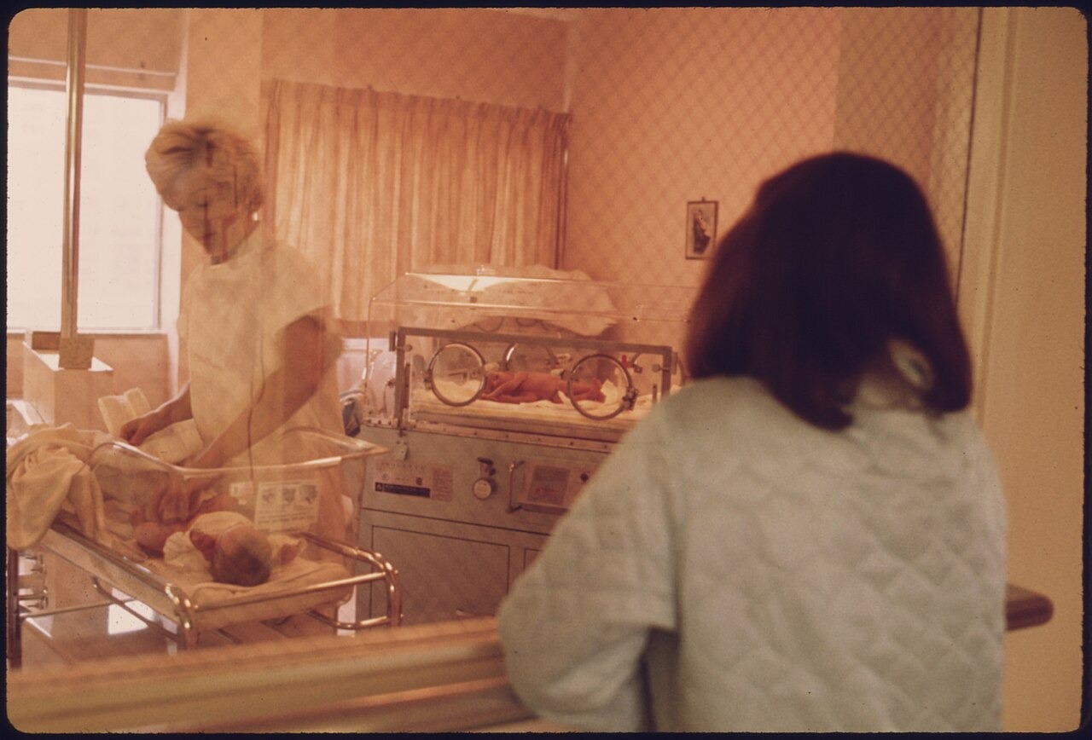
DIRECT INSTRUCTION
US.72
Birth rates exploded after the war — the Baby Boom was a dramatic rise in U.S. births from 1946 to 1964, driven by returning veterans starting families, postwar prosperity, and confidence in the future.
ZOOM IN
US.72 · What Was the Baby Boom?
U.S. History Hack · TroopToTeacher Technologies LLC · Aligned to TN Academic Standards & TCAP EOC
8

Slide 12
DIRECT INSTRUCTION
US.72
A generation of children reshaped the economy — boomers created massive demand for baby products, toys, and children’s clothing, and later teenage goods, driving decades of economic growth.
KEY POINT
A generation of children reshaped the economy — boomers created massive demand for baby products, toys, and children’s clothing, and later teenage goods, driving decades of economic growth.
US.72 · Reshaping the American Economy & New Markets
U.S. History Hack · TroopToTeacher Technologies LLC · Aligned to TN Academic Standards & TCAP EOC
9

Slide 13
DIRECT INSTRUCTION
US.72
Sheer numbers gave boomers lasting power — their size gave the generation enormous political and economic influence, shaping culture from the 1950s classroom boom through the 1960s counterculture and beyond.
KEY POINT
Sheer numbers gave boomers lasting power — their size gave the generation enormous political and economic influence, shaping culture from the 1950s classroom boom through the 1960s counterculture and beyond.
US.72 · Long-Term Cultural Impact
U.S. History Hack · TroopToTeacher Technologies LLC · Aligned to TN Academic Standards & TCAP EOC
10

Slide 14
SOURCE IT FIRST
US.72
Read the Census population report — identify who produced it and why before you read the numbers.
WHO
WHEN
WHY
U.S. Census Bureau
1955
Consider the author’s purpose and audience before reading the words.
Census Bureau Population Report
U.S. Census Bureau · 1955
"The birth rate has reached unprecedented levels since the end of World War II. Between 1946 and 1954, approximately 29 million babies were born in the United States, compared to 24 million in the preceding eight years. This surge in population is creating increased demand for schools, housing, and consumer goods targeted at families."
U.S. Census Bureau
U.S. History Hack · TroopToTeacher Technologies LLC · Aligned to TN Academic Standards & TCAP EOC
11

Slide 15
THREE PERSPECTIVES
US.72
A historian returns to three questions at the end of every reading. Use them to analyze this standard.
Who benefited?
Who bore the costs?
Who decided?
Who gained land, wealth, power, or protection?
Who lost land, labor, freedom, or life — and who was silenced?
Which people, offices, or courts held the authority?
US.72:
US.72:
US.72:
Industries built around children and families—toys, housing, schools, and later teen culture—and a generation that gained outsized influence.
Schools, hospitals, and public services strained to keep pace, and later generations who inherited the economic and social pressures of the boom.
Millions of individual families making private choices, and the businesses and governments that responded to the surge in population.
Anchor: Census Bureau Population Report, U.S. Census Bureau, 1955 (U.S. Census Bureau)
U.S. History Hack · TroopToTeacher Technologies LLC · Aligned to TN Academic Standards & TCAP EOC
12

Slide 16
KEY VOCABULARY · LANGUAGE SUPPORT
US.72
Words you need before we read
Baby Boom
En español: Explosión de Natalidad
WHAT IT MEANS
The dramatic increase in birth rates from 1946–1964, when 76 million babies were born, transforming the American economy and culture as they grew up.
U.S. History Hack · TroopToTeacher Technologies LLC · Aligned to TN Academic Standards & TCAP EOC
4

Slide 17
PROGRESS CHECK
US.72
Check your understanding
How did baby boomers reshape American consumer culture and economic growth in the 1950s and 1960s?
A
They had no significant economic impact due to their young age, which does not align with the documented historical record
B
Their massive numbers created huge demand for consumer goods, driving manufacturing growth, retail expansion, and new youth-targeted industries
C
They primarily affected only the housing market, although historical sources do not support this conclusion
D
Consumer culture declined during the baby boom years, which does not reflect the consensus among historians
Confidence: 😟 1 🙂 2 😀 3 — circle where you are; your teacher routes reteach or extension.
U.S. History Hack · TroopToTeacher Technologies LLC · Aligned to TN Academic Standards & TCAP EOC
5

Slide 18
US.73
Eisenhower Administration Developments
TN STANDARD
US.73 – Describe domestic developments during President Dwight D. Eisenhower’s administration, including advances in medicine and the creation of the Interstate Highway System.
I CAN
I can describe domestic developments during President Eisenhower’s administration, including advances in medicine and the creation of the Interstate Highway System.
U.S. History Hack · TroopToTeacher Technologies LLC · Aligned to TN Academic Standards & TCAP EOC
13

Slide 19
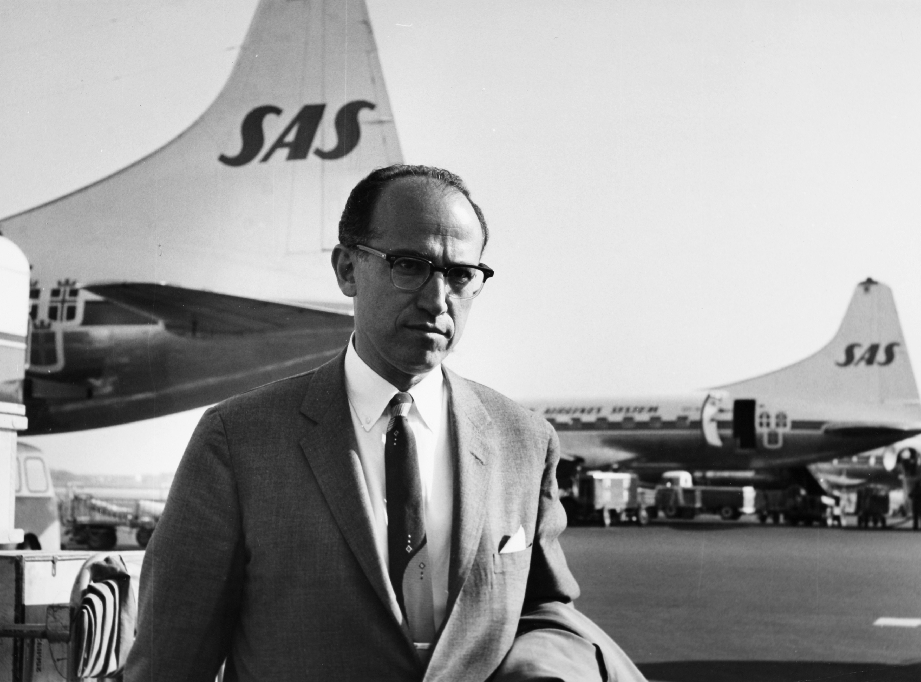
DIRECT INSTRUCTION
US.73
The Salk vaccine conquered a feared disease — the 1955 polio vaccine developed by Dr. Jonas Salk ended parents’ fear of a crippling disease and showed government’s role in advancing public health.
ZOOM IN
US.73 · Medical Breakthroughs: The Polio Vaccine
U.S. History Hack · TroopToTeacher Technologies LLC · Aligned to TN Academic Standards & TCAP EOC
14

Slide 20
DIRECT INSTRUCTION
US.73
The Interstate Highway System transformed the nation — authorized by Eisenhower in 1956, the 41,000-mile network created construction jobs, sped the movement of goods, and fueled automobile-related industries.
KEY POINT
The Interstate Highway System transformed the nation — authorized by Eisenhower in 1956, the 41,000-mile network created construction jobs, sped the movement of goods, and fueled automobile-related industries.
US.73 · Interstate Highway System: Economic Effects
U.S. History Hack · TroopToTeacher Technologies LLC · Aligned to TN Academic Standards & TCAP EOC
15

Slide 21
DIRECT INSTRUCTION
US.73
Highways carried unintended costs — they enabled suburban commuting but bypassed small towns and cut through urban—often minority—neighborhoods, draining downtowns and dividing communities.
KEY POINT
Highways carried unintended costs — they enabled suburban commuting but bypassed small towns and cut through urban—often minority—neighborhoods, draining downtowns and dividing communities.
US.73 · Social Effects & Unintended Consequences
U.S. History Hack · TroopToTeacher Technologies LLC · Aligned to TN Academic Standards & TCAP EOC
16

Slide 22
SOURCE IT FIRST
US.73
Read Eisenhower’s highway message — note the speaker, date, and purpose before you weigh his words.
WHO
WHEN
WHY
President Dwight D. Eisenhower
1955
Consider the author’s purpose and audience before reading the words.
Federal-Aid Highway Act Message
President Dwight D. Eisenhower · 1955
"Our unity as a nation is sustained by free communication of thought and by easy transportation of people and goods... Together, the united forces of our communication and transportation systems are dynamic elements in the very name we bear—United States. Without them, we would be a mere alliance of many separate parts."
Dwight D. Eisenhower Presidential Library
U.S. History Hack · TroopToTeacher Technologies LLC · Aligned to TN Academic Standards & TCAP EOC
17

Slide 23
THREE PERSPECTIVES
US.73
A historian returns to three questions at the end of every reading. Use them to analyze this standard.
Who benefited?
Who bore the costs?
Who decided?
Who gained land, wealth, power, or protection?
Who lost land, labor, freedom, or life — and who was silenced?
Which people, offices, or courts held the authority?
US.73:
US.73:
US.73:
American children spared from polio, suburban commuters and trucking industries served by new highways, and construction workers who built them.
Urban, often minority, neighborhoods divided or destroyed by highway construction, and small towns bypassed and left behind by the interstates.
President Eisenhower and Congress, who funded the highway system, and federal and state officials who chose the routes cutting through cities.
Anchor: Federal-Aid Highway Act Message, President Dwight D. Eisenhower, 1955 (Dwight D. Eisenhower Presidential Library)
U.S. History Hack · TroopToTeacher Technologies LLC · Aligned to TN Academic Standards & TCAP EOC
18

Slide 24
KEY VOCABULARY · LANGUAGE SUPPORT
US.73
Words you need before we read
Interstate Highway System
Polio Vaccine
En español: Sistema de Autopistas Interestatales
En español: Vacuna contra la Polio
WHAT IT MEANS
WHAT IT MEANS
Massive 41,000-mile highway network authorized by President Eisenhower in 1956 that transformed American travel, commerce, and settlement patterns.
The vaccine developed by Dr. Jonas Salk, announced safe in April 1955, that ended the epidemic that had paralyzed or killed thousands of children yearly.
U.S. History Hack · TroopToTeacher Technologies LLC · Aligned to TN Academic Standards & TCAP EOC
6

Slide 25
PROGRESS CHECK
US.73
Check your understanding
How did the Interstate Highway System contribute to suburban growth and urban decline?
A
Highways had no effect on population distribution, which contradicts the primary source evidence from this era, though this interpretation lacks supporting historical evidence
B
Highways strengthened urban centers, which contradicts the primary source evidence from this era, which does not align with the documented historical record
C
Highways enabled suburban commuting while bypassing small towns, dividing urban neighborhoods, and accelerating downtown decline as families moved to suburbs
D
Suburbs declined as highways made cities more accessible, yet the available evidence points to a different conclusion, which does not align with the documented historical record
Confidence: 😟 1 🙂 2 😀 3 — circle where you are; your teacher routes reteach or extension.
U.S. History Hack · TroopToTeacher Technologies LLC · Aligned to TN Academic Standards & TCAP EOC
7

Slide 26
US.74
Automobile's Growing Influence
TN STANDARD
US.74 – Describe the growing influence of the automobile on American society, including the growth of suburbia, fast food chains, and the hotel industry.
I CAN
I can describe the growing influence of the automobile on American society, including the growth of suburbia, fast food chains, and the hotel industry.
U.S. History Hack · TroopToTeacher Technologies LLC · Aligned to TN Academic Standards & TCAP EOC
19

Slide 27
DIRECT INSTRUCTION
US.74
Cars gave Americans unprecedented mobility — automobiles let people live far from work, shop at distant stores, and pursue leisure across wide areas, reshaping where and how Americans lived.
KEY POINT
Cars gave Americans unprecedented mobility — automobiles let people live far from work, shop at distant stores, and pursue leisure across wide areas, reshaping where and how Americans lived.
US.74 · Transforming American Daily Life & Suburban Growth
U.S. History Hack · TroopToTeacher Technologies LLC · Aligned to TN Academic Standards & TCAP EOC
20

Slide 28
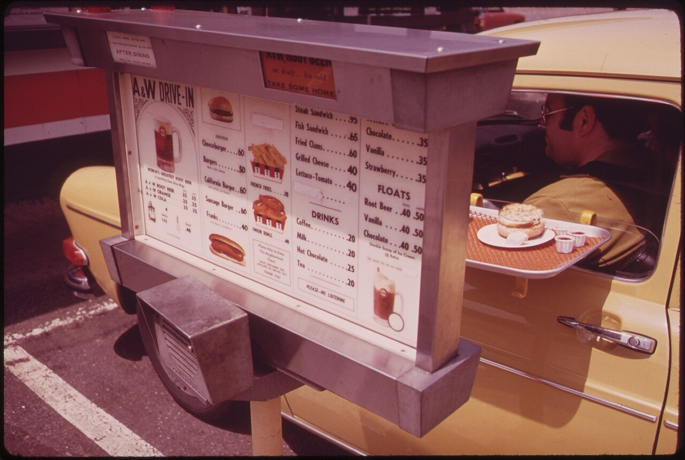
DIRECT INSTRUCTION
US.74
The automobile created whole new industries — car culture launched fast food, with Ray Kroc’s 1955 McDonald’s franchise pioneering drive-through service, and highway lodging chains like Holiday Inn.
ZOOM IN
US.74 · Fast Food & Hospitality Industries
U.S. History Hack · TroopToTeacher Technologies LLC · Aligned to TN Academic Standards & TCAP EOC
21

Slide 29
DIRECT INSTRUCTION
US.74
Car culture reshaped social life — drive-in movies, drive-through restaurants, and shopping malls with vast parking lots transformed leisure, courtship, and community around the automobile.
KEY POINT
Car culture reshaped social life — drive-in movies, drive-through restaurants, and shopping malls with vast parking lots transformed leisure, courtship, and community around the automobile.
US.74 · Broader Social Changes
U.S. History Hack · TroopToTeacher Technologies LLC · Aligned to TN Academic Standards & TCAP EOC
22

Slide 30
SOURCE IT FIRST
US.74
Read the McDonald’s franchise ad — consider who made it and why before you weigh the message.
WHO
WHEN
WHY
McDonald’s Corporation
1955
Consider the author’s purpose and audience before reading the words.
McDonald’s Franchise Advertisement
McDonald’s Corporation · 1955
"Join the McDonald’s System! Our revolutionary Speedee Service System serves customers in their automobiles in seconds, not minutes. Located on busy highways, our golden arches attract families on the go. Low prices, consistent quality, and fast service—the formula for success in the age of the automobile."
Library of Congress
U.S. History Hack · TroopToTeacher Technologies LLC · Aligned to TN Academic Standards & TCAP EOC
23

Slide 31
THREE PERSPECTIVES
US.74
A historian returns to three questions at the end of every reading. Use them to analyze this standard.
Who benefited?
Who bore the costs?
Who decided?
Who gained land, wealth, power, or protection?
Who lost land, labor, freedom, or life — and who was silenced?
Which people, offices, or courts held the authority?
US.74:
US.74:
US.74:
Automakers, oil companies, and new fast-food and motel chains, and suburban families who gained mobility and convenience.
City centers and public transit left to decline, and Americans increasingly dependent on cars and foreign oil to reach work and services.
Business entrepreneurs like Ray Kroc who built car-centered industries, and governments that funded roads over public transportation.
Anchor: McDonald’s Franchise Advertisement, McDonald’s Corporation, 1955 (Library of Congress)
U.S. History Hack · TroopToTeacher Technologies LLC · Aligned to TN Academic Standards & TCAP EOC
24

Slide 32
KEY VOCABULARY · LANGUAGE SUPPORT
US.74
Words you need before we read
Suburban Ideal
Interstate Highway System
Automobile Culture
En español: Ideal Suburbano
En español: Sistema de Autopistas Interestatales
En español: Cultura del Automóvil
WHAT IT MEANS
WHAT IT MEANS
WHAT IT MEANS
The 1950s American dream of owning a single-family home in the suburbs with a yard, garage, and modern appliances, drawing families out of cities.
Massive 41,000-mile highway network authorized by President Eisenhower in 1956 that transformed American travel, commerce, and settlement patterns.
The 1950s lifestyle centered on cars, which symbolized freedom and prosperity, reshaping cities, suburbs, and daily life across America.
U.S. History Hack · TroopToTeacher Technologies LLC · Aligned to TN Academic Standards & TCAP EOC
8

Slide 33
PROGRESS CHECK
US.74
Check your understanding
How did automobiles drive the expansion of fast food chains and the hotel industry?
A
Fast food and motels existed before car culture, though this interpretation lacks supporting historical evidence and does not reflect the scholarly consensus on this topic
B
The hospitality industry declined as car ownership increased, which does not align with the documented historical record
C
Fast food was only popular in urban areas, but this oversimplifies the complex factors at work, but the historical evidence paints a more nuanced picture
D
Car culture created demand for drive-in restaurants like McDonald's and roadside motels, spawning entirely new industries serving traveling Americans
Confidence: 😟 1 🙂 2 😀 3 — circle where you are; your teacher routes reteach or extension.
U.S. History Hack · TroopToTeacher Technologies LLC · Aligned to TN Academic Standards & TCAP EOC
9

Slide 34
US.75
Television and Mass Media Impact
TN STANDARD
US.75 – Analyze the increasing impact of television and mass media on the American home, politics, and economy.
I CAN
I can analyze the increasing impact of television and mass media on the American home, politics, and economy.
U.S. History Hack · TroopToTeacher Technologies LLC · Aligned to TN Academic Standards & TCAP EOC
25

Slide 35
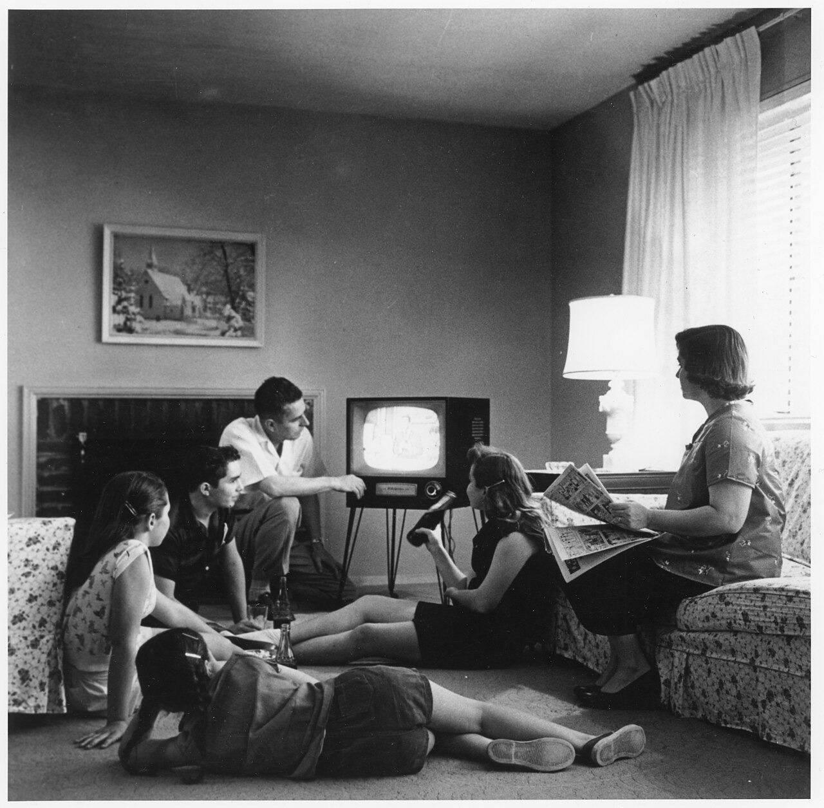
DIRECT INSTRUCTION
US.75
Television became the center of the home — by the late 1950s TV replaced radio as the main entertainment, reduced movie attendance, and reshaped family routines around programs and shared shows.
ZOOM IN
US.75 · Television Changes Family Life
U.S. History Hack · TroopToTeacher Technologies LLC · Aligned to TN Academic Standards & TCAP EOC
26

Slide 36
DIRECT INSTRUCTION
US.75
TV transformed American politics — it put a premium on appearance and communication; in the 1960 Kennedy-Nixon debates, TV viewers and radio listeners reached opposite conclusions about who won.
KEY POINT
TV transformed American politics — it put a premium on appearance and communication; in the 1960 Kennedy-Nixon debates, TV viewers and radio listeners reached opposite conclusions about who won.
US.75 · Television and Politics
U.S. History Hack · TroopToTeacher Technologies LLC · Aligned to TN Academic Standards & TCAP EOC
27

Slide 37
DIRECT INSTRUCTION
US.75
Mass media created a shared national culture — television advertising reached millions of homes at once, shaping consumer desire, while common programming promoted similar values across the country.
KEY POINT
Mass media created a shared national culture — television advertising reached millions of homes at once, shaping consumer desire, while common programming promoted similar values across the country.
US.75 · Advertising & Cultural Homogenization
U.S. History Hack · TroopToTeacher Technologies LLC · Aligned to TN Academic Standards & TCAP EOC
28

Slide 38
SOURCE IT FIRST
US.75
Read the account of TV and the 1960 election — identify the source and purpose before you weigh the claim.
WHO
WHEN
WHY
Theodore White, journalist
1961
Consider the author’s purpose and audience before reading the words.
Television and the 1960 Election
Theodore White, journalist · 1961
"Those who heard the debates on radio thought Nixon had won. But those who watched on television thought Kennedy had won. Nixon, recovering from illness, appeared pale, tired, and sweating under the studio lights. Kennedy, tanned and rested, projected youth, vigor, and confidence. Television had changed American politics forever."
John F. Kennedy Presidential Library
U.S. History Hack · TroopToTeacher Technologies LLC · Aligned to TN Academic Standards & TCAP EOC
29

Slide 39
THREE PERSPECTIVES
US.75
A historian returns to three questions at the end of every reading. Use them to analyze this standard.
Who benefited?
Who bore the costs?
Who decided?
Who gained land, wealth, power, or protection?
Who lost land, labor, freedom, or life — and who was silenced?
Which people, offices, or courts held the authority?
US.75:
US.75:
US.75:
Advertisers and networks reaching mass audiences, telegenic politicians, and corporations selling to a national consumer market.
Local and regional cultures flattened by national programming, and citizens whose politics were shaped by image over substance.
Broadcast networks, advertisers, and sponsors who controlled programming, and political campaigns that mastered the new medium.
Anchor: Television and the 1960 Election, Theodore White, journalist, 1961 (John F. Kennedy Presidential Library)
U.S. History Hack · TroopToTeacher Technologies LLC · Aligned to TN Academic Standards & TCAP EOC
30

Slide 40
KEY VOCABULARY · LANGUAGE SUPPORT
US.75
Words you need before we read
Television
Mass Media
En español: Televisión
En español: Medios Masivos
WHAT IT MEANS
WHAT IT MEANS
The electronic medium that became the dominant form of American entertainment and information by the late 1950s, creating shared national experiences.
Communication channels—TV, radio, newspapers, magazines—that reach large audiences at once; in the 1950s television became the most powerful medium.
U.S. History Hack · TroopToTeacher Technologies LLC · Aligned to TN Academic Standards & TCAP EOC
10

Slide 41
PROGRESS CHECK
US.75
Check your understanding
What impact did the 1960 Kennedy-Nixon debates have on the role of television in politics?
A
The debates demonstrated TV's power to influence voters through visual appearance—radio listeners thought Nixon won, but TV viewers favored the telegenic Kennedy, transforming how candidates campaign
B
The debates had no significant impact on political campaigns, but contemporary accounts suggest a different explanation, which does not align with the documented historical record
C
Both candidates were equally effective on television, despite limited evidence supporting this interpretation when examined alongside the available primary and secondary sources
D
Television was not used for political debates until the 1970s, although historical sources do not support this conclusion, although historical sources do not support this conclusion
Confidence: 😟 1 🙂 2 😀 3 — circle where you are; your teacher routes reteach or extension.
U.S. History Hack · TroopToTeacher Technologies LLC · Aligned to TN Academic Standards & TCAP EOC
11

Slide 42
US.76
Youth Culture and Tennessee Music
TN STANDARD
US.76 – Describe the emergence of a youth culture, including beatniks and the progression of popular music (from swing to rhythm and blues to rock ’n’ roll), and the impact of Tennessee on the music industry, including the influence of B.B. King, Elvis Presley, Stax Records, and Sun Studio. (TCA)
I CAN
I can describe the emergence of a youth culture, including beatniks and the progression of popular music, and the impact of Tennessee on the music industry, including B.B. King, Elvis Presley, Stax Records, and Sun Studio.
U.S. History Hack · TroopToTeacher Technologies LLC · Aligned to TN Academic Standards & TCAP EOC
31

Slide 43
DIRECT INSTRUCTION
US.76
The Beat Generation rejected conformity — beatniks turned away from 1950s materialism and conventional careers, embracing artistic expression, questioning authority, and inspiring a broader youth culture.
KEY POINT
The Beat Generation rejected conformity — beatniks turned away from 1950s materialism and conventional careers, embracing artistic expression, questioning authority, and inspiring a broader youth culture.
US.76 · The Beat Generation
U.S. History Hack · TroopToTeacher Technologies LLC · Aligned to TN Academic Standards & TCAP EOC
32

Slide 44
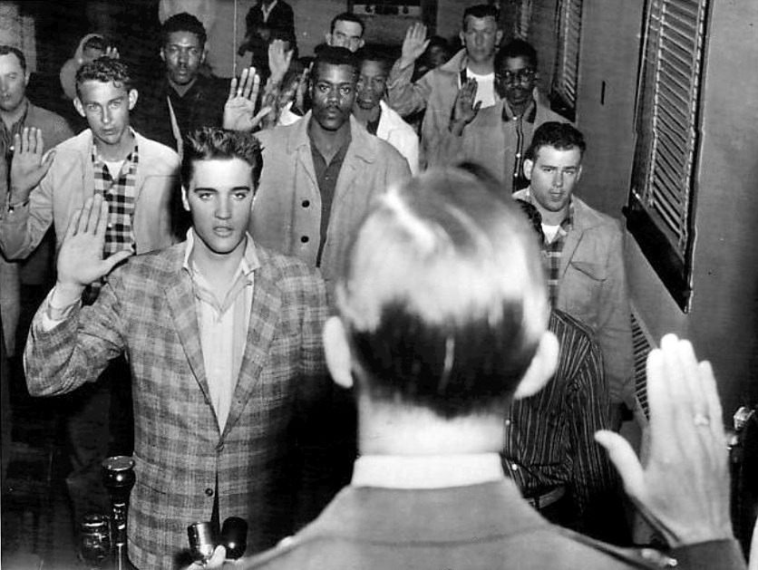
DIRECT INSTRUCTION
US.76
Tennessee stood at the center of American music — Memphis and Nashville powered popular music through Sun Studio’s role in rock ’n’ roll and Stax Records’ leadership in soul.
ZOOM IN
US.76 · Tennessee’s Central Role in Music
U.S. History Hack · TroopToTeacher Technologies LLC · Aligned to TN Academic Standards & TCAP EOC
33

Slide 45
DIRECT INSTRUCTION
US.76
Music crossed racial barriers — artists like Elvis Presley, recording at Sun Studio, brought African American musical styles to white audiences, while B.B. King and other blues artists shaped the sound.
KEY POINT
Music crossed racial barriers — artists like Elvis Presley, recording at Sun Studio, brought African American musical styles to white audiences, while B.B. King and other blues artists shaped the sound.
US.76 · Breaking Racial Barriers Through Music
U.S. History Hack · TroopToTeacher Technologies LLC · Aligned to TN Academic Standards & TCAP EOC
34

Slide 46
SOURCE IT FIRST
US.76
Read the Sun Studio press release — weigh who issued it and why before you read the words.
WHO
WHEN
WHY
Sun Records, Memphis, Tennessee
1954
Consider the author’s purpose and audience before reading the words.
Sun Studio Press Release
Sun Records, Memphis, Tennessee · 1954
"Memphis-based Sun Records announces the release of “That’s All Right” by Elvis Presley, a young truck driver from Tupelo, Mississippi. The record combines elements of country music with rhythm and blues, creating a new sound that is sweeping the South. Radio stations from Memphis to Nashville are reporting unprecedented listener demand."
Library of Congress
U.S. History Hack · TroopToTeacher Technologies LLC · Aligned to TN Academic Standards & TCAP EOC
35

Slide 47
THREE PERSPECTIVES
US.76
A historian returns to three questions at the end of every reading. Use them to analyze this standard.
Who benefited?
Who bore the costs?
Who decided?
Who gained land, wealth, power, or protection?
Who lost land, labor, freedom, or life — and who was silenced?
Which people, offices, or courts held the authority?
US.76:
US.76:
US.76:
Tennessee studios and cities that became music capitals, and young artists—Black and white—who reached new national audiences.
Many Black musicians whose styles were popularized by white artists while they received less fame and pay, and communities kept segregated offstage.
Producers like Sam Phillips and record labels who chose and marketed artists, and radio programmers who decided what audiences heard.
Anchor: Sun Studio Press Release, Sun Records, Memphis, Tennessee, 1954 (Library of Congress)
U.S. History Hack · TroopToTeacher Technologies LLC · Aligned to TN Academic Standards & TCAP EOC
36

Slide 48
KEY VOCABULARY · LANGUAGE SUPPORT
US.76
Words you need before we read
Beatniks
Rock ’n’ Roll
Elvis Presley
En español: Beatniks
En español: Rock ’n’ Roll
En español: Elvis Presley
WHAT IT MEANS
WHAT IT MEANS
WHAT IT MEANS
Members of the 1950s Beat Generation—writers like Jack Kerouac and Allen Ginsberg—who rejected mainstream culture, materialism, and conformity.
Revolutionary 1950s music genre combining rhythm and blues, country, and gospel; Elvis Presley became its “King,” representing youth rebellion.
Tennessee singer who became “The King of Rock ’n’ Roll” in the 1950s, revolutionizing popular culture and launching rock as a global phenomenon.
U.S. History Hack · TroopToTeacher Technologies LLC · Aligned to TN Academic Standards & TCAP EOC
12

Slide 49
PROGRESS CHECK
US.76
Check your understanding
Why did Tennessee become the center of American popular music development in the 1950s?
A
Tennessee had no significant role in music history, but this fails to account for the broader historical context and fails to account for key developments in the broader context
B
Sun Studio and Stax Records in Memphis combined African American and white musical traditions, while artists like Elvis and B.B. King crossed racial boundaries to create rock 'n' roll and soul music
C
Tennessee only produced country music, but this fails to account for the broader historical context when examined alongside the available primary and secondary sources, although historical sources do not support this conclusion
D
Music development occurred primarily in New York and Los Angeles, but contemporary accounts suggest a different explanation, which represents a common misconception about this historical period
Confidence: 😟 1 🙂 2 😀 3 — circle where you are; your teacher routes reteach or extension.
U.S. History Hack · TroopToTeacher Technologies LLC · Aligned to TN Academic Standards & TCAP EOC
13

Slide 50
US.77
Kennedy's New Frontier
TN STANDARD
US.77 – Describe President John F. Kennedy’s New Frontier programs to improve education, end racial discrimination, create the Peace Corps, and put a man on the moon.
I CAN
I can describe President John F. Kennedy’s New Frontier programs to improve education, end racial discrimination, create the Peace Corps, and put a man on the moon.
U.S. History Hack · TroopToTeacher Technologies LLC · Aligned to TN Academic Standards & TCAP EOC
37

Slide 51
DIRECT INSTRUCTION
US.77
The New Frontier set an ambitious agenda — Kennedy proposed federal aid for schools and affordable college, called for ending racial discrimination, and pushed economic growth at home and abroad.
KEY POINT
The New Frontier set an ambitious agenda — Kennedy proposed federal aid for schools and affordable college, called for ending racial discrimination, and pushed economic growth at home and abroad.
US.77 · New Frontier Goals
U.S. History Hack · TroopToTeacher Technologies LLC · Aligned to TN Academic Standards & TCAP EOC
38

Slide 52
DIRECT INSTRUCTION
US.77
The Peace Corps sent Americans to serve abroad — created by executive order in March 1961, it sent trained volunteers to developing countries to help with education, health, and development.
KEY POINT
The Peace Corps sent Americans to serve abroad — created by executive order in March 1961, it sent trained volunteers to developing countries to help with education, health, and development.
US.77 · The Peace Corps
U.S. History Hack · TroopToTeacher Technologies LLC · Aligned to TN Academic Standards & TCAP EOC
39

Slide 53
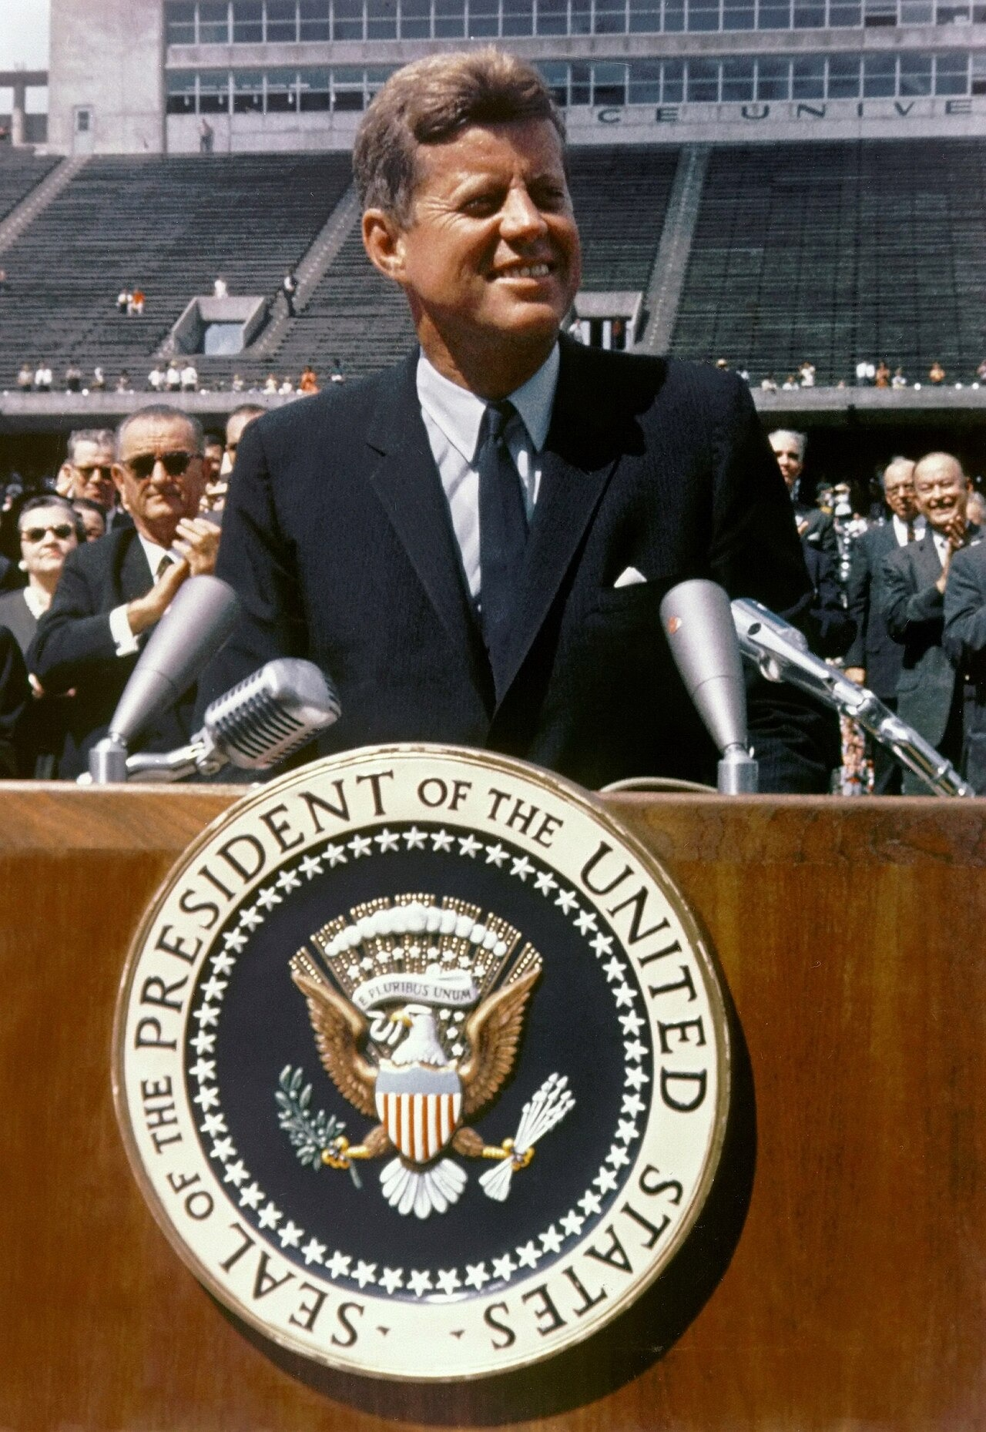
DIRECT INSTRUCTION
US.77
Kennedy made the moon a national goal — after Soviet launches of Sputnik (1957) and the first human in space (1961), he committed America to landing on the moon before the decade’s end.
ZOOM IN
US.77 · The Space Race Priority
U.S. History Hack · TroopToTeacher Technologies LLC · Aligned to TN Academic Standards & TCAP EOC
40

Slide 54
SOURCE IT FIRST
US.77
Read Kennedy’s Peace Corps message to Congress — note the speaker, date, and purpose before you analyze his words.
WHO
WHEN
WHY
President John F. Kennedy
March 1, 1961
Consider the author’s purpose and audience before reading the words.
Special Message to Congress on the Peace Corps
President John F. Kennedy · March 1, 1961
"I recommend to the Congress the establishment of a permanent Peace Corps—a pool of trained American men and women sent overseas by the U.S. Government to help foreign countries meet their urgent needs for skilled manpower... Life in the Peace Corps will not be easy... But if the life will not be easy, it will be rich and satisfying."
John F. Kennedy Presidential Library
U.S. History Hack · TroopToTeacher Technologies LLC · Aligned to TN Academic Standards & TCAP EOC
41

Slide 55
THREE PERSPECTIVES
US.77
A historian returns to three questions at the end of every reading. Use them to analyze this standard.
Who benefited?
Who bore the costs?
Who decided?
Who gained land, wealth, power, or protection?
Who lost land, labor, freedom, or life — and who was silenced?
Which people, offices, or courts held the authority?
US.77:
US.77:
US.77:
Students, developing nations served by the Peace Corps, and the aerospace industry and scientists propelled by the space program.
Taxpayers who funded costly programs, and Americans awaiting civil rights and education reforms stalled by Congress and cut short by Kennedy’s assassination.
President Kennedy, who set the agenda by message and executive order, and Congress, which funded or blocked New Frontier proposals.
Anchor: Special Message to Congress on the Peace Corps, President John F. Kennedy, March 1, 1961 (John F. Kennedy Presidential Library)
U.S. History Hack · TroopToTeacher Technologies LLC · Aligned to TN Academic Standards & TCAP EOC
42

Slide 56
KEY VOCABULARY · LANGUAGE SUPPORT
US.77
Words you need before we read
New Frontier
Peace Corps
Moon Landing Goal
En español: Nueva Frontera
En español: Cuerpo de Paz
En español: Objetivo de Aterrizaje Lunar
WHAT IT MEANS
WHAT IT MEANS
WHAT IT MEANS
President John F. Kennedy’s 1960s domestic program promoting economic growth, education, civil rights, and space exploration; a symbol of optimism.
Volunteer program created by President Kennedy in 1961, sending Americans to developing countries to help with education, health, and economic development.
President Kennedy’s 1961 pledge to land Americans on the moon before 1970, mobilizing national resources, advancing technology, and inspiring a generation.
U.S. History Hack · TroopToTeacher Technologies LLC · Aligned to TN Academic Standards & TCAP EOC
14

Slide 57
PROGRESS CHECK
US.77
Check your understanding
Why did Kennedy commit America to landing on the moon during the Cold War space race?
A
Kennedy had no interest in space exploration, which ignores key developments that shaped the outcome, but closer analysis reveals a more complicated historical reality
B
The moon landing was planned before Kennedy took office, although historical sources do not support this conclusion, though this interpretation lacks supporting historical evidence
C
After Soviet successes with Sputnik and Gagarin's flight, Kennedy committed to the moon landing to demonstrate American technological superiority and prove democracy could achieve ambitious goals
D
Kennedy's moon commitment was unpopular with Americans, although this overlooks critical economic and social factors, which contradicts the primary source evidence from this era
Confidence: 😟 1 🙂 2 😀 3 — circle where you are; your teacher routes reteach or extension.
U.S. History Hack · TroopToTeacher Technologies LLC · Aligned to TN Academic Standards & TCAP EOC
15

