Slide 1
U.S. HISTORY HACK
Unit 8
Postwar Prosperity & 1950s America
Consumerism · Suburbs & the G.I. Bill · The Baby Boom · Eisenhower · Cars & Highways · Television · Rock 'n' Roll & Tennessee Music · Kennedy's New Frontier · 1945–1963
Standards US.71 – US.77
US.71
US.72
US.73
US.74
US.75
US.76
US.77
TCAP EOC LECTURE DECK · Tennessee Academic Standards for U.S. History
TroopToTeacher Technologies LLC
Notes:
Unit 8 TCAP EOC lecture deck. Each standard runs as a full lesson: divider (standard + I Can), hook, direct instruction with a verified primary-source image, key figures, vocabulary, a student activity (paired to a printable worksheet), a TCAP-style check (question slide, then click to the reveal/answer-key slide), and a wrap-up with a teacher answer key in the speaker notes. All images are public-domain, captioned, and linked to the Library of Congress / National Archives.

Slide 2
UNIT ROADMAP
Where We Are Headed
Unit 8 · Postwar Prosperity & 1950s America (1945–1963) — Consumerism and the Suburbs, the Baby Boom, the Eisenhower Years, the Automobile and Interstate Highways, Television and Mass Media, Youth Culture and Tennessee Music, and Kennedy's New Frontier
US.71
1950s Prosperity & Consumerism
then
US.75
Television and Mass Media Impact
US.72
Baby Boomer Generation Impact
US.76
Youth Culture and Tennessee Music
US.73
Eisenhower Administration Developments
US.77
Kennedy's New Frontier
US.74
Automobile's Growing Influence
U.S. History Hack · TroopToTeacher Technologies LLC · Aligned to TN Academic Standards & TCAP EOC
2

Slide 3
BELL RINGER · HOOK
After World War II, the United States entered the greatest economic boom in its history. Returning veterans used the G.I. Bill to buy homes and attend college, families moved to fast-growing suburbs, and a "baby boom" added millions of children.
New highways, automobiles, fast food, and television reshaped daily life, while rock 'n' roll — much of it born in Tennessee — gave a new youth culture its sound.
How did prosperity, new technology, and mass culture in the 1950s change where Americans lived, what they bought, and how they saw themselves — and who was left out of the boom?
TURN & TALK
With a partner, list three things about American life today — homes, cars, TV, music, shopping — that you think began or grew rapidly in the 1950s. Then predict: which change do you think mattered most? Keep your list; we will return to it at the end of the unit.
U.S. History Hack · TroopToTeacher Technologies LLC · Aligned to TN Academic Standards & TCAP EOC
3
Notes:
Bell ringer (5 min). Features of modern American life rooted in the 1950s students may name: suburban housing developments and homeownership (Levittown, the G.I. Bill), the interstate highway system and car culture, fast food and motel chains, television as the dominant mass medium, consumer credit and advertising, and rock 'n' roll and a distinct teenage youth culture. Push students to also name who was left out — many Black families were excluded from suburbs and G.I. Bill benefits. Collect lists; revisit on the closing slide after students can answer with evidence — from consumerism and the suburbs, through the baby boom, Eisenhower, cars, and television, to Tennessee music and Kennedy's New Frontier.

Slide 4
STANDARD
SOCIAL STUDIES PRACTICES
US.71
SSP.01
Collect sources
SSP.02
Examine a source
SSP.05
Historical awareness
1950s Prosperity & Consumerism
TN ACADEMIC STANDARD
Analyze the impact of prosperity and consumerism in the 1950s, including: the growth of white-collar jobs, the "suburban ideal", the impact of the G.I. Bill, and the increased reliance on foreign oil.
I CAN
I can analyze the impact of prosperity and consumerism in the 1950s, including the growth of white-collar jobs, the "suburban ideal," the impact of the G.I. Bill, and the increased reliance on foreign oil.
U.S. History Hack · TroopToTeacher Technologies LLC · Aligned to TN Academic Standards & TCAP EOC
4

Slide 5
How This Deck Works — UDL 3.0 & MTSS
Teacher reference · CAST UDL 3.0 guidelines designed into every standard
EVERY LEARNER · SAME FIRM GOAL
ENGAGEMENT
REPRESENTATION
ACTION & EXPRESSION
Multiple means of the “why”
Multiple means of the “what”
Multiple means of the “how”
Welcoming Interests & Identities
Sustaining Effort & Persistence
Emotional Capacity
Perception
Language & Symbols
Building Knowledge
Interaction
Expression & Communication
Strategy Development
MTSS decision cycle: Tier 1 core for all → the Progress Check yields evidence → below mastery routes to targeted reteach (Tier 2, Teacher Guide §16); at/above mastery routes to extension. The goal never lowers.
U.S. History Hack · TEACHER DECK · Aligned to TN Academic Standards & TCAP EOC
1

Slide 6
US.71 · QUICK REVIEW
Do You Remember?
Before we start, retrieve what we have already learned. Answer from memory first — no notes.
1
Unit 7 We just finished Unit 7 on the Cold War. What was the main rivalry, and how did it shape American policy at home and abroad after World War II?
2
Unit Hook What big question should we keep in mind as we study 1950s prosperity—was the economic boom equally available to all Americans?
U.S. History Hack · TroopToTeacher Technologies LLC · Aligned to TN Academic Standards & TCAP EOC
5
Notes:
SPACED RETRIEVAL (US.71). Cold-call or whiteboards, 3-4 min, low stakes. Answers — 1) The Cold War was the rivalry between the United States and the Soviet Union. It shaped American policy by driving military spending, the formation of NATO, and domestic programs like the G.I. Bill and highway system that were partly justified as national-defense measures. 2) No. While many white veterans benefited from the G.I. Bill, suburbs, and white-collar jobs, discriminatory policies like redlining and restrictive covenants largely excluded African Americans from the same prosperity, making 1950s affluence deeply unequal.

Slide 7
US.71 · CONFIDENCE CHECK
Warm-Up — Quick Recall
DOK 1
LOW STAKES
Everyone can answer this. Thumbs / whiteboards — no notes.
Name one benefit the G.I. Bill provided to returning World War II veterans.
✓ ANSWER
College tuition, home loans, or vocational training (any one is correct).
COMMIT FIRST: have everyone answer before the reveal — this is the DOK 1 floor; the graded check later in this lesson moves up to DOK 2–3.
U.S. History Hack · TroopToTeacher Technologies LLC · Aligned to TN Academic Standards & TCAP EOC
6
Notes:
CONFIDENCE CHECK (US.71, DOK 1). 60-90 seconds. Have EVERY student commit (thumbs / whiteboard / choral) before revealing — this secures an early win and surfaces who is shaky before new content. Answer: College tuition, home loans, or vocational training (any one is correct). Key term to listen for: G.I. Bill. This is the low-floor entry; the graded Check for Understanding later in the standard rises to DOK 2–3.

Slide 8
US.71 · HOOK
Think About It
In the 1950s, America produced half the world’s manufactured goods, veterans came home to buy homes in brand-new suburbs, and a new middle class was born almost overnight—but not everyone got the same ticket to the American Dream.
DISCUSS
TIMING: Turn & Talk 60 sec → cold-call 2 pairs
If the G.I. Bill gave millions of veterans the chance to own a home and go to college, why did African American veterans receive far fewer of those benefits, and what does that reveal about who the “American Dream” was really for?
U.S. History Hack · TroopToTeacher Technologies LLC · Aligned to TN Academic Standards & TCAP EOC
7
Notes:
HOOK (US.71). Run tight: pose the provocation, give a silent 10-second think, then Turn & Talk 60 seconds. Cold-call 2–3 pairs (not volunteers) for a sentence-starter answer — "One force was ___ because ___" — then bridge to the standard. Keep total to ~4 minutes; do not let it sprawl. Return to this question at the unit close for an evidence-based answer.

Slide 9
US.71 · DIRECT INSTRUCTION
1 of 5
Post-War Economic Boom
The 1950s saw unprecedented American prosperity.
GDP grew from $200 billion (1940) to $500 billion (1960).
Low unemployment, rising wages, and consumer spending drove economic expansion.
The United States produced half of the world’s manufactured goods and enjoyed the highest standard of living in history.
This prosperity was fueled by pent-up consumer demand from wartime rationing, government spending, and technological innovation.
SENTENCE FRAME (EL & writing support)
The G.I. Bill changed American society by providing veterans with ___, which led to ___ in the American middle class.
U.S. History Hack · TroopToTeacher Technologies LLC · Aligned to TN Academic Standards & TCAP EOC
8
Notes:
FACILITATION (US.71). Ask students: if the government gave you money for college and a low-interest home loan, how would that change where you live and what you do for work? Teach in small steps; pause and check for understanding before the next chunk (aim 80%+ before moving on).

Slide 10
US.71 · DIRECT INSTRUCTION
2 of 5
Growth of White-Collar Jobs
The American economy shifted from manufacturing to services and management.
White-collar workers—office employees, managers, professionals, and salespeople—outnumbered blue-collar workers for the first time by 1956.
Large corporations like IBM, General Electric, and AT&T offered stable employment with benefits, pensions, and opportunities for advancement.
The “organization man” became a cultural archetype as corporate culture defined middle-class identity.
U.S. History Hack · TroopToTeacher Technologies LLC · Aligned to TN Academic Standards & TCAP EOC
9

Slide 11
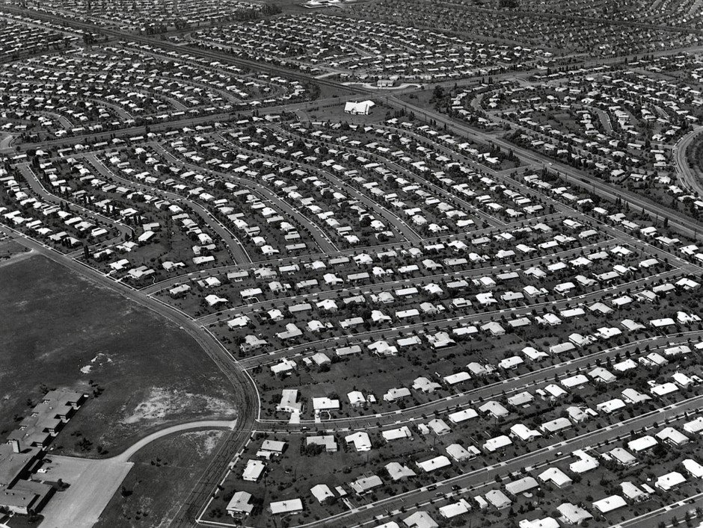
US.71 · DIRECT INSTRUCTION
3 of 5
The Suburban Ideal
Suburban development exploded as developers like William Levitt built planned communities of affordable, mass-produced homes.
Levittown, New York (1947) became the model for suburban development nationwide.
Suburbs offered space, safety, good schools, and the American Dream of homeownership.
However, restrictive covenants and redlining practices excluded African Americans and other minorities from most suburban communities, reinforcing racial segregation.
Unknown, c. 1959 Wikimedia Commons
U.S. History Hack · TroopToTeacher Technologies LLC · Aligned to TN Academic Standards & TCAP EOC
10

Slide 12
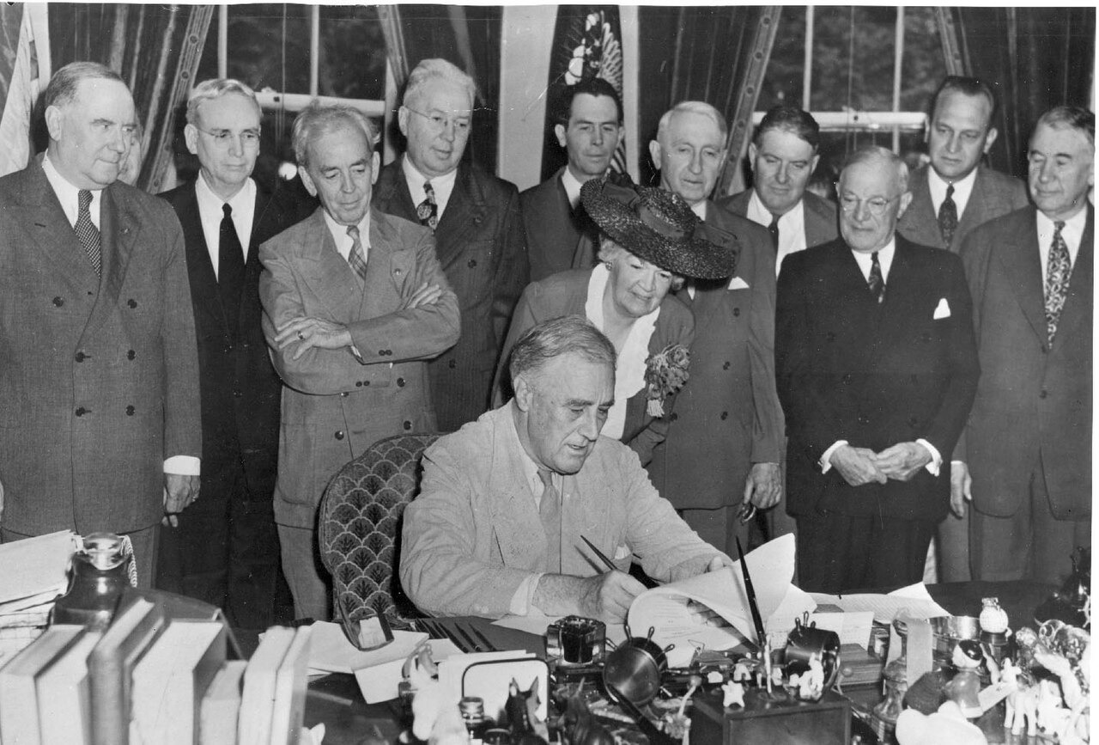
US.71 · DIRECT INSTRUCTION
4 of 5
Impact of the G.I. Bill
The Servicemen’s Readjustment Act of 1944 (G.I. Bill) transformed American society.
It provided veterans with college tuition, vocational training, low-interest home loans, and unemployment benefits.
By 1956, nearly 8 million veterans had used education benefits, doubling the college-educated population.
G.I. Bill home loans fueled suburban growth, creating a massive new middle class.
However, discriminatory implementation meant African American veterans received far fewer benefits.
U.S. Federal Government, June 22, 1944 National Archives
U.S. History Hack · TroopToTeacher Technologies LLC · Aligned to TN Academic Standards & TCAP EOC
11

Slide 13
US.71 · DIRECT INSTRUCTION
5 of 5
Increased Reliance on Foreign Oil
America’s car-centered suburban lifestyle dramatically increased oil consumption.
Domestic oil production could not keep pace with demand, and the U.S. began importing increasing amounts of foreign oil, particularly from the Middle East.
This growing dependence would later create economic vulnerability during the 1970s oil crises.
The interstate highway system, suburban sprawl, and consumer culture all reinforced reliance on petroleum.
U.S. History Hack · TroopToTeacher Technologies LLC · Aligned to TN Academic Standards & TCAP EOC
12

Slide 14
US.71 · PEOPLE WHO SHAPED THE ERA
Key Figure
William Levitt
Developer, Levittown
Built Levittown, NY (1947), first mass-produced suburb
Made homeownership affordable for returning veterans
Created the model for American suburban development
STRATEGY Use Levitt to show how mass production reshaped where Americans lived.
U.S. History Hack · TroopToTeacher Technologies LLC · Aligned to TN Academic Standards & TCAP EOC
13

Slide 15
US.71 · PRIMARY SOURCE ANALYSIS
Servicemen’s Readjustment Act (G.I. Bill)
Contextualization
U.S. Congress · 1944
ZOOM IN Find ONE detail that surprises you — be ready to name it.
"Any person who served in the active military or naval service... shall be entitled to vocational rehabilitation... The Administrator shall pay the educational institution... tuition, fees, books, and supplies. Each eligible person shall be entitled to a subsistence allowance... while pursuing a full-time course of education."
CONTEXT
When approximately 16 million Americans returned home from World War II, the federal government sought to ease their transition back to civilian life and prevent a repeat of the social unrest that followed World War I. The Servicemen’s Readjustment Act of 1944, known as the G.I. Bill, was one of the most sweeping pieces of legislation in American history, offering veterans education, job training, home loans, and unemployment compensation. It fundamentally reshaped American society by creating a new suburban middle class.
ANALYZE
U.S. Federal Government, June 22, 1944 National Archives
What benefits did the G.I. Bill provide to returning veterans?
SOURCE IT
WHO made it?
WHEN?
WHY does it matter?
FIRST
U.S. Congress
1944
Consider the author’s purpose and audience before reading the words.
SSP.02 · before you interpret
Source: National Archives
U.S. History Hack · TroopToTeacher Technologies LLC · Aligned to TN Academic Standards & TCAP EOC
14
Notes:
Primary-source analysis. SOURCE IT FIRST (SSP.02) — model the sourcing routine aloud before students interpret: WHO made this source? (U.S. Congress) WHEN? (1944) WHY does that matter? (Consider the author’s purpose and audience before reading the words.) Only then move to the ANALYZE question. Suggested answer: See teacher key. Practice skill: Contextualization.

Slide 16
US.71 · KEY VOCABULARY
Word Wall
White-Collar Jobs
Empleos de Cuello Blanco
Suburban Ideal
Ideal Suburbano
say: KOL-er
say: suh-BER-bin
WC
Office and professional occupations (managers, salespeople, clerks) that grew rapidly in the 1950s, outnumbering factory workers for the first time.
SI
The 1950s American dream of owning a single-family home in the suburbs with a yard, garage, and modern appliances, drawing families out of cities.
G.I. Bill
Ley G.I.
Consumerism
Consumismo
say: jee-eye BIL
say: kun-SOO-mer-izm
GI
The Servicemen’s Readjustment Act of 1944, which gave veterans college tuition, home loans, and job training, creating a massive new middle class.
CO
The 1950s economic culture of buying goods beyond basic needs—televisions, cars, appliances, homes—driving growth and defining postwar life.
Levittown
Levittown
Foreign Oil Dependence
Dependencia de Petróleo Extranjero
say: LEV-it-town
say: FOR-in oyl
LE
The first mass-produced suburb, built by William Levitt on Long Island starting in 1947 using assembly-line techniques to build homes quickly and cheaply.
FO
America’s growing reliance on imported petroleum from the Middle East to fuel its car-centered economy, creating vulnerabilities in the 1970s.
"say:" pronunciation guide (stressed syllable in CAPS) and a per-term visual anchor support newcomer English learners. Spanish term + full bilingual Frayer models are in the unit vocabulary set.
U.S. History Hack · TroopToTeacher Technologies LLC · Aligned to TN Academic Standards & TCAP EOC
1

Slide 17
US.71 · GUIDED PRACTICE — WE DO IT TOGETHER
Let’s Work One Together
Analyze cause and effect
MODEL PROMPT: How did the G.I. Bill change where and how Americans lived after World War II?
WORKED EXAMPLE (teacher models this aloud)
The G.I. Bill gave veterans low-interest home loans, which allowed millions to buy homes in new suburbs like Levittown. This caused suburban populations to explode, shifting American life away from cities.
THINK ALOUD
In the sections, underline one cause and one effect of either the G.I. Bill or white-collar job growth.
→ Now you try: With a partner, trace one chain of causes and effects that connects post-war prosperity to the suburban ideal. Be ready to share your chain.
U.S. History Hack · TroopToTeacher Technologies LLC · Aligned to TN Academic Standards & TCAP EOC
16
Notes:
GUIDED PRACTICE / WE DO (US.71). Skill modeled: Analyze cause and effect. Model the worked example aloud using the THINK ALOUD as your script, then release students to the activity ("With a partner, trace one chain of causes and effects that connects post-war prosperity to the suburban ideal. Be ready to share your chain."). This is the I Do → We Do → You Do bridge — do not skip it; aim for 80%+ success before independent work.

Slide 18
US.71 · STUDENT ACTIVITY
G.I. Bill Impact Analysis — Building the Suburban Middle Class
Groups of 3
15 min
YOUR TASK
Using your Cornell notes and the G.I. Bill excerpt, build a three-column chart labeled EDUCATION, HOUSING, and ECONOMY. For each column, explain how the G.I. Bill created that benefit for veterans and one concrete effect it had on American society (e.g., suburban growth, new middle class, college enrollment increase). Finish with a one-sentence claim, backed by evidence, on which benefit had the greatest long-term impact on American society.
DELIVERABLE
DIFFERENTIATION
Completed three-column chart (education / housing / economy, each with a G.I. Bill benefit + one concrete effect) AND a one-sentence evidence-based claim about the most significant benefit.
Entry: Chart with the three columns pre-labeled and a word bank (Levittown, college enrollment, suburban growth, middle class) to sort into the correct columns. Honors: Analyze why African American veterans received fewer G.I. Bill benefits and argue, using evidence, whether prosperity in the 1950s was equally distributed.
Companion printable: cornell-notes/unit-8/us71-prosperity-consumerism.pdf
U.S. History Hack · TroopToTeacher Technologies LLC · Aligned to TN Academic Standards & TCAP EOC
17
Notes:
Student activity for US.71. Pair with the printable: cornell-notes/unit-8/us71-prosperity-consumerism.pdf. Timing: 15. Deliverable: Completed three-column chart (education / housing / economy, each with a G.I. Bill benefit + one concrete effect) AND a one-sentence evidence-based claim about the most significant benefit.

Slide 19
US.71 · CHECK FOR UNDERSTANDING
TCAP-Style Question
DOK 2
EOC PRACTICE
How did the growth of white-collar jobs change American society in the 1950s?
It provided veterans with education benefits, home loans, and job training
A
It symbolized the counterculture’s ideals of peace, music, and communal spirit
B
It expanded the middle class and shifted workers from factories to offices
C
Rising household incomes, mass consumption of goods, and rapid suburban growth
D
ANSWER FIRST: students commit — then click / advance to reveal the correct answer and explanation.
U.S. History Hack · TroopToTeacher Technologies LLC · Aligned to TN Academic Standards & TCAP EOC
18
Notes:
CHECK FOR UNDERSTANDING (US.71, DOK 2). Have students commit to an answer (whiteboards, hand signal, or turn-and-talk) BEFORE advancing. Correct answer: C. The next slide reveals it. Why: The growth of white-collar jobs in the 1950s expanded office and professional work, which helped enlarge the middle class. Workers moved from factory floors to corporate offices, fueling the suburban lifestyle. A describes the G.I. Bill, not white-collar job growth. D describes consumerism broadly, not the specific shift in work.

Slide 20
US.71 · ANSWER REVEAL
TCAP-Style Question
✓ ANSWER KEY
How did the growth of white-collar jobs change American society in the 1950s?
A
It provided veterans with education benefits, home loans, and job training
B
It symbolized the counterculture’s ideals of peace, music, and communal spirit
C
It expanded the middle class and shifted workers from factories to offices
✓
D
Rising household incomes, mass consumption of goods, and rapid suburban growth
Correct answer: C. Why: The growth of white-collar jobs in the 1950s expanded office and professional work, which helped enlarge the middle class. Workers moved from factory floors to corporate offices, fueling the suburban lifestyle. A describes the G.I. Bill, not white-collar job growth. D describes consumerism broadly…
U.S. History Hack · TroopToTeacher Technologies LLC · Aligned to TN Academic Standards & TCAP EOC
19
Notes:
ANSWER KEY (US.71). Correct: C. The growth of white-collar jobs in the 1950s expanded office and professional work, which helped enlarge the middle class. Workers moved from factory floors to corporate offices, fueling the suburban lifestyle. A describes the G.I. Bill, not white-collar job growth. D describes consumerism broadly, not the specific shift in work.

Slide 21
US.71 · WRAP-UP
What You Need to Know for TCAP
KEY TAKEAWAYS
EXIT TICKET
DOK 2
Post-War Economic Boom
Growth of White-Collar Jobs
The Suburban Ideal
Impact of the G.I. Bill
Increased Reliance on Foreign Oil
Explain how the G.I. Bill and suburban growth together created a new American middle class. What did each contribute, and was the benefit available to all Americans?
★ HONORS / EXTENSION DOK 3 · SSP.04 Argumentation
Argue: was 1950s prosperity a genuine American success story or a story of unequal access? Use the G.I. Bill and suburban ideal as evidence and address the strongest counterargument. (SSP.04)
U.S. History Hack · TroopToTeacher Technologies LLC · Aligned to TN Academic Standards & TCAP EOC
20
Notes:
WRAP-UP / EXIT-TICKET KEY (US.71, DOK 2). Prompt: Explain how the G.I. Bill and suburban growth together created a new American middle class. What did each contribute, and was the benefit available to all Americans? Model answer: The G.I. Bill gave veterans affordable college tuition and low-interest home loans, while suburban developers like Levitt provided mass-produced affordable homes. Together they created millions of new homeowners with college educations—a new middle class. However, discriminatory implementation and restrictive covenants meant African American veterans received far fewer benefits, making the new prosperity unequally distributed. RETEACH TRIGGER — if a student misses this exit ticket: (1) <50% of class miss → spiral it into the next standard’s Quick Review opener (see the US.71 review prompts). (2) Individual/small group → reteach with the "Post-War Economic Boom" direct-instruction slide + re-run the SOURCE IT FIRST routine on the US.71 primary source, then assign the paired printable: cornell-notes/unit-8/us71-prosperity-consumerism.pdf. (3) Re-assess with the US.71 check-for-understanding reveal slide as a do-now the next day. Reteach anchors (this standard’s sections): Post-War Economic Boom; Growth of White-Collar Jobs; The Suburban Ideal; Impact of the G.I. Bill; Increased Reliance on Foreign Oil. I Can objective: I can analyze the impact of prosperity and consumerism in the 1950s, including the growth of white-collar jobs, the "suburban ideal," the impact of the G.I. Bill, and the increased reliance on foreign oil. HONORS / EXTENSION (DOK 3, for early finishers or advanced learners): Argue: was 1950s prosperity a genuine American success story or a story of unequal access? Use the G.I. Bill and suburban ideal as evidence and address the strongest counterargument. (SSP.04) — look for a clear claim plus two specific pieces of evidence.

Slide 22
STANDARD
SOCIAL STUDIES PRACTICES
US.72
SSP.02
Examine a source
SSP.05
Historical awareness
Baby Boomer Generation Impact
TN ACADEMIC STANDARD
Explain the impact of the baby boomer generation on the American economy and culture.
I CAN
I can explain the impact of the baby boomer generation on the American economy and culture.
U.S. History Hack · TroopToTeacher Technologies LLC · Aligned to TN Academic Standards & TCAP EOC
21

Slide 23
KEY VOCABULARY · LANGUAGE SUPPORT
US.71
Words you need before we read
White-Collar Jobs
Suburban Ideal
G.I. Bill
En español: Empleos de Cuello Blanco
En español: Ideal Suburbano
En español: Ley G.I.
WHAT IT MEANS
WHAT IT MEANS
WHAT IT MEANS
Office and professional occupations (managers, salespeople, clerks) that grew rapidly in the 1950s, outnumbering factory workers for the first time.
The 1950s American dream of owning a single-family home in the suburbs with a yard, garage, and modern appliances, drawing families out of cities.
The Servicemen’s Readjustment Act of 1944, which gave veterans college tuition, home loans, and job training, creating a massive new middle class.
UDL · REPRESENTATION → LANGUAGE & SYMBOLS
U.S. History Hack · TEACHER DECK · Aligned to TN Academic Standards & TCAP EOC
2

Slide 24
PROGRESS CHECK
US.71
Check your understanding
How did the "suburban ideal" both fulfill and contradict the American Dream during the 1950s?
A
Suburbs offered homeownership and prosperity for white families, but restrictive covenants and redlining excluded minorities, creating segregated communities that contradicted democratic ideals of equality
✓ KEY
B
Suburbs perfectly fulfilled the American Dream for all Americans, though this interpretation lacks supporting historical evidence when examined alongside the available primary and secondary sources
C
Suburban development had no racial dimensions, which does not align with the documented historical record when examined alongside the available primary and secondary sources, although historical sources do not support this conclusion
D
All Americans had equal access to suburban housing, but this fails to account for the broader historical context, which contradicts the primary source evidence from this era and does not reflect the scholarly consensus on this topic
UDL · ACTION & EXPRESSION → STRATEGY DEVELOPMENT
MTSS: below mastery → targeted reteach (Tier 2); at/above → extension. The goal never lowers.
U.S. History Hack · TEACHER DECK · Aligned to TN Academic Standards & TCAP EOC
3

Slide 25
US.72 · QUICK REVIEW
Do You Remember?
Before we start, retrieve what we have already learned. Answer from memory first — no notes.
1
US.71 In the last standard, we studied 1950s prosperity. How did the G.I. Bill and suburban growth connect to the conditions that caused the baby boom?
2
US.71 Name one economic characteristic of 1950s America that explains why families could afford to have more children.
U.S. History Hack · TroopToTeacher Technologies LLC · Aligned to TN Academic Standards & TCAP EOC
22
Notes:
SPACED RETRIEVAL (US.72). Cold-call or whiteboards, 3-4 min, low stakes. Answers — 1) The G.I. Bill gave veterans home loans and college tuition, creating economic stability. Suburbs offered affordable housing for families. These conditions—prosperity, housing, and optimism—encouraged veterans to marry and have children in record numbers, fueling the baby boom. 2) Low unemployment, rising wages, and affordable suburban housing gave families the economic security to have larger families. The postwar prosperity created the conditions for the baby boom.

Slide 26
US.72 · CONFIDENCE CHECK
Warm-Up — Quick Recall
DOK 1
LOW STAKES
Everyone can answer this. Thumbs / whiteboards — no notes.
What years mark the baby boom generation?
✓ ANSWER
1946 to 1964.
COMMIT FIRST: have everyone answer before the reveal — this is the DOK 1 floor; the graded check later in this lesson moves up to DOK 2–3.
U.S. History Hack · TroopToTeacher Technologies LLC · Aligned to TN Academic Standards & TCAP EOC
23
Notes:
CONFIDENCE CHECK (US.72, DOK 1). 60-90 seconds. Have EVERY student commit (thumbs / whiteboard / choral) before revealing — this secures an early win and surfaces who is shaky before new content. Answer: 1946 to 1964. Key term to listen for: Baby Boom. This is the low-floor entry; the graded Check for Understanding later in the standard rises to DOK 2–3.

Slide 27
US.72 · HOOK
Think About It
Between 1946 and 1964, 76 million babies were born in the United States—a generation so large it would reshape the economy, culture, and politics of an entire nation simply by growing up.
DISCUSS
TIMING: Turn & Talk 60 sec → cold-call 2 pairs
If a generation’s size alone can transform an economy, what happens when those 76 million baby boomers become teenagers—and then retirees? How does a demographic wave become a cultural revolution?
U.S. History Hack · TroopToTeacher Technologies LLC · Aligned to TN Academic Standards & TCAP EOC
24
Notes:
HOOK (US.72). Run tight: pose the provocation, give a silent 10-second think, then Turn & Talk 60 seconds. Cold-call 2–3 pairs (not volunteers) for a sentence-starter answer — "One force was ___ because ___" — then bridge to the standard. Keep total to ~4 minutes; do not let it sprawl. Return to this question at the unit close for an evidence-based answer.

Slide 28
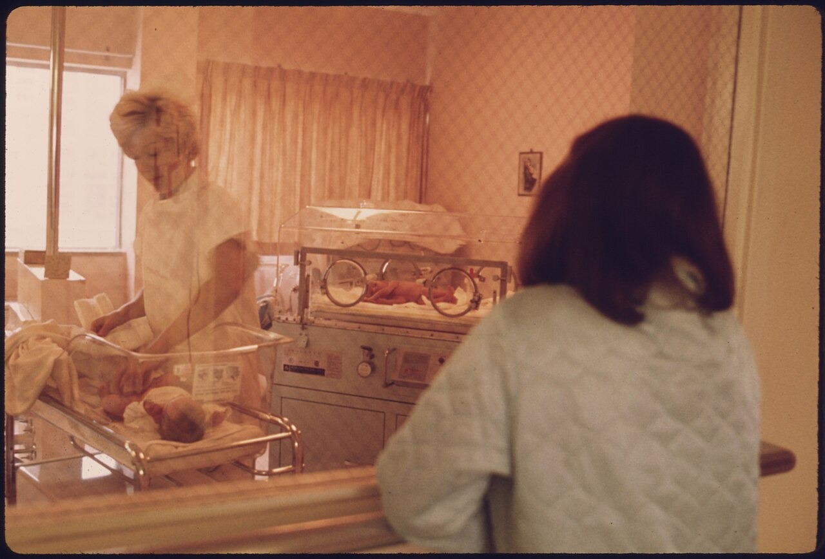
US.72 · DIRECT INSTRUCTION
1 of 4
What Was the Baby Boom?
The Baby Boom was a dramatic increase in U.S. birth rates from 1946–1964, peaking in the late 1950s.
Key factors included: returning WWII veterans starting families, economic prosperity allowing larger families, government policies like the G.I. Bill supporting homeownership, cultural emphasis on domesticity, and improved medical care reducing infant mortality.
SENTENCE FRAME (EL & writing support)
U.S. Federal Government (NARA, NAID 558170), c. 1959 National Archives
The baby boom generation grew because ___, and it changed the American economy by ___.
TEACHER CUE Chunk → cold-call → confirm before advancing.
U.S. History Hack · TroopToTeacher Technologies LLC · Aligned to TN Academic Standards & TCAP EOC
25
Notes:
FACILITATION (US.72). Ask students: if every family in the country suddenly had two or three more children, what would change in your community—schools, stores, neighborhoods? Teach in small steps; pause and check for understanding before the next chunk (aim 80%+ before moving on).

Slide 29
US.72 · DIRECT INSTRUCTION
2 of 4
Reshaping the American Economy
Baby boomers created massive demand for consumer goods—from baby products to toys, children’s clothing, and eventually teenage items.
This drove economic growth through increased manufacturing, retail expansion, and new industries.
Companies began targeting youth markets, creating the foundation for modern consumer culture.
U.S. History Hack · TroopToTeacher Technologies LLC · Aligned to TN Academic Standards & TCAP EOC
26

Slide 30
US.72 · DIRECT INSTRUCTION
3 of 4
New Markets and Industries
The baby boom generation sparked entirely new markets: pediatric healthcare expanded, toy manufacturers thrived, children’s clothing became a major industry, and education spending increased dramatically.
As boomers aged into teenagers, industries catering to youth—music, fashion, entertainment—experienced explosive growth.
U.S. History Hack · TroopToTeacher Technologies LLC · Aligned to TN Academic Standards & TCAP EOC
27

Slide 31
US.72 · DIRECT INSTRUCTION
4 of 4
Long-Term Cultural Impact
Baby boomers shaped American culture for decades.
Their sheer numbers gave them political and economic influence.
They drove the 1960s counterculture movement, transformed marketing and advertising, and continue to influence policy debates about Social Security and healthcare as they age.
U.S. History Hack · TroopToTeacher Technologies LLC · Aligned to TN Academic Standards & TCAP EOC
28

Slide 32
US.72 · PRIMARY SOURCE ANALYSIS
Census Bureau Population Report
Contextualization
U.S. Census Bureau · 1955
"The birth rate has reached unprecedented levels since the end of World War II. Between 1946 and 1954, approximately 29 million babies were born in the United States, compared to 24 million in the preceding eight years. This surge in population is creating increased demand for schools, housing, and consumer goods targeted at families."
CONTEXT
The 1950s saw one of the largest demographic explosions in American history: the baby boom. Returning veterans from World War II married and started families in record numbers, aided by the G.I. Bill’s home loans and economic prosperity. Between 1946 and 1964, approximately 76 million babies were born in the United States—a generation that would reshape the economy, culture, and politics for decades.
ANALYZE
According to this report, what economic effect was the baby boom having on American society?
READ CLOSELY Underline the exact words that answer the ANALYZE question — be ready to read them aloud.
SOURCE IT
WHO made it?
WHEN?
WHY does it matter?
FIRST
U.S. Census Bureau
1955
Consider the author’s purpose and audience before reading the words.
SSP.02 · before you interpret
Source: U.S. Census Bureau
U.S. History Hack · TroopToTeacher Technologies LLC · Aligned to TN Academic Standards & TCAP EOC
29
Notes:
Primary-source analysis. SOURCE IT FIRST (SSP.02) — model the sourcing routine aloud before students interpret: WHO made this source? (U.S. Census Bureau) WHEN? (1955) WHY does that matter? (Consider the author’s purpose and audience before reading the words.) Only then move to the ANALYZE question. Suggested answer: See teacher key. Practice skill: Contextualization.

Slide 33
US.72 · KEY VOCABULARY
Word Wall
Baby Boom
Explosión de Natalidad
Consumer Economy
Economía de Consumo
say: BAY-bee boom
say: kun-SOO-mer
BB
The dramatic increase in birth rates from 1946–1964, when 76 million babies were born, transforming the American economy and culture as they grew up.
CE
An economy driven by high household spending on homes, cars, and appliances — powered in the 1950s by postwar prosperity and Baby Boom families.
Suburbanization
Suburbanización
Youth Market
Mercado Juvenil
say: sub-ER-bun-ih-ZAY-shun
say: yooth
SU
The mass 1950s movement of families to newly built suburbs, driven by cheap housing, automobiles, and growing Baby Boom households.
YM
The large new consumer market of children and teenagers created by the Baby Boom, targeted by toy, music, food, and clothing industries.
Nuclear Family
Familia Nuclear
Postwar Prosperity
Prosperidad de Posguerra
say: NOO-klee-er
say: POHST-wor
NF
The 1950s ideal household of a married couple and their children, celebrated in advertising and television as the American norm.
PP
The broad economic growth and rising standard of living the United States enjoyed after World War II.
"say:" pronunciation guide (stressed syllable in CAPS) and a per-term visual anchor support newcomer English learners. Spanish term + full bilingual Frayer models are in the unit vocabulary set.
U.S. History Hack · TroopToTeacher Technologies LLC · Aligned to TN Academic Standards & TCAP EOC
2

Slide 34
US.72 · GUIDED PRACTICE — WE DO IT TOGETHER
Let’s Work One Together
Identify demographic cause and effect
MODEL PROMPT: How did a sudden increase in the birth rate change what businesses and schools had to do?
WORKED EXAMPLE (teacher models this aloud)
When millions of new babies were born after World War II, schools had to expand, toy companies grew rapidly, and neighborhoods needed more housing. A demographic change drove an economic change.
THINK ALOUD
In the sections, underline one economic or cultural change that the baby boom caused.
→ Now you try: With a partner, predict: if boomers grew from babies to teenagers, what new industries would emerge? Use the sections to support your prediction.
U.S. History Hack · TroopToTeacher Technologies LLC · Aligned to TN Academic Standards & TCAP EOC
31
Notes:
GUIDED PRACTICE / WE DO (US.72). Skill modeled: Identify demographic cause and effect. Model the worked example aloud using the THINK ALOUD as your script, then release students to the activity ("With a partner, predict: if boomers grew from babies to teenagers, what new industries would emerge? Use the sections to support your prediction."). This is the I Do → We Do → You Do bridge — do not skip it; aim for 80%+ success before independent work.

Slide 35
US.72 · STUDENT ACTIVITY
Baby Boom Ripple Effects — Mapping Economic and Cultural Change
Groups of 3
15 min
YOUR TASK
Using your Cornell notes and the Census Bureau report, create a cause-and-effect diagram starting with “massive increase in births 1946–1964.” Trace at least four ripple effects across two generations: (1) immediate economic effects in the 1950s (schools, toys, housing) and (2) long-term cultural effects as boomers became teenagers (music, fashion, consumer culture). Add one sentence explaining how a demographic change can drive an economic and cultural revolution.
DELIVERABLE
DIFFERENTIATION
Cause-and-effect diagram (at least four ripple effects across two time periods) AND one explanatory sentence connecting demographic change to economic and cultural change.
Entry: Diagram template with two circles pre-labeled (1950s effects / teenager effects) and a word bank of effects to place. Honors: Project forward—as boomers retire and age, what economic pressures does that create for Social Security and healthcare? Argue using the demographic evidence from the census report.
Companion printable: cornell-notes/unit-8/us72-baby-boomer-impact.pdf
U.S. History Hack · TroopToTeacher Technologies LLC · Aligned to TN Academic Standards & TCAP EOC
32
Notes:
Student activity for US.72. Pair with the printable: cornell-notes/unit-8/us72-baby-boomer-impact.pdf. Timing: 15. Deliverable: Cause-and-effect diagram (at least four ripple effects across two time periods) AND one explanatory sentence connecting demographic change to economic and cultural change.

Slide 36
US.72 · CHECK FOR UNDERSTANDING
TCAP-Style Question
DOK 2
EOC PRACTICE
How did the baby boom generation impact the American economy and culture?
It drove demand for schools, housing, consumer goods, and new services
A
It caused severe economic depression due to overcrowded job markets
B
It had minimal impact because most baby boomers emigrated to Europe
C
It primarily strengthened rural agricultural communities across America
D
ANSWER FIRST: students commit — then click / advance to reveal the correct answer and explanation.
U.S. History Hack · TroopToTeacher Technologies LLC · Aligned to TN Academic Standards & TCAP EOC
33
Notes:
CHECK FOR UNDERSTANDING (US.72, DOK 2). Have students commit to an answer (whiteboards, hand signal, or turn-and-talk) BEFORE advancing. Correct answer: A. The next slide reveals it. Why: The baby-boom generation drove huge demand for schools, houses, toys, cars, and later colleges and jobs. B is wrong because the boom fueled growth, not depression. C is wrong because boomers stayed and shaped American culture. D is wrong because the boom was most visible in suburban and urban areas, not rural farming communities.

Slide 37
US.72 · ANSWER REVEAL
TCAP-Style Question
✓ ANSWER KEY
How did the baby boom generation impact the American economy and culture?
A
It drove demand for schools, housing, consumer goods, and new services
✓
B
It caused severe economic depression due to overcrowded job markets
C
It had minimal impact because most baby boomers emigrated to Europe
D
It primarily strengthened rural agricultural communities across America
Correct answer: A. Why: The baby-boom generation drove huge demand for schools, houses, toys, cars, and later colleges and jobs. B is wrong because the boom fueled growth, not depression. C is wrong because boomers stayed and shaped American culture. D is wrong because the boom was most visible in suburban and urban…
U.S. History Hack · TroopToTeacher Technologies LLC · Aligned to TN Academic Standards & TCAP EOC
34
Notes:
ANSWER KEY (US.72). Correct: A. The baby-boom generation drove huge demand for schools, houses, toys, cars, and later colleges and jobs. B is wrong because the boom fueled growth, not depression. C is wrong because boomers stayed and shaped American culture. D is wrong because the boom was most visible in suburban and urban areas, not rural farming communities.

Slide 38
US.72 · WRAP-UP
What You Need to Know for TCAP
KEY TAKEAWAYS
EXIT TICKET
DOK 2
What Was the Baby Boom?
Reshaping the American Economy
New Markets and Industries
Long-Term Cultural Impact
Explain how the baby boom generation changed the American economy in two different ways—one immediate (1950s) and one longer-term (1960s-onward).
★ HONORS / EXTENSION DOK 3 · SSP.04 Argumentation
Argue: the baby boom was the single most important driver of postwar economic growth—agree or disagree? Use at least two specific economic effects as evidence, and acknowledge one factor that could challenge your argument. (SSP.04)
U.S. History Hack · TroopToTeacher Technologies LLC · Aligned to TN Academic Standards & TCAP EOC
35
Notes:
WRAP-UP / EXIT-TICKET KEY (US.72, DOK 2). Prompt: Explain how the baby boom generation changed the American economy in two different ways—one immediate (1950s) and one longer-term (1960s-onward). Model answer: Immediately in the 1950s, the baby boom created demand for baby products, schools, and housing, driving manufacturing and retail growth. As boomers became teenagers in the 1960s, they created a massive youth consumer market for music, fashion, and entertainment, transforming American culture and business. RETEACH TRIGGER — if a student misses this exit ticket: (1) <50% of class miss → spiral it into the next standard’s Quick Review opener (see the US.72 review prompts). (2) Individual/small group → reteach with the "What Was the Baby Boom?" direct-instruction slide + re-run the SOURCE IT FIRST routine on the US.72 primary source, then assign the paired printable: cornell-notes/unit-8/us72-baby-boomer-impact.pdf. (3) Re-assess with the US.72 check-for-understanding reveal slide as a do-now the next day. Reteach anchors (this standard’s sections): What Was the Baby Boom?; Reshaping the American Economy; New Markets and Industries; Long-Term Cultural Impact. I Can objective: I can explain the impact of the baby boomer generation on the American economy and culture. HONORS / EXTENSION (DOK 3, for early finishers or advanced learners): Argue: the baby boom was the single most important driver of postwar economic growth—agree or disagree? Use at least two specific economic effects as evidence, and acknowledge one factor that could challenge your argument. (SSP.04) — look for a clear claim plus two specific pieces of evidence.

Slide 39
STANDARD
SOCIAL STUDIES PRACTICES
US.73
SSP.01
Collect sources
SSP.02
Examine a source
SSP.05
Historical awareness
Eisenhower Administration Developments
TN ACADEMIC STANDARD
Describe domestic developments during President Dwight D. Eisenhower’s administration, including advances in medicine and the creation of the Interstate Highway System.
I CAN
I can describe domestic developments during President Eisenhower’s administration, including advances in medicine and the creation of the Interstate Highway System.
U.S. History Hack · TroopToTeacher Technologies LLC · Aligned to TN Academic Standards & TCAP EOC
36

Slide 40
KEY VOCABULARY · LANGUAGE SUPPORT
US.72
Words you need before we read
Baby Boom
En español: Explosión de Natalidad
WHAT IT MEANS
The dramatic increase in birth rates from 1946–1964, when 76 million babies were born, transforming the American economy and culture as they grew up.
UDL · REPRESENTATION → LANGUAGE & SYMBOLS
U.S. History Hack · TEACHER DECK · Aligned to TN Academic Standards & TCAP EOC
4

Slide 41
PROGRESS CHECK
US.72
Check your understanding
How did baby boomers reshape American consumer culture and economic growth in the 1950s and 1960s?
A
They had no significant economic impact due to their young age, which does not align with the documented historical record
B
Their massive numbers created huge demand for consumer goods, driving manufacturing growth, retail expansion, and new youth-targeted industries
✓ KEY
C
They primarily affected only the housing market, although historical sources do not support this conclusion
D
Consumer culture declined during the baby boom years, which does not reflect the consensus among historians
UDL · ACTION & EXPRESSION → STRATEGY DEVELOPMENT
MTSS: below mastery → targeted reteach (Tier 2); at/above → extension. The goal never lowers.
U.S. History Hack · TEACHER DECK · Aligned to TN Academic Standards & TCAP EOC
5

Slide 42
US.73 · QUICK REVIEW
Do You Remember?
Before we start, retrieve what we have already learned. Answer from memory first — no notes.
1
US.72 In the last standard, we studied the baby boom. How did the massive growth in population connect to the need for infrastructure like schools, roads, and hospitals?
2
US.72 Name one way baby boomers transformed demand for government services or public institutions.
U.S. History Hack · TroopToTeacher Technologies LLC · Aligned to TN Academic Standards & TCAP EOC
37
Notes:
SPACED RETRIEVAL (US.73). Cold-call or whiteboards, 3-4 min, low stakes. Answers — 1) The baby boom created millions of new Americans who needed schools, roads, hospitals, and housing. This demographic pressure made government investment in infrastructure and public health—like highways and the polio vaccine—both urgent and politically popular. 2) Baby boomers filled schools to overflowing, requiring massive expansion of public education. They also drove demand for pediatric healthcare and public health programs, including the mass polio vaccination campaigns of the 1950s.

Slide 43
US.73 · CONFIDENCE CHECK
Warm-Up — Quick Recall
DOK 1
LOW STAKES
Everyone can answer this. Thumbs / whiteboards — no notes.
What disease did the Salk vaccine virtually eliminate in the 1950s?
✓ ANSWER
Polio.
COMMIT FIRST: have everyone answer before the reveal — this is the DOK 1 floor; the graded check later in this lesson moves up to DOK 2–3.
U.S. History Hack · TroopToTeacher Technologies LLC · Aligned to TN Academic Standards & TCAP EOC
38
Notes:
CONFIDENCE CHECK (US.73, DOK 1). 60-90 seconds. Have EVERY student commit (thumbs / whiteboard / choral) before revealing — this secures an early win and surfaces who is shaky before new content. Answer: Polio. Key term to listen for: Polio Vaccine. This is the low-floor entry; the graded Check for Understanding later in the standard rises to DOK 2–3.

Slide 44
US.73 · HOOK
Think About It
President Eisenhower built 41,000 miles of interstate highway—the largest public works project in American history—and also funded the vaccine that eliminated a disease that paralyzed thousands of children every year.
DISCUSS
TIMING: Turn & Talk 60 sec → cold-call 2 pairs
When the government spends billions on highways and medicine, who benefits most—and who pays the price when those highways get routed straight through existing neighborhoods?
U.S. History Hack · TroopToTeacher Technologies LLC · Aligned to TN Academic Standards & TCAP EOC
39
Notes:
HOOK (US.73). Run tight: pose the provocation, give a silent 10-second think, then Turn & Talk 60 seconds. Cold-call 2–3 pairs (not volunteers) for a sentence-starter answer — "One force was ___ because ___" — then bridge to the standard. Keep total to ~4 minutes; do not let it sprawl. Return to this question at the unit close for an evidence-based answer.

Slide 45
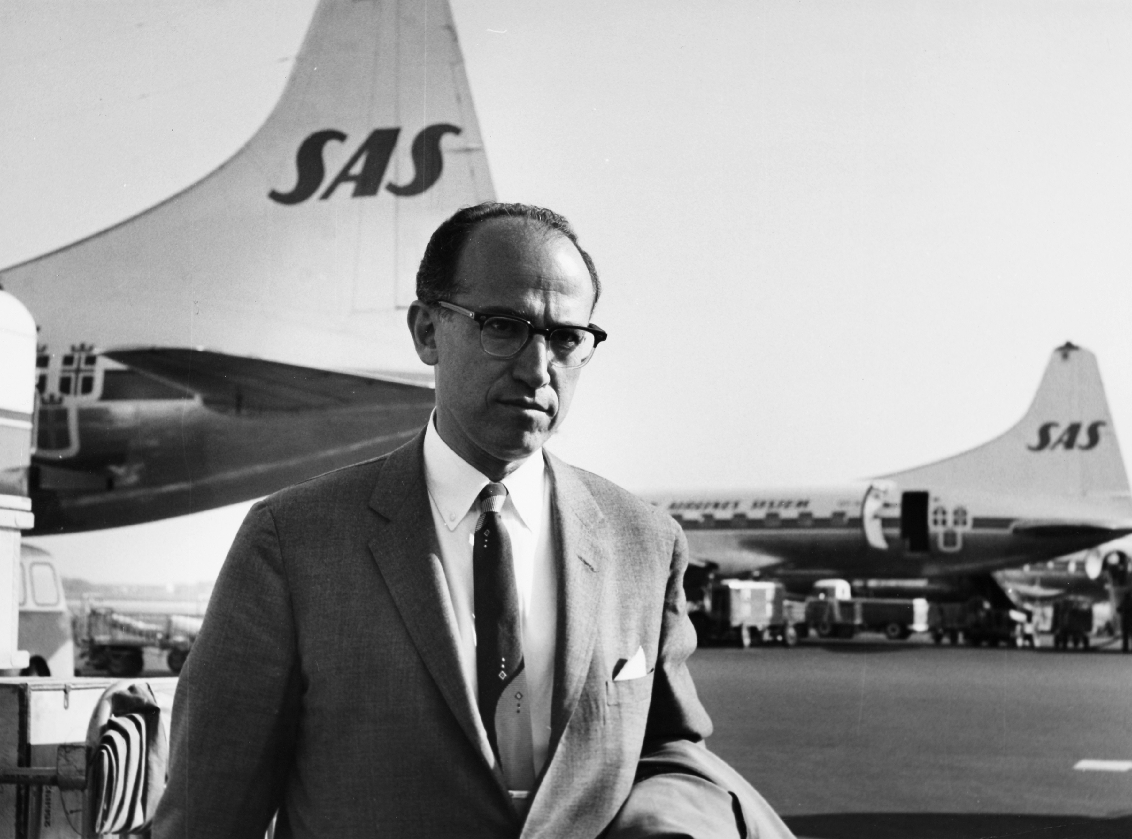
US.73 · DIRECT INSTRUCTION
1 of 4
Medical Breakthroughs: The Polio Vaccine
The 1955 Salk polio vaccine eliminated parents’ fears of their children contracting this crippling disease.
It demonstrated government’s role in public health, restored confidence in medical science, and allowed children to safely attend schools and public spaces without fear of epidemic. Before the vaccine, polio paralyzed or killed thousands of Americans annually.
SENTENCE FRAME (EL & writing support)
SAS Scandinavian Airlines, 1959 Wikimedia Commons
President Eisenhower’s Interstate Highway System was significant because it ___, even though it also caused ___.
TEACHER CUE Chunk → cold-call → confirm before advancing.
U.S. History Hack · TroopToTeacher Technologies LLC · Aligned to TN Academic Standards & TCAP EOC
40
Notes:
FACILITATION (US.73). Show a map of the interstate highway system and ask: what happened to the small towns that got bypassed, and who paid the price when highways were routed through city neighborhoods? Teach in small steps; pause and check for understanding before the next chunk (aim 80%+ before moving on).

Slide 46
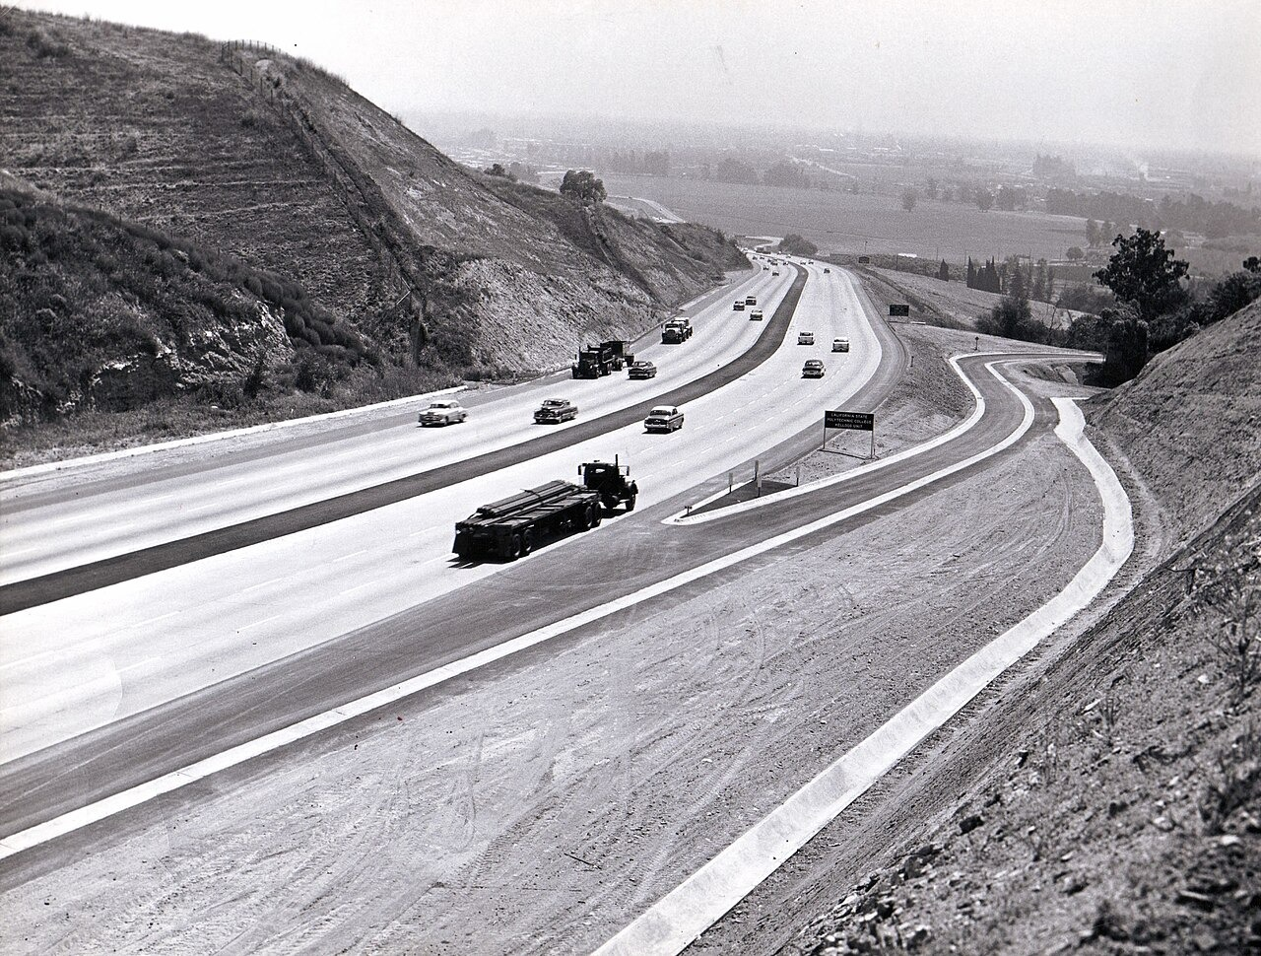
US.73 · DIRECT INSTRUCTION
2 of 4
Interstate Highway System: Economic Effects
The Interstate Highway System created millions of construction jobs, enabled easier movement of goods across the country, and fueled growth in automobile-related industries including car manufacturing, gas stations, motels, and fast food restaurants.
It became the largest public works project in American history.
Federal Highway Administration, 1957 Wikimedia Commons
U.S. History Hack · TroopToTeacher Technologies LLC · Aligned to TN Academic Standards & TCAP EOC
41

Slide 47
US.73 · DIRECT INSTRUCTION
3 of 4
Interstate Highway System: Social Effects
The highways enabled suburban expansion by allowing workers to commute longer distances.
However, they also contributed to the decline of small towns bypassed by the new roads and accelerated urban decay as middle-class families moved to suburbs.
Increased mobility transformed American family life and leisure activities.
U.S. History Hack · TroopToTeacher Technologies LLC · Aligned to TN Academic Standards & TCAP EOC
42

Slide 48
US.73 · DIRECT INSTRUCTION
4 of 4
Unintended Consequences
While highways brought economic benefits, they also divided urban neighborhoods—often minority communities—with massive road construction.
Downtown areas lost shoppers to suburban malls, and public transportation systems declined as car ownership became essential for American life.
U.S. History Hack · TroopToTeacher Technologies LLC · Aligned to TN Academic Standards & TCAP EOC
43

Slide 49
US.73 · PEOPLE WHO SHAPED THE ERA
Key Figures
Dwight D. Eisenhower
Jonas Salk
34th President (1953–1961)
Polio vaccine developer
Ended Korean War and maintained Cold War peace
Created the Interstate Highway System in 1956
Warned of the military-industrial complex
Developed the polio vaccine, announced safe and effective in 1955
Led mass vaccination campaigns that virtually eliminated polio
Demonstrated government-funded science could solve public health crises
STRATEGY Use Eisenhower to show how Cold War competition shaped domestic infrastructure investment.
STRATEGY Use Salk to show postwar faith that science and public investment could solve seemingly hopeless problems.
U.S. History Hack · TroopToTeacher Technologies LLC · Aligned to TN Academic Standards & TCAP EOC
44

Slide 50
US.73 · PRIMARY SOURCE ANALYSIS
Federal-Aid Highway Act Message
Sourcing
President Dwight D. Eisenhower · 1955
"Our unity as a nation is sustained by free communication of thought and by easy transportation of people and goods... Together, the united forces of our communication and transportation systems are dynamic elements in the very name we bear—United States. Without them, we would be a mere alliance of many separate parts."
CONTEXT
By the mid-1950s, America’s transportation infrastructure was inadequate for the age of the automobile. Eisenhower, who had seen the value of Germany’s Autobahn highway system during World War II, championed a national highway network both for economic development and national defense—to allow rapid military movement across the country. The Federal-Aid Highway Act of 1956 authorized 41,000 miles of limited-access highways funded primarily by federal gasoline taxes.
ANALYZE
Why did Eisenhower believe a national highway system was essential?
READ CLOSELY Underline the exact words that answer the ANALYZE question — be ready to read them aloud.
SOURCE IT
WHO made it?
WHEN?
WHY does it matter?
FIRST
President Dwight D. Eisenhower
1955
Consider the author’s purpose and audience before reading the words.
SSP.02 · before you interpret
Source: Dwight D. Eisenhower Presidential Library
U.S. History Hack · TroopToTeacher Technologies LLC · Aligned to TN Academic Standards & TCAP EOC
45
Notes:
Primary-source analysis. SOURCE IT FIRST (SSP.02) — model the sourcing routine aloud before students interpret: WHO made this source? (President Dwight D. Eisenhower) WHEN? (1955) WHY does that matter? (Consider the author’s purpose and audience before reading the words.) Only then move to the ANALYZE question. Suggested answer: See teacher key. Practice skill: Sourcing.

Slide 51
US.73 · KEY VOCABULARY
Word Wall
Interstate Highway System
Sistema de Autopistas Interestatales
Polio Vaccine
Vacuna contra la Polio
say: IN-ter-stayt HY-way
say:
IH
Massive 41,000-mile highway network authorized by President Eisenhower in 1956 that transformed American travel, commerce, and settlement patterns.
PV
The vaccine developed by Dr. Jonas Salk, announced safe in April 1955, that ended the epidemic that had paralyzed or killed thousands of children yearly.
Dwight D. Eisenhower
Dwight D. Eisenhower
Military-Industrial Complex
Complejo Militar-Industrial
say: EYE-zen-how-er
say: MIL-ih-tair-ee
DD
The 34th U.S. President (1953–1961) and former WWII general who ended the Korean War and launched the Interstate Highway System.
MI
The close relationship between the armed forces and defense industries that Eisenhower warned about in his 1961 farewell address.
Cold War Peace
Paz de la Guerra Fría
Urban Decline
Declive Urbano
say: kohld wor
say: UR-bin dih-KLYN
CW
Eisenhower's policy of avoiding direct war with the Soviet Union while containing communism through deterrence and diplomacy.
UD
The weakening of inner cities as highways and suburbs pulled residents and businesses away — an unintended consequence of the Interstate system.
"say:" pronunciation guide (stressed syllable in CAPS) and a per-term visual anchor support newcomer English learners. Spanish term + full bilingual Frayer models are in the unit vocabulary set.
U.S. History Hack · TroopToTeacher Technologies LLC · Aligned to TN Academic Standards & TCAP EOC
3

Slide 52
US.73 · GUIDED PRACTICE — WE DO IT TOGETHER
Let’s Work One Together
Evaluate intended and unintended consequences
MODEL PROMPT: What were the intended and unintended effects of the Interstate Highway System?
WORKED EXAMPLE (teacher models this aloud)
Eisenhower intended the highways to boost commerce and national defense. An unintended effect was that urban neighborhoods were sometimes divided by highway construction, harming minority communities.
THINK ALOUD
In the sections, underline one intended effect and one unintended consequence of the Interstate Highway System.
→ Now you try: With a partner, discuss: was the Interstate Highway System a success or a mixed result? Use evidence from at least two sections.
U.S. History Hack · TroopToTeacher Technologies LLC · Aligned to TN Academic Standards & TCAP EOC
47
Notes:
GUIDED PRACTICE / WE DO (US.73). Skill modeled: Evaluate intended and unintended consequences. Model the worked example aloud using the THINK ALOUD as your script, then release students to the activity ("With a partner, discuss: was the Interstate Highway System a success or a mixed result? Use evidence from at least two sections."). This is the I Do → We Do → You Do bridge — do not skip it; aim for 80%+ success before independent work.

Slide 53
US.73 · STUDENT ACTIVITY
Eisenhower’s America — Highway System Costs and Benefits
Groups of 3
15 min
YOUR TASK
Using your Cornell notes and Eisenhower’s Federal-Aid Highway Act message, create a T-chart labeled BENEFITS and COSTS of the Interstate Highway System. For each column, list at least three items drawn from the sections. Then compare: did the polio vaccine and the highway system both show that government investment could solve national problems? Write a one-paragraph argument with evidence from both the highway sections and the polio vaccine section.
DELIVERABLE
DIFFERENTIATION
T-chart with at least three benefits and three costs of the Interstate Highway System, AND a one-paragraph argument comparing government investment in highways and medicine.
Entry: T-chart with three benefits pre-filled; student adds costs and the connecting sentence only. Honors: Argue whether Eisenhower’s highway system was primarily a national-defense investment, an economic investment, or a social investment—use at least two pieces of evidence from the primary source and sections.
Companion printable: cornell-notes/unit-8/us73-eisenhower-developments.pdf
U.S. History Hack · TroopToTeacher Technologies LLC · Aligned to TN Academic Standards & TCAP EOC
48
Notes:
Student activity for US.73. Pair with the printable: cornell-notes/unit-8/us73-eisenhower-developments.pdf. Timing: 15. Deliverable: T-chart with at least three benefits and three costs of the Interstate Highway System, AND a one-paragraph argument comparing government investment in highways and medicine.

Slide 54
US.73 · CHECK FOR UNDERSTANDING
TCAP-Style Question
DOK 2
EOC PRACTICE
Why was the Interstate Highway System significant for American life?
It connected the nation, boosted commerce, enabled suburban growth, and provided defense routes
A
It made polio vaccines available at rest stops nationwide
B
It replaced all rail travel and eliminated the need for airports
C
It was built only in the South and had little national impact
D
ANSWER FIRST: students commit — then click / advance to reveal the correct answer and explanation.
U.S. History Hack · TroopToTeacher Technologies LLC · Aligned to TN Academic Standards & TCAP EOC
49
Notes:
CHECK FOR UNDERSTANDING (US.73, DOK 2). Have students commit to an answer (whiteboards, hand signal, or turn-and-talk) BEFORE advancing. Correct answer: A. The next slide reveals it. Why: The Interstate Highway System was significant because it connected the country, sped up trade, supported defense, and made suburban commuting easier. B is wrong because vaccines were not distributed through highways. C is wrong because rail and air travel continued. D is wrong because it covered the entire nation.

Slide 55
US.73 · ANSWER REVEAL
TCAP-Style Question
✓ ANSWER KEY
Why was the Interstate Highway System significant for American life?
A
It connected the nation, boosted commerce, enabled suburban growth, and provided defense routes
✓
B
It made polio vaccines available at rest stops nationwide
C
It replaced all rail travel and eliminated the need for airports
D
It was built only in the South and had little national impact
Correct answer: A. Why: The Interstate Highway System was significant because it connected the country, sped up trade, supported defense, and made suburban commuting easier. B is wrong because vaccines were not distributed through highways. C is wrong because rail and air travel continued. D is wrong because it covered…
U.S. History Hack · TroopToTeacher Technologies LLC · Aligned to TN Academic Standards & TCAP EOC
50
Notes:
ANSWER KEY (US.73). Correct: A. The Interstate Highway System was significant because it connected the country, sped up trade, supported defense, and made suburban commuting easier. B is wrong because vaccines were not distributed through highways. C is wrong because rail and air travel continued. D is wrong because it covered the entire nation.

Slide 56
US.73 · WRAP-UP
What You Need to Know for TCAP
KEY TAKEAWAYS
EXIT TICKET
DOK 2
Medical Breakthroughs: The Polio Vaccine
Interstate Highway System: Economic Effects
Interstate Highway System: Social Effects
Unintended Consequences
Compare the polio vaccine and the Interstate Highway System. How did both demonstrate that government investment could transform American life—and what were the costs of each?
★ HONORS / EXTENSION DOK 3 · SSP.04 Argumentation
Argue: Eisenhower’s two greatest domestic achievements—the highway system and support for the polio vaccine—reveal what he believed the federal government’s proper role was. What was that role, and does the evidence support or challenge his stated warnings about government overreach? (SSP.04)
U.S. History Hack · TroopToTeacher Technologies LLC · Aligned to TN Academic Standards & TCAP EOC
51
Notes:
WRAP-UP / EXIT-TICKET KEY (US.73, DOK 2). Prompt: Compare the polio vaccine and the Interstate Highway System. How did both demonstrate that government investment could transform American life—and what were the costs of each? Model answer: Both showed government investment solving national problems: the vaccine virtually eliminated polio, restoring parents’ confidence in public health, while the highway system connected the nation, boosted commerce, and enabled suburban growth. However, both had costs: highways divided urban neighborhoods and contributed to urban decay, while the vaccine campaign required massive federal coordination that not all accepted. RETEACH TRIGGER — if a student misses this exit ticket: (1) <50% of class miss → spiral it into the next standard’s Quick Review opener (see the US.73 review prompts). (2) Individual/small group → reteach with the "Medical Breakthroughs: The Polio Vaccine" direct-instruction slide + re-run the SOURCE IT FIRST routine on the US.73 primary source, then assign the paired printable: cornell-notes/unit-8/us73-eisenhower-developments.pdf. (3) Re-assess with the US.73 check-for-understanding reveal slide as a do-now the next day. Reteach anchors (this standard’s sections): Medical Breakthroughs: The Polio Vaccine; Interstate Highway System: Economic Effects; Interstate Highway System: Social Effects; Unintended Consequences. I Can objective: I can describe domestic developments during President Eisenhower’s administration, including advances in medicine and the creation of the Interstate Highway System. HONORS / EXTENSION (DOK 3, for early finishers or advanced learners): Argue: Eisenhower’s two greatest domestic achievements—the highway system and support for the polio vaccine—reveal what he believed the federal government’s proper role was. What was that role, and does the evidence support or challenge his stated warnings about government overreach? (SSP.04) — look for a clear claim plus two specific pieces of evidence.

Slide 57
STANDARD
SOCIAL STUDIES PRACTICES
US.74
SSP.02
Examine a source
SSP.03
Synthesize sources
SSP.04
Build an argument
SSP.05
Historical awareness
Automobile's Growing Influence
TN ACADEMIC STANDARD
Describe the growing influence of the automobile on American society, including the growth of suburbia, fast food chains, and the hotel industry.
I CAN
I can describe the growing influence of the automobile on American society, including the growth of suburbia, fast food chains, and the hotel industry.
U.S. History Hack · TroopToTeacher Technologies LLC · Aligned to TN Academic Standards & TCAP EOC
52

Slide 58
KEY VOCABULARY · LANGUAGE SUPPORT
US.73
Words you need before we read
Interstate Highway System
Polio Vaccine
En español: Sistema de Autopistas Interestatales
En español: Vacuna contra la Polio
WHAT IT MEANS
WHAT IT MEANS
Massive 41,000-mile highway network authorized by President Eisenhower in 1956 that transformed American travel, commerce, and settlement patterns.
The vaccine developed by Dr. Jonas Salk, announced safe in April 1955, that ended the epidemic that had paralyzed or killed thousands of children yearly.
UDL · REPRESENTATION → LANGUAGE & SYMBOLS
U.S. History Hack · TEACHER DECK · Aligned to TN Academic Standards & TCAP EOC
6

Slide 59
PROGRESS CHECK
US.73
Check your understanding
How did the Interstate Highway System contribute to suburban growth and urban decline?
A
Highways had no effect on population distribution, which contradicts the primary source evidence from this era, though this interpretation lacks supporting historical evidence
B
Highways strengthened urban centers, which contradicts the primary source evidence from this era, which does not align with the documented historical record
C
Highways enabled suburban commuting while bypassing small towns, dividing urban neighborhoods, and accelerating downtown decline as families moved to suburbs
✓ KEY
D
Suburbs declined as highways made cities more accessible, yet the available evidence points to a different conclusion, which does not align with the documented historical record
UDL · ACTION & EXPRESSION → STRATEGY DEVELOPMENT
MTSS: below mastery → targeted reteach (Tier 2); at/above → extension. The goal never lowers.
U.S. History Hack · TEACHER DECK · Aligned to TN Academic Standards & TCAP EOC
7

Slide 60
US.74 · QUICK REVIEW
Do You Remember?
Before we start, retrieve what we have already learned. Answer from memory first — no notes.
1
US.73 In the last standard, we studied the Interstate Highway System. How did Eisenhower’s highways directly enable the automobile culture we’re studying now?
2
US.73 What Eisenhower-era development made it physically possible for businesses like McDonald’s and Holiday Inn to expand across America?
U.S. History Hack · TroopToTeacher Technologies LLC · Aligned to TN Academic Standards & TCAP EOC
53
Notes:
SPACED RETRIEVAL (US.74). Cold-call or whiteboards, 3-4 min, low stakes. Answers — 1) The Interstate Highway System made long-distance car travel fast and reliable, enabling suburban commuting, cross-country trucking of goods, and the highway-adjacent businesses like motels and fast food chains that defined automobile culture. 2) The Interstate Highway System created the national road network that allowed chain businesses to locate along predictable, high-traffic corridors. Without the highways, drive-through restaurants and highway motels could not have scaled nationally.

Slide 61
US.74 · CONFIDENCE CHECK
Warm-Up — Quick Recall
DOK 1
LOW STAKES
Everyone can answer this. Thumbs / whiteboards — no notes.
Name one industry that grew directly because of the automobile in the 1950s.
✓ ANSWER
Fast food chains (like McDonald’s) or highway motels (like Holiday Inn) or suburban shopping malls (any one is correct).
COMMIT FIRST: have everyone answer before the reveal — this is the DOK 1 floor; the graded check later in this lesson moves up to DOK 2–3.
U.S. History Hack · TroopToTeacher Technologies LLC · Aligned to TN Academic Standards & TCAP EOC
54
Notes:
CONFIDENCE CHECK (US.74, DOK 1). 60-90 seconds. Have EVERY student commit (thumbs / whiteboard / choral) before revealing — this secures an early win and surfaces who is shaky before new content. Answer: Fast food chains (like McDonald’s) or highway motels (like Holiday Inn) or suburban shopping malls (any one is correct). Key term to listen for: Automobile Culture. This is the low-floor entry; the graded Check for Understanding later in the standard rises to DOK 2–3.

Slide 62
US.74 · HOOK
Think About It
In 1950, fewer than half of American families owned a car; by 1960, the car was so central to daily life that businesses, homes, schools, and entire cities were redesigned around it.
DISCUSS
TIMING: Turn & Talk 60 sec → cold-call 2 pairs
If you had to design a business specifically for a customer who never got out of their car, what would you build—and how does that thought experiment explain McDonald’s, Holiday Inn, and the shopping mall?
U.S. History Hack · TroopToTeacher Technologies LLC · Aligned to TN Academic Standards & TCAP EOC
55
Notes:
HOOK (US.74). Run tight: pose the provocation, give a silent 10-second think, then Turn & Talk 60 seconds. Cold-call 2–3 pairs (not volunteers) for a sentence-starter answer — "One force was ___ because ___" — then bridge to the standard. Keep total to ~4 minutes; do not let it sprawl. Return to this question at the unit close for an evidence-based answer.

Slide 63
US.74 · DIRECT INSTRUCTION
1 of 4
Transforming American Daily Life
Cars provided unprecedented personal mobility, allowing Americans to live farther from work, shop at distant locations, and pursue leisure activities across wider areas.
Family life became more mobile, dating patterns changed as teenagers gained independence, and the daily routine expanded beyond walking distance of home.
SENTENCE FRAME (EL & writing support)
The automobile changed American business and culture by creating ___ and encouraging Americans to ___.
U.S. History Hack · TroopToTeacher Technologies LLC · Aligned to TN Academic Standards & TCAP EOC
56
Notes:
FACILITATION (US.74). Ask students: name three things you pass on a drive that would not exist without cars—what does that tell us about how deeply the automobile reshaped American life? Teach in small steps; pause and check for understanding before the next chunk (aim 80%+ before moving on).

Slide 64
US.74 · DIRECT INSTRUCTION
2 of 4
Connection to Suburban Growth
Cars made suburban living practical by allowing workers to commute to city jobs while living in residential communities.
This enabled the explosive growth of suburbs like Levittown, as families could live miles from their workplace.
Suburban homes were designed around cars, with garages, wide driveways, and streets built for automobile traffic rather than pedestrians.
U.S. History Hack · TroopToTeacher Technologies LLC · Aligned to TN Academic Standards & TCAP EOC
57

Slide 65
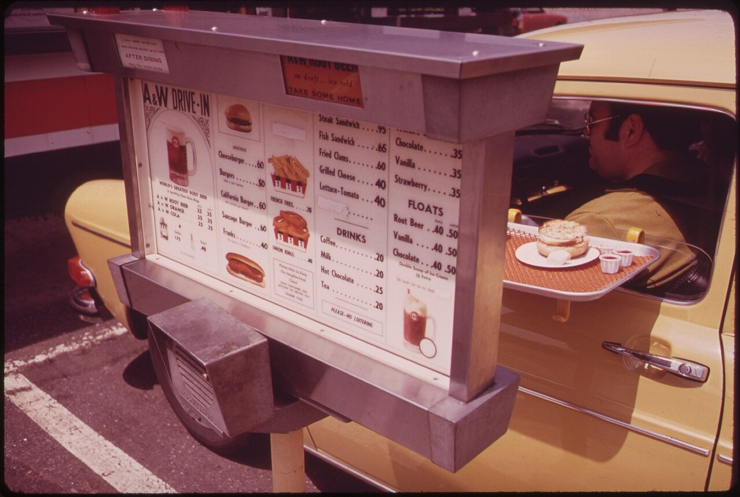
US.74 · DIRECT INSTRUCTION
3 of 4
Fast Food and Hospitality Industries
The automobile created entirely new industries.
McDonald’s, founded as a franchise by Ray Kroc in 1955, pioneered drive-through service for car customers.
Holiday Inn, founded in 1952, developed standardized motels along highways for automobile travelers.
These businesses located along highways and in suburbs, catering to car-dependent customers who wanted quick, convenient service.
Environmental Protection Agency / U.S. Federal Government, c. 1970–1975 National Archives
U.S. History Hack · TroopToTeacher Technologies LLC · Aligned to TN Academic Standards & TCAP EOC
58

Slide 66
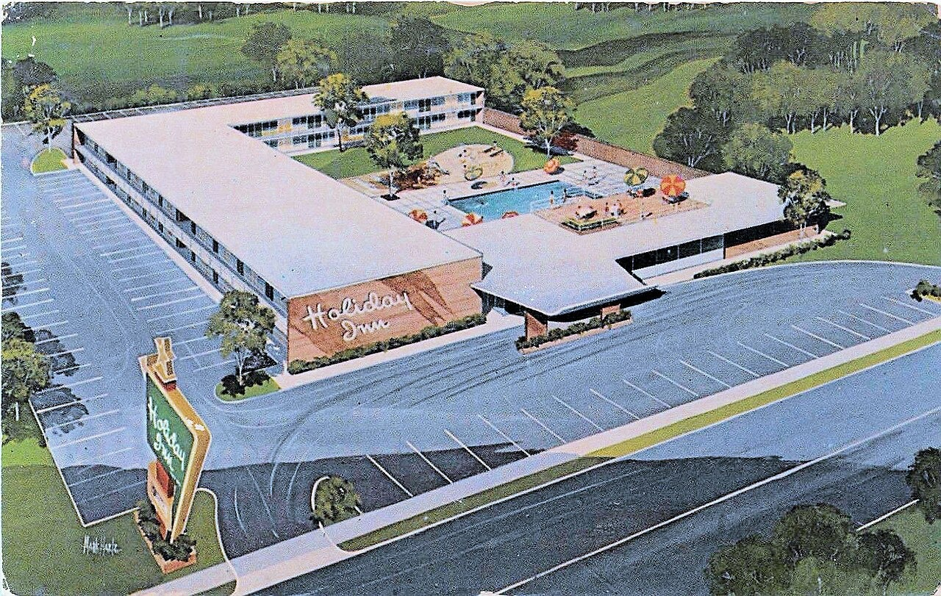
US.74 · DIRECT INSTRUCTION
4 of 4
Broader Social Changes
Automobile culture transformed social patterns beyond transportation.
Drive-in movies, drive-through restaurants, and shopping malls with large parking lots all centered on car culture.
Teenagers gained new independence through car ownership.
However, automobile dependence also contributed to urban decay, air pollution, and the decline of public transportation systems.
Unknown, 1957 Wikimedia Commons
U.S. History Hack · TroopToTeacher Technologies LLC · Aligned to TN Academic Standards & TCAP EOC
59

Slide 67
US.74 · PRIMARY SOURCE ANALYSIS
McDonald’s Franchise Advertisement
Corroboration
McDonald’s Corporation · 1955
"Join the McDonald’s System! Our revolutionary Speedee Service System serves customers in their automobiles in seconds, not minutes. Located on busy highways, our golden arches attract families on the go. Low prices, consistent quality, and fast service—the formula for success in the age of the automobile."
CONTEXT
After World War II, fast food chains like McDonald’s transformed the American food industry and consumer culture. Ray Kroc began franchising McDonald’s in 1954, and by the late 1950s the golden arches were appearing across America. The franchise model—where individuals could buy the right to operate a standardized restaurant using a proven formula—became a defining feature of American capitalism and the expanding consumer economy of the 1950s.
ANALYZE
How does this advertisement show the connection between automobiles and fast food chains?
READ CLOSELY Underline the exact words that answer the ANALYZE question — be ready to read them aloud.
SOURCE IT
WHO made it?
WHEN?
WHY does it matter?
FIRST
McDonald’s Corporation
1955
Consider the author’s purpose and audience before reading the words.
SSP.02 · before you interpret
Source: Library of Congress
U.S. History Hack · TroopToTeacher Technologies LLC · Aligned to TN Academic Standards & TCAP EOC
60
Notes:
Primary-source analysis. SOURCE IT FIRST (SSP.02) — model the sourcing routine aloud before students interpret: WHO made this source? (McDonald’s Corporation) WHEN? (1955) WHY does that matter? (Consider the author’s purpose and audience before reading the words.) Only then move to the ANALYZE question. Suggested answer: See teacher key. Practice skill: Corroboration.

Slide 68
US.74 · KEY VOCABULARY
Word Wall
Suburban Ideal
Ideal Suburbano
Interstate Highway System
Sistema de Autopistas Interestatales
say: suh-BER-bin
say: IN-ter-stayt HY-way
SI
The 1950s American dream of owning a single-family home in the suburbs with a yard, garage, and modern appliances, drawing families out of cities.
IH
Massive 41,000-mile highway network authorized by President Eisenhower in 1956 that transformed American travel, commerce, and settlement patterns.
Automobile Culture
Cultura del Automóvil
Fast Food Chains
Cadenas de Comida Rápida
say: AW-tuh-moh-beel
say: fast food
AC
The 1950s lifestyle centered on cars, which symbolized freedom and prosperity, reshaping cities, suburbs, and daily life across America.
FF
Restaurant businesses like McDonald’s that used assembly-line prep and drive-through service to feed automobile travelers quickly and cheaply.
Motel/Hotel Chains
Cadenas de Moteles/Hoteles
Levittown
Levittown
say: moh-TEL
say: LEV-it-town
MH
Standardized roadside lodging like Holiday Inn, founded 1952, built along highways to serve automobile travelers with predictable quality and amenities.
LE
The first mass-produced suburb, built by William Levitt on Long Island starting in 1947 using assembly-line techniques to build homes quickly and cheaply.
"say:" pronunciation guide (stressed syllable in CAPS) and a per-term visual anchor support newcomer English learners. Spanish term + full bilingual Frayer models are in the unit vocabulary set.
U.S. History Hack · TroopToTeacher Technologies LLC · Aligned to TN Academic Standards & TCAP EOC
4

Slide 69
US.74 · GUIDED PRACTICE — WE DO IT TOGETHER
Let’s Work One Together
Corroborate evidence from two sources
MODEL PROMPT: How do the McDonald’s advertisement and the Holiday Inn franchise history both show that the automobile created new American industries?
WORKED EXAMPLE (teacher models this aloud)
Both sources show businesses specifically designed for car travelers: McDonald’s puts its restaurants on highways and serves customers in their cars, while Holiday Inn builds standardized motels along major roads for automobile tourists.
THINK ALOUD
Underline one phrase in each source that proves the business was built for car culture, not for pedestrians.
→ Now you try: With a partner, write one sentence that uses both sources to corroborate the claim: the automobile created entirely new American industries.
U.S. History Hack · TroopToTeacher Technologies LLC · Aligned to TN Academic Standards & TCAP EOC
62
Notes:
GUIDED PRACTICE / WE DO (US.74). Skill modeled: Corroborate evidence from two sources. Model the worked example aloud using the THINK ALOUD as your script, then release students to the activity ("With a partner, write one sentence that uses both sources to corroborate the claim: the automobile created entirely new American industries."). This is the I Do → We Do → You Do bridge — do not skip it; aim for 80%+ success before independent work.

Slide 70
US.74 · STUDENT ACTIVITY
Automobile Economy — Drive-In America Business Case Study
Groups of 3
15 min
YOUR TASK
Using your Cornell notes and the McDonald’s franchise advertisement, analyze how the automobile created three new American industries: fast food, highway motels, and suburban shopping. For each industry, identify (a) the automobile-related need it met, (b) one specific company or example from the sections, and (c) one broader social effect. Then corroborate: how does the McDonald’s advertisement confirm what the Holiday Inn historical context says about automobile culture reshaping American business?
DELIVERABLE
DIFFERENTIATION
Three-industry analysis chart (fast food / motels / suburban shopping, each with need + example + social effect) AND one corroboration sentence connecting the McDonald’s ad to Holiday Inn evidence.
Entry: Chart with industry names and one column (automobile need) pre-filled for one industry; student completes the rest. Honors: Argue whether automobile culture’s economic benefits outweighed its social costs (urban decay, air pollution, decline of public transit)—use evidence from at least three different sections.
Companion printable: cornell-notes/unit-8/us74-automobile-influence.pdf
U.S. History Hack · TroopToTeacher Technologies LLC · Aligned to TN Academic Standards & TCAP EOC
63
Notes:
Student activity for US.74. Pair with the printable: cornell-notes/unit-8/us74-automobile-influence.pdf. Timing: 15. Deliverable: Three-industry analysis chart (fast food / motels / suburban shopping, each with need + example + social effect) AND one corroboration sentence connecting the McDonald’s ad to Holiday Inn evidence.

Slide 71
US.74 · CHECK FOR UNDERSTANDING
TCAP-Style Question
DOK 2
EOC PRACTICE
How did the automobile transform American business and culture in the 1950s?
It reduced consumer spending because families saved money on transit
A
It eliminated the need for any new road construction across the nation
B
It created fast food chains, motels, shopping centers, and drive-ins
C
It primarily benefited the railroad industry by increasing train travel
D
ANSWER FIRST: students commit — then click / advance to reveal the correct answer and explanation.
U.S. History Hack · TroopToTeacher Technologies LLC · Aligned to TN Academic Standards & TCAP EOC
64
Notes:
CHECK FOR UNDERSTANDING (US.74, DOK 2). Have students commit to an answer (whiteboards, hand signal, or turn-and-talk) BEFORE advancing. Correct answer: C. The next slide reveals it. Why: Automobiles transformed business and culture by encouraging fast-food chains, motels, shopping centers, and drive-in theaters. A is wrong because cars increased consumer spending instead of reducing it, and D is wrong because they did not mainly revive railroad travel. A car-centered economy became a defining feature of 1950s America.

Slide 72
US.74 · ANSWER REVEAL
TCAP-Style Question
✓ ANSWER KEY
How did the automobile transform American business and culture in the 1950s?
A
It reduced consumer spending because families saved money on transit
B
It eliminated the need for any new road construction across the nation
C
It created fast food chains, motels, shopping centers, and drive-ins
✓
D
It primarily benefited the railroad industry by increasing train travel
Correct answer: C. Why: Automobiles transformed business and culture by encouraging fast-food chains, motels, shopping centers, and drive-in theaters. A is wrong because cars increased consumer spending instead of reducing it, and D is wrong because they did not mainly revive railroad travel. A car-centered economy became…
U.S. History Hack · TroopToTeacher Technologies LLC · Aligned to TN Academic Standards & TCAP EOC
65
Notes:
ANSWER KEY (US.74). Correct: C. Automobiles transformed business and culture by encouraging fast-food chains, motels, shopping centers, and drive-in theaters. A is wrong because cars increased consumer spending instead of reducing it, and D is wrong because they did not mainly revive railroad travel. A car-centered economy became a defining feature of 1950s America.

Slide 73
US.74 · WRAP-UP
What You Need to Know for TCAP
KEY TAKEAWAYS
EXIT TICKET
DOK 2
Transforming American Daily Life
Connection to Suburban Growth
Fast Food and Hospitality Industries
Broader Social Changes
Explain how the automobile created two entirely new American industries, using specific evidence from the primary sources or sections.
★ HONORS / EXTENSION DOK 3 · SSP.04 Argumentation
Argue: automobile culture’s negative effects (urban decay, air pollution, decline of public transit, social isolation) outweighed its economic benefits to American society. Use evidence from at least two sections and acknowledge the strongest counterargument. (SSP.04)
U.S. History Hack · TroopToTeacher Technologies LLC · Aligned to TN Academic Standards & TCAP EOC
66
Notes:
WRAP-UP / EXIT-TICKET KEY (US.74, DOK 2). Prompt: Explain how the automobile created two entirely new American industries, using specific evidence from the primary sources or sections. Model answer: The automobile created the fast food industry: McDonald’s built drive-throughs on busy highways specifically to serve customers in their cars, as the franchise advertisement shows. It also created the highway motel industry: Holiday Inn, founded in 1952, offered standardized lodging for automobile travelers along major routes. Both industries were impossible before widespread car ownership and the interstate highway system. RETEACH TRIGGER — if a student misses this exit ticket: (1) <50% of class miss → spiral it into the next standard’s Quick Review opener (see the US.74 review prompts). (2) Individual/small group → reteach with the "Transforming American Daily Life" direct-instruction slide + re-run the SOURCE IT FIRST routine on the US.74 primary source, then assign the paired printable: cornell-notes/unit-8/us74-automobile-influence.pdf. (3) Re-assess with the US.74 check-for-understanding reveal slide as a do-now the next day. Reteach anchors (this standard’s sections): Transforming American Daily Life; Connection to Suburban Growth; Fast Food and Hospitality Industries; Broader Social Changes. I Can objective: I can describe the growing influence of the automobile on American society, including the growth of suburbia, fast food chains, and the hotel industry. HONORS / EXTENSION (DOK 3, for early finishers or advanced learners): Argue: automobile culture’s negative effects (urban decay, air pollution, decline of public transit, social isolation) outweighed its economic benefits to American society. Use evidence from at least two sections and acknowledge the strongest counterargument. (SSP.04) — look for a clear claim plus two specific pieces of evidence.

Slide 74
STANDARD
SOCIAL STUDIES PRACTICES
US.75
SSP.02
Examine a source
SSP.03
Synthesize sources
SSP.05
Historical awareness
Television and Mass Media Impact
TN ACADEMIC STANDARD
Analyze the increasing impact of television and mass media on the American home, politics, and economy.
I CAN
I can analyze the increasing impact of television and mass media on the American home, politics, and economy.
U.S. History Hack · TroopToTeacher Technologies LLC · Aligned to TN Academic Standards & TCAP EOC
67

Slide 75
KEY VOCABULARY · LANGUAGE SUPPORT
US.74
Words you need before we read
Suburban Ideal
Interstate Highway System
Automobile Culture
En español: Ideal Suburbano
En español: Sistema de Autopistas Interestatales
En español: Cultura del Automóvil
WHAT IT MEANS
WHAT IT MEANS
WHAT IT MEANS
The 1950s American dream of owning a single-family home in the suburbs with a yard, garage, and modern appliances, drawing families out of cities.
Massive 41,000-mile highway network authorized by President Eisenhower in 1956 that transformed American travel, commerce, and settlement patterns.
The 1950s lifestyle centered on cars, which symbolized freedom and prosperity, reshaping cities, suburbs, and daily life across America.
UDL · REPRESENTATION → LANGUAGE & SYMBOLS
U.S. History Hack · TEACHER DECK · Aligned to TN Academic Standards & TCAP EOC
8

Slide 76
PROGRESS CHECK
US.74
Check your understanding
How did automobiles drive the expansion of fast food chains and the hotel industry?
A
Fast food and motels existed before car culture, though this interpretation lacks supporting historical evidence and does not reflect the scholarly consensus on this topic
B
The hospitality industry declined as car ownership increased, which does not align with the documented historical record
C
Fast food was only popular in urban areas, but this oversimplifies the complex factors at work, but the historical evidence paints a more nuanced picture
D
Car culture created demand for drive-in restaurants like McDonald's and roadside motels, spawning entirely new industries serving traveling Americans
✓ KEY
UDL · ACTION & EXPRESSION → STRATEGY DEVELOPMENT
MTSS: below mastery → targeted reteach (Tier 2); at/above → extension. The goal never lowers.
U.S. History Hack · TEACHER DECK · Aligned to TN Academic Standards & TCAP EOC
9

Slide 77
US.75 · QUICK REVIEW
Do You Remember?
Before we start, retrieve what we have already learned. Answer from memory first — no notes.
1
US.74 In the last standard, we studied automobile culture. How did rising prosperity and consumer culture in the 1950s create the conditions for television to become dominant?
2
US.74 Name one similarity between how automobiles and televisions each reshaped American home design and family life.
U.S. History Hack · TroopToTeacher Technologies LLC · Aligned to TN Academic Standards & TCAP EOC
68
Notes:
SPACED RETRIEVAL (US.75). Cold-call or whiteboards, 3-4 min, low stakes. Answers — 1) Rising incomes and the culture of buying consumer goods made televisions affordable for most American families. The same consumerism that bought cars and suburban homes bought televisions, and companies quickly recognized TV advertising as the most powerful way to reach mass consumers. 2) Both reshuffled physical space around the new technology: homes were designed with garages for cars and living rooms arranged around television sets. Both also transformed leisure time and created new industries targeting car-dependent or TV-watching consumers.

Slide 78
US.75 · CONFIDENCE CHECK
Warm-Up — Quick Recall
DOK 1
LOW STAKES
Everyone can answer this. Thumbs / whiteboards — no notes.
What was the name of the 1960 presidential debate that showed television’s power in politics?
✓ ANSWER
The Kennedy-Nixon debate (first televised presidential debate).
COMMIT FIRST: have everyone answer before the reveal — this is the DOK 1 floor; the graded check later in this lesson moves up to DOK 2–3.
U.S. History Hack · TroopToTeacher Technologies LLC · Aligned to TN Academic Standards & TCAP EOC
69
Notes:
CONFIDENCE CHECK (US.75, DOK 1). 60-90 seconds. Have EVERY student commit (thumbs / whiteboard / choral) before revealing — this secures an early win and surfaces who is shaky before new content. Answer: The Kennedy-Nixon debate (first televised presidential debate). Key term to listen for: Television. This is the low-floor entry; the graded Check for Understanding later in the standard rises to DOK 2–3.

Slide 79
US.75 · HOOK
Think About It
In 1950, only 9% of American homes had a television; by 1960, that number was 90%—and the way Americans got information, chose their leaders, and spent their evenings had changed forever.
DISCUSS
TIMING: Turn & Talk 60 sec → cold-call 2 pairs
When radio listeners thought Nixon won the 1960 presidential debate but television viewers thought Kennedy won, what does that tell us about what democracy looks like in the age of television?
U.S. History Hack · TroopToTeacher Technologies LLC · Aligned to TN Academic Standards & TCAP EOC
70
Notes:
HOOK (US.75). Run tight: pose the provocation, give a silent 10-second think, then Turn & Talk 60 seconds. Cold-call 2–3 pairs (not volunteers) for a sentence-starter answer — "One force was ___ because ___" — then bridge to the standard. Keep total to ~4 minutes; do not let it sprawl. Return to this question at the unit close for an evidence-based answer.

Slide 80
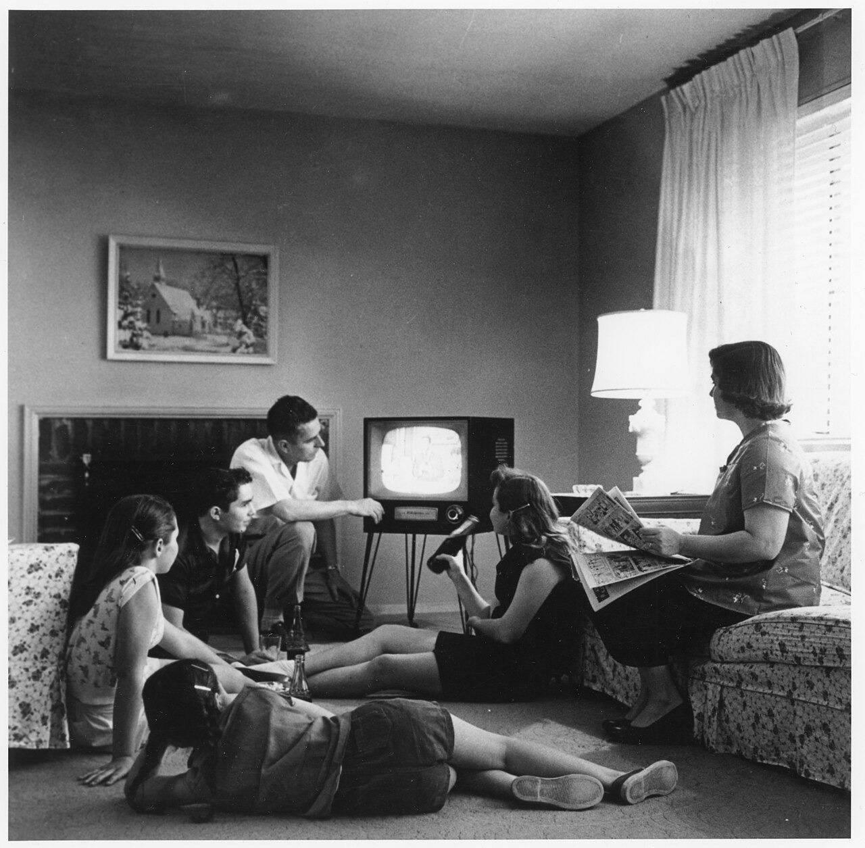
US.75 · DIRECT INSTRUCTION
1 of 4
Television Changes Family Life
Television became the center of family entertainment, replacing radio and reducing movie attendance.
Families scheduled activities around TV programs, shared common cultural experiences through popular shows, and spent more time at home.
TV also influenced home design, with living rooms arranged around television sets.
SENTENCE FRAME (EL & writing support)
Evert F. Baumgardner / National Archives, c. 1958 National Archives
Television changed American homes by ___, and it changed politics by making ___ as important as a candidate’s ideas.
TEACHER CUE Chunk → cold-call → confirm before advancing.
U.S. History Hack · TroopToTeacher Technologies LLC · Aligned to TN Academic Standards & TCAP EOC
71
Notes:
FACILITATION (US.75). Ask students: think about the last election you saw covered—would that candidate have won or lost if voters could only hear them on radio and not see them on screen? Teach in small steps; pause and check for understanding before the next chunk (aim 80%+ before moving on).

Slide 81
US.75 · DIRECT INSTRUCTION
2 of 4
Television and Politics
Television transformed politics by emphasizing candidates’ appearance and communication skills.
The 1960 Kennedy-Nixon debates showed TV’s power—radio listeners thought Nixon won, but TV viewers favored the telegenic Kennedy.
Politicians had to adapt their message and image for the visual medium.
U.S. History Hack · TroopToTeacher Technologies LLC · Aligned to TN Academic Standards & TCAP EOC
72

Slide 82
US.75 · DIRECT INSTRUCTION
3 of 4
Advertising and Consumer Culture
Television advertising created a powerful new marketing tool that could reach millions of households simultaneously.
Commercials shaped consumer desires, created brand awareness, and drove purchasing decisions.
Companies invested heavily in TV advertising, making it the dominant advertising medium by the late 1950s.
U.S. History Hack · TroopToTeacher Technologies LLC · Aligned to TN Academic Standards & TCAP EOC
73

Slide 83
US.75 · DIRECT INSTRUCTION
4 of 4
Cultural Homogenization
Television created shared national experiences as Americans across the country watched the same programs.
This promoted cultural homogenization—similar values, consumer preferences, and entertainment tastes spread nationwide.
However, critics argued TV content was often shallow and promoted conformity.
U.S. History Hack · TroopToTeacher Technologies LLC · Aligned to TN Academic Standards & TCAP EOC
74

Slide 84
US.75 · PRIMARY SOURCE ANALYSIS
Television and the 1960 Election
Close Reading
Theodore White, journalist · 1961
"Those who heard the debates on radio thought Nixon had won. But those who watched on television thought Kennedy had won. Nixon, recovering from illness, appeared pale, tired, and sweating under the studio lights. Kennedy, tanned and rested, projected youth, vigor, and confidence. Television had changed American politics forever."
CONTEXT
The 1960 presidential election between John F. Kennedy and Richard Nixon was the first to feature televised debates, and it demonstrated television’s transformative power in politics. By 1960, approximately 90% of American homes had televisions. Theodore White’s account in his landmark book “The Making of the President 1960” became the definitive record of how TV altered American electoral politics.
ANALYZE
According to this source, how did television change American politics?
READ CLOSELY Underline the exact words that answer the ANALYZE question — be ready to read them aloud.
SOURCE IT
WHO made it?
WHEN?
WHY does it matter?
FIRST
Theodore White, journalist
1961
Consider the author’s purpose and audience before reading the words.
SSP.02 · before you interpret
Source: John F. Kennedy Presidential Library
U.S. History Hack · TroopToTeacher Technologies LLC · Aligned to TN Academic Standards & TCAP EOC
75
Notes:
Primary-source analysis. SOURCE IT FIRST (SSP.02) — model the sourcing routine aloud before students interpret: WHO made this source? (Theodore White, journalist) WHEN? (1961) WHY does that matter? (Consider the author’s purpose and audience before reading the words.) Only then move to the ANALYZE question. Suggested answer: See teacher key. Practice skill: Close Reading.

Slide 85
US.75 · KEY VOCABULARY
Word Wall
Television
Televisión
Mass Media
Medios Masivos
say: TEL-uh-vizh-un
say: mas MEE-dee-uh
TE
The electronic medium that became the dominant form of American entertainment and information by the late 1950s, creating shared national experiences.
MM
Communication channels—TV, radio, newspapers, magazines—that reach large audiences at once; in the 1950s television became the most powerful medium.
Advertising
Publicidad
Consumer Culture
Cultura de Consumo
say: AD-ver-ty-zing
say: kun-SOO-mer
AD
The rapidly growing 1950s industry that used television to shape consumer desires and sell products to mass audiences.
CC
A society centered on buying goods; 1950s television and advertising encouraged Americans to define success through purchases.
Cultural Homogenization
Homogeneización Cultural
Nixon–Kennedy Debates
Debates Nixon–Kennedy
say: huh-mah-jen-ih-ZAY-shun
say: NIK-sun KEN-eh-dee
CH
The way national television gave Americans shared programs, products, and values, making regional cultures more alike.
NK
The first televised presidential debates (1960), which showed television's new power to shape politics and public opinion.
"say:" pronunciation guide (stressed syllable in CAPS) and a per-term visual anchor support newcomer English learners. Spanish term + full bilingual Frayer models are in the unit vocabulary set.
U.S. History Hack · TroopToTeacher Technologies LLC · Aligned to TN Academic Standards & TCAP EOC
5

Slide 86
US.75 · GUIDED PRACTICE — WE DO IT TOGETHER
Let’s Work One Together
Compare impacts across two domains
MODEL PROMPT: How did television change both American family life and American politics in different ways?
WORKED EXAMPLE (teacher models this aloud)
Television changed family life by becoming the center of home entertainment and reshaping the living room. It changed politics by making candidates’ appearance and communication skills as important as their ideas, as seen in the 1960 Kennedy-Nixon debates.
THINK ALOUD
In the sections, underline one sentence about TV’s effect on families and one sentence about its effect on politics.
→ Now you try: With a partner, rank television’s three biggest effects on American society and defend your top choice with a specific example from the sections.
U.S. History Hack · TroopToTeacher Technologies LLC · Aligned to TN Academic Standards & TCAP EOC
77
Notes:
GUIDED PRACTICE / WE DO (US.75). Skill modeled: Compare impacts across two domains. Model the worked example aloud using the THINK ALOUD as your script, then release students to the activity ("With a partner, rank television’s three biggest effects on American society and defend your top choice with a specific example from the sections."). This is the I Do → We Do → You Do bridge — do not skip it; aim for 80%+ success before independent work.

Slide 87
US.75 · STUDENT ACTIVITY
Television’s Triple Impact — Home, Politics, and Economy
Groups of 3
15 min
YOUR TASK
Using your Cornell notes and Theodore White’s account of the 1960 debates, analyze television’s impact across three arenas: HOME, POLITICS, and ECONOMY. For each arena, write two sentences—one describing what changed and one citing specific evidence from the sections or primary source. Then argue: was television’s greatest impact on American families, politics, or the economy? Back your claim with evidence.
DELIVERABLE
DIFFERENTIATION
Three-arena analysis (home / politics / economy, two sentences each) AND a one-sentence claim identifying television’s greatest impact with supporting evidence.
Entry: Arena chart with sentence starters provided (“Television changed home life by...”; “Television changed politics by...”; “Television changed the economy by...”). Honors: Extend the argument—if the 1960 Kennedy-Nixon debate was the first to use television, what does that suggest about the role of media image in democracy? Is that a positive or negative development? Use White’s account as evidence.
Companion printable: cornell-notes/unit-8/us75-television-mass-media.pdf
U.S. History Hack · TroopToTeacher Technologies LLC · Aligned to TN Academic Standards & TCAP EOC
78
Notes:
Student activity for US.75. Pair with the printable: cornell-notes/unit-8/us75-television-mass-media.pdf. Timing: 15. Deliverable: Three-arena analysis (home / politics / economy, two sentences each) AND a one-sentence claim identifying television’s greatest impact with supporting evidence.

Slide 88
US.75 · CHECK FOR UNDERSTANDING
TCAP-Style Question
DOK 2
EOC PRACTICE
How did television impact American politics during the 1950s and early 1960s?
It combined audio and visuals to influence consumer preferences at scale
A
Televised debates and news coverage transformed how voters chose leaders
B
TV advertising created national demand for products and shaped consumer desires
C
TV became the center of family entertainment and a source of news
D
ANSWER FIRST: students commit — then click / advance to reveal the correct answer and explanation.
U.S. History Hack · TroopToTeacher Technologies LLC · Aligned to TN Academic Standards & TCAP EOC
79
Notes:
CHECK FOR UNDERSTANDING (US.75, DOK 2). Have students commit to an answer (whiteboards, hand signal, or turn-and-talk) BEFORE advancing. Correct answer: B. The next slide reveals it. Why: Televised debates and news changed politics by making image, speaking style, and camera presence matter more to voters. A and C describe TV’s economic impact, not its political impact. D describes TV’s cultural role at home, not its effect on elections specifically.

Slide 89
US.75 · ANSWER REVEAL
TCAP-Style Question
✓ ANSWER KEY
How did television impact American politics during the 1950s and early 1960s?
A
It combined audio and visuals to influence consumer preferences at scale
B
Televised debates and news coverage transformed how voters chose leaders
✓
C
TV advertising created national demand for products and shaped consumer desires
D
TV became the center of family entertainment and a source of news
Correct answer: B. Why: Televised debates and news changed politics by making image, speaking style, and camera presence matter more to voters. A and C describe TV’s economic impact, not its political impact. D describes TV’s cultural role at home, not its effect on elections specifically.
U.S. History Hack · TroopToTeacher Technologies LLC · Aligned to TN Academic Standards & TCAP EOC
80
Notes:
ANSWER KEY (US.75). Correct: B. Televised debates and news changed politics by making image, speaking style, and camera presence matter more to voters. A and C describe TV’s economic impact, not its political impact. D describes TV’s cultural role at home, not its effect on elections specifically.

Slide 90
US.75 · WRAP-UP
What You Need to Know for TCAP
KEY TAKEAWAYS
EXIT TICKET
DOK 2
Television Changes Family Life
Television and Politics
Advertising and Consumer Culture
Cultural Homogenization
Using Theodore White’s account of the 1960 debates, explain how television changed the criteria voters used to evaluate presidential candidates.
★ HONORS / EXTENSION DOK 3 · SSP.04 Argumentation
Argue: television’s influence on democracy is ultimately harmful because it prioritizes image over substance. Use White’s account as evidence for your argument, and address the strongest counterargument (that TV also educated and informed voters). (SSP.04)
U.S. History Hack · TroopToTeacher Technologies LLC · Aligned to TN Academic Standards & TCAP EOC
81
Notes:
WRAP-UP / EXIT-TICKET KEY (US.75, DOK 2). Prompt: Using Theodore White’s account of the 1960 debates, explain how television changed the criteria voters used to evaluate presidential candidates. Model answer: Before television, voters judged candidates primarily by their positions and speaking voice (radio). Theodore White’s account shows that television added visual criteria: Nixon looked pale and tired on screen, while Kennedy appeared tanned and confident. Television made appearance, body language, and visual communication skills as important as policy positions, fundamentally changing what it means to be an effective political candidate. RETEACH TRIGGER — if a student misses this exit ticket: (1) <50% of class miss → spiral it into the next standard’s Quick Review opener (see the US.75 review prompts). (2) Individual/small group → reteach with the "Television Changes Family Life" direct-instruction slide + re-run the SOURCE IT FIRST routine on the US.75 primary source, then assign the paired printable: cornell-notes/unit-8/us75-television-mass-media.pdf. (3) Re-assess with the US.75 check-for-understanding reveal slide as a do-now the next day. Reteach anchors (this standard’s sections): Television Changes Family Life; Television and Politics; Advertising and Consumer Culture; Cultural Homogenization. I Can objective: I can analyze the increasing impact of television and mass media on the American home, politics, and economy. HONORS / EXTENSION (DOK 3, for early finishers or advanced learners): Argue: television’s influence on democracy is ultimately harmful because it prioritizes image over substance. Use White’s account as evidence for your argument, and address the strongest counterargument (that TV also educated and informed voters). (SSP.04) — look for a clear claim plus two specific pieces of evidence.

Slide 91
STANDARD
SOCIAL STUDIES PRACTICES
US.76
SSP.01
Collect sources
SSP.02
Examine a source
SSP.04
Build an argument
SSP.05
Historical awareness
Youth Culture and Tennessee Music
TN ACADEMIC STANDARD
Describe the emergence of a youth culture, including beatniks and the progression of popular music (from swing to rhythm and blues to rock ’n’ roll), and the impact of Tennessee on the music industry, including the influence of B.B. King, Elvis Presley, Stax Records, and Sun Studio. (TCA)
I CAN
I can describe the emergence of a youth culture, including beatniks and the progression of popular music, and the impact of Tennessee on the music industry, including B.B. King, Elvis Presley, Stax Records, and Sun Studio.
U.S. History Hack · TroopToTeacher Technologies LLC · Aligned to TN Academic Standards & TCAP EOC
82

Slide 92
KEY VOCABULARY · LANGUAGE SUPPORT
US.75
Words you need before we read
Television
Mass Media
En español: Televisión
En español: Medios Masivos
WHAT IT MEANS
WHAT IT MEANS
The electronic medium that became the dominant form of American entertainment and information by the late 1950s, creating shared national experiences.
Communication channels—TV, radio, newspapers, magazines—that reach large audiences at once; in the 1950s television became the most powerful medium.
UDL · REPRESENTATION → LANGUAGE & SYMBOLS
U.S. History Hack · TEACHER DECK · Aligned to TN Academic Standards & TCAP EOC
10

Slide 93
PROGRESS CHECK
US.75
Check your understanding
What impact did the 1960 Kennedy-Nixon debates have on the role of television in politics?
A
The debates demonstrated TV's power to influence voters through visual appearance—radio listeners thought Nixon won, but TV viewers favored the telegenic Kennedy, transforming how candidates campaign
✓ KEY
B
The debates had no significant impact on political campaigns, but contemporary accounts suggest a different explanation, which does not align with the documented historical record
C
Both candidates were equally effective on television, despite limited evidence supporting this interpretation when examined alongside the available primary and secondary sources
D
Television was not used for political debates until the 1970s, although historical sources do not support this conclusion, although historical sources do not support this conclusion
UDL · ACTION & EXPRESSION → STRATEGY DEVELOPMENT
MTSS: below mastery → targeted reteach (Tier 2); at/above → extension. The goal never lowers.
U.S. History Hack · TEACHER DECK · Aligned to TN Academic Standards & TCAP EOC
11

Slide 94
US.76 · QUICK REVIEW
Do You Remember?
Before we start, retrieve what we have already learned. Answer from memory first — no notes.
1
US.75 In the last standard, we studied television’s impact. How did television help spread youth culture and music like rock ’n’ roll to a national audience?
2
US.75 How did mass media’s ability to create shared national experiences connect to the rise of a distinct youth culture in the 1950s?
U.S. History Hack · TroopToTeacher Technologies LLC · Aligned to TN Academic Standards & TCAP EOC
83
Notes:
SPACED RETRIEVAL (US.76). Cold-call or whiteboards, 3-4 min, low stakes. Answers — 1) Television gave musicians a national platform—when Elvis appeared on The Ed Sullivan Show, millions of teenagers across the country saw him simultaneously. TV accelerated cultural homogenization, including the spread of youth music and fashion nationwide. 2) Mass media gave teenagers across the country the same music, fashion icons, and cultural touchstones simultaneously, creating a shared “youth culture” that was distinct from their parents’ generation and strong enough to challenge traditional values.

Slide 95
US.76 · CONFIDENCE CHECK
Warm-Up — Quick Recall
DOK 1
LOW STAKES
Everyone can answer this. Thumbs / whiteboards — no notes.
Name the Memphis recording studio where Elvis Presley recorded his first single.
✓ ANSWER
Sun Studio (also accepted: Sun Records).
COMMIT FIRST: have everyone answer before the reveal — this is the DOK 1 floor; the graded check later in this lesson moves up to DOK 2–3.
U.S. History Hack · TroopToTeacher Technologies LLC · Aligned to TN Academic Standards & TCAP EOC
84
Notes:
CONFIDENCE CHECK (US.76, DOK 1). 60-90 seconds. Have EVERY student commit (thumbs / whiteboard / choral) before revealing — this secures an early win and surfaces who is shaky before new content. Answer: Sun Studio (also accepted: Sun Records). Key term to listen for: Sun Studio. This is the low-floor entry; the graded Check for Understanding later in the standard rises to DOK 2–3.

Slide 96
US.76 · HOOK
Think About It
In the mid-1950s, a young truck driver from Tupelo, Mississippi walked into a small Memphis recording studio and recorded a song that blended Black rhythm and blues with white country music—and nothing in American culture was ever the same.
DISCUSS
TIMING: Turn & Talk 60 sec → cold-call 2 pairs
If music was one of the first places in 1950s America where Black and white traditions crossed over and blended together, what does that tell us about the power of culture to challenge segregation before the courts and laws did?
U.S. History Hack · TroopToTeacher Technologies LLC · Aligned to TN Academic Standards & TCAP EOC
85
Notes:
HOOK (US.76). Run tight: pose the provocation, give a silent 10-second think, then Turn & Talk 60 seconds. Cold-call 2–3 pairs (not volunteers) for a sentence-starter answer — "One force was ___ because ___" — then bridge to the standard. Keep total to ~4 minutes; do not let it sprawl. Return to this question at the unit close for an evidence-based answer.

Slide 97
US.76 · DIRECT INSTRUCTION
1 of 4
The Beat Generation
Beatniks rejected 1950s conformity, materialism, and conventional career paths.
They embraced artistic expression, questioned authority, experimented with alternative lifestyles, and criticized suburban conformity.
Writers like Jack Kerouac and Allen Ginsberg became cultural icons.
This laid groundwork for 1960s counterculture movements.
SENTENCE FRAME (EL & writing support)
Tennessee’s Sun Studio and Stax Records were important because they ___, which helped ___ in 1950s America.
U.S. History Hack · TroopToTeacher Technologies LLC · Aligned to TN Academic Standards & TCAP EOC
86
Notes:
FACILITATION (US.76). Play 10 seconds of Elvis’s “That’s All Right” and ask: what two musical traditions can you hear blended together, and why would that combination shock a 1954 audience? Teach in small steps; pause and check for understanding before the next chunk (aim 80%+ before moving on).

Slide 98
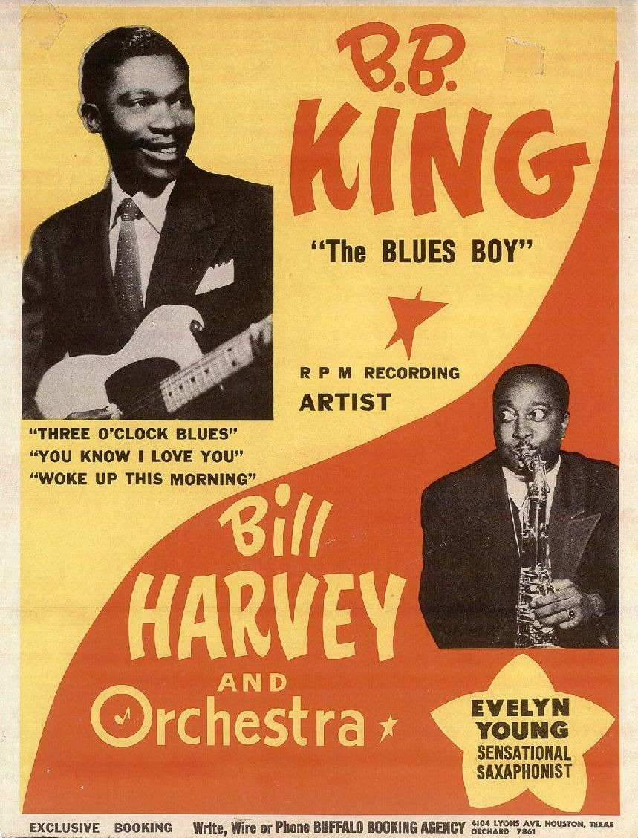
US.76 · DIRECT INSTRUCTION
2 of 4
Tennessee’s Central Role in Music
Tennessee, particularly Memphis and Nashville, became crucial to American popular music because of: Sun Studio’s role in developing rock ’n’ roll, Stax Records promoting rhythm and blues, the convergence of African American and white musical traditions, and artists like Elvis Presley and B.B. King who crossed racial boundaries in music.
★ TENNESSEE CONNECTION
Unknown, 1950s Wikimedia Commons
U.S. History Hack · TroopToTeacher Technologies LLC · Aligned to TN Academic Standards & TCAP EOC
87

Slide 99
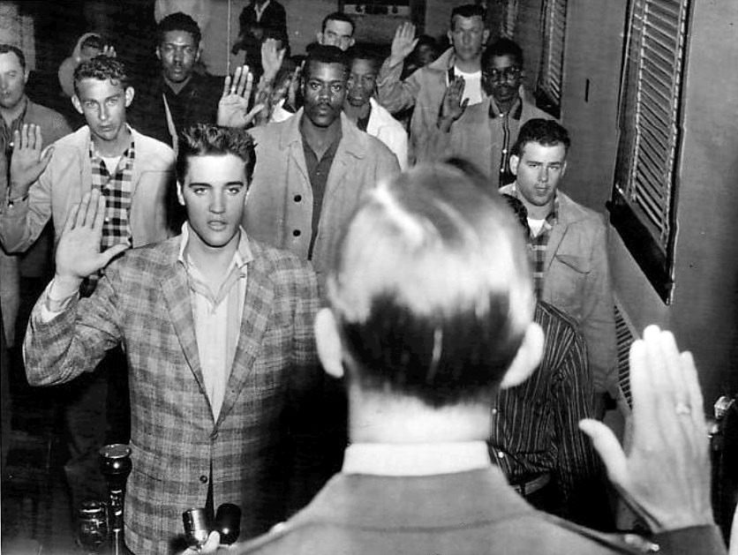
US.76 · DIRECT INSTRUCTION
3 of 4
Breaking Racial Barriers Through Music
Artists like Elvis Presley, who recorded at Sun Studio in Memphis, brought African American musical styles to white audiences.
B.B. King and other blues artists at Stax Records gained crossover appeal.
Music became one of the first areas where racial integration occurred naturally, challenging segregation through shared cultural experiences.
★ TENNESSEE CONNECTION
Associated Press / Standard-Sentinel, March 25, 1958 Wikimedia Commons
U.S. History Hack · TroopToTeacher Technologies LLC · Aligned to TN Academic Standards & TCAP EOC
88

Slide 100
US.76 · DIRECT INSTRUCTION
4 of 4
Sun Studio and Stax Records
Sun Studio, founded by Sam Phillips in Memphis, recorded Elvis Presley, Johnny Cash, Jerry Lee Lewis, and Carl Perkins—creating rock ’n’ roll.
Stax Records, also in Memphis, produced soul music with artists like Otis Redding and Booker T. & the M.G.’s.
These Tennessee institutions shaped American music history.
★ TENNESSEE CONNECTION
U.S. History Hack · TroopToTeacher Technologies LLC · Aligned to TN Academic Standards & TCAP EOC
89

Slide 101
US.76 · PEOPLE WHO SHAPED THE ERA
Key Figures
Elvis Presley
B.B. King
Sam Phillips
King of Rock ’n’ Roll
Blues legend, Memphis
Founder, Sun Studio
Recorded at Sun Studio in Memphis, combining country and blues
Brought African American musical styles to white audiences
Became the cultural symbol of 1950s youth rebellion
Mastered blues guitar on Memphis’s Beale Street
Influenced generations of rock and blues musicians worldwide
Bridged Black musical traditions and mainstream popular culture
Founded Sun Studio in Memphis in 1950
Recorded Elvis Presley, Johnny Cash, and Jerry Lee Lewis
Sought music that crossed racial boundaries to create a new American sound
STRATEGY Use Elvis to show how music crossed racial boundaries before laws did.
STRATEGY Use B.B. King to show how African American blues artists shaped the music that defined a generation.
STRATEGY Use Sam Phillips to show how a visionary producer turned Memphis into the birthplace of rock ’n’ roll.
U.S. History Hack · TroopToTeacher Technologies LLC · Aligned to TN Academic Standards & TCAP EOC
90

Slide 102
US.76 · PRIMARY SOURCE ANALYSIS
Sun Studio Press Release
Sourcing
Sun Records, Memphis, Tennessee · 1954
"Memphis-based Sun Records announces the release of “That’s All Right” by Elvis Presley, a young truck driver from Tupelo, Mississippi. The record combines elements of country music with rhythm and blues, creating a new sound that is sweeping the South. Radio stations from Memphis to Nashville are reporting unprecedented listener demand."
CONTEXT
Memphis, Tennessee’s Sun Studio, founded by Sam Phillips in 1950, became the birthplace of rock and roll. In the early 1950s, Phillips recorded blues, country, and gospel artists, seeking a sound that could cross racial boundaries. When a young Elvis Presley recorded there in 1954, the result combined Black rhythm and blues with white country music in a way that captured national attention and launched a cultural revolution in American music and youth culture.
ANALYZE
What does this document reveal about Tennessee’s role in the origins of rock and roll?
READ CLOSELY Underline the exact words that answer the ANALYZE question — be ready to read them aloud.
SOURCE IT
WHO made it?
WHEN?
WHY does it matter?
FIRST
Sun Records, Memphis, Tennessee
1954
Consider the author’s purpose and audience before reading the words.
SSP.02 · before you interpret
Source: Library of Congress
U.S. History Hack · TroopToTeacher Technologies LLC · Aligned to TN Academic Standards & TCAP EOC
91
Notes:
Primary-source analysis. SOURCE IT FIRST (SSP.02) — model the sourcing routine aloud before students interpret: WHO made this source? (Sun Records, Memphis, Tennessee) WHEN? (1954) WHY does that matter? (Consider the author’s purpose and audience before reading the words.) Only then move to the ANALYZE question. Suggested answer: See teacher key. Practice skill: Sourcing.

Slide 103
US.76 · KEY VOCABULARY
Word Wall
Beatniks
Beatniks
Rock ’n’ Roll
Rock ’n’ Roll
say: BEET-niks
say: rok un ROHL
BE
Members of the 1950s Beat Generation—writers like Jack Kerouac and Allen Ginsberg—who rejected mainstream culture, materialism, and conformity.
RN
Revolutionary 1950s music genre combining rhythm and blues, country, and gospel; Elvis Presley became its “King,” representing youth rebellion.
Elvis Presley
Elvis Presley
Sun Studio
Sun Studio
say: EL-vis PREZ-lee
say: sun STOO-dee-oh
EP
Tennessee singer who became “The King of Rock ’n’ Roll” in the 1950s, revolutionizing popular culture and launching rock as a global phenomenon.
SS
Memphis recording studio where Elvis Presley, Johnny Cash, Jerry Lee Lewis, and others recorded, creating the “Memphis Sound” of rock ’n’ roll.
Stax Records
Stax Records
B.B. King
B.B. King
say: staks
say: bee-bee KING
SR
Memphis record label founded 1957, legendary for soul music and home to Otis Redding and Isaac Hayes, putting Tennessee at the center of American music.
BB
Mississippi-born blues guitarist who recorded in Memphis and became “King of the Blues,” shaping rock, soul, and popular music from Tennessee.
"say:" pronunciation guide (stressed syllable in CAPS) and a per-term visual anchor support newcomer English learners. Spanish term + full bilingual Frayer models are in the unit vocabulary set.
U.S. History Hack · TroopToTeacher Technologies LLC · Aligned to TN Academic Standards & TCAP EOC
6

Slide 104
US.76 · GUIDED PRACTICE — WE DO IT TOGETHER
Let’s Work One Together
Trace the progression of an idea
MODEL PROMPT: How did American popular music evolve from swing to rhythm and blues to rock ’n’ roll, and why did Tennessee play a central role?
WORKED EXAMPLE (teacher models this aloud)
Swing was sophisticated adult dance music. Rhythm and blues emerged from African American communities with a rawer, more emotional sound. When artists like Elvis Presley blended R&B with country at Sun Studio in Memphis, rock ’n’ roll was born—Tennessee was at the center of this crossing of racial and musical boundaries.
THINK ALOUD
In the sections, underline one sentence that shows music crossing racial boundaries in Tennessee.
→ Now you try: With a partner, construct a three-step timeline: swing (1940s) → R&B (early 1950s) → rock ’n’ roll (mid-1950s), and name one Tennessee location for the last step.
U.S. History Hack · TroopToTeacher Technologies LLC · Aligned to TN Academic Standards & TCAP EOC
93
Notes:
GUIDED PRACTICE / WE DO (US.76). Skill modeled: Trace the progression of an idea. Model the worked example aloud using the THINK ALOUD as your script, then release students to the activity ("With a partner, construct a three-step timeline: swing (1940s) → R&B (early 1950s) → rock ’n’ roll (mid-1950s), and name one Tennessee location for the last step."). This is the I Do → We Do → You Do bridge — do not skip it; aim for 80%+ success before independent work.

Slide 105
US.76 · STUDENT ACTIVITY
Tennessee’s Music Revolution — Sun Studio and the Sound of Change
Groups of 3
15 min
YOUR TASK
Using your Cornell notes and the Sun Studio press release, trace the progression of American popular music from swing to rhythm and blues to rock ’n’ roll. For each genre, identify (a) the community that developed it, (b) one key characteristic, and (c) one Tennessee artist or institution connected to it. Then argue: how did Tennessee’s unique position at the crossroads of Black and white musical traditions make Memphis the birthplace of rock ’n’ roll? Use at least two pieces of evidence.
DELIVERABLE
DIFFERENTIATION
Three-genre progression chart (swing / R&B / rock ’n’ roll, each with community + characteristic + Tennessee connection) AND one argument paragraph about Tennessee’s unique role.
Entry: Chart with swing row pre-filled and genre names pre-labeled; student completes R&B and rock ’n’ roll rows. Honors: Argue whether music integration at Sun Studio and Stax Records was more powerful than legal integration in the 1950s—which form of change reached more Americans, and why? Use at least two specific examples.
Companion printable: cornell-notes/unit-8/us76-youth-culture-music.pdf
U.S. History Hack · TroopToTeacher Technologies LLC · Aligned to TN Academic Standards & TCAP EOC
94
Notes:
Student activity for US.76. Pair with the printable: cornell-notes/unit-8/us76-youth-culture-music.pdf. Timing: 15. Deliverable: Three-genre progression chart (swing / R&B / rock ’n’ roll, each with community + characteristic + Tennessee connection) AND one argument paragraph about Tennessee’s unique role.

Slide 106
US.76 · CHECK FOR UNDERSTANDING
TCAP-Style Question
DOK 2
EOC PRACTICE
How did the emergence of youth culture in the 1950s challenge traditional American values?
Memphis and Nashville became major centers for blues, rock, and country
A
They helped launch rock ’n’ roll by blending Black and white musical styles
B
It blended Black and white musical traditions, challenging racial boundaries
C
Rock ’n’ roll, beatniks, and teen rebellion challenged 1950s conformity
D
ANSWER FIRST: students commit — then click / advance to reveal the correct answer and explanation.
U.S. History Hack · TroopToTeacher Technologies LLC · Aligned to TN Academic Standards & TCAP EOC
95
Notes:
CHECK FOR UNDERSTANDING (US.76, DOK 2). Have students commit to an answer (whiteboards, hand signal, or turn-and-talk) BEFORE advancing. Correct answer: D. The next slide reveals it. Why: Youth culture challenged 1950s values through rock ’n’ roll, beat writing, new fashions, and teenage rebellion against conformity. A and B are too narrow because they focus only on Tennessee music history. This growing youth identity helped set the stage for the larger social conflicts of the 1960s.

Slide 107
US.76 · ANSWER REVEAL
TCAP-Style Question
✓ ANSWER KEY
How did the emergence of youth culture in the 1950s challenge traditional American values?
A
Memphis and Nashville became major centers for blues, rock, and country
B
They helped launch rock ’n’ roll by blending Black and white musical styles
C
It blended Black and white musical traditions, challenging racial boundaries
D
Rock ’n’ roll, beatniks, and teen rebellion challenged 1950s conformity
✓
Correct answer: D. Why: Youth culture challenged 1950s values through rock ’n’ roll, beat writing, new fashions, and teenage rebellion against conformity. A and B are too narrow because they focus only on Tennessee music history. This growing youth identity helped set the stage for the larger social conflicts of the 1960s.
U.S. History Hack · TroopToTeacher Technologies LLC · Aligned to TN Academic Standards & TCAP EOC
96
Notes:
ANSWER KEY (US.76). Correct: D. Youth culture challenged 1950s values through rock ’n’ roll, beat writing, new fashions, and teenage rebellion against conformity. A and B are too narrow because they focus only on Tennessee music history. This growing youth identity helped set the stage for the larger social conflicts of the 1960s.

Slide 108
US.76 · WRAP-UP
What You Need to Know for TCAP
KEY TAKEAWAYS
EXIT TICKET
DOK 2
The Beat Generation
Tennessee’s Central Role in Music
Breaking Racial Barriers Through Music
Sun Studio and Stax Records
Explain how Tennessee became the birthplace of rock ’n’ roll. Use at least two specific pieces of evidence about Sun Studio, Stax Records, or specific artists.
★ HONORS / EXTENSION DOK 3 · SSP.04 Argumentation
Argue: music in 1950s Memphis did more to challenge racial segregation than any law passed during that decade. Use at least two specific examples (artists, recordings, or venues) and address the strongest counterargument. (SSP.04)
U.S. History Hack · TroopToTeacher Technologies LLC · Aligned to TN Academic Standards & TCAP EOC
97
Notes:
WRAP-UP / EXIT-TICKET KEY (US.76, DOK 2). Prompt: Explain how Tennessee became the birthplace of rock ’n’ roll. Use at least two specific pieces of evidence about Sun Studio, Stax Records, or specific artists. Model answer: Tennessee, particularly Memphis, became the birthplace of rock ’n’ roll because of its unique position at the crossroads of Black and white musical traditions. Sun Studio, founded by Sam Phillips, recorded Elvis Presley combining Black rhythm and blues with white country music. Stax Records produced soul music with integrated musicians. Together, these Memphis institutions created the sound—and the cultural crossing of racial barriers—that defined rock ’n’ roll. RETEACH TRIGGER — if a student misses this exit ticket: (1) <50% of class miss → spiral it into the next standard’s Quick Review opener (see the US.76 review prompts). (2) Individual/small group → reteach with the "The Beat Generation" direct-instruction slide + re-run the SOURCE IT FIRST routine on the US.76 primary source, then assign the paired printable: cornell-notes/unit-8/us76-youth-culture-music.pdf. (3) Re-assess with the US.76 check-for-understanding reveal slide as a do-now the next day. Reteach anchors (this standard’s sections): The Beat Generation; Tennessee’s Central Role in Music; Breaking Racial Barriers Through Music; Sun Studio and Stax Records. I Can objective: I can describe the emergence of a youth culture, including beatniks and the progression of popular music, and the impact of Tennessee on the music industry, including B.B. King, Elvis Presley, Stax Records, and Sun Studio. HONORS / EXTENSION (DOK 3, for early finishers or advanced learners): Argue: music in 1950s Memphis did more to challenge racial segregation than any law passed during that decade. Use at least two specific examples (artists, recordings, or venues) and address the strongest counterargument. (SSP.04) — look for a clear claim plus two specific pieces of evidence.

Slide 109
STANDARD
SOCIAL STUDIES PRACTICES
US.77
SSP.01
Collect sources
SSP.02
Examine a source
SSP.04
Build an argument
SSP.05
Historical awareness
Kennedy's New Frontier
TN ACADEMIC STANDARD
Describe President John F. Kennedy’s New Frontier programs to improve education, end racial discrimination, create the Peace Corps, and put a man on the moon.
I CAN
I can describe President John F. Kennedy’s New Frontier programs to improve education, end racial discrimination, create the Peace Corps, and put a man on the moon.
U.S. History Hack · TroopToTeacher Technologies LLC · Aligned to TN Academic Standards & TCAP EOC
98

Slide 110
KEY VOCABULARY · LANGUAGE SUPPORT
US.76
Words you need before we read
Beatniks
Rock ’n’ Roll
Elvis Presley
En español: Beatniks
En español: Rock ’n’ Roll
En español: Elvis Presley
WHAT IT MEANS
WHAT IT MEANS
WHAT IT MEANS
Members of the 1950s Beat Generation—writers like Jack Kerouac and Allen Ginsberg—who rejected mainstream culture, materialism, and conformity.
Revolutionary 1950s music genre combining rhythm and blues, country, and gospel; Elvis Presley became its “King,” representing youth rebellion.
Tennessee singer who became “The King of Rock ’n’ Roll” in the 1950s, revolutionizing popular culture and launching rock as a global phenomenon.
UDL · REPRESENTATION → LANGUAGE & SYMBOLS
U.S. History Hack · TEACHER DECK · Aligned to TN Academic Standards & TCAP EOC
12

Slide 111
PROGRESS CHECK
US.76
Check your understanding
Why did Tennessee become the center of American popular music development in the 1950s?
A
Tennessee had no significant role in music history, but this fails to account for the broader historical context and fails to account for key developments in the broader context
B
Sun Studio and Stax Records in Memphis combined African American and white musical traditions, while artists like Elvis and B.B. King crossed racial boundaries to create rock 'n' roll and soul music
✓ KEY
C
Tennessee only produced country music, but this fails to account for the broader historical context when examined alongside the available primary and secondary sources, although historical sources do not support this conclusion
D
Music development occurred primarily in New York and Los Angeles, but contemporary accounts suggest a different explanation, which represents a common misconception about this historical period
UDL · ACTION & EXPRESSION → STRATEGY DEVELOPMENT
MTSS: below mastery → targeted reteach (Tier 2); at/above → extension. The goal never lowers.
U.S. History Hack · TEACHER DECK · Aligned to TN Academic Standards & TCAP EOC
13

Slide 112
US.77 · QUICK REVIEW
Do You Remember?
Before we start, retrieve what we have already learned. Answer from memory first — no notes.
1
US.76 In the last standard, we studied 1950s youth culture. How did the generation shaped by rock ’n’ roll and beatnik rebellion connect to the idealism Kennedy tapped with the Peace Corps?
2
US.76 Name one way 1950s youth culture laid the cultural groundwork for Kennedy’s “New Frontier” vision of a new generation taking charge.
U.S. History Hack · TroopToTeacher Technologies LLC · Aligned to TN Academic Standards & TCAP EOC
99
Notes:
SPACED RETRIEVAL (US.77). Cold-call or whiteboards, 3-4 min, low stakes. Answers — 1) The baby boom generation raised on rock ’n’ roll and youth rebellion was ready for Kennedy’s call to service. Kennedy’s “Ask not” message appealed to idealistic young Americans who had grown up questioning conformity and wanting to make a difference. 2) The 1950s youth culture had already established teenagers and young adults as a distinct, powerful force with their own identity and values. Kennedy, as the youngest elected president, directly appealed to this generational energy, promising a new era of public service and bold action.

Slide 113
US.77 · CONFIDENCE CHECK
Warm-Up — Quick Recall
DOK 1
LOW STAKES
Everyone can answer this. Thumbs / whiteboards — no notes.
What was President Kennedy’s “New Frontier” program?
✓ ANSWER
Domestic agenda to improve education, end racial discrimination, create the Peace Corps, and put a man on the moon.
COMMIT FIRST: have everyone answer before the reveal — this is the DOK 1 floor; the graded check later in this lesson moves up to DOK 2–3.
U.S. History Hack · TroopToTeacher Technologies LLC · Aligned to TN Academic Standards & TCAP EOC
100
Notes:
CONFIDENCE CHECK (US.77, DOK 1). 60-90 seconds. Have EVERY student commit (thumbs / whiteboard / choral) before revealing — this secures an early win and surfaces who is shaky before new content. Answer: Domestic agenda to improve education, end racial discrimination, create the Peace Corps, and put a man on the moon. Key term to listen for: New Frontier. This is the low-floor entry; the graded Check for Understanding later in the standard rises to DOK 2–3.

Slide 114
US.77 · HOOK
Think About It
John F. Kennedy took office at 43 as the youngest elected president in history, challenged Americans to “ask not what your country can do for you,” and promised to put a man on the moon before the decade was out—all within his first hundred days.
DISCUSS
TIMING: Turn & Talk 60 sec → cold-call 2 pairs
If Kennedy was assassinated in 1963 before most of his New Frontier programs were enacted, why do historians still consider his presidency transformative—what did he start that others finished?
U.S. History Hack · TroopToTeacher Technologies LLC · Aligned to TN Academic Standards & TCAP EOC
101
Notes:
HOOK (US.77). Run tight: pose the provocation, give a silent 10-second think, then Turn & Talk 60 seconds. Cold-call 2–3 pairs (not volunteers) for a sentence-starter answer — "One force was ___ because ___" — then bridge to the standard. Keep total to ~4 minutes; do not let it sprawl. Return to this question at the unit close for an evidence-based answer.

Slide 115
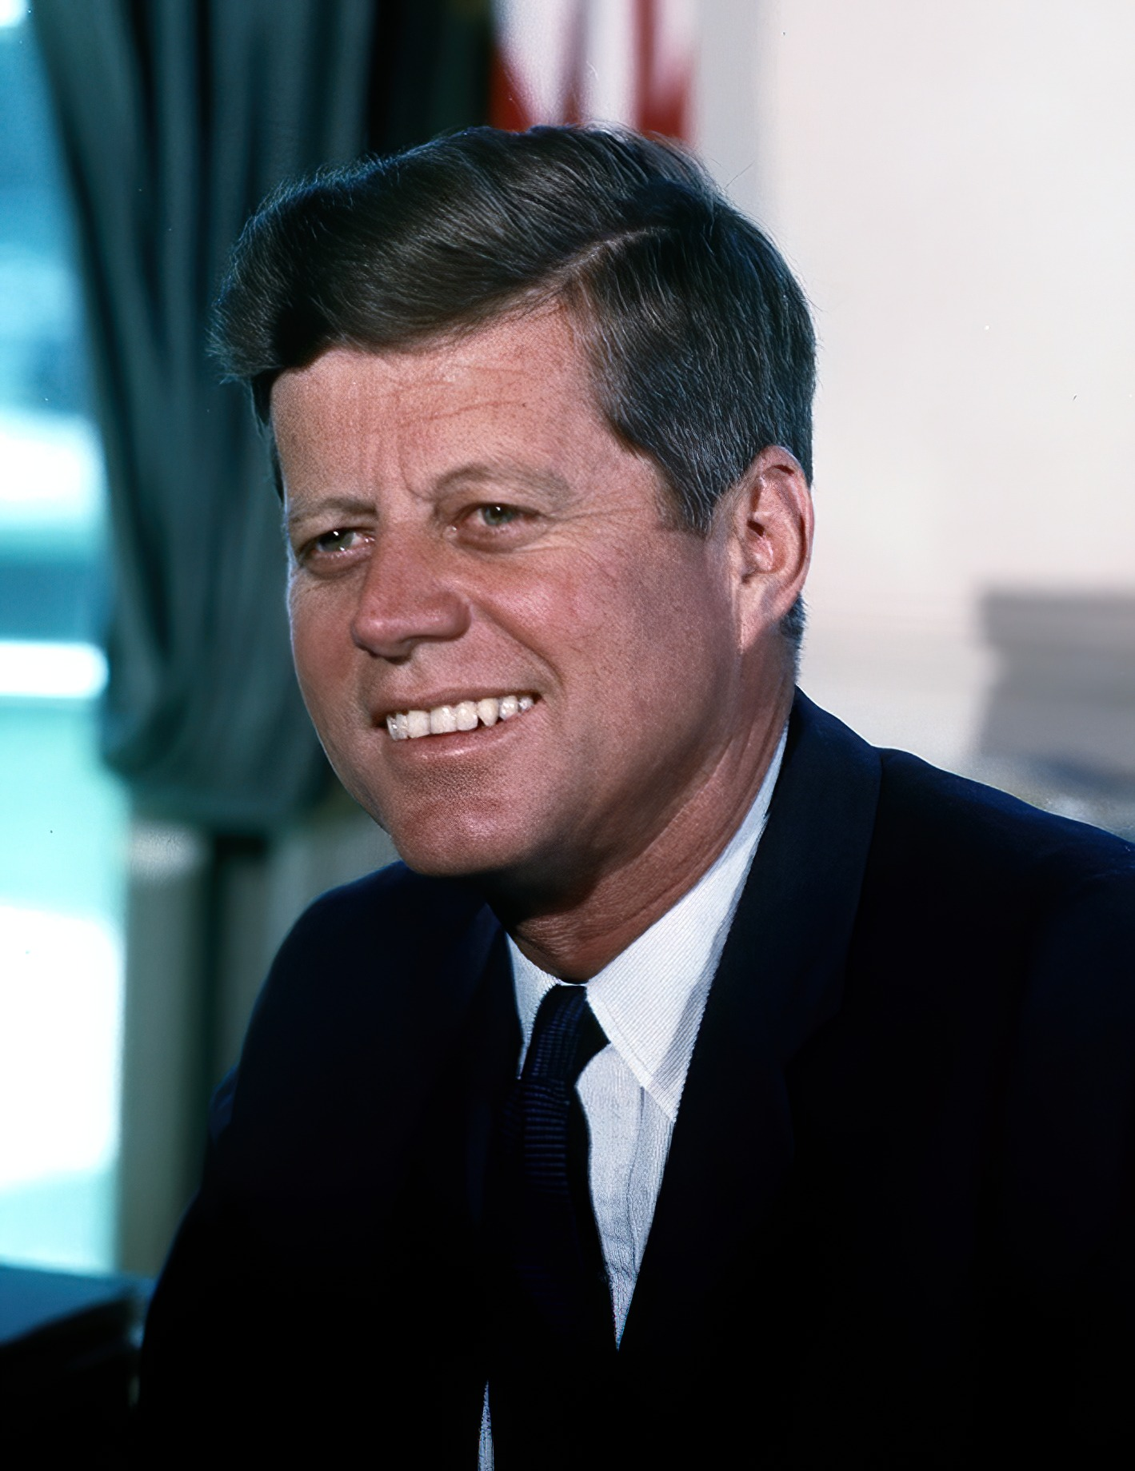
US.77 · DIRECT INSTRUCTION
1 of 4
New Frontier Goals
Kennedy’s New Frontier was an ambitious domestic and foreign policy agenda.
In education, Kennedy proposed federal aid to expand schools and make college more affordable.
He called for ending racial discrimination through civil rights enforcement.
He challenged a new generation to public service and sacrifice, declaring in his inaugural address: “Ask not what your country can do for you—ask what you can do for your country.”
SENTENCE FRAME (EL & writing support)
Cecil Stoughton / White House, c. 1961–1963 Wikimedia Commons
The New Frontier was a set of programs to ___, and Kennedy created the Peace Corps because ___.
TEACHER CUE Chunk → cold-call → confirm before advancing.
U.S. History Hack · TroopToTeacher Technologies LLC · Aligned to TN Academic Standards & TCAP EOC
102
Notes:
FACILITATION (US.77). Ask students: Kennedy said “Ask not what your country can do for you—ask what you can do for your country”—what specific program did he back up those words with, and why did that matter in the Cold War? Teach in small steps; pause and check for understanding before the next chunk (aim 80%+ before moving on).

Slide 116
US.77 · DIRECT INSTRUCTION
2 of 4
The Peace Corps
Kennedy established the Peace Corps by executive order in March 1961.
It sent trained American volunteers to developing countries to help with education, healthcare, and agriculture.
The Peace Corps reflected Kennedy’s strategy of competing with Soviet influence through goodwill and service rather than military force, and tapped the idealism of the baby boom generation.
U.S. History Hack · TroopToTeacher Technologies LLC · Aligned to TN Academic Standards & TCAP EOC
103

Slide 117
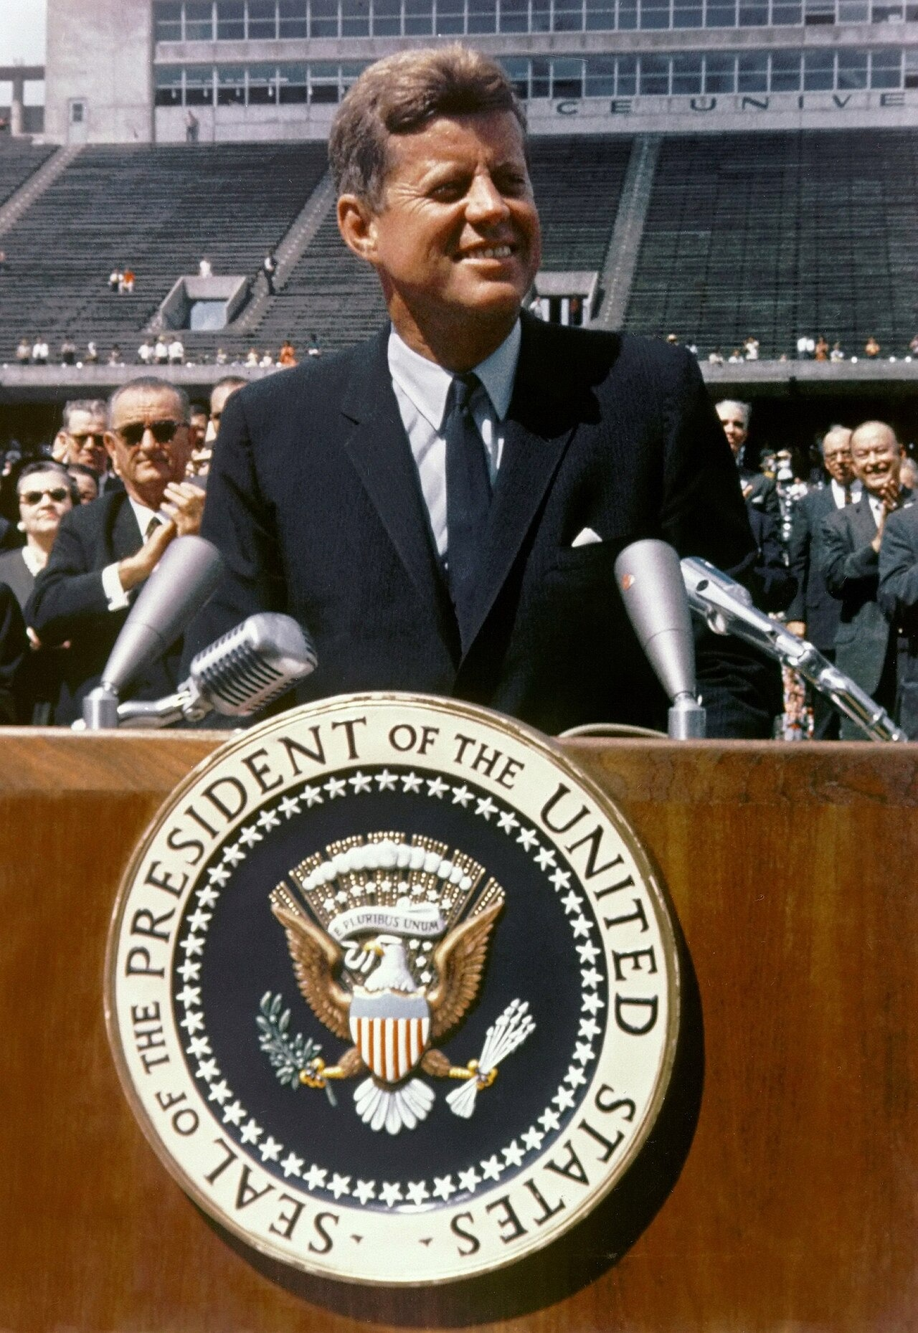
US.77 · DIRECT INSTRUCTION
3 of 4
The Space Race Priority
After the Soviet Union launched Sputnik (1957) and sent the first human to space (Yuri Gagarin, April 1961), Kennedy committed America to landing on the moon before the end of the decade.
In his September 1962 speech at Rice University he declared: “We choose to go to the Moon in this decade and do the other things, not because they are easy, but because they are hard.” The goal mobilized national resources and advanced technology.
NASA, September 12, 1962 Wikimedia Commons
U.S. History Hack · TroopToTeacher Technologies LLC · Aligned to TN Academic Standards & TCAP EOC
104

Slide 118
US.77 · DIRECT INSTRUCTION
4 of 4
Legacy and Limitations
Kennedy was assassinated in Dallas, Texas on November 22, 1963, before most New Frontier programs were fully enacted.
Many were blocked by Congress.
However, his assassination created political momentum: President Johnson used Kennedy’s memory to pass the Civil Rights Act of 1964 and other programs.
The moon landing was achieved in July 1969, fulfilling Kennedy’s promise.
U.S. History Hack · TroopToTeacher Technologies LLC · Aligned to TN Academic Standards & TCAP EOC
105

Slide 119
US.77 · PEOPLE WHO SHAPED THE ERA
Key Figure
John F. Kennedy
35th President (1961–1963)
Created the Peace Corps to send American volunteers abroad
Set the goal of landing on the moon before 1970
Proposed comprehensive civil rights legislation
STRATEGY Use Kennedy to show how Cold War competition and domestic idealism shaped the New Frontier programs.
U.S. History Hack · TroopToTeacher Technologies LLC · Aligned to TN Academic Standards & TCAP EOC
106

Slide 120
US.77 · PRIMARY SOURCE ANALYSIS
Special Message to Congress on the Peace Corps
Argumentation
President John F. Kennedy · March 1, 1961
ZOOM IN Find ONE detail that surprises you — be ready to name it.
"I recommend to the Congress the establishment of a permanent Peace Corps—a pool of trained American men and women sent overseas by the U.S. Government to help foreign countries meet their urgent needs for skilled manpower... Life in the Peace Corps will not be easy... But if the life will not be easy, it will be rich and satisfying."
CONTEXT
John F. Kennedy established the Peace Corps by executive order in March 1961, just weeks after taking office. The Peace Corps reflected Kennedy’s broader foreign policy vision of competing with Soviet influence in the developing world not through military force but through American volunteers sharing skills and goodwill. It also tapped into the idealism of the baby boom generation who wanted to serve and make a difference in the world.
ANALYZE
What was Kennedy’s vision for the Peace Corps?
NASA, September 12, 1962 Wikimedia Commons
SOURCE IT
WHO made it?
WHEN?
WHY does it matter?
FIRST
President John F. Kennedy
March 1, 1961
Consider the author’s purpose and audience before reading the words.
SSP.02 · before you interpret
Source: John F. Kennedy Presidential Library
U.S. History Hack · TroopToTeacher Technologies LLC · Aligned to TN Academic Standards & TCAP EOC
107
Notes:
Primary-source analysis. SOURCE IT FIRST (SSP.02) — model the sourcing routine aloud before students interpret: WHO made this source? (President John F. Kennedy) WHEN? (March 1, 1961) WHY does that matter? (Consider the author’s purpose and audience before reading the words.) Only then move to the ANALYZE question. Suggested answer: See teacher key. Practice skill: Argumentation.

Slide 121
US.77 · KEY VOCABULARY
Word Wall
New Frontier
Nueva Frontera
Peace Corps
Cuerpo de Paz
say: noo frun-TEER
say: pees KOR
NF
President John F. Kennedy’s 1960s domestic program promoting economic growth, education, civil rights, and space exploration; a symbol of optimism.
PC
Volunteer program created by President Kennedy in 1961, sending Americans to developing countries to help with education, health, and economic development.
Moon Landing Goal
Objetivo de Aterrizaje Lunar
Space Race
Carrera Espacial
say: moon LAND-ing
say: spays rays
ML
President Kennedy’s 1961 pledge to land Americans on the moon before 1970, mobilizing national resources, advancing technology, and inspiring a generation.
SR
The Cold War competition between the U.S. and Soviet Union to achieve firsts in space exploration; a top New Frontier priority.
John F. Kennedy
John F. Kennedy
Apollo Program
Programa Apolo
say: KEN-eh-dee
say: uh-POL-oh
JF
The 35th U.S. President (1961–1963) whose New Frontier promised progress in civil rights, the economy, and space.
AP
The NASA program launched under Kennedy's goal of landing an American on the Moon before the decade's end.
"say:" pronunciation guide (stressed syllable in CAPS) and a per-term visual anchor support newcomer English learners. Spanish term + full bilingual Frayer models are in the unit vocabulary set.
U.S. History Hack · TroopToTeacher Technologies LLC · Aligned to TN Academic Standards & TCAP EOC
7

Slide 122
US.77 · GUIDED PRACTICE — WE DO IT TOGETHER
Let’s Work One Together
Identify author’s argument and purpose
MODEL PROMPT: Why did Kennedy argue that the Peace Corps was important for American foreign policy?
WORKED EXAMPLE (teacher models this aloud)
Kennedy argued that trained American volunteers helping developing nations would advance U.S. interests by building goodwill and competing with Soviet influence—not through weapons, but through service.
THINK ALOUD
In the Peace Corps message, underline the phrase that shows Kennedy’s vision went beyond charity to Cold War strategy.
→ Now you try: With a partner, write one sentence: according to Kennedy, why would the Peace Corps be more effective in the Cold War than military force alone?
U.S. History Hack · TroopToTeacher Technologies LLC · Aligned to TN Academic Standards & TCAP EOC
109
Notes:
GUIDED PRACTICE / WE DO (US.77). Skill modeled: Identify author’s argument and purpose. Model the worked example aloud using the THINK ALOUD as your script, then release students to the activity ("With a partner, write one sentence: according to Kennedy, why would the Peace Corps be more effective in the Cold War than military force alone?"). This is the I Do → We Do → You Do bridge — do not skip it; aim for 80%+ success before independent work.

Slide 123
US.77 · STUDENT ACTIVITY
New Frontier in Action — Kennedy’s Programs and the Cold War
Groups of 3
15 min
YOUR TASK
Using your Cornell notes and Kennedy’s Peace Corps message, analyze three New Frontier programs: PEACE CORPS, MOON GOAL, and CIVIL RIGHTS. For each program, identify (a) the domestic problem or Cold War goal it addressed, (b) one piece of evidence from the sections or primary source, and (c) whether Kennedy achieved it. Then argue: which New Frontier program had the greatest long-term impact on America? Use evidence from the sections to defend your choice.
DELIVERABLE
DIFFERENTIATION
Three-program analysis chart (Peace Corps / moon goal / civil rights, each with goal + evidence + outcome) AND a one-paragraph argument identifying the most impactful program with evidence.
Entry: Chart with program names pre-labeled and one column (domestic or Cold War goal) pre-filled for the Peace Corps; student completes the remaining programs. Honors: Argue whether Kennedy’s assassination helped or hurt the New Frontier—did his death make more programs succeed through LBJ, or did it derail the agenda? Use specific evidence from the sections and what you know about the Great Society.
Companion printable: cornell-notes/unit-8/us77-kennedy-new-frontier.pdf
U.S. History Hack · TroopToTeacher Technologies LLC · Aligned to TN Academic Standards & TCAP EOC
110
Notes:
Student activity for US.77. Pair with the printable: cornell-notes/unit-8/us77-kennedy-new-frontier.pdf. Timing: 15. Deliverable: Three-program analysis chart (Peace Corps / moon goal / civil rights, each with goal + evidence + outcome) AND a one-paragraph argument identifying the most impactful program with evidence.

Slide 124
US.77 · CHECK FOR UNDERSTANDING
TCAP-Style Question
DOK 2
EOC PRACTICE
How did President Kennedy’s space program goal reflect Cold War competition?
Domestic agenda to improve education, end discrimination, and reach the moon
A
Send American volunteers to developing nations to provide assistance
B
Commitment to landing Americans on the moon before the decade ended
C
Landing on the moon would demonstrate American technological superiority
D
ANSWER FIRST: students commit — then click / advance to reveal the correct answer and explanation.
U.S. History Hack · TroopToTeacher Technologies LLC · Aligned to TN Academic Standards & TCAP EOC
111
Notes:
CHECK FOR UNDERSTANDING (US.77, DOK 2). Have students commit to an answer (whiteboards, hand signal, or turn-and-talk) BEFORE advancing. Correct answer: D. The next slide reveals it. Why: Kennedy’s moon goal reflected Cold War rivalry because landing Americans on the moon would prove U.S. scientific and technological strength against the Soviet Union. C is wrong because it states the goal but not its broader meaning, and B is wrong because the Peace Corps addressed a different part of the Cold War. The space race turned science into a contest for global prestige.

Slide 125
US.77 · ANSWER REVEAL
TCAP-Style Question
✓ ANSWER KEY
How did President Kennedy’s space program goal reflect Cold War competition?
A
Domestic agenda to improve education, end discrimination, and reach the moon
B
Send American volunteers to developing nations to provide assistance
C
Commitment to landing Americans on the moon before the decade ended
D
Landing on the moon would demonstrate American technological superiority
✓
Correct answer: D. Why: Kennedy’s moon goal reflected Cold War rivalry because landing Americans on the moon would prove U.S. scientific and technological strength against the Soviet Union. C is wrong because it states the goal but not its broader meaning, and B is wrong because the Peace Corps addressed a different part…
U.S. History Hack · TroopToTeacher Technologies LLC · Aligned to TN Academic Standards & TCAP EOC
112
Notes:
ANSWER KEY (US.77). Correct: D. Kennedy’s moon goal reflected Cold War rivalry because landing Americans on the moon would prove U.S. scientific and technological strength against the Soviet Union. C is wrong because it states the goal but not its broader meaning, and B is wrong because the Peace Corps addressed a different part of the Cold War. The space race turned science into a contest for global prestige.

Slide 126
US.77 · WRAP-UP
What You Need to Know for TCAP
KEY TAKEAWAYS
EXIT TICKET
DOK 2
New Frontier Goals
The Peace Corps
The Space Race Priority
Legacy and Limitations
Explain how two of Kennedy’s New Frontier programs were connected to Cold War competition. Use specific evidence from the primary source or sections.
★ HONORS / EXTENSION DOK 3 · SSP.04 Argumentation
Argue: Kennedy’s most lasting New Frontier legacy was not any specific program, but the idea that America had a responsibility to lead—through service, science, and moral courage. Use the Peace Corps message and at least one other piece of evidence to support your argument. (SSP.04)
U.S. History Hack · TroopToTeacher Technologies LLC · Aligned to TN Academic Standards & TCAP EOC
113
Notes:
WRAP-UP / EXIT-TICKET KEY (US.77, DOK 2). Prompt: Explain how two of Kennedy’s New Frontier programs were connected to Cold War competition. Use specific evidence from the primary source or sections. Model answer: Both the Peace Corps and the moon goal were direct responses to Cold War competition. The Peace Corps sent trained American volunteers to developing nations to build goodwill—competing with Soviet influence not through military force but through service. The moon goal challenged the Soviet Union’s early space victories (Sputnik, Gagarin) by committing America to a technological achievement that would demonstrate democratic superiority. Kennedy’s explicit language in the Rice speech—“not because they are easy, but because they are hard”—framed it as a Cold War challenge. RETEACH TRIGGER — if a student misses this exit ticket: (1) <50% of class miss → spiral it into the next standard’s Quick Review opener (see the US.77 review prompts). (2) Individual/small group → reteach with the "New Frontier Goals" direct-instruction slide + re-run the SOURCE IT FIRST routine on the US.77 primary source, then assign the paired printable: cornell-notes/unit-8/us77-kennedy-new-frontier.pdf. (3) Re-assess with the US.77 check-for-understanding reveal slide as a do-now the next day. Reteach anchors (this standard’s sections): New Frontier Goals; The Peace Corps; The Space Race Priority; Legacy and Limitations. I Can objective: I can describe President John F. Kennedy’s New Frontier programs to improve education, end racial discrimination, create the Peace Corps, and put a man on the moon. HONORS / EXTENSION (DOK 3, for early finishers or advanced learners): Argue: Kennedy’s most lasting New Frontier legacy was not any specific program, but the idea that America had a responsibility to lead—through service, science, and moral courage. Use the Peace Corps message and at least one other piece of evidence to support your argument. (SSP.04) — look for a clear claim plus two specific pieces of evidence.

Slide 127
Unit 8 Complete
Postwar Prosperity & 1950s America (1945–1963) · from consumerism, the G.I. Bill, and the suburbs, through the baby boom and the Eisenhower years, to cars and highways, television, Tennessee's rock 'n' roll, and Kennedy's New Frontier.
Revisit your unit hook: How did prosperity, new technology, and mass culture reshape American life in the 1950s — and who was left out? You can now answer with evidence — from the G.I. Bill and Levittown, the baby boom, and Eisenhower's interstate highways, to the automobile, television, Elvis and Memphis music, and Kennedy's New Frontier.
Next: Unit 9 — The Civil Rights Movement
U.S. History Hack · TroopToTeacher Technologies LLC · All primary sources verified against National Archives, Library of Congress, and U.S. Senate records. All images public domain.

Slide 128
KEY VOCABULARY · LANGUAGE SUPPORT
US.77
Words you need before we read
New Frontier
Peace Corps
Moon Landing Goal
En español: Nueva Frontera
En español: Cuerpo de Paz
En español: Objetivo de Aterrizaje Lunar
WHAT IT MEANS
WHAT IT MEANS
WHAT IT MEANS
President John F. Kennedy’s 1960s domestic program promoting economic growth, education, civil rights, and space exploration; a symbol of optimism.
Volunteer program created by President Kennedy in 1961, sending Americans to developing countries to help with education, health, and economic development.
President Kennedy’s 1961 pledge to land Americans on the moon before 1970, mobilizing national resources, advancing technology, and inspiring a generation.
UDL · REPRESENTATION → LANGUAGE & SYMBOLS
U.S. History Hack · TEACHER DECK · Aligned to TN Academic Standards & TCAP EOC
14

Slide 129
PROGRESS CHECK
US.77
Check your understanding
Why did Kennedy commit America to landing on the moon during the Cold War space race?
A
Kennedy had no interest in space exploration, which ignores key developments that shaped the outcome, but closer analysis reveals a more complicated historical reality
B
The moon landing was planned before Kennedy took office, although historical sources do not support this conclusion, though this interpretation lacks supporting historical evidence
C
After Soviet successes with Sputnik and Gagarin's flight, Kennedy committed to the moon landing to demonstrate American technological superiority and prove democracy could achieve ambitious goals
✓ KEY
D
Kennedy's moon commitment was unpopular with Americans, although this overlooks critical economic and social factors, which contradicts the primary source evidence from this era
UDL · ACTION & EXPRESSION → STRATEGY DEVELOPMENT
MTSS: below mastery → targeted reteach (Tier 2); at/above → extension. The goal never lowers.
U.S. History Hack · TEACHER DECK · Aligned to TN Academic Standards & TCAP EOC
15

