Slide 1
How This Deck Works
Universal Design for Learning · Multi-Tiered System of Supports
EVERY LEARNER · SAME FIRM GOAL
Multiple ways in
Multiple ways to see it
Multiple ways to show it
Every lesson opens with a real question and a clear “I can” goal, so you know why it matters and where you’re headed.
Direct instruction, primary sources, maps, and bilingual key vocabulary — the same ideas shown more than one way.
Model-with-me, sentence frames, and choices in how you respond — you reach the same goal by the route that works for you.
Your teacher checks your progress along the way and gives you another path if you need one — the goal never lowers.
U.S. History Hack · TroopToTeacher Technologies LLC · Aligned to TN Academic Standards & TCAP EOC
1

Slide 2
US.78
Brown v. Board of Education
TN STANDARD
US.78 – Examine the decision and impact of Brown v. Board of Education on desegregation. (TCA)
I CAN
I can examine the decision and impact of Brown v. Board of Education on desegregation.
U.S. History Hack · TroopToTeacher Technologies LLC · Aligned to TN Academic Standards & TCAP EOC
1

Slide 3
DIRECT INSTRUCTION
US.78
The NAACP built a legal strategy against segregation — for decades the "separate but equal" doctrine of Plessy v. Ferguson (1896) held; by the 1950s Thurgood Marshall and the NAACP challenged segregated schools, backed by Kenneth Clark’s doll tests showing the harm to Black children.
KEY POINT
The NAACP built a legal strategy against segregation — for decades the "separate but equal" doctrine of Plessy v. Ferguson (1896) held; by the 1950s Thurgood Marshall and the NAACP challenged segregated schools, backed by Kenneth Clark’s doll tests showing the harm to Black children.
US.78 · The Road to Brown
U.S. History Hack · TroopToTeacher Technologies LLC · Aligned to TN Academic Standards & TCAP EOC
2

Slide 4
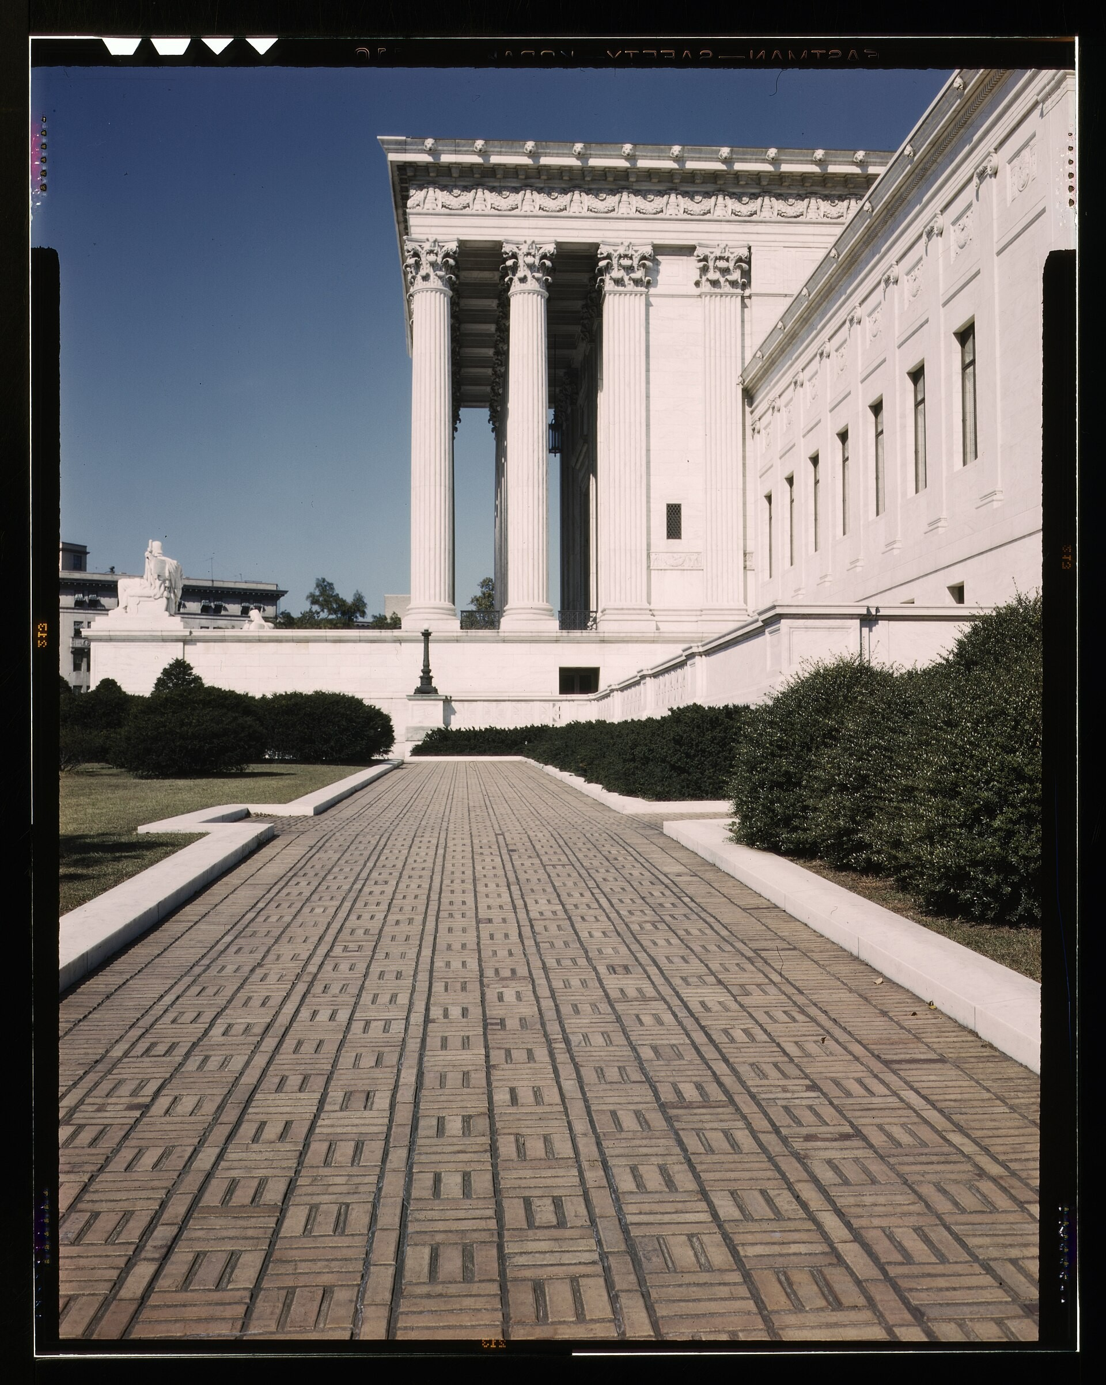
DIRECT INSTRUCTION
US.78
A unanimous Court struck down school segregation — the Supreme Court consolidated five cases; Chief Justice Earl Warren wrote that "separate educational facilities are inherently unequal," violating the 14th Amendment’s Equal Protection Clause.
ZOOM IN
US.78 · The Decision
U.S. History Hack · TroopToTeacher Technologies LLC · Aligned to TN Academic Standards & TCAP EOC
3

Slide 5
DIRECT INSTRUCTION
US.78
Ending segregation on paper proved slow — Brown II (1955) ordered desegregation "with all deliberate speed"; Southern "massive resistance" meant only 2% of Black Southern students attended integrated schools by 1964, yet Brown anchored the wider movement.
KEY POINT
Ending segregation on paper proved slow — Brown II (1955) ordered desegregation "with all deliberate speed"; Southern "massive resistance" meant only 2% of Black Southern students attended integrated schools by 1964, yet Brown anchored the wider movement.
US.78 · Impact & Resistance
U.S. History Hack · TroopToTeacher Technologies LLC · Aligned to TN Academic Standards & TCAP EOC
4

Slide 6
SOURCE IT FIRST
US.78
Read the Brown decision — weigh who wrote it and why before you read the words.
WHO
WHEN
WHY
Chief Justice Earl Warren
May 17, 1954
Consider the author’s purpose and audience before you interpret the words.
Brown v. Board of Education Decision
Chief Justice Earl Warren · May 17, 1954
"We conclude that, in the field of public education, the doctrine of "separate but equal" has no place. Separate educational facilities are inherently unequal. Therefore, we hold that the plaintiffs and others similarly situated... are, by reason of the segregation complained of, deprived of the equal protection of the laws guaranteed by the Fourteenth Amendment."
National Archives
U.S. History Hack · TroopToTeacher Technologies LLC · Aligned to TN Academic Standards & TCAP EOC
5

Slide 7
THREE PERSPECTIVES
US.78
A historian returns to three questions at the end of every reading. Use them to analyze this standard.
Who benefited?
Who bore the costs?
Who decided?
Who gained land, wealth, power, or protection?
Who lost land, labor, freedom, or life — and who was silenced?
Which people, offices, or courts held the authority?
US.78:
US.78:
US.78:
Black children and families who won a constitutional ruling against segregated schools, and the broader civil rights movement that gained legal footing.
Black students who still faced closed schools, private academies, and years of ’massive resistance’ before the ruling was enforced.
The U.S. Supreme Court, which issued the unanimous decision, and Southern officials and states who controlled how quickly it was obeyed.
Anchor: Brown v. Board of Education Decision, Chief Justice Earl Warren, May 17, 1954 (National Archives)
U.S. History Hack · TroopToTeacher Technologies LLC · Aligned to TN Academic Standards & TCAP EOC
6

Slide 8
KEY VOCABULARY · LANGUAGE SUPPORT
US.78
Words you need before we read
Brown v. Board of Education
Clinton 12
Little Rock Nine
En español: Brown contra el Consejo de Educación
En español: Los 12 de Clinton
En español: Los Nueve de Little Rock
WHAT IT MEANS
WHAT IT MEANS
WHAT IT MEANS
The landmark 1954 Supreme Court decision that declared state laws establishing separate public schools for Black and white students unconstitutional, overturning Plessy v. Ferguson and ending legal school…
The 12 African American students who integrated Clinton High School in Tennessee in 1956, making it the first state-supported high school in the South to integrate following Brown v. Board of Education.
The nine African American students who integrated Central High School in Little Rock, Arkansas in 1957, facing violent mobs and requiring federal troops protection ordered by President Eisenhower.
U.S. History Hack · TroopToTeacher Technologies LLC · Aligned to TN Academic Standards & TCAP EOC
2

Slide 9
PROGRESS CHECK
US.78
Check your understanding
Why was school desegregation so difficult to implement despite the Supreme Court's ruling?
A
Brown II's "all deliberate speed" language allowed gradual implementation while Southern states launched "massive resistance" campaigns
B
The ruling only applied to a few specific school districts, but the historical record tells a more complex story
C
Federal troops refused to enforce the decision, but this fails to account for the broader historical context
D
Most Black families preferred segregated schools, but contemporary accounts suggest a different explanation
Confidence: 😟 1 🙂 2 😀 3 — circle where you are; your teacher routes reteach or extension.
U.S. History Hack · TroopToTeacher Technologies LLC · Aligned to TN Academic Standards & TCAP EOC
3

Slide 10
US.79
Civil Rights Advocates and Opponents
TN STANDARD
US.79 – Examine the roles and actions of civil rights advocates and opponents and how they coincided, confronted, and challenged each other. (TCA)
I CAN
I can examine the roles and actions of civil rights advocates (e.g., Malcolm X, Thurgood Marshall, Rosa Parks) and opponents (e.g., Bull Connor, Orval Faubus, Strom Thurmond) and how they coincided, confronted, and challenged each other.
U.S. History Hack · TroopToTeacher Technologies LLC · Aligned to TN Academic Standards & TCAP EOC
7

Slide 11
DIRECT INSTRUCTION
US.79
Advocates led with different strategies — Martin Luther King Jr. organized nonviolent resistance and the SCLC; Malcolm X promoted Black nationalism, then human rights; Thurgood Marshall argued Brown and joined the Supreme Court; Rosa Parks sparked the Montgomery Bus Boycott.
KEY POINT
Advocates led with different strategies — Martin Luther King Jr. organized nonviolent resistance and the SCLC; Malcolm X promoted Black nationalism, then human rights; Thurgood Marshall argued Brown and joined the Supreme Court; Rosa Parks sparked the Montgomery Bus Boycott.
US.79 · Civil Rights Advocates
U.S. History Hack · TroopToTeacher Technologies LLC · Aligned to TN Academic Standards & TCAP EOC
8

Slide 12
DIRECT INSTRUCTION
US.79
Opponents used office and violence to resist — Bull Connor turned fire hoses and dogs on protesters; Governor Orval Faubus defied court orders at Little Rock; Senator Strom Thurmond led the Dixiecrat revolt and filibustered civil rights legislation for 24+ hours.
KEY POINT
Opponents used office and violence to resist — Bull Connor turned fire hoses and dogs on protesters; Governor Orval Faubus defied court orders at Little Rock; Senator Strom Thurmond led the Dixiecrat revolt and filibustered civil rights legislation for 24+ hours.
US.79 · Civil Rights Opponents
U.S. History Hack · TroopToTeacher Technologies LLC · Aligned to TN Academic Standards & TCAP EOC
9

Slide 13
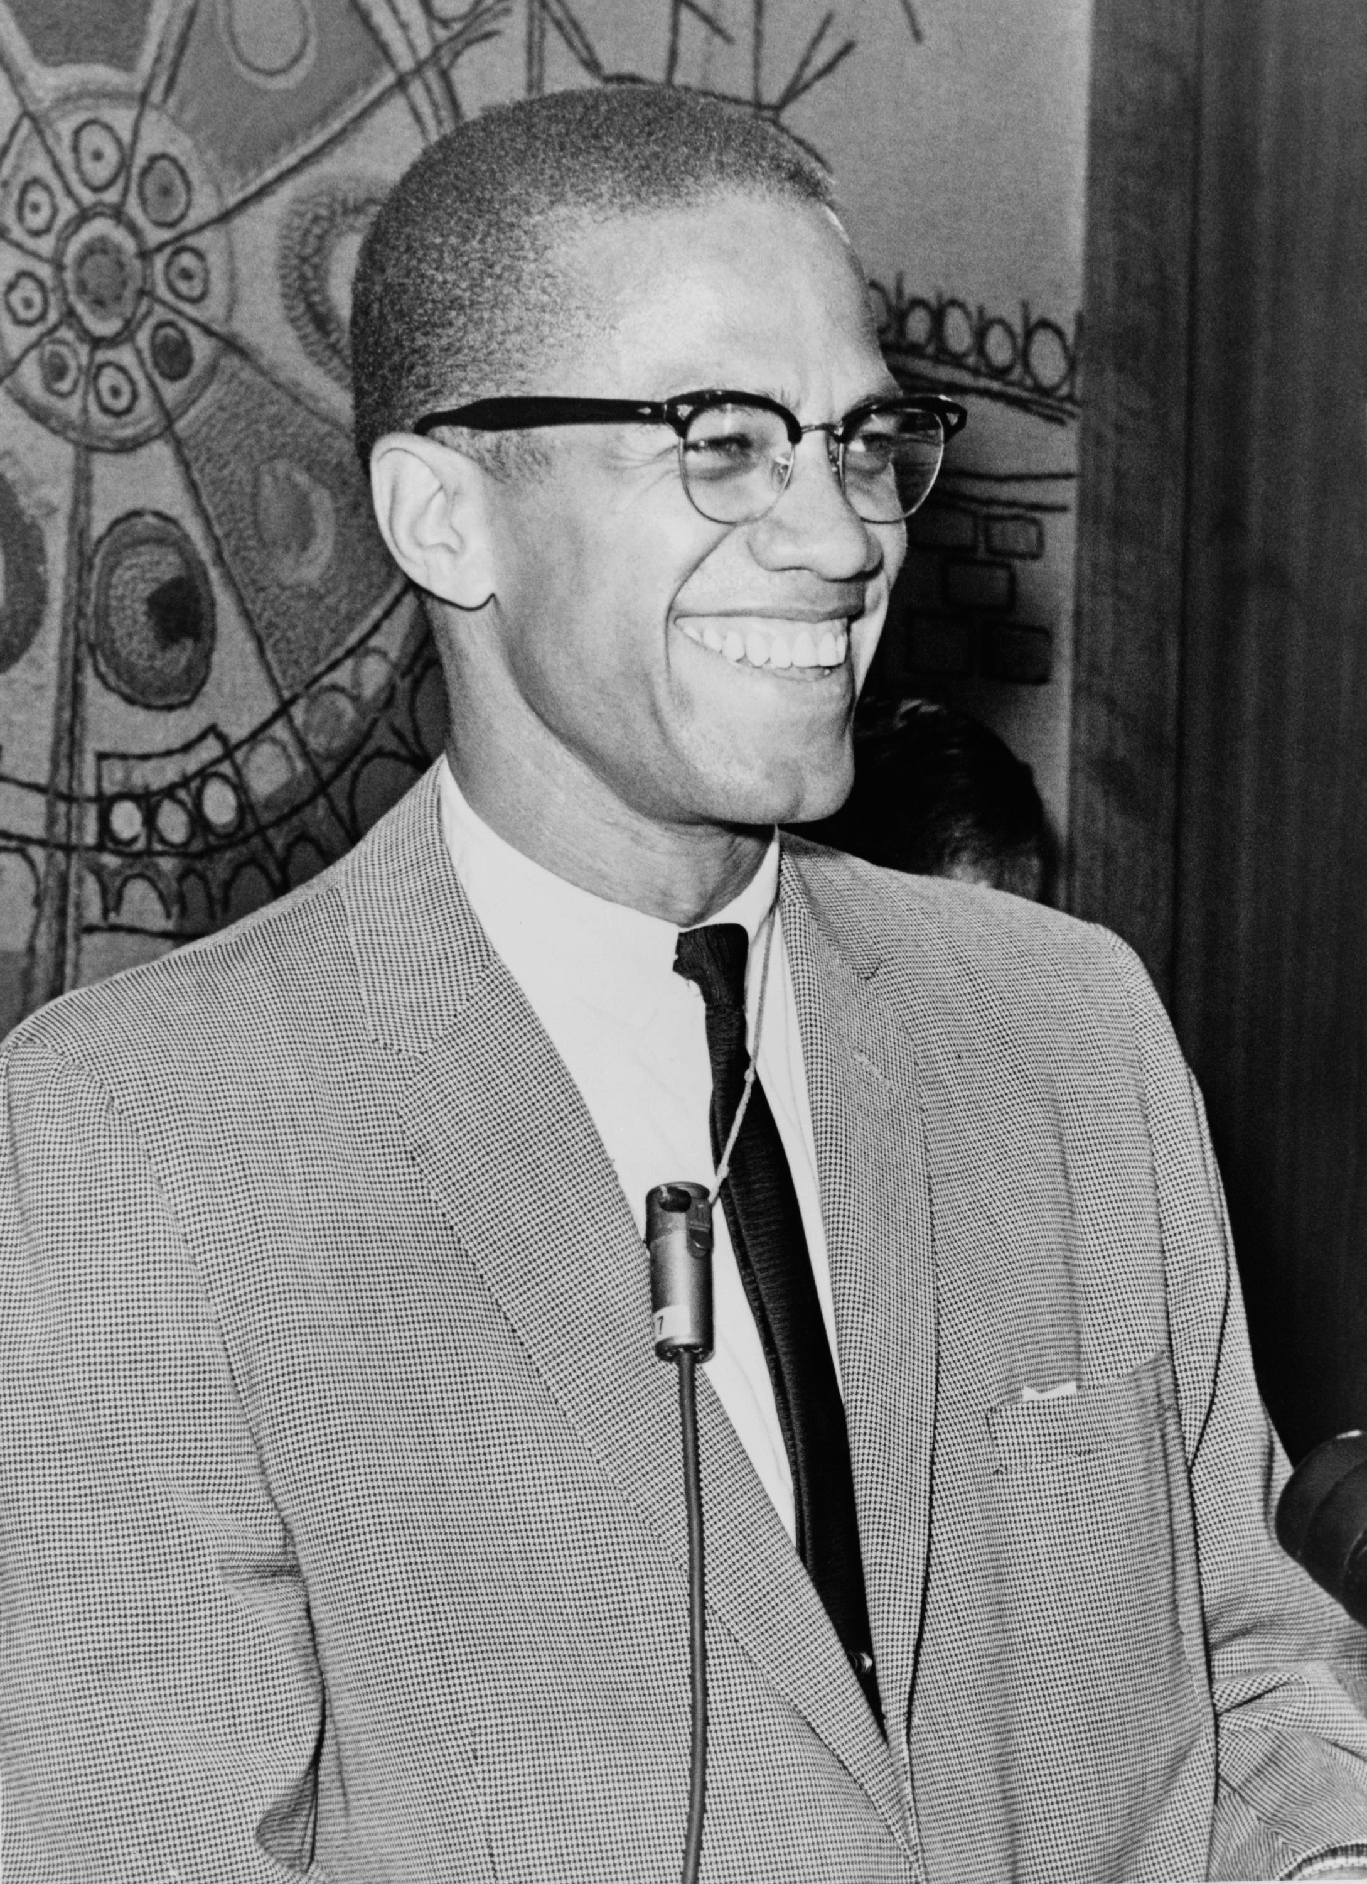
DIRECT INSTRUCTION
US.79
Nonviolence and self-defense both shaped the movement — King emphasized integration and nonviolence while Malcolm X first urged separation and self-defense; both evolved, and courtroom victories and mass protests reinforced one another.
ZOOM IN
US.79 · Comparing Approaches
U.S. History Hack · TroopToTeacher Technologies LLC · Aligned to TN Academic Standards & TCAP EOC
10

Slide 14
SOURCE IT FIRST
US.79
Read "The Ballot or the Bullet" — identify the speaker and purpose before you weigh the words.
WHO
WHEN
WHY
Malcolm X
April 3, 1964
Consider the author’s purpose and audience before you interpret the words.
The Ballot or the Bullet
Malcolm X · April 3, 1964
"It'll be the ballot or the bullet. It'll be liberty or it'll be death. And if you're not ready to pay that price don't use the word freedom in your vocabulary... I'm not an American. I'm one of the 22 million Black people who are the victims of Americanism... I don't see any American dream; I see an American nightmare."
Library of Congress
U.S. History Hack · TroopToTeacher Technologies LLC · Aligned to TN Academic Standards & TCAP EOC
11

Slide 15
THREE PERSPECTIVES
US.79
A historian returns to three questions at the end of every reading. Use them to analyze this standard.
Who benefited?
Who bore the costs?
Who decided?
Who gained land, wealth, power, or protection?
Who lost land, labor, freedom, or life — and who was silenced?
Which people, offices, or courts held the authority?
US.79:
US.79:
US.79:
African Americans who gained visible leaders and a range of strategies, and a movement strengthened by both legal and grassroots pressure.
Activists who faced violence, jail, and assassination, and Black communities targeted by officials like Connor, Faubus, and Thurmond.
Movement leaders and organizations who chose tactics, and the officials, governors, and senators who used their power to resist change.
Anchor: The Ballot or the Bullet, Malcolm X, April 3, 1964 (Library of Congress)
U.S. History Hack · TroopToTeacher Technologies LLC · Aligned to TN Academic Standards & TCAP EOC
12

Slide 16
KEY VOCABULARY · LANGUAGE SUPPORT
US.79
Words you need before we read
Rosa Parks
Dr. Martin Luther King Jr.
Malcolm X
En español: Rosa Parks
En español: Dr. Martin Luther King Jr.
En español: Malcolm X
WHAT IT MEANS
WHAT IT MEANS
WHAT IT MEANS
The "Mother of the Civil Rights Movement" who refused to give up her bus seat to a white passenger in Montgomery, Alabama in 1955, sparking the Montgomery Bus Boycott.
Baptist minister and the most prominent leader of the Civil Rights Movement, advocating nonviolent resistance and delivering the iconic "I Have a Dream" speech at the 1963 March on Washington.
Influential civil rights leader and Nation of Islam minister who advocated for Black nationalism, self-defense, and economic independence before his assassination in 1965.
U.S. History Hack · TroopToTeacher Technologies LLC · Aligned to TN Academic Standards & TCAP EOC
4

Slide 17
PROGRESS CHECK
US.79
Check your understanding
Compare the philosophies of Martin Luther King Jr. and Malcolm X regarding integration and Black identity.
A
Both leaders held identical views throughout their careers, which ignores key developments that shaped the outcome and oversimplifies the complex factors at work during this period
B
King emphasized integration through Christian love and nonviolence while Malcolm X initially promoted Black nationalism and self-defense, though both evolved over time
C
Malcolm X always supported King's nonviolent approach, despite limited evidence supporting this interpretation, but contemporary accounts and primary sources suggest otherwise
D
King opposed integration while Malcolm X supported it, though this interpretation lacks supporting historical evidence, and this view has been largely revised by modern historical research
Confidence: 😟 1 🙂 2 😀 3 — circle where you are; your teacher routes reteach or extension.
U.S. History Hack · TroopToTeacher Technologies LLC · Aligned to TN Academic Standards & TCAP EOC
5

Slide 18
US.80
Significant Civil Rights Events
TN STANDARD
US.80 – Describe the significant events in the struggle to secure civil rights for African Americans, including: Montgomery Bus Boycott, Integration of Clinton High School and Central High School, Freedom Riders, Highlander Folk School, Tent City in Fayette County, TN, marches/demonstrations/boycotts/sit-ins, March on Washington D.C., Birmingham bombings of 1963, and assassination of Martin Luther King Jr. (TCA)
I CAN
I can describe the significant events in the struggle to secure civil rights for African Americans, including the Montgomery Bus Boycott, Freedom Riders, March on Washington, Birmingham bombings, and assassination of Martin Luther King Jr.
U.S. History Hack · TroopToTeacher Technologies LLC · Aligned to TN Academic Standards & TCAP EOC
13

Slide 19
DIRECT INSTRUCTION
US.80
Early victories proved nonviolent protest worked — the Montgomery Bus Boycott (1955-1956), sparked by Rosa Parks, sustained 381 days and lifted King to national leadership; the 1960 Nashville sit-ins, led by John Lewis and Diane Nash, desegregated lunch counters.
KEY POINT
Early victories proved nonviolent protest worked — the Montgomery Bus Boycott (1955-1956), sparked by Rosa Parks, sustained 381 days and lifted King to national leadership; the 1960 Nashville sit-ins, led by John Lewis and Diane Nash, desegregated lunch counters.
US.80 · Early Movement Victories
U.S. History Hack · TroopToTeacher Technologies LLC · Aligned to TN Academic Standards & TCAP EOC
14

Slide 20
DIRECT INSTRUCTION
US.80
Tennessee stood at the center of the struggle — Clinton High School (1956) was the first Southern community to integrate under Brown; Highlander Folk School trained Rosa Parks and King; Fayette County’s Tent City (1960) sheltered Black sharecroppers evicted for trying to vote.
KEY POINT
Tennessee stood at the center of the struggle — Clinton High School (1956) was the first Southern community to integrate under Brown; Highlander Folk School trained Rosa Parks and King; Fayette County’s Tent City (1960) sheltered Black sharecroppers evicted for trying to vote.
US.80 · Tennessee’s Role
U.S. History Hack · TroopToTeacher Technologies LLC · Aligned to TN Academic Standards & TCAP EOC
15

Slide 21
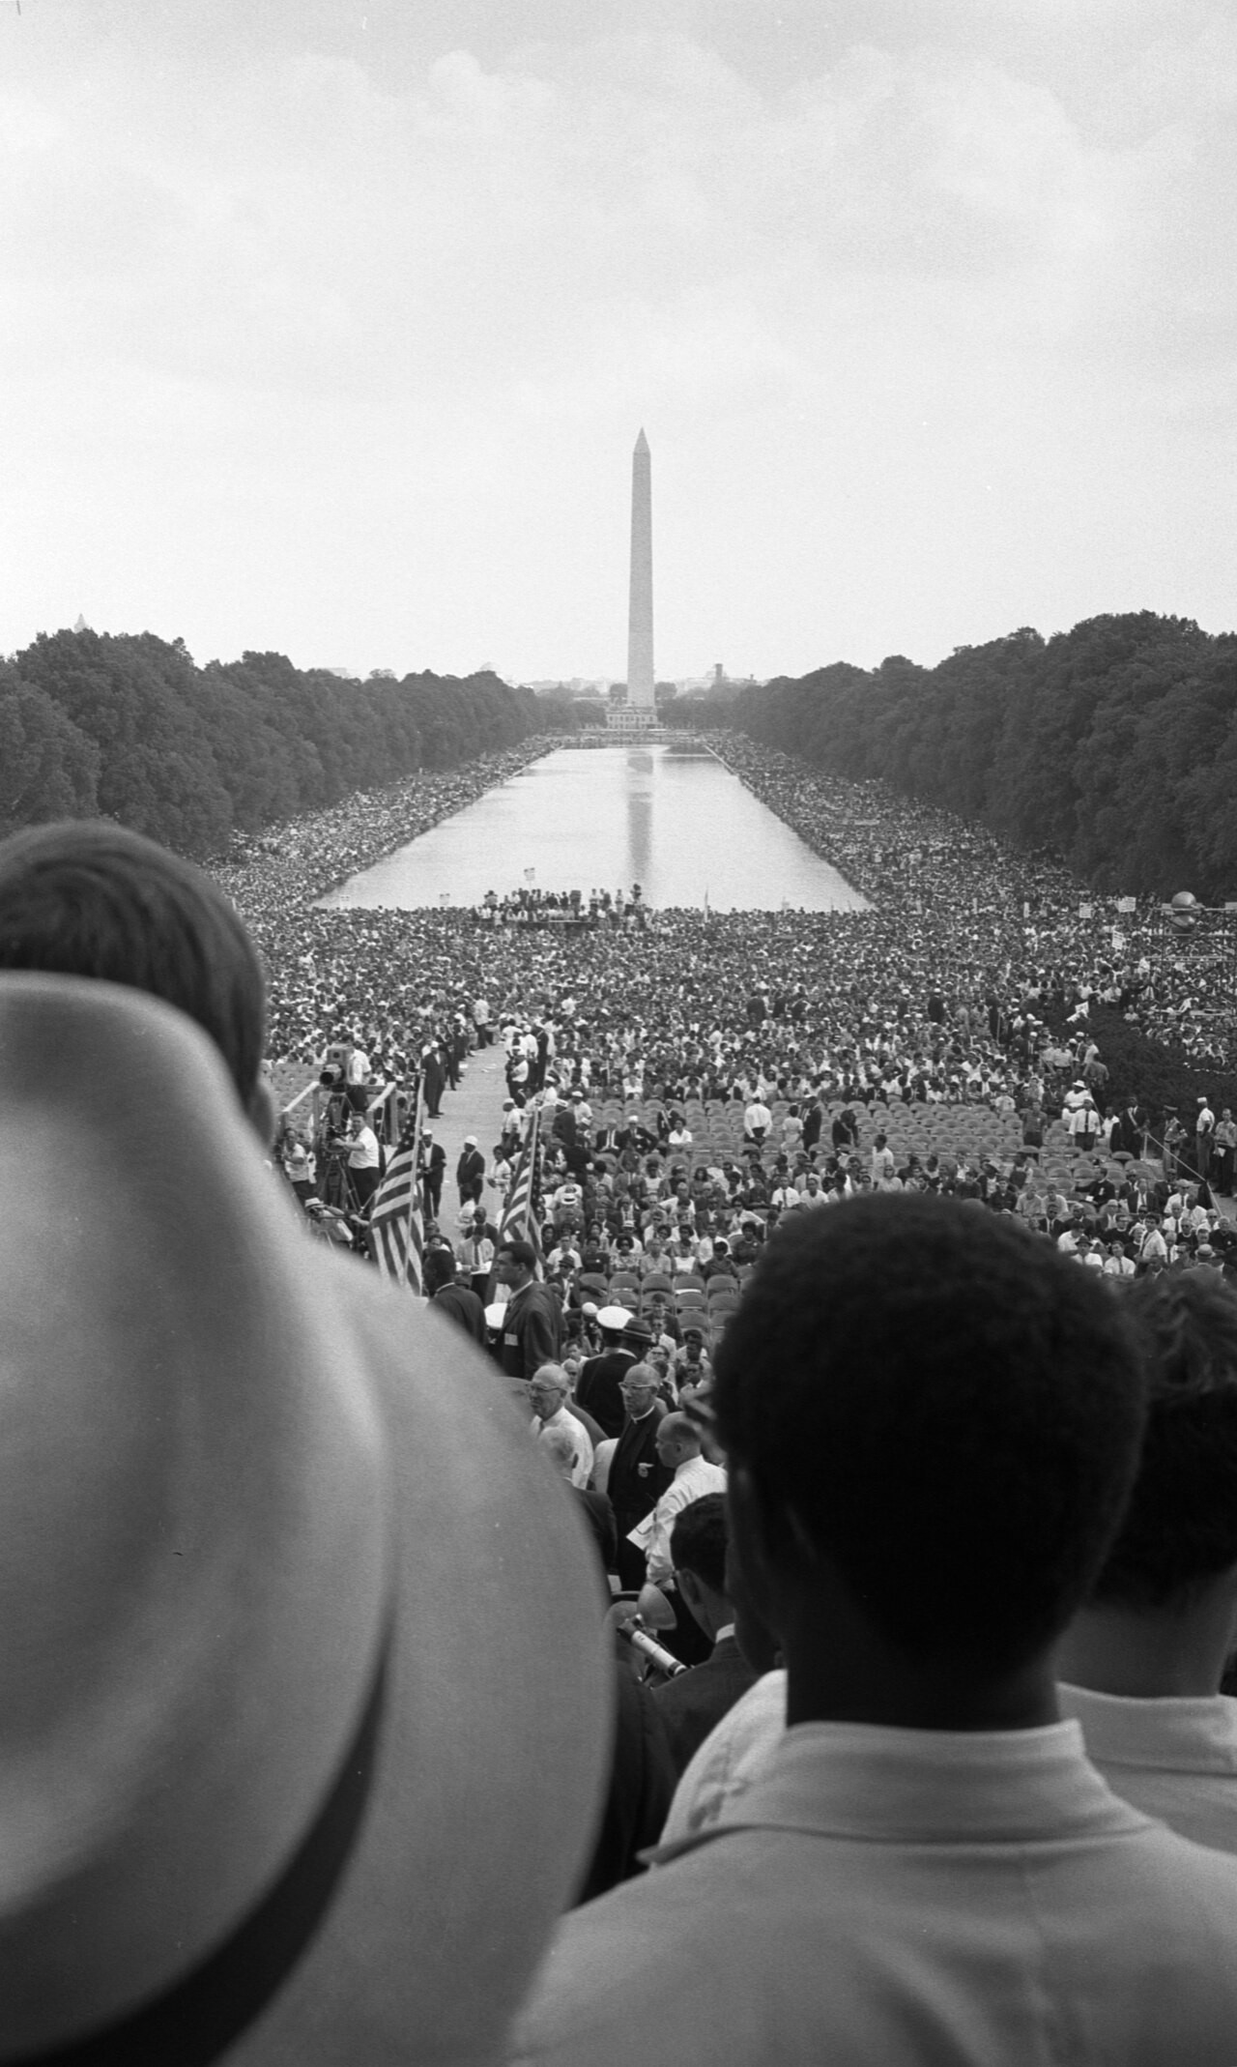
DIRECT INSTRUCTION
US.80
Confrontations forced federal action and legislation — the Little Rock Nine (1957) and Freedom Riders (1961) drew federal intervention, the Birmingham Campaign (1963) shocked the nation, and the March on Washington (1963) pressured Congress before King’s 1968 Memphis assassination.
ZOOM IN
US.80 · Confrontations & Culmination
U.S. History Hack · TroopToTeacher Technologies LLC · Aligned to TN Academic Standards & TCAP EOC
16

Slide 22
SOURCE IT FIRST
US.80
Read the "Letter from Birmingham Jail" — note the author, date, and purpose before you weigh his words.
WHO
WHEN
WHY
Dr. Martin Luther King Jr.
April 16, 1963
Consider the author’s purpose and audience before you interpret the words.
Letter from Birmingham Jail
Dr. Martin Luther King Jr. · April 16, 1963
"Injustice anywhere is a threat to justice everywhere. We are caught in an inescapable network of mutuality, tied in a single garment of destiny. Whatever affects one directly, affects all indirectly... I have almost reached the regrettable conclusion that the Negro's great stumbling block in his stride toward freedom is not the White Citizen's Counciler or the Ku Klux Klanner, but the white moderate."
The Martin Luther King, Jr. Research and Education Institute, Stanford University
U.S. History Hack · TroopToTeacher Technologies LLC · Aligned to TN Academic Standards & TCAP EOC
17

Slide 23
THREE PERSPECTIVES
US.80
A historian returns to three questions at the end of every reading. Use them to analyze this standard.
Who benefited?
Who bore the costs?
Who decided?
Who gained land, wealth, power, or protection?
Who lost land, labor, freedom, or life — and who was silenced?
Which people, offices, or courts held the authority?
US.80:
US.80:
US.80:
African Americans who won desegregated buses, lunch counters, and schools, and a movement that gained national attention and momentum.
Protesters who faced arrest, beatings, firebombings, and death, including sharecroppers evicted for voting and King, assassinated in Memphis.
Movement organizers who planned the actions, and presidents, courts, and Congress pressured into enforcing rights and passing legislation.
Anchor: Letter from Birmingham Jail, Dr. Martin Luther King Jr., April 16, 1963 (The Martin Luther King, Jr. Research and Education Institute, Stanford University)
U.S. History Hack · TroopToTeacher Technologies LLC · Aligned to TN Academic Standards & TCAP EOC
18

Slide 24
KEY VOCABULARY · LANGUAGE SUPPORT
US.80
Words you need before we read
Montgomery Bus Boycott
Freedom Riders
Highlander Folk School
En español: Boicot de Autobuses de Montgomery
En español: Jinetes de la Libertad
En español: Escuela Popular Highlander
WHAT IT MEANS
WHAT IT MEANS
WHAT IT MEANS
The 381-day boycott (1955-1956) of the Montgomery, Alabama bus system by African Americans protesting segregated seating, ending when the Supreme Court ruled bus segregation unconstitutional.
Interracial groups of civil rights activists who rode interstate buses into the segregated South in 1961 to challenge illegal segregation of public transportation, facing violent attacks.
Tennessee education center founded in 1932 that trained civil rights leaders including Rosa Parks, Martin Luther King Jr., and John Lewis in nonviolent resistance and organizing tactics.
U.S. History Hack · TroopToTeacher Technologies LLC · Aligned to TN Academic Standards & TCAP EOC
6

Slide 25
PROGRESS CHECK
US.80
Check your understanding
How did television coverage of events like Birmingham and Little Rock build national support for civil rights legislation?
A
Television had minimal impact on public opinion, despite limited evidence supporting this interpretation, but closer analysis reveals a more complicated historical reality
B
Television coverage primarily supported segregationists, yet the available evidence points to a different conclusion
C
Images of fire hoses, police dogs, and troops protecting children shocked Americans and generated sympathy for the movement, pressuring Congress to act
D
Most Americans did not have access to television coverage, yet the available evidence points to a different conclusion
Confidence: 😟 1 🙂 2 😀 3 — circle where you are; your teacher routes reteach or extension.
U.S. History Hack · TroopToTeacher Technologies LLC · Aligned to TN Academic Standards & TCAP EOC
7

Slide 26
US.81
Civil and Voting Rights Legislation
TN STANDARD
US.81 – Analyze civil and voting rights legislation, including: The Civil Rights Act of 1964, the Voting Rights Act of 1965, the Civil Rights Act of 1968 (e.g., Fair Housing Act), and the 24th Amendment. (TCA)
I CAN
I can analyze civil and voting rights legislation, including the Civil Rights Act of 1964, the Voting Rights Act of 1965, the Civil Rights Act of 1968 (Fair Housing Act), and the 24th Amendment.
U.S. History Hack · TroopToTeacher Technologies LLC · Aligned to TN Academic Standards & TCAP EOC
19

Slide 27
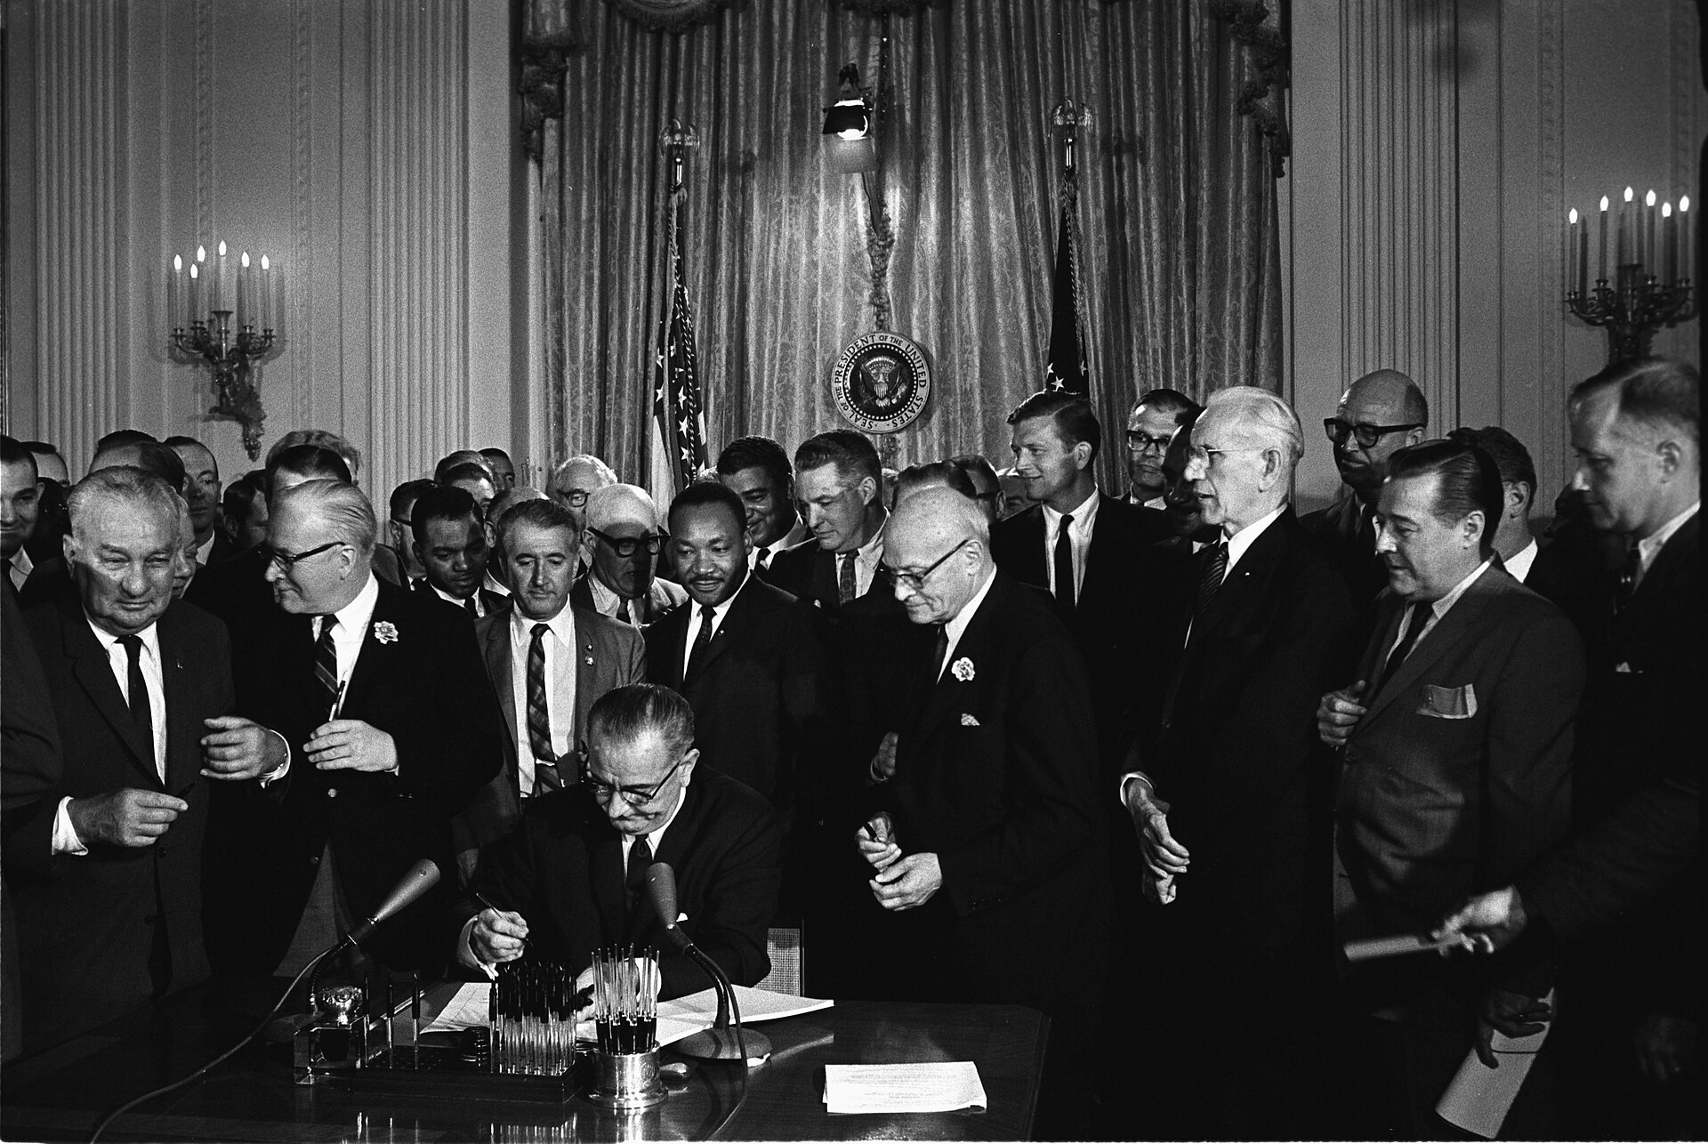
DIRECT INSTRUCTION
US.81
The Civil Rights Act of 1964 outlawed segregation — it banned discrimination in public accommodations, employment, and federally funded programs, created the EEOC, and ended legal segregation in public facilities.
ZOOM IN
US.81 · Civil Rights Act of 1964
U.S. History Hack · TroopToTeacher Technologies LLC · Aligned to TN Academic Standards & TCAP EOC
20

Slide 28
DIRECT INSTRUCTION
US.81
The Voting Rights Act of 1965 protected the ballot — it banned literacy tests, required federal approval for voting changes in covered areas, and sent federal registrars — lifting Black Southern voter registration from 23% to 61% by 1969.
KEY POINT
The Voting Rights Act of 1965 protected the ballot — it banned literacy tests, required federal approval for voting changes in covered areas, and sent federal registrars — lifting Black Southern voter registration from 23% to 61% by 1969.
US.81 · Voting Rights Act of 1965
U.S. History Hack · TroopToTeacher Technologies LLC · Aligned to TN Academic Standards & TCAP EOC
21

Slide 29
DIRECT INSTRUCTION
US.81
Later laws completed the legal framework — the 24th Amendment (1964) ended poll taxes in federal elections, and the Civil Rights Act of 1968 (Fair Housing Act), passed after King’s assassination, barred discrimination in housing.
KEY POINT
Later laws completed the legal framework — the 24th Amendment (1964) ended poll taxes in federal elections, and the Civil Rights Act of 1968 (Fair Housing Act), passed after King’s assassination, barred discrimination in housing.
US.81 · 24th Amendment & Fair Housing
U.S. History Hack · TroopToTeacher Technologies LLC · Aligned to TN Academic Standards & TCAP EOC
22

Slide 30
SOURCE IT FIRST
US.81
Read the Civil Rights Act of 1964 — identify who wrote it and why before you read the text.
WHO
WHEN
WHY
U.S. Congress
July 2, 1964
Consider the author’s purpose and audience before you interpret the words.
Civil Rights Act of 1964
U.S. Congress · July 2, 1964
"All persons shall be entitled to the full and equal enjoyment of the goods, services, facilities, privileges, advantages, and accommodations of any place of public accommodation... without discrimination or segregation on the ground of race, color, religion, or national origin."
National Archives
U.S. History Hack · TroopToTeacher Technologies LLC · Aligned to TN Academic Standards & TCAP EOC
23

Slide 31
THREE PERSPECTIVES
US.81
A historian returns to three questions at the end of every reading. Use them to analyze this standard.
Who benefited?
Who bore the costs?
Who decided?
Who gained land, wealth, power, or protection?
Who lost land, labor, freedom, or life — and who was silenced?
Which people, offices, or courts held the authority?
US.81:
US.81:
US.81:
African Americans and other minorities who gained legal protection in jobs, public places, voting, and housing, and millions of new Southern voters.
Activists who died pressing for the laws, and communities where weak enforcement and lingering discrimination limited the laws’ real effect.
Congress, which passed the legislation and amendment, and President Lyndon Johnson, who pushed and signed the landmark civil rights laws.
Anchor: Civil Rights Act of 1964, U.S. Congress, July 2, 1964 (National Archives)
U.S. History Hack · TroopToTeacher Technologies LLC · Aligned to TN Academic Standards & TCAP EOC
24

Slide 32
KEY VOCABULARY · LANGUAGE SUPPORT
US.81
Words you need before we read
Civil Rights Act of 1964
Voting Rights Act of 1965
Civil Rights Act of 1968 (Fair Housing Act)
En español: Ley de Derechos Civiles de 1964
En español: Ley de Derechos de Voto de 1965
En español: Ley de Derechos Civiles de 1968 (Ley de Vivienda Justa)
WHAT IT MEANS
WHAT IT MEANS
WHAT IT MEANS
Landmark federal legislation that outlawed discrimination based on race, color, religion, sex, or national origin, ending segregation in public accommodations and employment.
Federal legislation that outlawed discriminatory voting practices (literacy tests, poll taxes) used to disenfranchise African Americans, dramatically increasing Black voter registration in the South.
Federal law that prohibited discrimination in the sale, rental, and financing of housing based on race, religion, national origin, or sex, addressing residential segregation.
U.S. History Hack · TroopToTeacher Technologies LLC · Aligned to TN Academic Standards & TCAP EOC
8

Slide 33
PROGRESS CHECK
US.81
Check your understanding
Why was the Fair Housing Act (1968) necessary even after earlier civil rights legislation?
A
Earlier legislation had already addressed housing discrimination, although this view has been largely discredited by scholars
B
Housing discrimination was not a significant problem, despite limited evidence supporting this interpretation
C
The Fair Housing Act replaced the 1964 Civil Rights Act, which does not align with the documented historical record
D
The 1964 Act focused on public accommodations and employment but did not address residential segregation, which perpetuated inequality
Confidence: 😟 1 🙂 2 😀 3 — circle where you are; your teacher routes reteach or extension.
U.S. History Hack · TroopToTeacher Technologies LLC · Aligned to TN Academic Standards & TCAP EOC
9

Slide 34
US.82
American Indian, Chicano & Feminist Movements
TN STANDARD
US.82 – Analyze how the American Indian Movement, Chicano Movement, and Feminist Movement are related to the Civil Rights Movement in advancing equality across the broader spectrum of American society during this time period.
I CAN
I can analyze how the American Indian Movement, Chicano Movement, and Feminist Movement are related to the Civil Rights Movement in advancing equality across American society.
U.S. History Hack · TroopToTeacher Technologies LLC · Aligned to TN Academic Standards & TCAP EOC
25

Slide 35
DIRECT INSTRUCTION
US.82
The American Indian Movement demanded sovereignty — AIM pursued treaty rights, cultural preservation, and self-determination through the Occupation of Alcatraz (1969-1971), the Trail of Broken Treaties (1972), and Wounded Knee (1973), with Russell Means urging "Red Power."
KEY POINT
The American Indian Movement demanded sovereignty — AIM pursued treaty rights, cultural preservation, and self-determination through the Occupation of Alcatraz (1969-1971), the Trail of Broken Treaties (1972), and Wounded Knee (1973), with Russell Means urging "Red Power."
US.82 · American Indian Movement
U.S. History Hack · TroopToTeacher Technologies LLC · Aligned to TN Academic Standards & TCAP EOC
26

Slide 36
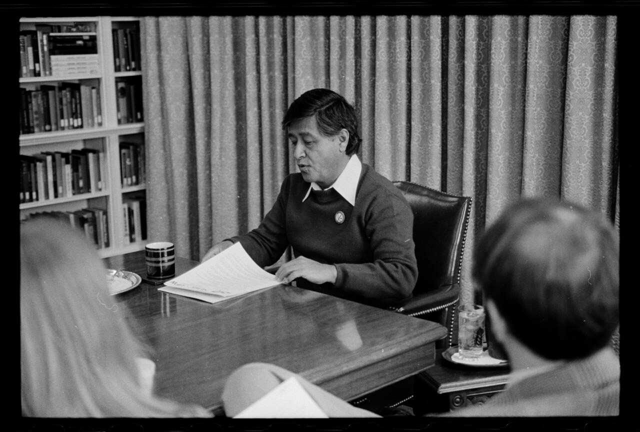
DIRECT INSTRUCTION
US.82
The Chicano Movement organized for equality — it sought educational equality, labor rights, and cultural pride through the 1968 East L.A. walkouts and La Raza Unida; Cesar Chavez built the United Farm Workers using nonviolent strikes and grape boycotts.
ZOOM IN
US.82 · Chicano Movement
U.S. History Hack · TroopToTeacher Technologies LLC · Aligned to TN Academic Standards & TCAP EOC
27

Slide 37
DIRECT INSTRUCTION
US.82
The feminist movement fought gender discrimination — it pursued equal pay, reproductive rights, and representation; Betty Friedan’s The Feminine Mystique (1963) and the founding of NOW challenged traditional gender roles using civil rights strategies.
KEY POINT
The feminist movement fought gender discrimination — it pursued equal pay, reproductive rights, and representation; Betty Friedan’s The Feminine Mystique (1963) and the founding of NOW challenged traditional gender roles using civil rights strategies.
US.82 · Feminist Movement
U.S. History Hack · TroopToTeacher Technologies LLC · Aligned to TN Academic Standards & TCAP EOC
28

Slide 38
SOURCE IT FIRST
US.82
Read the United Farm Workers Proclamation — weigh who issued it and why before you read the words.
WHO
WHEN
WHY
Dolores Huerta
1965
Consider the author’s purpose and audience before you interpret the words.
United Farm Workers Proclamation
Dolores Huerta · 1965
"We, the striking grape workers of California, join on this International Boycott Day with the consumers across the continent in planning the steps that lie ahead on the road to our liberation. Now we will suffer for the purpose of ending the poverty, the misery, and the injustice... We are suffering. We shall endure. We shall overcome."
Library of Congress
U.S. History Hack · TroopToTeacher Technologies LLC · Aligned to TN Academic Standards & TCAP EOC
29

Slide 39
THREE PERSPECTIVES
US.82
A historian returns to three questions at the end of every reading. Use them to analyze this standard.
Who benefited?
Who bore the costs?
Who decided?
Who gained land, wealth, power, or protection?
Who lost land, labor, freedom, or life — and who was silenced?
Which people, offices, or courts held the authority?
US.82:
US.82:
US.82:
American Indians, Mexican Americans, and women who won new rights, recognition, and organizations, and future movements that borrowed their tactics.
Activists who faced arrest and violence at Wounded Knee, on picket lines, and in protests, and groups whose full demands were only partly met.
Movement leaders like Russell Means, Cesar Chavez, and Betty Friedan who organized action, and the governments and employers they pressured to change.
Anchor: United Farm Workers Proclamation, Dolores Huerta, 1965 (Library of Congress)
U.S. History Hack · TroopToTeacher Technologies LLC · Aligned to TN Academic Standards & TCAP EOC
30

Slide 40
KEY VOCABULARY · LANGUAGE SUPPORT
US.82
Words you need before we read
American Indian Movement (AIM)
Chicano Movement
Feminist Movement (1960s)
En español: Movimiento Indio Americano
En español: Movimiento Chicano
En español: Movimiento Feminista (1960s)
WHAT IT MEANS
WHAT IT MEANS
WHAT IT MEANS
Civil rights organization founded in 1968 to address issues of poverty, police brutality, and treaty rights affecting Native Americans, using tactics inspired by the Black civil rights movement.
Mexican American civil rights movement of the 1960s-70s that fought for labor rights, education reform, political representation, and cultural pride, led by figures like Cesar Chavez.
The "Second Wave" women's rights movement that fought for equal pay, reproductive rights, workplace equality, and passage of the Equal Rights Amendment, led by activists like Betty Friedan.
U.S. History Hack · TroopToTeacher Technologies LLC · Aligned to TN Academic Standards & TCAP EOC
10

Slide 41
PROGRESS CHECK
US.82
Check your understanding
Compare how these movements both built upon and differed from the African American Civil Rights Movement.
A
They adopted similar tactics (protests, legal challenges, legislation) but pursued distinct goals reflecting their communities' unique experiences and cultural identities
B
These movements were completely unrelated to civil rights, although historical sources do not support this conclusion and oversimplifies the complex factors at work during this period
C
They opposed the African American civil rights movement, but the historical record tells a more complex story, which ignores significant political and cultural developments of the era
D
They were identical in every way to the civil rights movement, despite limited evidence supporting this interpretation and fails to account for key developments in the broader context
Confidence: 😟 1 🙂 2 😀 3 — circle where you are; your teacher routes reteach or extension.
U.S. History Hack · TroopToTeacher Technologies LLC · Aligned to TN Academic Standards & TCAP EOC
11

