Slide 1
U.S. HISTORY HACK
Unit 9
The Civil Rights Movement
Brown v. Board · Advocates & Opponents · Boycotts, Sit-ins & Marches · Civil & Voting Rights Legislation · The American Indian, Chicano & Feminist Movements · 1954–1968
Standards US.78 – US.82
US.78
US.79
US.80
US.81
US.82
TCAP EOC LECTURE DECK · Tennessee Academic Standards for U.S. History
TroopToTeacher Technologies LLC
Notes:
Unit 9 TCAP EOC lecture deck. Each standard runs as a full lesson: divider (standard + I Can), hook, direct instruction with a verified primary-source image, key figures, vocabulary, a student activity (paired to a printable worksheet), a TCAP-style check (question slide, then click to the reveal/answer-key slide), and a wrap-up with a teacher answer key in the speaker notes. All images are public-domain, captioned, and linked to the Library of Congress / National Archives.

Slide 2
UNIT ROADMAP
Where We Are Headed
Unit 9 · The Civil Rights Movement (1954–1968) — Brown v. Board of Education, the advocates and opponents of civil rights, the boycotts, sit-ins, Freedom Rides, and marches that changed the nation, the landmark civil and voting rights legislation, and the American Indian, Chicano, and Feminist movements that followed the same blueprint
US.78
Brown v. Board of Education
then
US.81
Civil and Voting Rights Legislation
US.79
Civil Rights Advocates and Opponents
US.82
American Indian, Chicano & Feminist Movements
US.80
Significant Civil Rights Events
Standards build in sequence (US.78 → US.82). Each runs as a full lesson: TN standard · “I Can” · direct instruction · verified primary source · vocabulary · guided + independent practice · TCAP-style check with reveal key.
U.S. History Hack · TroopToTeacher Technologies LLC · Aligned to TN Academic Standards & TCAP EOC
2

Slide 3
BELL RINGER · HOOK
In 1954, a unanimous Supreme Court ruled that segregated public schools were unconstitutional — but the law on paper was only the beginning.
Over the next fourteen years, ordinary Americans boycotted buses, sat in at lunch counters, rode buses into danger, and marched on Washington, forcing a nation to confront the gap between its ideals and its practice. Congress answered with the most sweeping civil rights laws since Reconstruction.
How did Americans move from a court ruling in 1954 to sweeping federal civil rights laws by 1968 — and what did it take, on the streets and in Congress, to close the gap between the nation's ideals and its practice?
TURN & TALK
With a partner, list three rights or freedoms you think Americans take for granted today — in schools, at the ballot box, or in public places. Then predict: which of these do you think had to be won through protest and law in the 1950s and 1960s? Keep your list; we will return to it at the end of the unit.
U.S. History Hack · TroopToTeacher Technologies LLC · Aligned to TN Academic Standards & TCAP EOC
3
Notes:
Bell ringer (5 min). Rights students may name: attending an integrated school, voting without a literacy test or poll tax, being served at any restaurant or store, riding public transportation without segregated seating, and equal treatment in housing and employment. Push students to connect each to a specific event or law in this unit — Brown v. Board (schools), the Voting Rights Act of 1965 (the ballot), the Civil Rights Act of 1964 (public places and jobs), the Montgomery Bus Boycott and Freedom Rides (transportation), and the Fair Housing Act of 1968 (housing). Collect lists; revisit on the closing slide after students can answer with evidence — from Brown, through the advocates and opponents and the major protest campaigns, to the legislation and the movements that borrowed the blueprint.

Slide 4
STANDARD
SOCIAL STUDIES PRACTICES
US.78
SSP.01
Collect sources
SSP.05
Historical awareness
SSP.06
Geographic awareness
Brown v. Board of Education
TN ACADEMIC STANDARD
Examine the decision and impact of Brown v. Board of Education on desegregation. (TCA)
I CAN
I can examine the decision and impact of Brown v. Board of Education on desegregation.
U.S. History Hack · TroopToTeacher Technologies LLC · Aligned to TN Academic Standards & TCAP EOC
4

Slide 5
How This Deck Works — UDL 3.0 & MTSS
Teacher reference · CAST UDL 3.0 guidelines designed into every standard
EVERY LEARNER · SAME FIRM GOAL
ENGAGEMENT
REPRESENTATION
ACTION & EXPRESSION
Multiple means of the “why”
Multiple means of the “what”
Multiple means of the “how”
Welcoming Interests & Identities
Sustaining Effort & Persistence
Emotional Capacity
Perception
Language & Symbols
Building Knowledge
Interaction
Expression & Communication
Strategy Development
MTSS decision cycle: Tier 1 core for all → the Progress Check yields evidence → below mastery routes to targeted reteach (Tier 2, Teacher Guide §16); at/above mastery routes to extension. The goal never lowers.
U.S. History Hack · TEACHER DECK · Aligned to TN Academic Standards & TCAP EOC
1

Slide 6
US.78 · QUICK REVIEW
Do You Remember?
Before we start, retrieve what we have already learned. Answer from memory first — no notes.
1
Unit 8 We just finished Unit 8 on postwar America and the 1950s. What was life like for many white middle-class Americans in the prosperous 1950s — and who was largely left out of that prosperity?
2
Unit Hook Look back at our unit hook. Why did the Supreme Court’s 1954 ruling need federal troops before some schools actually integrated?
U.S. History Hack · TroopToTeacher Technologies LLC · Aligned to TN Academic Standards & TCAP EOC
5
Notes:
SPACED RETRIEVAL (US.78). Cold-call or whiteboards, 3-4 min, low stakes. Answers — 1) The 1950s brought suburban growth, consumer goods, and a booming middle class for many white families. But African Americans and other minorities were largely excluded by legal segregation (Jim Crow), housing discrimination, and unequal schools — setting the stage for the Civil Rights Movement. 2) A court ruling declares the law, but it cannot enforce itself. Southern states used ‘massive resistance’ — delay, defiance, and violence — so the federal government had to send troops (as at Little Rock in 1957) to enforce desegregation.

Slide 7
US.78 · CONFIDENCE CHECK
Warm-Up — Quick Recall
DOK 1
LOW STAKES
Everyone can answer this. Thumbs / whiteboards — no notes.
What did the Supreme Court decide in Brown v. Board of Education (1954)?
✓ ANSWER
Segregated (‘separate but equal’) public schools are unconstitutional.
COMMIT FIRST: have everyone answer before the reveal — this is the DOK 1 floor; the graded check later in this lesson moves up to DOK 2–3.
U.S. History Hack · TroopToTeacher Technologies LLC · Aligned to TN Academic Standards & TCAP EOC
6
Notes:
CONFIDENCE CHECK (US.78, DOK 1). 60-90 seconds. Have EVERY student commit (thumbs / whiteboard / choral) before revealing — this secures an early win and surfaces who is shaky before new content. Answer: Segregated (‘separate but equal’) public schools are unconstitutional. Key term to listen for: Brown v. Board of Education. This is the low-floor entry; the graded Check for Understanding later in the standard rises to DOK 2–3.

Slide 8
US.78 · HOOK
Think About It
In 1954, nine justices of the U.S. Supreme Court agreed unanimously that separating children by race in public schools was unconstitutional — overturning a “separate but equal” doctrine that had stood for 58 years.
DISCUSS
TIMING: Turn & Talk 60 sec → cold-call 2 pairs
If the highest court in the land declared segregated schools illegal in 1954, why did it take years — and federal troops — before many schools actually integrated?
U.S. History Hack · TroopToTeacher Technologies LLC · Aligned to TN Academic Standards & TCAP EOC
7
Notes:
HOOK (US.78). Run tight: pose the provocation, give a silent 10-second think, then Turn & Talk 60 seconds. Cold-call 2–3 pairs (not volunteers) for a sentence-starter answer — "One force was ___ because ___" — then bridge to the standard. Keep total to ~4 minutes; do not let it sprawl. Return to this question at the unit close for an evidence-based answer.

Slide 9
US.78 · DIRECT INSTRUCTION
1 of 3
Historical Context Leading to Brown v. Board
The case emerged from decades of "separate but equal" doctrine established in Plessy v. Ferguson (1896).
By the 1950s, the NAACP's legal strategy, led by Thurgood Marshall, systematically challenged segregated education.
Previous cases like Sweatt v. Painter (1950) had already weakened the separate but equal principle in higher education.
Social science research, including Kenneth Clark's doll tests, demonstrated segregation's psychological harm to Black children.
SENTENCE FRAME (EL & writing support)
In Brown v. Board of Education, the Supreme Court decided that ___, which overturned the earlier rule of ___.
U.S. History Hack · TroopToTeacher Technologies LLC · Aligned to TN Academic Standards & TCAP EOC
8
Notes:
FACILITATION (US.78). Ask: if the highest court in the land says a practice is unconstitutional, does it end overnight? Why or why not? Teach in small steps; pause and check for understanding before the next chunk (aim 80%+ before moving on).

Slide 10
US.78 · DIRECT INSTRUCTION
2 of 3
Key Details of the Court Case and Decision
The Supreme Court consolidated five cases challenging school segregation.
Chief Justice Earl Warren wrote the unanimous decision stating that "separate educational facilities are inherently unequal" and violated the 14th Amendment's Equal Protection Clause.
The Court rejected the separate but equal doctrine for public education, declaring that segregation generated feelings of inferiority that damaged Black children's educational opportunities.
U.S. History Hack · TroopToTeacher Technologies LLC · Aligned to TN Academic Standards & TCAP EOC
9

Slide 11
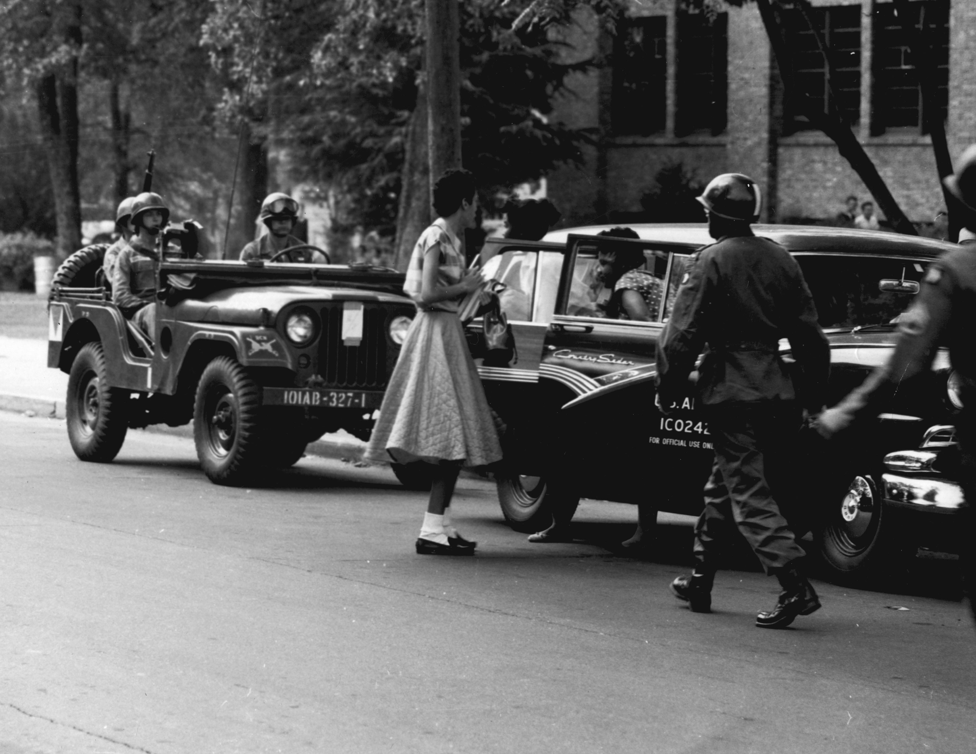
US.78 · DIRECT INSTRUCTION
3 of 3
Impact on Desegregation
The decision legally ended school segregation but implementation proved difficult.
Brown II (1955) ordered desegregation "with all deliberate speed," allowing gradual implementation.
Many Southern states resisted through "massive resistance" campaigns, creating private academies and closing public schools.
Progress was slow—by 1964, only 2% of Black Southern students attended integrated schools.
However, the decision provided legal foundation for the broader civil rights movement.
★ TENNESSEE CONNECTION
Clinton High School in Anderson County, Tennessee, was one of the first public high schools in the South to desegregate, in 1956 — the year after Brown — amid resistance that drew national attention.
U.S. Army, September 1957 National Archives
U.S. History Hack · TroopToTeacher Technologies LLC · Aligned to TN Academic Standards & TCAP EOC
10

Slide 12
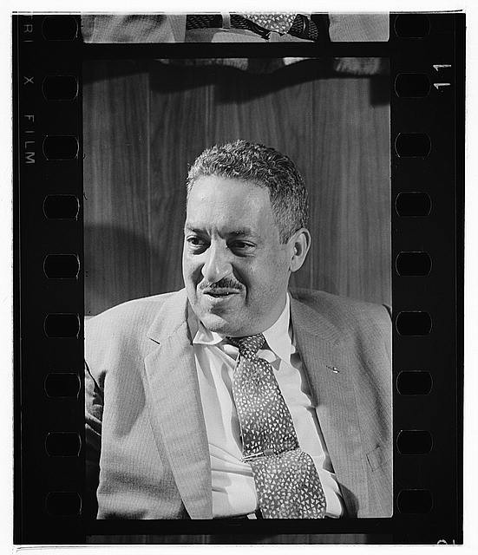
US.78 · PEOPLE WHO SHAPED THE ERA
Key Figure
Thurgood Marshall
NAACP lead attorney
Argued Brown v. Board of Education before the Supreme Court (1954)
Built the legal strategy that dismantled "separate but equal"
Thomas J. O'Halloran, U.S. News & World Report Magazine, September 17, 1957 Library of Congress
STRATEGY Legal challenge (litigation strategy)
U.S. History Hack · TroopToTeacher Technologies LLC · Aligned to TN Academic Standards & TCAP EOC
11

Slide 13
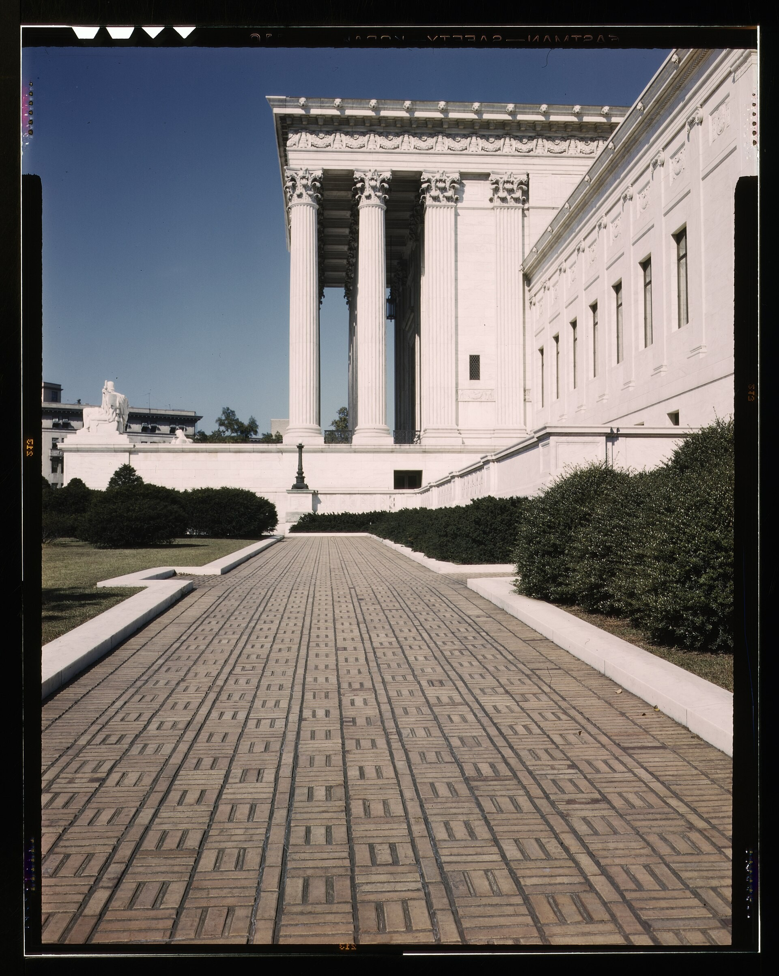
US.78 · PRIMARY SOURCE ANALYSIS
Brown v. Board of Education Decision
Close Reading
Chief Justice Earl Warren · May 17, 1954
ZOOM IN Find ONE detail that surprises you — be ready to name it.
"We conclude that, in the field of public education, the doctrine of "separate but equal" has no place. Separate educational facilities are inherently unequal. Therefore, we hold that the plaintiffs and others similarly situated... are, by reason of the segregation complained of, deprived of the equal protection of the laws guaranteed by the Fourteenth Amendment."
CONTEXT
Since 1896, the Supreme Court's Plessy v. Ferguson decision had enshrined 'separate but equal' as the law of the land, allowing racial segregation across American life. By the early 1950s, the NAACP had built a legal strategy to challenge segregation in court, leading to the Brown v. Board case combining lawsuits from five states. The unanimous 1954 ruling overturned Plessy and declared school segregation inherently unequal—but it did not end segregation overnight, as resistance in the South was fierce.
ANALYZE
FSA / U.S. Federal Government, 1939 Library of Congress
What did the Supreme Court rule about segregated schools?
SOURCE IT
WHO made it?
WHEN?
WHY does it matter?
FIRST
Chief Justice Earl Warren
May 17, 1954
Consider the author’s purpose and audience before you interpret the words.
SSP.02 · before you interpret
Source: National Archives
U.S. History Hack · TroopToTeacher Technologies LLC · Aligned to TN Academic Standards & TCAP EOC
12
Notes:
Primary-source analysis. SOURCE IT FIRST (SSP.02) — model the sourcing routine aloud before students interpret: WHO made this source? (Chief Justice Earl Warren) WHEN? (May 17, 1954) WHY does that matter? (Consider the author’s purpose and audience before you interpret the words.) Only then move to the ANALYZE question. Suggested answer: The Court ruled that "Separate educational facilities are inherently unequal" and segregation deprives students of "equal protection of the laws guaranteed by the Fourteenth Amendment." Practice skill: Close Reading.

Slide 14
US.78 · KEY VOCABULARY
Word Wall
Brown v. Board of Education
Brown contra el Consejo de Educación
Clinton 12
Los 12 de Clinton
say: brown VER-sus bord
say: KLIN-tun twelv
BV
The landmark 1954 Supreme Court decision that declared state laws establishing separate public schools for Black and white students unconstitutional, overturning Plessy v. Ferguson and ending legal school…
C1
The 12 African American students who integrated Clinton High School in Tennessee in 1956, making it the first state-supported high school in the South to integrate following Brown v. Board of Education.
Little Rock Nine
Los Nueve de Little Rock
Thurgood Marshall
Thurgood Marshall
say:
say: THUR-good MAR-shul
LR
The nine African American students who integrated Central High School in Little Rock, Arkansas in 1957, facing violent mobs and requiring federal troops protection ordered by President Eisenhower.
TM
Chief counsel for the NAACP Legal Defense Fund who argued Brown v. Board of Education before the Supreme Court and later became the first African American Supreme Court Justice in 1967.
Orval Faubus
Orval Faubus
Plessy v. Ferguson
Plessy contra Ferguson
say: OR-vul FAW-bus
say: PLES-ee VER-sus
OF
Arkansas Governor who defied the Supreme Court by using the National Guard to prevent the Little Rock Nine from integrating Central High School in 1957.
PV
The 1896 Supreme Court case that allowed 'separate but equal' segregation — the precedent overturned by Brown v. Board in 1954.
"say:" pronunciation guide (stressed syllable in CAPS) and a per-term visual anchor support newcomer English learners. Spanish term + full bilingual Frayer models are in the unit vocabulary set.
U.S. History Hack · TroopToTeacher Technologies LLC · Aligned to TN Academic Standards & TCAP EOC
1

Slide 15
US.78 · GUIDED PRACTICE — WE DO IT TOGETHER
Let’s Work One Together
Source a Supreme Court opinion
MODEL PROMPT: Read Chief Justice Warren’s words in Brown v. Board. What does the Court conclude, and on what constitutional basis?
WORKED EXAMPLE (teacher models this aloud)
Warren writes that "separate educational facilities are inherently unequal."
THINK ALOUD
I notice the Court ties inequality to the 14th Amendment’s equal-protection clause — that is the legal hook.
→ Now you try: Now you: underline the exact phrase that overturns "separate but equal," and name the amendment it relies on.
U.S. History Hack · TroopToTeacher Technologies LLC · Aligned to TN Academic Standards & TCAP EOC
14
Notes:
GUIDED PRACTICE / WE DO (US.78). Skill modeled: Source a Supreme Court opinion. Model the worked example aloud using the THINK ALOUD as your script, then release students to the activity ("Now you: underline the exact phrase that overturns "separate but equal," and name the amendment it relies on."). This is the I Do → We Do → You Do bridge — do not skip it; aim for 80%+ success before independent work.

Slide 16
US.78 · STUDENT ACTIVITY
Brown v. Board — Causes & Consequences Chart
Pairs
15 min
YOUR TASK
Using your Cornell notes and the Brown v. Board decision excerpt, complete the Causes & Consequences organizer. In the CAUSES column, list the legal and social conditions (Plessy ‘separate but equal,’ unequal schools, NAACP legal strategy) that led to the case. In the CONSEQUENCES column, trace what followed the 1954 ruling — both the legal victory and the resistance it provoked (massive resistance, Little Rock, Clinton HS in Tennessee). Finish with a one-sentence claim about why a court ruling alone could not immediately end segregation.
DELIVERABLE
DIFFERENTIATION
Completed Causes & Consequences organizer (3+ causes, 3+ consequences) plus a one-sentence evidence-based claim on why desegregation was slow to enforce.
Entry: Organizer pre-seeded with a word bank (Plessy v. Ferguson, NAACP, massive resistance, Little Rock Nine, Clinton 12) to sort into Causes vs. Consequences. Honors: Evaluate the long-term significance of Brown for the broader movement — was its greatest impact legal, moral, or strategic? Defend with evidence.
Companion printable: printables/unit-9/unit-9-cause-effect.html
U.S. History Hack · TroopToTeacher Technologies LLC · Aligned to TN Academic Standards & TCAP EOC
15
Notes:
Student activity for US.78. Pair with the printable: printables/unit-9/unit-9-cause-effect.html. Timing: 15. Deliverable: Completed Causes & Consequences organizer (3+ causes, 3+ consequences) plus a one-sentence evidence-based claim on why desegregation was slow to enforce.

Slide 17
US.78 · CHECK FOR UNDERSTANDING
TCAP-Style Question
DOK 3
EOC PRACTICE
What did the Supreme Court rule about segregated schools?
Separate schools are inherently unequal and violate the 14th Amendment
A
Segregated schools could continue if they were truly equal
B
States could decide their own segregation policies
C
The federal government had no authority over education
D
ANSWER FIRST: students commit — then click / advance to reveal the correct answer and explanation.
U.S. History Hack · TroopToTeacher Technologies LLC · Aligned to TN Academic Standards & TCAP EOC
16
Notes:
CHECK FOR UNDERSTANDING (US.78, DOK 3). Have students commit to an answer (whiteboards, hand signal, or turn-and-talk) BEFORE advancing. Correct answer: A. The next slide reveals it. Why: The Court ruled that "Separate educational facilities are inherently unequal" and segregation deprives students of "equal protection of the laws guaranteed by the Fourteenth Amendment."

Slide 18
US.78 · ANSWER REVEAL
TCAP-Style Question
✓ ANSWER KEY
What did the Supreme Court rule about segregated schools?
A
Separate schools are inherently unequal and violate the 14th Amendment
✓
B
Segregated schools could continue if they were truly equal
C
States could decide their own segregation policies
D
The federal government had no authority over education
Correct answer: A. Why: The Court ruled that "Separate educational facilities are inherently unequal" and segregation deprives students of "equal protection of the laws guaranteed by the Fourteenth Amendment."
U.S. History Hack · TroopToTeacher Technologies LLC · Aligned to TN Academic Standards & TCAP EOC
17
Notes:
ANSWER KEY (US.78). Correct: A. The Court ruled that "Separate educational facilities are inherently unequal" and segregation deprives students of "equal protection of the laws guaranteed by the Fourteenth Amendment."

Slide 19
US.78 · WRAP-UP
What You Need to Know for TCAP
KEY TAKEAWAYS
EXIT TICKET
DOK 2
Historical Context Leading to Brown v. Board
Key Details of the Court Case and Decision
Impact on Desegregation
Explain how Brown v. Board of Education overturned Plessy v. Ferguson, and give one reason desegregation was still difficult to achieve after the ruling.
★ HONORS / EXTENSION DOK 3 · SSP.04 Argumentation
Evaluate the long-term significance of Brown v. Board for the broader Civil Rights Movement. Was its greatest impact legal, moral, or strategic? Defend your answer with evidence.
U.S. History Hack · TroopToTeacher Technologies LLC · Aligned to TN Academic Standards & TCAP EOC
18
Notes:
WRAP-UP / EXIT-TICKET KEY (US.78, DOK 2). Prompt: Explain how Brown v. Board of Education overturned Plessy v. Ferguson, and give one reason desegregation was still difficult to achieve after the ruling. Model answer: Plessy v. Ferguson (1896) had allowed ‘separate but equal’ facilities. In Brown (1954) the Court ruled that separate schools are inherently unequal and unconstitutional, overturning that doctrine. Desegregation was still difficult because Southern states resisted — through delay, defiance (‘massive resistance’), and violence — requiring federal enforcement, such as troops at Little Rock in 1957. RETEACH TRIGGER — if a student misses this exit ticket: (1) <50% of class miss → spiral it into the next standard’s Quick Review opener (see the US.78 review prompts). (2) Individual/small group → reteach with the "Historical Context Leading to Brown v. Board" direct-instruction slide + re-run the SOURCE IT FIRST routine on the US.78 primary source, then assign the paired printable: printables/unit-9/unit-9-cause-effect.html. (3) Re-assess with the US.78 check-for-understanding reveal slide as a do-now the next day. Reteach anchors (this standard’s sections): Historical Context Leading to Brown v. Board; Key Details of the Court Case and Decision; Impact on Desegregation. I Can objective: I can examine the decision and impact of Brown v. Board of Education on desegregation. HONORS / EXTENSION (DOK 3, for early finishers or advanced learners): Evaluate the long-term significance of Brown v. Board for the broader Civil Rights Movement. Was its greatest impact legal, moral, or strategic? Defend your answer with evidence. — look for a clear claim plus two specific pieces of evidence.

Slide 20
STANDARD
SOCIAL STUDIES PRACTICES
US.79
SSP.03
Synthesize sources
SSP.04
Build an argument
SSP.06
Geographic awareness
Civil Rights Advocates and Opponents
TN ACADEMIC STANDARD
Examine the roles and actions of civil rights advocates and opponents and how they coincided, confronted, and challenged each other. (TCA)
I CAN
I can examine the roles and actions of civil rights advocates (e.g., Malcolm X, Thurgood Marshall, Rosa Parks) and opponents (e.g., Bull Connor, Orval Faubus, Strom Thurmond) and how they coincided, confronted, and challenged each other.
U.S. History Hack · TroopToTeacher Technologies LLC · Aligned to TN Academic Standards & TCAP EOC
19

Slide 21
KEY VOCABULARY · LANGUAGE SUPPORT
US.78
Words you need before we read
Brown v. Board of Education
Clinton 12
Little Rock Nine
En español: Brown contra el Consejo de Educación
En español: Los 12 de Clinton
En español: Los Nueve de Little Rock
WHAT IT MEANS
WHAT IT MEANS
WHAT IT MEANS
The landmark 1954 Supreme Court decision that declared state laws establishing separate public schools for Black and white students unconstitutional, overturning Plessy v. Ferguson and ending legal school…
The 12 African American students who integrated Clinton High School in Tennessee in 1956, making it the first state-supported high school in the South to integrate following Brown v. Board of Education.
The nine African American students who integrated Central High School in Little Rock, Arkansas in 1957, facing violent mobs and requiring federal troops protection ordered by President Eisenhower.
UDL · REPRESENTATION → LANGUAGE & SYMBOLS
U.S. History Hack · TEACHER DECK · Aligned to TN Academic Standards & TCAP EOC
2

Slide 22
PROGRESS CHECK
US.78
Check your understanding
Why was school desegregation so difficult to implement despite the Supreme Court's ruling?
A
Brown II's "all deliberate speed" language allowed gradual implementation while Southern states launched "massive resistance" campaigns
✓ KEY
B
The ruling only applied to a few specific school districts, but the historical record tells a more complex story
C
Federal troops refused to enforce the decision, but this fails to account for the broader historical context
D
Most Black families preferred segregated schools, but contemporary accounts suggest a different explanation
UDL · ACTION & EXPRESSION → STRATEGY DEVELOPMENT
MTSS: below mastery → targeted reteach (Tier 2); at/above → extension. The goal never lowers.
U.S. History Hack · TEACHER DECK · Aligned to TN Academic Standards & TCAP EOC
3

Slide 23
US.79 · QUICK REVIEW
Do You Remember?
Before we start, retrieve what we have already learned. Answer from memory first — no notes.
1
US.78 In the last standard we studied Brown v. Board of Education. What did the Court decide, and why was that decision the spark for the wider movement?
U.S. History Hack · TroopToTeacher Technologies LLC · Aligned to TN Academic Standards & TCAP EOC
20
Notes:
SPACED RETRIEVAL (US.79). Cold-call or whiteboards, 3-4 min, low stakes. Answers — 1) The Court ruled unanimously that ‘separate but equal’ schools were unconstitutional, overturning Plessy v. Ferguson. It gave the movement a legal victory and moral momentum to challenge segregation everywhere, not just in schools.

Slide 24
US.79 · CONFIDENCE CHECK
Warm-Up — Quick Recall
DOK 1
LOW STAKES
Everyone can answer this. Thumbs / whiteboards — no notes.
Name one civil rights advocate and one opponent from this standard.
✓ ANSWER
Advocate: Dr. King, Malcolm X, Thurgood Marshall, or Rosa Parks. Opponent: Bull Connor, Orval Faubus, or Strom Thurmond.
COMMIT FIRST: have everyone answer before the reveal — this is the DOK 1 floor; the graded check later in this lesson moves up to DOK 2–3.
U.S. History Hack · TroopToTeacher Technologies LLC · Aligned to TN Academic Standards & TCAP EOC
21
Notes:
CONFIDENCE CHECK (US.79, DOK 1). 60-90 seconds. Have EVERY student commit (thumbs / whiteboard / choral) before revealing — this secures an early win and surfaces who is shaky before new content. Answer: Advocate: Dr. King, Malcolm X, Thurgood Marshall, or Rosa Parks. Opponent: Bull Connor, Orval Faubus, or Strom Thurmond. Key term to listen for: advocate / opponent. This is the low-floor entry; the graded Check for Understanding later in the standard rises to DOK 2–3.

Slide 25
US.79 · HOOK
Think About It
Some civil rights leaders preached nonviolence and integration; others argued for self-defense and Black separatism — yet all of them were fighting the same system of segregation. Meanwhile, governors and police chiefs used the full power of the state to stop them.
DISCUSS
TIMING: Turn & Talk 60 sec → cold-call 2 pairs
When people share the same goal but disagree on how to reach it, does that division weaken a movement — or does it give the movement more ways to win?
U.S. History Hack · TroopToTeacher Technologies LLC · Aligned to TN Academic Standards & TCAP EOC
22
Notes:
HOOK (US.79). Run tight: pose the provocation, give a silent 10-second think, then Turn & Talk 60 seconds. Cold-call 2–3 pairs (not volunteers) for a sentence-starter answer — "One force was ___ because ___" — then bridge to the standard. Keep total to ~4 minutes; do not let it sprawl. Return to this question at the unit close for an evidence-based answer.

Slide 26
US.79 · DIRECT INSTRUCTION
1 of 3
Civil Rights Advocates
Martin Luther King Jr. led nonviolent resistance, organized the Montgomery Bus Boycott, founded the Southern Christian Leadership Conference (SCLC), and delivered the "I Have a Dream" speech.
Malcolm X initially promoted Black nationalism through the Nation of Islam, later evolving toward human rights after his pilgrimage to Mecca.
Thurgood Marshall served as NAACP chief legal counsel, argued Brown v. Board, and became the first Black Supreme Court Justice.
Rosa Parks sparked the Montgomery Bus Boycott and became a symbol of quiet dignity and resistance.
SENTENCE FRAME (EL & writing support)
Civil rights advocates like ___ used the strategy of ___, while opponents like ___ tried to ___.
U.S. History Hack · TroopToTeacher Technologies LLC · Aligned to TN Academic Standards & TCAP EOC
23
Notes:
FACILITATION (US.79). Ask: can two people want the same freedom but disagree completely on how to win it? Hold that as we meet advocates and opponents. Teach in small steps; pause and check for understanding before the next chunk (aim 80%+ before moving on).

Slide 27
US.79 · DIRECT INSTRUCTION
2 of 3
Civil Rights Opponents
Bull Connor, Birmingham Police Commissioner, used fire hoses and police dogs against peaceful protesters—his violent tactics backfired by generating sympathy for civil rights.
Orval Faubus, Arkansas Governor, defied federal court orders using the National Guard to prevent the Little Rock Nine from entering Central High School, forcing President Eisenhower to intervene.
Strom Thurmond, South Carolina Senator, led the "Dixiecrat" revolt in 1948 and conducted the longest individual Senate filibuster (24+ hours) against the 1957 Civil Rights Act.
U.S. History Hack · TroopToTeacher Technologies LLC · Aligned to TN Academic Standards & TCAP EOC
24

Slide 28
US.79 · DIRECT INSTRUCTION
3 of 3
Comparing Approaches
King emphasized integration and nonviolence while Malcolm X initially promoted separation and self-defense.
Both evolved—King became more critical of economic inequality while Malcolm X moved toward a broader human rights perspective.
Marshall used the courts while King used mass protests; both strategies complemented each other.
Legal victories provided the framework while protests generated political pressure for change.
U.S. History Hack · TroopToTeacher Technologies LLC · Aligned to TN Academic Standards & TCAP EOC
25

Slide 29
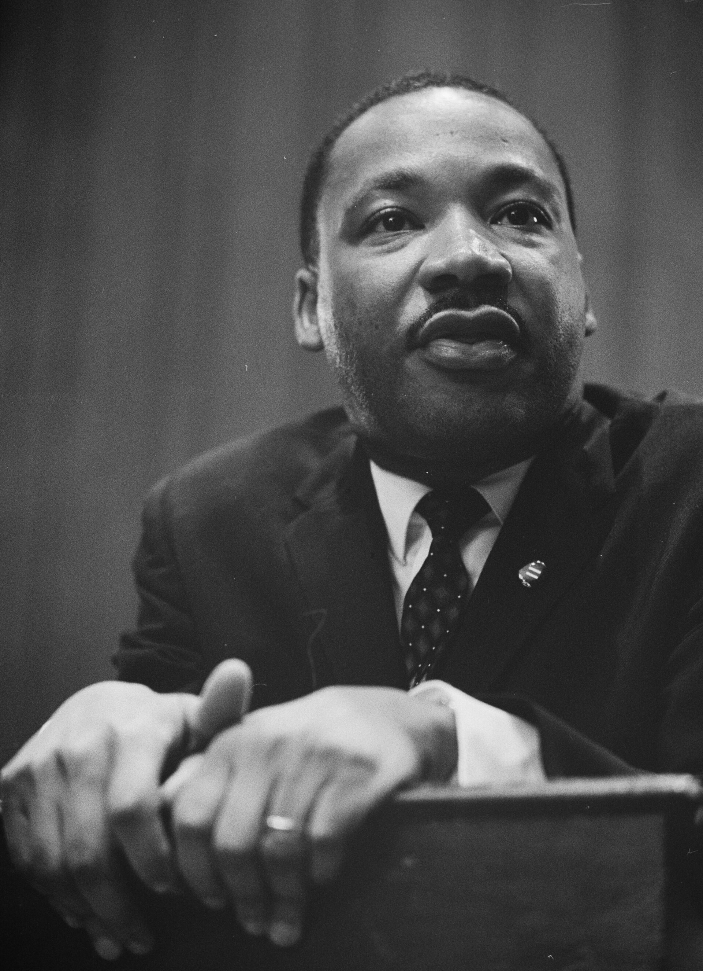
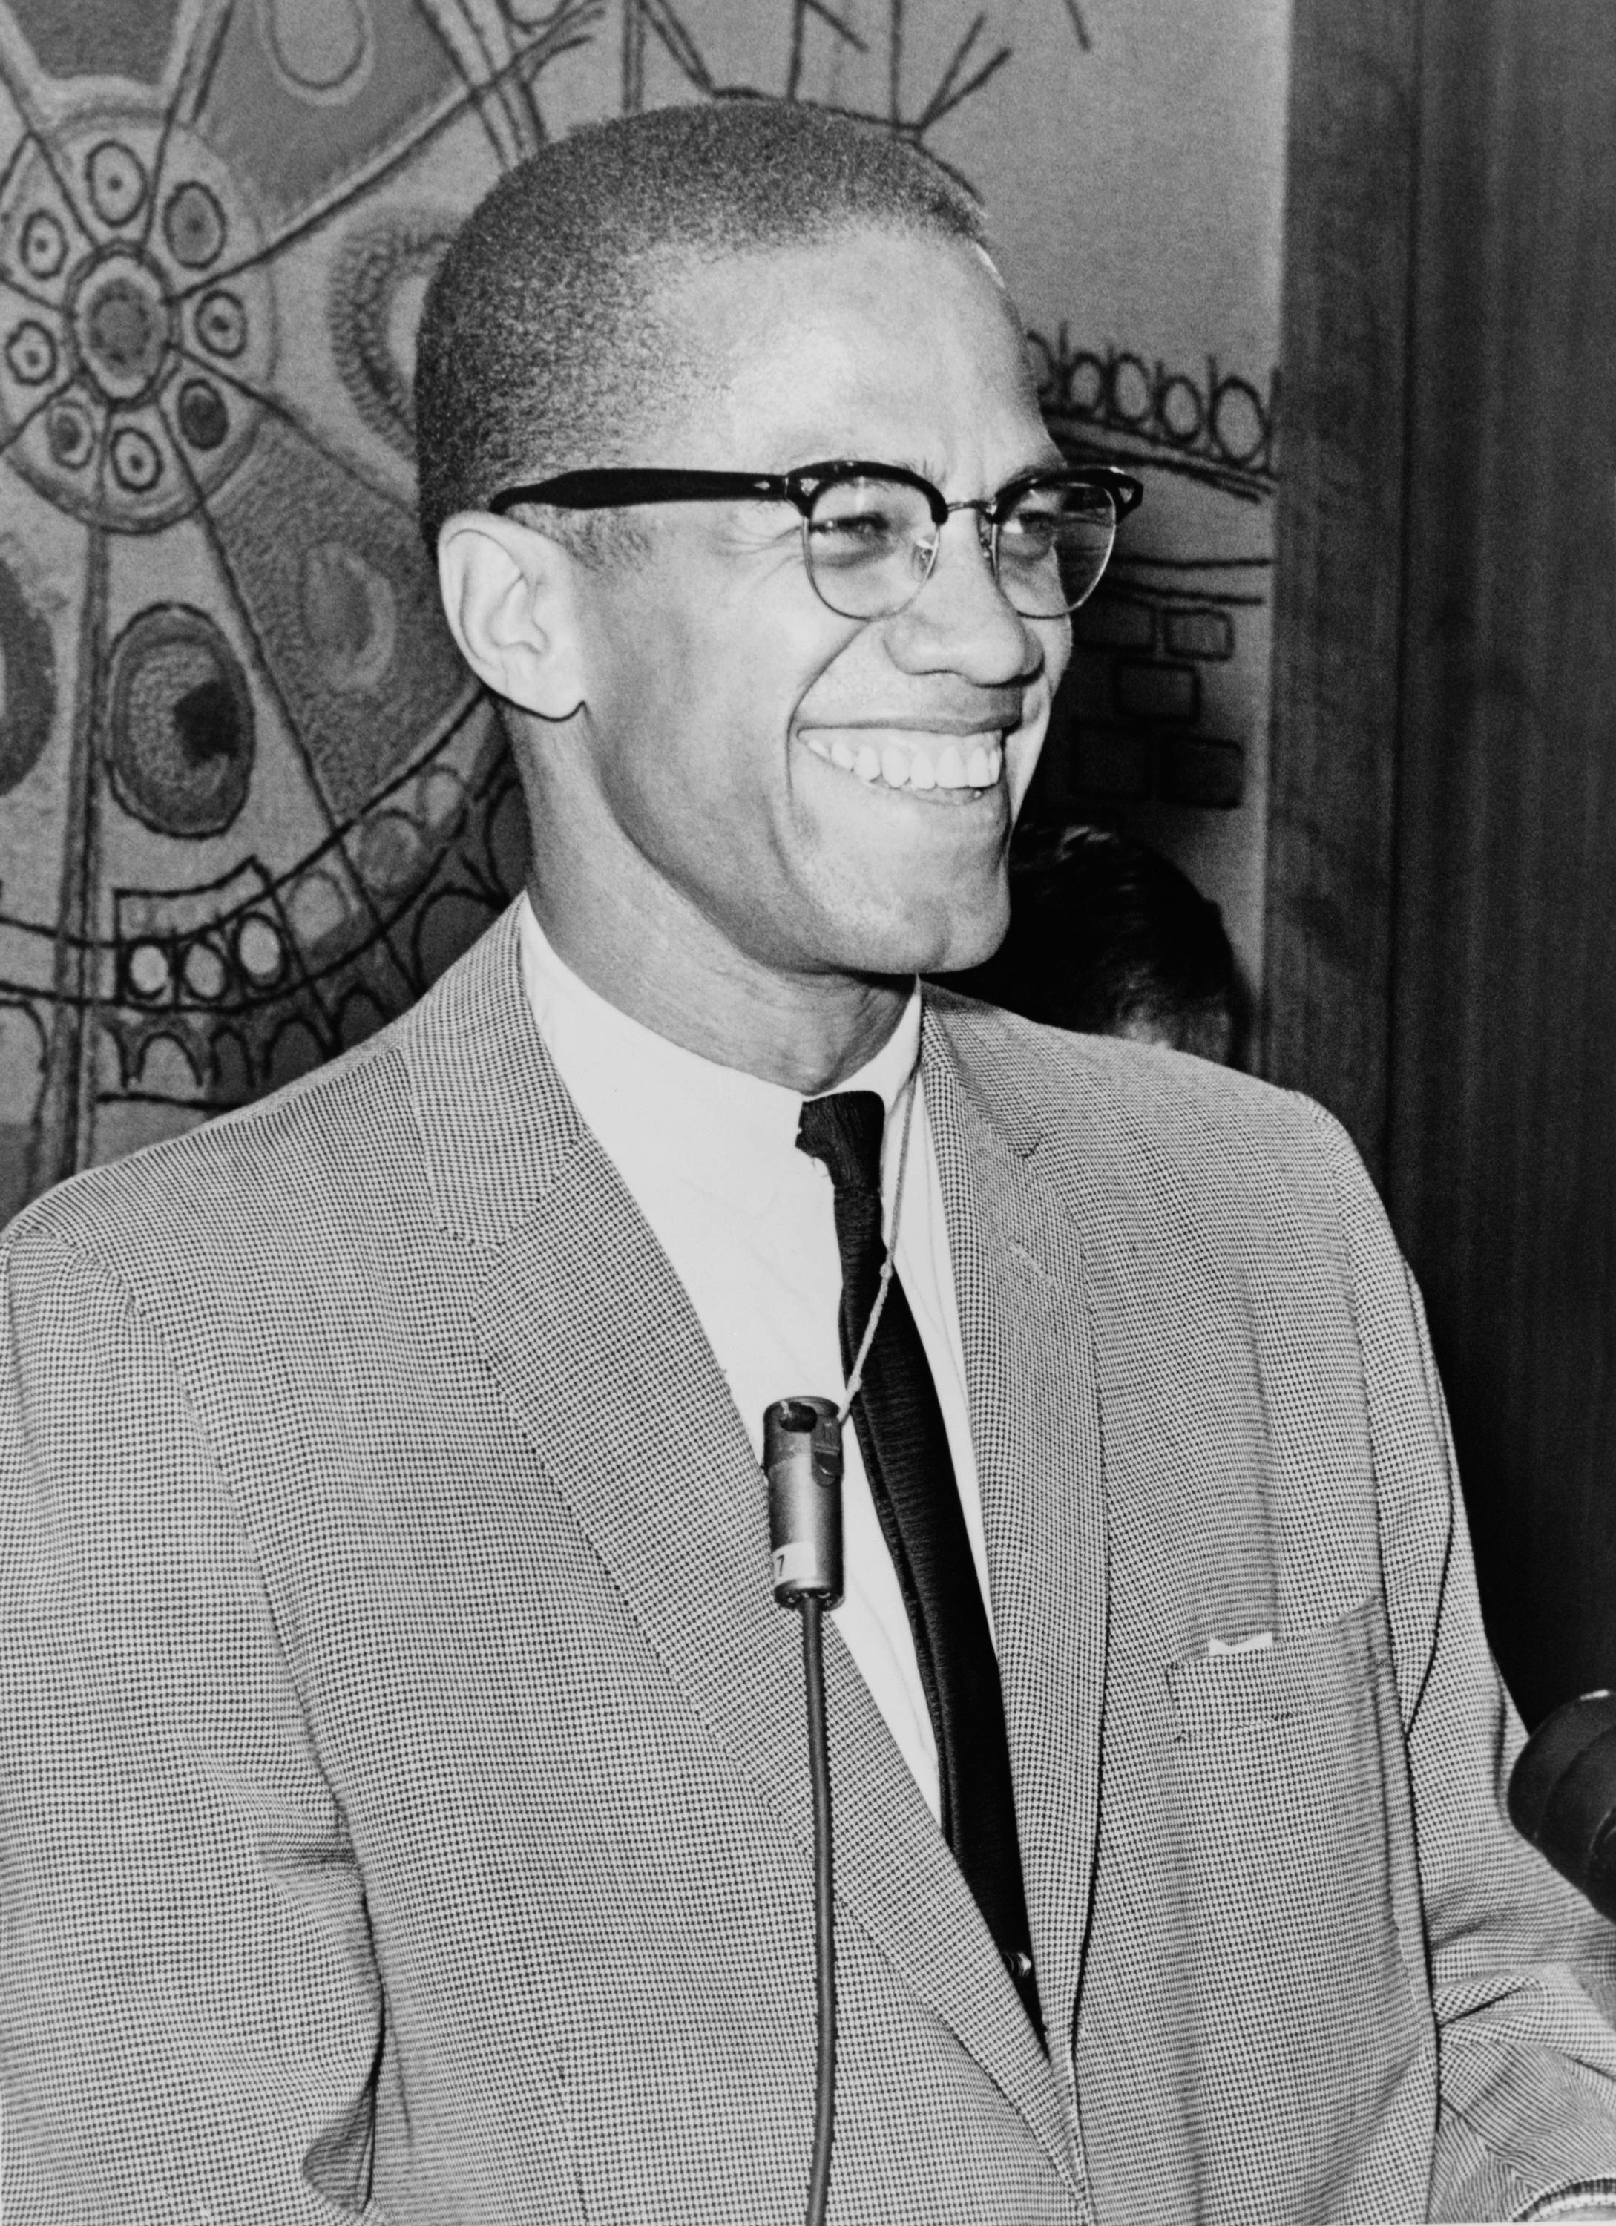
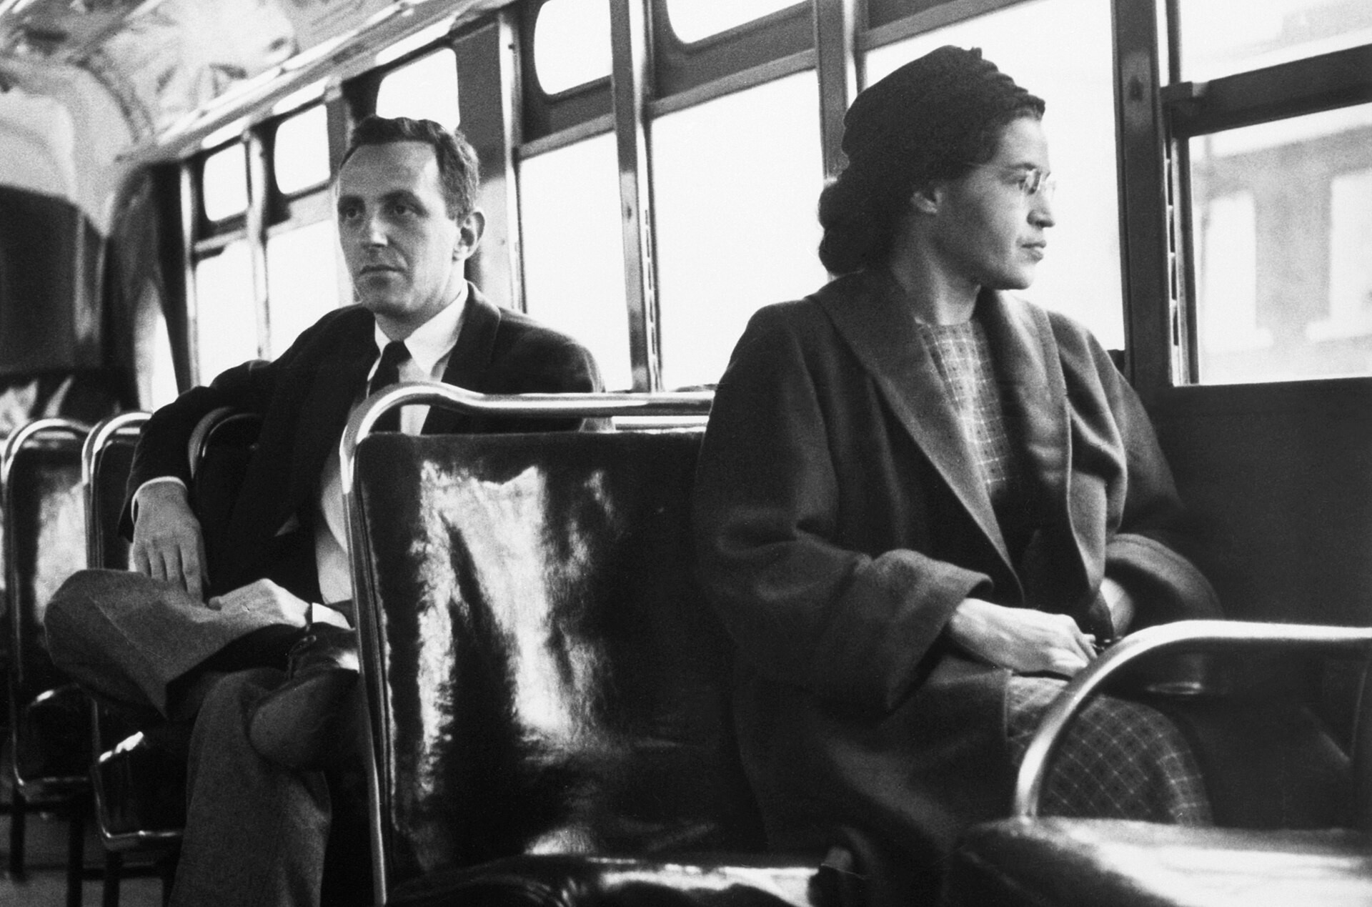
US.79 · PEOPLE WHO SHAPED THE ERA
Key Figures
Dr. Martin Luther King Jr.
Malcolm X
Rosa Parks
Civil rights leader
Activist & minister
Activist
Led the movement using nonviolent direct action
Delivered the "I Have a Dream" speech (1963)
Advocated Black self-determination and self-defense
Offered an alternative vision to integration
Refused to give up her bus seat (1955)
Sparked the Montgomery Bus Boycott
United Press International (UPI) wire photo, December 21, 1956 Published in U.S. newspapers
Marion S. Trikosko, U.S. News & World Report Magazine, March 26, 1964 Library of Congress
Ed Ford, New York World-Telegram & Sun, 1964 Library of Congress
STRATEGY Nonviolent resistance
STRATEGY Black self-determination
STRATEGY Principled civil disobedience
U.S. History Hack · TroopToTeacher Technologies LLC · Aligned to TN Academic Standards & TCAP EOC
26

Slide 30
US.79 · PRIMARY SOURCE ANALYSIS
The Ballot or the Bullet
Argumentation
Malcolm X · April 3, 1964
"It'll be the ballot or the bullet. It'll be liberty or it'll be death. And if you're not ready to pay that price don't use the word freedom in your vocabulary... I'm not an American. I'm one of the 22 million Black people who are the victims of Americanism... I don't see any American dream; I see an American nightmare."
CONTEXT
Malcolm X delivered 'The Ballot or the Bullet' speech in April 1964, just as the Civil Rights Act was being debated in Congress. His speech represented a different tradition in African American political thought—Black nationalism and self-defense—in contrast to King's nonviolent integration strategy. Malcolm X had recently left the Nation of Islam and was developing a more politically focused philosophy. His challenge to the American system was more radical than King's appeal to its ideals.
ANALYZE
READ CLOSELY Underline the exact words that answer the ANALYZE question — be ready to read them aloud.
How does Malcolm X's view of the civil rights struggle differ from nonviolent approaches?
SOURCE IT
WHO made it?
WHEN?
WHY does it matter?
FIRST
Malcolm X
April 3, 1964
Consider the author’s purpose and audience before you interpret the words.
SSP.02 · before you interpret
Source: National Archives
U.S. History Hack · TroopToTeacher Technologies LLC · Aligned to TN Academic Standards & TCAP EOC
27
Notes:
Primary-source analysis. SOURCE IT FIRST (SSP.02) — model the sourcing routine aloud before students interpret: WHO made this source? (Malcolm X) WHEN? (April 3, 1964) WHY does that matter? (Consider the author’s purpose and audience before you interpret the words.) Only then move to the ANALYZE question. Suggested answer: Malcolm X presents a more militant view, stating "It'll be the ballot or the bullet" and expressing skepticism about America, saying "I see an American nightmare." Practice skill: Argumentation.

Slide 31
US.79 · KEY VOCABULARY
Word Wall
Rosa Parks
Rosa Parks
Dr. Martin Luther King Jr.
Dr. Martin Luther King Jr.
say: ROH-zuh parks
say: LOO-ther king
RP
The "Mother of the Civil Rights Movement" who refused to give up her bus seat to a white passenger in Montgomery, Alabama in 1955, sparking the Montgomery Bus Boycott.
DM
Baptist minister and the most prominent leader of the Civil Rights Movement, advocating nonviolent resistance and delivering the iconic "I Have a Dream" speech at the 1963 March on Washington.
Malcolm X
Malcolm X
Bull Connor
Bull Connor
say: MAL-kum eks
say: bul KON-er
MX
Influential civil rights leader and Nation of Islam minister who advocated for Black nationalism, self-defense, and economic independence before his assassination in 1965.
BC
Birmingham, Alabama's Commissioner of Public Safety who violently opposed civil rights protesters in 1963, using police dogs and fire hoses against peaceful demonstrators, including children.
Strom Thurmond
Strom Thurmond
Nonviolent Resistance
Resistencia No Violenta
say: strom THUR-mund
say: non-VY-oh-lent
ST
South Carolina Senator who opposed civil rights legislation and conducted the longest individual filibuster in Senate history (24 hours, 18 minutes) against the Civil Rights Act of 1957.
NR
The strategy of peaceful protest — boycotts, sit-ins, marches — used by Dr. King and others to confront segregation.
"say:" pronunciation guide (stressed syllable in CAPS) and a per-term visual anchor support newcomer English learners. Spanish term + full bilingual Frayer models are in the unit vocabulary set.
U.S. History Hack · TroopToTeacher Technologies LLC · Aligned to TN Academic Standards & TCAP EOC
2

Slide 32
US.79 · GUIDED PRACTICE — WE DO IT TOGETHER
Let’s Work One Together
Compare two advocates’ strategies
MODEL PROMPT: King preached nonviolent integration; Malcolm X argued for self-determination "by any means necessary." How do their goals overlap and differ?
WORKED EXAMPLE (teacher models this aloud)
Both wanted freedom and dignity for Black Americans.
THINK ALOUD
They differ on method — King’s nonviolence vs. Malcolm X’s self-defense — and on integration vs. self-determination.
→ Now you try: Now you: write one sentence naming a shared goal and one naming their sharpest difference.
U.S. History Hack · TroopToTeacher Technologies LLC · Aligned to TN Academic Standards & TCAP EOC
29
Notes:
GUIDED PRACTICE / WE DO (US.79). Skill modeled: Compare two advocates’ strategies. Model the worked example aloud using the THINK ALOUD as your script, then release students to the activity ("Now you: write one sentence naming a shared goal and one naming their sharpest difference."). This is the I Do → We Do → You Do bridge — do not skip it; aim for 80%+ success before independent work.

Slide 33
US.79 · STUDENT ACTIVITY
MLK vs. Malcolm X — Strategy Venn Diagram
Pairs
15 min
YOUR TASK
Using your Cornell notes and the primary source excerpts, complete the Venn diagram comparing Dr. Martin Luther King Jr.’s nonviolent resistance with Malcolm X’s Black nationalism. In the outer circles, record each leader’s distinct goals and tactics; in the overlap, record what they shared (a common goal of ending oppression). Then add a row identifying how OPPONENTS — Bull Connor, Orval Faubus, Strom Thurmond — tried to resist. Finish with a claim about how having multiple strategies affected the movement.
DELIVERABLE
DIFFERENTIATION
Completed Venn diagram (2+ items per section, including the shared overlap) plus a one-sentence claim on whether differing strategies strengthened or weakened the movement.
Entry: Venn diagram with sentence stems and a word bank (nonviolence, integration, self-defense, Black nationalism, boycott, legal challenge) to place. Honors: Analyze how the actions of both advocates and opponents shaped national public opinion — whose actions moved opinion more, and why?
Companion printable: printables/unit-9/venn-mlk-s-nonviolent-resistance-vs-malcolm-x-s-black-nationalism.html
U.S. History Hack · TroopToTeacher Technologies LLC · Aligned to TN Academic Standards & TCAP EOC
30
Notes:
Student activity for US.79. Pair with the printable: printables/unit-9/venn-mlk-s-nonviolent-resistance-vs-malcolm-x-s-black-nationalism.html. Timing: 15. Deliverable: Completed Venn diagram (2+ items per section, including the shared overlap) plus a one-sentence claim on whether differing strategies strengthened or weakened the movement.

Slide 34
US.79 · CHECK FOR UNDERSTANDING
TCAP-Style Question
DOK 3
EOC PRACTICE
How does Malcolm X's view of the civil rights struggle differ from nonviolent approaches?
He advocated working within the existing political system
A
He believed in gradual integration over many decades
B
He supported cooperation with white political leaders
C
He emphasized self-defense and questioned whether America could deliver freedom
D
ANSWER FIRST: students commit — then click / advance to reveal the correct answer and explanation.
U.S. History Hack · TroopToTeacher Technologies LLC · Aligned to TN Academic Standards & TCAP EOC
31
Notes:
CHECK FOR UNDERSTANDING (US.79, DOK 3). Have students commit to an answer (whiteboards, hand signal, or turn-and-talk) BEFORE advancing. Correct answer: D. The next slide reveals it. Why: Malcolm X presents a more militant view, stating "It'll be the ballot or the bullet" and expressing skepticism about America, saying "I see an American nightmare."

Slide 35
US.79 · ANSWER REVEAL
TCAP-Style Question
✓ ANSWER KEY
How does Malcolm X's view of the civil rights struggle differ from nonviolent approaches?
A
He advocated working within the existing political system
B
He believed in gradual integration over many decades
C
He supported cooperation with white political leaders
D
He emphasized self-defense and questioned whether America could deliver freedom
✓
Correct answer: D. Why: Malcolm X presents a more militant view, stating "It'll be the ballot or the bullet" and expressing skepticism about America, saying "I see an American nightmare."
U.S. History Hack · TroopToTeacher Technologies LLC · Aligned to TN Academic Standards & TCAP EOC
32
Notes:
ANSWER KEY (US.79). Correct: D. Malcolm X presents a more militant view, stating "It'll be the ballot or the bullet" and expressing skepticism about America, saying "I see an American nightmare."

Slide 36
US.79 · WRAP-UP
What You Need to Know for TCAP
KEY TAKEAWAYS
EXIT TICKET
DOK 3
Civil Rights Advocates
Civil Rights Opponents
Comparing Approaches
Compare the strategies of Dr. Martin Luther King Jr. and Malcolm X. How were their goals similar, and how did their approaches differ?
★ HONORS / EXTENSION DOK 3 · SSP.04 Argumentation
Analyze how the actions of both advocates AND opponents (e.g., Bull Connor, Faubus) shaped national public opinion about civil rights. Whose actions did more to move public opinion — and why?
U.S. History Hack · TroopToTeacher Technologies LLC · Aligned to TN Academic Standards & TCAP EOC
33
Notes:
WRAP-UP / EXIT-TICKET KEY (US.79, DOK 3). Prompt: Compare the strategies of Dr. Martin Luther King Jr. and Malcolm X. How were their goals similar, and how did their approaches differ? Model answer: Both sought to end the oppression of African Americans. King advocated nonviolent direct action, integration, and moral appeal to the nation’s conscience. Malcolm X (early in his career) argued for Black self-reliance, self-defense, and separatism, criticizing nonviolence as too slow. Their differing tactics pressured segregation from multiple angles and appealed to different audiences. RETEACH TRIGGER — if a student misses this exit ticket: (1) <50% of class miss → spiral it into the next standard’s Quick Review opener (see the US.79 review prompts). (2) Individual/small group → reteach with the "Civil Rights Advocates" direct-instruction slide + re-run the SOURCE IT FIRST routine on the US.79 primary source, then assign the paired printable: printables/unit-9/venn-mlk-s-nonviolent-resistance-vs-malcolm-x-s-black-nationalism.html. (3) Re-assess with the US.79 check-for-understanding reveal slide as a do-now the next day. Reteach anchors (this standard’s sections): Civil Rights Advocates; Civil Rights Opponents; Comparing Approaches. I Can objective: I can examine the roles and actions of civil rights advocates (e.g., Malcolm X, Thurgood Marshall, Rosa Parks) and opponents (e.g., Bull Connor, Orval Faubus, Strom Thurmond) and how they coincided, confronted, and challenged each other. HONORS / EXTENSION (DOK 3, for early finishers or advanced learners): Analyze how the actions of both advocates AND opponents (e.g., Bull Connor, Faubus) shaped national public opinion about civil rights. Whose actions did more to move public opinion — and why? — look for a clear claim plus two specific pieces of evidence.

Slide 37
STANDARD
SOCIAL STUDIES PRACTICES
US.80
SSP.01
Collect sources
SSP.02
Examine a source
SSP.06
Geographic awareness
Significant Civil Rights Events
TN ACADEMIC STANDARD
Describe the significant events in the struggle to secure civil rights for African Americans, including: Montgomery Bus Boycott, Integration of Clinton High School and Central High School, Freedom Riders, Highlander Folk School, Tent City in Fayette County, TN, marches/demonstrations/boycotts/sit-ins, March on Washington D.C., Birmingham bombings of 1963, and assassination of Martin Luther King Jr. (TCA)
I CAN
I can describe the significant events in the struggle to secure civil rights for African Americans, including the Montgomery Bus Boycott, Freedom Riders, March on Washington, Birmingham bombings, and assassination of Martin Luther King Jr.
U.S. History Hack · TroopToTeacher Technologies LLC · Aligned to TN Academic Standards & TCAP EOC
34

Slide 38
KEY VOCABULARY · LANGUAGE SUPPORT
US.79
Words you need before we read
Rosa Parks
Dr. Martin Luther King Jr.
Malcolm X
En español: Rosa Parks
En español: Dr. Martin Luther King Jr.
En español: Malcolm X
WHAT IT MEANS
WHAT IT MEANS
WHAT IT MEANS
The "Mother of the Civil Rights Movement" who refused to give up her bus seat to a white passenger in Montgomery, Alabama in 1955, sparking the Montgomery Bus Boycott.
Baptist minister and the most prominent leader of the Civil Rights Movement, advocating nonviolent resistance and delivering the iconic "I Have a Dream" speech at the 1963 March on Washington.
Influential civil rights leader and Nation of Islam minister who advocated for Black nationalism, self-defense, and economic independence before his assassination in 1965.
UDL · REPRESENTATION → LANGUAGE & SYMBOLS
U.S. History Hack · TEACHER DECK · Aligned to TN Academic Standards & TCAP EOC
4

Slide 39
PROGRESS CHECK
US.79
Check your understanding
Compare the philosophies of Martin Luther King Jr. and Malcolm X regarding integration and Black identity.
A
Both leaders held identical views throughout their careers, which ignores key developments that shaped the outcome and oversimplifies the complex factors at work during this period
B
King emphasized integration through Christian love and nonviolence while Malcolm X initially promoted Black nationalism and self-defense, though both evolved over time
✓ KEY
C
Malcolm X always supported King's nonviolent approach, despite limited evidence supporting this interpretation, but contemporary accounts and primary sources suggest otherwise
D
King opposed integration while Malcolm X supported it, though this interpretation lacks supporting historical evidence, and this view has been largely revised by modern historical research
UDL · ACTION & EXPRESSION → STRATEGY DEVELOPMENT
MTSS: below mastery → targeted reteach (Tier 2); at/above → extension. The goal never lowers.
U.S. History Hack · TEACHER DECK · Aligned to TN Academic Standards & TCAP EOC
5

Slide 40
US.80 · QUICK REVIEW
Do You Remember?
Before we start, retrieve what we have already learned. Answer from memory first — no notes.
1
US.79 We just compared civil rights advocates and opponents. How did leaders like Dr. King, Malcolm X, and Thurgood Marshall each use different strategies to fight segregation?
U.S. History Hack · TroopToTeacher Technologies LLC · Aligned to TN Academic Standards & TCAP EOC
35
Notes:
SPACED RETRIEVAL (US.80). Cold-call or whiteboards, 3-4 min, low stakes. Answers — 1) King used nonviolent direct action and moral appeal; Malcolm X initially argued for Black self-reliance and self-defense; Marshall fought through the courts (winning Brown). Different tactics — legal, nonviolent protest, and militant advocacy — pressured the system from multiple directions.

Slide 41
US.80 · CONFIDENCE CHECK
Warm-Up — Quick Recall
DOK 1
LOW STAKES
Everyone can answer this. Thumbs / whiteboards — no notes.
What civil rights protest began after Rosa Parks was arrested in 1955?
✓ ANSWER
The Montgomery Bus Boycott.
COMMIT FIRST: have everyone answer before the reveal — this is the DOK 1 floor; the graded check later in this lesson moves up to DOK 2–3.
U.S. History Hack · TroopToTeacher Technologies LLC · Aligned to TN Academic Standards & TCAP EOC
36
Notes:
CONFIDENCE CHECK (US.80, DOK 1). 60-90 seconds. Have EVERY student commit (thumbs / whiteboard / choral) before revealing — this secures an early win and surfaces who is shaky before new content. Answer: The Montgomery Bus Boycott. Key term to listen for: Montgomery Bus Boycott. This is the low-floor entry; the graded Check for Understanding later in the standard rises to DOK 2–3.

Slide 42
US.80 · HOOK
Think About It
A single arrest on a Montgomery bus, a lunch counter in Nashville, a burning Greyhound in Alabama — a chain of ordinary places became the battlegrounds where ordinary people forced a nation to change.
DISCUSS
TIMING: Turn & Talk 60 sec → cold-call 2 pairs
Boycotts, sit-ins, Freedom Rides, and marches were all different tactics. What did each one accomplish that the others could not?
U.S. History Hack · TroopToTeacher Technologies LLC · Aligned to TN Academic Standards & TCAP EOC
37
Notes:
HOOK (US.80). Run tight: pose the provocation, give a silent 10-second think, then Turn & Talk 60 seconds. Cold-call 2–3 pairs (not volunteers) for a sentence-starter answer — "One force was ___ because ___" — then bridge to the standard. Keep total to ~4 minutes; do not let it sprawl. Return to this question at the unit close for an evidence-based answer.

Slide 43
US.80 · DIRECT INSTRUCTION
1 of 4
Early Movement Victories
The Montgomery Bus Boycott (1955-1956), sparked by Rosa Parks' arrest, demonstrated Black economic power through 381 days of sustained action.
It established nonviolent resistance as the primary strategy and elevated Martin Luther King Jr. to national leadership.
The Nashville Sit-ins (1960), led by John Lewis and Diane Nash, used disciplined nonviolent protests to desegregate lunch counters, inspiring similar actions nationwide.
SENTENCE FRAME (EL & writing support)
The ___ was an important civil rights event because it used the tactic of ___ to achieve ___.
★ TENNESSEE CONNECTION
The Nashville sit-ins (1960) — among these early movement victories — were led by Fisk and American Baptist students trained at Highlander Folk School in Monteagle, Tennessee. Their disciplined nonviolence made Nashville the first major Southern city to begin desegregating its downtown lunch counters.
U.S. History Hack · TroopToTeacher Technologies LLC · Aligned to TN Academic Standards & TCAP EOC
38
Notes:
FACILITATION (US.80). Ask: which is more powerful — a single act of courage, or thousands of ordinary people acting together? Watch for both today. Teach in small steps; pause and check for understanding before the next chunk (aim 80%+ before moving on).

Slide 44
US.80 · DIRECT INSTRUCTION
2 of 4
Tennessee's Role in the Movement
Clinton High School (1956) became the first Southern community to integrate its high school following Brown v. Board.
Twelve Black students faced violent opposition, requiring National Guard protection.
Highlander Folk School trained civil rights leaders including Rosa Parks and King in nonviolent resistance.
Tent City in Fayette County (1960) formed when Black sharecroppers evicted for attempting to vote created a community on donated land, demonstrating both retaliation and resilience.
★ TENNESSEE CONNECTION
The Nashville sit-ins of 1960, led by Fisk University students including Diane Nash and John Lewis, desegregated Nashville’s downtown lunch counters and became a national model for nonviolent protest. In Fayette County, Tennessee, evicted Black sharecroppers who registered to vote built ‘Tent City’ to survive.
U.S. History Hack · TroopToTeacher Technologies LLC · Aligned to TN Academic Standards & TCAP EOC
39

Slide 45
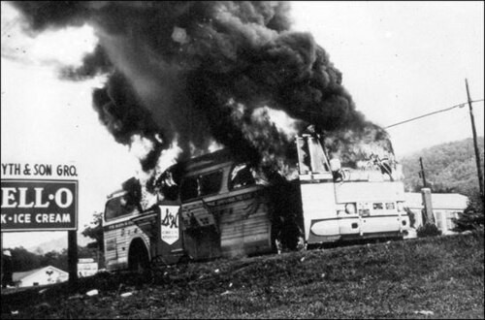
US.80 · DIRECT INSTRUCTION
3 of 4
Confrontations That Changed America
The Little Rock Nine (1957) faced Governor Faubus's defiance until President Eisenhower sent federal troops.
Freedom Riders (1961) tested desegregation rulings by riding buses through the South, facing firebombings and beatings that forced federal intervention.
The Birmingham Campaign (1963) targeted "the most segregated city in America," where Bull Connor's violent response to peaceful protesters shocked the nation.
U.S. National Park Service, May 14, 1961 Wikimedia Commons
U.S. History Hack · TroopToTeacher Technologies LLC · Aligned to TN Academic Standards & TCAP EOC
40

Slide 46
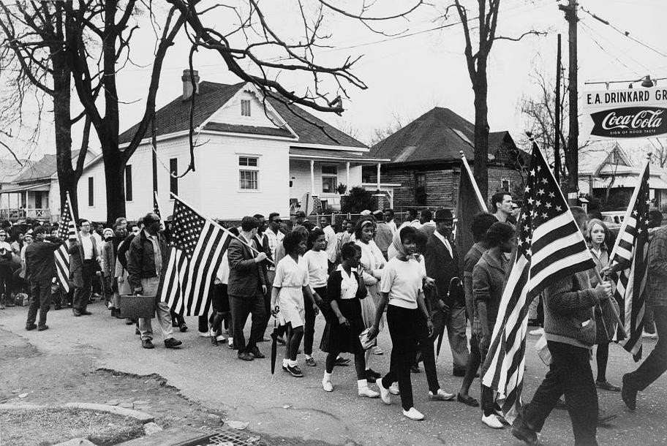
US.80 · DIRECT INSTRUCTION
4 of 4
Culminating Events
The March on Washington (1963) brought 250,000 people to hear King's "I Have a Dream" speech, pressuring Congress for legislation.
Martin Luther King Jr.'s assassination in Memphis (1968) while supporting striking sanitation workers triggered nationwide riots and galvanized support for the Fair Housing Act, marking both the movement's peak and transformation.
★ TENNESSEE CONNECTION
Dr. Martin Luther King Jr. was assassinated in Memphis, Tennessee, on April 4, 1968, where he had come to support striking sanitation workers — placing the movement’s tragic turning point on Tennessee soil.
Peter Pettus, 1965 Library of Congress
U.S. History Hack · TroopToTeacher Technologies LLC · Aligned to TN Academic Standards & TCAP EOC
41

Slide 47
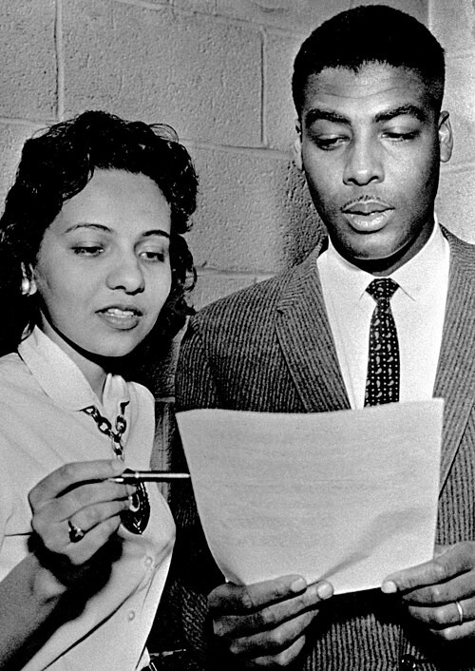
US.80 · PEOPLE WHO SHAPED THE ERA
Key Figures
Diane Nash
John Lewis
Student leader (Nashville)
Student leader
Helped lead the Nashville sit-in movement (1960)
Organized nonviolent campaigns with the SNCC
Led Nashville sit-ins and the Selma march
Later a long-serving U.S. Congressman
Gerald Holly, The Tennessean, April 9, 1960 The Tennessean (Nashville
STRATEGY Disciplined nonviolence
STRATEGY Direct action & sacrifice
U.S. History Hack · TroopToTeacher Technologies LLC · Aligned to TN Academic Standards & TCAP EOC
42

Slide 48
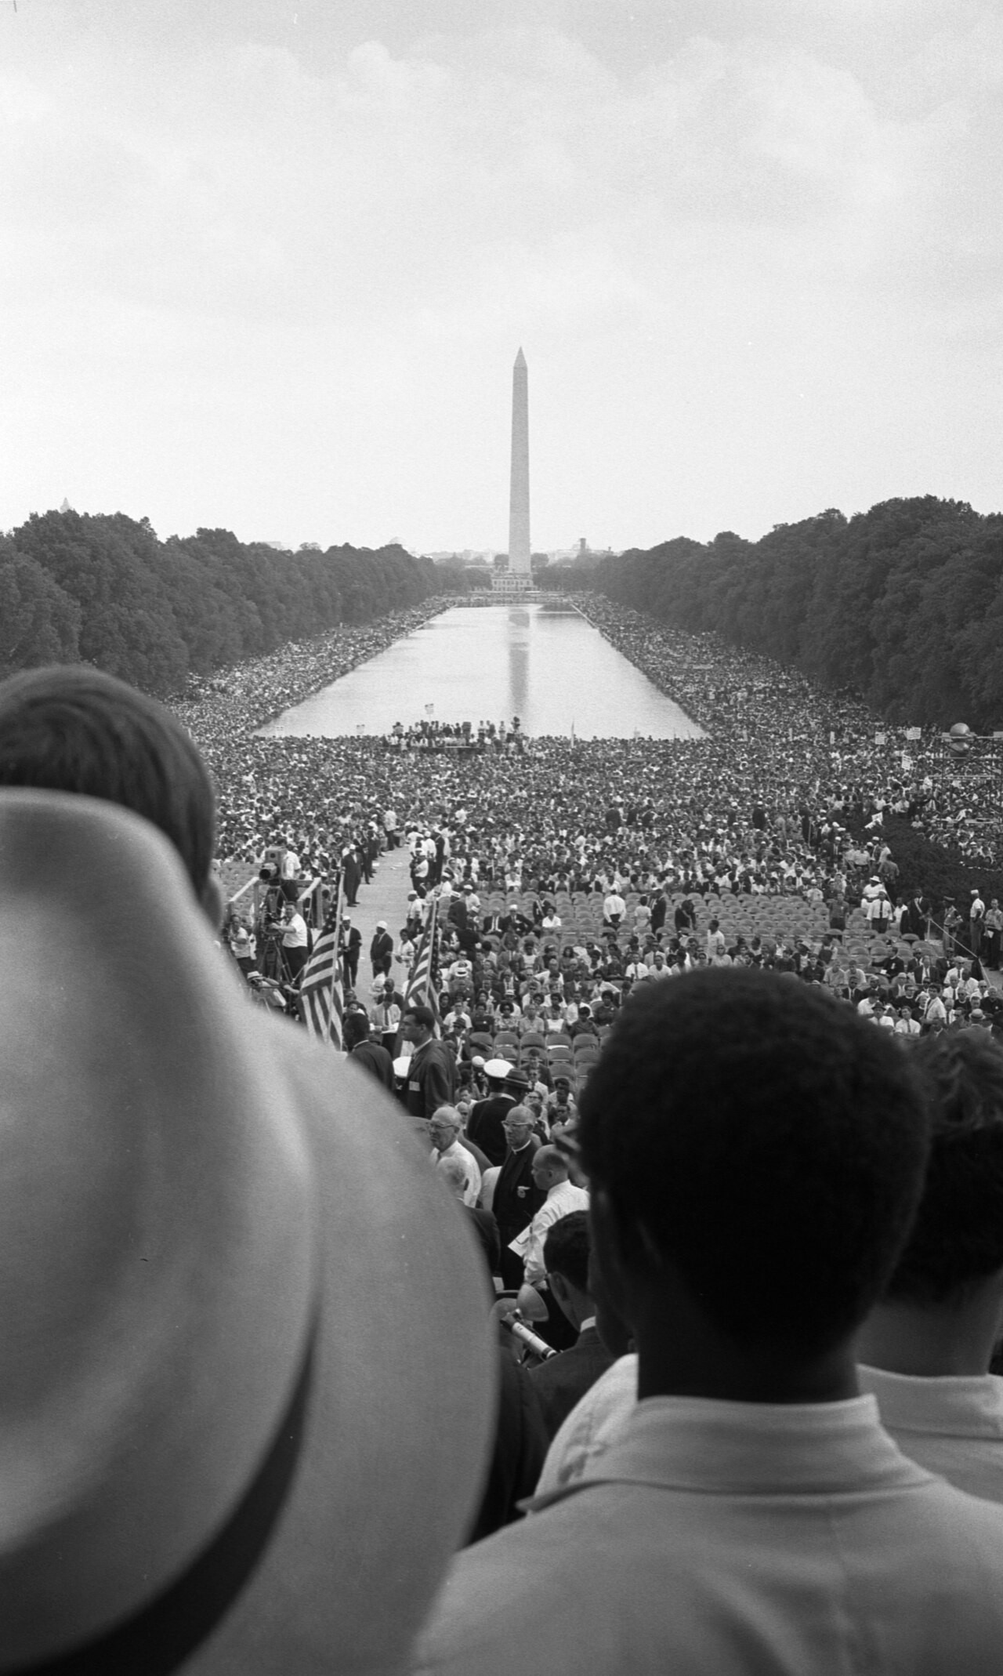
US.80 · PRIMARY SOURCE ANALYSIS
Letter from Birmingham Jail
Close Reading
Dr. Martin Luther King Jr. · April 16, 1963
ZOOM IN Find ONE detail that surprises you — be ready to name it.
"Injustice anywhere is a threat to justice everywhere. We are caught in an inescapable network of mutuality, tied in a single garment of destiny. Whatever affects one directly, affects all indirectly... I have almost reached the regrettable conclusion that the Negro's great stumbling block in his stride toward freedom is not the White Citizen's Counciler or the Ku Klux Klanner, but the white moderate."
CONTEXT
Dr. King wrote his famous letter in April 1963 from a Birmingham jail cell, where he had been imprisoned for violating an injunction against demonstrations. The letter was a response to a statement by eight white Alabama clergymen who had called the demonstrations 'unwise and untimely' while expressing sympathy for the civil rights cause. King's letter became one of the most eloquent defenses of nonviolent direct action and the moral urgency of civil rights in American history.
ANALYZE
Warren K. Leffler, U.S. News & World Report Magazine, August 28, 1963 Library of Congress
According to Dr. King, what is the greatest obstacle to civil rights progress?
SOURCE IT
WHO made it?
WHEN?
WHY does it matter?
FIRST
Dr. Martin Luther King Jr.
April 16, 1963
Consider the author’s purpose and audience before you interpret the words.
SSP.02 · before you interpret
Source: National Archives
U.S. History Hack · TroopToTeacher Technologies LLC · Aligned to TN Academic Standards & TCAP EOC
43
Notes:
Primary-source analysis. SOURCE IT FIRST (SSP.02) — model the sourcing routine aloud before students interpret: WHO made this source? (Dr. Martin Luther King Jr.) WHEN? (April 16, 1963) WHY does that matter? (Consider the author’s purpose and audience before you interpret the words.) Only then move to the ANALYZE question. Suggested answer: King states that "the Negro's great stumbling block" is not the KKK but "the white moderate," those who prefer gradual change to immediate action for justice. Practice skill: Close Reading.

Slide 49
US.80 · KEY VOCABULARY
Word Wall
Montgomery Bus Boycott
Boicot de Autobuses de Montgomery
Freedom Riders
Jinetes de la Libertad
say: munt-GUM-er-ee
say: FREE-dum RY-derz
MB
The 381-day boycott (1955-1956) of the Montgomery, Alabama bus system by African Americans protesting segregated seating, ending when the Supreme Court ruled bus segregation unconstitutional.
FR
Interracial groups of civil rights activists who rode interstate buses into the segregated South in 1961 to challenge illegal segregation of public transportation, facing violent attacks.
Highlander Folk School
Escuela Popular Highlander
Tent City (Fayette County, TN)
Ciudad de Tiendas (Condado de Fayette, TN)
say: HY-land-er
say: fay-ET
HF
Tennessee education center founded in 1932 that trained civil rights leaders including Rosa Parks, Martin Luther King Jr., and John Lewis in nonviolent resistance and organizing tactics.
TC
A 1960 settlement of African Americans evicted from their homes in Fayette County, Tennessee after registering to vote, living in tents to maintain their right to vote despite economic retaliation.
Sit-ins (Nashville)
Sentadas (Nashville)
March on Washington
Marcha en Washington
say: SIT-inz
say: WOSH-ing-tun
SI
Nonviolent protests where African Americans sat at segregated lunch counters requesting service, beginning in Greensboro (1960) and powerfully demonstrated in Nashville led by students like Diane Nash.
MO
The massive August 28, 1963 demonstration where over 250,000 people gathered at the Lincoln Memorial to demand civil rights, highlighted by Martin Luther King Jr.'s "I Have a Dream" speech.
"say:" pronunciation guide (stressed syllable in CAPS) and a per-term visual anchor support newcomer English learners. Spanish term + full bilingual Frayer models are in the unit vocabulary set.
U.S. History Hack · TroopToTeacher Technologies LLC · Aligned to TN Academic Standards & TCAP EOC
3

Slide 50
US.80 · GUIDED PRACTICE — WE DO IT TOGETHER
Let’s Work One Together
Trace cause and effect in a protest
MODEL PROMPT: The Montgomery Bus Boycott lasted 381 days. What triggered it, and what did it prove about nonviolent protest?
WORKED EXAMPLE (teacher models this aloud)
Rosa Parks’s arrest triggered a mass boycott organized by King and local leaders.
THINK ALOUD
The sustained, disciplined boycott showed economic pressure plus nonviolence could force change.
→ Now you try: Now you: name the trigger, the tactic, and the outcome for one event on today’s timeline.
U.S. History Hack · TroopToTeacher Technologies LLC · Aligned to TN Academic Standards & TCAP EOC
45
Notes:
GUIDED PRACTICE / WE DO (US.80). Skill modeled: Trace cause and effect in a protest. Model the worked example aloud using the THINK ALOUD as your script, then release students to the activity ("Now you: name the trigger, the tactic, and the outcome for one event on today’s timeline."). This is the I Do → We Do → You Do bridge — do not skip it; aim for 80%+ success before independent work.

Slide 51
US.80 · STUDENT ACTIVITY
Civil Rights Campaigns — SAPA Chart
Groups of 3
18 min
YOUR TASK
Using your Cornell notes, complete the SAPA chart (Situation — Action — Problem — Action) for THREE civil rights campaigns from this standard: choose from the Montgomery Bus Boycott, the Nashville sit-ins, the Freedom Rides, and the March on Washington. For each, identify the Situation (the injustice), the Action taken (the tactic), the Problem/resistance it met, and the further Action or outcome that resulted. Note Tennessee’s role where it applies (Nashville sit-ins, Highlander, Fayette County Tent City).
DELIVERABLE
DIFFERENTIATION
Completed SAPA chart for three campaigns, each with all four columns filled, plus one sentence identifying which tactic did the most to force federal action.
Entry: SAPA chart with two campaigns pre-filled as models and a word bank of tactics (boycott, sit-in, Freedom Ride, march) and outcomes. Honors: Analyze how different protest types achieved different goals — which tactic was most effective at forcing federal action, and why?
Companion printable: printables/unit-9/unit-9-sapa.html
U.S. History Hack · TroopToTeacher Technologies LLC · Aligned to TN Academic Standards & TCAP EOC
46
Notes:
Student activity for US.80. Pair with the printable: printables/unit-9/unit-9-sapa.html. Timing: 18. Deliverable: Completed SAPA chart for three campaigns, each with all four columns filled, plus one sentence identifying which tactic did the most to force federal action.

Slide 52
US.80 · CHECK FOR UNDERSTANDING
TCAP-Style Question
DOK 3
EOC PRACTICE
According to Dr. King, what is the greatest obstacle to civil rights progress?
The Ku Klux Klan
A
White moderates who prefer order over justice
B
Lack of funding for civil rights organizations
C
Disagreements among civil rights leaders
D
ANSWER FIRST: students commit — then click / advance to reveal the correct answer and explanation.
U.S. History Hack · TroopToTeacher Technologies LLC · Aligned to TN Academic Standards & TCAP EOC
47
Notes:
CHECK FOR UNDERSTANDING (US.80, DOK 3). Have students commit to an answer (whiteboards, hand signal, or turn-and-talk) BEFORE advancing. Correct answer: B. The next slide reveals it. Why: King states that "the Negro's great stumbling block" is not the KKK but "the white moderate," those who prefer gradual change to immediate action for justice.

Slide 53
US.80 · ANSWER REVEAL
TCAP-Style Question
✓ ANSWER KEY
According to Dr. King, what is the greatest obstacle to civil rights progress?
A
The Ku Klux Klan
B
White moderates who prefer order over justice
✓
C
Lack of funding for civil rights organizations
D
Disagreements among civil rights leaders
Correct answer: B. Why: King states that "the Negro's great stumbling block" is not the KKK but "the white moderate," those who prefer gradual change to immediate action for justice.
U.S. History Hack · TroopToTeacher Technologies LLC · Aligned to TN Academic Standards & TCAP EOC
48
Notes:
ANSWER KEY (US.80). Correct: B. King states that "the Negro's great stumbling block" is not the KKK but "the white moderate," those who prefer gradual change to immediate action for justice.

Slide 54
US.80 · WRAP-UP
What You Need to Know for TCAP
KEY TAKEAWAYS
EXIT TICKET
DOK 2
Early Movement Victories
Tennessee's Role in the Movement
Confrontations That Changed America
Culminating Events
Choose two civil rights events from this standard (boycott, sit-in, Freedom Ride, or march). Explain what tactic each used and what it accomplished.
★ HONORS / EXTENSION DOK 3 · SSP.04 Argumentation
Analyze how different types of protest (boycotts, sit-ins, Freedom Rides, marches) achieved different goals. Which tactic was most effective at forcing federal action, and why?
U.S. History Hack · TroopToTeacher Technologies LLC · Aligned to TN Academic Standards & TCAP EOC
49
Notes:
WRAP-UP / EXIT-TICKET KEY (US.80, DOK 2). Prompt: Choose two civil rights events from this standard (boycott, sit-in, Freedom Ride, or march). Explain what tactic each used and what it accomplished. Model answer: The Montgomery Bus Boycott used economic pressure (refusing to ride segregated buses) and ended bus segregation in Montgomery, establishing nonviolent resistance and launching Dr. King. The Nashville sit-ins used peaceful occupation of segregated lunch counters and successfully desegregated Nashville’s counters — becoming a model for the movement. Each used a different nonviolent tactic to target a specific form of segregation. RETEACH TRIGGER — if a student misses this exit ticket: (1) <50% of class miss → spiral it into the next standard’s Quick Review opener (see the US.80 review prompts). (2) Individual/small group → reteach with the "Early Movement Victories" direct-instruction slide + re-run the SOURCE IT FIRST routine on the US.80 primary source, then assign the paired printable: printables/unit-9/unit-9-sapa.html. (3) Re-assess with the US.80 check-for-understanding reveal slide as a do-now the next day. Reteach anchors (this standard’s sections): Early Movement Victories; Tennessee's Role in the Movement; Confrontations That Changed America; Culminating Events. I Can objective: I can describe the significant events in the struggle to secure civil rights for African Americans, including the Montgomery Bus Boycott, Freedom Riders, March on Washington, Birmingham bombings, and assassination of Martin Luther King Jr. HONORS / EXTENSION (DOK 3, for early finishers or advanced learners): Analyze how different types of protest (boycotts, sit-ins, Freedom Rides, marches) achieved different goals. Which tactic was most effective at forcing federal action, and why? — look for a clear claim plus two specific pieces of evidence.

Slide 55
STANDARD
SOCIAL STUDIES PRACTICES
US.81
SSP.03
Synthesize sources
SSP.05
Historical awareness
SSP.06
Geographic awareness
Civil and Voting Rights Legislation
TN ACADEMIC STANDARD
Analyze civil and voting rights legislation, including: The Civil Rights Act of 1964, the Voting Rights Act of 1965, the Civil Rights Act of 1968 (e.g., Fair Housing Act), and the 24th Amendment. (TCA)
I CAN
I can analyze civil and voting rights legislation, including the Civil Rights Act of 1964, the Voting Rights Act of 1965, the Civil Rights Act of 1968 (Fair Housing Act), and the 24th Amendment.
U.S. History Hack · TroopToTeacher Technologies LLC · Aligned to TN Academic Standards & TCAP EOC
50

Slide 56
KEY VOCABULARY · LANGUAGE SUPPORT
US.80
Words you need before we read
Montgomery Bus Boycott
Freedom Riders
Highlander Folk School
En español: Boicot de Autobuses de Montgomery
En español: Jinetes de la Libertad
En español: Escuela Popular Highlander
WHAT IT MEANS
WHAT IT MEANS
WHAT IT MEANS
The 381-day boycott (1955-1956) of the Montgomery, Alabama bus system by African Americans protesting segregated seating, ending when the Supreme Court ruled bus segregation unconstitutional.
Interracial groups of civil rights activists who rode interstate buses into the segregated South in 1961 to challenge illegal segregation of public transportation, facing violent attacks.
Tennessee education center founded in 1932 that trained civil rights leaders including Rosa Parks, Martin Luther King Jr., and John Lewis in nonviolent resistance and organizing tactics.
UDL · REPRESENTATION → LANGUAGE & SYMBOLS
U.S. History Hack · TEACHER DECK · Aligned to TN Academic Standards & TCAP EOC
6

Slide 57
PROGRESS CHECK
US.80
Check your understanding
How did television coverage of events like Birmingham and Little Rock build national support for civil rights legislation?
A
Television had minimal impact on public opinion, despite limited evidence supporting this interpretation, but closer analysis reveals a more complicated historical reality
B
Television coverage primarily supported segregationists, yet the available evidence points to a different conclusion
C
Images of fire hoses, police dogs, and troops protecting children shocked Americans and generated sympathy for the movement, pressuring Congress to act
✓ KEY
D
Most Americans did not have access to television coverage, yet the available evidence points to a different conclusion
UDL · ACTION & EXPRESSION → STRATEGY DEVELOPMENT
MTSS: below mastery → targeted reteach (Tier 2); at/above → extension. The goal never lowers.
U.S. History Hack · TEACHER DECK · Aligned to TN Academic Standards & TCAP EOC
7

Slide 58
US.81 · QUICK REVIEW
Do You Remember?
Before we start, retrieve what we have already learned. Answer from memory first — no notes.
1
US.80 In the last standard we studied the major events — Montgomery, the Nashville sit-ins, the Freedom Rides, and the March on Washington. How did these events create pressure for new laws?
U.S. History Hack · TroopToTeacher Technologies LLC · Aligned to TN Academic Standards & TCAP EOC
51
Notes:
SPACED RETRIEVAL (US.81). Cold-call or whiteboards, 3-4 min, low stakes. Answers — 1) Televised protests and violent responses (like Birmingham) shocked the nation and built public support. The March on Washington (1963) directly demanded civil rights legislation, pushing Congress and President Johnson to act.

Slide 59
US.81 · CONFIDENCE CHECK
Warm-Up — Quick Recall
DOK 1
LOW STAKES
Everyone can answer this. Thumbs / whiteboards — no notes.
What did the Civil Rights Act of 1964 make illegal?
✓ ANSWER
Discrimination based on race, color, religion, sex, or national origin in public places and employment.
COMMIT FIRST: have everyone answer before the reveal — this is the DOK 1 floor; the graded check later in this lesson moves up to DOK 2–3.
U.S. History Hack · TroopToTeacher Technologies LLC · Aligned to TN Academic Standards & TCAP EOC
52
Notes:
CONFIDENCE CHECK (US.81, DOK 1). 60-90 seconds. Have EVERY student commit (thumbs / whiteboard / choral) before revealing — this secures an early win and surfaces who is shaky before new content. Answer: Discrimination based on race, color, religion, sex, or national origin in public places and employment. Key term to listen for: Civil Rights Act of 1964. This is the low-floor entry; the graded Check for Understanding later in the standard rises to DOK 2–3.

Slide 60
US.81 · HOOK
Think About It
In just four years, Congress passed the Civil Rights Act of 1964, the 24th Amendment, the Voting Rights Act of 1965, and the Fair Housing Act of 1968 — dismantling in law the segregation that protest had exposed on the streets.
DISCUSS
TIMING: Turn & Talk 60 sec → cold-call 2 pairs
Protests can change hearts and headlines — but why does lasting change usually require an act of Congress or an amendment to the Constitution?
U.S. History Hack · TroopToTeacher Technologies LLC · Aligned to TN Academic Standards & TCAP EOC
53
Notes:
HOOK (US.81). Run tight: pose the provocation, give a silent 10-second think, then Turn & Talk 60 seconds. Cold-call 2–3 pairs (not volunteers) for a sentence-starter answer — "One force was ___ because ___" — then bridge to the standard. Keep total to ~4 minutes; do not let it sprawl. Return to this question at the unit close for an evidence-based answer.

Slide 61
US.81 · DIRECT INSTRUCTION
1 of 4
Civil Rights Act of 1964
This landmark legislation banned discrimination in public accommodations, employment, and federally funded programs.
It created the Equal Employment Opportunity Commission (EEOC) and strengthened voting rights enforcement.
The Act ended legal segregation in public facilities and opened economic opportunities for minorities, though housing discrimination and voting restrictions remained challenges.
SENTENCE FRAME (EL & writing support)
The ___ of ___ helped African Americans by ___, which the government could now enforce because ___.
U.S. History Hack · TroopToTeacher Technologies LLC · Aligned to TN Academic Standards & TCAP EOC
54
Notes:
FACILITATION (US.81). Ask: a march can change hearts, but what changes the law? Track how protest turned into legislation. Teach in small steps; pause and check for understanding before the next chunk (aim 80%+ before moving on).

Slide 62
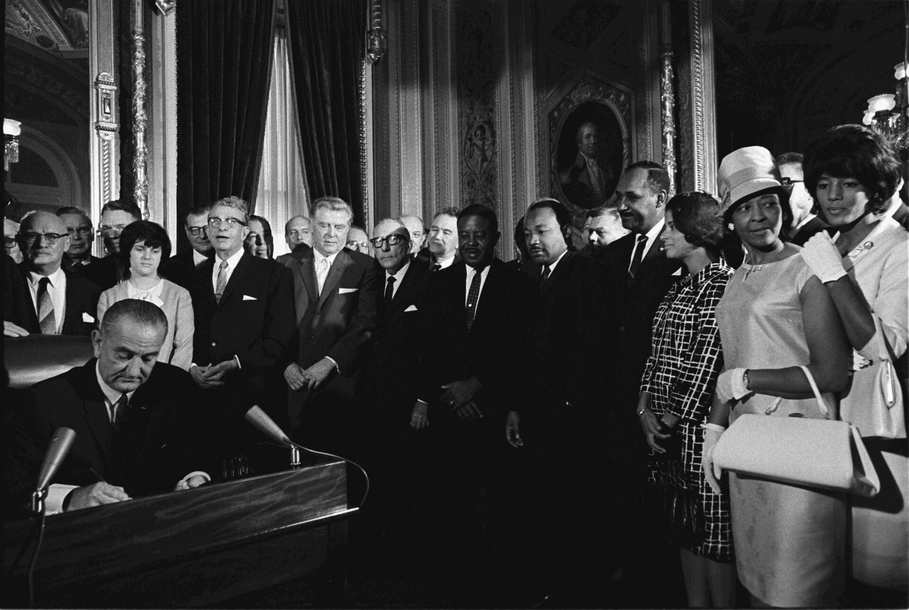
US.81 · DIRECT INSTRUCTION
2 of 4
Voting Rights Act of 1965
The Voting Rights Act banned literacy tests and other discriminatory voting practices.
It required federal approval for voting changes in covered jurisdictions and authorized federal voting registrars in areas with low minority registration.
The impact was dramatic—Black voter registration in the South increased from 23% to 61% by 1969, transforming Southern politics.
Yoichi R. Okamoto, LBJ Library, August 6, 1965 Wikimedia Commons
U.S. History Hack · TroopToTeacher Technologies LLC · Aligned to TN Academic Standards & TCAP EOC
55

Slide 63
US.81 · DIRECT INSTRUCTION
3 of 4
Civil Rights Act of 1968 (Fair Housing Act)
Passed after King's assassination amid national grief and urban riots, this Act prohibited discrimination in housing sales, rentals, and financing based on race, religion, national origin, or sex.
It addressed residential segregation, though enforcement remained weak.
The Act completed the legal framework for civil rights protection.
U.S. History Hack · TroopToTeacher Technologies LLC · Aligned to TN Academic Standards & TCAP EOC
56

Slide 64
US.81 · DIRECT INSTRUCTION
4 of 4
24th Amendment (1964)
This constitutional amendment eliminated poll taxes in federal elections, removing economic barriers to voting that particularly affected poor Black and white voters in the South.
It extended voting rights protection beyond racial discrimination to address economic discrimination in the electoral process.
U.S. History Hack · TroopToTeacher Technologies LLC · Aligned to TN Academic Standards & TCAP EOC
57

Slide 65
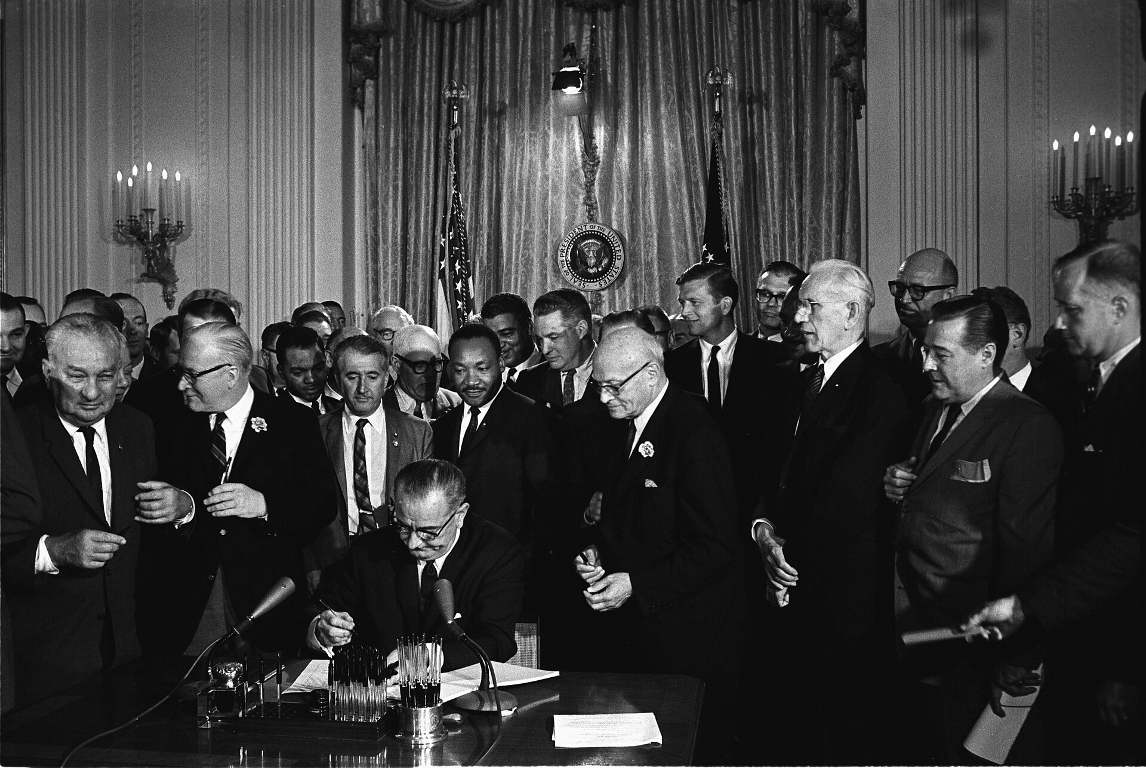
US.81 · PEOPLE WHO SHAPED THE ERA
Key Figure
President Lyndon B. Johnson
U.S. President
Signed the Civil Rights Act of 1964
Signed the Voting Rights Act of 1965
Cecil Stoughton, White House Press Office, July 2, 1964 Executive Office of the President of the United States
STRATEGY Federal legislation & enforcement
U.S. History Hack · TroopToTeacher Technologies LLC · Aligned to TN Academic Standards & TCAP EOC
58

Slide 66
US.81 · PRIMARY SOURCE ANALYSIS
Civil Rights Act of 1964
Close Reading
U.S. Congress · July 2, 1964
"All persons shall be entitled to the full and equal enjoyment of the goods, services, facilities, privileges, advantages, and accommodations of any place of public accommodation... without discrimination or segregation on the ground of race, color, religion, or national origin."
CONTEXT
The Civil Rights Act of 1964 was the most significant civil rights legislation since Reconstruction. It prohibited discrimination based on race, color, religion, sex, or national origin in employment and public accommodations like hotels, restaurants, and theaters. The bill had been proposed by Kennedy and was finally passed after his assassination under President Johnson, who used his legislative mastery to overcome a 60-day Southern filibuster in the Senate—the longest in Senate history.
ANALYZE
READ CLOSELY Underline the exact words that answer the ANALYZE question — be ready to read them aloud.
What did the Civil Rights Act of 1964 prohibit?
SOURCE IT
WHO made it?
WHEN?
WHY does it matter?
FIRST
U.S. Congress
July 2, 1964
Consider the author’s purpose and audience before you interpret the words.
SSP.02 · before you interpret
Source: National Archives
U.S. History Hack · TroopToTeacher Technologies LLC · Aligned to TN Academic Standards & TCAP EOC
59
Notes:
Primary-source analysis. SOURCE IT FIRST (SSP.02) — model the sourcing routine aloud before students interpret: WHO made this source? (U.S. Congress) WHEN? (July 2, 1964) WHY does that matter? (Consider the author’s purpose and audience before you interpret the words.) Only then move to the ANALYZE question. Suggested answer: The Act guarantees "full and equal enjoyment" of "any place of public accommodation... without discrimination or segregation on the ground of race, color, religion, or national origin." Practice skill: Close Reading.

Slide 67
US.81 · KEY VOCABULARY
Word Wall
Civil Rights Act of 1964
Ley de Derechos Civiles de 1964
Voting Rights Act of 1965
Ley de Derechos de Voto de 1965
say: SIV-ul ryts
say:
CR
Landmark federal legislation that outlawed discrimination based on race, color, religion, sex, or national origin, ending segregation in public accommodations and employment.
VR
Federal legislation that outlawed discriminatory voting practices (literacy tests, poll taxes) used to disenfranchise African Americans, dramatically increasing Black voter registration in the South.
Civil Rights Act of 1968 (Fair Housing Act)
Ley de Derechos Civiles de 1968 (Ley de Vivienda Justa)
24th Amendment
Enmienda 24
say: SIV-ul ryts
say: uh-MEND-ment
CR
Federal law that prohibited discrimination in the sale, rental, and financing of housing based on race, religion, national origin, or sex, addressing residential segregation.
2A
Constitutional amendment ratified in 1964 that abolished poll taxes in federal elections, removing a barrier used to prevent poor African Americans from voting.
March on Washington
Marcha sobre Washington
Lyndon B. Johnson
Lyndon B. Johnson
say: WOSH-ing-tun
say: LIN-dun
MO
The 1963 civil rights rally where Dr. King delivered his 'I Have a Dream' speech, pressing for jobs and freedom.
LB
The 36th U.S. President who signed the Civil Rights Act of 1964 and the Voting Rights Act of 1965 into law.
"say:" pronunciation guide (stressed syllable in CAPS) and a per-term visual anchor support newcomer English learners. Spanish term + full bilingual Frayer models are in the unit vocabulary set.
U.S. History Hack · TroopToTeacher Technologies LLC · Aligned to TN Academic Standards & TCAP EOC
4

Slide 68
US.81 · GUIDED PRACTICE — WE DO IT TOGETHER
Let’s Work One Together
Analyze what a law actually does
MODEL PROMPT: The Civil Rights Act of 1964 "banned discrimination." What specifically did it ban, and how was it enforced?
WORKED EXAMPLE (teacher models this aloud)
It outlawed segregation in public accommodations and discrimination in employment.
THINK ALOUD
Enforcement mattered — the federal government could now withhold funds and sue violators.
→ Now you try: Now you: for the Voting Rights Act of 1965, state what it banned and one enforcement tool it created.
U.S. History Hack · TroopToTeacher Technologies LLC · Aligned to TN Academic Standards & TCAP EOC
61
Notes:
GUIDED PRACTICE / WE DO (US.81). Skill modeled: Analyze what a law actually does. Model the worked example aloud using the THINK ALOUD as your script, then release students to the activity ("Now you: for the Voting Rights Act of 1965, state what it banned and one enforcement tool it created."). This is the I Do → We Do → You Do bridge — do not skip it; aim for 80%+ success before independent work.

Slide 69
US.81 · STUDENT ACTIVITY
Civil Rights Legislation — HIPP[O] Source Analysis
Pairs
15 min
YOUR TASK
Using your Cornell notes and the legislative excerpt (Civil Rights Act of 1964 or Voting Rights Act of 1965), complete the HIPP[O] organizer: Historical context, Intended audience, Purpose, Point of view, and Overall significance. Then build a short timeline placing the four measures in order — Civil Rights Act of 1964, 24th Amendment (1964), Voting Rights Act of 1965, and Fair Housing Act of 1968 — and note what each one made illegal or protected. Finish with a claim on why BOTH the 1964 and 1965 laws were necessary.
DELIVERABLE
DIFFERENTIATION
Completed HIPP[O] organizer for one law, an ordered list of the four measures with what each accomplished, and a one-sentence claim on why ending segregation did not automatically guarantee the vote.
Entry: HIPP[O] organizer with guiding questions and a matching activity linking each law to what it banned/protected. Honors: Evaluate which measure (1964 Act, 1965 Voting Rights Act, 24th Amendment, or 1968 Fair Housing Act) had the most transformative impact, defended with evidence.
Companion printable: printables/unit-9/hippo-primary-source-organizer.html
U.S. History Hack · TroopToTeacher Technologies LLC · Aligned to TN Academic Standards & TCAP EOC
62
Notes:
Student activity for US.81. Pair with the printable: printables/unit-9/hippo-primary-source-organizer.html. Timing: 15. Deliverable: Completed HIPP[O] organizer for one law, an ordered list of the four measures with what each accomplished, and a one-sentence claim on why ending segregation did not automatically guarantee the vote.

Slide 70
US.81 · CHECK FOR UNDERSTANDING
TCAP-Style Question
DOK 2
EOC PRACTICE
What did the Civil Rights Act of 1964 prohibit?
Discrimination in private homes
A
Only discrimination in federal government jobs
B
Discrimination in voting only
C
Discrimination in public places based on race, color, religion, or national origin
D
ANSWER FIRST: students commit — then click / advance to reveal the correct answer and explanation.
U.S. History Hack · TroopToTeacher Technologies LLC · Aligned to TN Academic Standards & TCAP EOC
63
Notes:
CHECK FOR UNDERSTANDING (US.81, DOK 2). Have students commit to an answer (whiteboards, hand signal, or turn-and-talk) BEFORE advancing. Correct answer: D. The next slide reveals it. Why: The Act guarantees "full and equal enjoyment" of "any place of public accommodation... without discrimination or segregation on the ground of race, color, religion, or national origin."

Slide 71
US.81 · ANSWER REVEAL
TCAP-Style Question
✓ ANSWER KEY
What did the Civil Rights Act of 1964 prohibit?
A
Discrimination in private homes
B
Only discrimination in federal government jobs
C
Discrimination in voting only
D
Discrimination in public places based on race, color, religion, or national origin
✓
Correct answer: D. Why: The Act guarantees "full and equal enjoyment" of "any place of public accommodation... without discrimination or segregation on the ground of race, color, religion, or national origin."
U.S. History Hack · TroopToTeacher Technologies LLC · Aligned to TN Academic Standards & TCAP EOC
64
Notes:
ANSWER KEY (US.81). Correct: D. The Act guarantees "full and equal enjoyment" of "any place of public accommodation... without discrimination or segregation on the ground of race, color, religion, or national origin."

Slide 72
US.81 · WRAP-UP
What You Need to Know for TCAP
KEY TAKEAWAYS
EXIT TICKET
DOK 2
Civil Rights Act of 1964
Voting Rights Act of 1965
Civil Rights Act of 1968 (Fair Housing Act)
24th Amendment (1964)
Explain the main purpose of the Civil Rights Act of 1964 and the Voting Rights Act of 1965. Why were BOTH laws necessary?
★ HONORS / EXTENSION DOK 3 · SSP.04 Argumentation
Evaluate which piece of civil rights legislation (1964 Act, 1965 Voting Rights Act, 24th Amendment, or 1968 Fair Housing Act) had the most transformative impact on American life. Defend your choice with evidence.
U.S. History Hack · TroopToTeacher Technologies LLC · Aligned to TN Academic Standards & TCAP EOC
65
Notes:
WRAP-UP / EXIT-TICKET KEY (US.81, DOK 2). Prompt: Explain the main purpose of the Civil Rights Act of 1964 and the Voting Rights Act of 1965. Why were BOTH laws necessary? Model answer: The Civil Rights Act of 1964 outlawed segregation and discrimination in public places, schools, and employment. The Voting Rights Act of 1965 specifically protected the right to vote by banning literacy tests and authorizing federal oversight of voter registration. Both were necessary because ending segregation (1964) did not automatically guarantee access to the ballot — voting discrimination required its own law. RETEACH TRIGGER — if a student misses this exit ticket: (1) <50% of class miss → spiral it into the next standard’s Quick Review opener (see the US.81 review prompts). (2) Individual/small group → reteach with the "Civil Rights Act of 1964" direct-instruction slide + re-run the SOURCE IT FIRST routine on the US.81 primary source, then assign the paired printable: printables/unit-9/hippo-primary-source-organizer.html. (3) Re-assess with the US.81 check-for-understanding reveal slide as a do-now the next day. Reteach anchors (this standard’s sections): Civil Rights Act of 1964; Voting Rights Act of 1965; Civil Rights Act of 1968 (Fair Housing Act); 24th Amendment (1964). I Can objective: I can analyze civil and voting rights legislation, including the Civil Rights Act of 1964, the Voting Rights Act of 1965, the Civil Rights Act of 1968 (Fair Housing Act), and the 24th Amendment. HONORS / EXTENSION (DOK 3, for early finishers or advanced learners): Evaluate which piece of civil rights legislation (1964 Act, 1965 Voting Rights Act, 24th Amendment, or 1968 Fair Housing Act) had the most transformative impact on American life. Defend your choice with evidence. — look for a clear claim plus two specific pieces of evidence.

Slide 73
STANDARD
SOCIAL STUDIES PRACTICES
US.82
SSP.04
Build an argument
SSP.05
Historical awareness
SSP.06
Geographic awareness
American Indian, Chicano & Feminist Movements
TN ACADEMIC STANDARD
Analyze how the American Indian Movement, Chicano Movement, and Feminist Movement are related to the Civil Rights Movement in advancing equality across the broader spectrum of American society during this time period.
I CAN
I can analyze how the American Indian Movement, Chicano Movement, and Feminist Movement are related to the Civil Rights Movement in advancing equality across American society.
U.S. History Hack · TroopToTeacher Technologies LLC · Aligned to TN Academic Standards & TCAP EOC
66

Slide 74
KEY VOCABULARY · LANGUAGE SUPPORT
US.81
Words you need before we read
Civil Rights Act of 1964
Voting Rights Act of 1965
Civil Rights Act of 1968 (Fair Housing Act)
En español: Ley de Derechos Civiles de 1964
En español: Ley de Derechos de Voto de 1965
En español: Ley de Derechos Civiles de 1968 (Ley de Vivienda Justa)
WHAT IT MEANS
WHAT IT MEANS
WHAT IT MEANS
Landmark federal legislation that outlawed discrimination based on race, color, religion, sex, or national origin, ending segregation in public accommodations and employment.
Federal legislation that outlawed discriminatory voting practices (literacy tests, poll taxes) used to disenfranchise African Americans, dramatically increasing Black voter registration in the South.
Federal law that prohibited discrimination in the sale, rental, and financing of housing based on race, religion, national origin, or sex, addressing residential segregation.
UDL · REPRESENTATION → LANGUAGE & SYMBOLS
U.S. History Hack · TEACHER DECK · Aligned to TN Academic Standards & TCAP EOC
8

Slide 75
PROGRESS CHECK
US.81
Check your understanding
Why was the Fair Housing Act (1968) necessary even after earlier civil rights legislation?
A
Earlier legislation had already addressed housing discrimination, although this view has been largely discredited by scholars
B
Housing discrimination was not a significant problem, despite limited evidence supporting this interpretation
C
The Fair Housing Act replaced the 1964 Civil Rights Act, which does not align with the documented historical record
D
The 1964 Act focused on public accommodations and employment but did not address residential segregation, which perpetuated inequality
✓ KEY
UDL · ACTION & EXPRESSION → STRATEGY DEVELOPMENT
MTSS: below mastery → targeted reteach (Tier 2); at/above → extension. The goal never lowers.
U.S. History Hack · TEACHER DECK · Aligned to TN Academic Standards & TCAP EOC
9

Slide 76
US.82 · QUICK REVIEW
Do You Remember?
Before we start, retrieve what we have already learned. Answer from memory first — no notes.
1
US.81 We just analyzed the major civil rights laws. What did the Civil Rights Act of 1964 and the Voting Rights Act of 1965 accomplish?
U.S. History Hack · TroopToTeacher Technologies LLC · Aligned to TN Academic Standards & TCAP EOC
67
Notes:
SPACED RETRIEVAL (US.82). Cold-call or whiteboards, 3-4 min, low stakes. Answers — 1) The Civil Rights Act of 1964 banned discrimination in public places and employment; the Voting Rights Act of 1965 outlawed practices like literacy tests and authorized federal oversight of registration, dramatically increasing Black voter participation.

Slide 77
US.82 · CONFIDENCE CHECK
Warm-Up — Quick Recall
DOK 1
LOW STAKES
Everyone can answer this. Thumbs / whiteboards — no notes.
Name the three movements this standard connects to the Civil Rights Movement.
✓ ANSWER
The American Indian Movement (AIM), the Chicano Movement, and the Feminist Movement.
COMMIT FIRST: have everyone answer before the reveal — this is the DOK 1 floor; the graded check later in this lesson moves up to DOK 2–3.
U.S. History Hack · TroopToTeacher Technologies LLC · Aligned to TN Academic Standards & TCAP EOC
68
Notes:
CONFIDENCE CHECK (US.82, DOK 1). 60-90 seconds. Have EVERY student commit (thumbs / whiteboard / choral) before revealing — this secures an early win and surfaces who is shaky before new content. Answer: The American Indian Movement (AIM), the Chicano Movement, and the Feminist Movement. Key term to listen for: AIM / Chicano / Feminist. This is the low-floor entry; the graded Check for Understanding later in the standard rises to DOK 2–3.

Slide 78
US.82 · HOOK
Think About It
The African American freedom struggle became a blueprint. American Indians occupied Alcatraz, Mexican American farm workers organized a national grape boycott, and women marched for equal rights — each borrowing tactics from the movement that came before them.
DISCUSS
TIMING: Turn & Talk 60 sec → cold-call 2 pairs
If one movement’s strategies can be adopted by completely different groups, what does that tell us about how social change spreads in America?
U.S. History Hack · TroopToTeacher Technologies LLC · Aligned to TN Academic Standards & TCAP EOC
69
Notes:
HOOK (US.82). Run tight: pose the provocation, give a silent 10-second think, then Turn & Talk 60 seconds. Cold-call 2–3 pairs (not volunteers) for a sentence-starter answer — "One force was ___ because ___" — then bridge to the standard. Keep total to ~4 minutes; do not let it sprawl. Return to this question at the unit close for an evidence-based answer.

Slide 79
US.82 · DIRECT INSTRUCTION
1 of 4
American Indian Movement (AIM)
AIM pursued tribal sovereignty, treaty rights, cultural preservation, and economic development on reservations.
Key actions included the Occupation of Alcatraz (1969-1971), Trail of Broken Treaties march (1972), and Wounded Knee occupation (1973).
Leader Russell Means advocated for "Red Power" and challenged federal Indian policies, using tactics similar to the civil rights movement while asserting distinct cultural identity.
SENTENCE FRAME (EL & writing support)
The ___ Movement built on the Civil Rights Movement by ___, in order to win rights for ___.
U.S. History Hack · TroopToTeacher Technologies LLC · Aligned to TN Academic Standards & TCAP EOC
70
Notes:
FACILITATION (US.82). Ask: once one group wins civil rights, do other groups follow the same path? Look for the shared playbook. Teach in small steps; pause and check for understanding before the next chunk (aim 80%+ before moving on).

Slide 80
US.82 · DIRECT INSTRUCTION
2 of 4
Chicano Movement
The Chicano Movement sought educational equality, labor rights, political representation, and cultural pride for Mexican Americans.
Key actions included East L.A. school walkouts (1968), formation of La Raza Unida Party, and grape boycotts.
Cesar Chavez organized the United Farm Workers, using nonviolent tactics including strikes and boycotts to demand equal opportunities in employment and education.
U.S. History Hack · TroopToTeacher Technologies LLC · Aligned to TN Academic Standards & TCAP EOC
71

Slide 81
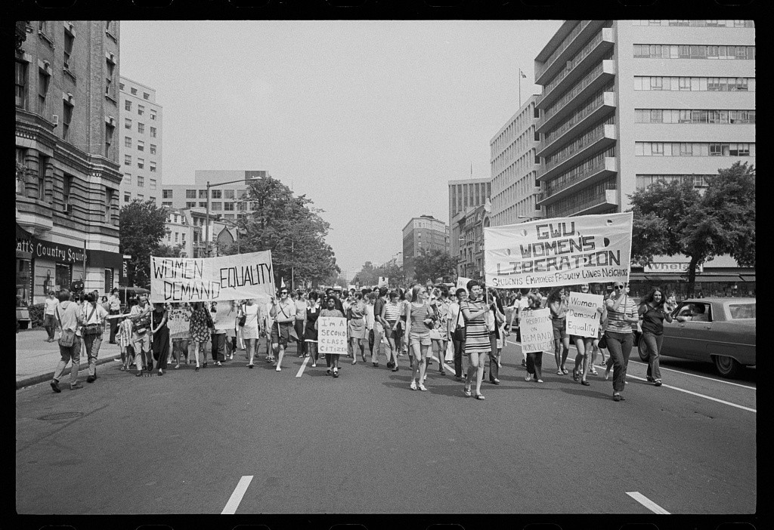
US.82 · DIRECT INSTRUCTION
3 of 4
Feminist Movement
The feminist movement pursued equal pay, reproductive rights, political representation, and ending gender discrimination.
Key actions included formation of the National Organization for Women (NOW), consciousness-raising groups, and protests against discriminatory practices.
Betty Friedan wrote "The Feminine Mystique" (1963), co-founded NOW, and challenged traditional gender roles, using civil rights legal strategies and protest tactics.
Warren K. Leffler, U.S. News & World Report Magazine, August 26, 1970 Library of Congress
U.S. History Hack · TroopToTeacher Technologies LLC · Aligned to TN Academic Standards & TCAP EOC
72

Slide 82
US.82 · DIRECT INSTRUCTION
4 of 4
Synthesizing Connections
All movements shared common elements: legal strategies to challenge discriminatory laws, direct action through protests and demonstrations, pursuit of protective federal legislation, emphasis on group pride and cultural distinctiveness, coalition building with other movements, and strategic use of media.
These movements collectively expanded civil rights from racial equality to broader concepts of human equality, creating templates for future social justice movements.
U.S. History Hack · TroopToTeacher Technologies LLC · Aligned to TN Academic Standards & TCAP EOC
73

Slide 83
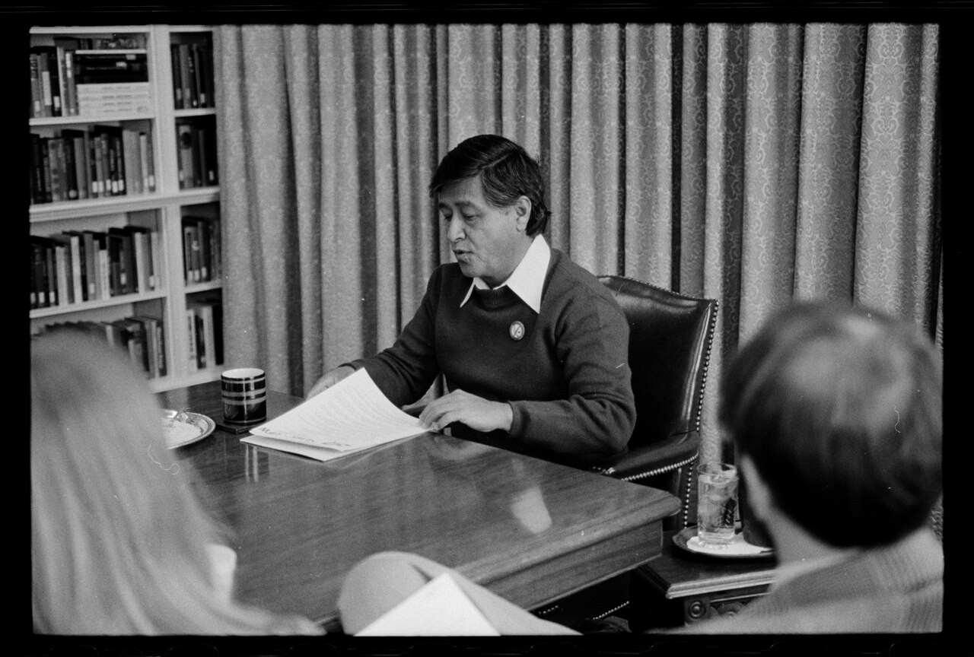
US.82 · PEOPLE WHO SHAPED THE ERA
Key Figures
Cesar Chavez
Betty Friedan
Labor & Chicano leader
Feminist author & organizer
Co-founded the United Farm Workers (UFW)
Used nonviolent boycotts to win farmworker rights
Wrote "The Feminine Mystique" (1963)
Co-founded the National Organization for Women (NOW)
Marion S. Trikosko, U.S. News & World Report Magazine, April 20, 1979 Library of Congress
STRATEGY Nonviolent labor organizing
STRATEGY Consciousness-raising & organizing
U.S. History Hack · TroopToTeacher Technologies LLC · Aligned to TN Academic Standards & TCAP EOC
74

Slide 84
US.82 · PRIMARY SOURCE ANALYSIS
United Farm Workers Proclamation
Corroboration
Dolores Huerta · 1965
"We, the striking grape workers of California, join on this International Boycott Day with the consumers across the continent in planning the steps that lie ahead on the road to our liberation. Now we will suffer for the purpose of ending the poverty, the misery, and the injustice... We are suffering. We shall endure. We shall overcome."
CONTEXT
The United Farm Workers' 1965 Delano Grape Strike and subsequent consumer boycott of California table grapes became one of the most successful labor actions of the 1960s. César Chávez and the UFW issued proclamations explaining their demands and seeking public solidarity. The Proclamation drew on religious language and the tradition of nonviolent civil rights protest to frame the farm workers' struggle as a moral cause worthy of national support.
ANALYZE
How does this proclamation connect to the broader civil rights movement?
READ CLOSELY Underline the exact words that answer the ANALYZE question — be ready to read them aloud.
SOURCE IT
WHO made it?
WHEN?
WHY does it matter?
FIRST
Dolores Huerta
1965
Consider the author’s purpose and audience before you interpret the words.
SSP.02 · before you interpret
Source: National Archives
U.S. History Hack · TroopToTeacher Technologies LLC · Aligned to TN Academic Standards & TCAP EOC
75
Notes:
Primary-source analysis. SOURCE IT FIRST (SSP.02) — model the sourcing routine aloud before students interpret: WHO made this source? (Dolores Huerta) WHEN? (1965) WHY does that matter? (Consider the author’s purpose and audience before you interpret the words.) Only then move to the ANALYZE question. Suggested answer: The proclamation echoes civil rights language with "We shall overcome" and frames the struggle as fighting "poverty, the misery, and the injustice," connecting it to the broader movement. Practice skill: Corroboration.

Slide 85
US.82 · KEY VOCABULARY
Word Wall
American Indian Movement (AIM)
Movimiento Indio Americano
Chicano Movement
Movimiento Chicano
say: AY-im
say: chih-KAH-noh
AI
Civil rights organization founded in 1968 to address issues of poverty, police brutality, and treaty rights affecting Native Americans, using tactics inspired by the Black civil rights movement.
CM
Mexican American civil rights movement of the 1960s-70s that fought for labor rights, education reform, political representation, and cultural pride, led by figures like Cesar Chavez.
Feminist Movement (1960s)
Movimiento Feminista (1960s)
Cesar Chavez
César Chávez
say: FEM-ih-nist
say: SAY-zar SHAH-vez
FM
The "Second Wave" women's rights movement that fought for equal pay, reproductive rights, workplace equality, and passage of the Equal Rights Amendment, led by activists like Betty Friedan.
CC
The labor leader who co-founded the United Farm Workers and led nonviolent strikes and boycotts for Mexican American farmworkers.
Equal Rights Amendment
Enmienda de Igualdad de Derechos
United Farm Workers
Unión de Campesinos
say: EE-kwul ryts
say: farm WUR-kerz
ER
A proposed constitutional amendment (revived in the 1970s feminist movement) to guarantee equal legal rights regardless of sex.
UF
The labor union founded by Cesar Chavez and Dolores Huerta to fight for better pay and conditions for farm laborers.
"say:" pronunciation guide (stressed syllable in CAPS) and a per-term visual anchor support newcomer English learners. Spanish term + full bilingual Frayer models are in the unit vocabulary set.
U.S. History Hack · TroopToTeacher Technologies LLC · Aligned to TN Academic Standards & TCAP EOC
5

Slide 86
US.82 · GUIDED PRACTICE — WE DO IT TOGETHER
Let’s Work One Together
Connect movements to the Civil Rights Movement
MODEL PROMPT: Chavez, AIM, and NOW borrowed tactics from the African American freedom struggle. Name one tactic they shared.
WORKED EXAMPLE (teacher models this aloud)
All used nonviolent protest, organizing, and appeals to equal rights.
THINK ALOUD
They adapted the same playbook — boycotts, marches, and legislation — to new communities.
→ Now you try: Now you: pick one movement and name a goal it shared with, and one way it differed from, the CRM.
U.S. History Hack · TroopToTeacher Technologies LLC · Aligned to TN Academic Standards & TCAP EOC
77
Notes:
GUIDED PRACTICE / WE DO (US.82). Skill modeled: Connect movements to the Civil Rights Movement. Model the worked example aloud using the THINK ALOUD as your script, then release students to the activity ("Now you: pick one movement and name a goal it shared with, and one way it differed from, the CRM."). This is the I Do → We Do → You Do bridge — do not skip it; aim for 80%+ success before independent work.

Slide 87
US.82 · STUDENT ACTIVITY
Movements Compared — Civil Rights Blueprint Venn
Groups of 3
18 min
YOUR TASK
Using your Cornell notes, complete the comparison organizer for the American Indian Movement (AIM), the Chicano Movement, and the Feminist Movement. For each movement, record its main goal, its key leader (Russell Means, Cesar Chavez, Betty Friedan), and the civil-rights tactic it borrowed (protest, boycott, legal challenge, demand for legislation). In the shared/overlap space, record what all three took from the African American Civil Rights Movement. Finish with a claim on how these movements expanded the definition of ‘civil rights.’
DELIVERABLE
DIFFERENTIATION
Completed comparison organizer (goal + leader + borrowed tactic for each of the three movements, plus the shared blueprint) and a one-sentence claim on how they expanded civil rights beyond race.
Entry: Organizer with movements pre-labeled and a word bank (grape boycott, Alcatraz occupation, equal pay, treaty rights, organized protest) to sort. Honors: Analyze how these movements collectively redefined civil rights — did broadening the struggle strengthen or dilute the pursuit of equality? Argue with evidence.
Companion printable: printables/unit-9/unit-9-venn.html
U.S. History Hack · TroopToTeacher Technologies LLC · Aligned to TN Academic Standards & TCAP EOC
78
Notes:
Student activity for US.82. Pair with the printable: printables/unit-9/unit-9-venn.html. Timing: 18. Deliverable: Completed comparison organizer (goal + leader + borrowed tactic for each of the three movements, plus the shared blueprint) and a one-sentence claim on how they expanded civil rights beyond race.

Slide 88
US.82 · CHECK FOR UNDERSTANDING
TCAP-Style Question
DOK 2
EOC PRACTICE
How does this proclamation connect to the broader civil rights movement?
It uses similar language and tactics, including "We shall overcome"
A
It explicitly rejects the civil rights movement's methods
B
It focuses only on wages without addressing social justice
C
It calls for violent confrontation with growers
D
ANSWER FIRST: students commit — then click / advance to reveal the correct answer and explanation.
U.S. History Hack · TroopToTeacher Technologies LLC · Aligned to TN Academic Standards & TCAP EOC
79
Notes:
CHECK FOR UNDERSTANDING (US.82, DOK 2). Have students commit to an answer (whiteboards, hand signal, or turn-and-talk) BEFORE advancing. Correct answer: A. The next slide reveals it. Why: The proclamation echoes civil rights language with "We shall overcome" and frames the struggle as fighting "poverty, the misery, and the injustice," connecting it to the broader movement.

Slide 89
US.82 · ANSWER REVEAL
TCAP-Style Question
✓ ANSWER KEY
How does this proclamation connect to the broader civil rights movement?
A
It uses similar language and tactics, including "We shall overcome"
✓
B
It explicitly rejects the civil rights movement's methods
C
It focuses only on wages without addressing social justice
D
It calls for violent confrontation with growers
Correct answer: A. Why: The proclamation echoes civil rights language with "We shall overcome" and frames the struggle as fighting "poverty, the misery, and the injustice," connecting it to the broader movement.
U.S. History Hack · TroopToTeacher Technologies LLC · Aligned to TN Academic Standards & TCAP EOC
80
Notes:
ANSWER KEY (US.82). Correct: A. The proclamation echoes civil rights language with "We shall overcome" and frames the struggle as fighting "poverty, the misery, and the injustice," connecting it to the broader movement.

Slide 90
US.82 · WRAP-UP
What You Need to Know for TCAP
KEY TAKEAWAYS
EXIT TICKET
DOK 3
American Indian Movement (AIM)
Chicano Movement
Feminist Movement
Synthesizing Connections
Explain how the American Indian Movement, the Chicano Movement, and the Feminist Movement each built on the strategies of the African American Civil Rights Movement.
★ HONORS / EXTENSION DOK 3 · SSP.04 Argumentation
Analyze how these movements collectively expanded the definition of civil rights in America. Did broadening the movement strengthen or dilute the pursuit of equality? Argue your position with evidence.
U.S. History Hack · TroopToTeacher Technologies LLC · Aligned to TN Academic Standards & TCAP EOC
81
Notes:
WRAP-UP / EXIT-TICKET KEY (US.82, DOK 3). Prompt: Explain how the American Indian Movement, the Chicano Movement, and the Feminist Movement each built on the strategies of the African American Civil Rights Movement. Model answer: Each movement adopted civil-rights tactics — organized protest, legal challenges, boycotts, and demands for federal legislation. AIM used occupations and protest to demand treaty rights; the Chicano Movement used the grape boycott and labor organizing (Cesar Chavez, UFW) to win farm-worker rights; the Feminist Movement used organizing and legislation to demand equality in work, pay, and law. All expanded the meaning of ‘civil rights’ beyond race. RETEACH TRIGGER — if a student misses this exit ticket: (1) <50% of class miss → spiral it into the next standard’s Quick Review opener (see the US.82 review prompts). (2) Individual/small group → reteach with the "American Indian Movement (AIM)" direct-instruction slide + re-run the SOURCE IT FIRST routine on the US.82 primary source, then assign the paired printable: printables/unit-9/unit-9-venn.html. (3) Re-assess with the US.82 check-for-understanding reveal slide as a do-now the next day. Reteach anchors (this standard’s sections): American Indian Movement (AIM); Chicano Movement; Feminist Movement; Synthesizing Connections. I Can objective: I can analyze how the American Indian Movement, Chicano Movement, and Feminist Movement are related to the Civil Rights Movement in advancing equality across American society. HONORS / EXTENSION (DOK 3, for early finishers or advanced learners): Analyze how these movements collectively expanded the definition of civil rights in America. Did broadening the movement strengthen or dilute the pursuit of equality? Argue your position with evidence. — look for a clear claim plus two specific pieces of evidence.

Slide 91
Unit 9 Complete
The Civil Rights Movement (1954–1968) · from Brown v. Board of Education, through the advocates and opponents of civil rights and the boycotts, sit-ins, Freedom Rides, and marches, to the landmark civil and voting rights legislation and the American Indian, Chicano, and Feminist movements that followed.
Revisit your unit hook: How did Americans move from a court ruling in 1954 to sweeping federal civil rights laws by 1968 — and what did it take to close the gap between the nation's ideals and its practice? You can now answer with evidence — from Brown v. Board and the strategies of King, Malcolm X, Marshall, and Parks, through Montgomery, the Nashville sit-ins, the Freedom Rides, and the March on Washington, to the Civil Rights Act of 1964, the Voting Rights Act of 1965, and the movements that expanded the meaning of civil rights.
Next: Unit 10 — The Great Society & the Modern Era
U.S. History Hack · TroopToTeacher Technologies LLC · All primary sources verified against National Archives, Library of Congress, and U.S. Senate records. All images public domain.

Slide 92
KEY VOCABULARY · LANGUAGE SUPPORT
US.82
Words you need before we read
American Indian Movement (AIM)
Chicano Movement
Feminist Movement (1960s)
En español: Movimiento Indio Americano
En español: Movimiento Chicano
En español: Movimiento Feminista (1960s)
WHAT IT MEANS
WHAT IT MEANS
WHAT IT MEANS
Civil rights organization founded in 1968 to address issues of poverty, police brutality, and treaty rights affecting Native Americans, using tactics inspired by the Black civil rights movement.
Mexican American civil rights movement of the 1960s-70s that fought for labor rights, education reform, political representation, and cultural pride, led by figures like Cesar Chavez.
The "Second Wave" women's rights movement that fought for equal pay, reproductive rights, workplace equality, and passage of the Equal Rights Amendment, led by activists like Betty Friedan.
UDL · REPRESENTATION → LANGUAGE & SYMBOLS
U.S. History Hack · TEACHER DECK · Aligned to TN Academic Standards & TCAP EOC
10

Slide 93
PROGRESS CHECK
US.82
Check your understanding
Compare how these movements both built upon and differed from the African American Civil Rights Movement.
A
They adopted similar tactics (protests, legal challenges, legislation) but pursued distinct goals reflecting their communities' unique experiences and cultural identities
✓ KEY
B
These movements were completely unrelated to civil rights, although historical sources do not support this conclusion and oversimplifies the complex factors at work during this period
C
They opposed the African American civil rights movement, but the historical record tells a more complex story, which ignores significant political and cultural developments of the era
D
They were identical in every way to the civil rights movement, despite limited evidence supporting this interpretation and fails to account for key developments in the broader context
UDL · ACTION & EXPRESSION → STRATEGY DEVELOPMENT
MTSS: below mastery → targeted reteach (Tier 2); at/above → extension. The goal never lowers.
U.S. History Hack · TEACHER DECK · Aligned to TN Academic Standards & TCAP EOC
11

