Slide 1
How This Deck Works — UDL & MTSS
Universal supports built into every standard. One firm learning goal; flexible ways to reach it.
CORE PATH
SUPPORT OPTION
LANGUAGE SUPPORT
The essential instruction every student receives.
An optional scaffold that keeps the goal, not lowers it.
Vocabulary, pronunciation, and Spanish cognates for access.
RESPONSE CHOICE
PROGRESS CHECK
EXTENSION
Show learning by writing, saying/recording, or diagramming.
A quick DOK-2/3 check to guide reteach or extend.
A deeper challenge once the goal is met.
Options are available by design and support access without lowering the learning goal.
Supports work alongside — never in place of — required IEP or 504 accommodations.
U.S. History Hack · TroopToTeacher Technologies LLC · Aligned to TN Academic Standards & TCAP EOC
1

Slide 2
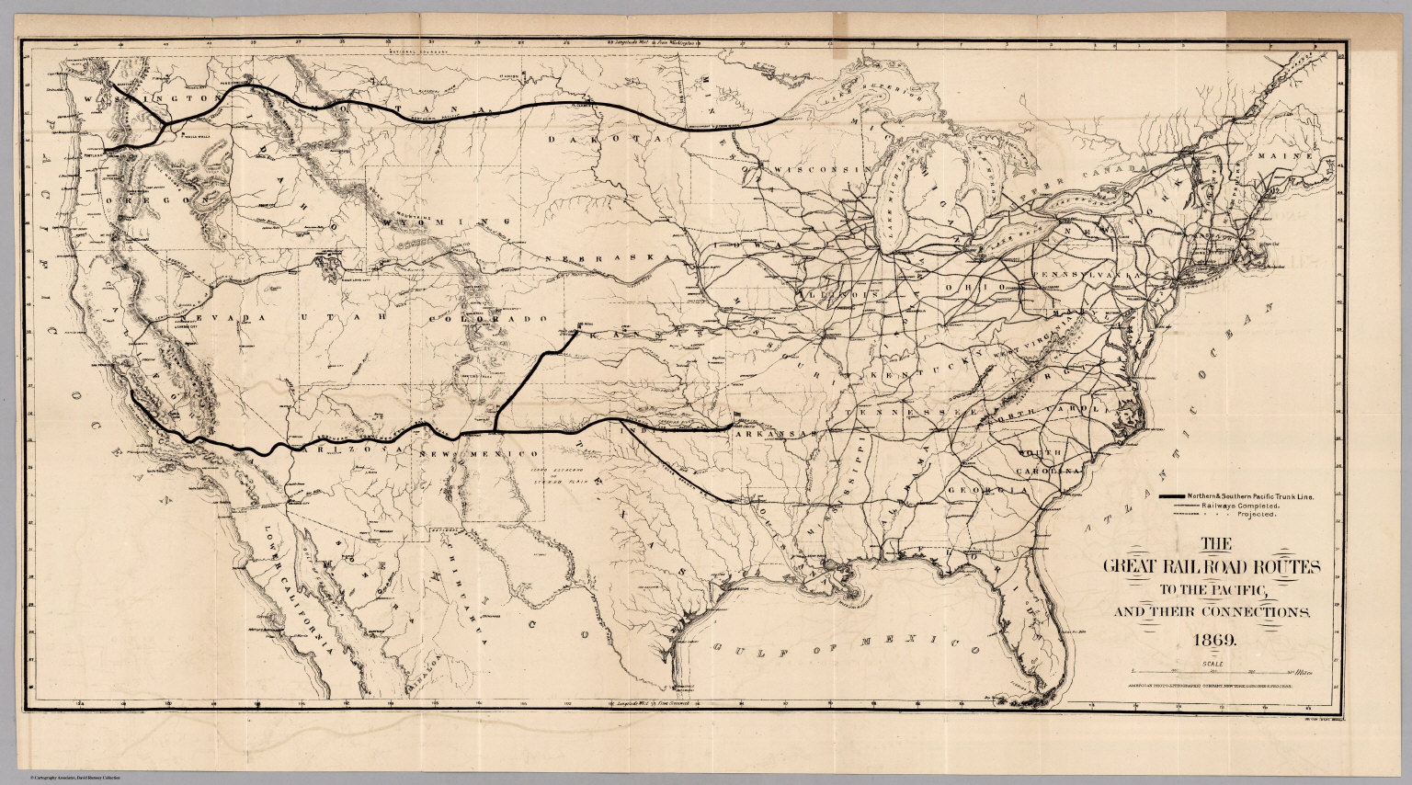
HOOK
US.01
How do you settle a continent — and who pays the price when you do?
ZOOM IN
US.01 · Homestead Act & Transcontinental Railroad
U.S. History Hack · TroopToTeacher Technologies LLC · Aligned to TN Academic Standards & TCAP EOC
2

Slide 3
KEY VOCABULARY · LANGUAGE SUPPORT
US.01
Say it, see it, connect it — terms you need for this standard.
Homestead Act
Transcontinental Railroad
Westward Expansion
say: HOHM-sted
say: tranz-kon-tih-NEN-tul RAYL-rohd
say: WEST-werd ek-SPAN-shun
ES: Ley de Homestead
ES: Ferrocarril Transcontinental
ES: Expansión hacia el Oeste
An 1862 law that provided 160 acres of public land to settlers who agreed to live on and improve the land for five years, encouraging westward expansion.
A continuous railroad line completed in 1869 that connected the eastern United States with the Pacific coast, revolutionizing transportation and commerce.
The 19th-century movement of settlers, railroads, and U.S. authority across the continent toward the Pacific, encouraged by free land and new transportation.
U.S. History Hack · TroopToTeacher Technologies LLC · Aligned to TN Academic Standards & TCAP EOC
3

Slide 4
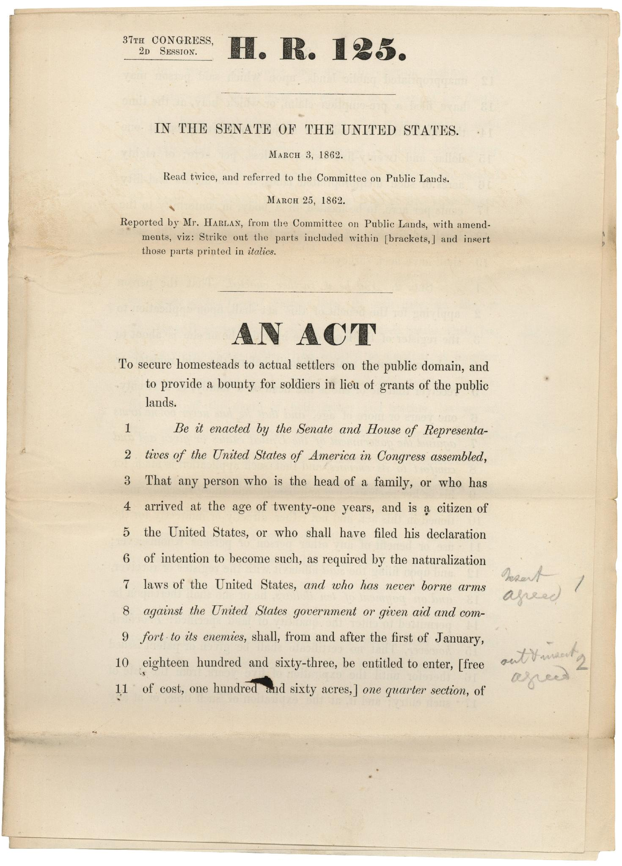
DIRECT INSTRUCTION
US.01
In 1862, Congress offered 160 acres of free land to anyone who would farm it for five years.
ZOOM IN
US.01 · The Homestead Act (1862)
U.S. History Hack · TroopToTeacher Technologies LLC · Aligned to TN Academic Standards & TCAP EOC
4

Slide 5
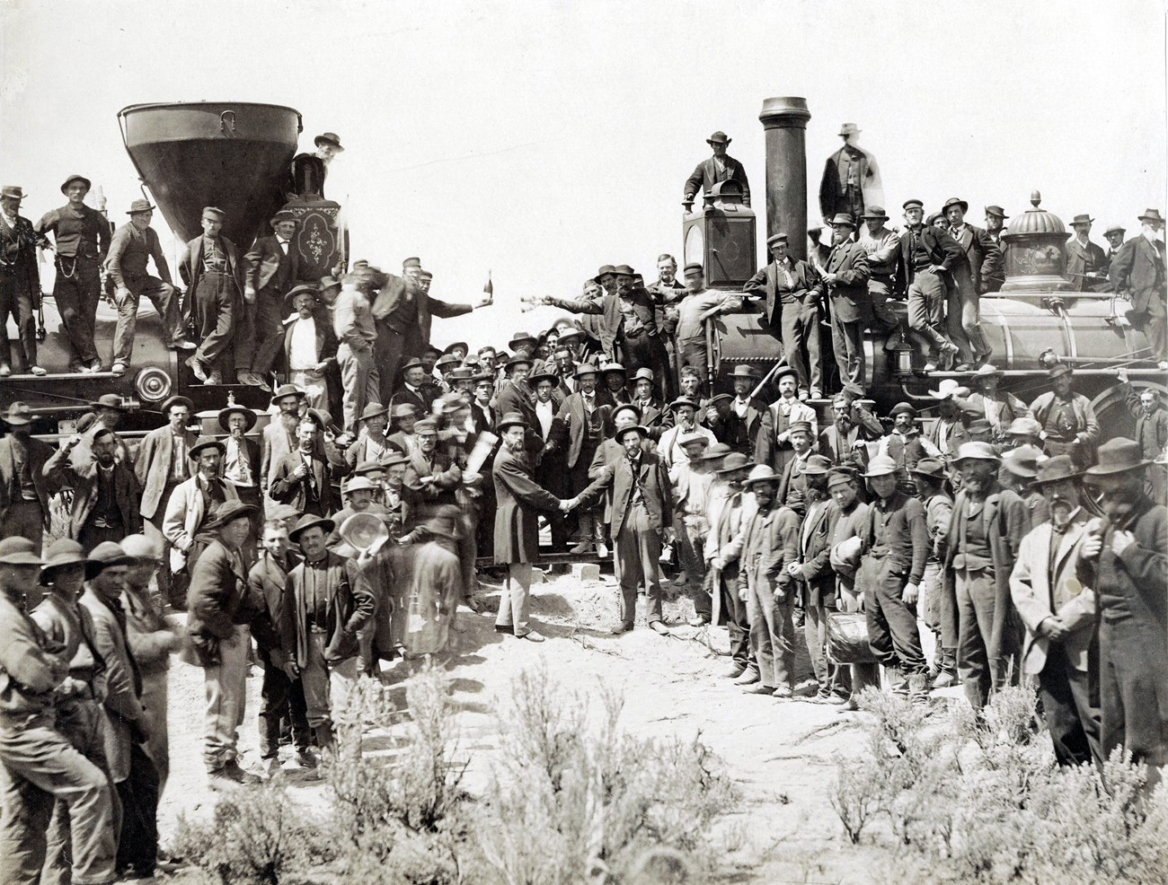
DIRECT INSTRUCTION
US.01
The Transcontinental Railroad (1869) cut a cross-country trip from months to days — and opened the West to settlement and extraction.
ZOOM IN
US.01 · The Transcontinental Railroad (1869)
U.S. History Hack · TroopToTeacher Technologies LLC · Aligned to TN Academic Standards & TCAP EOC
5

Slide 6
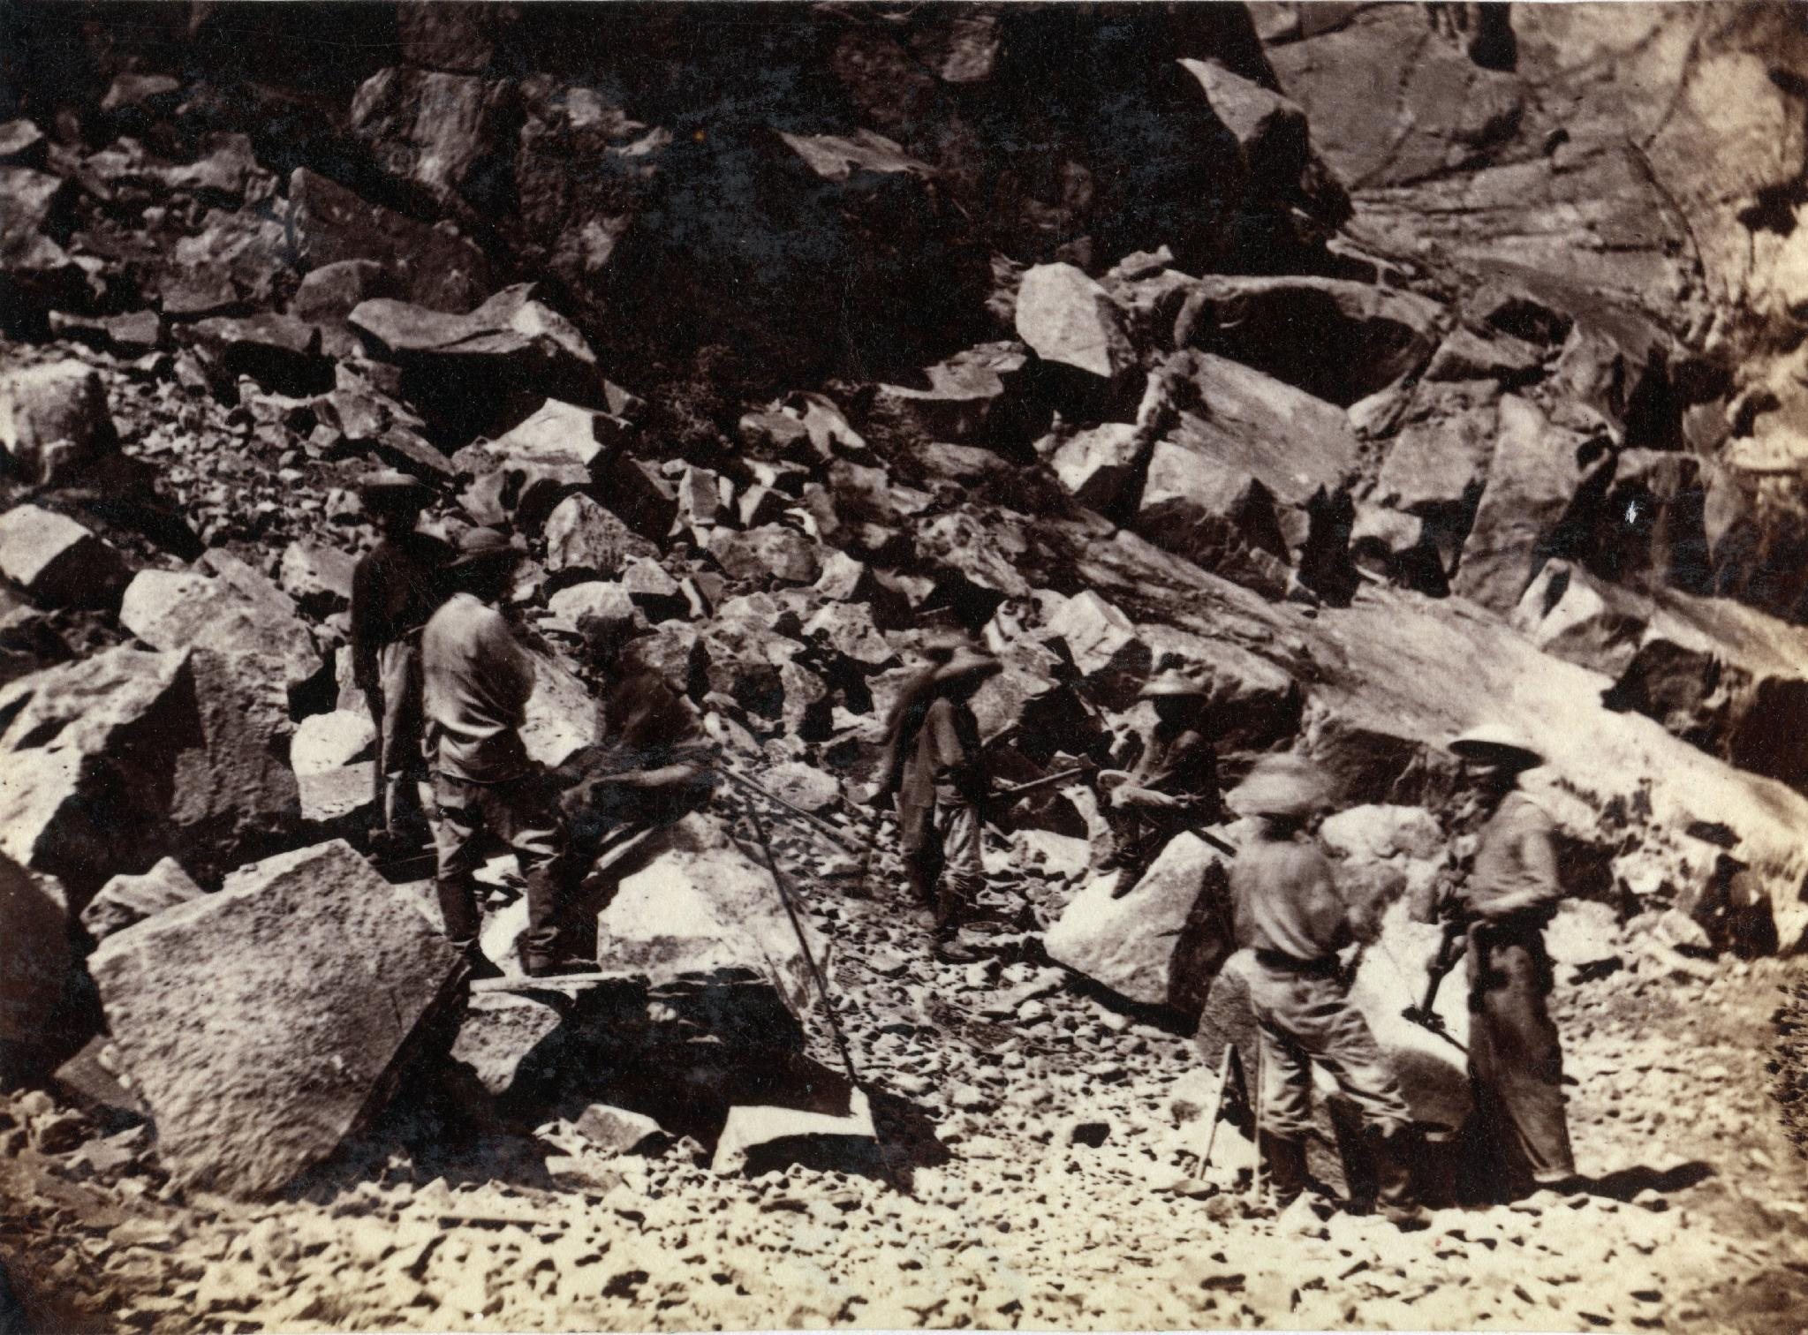
DIRECT INSTRUCTION
US.01
Chinese laborers built much of the Central Pacific — doing the most dangerous work while facing open discrimination.
ZOOM IN
US.01 · Who Built It
U.S. History Hack · TroopToTeacher Technologies LLC · Aligned to TN Academic Standards & TCAP EOC
6

Slide 7
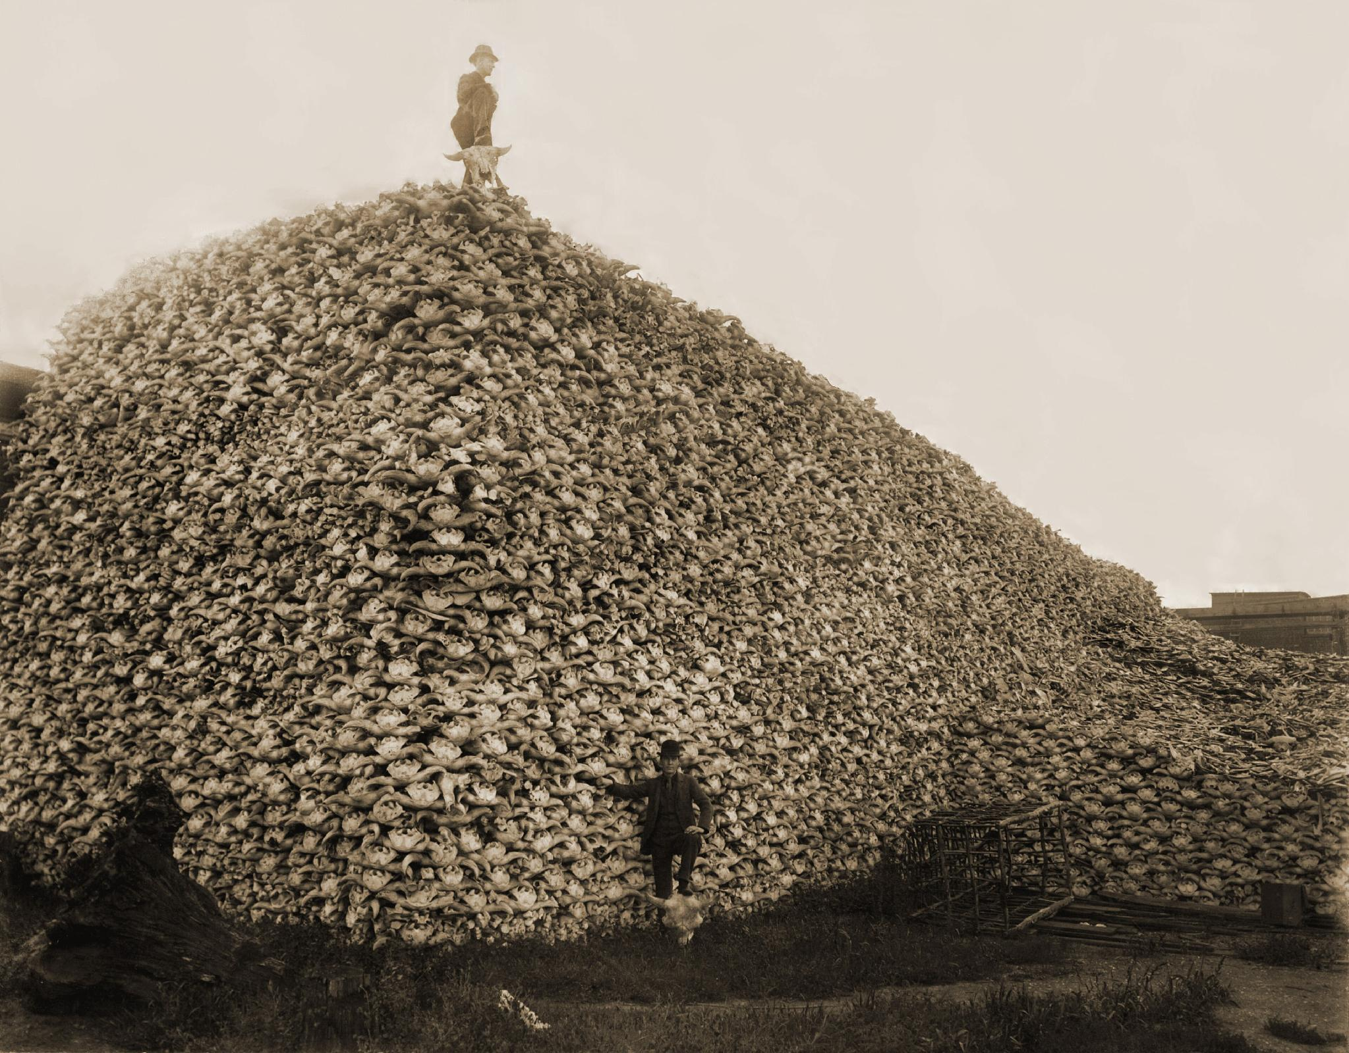
DIRECT INSTRUCTION
US.01
The same expansion forced relocations, broke treaties, and collapsed the buffalo herds Plains nations depended on.
ZOOM IN
US.01 · The Cost to Native Nations
U.S. History Hack · TroopToTeacher Technologies LLC · Aligned to TN Academic Standards & TCAP EOC
7

Slide 8
SOURCE IT FIRST
US.01
The law itself shows the government's intent — read who it includes, and who it leaves out.
WHO
WHEN
WHY
U.S. Congress (federal statute).
1862, during the Civil War.
A law reveals the government’s intent — ask who benefits and who is left out.
Homestead Act
Pacific Railway Act
U.S. Congress · May 20, 1862 (12 Stat. 392)
U.S. Congress · July 1, 1862 (12 Stat. 489)
"Any person who is the head of a family, or who has arrived at the age of twenty-one years, and is a citizen of the United States... shall be entitled to enter one quarter section [160 acres] of unappropriated public lands."
"The United States shall extinguish as rapidly as may be the Indian titles to all lands falling under the operation of this act... There is hereby granted to the said company... every alternate section of public land, designated by odd numbers."
National Archives
National Archives
U.S. History Hack · TroopToTeacher Technologies LLC · Aligned to TN Academic Standards & TCAP EOC
8

Slide 9
THREE PERSPECTIVES
US.01
At the end of each reading, a historian returns to three questions. Use them to analyze any event, policy, or decision in U.S. history.
Who benefited?
Who bore the costs?
Who decided?
Who gained land, wealth, power, or protection from this event?
Who lost land, labor, freedom, or life — and who was silenced?
Which people, offices, or courts held the authority to make the choice?
US.01:
US.01:
US.01:
Settlers who claimed 160-acre homesteads; railroad companies that received alternate-section land grants; eastern markets and manufacturers reached by the new rail lines.
Plains nations, who lost lands and treaty rights and whose buffalo herds collapsed; Chinese laborers, who did the most dangerous railroad work while facing wage discrimination and exclusion.
The U.S. Congress and the federal government, acting through the Homestead Act and the Pacific Railway Act of 1862.
Anchor: Homestead Act & Pacific Railway Act, 1862 (National Archives)
U.S. History Hack · TroopToTeacher Technologies LLC · Aligned to TN Academic Standards & TCAP EOC
9

Slide 10
WE DO
US.01
Trace one effect: the railroad → the buffalo → the people.
ZOOM IN
MODELED PROMPT
Trace ONE effect of the Transcontinental Railroad on American Indian nations.
CAUSE → EFFECT → CONSEQUENCE
CAUSE: The railroad cut directly through Plains hunting grounds (1869). → EFFECT: Settlers and hunters poured in and the buffalo herds collapsed. → CONSEQUENCE: Plains nations lost the food source their economy depended on and were pushed onto reservations.
TEACHER THINK-ALOUD
Watch how I do it: I start with the policy (the cause), I underline the change it set in motion (the effect), then I push one step further to the human consequence. I do NOT stop at "railroad was built" — I ask "so what happened to people because of it?"
Then you try: Now you complete two more cause→effect chains on your own in the activity.
U.S. History Hack · TroopToTeacher Technologies LLC · Aligned to TN Academic Standards & TCAP EOC
10

Slide 11
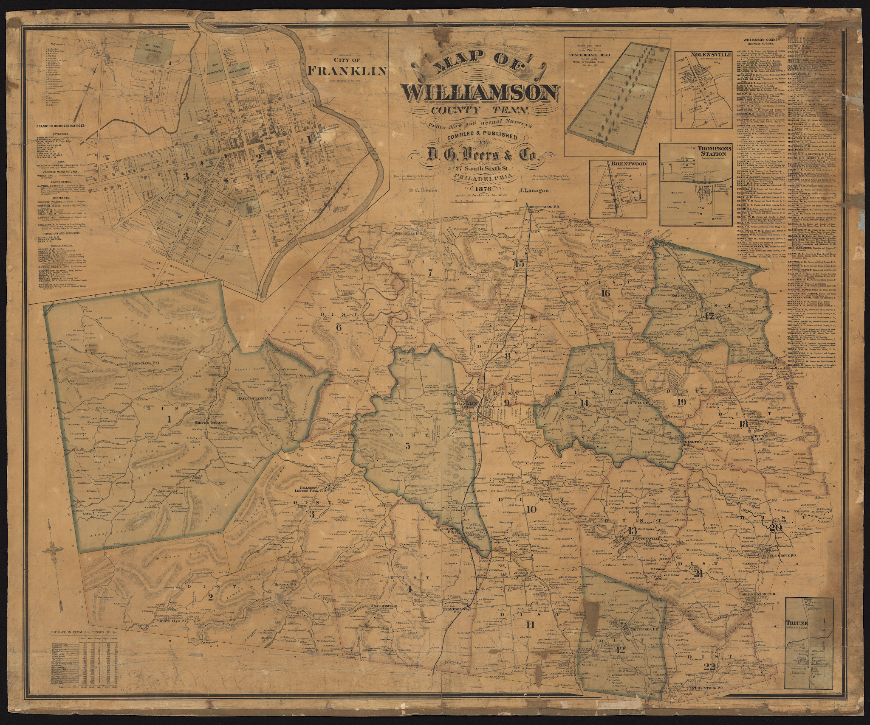
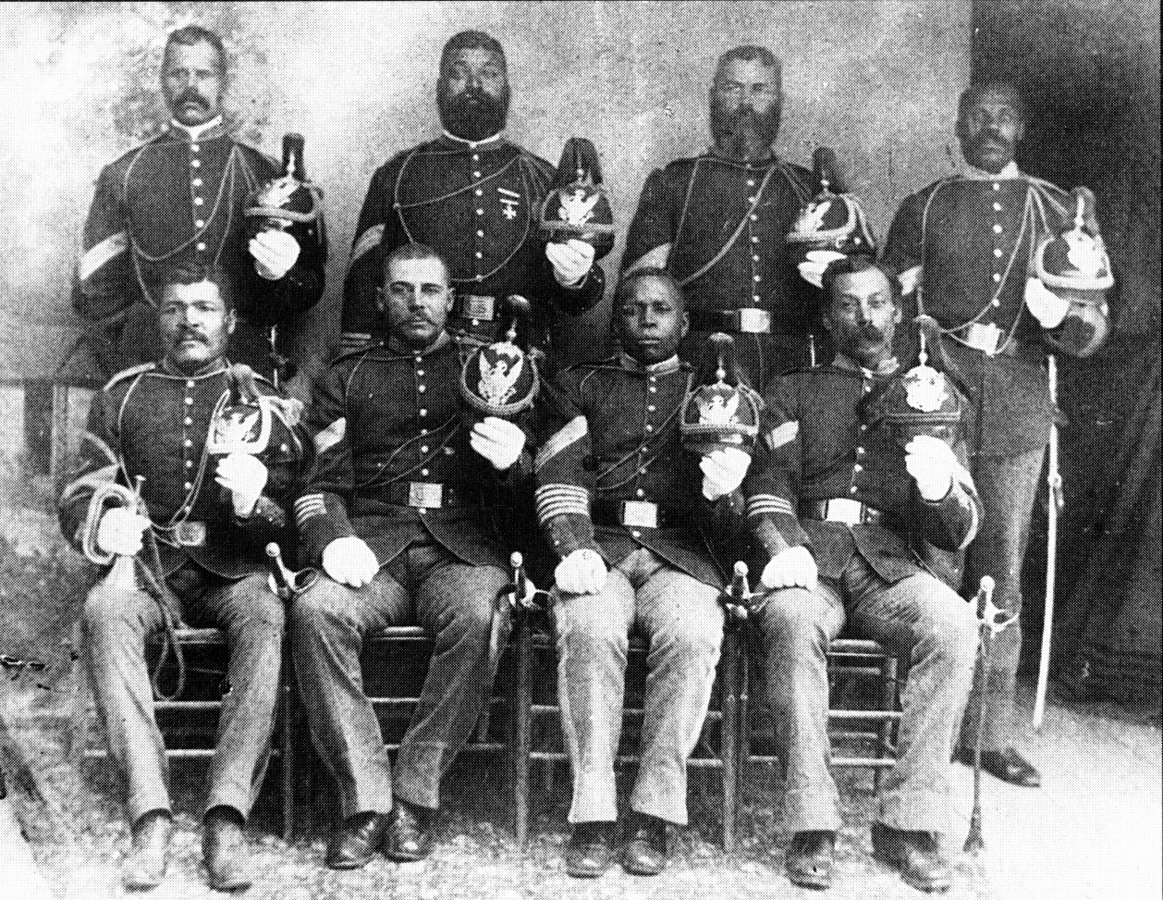
TENNESSEE CONNECTION · WILLIAMSON COUNTY
A hometown hero: George Jordan of Triune, Williamson County — the only Medal of Honor recipient from our county.
ZOOM IN
ZOOM IN
9th U.S. Cavalry NCOs, 1889 (Buffalo Soldiers)
★ George Jordan was born around 1847 in the Triune area of Williamson County, Tennessee.
★ He is the only Medal of Honor recipient from Williamson County.
★ He served with the 9th U.S. Cavalry (Buffalo Soldiers), earning the Medal of Honor for Fort Tularosa (1880) and Carrizo Canyon (1881), issued in 1890.
1878 Williamson County map (Tennessee State Library & Archives) locating Triune, Jordan's home community.
U.S. History Hack · TroopToTeacher Technologies LLC · Aligned to TN Academic Standards & TCAP EOC
11

Slide 12
PROGRESS CHECK
DOK 3
US.01
A homesteading family and a Lakota family in 1875 would most likely have described the Homestead Act in very different ways. Which statement best explains why?
A
The Homestead Act applied only to settlers and never affected American Indians in any way.
B
The same law that opened “free” land to settlers took that land away from American Indians who already lived on it.
C
Both families received 160 acres each under the law, so their views would have matched.
D
The law was written to benefit American Indians first and settlers second.
RESPONSE CHOICE — commit before advancing: write it, say/record it, or diagram it. Teacher reveal follows.
U.S. History Hack · TroopToTeacher Technologies LLC · Aligned to TN Academic Standards & TCAP EOC
12

Slide 13
US.02
Federal Policies Toward American Indians
TN STANDARD
US.02 – Examine federal policies toward American Indians, including the movement to reservations, assimilation, boarding schools, and the Dawes Act.
I CAN
I can examine federal policies toward American Indians, including the movement to reservations, assimilation, boarding schools, and the Dawes Act.
U.S. History Hack · TroopToTeacher Technologies LLC · Aligned to TN Academic Standards & TCAP EOC
13

Slide 14
KEY VOCABULARY · LANGUAGE SUPPORT
US.02
Say it, see it, connect it — terms you need for this standard.
Reservation System
Assimilation
Dawes Act
say: rez-er-VAY-shun SIS-tum
say: uh-sim-ih-LAY-shun
say: DAWZ
ES: Sistema de Reservaciones
ES: Asimilación
ES: Ley Dawes
Federal policy that confined Native American tribes to designated areas of land, often far from their ancestral territories, to control indigenous populations and open land for white settlement.
Federal policy aimed at forcing Native Americans to abandon their traditional cultures and adopt European-American ways of life, including language, religion, and customs.
An 1887 law that divided tribal lands into individual allotments, aiming to break up reservations and assimilate Native Americans; it resulted in massive Native land loss.
U.S. History Hack · TroopToTeacher Technologies LLC · Aligned to TN Academic Standards & TCAP EOC
14

Slide 15
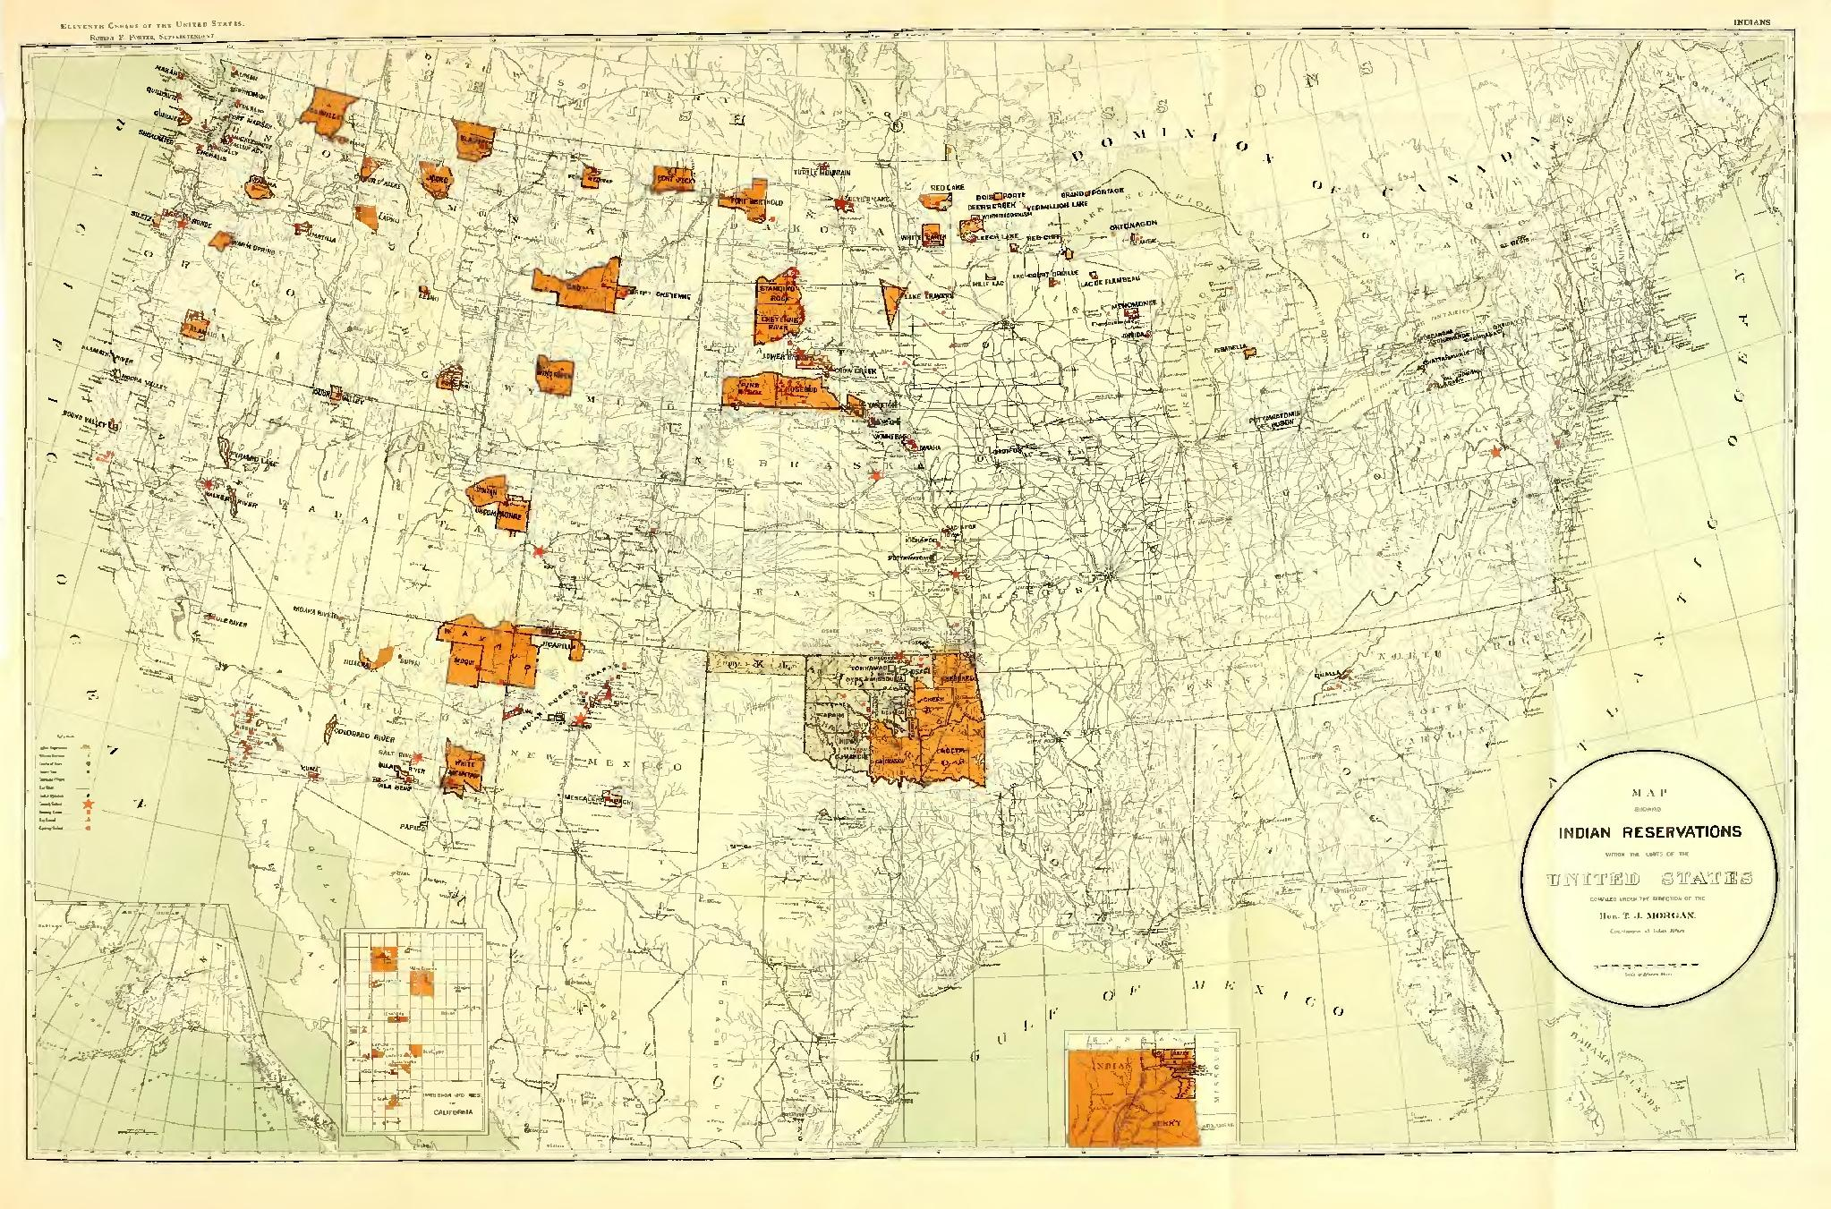
DIRECT INSTRUCTION
US.02
After the Civil War, the federal government confined American Indian nations to reservations far smaller than their homelands.
ZOOM IN
US.02 · Movement to Reservations
U.S. History Hack · TroopToTeacher Technologies LLC · Aligned to TN Academic Standards & TCAP EOC
15

Slide 16
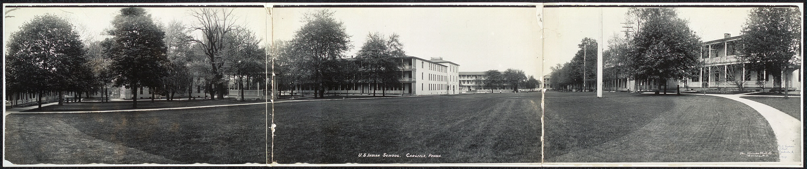
DIRECT INSTRUCTION
US.02
Boarding schools like Carlisle pursued forced assimilation under the motto “Kill the Indian, save the man.”
ZOOM IN
US.02 · Assimilation & Boarding Schools
U.S. History Hack · TroopToTeacher Technologies LLC · Aligned to TN Academic Standards & TCAP EOC
16

Slide 17
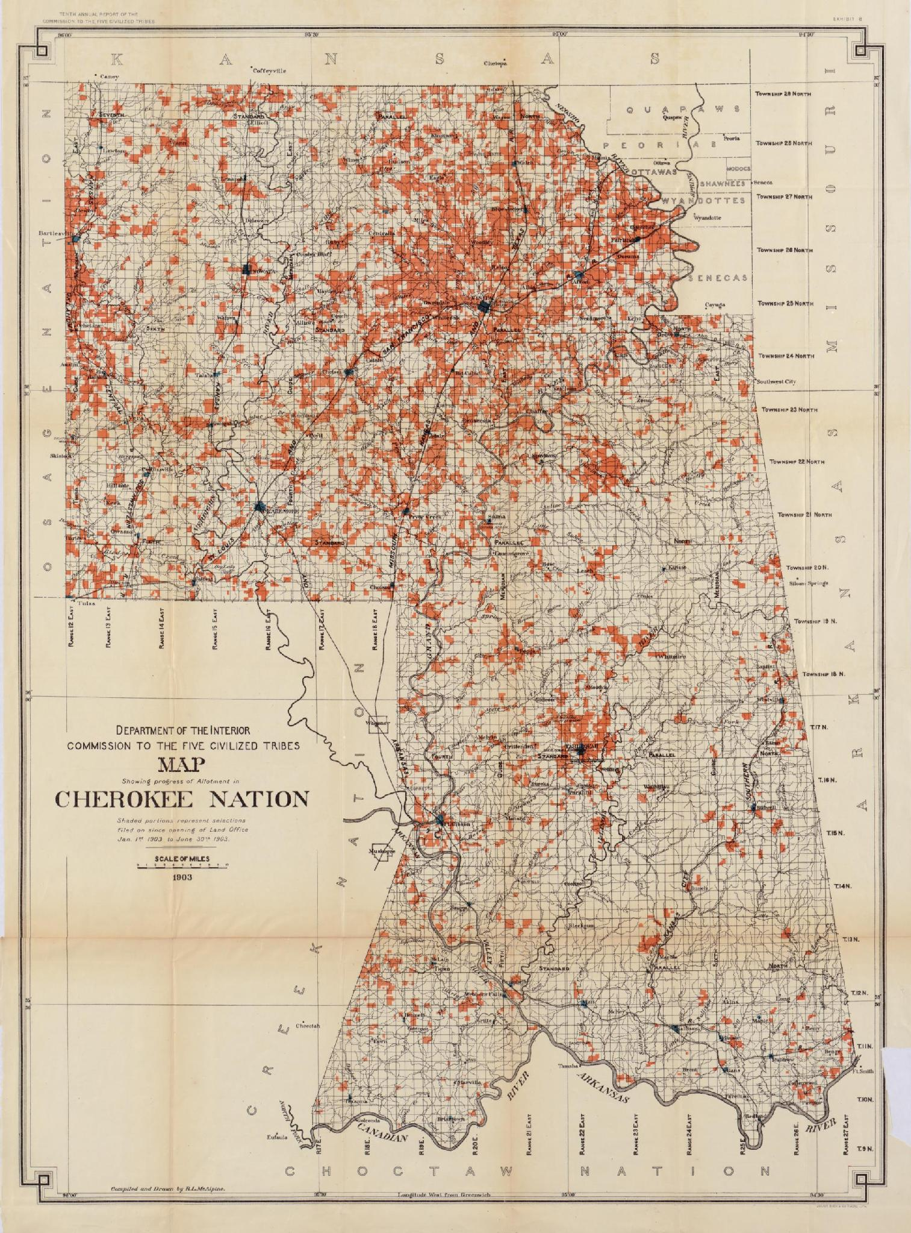
DIRECT INSTRUCTION
US.02
The Dawes Act (1887) broke up tribal land — holdings fell from 138 million acres to 48 million by 1934.
ZOOM IN
US.02 · The Dawes Act & Its Impact
U.S. History Hack · TroopToTeacher Technologies LLC · Aligned to TN Academic Standards & TCAP EOC
17

Slide 18
SOURCE IT FIRST
US.02
The Dawes Act itself shows the government’s intent — read what it did to communal land.
WHO
WHEN
WHY
U.S. Congress (federal statute).
February 8, 1887 (24 Stat. 388).
A law reveals intent — ask what it dismantled and who gained the “surplus” land.
Dawes General Allotment Act
Annual Report of the Commissioner of Indian Affairs
U.S. Congress · Feb 8, 1887 (24 Stat. 388)
Office of Indian Affairs · 1890
"...the President of the United States be authorized... to allot the lands in said reservation in severalty to any Indian located thereon in quantities as follows: To each head of a family, one-quarter of a section [160 acres]."
"The great object... is the disintegration of the tribes... and their absorption into the national life as American citizens."
Library of Congress / Statutes at Large
HathiTrust / U.S. Government
U.S. History Hack · TroopToTeacher Technologies LLC · Aligned to TN Academic Standards & TCAP EOC
18

Slide 19
THREE PERSPECTIVES
US.02
A historian returns to three questions at the end of every reading. Use them to analyze this standard.
Who benefited?
Who bore the costs?
Who decided?
Who gained land, wealth, power, or protection?
Who lost land, labor, freedom, or life — and who was silenced?
Which people, offices, or courts held the authority?
US.02:
US.02:
US.02:
White settlers who purchased “surplus” reservation land; railroads and speculators; the federal government advancing westward settlement.
American Indian nations, who lost 90 million acres, communal landholding, languages, and children taken to boarding schools — a documented cultural genocide.
The U.S. Congress and the Office of Indian Affairs, acting through the Dawes Act and reservation/assimilation policy.
Anchor: Dawes General Allotment Act, 1887 (Statutes at Large)
U.S. History Hack · TroopToTeacher Technologies LLC · Aligned to TN Academic Standards & TCAP EOC
19

Slide 20
PROGRESS CHECK
DOK 2
US.02
Based on the excerpt, what was the most likely long-term effect of dividing tribal land “in severalty” under the Dawes Act?
A
It strengthened tribal governments and expanded reservation territory.
B
It returned ancestral homelands to tribal control.
C
It had no measurable effect on Native landholding.
D
It broke up communal tribal ownership and led to large-scale Native land loss.
RESPONSE CHOICE — commit before advancing: write it, say/record it, or diagram it. Teacher reveal follows.
U.S. History Hack · TroopToTeacher Technologies LLC · Aligned to TN Academic Standards & TCAP EOC
20

Slide 21
US.03
Compromise of 1877, Jim Crow & Plessy v. Ferguson
TN STANDARD
US.03 – Explain the impact of the Compromise of 1877, including Jim Crow laws, lynching, disenfranchisement methods, the efforts of Benjamin “Pap” Singleton and the Exodusters, and the Plessy v. Ferguson decision.
I CAN
I can explain the impact of the Compromise of 1877, including Jim Crow laws, lynching, disenfranchisement, the Exodusters, and Plessy v. Ferguson.
U.S. History Hack · TroopToTeacher Technologies LLC · Aligned to TN Academic Standards & TCAP EOC
21

Slide 22
KEY VOCABULARY · LANGUAGE SUPPORT
US.03
Say it, see it, connect it — terms you need for this standard.
Compromise of 1877
Jim Crow Laws
Disenfranchisement
say: KOM-pruh-myz
say: jim kroh
say: dis-en-FRAN-chyz-ment
ES: Compromiso de 1877
ES: Leyes de Jim Crow
ES: Privación del Derecho al Voto
An informal agreement resolving the disputed 1876 election: Rutherford B. Hayes became president in exchange for removing federal troops from the South, effectively ending Reconstruction.
State and local laws enacted primarily in the South between 1877 and the 1960s that enforced racial segregation and denied African Americans their constitutional rights.
The systematic denial of voting rights through poll taxes, literacy tests, grandfather clauses, and violence, primarily targeting African American voters.
U.S. History Hack · TroopToTeacher Technologies LLC · Aligned to TN Academic Standards & TCAP EOC
22

Slide 23
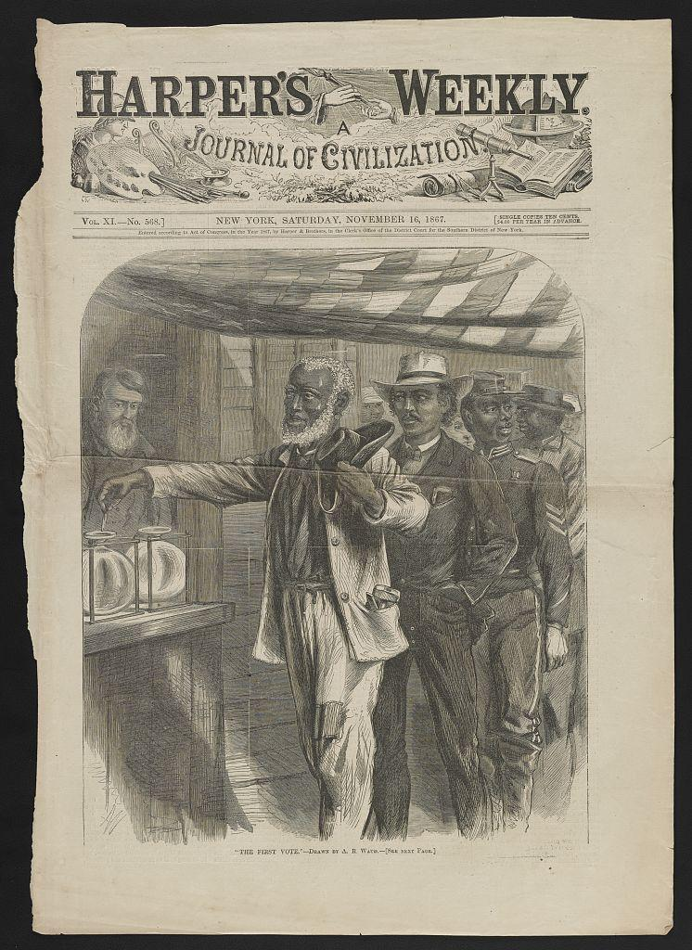
DIRECT INSTRUCTION
US.03
The Compromise of 1877 withdrew federal troops from the South — ending Reconstruction and its protections.
ZOOM IN
US.03 · The Election of 1876 & End of Reconstruction
U.S. History Hack · TroopToTeacher Technologies LLC · Aligned to TN Academic Standards & TCAP EOC
23

Slide 24
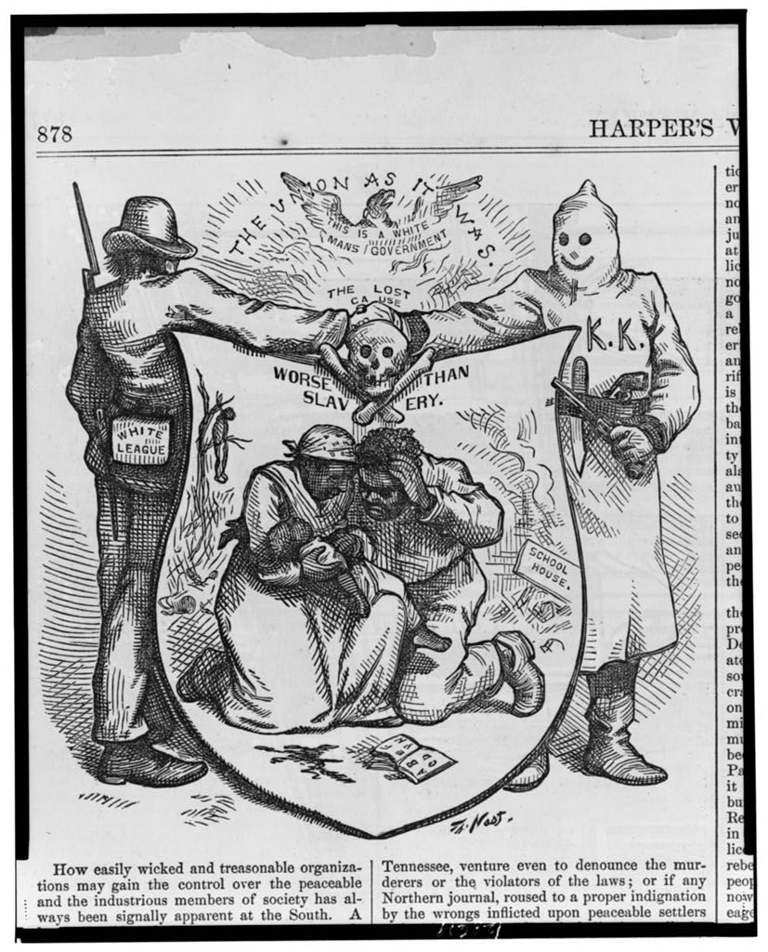
DIRECT INSTRUCTION
US.03
With protection gone, Southern states built Jim Crow — segregation, poll taxes, literacy tests, and lynching.
ZOOM IN
US.03 · Jim Crow, Lynching & Disenfranchisement
U.S. History Hack · TroopToTeacher Technologies LLC · Aligned to TN Academic Standards & TCAP EOC
24

Slide 25
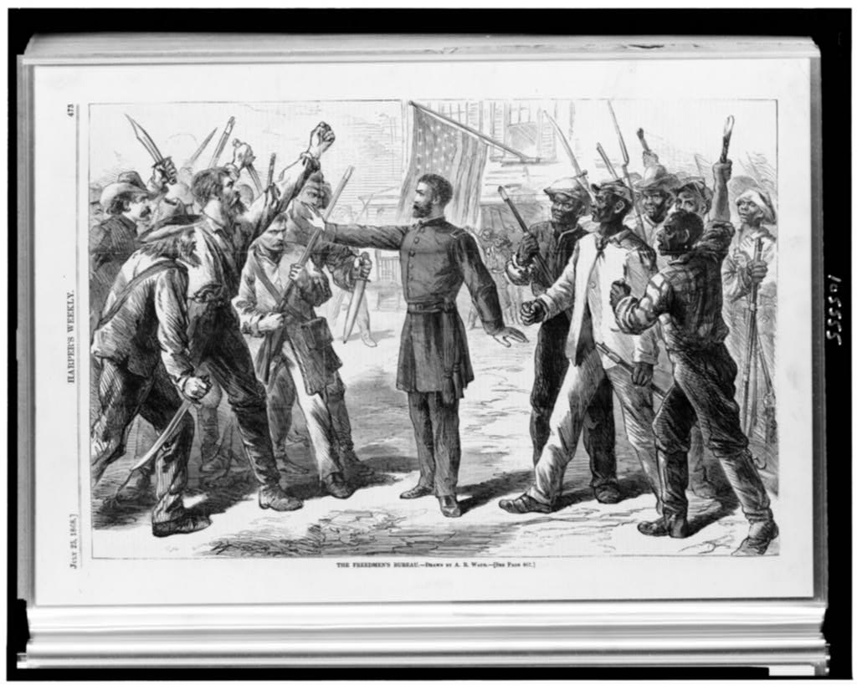
DIRECT INSTRUCTION
US.03
Pap Singleton led the Exodusters — thousands of Black Southerners who migrated to Kansas to escape Jim Crow terror.
ZOOM IN
US.03 · Pap Singleton & the Exodusters
U.S. History Hack · TroopToTeacher Technologies LLC · Aligned to TN Academic Standards & TCAP EOC
25

Slide 26
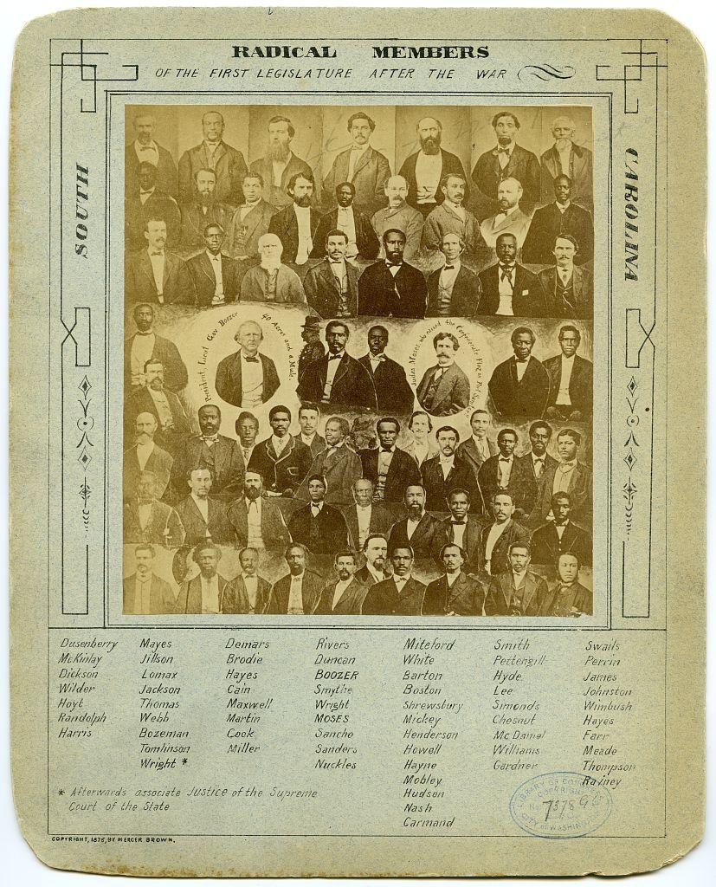
DIRECT INSTRUCTION
US.03
Plessy v. Ferguson (1896) made “separate but equal” law — legitimizing segregation for nearly sixty years.
ZOOM IN
US.03 · Plessy v. Ferguson
U.S. History Hack · TroopToTeacher Technologies LLC · Aligned to TN Academic Standards & TCAP EOC
26

Slide 27
SOURCE IT FIRST
US.03
The Court’s own words show the doctrine — read what “separate but equal” actually authorized.
WHO
WHEN
WHY
The Supreme Court of the United States (7–1 majority, Justice Brown).
May 18, 1896.
A ruling sets the law of the land — ask what it permitted and whom it left unprotected.
Plessy v. Ferguson (majority opinion)
Harlan dissent, Plessy v. Ferguson
Supreme Court of the United States · May 18, 1896 (163 U.S. 537)
Justice John Marshall Harlan · May 18, 1896
"Laws permitting, and even requiring, [the] separation [of the races] in places where they are liable to be brought into contact do not necessarily imply the inferiority of either race..."
"Our Constitution is color-blind, and neither knows nor tolerates classes among citizens."
Library of Congress / U.S. Reports
Library of Congress / U.S. Reports
U.S. History Hack · TroopToTeacher Technologies LLC · Aligned to TN Academic Standards & TCAP EOC
27

Slide 28
THREE PERSPECTIVES
US.03
A historian returns to three questions at the end of every reading. Use them to analyze this standard.
Who benefited?
Who bore the costs?
Who decided?
Who gained land, wealth, power, or protection?
Who lost land, labor, freedom, or life — and who was silenced?
Which people, offices, or courts held the authority?
US.03:
US.03:
US.03:
White Democratic “Redeemer” governments in the South, who regained political control; the national parties that traded away Black civil rights for the presidency.
African Americans, who lost federal protection, the vote, and equal access — and faced lynching. Those who resisted, like the Exodusters, were forced to flee.
The disputed 1876 electoral commission and party leaders (Compromise of 1877); Southern legislatures (Jim Crow laws); and the U.S. Supreme Court (Plessy).
Anchor: Plessy v. Ferguson, 1896 (U.S. Reports)
U.S. History Hack · TroopToTeacher Technologies LLC · Aligned to TN Academic Standards & TCAP EOC
28

Slide 29
PROGRESS CHECK
DOK 3
US.03
The Plessy majority reasoned that “separate” facilities did not make one race inferior. Which later argument most directly challenges that reasoning?
A
That segregation was acceptable as long as both facilities were physically identical.
B
That the Constitution explicitly required racial separation.
C
That state-enforced separation itself signals and enforces inequality, regardless of facility quality.
D
That African Americans had freely chosen separate facilities.
RESPONSE CHOICE — commit before advancing: write it, say/record it, or diagram it. Teacher reveal follows.
U.S. History Hack · TroopToTeacher Technologies LLC · Aligned to TN Academic Standards & TCAP EOC
29

Slide 30
US.04
Gilded Age Politics and Economics
TN STANDARD
US.04 – Analyze the causes and consequences of Gilded Age politics and economics, including political machines, major scandals, civil service reform, and the economic differences between farmers, wage earners, and industrial capitalists.
I CAN
I can analyze the causes and consequences of Gilded Age politics and economics, including political machines, scandals, civil service reform, and economic inequality.
U.S. History Hack · TroopToTeacher Technologies LLC · Aligned to TN Academic Standards & TCAP EOC
30

Slide 31
KEY VOCABULARY · LANGUAGE SUPPORT
US.04
Say it, see it, connect it — terms you need for this standard.
Gilded Age
Political Machines
Spoils System
say: GIL-dud ayj
say: puh-LIT-ih-kul muh-SHEENZ
say: spoylz SIS-tum
ES: Edad Dorada
ES: Máquinas Políticas
ES: Sistema de Botín
The period from roughly 1870 to 1900 of rapid growth, industrialization, and extreme wealth inequality — named by Mark Twain to suggest a thin gold layer over deep social problems.
Corrupt organizations that controlled city politics through patronage, bribery, and vote manipulation, often trading services to immigrants for political support.
The practice of rewarding political supporters with government jobs regardless of qualifications — 'to the victor belong the spoils.'
U.S. History Hack · TroopToTeacher Technologies LLC · Aligned to TN Academic Standards & TCAP EOC
31

Slide 32
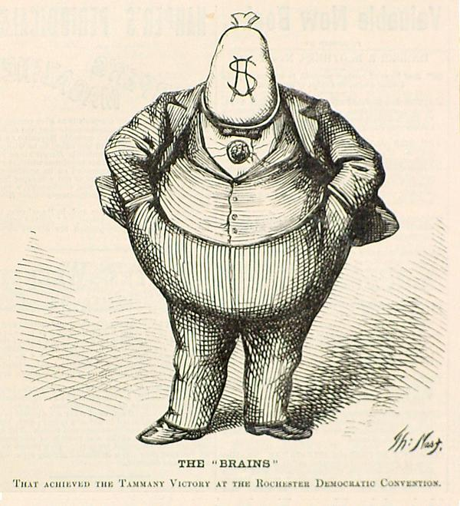
DIRECT INSTRUCTION
US.04
Political machines like Boss Tweed’s Tammany Hall ran cities through patronage — funneling millions in public funds.
ZOOM IN
US.04 · Political Machines & Boss Tweed
U.S. History Hack · TroopToTeacher Technologies LLC · Aligned to TN Academic Standards & TCAP EOC
32

Slide 33
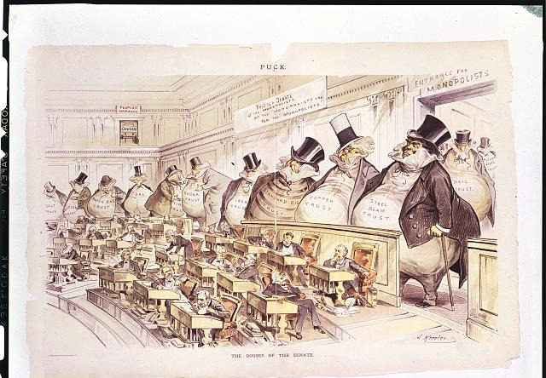
DIRECT INSTRUCTION
US.04
Scandals ran deep: Crédit Mobilier and the spoils system — until Garfield’s 1881 assassination forced reform.
ZOOM IN
US.04 · Scandals & the Spoils System
U.S. History Hack · TroopToTeacher Technologies LLC · Aligned to TN Academic Standards & TCAP EOC
33

Slide 34
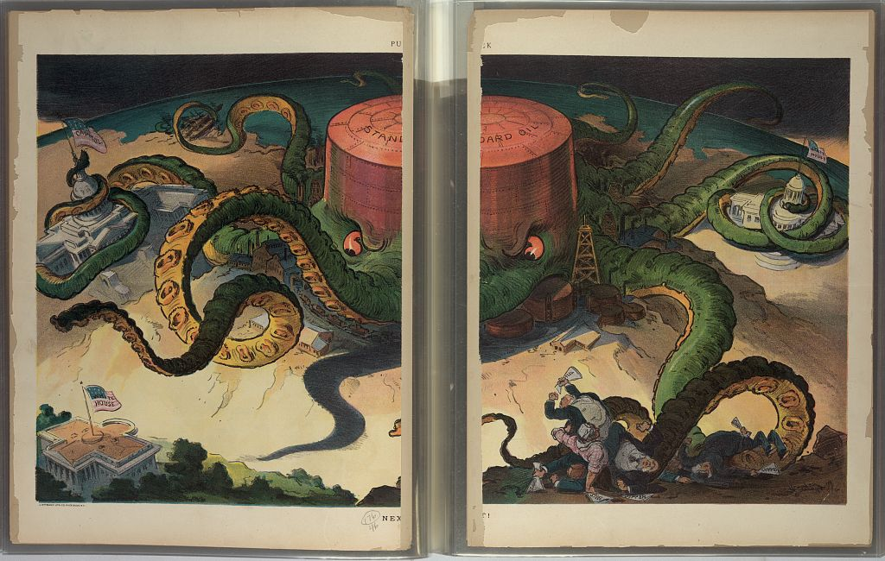
DIRECT INSTRUCTION
US.04
The Pendleton Act (1883) began merit-based hiring; the Interstate Commerce Act (1887) began federal economic regulation.
ZOOM IN
US.04 · Civil Service & Economic Reform
U.S. History Hack · TroopToTeacher Technologies LLC · Aligned to TN Academic Standards & TCAP EOC
34

Slide 35
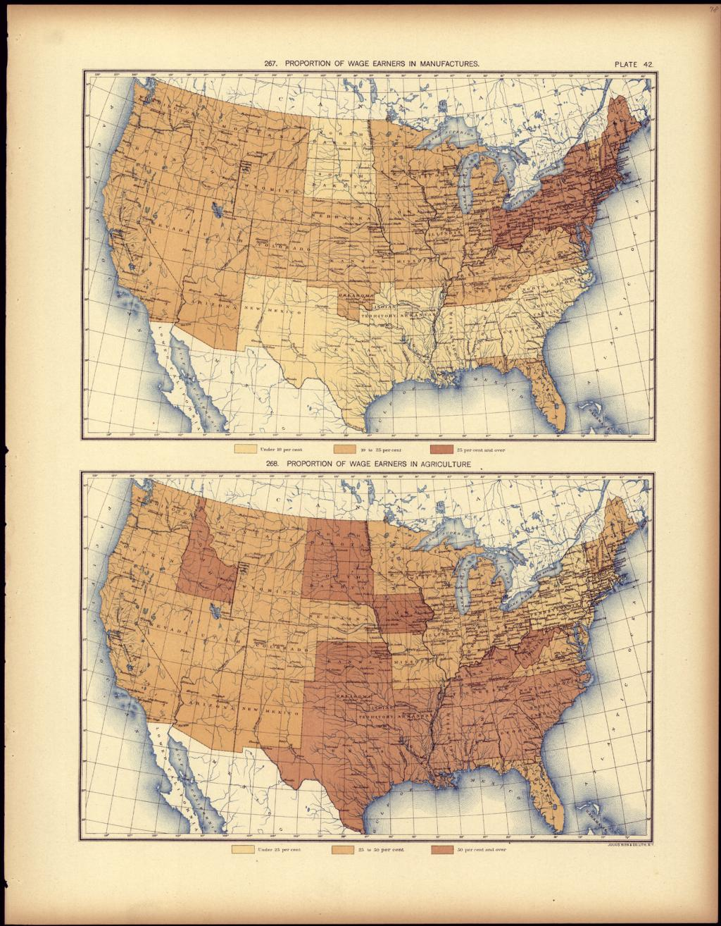
DIRECT INSTRUCTION
US.04
Wealth concentrated at the top while farmers and wage earners struggled with debt, low pay, and danger.
ZOOM IN
US.04 · Economic Disparity
U.S. History Hack · TroopToTeacher Technologies LLC · Aligned to TN Academic Standards & TCAP EOC
35

Slide 36
SOURCE IT FIRST
US.04
A close observer named the era’s corruption — read how power actually worked in the Gilded Age.
WHO
WHEN
WHY
James Bryce, British observer of American government.
1888 (The American Commonwealth).
An outside observer describes what insiders took for granted — ask what he says corrupted city government.
The American Commonwealth
Pendleton Civil Service Reform Act
James Bryce · 1888
U.S. Congress · January 16, 1883 (22 Stat. 403)
"The Boss... has a fine sense of political values... He dispenses places, rewards the loyal, punishes the mutinous... The machine works because it feeds those who serve it."
"...appointments to the [classified] service... shall be made... from among those graded highest as the results of such competitive examinations."
HathiTrust / Public Domain
Library of Congress / Statutes at Large
U.S. History Hack · TroopToTeacher Technologies LLC · Aligned to TN Academic Standards & TCAP EOC
36

Slide 37
THREE PERSPECTIVES
US.04
A historian returns to three questions at the end of every reading. Use them to analyze this standard.
Who benefited?
Who bore the costs?
Who decided?
Who gained land, wealth, power, or protection?
Who lost land, labor, freedom, or life — and who was silenced?
Which people, offices, or courts held the authority?
US.04:
US.04:
US.04:
Political bosses and their machines; industrial capitalists who concentrated wealth; office-seekers rewarded by the spoils system.
Farmers facing falling prices and high rail rates; wage earners in dangerous, low-paid jobs; taxpayers whose funds were siphoned by machines.
City machines and party bosses; the U.S. Congress, which passed the Pendleton Act (1883) and Interstate Commerce Act (1887).
Anchor: The American Commonwealth (Bryce, 1888) & Pendleton Act, 1883
U.S. History Hack · TroopToTeacher Technologies LLC · Aligned to TN Academic Standards & TCAP EOC
37

Slide 38
PROGRESS CHECK
DOK 2
US.04
How does Bryce’s description of the political “Boss” help explain why the Pendleton Civil Service Reform Act was needed?
A
Both reveal a spoils system in which offices and contracts were handed out for political loyalty, which reformers tried to end.
B
Both praise the political machines as honest and efficient.
C
Both argue that government jobs should be sold to the highest bidder.
D
Both were written after the spoils system ended.
RESPONSE CHOICE — commit before advancing: write it, say/record it, or diagram it. Teacher reveal follows.
U.S. History Hack · TroopToTeacher Technologies LLC · Aligned to TN Academic Standards & TCAP EOC
38

Slide 39
US.05
Inventions & Innovations of Business Leaders & Entrepreneurs
TN STANDARD
US.05 – Describe the changes in American life that resulted from the inventions and innovations of business leaders and entrepreneurs of the period, including Bell, Bessemer, Carnegie, Edison, Morgan, Rockefeller, Tesla, Vanderbilt, Madam C.J. Walker, and George Washington Carver.
I CAN
I can describe the changes in American life that resulted from the inventions and innovations of business leaders and entrepreneurs of the period.
U.S. History Hack · TroopToTeacher Technologies LLC · Aligned to TN Academic Standards & TCAP EOC
39

Slide 40
KEY VOCABULARY · LANGUAGE SUPPORT
US.05
Say it, see it, connect it — terms you need for this standard.
Robber Barons / Captains of Industry
Vertical Integration
Horizontal Integration
say: ROB-er BAIR-unz
say: VUR-tih-kul in-teh-GRAY-shun
say: hor-ih-ZON-tul in-teh-GRAY-shun
ES: Barones Ladrones / Capitanes de Industria
ES: Integración Vertical
ES: Integración Horizontal
Wealthy late-1800s industrialists who built massive business empires; critics called them 'robber barons,' supporters 'captains of industry.'
A business strategy where a company controls all stages of production, from raw materials to finished product — practiced by Andrew Carnegie in steel.
A business strategy where a company buys out competitors in the same industry to reduce competition and control prices — practiced by John D. Rockefeller in oil.
U.S. History Hack · TroopToTeacher Technologies LLC · Aligned to TN Academic Standards & TCAP EOC
40

Slide 41
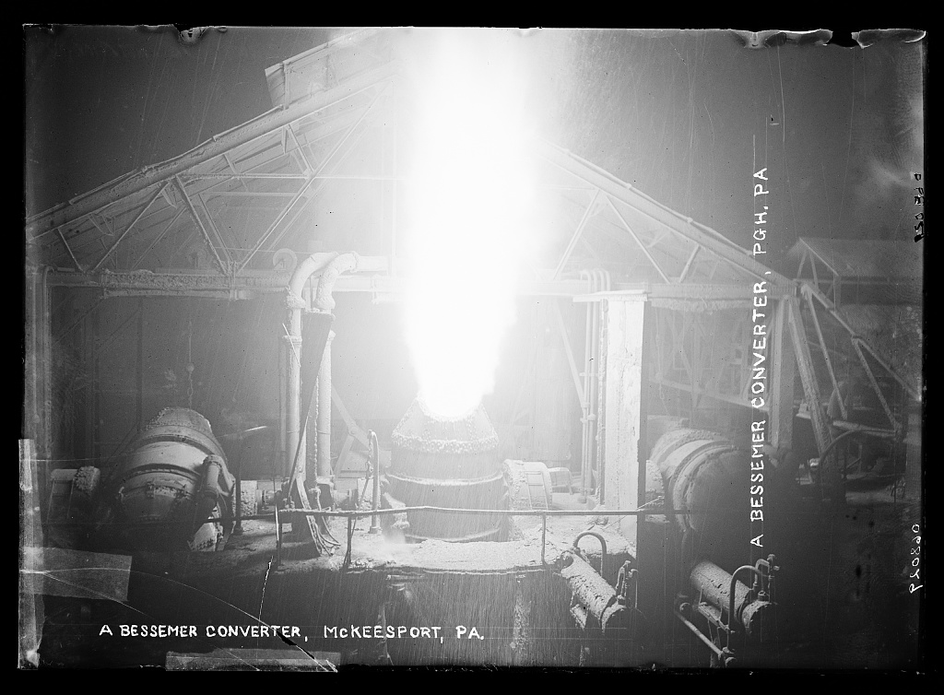
DIRECT INSTRUCTION
US.05
New inventions reshaped daily life: Bell’s telephone, Edison’s light and power, Tesla’s AC, Bessemer’s steel.
ZOOM IN
US.05 · Technological Innovations
U.S. History Hack · TroopToTeacher Technologies LLC · Aligned to TN Academic Standards & TCAP EOC
41

Slide 42
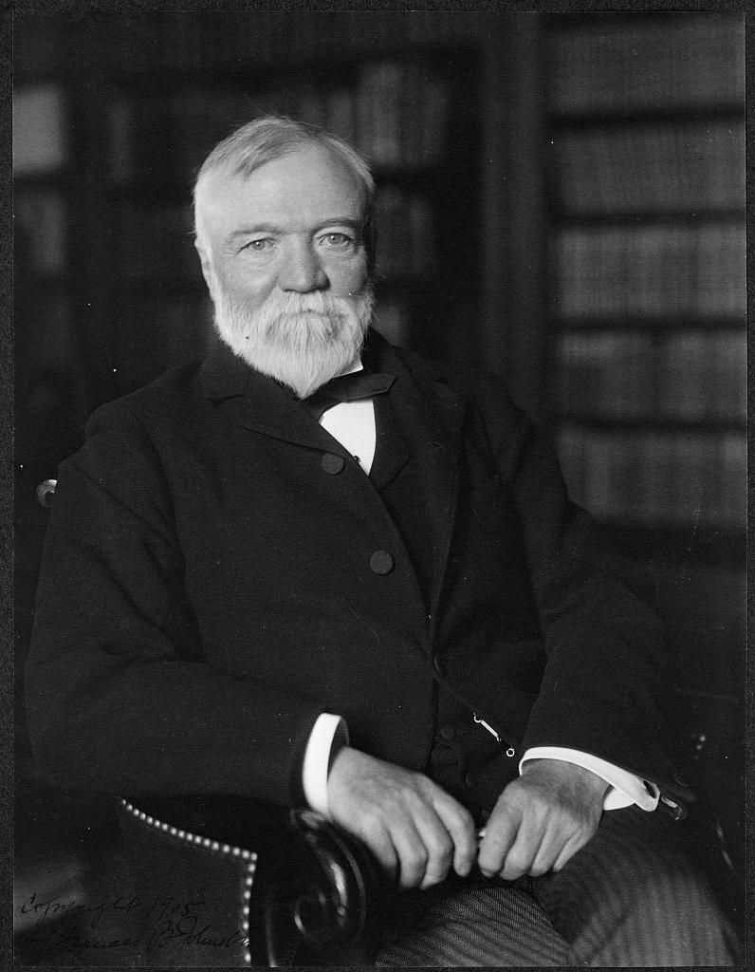
DIRECT INSTRUCTION
US.05
Industrial titans consolidated power: Carnegie (steel), Rockefeller (oil), Morgan (finance), Vanderbilt (rail).
ZOOM IN
US.05 · Industrial Titans
U.S. History Hack · TroopToTeacher Technologies LLC · Aligned to TN Academic Standards & TCAP EOC
42

Slide 43
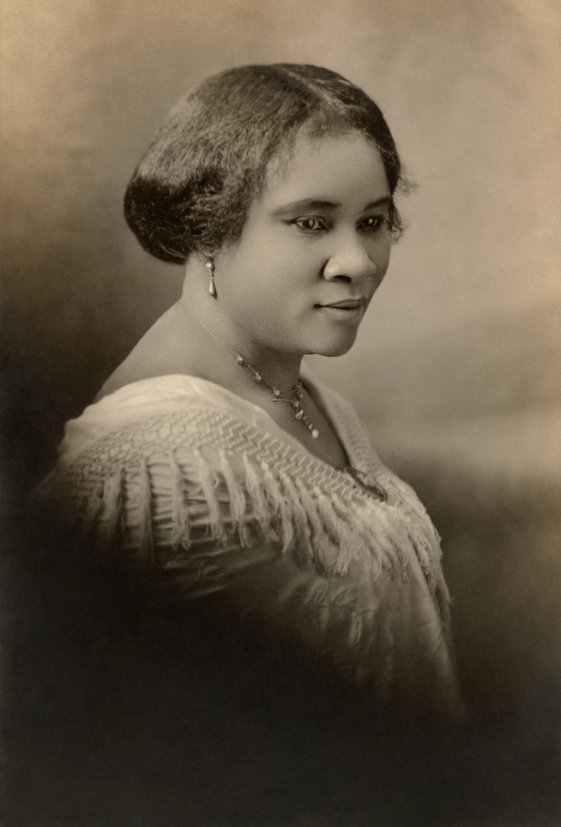
DIRECT INSTRUCTION
US.05
African American entrepreneurs broke through: Madam C.J. Walker built a fortune; Carver transformed Southern farming.
ZOOM IN
US.05 · African American Entrepreneurs
U.S. History Hack · TroopToTeacher Technologies LLC · Aligned to TN Academic Standards & TCAP EOC
43

Slide 44
SOURCE IT FIRST
US.05
Carnegie explained how the rich should use their wealth — read his “Gospel of Wealth.”
WHO
WHEN
WHY
Andrew Carnegie, steel magnate.
1889 (“Wealth,” North American Review).
A titan justifies his own fortune — ask what he claims the wealthy owe society, and what he leaves out about workers.
“Wealth” (The Gospel of Wealth)
The Freeman (on Madam C.J. Walker)
Andrew Carnegie · June 1889
The Freeman (Indianapolis) · c. 1911
"The man who dies thus rich dies disgraced... This, then, is held to be the duty of the man of wealth: to consider all surplus revenues... as trust funds... to produce the most beneficial results for the community."
"Mrs. Walker... has built up a business... giving employment to hundreds of colored women... a monument to Negro thrift and enterprise."
Public Domain / North American Review
Public Domain / Indianapolis Freeman
U.S. History Hack · TroopToTeacher Technologies LLC · Aligned to TN Academic Standards & TCAP EOC
44

Slide 45
THREE PERSPECTIVES
US.05
A historian returns to three questions at the end of every reading. Use them to analyze this standard.
Who benefited?
Who bore the costs?
Who decided?
Who gained land, wealth, power, or protection?
Who lost land, labor, freedom, or life — and who was silenced?
Which people, offices, or courts held the authority?
US.05:
US.05:
US.05:
Industrialists who amassed fortunes; consumers gaining new technologies; entrepreneurs like Walker and Carver who created jobs and products.
Workers who faced dangerous conditions and low wages while owners consolidated monopolies; small competitors bought out or driven under.
Private business leaders — Carnegie, Rockefeller, Morgan, Vanderbilt — and the inventors and entrepreneurs whose choices reshaped the economy.
Anchor: Carnegie, “Wealth” (Gospel of Wealth), 1889
U.S. History Hack · TroopToTeacher Technologies LLC · Aligned to TN Academic Standards & TCAP EOC
45

Slide 46
PROGRESS CHECK
DOK 2
US.05
A wealthy 1890s steel magnate funds free public libraries across the country instead of leaving his entire fortune to his heirs. Whose philosophy does this best reflect, and why?
A
Carnegie’s philosophy, because it displays wealth publicly to impress others.
B
The opposite of Carnegie’s view, because he insisted fortunes pass to children.
C
The opposite of Carnegie’s view, because he opposed all charitable giving.
D
Carnegie’s “Gospel of Wealth,” because surplus wealth is used as a trust to benefit society.
RESPONSE CHOICE — commit before advancing: write it, say/record it, or diagram it. Teacher reveal follows.
U.S. History Hack · TroopToTeacher Technologies LLC · Aligned to TN Academic Standards & TCAP EOC
46

Slide 47
US.06
Industrial Centers and Urbanization
TN STANDARD
US.06 – Locate major industrial centers, and describe how industrialization influenced the movement of people from rural to urban areas: Boston, Chicago, New York City, Pittsburgh, San Francisco.
I CAN
I can locate major industrial centers and describe how industrialization moved people from rural to urban areas.
U.S. History Hack · TroopToTeacher Technologies LLC · Aligned to TN Academic Standards & TCAP EOC
47

Slide 48
KEY VOCABULARY · LANGUAGE SUPPORT
US.06
Say it, see it, connect it — terms you need for this standard.
Urbanization
Granger Movement
Populism
say: ur-bun-ih-ZAY-shun
say: GRAYN-jer MOOV-ment
say: POP-yuh-liz-um
ES: Urbanización
ES: Movimiento Granger
ES: Populismo
The rapid growth of cities due to industrialization and mass migration, transforming America from a predominantly rural to an urban society.
A farmers' organization founded in 1867 that advocated railroad regulation and fought monopolistic practices that harmed farmers through high shipping rates.
An 1890s political movement of farmers and workers seeking railroad regulation, a graduated income tax, and free coinage of silver to combat economic inequality.
U.S. History Hack · TroopToTeacher Technologies LLC · Aligned to TN Academic Standards & TCAP EOC
48

Slide 49
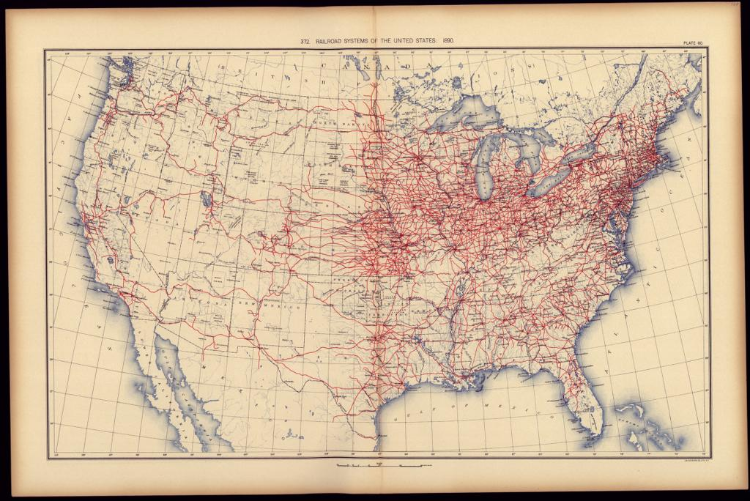
DIRECT INSTRUCTION
US.06
Industry clustered by geography: Pittsburgh steel, Chicago rail & meatpacking, NYC finance, Boston textiles, San Francisco Pacific trade.
ZOOM IN
US.06 · Major Industrial Centers
U.S. History Hack · TroopToTeacher Technologies LLC · Aligned to TN Academic Standards & TCAP EOC
49

Slide 50
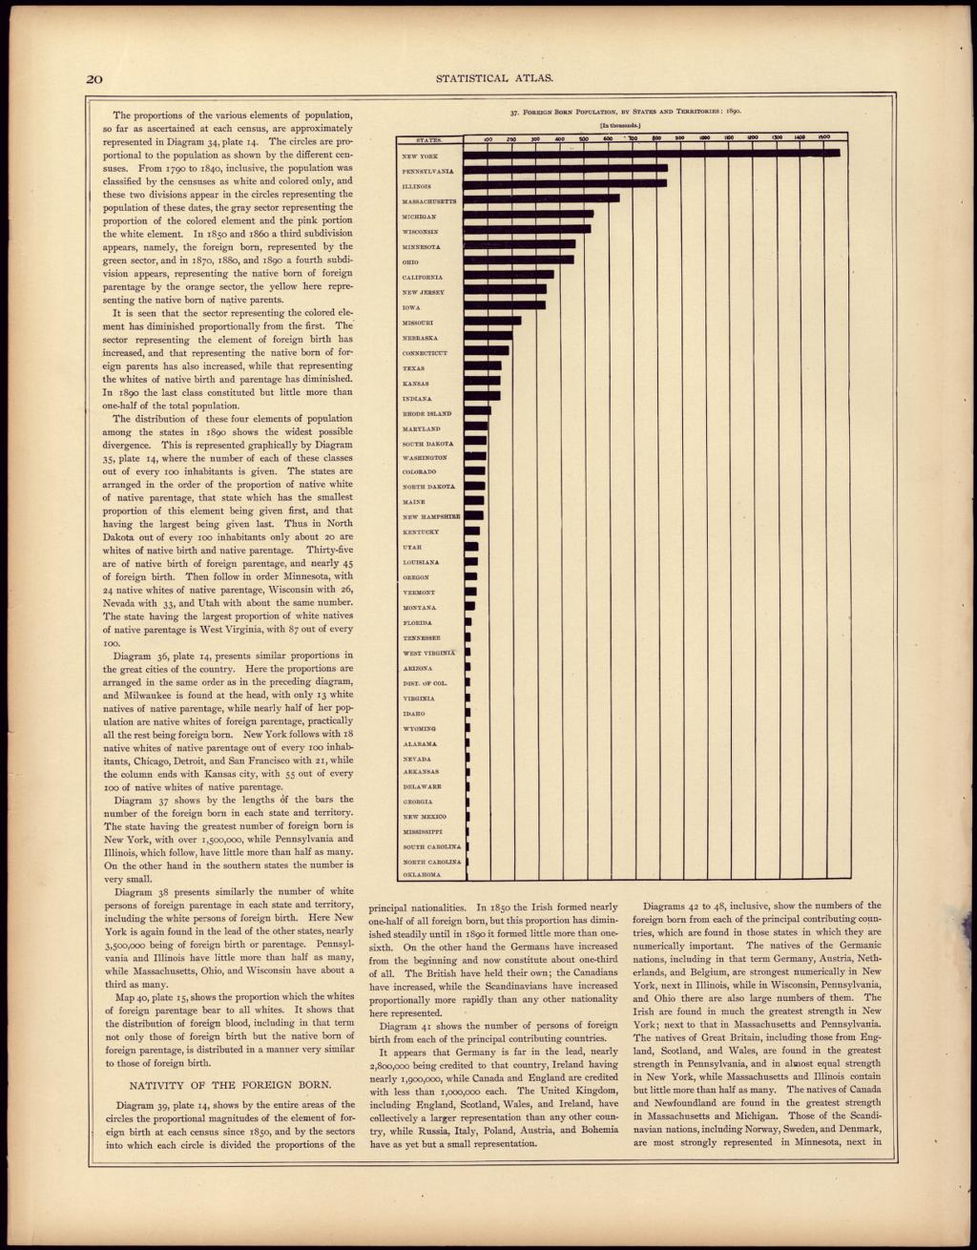
DIRECT INSTRUCTION
US.06
Factory wages pulled millions off farms — Chicago grew from 30,000 in 1850 to over 1 million by 1890.
ZOOM IN
US.06 · Rural-to-Urban Migration
U.S. History Hack · TroopToTeacher Technologies LLC · Aligned to TN Academic Standards & TCAP EOC
50

Slide 51
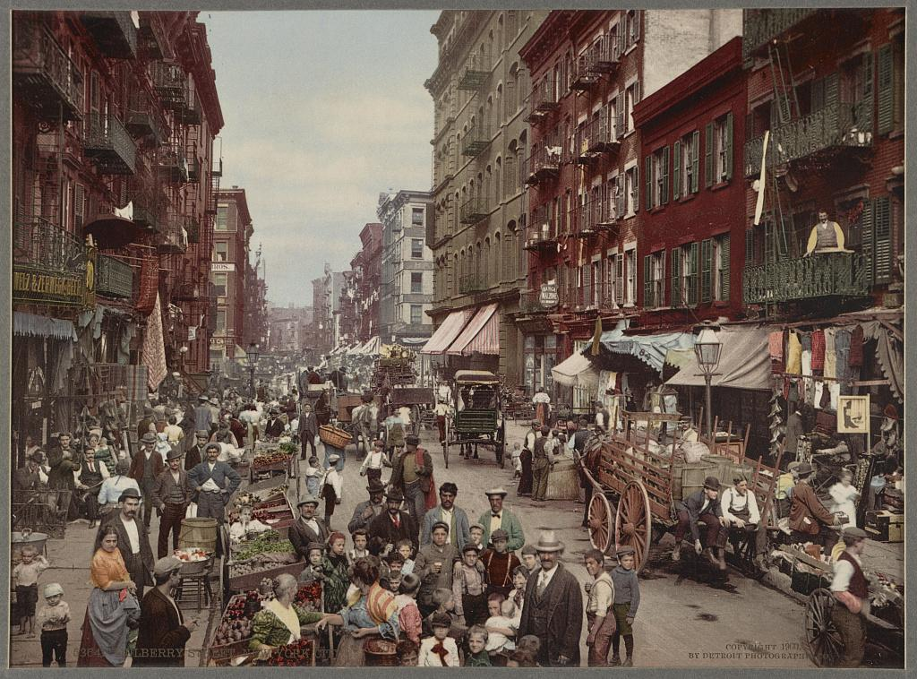
DIRECT INSTRUCTION
US.06
Cities grew faster than they could cope — crowded tenements, poor sanitation, and new social problems.
ZOOM IN
US.06 · Costs of Rapid Growth
U.S. History Hack · TroopToTeacher Technologies LLC · Aligned to TN Academic Standards & TCAP EOC
51

Slide 52
SOURCE IT FIRST
US.06
A map is a primary source too — read where manufacturing wage earners concentrated in 1890.
WHO
WHEN
WHY
Henry Gannett / U.S. Census Office.
1898 (from the 1890 Eleventh Census).
A statistical map shows where industry pulled people — ask which regions drew workers and which were left behind.
Proportion of Wage Earners in Manufactures, 1890
How the Other Half Lives (on tenement crowding)
Henry Gannett / U.S. Census Office · 1898
Jacob Riis · 1890
"[Statistical Atlas map] The darkest shading marks the industrial Northeast and Great Lakes — the manufacturing core drawing workers from farms and abroad."
"In the tenements all the influences make for evil... The gap between the classes... is widening day by day."
Library of Congress, Geography & Map Division
Public Domain / Scribner’s
U.S. History Hack · TroopToTeacher Technologies LLC · Aligned to TN Academic Standards & TCAP EOC
52

Slide 53
THREE PERSPECTIVES
US.06
A historian returns to three questions at the end of every reading. Use them to analyze this standard.
Who benefited?
Who bore the costs?
Who decided?
Who gained land, wealth, power, or protection?
Who lost land, labor, freedom, or life — and who was silenced?
Which people, offices, or courts held the authority?
US.06:
US.06:
US.06:
Factory owners with a concentrated labor supply; cities that grew into commercial powers; workers who found steady wages.
Tenement dwellers in overcrowded, unsanitary housing; rural communities drained of population; workers exposed to industrial hazards.
Industrialists choosing plant locations near coal, rail, and ports; and the market forces of wages and transportation that shaped where people moved.
Anchor: Wage-Earners Map, 1890 (LOC) & Riis, How the Other Half Lives, 1890
U.S. History Hack · TroopToTeacher Technologies LLC · Aligned to TN Academic Standards & TCAP EOC
53

Slide 54
PROGRESS CHECK
DOK 2
US.06
A folk saying held that immigrants came expecting “streets paved with gold,” only to find the streets unpaved — and that they were expected to pave them. What does this reveal about the immigrant experience?
A
Immigrants found immediate wealth and success.
B
Reality fell far short of expectations, and immigrants faced hard labor.
C
American cities were well-developed and welcoming.
D
Immigrants were given skilled professional jobs.
RESPONSE CHOICE — commit before advancing: write it, say/record it, or diagram it. Teacher reveal follows.
U.S. History Hack · TroopToTeacher Technologies LLC · Aligned to TN Academic Standards & TCAP EOC
54

Slide 55
US.07
Immigration: Old vs. New Immigrants
TN STANDARD
US.07 – Describe the differences between “old” and “new” immigrants, analyze the assimilation process, and determine the impacts of increased migration on American society, including Ellis Island, Angel Island, push/pull factors, nativism, the Chinese Exclusion Act, and the Gentlemen’s Agreement.
I CAN
I can describe the differences between “old” and “new” immigrants, analyze assimilation, and determine the impacts of increased migration on American society.
U.S. History Hack · TroopToTeacher Technologies LLC · Aligned to TN Academic Standards & TCAP EOC
55

Slide 56
KEY VOCABULARY · LANGUAGE SUPPORT
US.07
Say it, see it, connect it — terms you need for this standard.
Old Immigrants
New Immigrants
Ellis Island
say: ohld IM-ih-grunts
say: noo IM-ih-grunts
say: EL-is EYE-lund
ES: Viejos Inmigrantes
ES: Nuevos Inmigrantes
ES: Isla Ellis
Immigrants who came primarily from Northern and Western Europe before 1880, often Protestant and more easily assimilated.
Immigrants who came primarily from Southern and Eastern Europe and Asia after 1880, often Catholic, Jewish, or Orthodox, facing greater discrimination.
The primary immigration processing station in New York Harbor from 1892 to 1954, where over 12 million immigrants — primarily Europeans — entered the United States.
U.S. History Hack · TroopToTeacher Technologies LLC · Aligned to TN Academic Standards & TCAP EOC
56

Slide 57
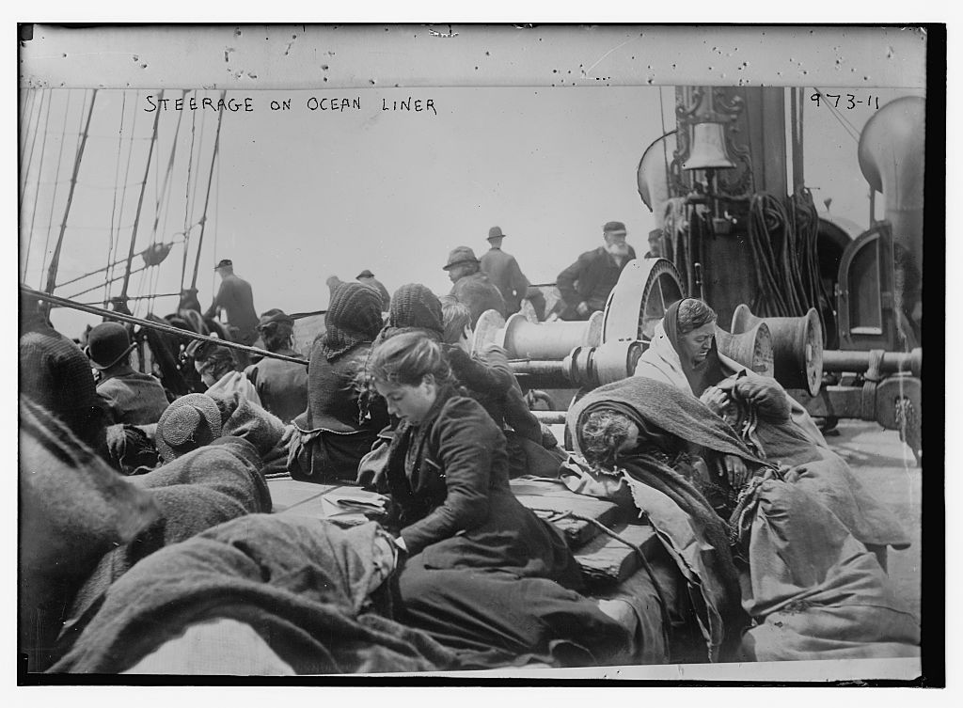
DIRECT INSTRUCTION
US.07
“Old” immigrants came from Northern/Western Europe; “new” immigrants (1880–1920) came from Southern/Eastern Europe and Asia.
ZOOM IN
US.07 · Old vs. New Immigrants
U.S. History Hack · TroopToTeacher Technologies LLC · Aligned to TN Academic Standards & TCAP EOC
57

Slide 58
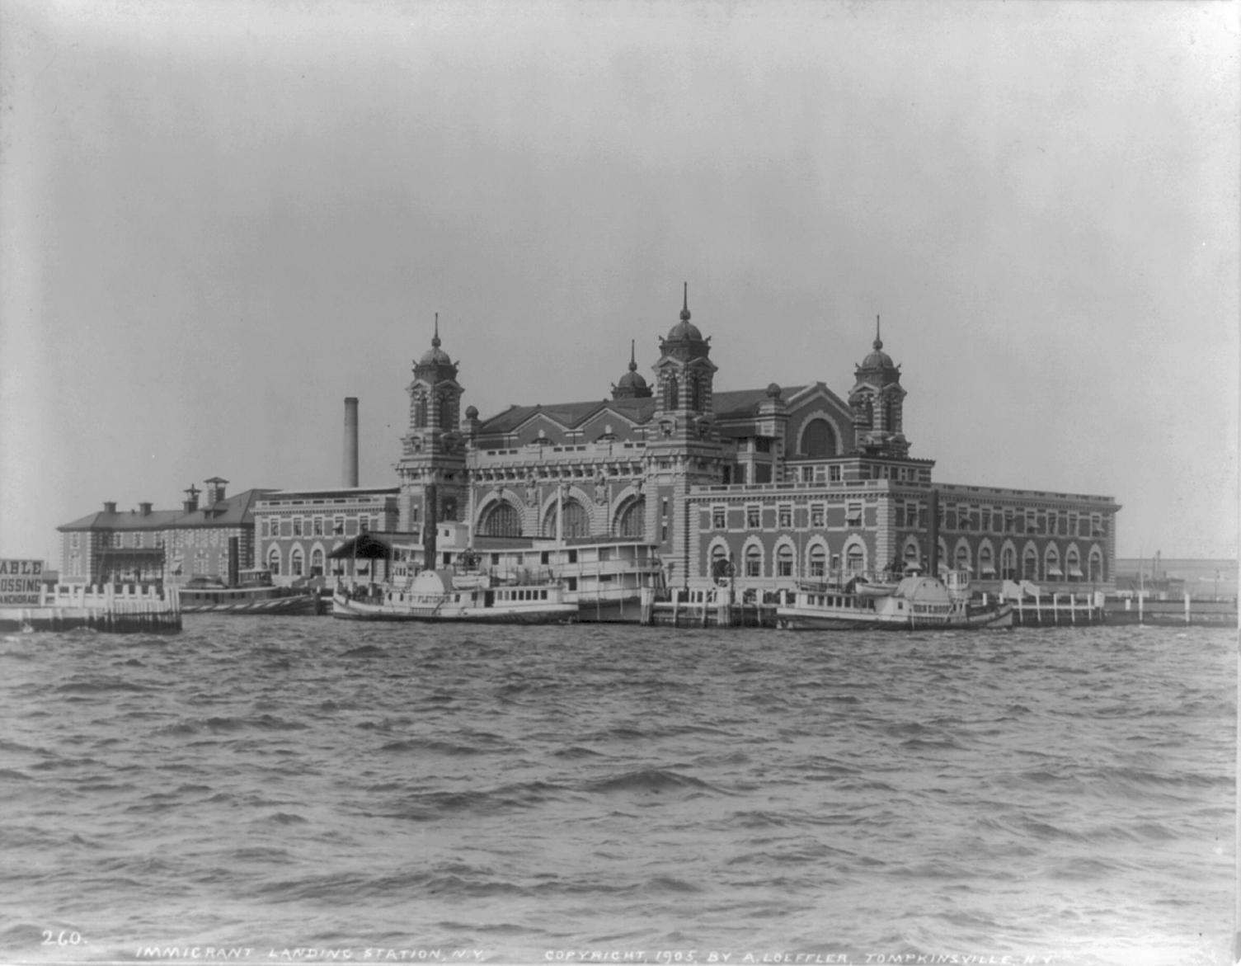
DIRECT INSTRUCTION
US.07
Ellis Island processed Europeans; Angel Island restricted Asians. Jane Addams’s Hull House aided assimilation.
ZOOM IN
US.07 · Entry Points & Assimilation
U.S. History Hack · TroopToTeacher Technologies LLC · Aligned to TN Academic Standards & TCAP EOC
58

Slide 59
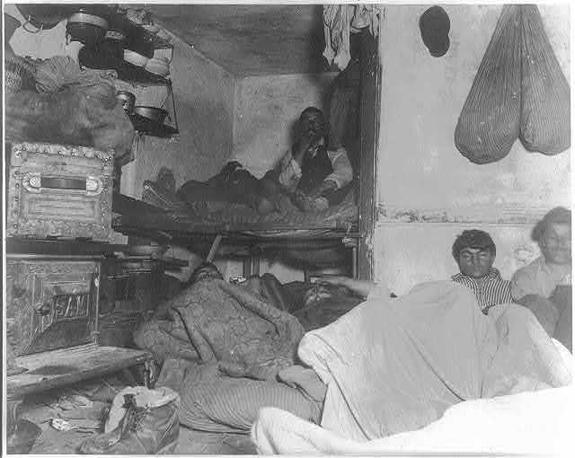
DIRECT INSTRUCTION
US.07
Push factors (persecution, poverty) and pull factors (opportunity, freedom) drove the largest migration in U.S. history.
ZOOM IN
US.07 · Push & Pull Factors
U.S. History Hack · TroopToTeacher Technologies LLC · Aligned to TN Academic Standards & TCAP EOC
59

Slide 60
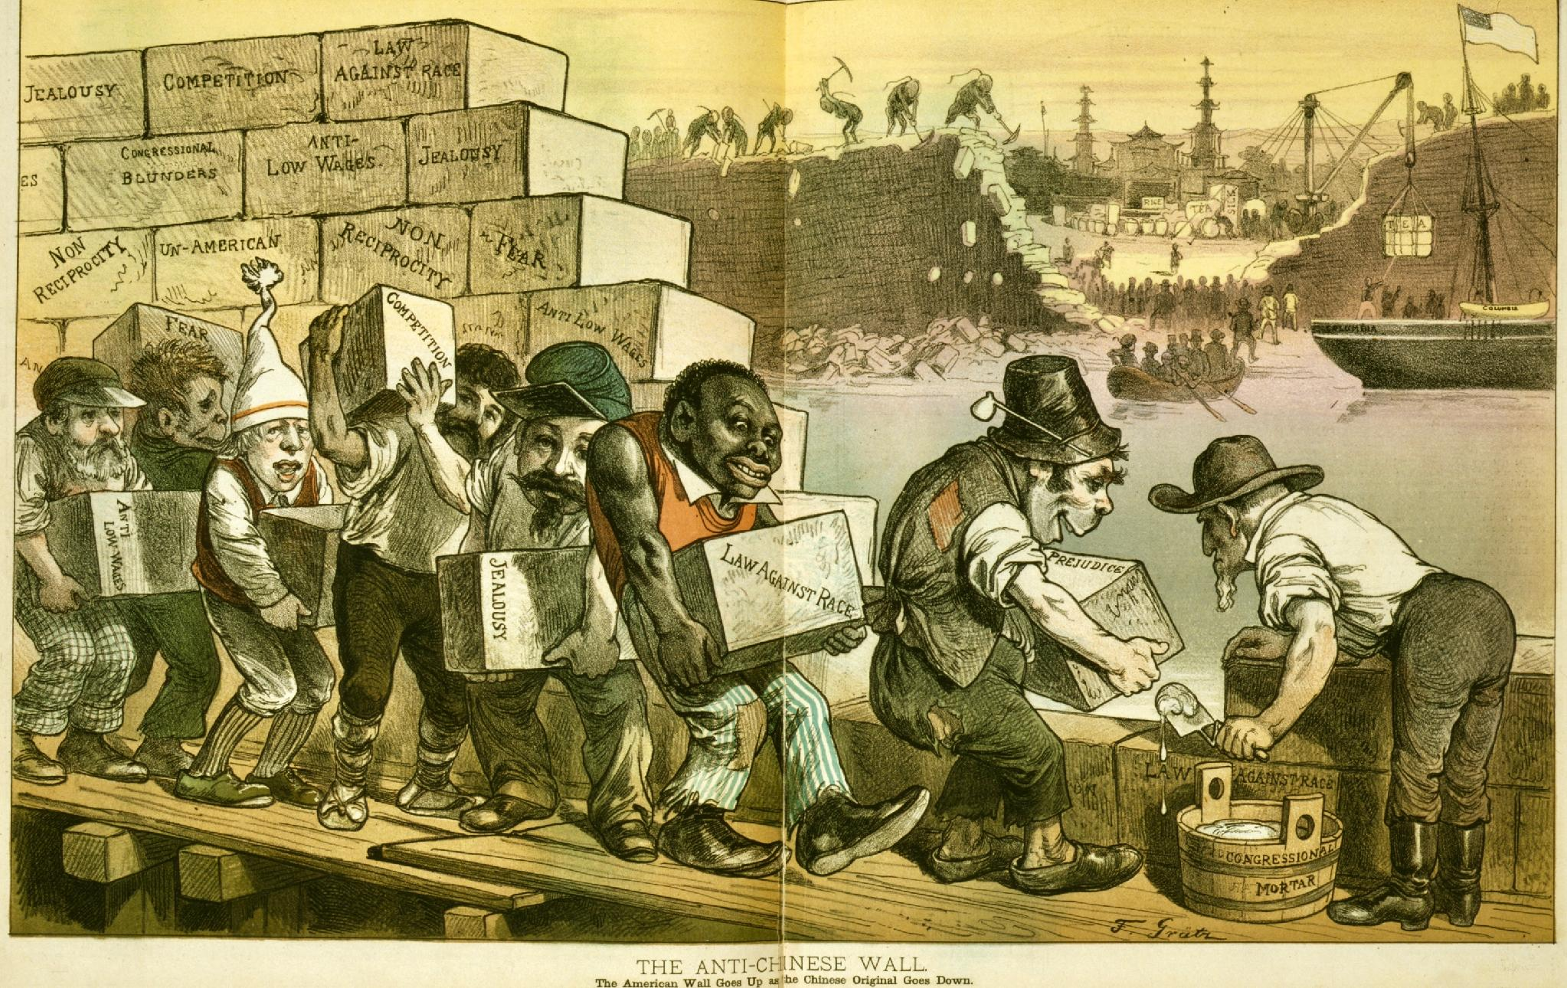
DIRECT INSTRUCTION
US.07
Nativism produced restriction: the Chinese Exclusion Act (1882) and the Gentlemen’s Agreement (1907).
ZOOM IN
US.07 · Nativism & Restriction
U.S. History Hack · TroopToTeacher Technologies LLC · Aligned to TN Academic Standards & TCAP EOC
60

Slide 61
SOURCE IT FIRST
US.07
The first federal law to bar a nationality — read who the Chinese Exclusion Act shut out.
WHO
WHEN
WHY
U.S. Congress (federal statute).
May 6, 1882 (22 Stat. 58).
It was the first U.S. law to bar an entire nationality — ask whom it targeted and what precedent it set.
Chinese Exclusion Act
Twenty Years at Hull-House
U.S. Congress · May 6, 1882 (22 Stat. 58)
Jane Addams · 1910
"...the coming of Chinese laborers to the United States be, and the same is hereby, suspended... it shall not be lawful for any Chinese laborer to come... to remain within the United States."
"We early found ourselves spending many hours in efforts to secure... justice for immigrants... whom the state had left unprotected."
National Archives
Public Domain / Macmillan
U.S. History Hack · TroopToTeacher Technologies LLC · Aligned to TN Academic Standards & TCAP EOC
61

Slide 62
THREE PERSPECTIVES
US.07
A historian returns to three questions at the end of every reading. Use them to analyze this standard.
Who benefited?
Who bore the costs?
Who decided?
Who gained land, wealth, power, or protection?
Who lost land, labor, freedom, or life — and who was silenced?
Which people, offices, or courts held the authority?
US.07:
US.07:
US.07:
Employers gaining cheap labor; the growing industrial economy; immigrants who found opportunity and religious freedom.
New immigrants facing discrimination, tenement poverty, and hostility; Chinese and Japanese immigrants barred by exclusion laws.
The U.S. Congress (Chinese Exclusion Act, 1882) and the executive branch (Gentlemen’s Agreement, 1907), driven by rising nativism.
Anchor: Chinese Exclusion Act, 1882 (National Archives) & Addams, Twenty Years at Hull-House
U.S. History Hack · TroopToTeacher Technologies LLC · Aligned to TN Academic Standards & TCAP EOC
62

Slide 63
PROGRESS CHECK
DOK 2
US.07
According to Jane Addams, what was the philosophy behind Hull-House?
A
That different social classes depend on and can help each other.
B
That wealthy people should live separately from immigrants.
C
That immigrants should return to their home countries.
D
That government should provide all social services.
RESPONSE CHOICE — commit before advancing: write it, say/record it, or diagram it. Teacher reveal follows.
U.S. History Hack · TroopToTeacher Technologies LLC · Aligned to TN Academic Standards & TCAP EOC
63

Slide 64
REACHED — AND LEFT OUT
Whose story the industrial era told — and who paid its costs
History Hack-authored synthesis grounded in this unit’s sourced record — read across the standards, not around them.
American Indian Nations
Chinese Laborers
African Americans
New Immigrants & Reformers
Westward expansion and the railroad (US.01) crossed treaty lands; reservation, assimilation, boarding-school, and Dawes Act policy (US.02) cut tribal holdings from 138 to 48 million acres by 1934.
Chinese workers built the most dangerous stretches of the Central Pacific (US.01) yet faced wage discrimination and, in 1882, the first federal law to bar a nationality — the Chinese Exclusion Act (US.07).
The Compromise of 1877 ended Reconstruction’s protections (US.03); the Exodusters fled to Kansas, and Madam C.J. Walker and George Washington Carver (US.05) built enterprise under Jim Crow.
Southern and Eastern European and Asian arrivals (US.07) met nativism and tenement poverty; reformers like Jane Addams at Hull-House organized mutual aid across classes.
Verified public-domain images and named Key-Figure entries for these histories are a pending content addition.
U.S. History Hack · TroopToTeacher Technologies LLC · Aligned to TN Academic Standards & TCAP EOC
64

Slide 65
GEOGRAPHER'S LENS · US.01 — COLOR MAP FOR PROJECTION
Matthews, Northrup & Co's Official Railroad Map of the United States, Dominion of Canada and Mexico
This is the full-color version of the black-and-white map on the workbook Geographer's Lens page for US.01. Source: Matthews, Northrup & Co. Matthews, Northrup & Co's Official Railroad Map of the United States, Dominion of Canada and Mexico Perfected to Date from Latest Authentic Sources. Buffalo, 1890. Map. Library of Congress Geography and Map Division, call number G3701.P3 1890 .M3. https://www.loc.gov/item/gm71000843/. Public Domain — No Known Restrictions on Publication

Slide 66
GEOGRAPHER'S LENS · US.06 — COLOR MAP FOR PROJECTION
Foreign Born Population, by States and Territories: 1890
This is the full-color version of the black-and-white map on the workbook Geographer's Lens page for US.06. Source: Gannett, Henry, and U.S. Census Office. "Foreign Born Population, by States and Territories: 1890." In Statistical Atlas of the United States, Based upon the Results of the Eleventh Census. Washington, DC: U.S. Census Office, 1898. Library of Congress Geography and Map Division, call number G1201.G1 U53 1898. https://www.loc.gov/resource/g3701gm.gct00010/?sp=35. Public Domain — U.S. Government Work

