Slide 1
U.S. HISTORY HACK
Unit 1
The Rise of Industrialization
Westward Expansion · The Gilded Age · Immigration · 1877–1900
Standards US.01 – US.07
US.01
US.02
US.03
US.04
US.05
US.06
US.07
TCAP EOC LECTURE DECK · Tennessee Academic Standards for U.S. History
TroopToTeacher Technologies LLC
Notes:
Unit 1 TCAP EOC lecture deck. Each standard runs as a full lesson: divider (standard + I Can), hook, direct instruction with a verified primary-source image, key figures, vocabulary, a student activity (paired to a printable worksheet), a TCAP-style check (question slide, then click to the reveal/answer-key slide), and a wrap-up with a teacher answer key in the speaker notes. All images are public-domain, captioned, and linked to the Library of Congress / National Archives.

Slide 2
UNIT ROADMAP
Where We Are Headed
Unit 1 · The Rise of Industrialization (1877–1900) — Westward Expansion, the Gilded Age & Immigration
US.01
Homestead Act and Transcontinental Railroad
US.05
Inventions & Innovations of Business Leaders & Entrepreneurs
then
US.02
Federal Policies Toward American Indians
US.06
Industrial Centers and Urbanization
US.03
Compromise of 1877, Jim Crow & Plessy v. Ferguson
US.07
Immigration: Old vs. New Immigrants
US.04
Gilded Age Politics and Economics
Standards build in sequence (US.01 → US.07). Each runs as a full lesson: TN standard · “I Can” · direct instruction · verified primary source · vocabulary · guided + independent practice · TCAP-style check with reveal key.
U.S. History Hack · TroopToTeacher Technologies LLC · Aligned to TN Academic Standards & TCAP EOC
2

Slide 3
BELL RINGER · HOOK
In 1865, most Americans lived on farms.
By 1920, most lived in cities.
What forces could move an entire nation off the land and into the factory in just 55 years?
TURN & TALK
With a partner, list three things that might pull people toward cities — and three things that might push them off the farm. Keep your list; we will return to it at the end of the unit.
U.S. History Hack · TroopToTeacher Technologies LLC · Aligned to TN Academic Standards & TCAP EOC
3
Notes:
Bell ringer (5 min). Push factors: drought/crop failure, falling crop prices, farm debt/mechanization, lack of land. Pull factors: factory jobs, higher wages, electricity, entertainment, immigrant communities. Collect lists; revisit on the closing slide.

Slide 4
How This Deck Works — UDL & MTSS
Universal supports built into every standard. One firm learning goal; flexible ways to reach it.
CORE PATH
SUPPORT OPTION
LANGUAGE SUPPORT
The essential instruction every student receives.
An optional scaffold that keeps the goal, not lowers it.
Vocabulary, pronunciation, and Spanish cognates for access.
RESPONSE CHOICE
PROGRESS CHECK
EXTENSION
Show learning by writing, saying/recording, or diagramming.
A quick DOK-2/3 check to guide reteach or extend.
A deeper challenge once the goal is met.
Options are available by design and support access without lowering the learning goal.
Supports work alongside — never in place of — required IEP or 504 accommodations.
U.S. History Hack · TroopToTeacher Technologies LLC · Aligned to TN Academic Standards & TCAP EOC
4

Slide 5
STANDARD
SOCIAL STUDIES PRACTICES
US.01
SSP.01
Collect sources
SSP.02
Examine a source
SSP.05
Historical awareness
SSP.06
Geographic awareness
Homestead Act and Transcontinental Railroad
FOLLOW ALONG
Open the Mission Book → Stop 1
Open the Flight Log → Entry 1
TN ACADEMIC STANDARD
Explain how the Homestead Act and the Transcontinental Railroad impacted the settlement of the West.
I CAN
I can explain how the Homestead Act and the Transcontinental Railroad impacted the settlement of the West, including their effects on American Indians, immigrants, and settlers.
U.S. History Hack · TroopToTeacher Technologies LLC · Aligned to TN Academic Standards & TCAP EOC
5

Slide 6
US.01 · QUICK REVIEW
Do You Remember?
Before we start, retrieve what we have already learned. Answer from memory first — no notes.
1
Unit Hook Name one PUSH factor and one PULL factor that moved Americans from farms to cities.
2
Prior What major war had just ended in 1865, and what region was being rebuilt?
U.S. History Hack · TroopToTeacher Technologies LLC · Aligned to TN Academic Standards & TCAP EOC
6
Notes:
SPACED RETRIEVAL (US.01). Cold-call or whiteboards, 3-4 min, low stakes. Answers — 1) Push: drought/debt/falling prices. Pull: factory jobs, higher wages, city amenities. 2) The Civil War; the South was being rebuilt during Reconstruction.

Slide 7
US.01 · CONFIDENCE CHECK
Warm-Up — Quick Recall
DOK 1
LOW STAKES
Everyone can answer this. Thumbs / whiteboards — no notes.
TRUE or FALSE: The Homestead Act offered free public land to settlers who farmed it.
✓ ANSWER
TRUE — 160 acres after five years of living on and improving the claim.
COMMIT FIRST: have everyone answer before the reveal — this is the DOK 1 floor; the graded check later in this lesson moves up to DOK 2–3.
U.S. History Hack · TroopToTeacher Technologies LLC · Aligned to TN Academic Standards & TCAP EOC
7
Notes:
CONFIDENCE CHECK (US.01, DOK 1). 60-90 seconds. Have EVERY student commit (thumbs / whiteboard / choral) before revealing — this secures an early win and surfaces who is shaky before new content. Answer: TRUE — 160 acres after five years of living on and improving the claim. Key term to listen for: Homestead Act. This is the low-floor entry; the graded Check for Understanding later in the standard rises to DOK 2–3.

Slide 8
US.01 · HOOK
Think About It
160 acres of land — free — to almost anyone willing to farm it for five years.
DISCUSS
TIMING: Turn & Talk 60 sec → cold-call 2 pairs
If the government offered you free land out West in 1862, would you go? What would you have to give up — and who already lived there?
U.S. History Hack · TroopToTeacher Technologies LLC · Aligned to TN Academic Standards & TCAP EOC
8
Notes:
HOOK (US.01). Run tight: pose the provocation, give a silent 10-second think, then Turn & Talk 60 seconds. Cold-call 2–3 pairs (not volunteers) for a sentence-starter answer — "One force was ___ because ___" — then bridge to the standard. Keep total to ~4 minutes; do not let it sprawl. Return to this question at the unit close for an evidence-based answer.

Slide 9
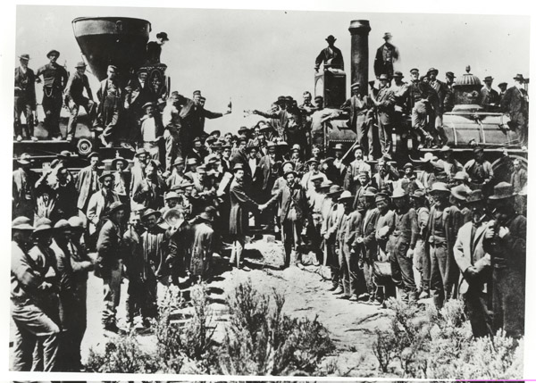
US.01 · DIRECT INSTRUCTION
1 of 3
Sequence the expansion of the United States
The Homestead Act of 1862 offered 160 acres of free land to settlers who would farm it for five years.
Combined with the completion of the Transcontinental Railroad in 1869, these policies accelerated westward expansion as part of Manifest Destiny—the belief that Americans were destined to spread across the continent.
The Union Pacific built westward from Omaha while the Central Pacific built eastward from Sacramento, meeting at Promontory Summit, Utah.
SENTENCE FRAME · LANGUAGE SUPPORT
Andrew J. Russell, 1869 National Archives and Records Administration
The Homestead Act and the railroad ________ western settlement because ________.
TEACHER CUE Chunk → cold-call → confirm before advancing.
FLIGHT LOG · Cornell Notes — US.01: jot notes here as we go.
U.S. History Hack · TroopToTeacher Technologies LLC · Aligned to TN Academic Standards & TCAP EOC
9
Notes:
FACILITATION (US.01). Think-aloud as you read: "I keep asking — good for whom, costly for whom?" Cold-call two students to name a winner and a loser of expansion before moving on. Teach in small steps; pause and check for understanding before the next chunk (aim 80%+ before moving on).

Slide 10
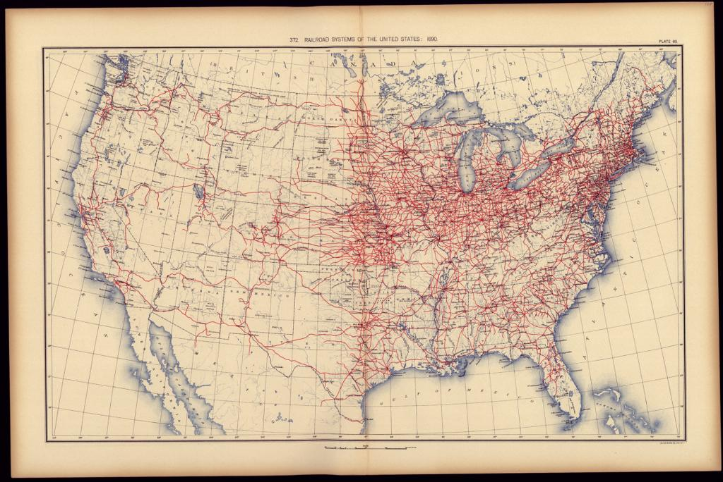
US.01 · DIRECT INSTRUCTION
2 of 3
Impact on Western Settlement
The Transcontinental Railroad dramatically reduced travel time from months to days, opening the West to settlement, commerce, and resource extraction.
Towns sprang up along rail lines, and agricultural products could now reach eastern markets efficiently.
However, this expansion came at tremendous cost to American Indian nations whose lands were taken and whose way of life was destroyed.
Matthews-Northrup Company, 1890 Library of Congress
U.S. History Hack · TroopToTeacher Technologies LLC · Aligned to TN Academic Standards & TCAP EOC
10

Slide 11
US.01 · DIRECT INSTRUCTION
3 of 3
Impact on American Indians, Immigrants, and Settlers
Western expansion devastated American Indian communities through forced relocations, broken treaties, and the near-extinction of buffalo herds they depended upon.
Immigrants, particularly Chinese workers who built much of the Central Pacific, faced discrimination despite their crucial contributions.
The "Buffalo Soldiers"—African American cavalry regiments—served on the frontier, including George Jordan of Williamson County, Tennessee, who received the Medal of Honor for his service.
★ TENNESSEE CONNECTION
Buffalo Soldier George Jordan of Williamson County, Tennessee earned the Medal of Honor for his frontier service — a direct Tennessee link to westward expansion.
U.S. History Hack · TroopToTeacher Technologies LLC · Aligned to TN Academic Standards & TCAP EOC
11

Slide 12
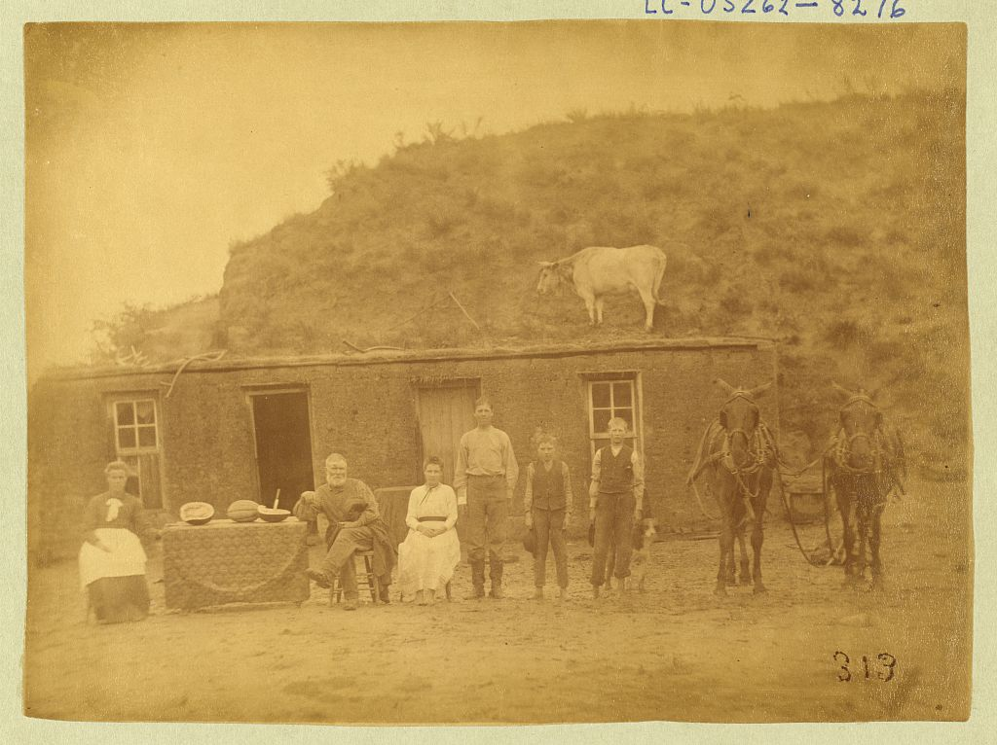
US.01 · PRIMARY SOURCE ANALYSIS
Homestead Act
Close Reading
U.S. Congress · May 20, 1862 (12 Stat. 392)
ZOOM IN Find ONE detail that surprises you — be ready to name it.
"Any person who is the head of a family, or who has arrived at the age of twenty-one years, and is a citizen of the United States, or who shall have filed his declaration of intention to become such... shall be entitled to enter one quarter section [160 acres] of unappropriated public lands."
CONTEXT
Passed during the Civil War, the Homestead Act offered western land to encourage settlement and strengthen Union-aligned development of the frontier.
ANALYZE
A homesteading family and a Lakota family in 1875 would most likely have described the Homestead Act in very different ways. Which statement best explains why?
Solomon D. Butcher, 1886 Library of Congress
SOURCE IT
WHO made it?
WHEN?
WHY does it matter?
FIRST
U.S. Congress (federal statute).
1862, during the Civil War.
A law reveals the government’s intent — ask who benefits and who is left out.
SSP.02 · before you interpret
Source: National Archives
U.S. History Hack · TroopToTeacher Technologies LLC · Aligned to TN Academic Standards & TCAP EOC
12
Notes:
Primary-source analysis. SOURCE IT FIRST (SSP.02) — model the sourcing routine aloud before students interpret: WHO made this source? (U.S. Congress (federal statute).) WHEN? (1862, during the Civil War.) WHY does that matter? (A law reveals the government’s intent — ask who benefits and who is left out.) Only then move to the ANALYZE question. Suggested answer: DOK 3: Students must weigh competing perspectives. The Act’s "free" 160-acre grants to settlers came from land that the federal government took from American Indian nations, so the same policy meant opportunity for one group and dispossession for another. Practice skill: Close Reading.

Slide 13
US.01 · KEY VOCABULARY
Word Wall
Homestead Act
Ley de Homestead
Transcontinental Railroad
Ferrocarril Transcontinental
say: HOHM-sted
say: tranz-kon-tih-NEN-tul RAYL-rohd
An 1862 law that provided 160 acres of public land to settlers who agreed to live on and improve the land for five years, encouraging westward expansion.
A continuous railroad line completed in 1869 that connected the eastern United States with the Pacific coast, revolutionizing transportation and commerce.
Westward Expansion
Expansión hacia el Oeste
Manifest Destiny
Destino Manifiesto
say: WEST-werd ek-SPAN-shun
say: MAN-ih-fest DES-tih-nee
The 19th-century movement of settlers, railroads, and U.S. authority across the continent toward the Pacific, encouraged by free land and new transportation.
The widely held 1800s belief that the United States was destined to expand across the entire continent, used to justify the displacement of American Indians.
Land Grant
Concesión de Tierras
Reservation
Reservación
say: LAND grant
say: rez-er-VAY-shun
A gift of public land from the government — to railroad companies or settlers — used to fund and accelerate western settlement.
An area of land set aside by the federal government for American Indian tribes, frequently far from their ancestral homelands.
"say:" pronunciation guide (stressed syllable in CAPS) and a per-term visual anchor support newcomer English learners. Spanish term + full bilingual Frayer models are in the unit vocabulary set.
U.S. History Hack · TroopToTeacher Technologies LLC · Aligned to TN Academic Standards & TCAP EOC
13

Slide 14
US.01 · GUIDED PRACTICE — WE DO IT TOGETHER
Let’s Work One Together
Cause → Effect reasoning
MODEL PROMPT: Trace ONE effect of the Transcontinental Railroad on American Indian nations.
WORKED EXAMPLE (teacher models this aloud)
CAUSE: The railroad cut directly through Plains hunting grounds (1869). → EFFECT: Settlers and hunters poured in and the buffalo herds collapsed. → CONSEQUENCE: Plains nations lost the food source their economy depended on and were pushed onto reservations.
THINK ALOUD
Watch how I do it: I start with the policy (the cause), I underline the change it set in motion (the effect), then I push one step further to the human consequence. I do NOT stop at "railroad was built" — I ask "so what happened to people because of it?"
→ Now you try: Now you complete two more cause→effect chains on your own in the activity.
U.S. History Hack · TroopToTeacher Technologies LLC · Aligned to TN Academic Standards & TCAP EOC
14
Notes:
GUIDED PRACTICE / WE DO (US.01). Skill modeled: Cause → Effect reasoning. Model the worked example aloud using the THINK ALOUD as your script, then release students to the activity ("Now you complete two more cause→effect chains on your own in the activity."). This is the I Do → We Do → You Do bridge — do not skip it; aim for 80%+ success before independent work.

Slide 15
US.01 · STUDENT ACTIVITY
Cause-and-Effect Web: Tying the Nation Together
Pairs
10–12 min
YOUR TASK
Using the railroad map and the Golden Spike photo, list THREE effects of the Transcontinental Railroad on (a) settlers, (b) immigrant labor, and (c) American Indian nations. For each effect, mark whether it was a benefit or a cost — and to whom.
Matthews-Northrup Company, 1890 Library of Congress
DELIVERABLE
SUPPORT OPTIONS
Completed cause-effect web with at least 6 labeled effects.
SUPPORT OPTION: sentence stems provided. EXTENSION: rank the three groups by net impact and defend the order.
Flight Log — write here: US.01 — write your response in your Flight Log; the Cornell Notes page for US.01 aligns to these Direct Instruction slides.
U.S. History Hack · TroopToTeacher Technologies LLC · Aligned to TN Academic Standards & TCAP EOC
15
Notes:
Student activity for US.01. Pair with the printable: Cornell Notes — US.01: Transcontinental Railroad & Industrial Expansion (Teacher Tools › Worksheets › Cornell Notes). Timing: 10–12 min. Deliverable: Completed cause-effect web with at least 6 labeled effects.

Slide 16
US.01 · CHECK FOR UNDERSTANDING
TCAP-Style Question
DOK 3
EOC PRACTICE
A homesteading family and a Lakota family in 1875 would most likely have described the Homestead Act in very different ways. Which statement best explains why?
The Homestead Act applied only to settlers and never affected American Indians in any way.
A
The same law that opened “free” land to settlers took that land away from American Indians who already lived on it.
B
Both families received 160 acres each under the law, so their views would have matched.
C
The law was written to benefit American Indians first and settlers second.
D
ANSWER FIRST: students commit — then click / advance to reveal the correct answer and explanation.
U.S. History Hack · TroopToTeacher Technologies LLC · Aligned to TN Academic Standards & TCAP EOC
16
Notes:
CHECK FOR UNDERSTANDING (US.01, DOK 3). Have students commit to an answer (whiteboards, hand signal, or turn-and-talk) BEFORE advancing. Correct answer: A. The next slide reveals it. Why: DOK 3: Students must weigh competing perspectives. The Act’s "free" 160-acre grants to settlers came from land that the federal government took from American Indian nations, so the same policy meant opportunity for one group and dispossession for another.

Slide 17
US.01 · ANSWER REVEAL
TCAP-Style Question
✓ ANSWER KEY
A homesteading family and a Lakota family in 1875 would most likely have described the Homestead Act in very different ways. Which statement best explains why?
A
The Homestead Act applied only to settlers and never affected American Indians in any way.
B
The same law that opened “free” land to settlers took that land away from American Indians who already lived on it.
✓
C
Both families received 160 acres each under the law, so their views would have matched.
D
The law was written to benefit American Indians first and settlers second.
Correct answer: B. Why: DOK 3: Students must weigh competing perspectives. The Act’s "free" 160-acre grants to settlers came from land that the federal government took from American Indian nations, so the same policy meant opportunity for one group and dispossession for another.
U.S. History Hack · TroopToTeacher Technologies LLC · Aligned to TN Academic Standards & TCAP EOC
17
Notes:
ANSWER KEY (US.01). Correct: A. DOK 3: Students must weigh competing perspectives. The Act’s "free" 160-acre grants to settlers came from land that the federal government took from American Indian nations, so the same policy meant opportunity for one group and dispossession for another.

Slide 18
US.01 · WRAP-UP
What You Need to Know for TCAP
KEY TAKEAWAYS
EXIT TICKET
DOK 2
Sequence the expansion of the United States
Impact on Western Settlement
Impact on American Indians, Immigrants, and Settlers
Explain ONE way the Homestead Act or the railroad helped settlers AND ONE way it harmed American Indians.
★ EXTENSION DOK 3 · SSP.04 Argumentation
Argue: was westward expansion mainly “opportunity” or mainly “dispossession”? Defend your claim with TWO specific pieces of evidence.
TEACHER DECISION BAND PROGRESS CHECK → identify barrier → select support → reteach → recheck → extend
SCAFFOLD FADING Guided → Light → independent as evidence grows; required IEP/504 supports do not fade unless the authorized team changes them.
U.S. History Hack · TroopToTeacher Technologies LLC · Aligned to TN Academic Standards & TCAP EOC
18
Notes:
WRAP-UP / EXIT-TICKET KEY (US.01, DOK 2). Prompt: Explain ONE way the Homestead Act or the railroad helped settlers AND ONE way it harmed American Indians. Model answer: E.g., free 160-acre claims/rail access drew settlers; the same land was taken from American Indian nations, who were pushed onto reservations. RETEACH TRIGGER — if a student misses this exit ticket: (1) <50% of class miss → spiral it into the next standard’s Quick Review opener (see the US.01 review prompts). (2) Individual/small group → reteach with the "Sequence the expansion of the United States" direct-instruction slide + re-run the SOURCE IT FIRST routine on the US.01 primary source, then assign the paired printable: Cornell Notes — US.01: Transcontinental Railroad & Industrial Expansion (Teacher Tools › Worksheets › Cornell Notes). (3) Re-assess with the US.01 check-for-understanding reveal slide as a do-now the next day. Reteach anchors (this standard’s sections): Sequence the expansion of the United States; Impact on Western Settlement; Impact on American Indians, Immigrants, and Settlers. I Can objective: I can explain how the Homestead Act and the Transcontinental Railroad impacted the settlement of the West, including their effects on American Indians, immigrants, and settlers. EXTENSION (DOK 3, for early finishers or advanced learners): Argue: was westward expansion mainly “opportunity” or mainly “dispossession”? Defend your claim with TWO specific pieces of evidence. — look for a clear claim plus two specific pieces of evidence.

Slide 19
STANDARD
SOCIAL STUDIES PRACTICES
US.02
SSP.01
Collect sources
SSP.02
Examine a source
SSP.03
Synthesize sources
SSP.05
Historical awareness
Federal Policies Toward American Indians
SSP.06
Geographic awareness
FOLLOW ALONG
Open the Mission Book → Stop 2
Open the Flight Log → Entry 2
TN ACADEMIC STANDARD
Examine federal policies toward American Indians, including the movement to reservations, assimilation, boarding schools, and the Dawes Act.
I CAN
I can examine federal policies toward American Indians, including the movement to reservations, assimilation, boarding schools, and the Dawes Act.
U.S. History Hack · TroopToTeacher Technologies LLC · Aligned to TN Academic Standards & TCAP EOC
19

Slide 20
US.02 · QUICK REVIEW
Do You Remember?
Before we start, retrieve what we have already learned. Answer from memory first — no notes.
1
US.01 How did the Homestead Act and the railroads change WHO lived on western land?
2
US.01 Define “Manifest Destiny” in one sentence.
U.S. History Hack · TroopToTeacher Technologies LLC · Aligned to TN Academic Standards & TCAP EOC
20
Notes:
SPACED RETRIEVAL (US.02). Cold-call or whiteboards, 3-4 min, low stakes. Answers — 1) They drew settlers/immigrants west onto land taken from American Indians. 2) The belief the U.S. was destined to expand across the continent.

Slide 21
US.02 · CONFIDENCE CHECK
Warm-Up — Quick Recall
DOK 1
LOW STAKES
Everyone can answer this. Thumbs / whiteboards — no notes.
In one word: what kind of school tried to erase Native languages and culture?
✓ ANSWER
A boarding (assimilation) school — e.g., Carlisle.
COMMIT FIRST: have everyone answer before the reveal — this is the DOK 1 floor; the graded check later in this lesson moves up to DOK 2–3.
U.S. History Hack · TroopToTeacher Technologies LLC · Aligned to TN Academic Standards & TCAP EOC
21
Notes:
CONFIDENCE CHECK (US.02, DOK 1). 60-90 seconds. Have EVERY student commit (thumbs / whiteboard / choral) before revealing — this secures an early win and surfaces who is shaky before new content. Answer: A boarding (assimilation) school — e.g., Carlisle. Key term to listen for: assimilation. This is the low-floor entry; the graded Check for Understanding later in the standard rises to DOK 2–3.

Slide 22
US.02 · HOOK
Think About It
"Kill the Indian in him, and save the man."
— Capt. Richard H. Pratt, 1892
DISCUSS
TIMING: Turn & Talk 60 sec → cold-call 2 pairs
What does it mean for a government to try to erase a culture? As you read today, watch for the difference between what these policies claimed to do and what they actually did — and use the evidence to judge for yourself.
U.S. History Hack · TroopToTeacher Technologies LLC · Aligned to TN Academic Standards & TCAP EOC
22
Notes:
HOOK (US.02). Run tight: pose the provocation, give a silent 10-second think, then Turn & Talk 60 seconds. Cold-call 2–3 pairs (not volunteers) for a sentence-starter answer — "One force was ___ because ___" — then bridge to the standard. Keep total to ~4 minutes; do not let it sprawl. Return to this question at the unit close for an evidence-based answer.

Slide 23
US.02 · DIRECT INSTRUCTION
1 of 3
Movement to Reservations
After the Civil War, the federal government expanded a policy of confining American Indian nations to reservations—designated territories far smaller than their traditional homelands.
Officials stated two goals: to open western land for white settlement and railroads, and to end armed conflict on the Plains.
Many treaties were signed under military and economic pressure, and tribes surrendered millions of acres.
Resistance continued: at the Battle of the Little Bighorn (1876), Lakota and Cheyenne forces under Sitting Bull and Crazy Horse defeated Lt. Col. George Custer—a Native victory that intensified U.S. efforts to break tribal power.
SENTENCE FRAME · LANGUAGE SUPPORT
Federal Indian policy claimed to ________, but in practice it ________.
FLIGHT LOG · Cornell Notes — US.02: jot notes here as we go.
U.S. History Hack · TroopToTeacher Technologies LLC · Aligned to TN Academic Standards & TCAP EOC
23
Notes:
FACILITATION (US.02). Model the two-column move out loud (claim vs. result). Pause and have students whisper-read the policy’s stated goal to a partner before you reveal the consequence. Teach in small steps; pause and check for understanding before the next chunk (aim 80%+ before moving on).

Slide 24
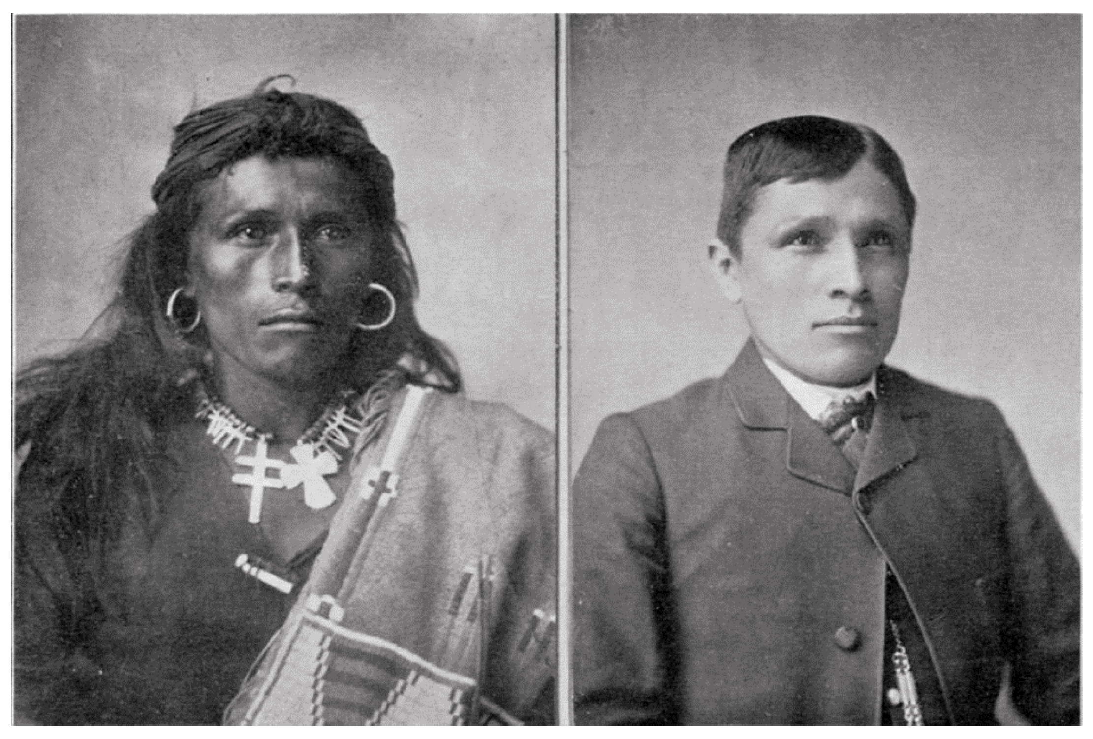
US.02 · DIRECT INSTRUCTION
2 of 3
Assimilation and Boarding Schools
Alongside removal, the government pursued a policy of assimilation—using schools and law to replace tribal cultures with Euro-American ones.
At off-reservation boarding schools such as the Carlisle Indian Industrial School (founded 1879), Captain Richard H. Pratt summarized the aim in 1892: “Kill the Indian in him, and save the man.” Children were removed from their families and often forbidden to speak their languages, wear their clothing, or practice their religions.
Historians today describe this systematic effort to erase Native identity as cultural genocide, and document its lasting, multi-generational harm.
John N. Choate, 1882 and 1885 Beinecke Rare Book and Manuscript Library
U.S. History Hack · TroopToTeacher Technologies LLC · Aligned to TN Academic Standards & TCAP EOC
24

Slide 25
US.02 · DIRECT INSTRUCTION
3 of 3
The Dawes Act and Its Impact
The Dawes Severalty Act of 1887 broke up communal tribal lands into individual allotments—160 acres to each head of a family—stating the goal of turning American Indians into independent farmers and U.S. citizens.
The actual effect was a massive transfer of land: American Indians held about 150 million acres before the Act, and lost roughly two-thirds of their land base—over 90 million acres—by 1934.
“Surplus” land was sold to white settlers, and additional allotted land was lost through taxation, fraud, and forced sales.
The Act dismantled the communal landholding central to many tribal cultures.
U.S. History Hack · TroopToTeacher Technologies LLC · Aligned to TN Academic Standards & TCAP EOC
25

Slide 26
US.02 · PRIMARY SOURCE ANALYSIS
Dawes General Allotment Act
Close Reading
U.S. Congress · February 8, 1887 (24 Stat. 388)
"In all cases where any tribe or band of Indians has been, or shall hereafter be, located upon any reservation created for their use... the President of the United States be authorized... to allot the lands in said reservation in severalty to any Indian located thereon in quantities as follows: To each head of a family, one-quarter of a section [160 acres]."
CONTEXT
Part of the federal assimilation era. The Dawes Act broke tribal landholdings into individual allotments and opened the remaining “surplus” to non-Native settlement. American Indians lost roughly two-thirds of their land—over 90 million acres—between 1887 and 1934.
ANALYZE
Based on the excerpt, what was the most likely long-term effect of dividing tribal land "in severalty" under the Dawes Act?
SOURCE IT
WHO made it?
WHEN?
WHY does it matter?
FIRST
U.S. Congress (the Dawes/General Allotment Act).
1887.
The law’s wording shows the stated goal; compare it to the documented result.
SSP.02 · before you interpret
Source: National Archives
U.S. History Hack · TroopToTeacher Technologies LLC · Aligned to TN Academic Standards & TCAP EOC
26
Notes:
Primary-source analysis. SOURCE IT FIRST (SSP.02) — model the sourcing routine aloud before students interpret: WHO made this source? (U.S. Congress (the Dawes/General Allotment Act).) WHEN? (1887.) WHY does that matter? (The law’s wording shows the stated goal; compare it to the documented result.) Only then move to the ANALYZE question. Suggested answer: DOK 2: The Act allotted land to individuals and declared the remainder "surplus" for sale, predictably dissolving collective tribal holdings and transferring tens of millions of acres out of Native hands. Practice skill: Close Reading.

Slide 27
US.02 · KEY VOCABULARY
Word Wall
Reservation System
Sistema de Reservaciones
Assimilation
Asimilación
say: uh-sim-ih-LAY-shun
Federal policy that confined Native American tribes to designated areas of land, often far from their ancestral territories, as part of efforts to control indigenous populations and open land for white settlement.
Federal policy aimed at forcing Native Americans to abandon their traditional cultures and adopt European-American ways of life, including language, religion, and customs.
Dawes Act
Ley Dawes
Allotment
Asignación de Parcelas
say: DAWZ
An 1887 law that divided tribal lands into individual allotments for Native American families, aiming to break up reservations and assimilate Native Americans into mainstream American culture. It caused the loss of about 90 million acres of tribal land.
The division of communal tribal land into small individual plots under the Dawes Act, which opened "surplus" land to white settlers and caused massive Native land loss.
Boarding School
Internado
Sovereignty
Soberanía
Off-reservation schools, such as Carlisle, where Native children were forced to abandon their languages, names, and cultures to be "assimilated" into white society.
The right of a tribe or nation to govern itself; federal Indian policy in this era steadily eroded tribal sovereignty.
"say:" pronunciation guide (stressed syllable in CAPS) and a per-term visual anchor support newcomer English learners. Spanish term + full bilingual Frayer models are in the unit vocabulary set.
U.S. History Hack · TroopToTeacher Technologies LLC · Aligned to TN Academic Standards & TCAP EOC
27

Slide 28
US.02 · GUIDED PRACTICE — WE DO IT TOGETHER
Let’s Work One Together
Stated goal vs. real consequence
MODEL PROMPT: Separate what the Dawes Act CLAIMED to do from what it actually DID.
WORKED EXAMPLE (teacher models this aloud)
STATED GOAL: "Civilize" and assimilate Native peoples by making them individual farmers. → REAL CONSEQUENCE: Communal land was split into allotments and ~90 million acres of tribal land was lost.
THINK ALOUD
Watch my move: I put the policy’s own words in one column and the documented outcome in the other. The gap between those two columns is the historical argument.
→ Now you try: You build the same two-column split for the boarding-school policy in the activity.
U.S. History Hack · TroopToTeacher Technologies LLC · Aligned to TN Academic Standards & TCAP EOC
28
Notes:
GUIDED PRACTICE / WE DO (US.02). Skill modeled: Stated goal vs. real consequence. Model the worked example aloud using the THINK ALOUD as your script, then release students to the activity ("You build the same two-column split for the boarding-school policy in the activity."). This is the I Do → We Do → You Do bridge — do not skip it; aim for 80%+ success before independent work.

Slide 29
US.02 · STUDENT ACTIVITY
Claim & Evidence: What Did the Policy Do?
Pairs → Whole class
12–15 min
YOUR TASK
Examine the Tom Torlino before/after photographs and the Dawes Act excerpt. In your own words, write what each policy CLAIMED to do and what it ACTUALLY did, citing one piece of evidence for each. Then take a position: was federal assimilation policy primarily about land, about culture, or both? Support your claim with evidence from today's sources.
DELIVERABLE
SUPPORT OPTIONS
A claim-evidence-reasoning (CER) paragraph with at least two cited sources.
SUPPORT OPTION: T-chart (Claimed | Actually) instead of paragraph. EXTENSION: evaluate the term “cultural genocide” — is it supported by the evidence? Why or why not?
Flight Log — write here: US.02 — write your response in your Flight Log; the Cornell Notes page for US.02 aligns to these Direct Instruction slides.
U.S. History Hack · TroopToTeacher Technologies LLC · Aligned to TN Academic Standards & TCAP EOC
29
Notes:
Student activity for US.02. Pair with the printable: Cornell Notes — US.02: Federal Policies Toward American Indians (Teacher Tools › Worksheets › Cornell Notes). Timing: 12–15 min. Deliverable: A claim-evidence-reasoning (CER) paragraph with at least two cited sources.

Slide 30
US.02 · CHECK FOR UNDERSTANDING
TCAP-Style Question
DOK 2
EOC PRACTICE
Based on the excerpt, what was the most likely long-term effect of dividing tribal land "in severalty" under the Dawes Act?
It strengthened tribal governments and expanded reservation territory.
A
It returned ancestral homelands to tribal control.
B
It had no measurable effect on Native landholding.
C
It broke up communal tribal ownership and led to large-scale Native land loss.
D
ANSWER FIRST: students commit — then click / advance to reveal the correct answer and explanation.
U.S. History Hack · TroopToTeacher Technologies LLC · Aligned to TN Academic Standards & TCAP EOC
30
Notes:
CHECK FOR UNDERSTANDING (US.02, DOK 2). Have students commit to an answer (whiteboards, hand signal, or turn-and-talk) BEFORE advancing. Correct answer: A. The next slide reveals it. Why: DOK 2: The Act allotted land to individuals and declared the remainder "surplus" for sale, predictably dissolving collective tribal holdings and transferring tens of millions of acres out of Native hands.

Slide 31
US.02 · ANSWER REVEAL
TCAP-Style Question
✓ ANSWER KEY
Based on the excerpt, what was the most likely long-term effect of dividing tribal land "in severalty" under the Dawes Act?
A
It strengthened tribal governments and expanded reservation territory.
B
It returned ancestral homelands to tribal control.
C
It had no measurable effect on Native landholding.
D
It broke up communal tribal ownership and led to large-scale Native land loss.
✓
Correct answer: D. Why: DOK 2: The Act allotted land to individuals and declared the remainder "surplus" for sale, predictably dissolving collective tribal holdings and transferring tens of millions of acres out of Native hands.
U.S. History Hack · TroopToTeacher Technologies LLC · Aligned to TN Academic Standards & TCAP EOC
31
Notes:
ANSWER KEY (US.02). Correct: A. DOK 2: The Act allotted land to individuals and declared the remainder "surplus" for sale, predictably dissolving collective tribal holdings and transferring tens of millions of acres out of Native hands.

Slide 32
US.02 · WRAP-UP
What You Need to Know for TCAP
KEY TAKEAWAYS
EXIT TICKET
DOK 3
Movement to Reservations
Assimilation and Boarding Schools
The Dawes Act and Its Impact
A policy can claim one goal but cause another. Using the Dawes Act, give the stated goal and one real consequence.
★ EXTENSION DOK 3 · SSP.04 Argumentation
Evaluate: did assimilation policy and the Dawes Act share the same underlying assumption about Native cultures? Support with evidence from both.
TEACHER DECISION BAND PROGRESS CHECK → identify barrier → select support → reteach → recheck → extend
SCAFFOLD FADING Guided → Light → independent as evidence grows; required IEP/504 supports do not fade unless the authorized team changes them.
U.S. History Hack · TroopToTeacher Technologies LLC · Aligned to TN Academic Standards & TCAP EOC
32
Notes:
WRAP-UP / EXIT-TICKET KEY (US.02, DOK 3). Prompt: A policy can claim one goal but cause another. Using the Dawes Act, give the stated goal and one real consequence. Model answer: Stated: “assimilate”/“civilize” Native peoples; consequence: communal land broken into allotments → massive Native land loss. RETEACH TRIGGER — if a student misses this exit ticket: (1) <50% of class miss → spiral it into the next standard’s Quick Review opener (see the US.02 review prompts). (2) Individual/small group → reteach with the "Movement to Reservations" direct-instruction slide + re-run the SOURCE IT FIRST routine on the US.02 primary source, then assign the paired printable: Cornell Notes — US.02: Federal Policies Toward American Indians (Teacher Tools › Worksheets › Cornell Notes). (3) Re-assess with the US.02 check-for-understanding reveal slide as a do-now the next day. Reteach anchors (this standard’s sections): Movement to Reservations; Assimilation and Boarding Schools; The Dawes Act and Its Impact. I Can objective: I can examine federal policies toward American Indians, including the movement to reservations, assimilation, boarding schools, and the Dawes Act. EXTENSION (DOK 3, for early finishers or advanced learners): Evaluate: did assimilation policy and the Dawes Act share the same underlying assumption about Native cultures? Support with evidence from both. — look for a clear claim plus two specific pieces of evidence.

Slide 33
STANDARD
SOCIAL STUDIES PRACTICES
US.03
SSP.01
Collect sources
SSP.02
Examine a source
SSP.03
Synthesize sources
SSP.04
Build an argument
Compromise of 1877, Jim Crow & Plessy v. Ferguson
SSP.05
Historical awareness
FOLLOW ALONG
Open the Mission Book → Stop 3
Open the Flight Log → Entry 3
TN ACADEMIC STANDARD
Explain the impact of the Compromise of 1877, including Jim Crow laws, lynching, disenfranchisement methods, the efforts of Benjamin "Pap" Singleton and the Exodusters, and the Plessy v. Ferguson decision. (TCA)
I CAN
I can explain the impact of the Compromise of 1877, including Jim Crow laws, lynching, disenfranchisement methods, the efforts of Benjamin "Pap" Singleton and the Exodusters, and the Plessy v. Ferguson decision.
U.S. History Hack · TroopToTeacher Technologies LLC · Aligned to TN Academic Standards & TCAP EOC
33

Slide 34
US.03 · QUICK REVIEW
Do You Remember?
Before we start, retrieve what we have already learned. Answer from memory first — no notes.
1
US.02 What was the main effect of the Dawes Act on tribal land?
2
US.01 What does “reservation” mean?
U.S. History Hack · TroopToTeacher Technologies LLC · Aligned to TN Academic Standards & TCAP EOC
34
Notes:
SPACED RETRIEVAL (US.03). Cold-call or whiteboards, 3-4 min, low stakes. Answers — 1) It broke up communal land into allotments, causing massive Native land loss. 2) Land set aside by the federal government for American Indian tribes.

Slide 35
US.03 · CONFIDENCE CHECK
Warm-Up — Quick Recall
DOK 1
LOW STAKES
Everyone can answer this. Thumbs / whiteboards — no notes.
Finish the phrase: the 1896 Supreme Court rule was "separate but _____" (one word).
✓ ANSWER
"equal" — Plessy v. Ferguson legalized segregation.
COMMIT FIRST: have everyone answer before the reveal — this is the DOK 1 floor; the graded check later in this lesson moves up to DOK 2–3.
U.S. History Hack · TroopToTeacher Technologies LLC · Aligned to TN Academic Standards & TCAP EOC
35
Notes:
CONFIDENCE CHECK (US.03, DOK 1). 60-90 seconds. Have EVERY student commit (thumbs / whiteboard / choral) before revealing — this secures an early win and surfaces who is shaky before new content. Answer: "equal" — Plessy v. Ferguson legalized segregation. Key term to listen for: segregation. This is the low-floor entry; the graded Check for Understanding later in the standard rises to DOK 2–3.

Slide 36
US.03 · HOOK
Think About It
In 1877, the last federal troops left the South. Within 20 years, segregation was the law of the land.
DISCUSS
TIMING: Turn & Talk 60 sec → cold-call 2 pairs
How can rights that were written into the Constitution be taken away in practice? Predict: what tools might a government use to deny rights without changing the Constitution?
U.S. History Hack · TroopToTeacher Technologies LLC · Aligned to TN Academic Standards & TCAP EOC
36
Notes:
HOOK (US.03). Run tight: pose the provocation, give a silent 10-second think, then Turn & Talk 60 seconds. Cold-call 2–3 pairs (not volunteers) for a sentence-starter answer — "One force was ___ because ___" — then bridge to the standard. Keep total to ~4 minutes; do not let it sprawl. Return to this question at the unit close for an evidence-based answer.

Slide 37
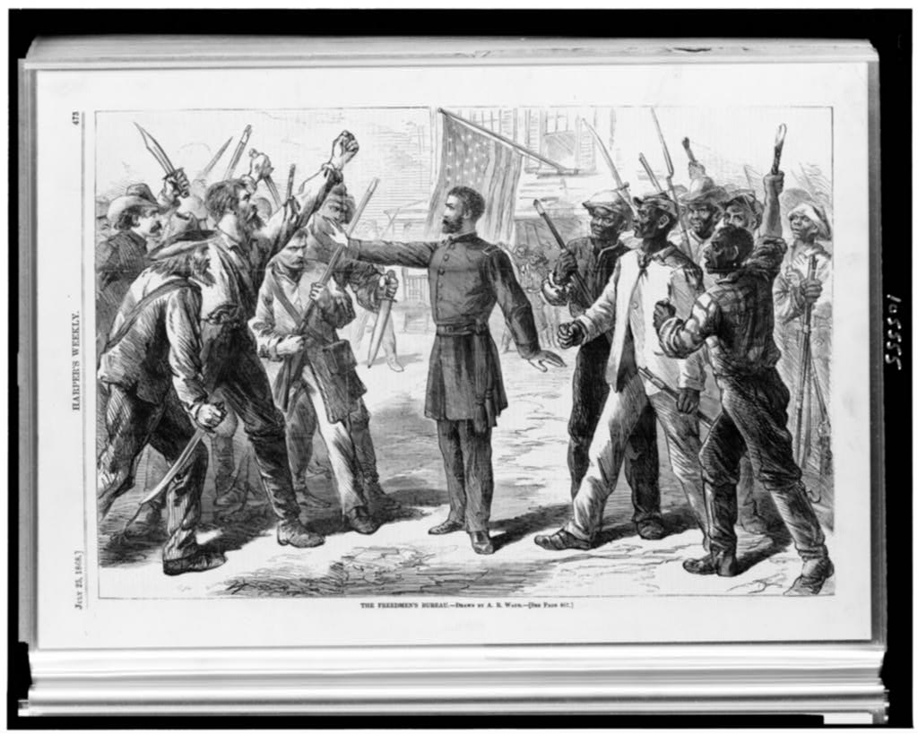
US.03 · DIRECT INSTRUCTION
1 of 4
The Election of 1876 and End of Reconstruction
The disputed 1876 presidential election between Republican Rutherford B. Hayes and Democrat Samuel Tilden led to the Compromise of 1877.
In exchange for the presidency, Hayes agreed to withdraw federal troops from the South, effectively ending Reconstruction.
This abandonment left African Americans without federal protection against increasingly hostile state governments.
SENTENCE FRAME · LANGUAGE SUPPORT
Alfred R. Waud, 1868 Library of Congress
After Reconstruction ended, Black Americans lost rights because ________ was used to ________.
TEACHER CUE Chunk → cold-call → confirm before advancing.
FLIGHT LOG · Cornell Notes — US.03: jot notes here as we go.
U.S. History Hack · TroopToTeacher Technologies LLC · Aligned to TN Academic Standards & TCAP EOC
37
Notes:
FACILITATION (US.03). Think-aloud: "A right I can’t use isn’t really a right." Cold-call for the NAME of a specific denial tool — push past "racism" to poll tax, literacy test, Plessy. Teach in small steps; pause and check for understanding before the next chunk (aim 80%+ before moving on).

Slide 38
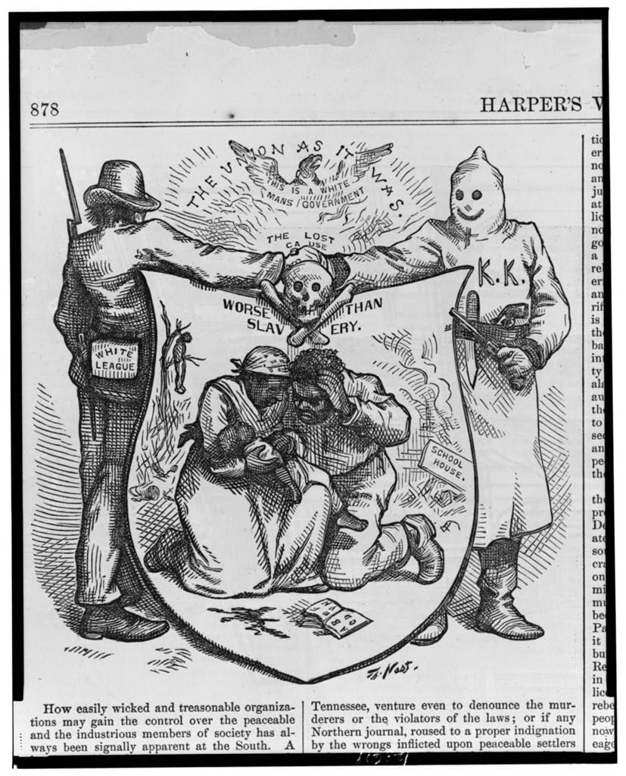
US.03 · DIRECT INSTRUCTION
2 of 4
Jim Crow Laws, Lynching, and Disenfranchisement
With federal protection gone, Southern states implemented Jim Crow laws enforcing racial segregation in all aspects of life.
African Americans faced systematic disenfranchisement through poll taxes, literacy tests, grandfather clauses, and white primaries.
Those who resisted faced terrorism, including lynching—public murders that went unpunished and were often celebrated by white communities.
Thomas Nast, 1874 Library of Congress
U.S. History Hack · TroopToTeacher Technologies LLC · Aligned to TN Academic Standards & TCAP EOC
38

Slide 39
US.03 · DIRECT INSTRUCTION
3 of 4
Pap Singleton and the Exodusters
Benjamin "Pap" Singleton, a formerly enslaved man, organized the migration of thousands of African Americans from the South to Kansas in 1879.
These "Exodusters" sought to escape violence and oppression, establishing communities like Nicodemus, Kansas.
While conditions in Kansas were often harsh, the Exoduster movement represented African American agency and resistance to Jim Crow terror.
U.S. History Hack · TroopToTeacher Technologies LLC · Aligned to TN Academic Standards & TCAP EOC
39

Slide 40
US.03 · DIRECT INSTRUCTION
4 of 4
Plessy v. Ferguson and "Separate But Equal"
The 1896 Supreme Court decision in Plessy v. Ferguson established the "separate but equal" doctrine, ruling that racial segregation was constitutional as long as facilities were supposedly equal.
In practice, facilities for African Americans were grossly inferior.
This decision legitimized Jim Crow segregation for nearly sixty years until Brown v. Board of Education (1954).
U.S. History Hack · TroopToTeacher Technologies LLC · Aligned to TN Academic Standards & TCAP EOC
40

Slide 41
US.03 · PEOPLE WHO SHAPED THE ERA
Key Figures
Ida B. Wells
Booker T. Washington
Investigative Journalist · Newspaper Editor
Educator · Author
Led the first anti-lynching campaign in American history
Co-founded the NAACP
Documented over 700 lynchings in "Southern Horrors"
Founded and led Tuskegee Institute
Became the most influential African American leader of his era
Delivered the "Atlanta Compromise" speech
STRATEGY Investigative journalism
STRATEGY Gradual self-help
U.S. History Hack · TroopToTeacher Technologies LLC · Aligned to TN Academic Standards & TCAP EOC
41

Slide 42
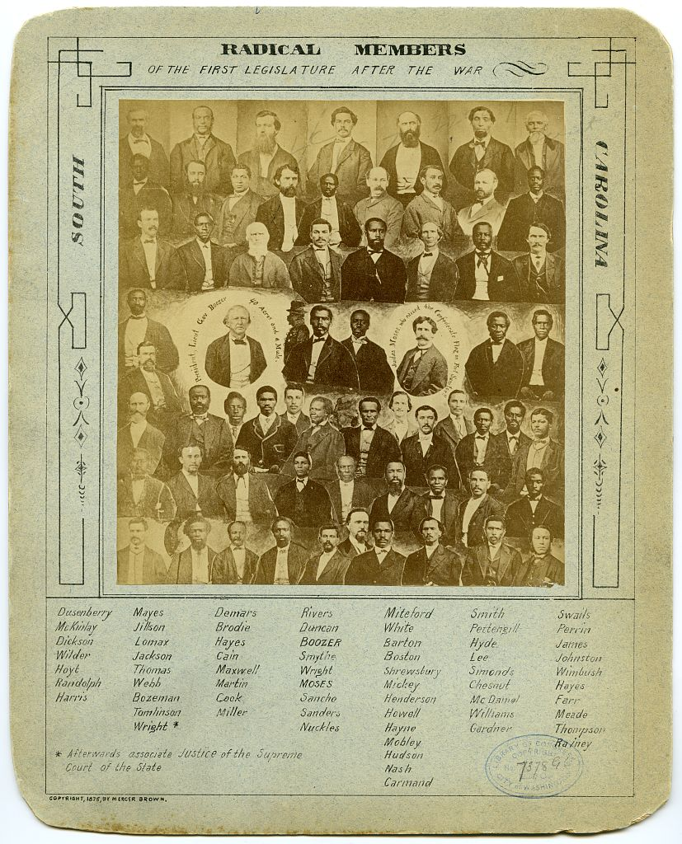
US.03 · PRIMARY SOURCE ANALYSIS
Plessy v. Ferguson Decision
Argumentation
Supreme Court of the United States · May 18, 1896 (163 U.S. 537)
ZOOM IN Find ONE detail that surprises you — be ready to name it.
"Laws permitting, and even requiring, their separation in places where they are liable to be brought into contact do not necessarily imply the inferiority of either race to the other... We consider the underlying fallacy of the plaintiff's argument to consist in the assumption that the enforced separation of the two races stamps the colored race with a badge of inferiority."
CONTEXT
After the Compromise of 1877 ended Reconstruction, Southern states systematically dismantled the civil and political rights that African Americans had gained after the Civil War. By the 1890s, a system of racial segregation laws — known as Jim Crow — had spread across the South, enforced by violence, poll taxes, literacy tests, and legal barriers. The 1896 Supreme Court case Plessy v. Ferguson arose when Homer Plessy, a man of mixed race, deliberately challenged a Louisiana law requiring separate railroad cars. The Court's 7-1 ruling created the 'separate but equal' doctrine, providing legal cover for segregation for the next 58 years until Brown v. Board of Education (1954).
ANALYZE
The Plessy majority reasoned that "separate" facilities did not make one race inferior. Which later argument most directly challenges that reasoning?
Shorey (photographer), 1876 Library of Congress
SOURCE IT
WHO made it?
WHEN?
WHY does it matter?
FIRST
The U.S. Supreme Court — majority opinion by Justice Henry Billings Brown.
May 18, 1896 (Plessy v. Ferguson, 163 U.S. 537).
The nation's highest court is stating the law of the land — its reasoning shaped segregation for 58 years, until Brown v. Board…
SSP.02 · before you interpret
Source: Library of Congress
U.S. History Hack · TroopToTeacher Technologies LLC · Aligned to TN Academic Standards & TCAP EOC
42
Notes:
Primary-source analysis. SOURCE IT FIRST (SSP.02) — model the sourcing routine aloud before students interpret: WHO made this source? (The U.S. Supreme Court — majority opinion by Justice Henry Billings Brown.) WHEN? (May 18, 1896 (Plessy v. Ferguson, 163 U.S. 537).) WHY does that matter? (The nation's highest court is stating the law of the land — its reasoning shaped segregation for 58 years, until Brown v. Board (1954).) Only then move to the ANALYZE question. Suggested answer: DOK 3: This requires evaluating the Court’s logic. Justice Harlan’s dissent — and later Brown v. Board (1954) — argued that government-mandated separation is inherently unequal because the law itself brands a group as inferior, directly rejecting the "separate but equal" reasoning. Practice skill: Argumentation.

Slide 43
US.03 · KEY VOCABULARY
Word Wall
Compromise of 1877
Compromiso de 1877
Jim Crow Laws
Leyes de Jim Crow
An informal agreement that resolved the disputed 1876 presidential election, resulting in Rutherford B. Hayes becoming president in exchange for removing federal troops from the South, effectively ending Reconstruction.
State and local laws enacted primarily in the Southern states between 1877 and the 1960s that enforced racial segregation and denied African Americans their constitutional rights.
Disenfranchisement
Privación del Derecho al Voto
Plessy v. Ferguson
Plessy contra Ferguson
say: dis-en-FRAN-chyz-ment
The systematic denial of voting rights through methods such as poll taxes, literacy tests, grandfather clauses, and violence, primarily targeting African American voters.
An 1896 Supreme Court decision that upheld racial segregation under the doctrine of "separate but equal," legitimizing Jim Crow laws for nearly 60 years.
Exodusters
Exodusters (colonos negros)
African Americans who migrated from the South to Kansas and other western states in the late 1870s, seeking to escape racial violence and economic oppression. Led by figures like Benjamin "Pap" Singleton.
"say:" pronunciation guide (stressed syllable in CAPS) and a per-term visual anchor support newcomer English learners. Spanish term + full bilingual Frayer models are in the unit vocabulary set.
U.S. History Hack · TroopToTeacher Technologies LLC · Aligned to TN Academic Standards & TCAP EOC
43

Slide 44
US.03 · GUIDED PRACTICE — WE DO IT TOGETHER
Let’s Work One Together
Rights on paper vs. in practice
MODEL PROMPT: Show how a right in the Constitution could be denied in practice after 1877.
WORKED EXAMPLE (teacher models this aloud)
ON PAPER: The 15th Amendment guaranteed Black men the vote. → IN PRACTICE: Poll taxes and literacy tests blocked them, and Plessy v. Ferguson (1896) legalized segregation.
THINK ALOUD
Notice I name the specific tool (poll tax) and the specific court case (Plessy) — vague answers like "racism" do not earn the point. I anchor every claim to a named mechanism.
→ Now you try: You match two more denial-tools to the right each one defeated in the activity.
U.S. History Hack · TroopToTeacher Technologies LLC · Aligned to TN Academic Standards & TCAP EOC
44
Notes:
GUIDED PRACTICE / WE DO (US.03). Skill modeled: Rights on paper vs. in practice. Model the worked example aloud using the THINK ALOUD as your script, then release students to the activity ("You match two more denial-tools to the right each one defeated in the activity."). This is the I Do → We Do → You Do bridge — do not skip it; aim for 80%+ success before independent work.

Slide 45
US.03 · STUDENT ACTIVITY
Reading a Political Cartoon as Evidence
Pairs
10–12 min
YOUR TASK
Analyze Thomas Nast's “Worse Than Slavery” cartoon and the Freedmen's Bureau image. Identify (1) the artist's point of view, (2) two symbols and their meaning, and (3) what the cartoon argues about why Reconstruction's protections collapsed.
Shorey (photographer), 1876 Library of Congress
DELIVERABLE
SUPPORT OPTIONS
Annotated cartoon analysis with point-of-view statement.
SUPPORT OPTION: guided symbol list. EXTENSION: compare Nast's view to the photo of the SC legislature — do the sources corroborate?
Flight Log — write here: US.03 — write your response in your Flight Log; the Cornell Notes page for US.03 aligns to these Direct Instruction slides.
U.S. History Hack · TroopToTeacher Technologies LLC · Aligned to TN Academic Standards & TCAP EOC
45
Notes:
Student activity for US.03. Pair with the printable: Cornell Notes — US.03: Reconstruction (Amendments, Freedmen's Bureau, End of Reconstruction). Timing: 10–12 min. Deliverable: Annotated cartoon analysis with point-of-view statement.

Slide 46
US.03 · CHECK FOR UNDERSTANDING
TCAP-Style Question
DOK 3
EOC PRACTICE
The Plessy majority reasoned that "separate" facilities did not make one race inferior. Which later argument most directly challenges that reasoning?
That segregation was acceptable as long as both facilities were physically identical.
A
That the Constitution explicitly required racial separation.
B
That state-enforced separation itself signals and enforces inequality, regardless of facility quality.
C
That African Americans had freely chosen separate facilities.
D
ANSWER FIRST: students commit — then click / advance to reveal the correct answer and explanation.
U.S. History Hack · TroopToTeacher Technologies LLC · Aligned to TN Academic Standards & TCAP EOC
46
Notes:
CHECK FOR UNDERSTANDING (US.03, DOK 3). Have students commit to an answer (whiteboards, hand signal, or turn-and-talk) BEFORE advancing. Correct answer: A. The next slide reveals it. Why: DOK 3: This requires evaluating the Court’s logic. Justice Harlan’s dissent — and later Brown v. Board (1954) — argued that government-mandated separation is inherently unequal because the law itself brands a group as inferior, directly rejecting the "separate but equal" reasoning.

Slide 47
US.03 · ANSWER REVEAL
TCAP-Style Question
✓ ANSWER KEY
The Plessy majority reasoned that "separate" facilities did not make one race inferior. Which later argument most directly challenges that reasoning?
A
That segregation was acceptable as long as both facilities were physically identical.
B
That the Constitution explicitly required racial separation.
C
That state-enforced separation itself signals and enforces inequality, regardless of facility quality.
✓
D
That African Americans had freely chosen separate facilities.
Correct answer: C. Why: DOK 3: This requires evaluating the Court’s logic. Justice Harlan’s dissent — and later Brown v. Board (1954) — argued that government-mandated separation is inherently unequal because the law itself brands a group as inferior, directly rejecting the "separate but equal" reasoning.
U.S. History Hack · TroopToTeacher Technologies LLC · Aligned to TN Academic Standards & TCAP EOC
47
Notes:
ANSWER KEY (US.03). Correct: A. DOK 3: This requires evaluating the Court’s logic. Justice Harlan’s dissent — and later Brown v. Board (1954) — argued that government-mandated separation is inherently unequal because the law itself brands a group as inferior, directly rejecting the "separate but equal" reasoning.

Slide 48
US.03 · WRAP-UP
What You Need to Know for TCAP
KEY TAKEAWAYS
EXIT TICKET
DOK 3
The Election of 1876 and End of Reconstruction
Jim Crow Laws, Lynching, and Disenfranchisement
Pap Singleton and the Exodusters
Plessy v. Ferguson and "Separate But Equal"
Rights can exist on paper but be denied in practice. Name one tool used to deny Black Americans rights after 1877 and explain how it worked.
★ EXTENSION DOK 3 · SSP.04 Argumentation
Construct an argument: which did MORE to undo Reconstruction — legal tools (Plessy, Jim Crow laws) or extralegal force (violence, intimidation)? Cite evidence.
TEACHER DECISION BAND PROGRESS CHECK → identify barrier → select support → reteach → recheck → extend
SCAFFOLD FADING Guided → Light → independent as evidence grows; required IEP/504 supports do not fade unless the authorized team changes them.
U.S. History Hack · TroopToTeacher Technologies LLC · Aligned to TN Academic Standards & TCAP EOC
48
Notes:
WRAP-UP / EXIT-TICKET KEY (US.03, DOK 3). Prompt: Rights can exist on paper but be denied in practice. Name one tool used to deny Black Americans rights after 1877 and explain how it worked. Model answer: E.g., poll taxes/literacy tests disenfranchised voters; Jim Crow laws + Plessy legalized segregation despite the 14th/15th Amendments. RETEACH TRIGGER — if a student misses this exit ticket: (1) <50% of class miss → spiral it into the next standard’s Quick Review opener (see the US.03 review prompts). (2) Individual/small group → reteach with the "The Election of 1876 and End of Reconstruction" direct-instruction slide + re-run the SOURCE IT FIRST routine on the US.03 primary source, then assign the paired printable: Cornell Notes — US.03: Reconstruction (Amendments, Freedmen's Bureau, End of Reconstruction). (3) Re-assess with the US.03 check-for-understanding reveal slide as a do-now the next day. Reteach anchors (this standard’s sections): The Election of 1876 and End of Reconstruction; Jim Crow Laws, Lynching, and Disenfranchisement; Pap Singleton and the Exodusters; Plessy v. Ferguson and "Separate But Equal". I Can objective: I can explain the impact of the Compromise of 1877, including Jim Crow laws, lynching, disenfranchisement methods, the efforts of Benjamin "Pap" Singleton and the Exodusters, and the Plessy v. Ferguson decision. EXTENSION (DOK 3, for early finishers or advanced learners): Construct an argument: which did MORE to undo Reconstruction — legal tools (Plessy, Jim Crow laws) or extralegal force (violence, intimidation)? Cite evidence. — look for a clear claim plus two specific pieces of evidence.

Slide 49
STANDARD
SOCIAL STUDIES PRACTICES
US.04
SSP.01
Collect sources
SSP.02
Examine a source
SSP.03
Synthesize sources
SSP.04
Build an argument
Gilded Age Politics and Economics
SSP.05
Historical awareness
FOLLOW ALONG
Open the Mission Book → Stop 4
Open the Flight Log → Entry 4
TN ACADEMIC STANDARD
Analyze the causes and consequences of Gilded Age politics and economics as well as the significance of the rise of political machines, major scandals, civil service reform, and the economic difference between farmers, wage earners, and industrial capitalists, including: Boss Tweed, Thomas Nast, Credit Mobilier, Spoils system and President James A. Garfield's assassination, Pendleton Act, Interstate Commerce Act.
I CAN
I can analyze the causes and consequences of Gilded Age politics and economics, including political machines, major scandals, civil service reform, and economic differences between farmers, wage earners, and industrial capitalists.
U.S. History Hack · TroopToTeacher Technologies LLC · Aligned to TN Academic Standards & TCAP EOC
49

Slide 50
US.04 · QUICK REVIEW
Do You Remember?
Before we start, retrieve what we have already learned. Answer from memory first — no notes.
1
US.03 What ended Reconstruction, and what replaced Black voting rights in the South?
2
US.03 What did the Supreme Court decide in Plessy v. Ferguson?
U.S. History Hack · TroopToTeacher Technologies LLC · Aligned to TN Academic Standards & TCAP EOC
50
Notes:
SPACED RETRIEVAL (US.04). Cold-call or whiteboards, 3-4 min, low stakes. Answers — 1) The Compromise of 1877; Jim Crow laws and disenfranchisement replaced those rights. 2) It upheld “separate but equal,” legalizing segregation.

Slide 51
US.04 · CONFIDENCE CHECK
Warm-Up — Quick Recall
DOK 1
LOW STAKES
Everyone can answer this. Thumbs / whiteboards — no notes.
What do we call a party organization that traded jobs and favors for votes?
✓ ANSWER
A political machine (e.g., Tammany Hall under Boss Tweed).
COMMIT FIRST: have everyone answer before the reveal — this is the DOK 1 floor; the graded check later in this lesson moves up to DOK 2–3.
U.S. History Hack · TroopToTeacher Technologies LLC · Aligned to TN Academic Standards & TCAP EOC
51
Notes:
CONFIDENCE CHECK (US.04, DOK 1). 60-90 seconds. Have EVERY student commit (thumbs / whiteboard / choral) before revealing — this secures an early win and surfaces who is shaky before new content. Answer: A political machine (e.g., Tammany Hall under Boss Tweed). Key term to listen for: political machine. This is the low-floor entry; the graded Check for Understanding later in the standard rises to DOK 2–3.

Slide 52
US.04 · HOOK
Think About It
One New York political boss stole an estimated $200 million — and almost no one stopped him.
DISCUSS
TIMING: Turn & Talk 60 sec → cold-call 2 pairs
Why might city residents support a corrupt political machine? What might they get in return? List two possibilities.
U.S. History Hack · TroopToTeacher Technologies LLC · Aligned to TN Academic Standards & TCAP EOC
52
Notes:
HOOK (US.04). Run tight: pose the provocation, give a silent 10-second think, then Turn & Talk 60 seconds. Cold-call 2–3 pairs (not volunteers) for a sentence-starter answer — "One force was ___ because ___" — then bridge to the standard. Keep total to ~4 minutes; do not let it sprawl. Return to this question at the unit close for an evidence-based answer.

Slide 53
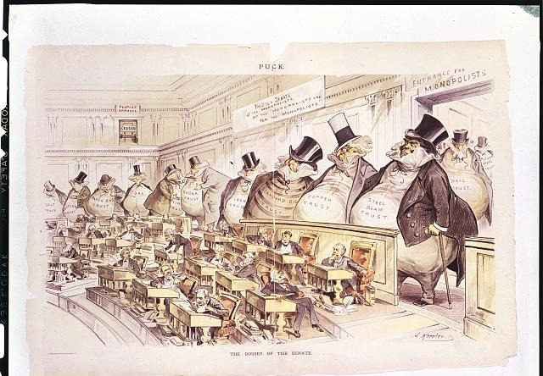
US.04 · DIRECT INSTRUCTION
1 of 4
Political Machines and Boss Tweed
The Gilded Age (1870s-1900) saw the rise of powerful political machines that controlled city governments through patronage and corruption.
Boss Tweed's Tammany Hall in New York City epitomized this system, funneling millions in public funds to Tweed and his associates.
Political cartoonist Thomas Nast exposed Tweed's corruption through devastating illustrations in Harper's Weekly.
SENTENCE FRAME · LANGUAGE SUPPORT
Joseph Keppler, 1889 Library of Congress
A political machine stayed in power by ________, which helped ________ but harmed ________.
TEACHER CUE Chunk → cold-call → confirm before advancing.
FLIGHT LOG · Cornell Notes — US.04: jot notes here as we go.
U.S. History Hack · TroopToTeacher Technologies LLC · Aligned to TN Academic Standards & TCAP EOC
53
Notes:
FACILITATION (US.04). Hold the tension out loud: "Both can be true." Have students give a thumbs-up/down on whether they’d take the machine’s help, then defend it to a neighbor. Teach in small steps; pause and check for understanding before the next chunk (aim 80%+ before moving on).

Slide 54
US.04 · DIRECT INSTRUCTION
2 of 4
Major Scandals and the Spoils System
The era was marked by corruption at all levels.
The Crédit Mobilier scandal revealed that railroad executives and congressmen had profited enormously from fraudulent construction contracts.
The spoils system—giving government jobs to political supporters regardless of qualification—reached its peak.
President James Garfield's assassination by a disappointed office-seeker in 1881 finally prompted reform.
U.S. History Hack · TroopToTeacher Technologies LLC · Aligned to TN Academic Standards & TCAP EOC
54

Slide 55
US.04 · DIRECT INSTRUCTION
3 of 4
Civil Service Reform
Garfield's assassination led to the Pendleton Civil Service Act of 1883, which established merit-based hiring for federal positions through competitive examinations.
This began the long process of professionalizing government service, though political influence remained significant in many positions.
U.S. History Hack · TroopToTeacher Technologies LLC · Aligned to TN Academic Standards & TCAP EOC
55

Slide 56
US.04 · DIRECT INSTRUCTION
4 of 4
Economic Disparity
The Gilded Age saw extreme wealth concentration among industrial capitalists while farmers struggled with falling crop prices, high railroad shipping rates, and debt.
Wage earners faced dangerous working conditions, long hours, and low pay.
The Interstate Commerce Act of 1887 attempted to regulate railroad rates, representing early federal intervention in the economy.
U.S. History Hack · TroopToTeacher Technologies LLC · Aligned to TN Academic Standards & TCAP EOC
56

Slide 57
US.04 · PRIMARY SOURCE ANALYSIS
Pendleton Civil Service Reform Act
Contextualization
U.S. Congress · January 16, 1883
"No person in the public service is for that reason under any obligations to contribute to any political fund, or to render any political service, and he will not be removed or otherwise prejudiced for refusing to do so... No person in said service has any right to use his official authority or influence to coerce the political action of any person or body."
CONTEXT
During the Gilded Age, the 'spoils system' — where elected officials rewarded political supporters with government jobs regardless of qualifications — had corrupted American government at every level. Political machines like Tammany Hall in New York City handed out thousands of jobs to loyal party members, and government workers were expected to donate a portion of their salaries to political campaigns. The assassination of President James Garfield in 1881 by a disappointed office-seeker shocked the nation and created overwhelming pressure for reform. The Pendleton Civil Service Reform Act of 1883 created a merit-based civil service system, requiring competitive exams for federal jobs and prohibiting political coercion of government workers.
ANALYZE
What problem was the Pendleton Act designed to address?
SOURCE IT
WHO made it?
WHEN?
WHY does it matter?
FIRST
U.S. Congress (the Pendleton Civil Service Act).
1883.
A reform law tells you what problem lawmakers were trying to fix.
SSP.02 · before you interpret
Source: National Archives
U.S. History Hack · TroopToTeacher Technologies LLC · Aligned to TN Academic Standards & TCAP EOC
57
Notes:
Primary-source analysis. SOURCE IT FIRST (SSP.02) — model the sourcing routine aloud before students interpret: WHO made this source? (U.S. Congress (the Pendleton Civil Service Act).) WHEN? (1883.) WHY does that matter? (A reform law tells you what problem lawmakers were trying to fix.) Only then move to the ANALYZE question. Suggested answer: The Act prohibited requiring political contributions from government workers and banned using "official authority or influence to coerce the political action of any person." Practice skill: Contextualization.

Slide 58
US.04 · KEY VOCABULARY
Word Wall
Gilded Age
Edad Dorada
Political Machines
Máquinas Políticas
The period from roughly 1870 to 1900 characterized by rapid economic growth, industrialization, and extreme wealth inequality. Named by Mark Twain to suggest that a thin layer of prosperity covered deep social problems and inequality.
Corrupt organizations that controlled city politics through patronage, bribery, and vote manipulation, often providing services to immigrants in exchange for political support.
Spoils System
Sistema de Botín
Boss Tweed
Jefe Tweed
The practice of rewarding political supporters with government jobs regardless of qualifications, based on the principle "to the victor belong the spoils."
William M. Tweed, leader of New York City's Tammany Hall political machine, who controlled city politics and stole millions through kickbacks and corruption in the 1860s-1870s.
Thomas Nast
Thomas Nast
Pendleton Act
Ley Pendleton
A political cartoonist whose illustrations exposed Boss Tweed's corruption and helped bring down the Tammany Hall machine, demonstrating the power of the press.
An 1883 federal law that established the Civil Service Commission and required government jobs to be awarded based on merit through competitive examinations rather than political connections.
"say:" pronunciation guide (stressed syllable in CAPS) and a per-term visual anchor support newcomer English learners. Spanish term + full bilingual Frayer models are in the unit vocabulary set.
U.S. History Hack · TroopToTeacher Technologies LLC · Aligned to TN Academic Standards & TCAP EOC
58

Slide 59
US.04 · GUIDED PRACTICE — WE DO IT TOGETHER
Let’s Work One Together
Reason + cost analysis
MODEL PROMPT: Explain why a poor immigrant might SUPPORT a corrupt political machine.
WORKED EXAMPLE (teacher models this aloud)
REASON: Tweed’s machine gave new arrivals jobs, coal, and food when no one else would. → COST: That help was paid for with graft, rigged contracts, and higher taxes — an estimated $200 million stolen.
THINK ALOUD
Watch how I hold two true things at once: the machine genuinely helped people AND it robbed the city. A strong answer refuses to flatten that into "machines were just bad."
→ Now you try: You weigh one more machine benefit against its cost in the activity.
U.S. History Hack · TroopToTeacher Technologies LLC · Aligned to TN Academic Standards & TCAP EOC
59
Notes:
GUIDED PRACTICE / WE DO (US.04). Skill modeled: Reason + cost analysis. Model the worked example aloud using the THINK ALOUD as your script, then release students to the activity ("You weigh one more machine benefit against its cost in the activity."). This is the I Do → We Do → You Do bridge — do not skip it; aim for 80%+ success before independent work.

Slide 60
US.04 · STUDENT ACTIVITY
Machine Politics: Trade-Off Analysis
Small groups
10 min
YOUR TASK
Using “The Bosses of the Senate” cartoon, list what a city political machine GAVE residents and what it TOOK. Then decide: why would voters keep electing a corrupt machine? Reach a group consensus and be ready to defend it.
Joseph Keppler, 1889 Library of Congress
DELIVERABLE
SUPPORT OPTIONS
Give/Take T-chart plus a one-sentence group claim.
SUPPORT OPTION: provide 3 give/take examples to sort. EXTENSION: connect to a modern trade-off between services and accountability.
Flight Log — write here: US.04 — write your response in your Flight Log; the Cornell Notes page for US.04 aligns to these Direct Instruction slides.
U.S. History Hack · TroopToTeacher Technologies LLC · Aligned to TN Academic Standards & TCAP EOC
60
Notes:
Student activity for US.04. Pair with the printable: Cornell Notes — US.04: Gilded Age Politics (Machines, Scandals & Civil Service Reform). Timing: 10 min. Deliverable: Give/Take T-chart plus a one-sentence group claim.

Slide 61
US.04 · CHECK FOR UNDERSTANDING
TCAP-Style Question
DOK 2
EOC PRACTICE
How does Bryce's description of the political 'Boss' help explain why the Pendleton Civil Service Reform Act was needed?
Both reveal a spoils system in which offices and contracts were handed out for political loyalty, which reformers tried to end.
A
Both praise the political machines as honest and efficient.
B
Both argue that government jobs should be sold to the highest bidder.
C
Both were written after the spoils system ended.
D
ANSWER FIRST: students commit — then click / advance to reveal the correct answer and explanation.
U.S. History Hack · TroopToTeacher Technologies LLC · Aligned to TN Academic Standards & TCAP EOC
61
Notes:
CHECK FOR UNDERSTANDING (US.04, DOK 2). Have students commit to an answer (whiteboards, hand signal, or turn-and-talk) BEFORE advancing. Correct answer: C. The next slide reveals it. Why: Bryce's analysis describes the 'spoils system'—bosses using public offices, contracts, and money to reward loyalty. The Pendleton Act attacked exactly this by requiring competitive exams for federal jobs. The outside observer's description and the reform law corroborate each other: machine corruption was the problem the Pendleton Act was designed to fix.

Slide 62
US.04 · ANSWER REVEAL
TCAP-Style Question
✓ ANSWER KEY
How does Bryce's description of the political 'Boss' help explain why the Pendleton Civil Service Reform Act was needed?
A
Both reveal a spoils system in which offices and contracts were handed out for political loyalty, which reformers tried to end.
✓
B
Both praise the political machines as honest and efficient.
C
Both argue that government jobs should be sold to the highest bidder.
D
Both were written after the spoils system ended.
Correct answer: A. Why: Bryce's analysis describes the 'spoils system'—bosses using public offices, contracts, and money to reward loyalty. The Pendleton Act attacked exactly this by requiring competitive exams for federal jobs. The outside observer's description and the reform law corroborate each other: machine…
U.S. History Hack · TroopToTeacher Technologies LLC · Aligned to TN Academic Standards & TCAP EOC
62
Notes:
ANSWER KEY (US.04). Correct: C. Bryce's analysis describes the 'spoils system'—bosses using public offices, contracts, and money to reward loyalty. The Pendleton Act attacked exactly this by requiring competitive exams for federal jobs. The outside observer's description and the reform law corroborate each other: machine corruption was the problem the Pendleton Act was designed to fix.

Slide 63
US.04 · WRAP-UP
What You Need to Know for TCAP
KEY TAKEAWAYS
EXIT TICKET
DOK 2
Political Machines and Boss Tweed
Major Scandals and the Spoils System
Civil Service Reform
Economic Disparity
Why might poor city residents SUPPORT a corrupt political machine? Give one reason and one cost of that support.
★ EXTENSION DOK 3 · SSP.04 Argumentation
Argue: were political machines a net good or a net harm for new immigrants? Take a position and weigh services against costs with evidence.
TEACHER DECISION BAND PROGRESS CHECK → identify barrier → select support → reteach → recheck → extend
SCAFFOLD FADING Guided → Light → independent as evidence grows; required IEP/504 supports do not fade unless the authorized team changes them.
U.S. History Hack · TroopToTeacher Technologies LLC · Aligned to TN Academic Standards & TCAP EOC
63
Notes:
WRAP-UP / EXIT-TICKET KEY (US.04, DOK 2). Prompt: Why might poor city residents SUPPORT a corrupt political machine? Give one reason and one cost of that support. Model answer: Reason: machines gave jobs, food, services to immigrants; cost: graft, higher taxes, corrupt government (e.g., Tweed). RETEACH TRIGGER — if a student misses this exit ticket: (1) <50% of class miss → spiral it into the next standard’s Quick Review opener (see the US.04 review prompts). (2) Individual/small group → reteach with the "Political Machines and Boss Tweed" direct-instruction slide + re-run the SOURCE IT FIRST routine on the US.04 primary source, then assign the paired printable: Cornell Notes — US.04: Gilded Age Politics (Machines, Scandals & Civil Service Reform). (3) Re-assess with the US.04 check-for-understanding reveal slide as a do-now the next day. Reteach anchors (this standard’s sections): Political Machines and Boss Tweed; Major Scandals and the Spoils System; Civil Service Reform; Economic Disparity. I Can objective: I can analyze the causes and consequences of Gilded Age politics and economics, including political machines, major scandals, civil service reform, and economic differences between farmers, wage earners, and industrial capitalists. EXTENSION (DOK 3, for early finishers or advanced learners): Argue: were political machines a net good or a net harm for new immigrants? Take a position and weigh services against costs with evidence. — look for a clear claim plus two specific pieces of evidence.

Slide 64
STANDARD
SOCIAL STUDIES PRACTICES
US.05
SSP.01
Collect sources
SSP.02
Examine a source
SSP.05
Historical awareness
Inventions & Innovations of Business Leaders & Entrepreneurs
FOLLOW ALONG
Open the Mission Book → Stop 5
Open the Flight Log → Entry 5
TN ACADEMIC STANDARD
Describe the changes in American life that resulted from the inventions and innovations of business leaders and entrepreneurs of the period, including: Alexander Graham Bell, Henry Bessemer, Andrew Carnegie, Thomas Edison, J.P. Morgan, John D. Rockefeller, Nikola Tesla, Cornelius Vanderbilt, Madam C.J. Walker, George Washington Carver.
I CAN
I can describe the changes in American life that resulted from the inventions and innovations of business leaders and entrepreneurs of the period, including Alexander Graham Bell, Andrew Carnegie, Thomas Edison, John D. Rockefeller, Madam C.J. Walker, and George Washington Carver.
U.S. History Hack · TroopToTeacher Technologies LLC · Aligned to TN Academic Standards & TCAP EOC
64

Slide 65
US.05 · QUICK REVIEW
Do You Remember?
Before we start, retrieve what we have already learned. Answer from memory first — no notes.
1
US.04 What was a political machine, and how did bosses like Tweed stay in power?
2
US.04 What problem did the Pendleton Act fix?
U.S. History Hack · TroopToTeacher Technologies LLC · Aligned to TN Academic Standards & TCAP EOC
65
Notes:
SPACED RETRIEVAL (US.05). Cold-call or whiteboards, 3-4 min, low stakes. Answers — 1) A party organization that traded jobs/services for votes, often through corruption. 2) It ended the spoils system’s forced political contributions; created merit hiring.

Slide 66
US.05 · CONFIDENCE CHECK
Warm-Up — Quick Recall
DOK 1
LOW STAKES
Everyone can answer this. Thumbs / whiteboards — no notes.
Owning every step from raw material to finished product is called ____ integration.
✓ ANSWER
Vertical integration (Carnegie in steel).
COMMIT FIRST: have everyone answer before the reveal — this is the DOK 1 floor; the graded check later in this lesson moves up to DOK 2–3.
U.S. History Hack · TroopToTeacher Technologies LLC · Aligned to TN Academic Standards & TCAP EOC
66
Notes:
CONFIDENCE CHECK (US.05, DOK 1). 60-90 seconds. Have EVERY student commit (thumbs / whiteboard / choral) before revealing — this secures an early win and surfaces who is shaky before new content. Answer: Vertical integration (Carnegie in steel). Key term to listen for: vertical integration. This is the low-floor entry; the graded Check for Understanding later in the standard rises to DOK 2–3.

Slide 67
US.05 · HOOK
Think About It
One man controlled 90% of all the oil refined in the United States.
DISCUSS
TIMING: Turn & Talk 60 sec → cold-call 2 pairs
Is it possible to be both a "robber baron" and a "captain of industry" at the same time? Hold that question as we meet the people who built modern America.
U.S. History Hack · TroopToTeacher Technologies LLC · Aligned to TN Academic Standards & TCAP EOC
67
Notes:
HOOK (US.05). Run tight: pose the provocation, give a silent 10-second think, then Turn & Talk 60 seconds. Cold-call 2–3 pairs (not volunteers) for a sentence-starter answer — "One force was ___ because ___" — then bridge to the standard. Keep total to ~4 minutes; do not let it sprawl. Return to this question at the unit close for an evidence-based answer.

Slide 68
US.05 · DIRECT INSTRUCTION
1 of 3
Technological Innovations
The late 19th century saw transformative inventions that reshaped American life.
Alexander Graham Bell's telephone (1876) revolutionized communication.
Thomas Edison's electrical systems and light bulb brought power to homes and factories.
Nikola Tesla's alternating current system enabled long-distance electrical transmission.
Henry Bessemer's steel process made skyscrapers and modern infrastructure possible.
SENTENCE FRAME · LANGUAGE SUPPORT
________ used ________ integration to dominate the ________ industry.
FLIGHT LOG · Cornell Notes — US.05: jot notes here as we go.
U.S. History Hack · TroopToTeacher Technologies LLC · Aligned to TN Academic Standards & TCAP EOC
68
Notes:
FACILITATION (US.05). Model staking a claim, then say "but the strongest objection is…" Cold-call students to supply the counter-argument before they pick a side. Teach in small steps; pause and check for understanding before the next chunk (aim 80%+ before moving on).

Slide 69
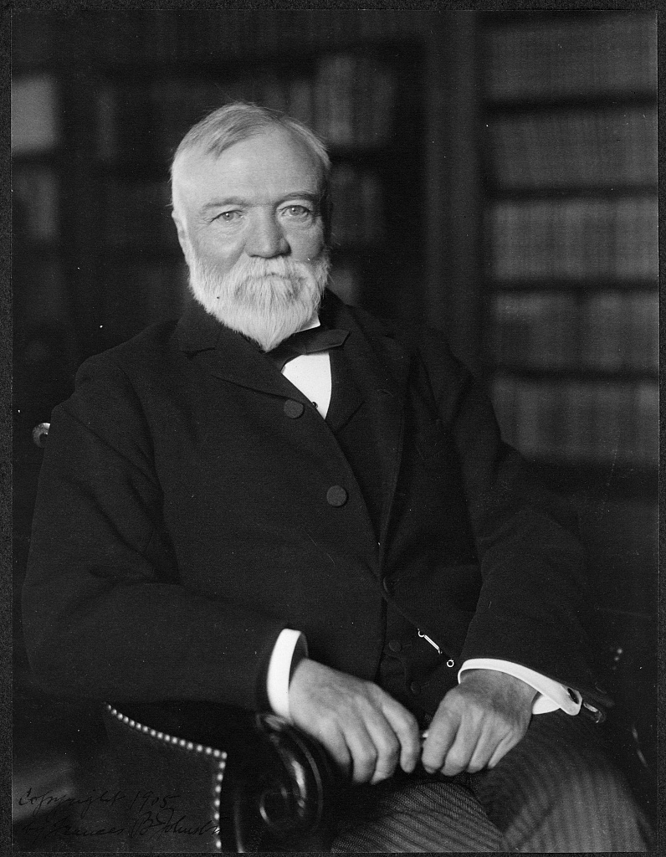
US.05 · DIRECT INSTRUCTION
2 of 3
Industrial Titans
Andrew Carnegie built a steel empire through vertical integration, controlling every step from iron mines to finished products.
John D. Rockefeller's Standard Oil pioneered horizontal integration, buying out competitors to dominate the oil industry.
J.P. Morgan wielded enormous financial power, reorganizing railroads and creating U.S. Steel.
Cornelius Vanderbilt consolidated railroad networks, enabling national commerce.
★ TENNESSEE CONNECTION
Cornelius Vanderbilt’s $1 million gift founded Vanderbilt University in Nashville (1873), tying the era’s industrial fortunes directly to Tennessee.
Marceau, New York (photographer), c. 1913 Library of Congress
U.S. History Hack · TroopToTeacher Technologies LLC · Aligned to TN Academic Standards & TCAP EOC
69

Slide 70
US.05 · DIRECT INSTRUCTION
3 of 3
African American Entrepreneurs
Despite facing discrimination, African American entrepreneurs made significant contributions.
Madam C.J. Walker became America's first female self-made millionaire through her hair care products, employing thousands of Black women.
George Washington Carver's agricultural research at Tuskegee Institute developed hundreds of products from peanuts and sweet potatoes, helping diversify Southern agriculture.
U.S. History Hack · TroopToTeacher Technologies LLC · Aligned to TN Academic Standards & TCAP EOC
70

Slide 71
US.05 · PEOPLE WHO SHAPED THE ERA
Key Figures
Andrew Carnegie
Steel Manufacturer
John D. Rockefeller
Oil Industry Executive
Thomas Edison
Inventor
Built Carnegie Steel Company into the largest steel producer in the world
Pioneered vertical integration in American industry
Founded Standard Oil, controlling 90% of U.S. oil refining
Pioneered the trust as a form of business organization
Invented the practical incandescent light bulb
Created the first industrial research laboratory
STRATEGY Vertical integration
STRATEGY Trust / monopoly
STRATEGY Invention → industry
Cornelius Vanderbilt
Shipping Magnate
J.P. Morgan
Banker
Built the largest fortune in American history to that time
Created the New York Central Railroad system
Created J.P. Morgan & Co., the most powerful bank in America
Organized U.S. Steel, the first billion-dollar corporation
STRATEGY Railroad consolidation
STRATEGY Finance capitalism
U.S. History Hack · TroopToTeacher Technologies LLC · Aligned to TN Academic Standards & TCAP EOC
71

Slide 72
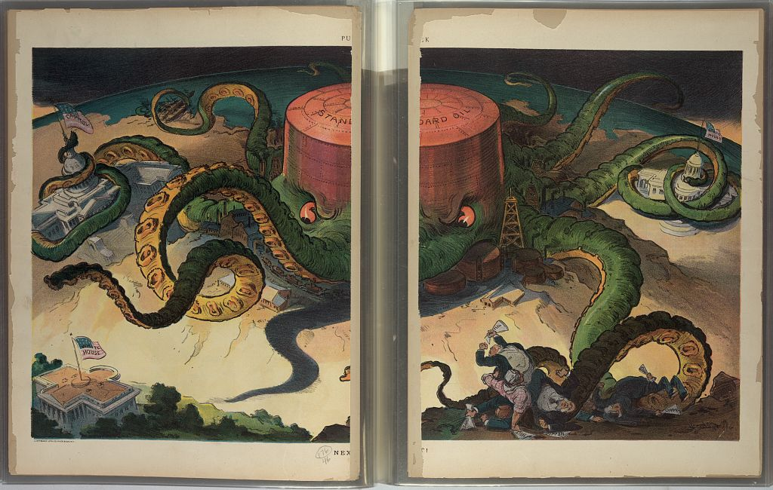
US.05 · PRIMARY SOURCE ANALYSIS
The Gospel of Wealth
Argumentation
Andrew Carnegie · 1889
ZOOM IN Find ONE detail that surprises you — be ready to name it.
"This, then, is held to be the duty of the man of Wealth: First, to set an example of modest, unostentatious living, shunning display or extravagance; to provide moderately for the legitimate wants of those dependent upon him; and after doing so to consider all surplus revenues which come to him simply as trust funds... the man of wealth thus becoming the mere agent and trustee for his poorer brethren."
CONTEXT
Andrew Carnegie was the most famous example of a 'rags to riches' story in Gilded Age America. An immigrant from Scotland who started as a factory bobbin boy, Carnegie built the largest steel company in the world through relentless efficiency, brutal labor practices, and shrewd business dealings. By the late 1880s, he was worth hundreds of millions of dollars. In 'The Gospel of Wealth' (1889), Carnegie argued that wealthy men had a duty to use their fortunes to benefit society — a philosophy that justified both extreme wealth concentration and a paternalistic approach to charity. Carnegie himself donated over $350 million to libraries, universities, and public institutions before his death.
ANALYZE
A wealthy 1890s steel magnate funds free public libraries across the country instead of leaving his entire fortune to his heirs. Whose philosophy does this best reflect, and why?
Udo J. Keppler, 1904 Library of Congress
SOURCE IT
WHO made it?
WHEN?
WHY does it matter?
FIRST
Andrew Carnegie — steel magnate and one of the wealthiest men in America.
1889 (Gilded Age).
A titan of industry is defining his own duty to society — read it as self-justification and as a genuine argument about wealth.
SSP.02 · before you interpret
Source: Carnegie Corporation of New York
U.S. History Hack · TroopToTeacher Technologies LLC · Aligned to TN Academic Standards & TCAP EOC
72
Notes:
Primary-source analysis. SOURCE IT FIRST (SSP.02) — model the sourcing routine aloud before students interpret: WHO made this source? (Andrew Carnegie — steel magnate and one of the wealthiest men in America.) WHEN? (1889 (Gilded Age).) WHY does that matter? (A titan of industry is defining his own duty to society — read it as self-justification and as a genuine argument about wealth.) Only then move to the ANALYZE question. Suggested answer: DOK 2: Students apply the source to a new case. Carnegie argued the rich should live modestly and administer surplus wealth "as trust funds" for the public good — funding libraries is a textbook example of his Gospel of Wealth. Practice skill: Argumentation.

Slide 73
US.05 · KEY VOCABULARY
Word Wall
Robber Barons/Captains of Industry
Barones Ladrones/Capitanes de Industria
Vertical Integration
Integración Vertical
say: VUR-tih-kul in-teh-GRAY-shun
Wealthy industrialists of the late 1800s who built massive business empires. Critics called them "robber barons" for ruthless practices; supporters called them "captains of industry" for economic growth.
A business strategy where a company controls all stages of production, from raw materials to finished product, as practiced by Andrew Carnegie in the steel industry.
Horizontal Integration
Integración Horizontal
Monopoly
Monopolio
say: muh-NOP-uh-lee
A business strategy where a company buys out competitors in the same industry to reduce competition and control prices, as practiced by John D. Rockefeller in oil.
Complete control of a product or service by a single company, eliminating competition and allowing the company to set prices.
Trust
Trust (Fideicomiso)
Bessemer Process
Proceso Bessemer
A legal arrangement where stockholders in several companies transferred their shares to a single board of trustees, creating a monopoly while appearing to remain separate companies.
An efficient method of making steel by blowing air through molten iron, developed by Henry Bessemer, that made mass production of steel possible and revolutionized construction and manufacturing.
"say:" pronunciation guide (stressed syllable in CAPS) and a per-term visual anchor support newcomer English learners. Spanish term + full bilingual Frayer models are in the unit vocabulary set.
U.S. History Hack · TroopToTeacher Technologies LLC · Aligned to TN Academic Standards & TCAP EOC
73

Slide 74
US.05 · GUIDED PRACTICE — WE DO IT TOGETHER
Let’s Work One Together
Claim + evidence (argument)
MODEL PROMPT: Was Rockefeller a "robber baron" or a "captain of industry"? Stake a claim and cite evidence.
WORKED EXAMPLE (teacher models this aloud)
CLAIM: Rockefeller was a captain of industry. → EVIDENCE: Standard Oil’s efficiency cut kerosene prices for ordinary families, and he later gave away over $500 million. → COUNTER I must answer: he also crushed competitors and squeezed railroads for secret rebates.
THINK ALOUD
See the structure: Claim → Evidence → and I name the strongest counter-argument so I can answer it. An argument that ignores the other side is weak.
→ Now you try: You take a position on a second titan and back it with one piece of evidence in the activity.
U.S. History Hack · TroopToTeacher Technologies LLC · Aligned to TN Academic Standards & TCAP EOC
74
Notes:
GUIDED PRACTICE / WE DO (US.05). Skill modeled: Claim + evidence (argument). Model the worked example aloud using the THINK ALOUD as your script, then release students to the activity ("You take a position on a second titan and back it with one piece of evidence in the activity."). This is the I Do → We Do → You Do bridge — do not skip it; aim for 80%+ success before independent work.

Slide 75
US.05 · STUDENT ACTIVITY
Robber Baron or Captain of Industry?
Pairs (assigned positions)
12 min
YOUR TASK
Using the Carnegie portrait and the Standard Oil “Next!” cartoon, build the strongest case for ONE label — “robber baron” OR “captain of industry” — for a Gilded Age titan. Cite at least two specific actions as evidence.
Marceau, New York (photographer), c. 1913 Library of Congress
DELIVERABLE
SUPPORT OPTIONS
A position card with claim + two pieces of evidence.
SUPPORT OPTION: evidence bank provided. EXTENSION: argue the opposite label, then decide which case is stronger.
Flight Log — write here: US.05 — write your response in your Flight Log; the Cornell Notes page for US.05 aligns to these Direct Instruction slides.
U.S. History Hack · TroopToTeacher Technologies LLC · Aligned to TN Academic Standards & TCAP EOC
75
Notes:
Student activity for US.05. Pair with the printable: Cornell Notes — US.05: Inventions & Innovators of the Industrial Age. Timing: 12 min. Deliverable: A position card with claim + two pieces of evidence.

Slide 76
US.05 · CHECK FOR UNDERSTANDING
TCAP-Style Question
DOK 2
EOC PRACTICE
A wealthy 1890s steel magnate funds free public libraries across the country instead of leaving his entire fortune to his heirs. Whose philosophy does this best reflect, and why?
Carnegie’s philosophy, because it displays wealth publicly to impress others.
A
The opposite of Carnegie’s view, because he insisted fortunes pass to children.
B
The opposite of Carnegie’s view, because he opposed all charitable giving.
C
Carnegie’s “Gospel of Wealth,” because surplus wealth is used as a trust to benefit society.
D
ANSWER FIRST: students commit — then click / advance to reveal the correct answer and explanation.
U.S. History Hack · TroopToTeacher Technologies LLC · Aligned to TN Academic Standards & TCAP EOC
76
Notes:
CHECK FOR UNDERSTANDING (US.05, DOK 2). Have students commit to an answer (whiteboards, hand signal, or turn-and-talk) BEFORE advancing. Correct answer: A. The next slide reveals it. Why: DOK 2: Students apply the source to a new case. Carnegie argued the rich should live modestly and administer surplus wealth "as trust funds" for the public good — funding libraries is a textbook example of his Gospel of Wealth.

Slide 77
US.05 · ANSWER REVEAL
TCAP-Style Question
✓ ANSWER KEY
A wealthy 1890s steel magnate funds free public libraries across the country instead of leaving his entire fortune to his heirs. Whose philosophy does this best reflect, and why?
A
Carnegie’s philosophy, because it displays wealth publicly to impress others.
B
The opposite of Carnegie’s view, because he insisted fortunes pass to children.
C
The opposite of Carnegie’s view, because he opposed all charitable giving.
D
Carnegie’s “Gospel of Wealth,” because surplus wealth is used as a trust to benefit society.
✓
Correct answer: D. Why: DOK 2: Students apply the source to a new case. Carnegie argued the rich should live modestly and administer surplus wealth "as trust funds" for the public good — funding libraries is a textbook example of his Gospel of Wealth.
U.S. History Hack · TroopToTeacher Technologies LLC · Aligned to TN Academic Standards & TCAP EOC
77
Notes:
ANSWER KEY (US.05). Correct: A. DOK 2: Students apply the source to a new case. Carnegie argued the rich should live modestly and administer surplus wealth "as trust funds" for the public good — funding libraries is a textbook example of his Gospel of Wealth.

Slide 78
US.05 · WRAP-UP
What You Need to Know for TCAP
KEY TAKEAWAYS
EXIT TICKET
DOK 3
Technological Innovations
Industrial Titans
African American Entrepreneurs
Was a figure like Rockefeller a “robber baron” or a “captain of industry”? Take a position and cite ONE piece of evidence.
★ EXTENSION DOK 3 · SSP.04 Argumentation
Evaluate the “Gospel of Wealth”: does large-scale philanthropy justify how the fortune was earned? Defend your judgment with evidence.
TEACHER DECISION BAND PROGRESS CHECK → identify barrier → select support → reteach → recheck → extend
SCAFFOLD FADING Guided → Light → independent as evidence grows; required IEP/504 supports do not fade unless the authorized team changes them.
U.S. History Hack · TroopToTeacher Technologies LLC · Aligned to TN Academic Standards & TCAP EOC
78
Notes:
WRAP-UP / EXIT-TICKET KEY (US.05, DOK 3). Prompt: Was a figure like Rockefeller a “robber baron” or a “captain of industry”? Take a position and cite ONE piece of evidence. Model answer: Either defensible: robber baron (crushed competitors, low wages) OR captain of industry (efficiency, cheaper goods, philanthropy). Must cite evidence. RETEACH TRIGGER — if a student misses this exit ticket: (1) <50% of class miss → spiral it into the next standard’s Quick Review opener (see the US.05 review prompts). (2) Individual/small group → reteach with the "Technological Innovations" direct-instruction slide + re-run the SOURCE IT FIRST routine on the US.05 primary source, then assign the paired printable: Cornell Notes — US.05: Inventions & Innovators of the Industrial Age. (3) Re-assess with the US.05 check-for-understanding reveal slide as a do-now the next day. Reteach anchors (this standard’s sections): Technological Innovations; Industrial Titans; African American Entrepreneurs. I Can objective: I can describe the changes in American life that resulted from the inventions and innovations of business leaders and entrepreneurs of the period, including Alexander Graham Bell, Andrew Carnegie, Thomas Edison, John D. Rockefeller, Madam C.J. Walker, and George Washington Carver. EXTENSION (DOK 3, for early finishers or advanced learners): Evaluate the “Gospel of Wealth”: does large-scale philanthropy justify how the fortune was earned? Defend your judgment with evidence. — look for a clear claim plus two specific pieces of evidence.

Slide 79
STANDARD
SOCIAL STUDIES PRACTICES
US.06
SSP.01
Collect sources
SSP.05
Historical awareness
SSP.06
Geographic awareness
Industrial Centers and Urbanization
FOLLOW ALONG
Open the Mission Book → Stop 6
Open the Flight Log → Entry 6
TN ACADEMIC STANDARD
Locate the following major industrial centers, and describe how industrialization influenced the movement of people from rural to urban areas: Boston, Chicago, New York City, Pittsburgh, San Francisco.
I CAN
I can locate major industrial centers and describe how industrialization influenced the movement of people from rural to urban areas.
U.S. History Hack · TroopToTeacher Technologies LLC · Aligned to TN Academic Standards & TCAP EOC
79

Slide 80
US.06 · QUICK REVIEW
Do You Remember?
Before we start, retrieve what we have already learned. Answer from memory first — no notes.
1
US.05 Explain vertical vs. horizontal integration in one sentence each.
2
US.05 What was Carnegie’s “Gospel of Wealth”?
U.S. History Hack · TroopToTeacher Technologies LLC · Aligned to TN Academic Standards & TCAP EOC
80
Notes:
SPACED RETRIEVAL (US.06). Cold-call or whiteboards, 3-4 min, low stakes. Answers — 1) Vertical: control all production stages. Horizontal: buy out competitors in the same industry. 2) The idea the rich should live modestly and give surplus wealth to benefit society.

Slide 81
US.06 · CONFIDENCE CHECK
Warm-Up — Quick Recall
DOK 1
LOW STAKES
Everyone can answer this. Thumbs / whiteboards — no notes.
What word means the fast growth of cities as people move in?
✓ ANSWER
Urbanization.
COMMIT FIRST: have everyone answer before the reveal — this is the DOK 1 floor; the graded check later in this lesson moves up to DOK 2–3.
U.S. History Hack · TroopToTeacher Technologies LLC · Aligned to TN Academic Standards & TCAP EOC
81
Notes:
CONFIDENCE CHECK (US.06, DOK 1). 60-90 seconds. Have EVERY student commit (thumbs / whiteboard / choral) before revealing — this secures an early win and surfaces who is shaky before new content. Answer: Urbanization. Key term to listen for: urbanization. This is the low-floor entry; the graded Check for Understanding later in the standard rises to DOK 2–3.

Slide 82
US.06 · HOOK
Think About It
Chicago went from 30,000 people to over 1,000,000 in just 40 years.
DISCUSS
TIMING: Turn & Talk 60 sec → cold-call 2 pairs
What does a city need to grow that fast — and what problems would explode along with the population? Brainstorm three of each.
U.S. History Hack · TroopToTeacher Technologies LLC · Aligned to TN Academic Standards & TCAP EOC
82
Notes:
HOOK (US.06). Run tight: pose the provocation, give a silent 10-second think, then Turn & Talk 60 seconds. Cold-call 2–3 pairs (not volunteers) for a sentence-starter answer — "One force was ___ because ___" — then bridge to the standard. Keep total to ~4 minutes; do not let it sprawl. Return to this question at the unit close for an evidence-based answer.

Slide 83
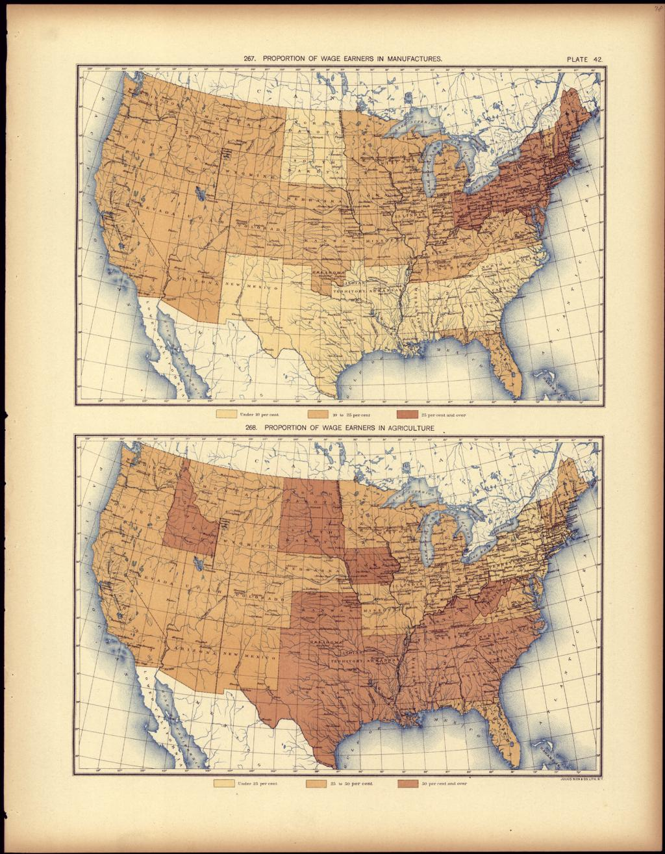
US.06 · DIRECT INSTRUCTION
1 of 3
Major Industrial Centers
Industrialization concentrated in cities with geographic advantages.
Pittsburgh became the steel capital due to access to coal, iron ore, and rivers.
Chicago emerged as a railroad hub and meatpacking center.
New York City dominated finance and trade through its port.
Boston led in textiles and manufacturing.
San Francisco served as the gateway to Pacific trade and western resources.
SENTENCE FRAME · LANGUAGE SUPPORT
Henry Gannett / U.S. Census Office, 1898 Library of Congress
Cities grew rapidly because ________, which created the problem of ________.
TEACHER CUE Chunk → cold-call → confirm before advancing.
FLIGHT LOG · Cornell Notes — US.06: jot notes here as we go.
U.S. History Hack · TroopToTeacher Technologies LLC · Aligned to TN Academic Standards & TCAP EOC
83
Notes:
FACILITATION (US.06). Think-aloud the arrow: "growth caused this problem." Have students turn-and-talk one cause and one problem before you chart them. Teach in small steps; pause and check for understanding before the next chunk (aim 80%+ before moving on).

Slide 84
US.06 · DIRECT INSTRUCTION
2 of 3
Rural-to-Urban Migration
Industrialization drew millions from farms to cities seeking factory jobs.
The promise of wages attracted both native-born Americans and immigrants.
Cities grew explosively—Chicago's population increased from 30,000 in 1850 to over 1 million by 1890.
This rapid growth created overcrowded tenements, inadequate sanitation, and new social challenges.
U.S. History Hack · TroopToTeacher Technologies LLC · Aligned to TN Academic Standards & TCAP EOC
84

Slide 85
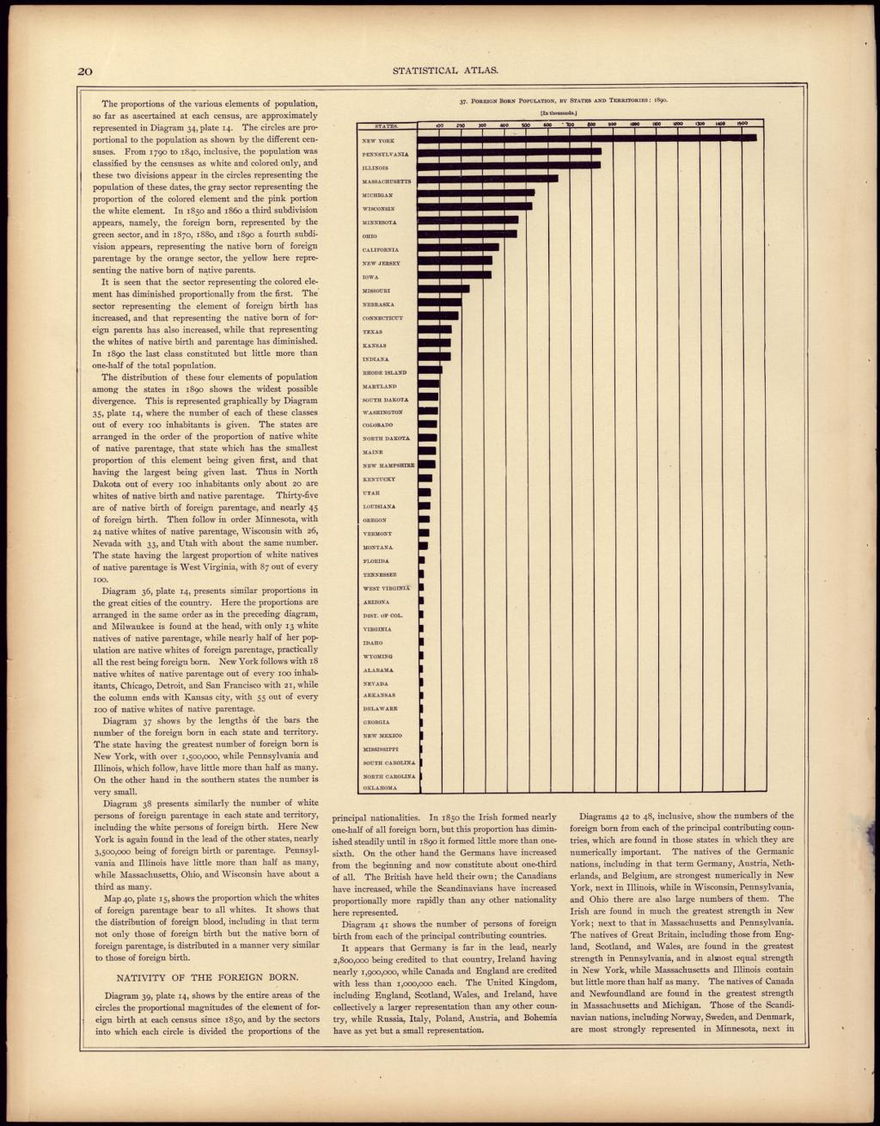
US.06 · DIRECT INSTRUCTION
3 of 3
Geographic Factors in Industrial Location
Industries located based on access to raw materials, transportation, markets, and labor.
Steel mills clustered near coal and iron deposits.
Textile mills used water power and later concentrated near ports for cotton imports.
Meatpacking centered in Chicago due to railroad connections to cattle ranges and eastern markets.
These patterns shaped regional development for generations.
Henry Gannett / U.S. Census Office, 1898 Library of Congress
U.S. History Hack · TroopToTeacher Technologies LLC · Aligned to TN Academic Standards & TCAP EOC
85

Slide 86
US.06 · PEOPLE WHO SHAPED THE ERA
Key Figures
Samuel Gompers
Eugene V. Debs
Labor Union Leader · Cigar Maker
Labor Organizer · Socialist Leader
Founded the American Federation of Labor (AFL)
Served as AFL President for 37 years
Pioneered "bread and butter" unionism focusing on wages and hours
Founded the American Railway Union
Led the Pullman Strike of 1894
Co-founded the Industrial Workers of the World (IWW)
STRATEGY Skilled-craft unionism (AFL)
STRATEGY Industrial unionism / socialism
U.S. History Hack · TroopToTeacher Technologies LLC · Aligned to TN Academic Standards & TCAP EOC
86

Slide 87
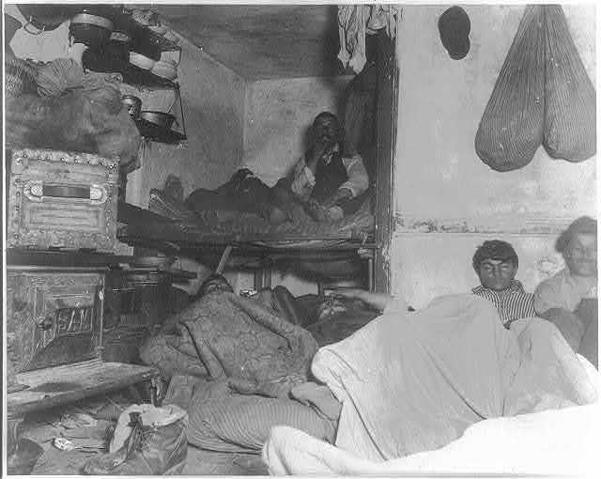
US.06 · PRIMARY SOURCE ANALYSIS
How the Other Half Lives
Contextualization
Jacob Riis · 1890
ZOOM IN Find ONE detail that surprises you — be ready to name it.
"In the tenements all the influences make for evil; because they are the hot-beds of the epidemics that carry death to rich and poor alike; the nurseries of pauperism and crime that fill our jails and police courts; that throw off a scum of forty thousand human wrecks to the island asylums and workhouses year by year."
CONTEXT
By 1890, millions of immigrants — primarily from Southern and Eastern Europe — had poured into American cities to work in factories, mines, and mills. In cities like New York, Chicago, and Pittsburgh, the poor were crowded into tenement buildings: dark, airless apartment buildings with shared toilets, no running water, and extreme overcrowding. Jacob Riis, a Danish immigrant himself who had experienced poverty firsthand, used the new technology of flash photography to document conditions in New York's Lower East Side slums. 'How the Other Half Lives' shocked middle-class readers and helped spark the progressive reform movement.
ANALYZE
How does Jacob Riis characterize living conditions in tenements?
Jacob A. Riis, 1889 Library of Congress
SOURCE IT
WHO made it?
WHEN?
WHY does it matter?
FIRST
Jacob Riis, reformer-photographer (How the Other Half Lives).
1890.
Riis wanted to shock readers into reform — weigh that purpose against the image.
SSP.02 · before you interpret
Source: Library of Congress
U.S. History Hack · TroopToTeacher Technologies LLC · Aligned to TN Academic Standards & TCAP EOC
87
Notes:
Primary-source analysis. SOURCE IT FIRST (SSP.02) — model the sourcing routine aloud before students interpret: WHO made this source? (Jacob Riis, reformer-photographer (How the Other Half Lives).) WHEN? (1890.) WHY does that matter? (Riis wanted to shock readers into reform — weigh that purpose against the image.) Only then move to the ANALYZE question. Suggested answer: Riis describes tenements as "hot-beds of the epidemics" and "nurseries of pauperism and crime," presenting them as sources of social problems. Practice skill: Contextualization.

Slide 88
US.06 · KEY VOCABULARY
Word Wall
Urbanization
Urbanización
Granger Movement
Movimiento Granger
say: ur-bun-ih-ZAY-shun
The rapid growth of cities due to industrialization and mass migration, transforming America from a predominantly rural to urban society.
A farmers' organization founded in 1867 that advocated for railroad regulation and fought against monopolistic practices that harmed farmers through high shipping rates.
Populism
Populismo
Interstate Commerce Act
Ley de Comercio Interestatal
A political movement in the 1890s representing farmers and workers who sought government regulation of railroads, graduated income tax, and the free coinage of silver to combat economic inequality.
An 1887 federal law that created the Interstate Commerce Commission to regulate railroad rates and practices, representing the first federal regulatory agency.
Tenement
Vivienda de Vecindad
Industrialization
Industrialización
say: TEN-uh-ment
A crowded, often unsafe urban apartment building where many poor and immigrant families lived during rapid industrial-era city growth.
The shift from an economy based on farming and handcraft to one based on large factories, machines, and mass production.
"say:" pronunciation guide (stressed syllable in CAPS) and a per-term visual anchor support newcomer English learners. Spanish term + full bilingual Frayer models are in the unit vocabulary set.
U.S. History Hack · TroopToTeacher Technologies LLC · Aligned to TN Academic Standards & TCAP EOC
88

Slide 89
US.06 · GUIDED PRACTICE — WE DO IT TOGETHER
Let’s Work One Together
Cause → problem (urbanization)
MODEL PROMPT: Connect ONE cause of rapid city growth to ONE problem it created.
WORKED EXAMPLE (teacher models this aloud)
CAUSE: Factory jobs pulled rural Americans and immigrants into cities like Chicago. → PROBLEM: Housing could not keep up, so families crowded into unsafe tenements with no clean water.
THINK ALOUD
Watch me link, not list: I do not just name "overcrowding" — I show the cause that produced it. The arrow is the thinking.
→ Now you try: You build two more cause→problem links in the activity.
U.S. History Hack · TroopToTeacher Technologies LLC · Aligned to TN Academic Standards & TCAP EOC
89
Notes:
GUIDED PRACTICE / WE DO (US.06). Skill modeled: Cause → problem (urbanization). Model the worked example aloud using the THINK ALOUD as your script, then release students to the activity ("You build two more cause→problem links in the activity."). This is the I Do → We Do → You Do bridge — do not skip it; aim for 80%+ success before independent work.

Slide 90
US.06 · STUDENT ACTIVITY
Mapping the Industrial City
Pairs
10 min
YOUR TASK
Using the 1890 wage-earners and foreign-born maps, identify the regions where industry and immigration concentrated. Predict THREE problems a city would face when its population multiplies in 40 years, and THREE things it needs to grow.
Henry Gannett / U.S. Census Office, 1898 Library of Congress
DELIVERABLE
SUPPORT OPTIONS
Map-annotation chart: needs vs. problems.
SUPPORT OPTION: labeled map regions provided. EXTENSION: explain the correlation between manufacturing density and foreign-born population.
Flight Log — write here: US.06 — write your response in your Flight Log; the Cornell Notes page for US.06 aligns to these Direct Instruction slides.
U.S. History Hack · TroopToTeacher Technologies LLC · Aligned to TN Academic Standards & TCAP EOC
90
Notes:
Student activity for US.06. Pair with the printable: Cornell Notes — US.06: Industrialization & Urbanization. Timing: 10 min. Deliverable: Map-annotation chart: needs vs. problems.

Slide 91
US.06 · CHECK FOR UNDERSTANDING
TCAP-Style Question
DOK 2
EOC PRACTICE
What does this folk saying reveal about the immigrant experience in America?
Immigrants found immediate wealth and success.
A
Reality fell far short of expectations, and immigrants faced hard labor.
B
American cities were well-developed and welcoming.
C
Immigrants were given skilled professional jobs.
D
ANSWER FIRST: students commit — then click / advance to reveal the correct answer and explanation.
U.S. History Hack · TroopToTeacher Technologies LLC · Aligned to TN Academic Standards & TCAP EOC
91
Notes:
CHECK FOR UNDERSTANDING (US.06, DOK 2). Have students commit to an answer (whiteboards, hand signal, or turn-and-talk) BEFORE advancing. Correct answer: C. The next slide reveals it. Why: The letter contrasts the dream of "streets paved with gold" with the reality of unpaved streets that immigrants themselves "were expected to pave," highlighting difficult conditions.

Slide 92
US.06 · ANSWER REVEAL
TCAP-Style Question
✓ ANSWER KEY
What does this folk saying reveal about the immigrant experience in America?
A
Immigrants found immediate wealth and success.
B
Reality fell far short of expectations, and immigrants faced hard labor.
✓
C
American cities were well-developed and welcoming.
D
Immigrants were given skilled professional jobs.
Correct answer: B. Why: The letter contrasts the dream of "streets paved with gold" with the reality of unpaved streets that immigrants themselves "were expected to pave," highlighting difficult conditions.
U.S. History Hack · TroopToTeacher Technologies LLC · Aligned to TN Academic Standards & TCAP EOC
92
Notes:
ANSWER KEY (US.06). Correct: C. The letter contrasts the dream of "streets paved with gold" with the reality of unpaved streets that immigrants themselves "were expected to pave," highlighting difficult conditions.

Slide 93
US.06 · WRAP-UP
What You Need to Know for TCAP
KEY TAKEAWAYS
EXIT TICKET
DOK 2
Major Industrial Centers
Rural-to-Urban Migration
Geographic Factors in Industrial Location
Explain ONE cause of rapid urbanization AND ONE problem it created in cities.
★ EXTENSION DOK 3 · SSP.04 Argumentation
Argue: who bore the greatest cost of rapid urbanization — immigrants, workers, or city governments? Defend with TWO pieces of evidence.
TEACHER DECISION BAND PROGRESS CHECK → identify barrier → select support → reteach → recheck → extend
SCAFFOLD FADING Guided → Light → independent as evidence grows; required IEP/504 supports do not fade unless the authorized team changes them.
U.S. History Hack · TroopToTeacher Technologies LLC · Aligned to TN Academic Standards & TCAP EOC
93
Notes:
WRAP-UP / EXIT-TICKET KEY (US.06, DOK 2). Prompt: Explain ONE cause of rapid urbanization AND ONE problem it created in cities. Model answer: Cause: factory jobs drew rural + immigrant workers; problem: overcrowded tenements, disease, strained sanitation. RETEACH TRIGGER — if a student misses this exit ticket: (1) <50% of class miss → spiral it into the next standard’s Quick Review opener (see the US.06 review prompts). (2) Individual/small group → reteach with the "Major Industrial Centers" direct-instruction slide + re-run the SOURCE IT FIRST routine on the US.06 primary source, then assign the paired printable: Cornell Notes — US.06: Industrialization & Urbanization. (3) Re-assess with the US.06 check-for-understanding reveal slide as a do-now the next day. Reteach anchors (this standard’s sections): Major Industrial Centers; Rural-to-Urban Migration; Geographic Factors in Industrial Location. I Can objective: I can locate major industrial centers and describe how industrialization influenced the movement of people from rural to urban areas. EXTENSION (DOK 3, for early finishers or advanced learners): Argue: who bore the greatest cost of rapid urbanization — immigrants, workers, or city governments? Defend with TWO pieces of evidence. — look for a clear claim plus two specific pieces of evidence.

Slide 94
STANDARD
SOCIAL STUDIES PRACTICES
US.07
SSP.01
Collect sources
SSP.02
Examine a source
SSP.03
Synthesize sources
SSP.04
Build an argument
Immigration: Old vs. New Immigrants
SSP.05
Historical awareness
SSP.06
Geographic awareness
FOLLOW ALONG
Open the Mission Book → Stop 7
Open the Flight Log → Entry 7
TN ACADEMIC STANDARD
Describe the differences between "old" and "new" immigrants, analyze the assimilation process for "new" immigrants, and determine the impacts of increased migration on American society, including: Angel Island, Ellis Island, Push and pull factors, Ethnic clusters, Jane Addams, Competition for jobs, Rise of nativism, Jacob Riis, Chinese Exclusion Act and Gentleman's Agreement.
I CAN
I can describe the differences between "old" and "new" immigrants; explain entry points (Ellis Island and Angel Island), push and pull factors, and the formation of ethnic clusters; and analyze nativism and restrictions such as the Chinese Exclusion Act and the Gentlemen’s Agreement on American society.
U.S. History Hack · TroopToTeacher Technologies LLC · Aligned to TN Academic Standards & TCAP EOC
94

Slide 95
US.07 · QUICK REVIEW
Do You Remember?
Before we start, retrieve what we have already learned. Answer from memory first — no notes.
1
US.06 Why did cities grow so fast during industrialization?
2
US.06 What was a tenement?
U.S. History Hack · TroopToTeacher Technologies LLC · Aligned to TN Academic Standards & TCAP EOC
95
Notes:
SPACED RETRIEVAL (US.07). Cold-call or whiteboards, 3-4 min, low stakes. Answers — 1) Factory jobs drew rural Americans and immigrants into urban centers (urbanization). 2) A crowded, often unsafe urban apartment building housing poor and immigrant families.

Slide 96
US.07 · CONFIDENCE CHECK
Warm-Up — Quick Recall
DOK 1
LOW STAKES
Everyone can answer this. Thumbs / whiteboards — no notes.
TRUE or FALSE: “New” immigrants (1880–1920) came mostly from southern & eastern Europe.
✓ ANSWER
TRUE — plus Asia; “old” immigrants came earlier from N./W. Europe.
COMMIT FIRST: have everyone answer before the reveal — this is the DOK 1 floor; the graded check later in this lesson moves up to DOK 2–3.
U.S. History Hack · TroopToTeacher Technologies LLC · Aligned to TN Academic Standards & TCAP EOC
96
Notes:
CONFIDENCE CHECK (US.07, DOK 1). 60-90 seconds. Have EVERY student commit (thumbs / whiteboard / choral) before revealing — this secures an early win and surfaces who is shaky before new content. Answer: TRUE — plus Asia; “old” immigrants came earlier from N./W. Europe. Key term to listen for: new immigrants. This is the low-floor entry; the graded Check for Understanding later in the standard rises to DOK 2–3.

Slide 97
US.07 · HOOK
Think About It
Between 1880 and 1920, more than 20 million immigrants arrived in the United States.
DISCUSS
TIMING: Turn & Talk 60 sec → cold-call 2 pairs
Why do people leave everything behind to start over in a new country? And why might native-born Americans react with fear? We will see both sides today.
U.S. History Hack · TroopToTeacher Technologies LLC · Aligned to TN Academic Standards & TCAP EOC
97
Notes:
HOOK (US.07). Run tight: pose the provocation, give a silent 10-second think, then Turn & Talk 60 seconds. Cold-call 2–3 pairs (not volunteers) for a sentence-starter answer — "One force was ___ because ___" — then bridge to the standard. Keep total to ~4 minutes; do not let it sprawl. Return to this question at the unit close for an evidence-based answer.

Slide 98
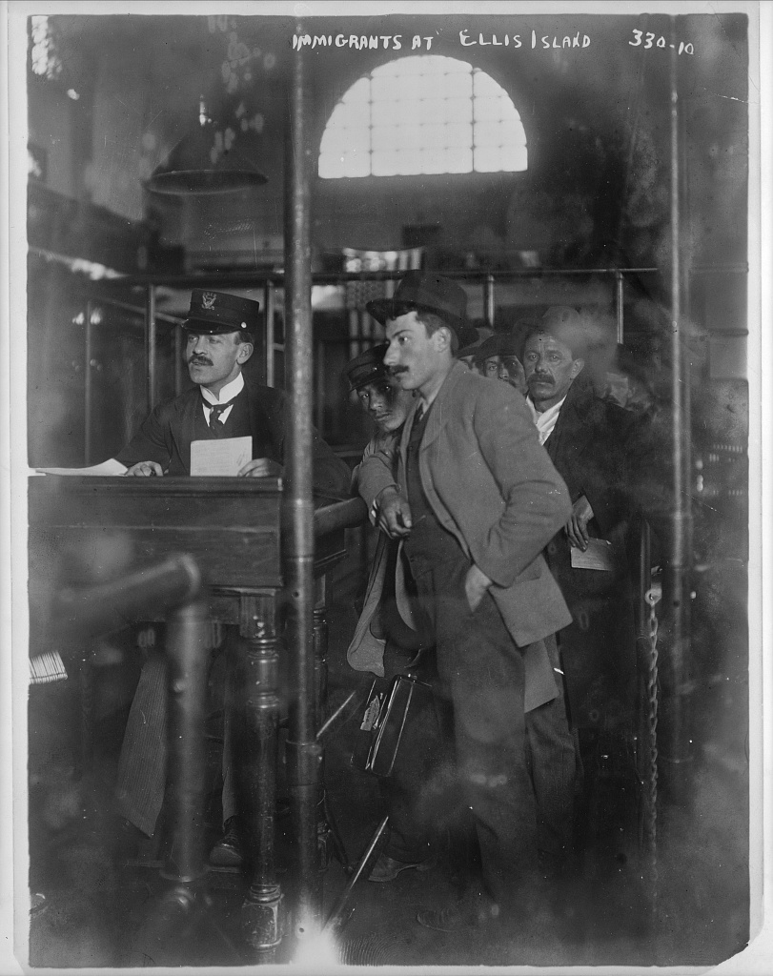
US.07 · DIRECT INSTRUCTION
1 of 4
Old and New Immigrants
"Old" immigrants (pre-1880) came primarily from Northern and Western Europe—Britain, Ireland, Germany, Scandinavia.
They often spoke English or related languages and were predominantly Protestant.
"New" immigrants (1880-1920) came from Southern and Eastern Europe—Italy, Poland, Russia, Greece—as well as Asia.
They brought different languages, religions (Catholic, Orthodox, Jewish), and customs that many Americans viewed with suspicion.
SENTENCE FRAME · LANGUAGE SUPPORT
Detroit Publishing Company, c. 1910–1920 Library of Congress
“New” immigrants came to the U.S. because ________, but some native-born Americans reacted with ________.
TEACHER CUE Chunk → cold-call → confirm before advancing.
FLIGHT LOG · Cornell Notes — US.07: jot notes here as we go.
U.S. History Hack · TroopToTeacher Technologies LLC · Aligned to TN Academic Standards & TCAP EOC
98
Notes:
FACILITATION (US.07). Voice both perspectives with historical empathy. Cold-call one push factor and one nativist fear, then ask which surprised them. Teach in small steps; pause and check for understanding before the next chunk (aim 80%+ before moving on).

Slide 99
US.07 · DIRECT INSTRUCTION
2 of 4
Entry Points and the Assimilation Process
Ellis Island in New York Harbor processed millions of European immigrants, while Angel Island in San Francisco served Asian immigrants with far more restrictive procedures.
New immigrants faced difficult assimilation: language barriers, discrimination, and unfamiliar customs.
Jane Addams's Hull House in Chicago pioneered settlement houses that helped immigrants learn English, navigate American systems, and maintain cultural connections.
U.S. History Hack · TroopToTeacher Technologies LLC · Aligned to TN Academic Standards & TCAP EOC
99

Slide 100
US.07 · DIRECT INSTRUCTION
3 of 4
Push and Pull Factors
Push factors drove people from their homelands: religious persecution (especially of Jews in Russia), poverty, political upheaval, and lack of opportunity.
Pull factors attracted them to America: economic opportunity, religious freedom, land availability, and established immigrant communities.
Letters from successful immigrants encouraged others to follow.
U.S. History Hack · TroopToTeacher Technologies LLC · Aligned to TN Academic Standards & TCAP EOC
100

Slide 101
US.07 · DIRECT INSTRUCTION
4 of 4
Nativism and Restriction
The rise of nativism—hostility toward immigrants—led to restrictive legislation.
The Chinese Exclusion Act of 1882 banned Chinese immigration for ten years (repeatedly renewed until 1943).
The Gentleman's Agreement of 1907 limited Japanese immigration.
Jacob Riis's photographs and writings, including "How the Other Half Lives," exposed immigrant living conditions, prompting both sympathy and nativist fears.
U.S. History Hack · TroopToTeacher Technologies LLC · Aligned to TN Academic Standards & TCAP EOC
101

Slide 102
US.07 · PEOPLE WHO SHAPED THE ERA
Key Figure
Jane Addams
Social Worker · Settlement House Founder
Co-founded Hull House, the most influential settlement house in America
First American woman to win the Nobel Peace Prize (1931)
Founded the Women's International League for Peace and Freedom
STRATEGY Settlement-house reform
U.S. History Hack · TroopToTeacher Technologies LLC · Aligned to TN Academic Standards & TCAP EOC
102

Slide 103
US.07 · PRIMARY SOURCE ANALYSIS
Chinese Exclusion Act
Close Reading
U.S. Congress · May 6, 1882 (22 Stat. 58)
"The coming of Chinese laborers to this country endangers the good order of certain localities within the territory thereof: Therefore... the coming of Chinese laborers to the United States be, and the same is hereby, suspended; and during such suspension it shall not be lawful for any Chinese laborer to come, or having so come after the expiration of said ninety days, to remain within the United States."
CONTEXT
Chinese immigrants had played an essential role in building the transcontinental railroad and developing the American West, yet they faced intense racial hostility from white workers and politicians. Anti-Chinese riots broke out in cities across the West, and nativist groups pressured Congress to restrict Chinese immigration. The Chinese Exclusion Act of 1882 was the first major federal law to restrict immigration based on race and nationality, banning Chinese laborers from entering the country and barring Chinese immigrants from ever becoming U.S. citizens. It would not be fully repealed until 1943.
ANALYZE
What was the stated justification for the Chinese Exclusion Act?
SOURCE IT
WHO made it?
WHEN?
WHY does it matter?
FIRST
U.S. Congress (the Chinese Exclusion Act).
1882.
The first U.S. law to bar an entire nationality — ask whose fears it answered.
SSP.02 · before you interpret
Source: National Archives
U.S. History Hack · TroopToTeacher Technologies LLC · Aligned to TN Academic Standards & TCAP EOC
103
Notes:
Primary-source analysis. SOURCE IT FIRST (SSP.02) — model the sourcing routine aloud before students interpret: WHO made this source? (U.S. Congress (the Chinese Exclusion Act).) WHEN? (1882.) WHY does that matter? (The first U.S. law to bar an entire nationality — ask whose fears it answered.) Only then move to the ANALYZE question. Suggested answer: The Act claims "The coming of Chinese laborers to this country endangers the good order of certain localities," using this as justification for exclusion. Practice skill: Close Reading.

Slide 104
US.07 · KEY VOCABULARY
Word Wall
Old Immigrants
Viejos Inmigrantes
New Immigrants
Nuevos Inmigrantes
Immigrants who came to the United States primarily from Northern and Western Europe (England, Ireland, Germany, Scandinavia) before 1880, often Protestant and more easily assimilated.
Immigrants who came to the United States primarily from Southern and Eastern Europe (Italy, Poland, Russia) and Asia after 1880, often Catholic, Jewish, or Orthodox Christian, facing greater discrimination.
Ellis Island
Isla Ellis
Angel Island
Isla Ángel
The primary immigration processing station in New York Harbor from 1892 to 1954, where over 12 million immigrants entered the United States, primarily from Europe.
The immigration station in San Francisco Bay from 1910 to 1940 that primarily processed Asian immigrants, especially Chinese, who faced lengthy detentions and harsh interrogations.
Push-Pull Factors
Factores de Empuje y Atracción
Ethnic Clusters
Grupos Étnicos
Push factors (poverty, persecution, lack of opportunity) drove people to leave their homelands, while pull factors (jobs, freedom, land) attracted them to America.
Neighborhoods where immigrants from the same country or region settled together, maintaining their language, culture, and traditions while adapting to American life.
"say:" pronunciation guide (stressed syllable in CAPS) and a per-term visual anchor support newcomer English learners. Spanish term + full bilingual Frayer models are in the unit vocabulary set.
U.S. History Hack · TroopToTeacher Technologies LLC · Aligned to TN Academic Standards & TCAP EOC
104

Slide 105
US.07 · GUIDED PRACTICE — WE DO IT TOGETHER
Let’s Work One Together
Compare across perspectives
MODEL PROMPT: Compare a "new" immigrant’s reason to come with a native-born reason to fear them.
WORKED EXAMPLE (teacher models this aloud)
IMMIGRANT PUSH: Persecution and poverty in southern/eastern Europe and Asia drove millions to leave. → NATIVIST REACTION: Native-born workers feared job competition and prejudice, producing laws like the Chinese Exclusion Act (1882).
THINK ALOUD
Notice I give each side its own evidence and treat both as real historical viewpoints — historical empathy means I explain the fear without excusing it.
→ Now you try: You compare one more push factor with one nativist reaction in the activity.
U.S. History Hack · TroopToTeacher Technologies LLC · Aligned to TN Academic Standards & TCAP EOC
105
Notes:
GUIDED PRACTICE / WE DO (US.07). Skill modeled: Compare across perspectives. Model the worked example aloud using the THINK ALOUD as your script, then release students to the activity ("You compare one more push factor with one nativist reaction in the activity."). This is the I Do → We Do → You Do bridge — do not skip it; aim for 80%+ success before independent work.

Slide 106
US.07 · STUDENT ACTIVITY
Two Sides of Immigration
Pairs → Whole class
12 min
YOUR TASK
Examine Jacob Riis's “Five Cents a Spot” photograph and the Ellis Island inspection-room image. Write one sentence from the perspective of a new immigrant and one from a nativist worried about change. Then explain what Riis wanted viewers to FEEL and DO.
Jacob A. Riis, 1889 Library of Congress
DELIVERABLE
SUPPORT OPTIONS
Two perspective sentences + a photographer's-purpose statement.
SUPPORT OPTION: sentence stems for both perspectives. EXTENSION: evaluate whether a staged photo is reliable evidence.
Flight Log — write here: US.07 — write your response in your Flight Log; the Cornell Notes page for US.07 aligns to these Direct Instruction slides.
U.S. History Hack · TroopToTeacher Technologies LLC · Aligned to TN Academic Standards & TCAP EOC
106
Notes:
Student activity for US.07. Pair with the printable: Cornell Notes — US.07: Immigration & Urbanization. Timing: 12 min. Deliverable: Two perspective sentences + a photographer's-purpose statement.

Slide 107
US.07 · CHECK FOR UNDERSTANDING
TCAP-Style Question
DOK 2
EOC PRACTICE
According to Jane Addams, what was the philosophy behind Hull-House?
That different social classes depend on and can help each other.
A
That wealthy people should live separately from immigrants.
B
That immigrants should return to their home countries.
C
That government should provide all social services.
D
ANSWER FIRST: students commit — then click / advance to reveal the correct answer and explanation.
U.S. History Hack · TroopToTeacher Technologies LLC · Aligned to TN Academic Standards & TCAP EOC
107
Notes:
CHECK FOR UNDERSTANDING (US.07, DOK 2). Have students commit to an answer (whiteboards, hand signal, or turn-and-talk) BEFORE advancing. Correct answer: B. The next slide reveals it. Why: Addams states Hull-House operated on "the theory that the dependence of classes on each other is reciprocal," emphasizing mutual benefit.

Slide 108
US.07 · ANSWER REVEAL
TCAP-Style Question
✓ ANSWER KEY
According to Jane Addams, what was the philosophy behind Hull-House?
A
That different social classes depend on and can help each other.
✓
B
That wealthy people should live separately from immigrants.
C
That immigrants should return to their home countries.
D
That government should provide all social services.
Correct answer: A. Why: Addams states Hull-House operated on "the theory that the dependence of classes on each other is reciprocal," emphasizing mutual benefit.
U.S. History Hack · TroopToTeacher Technologies LLC · Aligned to TN Academic Standards & TCAP EOC
108
Notes:
ANSWER KEY (US.07). Correct: B. Addams states Hull-House operated on "the theory that the dependence of classes on each other is reciprocal," emphasizing mutual benefit.

Slide 109
US.07 · WRAP-UP
What You Need to Know for TCAP
KEY TAKEAWAYS
EXIT TICKET
DOK 3
Old and New Immigrants
Entry Points and the Assimilation Process
Push and Pull Factors
Nativism and Restriction
Compare a PUSH factor for a “new” immigrant with a reason native-born Americans reacted with nativism. Which surprises you more and why?
★ EXTENSION DOK 3 · SSP.04 Argumentation
Construct an argument: was the Chinese Exclusion Act an economic policy or a racial one? Use specific evidence to defend your claim.
TEACHER DECISION BAND PROGRESS CHECK → identify barrier → select support → reteach → recheck → extend
SCAFFOLD FADING Guided → Light → independent as evidence grows; required IEP/504 supports do not fade unless the authorized team changes them.
U.S. History Hack · TroopToTeacher Technologies LLC · Aligned to TN Academic Standards & TCAP EOC
109
Notes:
WRAP-UP / EXIT-TICKET KEY (US.07, DOK 3). Prompt: Compare a PUSH factor for a “new” immigrant with a reason native-born Americans reacted with nativism. Which surprises you more and why? Model answer: Push: poverty/persecution in S./E. Europe or Asia; nativism: job competition + prejudice (e.g., Chinese Exclusion Act). Reasoning required. RETEACH TRIGGER — if a student misses this exit ticket: (1) <50% of class miss → spiral it into the next standard’s Quick Review opener (see the US.07 review prompts). (2) Individual/small group → reteach with the "Old and New Immigrants" direct-instruction slide + re-run the SOURCE IT FIRST routine on the US.07 primary source, then assign the paired printable: Cornell Notes — US.07: Immigration & Urbanization. (3) Re-assess with the US.07 check-for-understanding reveal slide as a do-now the next day. Reteach anchors (this standard’s sections): Old and New Immigrants; Entry Points and the Assimilation Process; Push and Pull Factors; Nativism and Restriction. I Can objective: I can describe the differences between "old" and "new" immigrants; explain entry points (Ellis Island and Angel Island), push and pull factors, and the formation of ethnic clusters; and analyze nativism and restrictions such as the Chinese Exclusion Act and the Gentlemen’s Agreement on American society. EXTENSION (DOK 3, for early finishers or advanced learners): Construct an argument: was the Chinese Exclusion Act an economic policy or a racial one? Use specific evidence to defend your claim. — look for a clear claim plus two specific pieces of evidence.

Slide 110
REACHED — AND LEFT OUT
Whose story the industrial era told — and who paid its costs
History Hack-authored synthesis grounded in this unit’s sourced record — read across the standards, not around them.
American Indian Nations
Chinese Laborers
African Americans
New Immigrants & Reformers
Westward expansion and the railroad (US.01) crossed treaty lands; reservation, assimilation, boarding-school, and Dawes Act policy (US.02) cut tribal holdings from 138 to 48 million acres by 1934.
Chinese workers built the most dangerous stretches of the Central Pacific (US.01) yet faced wage discrimination and, in 1882, the first federal law to bar a nationality — the Chinese Exclusion Act (US.07).
The Compromise of 1877 ended Reconstruction’s protections (US.03); the Exodusters fled to Kansas, and Madam C.J. Walker and George Washington Carver (US.05) built enterprise under Jim Crow.
Southern and Eastern European and Asian arrivals (US.07) met nativism and tenement poverty; reformers like Jane Addams at Hull-House organized mutual aid across classes.
Verified public-domain images and named Key-Figure entries for these histories are a pending content addition.
U.S. History Hack · TroopToTeacher Technologies LLC · Aligned to TN Academic Standards & TCAP EOC
110

Slide 111
Unit 1 Complete
The Rise of Industrialization (1877–1900) — from the open frontier to the crowded city: westward expansion, the Gilded Age, and a nation remade by immigration.
Revisit your unit hook: What forces moved a nation off the land and into the factory? You can now answer with evidence — from the Homestead Act to the Chinese Exclusion Act.
Next: Unit 2 — Progressivism & American Imperialism
U.S. History Hack · TroopToTeacher Technologies LLC · All primary sources verified against National Archives, Library of Congress, and U.S. Senate records. All images public domain.

Slide 112
GEOGRAPHER'S LENS · US.01 — COLOR MAP FOR PROJECTION
Matthews, Northrup & Co's Official Railroad Map of the United States, Dominion of Canada and Mexico
This is the full-color version of the black-and-white map on the workbook Geographer's Lens page for US.01. Source: Matthews, Northrup & Co. Matthews, Northrup & Co's Official Railroad Map of the United States, Dominion of Canada and Mexico Perfected to Date from Latest Authentic Sources. Buffalo, 1890. Map. Library of Congress Geography and Map Division, call number G3701.P3 1890 .M3. https://www.loc.gov/item/gm71000843/. Public Domain — No Known Restrictions on Publication

Slide 113
GEOGRAPHER'S LENS · US.06 — COLOR MAP FOR PROJECTION
Foreign Born Population, by States and Territories: 1890
This is the full-color version of the black-and-white map on the workbook Geographer's Lens page for US.06. Source: Gannett, Henry, and U.S. Census Office. "Foreign Born Population, by States and Territories: 1890." In Statistical Atlas of the United States, Based upon the Results of the Eleventh Census. Washington, DC: U.S. Census Office, 1898. Library of Congress Geography and Map Division, call number G1201.G1 U53 1898. https://www.loc.gov/resource/g3701gm.gct00010/?sp=35. Public Domain — U.S. Government Work

