Slide 1
U.S. HISTORY HACK
Unit 6
World War II
Totalitarianism · American Entry · Battles & Leaders · Home Front · Atomic Bomb · Postwar Order · 1919–1945
Standards US.45 – US.58
US.45
US.46
US.47
US.48
US.49
US.50
US.51
US.52
US.53
US.54
US.55
US.56
US.57
US.58
TCAP EOC LECTURE DECK · Tennessee Academic Standards for U.S. History
TroopToTeacher Technologies LLC
Notes:
Unit 6 TCAP EOC lecture deck. Each standard runs as a full lesson: divider (standard + I Can), hook, direct instruction with a verified primary-source image, key figures, vocabulary, a student activity (paired to a printable worksheet), a TCAP-style check (question slide, then click to the reveal/answer-key slide), and a wrap-up with a teacher answer key in the speaker notes. All images are public-domain, captioned, and linked to the Library of Congress / National Archives.

Slide 2
UNIT ROADMAP
Where We Are Headed
Unit 6 · World War II (1919–1945) — the Rise of Totalitarianism, American Entry, the War Fronts, the Home Front, and the Postwar Order
US.45
Rise and Spread of Fascism, Communism, and Totalitarianism
then
US.52
Women in World War II
US.46
FDR's Response to World Crises
US.53
African Americans in WWII
US.47
U.S. Response to the Holocaust
US.54
Japanese American Internment & Korematsu
US.48
American Entry into World War II
US.55
Home Front Mobilization
US.49
WWII Leaders & Key Figures
US.56
Manhattan Project & Atomic Bomb
US.50
Major WWII Battles: Midway, Iwo Jima, Okinawa & D-Day
US.57
Yalta and Potsdam Conferences
US.51
Special Fighting Forces in WWII
US.58
Founding of the United Nations & Cordell Hull
U.S. History Hack · TroopToTeacher Technologies LLC · Aligned to TN Academic Standards & TCAP EOC
2

Slide 3
How did the United States move from neutrality to total war — and what did victory cost, both abroad and at home?
BELL RINGER · HOOK
On December 7, 1941, Japanese planes struck the U.S. fleet at Pearl Harbor, and a nation that had tried to stay out of Europe's war was pulled fully into the largest conflict in human history.
Across the next four years the United States would mobilize its factories, its people, and its science — and confront choices about freedom, sacrifice, and power that still shape the world today.
TURN & TALK
With a partner, list three reasons a country might try to stay out of a foreign war, and one thing that could force it to fight anyway. Then predict: once the U.S. entered WWII, whose lives at home would change the most? Keep your list; we will return to it at the end of the unit.
U.S. History Hack · TroopToTeacher Technologies LLC · Aligned to TN Academic Standards & TCAP EOC
3
Notes:
Bell ringer (5 min). Reasons to stay neutral students may name: distance/oceans, memory of WWI losses, the Great Depression at home, isolationism, the Neutrality Acts. Forcing events: Pearl Harbor, attacks on U.S. shipping, alliances/treaty obligations, threats to democracy. Lives changed at home: women entering war work (Rosie the Riveter), African Americans (Double V, Second Great Migration), Japanese Americans (internment under EO 9066), families rationing and buying war bonds, Tennessee\x27s Oak Ridge and Camp Forrest. Collect lists; revisit on the closing slide after students can answer with evidence — from totalitarianism and Pearl Harbor to D-Day, the home front, the atomic bomb, and the United Nations.

Slide 4
STANDARD
SOCIAL STUDIES PRACTICES
US.45
SSP.02
Examine a source
SSP.04
Build an argument
SSP.05
Historical awareness
Rise and Spread of Fascism, Communism, and Totalitarianism
TN ACADEMIC STANDARD
Explain the rise and spread of fascism, communism, and totalitarianism internationally.
I CAN
I can explain the rise and spread of fascism, communism, and totalitarianism internationally, including the key characteristics and leaders of each system.
U.S. History Hack · TroopToTeacher Technologies LLC · Aligned to TN Academic Standards & TCAP EOC
4

Slide 5
How This Deck Works — UDL 3.0 & MTSS
Teacher reference · CAST UDL 3.0 guidelines designed into every standard
EVERY LEARNER · SAME FIRM GOAL
ENGAGEMENT
REPRESENTATION
ACTION & EXPRESSION
Multiple means of the “why”
Multiple means of the “what”
Multiple means of the “how”
Welcoming Interests & Identities
Sustaining Effort & Persistence
Emotional Capacity
Perception
Language & Symbols
Building Knowledge
Interaction
Expression & Communication
Strategy Development
MTSS decision cycle: Tier 1 core for all → the Progress Check yields evidence → below mastery routes to targeted reteach (Tier 2, Teacher Guide §16); at/above mastery routes to extension. The goal never lowers.
U.S. History Hack · TEACHER DECK · Aligned to TN Academic Standards & TCAP EOC
1

Slide 6
US.45 · QUICK REVIEW
Do You Remember?
Before we start, retrieve what we have already learned. Answer from memory first — no notes.
1
Unit 5 What era did we just finish, and how did it set the stage for the 1930s?
2
Unit Hook What is the big question of Unit 6?
U.S. History Hack · TroopToTeacher Technologies LLC · Aligned to TN Academic Standards & TCAP EOC
5
Notes:
SPACED RETRIEVAL (US.45). Cold-call or whiteboards, 3-4 min, low stakes. Answers — 1) The Great Depression and the New Deal, a worldwide economic collapse that left millions desperate and made extreme dictators look appealing in struggling nations. 2) How did fascism and totalitarianism rise, how and why did the U.S. enter World War II, how was the war fought and won, and how did it reshape America and the world?

Slide 7
US.45 · CONFIDENCE CHECK
Warm-Up — Quick Recall
DOK 1
LOW STAKES
Everyone can answer this. Thumbs / whiteboards — no notes.
Name one totalitarian dictator who rose to power before World War II.
✓ ANSWER
Adolf Hitler (Germany), Benito Mussolini (Italy), or Joseph Stalin (Soviet Union).
COMMIT FIRST: have everyone answer before the reveal — this is the DOK 1 floor; the graded check later in this lesson moves up to DOK 2–3.
U.S. History Hack · TroopToTeacher Technologies LLC · Aligned to TN Academic Standards & TCAP EOC
6
Notes:
CONFIDENCE CHECK (US.45, DOK 1). 60-90 seconds. Have EVERY student commit (thumbs / whiteboard / choral) before revealing — this secures an early win and surfaces who is shaky before new content. Answer: Adolf Hitler (Germany), Benito Mussolini (Italy), or Joseph Stalin (Soviet Union). Key term to listen for: Totalitarianism. This is the low-floor entry; the graded Check for Understanding later in the standard rises to DOK 2–3.

Slide 8
US.45 · HOOK
Think About It
In the 1920s and 1930s, as democracies struggled with depression and the wreckage of World War I, new dictators, Mussolini, Hitler, and Stalin, promised order, glory, and revenge, and millions of desperate people handed them total power.
DISCUSS
TIMING: Turn & Talk 60 sec → cold-call 2 pairs
Why would free people willingly give up their liberty to a dictator, and what makes fascism, communism, and totalitarianism so dangerous?
U.S. History Hack · TroopToTeacher Technologies LLC · Aligned to TN Academic Standards & TCAP EOC
7
Notes:
HOOK (US.45). Run tight: pose the provocation, give a silent 10-second think, then Turn & Talk 60 seconds. Cold-call 2–3 pairs (not volunteers) for a sentence-starter answer — "One force was ___ because ___" — then bridge to the standard. Keep total to ~4 minutes; do not let it sprawl. Return to this question at the unit close for an evidence-based answer.

Slide 9
US.45 · DIRECT INSTRUCTION
1 of 4
Key Characteristics of Fascism
Fascism is characterized by ultranationalism (extreme devotion to nation above individual rights), authoritarian leadership with dictatorial power concentrated in a single leader (Führer, Duce), and militarism glorifying war and aggressive expansion.
Fascists violently opposed communism and socialism, used mass mobilization through rallies and propaganda, and created a cult of personality around their leaders.
They also scapegoated minority groups for national problems while maintaining a corporate state with government control of the economy.
SENTENCE FRAME (EL & writing support)
Fascism, communism, and totalitarianism were alike because ________, but they differed in ________.
U.S. History Hack · TroopToTeacher Technologies LLC · Aligned to TN Academic Standards & TCAP EOC
8
Notes:
FACILITATION (US.45). Put the words FASCISM and COMMUNISM on the board and ask what a government looks like when one person controls everything - before defining either. Teach in small steps; pause and check for understanding before the next chunk (aim 80%+ before moving on).

Slide 10
US.45 · DIRECT INSTRUCTION
2 of 4
Fundamental Tenets of Communism
Communism is based on class struggle as the driving force of history, requiring a proletarian revolution where the working class overthrows capitalism.
It promotes collective ownership with state control of production and property, aiming for a classless society.
Communists viewed their revolution as an international movement, led by a vanguard Communist Party governing on behalf of workers.
The system relies on central planning where government directs all economic activity, and historically promoted atheism, opposing organized religion.
U.S. History Hack · TroopToTeacher Technologies LLC · Aligned to TN Academic Standards & TCAP EOC
9

Slide 11
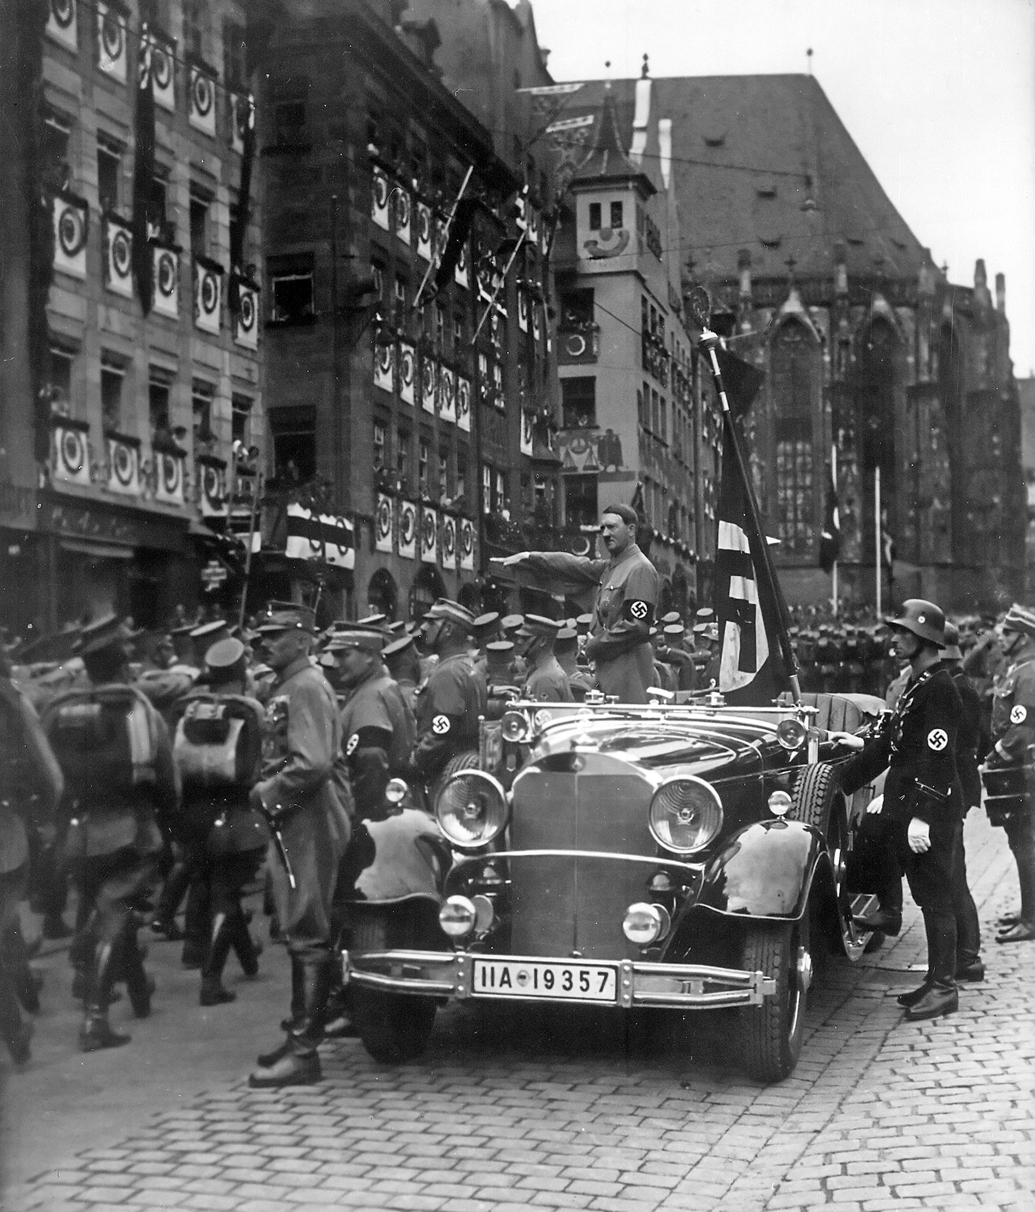
US.45 · DIRECT INSTRUCTION
3 of 4
Totalitarianism in Italy, Germany, and Soviet Union
Totalitarianism is a political system where government exercises complete control over all public and private life.
In Italy, Benito Mussolini ("Il Duce") established fascist dictatorship (1922-1943), using Blackshirts to intimidate opponents.
In the Soviet Union, Joseph Stalin consolidated power after Lenin's death, implementing Five-Year Plans, forced collectivization causing famine, and the Great Purge eliminating millions.
In Germany, Adolf Hitler ("Führer") established Nazi dictatorship (1933-1945), promoting Aryan supremacy and anti-Semitism, using the Gestapo secret police, and seeking "Lebensraum" through territorial expansion.
Charles Russell (donor) / National Archives and Records Administration (NARA), September 1935 National Archives
U.S. History Hack · TroopToTeacher Technologies LLC · Aligned to TN Academic Standards & TCAP EOC
10

Slide 12
US.45 · DIRECT INSTRUCTION
4 of 4
Factors Facilitating International Spread
Common factors enabling totalitarianism included the Great Depression creating conditions for radical solutions, political instability with weak democratic governments, social upheaval from war and revolution, charismatic leaders promising simple solutions, and mass communication enabling propaganda.
The League of Nations' weakness, Western appeasement policies, and economic nationalism allowed aggression to go unchallenged.
German rearmament, Italian conquest of Ethiopia, and Japanese expansion in Asia demonstrated international system breakdown.
U.S. History Hack · TroopToTeacher Technologies LLC · Aligned to TN Academic Standards & TCAP EOC
11

Slide 13
US.45 · PEOPLE WHO SHAPED THE ERA
Key Figures
Adolf Hitler
Joseph Stalin
Nazi dictator of Germany (1889-1945)
Soviet dictator (1878-1953)
Built a totalitarian one-party state after 1933
Preached ultranationalism, racism, and endless expansion
Launched the aggression that started WWII in Europe
Turned the USSR into a totalitarian communist state
Used purges, gulags, and terror to hold power
Later joined the Allies against Hitler
STRATEGY Use Hitler to define fascism/totalitarianism from a real regime, not an abstraction.
STRATEGY Pair Stalin with Hitler so students see totalitarianism on both the far left and far right.
U.S. History Hack · TroopToTeacher Technologies LLC · Aligned to TN Academic Standards & TCAP EOC
12

Slide 14
US.45 · PRIMARY SOURCE ANALYSIS
The Doctrine of Fascism
Argumentation
Benito Mussolini · 1932
"The Fascist State organizes the nation, but leaves a sufficient margin of liberty to the individual; the latter is deprived of all useless and possibly harmful freedom, but retains what is essential; the deciding power in this question cannot be the individual, but the State alone... The Fascist conception of the State is all-embracing; outside of it no human or spiritual values can exist, much less have value."
CONTEXT
By 1932, Europe was in political turmoil as the Great Depression shook democratic governments to their foundations. Mussolini had already seized power in Italy in 1922 and was building a new kind of authoritarian state called fascism, which prioritized the nation and state above all individual rights. His ideas were spreading, influencing Hitler's rise in Germany and threatening democratic values worldwide.
ANALYZE
According to this excerpt, what is the Fascist view of the relationship between the individual and the State?
READ CLOSELY Underline the exact words that answer the ANALYZE question — be ready to read them aloud.
SOURCE IT
WHO made it?
WHEN?
WHY does it matter?
FIRST
Benito Mussolini
1932
Consider the author's purpose and audience before reading the words.
SSP.02 · before you interpret
Source: Internet Archive
U.S. History Hack · TroopToTeacher Technologies LLC · Aligned to TN Academic Standards & TCAP EOC
13
Notes:
Primary-source analysis. SOURCE IT FIRST (SSP.02) — model the sourcing routine aloud before students interpret: WHO made this source? (Benito Mussolini) WHEN? (1932) WHY does that matter? (Consider the author's purpose and audience before reading the words.) Only then move to the ANALYZE question. Suggested answer: See teacher key. Practice skill: Argumentation.

Slide 15
US.45 · KEY VOCABULARY
Word Wall
Fascism
Fascismo
Totalitarianism
Totalitarismo
say: FASH-iz-um
say: toh-tal-ih-TAIR-ee-uh-niz-um
F
An authoritarian political ideology that emphasizes extreme nationalism, militarism, totalitarian control, and a dictatorial leader. Suppresses opposition and glorifies the state above individual rights.
T
A system of government where the state controls every aspect of public and private life, using propaganda, secret police, and terror to eliminate opposition.
Communism
Comunismo
Adolf Hitler
Adolf Hitler
say: KOM-yoo-niz-um
say: AY-dolf HIT-ler
C
A political and economic system in which the state owns property and the means of production in the name of the working class; in the 20th century it took the form of one-party dictatorship under leaders like Vladimir Lenin and Joseph Stalin in the Soviet Union.
AH
Nazi dictator of Germany (1933-1945) who led Germany into World War II and orchestrated the Holocaust, resulting in the deaths of 6 million Jews and millions of others.
Benito Mussolini
Benito Mussolini
Joseph Stalin
Joseph Stalin
say: beh-NEE-toh moo-suh-LEE-nee
say: JOH-zef STAH-lin
BM
Fascist dictator of Italy (1922-1943) who created the first fascist state, formed the Axis alliance with Hitler, and led Italy into World War II.
JS
Communist dictator of the Soviet Union (1924-1953) who ruled through terror, forced collectivization, and purges, resulting in millions of deaths.
"say:" pronunciation guide (stressed syllable in CAPS) and a per-term visual anchor support newcomer English learners. Spanish term + full bilingual Frayer models are in the unit vocabulary set.
U.S. History Hack · TroopToTeacher Technologies LLC · Aligned to TN Academic Standards & TCAP EOC
14

Slide 16
US.45 · GUIDED PRACTICE — WE DO IT TOGETHER
Let’s Work One Together
Compare authoritarian systems
MODEL PROMPT: What do fascism and communism share, and where do they split?
WORKED EXAMPLE (teacher models this aloud)
Both crush individual rights and opposition under one party. They split on economics: fascism keeps private property under state control; communism abolishes it. The tool - total control - is the same.
THINK ALOUD
In the section, underline one shared trait and one difference.
→ Now you try: With a partner, name the single feature that makes a government 'totalitarian,' citing a line.
U.S. History Hack · TroopToTeacher Technologies LLC · Aligned to TN Academic Standards & TCAP EOC
15
Notes:
GUIDED PRACTICE / WE DO (US.45). Skill modeled: Compare authoritarian systems. Model the worked example aloud using the THINK ALOUD as your script, then release students to the activity ("With a partner, name the single feature that makes a government 'totalitarian,' citing a line."). This is the I Do → We Do → You Do bridge — do not skip it; aim for 80%+ success before independent work.

Slide 17
US.45 · STUDENT ACTIVITY
Three Roads to Dictatorship — Comparing Fascism, Communism, and Totalitarianism
Groups of 3
15 min
YOUR TASK
Using your Cornell notes and Mussolini's 'Doctrine of Fascism' excerpt, build a comparison chart with three columns: FASCISM, COMMUNISM, and TOTALITARIANISM. For each, record its core belief, one leader (Mussolini, Hitler, Stalin), and how it controlled its people. Add one factor that helped these systems spread after World War I (economic depression, fear, nationalism, weak democracies). Finish with a one-sentence claim naming what all three systems had in common.
DELIVERABLE
DIFFERENTIATION
Completed three-column comparison chart (belief, leader, method of control, plus one spread factor) AND a one-sentence evidence-based claim about their shared features.
Entry: Chart with the three systems pre-labeled and a word bank of beliefs, leaders, and control methods to sort. Honors: Write a paragraph arguing whether fascism and communism were opposites or mirror images, using Mussolini's words as evidence.
Companion printable: cornell-notes/unit-6/us45-fascism-communism-totalitarianism.pdf
U.S. History Hack · TroopToTeacher Technologies LLC · Aligned to TN Academic Standards & TCAP EOC
16
Notes:
Student activity for US.45. Pair with the printable: cornell-notes/unit-6/us45-fascism-communism-totalitarianism.pdf. Timing: 15. Deliverable: Completed three-column comparison chart (belief, leader, method of control, plus one spread factor) AND a one-sentence evidence-based claim about their shared features.

Slide 18
US.45 · CHECK FOR UNDERSTANDING
TCAP-Style Question
DOK 2
EOC PRACTICE
Read the excerpt below.
"Germany alone is not to blame for this war. The atmosphere of militarism that has poisoned Europe — the arms race, the secret treaties, the nationalism that inflames every petty dispute — has made this catastrophe inevitable." — Socialist Newspaper Vorwärts, Berlin, August 1914
Which of the following best describes the rise of dictators and extreme nationalism as a long-term cause of World War II, similar to the dynamics described here for WWI?
Extreme nationalism, economic grievances, and militarism created conditions in which charismatic demagogues could rise to power by exploiting popular anger.
A
Communist revolutions swept through Europe, and fascist dictators rose as the only force capable of stopping communism's spread.
B
Democratic parties lost elections in Germany, Italy, and Japan, peacefully transferring power to fascist parties through legitimate processes.
C
Economic prosperity in the 1920s created excessive confidence that led nations to pursue reckless expansionist policies.
D
ANSWER FIRST: students commit — then click / advance to reveal the correct answer and explanation.
U.S. History Hack · TroopToTeacher Technologies LLC · Aligned to TN Academic Standards & TCAP EOC
17
Notes:
CHECK FOR UNDERSTANDING (US.45, DOK 2). Have students commit to an answer (whiteboards, hand signal, or turn-and-talk) BEFORE advancing. Correct answer: A. The next slide reveals it. Why: The excerpt describes how extreme nationalism, militarism, and an arms race created the conditions for WWI. These same forces — extreme nationalism, economic grievance, and militarism — fueled the rise of fascist dictators like Hitler, Mussolini, and military regimes in Japan in the 1930s. Hitler exploited German nationalism, economic humiliation from WWI, and fear of communism to seize power and pursue aggressive expansion. Option B is incorrect because communist revolutions were a separate phenomenon. Option C is incorrect because democracy's failure is more nuanced than simply losing elections. Option D is incorrect because it describes a consequence, not the causes of dictatorship.

Slide 19
US.45 · ANSWER REVEAL
TCAP-Style Question
✓ ANSWER KEY
Read the excerpt below.
"Germany alone is not to blame for this war. The atmosphere of militarism that has poisoned Europe — the arms race, the secret treaties, the nationalism that inflames every petty dispute — has made this catastrophe inevitable." — Socialist Newspaper Vorwärts, Berlin, August 1914
Which of the following best describes the rise of dictators and extreme nationalism as a long-term cause of World War II, similar to the dynamics described here for WWI?
A
Extreme nationalism, economic grievances, and militarism created conditions in which charismatic demagogues could rise to power by exploiting popular anger.
✓
B
Communist revolutions swept through Europe, and fascist dictators rose as the only force capable of stopping communism's spread.
C
Democratic parties lost elections in Germany, Italy, and Japan, peacefully transferring power to fascist parties through legitimate processes.
D
Economic prosperity in the 1920s created excessive confidence that led nations to pursue reckless expansionist policies.
Correct answer: A. Why: The excerpt describes how extreme nationalism, militarism, and an arms race created the conditions for WWI. These same forces — extreme nationalism, economic grievance, and militarism — fueled the rise of fascist dictators like Hitler, Mussolini, and military regimes in Japan in the 1930s. Hitler exploited German nationalism, economic humiliation from WWI, and fear of communism to seize power and pursue aggressive expansion.
U.S. History Hack · TroopToTeacher Technologies LLC · Aligned to TN Academic Standards & TCAP EOC
18
Notes:
ANSWER KEY (US.45). Correct: A. The excerpt describes how extreme nationalism, militarism, and an arms race created the conditions for WWI. These same forces — extreme nationalism, economic grievance, and militarism — fueled the rise of fascist dictators like Hitler, Mussolini, and military regimes in Japan in the 1930s. Hitler exploited German nationalism, economic humiliation from WWI, and fear of communism to seize power and pursue aggressive expansion. Option B is incorrect because communist revolutions were a separate phenomenon. Option C is incorrect because democracy's failure is more nuanced than simply losing elections. Option D is incorrect because it describes a consequence, not the causes of dictatorship.

Slide 20
US.45 · WRAP-UP
What You Need to Know for TCAP
KEY TAKEAWAYS
EXIT TICKET
DOK 2
Key Characteristics of Fascism
Fundamental Tenets of Communism
Totalitarianism in Italy, Germany, and Soviet Union
Factors Facilitating International Spread
Explain how fascism, communism, and totalitarianism are alike and different, and name one factor that helped them spread after World War I.
★ HONORS / EXTENSION DOK 3 · SSP.04 Argumentation
Evaluate: Were fascism and communism true opposites or mirror images of each other? Argue your position with at least two pieces of evidence. (SSP.04)
U.S. History Hack · TroopToTeacher Technologies LLC · Aligned to TN Academic Standards & TCAP EOC
19
Notes:
WRAP-UP / EXIT-TICKET KEY (US.45, DOK 2). Prompt: Explain how fascism, communism, and totalitarianism are alike and different, and name one factor that helped them spread after World War I. Model answer: All three were forms of dictatorship that crushed opposition and demanded total loyalty to the state. Fascism (Mussolini, Hitler) glorified the nation and race and kept private property under state control; communism (Stalin) claimed to represent workers and abolished private ownership. Totalitarianism describes the total government control common to all of them. They spread because economic depression, resentment over World War I, fear, and weak democracies made desperate people willing to trade freedom for order and strong leadership. RETEACH TRIGGER — if a student misses this exit ticket: (1) <50% of class miss → spiral it into the next standard’s Quick Review opener (see the US.45 review prompts). (2) Individual/small group → reteach with the "Key Characteristics of Fascism" direct-instruction slide + re-run the SOURCE IT FIRST routine on the US.45 primary source, then assign the paired printable: cornell-notes/unit-6/us45-fascism-communism-totalitarianism.pdf. (3) Re-assess with the US.45 check-for-understanding reveal slide as a do-now the next day. Reteach anchors (this standard’s sections): Key Characteristics of Fascism; Fundamental Tenets of Communism; Totalitarianism in Italy, Germany, and Soviet Union; Factors Facilitating International Spread. I Can objective: I can explain the rise and spread of fascism, communism, and totalitarianism internationally, including the key characteristics and leaders of each system. HONORS / EXTENSION (DOK 3, for early finishers or advanced learners): Evaluate: Were fascism and communism true opposites or mirror images of each other? Argue your position with at least two pieces of evidence. (SSP.04) — look for a clear claim plus two specific pieces of evidence.

Slide 21
STANDARD
SOCIAL STUDIES PRACTICES
US.46
SSP.02
Examine a source
SSP.01
Collect sources
SSP.05
Historical awareness
FDR's Response to World Crises
TN ACADEMIC STANDARD
Explain President Franklin D. Roosevelt's response to world crises, including: The Quarantine Speech, the Four Freedoms speech, the Atlantic Charter, and the Lend-Lease Act.
I CAN
I can explain President Franklin D. Roosevelt's response to world crises, including the Quarantine Speech, the Four Freedoms speech, the Atlantic Charter, and the Lend-Lease Act.
U.S. History Hack · TroopToTeacher Technologies LLC · Aligned to TN Academic Standards & TCAP EOC
20

Slide 22
KEY VOCABULARY · LANGUAGE SUPPORT
US.45
Words you need before we read
Fascism
Totalitarianism
Communism
En español: Fascismo
En español: Totalitarismo
En español: Comunismo
WHAT IT MEANS
WHAT IT MEANS
WHAT IT MEANS
An authoritarian political ideology that emphasizes extreme nationalism, militarism, totalitarian control, and a dictatorial leader. Suppresses opposition and glorifies the state above individual rights.
A system of government where the state controls every aspect of public and private life, using propaganda, secret police, and terror to eliminate opposition.
A political and economic system in which the state owns property and the means of production in the name of the working class; in the 20th century it took the form of one-party dictatorship under leaders like Vladimir Lenin and Joseph Stalin in the Soviet Union.
UDL · REPRESENTATION → LANGUAGE & SYMBOLS
U.S. History Hack · TEACHER DECK · Aligned to TN Academic Standards & TCAP EOC
2

Slide 23
PROGRESS CHECK
US.45
Check your understanding
How did economic crisis and political instability enable the rise of totalitarian regimes in Italy, Germany, and the Soviet Union?
A
The Great Depression, post-WWI disappointment, and political chaos created conditions where people accepted radical solutions and strong leaders promising stability
✓ KEY
B
Economic prosperity led people to seek stronger government control, although this view has been largely discredited by scholars, which does not align with the documented historical record
C
Totalitarian regimes rose during periods of peace and prosperity, despite the fact that multiple sources contradict this view, which does not align with the documented historical record
D
Democratic governments actively promoted totalitarianism, which does not align with the documented historical record, but the historical evidence paints a more nuanced picture
UDL · ACTION & EXPRESSION → STRATEGY DEVELOPMENT
MTSS: below mastery → targeted reteach (Tier 2); at/above → extension. The goal never lowers.
U.S. History Hack · TEACHER DECK · Aligned to TN Academic Standards & TCAP EOC
3

Slide 24
US.46 · QUICK REVIEW
Do You Remember?
Before we start, retrieve what we have already learned. Answer from memory first — no notes.
1
US.45 Name the three totalitarian systems and one leader of each.
2
US.45 What is totalitarianism?
U.S. History Hack · TroopToTeacher Technologies LLC · Aligned to TN Academic Standards & TCAP EOC
21
Notes:
SPACED RETRIEVAL (US.46). Cold-call or whiteboards, 3-4 min, low stakes. Answers — 1) Fascism (Mussolini in Italy, Hitler in Germany) and communism (Stalin in the Soviet Union), all forms of totalitarianism. 2) A system in which the government controls nearly every part of public and private life and crushes all opposition.

Slide 25
US.46 · CONFIDENCE CHECK
Warm-Up — Quick Recall
DOK 1
LOW STAKES
Everyone can answer this. Thumbs / whiteboards — no notes.
Before entering the war, what policy did the U.S. use to aid the Allies with weapons and supplies?
✓ ANSWER
The Lend-Lease Act of 1941.
COMMIT FIRST: have everyone answer before the reveal — this is the DOK 1 floor; the graded check later in this lesson moves up to DOK 2–3.
U.S. History Hack · TroopToTeacher Technologies LLC · Aligned to TN Academic Standards & TCAP EOC
22
Notes:
CONFIDENCE CHECK (US.46, DOK 1). 60-90 seconds. Have EVERY student commit (thumbs / whiteboard / choral) before revealing — this secures an early win and surfaces who is shaky before new content. Answer: The Lend-Lease Act of 1941. Key term to listen for: Lend-Lease Act (1941). This is the low-floor entry; the graded Check for Understanding later in the standard rises to DOK 2–3.

Slide 26
US.46 · HOOK
Think About It
As Europe fell to Hitler and Japan expanded across the Pacific, a still-neutral United States watched, until President Roosevelt began step by step to turn the nation into what he called the 'great arsenal of democracy.'
DISCUSS
TIMING: Turn & Talk 60 sec → cold-call 2 pairs
How does a president move a reluctant, isolationist nation toward war without ever firing a shot?
U.S. History Hack · TroopToTeacher Technologies LLC · Aligned to TN Academic Standards & TCAP EOC
23
Notes:
HOOK (US.46). Run tight: pose the provocation, give a silent 10-second think, then Turn & Talk 60 seconds. Cold-call 2–3 pairs (not volunteers) for a sentence-starter answer — "One force was ___ because ___" — then bridge to the standard. Keep total to ~4 minutes; do not let it sprawl. Return to this question at the unit close for an evidence-based answer.

Slide 27
US.46 · DIRECT INSTRUCTION
1 of 4
Quarantine Speech (October 5, 1937)
As Japan invaded China and European tensions grew, Roosevelt faced strong isolationist sentiment reflected in the Neutrality Acts (1935-1937).
In his Quarantine Speech, FDR compared aggressor nations to a disease requiring quarantine, suggesting peace-loving nations should cooperate against aggressors.
This was the first major departure from strict isolationism, laying groundwork for later interventionist policies, though public reaction was mixed and no immediate policy changes resulted.
SENTENCE FRAME (EL & writing support)
FDR moved the U.S. away from neutrality by ________ and ________, which helped the Allies because ________.
U.S. History Hack · TroopToTeacher Technologies LLC · Aligned to TN Academic Standards & TCAP EOC
24
Notes:
FACILITATION (US.46). Ask: if a fire is burning in your neighbor's house, do you wait until it reaches yours? Then meet FDR deciding how much to help the Allies. Teach in small steps; pause and check for understanding before the next chunk (aim 80%+ before moving on).

Slide 28
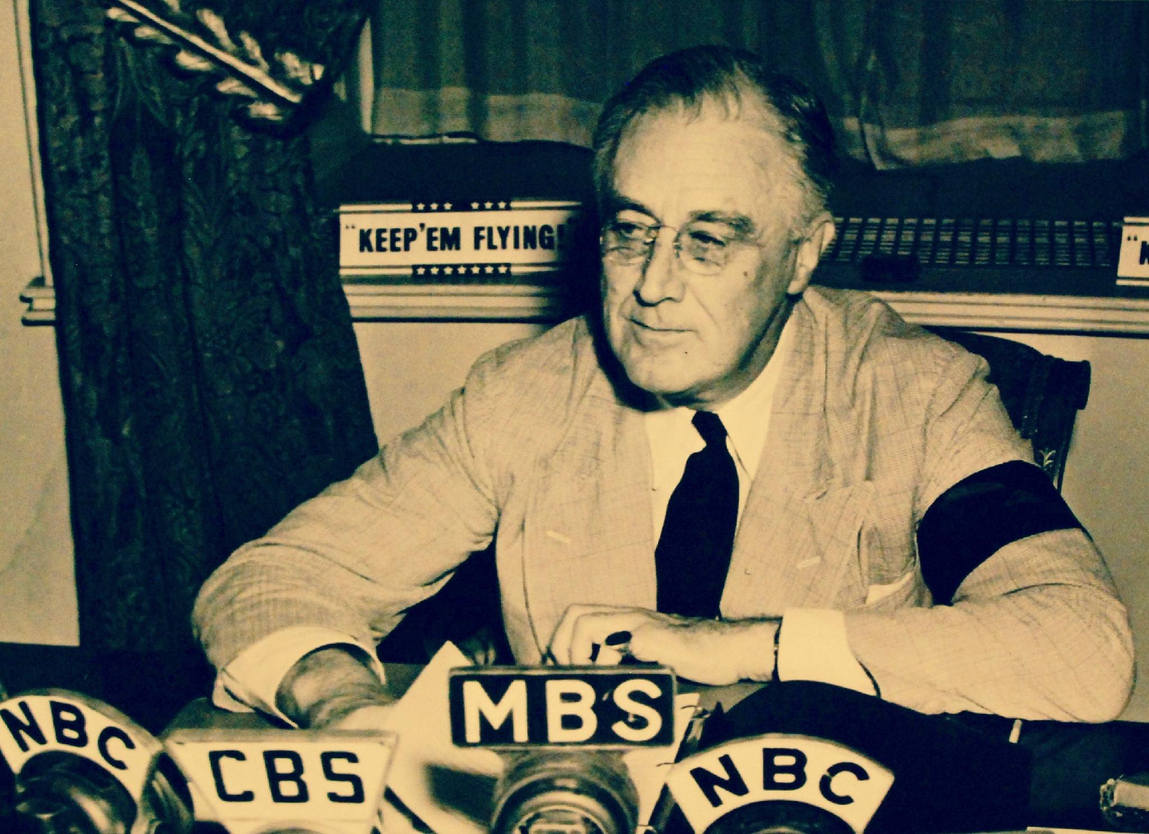
US.46 · DIRECT INSTRUCTION
2 of 4
Four Freedoms Speech (January 6, 1941)
Roosevelt outlined four essential freedoms that should exist "everywhere in the world": Freedom of Speech and Expression, Freedom of Worship, Freedom from Want (economic security), and Freedom from Fear (reduction of armaments).
These freedoms provided moral justification for U.S. involvement in war, defined what America would fight for, and outlined goals for post-war international order.
The Four Freedoms contrasted democratic values with fascist oppression and later influenced the Universal Declaration of Human Rights.
OWI / U.S. Government, September 11, 1941 National Archives
U.S. History Hack · TroopToTeacher Technologies LLC · Aligned to TN Academic Standards & TCAP EOC
25

Slide 29
US.46 · DIRECT INSTRUCTION
3 of 4
Atlantic Charter (August 14, 1941)
Meeting secretly with Winston Churchill off Newfoundland, Roosevelt established war aims and post-war principles: no territorial aggrandizement, self-determination for peoples, economic cooperation and free trade, freedom of the seas, disarmament after war, and collective security through international organization.
The Charter became the foundation for the United Nations, encouraged decolonization movements, and established precedents for international human rights law.
U.S. History Hack · TroopToTeacher Technologies LLC · Aligned to TN Academic Standards & TCAP EOC
26

Slide 30
US.46 · DIRECT INSTRUCTION
4 of 4
Lend-Lease Act (March 11, 1941)
The Lend-Lease Act allowed the U.S. to provide military equipment to Britain without requiring immediate payment, circumventing neutrality while making America the "Arsenal of Democracy." Eventually totaling $50 billion, aid went primarily to Britain (60%), Soviet Union (20%), and China.
The program enabled British survival, supported Soviet resistance to German invasion, and stimulated U.S. industrial production while effectively ending true American neutrality.
U.S. History Hack · TroopToTeacher Technologies LLC · Aligned to TN Academic Standards & TCAP EOC
27

Slide 31
US.46 · PEOPLE WHO SHAPED THE ERA
Key Figure
Franklin D. Roosevelt
32nd President; responding to world crises
Gave the 1937 Quarantine Speech warning against aggressors
Won Lend-Lease (1941) to arm Britain short of war
Framed the fight as defending the 'Four Freedoms'
STRATEGY Trace FDR's steps from neutrality toward intervention - each speech and law moves the line.
U.S. History Hack · TroopToTeacher Technologies LLC · Aligned to TN Academic Standards & TCAP EOC
28

Slide 32
US.46 · PRIMARY SOURCE ANALYSIS
The Four Freedoms Speech
Close Reading
President Franklin D. Roosevelt · January 6, 1941
"In the future days, which we seek to make secure, we look forward to a world founded upon four essential human freedoms. The first is freedom of speech and expression—everywhere in the world. The second is freedom of every person to worship God in his own way—everywhere in the world. The third is freedom from want... The fourth is freedom from fear."
CONTEXT
In January 1941, World War II was raging in Europe and Asia, but the United States had not yet entered the conflict. Many Americans wanted to stay out of foreign wars, a position called isolationism. Roosevelt used this address—his annual State of the Union—to argue that America had a stake in a free world and to prepare the public for a more active role in supporting democracies under attack.
ANALYZE
What is the main argument President Roosevelt makes in this excerpt?
READ CLOSELY Underline the exact words that answer the ANALYZE question — be ready to read them aloud.
SOURCE IT
WHO made it?
WHEN?
WHY does it matter?
FIRST
President Franklin D. Roosevelt
January 6, 1941
Consider the author's purpose and audience before reading the words.
SSP.02 · before you interpret
Source: National Archives
U.S. History Hack · TroopToTeacher Technologies LLC · Aligned to TN Academic Standards & TCAP EOC
29
Notes:
Primary-source analysis. SOURCE IT FIRST (SSP.02) — model the sourcing routine aloud before students interpret: WHO made this source? (President Franklin D. Roosevelt) WHEN? (January 6, 1941) WHY does that matter? (Consider the author's purpose and audience before reading the words.) Only then move to the ANALYZE question. Suggested answer: See teacher key. Practice skill: Close Reading.

Slide 33
US.46 · KEY VOCABULARY
Word Wall
Quarantine Speech
Discurso de la Cuarentena
Four Freedoms Speech
Discurso de las Cuatro Libertades
say: KWOR-un-teen speech
say: for FREE-dumz speech
QS
FDR's 1937 address proposing that peace-loving nations 'quarantine' aggressor states to halt the spread of international lawlessness.
FF
FDR's 1941 speech defining American war aims: freedom of speech, freedom of worship, freedom from want, and freedom from fear.
Lend-Lease Act (1941)
Ley de Préstamo y Arriendo (1941)
Appeasement
Apaciguamiento
say: lend lees akt
say: uh-PEEZ-ment
LA
U.S. program allowing the President to lend or lease war supplies to any nation deemed vital to American defense, primarily Britain and the Soviet Union.
A
Policy of making concessions to aggressive powers to avoid conflict. Britain's PM Chamberlain practiced appeasement with Hitler at the Munich Conference (1938), allowing Germany to annex the Sudetenland from Czechoslovakia.
Axis Powers
Potencias del Eje
Allied Powers
Potencias Aliadas
say: AK-sis POW-erz
say: AL-yd POW-erz
AP
Military alliance of Germany, Italy, and Japan during World War II. United by shared goals of territorial expansion, militarism, and opposition to democratic nations.
AP
The World War II coalition led by the United States, Great Britain, and the Soviet Union that fought and defeated the Axis Powers.
"say:" pronunciation guide (stressed syllable in CAPS) and a per-term visual anchor support newcomer English learners. Spanish term + full bilingual Frayer models are in the unit vocabulary set.
U.S. History Hack · TroopToTeacher Technologies LLC · Aligned to TN Academic Standards & TCAP EOC
30

Slide 34
US.46 · GUIDED PRACTICE — WE DO IT TOGETHER
Let’s Work One Together
Trace a leader's shifting policy
MODEL PROMPT: How did FDR move America closer to war without declaring it?
WORKED EXAMPLE (teacher models this aloud)
Step by step: the Quarantine Speech named the danger, Lend-Lease armed the Allies, and the Four Freedoms defined the cause. Each move edged past neutrality.
THINK ALOUD
List FDR's actions in order and label each 'more neutral' or 'more involved.'
→ Now you try: Pick the boldest step short of war and defend your choice with evidence.
U.S. History Hack · TroopToTeacher Technologies LLC · Aligned to TN Academic Standards & TCAP EOC
31
Notes:
GUIDED PRACTICE / WE DO (US.46). Skill modeled: Trace a leader's shifting policy. Model the worked example aloud using the THINK ALOUD as your script, then release students to the activity ("Pick the boldest step short of war and defend your choice with evidence."). This is the I Do → We Do → You Do bridge — do not skip it; aim for 80%+ success before independent work.

Slide 35
US.46 · STUDENT ACTIVITY
From Neutral to Arsenal — Tracking FDR's Response
Pairs
15 min
YOUR TASK
Read the Four Freedoms speech excerpt and use your notes to build a timeline of FDR's four key responses to the world crisis: the Quarantine Speech (1937), the Four Freedoms speech (Jan 1941), the Lend-Lease Act (March 1941), and the Atlantic Charter (Aug 1941). For each, write one sentence on what it did and how it moved the U.S. away from strict neutrality. Finish with a one-sentence claim on whether FDR was leading the nation toward war or trying to keep it out.
DELIVERABLE
DIFFERENTIATION
Completed four-step timeline (one sentence each on purpose + move away from neutrality) AND a one-sentence evidence-based claim about FDR's intent.
Entry: Timeline with the four events pre-placed and a word bank of descriptions to match. Honors: Write a paragraph using the Four Freedoms speech to explain how FDR framed aid to the Allies as a defense of democracy itself.
Companion printable: cornell-notes/unit-6/us46-fdr-response-world-crises.pdf
U.S. History Hack · TroopToTeacher Technologies LLC · Aligned to TN Academic Standards & TCAP EOC
32
Notes:
Student activity for US.46. Pair with the printable: cornell-notes/unit-6/us46-fdr-response-world-crises.pdf. Timing: 15. Deliverable: Completed four-step timeline (one sentence each on purpose + move away from neutrality) AND a one-sentence evidence-based claim about FDR's intent.

Slide 36
US.46 · CHECK FOR UNDERSTANDING
TCAP-Style Question
DOK 2
EOC PRACTICE
What was the primary significance of FDR's Quarantine Speech of 1937 in relation to American foreign policy?
It committed the United States to immediately entering the war against Nazi Germany.
A
It suggested that aggressive nations should be isolated, signaling a possible shift away from strict neutrality.
B
It announced the creation of the Lend-Lease program to supply weapons to Allied nations.
C
It declared that the U.S. would defend any nation attacked by a foreign aggressor.
D
ANSWER FIRST: students commit — then click / advance to reveal the correct answer and explanation.
U.S. History Hack · TroopToTeacher Technologies LLC · Aligned to TN Academic Standards & TCAP EOC
33
Notes:
CHECK FOR UNDERSTANDING (US.46, DOK 2). Have students commit to an answer (whiteboards, hand signal, or turn-and-talk) BEFORE advancing. Correct answer: B. The next slide reveals it. Why: In the Quarantine Speech, FDR compared aggressive nations to a disease epidemic and suggested that the international community might need to 'quarantine' them — hinting at collective action against aggressor states and marking a cautious move away from strict neutrality, though public and congressional isolationism remained strong.

Slide 37
US.46 · ANSWER REVEAL
TCAP-Style Question
✓ ANSWER KEY
What was the primary significance of FDR's Quarantine Speech of 1937 in relation to American foreign policy?
A
It committed the United States to immediately entering the war against Nazi Germany.
B
It suggested that aggressive nations should be isolated, signaling a possible shift away from strict neutrality.
✓
C
It announced the creation of the Lend-Lease program to supply weapons to Allied nations.
D
It declared that the U.S. would defend any nation attacked by a foreign aggressor.
Correct answer: B. Why: In the Quarantine Speech, FDR compared aggressive nations to a disease epidemic and suggested that the international community might need to 'quarantine' them — hinting at collective action against aggressor states and marking a cautious move away from strict neutrality, though public and congressional isolationism remained strong.
U.S. History Hack · TroopToTeacher Technologies LLC · Aligned to TN Academic Standards & TCAP EOC
34
Notes:
ANSWER KEY (US.46). Correct: B. In the Quarantine Speech, FDR compared aggressive nations to a disease epidemic and suggested that the international community might need to 'quarantine' them — hinting at collective action against aggressor states and marking a cautious move away from strict neutrality, though public and congressional isolationism remained strong.

Slide 38
US.46 · WRAP-UP
What You Need to Know for TCAP
KEY TAKEAWAYS
EXIT TICKET
DOK 2
Quarantine Speech (October 5, 1937)
Four Freedoms Speech (January 6, 1941)
Atlantic Charter (August 14, 1941)
Lend-Lease Act (March 11, 1941)
Explain how FDR moved the U.S. from neutrality toward supporting the Allies. Give at least two specific actions.
★ HONORS / EXTENSION DOK 3 · SSP.04 Argumentation
Evaluate: Was FDR leading the nation toward war or genuinely trying to keep it out? Argue with at least two pieces of evidence. (SSP.04)
U.S. History Hack · TroopToTeacher Technologies LLC · Aligned to TN Academic Standards & TCAP EOC
35
Notes:
WRAP-UP / EXIT-TICKET KEY (US.46, DOK 2). Prompt: Explain how FDR moved the U.S. from neutrality toward supporting the Allies. Give at least two specific actions. Model answer: FDR gradually shifted the U.S. from isolation to active support. In the Quarantine Speech (1937) he warned against aggressor nations. In the Four Freedoms speech (1941) he framed the coming struggle as a defense of universal freedoms. The Lend-Lease Act (1941) let the U.S. supply Britain and the Allies with weapons, and the Atlantic Charter (1941) set shared war aims with Churchill. Together these steps made America the 'arsenal of democracy' before Pearl Harbor. RETEACH TRIGGER — if a student misses this exit ticket: (1) <50% of class miss → spiral it into the next standard’s Quick Review opener (see the US.46 review prompts). (2) Individual/small group → reteach with the "Quarantine Speech (October 5, 1937)" direct-instruction slide + re-run the SOURCE IT FIRST routine on the US.46 primary source, then assign the paired printable: cornell-notes/unit-6/us46-fdr-response-world-crises.pdf. (3) Re-assess with the US.46 check-for-understanding reveal slide as a do-now the next day. Reteach anchors (this standard’s sections): Quarantine Speech (October 5, 1937); Four Freedoms Speech (January 6, 1941); Atlantic Charter (August 14, 1941); Lend-Lease Act (March 11, 1941). I Can objective: I can explain President Franklin D. Roosevelt's response to world crises, including the Quarantine Speech, the Four Freedoms speech, the Atlantic Charter, and the Lend-Lease Act. HONORS / EXTENSION (DOK 3, for early finishers or advanced learners): Evaluate: Was FDR leading the nation toward war or genuinely trying to keep it out? Argue with at least two pieces of evidence. (SSP.04) — look for a clear claim plus two specific pieces of evidence.

Slide 39
STANDARD
SOCIAL STUDIES PRACTICES
US.47
SSP.02
Examine a source
SSP.03
Synthesize sources
SSP.05
Historical awareness
U.S. Response to the Holocaust
TN ACADEMIC STANDARD
Analyze the response of the U.S. to the plight of European Jews before the start of the war, the U.S. liberation of concentration camps during the war, and the immigration of Holocaust survivors after the war.
I CAN
I can analyze the response of the U.S. to the plight of European Jews before the war, the liberation of concentration camps during the war, and the immigration of Holocaust survivors after the war.
U.S. History Hack · TroopToTeacher Technologies LLC · Aligned to TN Academic Standards & TCAP EOC
36

Slide 40
KEY VOCABULARY · LANGUAGE SUPPORT
US.46
Words you need before we read
Quarantine Speech
Four Freedoms Speech
Lend-Lease Act (1941)
En español: Discurso de la Cuarentena
En español: Discurso de las Cuatro Libertades
En español: Ley de Préstamo y Arriendo (1941)
WHAT IT MEANS
WHAT IT MEANS
WHAT IT MEANS
FDR's 1937 address proposing that peace-loving nations 'quarantine' aggressor states to halt the spread of international lawlessness.
FDR's 1941 speech defining American war aims: freedom of speech, freedom of worship, freedom from want, and freedom from fear.
U.S. program allowing the President to lend or lease war supplies to any nation deemed vital to American defense, primarily Britain and the Soviet Union.
UDL · REPRESENTATION → LANGUAGE & SYMBOLS
U.S. History Hack · TEACHER DECK · Aligned to TN Academic Standards & TCAP EOC
4

Slide 41
PROGRESS CHECK
US.46
Check your understanding
How did the Atlantic Charter establish principles for the post-war international order?
A
It focused only on immediate military strategy, yet the available evidence points to a different conclusion, which contradicts the primary source evidence from this era
B
It established principles including self-determination, free trade, collective security, and disarmament that became the foundation for the United Nations and post-war international law
✓ KEY
C
It divided the world into American and British spheres of influence, despite the fact that multiple sources contradict this view, but closer analysis reveals a more complicated historical reality
D
It had no lasting impact on international relations, though this interpretation lacks supporting historical evidence, although historical sources do not support this conclusion
UDL · ACTION & EXPRESSION → STRATEGY DEVELOPMENT
MTSS: below mastery → targeted reteach (Tier 2); at/above → extension. The goal never lowers.
U.S. History Hack · TEACHER DECK · Aligned to TN Academic Standards & TCAP EOC
5

Slide 42
US.47 · QUICK REVIEW
Do You Remember?
Before we start, retrieve what we have already learned. Answer from memory first — no notes.
1
US.46 What was the Lend-Lease Act?
2
US.46 What were the 'Four Freedoms' FDR named?
U.S. History Hack · TroopToTeacher Technologies LLC · Aligned to TN Academic Standards & TCAP EOC
37
Notes:
SPACED RETRIEVAL (US.47). Cold-call or whiteboards, 3-4 min, low stakes. Answers — 1) A 1941 law letting the U.S. send weapons and supplies to Britain and other Allies before it officially entered the war, making America the 'arsenal of democracy.' 2) Freedom of speech, freedom of worship, freedom from want, and freedom from fear, the values he said the Allies were defending.

Slide 43
US.47 · CONFIDENCE CHECK
Warm-Up — Quick Recall
DOK 1
LOW STAKES
Everyone can answer this. Thumbs / whiteboards — no notes.
What name is given to the Nazi genocide of six million Jews?
✓ ANSWER
The Holocaust.
COMMIT FIRST: have everyone answer before the reveal — this is the DOK 1 floor; the graded check later in this lesson moves up to DOK 2–3.
U.S. History Hack · TroopToTeacher Technologies LLC · Aligned to TN Academic Standards & TCAP EOC
38
Notes:
CONFIDENCE CHECK (US.47, DOK 1). 60-90 seconds. Have EVERY student commit (thumbs / whiteboard / choral) before revealing — this secures an early win and surfaces who is shaky before new content. Answer: The Holocaust. Key term to listen for: Holocaust. This is the low-floor entry; the graded Check for Understanding later in the standard rises to DOK 2–3.

Slide 44
US.47 · HOOK
Think About It
By 1945, Allied soldiers opening the gates of Nazi concentration camps found horrors almost beyond belief, six million Jews and millions of others murdered in a state-organized genocide the world had failed to stop.
DISCUSS
TIMING: Turn & Talk 60 sec → cold-call 2 pairs
What did the United States and the world know about the Holocaust, when did they know it, and what did they do, or fail to do, about it?
U.S. History Hack · TroopToTeacher Technologies LLC · Aligned to TN Academic Standards & TCAP EOC
39
Notes:
HOOK (US.47). Run tight: pose the provocation, give a silent 10-second think, then Turn & Talk 60 seconds. Cold-call 2–3 pairs (not volunteers) for a sentence-starter answer — "One force was ___ because ___" — then bridge to the standard. Keep total to ~4 minutes; do not let it sprawl. Return to this question at the unit close for an evidence-based answer.

Slide 45
US.47 · DIRECT INSTRUCTION
1 of 4
U.S. Response Before the War
The National Origins Act (1924) limited immigration from Eastern and Southern Europe where most Jews lived.
The quota system severely restricted Jewish immigration, and U.S. consuls often denied visas.
The St. Louis incident (1939) saw a ship carrying 937 Jewish refugees turned away from U.S. ports.
The Evian Conference (1938) failed to increase refugee admissions.
American anti-Semitism, isolationism, economic concerns during the Depression, and security fears all limited response.
The War Refugee Board wasn't created until 1944.
SENTENCE FRAME (EL & writing support)
Before the war the U.S. responded to the Holocaust by ________, and during the war it ________.
U.S. History Hack · TroopToTeacher Technologies LLC · Aligned to TN Academic Standards & TCAP EOC
40
Notes:
FACILITATION (US.47). Show the phrase 'the world knew' and ask what responsibility knowledge creates - before revealing what U.S. officials knew about the Holocaust. Teach in small steps; pause and check for understanding before the next chunk (aim 80%+ before moving on).

Slide 46
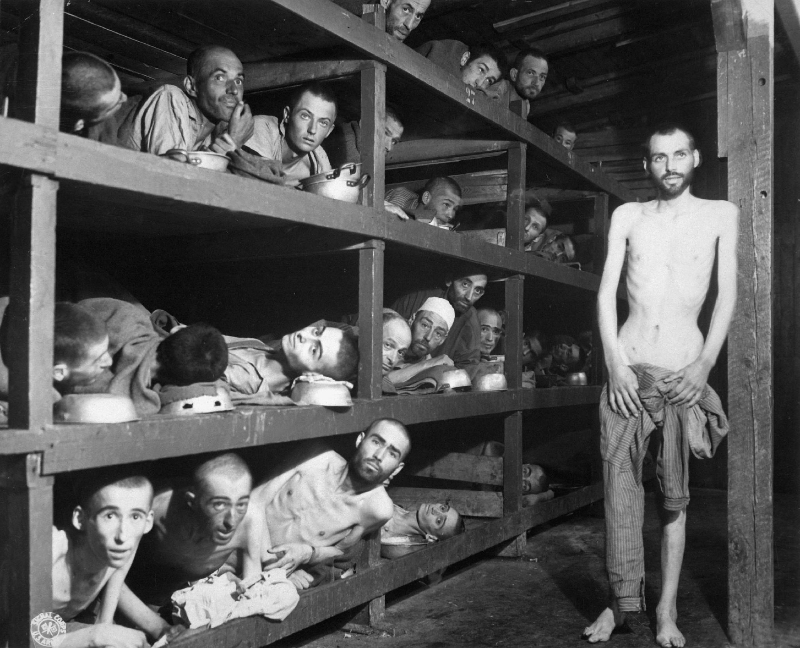
US.47 · DIRECT INSTRUCTION
2 of 4
Liberation of Concentration Camps
Soviet forces liberated Majdanek (1944) and Auschwitz (1945), while U.S. forces liberated Buchenwald, Dachau, and Mauthausen.
American soldiers were unprepared for the extent of Nazi atrocities.
Military photographers documented evidence while medical personnel treated survivors.
The Army provided food, medical care, and shelter, forced local German civilians to view camps, and established displaced persons camps.
Liberation footage shocked the American public and provided evidence for the Nuremberg trials.
Private H. Miller / U.S. Army Signal Corps, April 16, 1945 National Archives
U.S. History Hack · TroopToTeacher Technologies LLC · Aligned to TN Academic Standards & TCAP EOC
41

Slide 47
US.47 · DIRECT INSTRUCTION
3 of 4
Post-War Immigration of Holocaust Survivors
The Displaced Persons Act (1948) initially admitted 205,000 displaced persons but gave preference to Baltic refugees over Jews.
Amendments in 1950 expanded the program, eventually admitting about 80,000 Jewish survivors.
Survivors faced bureaucratic delays, quota limitations, and anti-Semitic opposition.
Jewish organizations provided financial and social support, helping survivors integrate into American society, rebuild careers, and preserve Holocaust memory through testimonies.
U.S. History Hack · TroopToTeacher Technologies LLC · Aligned to TN Academic Standards & TCAP EOC
42

Slide 48
US.47 · DIRECT INSTRUCTION
4 of 4
Moral and Ethical Implications (Honors)
Kristallnacht (November 9-10, 1938) was a coordinated Nazi attack on Jewish businesses and synagogues.
The U.S. recalled its ambassador and extended tourist visas but maintained immigration quotas.
This raises questions about whether the U.S. should have done more to help Jewish refugees, the responsibility of bystander nations during genocide, and the tension between moral obligations and national security concerns.
These events contributed to the development of genocide prevention and international human rights law.
U.S. History Hack · TroopToTeacher Technologies LLC · Aligned to TN Academic Standards & TCAP EOC
43

Slide 49
US.47 · PEOPLE WHO SHAPED THE ERA
Key Figure
Elie Wiesel
Holocaust survivor & witness (1928-2016)
Survived Auschwitz and Buchenwald as a teenager
Bore witness so the genocide could not be denied
His testimony makes the Holocaust a human, documented reality
STRATEGY Use survivor testimony to move from statistics to individual human evidence.
U.S. History Hack · TroopToTeacher Technologies LLC · Aligned to TN Academic Standards & TCAP EOC
44

Slide 50
US.47 · PRIMARY SOURCE ANALYSIS
Testimony of Holocaust Survivor
Contextualization
Elie Wiesel · 1945 (describing liberation)
"On April 10, there were still some 20,000 prisoners in the camp, including several hundred children. It was decided to evacuate all of us at once... On April 11, at about six o'clock in the evening, the first American tanks stood at the gates of Buchenwald. Our first act as free men was to throw ourselves onto the provisions. That's all we thought about. Nothing else mattered."
CONTEXT
The Holocaust was Nazi Germany's systematic murder of six million Jews and millions of others during World War II. By April 1945, Allied armies were liberating concentration camps like Buchenwald and discovering the horrific conditions inside. Elie Wiesel, a Holocaust survivor who would later win the Nobel Peace Prize, was one of the survivors liberated at Buchenwald on April 11, 1945.
ANALYZE
What does this excerpt reveal about the condition of concentration camp prisoners at liberation?
READ CLOSELY Underline the exact words that answer the ANALYZE question — be ready to read them aloud.
SOURCE IT
WHO made it?
WHEN?
WHY does it matter?
FIRST
Elie Wiesel
1945 (describing liberation)
Consider the author's purpose and audience before reading the words.
SSP.02 · before you interpret
Source: United States Holocaust Memorial Museum
U.S. History Hack · TroopToTeacher Technologies LLC · Aligned to TN Academic Standards & TCAP EOC
45
Notes:
Primary-source analysis. SOURCE IT FIRST (SSP.02) — model the sourcing routine aloud before students interpret: WHO made this source? (Elie Wiesel) WHEN? (1945 (describing liberation)) WHY does that matter? (Consider the author's purpose and audience before reading the words.) Only then move to the ANALYZE question. Suggested answer: See teacher key. Practice skill: Contextualization.

Slide 51
US.47 · KEY VOCABULARY
Word Wall
Holocaust
Holocausto
Nuremberg Laws (1935)
Leyes de Nuremberg (1935)
say: HOL-uh-kawst
say: NOOR-em-berg lawz
H
Nazi Germany's systematic genocide of 6 million Jews and millions of others (Roma, disabled, homosexuals, political opponents) during World War II.
NL
Nazi racial laws that stripped Jews of German citizenship, banned intermarriage between Jews and non-Jews, and defined "Jewishness" by ancestry. They institutionalized anti-Semitic persecution.
Adolf Hitler
Adolf Hitler
Totalitarianism
Totalitarismo
say: AY-dolf HIT-ler
say: toh-tal-ih-TAIR-ee-uh-niz-um
AH
Nazi dictator of Germany (1933-1945) who led Germany into World War II and orchestrated the Holocaust, resulting in the deaths of 6 million Jews and millions of others.
T
A system of government where the state controls every aspect of public and private life, using propaganda, secret police, and terror to eliminate opposition.
Appeasement
Apaciguamiento
Axis Powers
Potencias del Eje
say: uh-PEEZ-ment
say: AK-sis POW-erz
A
Policy of making concessions to aggressive powers to avoid conflict. Britain's PM Chamberlain practiced appeasement with Hitler at the Munich Conference (1938), allowing Germany to annex the Sudetenland from Czechoslovakia.
AP
Military alliance of Germany, Italy, and Japan during World War II. United by shared goals of territorial expansion, militarism, and opposition to democratic nations.
"say:" pronunciation guide (stressed syllable in CAPS) and a per-term visual anchor support newcomer English learners. Spanish term + full bilingual Frayer models are in the unit vocabulary set.
U.S. History Hack · TroopToTeacher Technologies LLC · Aligned to TN Academic Standards & TCAP EOC
46

Slide 52
US.47 · GUIDED PRACTICE — WE DO IT TOGETHER
Let’s Work One Together
Weigh evidence of a response
MODEL PROMPT: Did the U.S. do enough for Europe's Jews before and during the war?
WORKED EXAMPLE (teacher models this aloud)
The survivor testimony shows the horror; the Treasury report shows officials knew and delayed. Judge the response against what was known at the time, not only hindsight.
THINK ALOUD
Find one detail showing what U.S. officials knew and one showing what they did.
→ Now you try: Take a position on whether the response was adequate, citing both sources.
U.S. History Hack · TroopToTeacher Technologies LLC · Aligned to TN Academic Standards & TCAP EOC
47
Notes:
GUIDED PRACTICE / WE DO (US.47). Skill modeled: Weigh evidence of a response. Model the worked example aloud using the THINK ALOUD as your script, then release students to the activity ("Take a position on whether the response was adequate, citing both sources."). This is the I Do → We Do → You Do bridge — do not skip it; aim for 80%+ success before independent work.

Slide 53
US.47 · STUDENT ACTIVITY
Knowledge and Response — The U.S. and the Holocaust
Pairs
15 min
YOUR TASK
Read the survivor testimony excerpt and study the Buchenwald liberation photograph. Complete a three-part organizer: (1) BEFORE THE WAR, how the U.S. responded to European Jews seeking refuge; (2) DURING THE WAR, the liberation of the concentration camps; (3) AFTER THE WAR, the immigration of survivors. Add one specific detail per section. Finish with a one-sentence claim, supported by evidence, on what responsibility nations have when they learn of genocide.
DELIVERABLE
DIFFERENTIATION
Completed three-part organizer (before / during / after, one detail each) AND a one-sentence evidence-based claim about national responsibility.
Entry: Organizer with the three time periods pre-labeled and a fact bank to sort. Honors: Write a paragraph analyzing why the liberation photographs became such powerful evidence, using details you can see in the image.
Companion printable: cornell-notes/unit-6/us47-us-response-holocaust.pdf
U.S. History Hack · TroopToTeacher Technologies LLC · Aligned to TN Academic Standards & TCAP EOC
48
Notes:
Student activity for US.47. Pair with the printable: cornell-notes/unit-6/us47-us-response-holocaust.pdf. Timing: 15. Deliverable: Completed three-part organizer (before / during / after, one detail each) AND a one-sentence evidence-based claim about national responsibility.

Slide 54
US.47 · CHECK FOR UNDERSTANDING
TCAP-Style Question
DOK 2
EOC PRACTICE
How did the U.S. respond to the Holocaust before entering World War II?
Maintained strict immigration quotas and turned away refugee ships like St. Louis.
A
Military alliance between fascist and militarist powers Italy, Germany, and Japan.
B
Establish German racial supremacy and expand living space (Lebensraum) eastward.
C
1934 Nazi purge eliminating Hitler's political rivals and consolidating power.
D
ANSWER FIRST: students commit — then click / advance to reveal the correct answer and explanation.
U.S. History Hack · TroopToTeacher Technologies LLC · Aligned to TN Academic Standards & TCAP EOC
49
Notes:
CHECK FOR UNDERSTANDING (US.47, DOK 2). Have students commit to an answer (whiteboards, hand signal, or turn-and-talk) BEFORE advancing. Correct answer: A. The next slide reveals it. Why: Maintained strict immigration quotas and turned away refugee ships like St. Louis. Nazi antisemitism moved from discrimination to mass murder, killing about six million Jews and millions of other victims. B is incorrect because it describes a different program, event, or idea than this Holocaust term or Nazi policy. It remains central to understanding the dangers of racism, dictatorship, and unchecked state power.

Slide 55
US.47 · ANSWER REVEAL
TCAP-Style Question
✓ ANSWER KEY
How did the U.S. respond to the Holocaust before entering World War II?
A
Maintained strict immigration quotas and turned away refugee ships like St. Louis.
✓
B
Military alliance between fascist and militarist powers Italy, Germany, and Japan.
C
Establish German racial supremacy and expand living space (Lebensraum) eastward.
D
1934 Nazi purge eliminating Hitler's political rivals and consolidating power.
Correct answer: A. Why: Maintained strict immigration quotas and turned away refugee ships like St. Louis. Nazi antisemitism moved from discrimination to mass murder, killing about six million Jews and millions of other victims. B is incorrect because it describes a different program, event, or idea than this Holocaust term or Nazi policy.
U.S. History Hack · TroopToTeacher Technologies LLC · Aligned to TN Academic Standards & TCAP EOC
50
Notes:
ANSWER KEY (US.47). Correct: A. Maintained strict immigration quotas and turned away refugee ships like St. Louis. Nazi antisemitism moved from discrimination to mass murder, killing about six million Jews and millions of other victims. B is incorrect because it describes a different program, event, or idea than this Holocaust term or Nazi policy. It remains central to understanding the dangers of racism, dictatorship, and unchecked state power.

Slide 56
US.47 · WRAP-UP
What You Need to Know for TCAP
KEY TAKEAWAYS
EXIT TICKET
DOK 2
U.S. Response Before the War
Liberation of Concentration Camps
Post-War Immigration of Holocaust Survivors
Moral and Ethical Implications (Honors)
Describe the U.S. response to the Holocaust before, during, and after the war. Give one specific example from each period.
★ HONORS / EXTENSION DOK 3 · SSP.04 Argumentation
Evaluate: Given what the U.S. knew, did it do enough to respond to the Holocaust? Defend your claim with evidence. (SSP.04)
U.S. History Hack · TroopToTeacher Technologies LLC · Aligned to TN Academic Standards & TCAP EOC
51
Notes:
WRAP-UP / EXIT-TICKET KEY (US.47, DOK 2). Prompt: Describe the U.S. response to the Holocaust before, during, and after the war. Give one specific example from each period. Model answer: Before the war, the U.S. limited immigration and turned away many Jewish refugees fleeing Nazi persecution. During the war, Allied forces liberated concentration camps in 1945 and documented the genocide, though critics argue more could have been done sooner. After the war, the U.S. helped resettle Holocaust survivors and supported the Nuremberg trials of Nazi leaders. The full horror shaped postwar human-rights commitments. RETEACH TRIGGER — if a student misses this exit ticket: (1) <50% of class miss → spiral it into the next standard’s Quick Review opener (see the US.47 review prompts). (2) Individual/small group → reteach with the "U.S. Response Before the War" direct-instruction slide + re-run the SOURCE IT FIRST routine on the US.47 primary source, then assign the paired printable: cornell-notes/unit-6/us47-us-response-holocaust.pdf. (3) Re-assess with the US.47 check-for-understanding reveal slide as a do-now the next day. Reteach anchors (this standard’s sections): U.S. Response Before the War; Liberation of Concentration Camps; Post-War Immigration of Holocaust Survivors; Moral and Ethical Implications (Honors). I Can objective: I can analyze the response of the U.S. to the plight of European Jews before the war, the liberation of concentration camps during the war, and the immigration of Holocaust survivors after the war. HONORS / EXTENSION (DOK 3, for early finishers or advanced learners): Evaluate: Given what the U.S. knew, did it do enough to respond to the Holocaust? Defend your claim with evidence. (SSP.04) — look for a clear claim plus two specific pieces of evidence.

Slide 57
STANDARD
SOCIAL STUDIES PRACTICES
US.48
SSP.02
Examine a source
SSP.05
Historical awareness
SSP.01
Collect sources
American Entry into World War II
TN ACADEMIC STANDARD
Explain the reasons for American entry into World War II, including the attack on Pearl Harbor.
I CAN
I can explain the reasons for American entry into World War II, including the attack on Pearl Harbor.
U.S. History Hack · TroopToTeacher Technologies LLC · Aligned to TN Academic Standards & TCAP EOC
52

Slide 58
KEY VOCABULARY · LANGUAGE SUPPORT
US.47
Words you need before we read
Holocaust
Nuremberg Laws (1935)
Adolf Hitler
En español: Holocausto
En español: Leyes de Nuremberg (1935)
En español: Adolf Hitler
WHAT IT MEANS
WHAT IT MEANS
WHAT IT MEANS
Nazi Germany's systematic genocide of 6 million Jews and millions of others (Roma, disabled, homosexuals, political opponents) during World War II.
Nazi racial laws that stripped Jews of German citizenship, banned intermarriage between Jews and non-Jews, and defined "Jewishness" by ancestry. They institutionalized anti-Semitic persecution.
Nazi dictator of Germany (1933-1945) who led Germany into World War II and orchestrated the Holocaust, resulting in the deaths of 6 million Jews and millions of others.
UDL · REPRESENTATION → LANGUAGE & SYMBOLS
U.S. History Hack · TEACHER DECK · Aligned to TN Academic Standards & TCAP EOC
6

Slide 59
PROGRESS CHECK
US.47
Check your understanding
How did U.S. immigration restrictions and public attitudes limit American response to Jewish refugees before WWII?
A
The U.S. welcomed all Jewish refugees without restriction, which ignores key developments that shaped the outcome, but closer analysis reveals a more complicated historical reality
B
Only economic factors affected refugee policy, which does not reflect the consensus among historians and fails to account for key developments in the broader context
C
The National Origins Act quotas, consular obstruction, anti-Semitism, isolationism, and economic fears during the Depression combined to severely limit Jewish immigration
✓ KEY
D
The U.S. had no immigration restrictions in the 1930s, but this oversimplifies the complex factors at work, although historical sources do not support this conclusion
UDL · ACTION & EXPRESSION → STRATEGY DEVELOPMENT
MTSS: below mastery → targeted reteach (Tier 2); at/above → extension. The goal never lowers.
U.S. History Hack · TEACHER DECK · Aligned to TN Academic Standards & TCAP EOC
7

Slide 60
US.48 · QUICK REVIEW
Do You Remember?
Before we start, retrieve what we have already learned. Answer from memory first — no notes.
1
US.47 What was the Holocaust?
2
US.47 How did Americans confirm the full scale of the Holocaust?
U.S. History Hack · TroopToTeacher Technologies LLC · Aligned to TN Academic Standards & TCAP EOC
53
Notes:
SPACED RETRIEVAL (US.48). Cold-call or whiteboards, 3-4 min, low stakes. Answers — 1) The Nazi state's systematic, organized murder of six million Jews and millions of others during World War II. 2) Allied soldiers liberated the concentration camps in 1945 and documented the horrors they found with photographs and film.

Slide 61
US.48 · CONFIDENCE CHECK
Warm-Up — Quick Recall
DOK 1
LOW STAKES
Everyone can answer this. Thumbs / whiteboards — no notes.
What Japanese attack brought the United States into World War II?
✓ ANSWER
The attack on Pearl Harbor, December 7, 1941.
COMMIT FIRST: have everyone answer before the reveal — this is the DOK 1 floor; the graded check later in this lesson moves up to DOK 2–3.
U.S. History Hack · TroopToTeacher Technologies LLC · Aligned to TN Academic Standards & TCAP EOC
54
Notes:
CONFIDENCE CHECK (US.48, DOK 1). 60-90 seconds. Have EVERY student commit (thumbs / whiteboard / choral) before revealing — this secures an early win and surfaces who is shaky before new content. Answer: The attack on Pearl Harbor, December 7, 1941. Key term to listen for: Pearl Harbor. This is the low-floor entry; the graded Check for Understanding later in the standard rises to DOK 2–3.

Slide 62
US.48 · HOOK
Think About It
On the morning of December 7, 1941, Japanese planes struck the U.S. naval base at Pearl Harbor, killing more than 2,400 Americans and sinking or damaging much of the Pacific fleet in under two hours.
DISCUSS
TIMING: Turn & Talk 60 sec → cold-call 2 pairs
Was Pearl Harbor the cause of American entry into World War II, or the spark that lit a fire already waiting to burn?
U.S. History Hack · TroopToTeacher Technologies LLC · Aligned to TN Academic Standards & TCAP EOC
55
Notes:
HOOK (US.48). Run tight: pose the provocation, give a silent 10-second think, then Turn & Talk 60 seconds. Cold-call 2–3 pairs (not volunteers) for a sentence-starter answer — "One force was ___ because ___" — then bridge to the standard. Keep total to ~4 minutes; do not let it sprawl. Return to this question at the unit close for an evidence-based answer.

Slide 63
US.48 · DIRECT INSTRUCTION
1 of 4
Factors in the European Theater
German U-boats attacked U.S. ships carrying Lend-Lease supplies, leading to an undeclared naval war with the U.S. Navy escorting convoys and engaging German submarines.
The Atlantic Charter created moral and strategic partnership with Britain.
The Destroyer Deal exchanged U.S. destroyers for British bases, and U.S. forces occupied Iceland to prevent German control.
These actions increasingly moved America toward war despite isolationist opposition.
SENTENCE FRAME (EL & writing support)
The U.S. entered World War II because of ________ in Europe and ________ in the Pacific, but the immediate trigger was ________.
U.S. History Hack · TroopToTeacher Technologies LLC · Aligned to TN Academic Standards & TCAP EOC
56
Notes:
FACILITATION (US.48). Play the idea of a single morning that changed everything, then reveal the date: December 7, 1941. Teach in small steps; pause and check for understanding before the next chunk (aim 80%+ before moving on).

Slide 64
US.48 · DIRECT INSTRUCTION
2 of 4
Factors in the Pacific Theater
Japan conquered much of China and Southeast Asia, threatening U.S. territories and interests.
In response, the U.S. imposed economic sanctions including an oil embargo and froze Japanese assets (July 1941).
The Hull Note demanded Japanese withdrawal from China and Indochina, but negotiations failed to resolve differences.
Japan's military leaders saw war with America as inevitable given the economic pressure.
U.S. History Hack · TroopToTeacher Technologies LLC · Aligned to TN Academic Standards & TCAP EOC
57

Slide 65
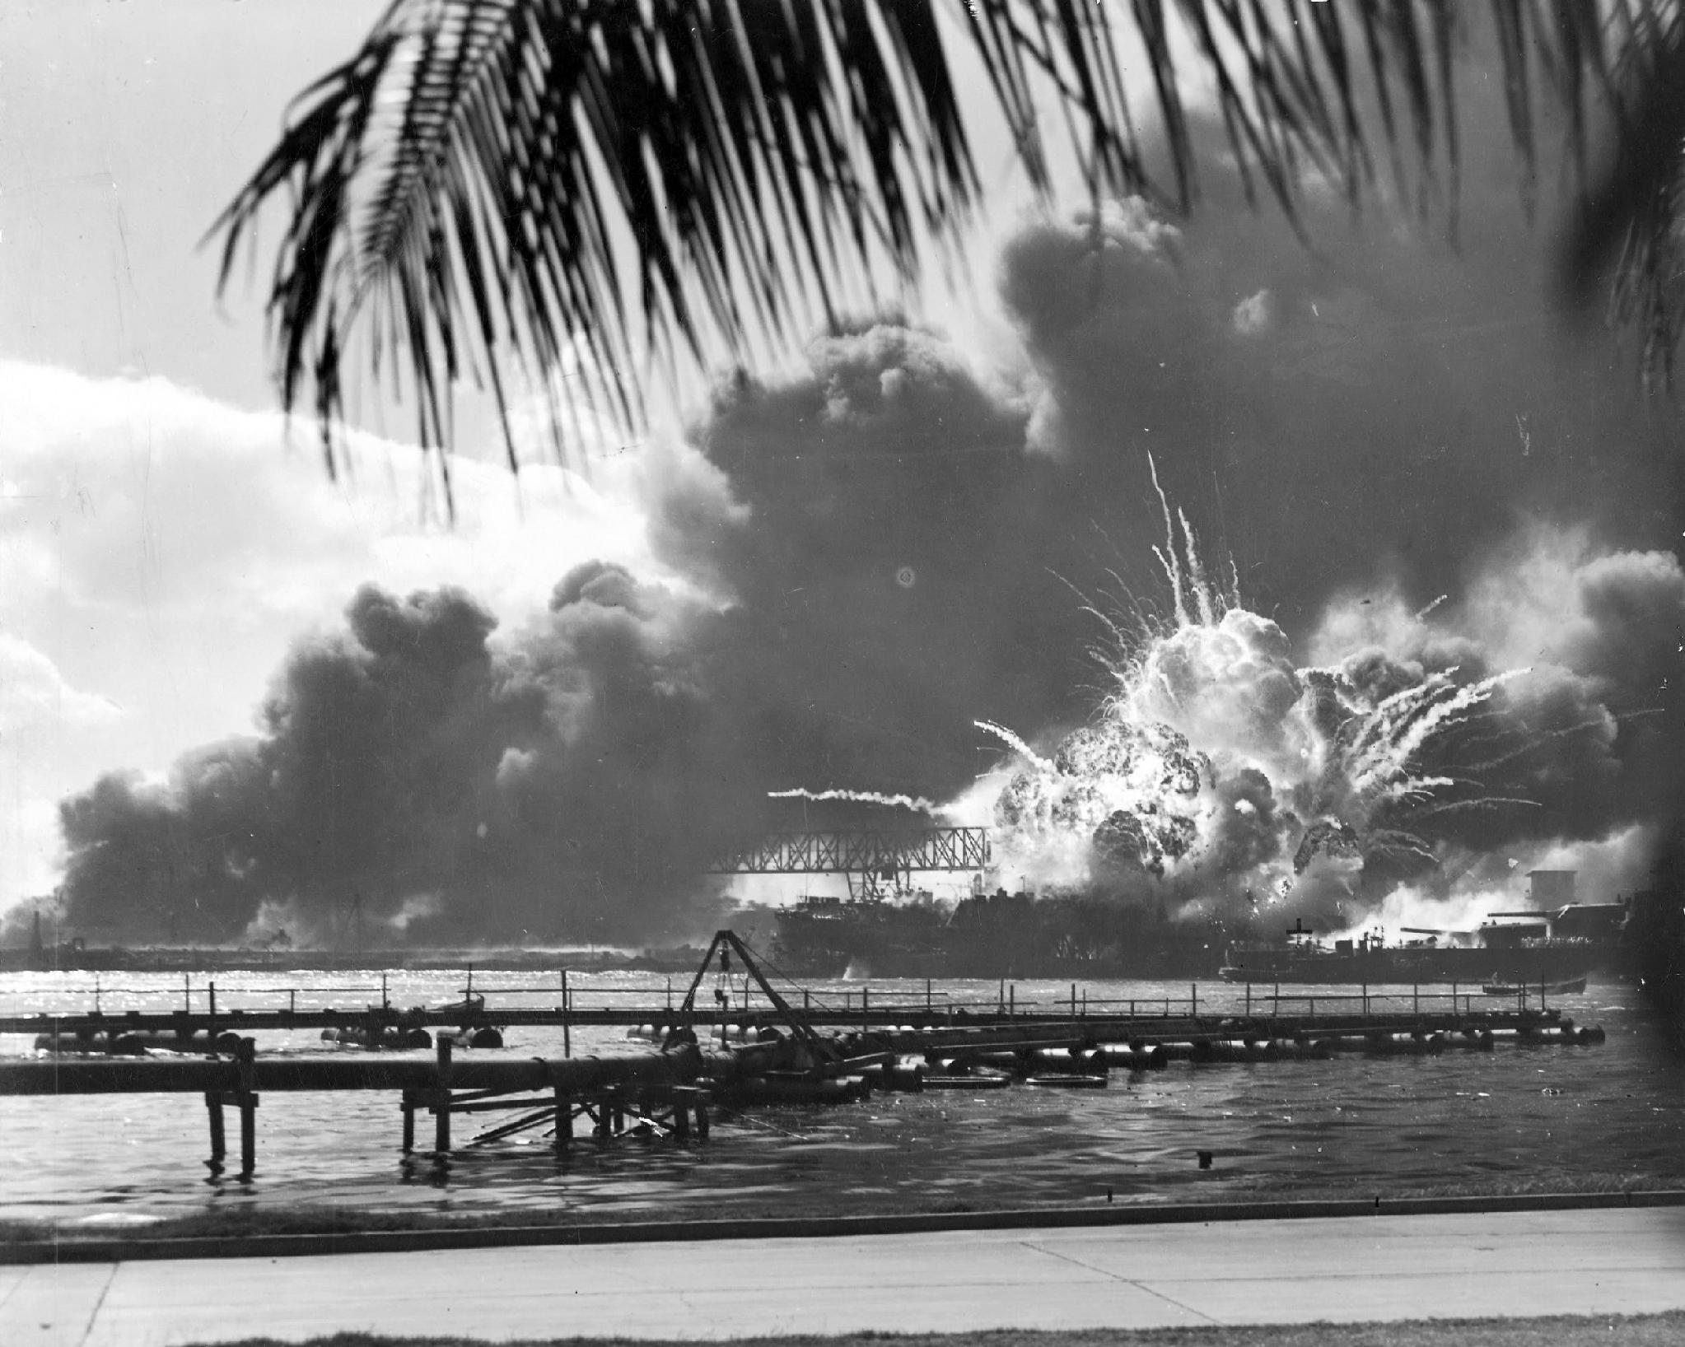
US.48 · DIRECT INSTRUCTION
3 of 4
Attack on Pearl Harbor (December 7, 1941)
Japan planned to eliminate the U.S. Pacific Fleet to prevent interference with expansion.
Six aircraft carriers launched 353 planes in two waves on Sunday morning when defenses were relaxed.
The attack sank or damaged 8 battleships, destroyed 188 planes, and killed 2,403 Americans.
Intelligence failures left U.S. forces completely unprepared.
Roosevelt's "Date of Infamy" speech galvanized the nation, and Congress declared war with only one dissenting vote.
Unknown U.S. Navy photographer / U.S. Navy, December 7, 1941 National Archives
U.S. History Hack · TroopToTeacher Technologies LLC · Aligned to TN Academic Standards & TCAP EOC
58

Slide 66
US.48 · DIRECT INSTRUCTION
4 of 4
Consequences of American Entry
Pearl Harbor destroyed isolationist opposition and unified American public opinion.
Germany and Italy declared war on the U.S. (December 11), making the conflict worldwide.
Domestically, war ended the Great Depression and created full employment, while the government gained unprecedented powers.
Internationally, U.S. entry provided resources necessary to defeat the Axis, established America as the dominant world power, and led to the creation of the United Nations.
U.S. History Hack · TroopToTeacher Technologies LLC · Aligned to TN Academic Standards & TCAP EOC
59

Slide 67
US.48 · PEOPLE WHO SHAPED THE ERA
Key Figure
Franklin D. Roosevelt
32nd President; asked Congress to declare war
Called Dec 7, 1941 'a date which will live in infamy'
Secured a declaration of war on Japan within a day
Led the mobilization of the 'Arsenal of Democracy'
STRATEGY Use FDR's Infamy speech to show how leadership turns a shock into a national war effort.
U.S. History Hack · TroopToTeacher Technologies LLC · Aligned to TN Academic Standards & TCAP EOC
60

Slide 68
US.48 · PRIMARY SOURCE ANALYSIS
Day of Infamy Speech
Close Reading
President Franklin D. Roosevelt · December 8, 1941
"Yesterday, December 7th, 1941—a date which will live in infamy—the United States of America was suddenly and deliberately attacked by naval and air forces of the Empire of Japan. The United States was at peace with that nation and, at the solicitation of Japan, was still in conversation with its government and its Emperor looking toward the maintenance of peace in the Pacific."
CONTEXT
On December 7, 1941, Japan launched a surprise attack on the U.S. naval base at Pearl Harbor, Hawaii, killing more than 2,400 Americans and destroying or damaging much of the Pacific Fleet. The next day, President Roosevelt addressed Congress to ask for a declaration of war. His speech—delivered in just six minutes—is one of the most famous in American history and helped unite a divided country behind the war effort.
ANALYZE
According to Roosevelt, why was the Japanese attack particularly treacherous?
READ CLOSELY Underline the exact words that answer the ANALYZE question — be ready to read them aloud.
SOURCE IT
WHO made it?
WHEN?
WHY does it matter?
FIRST
President Franklin D. Roosevelt
December 8, 1941
Consider the author's purpose and audience before reading the words.
SSP.02 · before you interpret
Source: National Archives
U.S. History Hack · TroopToTeacher Technologies LLC · Aligned to TN Academic Standards & TCAP EOC
61
Notes:
Primary-source analysis. SOURCE IT FIRST (SSP.02) — model the sourcing routine aloud before students interpret: WHO made this source? (President Franklin D. Roosevelt) WHEN? (December 8, 1941) WHY does that matter? (Consider the author's purpose and audience before reading the words.) Only then move to the ANALYZE question. Suggested answer: See teacher key. Practice skill: Close Reading.

Slide 69
US.48 · KEY VOCABULARY
Word Wall
Pearl Harbor
Pearl Harbor
Hideki Tojo
Hideki Tojo
say: purl HAR-ber
say: hee-DEH-kee TOH-joh
PH
Japan's surprise attack on the U.S. naval base in Hawaii on December 7, 1941, killing over 2,400 Americans and bringing the United States into World War II.
HT
Japanese military leader and Prime Minister (1941-1944) who led Japan into World War II and authorized the attack on Pearl Harbor.
Axis Powers
Potencias del Eje
Allied Powers
Potencias Aliadas
say: AK-sis POW-erz
say: AL-yd POW-erz
AP
Military alliance of Germany, Italy, and Japan during World War II. United by shared goals of territorial expansion, militarism, and opposition to democratic nations.
AP
The World War II coalition led by the United States, Great Britain, and the Soviet Union that fought and defeated the Axis Powers.
Lend-Lease Act (1941)
Ley de Préstamo y Arriendo (1941)
Nazi-Soviet Pact (1939)
Pacto Nazi-Soviético (1939)
say: lend lees akt
say: NOT-see SOH-vee-et pakt
LA
U.S. program allowing the President to lend or lease war supplies to any nation deemed vital to American defense, primarily Britain and the Soviet Union.
NP
Non-aggression agreement between Hitler and Stalin (August 1939) that shocked the world. Secret provisions divided Poland and Eastern Europe between Germany and the Soviet Union.
"say:" pronunciation guide (stressed syllable in CAPS) and a per-term visual anchor support newcomer English learners. Spanish term + full bilingual Frayer models are in the unit vocabulary set.
U.S. History Hack · TroopToTeacher Technologies LLC · Aligned to TN Academic Standards & TCAP EOC
62

Slide 70
US.48 · GUIDED PRACTICE — WE DO IT TOGETHER
Let’s Work One Together
Explain causes of a decision
MODEL PROMPT: Why did Pearl Harbor unite Americans behind war?
WORKED EXAMPLE (teacher models this aloud)
A surprise attack on U.S. soil ended the debate over neutrality. FDR's 'infamy' framing turned shock into resolve, and Congress declared war almost unanimously.
THINK ALOUD
Underline the phrase in the speech built to unify the country.
→ Now you try: Explain how one word choice moved public opinion, citing the text.
U.S. History Hack · TroopToTeacher Technologies LLC · Aligned to TN Academic Standards & TCAP EOC
63
Notes:
GUIDED PRACTICE / WE DO (US.48). Skill modeled: Explain causes of a decision. Model the worked example aloud using the THINK ALOUD as your script, then release students to the activity ("Explain how one word choice moved public opinion, citing the text."). This is the I Do → We Do → You Do bridge — do not skip it; aim for 80%+ success before independent work.

Slide 71
US.48 · STUDENT ACTIVITY
Two Theaters, One War — Why America Entered
Pairs
15 min
YOUR TASK
Read FDR's 'Day of Infamy' speech excerpt and review the Pearl Harbor photograph. Build a two-column chart: EUROPEAN THEATER FACTORS (Axis aggression, fall of France, threat to Britain, aid to Allies) and PACIFIC THEATER FACTORS (Japanese expansion, U.S. embargo, the attack on Pearl Harbor). List at least two per column. Then write a one-sentence claim on whether Pearl Harbor caused U.S. entry or simply triggered a decision that was already coming.
DELIVERABLE
DIFFERENTIATION
Completed two-theater factors chart (2+ per column) AND a one-sentence evidence-based claim about the cause of U.S. entry.
Entry: Chart pre-labeled 'European Theater' and 'Pacific Theater' with a word bank of factors to sort. Honors: Write a paragraph using the 'Day of Infamy' speech to explain how FDR united the country behind a declaration of war.
Companion printable: cornell-notes/unit-6/us48-american-entry-wwii.pdf
U.S. History Hack · TroopToTeacher Technologies LLC · Aligned to TN Academic Standards & TCAP EOC
64
Notes:
Student activity for US.48. Pair with the printable: cornell-notes/unit-6/us48-american-entry-wwii.pdf. Timing: 15. Deliverable: Completed two-theater factors chart (2+ per column) AND a one-sentence evidence-based claim about the cause of U.S. entry.

Slide 72
US.48 · CHECK FOR UNDERSTANDING
TCAP-Style Question
DOK 2
EOC PRACTICE
How did the U.S. policy of neutrality evolve before Pearl Harbor?
From strict isolationism to "Arsenal of Democracy" providing aid to the Allies.
A
As a sudden, deliberate, and premeditated attack requiring righteous response.
B
Isolationist organization opposing U.S. entry into WWII before Pearl Harbor.
C
Unified Americans behind the war effort and ended isolationist sentiment overnight.
D
ANSWER FIRST: students commit — then click / advance to reveal the correct answer and explanation.
U.S. History Hack · TroopToTeacher Technologies LLC · Aligned to TN Academic Standards & TCAP EOC
65
Notes:
CHECK FOR UNDERSTANDING (US.48, DOK 2). Have students commit to an answer (whiteboards, hand signal, or turn-and-talk) BEFORE advancing. Correct answer: A. The next slide reveals it. Why: From strict isolationism to "Arsenal of Democracy" providing aid to the Allies. The attack on December 7, 1941 pushed the United States fully into World War II. C is incorrect because it describes a different program, event, or idea than this World War II event. This helps explain how World War II became a global turning point in military strategy and international power.

Slide 73
US.48 · ANSWER REVEAL
TCAP-Style Question
✓ ANSWER KEY
How did the U.S. policy of neutrality evolve before Pearl Harbor?
A
From strict isolationism to "Arsenal of Democracy" providing aid to the Allies.
✓
B
As a sudden, deliberate, and premeditated attack requiring righteous response.
C
Isolationist organization opposing U.S. entry into WWII before Pearl Harbor.
D
Unified Americans behind the war effort and ended isolationist sentiment overnight.
Correct answer: A. Why: From strict isolationism to "Arsenal of Democracy" providing aid to the Allies. The attack on December 7, 1941 pushed the United States fully into World War II. C is incorrect because it describes a different program, event, or idea than this World War II event. This helps explain how World War II became a global turning point in military strategy and international power.
U.S. History Hack · TroopToTeacher Technologies LLC · Aligned to TN Academic Standards & TCAP EOC
66
Notes:
ANSWER KEY (US.48). Correct: A. From strict isolationism to "Arsenal of Democracy" providing aid to the Allies. The attack on December 7, 1941 pushed the United States fully into World War II. C is incorrect because it describes a different program, event, or idea than this World War II event. This helps explain how World War II became a global turning point in military strategy and international power.

Slide 74
US.48 · WRAP-UP
What You Need to Know for TCAP
KEY TAKEAWAYS
EXIT TICKET
DOK 2
Factors in the European Theater
Factors in the Pacific Theater
Attack on Pearl Harbor (December 7, 1941)
Consequences of American Entry
Explain the reasons the United States entered World War II. Address both the European and Pacific theaters.
★ HONORS / EXTENSION DOK 3 · SSP.04 Argumentation
Evaluate: Did Pearl Harbor cause U.S. entry into WWII, or simply trigger a decision that was already coming? Argue with evidence. (SSP.04)
U.S. History Hack · TroopToTeacher Technologies LLC · Aligned to TN Academic Standards & TCAP EOC
67
Notes:
WRAP-UP / EXIT-TICKET KEY (US.48, DOK 2). Prompt: Explain the reasons the United States entered World War II. Address both the European and Pacific theaters. Model answer: The U.S. entered for reasons in both theaters. In Europe, Axis aggression, the fall of France, and the threat to Britain drew America into supplying the Allies. In the Pacific, Japanese expansion collided with U.S. interests, and the American oil embargo pushed Japan toward war. The immediate trigger was the surprise attack on Pearl Harbor on December 7, 1941, which killed thousands and united Americans behind a declaration of war on Japan, and then Germany. RETEACH TRIGGER — if a student misses this exit ticket: (1) <50% of class miss → spiral it into the next standard’s Quick Review opener (see the US.48 review prompts). (2) Individual/small group → reteach with the "Factors in the European Theater" direct-instruction slide + re-run the SOURCE IT FIRST routine on the US.48 primary source, then assign the paired printable: cornell-notes/unit-6/us48-american-entry-wwii.pdf. (3) Re-assess with the US.48 check-for-understanding reveal slide as a do-now the next day. Reteach anchors (this standard’s sections): Factors in the European Theater; Factors in the Pacific Theater; Attack on Pearl Harbor (December 7, 1941); Consequences of American Entry. I Can objective: I can explain the reasons for American entry into World War II, including the attack on Pearl Harbor. HONORS / EXTENSION (DOK 3, for early finishers or advanced learners): Evaluate: Did Pearl Harbor cause U.S. entry into WWII, or simply trigger a decision that was already coming? Argue with evidence. (SSP.04) — look for a clear claim plus two specific pieces of evidence.

Slide 75
STANDARD
SOCIAL STUDIES PRACTICES
US.49
SSP.01
Collect sources
SSP.05
Historical awareness
SSP.03
Synthesize sources
WWII Leaders & Key Figures
TN ACADEMIC STANDARD
Identify the roles and the significant actions of the following individuals in World War II: Winston Churchill, Dwight D. Eisenhower, Adolf Hitler, Douglas MacArthur, George C. Marshall, Benito Mussolini, President Franklin D. Roosevelt, Joseph Stalin, Hideki Tojo, President Harry S. Truman.
I CAN
I can identify the roles and the significant actions of key individuals in World War II, including Churchill, Eisenhower, Hitler, MacArthur, Marshall, Mussolini, FDR, Stalin, Tojo, and Truman.
U.S. History Hack · TroopToTeacher Technologies LLC · Aligned to TN Academic Standards & TCAP EOC
68

Slide 76
KEY VOCABULARY · LANGUAGE SUPPORT
US.48
Words you need before we read
Pearl Harbor
Hideki Tojo
Axis Powers
En español: Pearl Harbor
En español: Hideki Tojo
En español: Potencias del Eje
WHAT IT MEANS
WHAT IT MEANS
WHAT IT MEANS
Japan's surprise attack on the U.S. naval base in Hawaii on December 7, 1941, killing over 2,400 Americans and bringing the United States into World War II.
Japanese military leader and Prime Minister (1941-1944) who led Japan into World War II and authorized the attack on Pearl Harbor.
Military alliance of Germany, Italy, and Japan during World War II. United by shared goals of territorial expansion, militarism, and opposition to democratic nations.
UDL · REPRESENTATION → LANGUAGE & SYMBOLS
U.S. History Hack · TEACHER DECK · Aligned to TN Academic Standards & TCAP EOC
8

Slide 77
PROGRESS CHECK
US.48
Check your understanding
How did the Pearl Harbor attack unite American public opinion and end isolationism?
A
Public opinion remained divided after Pearl Harbor, which contradicts the primary source evidence from this era, but the historical evidence paints a more nuanced picture
B
Isolationism continued throughout the war, but the historical record tells a more complex story and oversimplifies the complex factors at work during this period
C
Pearl Harbor had no effect on public opinion, but the historical record tells a more complex story and oversimplifies the complex factors at work during this period
D
The surprise attack shocked Americans, Roosevelt's "Date of Infamy" speech galvanized the nation, and Congress declared war with only one dissenting vote, destroying isolationist opposition
✓ KEY
UDL · ACTION & EXPRESSION → STRATEGY DEVELOPMENT
MTSS: below mastery → targeted reteach (Tier 2); at/above → extension. The goal never lowers.
U.S. History Hack · TEACHER DECK · Aligned to TN Academic Standards & TCAP EOC
9

Slide 78
US.49 · QUICK REVIEW
Do You Remember?
Before we start, retrieve what we have already learned. Answer from memory first — no notes.
1
US.48 What happened on December 7, 1941?
2
US.48 Why did the U.S. declare war after Pearl Harbor?
U.S. History Hack · TroopToTeacher Technologies LLC · Aligned to TN Academic Standards & TCAP EOC
69
Notes:
SPACED RETRIEVAL (US.49). Cold-call or whiteboards, 3-4 min, low stakes. Answers — 1) Japan attacked the U.S. naval base at Pearl Harbor, Hawaii, bringing the United States into World War II. 2) The surprise attack killed thousands and destroyed much of the Pacific fleet, uniting Americans behind FDR's call for a declaration of war.

Slide 79
US.49 · CONFIDENCE CHECK
Warm-Up — Quick Recall
DOK 1
LOW STAKES
Everyone can answer this. Thumbs / whiteboards — no notes.
Who was the U.S. president for most of World War II?
✓ ANSWER
Franklin D. Roosevelt (Harry S. Truman took over in April 1945).
COMMIT FIRST: have everyone answer before the reveal — this is the DOK 1 floor; the graded check later in this lesson moves up to DOK 2–3.
U.S. History Hack · TroopToTeacher Technologies LLC · Aligned to TN Academic Standards & TCAP EOC
70
Notes:
CONFIDENCE CHECK (US.49, DOK 1). 60-90 seconds. Have EVERY student commit (thumbs / whiteboard / choral) before revealing — this secures an early win and surfaces who is shaky before new content. Answer: Franklin D. Roosevelt (Harry S. Truman took over in April 1945). Key term to listen for: Allied Powers. This is the low-floor entry; the graded Check for Understanding later in the standard rises to DOK 2–3.

Slide 80
US.49 · HOOK
Think About It
World War II was shaped by a handful of towering figures, Roosevelt, Churchill, and Stalin against Hitler, Mussolini, and Tojo, whose decisions sent tens of millions to war and reshaped the world.
DISCUSS
TIMING: Turn & Talk 60 sec → cold-call 2 pairs
How much does history depend on individual leaders, and which of these figures most changed the outcome of the war?
U.S. History Hack · TroopToTeacher Technologies LLC · Aligned to TN Academic Standards & TCAP EOC
71
Notes:
HOOK (US.49). Run tight: pose the provocation, give a silent 10-second think, then Turn & Talk 60 seconds. Cold-call 2–3 pairs (not volunteers) for a sentence-starter answer — "One force was ___ because ___" — then bridge to the standard. Keep total to ~4 minutes; do not let it sprawl. Return to this question at the unit close for an evidence-based answer.

Slide 81
US.49 · DIRECT INSTRUCTION
1 of 4
Allied Political Leaders
Winston Churchill served as British Prime Minister (1940-1945), inspiring British resistance during the Battle of Britain and partnering with FDR on the Atlantic Charter.
Franklin D. Roosevelt led America as President, implementing Lend-Lease, maintaining the Grand Alliance with Churchill and Stalin, and supporting the "Europe First" strategy.
Joseph Stalin defended the Soviet Union against German invasion, achieved victory at Stalingrad, and led the massive Soviet advance that captured Berlin.
Harry S. Truman became President in 1945, making the atomic bomb decision and overseeing Japanese surrender.
SENTENCE FRAME (EL & writing support)
One important Allied leader was ________, who ________, while an Axis leader, ________, ________.
U.S. History Hack · TroopToTeacher Technologies LLC · Aligned to TN Academic Standards & TCAP EOC
72
Notes:
FACILITATION (US.49). Ask: does history turn on great leaders or on millions of ordinary people? Hold the tension, then meet the leaders of WWII. Teach in small steps; pause and check for understanding before the next chunk (aim 80%+ before moving on).

Slide 82
US.49 · DIRECT INSTRUCTION
2 of 4
Allied Military Leaders
Dwight D. Eisenhower served as Supreme Allied Commander in Europe, planning D-Day and successfully managing the multinational Allied command.
Douglas MacArthur commanded Allied forces in the Southwest Pacific, developing the island-hopping strategy and accepting Japanese surrender aboard USS Missouri.
George C. Marshall, as Army Chief of Staff, organized the expansion of the U.S. Army from 200,000 to 8 million, developed the "Europe First" strategy, and coordinated global logistics.
U.S. History Hack · TroopToTeacher Technologies LLC · Aligned to TN Academic Standards & TCAP EOC
73

Slide 83
US.49 · DIRECT INSTRUCTION
3 of 4
Axis Leaders
Adolf Hitler, as Führer of Nazi Germany, developed blitzkrieg tactics, launched Operation Barbarossa against the Soviet Union, and orchestrated the Holocaust before committing suicide as Berlin fell.
Benito Mussolini established fascist Italy and formed the Axis alliance, but Italian military failures required German rescue before he was captured and executed by partisans.
Hideki Tojo, Japanese Prime Minister, authorized the Pearl Harbor attack and led Japan's Pacific conquest before being executed as a war criminal.
U.S. History Hack · TroopToTeacher Technologies LLC · Aligned to TN Academic Standards & TCAP EOC
74

Slide 84
US.49 · DIRECT INSTRUCTION
4 of 4
Comparing Leadership Approaches
Churchill provided inspirational leadership through rhetoric and determination.
Eisenhower excelled at diplomatic coalition management.
Hitler's dictatorial style led to strategic mistakes like fighting a two-front war.
MacArthur was dramatic and media-conscious.
Marshall demonstrated exceptional organizational ability.
Roosevelt and Churchill maintained a "special relationship" while managing the difficult alliance with Stalin.
The contrast between Allied cooperation and Axis failures in coordination contributed significantly to the war's outcome.
U.S. History Hack · TroopToTeacher Technologies LLC · Aligned to TN Academic Standards & TCAP EOC
75

Slide 85
US.49 · PEOPLE WHO SHAPED THE ERA
Key Figures
Winston Churchill
Dwight D. Eisenhower
Franklin D. Roosevelt
British Prime Minister (1874-1965)
Supreme Allied Commander, Europe (1890-1969)
32nd President; commander in chief
Rallied Britain to fight on alone in 1940
Forged the alliance with FDR and Stalin
Symbolized Allied resolve with his defiant speeches
Planned and commanded the D-Day invasion
Held the multinational Allied force together
Later became the 34th U.S. president
Directed U.S. grand strategy across two theaters
Kept the Grand Alliance together through tension
Defined Allied war aims from the Atlantic Charter on
STRATEGY Use Churchill to represent Allied leadership and the power of wartime rhetoric.
STRATEGY Use Eisenhower to show the organizational genius behind Allied victory.
STRATEGY Anchor the Allied leaders around FDR as the coalition's political center.
U.S. History Hack · TroopToTeacher Technologies LLC · Aligned to TN Academic Standards & TCAP EOC
76

Slide 86
US.49 · PRIMARY SOURCE ANALYSIS
We Shall Fight on the Beaches Speech
Close Reading
Winston Churchill · June 4, 1940
"We shall fight on the beaches, we shall fight on the landing grounds, we shall fight in the fields and in the streets, we shall fight in the hills; we shall never surrender, and even if, which I do not for a moment believe, this Island or a large part of it were subjugated and starving, then our Empire beyond the seas... would carry on the struggle."
CONTEXT
In June 1940, Nazi Germany had just defeated France and driven British forces off the European continent at Dunkirk. Britain stood almost alone against Hitler's military machine, and many feared German invasion was imminent. Churchill had just become Prime Minister weeks earlier and used this speech to the House of Commons to steel the British people's resolve and signal to America and the world that Britain would not surrender.
ANALYZE
What message was Churchill conveying to the British people in this speech?
READ CLOSELY Underline the exact words that answer the ANALYZE question — be ready to read them aloud.
SOURCE IT
WHO made it?
WHEN?
WHY does it matter?
FIRST
Winston Churchill
June 4, 1940
Consider the author's purpose and audience before reading the words.
SSP.02 · before you interpret
Source: International Churchill Society
U.S. History Hack · TroopToTeacher Technologies LLC · Aligned to TN Academic Standards & TCAP EOC
77
Notes:
Primary-source analysis. SOURCE IT FIRST (SSP.02) — model the sourcing routine aloud before students interpret: WHO made this source? (Winston Churchill) WHEN? (June 4, 1940) WHY does that matter? (Consider the author's purpose and audience before reading the words.) Only then move to the ANALYZE question. Suggested answer: See teacher key. Practice skill: Close Reading.

Slide 87
US.49 · KEY VOCABULARY
Word Wall
Dwight D. Eisenhower
Dwight D. Eisenhower
Adolf Hitler
Adolf Hitler
say: dwyt EYE-zen-how-er
say: AY-dolf HIT-ler
DD
Supreme Commander of Allied Forces in Europe who planned and led the D-Day invasion and coordinated Allied victory in Europe. Later became 34th President.
AH
Nazi dictator of Germany (1933-1945) who led Germany into World War II and orchestrated the Holocaust, resulting in the deaths of 6 million Jews and millions of others.
Joseph Stalin
Joseph Stalin
Hideki Tojo
Hideki Tojo
say: JOH-zef STAH-lin
say: hee-DEH-kee TOH-joh
JS
Communist dictator of the Soviet Union (1924-1953) who ruled through terror, forced collectivization, and purges, resulting in millions of deaths.
HT
Japanese military leader and Prime Minister (1941-1944) who led Japan into World War II and authorized the attack on Pearl Harbor.
Allied Powers
Potencias Aliadas
Axis Powers
Potencias del Eje
say: AL-yd POW-erz
say: AK-sis POW-erz
AP
The World War II coalition led by the United States, Great Britain, and the Soviet Union that fought and defeated the Axis Powers.
AP
Military alliance of Germany, Italy, and Japan during World War II. United by shared goals of territorial expansion, militarism, and opposition to democratic nations.
"say:" pronunciation guide (stressed syllable in CAPS) and a per-term visual anchor support newcomer English learners. Spanish term + full bilingual Frayer models are in the unit vocabulary set.
U.S. History Hack · TroopToTeacher Technologies LLC · Aligned to TN Academic Standards & TCAP EOC
78

Slide 88
US.49 · GUIDED PRACTICE — WE DO IT TOGETHER
Let’s Work One Together
Match individuals to their roles
MODEL PROMPT: How did Churchill, Eisenhower, and FDR each shape the Allied effort?
WORKED EXAMPLE (teacher models this aloud)
Churchill supplied resolve and rhetoric, Eisenhower supplied military planning, FDR supplied strategy and the alliance. Different roles, one coalition.
THINK ALOUD
Assign each leader a one-word role (resolve / planning / strategy).
→ Now you try: Argue which role mattered most at a turning point, with evidence.
U.S. History Hack · TroopToTeacher Technologies LLC · Aligned to TN Academic Standards & TCAP EOC
79
Notes:
GUIDED PRACTICE / WE DO (US.49). Skill modeled: Match individuals to their roles. Model the worked example aloud using the THINK ALOUD as your script, then release students to the activity ("Argue which role mattered most at a turning point, with evidence."). This is the I Do → We Do → You Do bridge — do not skip it; aim for 80%+ success before independent work.

Slide 89
US.49 · STUDENT ACTIVITY
Who Led the World at War — Allied and Axis Leaders
Groups of 3
15 min
YOUR TASK
Using Churchill's 'We Shall Fight on the Beaches' excerpt and your notes, build a leaders chart with three columns: ALLIED POLITICAL (FDR, Churchill, Stalin, Truman), ALLIED MILITARY (Eisenhower, MacArthur, Marshall), and AXIS (Hitler, Mussolini, Tojo). For each leader, write one significant action. Finish with a one-sentence claim on which single leader's actions most changed the war's outcome, with evidence.
DELIVERABLE
DIFFERENTIATION
Completed leaders chart (one significant action per leader across the three columns) AND a one-sentence evidence-based claim about the most decisive leader.
Entry: Chart with leaders pre-listed and a bank of actions to match. Honors: Write a paragraph using Churchill's speech to explain how wartime leaders used words, not just armies, as weapons.
Companion printable: cornell-notes/unit-6/us49-wwii-leaders.pdf
U.S. History Hack · TroopToTeacher Technologies LLC · Aligned to TN Academic Standards & TCAP EOC
80
Notes:
Student activity for US.49. Pair with the printable: cornell-notes/unit-6/us49-wwii-leaders.pdf. Timing: 15. Deliverable: Completed leaders chart (one significant action per leader across the three columns) AND a one-sentence evidence-based claim about the most decisive leader.

Slide 90
US.49 · CHECK FOR UNDERSTANDING
TCAP-Style Question
DOK 2
EOC PRACTICE
How did the roles of General Dwight D. Eisenhower and General Douglas MacArthur differ in World War II?
Eisenhower served as Supreme Allied Commander in Europe while MacArthur commanded Allied forces in the Pacific.
A
Eisenhower commanded Pacific island-hopping campaigns while MacArthur directed the D-Day landings in Europe.
B
Eisenhower focused on the naval war in the Atlantic while MacArthur managed the bombing campaign over Japan.
C
Both generals shared command of European theater operations, with Eisenhower directing ground forces and MacArthur directing air forces.
D
ANSWER FIRST: students commit — then click / advance to reveal the correct answer and explanation.
U.S. History Hack · TroopToTeacher Technologies LLC · Aligned to TN Academic Standards & TCAP EOC
81
Notes:
CHECK FOR UNDERSTANDING (US.49, DOK 2). Have students commit to an answer (whiteboards, hand signal, or turn-and-talk) BEFORE advancing. Correct answer: A. The next slide reveals it. Why: Eisenhower served as Supreme Commander of Allied Expeditionary Forces in Europe, overseeing operations including D-Day, while MacArthur commanded Allied forces in the Southwest Pacific, directing the island-hopping campaign and eventually accepting Japan's surrender.

Slide 91
US.49 · ANSWER REVEAL
TCAP-Style Question
✓ ANSWER KEY
How did the roles of General Dwight D. Eisenhower and General Douglas MacArthur differ in World War II?
A
Eisenhower served as Supreme Allied Commander in Europe while MacArthur commanded Allied forces in the Pacific.
✓
B
Eisenhower commanded Pacific island-hopping campaigns while MacArthur directed the D-Day landings in Europe.
C
Eisenhower focused on the naval war in the Atlantic while MacArthur managed the bombing campaign over Japan.
D
Both generals shared command of European theater operations, with Eisenhower directing ground forces and MacArthur directing air forces.
Correct answer: A. Why: Eisenhower served as Supreme Commander of Allied Expeditionary Forces in Europe, overseeing operations including D-Day, while MacArthur commanded Allied forces in the Southwest Pacific, directing the island-hopping campaign and eventually accepting Japan's surrender.
U.S. History Hack · TroopToTeacher Technologies LLC · Aligned to TN Academic Standards & TCAP EOC
82
Notes:
ANSWER KEY (US.49). Correct: A. Eisenhower served as Supreme Commander of Allied Expeditionary Forces in Europe, overseeing operations including D-Day, while MacArthur commanded Allied forces in the Southwest Pacific, directing the island-hopping campaign and eventually accepting Japan's surrender.

Slide 92
US.49 · WRAP-UP
What You Need to Know for TCAP
KEY TAKEAWAYS
EXIT TICKET
DOK 2
Allied Political Leaders
Allied Military Leaders
Axis Leaders
Comparing Leadership Approaches
Identify two key WWII leaders (one Allied, one Axis) and explain one significant action of each.
★ HONORS / EXTENSION DOK 3 · SSP.04 Argumentation
Evaluate: Which single leader's actions most changed the outcome of World War II? Defend your choice with at least two pieces of evidence. (SSP.04)
U.S. History Hack · TroopToTeacher Technologies LLC · Aligned to TN Academic Standards & TCAP EOC
83
Notes:
WRAP-UP / EXIT-TICKET KEY (US.49, DOK 2). Prompt: Identify two key WWII leaders (one Allied, one Axis) and explain one significant action of each. Model answer: Allied leaders shaped the path to victory: FDR mobilized U.S. industry and forged the alliance; Churchill rallied Britain to hold out against Germany; Stalin's Soviet Union absorbed and then reversed the German invasion; Eisenhower commanded the D-Day invasion. Axis leaders drove the aggression: Hitler launched the conquest of Europe and the Holocaust; Mussolini allied fascist Italy with Germany; Tojo directed Japan's expansion and the attack on Pearl Harbor. RETEACH TRIGGER — if a student misses this exit ticket: (1) <50% of class miss → spiral it into the next standard’s Quick Review opener (see the US.49 review prompts). (2) Individual/small group → reteach with the "Allied Political Leaders" direct-instruction slide + re-run the SOURCE IT FIRST routine on the US.49 primary source, then assign the paired printable: cornell-notes/unit-6/us49-wwii-leaders.pdf. (3) Re-assess with the US.49 check-for-understanding reveal slide as a do-now the next day. Reteach anchors (this standard’s sections): Allied Political Leaders; Allied Military Leaders; Axis Leaders; Comparing Leadership Approaches. I Can objective: I can identify the roles and the significant actions of key individuals in World War II, including Churchill, Eisenhower, Hitler, MacArthur, Marshall, Mussolini, FDR, Stalin, Tojo, and Truman. HONORS / EXTENSION (DOK 3, for early finishers or advanced learners): Evaluate: Which single leader's actions most changed the outcome of World War II? Defend your choice with at least two pieces of evidence. (SSP.04) — look for a clear claim plus two specific pieces of evidence.

Slide 93
STANDARD
SOCIAL STUDIES PRACTICES
US.50
SSP.06
Geographic awareness
SSP.02
Examine a source
SSP.05
Historical awareness
Major WWII Battles: Midway, Iwo Jima, Okinawa & D-Day
TN ACADEMIC STANDARD
Explain the role of geographic and military factors on the outcomes of battles in the Pacific and European theaters of war, including the Battles of Midway, Iwo Jima, Okinawa, and D-Day.
I CAN
I can explain the role of geographic and military factors on the outcomes of battles in the Pacific and European theaters, including Midway, Iwo Jima, Okinawa, and D-Day.
U.S. History Hack · TroopToTeacher Technologies LLC · Aligned to TN Academic Standards & TCAP EOC
84

Slide 94
KEY VOCABULARY · LANGUAGE SUPPORT
US.49
Words you need before we read
Dwight D. Eisenhower
Adolf Hitler
Joseph Stalin
En español: Dwight D. Eisenhower
En español: Adolf Hitler
En español: Joseph Stalin
WHAT IT MEANS
WHAT IT MEANS
WHAT IT MEANS
Supreme Commander of Allied Forces in Europe who planned and led the D-Day invasion and coordinated Allied victory in Europe. Later became 34th President.
Nazi dictator of Germany (1933-1945) who led Germany into World War II and orchestrated the Holocaust, resulting in the deaths of 6 million Jews and millions of others.
Communist dictator of the Soviet Union (1924-1953) who ruled through terror, forced collectivization, and purges, resulting in millions of deaths.
UDL · REPRESENTATION → LANGUAGE & SYMBOLS
U.S. History Hack · TEACHER DECK · Aligned to TN Academic Standards & TCAP EOC
10

Slide 95
PROGRESS CHECK
US.49
Check your understanding
How did Allied leaders like Roosevelt, Churchill, and Stalin coordinate their war efforts despite different goals?
A
Through conferences at Tehran and Yalta, the "Europe First" strategy, and division of responsibilities, they maintained cooperation despite tensions over post-war Europe and different ideological systems
✓ KEY
B
They never coordinated their efforts, which does not align with the documented historical record and oversimplifies the complex factors at work during this period despite the fact that multiple contemporary sources contradict this
C
Stalin made all decisions for the alliance, though this interpretation lacks supporting historical evidence, although this overlooks critical economic and social factors involved
D
They fought completely separate wars, although historical sources do not support this conclusion and oversimplifies the complex factors at work during this period when examined alongside the available primary and secondary sources
UDL · ACTION & EXPRESSION → STRATEGY DEVELOPMENT
MTSS: below mastery → targeted reteach (Tier 2); at/above → extension. The goal never lowers.
U.S. History Hack · TEACHER DECK · Aligned to TN Academic Standards & TCAP EOC
11

Slide 96
US.50 · QUICK REVIEW
Do You Remember?
Before we start, retrieve what we have already learned. Answer from memory first — no notes.
1
US.49 Name one Allied leader and one Axis leader.
2
US.49 Who was the Supreme Allied Commander for the D-Day invasion?
U.S. History Hack · TroopToTeacher Technologies LLC · Aligned to TN Academic Standards & TCAP EOC
85
Notes:
SPACED RETRIEVAL (US.50). Cold-call or whiteboards, 3-4 min, low stakes. Answers — 1) Allied: FDR, Churchill, Stalin, Truman, Eisenhower, MacArthur, or Marshall. Axis: Hitler, Mussolini, or Tojo. 2) General Dwight D. Eisenhower.

Slide 97
US.50 · CONFIDENCE CHECK
Warm-Up — Quick Recall
DOK 1
LOW STAKES
Everyone can answer this. Thumbs / whiteboards — no notes.
What was the June 6, 1944 Allied invasion of France called?
✓ ANSWER
D-Day, the Normandy invasion.
COMMIT FIRST: have everyone answer before the reveal — this is the DOK 1 floor; the graded check later in this lesson moves up to DOK 2–3.
U.S. History Hack · TroopToTeacher Technologies LLC · Aligned to TN Academic Standards & TCAP EOC
86
Notes:
CONFIDENCE CHECK (US.50, DOK 1). 60-90 seconds. Have EVERY student commit (thumbs / whiteboard / choral) before revealing — this secures an early win and surfaces who is shaky before new content. Answer: D-Day, the Normandy invasion. Key term to listen for: D-Day (Normandy Invasion). This is the low-floor entry; the graded Check for Understanding later in the standard rises to DOK 2–3.

Slide 98
US.50 · HOOK
Think About It
From a tiny Pacific atoll called Midway to the storm-tossed beaches of Normandy, the outcome of World War II turned on a few decisive battles where geography, timing, and courage decided the fate of nations.
DISCUSS
TIMING: Turn & Talk 60 sec → cold-call 2 pairs
How did geography and military strategy turn the tide of World War II in both the Pacific and Europe?
U.S. History Hack · TroopToTeacher Technologies LLC · Aligned to TN Academic Standards & TCAP EOC
87
Notes:
HOOK (US.50). Run tight: pose the provocation, give a silent 10-second think, then Turn & Talk 60 seconds. Cold-call 2–3 pairs (not volunteers) for a sentence-starter answer — "One force was ___ because ___" — then bridge to the standard. Keep total to ~4 minutes; do not let it sprawl. Return to this question at the unit close for an evidence-based answer.

Slide 99
US.50 · DIRECT INSTRUCTION
1 of 4
Battle of Midway (June 1942)
Midway Atoll's strategic location in the central Pacific made it crucial for both Japanese expansion and American defense.
U.S. codebreakers broke Japanese naval codes, revealing attack plans.
American carriers ambushed the Japanese fleet, sinking four aircraft carriers and destroying Japan's offensive capability.
This "Miracle at Midway" shifted the Pacific war's momentum permanently to the Allies, demonstrating the critical importance of intelligence in modern warfare.
SENTENCE FRAME (EL & writing support)
The Battle of ________ mattered because ________, showing how geography shaped the war.
U.S. History Hack · TroopToTeacher Technologies LLC · Aligned to TN Academic Standards & TCAP EOC
88
Notes:
FACILITATION (US.50). Put a map of a coastline on the board and ask what makes one beach easy to defend and another easy to invade. Teach in small steps; pause and check for understanding before the next chunk (aim 80%+ before moving on).

Slide 100
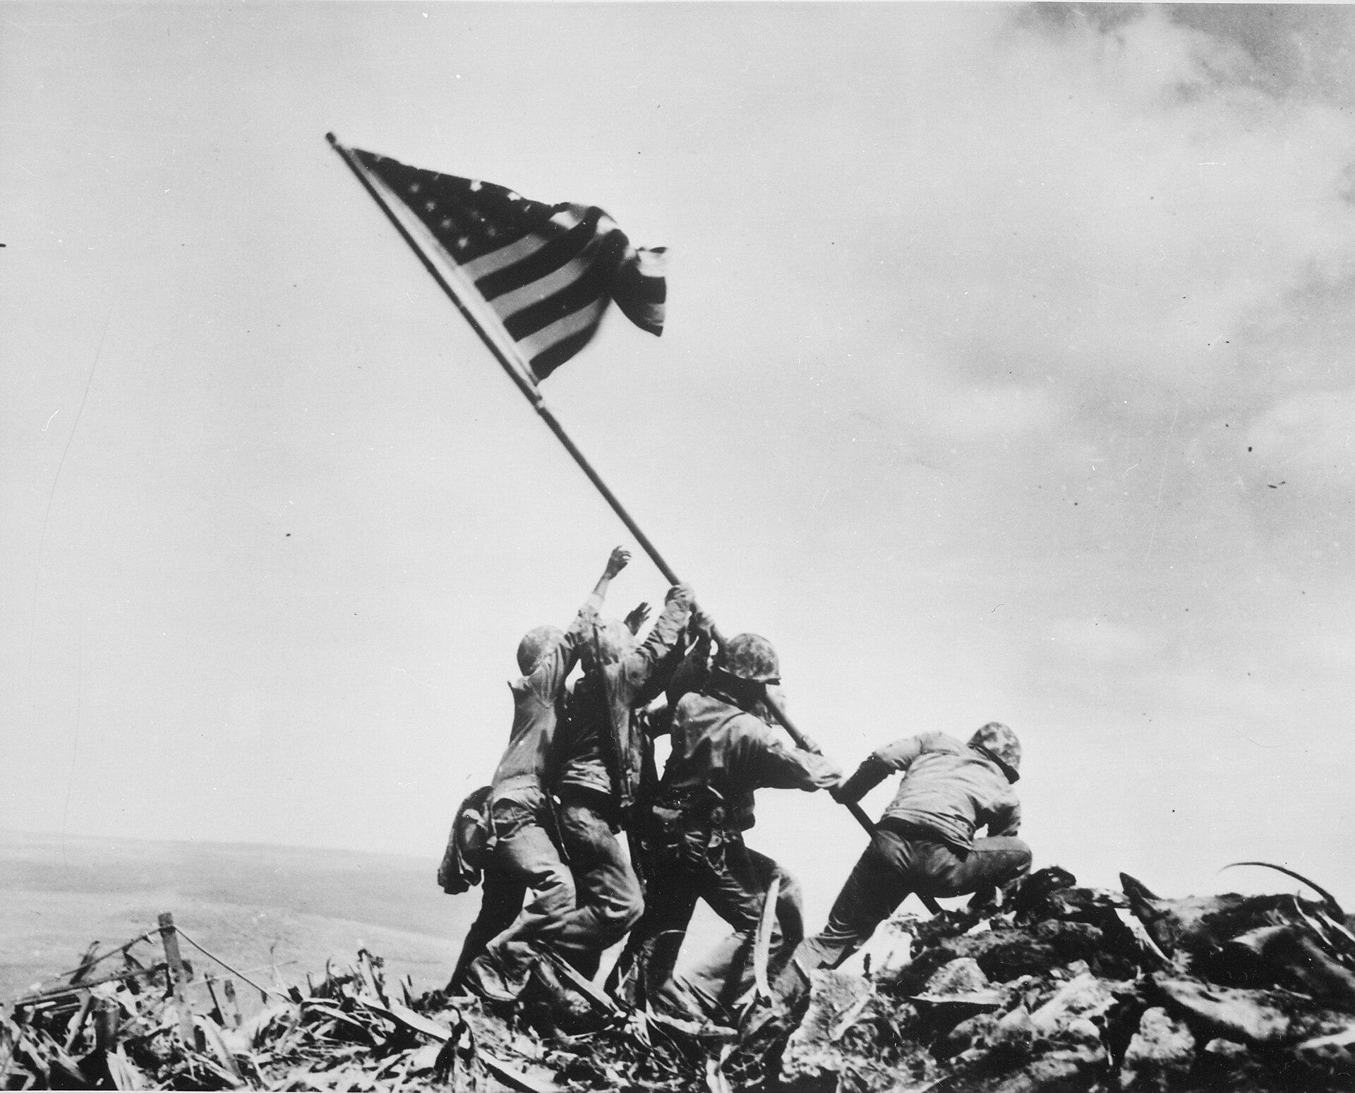
US.50 · DIRECT INSTRUCTION
2 of 4
Battle of Iwo Jima (February-March 1945)
Iwo Jima's volcanic terrain created natural fortifications that Japanese defenders exploited through an extensive tunnel system.
The island's airfields were needed for emergency landings by B-29 bombers attacking Japan and for fighter escorts.
Despite knowing the location of Japanese defenses, Marines suffered nearly 7,000 killed and 20,000 wounded in 36 days of fighting.
The iconic flag raising on Mount Suribachi became a symbol of American determination.
Joe Rosenthal / Associated Press (remade from NARA File 520748), February 23, 1945 National Archives
U.S. History Hack · TroopToTeacher Technologies LLC · Aligned to TN Academic Standards & TCAP EOC
89

Slide 101
US.50 · DIRECT INSTRUCTION
3 of 4
Battle of Okinawa (April-June 1945)
Okinawa's proximity to Japan (340 miles) made it essential as a staging base for invasion.
The 82-day battle was the bloodiest Pacific campaign, with over 12,000 Americans killed and 110,000 Japanese military deaths.
Mass kamikaze attacks damaged or sank hundreds of ships.
The horrific casualties influenced American decisions about invading Japan versus using atomic weapons, as projected invasion casualties ran into the hundreds of thousands.
U.S. History Hack · TroopToTeacher Technologies LLC · Aligned to TN Academic Standards & TCAP EOC
90

Slide 102
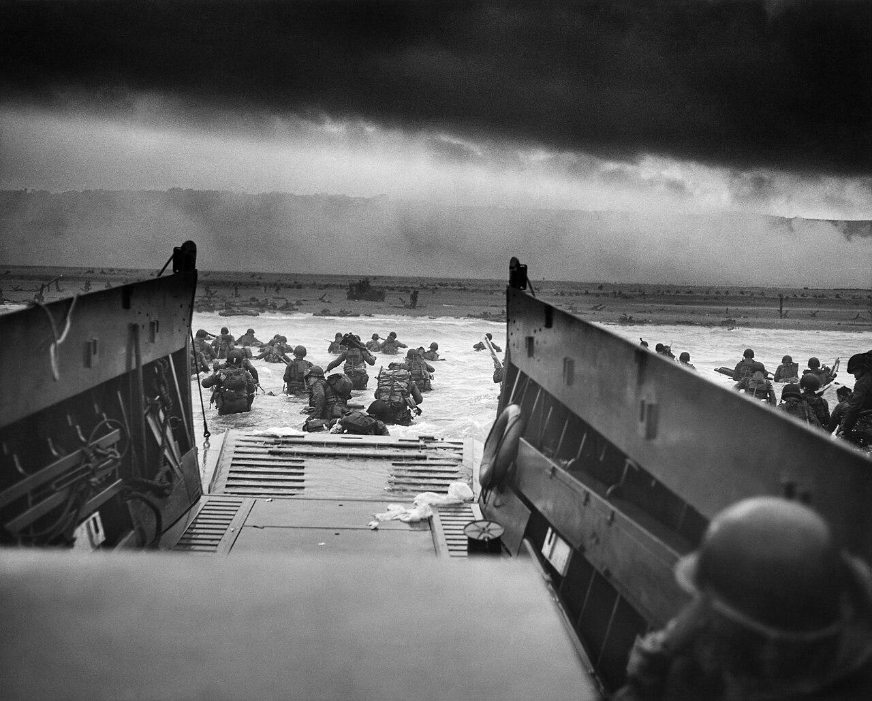
US.50 · DIRECT INSTRUCTION
4 of 4
D-Day: Normandy Invasion (June 6, 1944)
The Normandy coast was chosen for its beaches suitable for landing craft, proximity to English ports, and weaker defenses than Pas-de-Calais.
Allied deception operations convinced Germans the main attack would come elsewhere.
Despite heavy casualties at Omaha Beach, Allied forces established beachheads and broke through German defenses.
The largest amphibious invasion in history required unprecedented coordination of land, sea, and air forces, opening the Western Front that would ultimately liberate Western Europe.
Chief Photographer’s Mate Robert F. Sargent / U.S. Coast Guard, June 6, 1944 National Archives
U.S. History Hack · TroopToTeacher Technologies LLC · Aligned to TN Academic Standards & TCAP EOC
91

Slide 103
US.50 · PEOPLE WHO SHAPED THE ERA
Key Figure
Gen. Dwight D. Eisenhower
Commander of D-Day (1890-1969)
Chose June 6, 1944 despite risky weather
Coordinated air, sea, and land forces at Normandy
Opened the Western front that doomed Nazi Germany
STRATEGY Tie Eisenhower's decisions to the geographic and logistical factors driving each battle.
U.S. History Hack · TroopToTeacher Technologies LLC · Aligned to TN Academic Standards & TCAP EOC
92

Slide 104
US.50 · PRIMARY SOURCE ANALYSIS
Order of the Day - D-Day
Contextualization
General Dwight D. Eisenhower · June 6, 1944
"Soldiers, Sailors, and Airmen of the Allied Expeditionary Force! You are about to embark upon the Great Crusade, toward which we have striven these many months. The eyes of the world are upon you. The hope and prayers of liberty-loving people everywhere march with you... The tide has turned! The free men of the world are marching together to Victory!"
CONTEXT
By June 1944, the Allies had been fighting Nazi Germany for nearly five years. The D-Day invasion of Normandy, France was the largest amphibious military operation in history, involving nearly 160,000 Allied troops crossing the English Channel to open a western front against Hitler. General Eisenhower issued this order to boost morale and convey the historic significance of what soldiers were about to attempt.
ANALYZE
How does Eisenhower describe the significance of the D-Day invasion?
READ CLOSELY Underline the exact words that answer the ANALYZE question — be ready to read them aloud.
SOURCE IT
WHO made it?
WHEN?
WHY does it matter?
FIRST
General Dwight D. Eisenhower
June 6, 1944
Consider the author's purpose and audience before reading the words.
SSP.02 · before you interpret
Source: National Archives
U.S. History Hack · TroopToTeacher Technologies LLC · Aligned to TN Academic Standards & TCAP EOC
93
Notes:
Primary-source analysis. SOURCE IT FIRST (SSP.02) — model the sourcing routine aloud before students interpret: WHO made this source? (General Dwight D. Eisenhower) WHEN? (June 6, 1944) WHY does that matter? (Consider the author's purpose and audience before reading the words.) Only then move to the ANALYZE question. Suggested answer: See teacher key. Practice skill: Contextualization.

Slide 105
US.50 · KEY VOCABULARY
Word Wall
D-Day (Normandy Invasion)
Día D (Invasión de Normandía)
Battle of Midway
Batalla de Midway
say: dee-day NOR-mun-dee
say: BAT-ul uv MID-way
D
June 6, 1944 Allied invasion of Nazi-occupied France across the beaches of Normandy, the largest amphibious assault in history, turning point of the war in Europe.
BO
June 1942 decisive U.S. naval victory that stopped Japanese expansion in the Pacific and marked the turning point of the Pacific War.
Battle of Iwo Jima
Batalla de Iwo Jima
Battle of the Bulge
Batalla de las Ardenas
say: BAT-ul uv EE-woh JEE-muh
say: BAT-ul uv thuh bulj
BO
February-March 1945 brutal battle for a strategic Pacific island, famous for the iconic flag-raising photograph on Mount Suribachi.
BO
Germany's last major offensive (December 1944-January 1945) in the Ardennes forest, creating a "bulge" in Allied lines before being defeated.
Dwight D. Eisenhower
Dwight D. Eisenhower
Allied Powers
Potencias Aliadas
say: dwyt EYE-zen-how-er
say: AL-yd POW-erz
DD
Supreme Commander of Allied Forces in Europe who planned and led the D-Day invasion and coordinated Allied victory in Europe. Later became 34th President.
AP
The World War II coalition led by the United States, Great Britain, and the Soviet Union that fought and defeated the Axis Powers.
"say:" pronunciation guide (stressed syllable in CAPS) and a per-term visual anchor support newcomer English learners. Spanish term + full bilingual Frayer models are in the unit vocabulary set.
U.S. History Hack · TroopToTeacher Technologies LLC · Aligned to TN Academic Standards & TCAP EOC
94

Slide 106
US.50 · GUIDED PRACTICE — WE DO IT TOGETHER
Let’s Work One Together
Link geography to military outcome
MODEL PROMPT: Why did geography decide the outcome at Normandy and Midway?
WORKED EXAMPLE (teacher models this aloud)
At Normandy, beaches, tides, and surprise shaped the landing; at Midway, distance and carrier range decided the battle. Terrain and logistics, not just courage, drove results.
THINK ALOUD
Circle one geographic factor named in the source.
→ Now you try: Explain how that factor changed the battle's outcome, citing the text.
U.S. History Hack · TroopToTeacher Technologies LLC · Aligned to TN Academic Standards & TCAP EOC
95
Notes:
GUIDED PRACTICE / WE DO (US.50). Skill modeled: Link geography to military outcome. Model the worked example aloud using the THINK ALOUD as your script, then release students to the activity ("Explain how that factor changed the battle's outcome, citing the text."). This is the I Do → We Do → You Do bridge — do not skip it; aim for 80%+ success before independent work.

Slide 107
US.50 · STUDENT ACTIVITY
Terrain and Turning Points — Geography of the Great Battles
Pairs
15 min
YOUR TASK
Read Eisenhower's D-Day 'Order of the Day' and review the Normandy photograph. For four battles, Midway, Iwo Jima, Okinawa, and D-Day, record the theater (Pacific or European), one geographic or military factor that shaped the outcome, and the result. Finish with a one-sentence claim on how geography decided one of these battles, supported by evidence.
DELIVERABLE
DIFFERENTIATION
Completed four-battle chart (theater, geographic/military factor, result) AND a one-sentence evidence-based claim about geography's role.
Entry: Chart with the four battles pre-labeled and a word bank of factors and results to place. Honors: Write a paragraph using Eisenhower's order to explain the enormous risk and planning behind the D-Day invasion.
Companion printable: cornell-notes/unit-6/us50-major-wwii-battles.pdf
U.S. History Hack · TroopToTeacher Technologies LLC · Aligned to TN Academic Standards & TCAP EOC
96
Notes:
Student activity for US.50. Pair with the printable: cornell-notes/unit-6/us50-major-wwii-battles.pdf. Timing: 15. Deliverable: Completed four-battle chart (theater, geographic/military factor, result) AND a one-sentence evidence-based claim about geography's role.

Slide 108
US.50 · CHECK FOR UNDERSTANDING
TCAP-Style Question
DOK 2
EOC PRACTICE
Why was the Battle of Midway considered a turning point in the Pacific theater of World War II?
Because American forces captured the Japanese home island of Kyushu, threatening Tokyo directly.
A
Because the U.S. destroyed four Japanese aircraft carriers, permanently crippling Japan's offensive naval power.
B
Because the battle ended Japan's alliance with Germany, allowing the U.S. to focus all resources on Europe.
C
Because American forces first used the atomic bomb in the battle, forcing Japan to negotiate a ceasefire.
D
ANSWER FIRST: students commit — then click / advance to reveal the correct answer and explanation.
U.S. History Hack · TroopToTeacher Technologies LLC · Aligned to TN Academic Standards & TCAP EOC
97
Notes:
CHECK FOR UNDERSTANDING (US.50, DOK 2). Have students commit to an answer (whiteboards, hand signal, or turn-and-talk) BEFORE advancing. Correct answer: B. The next slide reveals it. Why: At Midway, U.S. naval intelligence cracked Japanese codes, enabling American carrier aircraft to surprise and sink four Japanese fleet carriers — the core of Japan's offensive capacity. This irreplaceable loss shifted the strategic initiative in the Pacific to the United States.

Slide 109
US.50 · ANSWER REVEAL
TCAP-Style Question
✓ ANSWER KEY
Why was the Battle of Midway considered a turning point in the Pacific theater of World War II?
A
Because American forces captured the Japanese home island of Kyushu, threatening Tokyo directly.
B
Because the U.S. destroyed four Japanese aircraft carriers, permanently crippling Japan's offensive naval power.
✓
C
Because the battle ended Japan's alliance with Germany, allowing the U.S. to focus all resources on Europe.
D
Because American forces first used the atomic bomb in the battle, forcing Japan to negotiate a ceasefire.
Correct answer: B. Why: At Midway, U.S. naval intelligence cracked Japanese codes, enabling American carrier aircraft to surprise and sink four Japanese fleet carriers — the core of Japan's offensive capacity. This irreplaceable loss shifted the strategic initiative in the Pacific to the United States.
U.S. History Hack · TroopToTeacher Technologies LLC · Aligned to TN Academic Standards & TCAP EOC
98
Notes:
ANSWER KEY (US.50). Correct: B. At Midway, U.S. naval intelligence cracked Japanese codes, enabling American carrier aircraft to surprise and sink four Japanese fleet carriers — the core of Japan's offensive capacity. This irreplaceable loss shifted the strategic initiative in the Pacific to the United States.

Slide 110
US.50 · WRAP-UP
What You Need to Know for TCAP
KEY TAKEAWAYS
EXIT TICKET
DOK 2
Battle of Midway (June 1942)
Battle of Iwo Jima (February-March 1945)
Battle of Okinawa (April-June 1945)
D-Day: Normandy Invasion (June 6, 1944)
Explain how geographic and military factors shaped the outcome of two major WWII battles.
★ HONORS / EXTENSION DOK 3 · SSP.04 Argumentation
Evaluate: In WWII, did geography or leadership matter more in deciding battles? Argue your position with evidence. (SSP.04)
U.S. History Hack · TroopToTeacher Technologies LLC · Aligned to TN Academic Standards & TCAP EOC
99
Notes:
WRAP-UP / EXIT-TICKET KEY (US.50, DOK 2). Prompt: Explain how geographic and military factors shaped the outcome of two major WWII battles. Model answer: Geography and strategy decided key battles. At Midway (1942), U.S. code-breaking and control of a vital Pacific island let a smaller fleet ambush and sink four Japanese carriers, turning the Pacific war. At Iwo Jima and Okinawa, island geography made for costly assaults that brought the U.S. within striking range of Japan. D-Day (1944) required crossing the English Channel to seize the Normandy beaches, opening the Western Front and squeezing Germany between the Allies and the Soviets. RETEACH TRIGGER — if a student misses this exit ticket: (1) <50% of class miss → spiral it into the next standard’s Quick Review opener (see the US.50 review prompts). (2) Individual/small group → reteach with the "Battle of Midway (June 1942)" direct-instruction slide + re-run the SOURCE IT FIRST routine on the US.50 primary source, then assign the paired printable: cornell-notes/unit-6/us50-major-wwii-battles.pdf. (3) Re-assess with the US.50 check-for-understanding reveal slide as a do-now the next day. Reteach anchors (this standard’s sections): Battle of Midway (June 1942); Battle of Iwo Jima (February-March 1945); Battle of Okinawa (April-June 1945); D-Day: Normandy Invasion (June 6, 1944). I Can objective: I can explain the role of geographic and military factors on the outcomes of battles in the Pacific and European theaters, including Midway, Iwo Jima, Okinawa, and D-Day. HONORS / EXTENSION (DOK 3, for early finishers or advanced learners): Evaluate: In WWII, did geography or leadership matter more in deciding battles? Argue your position with evidence. (SSP.04) — look for a clear claim plus two specific pieces of evidence.

Slide 111
STANDARD
SOCIAL STUDIES PRACTICES
US.51
SSP.01
Collect sources
SSP.05
Historical awareness
SSP.04
Build an argument
Special Fighting Forces in WWII
TN ACADEMIC STANDARD
Identify the roles and sacrifices of individual American soldiers, as well as the unique contributions of special fighting forces such as the Tuskegee Airmen, the 442nd Regimental Combat team, the 101st Airborne, and the Navajo Code Talkers.
I CAN
I can identify the roles and sacrifices of individual American soldiers and the unique contributions of special fighting forces such as the Tuskegee Airmen, the 442nd Regimental Combat Team, the 101st Airborne, and the Navajo Code Talkers.
U.S. History Hack · TroopToTeacher Technologies LLC · Aligned to TN Academic Standards & TCAP EOC
100

Slide 112
KEY VOCABULARY · LANGUAGE SUPPORT
US.50
Words you need before we read
D-Day (Normandy Invasion)
Battle of Midway
Battle of Iwo Jima
En español: Día D (Invasión de Normandía)
En español: Batalla de Midway
En español: Batalla de Iwo Jima
WHAT IT MEANS
WHAT IT MEANS
WHAT IT MEANS
June 6, 1944 Allied invasion of Nazi-occupied France across the beaches of Normandy, the largest amphibious assault in history, turning point of the war in Europe.
June 1942 decisive U.S. naval victory that stopped Japanese expansion in the Pacific and marked the turning point of the Pacific War.
February-March 1945 brutal battle for a strategic Pacific island, famous for the iconic flag-raising photograph on Mount Suribachi.
UDL · REPRESENTATION → LANGUAGE & SYMBOLS
U.S. History Hack · TEACHER DECK · Aligned to TN Academic Standards & TCAP EOC
12

Slide 113
PROGRESS CHECK
US.50
Check your understanding
How did geographic features of the Pacific islands affect American military strategy in battles like Midway and Iwo Jima?
A
Geography had no effect on Pacific strategy, though this interpretation lacks supporting historical evidence, although historical sources do not support this conclusion
B
Midway's central location made it strategically vital, while Iwo Jima's volcanic terrain created natural fortifications requiring costly direct assault to secure airfields needed for bombing Japan
✓ KEY
C
All Pacific islands were geographically identical, which does not reflect the consensus among historians, but the historical evidence paints a more nuanced picture and does not reflect the scholarly consensus on this topic
D
American forces avoided geographic challenges entirely, which does not align with the documented historical record, and this view has been largely revised by modern historical research
UDL · ACTION & EXPRESSION → STRATEGY DEVELOPMENT
MTSS: below mastery → targeted reteach (Tier 2); at/above → extension. The goal never lowers.
U.S. History Hack · TEACHER DECK · Aligned to TN Academic Standards & TCAP EOC
13

Slide 114
US.51 · QUICK REVIEW
Do You Remember?
Before we start, retrieve what we have already learned. Answer from memory first — no notes.
1
US.50 Why was the Battle of Midway (1942) a turning point?
2
US.50 What was D-Day?
U.S. History Hack · TroopToTeacher Technologies LLC · Aligned to TN Academic Standards & TCAP EOC
101
Notes:
SPACED RETRIEVAL (US.51). Cold-call or whiteboards, 3-4 min, low stakes. Answers — 1) The U.S. destroyed four Japanese aircraft carriers, halting Japan's advance and shifting the Pacific war in the Allies' favor. 2) The June 6, 1944 Allied invasion of Normandy, France, the largest seaborne invasion in history, that opened the Western Front against Germany.

Slide 115
US.51 · CONFIDENCE CHECK
Warm-Up — Quick Recall
DOK 1
LOW STAKES
Everyone can answer this. Thumbs / whiteboards — no notes.
Name one special fighting force made up of a minority group in WWII.
✓ ANSWER
The Tuskegee Airmen, the 442nd Regimental Combat Team, or the Navajo Code Talkers.
COMMIT FIRST: have everyone answer before the reveal — this is the DOK 1 floor; the graded check later in this lesson moves up to DOK 2–3.
U.S. History Hack · TroopToTeacher Technologies LLC · Aligned to TN Academic Standards & TCAP EOC
102
Notes:
CONFIDENCE CHECK (US.51, DOK 1). 60-90 seconds. Have EVERY student commit (thumbs / whiteboard / choral) before revealing — this secures an early win and surfaces who is shaky before new content. Answer: The Tuskegee Airmen, the 442nd Regimental Combat Team, or the Navajo Code Talkers. Key term to listen for: Tuskegee Airmen. This is the low-floor entry; the graded Check for Understanding later in the standard rises to DOK 2–3.

Slide 116
US.51 · HOOK
Think About It
They fought two wars at once, one against the Axis abroad and one against prejudice at home: the Tuskegee Airmen, the Japanese American 442nd, the paratroopers of the 101st Airborne, and the Navajo Code Talkers whose language the enemy never broke.
DISCUSS
TIMING: Turn & Talk 60 sec → cold-call 2 pairs
Why would Americans risk their lives for a country that did not yet grant them equal rights, and what did their service prove?
U.S. History Hack · TroopToTeacher Technologies LLC · Aligned to TN Academic Standards & TCAP EOC
103
Notes:
HOOK (US.51). Run tight: pose the provocation, give a silent 10-second think, then Turn & Talk 60 seconds. Cold-call 2–3 pairs (not volunteers) for a sentence-starter answer — "One force was ___ because ___" — then bridge to the standard. Keep total to ~4 minutes; do not let it sprawl. Return to this question at the unit close for an evidence-based answer.

Slide 117
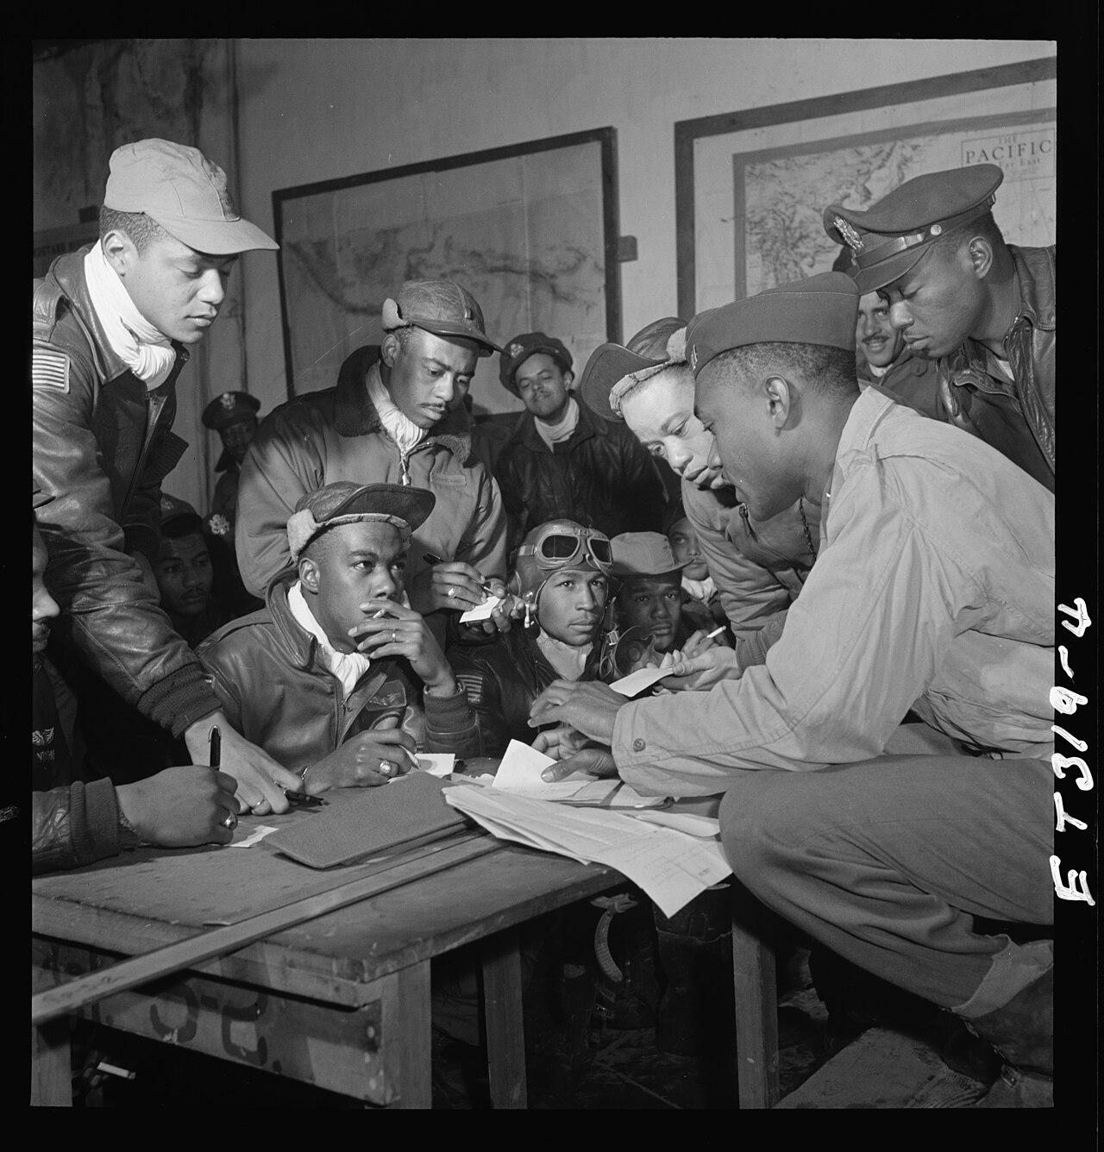
US.51 · DIRECT INSTRUCTION
1 of 5
Tuskegee Airmen
The Tuskegee Airmen were the first African American military aviators in the U.S. Armed Forces.
Trained at Tuskegee Army Air Field in Alabama, the 332nd Fighter Group flew over 15,000 sorties in Europe and North Africa.
They earned over 150 Distinguished Flying Crosses and a Presidential Unit Citation.
Despite facing racism and segregation within the military, they compiled an outstanding combat record, helping to pave the way for the desegregation of the armed forces in 1948.
SENTENCE FRAME (EL & writing support)
Toni Frissell / Library of Congress, Toni Frissell Collection, March 1945 Library of Congress
The ________ contributed to the war by ________, even though they faced ________ at home.
TEACHER CUE Chunk → cold-call → confirm before advancing.
U.S. History Hack · TroopToTeacher Technologies LLC · Aligned to TN Academic Standards & TCAP EOC
104
Notes:
FACILITATION (US.51). Ask: why would someone fight for a country that treats them as second-class - then meet the Tuskegee Airmen and the 442nd. Teach in small steps; pause and check for understanding before the next chunk (aim 80%+ before moving on).

Slide 118
US.51 · DIRECT INSTRUCTION
2 of 5
442nd Regimental Combat Team
The 442nd was composed almost entirely of Japanese American volunteers, many of whose families were confined in internment camps.
Fighting in Europe, they became the most decorated unit of their size in U.S. military history, earning over 18,000 individual decorations including 21 Medals of Honor.
Their motto "Go for Broke" reflected their determination to prove their loyalty to America despite the government's unjust treatment of their families.
U.S. History Hack · TroopToTeacher Technologies LLC · Aligned to TN Academic Standards & TCAP EOC
105

Slide 119
US.51 · DIRECT INSTRUCTION
3 of 5
101st Airborne Division
The "Screaming Eagles" of the 101st Airborne Division parachuted into Normandy on D-Day, June 6, 1944, securing key bridges and crossroads behind enemy lines to support the beach landings.
They later defended Bastogne during the Battle of the Bulge, where Acting Commander General Anthony McAuliffe famously replied "Nuts!" to a German surrender demand.
Their elite training and courage under fire made them one of the most celebrated units in American military history.
★ TENNESSEE CONNECTION
The 101st Airborne Division, the 'Screaming Eagles,' has deep Tennessee ties: the division is headquartered at Fort Campbell on the Tennessee-Kentucky border. In WWII its paratroopers dropped behind enemy lines on D-Day to secure bridges and crossroads and later held the line at Bastogne during the Battle of the Bulge.
U.S. History Hack · TroopToTeacher Technologies LLC · Aligned to TN Academic Standards & TCAP EOC
106

Slide 120
US.51 · DIRECT INSTRUCTION
4 of 5
Navajo Code Talkers
Navajo Marines developed an unbreakable military code based on their native language, which had no written form and was virtually unknown outside the Navajo Nation.
Code Talkers served in every major Marine operation in the Pacific from 1942-1945, transmitting battlefield communications that the Japanese never deciphered.
Their contributions were so vital that commanders credited them with the success at Iwo Jima.
Their service remained classified until 1968 and was formally recognized with Congressional Gold Medals in 2001.
U.S. History Hack · TroopToTeacher Technologies LLC · Aligned to TN Academic Standards & TCAP EOC
107

Slide 121
US.51 · DIRECT INSTRUCTION
5 of 5
Individual Sacrifice and Legacy
These special fighting forces demonstrated extraordinary courage while often fighting two wars—one against foreign enemies and another against discrimination at home.
Their sacrifices challenged racial prejudices, proved that patriotism transcended race and ethnicity, and contributed to post-war civil rights advances.
Veterans of these units became leaders in their communities and advocates for equality, using their military records to demand the rights they had fought to defend.
U.S. History Hack · TroopToTeacher Technologies LLC · Aligned to TN Academic Standards & TCAP EOC
108

Slide 122
US.51 · PEOPLE WHO SHAPED THE ERA
Key Figures
The Tuskegee Airmen
The 442nd Regimental Combat Team
The Navajo Code Talkers
First Black U.S. military pilots
Japanese American Army unit
Marine communications specialists
Flew hundreds of bomber-escort missions in Europe
Earned an outstanding combat record despite segregation
Proved the case against a segregated military
Became the most decorated unit of its size in U.S. history
Fought in Italy and France while families sat in camps
Embodied 'Go for Broke' loyalty under injustice
Turned the Navajo language into an unbreakable code
Transmitted vital orders in Pacific battles
Gave the U.S. a decisive communications edge
STRATEGY Use the Airmen to connect battlefield sacrifice to the fight for civil rights at home.
STRATEGY Pair the 442nd with internment (US.54) so students hold sacrifice and injustice together.
STRATEGY Use the Code Talkers to show how diverse Americans made unique, decisive contributions.
U.S. History Hack · TroopToTeacher Technologies LLC · Aligned to TN Academic Standards & TCAP EOC
109

Slide 123
US.51 · PRIMARY SOURCE ANALYSIS
Tuskegee Airmen Commendation
Corroboration
U.S. Army Air Forces · 1945
"The 332nd Fighter Group has established an outstanding record by continuously outstanding performance of duty... Your formation has not lost a single bomber to enemy fighters. The determination, technique, and courage shown by your group in engaging enemy aircraft has been outstanding."
CONTEXT
The Tuskegee Airmen were the first African American military aviators in the U.S. armed forces, trained at Tuskegee Army Air Field in Alabama during World War II. They served in a racially segregated military that many believed African Americans were unfit to be combat pilots. Their outstanding record as escort fighters—protecting bombers on missions over Europe—helped challenge racial stereotypes and laid the groundwork for military desegregation.
ANALYZE
What evidence does this document provide about the Tuskegee Airmen's military effectiveness?
READ CLOSELY Underline the exact words that answer the ANALYZE question — be ready to read them aloud.
SOURCE IT
WHO made it?
WHEN?
WHY does it matter?
FIRST
U.S. Army Air Forces
1945
Consider the author's purpose and audience before reading the words.
SSP.02 · before you interpret
Source: National Archives
U.S. History Hack · TroopToTeacher Technologies LLC · Aligned to TN Academic Standards & TCAP EOC
110
Notes:
Primary-source analysis. SOURCE IT FIRST (SSP.02) — model the sourcing routine aloud before students interpret: WHO made this source? (U.S. Army Air Forces) WHEN? (1945) WHY does that matter? (Consider the author's purpose and audience before reading the words.) Only then move to the ANALYZE question. Suggested answer: See teacher key. Practice skill: Corroboration.

Slide 124
US.51 · KEY VOCABULARY
Word Wall
Tuskegee Airmen
Aviadores de Tuskegee
442nd Regimental Combat Team
442º Equipo de Combate Regimental
say: tus-KEE-gee AIR-men
say: for-for-tee-SEK-und rej-ih-MEN-tul
TA
First African American military pilots who fought in World War II, proving their skill despite facing racial discrimination and segregation.
RC
All Japanese-American unit that became the most decorated unit in U.S. military history, fighting in Europe while their families were interned at home.
Navajo Code Talkers
Descifradores de Código Navajo
Battle of Iwo Jima
Batalla de Iwo Jima
say: NAV-uh-hoh kohd TAWK-erz
say: BAT-ul uv EE-woh JEE-muh
NC
Navajo Marines who used their native language to create an unbreakable code for military communications in the Pacific theater.
BO
February-March 1945 brutal battle for a strategic Pacific island, famous for the iconic flag-raising photograph on Mount Suribachi.
Allied Powers
Potencias Aliadas
Holocaust
Holocausto
say: AL-yd POW-erz
say: HOL-uh-kawst
AP
The World War II coalition led by the United States, Great Britain, and the Soviet Union that fought and defeated the Axis Powers.
H
Nazi Germany's systematic genocide of 6 million Jews and millions of others (Roma, disabled, homosexuals, political opponents) during World War II.
"say:" pronunciation guide (stressed syllable in CAPS) and a per-term visual anchor support newcomer English learners. Spanish term + full bilingual Frayer models are in the unit vocabulary set.
U.S. History Hack · TroopToTeacher Technologies LLC · Aligned to TN Academic Standards & TCAP EOC
111

Slide 125
US.51 · GUIDED PRACTICE — WE DO IT TOGETHER
Let’s Work One Together
Evaluate contributions under injustice
MODEL PROMPT: What made the Tuskegee Airmen's record so significant?
WORKED EXAMPLE (teacher models this aloud)
They fought and excelled while serving in a segregated military. Their record was evidence, not just valor - it refuted the claim that Black pilots couldn't perform.
THINK ALOUD
Find the sentence naming their combat achievement.
→ Now you try: Explain how their service became an argument for change at home.
U.S. History Hack · TroopToTeacher Technologies LLC · Aligned to TN Academic Standards & TCAP EOC
112
Notes:
GUIDED PRACTICE / WE DO (US.51). Skill modeled: Evaluate contributions under injustice. Model the worked example aloud using the THINK ALOUD as your script, then release students to the activity ("Explain how their service became an argument for change at home."). This is the I Do → We Do → You Do bridge — do not skip it; aim for 80%+ success before independent work.

Slide 126
US.51 · STUDENT ACTIVITY
Fighting Two Wars — Special Forces and Individual Sacrifice
Groups of 3
15 min
YOUR TASK
Read the Tuskegee Airmen commendation and study the photograph. Build a chart for four special forces, the Tuskegee Airmen, the 442nd Regimental Combat Team, the 101st Airborne, and the Navajo Code Talkers, recording their unique contribution and one obstacle or sacrifice each faced. Finish with a one-sentence claim on how these groups fought discrimination at home while fighting the enemy abroad, with evidence.
DELIVERABLE
DIFFERENTIATION
Completed four-unit chart (contribution + obstacle/sacrifice each) AND a one-sentence evidence-based claim about the 'two wars' these soldiers fought.
Entry: Chart with the four units pre-labeled and a fact bank of contributions to sort. Honors: Write a paragraph using the Tuskegee Airmen commendation to argue how their record challenged racist assumptions of the era.
Companion printable: cornell-notes/unit-6/us51-special-fighting-forces.pdf
U.S. History Hack · TroopToTeacher Technologies LLC · Aligned to TN Academic Standards & TCAP EOC
113
Notes:
Student activity for US.51. Pair with the printable: cornell-notes/unit-6/us51-special-fighting-forces.pdf. Timing: 15. Deliverable: Completed four-unit chart (contribution + obstacle/sacrifice each) AND a one-sentence evidence-based claim about the 'two wars' these soldiers fought.

Slide 127
US.51 · CHECK FOR UNDERSTANDING
TCAP-Style Question
DOK 2
EOC PRACTICE
What role did Navajo Code Talkers play in WWII?
Served as translators helping communicate with Japanese prisoners of war in camps.
A
Used Navajo language to create unbreakable military codes in the Pacific theater.
B
Fought exclusively in the European theater as specialized infantry scout units.
C
Worked as intelligence analysts decoding Japanese military radio transmissions at bases.
D
ANSWER FIRST: students commit — then click / advance to reveal the correct answer and explanation.
U.S. History Hack · TroopToTeacher Technologies LLC · Aligned to TN Academic Standards & TCAP EOC
114
Notes:
CHECK FOR UNDERSTANDING (US.51, DOK 2). Have students commit to an answer (whiteboards, hand signal, or turn-and-talk) BEFORE advancing. Correct answer: B. The next slide reveals it. Why: Used Navajo language to create unbreakable military codes in the Pacific theater. D is incorrect because it describes a different program, event, or idea than the topic in the question. It connects wartime change to the longer struggle for civil rights and equal treatment.

Slide 128
US.51 · ANSWER REVEAL
TCAP-Style Question
✓ ANSWER KEY
What role did Navajo Code Talkers play in WWII?
A
Served as translators helping communicate with Japanese prisoners of war in camps.
B
Used Navajo language to create unbreakable military codes in the Pacific theater.
✓
C
Fought exclusively in the European theater as specialized infantry scout units.
D
Worked as intelligence analysts decoding Japanese military radio transmissions at bases.
Correct answer: B. Why: Used Navajo language to create unbreakable military codes in the Pacific theater. D is incorrect because it describes a different program, event, or idea than the topic in the question. It connects wartime change to the longer struggle for civil rights and equal treatment.
U.S. History Hack · TroopToTeacher Technologies LLC · Aligned to TN Academic Standards & TCAP EOC
115
Notes:
ANSWER KEY (US.51). Correct: B. Used Navajo language to create unbreakable military codes in the Pacific theater. D is incorrect because it describes a different program, event, or idea than the topic in the question. It connects wartime change to the longer struggle for civil rights and equal treatment.

Slide 129
US.51 · WRAP-UP
What You Need to Know for TCAP
KEY TAKEAWAYS
EXIT TICKET
DOK 2
Tuskegee Airmen
442nd Regimental Combat Team
101st Airborne Division
Navajo Code Talkers
Individual Sacrifice and Legacy
Describe the contributions of two special fighting forces in WWII and one obstacle they overcame.
★ HONORS / EXTENSION DOK 3 · SSP.04 Argumentation
Evaluate: What did the service of these units prove about the injustice of discrimination at home? Argue with evidence. (SSP.04)
U.S. History Hack · TroopToTeacher Technologies LLC · Aligned to TN Academic Standards & TCAP EOC
116
Notes:
WRAP-UP / EXIT-TICKET KEY (US.51, DOK 2). Prompt: Describe the contributions of two special fighting forces in WWII and one obstacle they overcame. Model answer: Special units made vital contributions despite discrimination. The Tuskegee Airmen, the first Black military pilots, flew successful escort missions while facing segregation. The Japanese American 442nd Regimental Combat Team became one of the most decorated units in U.S. history even as their families were interned at home. The 101st Airborne parachuted behind enemy lines on D-Day. The Navajo Code Talkers created an unbreakable code from their language, saving countless lives. RETEACH TRIGGER — if a student misses this exit ticket: (1) <50% of class miss → spiral it into the next standard’s Quick Review opener (see the US.51 review prompts). (2) Individual/small group → reteach with the "Tuskegee Airmen" direct-instruction slide + re-run the SOURCE IT FIRST routine on the US.51 primary source, then assign the paired printable: cornell-notes/unit-6/us51-special-fighting-forces.pdf. (3) Re-assess with the US.51 check-for-understanding reveal slide as a do-now the next day. Reteach anchors (this standard’s sections): Tuskegee Airmen; 442nd Regimental Combat Team; 101st Airborne Division; Navajo Code Talkers; Individual Sacrifice and Legacy. I Can objective: I can identify the roles and sacrifices of individual American soldiers and the unique contributions of special fighting forces such as the Tuskegee Airmen, the 442nd Regimental Combat Team, the 101st Airborne, and the Navajo Code Talkers. HONORS / EXTENSION (DOK 3, for early finishers or advanced learners): Evaluate: What did the service of these units prove about the injustice of discrimination at home? Argue with evidence. (SSP.04) — look for a clear claim plus two specific pieces of evidence.

Slide 130
STANDARD
SOCIAL STUDIES PRACTICES
US.52
SSP.02
Examine a source
SSP.03
Synthesize sources
SSP.05
Historical awareness
Women in World War II
TN ACADEMIC STANDARD
Examine and explain the entry of large numbers of women into the workforce and armed forces during World War II and the subsequent impact on American society.
I CAN
I can examine and explain the entry of large numbers of women into the workforce and armed forces during World War II and the subsequent impact on American society.
U.S. History Hack · TroopToTeacher Technologies LLC · Aligned to TN Academic Standards & TCAP EOC
117

Slide 131
KEY VOCABULARY · LANGUAGE SUPPORT
US.51
Words you need before we read
Tuskegee Airmen
442nd Regimental Combat Team
Navajo Code Talkers
En español: Aviadores de Tuskegee
En español: 442º Equipo de Combate Regimental
En español: Descifradores de Código Navajo
WHAT IT MEANS
WHAT IT MEANS
WHAT IT MEANS
First African American military pilots who fought in World War II, proving their skill despite facing racial discrimination and segregation.
All Japanese-American unit that became the most decorated unit in U.S. military history, fighting in Europe while their families were interned at home.
Navajo Marines who used their native language to create an unbreakable code for military communications in the Pacific theater.
UDL · REPRESENTATION → LANGUAGE & SYMBOLS
U.S. History Hack · TEACHER DECK · Aligned to TN Academic Standards & TCAP EOC
14

Slide 132
PROGRESS CHECK
US.51
Check your understanding
Why is the service of the 442nd Regimental Combat Team particularly significant given the internment of Japanese Americans?
A
Their service had no connection to internment policies, but the historical record tells a more complex story, and this view has been largely revised by modern historical research
B
The 442nd was composed of non-Japanese American soldiers, but this fails to account for the broader historical context, but the historical evidence paints a more nuanced picture
C
Japanese American soldiers volunteered to fight for a country that imprisoned their families, becoming the most decorated unit of their size while proving their loyalty despite profound injustice
✓ KEY
D
They served only in the Pacific theater, but this fails to account for the broader historical context and does not reflect the scholarly consensus on this topic, which contradicts the primary source evidence from this era
UDL · ACTION & EXPRESSION → STRATEGY DEVELOPMENT
MTSS: below mastery → targeted reteach (Tier 2); at/above → extension. The goal never lowers.
U.S. History Hack · TEACHER DECK · Aligned to TN Academic Standards & TCAP EOC
15

Slide 133
US.52 · QUICK REVIEW
Do You Remember?
Before we start, retrieve what we have already learned. Answer from memory first — no notes.
1
US.51 Who were the Tuskegee Airmen?
2
US.51 What did the Navajo Code Talkers do?
U.S. History Hack · TroopToTeacher Technologies LLC · Aligned to TN Academic Standards & TCAP EOC
118
Notes:
SPACED RETRIEVAL (US.52). Cold-call or whiteboards, 3-4 min, low stakes. Answers — 1) The first African American military pilots, who flew with distinction in WWII and helped prove the case for integrating the armed forces. 2) They used the Navajo language to create an unbreakable battlefield code that the Japanese never deciphered.

Slide 134
US.52 · CONFIDENCE CHECK
Warm-Up — Quick Recall
DOK 1
LOW STAKES
Everyone can answer this. Thumbs / whiteboards — no notes.
What nickname symbolized women who took factory jobs during WWII?
✓ ANSWER
Rosie the Riveter.
COMMIT FIRST: have everyone answer before the reveal — this is the DOK 1 floor; the graded check later in this lesson moves up to DOK 2–3.
U.S. History Hack · TroopToTeacher Technologies LLC · Aligned to TN Academic Standards & TCAP EOC
119
Notes:
CONFIDENCE CHECK (US.52, DOK 1). 60-90 seconds. Have EVERY student commit (thumbs / whiteboard / choral) before revealing — this secures an early win and surfaces who is shaky before new content. Answer: Rosie the Riveter. Key term to listen for: Rosie the Riveter. This is the low-floor entry; the graded Check for Understanding later in the standard rises to DOK 2–3.

Slide 135
US.52 · HOOK
Think About It
As millions of men shipped out to war, American women poured into shipyards and aircraft plants, riveting bombers and welding warships, while others joined the armed forces, changing forever the idea of what women could do.
DISCUSS
TIMING: Turn & Talk 60 sec → cold-call 2 pairs
Did World War II permanently transform women's place in American society, or was 'Rosie the Riveter' only welcome until the men came home?
U.S. History Hack · TroopToTeacher Technologies LLC · Aligned to TN Academic Standards & TCAP EOC
120
Notes:
HOOK (US.52). Run tight: pose the provocation, give a silent 10-second think, then Turn & Talk 60 seconds. Cold-call 2–3 pairs (not volunteers) for a sentence-starter answer — "One force was ___ because ___" — then bridge to the standard. Keep total to ~4 minutes; do not let it sprawl. Return to this question at the unit close for an evidence-based answer.

Slide 136
US.52 · DIRECT INSTRUCTION
1 of 4
Factors Leading to Women's Participation
With 16 million men serving in the armed forces, a massive labor shortage emerged as war production required doubling the manufacturing workforce.
Government campaigns like "Rosie the Riveter" recruited women, while economic necessity pushed many families to rely on women's income.
Women in the workforce grew from 12 million (1940) to 20 million (1945), comprising 36% of the civilian workforce.
Women made up 65% of aircraft industry workers by war's end.
SENTENCE FRAME (EL & writing support)
Women entered the workforce during WWII because ________, and one lasting effect was ________.
U.S. History Hack · TroopToTeacher Technologies LLC · Aligned to TN Academic Standards & TCAP EOC
121
Notes:
FACILITATION (US.52). Show a 'We Can Do It!' style prompt and ask what happens to a workforce when millions of men leave for war. Teach in small steps; pause and check for understanding before the next chunk (aim 80%+ before moving on).

Slide 137
US.52 · DIRECT INSTRUCTION
2 of 4
Challenges and Opportunities
Women faced discrimination including lower pay (about 65% of men's wages), dangerous conditions, long hours, and inadequate facilities.
Social challenges included limited childcare, expectations to maintain domestic duties, and criticism for abandoning traditional roles.
However, women gained economic independence, learned technical skills, some achieved supervisory positions, and military service provided professional training in communications, mechanics, and aviation.
U.S. History Hack · TroopToTeacher Technologies LLC · Aligned to TN Academic Standards & TCAP EOC
122

Slide 138
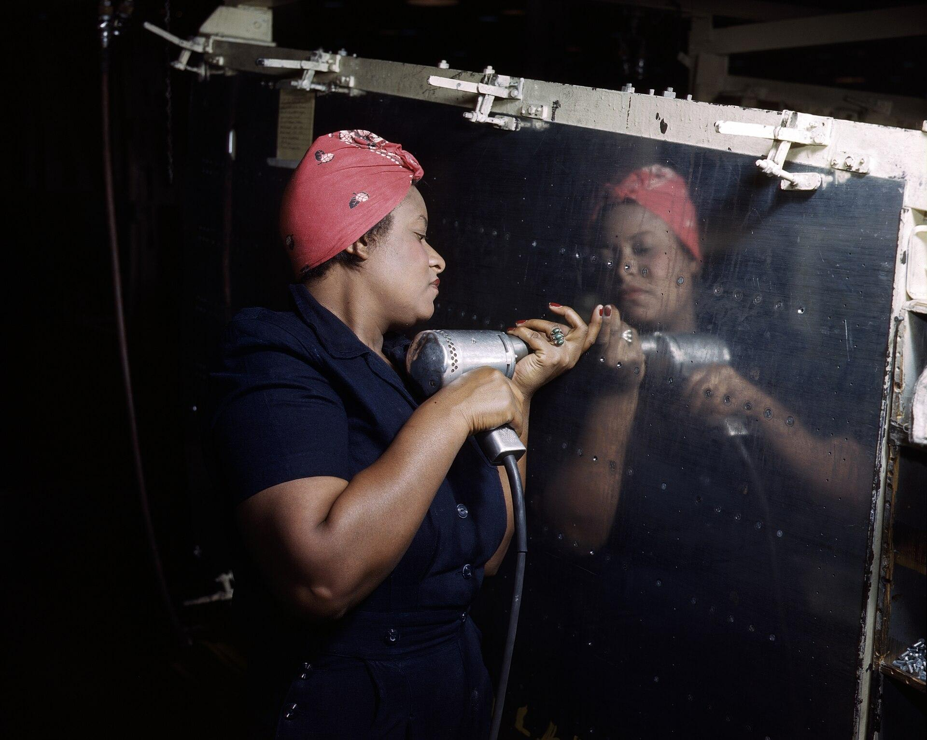
US.52 · DIRECT INSTRUCTION
3 of 4
Impact on Production and Economy
Women built bombers, fighters, and transport planes; constructed Liberty ships; manufactured ammunition and explosives; and assembled radios and radar equipment.
Women's entry helped achieve record production levels—296,000 aircraft, 86,000 tanks, 2.3 million trucks.
This contribution was essential to Allied victory, demonstrating women's capabilities in technical and leadership roles previously reserved for men.
Alfred T. Palmer / U.S. OWI (OWI) / FSA, February 1943 Library of Congress
U.S. History Hack · TroopToTeacher Technologies LLC · Aligned to TN Academic Standards & TCAP EOC
123

Slide 139
US.52 · DIRECT INSTRUCTION
4 of 4
Long-term Effects on Society
After the war, many women were laid off to make room for returning veterans, and social pressure emphasized homemaking and motherhood.
However, women's labor force participation never returned to pre-war levels.
The experience provided foundation for the women's rights movement of the 1960s-70s, established precedents for equal employment opportunities, and created pathways for women in previously male professions.
Military services became permanent parts of armed forces.
U.S. History Hack · TroopToTeacher Technologies LLC · Aligned to TN Academic Standards & TCAP EOC
124

Slide 140
US.52 · PEOPLE WHO SHAPED THE ERA
Key Figure
Rosie the Riveter
Symbol of women war workers
Represented millions of women in defense plants
Filled skilled industrial jobs once closed to women
Reshaped ideas about what women could do
STRATEGY Use Rosie as an entry point, then move to the real women (like the Nashville plant workers) behind the icon.
U.S. History Hack · TroopToTeacher Technologies LLC · Aligned to TN Academic Standards & TCAP EOC
125

Slide 141
US.52 · PRIMARY SOURCE ANALYSIS
War Production Board Poster Text
Close Reading
U.S. War Production Board · 1943
"Do the job HE left behind. Women workers are needed in aircraft plants, shipyards, and munitions factories. Apply at your nearest U.S. Employment Service office. Every woman who takes a war job brings Victory closer. The more women at work—the sooner we win!"
CONTEXT
When millions of American men went to war after Pearl Harbor, the industrial workforce had a massive labor shortage. The War Production Board recruited women to fill factory jobs in defense industries, producing ships, aircraft, tanks, and ammunition. This wartime mobilization fundamentally shifted gender roles in America—by 1944, nearly 20 million women were working, many for the first time in industrial jobs.
ANALYZE
What argument does this poster make to encourage women to work?
READ CLOSELY Underline the exact words that answer the ANALYZE question — be ready to read them aloud.
SOURCE IT
WHO made it?
WHEN?
WHY does it matter?
FIRST
U.S. War Production Board
1943
Consider the author's purpose and audience before reading the words.
SSP.02 · before you interpret
Source: Library of Congress
U.S. History Hack · TroopToTeacher Technologies LLC · Aligned to TN Academic Standards & TCAP EOC
126
Notes:
Primary-source analysis. SOURCE IT FIRST (SSP.02) — model the sourcing routine aloud before students interpret: WHO made this source? (U.S. War Production Board) WHEN? (1943) WHY does that matter? (Consider the author's purpose and audience before reading the words.) Only then move to the ANALYZE question. Suggested answer: See teacher key. Practice skill: Close Reading.

Slide 142
US.52 · KEY VOCABULARY
Word Wall
Rosie the Riveter
Rosie la Remachadora
Tuskegee Airmen
Aviadores de Tuskegee
say: ROH-zee thuh RIV-eh-ter
say: tus-KEE-gee AIR-men
RT
Cultural icon representing millions of American women who worked in factories and shipyards during World War II, filling jobs left by men who went to war.
TA
First African American military pilots who fought in World War II, proving their skill despite facing racial discrimination and segregation.
Rationing
Racionamiento
War Bonds
Bonos de Guerra
say: RASH-un-ing
say: wor bondz
R
Government-controlled limits on consumer goods during WWII to ensure adequate supplies for the military, requiring ration books and coupons.
WB
Government bonds sold to citizens to finance the war effort, promoted through massive publicity campaigns featuring celebrities and patriotic appeals.
Allied Powers
Potencias Aliadas
442nd Regimental Combat Team
442º Equipo de Combate Regimental
say: AL-yd POW-erz
say: for-for-tee-SEK-und rej-ih-MEN-tul
AP
The World War II coalition led by the United States, Great Britain, and the Soviet Union that fought and defeated the Axis Powers.
RC
All Japanese-American unit that became the most decorated unit in U.S. military history, fighting in Europe while their families were interned at home.
"say:" pronunciation guide (stressed syllable in CAPS) and a per-term visual anchor support newcomer English learners. Spanish term + full bilingual Frayer models are in the unit vocabulary set.
U.S. History Hack · TroopToTeacher Technologies LLC · Aligned to TN Academic Standards & TCAP EOC
127

Slide 143
US.52 · GUIDED PRACTICE — WE DO IT TOGETHER
Let’s Work One Together
Analyze wartime social change
MODEL PROMPT: How did the war change women's place in the workforce?
WORKED EXAMPLE (teacher models this aloud)
Labor shortages opened skilled defense jobs to millions of women. Propaganda like Rosie recruited them; the experience reshaped expectations even after the war.
THINK ALOUD
Underline one job or industry women entered.
→ Now you try: Predict one lasting effect of this change and support it with the text.
U.S. History Hack · TroopToTeacher Technologies LLC · Aligned to TN Academic Standards & TCAP EOC
128
Notes:
GUIDED PRACTICE / WE DO (US.52). Skill modeled: Analyze wartime social change. Model the worked example aloud using the THINK ALOUD as your script, then release students to the activity ("Predict one lasting effect of this change and support it with the text."). This is the I Do → We Do → You Do bridge — do not skip it; aim for 80%+ success before independent work.

Slide 144
US.52 · STUDENT ACTIVITY
Rosie Goes to Work — Women and the War Effort
Pairs
15 min
YOUR TASK
Study the Vultee-Nashville 'Rosie' photograph and the War Production Board poster. Complete a three-part organizer: (1) WHY women entered the workforce and armed forces in large numbers; (2) the CHALLENGES and OPPORTUNITIES they faced; (3) the LONG-TERM EFFECTS on American society. Add two items per section. Finish with a one-sentence claim on whether wartime work permanently changed women's place in society.
DELIVERABLE
DIFFERENTIATION
Completed three-part organizer (why / challenges-opportunities / long-term effects, 2+ each) AND a one-sentence evidence-based claim about lasting change.
Entry: Organizer with the three sections pre-labeled and a word bank of details to place. Honors: Write a paragraph using the 'Rosie' photograph to analyze how wartime propaganda both empowered and limited women workers.
Companion printable: cornell-notes/unit-6/us52-women-in-wwii.pdf
U.S. History Hack · TroopToTeacher Technologies LLC · Aligned to TN Academic Standards & TCAP EOC
129
Notes:
Student activity for US.52. Pair with the printable: cornell-notes/unit-6/us52-women-in-wwii.pdf. Timing: 15. Deliverable: Completed three-part organizer (why / challenges-opportunities / long-term effects, 2+ each) AND a one-sentence evidence-based claim about lasting change.

Slide 145
US.52 · CHECK FOR UNDERSTANDING
TCAP-Style Question
DOK 2
EOC PRACTICE
How did women's large-scale entry into the workforce during World War II challenge traditional social expectations in the United States?
It permanently ended the expectation that women would return to domestic roles after the war.
A
It caused Congress to immediately pass equal pay legislation to ensure women earned the same wages as men.
B
It led the military to commission women as officers with full command authority over male soldiers.
C
It demonstrated that women could perform industrial and technical jobs previously considered exclusively male, challenging gender-based occupational limits.
D
ANSWER FIRST: students commit — then click / advance to reveal the correct answer and explanation.
U.S. History Hack · TroopToTeacher Technologies LLC · Aligned to TN Academic Standards & TCAP EOC
130
Notes:
CHECK FOR UNDERSTANDING (US.52, DOK 2). Have students commit to an answer (whiteboards, hand signal, or turn-and-talk) BEFORE advancing. Correct answer: D. The next slide reveals it. Why: Wartime labor needs brought millions of women — symbolized by 'Rosie the Riveter' — into factories, shipyards, and offices doing work previously deemed unsuitable for women, proving their competence in industrial roles and planting seeds for later challenges to gender-based employment discrimination.

Slide 146
US.52 · ANSWER REVEAL
TCAP-Style Question
✓ ANSWER KEY
How did women's large-scale entry into the workforce during World War II challenge traditional social expectations in the United States?
A
It permanently ended the expectation that women would return to domestic roles after the war.
B
It caused Congress to immediately pass equal pay legislation to ensure women earned the same wages as men.
C
It led the military to commission women as officers with full command authority over male soldiers.
D
It demonstrated that women could perform industrial and technical jobs previously considered exclusively male, challenging gender-based occupational limits.
✓
Correct answer: D. Why: Wartime labor needs brought millions of women — symbolized by 'Rosie the Riveter' — into factories, shipyards, and offices doing work previously deemed unsuitable for women, proving their competence in industrial roles and planting seeds for later challenges to gender-based employment discrimination.
U.S. History Hack · TroopToTeacher Technologies LLC · Aligned to TN Academic Standards & TCAP EOC
131
Notes:
ANSWER KEY (US.52). Correct: D. Wartime labor needs brought millions of women — symbolized by 'Rosie the Riveter' — into factories, shipyards, and offices doing work previously deemed unsuitable for women, proving their competence in industrial roles and planting seeds for later challenges to gender-based employment discrimination.

Slide 147
US.52 · WRAP-UP
What You Need to Know for TCAP
KEY TAKEAWAYS
EXIT TICKET
DOK 2
Factors Leading to Women's Participation
Challenges and Opportunities
Impact on Production and Economy
Long-term Effects on Society
Explain why large numbers of women entered the workforce during WWII and one lasting effect.
★ HONORS / EXTENSION DOK 3 · SSP.04 Argumentation
Evaluate: Did WWII permanently change women's place in American society, or only temporarily? Argue with evidence. (SSP.04)
U.S. History Hack · TroopToTeacher Technologies LLC · Aligned to TN Academic Standards & TCAP EOC
132
Notes:
WRAP-UP / EXIT-TICKET KEY (US.52, DOK 2). Prompt: Explain why large numbers of women entered the workforce during WWII and one lasting effect. Model answer: As millions of men joined the military, industry faced a labor shortage, so women were recruited into factories, shipyards, and defense plants, symbolized by 'Rosie the Riveter,' and many joined the armed forces in support roles. Their work was essential to war production. Although many were pushed out when the men returned, the experience challenged old ideas about women's abilities and helped lay the groundwork for later movements for women's rights and workplace equality. RETEACH TRIGGER — if a student misses this exit ticket: (1) <50% of class miss → spiral it into the next standard’s Quick Review opener (see the US.52 review prompts). (2) Individual/small group → reteach with the "Factors Leading to Women's Participation" direct-instruction slide + re-run the SOURCE IT FIRST routine on the US.52 primary source, then assign the paired printable: cornell-notes/unit-6/us52-women-in-wwii.pdf. (3) Re-assess with the US.52 check-for-understanding reveal slide as a do-now the next day. Reteach anchors (this standard’s sections): Factors Leading to Women's Participation; Challenges and Opportunities; Impact on Production and Economy; Long-term Effects on Society. I Can objective: I can examine and explain the entry of large numbers of women into the workforce and armed forces during World War II and the subsequent impact on American society. HONORS / EXTENSION (DOK 3, for early finishers or advanced learners): Evaluate: Did WWII permanently change women's place in American society, or only temporarily? Argue with evidence. (SSP.04) — look for a clear claim plus two specific pieces of evidence.

Slide 148
STANDARD
SOCIAL STUDIES PRACTICES
US.53
SSP.02
Examine a source
SSP.04
Build an argument
SSP.05
Historical awareness
African Americans in WWII
TN ACADEMIC STANDARD
Examine the impact of World War II on economic and social conditions for African Americans, including the Fair Employment Practices Committee and the eventual integration of the armed forces by President Harry S. Truman. (TCA)
I CAN
I can examine the impact of World War II on economic and social conditions for African Americans, including the Fair Employment Practices Committee and the eventual integration of the armed forces by President Truman.
U.S. History Hack · TroopToTeacher Technologies LLC · Aligned to TN Academic Standards & TCAP EOC
133

Slide 149
KEY VOCABULARY · LANGUAGE SUPPORT
US.52
Words you need before we read
Rosie the Riveter
Tuskegee Airmen
Rationing
En español: Rosie la Remachadora
En español: Aviadores de Tuskegee
En español: Racionamiento
WHAT IT MEANS
WHAT IT MEANS
WHAT IT MEANS
Cultural icon representing millions of American women who worked in factories and shipyards during World War II, filling jobs left by men who went to war.
First African American military pilots who fought in World War II, proving their skill despite facing racial discrimination and segregation.
Government-controlled limits on consumer goods during WWII to ensure adequate supplies for the military, requiring ration books and coupons.
UDL · REPRESENTATION → LANGUAGE & SYMBOLS
U.S. History Hack · TEACHER DECK · Aligned to TN Academic Standards & TCAP EOC
16

Slide 150
PROGRESS CHECK
US.52
Check your understanding
How did "Rosie the Riveter" symbolize both opportunities and challenges facing working women?
A
Rosie only represented challenges women faced, despite limited evidence supporting this interpretation, which does not align with the documented historical record
B
Rosie represented only wealthy women, which does not reflect the consensus among historians despite the fact that multiple contemporary sources contradict this and does not reflect the scholarly consensus on this topic
C
The symbol had no cultural significance, which contradicts the primary source evidence from this era, but closer analysis reveals a more complicated historical reality
D
Rosie symbolized women's capability and patriotic duty while obscuring challenges like lower pay, discrimination, inadequate childcare, and expectations to maintain domestic responsibilities
✓ KEY
UDL · ACTION & EXPRESSION → STRATEGY DEVELOPMENT
MTSS: below mastery → targeted reteach (Tier 2); at/above → extension. The goal never lowers.
U.S. History Hack · TEACHER DECK · Aligned to TN Academic Standards & TCAP EOC
17

Slide 151
US.53 · QUICK REVIEW
Do You Remember?
Before we start, retrieve what we have already learned. Answer from memory first — no notes.
1
US.52 What does 'Rosie the Riveter' represent?
2
US.52 Name one long-term effect of women's WWII work.
U.S. History Hack · TroopToTeacher Technologies LLC · Aligned to TN Academic Standards & TCAP EOC
134
Notes:
SPACED RETRIEVAL (US.53). Cold-call or whiteboards, 3-4 min, low stakes. Answers — 1) The millions of American women who took factory and defense jobs during WWII, symbolizing women's vital wartime work. 2) It challenged old ideas about women's roles and helped lay groundwork for later movements for women's rights and workplace equality.

Slide 152
US.53 · CONFIDENCE CHECK
Warm-Up — Quick Recall
DOK 1
LOW STAKES
Everyone can answer this. Thumbs / whiteboards — no notes.
What order banned racial discrimination in WWII defense industries?
✓ ANSWER
Executive Order 8802.
COMMIT FIRST: have everyone answer before the reveal — this is the DOK 1 floor; the graded check later in this lesson moves up to DOK 2–3.
U.S. History Hack · TroopToTeacher Technologies LLC · Aligned to TN Academic Standards & TCAP EOC
135
Notes:
CONFIDENCE CHECK (US.53, DOK 1). 60-90 seconds. Have EVERY student commit (thumbs / whiteboard / choral) before revealing — this secures an early win and surfaces who is shaky before new content. Answer: Executive Order 8802. Key term to listen for: Executive Order 8802. This is the low-floor entry; the graded Check for Understanding later in the standard rises to DOK 2–3.

Slide 153
US.53 · HOOK
Think About It
African Americans left the South by the millions for wartime factory jobs, launched a 'Double V' campaign for victory abroad and at home, and by 1948 had won a presidential order integrating the armed forces.
DISCUSS
TIMING: Turn & Talk 60 sec → cold-call 2 pairs
How did fighting a war against Nazi racism abroad push African Americans, and the nation, toward confronting racism at home?
U.S. History Hack · TroopToTeacher Technologies LLC · Aligned to TN Academic Standards & TCAP EOC
136
Notes:
HOOK (US.53). Run tight: pose the provocation, give a silent 10-second think, then Turn & Talk 60 seconds. Cold-call 2–3 pairs (not volunteers) for a sentence-starter answer — "One force was ___ because ___" — then bridge to the standard. Keep total to ~4 minutes; do not let it sprawl. Return to this question at the unit close for an evidence-based answer.

Slide 154
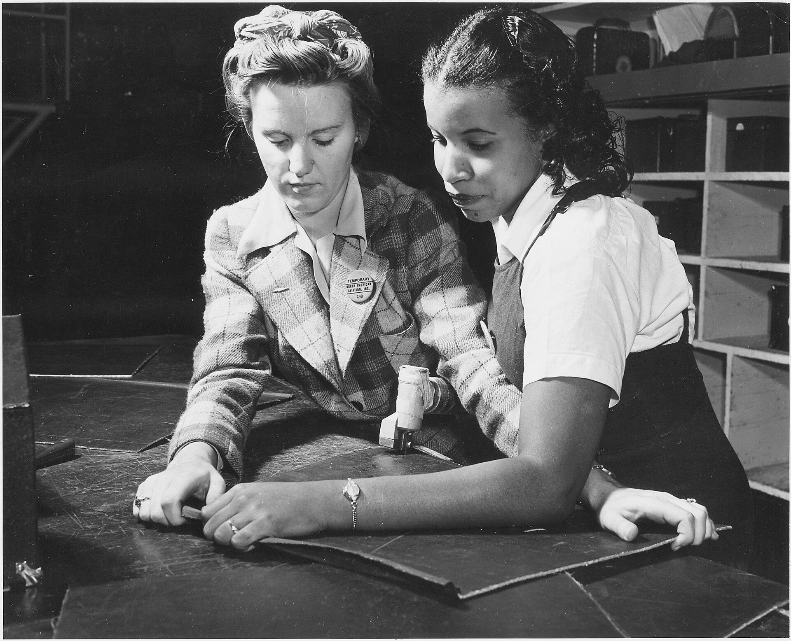
US.53 · DIRECT INSTRUCTION
1 of 4
Second Great Migration and Economic Opportunities
1.5 million African Americans moved North and West during the 1940s to cities like Detroit, Chicago, and Los Angeles.
Defense industries offered higher wages than Southern agriculture, and average Black family income doubled during the war.
However, discrimination persisted—many employers refused to hire African Americans, job segregation confined Black workers to lowest-paying positions, and limited advancement opportunities existed.
SENTENCE FRAME (EL & writing support)
Unknown / U.S. Army Signal Corps / OWI, c. 1942 National Archives
World War II changed conditions for African Americans by ________, for example ________.
TEACHER CUE Chunk → cold-call → confirm before advancing.
U.S. History Hack · TroopToTeacher Technologies LLC · Aligned to TN Academic Standards & TCAP EOC
137
Notes:
FACILITATION (US.53). Write 'Double V' on the board and ask: two victories - over what, and where? Teach in small steps; pause and check for understanding before the next chunk (aim 80%+ before moving on).

Slide 155
US.53 · DIRECT INSTRUCTION
2 of 4
Double V Campaign and Wartime Experiences
The Pittsburgh Courier promoted the "Double V" campaign—victory against fascism abroad and racism at home.
One million African Americans served in segregated armed forces, facing prejudice and unequal treatment even while fighting for democracy.
NAACP membership grew from 50,000 to 450,000 during the war.
War rhetoric about democracy and freedom raised consciousness about civil rights contradictions in American society.
U.S. History Hack · TroopToTeacher Technologies LLC · Aligned to TN Academic Standards & TCAP EOC
138

Slide 156
US.53 · DIRECT INSTRUCTION
3 of 4
Fair Employment Practices Committee (FEPC)
A. Philip Randolph threatened a 100,000-person march on Washington, pressuring FDR to issue Executive Order 8802 (June 25, 1941) creating the FEPC.
The committee investigated discrimination complaints from defense workers and held public hearings exposing discriminatory practices.
Though it could only make recommendations without enforcement power, the FEPC established the principle of federal intervention in employment discrimination and laid groundwork for later civil rights agencies.
U.S. History Hack · TroopToTeacher Technologies LLC · Aligned to TN Academic Standards & TCAP EOC
139

Slide 157
US.53 · DIRECT INSTRUCTION
4 of 4
Integration of Armed Forces
Executive Order 9981 (1948) by President Truman ordered desegregation of the armed forces, citing merit and fairness.
Implementation was gradual but historic, representing the first major federal civil rights action of the post-war era.
The order built on WWII service records of units like the Tuskegee Airmen and 761st Tank Battalion, which had proven African American military capability.
Military integration became a model for later civilian desegregation efforts.
U.S. History Hack · TroopToTeacher Technologies LLC · Aligned to TN Academic Standards & TCAP EOC
140

Slide 158
US.53 · PEOPLE WHO SHAPED THE ERA
Key Figures
Franklin D. Roosevelt
James G. Thompson / 'Double V'
32nd President; issued EO 8802
Voice of the Double V Campaign
Signed Executive Order 8802 (1941) banning defense-job discrimination
Created the Fair Employment Practices Committee
Acted under pressure from the threatened March on Washington
Called for victory over fascism abroad AND racism at home
His letter launched the Pittsburgh Courier's Double V drive
Framed Black service as a claim on full citizenship
STRATEGY Use EO 8802 to show wartime pressure producing the first federal fair-employment action.
STRATEGY Use Double V to connect wartime service directly to postwar civil-rights arguments.
U.S. History Hack · TroopToTeacher Technologies LLC · Aligned to TN Academic Standards & TCAP EOC
141

Slide 159
US.53 · PRIMARY SOURCE ANALYSIS
Executive Order 8802
Close Reading
President Franklin D. Roosevelt · June 25, 1941
"There shall be no discrimination in the employment of workers in defense industries or Government because of race, creed, color, or national origin... It is the duty of employers and of labor organizations... to provide for the full and equitable participation of all workers in defense industries."
CONTEXT
Before World War II, African Americans were systematically excluded from many defense industry jobs due to racial discrimination. Civil rights leader A. Philip Randolph threatened to organize a march of 100,000 Black Americans on Washington unless the government acted. Faced with this pressure, Roosevelt issued Executive Order 8802 in June 1941—the first federal action since Reconstruction to promote racial equality in employment.
ANALYZE
What was the purpose of Executive Order 8802?
READ CLOSELY Underline the exact words that answer the ANALYZE question — be ready to read them aloud.
SOURCE IT
WHO made it?
WHEN?
WHY does it matter?
FIRST
President Franklin D. Roosevelt
June 25, 1941
Consider the author's purpose and audience before reading the words.
SSP.02 · before you interpret
Source: National Archives
U.S. History Hack · TroopToTeacher Technologies LLC · Aligned to TN Academic Standards & TCAP EOC
142
Notes:
Primary-source analysis. SOURCE IT FIRST (SSP.02) — model the sourcing routine aloud before students interpret: WHO made this source? (President Franklin D. Roosevelt) WHEN? (June 25, 1941) WHY does that matter? (Consider the author's purpose and audience before reading the words.) Only then move to the ANALYZE question. Suggested answer: See teacher key. Practice skill: Close Reading.

Slide 160
US.53 · KEY VOCABULARY
Word Wall
Executive Order 8802
Orden Ejecutiva 8802
Double V Campaign
Campaña de la Doble V
say: eg-ZEK-yuh-tiv OR-der
say: DUB-ul vee kam-PAYN
EO
The June 1941 order signed by President Roosevelt banning racial discrimination in the defense industry and creating the Fair Employment Practices Committee.
DV
A World War II campaign led by the Black press calling for a 'Double Victory' - over fascism abroad and racial discrimination at home.
Tuskegee Airmen
Aviadores de Tuskegee
Rosie the Riveter
Rosie la Remachadora
say: tus-KEE-gee AIR-men
say: ROH-zee thuh RIV-eh-ter
TA
First African American military pilots who fought in World War II, proving their skill despite facing racial discrimination and segregation.
RT
Cultural icon representing millions of American women who worked in factories and shipyards during World War II, filling jobs left by men who went to war.
Rationing
Racionamiento
War Bonds
Bonos de Guerra
say: RASH-un-ing
say: wor bondz
R
Government-controlled limits on consumer goods during WWII to ensure adequate supplies for the military, requiring ration books and coupons.
WB
Government bonds sold to citizens to finance the war effort, promoted through massive publicity campaigns featuring celebrities and patriotic appeals.
"say:" pronunciation guide (stressed syllable in CAPS) and a per-term visual anchor support newcomer English learners. Spanish term + full bilingual Frayer models are in the unit vocabulary set.
U.S. History Hack · TroopToTeacher Technologies LLC · Aligned to TN Academic Standards & TCAP EOC
143

Slide 161
US.53 · GUIDED PRACTICE — WE DO IT TOGETHER
Let’s Work One Together
Connect service to civil-rights claims
MODEL PROMPT: How did 'Double V' link the war to the fight for equality?
WORKED EXAMPLE (teacher models this aloud)
Black Americans demanded victory over fascism abroad AND racism at home. EO 8802 and wartime service became evidence in a larger argument for citizenship.
THINK ALOUD
Identify the two 'victories' the campaign demanded.
→ Now you try: Explain how wartime service strengthened postwar civil-rights arguments.
U.S. History Hack · TroopToTeacher Technologies LLC · Aligned to TN Academic Standards & TCAP EOC
144
Notes:
GUIDED PRACTICE / WE DO (US.53). Skill modeled: Connect service to civil-rights claims. Model the worked example aloud using the THINK ALOUD as your script, then release students to the activity ("Explain how wartime service strengthened postwar civil-rights arguments."). This is the I Do → We Do → You Do bridge — do not skip it; aim for 80%+ success before independent work.

Slide 162
US.53 · STUDENT ACTIVITY
The Double V — African Americans in WWII
Groups of 3
15 min
YOUR TASK
Read Executive Order 8802 and study the integrated-workers photograph. Build a chart tracking four developments: the Second Great Migration and new jobs, the Double V campaign, the Fair Employment Practices Committee (FEPC), and Truman's integration of the armed forces. Write one sentence on the significance of each. Finish with a one-sentence claim on how WWII advanced the later civil rights movement, with evidence.
DELIVERABLE
DIFFERENTIATION
Completed four-development chart (one-sentence significance each) AND a one-sentence evidence-based claim linking WWII to civil rights.
Entry: Chart with the four developments pre-labeled and a fact bank to sort. Honors: Write a paragraph using Executive Order 8802 to explain what the 'Double V' (victory abroad and at home) meant to Black Americans.
Companion printable: cornell-notes/unit-6/us53-african-americans-wwii.pdf
U.S. History Hack · TroopToTeacher Technologies LLC · Aligned to TN Academic Standards & TCAP EOC
145
Notes:
Student activity for US.53. Pair with the printable: cornell-notes/unit-6/us53-african-americans-wwii.pdf. Timing: 15. Deliverable: Completed four-development chart (one-sentence significance each) AND a one-sentence evidence-based claim linking WWII to civil rights.

Slide 163
US.53 · CHECK FOR UNDERSTANDING
TCAP-Style Question
DOK 2
EOC PRACTICE
How did the Double V campaign connect the war abroad to civil rights at home?
It linked victory over fascism overseas with demands for racial equality in the United States.
A
Working full-time in factories while still managing household and childcare responsibilities.
B
Many were pressured to leave jobs for returning servicemen, facing social pressure to return home.
C
Entered workforce in record numbers, gained independence, and challenged gender roles.
D
ANSWER FIRST: students commit — then click / advance to reveal the correct answer and explanation.
U.S. History Hack · TroopToTeacher Technologies LLC · Aligned to TN Academic Standards & TCAP EOC
146
Notes:
CHECK FOR UNDERSTANDING (US.53, DOK 2). Have students commit to an answer (whiteboards, hand signal, or turn-and-talk) BEFORE advancing. Correct answer: A. The next slide reveals it. Why: It linked victory over fascism overseas with demands for racial equality in the United States. African Americans linked victory over fascism abroad with the struggle against segregation at home. C is incorrect because it describes a different program, event, or idea than this civil rights development. These developments helped set the stage for World War II by weakening collective resistance to aggressive dictators.

Slide 164
US.53 · ANSWER REVEAL
TCAP-Style Question
✓ ANSWER KEY
How did the Double V campaign connect the war abroad to civil rights at home?
A
It linked victory over fascism overseas with demands for racial equality in the United States.
✓
B
Working full-time in factories while still managing household and childcare responsibilities.
C
Many were pressured to leave jobs for returning servicemen, facing social pressure to return home.
D
Entered workforce in record numbers, gained independence, and challenged gender roles.
Correct answer: A. Why: It linked victory over fascism overseas with demands for racial equality in the United States. African Americans linked victory over fascism abroad with the struggle against segregation at home. C is incorrect because it describes a different program, event, or idea than this civil rights development.
U.S. History Hack · TroopToTeacher Technologies LLC · Aligned to TN Academic Standards & TCAP EOC
147
Notes:
ANSWER KEY (US.53). Correct: A. It linked victory over fascism overseas with demands for racial equality in the United States. African Americans linked victory over fascism abroad with the struggle against segregation at home. C is incorrect because it describes a different program, event, or idea than this civil rights development. These developments helped set the stage for World War II by weakening collective resistance to aggressive dictators.

Slide 165
US.53 · WRAP-UP
What You Need to Know for TCAP
KEY TAKEAWAYS
EXIT TICKET
DOK 2
Second Great Migration and Economic Opportunities
Double V Campaign and Wartime Experiences
Fair Employment Practices Committee (FEPC)
Integration of Armed Forces
Explain how WWII changed economic and social conditions for African Americans. Give at least two specific examples.
★ HONORS / EXTENSION DOK 3 · SSP.04 Argumentation
Evaluate: How did fighting Nazi racism abroad push the U.S. to confront racism at home? Argue with evidence. (SSP.04)
U.S. History Hack · TroopToTeacher Technologies LLC · Aligned to TN Academic Standards & TCAP EOC
148
Notes:
WRAP-UP / EXIT-TICKET KEY (US.53, DOK 2). Prompt: Explain how WWII changed economic and social conditions for African Americans. Give at least two specific examples. Model answer: WWII opened new opportunities and fueled activism. The Second Great Migration drew millions of African Americans north and west for defense jobs. The Double V campaign demanded victory over the Axis abroad and racism at home. Pressure led FDR to issue Executive Order 8802, banning discrimination in defense industries and creating the FEPC. In 1948, President Truman ordered the integration of the armed forces, a major step toward civil rights. RETEACH TRIGGER — if a student misses this exit ticket: (1) <50% of class miss → spiral it into the next standard’s Quick Review opener (see the US.53 review prompts). (2) Individual/small group → reteach with the "Second Great Migration and Economic Opportunities" direct-instruction slide + re-run the SOURCE IT FIRST routine on the US.53 primary source, then assign the paired printable: cornell-notes/unit-6/us53-african-americans-wwii.pdf. (3) Re-assess with the US.53 check-for-understanding reveal slide as a do-now the next day. Reteach anchors (this standard’s sections): Second Great Migration and Economic Opportunities; Double V Campaign and Wartime Experiences; Fair Employment Practices Committee (FEPC); Integration of Armed Forces. I Can objective: I can examine the impact of World War II on economic and social conditions for African Americans, including the Fair Employment Practices Committee and the eventual integration of the armed forces by President Truman. HONORS / EXTENSION (DOK 3, for early finishers or advanced learners): Evaluate: How did fighting Nazi racism abroad push the U.S. to confront racism at home? Argue with evidence. (SSP.04) — look for a clear claim plus two specific pieces of evidence.

Slide 166
STANDARD
SOCIAL STUDIES PRACTICES
US.54
SSP.02
Examine a source
SSP.04
Build an argument
SSP.05
Historical awareness
Japanese American Internment & Korematsu
TN ACADEMIC STANDARD
Describe the constitutional issues and impact of the internment of Japanese Americans on the U.S., including the Fred Korematsu v. United States of America decision.
I CAN
I can describe the constitutional issues and impact of the internment of Japanese Americans on the U.S., including the Fred Korematsu v. United States of America decision.
U.S. History Hack · TroopToTeacher Technologies LLC · Aligned to TN Academic Standards & TCAP EOC
149

Slide 167
KEY VOCABULARY · LANGUAGE SUPPORT
US.53
Words you need before we read
Executive Order 8802
Double V Campaign
Tuskegee Airmen
En español: Orden Ejecutiva 8802
En español: Campaña de la Doble V
En español: Aviadores de Tuskegee
WHAT IT MEANS
WHAT IT MEANS
WHAT IT MEANS
The June 1941 order signed by President Roosevelt banning racial discrimination in the defense industry and creating the Fair Employment Practices Committee.
A World War II campaign led by the Black press calling for a 'Double Victory' - over fascism abroad and racial discrimination at home.
First African American military pilots who fought in World War II, proving their skill despite facing racial discrimination and segregation.
UDL · REPRESENTATION → LANGUAGE & SYMBOLS
U.S. History Hack · TEACHER DECK · Aligned to TN Academic Standards & TCAP EOC
18

Slide 168
PROGRESS CHECK
US.53
Check your understanding
What was the "Double V" campaign, and how did it connect the fight against fascism abroad with civil rights at home?
A
The Pittsburgh Courier's campaign demanded victory over fascism abroad and over racism at home, arguing that fighting for democracy overseas exposed the contradiction of denying democracy to Black Americans
✓ KEY
B
It focused only on military victory, although this view has been largely discredited by scholars, which does not align with the documented historical record, which represents a common misconception about this historical period
C
It supported segregation, though this interpretation lacks supporting historical evidence, though this interpretation lacks supporting historical evidence, but closer analysis reveals a more complicated historical reality
D
It had no connection to civil rights, which ignores key developments that shaped the outcome, which represents a common misconception about this historical period, although historical sources do not support this conclusion
UDL · ACTION & EXPRESSION → STRATEGY DEVELOPMENT
MTSS: below mastery → targeted reteach (Tier 2); at/above → extension. The goal never lowers.
U.S. History Hack · TEACHER DECK · Aligned to TN Academic Standards & TCAP EOC
19

Slide 169
US.54 · QUICK REVIEW
Do You Remember?
Before we start, retrieve what we have already learned. Answer from memory first — no notes.
1
US.53 What was the 'Double V' campaign?
2
US.53 What did Executive Order 8802 do?
U.S. History Hack · TroopToTeacher Technologies LLC · Aligned to TN Academic Standards & TCAP EOC
150
Notes:
SPACED RETRIEVAL (US.54). Cold-call or whiteboards, 3-4 min, low stakes. Answers — 1) An African American wartime campaign for two victories, over the Axis abroad and over racism and discrimination at home. 2) It banned racial discrimination in defense industries and created the Fair Employment Practices Committee (FEPC).

Slide 170
US.54 · CONFIDENCE CHECK
Warm-Up — Quick Recall
DOK 1
LOW STAKES
Everyone can answer this. Thumbs / whiteboards — no notes.
What group was forced into internment camps after Pearl Harbor?
✓ ANSWER
Japanese Americans, most of them U.S. citizens.
COMMIT FIRST: have everyone answer before the reveal — this is the DOK 1 floor; the graded check later in this lesson moves up to DOK 2–3.
U.S. History Hack · TroopToTeacher Technologies LLC · Aligned to TN Academic Standards & TCAP EOC
151
Notes:
CONFIDENCE CHECK (US.54, DOK 1). 60-90 seconds. Have EVERY student commit (thumbs / whiteboard / choral) before revealing — this secures an early win and surfaces who is shaky before new content. Answer: Japanese Americans, most of them U.S. citizens. Key term to listen for: Japanese Internment. This is the low-floor entry; the graded Check for Understanding later in the standard rises to DOK 2–3.

Slide 171
US.54 · HOOK
Think About It
After Pearl Harbor, the U.S. government forced more than 110,000 Japanese Americans, most of them U.S. citizens, from their homes into remote internment camps, and the Supreme Court said it was legal.
DISCUSS
TIMING: Turn & Talk 60 sec → cold-call 2 pairs
When the nation is at war, how far can the government go in taking away the rights of its own citizens?
U.S. History Hack · TroopToTeacher Technologies LLC · Aligned to TN Academic Standards & TCAP EOC
152
Notes:
HOOK (US.54). Run tight: pose the provocation, give a silent 10-second think, then Turn & Talk 60 seconds. Cold-call 2–3 pairs (not volunteers) for a sentence-starter answer — "One force was ___ because ___" — then bridge to the standard. Keep total to ~4 minutes; do not let it sprawl. Return to this question at the unit close for an evidence-based answer.

Slide 172
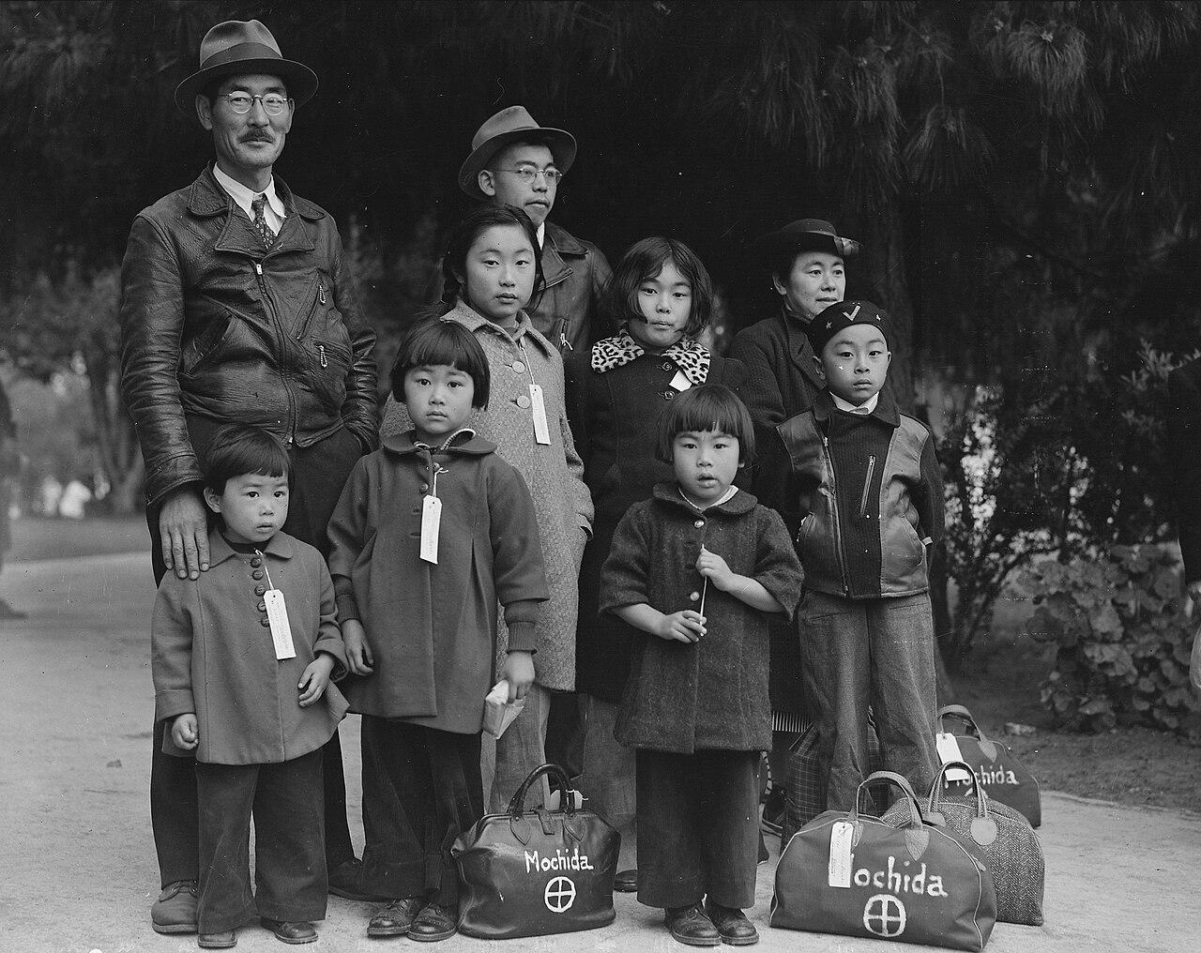
US.54 · DIRECT INSTRUCTION
1 of 4
Executive Order 9066 and Internment
Following Pearl Harbor, Executive Order 9066 (February 1942) authorized removal of persons from designated military areas, leading to internment of approximately 120,000 Japanese Americans—two-thirds of whom were U.S. citizens.
Families were forced to abandon homes, businesses, and property, often selling possessions at severe losses.
They were transported to remote internment camps surrounded by barbed wire and guard towers, losing their civil liberties based solely on ancestry.
SENTENCE FRAME (EL & writing support)
Dorothea Lange / War Relocation Authority / National Archives and Records Administration, May 8, 1942 National Archives
Executive Order 9066 led to ________, which raised the constitutional issue of ________.
TEACHER CUE Chunk → cold-call → confirm before advancing.
U.S. History Hack · TroopToTeacher Technologies LLC · Aligned to TN Academic Standards & TCAP EOC
153
Notes:
FACILITATION (US.54). Ask: in a national emergency, can the government suspend the rights of its own citizens? Then meet Executive Order 9066. Teach in small steps; pause and check for understanding before the next chunk (aim 80%+ before moving on).

Slide 173
US.54 · DIRECT INSTRUCTION
2 of 4
Constitutional Issues
Internment violated fundamental constitutional principles: due process (no individual hearings or evidence of disloyalty), equal protection (restrictive racial classification treating all Japanese Americans as suspects), and arguably habeas corpus (detention without charges).
No similar mass detention was imposed on German or Italian Americans, highlighting the racial basis of the policy.
Civil liberties groups protested, but wartime hysteria and racism overcame constitutional protections.
U.S. History Hack · TroopToTeacher Technologies LLC · Aligned to TN Academic Standards & TCAP EOC
154

Slide 174
US.54 · DIRECT INSTRUCTION
3 of 4
Korematsu v. United States (1944)
Fred Korematsu refused to report for internment and was arrested.
The Supreme Court upheld the exclusion order 6-3, ruling that wartime necessity justified the racial classification.
Justice Frank Murphy's dissent called the decision "legalization of racism." The decision was widely criticized and formally repudiated decades later.
In 1983, Korematsu's conviction was vacated after evidence emerged that the government had suppressed evidence contradicting military necessity claims.
U.S. History Hack · TroopToTeacher Technologies LLC · Aligned to TN Academic Standards & TCAP EOC
155

Slide 175
US.54 · DIRECT INSTRUCTION
4 of 4
Impact and Historical Lessons
Internees lost an estimated $400 million in property and suffered lasting psychological trauma.
The Civil Liberties Act of 1988 formally apologized and provided $20,000 reparations to surviving internees.
Historical lessons emphasize the danger of racial profiling during wartime, the importance of judicial review protecting civil liberties, and how fear can override constitutional protections.
The internment serves as a cautionary example still invoked in contemporary civil liberties debates.
U.S. History Hack · TroopToTeacher Technologies LLC · Aligned to TN Academic Standards & TCAP EOC
156

Slide 176
US.54 · PEOPLE WHO SHAPED THE ERA
Key Figures
Franklin D. Roosevelt
Justice Frank Murphy
32nd President; signed EO 9066
Supreme Court dissenter in Korematsu
Signed Executive Order 9066 (1942)
Authorized removal of ~120,000 Japanese Americans
Most were U.S. citizens never charged with any crime
Dissented forcefully in Korematsu v. U.S. (1944)
Called internment a descent into 'the ugly abyss of racism'
Gave students the constitutional case against internment
STRATEGY Present EO 9066 as documented action, then let the Murphy dissent supply the constitutional counter-argument.
STRATEGY Use Murphy's dissent to model evidence-based constitutional argument.
U.S. History Hack · TroopToTeacher Technologies LLC · Aligned to TN Academic Standards & TCAP EOC
157

Slide 177
US.54 · PRIMARY SOURCE ANALYSIS
Executive Order 9066
Close Reading
President Franklin D. Roosevelt · February 19, 1942
"I hereby authorize and direct the Secretary of War, and the Military Commanders whom he may from time to time designate... to prescribe military areas in such places and of such extent as he or the appropriate Military Commander may determine, from which any or all persons may be excluded."
CONTEXT
After Japan attacked Pearl Harbor in December 1941, anti-Japanese sentiment surged on the West Coast of the United States. Military leaders and politicians claimed Japanese Americans could not be trusted and might commit acts of sabotage. Executive Order 9066 authorized the military to relocate and intern approximately 120,000 people of Japanese ancestry—most of them American citizens—in camps throughout the interior of the country.
ANALYZE
What power did Executive Order 9066 grant to military authorities?
READ CLOSELY Underline the exact words that answer the ANALYZE question — be ready to read them aloud.
SOURCE IT
WHO made it?
WHEN?
WHY does it matter?
FIRST
President Franklin D. Roosevelt
February 19, 1942
Consider the author's purpose and audience before reading the words.
SSP.02 · before you interpret
Source: National Archives
U.S. History Hack · TroopToTeacher Technologies LLC · Aligned to TN Academic Standards & TCAP EOC
158
Notes:
Primary-source analysis. SOURCE IT FIRST (SSP.02) — model the sourcing routine aloud before students interpret: WHO made this source? (President Franklin D. Roosevelt) WHEN? (February 19, 1942) WHY does that matter? (Consider the author's purpose and audience before reading the words.) Only then move to the ANALYZE question. Suggested answer: See teacher key. Practice skill: Close Reading.

Slide 178
US.54 · KEY VOCABULARY
Word Wall
Japanese Internment
Internamiento Japonés
Korematsu v. United States
Korematsu contra Estados Unidos
say: jap-uh-NEEZ in-TERN-ment
say: kor-eh-MAT-soo
JI
The forced relocation and incarceration of 120,000 Japanese Americans (two-thirds U.S. citizens) in concentration camps during WWII, based on racial prejudice, not evidence of disloyalty.
KV
1944 Supreme Court decision upholding Japanese internment as a wartime necessity, later widely condemned as one of the Court's worst decisions.
Executive Order 9066
Orden Ejecutiva 9066
442nd Regimental Combat Team
442º Equipo de Combate Regimental
say: eg-ZEK-yuh-tiv OR-der
say: for-for-tee-SEK-und rej-ih-MEN-tul
EO
The February 1942 order signed by President Roosevelt authorizing the military to exclude and relocate Japanese Americans from the West Coast.
RC
All Japanese-American unit that became the most decorated unit in U.S. military history, fighting in Europe while their families were interned at home.
Pearl Harbor
Pearl Harbor
Totalitarianism
Totalitarismo
say: purl HAR-ber
say: toh-tal-ih-TAIR-ee-uh-niz-um
PH
Japan's surprise attack on the U.S. naval base in Hawaii on December 7, 1941, killing over 2,400 Americans and bringing the United States into World War II.
T
A system of government where the state controls every aspect of public and private life, using propaganda, secret police, and terror to eliminate opposition.
"say:" pronunciation guide (stressed syllable in CAPS) and a per-term visual anchor support newcomer English learners. Spanish term + full bilingual Frayer models are in the unit vocabulary set.
U.S. History Hack · TroopToTeacher Technologies LLC · Aligned to TN Academic Standards & TCAP EOC
159

Slide 179
US.54 · GUIDED PRACTICE — WE DO IT TOGETHER
Let’s Work One Together
Build a constitutional argument
MODEL PROMPT: Was internment constitutional? What does the evidence show?
WORKED EXAMPLE (teacher models this aloud)
EO 9066 authorized removal; Korematsu upheld it; Murphy's dissent called it racism. Weigh the wartime-necessity claim against the rights of citizens never charged.
THINK ALOUD
Find one line defending internment and one line attacking it.
→ Now you try: State your position and support it with a specific quote.
U.S. History Hack · TroopToTeacher Technologies LLC · Aligned to TN Academic Standards & TCAP EOC
160
Notes:
GUIDED PRACTICE / WE DO (US.54). Skill modeled: Build a constitutional argument. Model the worked example aloud using the THINK ALOUD as your script, then release students to the activity ("State your position and support it with a specific quote."). This is the I Do → We Do → You Do bridge — do not skip it; aim for 80%+ success before independent work.

Slide 180
US.54 · STUDENT ACTIVITY
Liberty on Trial — Japanese American Internment and Korematsu
Pairs
15 min
YOUR TASK
Read Executive Order 9066 and study the Mochida family photograph. Complete a four-part organizer: (1) what EO 9066 ordered; (2) the CONSTITUTIONAL ISSUES it raised; (3) the ruling in Korematsu v. United States (1944); (4) the IMPACT and later lessons (the 1988 apology and reparations). Add one detail per section. Finish with a one-sentence claim on when, if ever, national security can justify limiting citizens' rights.
DELIVERABLE
DIFFERENTIATION
Completed four-part organizer (order / constitutional issues / Korematsu ruling / impact, one detail each) AND a one-sentence evidence-based claim about rights and security.
Entry: Organizer with the four parts pre-labeled and a fact bank to sort. Honors: Write a paragraph using the Mochida family photograph and EO 9066 to argue whether the Korematsu decision protected or betrayed the Constitution.
Companion printable: cornell-notes/unit-6/us54-japanese-internment-korematsu.pdf
U.S. History Hack · TroopToTeacher Technologies LLC · Aligned to TN Academic Standards & TCAP EOC
161
Notes:
Student activity for US.54. Pair with the printable: cornell-notes/unit-6/us54-japanese-internment-korematsu.pdf. Timing: 15. Deliverable: Completed four-part organizer (order / constitutional issues / Korematsu ruling / impact, one detail each) AND a one-sentence evidence-based claim about rights and security.

Slide 181
US.54 · CHECK FOR UNDERSTANDING
TCAP-Style Question
DOK 2
EOC PRACTICE
Read the excerpt below.
"The forced relocation of Japanese Americans from the West Coast is a military necessity. We cannot distinguish loyal from disloyal in wartime." — General John DeWitt, Testimony Before Congress, 1943
Which of the following best describes the policy toward Japanese Americans described in this excerpt?
Japanese Americans voluntarily relocated to inland communities to avoid potential anti-Japanese violence on the West Coast.
A
Japanese diplomats and nationals were expelled from the United States after Pearl Harbor as enemy aliens.
B
Approximately 120,000 Japanese Americans, most of them citizens, were forcibly removed from their homes and confined to internment camps.
C
All Asian Americans were required to register with the federal government and carry identification cards during the war.
D
ANSWER FIRST: students commit — then click / advance to reveal the correct answer and explanation.
U.S. History Hack · TroopToTeacher Technologies LLC · Aligned to TN Academic Standards & TCAP EOC
162
Notes:
CHECK FOR UNDERSTANDING (US.54, DOK 2). Have students commit to an answer (whiteboards, hand signal, or turn-and-talk) BEFORE advancing. Correct answer: C. The next slide reveals it. Why: Following Executive Order 9066 signed by President Roosevelt in 1942, approximately 120,000 Japanese Americans — two-thirds of whom were American citizens — were forcibly relocated to internment camps for the duration of the war. This policy was later condemned as a violation of civil liberties driven by racial prejudice rather than genuine military necessity, as the government never produced evidence of Japanese American disloyalty. Option A is incorrect because it was not voluntary — relocation was forced. Option B is incorrect because the policy applied to Americans of Japanese descent, not Japanese diplomats. Option D is incorrect because the policy was applied to Japanese Americans specifically, not all Asian Americans.

Slide 182
US.54 · ANSWER REVEAL
TCAP-Style Question
✓ ANSWER KEY
Read the excerpt below.
"The forced relocation of Japanese Americans from the West Coast is a military necessity. We cannot distinguish loyal from disloyal in wartime." — General John DeWitt, Testimony Before Congress, 1943
Which of the following best describes the policy toward Japanese Americans described in this excerpt?
A
Japanese Americans voluntarily relocated to inland communities to avoid potential anti-Japanese violence on the West Coast.
B
Japanese diplomats and nationals were expelled from the United States after Pearl Harbor as enemy aliens.
C
Approximately 120,000 Japanese Americans, most of them citizens, were forcibly removed from their homes and confined to internment camps.
✓
D
All Asian Americans were required to register with the federal government and carry identification cards during the war.
Correct answer: C. Why: Following Executive Order 9066 signed by President Roosevelt in 1942, approximately 120,000 Japanese Americans — two-thirds of whom were American citizens — were forcibly relocated to internment camps for the duration of the war. This policy was later condemned as a violation of civil liberties driven by racial prejudice rather than genuine military necessity, as the government never produced evidence of Japanese American disloyalty.
U.S. History Hack · TroopToTeacher Technologies LLC · Aligned to TN Academic Standards & TCAP EOC
163
Notes:
ANSWER KEY (US.54). Correct: C. Following Executive Order 9066 signed by President Roosevelt in 1942, approximately 120,000 Japanese Americans — two-thirds of whom were American citizens — were forcibly relocated to internment camps for the duration of the war. This policy was later condemned as a violation of civil liberties driven by racial prejudice rather than genuine military necessity, as the government never produced evidence of Japanese American disloyalty. Option A is incorrect because it was not voluntary — relocation was forced. Option B is incorrect because the policy applied to Americans of Japanese descent, not Japanese diplomats. Option D is incorrect because the policy was applied to Japanese Americans specifically, not all Asian Americans.

Slide 183
US.54 · WRAP-UP
What You Need to Know for TCAP
KEY TAKEAWAYS
EXIT TICKET
DOK 2
Executive Order 9066 and Internment
Constitutional Issues
Korematsu v. United States (1944)
Impact and Historical Lessons
Describe the internment of Japanese Americans and the constitutional issues it raised, including Korematsu v. United States.
★ HONORS / EXTENSION DOK 3 · SSP.04 Argumentation
Evaluate: When, if ever, can national security justify limiting the rights of citizens? Defend your position with evidence. (SSP.04)
U.S. History Hack · TroopToTeacher Technologies LLC · Aligned to TN Academic Standards & TCAP EOC
164
Notes:
WRAP-UP / EXIT-TICKET KEY (US.54, DOK 2). Prompt: Describe the internment of Japanese Americans and the constitutional issues it raised, including Korematsu v. United States. Model answer: After Pearl Harbor, Executive Order 9066 authorized the forced removal of more than 110,000 Japanese Americans, most U.S. citizens, into internment camps, without trials or evidence of disloyalty. This raised grave constitutional issues about due process and equal protection. In Korematsu v. United States (1944), the Supreme Court upheld the internment as a wartime necessity, a ruling later condemned as a serious injustice; in 1988 the government formally apologized and paid reparations. RETEACH TRIGGER — if a student misses this exit ticket: (1) <50% of class miss → spiral it into the next standard’s Quick Review opener (see the US.54 review prompts). (2) Individual/small group → reteach with the "Executive Order 9066 and Internment" direct-instruction slide + re-run the SOURCE IT FIRST routine on the US.54 primary source, then assign the paired printable: cornell-notes/unit-6/us54-japanese-internment-korematsu.pdf. (3) Re-assess with the US.54 check-for-understanding reveal slide as a do-now the next day. Reteach anchors (this standard’s sections): Executive Order 9066 and Internment; Constitutional Issues; Korematsu v. United States (1944); Impact and Historical Lessons. I Can objective: I can describe the constitutional issues and impact of the internment of Japanese Americans on the U.S., including the Fred Korematsu v. United States of America decision. HONORS / EXTENSION (DOK 3, for early finishers or advanced learners): Evaluate: When, if ever, can national security justify limiting the rights of citizens? Defend your position with evidence. (SSP.04) — look for a clear claim plus two specific pieces of evidence.

Slide 184
STANDARD
SOCIAL STUDIES PRACTICES
US.55
SSP.01
Collect sources
SSP.02
Examine a source
SSP.06
Geographic awareness
Home Front Mobilization
TN ACADEMIC STANDARD
Describe the war's impact on the home front, including: rationing, bond drives, propaganda, movement to cities and industrial centers, Bracero program, conversion of factories for wartime production, location of prisoner of war camps in Tennessee.
I CAN
I can describe the war's impact on the home front, including rationing, bond drives, propaganda, movement to cities, the Bracero program, conversion of factories, and prisoner of war camps in Tennessee.
U.S. History Hack · TroopToTeacher Technologies LLC · Aligned to TN Academic Standards & TCAP EOC
165

Slide 185
KEY VOCABULARY · LANGUAGE SUPPORT
US.54
Words you need before we read
Japanese Internment
Korematsu v. United States
Executive Order 9066
En español: Internamiento Japonés
En español: Korematsu contra Estados Unidos
En español: Orden Ejecutiva 9066
WHAT IT MEANS
WHAT IT MEANS
WHAT IT MEANS
The forced relocation and incarceration of 120,000 Japanese Americans (two-thirds U.S. citizens) in concentration camps during WWII, based on racial prejudice, not evidence of disloyalty.
1944 Supreme Court decision upholding Japanese internment as a wartime necessity, later widely condemned as one of the Court's worst decisions.
The February 1942 order signed by President Roosevelt authorizing the military to exclude and relocate Japanese Americans from the West Coast.
UDL · REPRESENTATION → LANGUAGE & SYMBOLS
U.S. History Hack · TEACHER DECK · Aligned to TN Academic Standards & TCAP EOC
20

Slide 186
PROGRESS CHECK
US.54
Check your understanding
How did Executive Order 9066 violate constitutional principles of due process and equal protection?
A
It followed all constitutional procedures, although historical sources do not support this conclusion, though this interpretation lacks supporting historical evidence, but the historical evidence paints a more nuanced picture
B
It denied due process by detaining people without individual hearings or evidence, and violated equal protection by targeting Japanese Americans while not similarly treating German or Italian Americans
✓ KEY
C
It only affected non-citizens, but the historical record tells a more complex story, but closer analysis reveals a more complicated historical reality, although historical sources do not support this conclusion
D
The Constitution does not protect against internment, which does not align with the documented historical record, which ignores significant political and cultural developments of the era
UDL · ACTION & EXPRESSION → STRATEGY DEVELOPMENT
MTSS: below mastery → targeted reteach (Tier 2); at/above → extension. The goal never lowers.
U.S. History Hack · TEACHER DECK · Aligned to TN Academic Standards & TCAP EOC
21

Slide 187
US.55 · QUICK REVIEW
Do You Remember?
Before we start, retrieve what we have already learned. Answer from memory first — no notes.
1
US.54 What did Executive Order 9066 authorize?
2
US.54 What did the Supreme Court rule in Korematsu v. United States (1944)?
U.S. History Hack · TroopToTeacher Technologies LLC · Aligned to TN Academic Standards & TCAP EOC
166
Notes:
SPACED RETRIEVAL (US.55). Cold-call or whiteboards, 3-4 min, low stakes. Answers — 1) The forced removal and internment of more than 110,000 Japanese Americans, most of them U.S. citizens, from the West Coast. 2) It upheld the internment as a wartime necessity, a decision later widely condemned as a grave injustice.

Slide 188
US.55 · CONFIDENCE CHECK
Warm-Up — Quick Recall
DOK 1
LOW STAKES
Everyone can answer this. Thumbs / whiteboards — no notes.
Name one way American civilians conserved resources for the war.
✓ ANSWER
Rationing (or victory gardens, scrap drives, or buying war bonds).
COMMIT FIRST: have everyone answer before the reveal — this is the DOK 1 floor; the graded check later in this lesson moves up to DOK 2–3.
U.S. History Hack · TroopToTeacher Technologies LLC · Aligned to TN Academic Standards & TCAP EOC
167
Notes:
CONFIDENCE CHECK (US.55, DOK 1). 60-90 seconds. Have EVERY student commit (thumbs / whiteboard / choral) before revealing — this secures an early win and surfaces who is shaky before new content. Answer: Rationing (or victory gardens, scrap drives, or buying war bonds). Key term to listen for: Rationing. This is the low-floor entry; the graded Check for Understanding later in the standard rises to DOK 2–3.

Slide 189
US.55 · HOOK
Think About It
World War II reached into every American kitchen and back yard: families rationed sugar and gas, bought war bonds, planted victory gardens, and turned car factories into tank factories almost overnight.
DISCUSS
TIMING: Turn & Talk 60 sec → cold-call 2 pairs
How did a war fought on other continents transform daily life for ordinary Americans on the home front?
U.S. History Hack · TroopToTeacher Technologies LLC · Aligned to TN Academic Standards & TCAP EOC
168
Notes:
HOOK (US.55). Run tight: pose the provocation, give a silent 10-second think, then Turn & Talk 60 seconds. Cold-call 2–3 pairs (not volunteers) for a sentence-starter answer — "One force was ___ because ___" — then bridge to the standard. Keep total to ~4 minutes; do not let it sprawl. Return to this question at the unit close for an evidence-based answer.

Slide 190
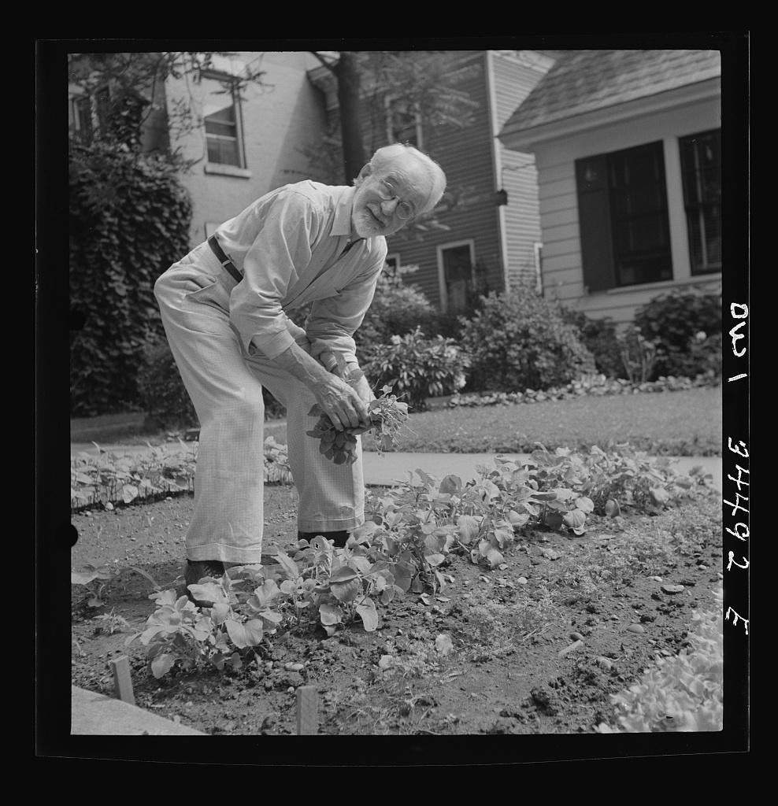
US.55 · DIRECT INSTRUCTION
1 of 4
Rationing and Conservation
Ration books with coupons controlled civilian access to gasoline, tires, sugar, meat, coffee, and other commodities.
This ensured military supplies while distributing scarce goods fairly.
Victory gardens encouraged citizens to grow their own vegetables, while scrap drives collected metal, rubber, and other materials.
These programs fostered civilian investment in the war effort and created shared sacrifice that built national unity.
SENTENCE FRAME (EL & writing support)
Marjory Collins / U.S. OWI, June 1943 Library of Congress
On the home front, Americans supported the war by ________, ________, and ________.
TEACHER CUE Chunk → cold-call → confirm before advancing.
U.S. History Hack · TroopToTeacher Technologies LLC · Aligned to TN Academic Standards & TCAP EOC
169
Notes:
FACILITATION (US.55). Ask students what they'd give up for a year to help win a war, then reveal what Americans actually rationed. Teach in small steps; pause and check for understanding before the next chunk (aim 80%+ before moving on).

Slide 191
US.55 · DIRECT INSTRUCTION
2 of 4
War Bonds and Propaganda
Liberty and Victory bonds financed the war while giving civilians a direct stake in victory.
Bond drives featured celebrities and patriotic appeals, raising billions of dollars.
The Office of War Information coordinated propaganda through films, posters, and radio, boosting morale and labor recruitment.
Propaganda portrayed the enemy as evil while celebrating American values and workers' contributions.
U.S. History Hack · TroopToTeacher Technologies LLC · Aligned to TN Academic Standards & TCAP EOC
170

Slide 192
US.55 · DIRECT INSTRUCTION
3 of 4
Migration, Factory Conversion, and Bracero Program
Millions migrated to defense industry centers, creating housing shortages and demographic shifts that reshaped American cities.
Auto plants converted to tank and aircraft factories through rapid retooling that enabled massive production increases.
The Bracero Program (1942) brought contract labor from Mexico to fill agricultural shortages, providing economic benefits while creating exploitation issues that would persist for decades.
U.S. History Hack · TroopToTeacher Technologies LLC · Aligned to TN Academic Standards & TCAP EOC
171

Slide 193
US.55 · DIRECT INSTRUCTION
4 of 4
Tennessee's Wartime Role
Tennessee hosted significant wartime facilities including POW camps that housed Axis prisoners, providing labor for local agriculture and industry.
Camp Forrest and other installations trained troops and processed prisoners.
Most significantly, Oak Ridge was secretly built to enrich uranium for the Manhattan Project, making Tennessee crucial to developing the atomic bomb.
These facilities transformed Tennessee's economy and population.
★ TENNESSEE CONNECTION
Tennessee played a major home-front role in World War II. The state hosted large training installations such as Camp Forrest and prisoner-of-war camps that held Axis prisoners, whose labor supported local agriculture and industry, tying communities across Tennessee directly to the war effort.
U.S. History Hack · TroopToTeacher Technologies LLC · Aligned to TN Academic Standards & TCAP EOC
172

Slide 194
US.55 · PEOPLE WHO SHAPED THE ERA
Key Figure
The American Home Front
Civilians, 1941-1945
Accepted rationing of gas, sugar, meat, and rubber
Bought war bonds and planted victory gardens
Moved to boomtowns for defense work
STRATEGY Keep the home front concrete: one ration book, one victory garden, one defense paycheck.
U.S. History Hack · TroopToTeacher Technologies LLC · Aligned to TN Academic Standards & TCAP EOC
173

Slide 195
US.55 · PRIMARY SOURCE ANALYSIS
War Ration Book Instructions
Sourcing
Office of Price Administration · 1943
"This book is your Government's guarantee of your fair share of goods made scarce by war. Price ceilings and rationing are the most fair way to distribute scarce goods. Misuse of rationing stamps is a crime punishable by fine or imprisonment. Your Government needs your compliance."
CONTEXT
During World War II, the U.S. government managed shortages of everyday goods by introducing rationing. Items like meat, butter, sugar, gasoline, and rubber were in short supply because they were needed for the war effort. The Office of Price Administration issued ration books to ensure that every American family received a fair share, and it became a symbol of the home front sacrifice that civilians were asked to make.
ANALYZE
According to this document, why did the government implement rationing?
READ CLOSELY Underline the exact words that answer the ANALYZE question — be ready to read them aloud.
SOURCE IT
WHO made it?
WHEN?
WHY does it matter?
FIRST
Office of Price Administration
1943
Consider the author's purpose and audience before reading the words.
SSP.02 · before you interpret
Source: National Archives
U.S. History Hack · TroopToTeacher Technologies LLC · Aligned to TN Academic Standards & TCAP EOC
174
Notes:
Primary-source analysis. SOURCE IT FIRST (SSP.02) — model the sourcing routine aloud before students interpret: WHO made this source? (Office of Price Administration) WHEN? (1943) WHY does that matter? (Consider the author's purpose and audience before reading the words.) Only then move to the ANALYZE question. Suggested answer: See teacher key. Practice skill: Sourcing.

Slide 196
US.55 · KEY VOCABULARY
Word Wall
Rationing
Racionamiento
War Bonds
Bonos de Guerra
say: RASH-un-ing
say: wor bondz
R
Government-controlled limits on consumer goods during WWII to ensure adequate supplies for the military, requiring ration books and coupons.
WB
Government bonds sold to citizens to finance the war effort, promoted through massive publicity campaigns featuring celebrities and patriotic appeals.
Rosie the Riveter
Rosie la Remachadora
Manhattan Project
Proyecto Manhattan
say: ROH-zee thuh RIV-eh-ter
say: man-HAT-un PROJ-ekt
RT
Cultural icon representing millions of American women who worked in factories and shipyards during World War II, filling jobs left by men who went to war.
MP
Top-secret U.S. program to develop the atomic bomb, involving sites at Oak Ridge (Tennessee), Los Alamos (New Mexico), and Hanford (Washington).
Allied Powers
Potencias Aliadas
Executive Order 8802
Orden Ejecutiva 8802
say: AL-yd POW-erz
say: eg-ZEK-yuh-tiv OR-der
AP
The World War II coalition led by the United States, Great Britain, and the Soviet Union that fought and defeated the Axis Powers.
EO
The June 1941 order signed by President Roosevelt banning racial discrimination in the defense industry and creating the Fair Employment Practices Committee.
"say:" pronunciation guide (stressed syllable in CAPS) and a per-term visual anchor support newcomer English learners. Spanish term + full bilingual Frayer models are in the unit vocabulary set.
U.S. History Hack · TroopToTeacher Technologies LLC · Aligned to TN Academic Standards & TCAP EOC
175

Slide 197
US.55 · GUIDED PRACTICE — WE DO IT TOGETHER
Let’s Work One Together
Explain home-front mobilization
MODEL PROMPT: How did ordinary civilians help win the war?
WORKED EXAMPLE (teacher models this aloud)
Rationing freed supplies for the military, war bonds funded the effort, and victory gardens eased shortages. Small daily choices scaled up to national power.
THINK ALOUD
List three specific home-front sacrifices from the section.
→ Now you try: Rank them by impact and defend your top choice with evidence.
U.S. History Hack · TroopToTeacher Technologies LLC · Aligned to TN Academic Standards & TCAP EOC
176
Notes:
GUIDED PRACTICE / WE DO (US.55). Skill modeled: Explain home-front mobilization. Model the worked example aloud using the THINK ALOUD as your script, then release students to the activity ("Rank them by impact and defend your top choice with evidence."). This is the I Do → We Do → You Do bridge — do not skip it; aim for 80%+ success before independent work.

Slide 198
US.55 · STUDENT ACTIVITY
Everyone Serves — Mobilizing the Home Front
Groups of 3
15 min
YOUR TASK
Study the War Ration Book and the victory-garden photograph. Build a chart of home-front mobilization covering rationing and conservation, war bonds and propaganda, migration and factory conversion and the Bracero program, and Tennessee's wartime role (including POW camps). Write one sentence on how each helped the war effort. Finish with a one-sentence claim on how the war reached into the daily lives of ordinary Americans, with evidence.
DELIVERABLE
DIFFERENTIATION
Completed home-front chart (one-sentence contribution each) AND a one-sentence evidence-based claim about the war's reach into daily life.
Entry: Chart with the mobilization categories pre-labeled and a word bank to sort. Honors: Write a paragraph using the ration book and victory-garden image to explain how the government turned civilians into active participants in the war.
Companion printable: cornell-notes/unit-6/us55-home-front-mobilization.pdf
U.S. History Hack · TroopToTeacher Technologies LLC · Aligned to TN Academic Standards & TCAP EOC
177
Notes:
Student activity for US.55. Pair with the printable: cornell-notes/unit-6/us55-home-front-mobilization.pdf. Timing: 15. Deliverable: Completed home-front chart (one-sentence contribution each) AND a one-sentence evidence-based claim about the war's reach into daily life.

Slide 199
US.55 · CHECK FOR UNDERSTANDING
TCAP-Style Question
DOK 2
EOC PRACTICE
Read the excerpt below.
"Americans are asked to observe meatless Tuesdays, wheatless Wednesdays, and to grow their own vegetables in Victory Gardens. The victory begins at your dinner table." — Office of Price Administration Bulletin, 1943
Which of the following best describes the purpose of rationing and Victory Gardens on the American home front during World War II?
To combat wartime inflation by reducing the prices of food and consumer goods for all Americans.
A
To redirect essential resources to the military effort and build civilian morale by involving all Americans in the war effort.
B
To compensate for the federal government's failure to organize an effective agricultural production system.
C
To reduce dependence on imports from Europe by encouraging domestic food production.
D
ANSWER FIRST: students commit — then click / advance to reveal the correct answer and explanation.
U.S. History Hack · TroopToTeacher Technologies LLC · Aligned to TN Academic Standards & TCAP EOC
178
Notes:
CHECK FOR UNDERSTANDING (US.55, DOK 2). Have students commit to an answer (whiteboards, hand signal, or turn-and-talk) BEFORE advancing. Correct answer: B. The next slide reveals it. Why: Rationing and Victory Gardens were part of the home front mobilization to redirect key resources — meat, wheat, rubber, gasoline, metals — from civilian consumption to military use. They also helped manage potential food shortages and build civilian morale by making every American feel they were contributing to the war effort. Victory Gardens produced approximately 40% of all vegetables grown in the U.S. during the war. Option A is incorrect because these programs were not primarily about combating inflation — that was war bonds' role. Option C is incorrect because Victory Gardens were promoted by the government, not as a response to government failure. Option D is incorrect because these programs were broadly successful and popular.

Slide 200
US.55 · ANSWER REVEAL
TCAP-Style Question
✓ ANSWER KEY
Read the excerpt below.
"Americans are asked to observe meatless Tuesdays, wheatless Wednesdays, and to grow their own vegetables in Victory Gardens. The victory begins at your dinner table." — Office of Price Administration Bulletin, 1943
Which of the following best describes the purpose of rationing and Victory Gardens on the American home front during World War II?
A
To combat wartime inflation by reducing the prices of food and consumer goods for all Americans.
B
To redirect essential resources to the military effort and build civilian morale by involving all Americans in the war effort.
✓
C
To compensate for the federal government's failure to organize an effective agricultural production system.
D
To reduce dependence on imports from Europe by encouraging domestic food production.
Correct answer: B. Why: Rationing and Victory Gardens were part of the home front mobilization to redirect key resources — meat, wheat, rubber, gasoline, metals — from civilian consumption to military use. They also helped manage potential food shortages and build civilian morale by making every American feel they were contributing to the war effort.
U.S. History Hack · TroopToTeacher Technologies LLC · Aligned to TN Academic Standards & TCAP EOC
179
Notes:
ANSWER KEY (US.55). Correct: B. Rationing and Victory Gardens were part of the home front mobilization to redirect key resources — meat, wheat, rubber, gasoline, metals — from civilian consumption to military use. They also helped manage potential food shortages and build civilian morale by making every American feel they were contributing to the war effort. Victory Gardens produced approximately 40% of all vegetables grown in the U.S. during the war. Option A is incorrect because these programs were not primarily about combating inflation — that was war bonds' role. Option C is incorrect because Victory Gardens were promoted by the government, not as a response to government failure. Option D is incorrect because these programs were broadly successful and popular.

Slide 201
US.55 · WRAP-UP
What You Need to Know for TCAP
KEY TAKEAWAYS
EXIT TICKET
DOK 2
Rationing and Conservation
War Bonds and Propaganda
Migration, Factory Conversion, and Bracero Program
Tennessee's Wartime Role
Describe how the war mobilized the American home front. Give at least three specific examples.
★ HONORS / EXTENSION DOK 3 · SSP.04 Argumentation
Evaluate: How much did the home front's effort contribute to Allied victory compared with the fighting itself? Argue with evidence. (SSP.04)
U.S. History Hack · TroopToTeacher Technologies LLC · Aligned to TN Academic Standards & TCAP EOC
180
Notes:
WRAP-UP / EXIT-TICKET KEY (US.55, DOK 2). Prompt: Describe how the war mobilized the American home front. Give at least three specific examples. Model answer: The war transformed civilian life. Families rationed scarce goods like sugar, meat, and gasoline, and planted victory gardens to grow their own food. Americans bought war bonds to fund the effort and answered propaganda calls to conserve and produce. Factories converted from making cars to making tanks and planes, workers migrated to industrial cities, and the Bracero program brought in labor. Tennessee hosted training bases, POW camps, and the secret work at Oak Ridge. RETEACH TRIGGER — if a student misses this exit ticket: (1) <50% of class miss → spiral it into the next standard’s Quick Review opener (see the US.55 review prompts). (2) Individual/small group → reteach with the "Rationing and Conservation" direct-instruction slide + re-run the SOURCE IT FIRST routine on the US.55 primary source, then assign the paired printable: cornell-notes/unit-6/us55-home-front-mobilization.pdf. (3) Re-assess with the US.55 check-for-understanding reveal slide as a do-now the next day. Reteach anchors (this standard’s sections): Rationing and Conservation; War Bonds and Propaganda; Migration, Factory Conversion, and Bracero Program; Tennessee's Wartime Role. I Can objective: I can describe the war's impact on the home front, including rationing, bond drives, propaganda, movement to cities, the Bracero program, conversion of factories, and prisoner of war camps in Tennessee. HONORS / EXTENSION (DOK 3, for early finishers or advanced learners): Evaluate: How much did the home front's effort contribute to Allied victory compared with the fighting itself? Argue with evidence. (SSP.04) — look for a clear claim plus two specific pieces of evidence.

Slide 202
STANDARD
SOCIAL STUDIES PRACTICES
US.56
SSP.04
Build an argument
SSP.02
Examine a source
SSP.05
Historical awareness
Manhattan Project & Atomic Bomb
TN ACADEMIC STANDARD
Describe the Manhattan Project and explain the rationale for using the atomic bomb to end the war.
I CAN
I can describe the Manhattan Project and explain the rationale for using the atomic bomb to end the war.
U.S. History Hack · TroopToTeacher Technologies LLC · Aligned to TN Academic Standards & TCAP EOC
181

Slide 203
KEY VOCABULARY · LANGUAGE SUPPORT
US.55
Words you need before we read
Rationing
War Bonds
Rosie the Riveter
En español: Racionamiento
En español: Bonos de Guerra
En español: Rosie la Remachadora
WHAT IT MEANS
WHAT IT MEANS
WHAT IT MEANS
Government-controlled limits on consumer goods during WWII to ensure adequate supplies for the military, requiring ration books and coupons.
Government bonds sold to citizens to finance the war effort, promoted through massive publicity campaigns featuring celebrities and patriotic appeals.
Cultural icon representing millions of American women who worked in factories and shipyards during World War II, filling jobs left by men who went to war.
UDL · REPRESENTATION → LANGUAGE & SYMBOLS
U.S. History Hack · TEACHER DECK · Aligned to TN Academic Standards & TCAP EOC
22

Slide 204
PROGRESS CHECK
US.55
Check your understanding
What role did propaganda play in maintaining civilian morale and support for the war effort?
A
Propaganda was not used during WWII, but this fails to account for the broader historical context, but contemporary accounts and primary sources suggest otherwise
B
Propaganda only targeted military personnel, yet the available evidence points to a different conclusion, but the historical evidence paints a more nuanced picture
C
The Office of War Information used films, posters, and radio to demonize enemies, celebrate American values, recruit workers, and build national unity through shared purpose and sacrifice
✓ KEY
D
Propaganda undermined the war effort, but this fails to account for the broader historical context, but contemporary accounts and primary sources suggest otherwise
UDL · ACTION & EXPRESSION → STRATEGY DEVELOPMENT
MTSS: below mastery → targeted reteach (Tier 2); at/above → extension. The goal never lowers.
U.S. History Hack · TEACHER DECK · Aligned to TN Academic Standards & TCAP EOC
23

Slide 205
US.56 · QUICK REVIEW
Do You Remember?
Before we start, retrieve what we have already learned. Answer from memory first — no notes.
1
US.55 Name two ways Americans supported the war on the home front.
2
US.55 What was one of Tennessee's wartime roles?
U.S. History Hack · TroopToTeacher Technologies LLC · Aligned to TN Academic Standards & TCAP EOC
182
Notes:
SPACED RETRIEVAL (US.56). Cold-call or whiteboards, 3-4 min, low stakes. Answers — 1) Any two of: rationing scarce goods, buying war bonds, planting victory gardens, scrap drives, or converting factories to war production. 2) Tennessee hosted war facilities and POW camps and, at Oak Ridge, played a secret key role in producing material for the atomic bomb.

Slide 206
US.56 · CONFIDENCE CHECK
Warm-Up — Quick Recall
DOK 1
LOW STAKES
Everyone can answer this. Thumbs / whiteboards — no notes.
What secret project built the atomic bomb, with a key site in Tennessee?
✓ ANSWER
The Manhattan Project, with a major site at Oak Ridge.
COMMIT FIRST: have everyone answer before the reveal — this is the DOK 1 floor; the graded check later in this lesson moves up to DOK 2–3.
U.S. History Hack · TroopToTeacher Technologies LLC · Aligned to TN Academic Standards & TCAP EOC
183
Notes:
CONFIDENCE CHECK (US.56, DOK 1). 60-90 seconds. Have EVERY student commit (thumbs / whiteboard / choral) before revealing — this secures an early win and surfaces who is shaky before new content. Answer: The Manhattan Project, with a major site at Oak Ridge. Key term to listen for: Manhattan Project. This is the low-floor entry; the graded Check for Understanding later in the standard rises to DOK 2–3.

Slide 207
US.56 · HOOK
Think About It
In the hills of Oak Ridge, Tennessee, and the deserts of New Mexico, tens of thousands of workers built the most powerful, and most terrifying, weapon in human history, most of them never knowing what they were making.
DISCUSS
TIMING: Turn & Talk 60 sec → cold-call 2 pairs
Was dropping the atomic bomb a justified way to end the war and save lives, or the opening of a dangerous new age?
U.S. History Hack · TroopToTeacher Technologies LLC · Aligned to TN Academic Standards & TCAP EOC
184
Notes:
HOOK (US.56). Run tight: pose the provocation, give a silent 10-second think, then Turn & Talk 60 seconds. Cold-call 2–3 pairs (not volunteers) for a sentence-starter answer — "One force was ___ because ___" — then bridge to the standard. Keep total to ~4 minutes; do not let it sprawl. Return to this question at the unit close for an evidence-based answer.

Slide 208
US.56 · DIRECT INSTRUCTION
1 of 4
Oak Ridge, Tennessee Selection
Oak Ridge was selected for uranium enrichment because of its remote location providing security isolation, abundant electrical power from TVA, good transportation access, and available land.
The "Secret City" grew to 75,000 residents, most unaware of their work's purpose.
Oak Ridge produced enriched uranium for the "Little Boy" bomb dropped on Hiroshima, making Tennessee crucial to the atomic bomb's development.
SENTENCE FRAME (EL & writing support)
The Manhattan Project ________, and Truman used the atomic bomb because ________.
★ TENNESSEE CONNECTION
Oak Ridge, Tennessee was chosen as a secret Manhattan Project site for uranium enrichment because of its remote, secure location, abundant TVA electrical power, good rail access, and available land. The 'Secret City' grew almost overnight to tens of thousands of workers, most of whom never knew they were helping build the atomic bomb.
U.S. History Hack · TroopToTeacher Technologies LLC · Aligned to TN Academic Standards & TCAP EOC
185
Notes:
FACILITATION (US.56). Pose Truman's dilemma without the answer: invade Japan at huge cost, or use a terrible new weapon. Let them sit with it. Teach in small steps; pause and check for understanding before the next chunk (aim 80%+ before moving on).

Slide 209
US.56 · DIRECT INSTRUCTION
2 of 4
Manhattan Project Overview
The secret multi-site program included Los Alamos (weapon design), Oak Ridge (uranium enrichment), and Hanford (plutonium production).
Led by General Leslie Groves and scientist J. Robert Oppenheimer, the project employed over 125,000 people and cost nearly $2 billion.
The Trinity test (July 16, 1945) successfully demonstrated the first nuclear explosion in New Mexico, proving the concept worked.
U.S. History Hack · TroopToTeacher Technologies LLC · Aligned to TN Academic Standards & TCAP EOC
186

Slide 210
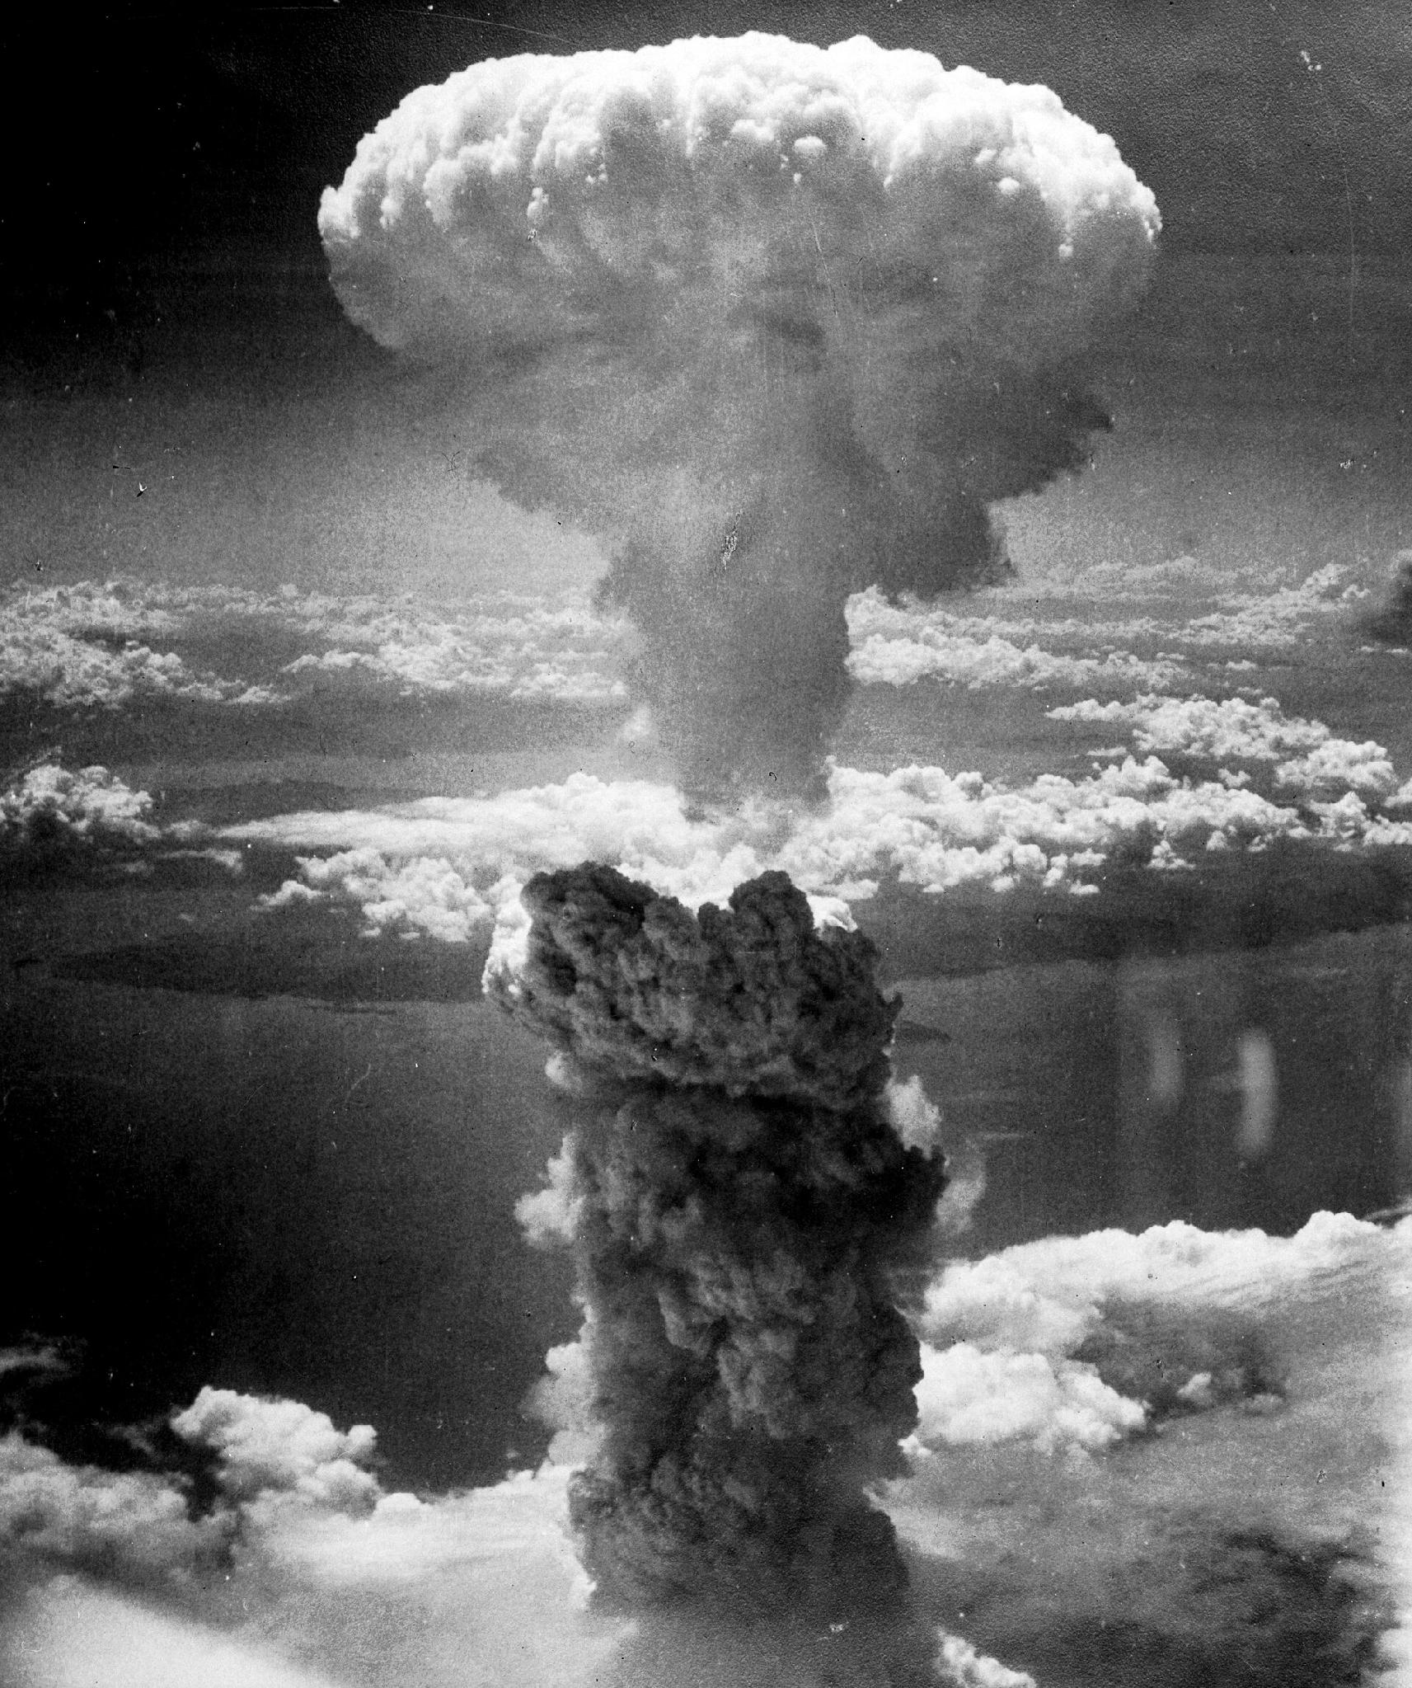
US.56 · DIRECT INSTRUCTION
3 of 4
Rationale for Using Atomic Weapons
President Truman authorized atomic bombs to end the war quickly, avoiding a costly invasion of Japan projected to cause hundreds of thousands of American casualties based on Okinawa experience.
Additional factors included forcing rapid Japanese surrender, demonstrating American power to the Soviet Union, and justifying the massive investment in the Manhattan Project.
The bombs on Hiroshima (August 6) and Nagasaki (August 9) killed over 100,000 immediately, with more dying later from radiation.
Charles Levy / U.S. Army Air Forces / National Archives and Records Administration, August 9, 1945 National Archives
U.S. History Hack · TroopToTeacher Technologies LLC · Aligned to TN Academic Standards & TCAP EOC
187

Slide 211
US.56 · DIRECT INSTRUCTION
4 of 4
Ethical Debate
Arguments for use included ending the war quickly, saving lives on both sides that invasion would cost, and Japanese refusal to surrender despite conventional bombing.
Arguments against included the targeting of civilians, long-term radiation effects, potential alternatives like demonstration or modified surrender terms, and the precedent of nuclear warfare.
This debate continues among historians and ethicists, with no consensus on whether the decision was justified.
U.S. History Hack · TroopToTeacher Technologies LLC · Aligned to TN Academic Standards & TCAP EOC
188

Slide 212
US.56 · PEOPLE WHO SHAPED THE ERA
Key Figure
Harry S. Truman
33rd President (1945-1953)
Took office in April 1945 after FDR's death
Learned of the atomic bomb only as president
Ordered the bombings of Hiroshima and Nagasaki
STRATEGY Use Truman to frame the atomic decision as a real leader weighing invasion casualties against the bomb.
U.S. History Hack · TroopToTeacher Technologies LLC · Aligned to TN Academic Standards & TCAP EOC
189

Slide 213
US.56 · PRIMARY SOURCE ANALYSIS
Statement on the Atomic Bomb
Close Reading
President Harry S. Truman · August 6, 1945
"Sixteen hours ago an American airplane dropped one bomb on Hiroshima, an important Japanese Army base. That bomb had more power than 20,000 tons of T.N.T... We are now prepared to obliterate more rapidly and completely every productive enterprise the Japanese have above ground in any city... If they do not now accept our terms they may expect a rain of ruin from the air."
CONTEXT
By August 1945, World War II in Europe had ended but fierce fighting continued in the Pacific. Estimates projected that a land invasion of Japan could cost hundreds of thousands of American and Japanese lives. President Truman made the decision to use the newly developed atomic bomb—the product of the secret Manhattan Project—hoping to force Japan's surrender without an invasion. The first bomb was dropped on Hiroshima on August 6, 1945, killing approximately 80,000 people instantly.
ANALYZE
READ CLOSELY Underline the exact words that answer the ANALYZE question — be ready to read them aloud.
What ultimatum does Truman issue to Japan in this statement?
SOURCE IT
WHO made it?
WHEN?
WHY does it matter?
FIRST
President Harry S. Truman
August 6, 1945
Consider the author's purpose and audience before reading the words.
SSP.02 · before you interpret
Source: Harry S. Truman Presidential Library
U.S. History Hack · TroopToTeacher Technologies LLC · Aligned to TN Academic Standards & TCAP EOC
190
Notes:
Primary-source analysis. SOURCE IT FIRST (SSP.02) — model the sourcing routine aloud before students interpret: WHO made this source? (President Harry S. Truman) WHEN? (August 6, 1945) WHY does that matter? (Consider the author's purpose and audience before reading the words.) Only then move to the ANALYZE question. Suggested answer: See teacher key. Practice skill: Close Reading.

Slide 214
US.56 · KEY VOCABULARY
Word Wall
Manhattan Project
Proyecto Manhattan
Atomic Bomb
Bomba Atómica
say: man-HAT-un PROJ-ekt
say: uh-TOM-ik bom
MP
Top-secret U.S. program to develop the atomic bomb, involving sites at Oak Ridge (Tennessee), Los Alamos (New Mexico), and Hanford (Washington).
AB
Nuclear weapons dropped on Hiroshima (August 6) and Nagasaki (August 9, 1945), killing over 200,000 people and forcing Japan's surrender, ending World War II.
Battle of Iwo Jima
Batalla de Iwo Jima
Allied Powers
Potencias Aliadas
say: BAT-ul uv EE-woh JEE-muh
say: AL-yd POW-erz
BO
February-March 1945 brutal battle for a strategic Pacific island, famous for the iconic flag-raising photograph on Mount Suribachi.
AP
The World War II coalition led by the United States, Great Britain, and the Soviet Union that fought and defeated the Axis Powers.
Hideki Tojo
Hideki Tojo
Pearl Harbor
Pearl Harbor
say: hee-DEH-kee TOH-joh
say: purl HAR-ber
HT
Japanese military leader and Prime Minister (1941-1944) who led Japan into World War II and authorized the attack on Pearl Harbor.
PH
Japan's surprise attack on the U.S. naval base in Hawaii on December 7, 1941, killing over 2,400 Americans and bringing the United States into World War II.
"say:" pronunciation guide (stressed syllable in CAPS) and a per-term visual anchor support newcomer English learners. Spanish term + full bilingual Frayer models are in the unit vocabulary set.
U.S. History Hack · TroopToTeacher Technologies LLC · Aligned to TN Academic Standards & TCAP EOC
191

Slide 215
US.56 · GUIDED PRACTICE — WE DO IT TOGETHER
Let’s Work One Together
Evaluate a high-stakes decision
MODEL PROMPT: What was Truman's rationale for using the atomic bomb?
WORKED EXAMPLE (teacher models this aloud)
Truman argued the bomb would end the war fast and avoid a costly invasion of Japan. Weigh that stated rationale against the human cost of Hiroshima and Nagasaki.
THINK ALOUD
Underline Truman's stated reason in the source.
→ Now you try: Judge whether the rationale justified the decision, citing evidence.
U.S. History Hack · TroopToTeacher Technologies LLC · Aligned to TN Academic Standards & TCAP EOC
192
Notes:
GUIDED PRACTICE / WE DO (US.56). Skill modeled: Evaluate a high-stakes decision. Model the worked example aloud using the THINK ALOUD as your script, then release students to the activity ("Judge whether the rationale justified the decision, citing evidence."). This is the I Do → We Do → You Do bridge — do not skip it; aim for 80%+ success before independent work.

Slide 216
US.56 · STUDENT ACTIVITY
The Weight of the Decision — The Manhattan Project and the Bomb
Pairs
15 min
YOUR TASK
Read Truman's statement on the atomic bomb and use your notes to complete a four-part organizer: (1) why OAK RIDGE, TENNESSEE was selected; (2) an overview of the MANHATTAN PROJECT; (3) the RATIONALE for using the bomb to end the war; (4) the ETHICAL DEBATE that followed. Add one detail per section. Finish with a one-sentence claim, backed by evidence, on whether the decision to drop the bomb was justified.
DELIVERABLE
DIFFERENTIATION
Completed four-part organizer (Oak Ridge / project overview / rationale / ethical debate, one detail each) AND a one-sentence evidence-based claim about the decision.
Entry: Organizer with the four parts pre-labeled and a fact bank to sort. Honors: Write a paragraph using Truman's statement to weigh the argument that the bomb saved lives against the argument that it caused unjustifiable civilian deaths.
Companion printable: cornell-notes/unit-6/us56-manhattan-project-atomic-bomb.pdf
U.S. History Hack · TroopToTeacher Technologies LLC · Aligned to TN Academic Standards & TCAP EOC
193
Notes:
Student activity for US.56. Pair with the printable: cornell-notes/unit-6/us56-manhattan-project-atomic-bomb.pdf. Timing: 15. Deliverable: Completed four-part organizer (Oak Ridge / project overview / rationale / ethical debate, one detail each) AND a one-sentence evidence-based claim about the decision.

Slide 217
US.56 · CHECK FOR UNDERSTANDING
TCAP-Style Question
DOK 2
EOC PRACTICE
The Manhattan Project's Oak Ridge, Tennessee facility was critical to the atomic bomb because —
Oak Ridge housed the scientists who designed the bomb's explosive mechanism.
A
It was the site of the Trinity test where the bomb was first detonated.
B
It was where the bombs were assembled and tested.
C
Oak Ridge's Y-12 and K-25 plants enriched uranium.
D
ANSWER FIRST: students commit — then click / advance to reveal the correct answer and explanation.
U.S. History Hack · TroopToTeacher Technologies LLC · Aligned to TN Academic Standards & TCAP EOC
194
Notes:
CHECK FOR UNDERSTANDING (US.56, DOK 2). Have students commit to an answer (whiteboards, hand signal, or turn-and-talk) BEFORE advancing. Correct answer: D. The next slide reveals it. Why: Oak Ridge's Y-12 and K-25 plants enriched uranium. The United States secretly developed nuclear weapons, which changed warfare and diplomacy after 1945. A is incorrect because it describes a different program, event, or idea than this World War II event. This helps explain how World War II became a global turning point in military strategy and international power.

Slide 218
US.56 · ANSWER REVEAL
TCAP-Style Question
✓ ANSWER KEY
The Manhattan Project's Oak Ridge, Tennessee facility was critical to the atomic bomb because —
A
Oak Ridge housed the scientists who designed the bomb's explosive mechanism.
B
It was the site of the Trinity test where the bomb was first detonated.
C
It was where the bombs were assembled and tested.
D
Oak Ridge's Y-12 and K-25 plants enriched uranium.
✓
Correct answer: D. Why: Oak Ridge's Y-12 and K-25 plants enriched uranium. The United States secretly developed nuclear weapons, which changed warfare and diplomacy after 1945. A is incorrect because it describes a different program, event, or idea than this World War II event. This helps explain how World War II became a global turning point in military strategy and international power.
U.S. History Hack · TroopToTeacher Technologies LLC · Aligned to TN Academic Standards & TCAP EOC
195
Notes:
ANSWER KEY (US.56). Correct: D. Oak Ridge's Y-12 and K-25 plants enriched uranium. The United States secretly developed nuclear weapons, which changed warfare and diplomacy after 1945. A is incorrect because it describes a different program, event, or idea than this World War II event. This helps explain how World War II became a global turning point in military strategy and international power.

Slide 219
US.56 · WRAP-UP
What You Need to Know for TCAP
KEY TAKEAWAYS
EXIT TICKET
DOK 2
Oak Ridge, Tennessee Selection
Manhattan Project Overview
Rationale for Using Atomic Weapons
Ethical Debate
Describe the Manhattan Project and explain the rationale for using the atomic bomb.
★ HONORS / EXTENSION DOK 3 · SSP.04 Argumentation
Evaluate: Was the decision to drop the atomic bomb justified? Defend your position with at least two pieces of evidence. (SSP.04)
U.S. History Hack · TroopToTeacher Technologies LLC · Aligned to TN Academic Standards & TCAP EOC
196
Notes:
WRAP-UP / EXIT-TICKET KEY (US.56, DOK 2). Prompt: Describe the Manhattan Project and explain the rationale for using the atomic bomb. Model answer: The Manhattan Project was the secret, multi-site U.S. program that built the first atomic bombs, with uranium enrichment at Oak Ridge, Tennessee, plutonium at Hanford, and weapon design at Los Alamos. President Truman decided to use the bombs on Hiroshima and Nagasaki in August 1945, arguing that they would force Japan's rapid surrender and avoid a costly invasion expected to cost hundreds of thousands of lives. The bombs ended the war but opened a dangerous nuclear age. RETEACH TRIGGER — if a student misses this exit ticket: (1) <50% of class miss → spiral it into the next standard’s Quick Review opener (see the US.56 review prompts). (2) Individual/small group → reteach with the "Oak Ridge, Tennessee Selection" direct-instruction slide + re-run the SOURCE IT FIRST routine on the US.56 primary source, then assign the paired printable: cornell-notes/unit-6/us56-manhattan-project-atomic-bomb.pdf. (3) Re-assess with the US.56 check-for-understanding reveal slide as a do-now the next day. Reteach anchors (this standard’s sections): Oak Ridge, Tennessee Selection; Manhattan Project Overview; Rationale for Using Atomic Weapons; Ethical Debate. I Can objective: I can describe the Manhattan Project and explain the rationale for using the atomic bomb to end the war. HONORS / EXTENSION (DOK 3, for early finishers or advanced learners): Evaluate: Was the decision to drop the atomic bomb justified? Defend your position with at least two pieces of evidence. (SSP.04) — look for a clear claim plus two specific pieces of evidence.

Slide 220
STANDARD
SOCIAL STUDIES PRACTICES
US.57
SSP.02
Examine a source
SSP.03
Synthesize sources
SSP.05
Historical awareness
Yalta and Potsdam Conferences
TN ACADEMIC STANDARD
Explain the major outcomes of the Yalta and Potsdam Conferences.
I CAN
I can explain the major outcomes of the Yalta and Potsdam Conferences.
U.S. History Hack · TroopToTeacher Technologies LLC · Aligned to TN Academic Standards & TCAP EOC
197

Slide 221
KEY VOCABULARY · LANGUAGE SUPPORT
US.56
Words you need before we read
Manhattan Project
Atomic Bomb
Battle of Iwo Jima
En español: Proyecto Manhattan
En español: Bomba Atómica
En español: Batalla de Iwo Jima
WHAT IT MEANS
WHAT IT MEANS
WHAT IT MEANS
Top-secret U.S. program to develop the atomic bomb, involving sites at Oak Ridge (Tennessee), Los Alamos (New Mexico), and Hanford (Washington).
Nuclear weapons dropped on Hiroshima (August 6) and Nagasaki (August 9, 1945), killing over 200,000 people and forcing Japan's surrender, ending World War II.
February-March 1945 brutal battle for a strategic Pacific island, famous for the iconic flag-raising photograph on Mount Suribachi.
UDL · REPRESENTATION → LANGUAGE & SYMBOLS
U.S. History Hack · TEACHER DECK · Aligned to TN Academic Standards & TCAP EOC
24

Slide 222
PROGRESS CHECK
US.56
Check your understanding
What factors influenced President Truman's decision to use atomic weapons against Japan?
A
Truman made the decision without considering alternatives, which does not align with the documented historical record, although historical sources do not support this conclusion
B
Only military factors were considered, but this fails to account for the broader historical context, which represents a common misconception about this historical period
C
Truman opposed using the bombs, but this fails to account for the broader historical context, which does not align with the documented historical record
D
Projected invasion casualties based on Okinawa, desire to end the war quickly, demonstrating power to the Soviet Union, and Japanese refusal to surrender all influenced the decision
✓ KEY
UDL · ACTION & EXPRESSION → STRATEGY DEVELOPMENT
MTSS: below mastery → targeted reteach (Tier 2); at/above → extension. The goal never lowers.
U.S. History Hack · TEACHER DECK · Aligned to TN Academic Standards & TCAP EOC
25

Slide 223
US.57 · QUICK REVIEW
Do You Remember?
Before we start, retrieve what we have already learned. Answer from memory first — no notes.
1
US.56 What was the Manhattan Project?
2
US.56 What was the main rationale for using the atomic bomb?
U.S. History Hack · TroopToTeacher Technologies LLC · Aligned to TN Academic Standards & TCAP EOC
198
Notes:
SPACED RETRIEVAL (US.57). Cold-call or whiteboards, 3-4 min, low stakes. Answers — 1) The secret U.S. program that developed the first atomic bombs, with a major site at Oak Ridge, Tennessee. 2) President Truman argued it would force Japan's surrender quickly and avoid a costly invasion that could kill hundreds of thousands.

Slide 224
US.57 · CONFIDENCE CHECK
Warm-Up — Quick Recall
DOK 1
LOW STAKES
Everyone can answer this. Thumbs / whiteboards — no notes.
Name one of the two major Allied conferences that planned the postwar world.
✓ ANSWER
The Yalta Conference or the Potsdam Conference (both 1945).
COMMIT FIRST: have everyone answer before the reveal — this is the DOK 1 floor; the graded check later in this lesson moves up to DOK 2–3.
U.S. History Hack · TroopToTeacher Technologies LLC · Aligned to TN Academic Standards & TCAP EOC
199
Notes:
CONFIDENCE CHECK (US.57, DOK 1). 60-90 seconds. Have EVERY student commit (thumbs / whiteboard / choral) before revealing — this secures an early win and surfaces who is shaky before new content. Answer: The Yalta Conference or the Potsdam Conference (both 1945). Key term to listen for: Yalta Conference. This is the low-floor entry; the graded Check for Understanding later in the standard rises to DOK 2–3.

Slide 225
US.57 · HOOK
Think About It
As victory neared, the leaders of the United States, Britain, and the Soviet Union met at Yalta and Potsdam to divide up the postwar world, and in the process planted the seeds of the Cold War.
DISCUSS
TIMING: Turn & Talk 60 sec → cold-call 2 pairs
When allies win a war together but distrust one another, how do the peace they make and the lines they draw shape the decades that follow?
U.S. History Hack · TroopToTeacher Technologies LLC · Aligned to TN Academic Standards & TCAP EOC
200
Notes:
HOOK (US.57). Run tight: pose the provocation, give a silent 10-second think, then Turn & Talk 60 seconds. Cold-call 2–3 pairs (not volunteers) for a sentence-starter answer — "One force was ___ because ___" — then bridge to the standard. Keep total to ~4 minutes; do not let it sprawl. Return to this question at the unit close for an evidence-based answer.

Slide 226
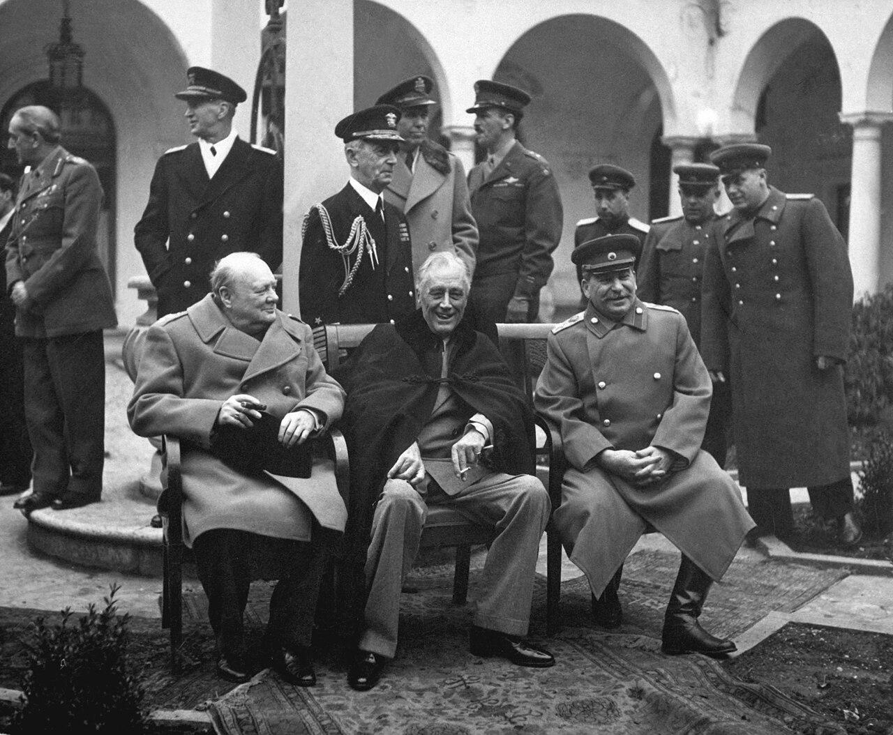
US.57 · DIRECT INSTRUCTION
1 of 4
Yalta Conference (February 1945)
Roosevelt, Churchill, and Stalin met as Allied victory approached.
Major agreements included UN formation plans, division of Germany into occupation zones, and Soviet entry into the war against Japan.
Controversially, Stalin promised "free elections" in liberated Eastern Europe—a promise he would break.
The conference also addressed reparations from Germany and arrangements for post-war Poland.
Roosevelt sought Soviet cooperation for the post-war order.
SENTENCE FRAME (EL & writing support)
U.S. Army Signal Corps / U.S. Federal Government, February 1945 National Archives
At Yalta and Potsdam the Allies agreed to ________, but disagreed over ________, which helped start the Cold War.
TEACHER CUE Chunk → cold-call → confirm before advancing.
U.S. History Hack · TroopToTeacher Technologies LLC · Aligned to TN Academic Standards & TCAP EOC
201
Notes:
FACILITATION (US.57). Show three leaders seated together and ask what they'd argue about once the common enemy was nearly beaten. Teach in small steps; pause and check for understanding before the next chunk (aim 80%+ before moving on).

Slide 227
US.57 · DIRECT INSTRUCTION
2 of 4
Potsdam Conference (July-August 1945)
Truman (replacing the deceased Roosevelt), Churchill (replaced mid-conference by Attlee), and Stalin met as Germany surrendered.
The conference confirmed occupation zones, issued the Potsdam Declaration ultimatum to Japan demanding unconditional surrender, and agreed on German demilitarization and denazification.
Tensions over Eastern Europe and reparations surfaced, revealing the growing divide between Soviet and Western visions for post-war Europe.
U.S. History Hack · TroopToTeacher Technologies LLC · Aligned to TN Academic Standards & TCAP EOC
202

Slide 228
US.57 · DIRECT INSTRUCTION
3 of 4
Cold War Origins
Disagreements over Eastern Europe proved irreconcilable.
Stalin's interpretation of "free elections" meant communist-controlled governments, while the West expected genuine democratic choice.
Soviet occupation of Eastern Europe created what Churchill would call the "Iron Curtain." German reparations disputes, with the Soviets stripping their zone of industrial equipment, deepened mistrust.
These wartime conferences set the stage for the Cold War division of Europe.
U.S. History Hack · TroopToTeacher Technologies LLC · Aligned to TN Academic Standards & TCAP EOC
203

Slide 229
US.57 · DIRECT INSTRUCTION
4 of 4
Assessment of Allied Diplomacy
Critics argue Roosevelt conceded too much to Stalin at Yalta, though defenders note Soviet armies already occupied Eastern Europe and FDR sought Soviet help against Japan.
Truman took a harder line at Potsdam but faced the same reality of Soviet military control.
Whether better outcomes were possible remains debated—the fundamental conflict between Soviet security concerns and Western democratic values may have made Cold War inevitable regardless of conference diplomacy.
U.S. History Hack · TroopToTeacher Technologies LLC · Aligned to TN Academic Standards & TCAP EOC
204

Slide 230
US.57 · PEOPLE WHO SHAPED THE ERA
Key Figures
Franklin D. Roosevelt
Harry S. Truman
32nd President; at Yalta
33rd President; at Potsdam
Met Churchill and Stalin at Yalta (Feb 1945)
Sought Soviet help against Japan and a postwar UN
Died before the Potsdam Conference
Represented the U.S. at Potsdam (July-Aug 1945)
Issued the Potsdam Declaration demanding Japan's surrender
Faced rising tension with Stalin over postwar Europe
STRATEGY Use FDR at Yalta and Truman at Potsdam to show continuity and change in Allied diplomacy.
STRATEGY Contrast Potsdam's hardening tone with Yalta to preview the coming Cold War.
U.S. History Hack · TroopToTeacher Technologies LLC · Aligned to TN Academic Standards & TCAP EOC
205

Slide 231
US.57 · PRIMARY SOURCE ANALYSIS
Yalta Conference Communiqué
Argumentation
Roosevelt, Churchill, and Stalin · February 1945
"We have agreed on common policies and plans for enforcing the unconditional surrender terms which we shall impose together on Nazi Germany... It is our inflexible purpose to destroy German militarism and Nazism and to ensure that Germany will never again be able to disturb the peace of the world."
CONTEXT
In February 1945, with Germany's defeat approaching, the leaders of the three main Allied powers—Roosevelt, Churchill, and Stalin—met at Yalta in Soviet Crimea to plan the post-war world. They made key decisions about Germany's defeat and occupation, the establishment of the United Nations, and the future of Eastern Europe. Many historians see Yalta as marking the beginning of tensions that would become the Cold War, as Stalin soon violated promises about free elections in Eastern Europe.
ANALYZE
READ CLOSELY Underline the exact words that answer the ANALYZE question — be ready to read them aloud.
What was the shared goal of the Allied leaders at Yalta regarding Germany?
SOURCE IT
WHO made it?
WHEN?
WHY does it matter?
FIRST
Roosevelt, Churchill, and Stalin
February 1945
Consider the author's purpose and audience before reading the words.
SSP.02 · before you interpret
Source: Avalon Project, Yale Law School
U.S. History Hack · TroopToTeacher Technologies LLC · Aligned to TN Academic Standards & TCAP EOC
206
Notes:
Primary-source analysis. SOURCE IT FIRST (SSP.02) — model the sourcing routine aloud before students interpret: WHO made this source? (Roosevelt, Churchill, and Stalin) WHEN? (February 1945) WHY does that matter? (Consider the author's purpose and audience before reading the words.) Only then move to the ANALYZE question. Suggested answer: See teacher key. Practice skill: Argumentation.

Slide 232
US.57 · KEY VOCABULARY
Word Wall
Yalta Conference
Conferencia de Yalta
Potsdam Conference
Conferencia de Potsdam
say: YAWL-tuh KON-fer-ens
say: POTS-dam KON-fer-ens
YC
February 1945 meeting of Roosevelt, Churchill, and Stalin to plan post-war Europe, dividing Germany and establishing spheres of influence.
PC
July-August 1945 meeting of Truman, Churchill/Attlee, and Stalin finalizing plans for occupied Germany and issuing surrender terms to Japan.
Joseph Stalin
Joseph Stalin
Atomic Bomb
Bomba Atómica
say: JOH-zef STAH-lin
say: uh-TOM-ik bom
JS
Communist dictator of the Soviet Union (1924-1953) who ruled through terror, forced collectivization, and purges, resulting in millions of deaths.
AB
Nuclear weapons dropped on Hiroshima (August 6) and Nagasaki (August 9, 1945), killing over 200,000 people and forcing Japan's surrender, ending World War II.
Allied Powers
Potencias Aliadas
Axis Powers
Potencias del Eje
say: AL-yd POW-erz
say: AK-sis POW-erz
AP
The World War II coalition led by the United States, Great Britain, and the Soviet Union that fought and defeated the Axis Powers.
AP
Military alliance of Germany, Italy, and Japan during World War II. United by shared goals of territorial expansion, militarism, and opposition to democratic nations.
"say:" pronunciation guide (stressed syllable in CAPS) and a per-term visual anchor support newcomer English learners. Spanish term + full bilingual Frayer models are in the unit vocabulary set.
U.S. History Hack · TroopToTeacher Technologies LLC · Aligned to TN Academic Standards & TCAP EOC
207

Slide 233
US.57 · GUIDED PRACTICE — WE DO IT TOGETHER
Let’s Work One Together
Summarize diplomatic outcomes
MODEL PROMPT: What did the Allies decide at Yalta and Potsdam?
WORKED EXAMPLE (teacher models this aloud)
Yalta planned the UN, Soviet entry against Japan, and a divided Germany; Potsdam hardened terms and demanded Japan's surrender. Cooperation was already fraying into rivalry.
THINK ALOUD
List one outcome from each conference.
→ Now you try: Explain one seed of the coming Cold War planted at these meetings.
U.S. History Hack · TroopToTeacher Technologies LLC · Aligned to TN Academic Standards & TCAP EOC
208
Notes:
GUIDED PRACTICE / WE DO (US.57). Skill modeled: Summarize diplomatic outcomes. Model the worked example aloud using the THINK ALOUD as your script, then release students to the activity ("Explain one seed of the coming Cold War planted at these meetings."). This is the I Do → We Do → You Do bridge — do not skip it; aim for 80%+ success before independent work.

Slide 234
US.57 · STUDENT ACTIVITY
Dividing the Postwar World — Yalta and Potsdam
Pairs
15 min
YOUR TASK
Read the Yalta Communique and review the Big Three photograph. Build a two-column chart: YALTA (Feb 1945) outcomes and POTSDAM (July-Aug 1945) outcomes, listing the leaders present and at least two decisions from each. Then note one way these conferences planted seeds of the Cold War. Finish with a one-sentence claim on whether the Allies cooperated or already distrusted one another, with evidence.
DELIVERABLE
DIFFERENTIATION
Completed two-conference chart (leaders + 2 decisions each, plus one Cold War seed) AND a one-sentence evidence-based claim about Allied unity.
Entry: Chart pre-labeled 'Yalta' and 'Potsdam' with a word bank of decisions and leaders to sort. Honors: Write a paragraph using the Yalta Communique to explain how wartime agreements over Poland and Eastern Europe helped spark the Cold War.
Companion printable: cornell-notes/unit-6/us57-yalta-potsdam.pdf
U.S. History Hack · TroopToTeacher Technologies LLC · Aligned to TN Academic Standards & TCAP EOC
209
Notes:
Student activity for US.57. Pair with the printable: cornell-notes/unit-6/us57-yalta-potsdam.pdf. Timing: 15. Deliverable: Completed two-conference chart (leaders + 2 decisions each, plus one Cold War seed) AND a one-sentence evidence-based claim about Allied unity.

Slide 235
US.57 · CHECK FOR UNDERSTANDING
TCAP-Style Question
DOK 2
EOC PRACTICE
Read the excerpt below.
"The leaders of the Allied powers — Churchill, Roosevelt, and Stalin — met at Yalta to determine the shape of the post-war world. Each came with different goals, and each left with only part of what he wanted." — Historian Robert Dallek, Franklin D. Roosevelt: A Political Life, 2017
Which of the following best describes a major decision made at the Yalta Conference (February 1945)?
Plans for dividing Germany into occupation zones, establishing the United Nations, and the Soviet Union's entry into the Pacific War.
A
The decision to use atomic bombs on Japan to force a rapid end to the Pacific War.
B
The Marshall Plan to provide economic aid to war-devastated European nations to prevent communist takeover.
C
The division of Korea at the 38th parallel into Soviet and American spheres of influence.
D
ANSWER FIRST: students commit — then click / advance to reveal the correct answer and explanation.
U.S. History Hack · TroopToTeacher Technologies LLC · Aligned to TN Academic Standards & TCAP EOC
210
Notes:
CHECK FOR UNDERSTANDING (US.57, DOK 2). Have students commit to an answer (whiteboards, hand signal, or turn-and-talk) BEFORE advancing. Correct answer: A. The next slide reveals it. Why: At the Yalta Conference, the Big Three (Roosevelt, Churchill, and Stalin) agreed on plans for the postwar world, including the division of Germany into occupation zones, free elections in liberated Eastern European countries (a promise Stalin later broke), the creation of the United Nations, and Soviet entry into the Pacific War against Japan. Option B is incorrect because the decision to use atomic bombs was made separately by Truman after Roosevelt's death. Option C is incorrect because the Marshall Plan was proposed by Secretary of State Marshall in 1947, after Yalta. Option D is incorrect because the Korean division was not decided at Yalta.

Slide 236
US.57 · ANSWER REVEAL
TCAP-Style Question
✓ ANSWER KEY
Read the excerpt below.
"The leaders of the Allied powers — Churchill, Roosevelt, and Stalin — met at Yalta to determine the shape of the post-war world. Each came with different goals, and each left with only part of what he wanted." — Historian Robert Dallek, Franklin D. Roosevelt: A Political Life, 2017
Which of the following best describes a major decision made at the Yalta Conference (February 1945)?
A
Plans for dividing Germany into occupation zones, establishing the United Nations, and the Soviet Union's entry into the Pacific War.
✓
B
The decision to use atomic bombs on Japan to force a rapid end to the Pacific War.
C
The Marshall Plan to provide economic aid to war-devastated European nations to prevent communist takeover.
D
The division of Korea at the 38th parallel into Soviet and American spheres of influence.
Correct answer: A. Why: At the Yalta Conference, the Big Three (Roosevelt, Churchill, and Stalin) agreed on plans for the postwar world, including the division of Germany into occupation zones, free elections in liberated Eastern European countries (a promise Stalin later broke), the creation of the United Nations, and Soviet entry into the Pacific War against Japan.
U.S. History Hack · TroopToTeacher Technologies LLC · Aligned to TN Academic Standards & TCAP EOC
211
Notes:
ANSWER KEY (US.57). Correct: A. At the Yalta Conference, the Big Three (Roosevelt, Churchill, and Stalin) agreed on plans for the postwar world, including the division of Germany into occupation zones, free elections in liberated Eastern European countries (a promise Stalin later broke), the creation of the United Nations, and Soviet entry into the Pacific War against Japan. Option B is incorrect because the decision to use atomic bombs was made separately by Truman after Roosevelt's death. Option C is incorrect because the Marshall Plan was proposed by Secretary of State Marshall in 1947, after Yalta. Option D is incorrect because the Korean division was not decided at Yalta.

Slide 237
US.57 · WRAP-UP
What You Need to Know for TCAP
KEY TAKEAWAYS
EXIT TICKET
DOK 2
Yalta Conference (February 1945)
Potsdam Conference (July-August 1945)
Cold War Origins
Assessment of Allied Diplomacy
Explain the major outcomes of the Yalta and Potsdam Conferences and how they contributed to the Cold War.
★ HONORS / EXTENSION DOK 3 · SSP.04 Argumentation
Evaluate: Did the Allies genuinely cooperate at Yalta and Potsdam, or had the Cold War already begun? Argue with evidence. (SSP.04)
U.S. History Hack · TroopToTeacher Technologies LLC · Aligned to TN Academic Standards & TCAP EOC
212
Notes:
WRAP-UP / EXIT-TICKET KEY (US.57, DOK 2). Prompt: Explain the major outcomes of the Yalta and Potsdam Conferences and how they contributed to the Cold War. Model answer: At Yalta (February 1945), the Big Three, Roosevelt, Churchill, and Stalin, agreed to divide Germany, hold elections in liberated Europe, and create the United Nations, but disagreed over the fate of Poland. At Potsdam (July-August 1945), Truman, now president, faced Stalin over Eastern Europe and issued an ultimatum to Japan. Soviet control of Eastern Europe and mutual distrust between the superpowers turned wartime allies into Cold War rivals. RETEACH TRIGGER — if a student misses this exit ticket: (1) <50% of class miss → spiral it into the next standard’s Quick Review opener (see the US.57 review prompts). (2) Individual/small group → reteach with the "Yalta Conference (February 1945)" direct-instruction slide + re-run the SOURCE IT FIRST routine on the US.57 primary source, then assign the paired printable: cornell-notes/unit-6/us57-yalta-potsdam.pdf. (3) Re-assess with the US.57 check-for-understanding reveal slide as a do-now the next day. Reteach anchors (this standard’s sections): Yalta Conference (February 1945); Potsdam Conference (July-August 1945); Cold War Origins; Assessment of Allied Diplomacy. I Can objective: I can explain the major outcomes of the Yalta and Potsdam Conferences. HONORS / EXTENSION (DOK 3, for early finishers or advanced learners): Evaluate: Did the Allies genuinely cooperate at Yalta and Potsdam, or had the Cold War already begun? Argue with evidence. (SSP.04) — look for a clear claim plus two specific pieces of evidence.

Slide 238
STANDARD
SOCIAL STUDIES PRACTICES
US.58
SSP.01
Collect sources
SSP.03
Synthesize sources
SSP.05
Historical awareness
Founding of the United Nations & Cordell Hull
TN ACADEMIC STANDARD
Identify and explain the reasons for the founding of the United Nations, including the role of Cordell Hull.
I CAN
I can identify and explain the reasons for the founding of the United Nations, including the role of Cordell Hull.
U.S. History Hack · TroopToTeacher Technologies LLC · Aligned to TN Academic Standards & TCAP EOC
213

Slide 239
KEY VOCABULARY · LANGUAGE SUPPORT
US.57
Words you need before we read
Yalta Conference
Potsdam Conference
Joseph Stalin
En español: Conferencia de Yalta
En español: Conferencia de Potsdam
En español: Joseph Stalin
WHAT IT MEANS
WHAT IT MEANS
WHAT IT MEANS
February 1945 meeting of Roosevelt, Churchill, and Stalin to plan post-war Europe, dividing Germany and establishing spheres of influence.
July-August 1945 meeting of Truman, Churchill/Attlee, and Stalin finalizing plans for occupied Germany and issuing surrender terms to Japan.
Communist dictator of the Soviet Union (1924-1953) who ruled through terror, forced collectivization, and purges, resulting in millions of deaths.
UDL · REPRESENTATION → LANGUAGE & SYMBOLS
U.S. History Hack · TEACHER DECK · Aligned to TN Academic Standards & TCAP EOC
26

Slide 240
PROGRESS CHECK
US.57
Check your understanding
How did the Potsdam Conference reveal growing tensions between the United States and Soviet Union?
A
Disputes over Eastern European governments, German reparations, and differing visions for post-war Europe revealed fundamental disagreements that would define the Cold War
✓ KEY
B
Potsdam showed complete Allied unity, though this interpretation lacks supporting historical evidence, which ignores significant political and cultural developments of the era
C
Only minor disagreements emerged, despite the fact that multiple sources contradict this view, which represents a common misconception about this historical period
D
The Soviet Union was excluded from Potsdam, though this interpretation lacks supporting historical evidence, though this interpretation lacks supporting historical evidence
UDL · ACTION & EXPRESSION → STRATEGY DEVELOPMENT
MTSS: below mastery → targeted reteach (Tier 2); at/above → extension. The goal never lowers.
U.S. History Hack · TEACHER DECK · Aligned to TN Academic Standards & TCAP EOC
27

Slide 241
US.58 · QUICK REVIEW
Do You Remember?
Before we start, retrieve what we have already learned. Answer from memory first — no notes.
1
US.57 Where did the 'Big Three' meet in early 1945 to plan the postwar world?
2
US.57 How did Yalta and Potsdam help start the Cold War?
U.S. History Hack · TroopToTeacher Technologies LLC · Aligned to TN Academic Standards & TCAP EOC
214
Notes:
SPACED RETRIEVAL (US.58). Cold-call or whiteboards, 3-4 min, low stakes. Answers — 1) At the Yalta Conference (February 1945), attended by Roosevelt, Churchill, and Stalin. 2) Disagreements over the fate of Poland and Eastern Europe, and growing distrust between the U.S. and the Soviet Union, divided the former allies.

Slide 242
US.58 · CONFIDENCE CHECK
Warm-Up — Quick Recall
DOK 1
LOW STAKES
Everyone can answer this. Thumbs / whiteboards — no notes.
What international organization was founded in 1945 to keep the peace?
✓ ANSWER
The United Nations.
COMMIT FIRST: have everyone answer before the reveal — this is the DOK 1 floor; the graded check later in this lesson moves up to DOK 2–3.
U.S. History Hack · TroopToTeacher Technologies LLC · Aligned to TN Academic Standards & TCAP EOC
215
Notes:
CONFIDENCE CHECK (US.58, DOK 1). 60-90 seconds. Have EVERY student commit (thumbs / whiteboard / choral) before revealing — this secures an early win and surfaces who is shaky before new content. Answer: The United Nations. Key term to listen for: United Nations. This is the low-floor entry; the graded Check for Understanding later in the standard rises to DOK 2–3.

Slide 243
US.58 · HOOK
Think About It
Determined not to repeat the failure of the League of Nations, the Allies, led in part by Tennessean Cordell Hull, built a new global organization, the United Nations, to keep the peace after the deadliest war in history.
DISCUSS
TIMING: Turn & Talk 60 sec → cold-call 2 pairs
Why did the League of Nations fail, and could a new United Nations succeed where it had not?
U.S. History Hack · TroopToTeacher Technologies LLC · Aligned to TN Academic Standards & TCAP EOC
216
Notes:
HOOK (US.58). Run tight: pose the provocation, give a silent 10-second think, then Turn & Talk 60 seconds. Cold-call 2–3 pairs (not volunteers) for a sentence-starter answer — "One force was ___ because ___" — then bridge to the standard. Keep total to ~4 minutes; do not let it sprawl. Return to this question at the unit close for an evidence-based answer.

Slide 244
US.58 · DIRECT INSTRUCTION
1 of 4
Lessons from League of Nations Failure
The League of Nations failed because the United States never joined, it lacked enforcement mechanisms, major powers could ignore it, and it couldn't prevent aggression by Germany, Italy, and Japan.
Planners sought to avoid these weaknesses in a new organization.
American participation would be essential, and the new organization needed stronger enforcement authority, particularly through the Security Council with major power veto and potential for military action.
SENTENCE FRAME (EL & writing support)
The United Nations was founded to ________, and it tried to avoid the League of Nations' failure by ________.
U.S. History Hack · TroopToTeacher Technologies LLC · Aligned to TN Academic Standards & TCAP EOC
217
Notes:
FACILITATION (US.58). Ask: after two world wars in thirty years, what could actually keep the peace? Then reveal the founding of the UN. Teach in small steps; pause and check for understanding before the next chunk (aim 80%+ before moving on).

Slide 245
US.58 · DIRECT INSTRUCTION
2 of 4
Cordell Hull's Role
Cordell Hull, FDR's Secretary of State and a Tennessean, was instrumental in planning the United Nations.
He advocated for international organization throughout the war, led U.S. delegation efforts in preliminary planning, and helped shape UN principles.
His decades of work promoting international cooperation earned him the Nobel Peace Prize in 1945, making him one of Tennessee's most significant contributions to world history.
★ TENNESSEE CONNECTION
Cordell Hull, a Tennessean and FDR's long-serving Secretary of State, was so central to planning the postwar peace organization that he is often called the 'Father of the United Nations.' He won the 1945 Nobel Peace Prize for his work, a lasting Tennessee connection to the founding of the UN.
U.S. History Hack · TroopToTeacher Technologies LLC · Aligned to TN Academic Standards & TCAP EOC
218

Slide 246
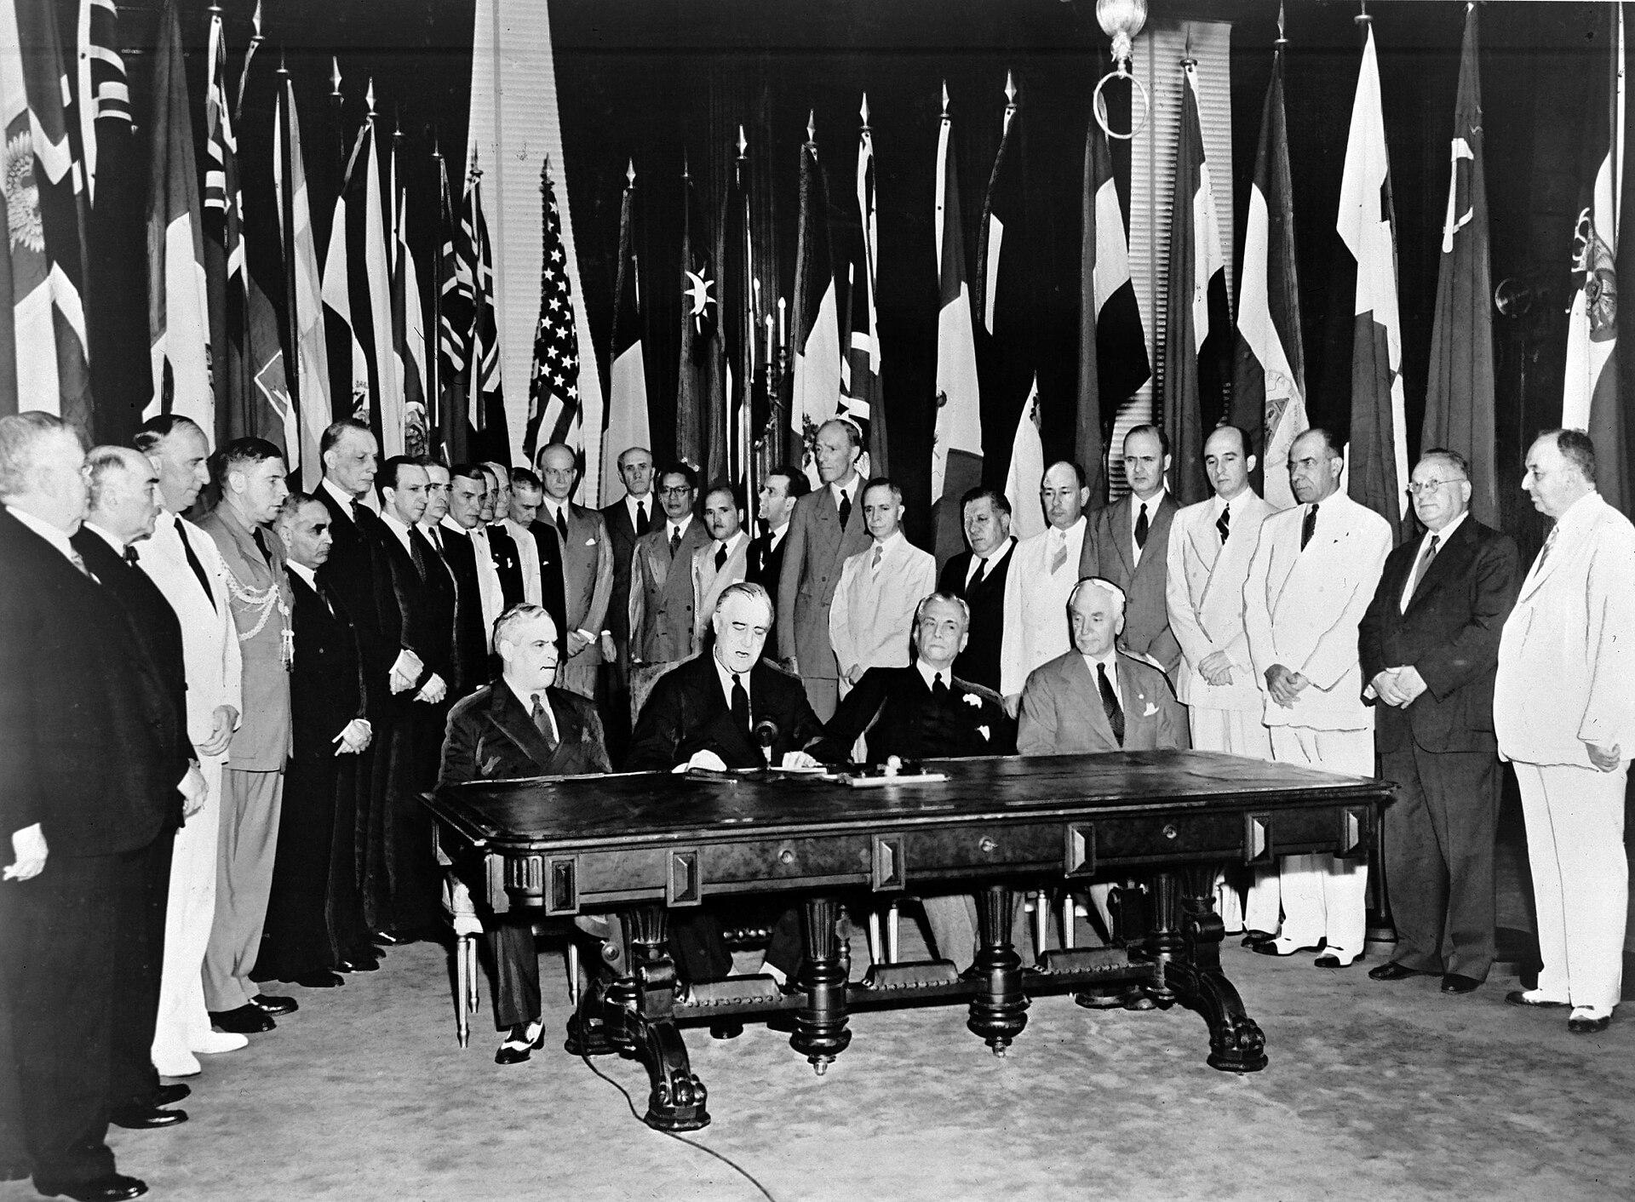
US.58 · DIRECT INSTRUCTION
3 of 4
UN Goals and Structure
The United Nations was designed to maintain international peace and security through collective action, develop friendly relations among nations based on equal rights and self-determination, promote social progress and human rights, and facilitate international cooperation on economic and humanitarian issues.
The Security Council with five permanent members (US, UK, France, China, USSR) had primary responsibility for peace and security, with veto power ensuring major power buy-in.
Unknown photographer / United Nations, January 1, 1942 Wikimedia Commons
U.S. History Hack · TroopToTeacher Technologies LLC · Aligned to TN Academic Standards & TCAP EOC
219

Slide 247
US.58 · DIRECT INSTRUCTION
4 of 4
UN Legacy and Limitations
The UN successfully avoided the League's fate—American membership was secured, and the organization has survived.
However, Cold War rivalry often paralyzed the Security Council through vetoes.
The UN has been most effective in humanitarian work, peacekeeping in conflicts where major powers agree, and establishing international norms through declarations and treaties.
Its limitations in preventing great power conflicts reflect the inherent challenges of international organization.
U.S. History Hack · TroopToTeacher Technologies LLC · Aligned to TN Academic Standards & TCAP EOC
220

Slide 248
US.58 · PEOPLE WHO SHAPED THE ERA
Key Figure
Cordell Hull
Secretary of State (1933-1944)
Called the 'Father of the United Nations'
Laid the diplomatic groundwork for the UN
Won the 1945 Nobel Peace Prize
STRATEGY Use Hull to show that the UN grew out of deliberate American planning, not accident.
U.S. History Hack · TroopToTeacher Technologies LLC · Aligned to TN Academic Standards & TCAP EOC
221

Slide 249
US.58 · PRIMARY SOURCE ANALYSIS
United Nations Charter Preamble
Close Reading
United Nations · June 26, 1945
"We the peoples of the United Nations determined to save succeeding generations from the scourge of war, which twice in our lifetime has brought untold sorrow to mankind, and to reaffirm faith in fundamental human rights, in the dignity and worth of the human person, in the equal rights of men and women and of nations large and small."
CONTEXT
The United Nations was founded in June 1945, just weeks after Germany's surrender and before Japan's. The world had just survived two devastating world wars in thirty years, and world leaders were determined to create an international body that could prevent future conflicts. Representatives of 50 nations signed the UN Charter in San Francisco, establishing an organization designed to promote peace, human rights, and international cooperation.
ANALYZE
According to the UN Charter, what was the primary motivation for creating the United Nations?
READ CLOSELY Underline the exact words that answer the ANALYZE question — be ready to read them aloud.
SOURCE IT
WHO made it?
WHEN?
WHY does it matter?
FIRST
United Nations
June 26, 1945
Consider the author's purpose and audience before reading the words.
SSP.02 · before you interpret
Source: United Nations
U.S. History Hack · TroopToTeacher Technologies LLC · Aligned to TN Academic Standards & TCAP EOC
222
Notes:
Primary-source analysis. SOURCE IT FIRST (SSP.02) — model the sourcing routine aloud before students interpret: WHO made this source? (United Nations) WHEN? (June 26, 1945) WHY does that matter? (Consider the author's purpose and audience before reading the words.) Only then move to the ANALYZE question. Suggested answer: See teacher key. Practice skill: Close Reading.

Slide 250
US.58 · KEY VOCABULARY
Word Wall
United Nations
United Nations
Cordell Hull
Cordell Hull
say: yoo-NY-ted NAY-shunz
say: kor-DEL hul
UN
An international organization founded in 1945 by 50 nations to maintain global peace, security, and cooperation and to prevent another world war through collective diplomacy.
CH
U.S. Secretary of State under Franklin D. Roosevelt (1933-1944), awarded the 1945 Nobel Peace Prize for his role in creating the United Nations.
Yalta Conference
Conferencia de Yalta
Allied Powers
Potencias Aliadas
say: YAWL-tuh KON-fer-ens
say: AL-yd POW-erz
YC
February 1945 meeting of Roosevelt, Churchill, and Stalin to plan post-war Europe, dividing Germany and establishing spheres of influence.
AP
The World War II coalition led by the United States, Great Britain, and the Soviet Union that fought and defeated the Axis Powers.
Four Freedoms Speech
Discurso de las Cuatro Libertades
Holocaust
Holocausto
say: for FREE-dumz speech
say: HOL-uh-kawst
FF
FDR's 1941 speech defining American war aims: freedom of speech, freedom of worship, freedom from want, and freedom from fear.
H
Nazi Germany's systematic genocide of 6 million Jews and millions of others (Roma, disabled, homosexuals, political opponents) during World War II.
"say:" pronunciation guide (stressed syllable in CAPS) and a per-term visual anchor support newcomer English learners. Spanish term + full bilingual Frayer models are in the unit vocabulary set.
U.S. History Hack · TroopToTeacher Technologies LLC · Aligned to TN Academic Standards & TCAP EOC
223

Slide 251
US.58 · GUIDED PRACTICE — WE DO IT TOGETHER
Let’s Work One Together
Explain the purpose of an institution
MODEL PROMPT: Why did the Allies build the United Nations?
WORKED EXAMPLE (teacher models this aloud)
Having seen appeasement and total war fail to keep peace, leaders wanted a permanent forum to resolve disputes. The UN Charter's preamble states that goal directly.
THINK ALOUD
Find the preamble's stated purpose for the UN.
→ Now you try: Explain how the UN was meant to fix what the 1930s got wrong.
U.S. History Hack · TroopToTeacher Technologies LLC · Aligned to TN Academic Standards & TCAP EOC
224
Notes:
GUIDED PRACTICE / WE DO (US.58). Skill modeled: Explain the purpose of an institution. Model the worked example aloud using the THINK ALOUD as your script, then release students to the activity ("Explain how the UN was meant to fix what the 1930s got wrong."). This is the I Do → We Do → You Do bridge — do not skip it; aim for 80%+ success before independent work.

Slide 252
US.58 · STUDENT ACTIVITY
Never Again — Building the United Nations
Pairs
15 min
YOUR TASK
Read the UN Charter Preamble and study the Declaration by United Nations photograph. Complete a four-part organizer: (1) the LESSONS learned from the League of Nations' failure; (2) CORDELL HULL's role as 'Father of the United Nations'; (3) the UN's GOALS and basic STRUCTURE; (4) the UN's LEGACY and LIMITATIONS. Add one detail per section. Finish with a one-sentence claim on whether the UN corrected the weaknesses that doomed the League, with evidence.
DELIVERABLE
DIFFERENTIATION
Completed four-part organizer (League lessons / Hull's role / goals-structure / legacy-limits, one detail each) AND a one-sentence evidence-based claim comparing the UN to the League.
Entry: Organizer with the four parts pre-labeled and a fact bank to sort. Honors: Write a paragraph using the UN Charter Preamble to argue whether the UN's design fixed the specific flaws that made the League of Nations powerless.
Companion printable: cornell-notes/unit-6/us58-united-nations-cordell-hull.pdf
U.S. History Hack · TroopToTeacher Technologies LLC · Aligned to TN Academic Standards & TCAP EOC
225
Notes:
Student activity for US.58. Pair with the printable: cornell-notes/unit-6/us58-united-nations-cordell-hull.pdf. Timing: 15. Deliverable: Completed four-part organizer (League lessons / Hull's role / goals-structure / legacy-limits, one detail each) AND a one-sentence evidence-based claim comparing the UN to the League.

Slide 253
US.58 · CHECK FOR UNDERSTANDING
TCAP-Style Question
DOK 2
EOC PRACTICE
How did the experiences of World War II most directly influence the founding of the United Nations in 1945?
The war demonstrated that economic competition between nations was the root cause of all conflicts, requiring a global trade body.
A
The failure of the League of Nations and the devastation of WWII showed the need for a stronger international organization to maintain peace.
B
Allied leaders created the United Nations primarily to coordinate the occupation of defeated Germany and Japan.
C
The development of nuclear weapons convinced world leaders that a global government with military authority over all nations was necessary.
D
ANSWER FIRST: students commit — then click / advance to reveal the correct answer and explanation.
U.S. History Hack · TroopToTeacher Technologies LLC · Aligned to TN Academic Standards & TCAP EOC
226
Notes:
CHECK FOR UNDERSTANDING (US.58, DOK 2). Have students commit to an answer (whiteboards, hand signal, or turn-and-talk) BEFORE advancing. Correct answer: B. The next slide reveals it. Why: The League of Nations had failed to prevent WWII, and the war's unprecedented death toll demonstrated that international cooperation to prevent future conflicts was essential; Cordell Hull and others championed the UN as a reformed, stronger version of collective security to replace the failed League.

Slide 254
US.58 · ANSWER REVEAL
TCAP-Style Question
✓ ANSWER KEY
How did the experiences of World War II most directly influence the founding of the United Nations in 1945?
A
The war demonstrated that economic competition between nations was the root cause of all conflicts, requiring a global trade body.
B
The failure of the League of Nations and the devastation of WWII showed the need for a stronger international organization to maintain peace.
✓
C
Allied leaders created the United Nations primarily to coordinate the occupation of defeated Germany and Japan.
D
The development of nuclear weapons convinced world leaders that a global government with military authority over all nations was necessary.
Correct answer: B. Why: The League of Nations had failed to prevent WWII, and the war's unprecedented death toll demonstrated that international cooperation to prevent future conflicts was essential; Cordell Hull and others championed the UN as a reformed, stronger version of collective security to replace the failed League.
U.S. History Hack · TroopToTeacher Technologies LLC · Aligned to TN Academic Standards & TCAP EOC
227
Notes:
ANSWER KEY (US.58). Correct: B. The League of Nations had failed to prevent WWII, and the war's unprecedented death toll demonstrated that international cooperation to prevent future conflicts was essential; Cordell Hull and others championed the UN as a reformed, stronger version of collective security to replace the failed League.

Slide 255
US.58 · WRAP-UP
What You Need to Know for TCAP
KEY TAKEAWAYS
EXIT TICKET
DOK 2
Lessons from League of Nations Failure
Cordell Hull's Role
UN Goals and Structure
UN Legacy and Limitations
Explain why the United Nations was founded and how it aimed to avoid the failures of the League of Nations.
★ HONORS / EXTENSION DOK 3 · SSP.04 Argumentation
Evaluate: Did the UN's design truly fix the flaws that doomed the League of Nations? Argue with at least two pieces of evidence. (SSP.04)
U.S. History Hack · TroopToTeacher Technologies LLC · Aligned to TN Academic Standards & TCAP EOC
228
Notes:
WRAP-UP / EXIT-TICKET KEY (US.58, DOK 2). Prompt: Explain why the United Nations was founded and how it aimed to avoid the failures of the League of Nations. Model answer: The United Nations was founded in 1945 to prevent another world war after the League of Nations had failed, largely because the U.S. never joined and it had no power to enforce decisions. Cordell Hull, FDR's Tennessean Secretary of State, helped plan it and is called a 'Father of the United Nations.' The UN gave major powers permanent Security Council seats and enforcement tools the League lacked, though it still faces limits on its power. RETEACH TRIGGER — if a student misses this exit ticket: (1) <50% of class miss → spiral it into the next standard’s Quick Review opener (see the US.58 review prompts). (2) Individual/small group → reteach with the "Lessons from League of Nations Failure" direct-instruction slide + re-run the SOURCE IT FIRST routine on the US.58 primary source, then assign the paired printable: cornell-notes/unit-6/us58-united-nations-cordell-hull.pdf. (3) Re-assess with the US.58 check-for-understanding reveal slide as a do-now the next day. Reteach anchors (this standard’s sections): Lessons from League of Nations Failure; Cordell Hull's Role; UN Goals and Structure; UN Legacy and Limitations. I Can objective: I can identify and explain the reasons for the founding of the United Nations, including the role of Cordell Hull. HONORS / EXTENSION (DOK 3, for early finishers or advanced learners): Evaluate: Did the UN's design truly fix the flaws that doomed the League of Nations? Argue with at least two pieces of evidence. (SSP.04) — look for a clear claim plus two specific pieces of evidence.

Slide 256
Unit 6 Complete
World War II (1919–1945) · from the rise of fascism, communism, and totalitarianism and the attack on Pearl Harbor to the war fronts, the home front, the atomic bomb, and the founding of the United Nations.
Revisit your unit hook: How did the U.S. move from neutrality to total war, and what did victory cost? You can now answer with evidence — from the Neutrality Acts and Pearl Harbor to D-Day and Midway, from Rosie the Riveter and the Double V campaign to Japanese American internment, and from the Manhattan Project to Yalta, Potsdam, and the UN.
Next: Unit 7 — The Cold War & Postwar America
U.S. History Hack · TroopToTeacher Technologies LLC · All primary sources verified against National Archives, Library of Congress, and U.S. Senate records. All images public domain.

Slide 257
KEY VOCABULARY · LANGUAGE SUPPORT
US.58
Words you need before we read
United Nations
Cordell Hull
Yalta Conference
En español: United Nations
En español: Cordell Hull
En español: Conferencia de Yalta
WHAT IT MEANS
WHAT IT MEANS
WHAT IT MEANS
An international organization founded in 1945 by 50 nations to maintain global peace, security, and cooperation and to prevent another world war through collective diplomacy.
U.S. Secretary of State under Franklin D. Roosevelt (1933-1944), awarded the 1945 Nobel Peace Prize for his role in creating the United Nations.
February 1945 meeting of Roosevelt, Churchill, and Stalin to plan post-war Europe, dividing Germany and establishing spheres of influence.
UDL · REPRESENTATION → LANGUAGE & SYMBOLS
U.S. History Hack · TEACHER DECK · Aligned to TN Academic Standards & TCAP EOC
28

Slide 258
PROGRESS CHECK
US.58
Check your understanding
What were the main goals of the United Nations, and how did they reflect wartime experiences?
A
The UN had no connection to WWII experiences, although this view has been largely discredited by scholars, but closer analysis reveals a more complicated historical reality, but the historical evidence paints a more nuanced picture
B
Goals of maintaining peace, promoting human rights, enabling self-determination, and fostering cooperation directly addressed the failures that led to WWII—aggression, human rights violations, and economic nationalism
✓ KEY
C
The UN focused only on trade issues, although this view has been largely discredited by scholars and does not reflect the scholarly consensus on this topic, which ignores significant political and cultural developments of the era
D
Wartime experiences were irrelevant to UN design, but this fails to account for the broader historical context, which represents a common misconception about this historical period, which contradicts the primary source evidence from this era
UDL · ACTION & EXPRESSION → STRATEGY DEVELOPMENT
MTSS: below mastery → targeted reteach (Tier 2); at/above → extension. The goal never lowers.
U.S. History Hack · TEACHER DECK · Aligned to TN Academic Standards & TCAP EOC
29

