Slide 1
Don’t be intimidated by SEM
Fernanda Alves Martins
Javier Martínez Arribas
CIBIO – June 2024

Slide 2
Imagine you need to evaluate a real-world example of a questionnaire known as the SPSS Anxiety Questionnaire (SAQ), as described by Andy Field. The first eight items of the questionnaire are as follows (note that these items have been slightly modified from the original dataset):
SEM makes me cry
My friends will think I’m stupid for not being able to cope with lavaan
CFA excite me
I dream that Pearson is attacking me with correlation coefficients
I don’t understand statistics
I have little experience with R
R libraries hate me
I have never been good at scripting with R

Slide 3
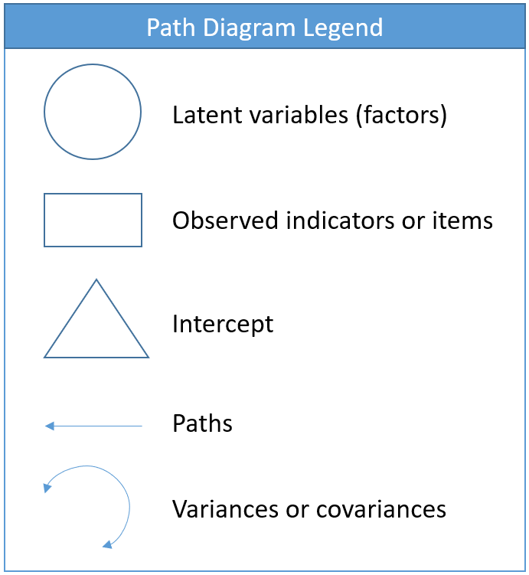
A path diagram can help us grasp our CFA model better because it provides a symbolic, one-to-one visualization of the measurement model and the implied covariance of the model. Before we present the actual path diagram, the table below defines the symbols we will use.

Slide 4
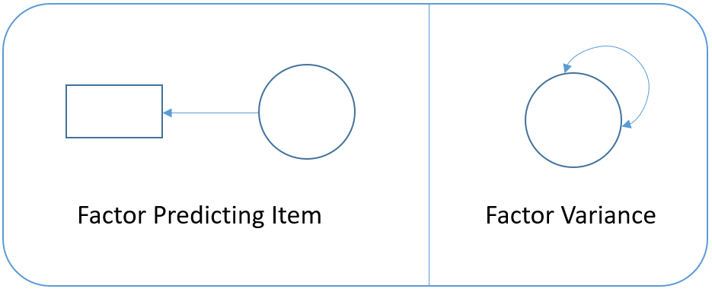
For example:

Slide 5
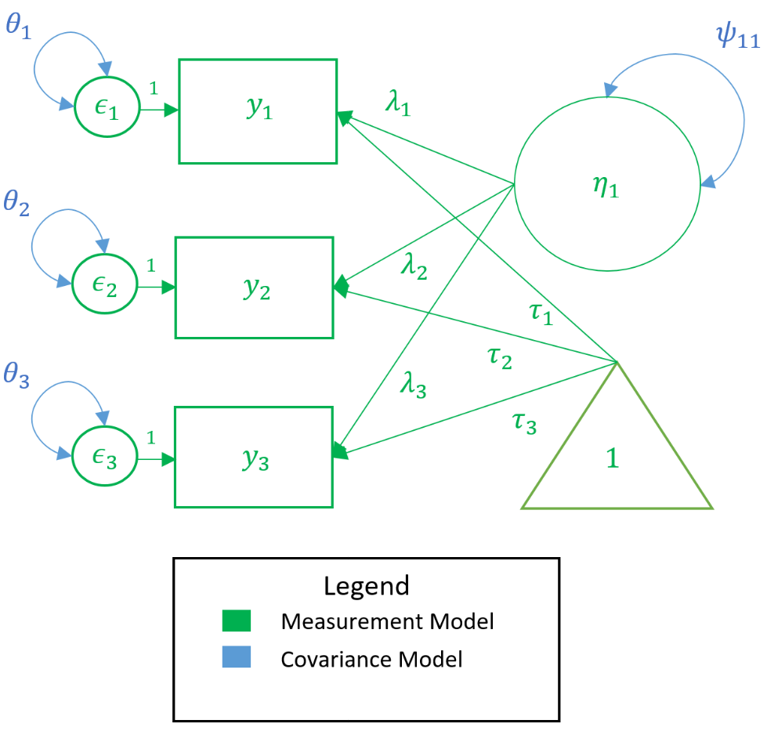
Or for example:

Slide 6
Before running our first factor analysis, let us introduce some of the most frequently used syntax in lavaan: ~ predict, used for regression of observed outcome to observed predictors =~ indicator, used for latent variable to observed indicator in factor analysis measurement models ~~ covariance ~1 intercept or mean (e.g., q01 ~ 1 estimates the mean of variable q01) 1* fixes parameter or loading to one NA* frees parameter or loading (useful to override default marker method) a* labels the parameter ‘a’, used for model constraints

Slide 7
The identification problem
The known values serve as the primary restriction in terms of how many total parameters we can estimate. For simplicity, let’s assume that the total number of parameters come only from the model-implied covariance matrix.
> round(cov(data[,3:5]),2)
The number of known parameters are p(p+1)/2

Slide 8
Number of free parameters = number of unique parameters – number of fixed parameters df = number of known parameters – number of free parameters
The identification problem
df negative, known < free (under-identified, bad)
df = 0, known = free (just identified or saturated, neither bad nor good)
df positive, known > free (over-identified, good)

Slide 9
The identification problem
lavaan WARNING: Could not compute standard errors! The information matrix could not be inverted. This may be a symptom that the model is not identified.
lavaan uses two methods to avoid this error:
marker method fixes the first loading of each factor to 1
variance standardization method fixes the variance of each factor to 1 but freely estimates all loadings.

Slide 10
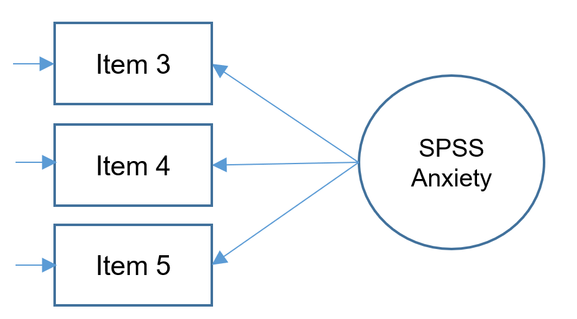
Three item (one) factor analysis Assume that the covariance among items is due to a single common factor.

Slide 11
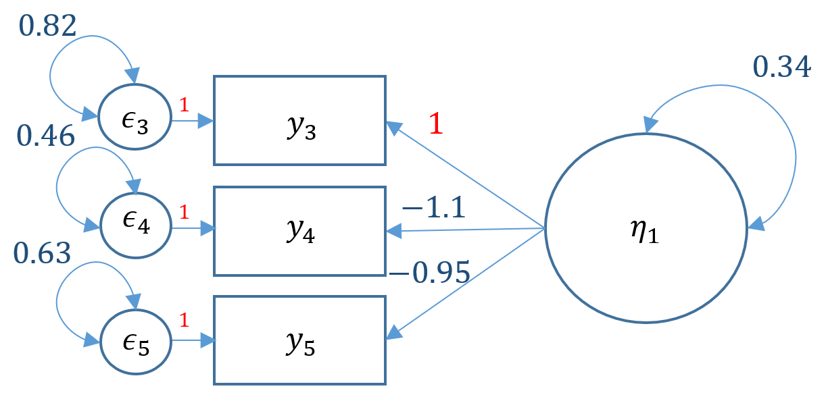
m1a <- ' f =~ q03 + q04 + q05' onefac3items_a <- cfa(m1a, data=dat) summary(onefac3items_a, standardized=TRUE)

Slide 12
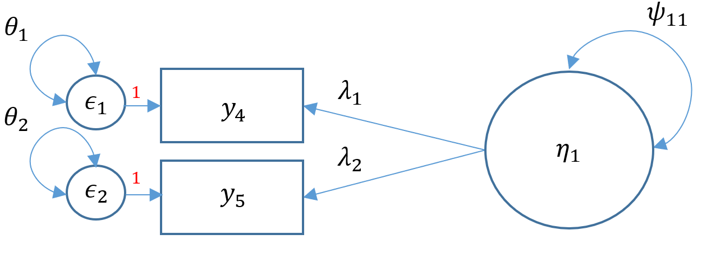
Two item (one) factor analysis

Slide 13
Two item (one) factor analysis
m2a <- 'f1 =~ q03 + q04’
onefac2items <- cfa(m2a, data=dat) summary(onefac2items)
<...output omitted ...>
lavaan WARNING:
Could not compute standard errors! The information matrix could not be inverted. This may be a symptom that the model is not identified.

Slide 14
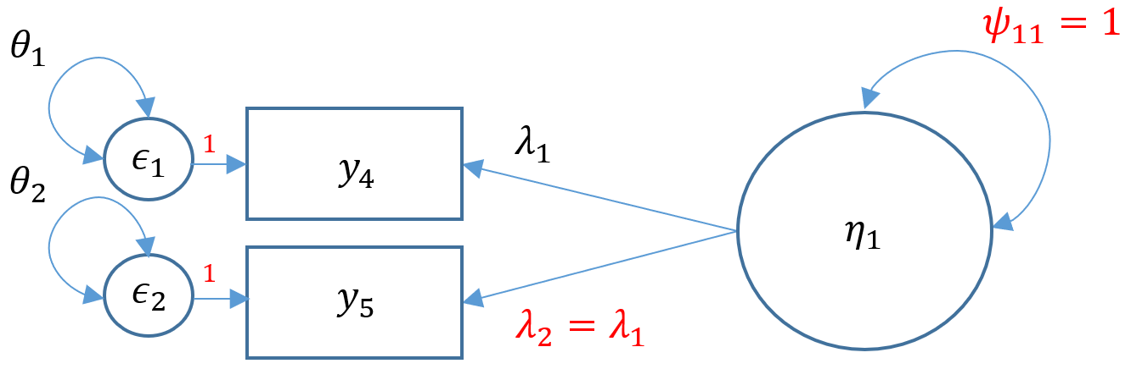
Two item (one) factor analysis

Slide 15
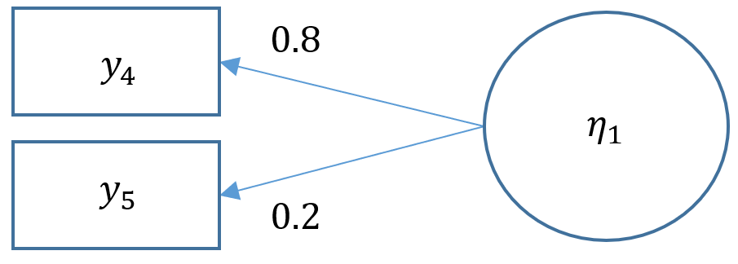
m2b <- 'f1 =~ a*q04 + a*q05’ onefac2items_b <- cfa(m2b, data=dat,std.lv=TRUE) summary(onefac2items_b)
The limitation of doing this is that there is no way to assess the fit of this model.
So if the real values were:
It is always better to fit a CFA with more than three items and assess the fit of the model unless cost or theoretical limitations prevent you from doing otherwise.

Slide 16
Model fit statistics
When fit measures are requested, lavaan outputs a plethora of statistics, but we will focus on the four commonly used ones:
Model chi-square is the chi-square statistic we obtain from the maximum likelihood statistic (in lavaan, this is known as the Test Statistic for the Model Test User Model)
CFI is the Comparative Fit Index – values can range between 0 and 1 (values greater than 0.90, conservatively 0.95 indicate good fit)
TLI Tucker Lewis Index which also ranges between 0 and 1 (if it’s greater than 1 it should be rounded to 1) with values greater than 0.90 indicating good fit. If the CFI and TLI are less than one, the CFI is always greater than the TLI.
RMSEA is the root mean square error of approximation
In lavaan, you also obtain a p-value of close fit, that the RMSEA < 0.05. If you reject the model, it means your model is not a close fitting model.

Slide 17
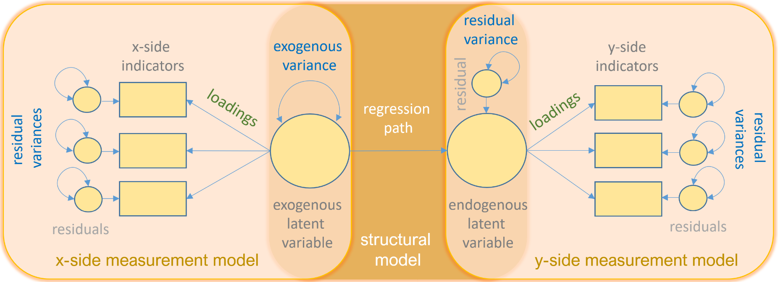
SEM models

