Slide 1
Data Deduplication Problem
Author: Amey Muley

Slide 2
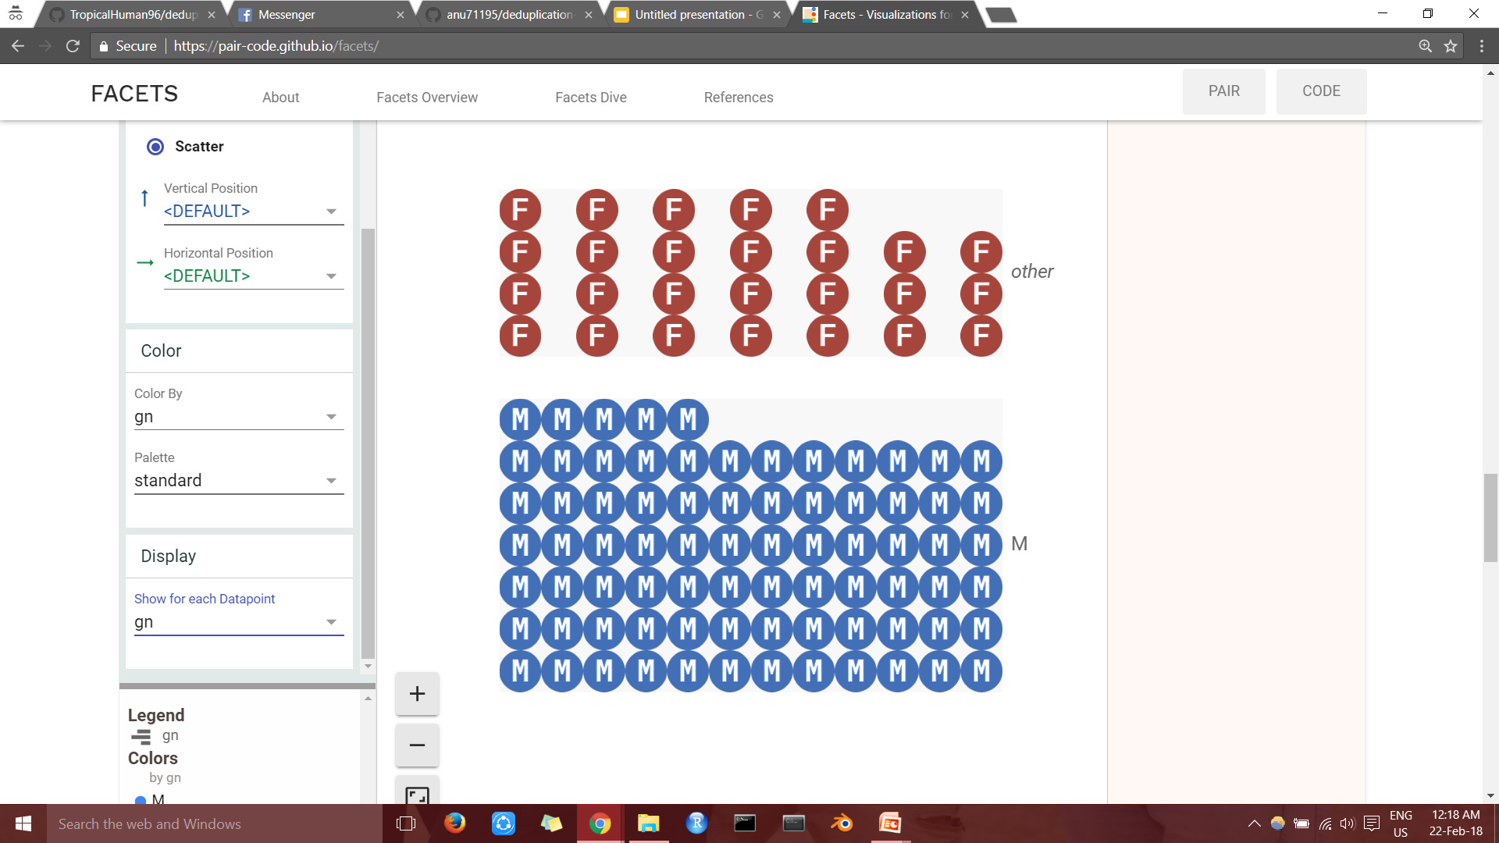
Data Visualization- gender classification
26 females and 77 males found in the dataset

Slide 3
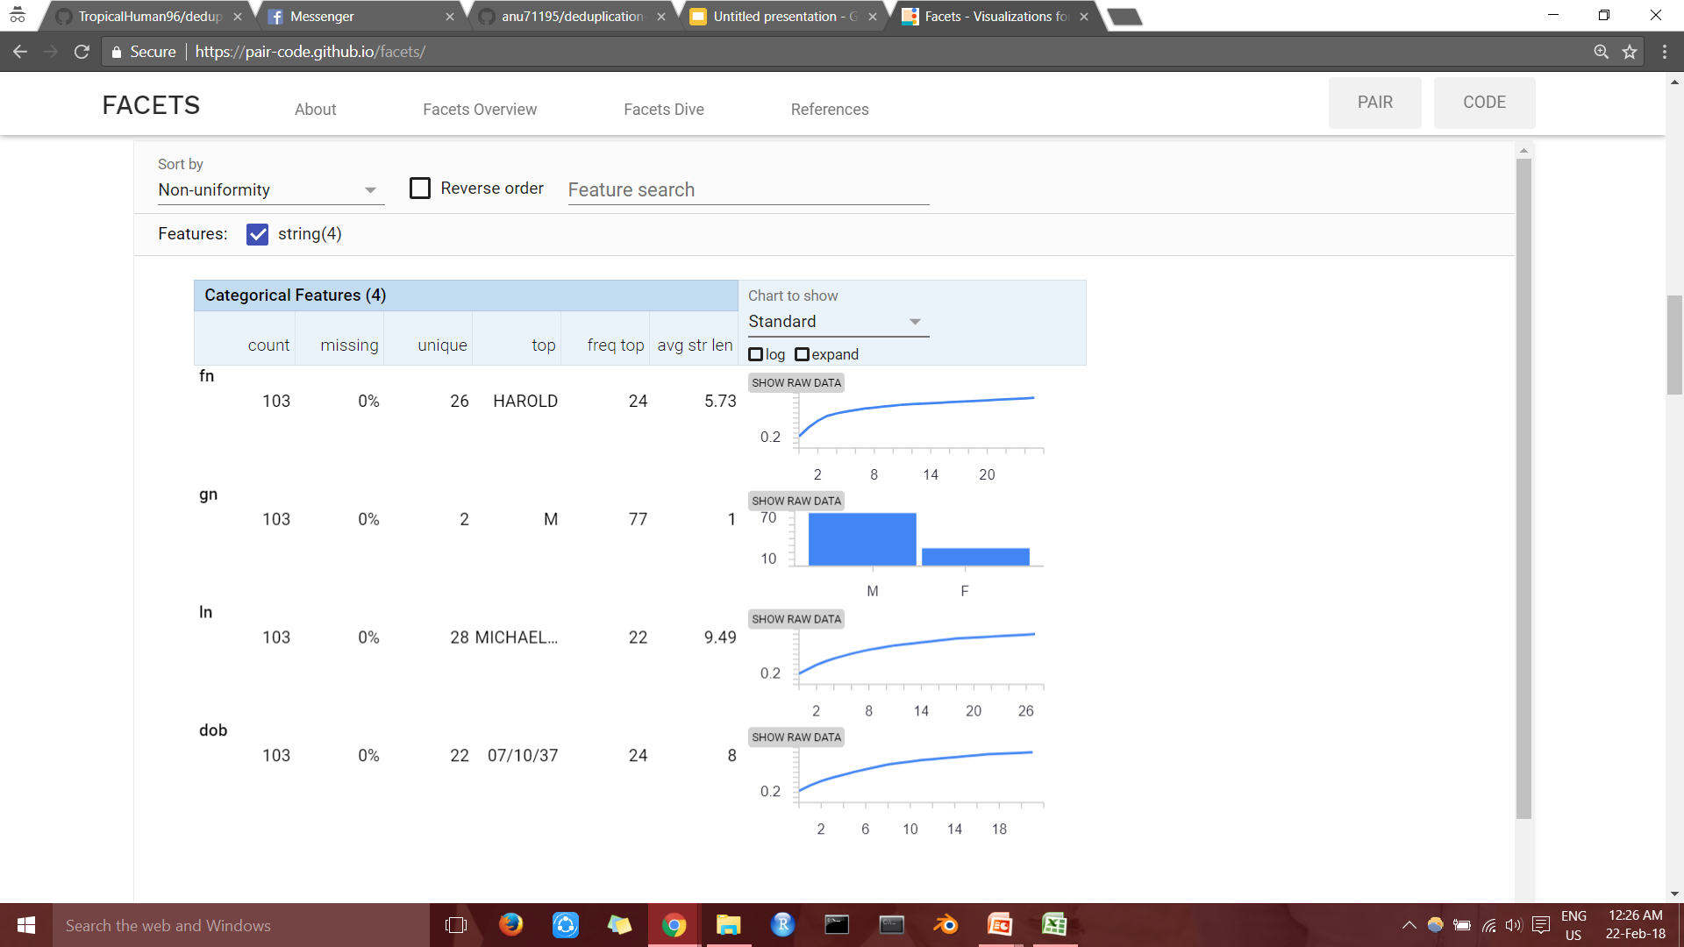
Data Visualization- Descriptive Statistics of the data

Slide 4
Approach to the problem
Fuzzy-wuzzy matching has been used for the cost calculation. It uses Levenshtein distance to calculate the differences between sequences in a simple-to-use package. “fuzz.ratio()” is used in the code which gives the percentage similarity between two strings.
The closeness of a match is often measured in terms of edit distance, which is the number of primitive operations necessary to convert the string into an exact match. Primitive operations are usually: insertion (to insert a new character at a given position), deletion (to delete a particular character) and substitution (to replace a character with a new one).

Slide 5
Training Data and Testing Data
The given sample data has been distributed into two datasets- training data and testing data. The training data file contains the data used to train the file. The training and the test data is further distributed into two dataframes as a part of the code- one containing the male patients and the other containing female patients, which reduces the time complexity of the code(as compared to when entire data as a whole is selected and run).
The testing data contains the same features as the training data and it is taken by the data_deduplication_code.py file which gives the output i.e. number of unique entries of the data.

Slide 6
extdata.py
This file contains all the required data which has been externally used by the data_deduplication_code.py file as parameters. The names of the training and the testing file has also been written in this file. The file names can be changed as per the convenience.

Slide 7
deduplication.py
This is the main code which contains the entire model for the procedure. The fuzzy-wuzzy string matching has been used for the calculation of costs, which helps us in calculating the percentage similarity and thus, the score. The male and female entries are separated in the beginning, and both the data frames are trained separately
The number of unique names in the training data and names of training file, input file and output file are imported from data.py file. The system is trained and a specific optimum threshold is calculated, which is further applied on the testing data.

