Slide 1
Zigbee, domotic and open source !

Slide 2
What will we see ?
Zigbee : what is it ?
Zigbee fundamentals
Our case : the « bulb issue »
Implementing our very own gateway : steps and feedback

Slide 3
What will we see ?
Zigbee : what is it ?
Zigbee fundamentals
Our case : the « bulb issue »
Implementing our very own gateway : steps and feedback

Slide 4

Zigbee : what is it ?
Radio protocol for IoT
Goals : simplicity, low cost and low energy, scalable
Specified by Zigbee Alliance
www.zigbee.org

Slide 5
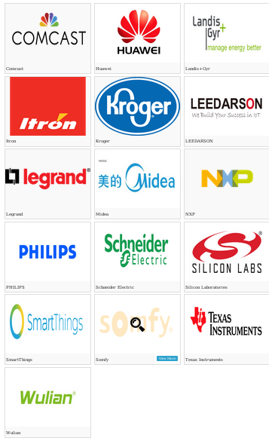
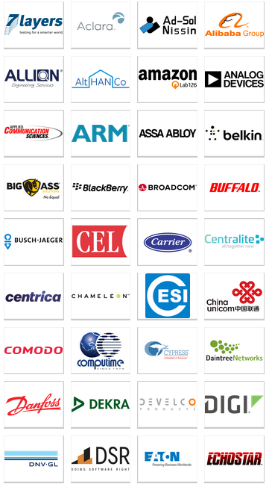

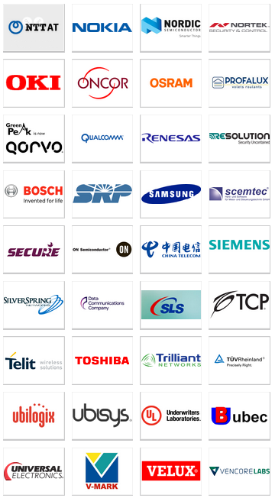

Zigbee : what is it ?
http://www.zigbee.org/zigbeealliance/our-members/
Notes:
Only promoters and partners shown, there are adpoters too
Red : promoters

Slide 6
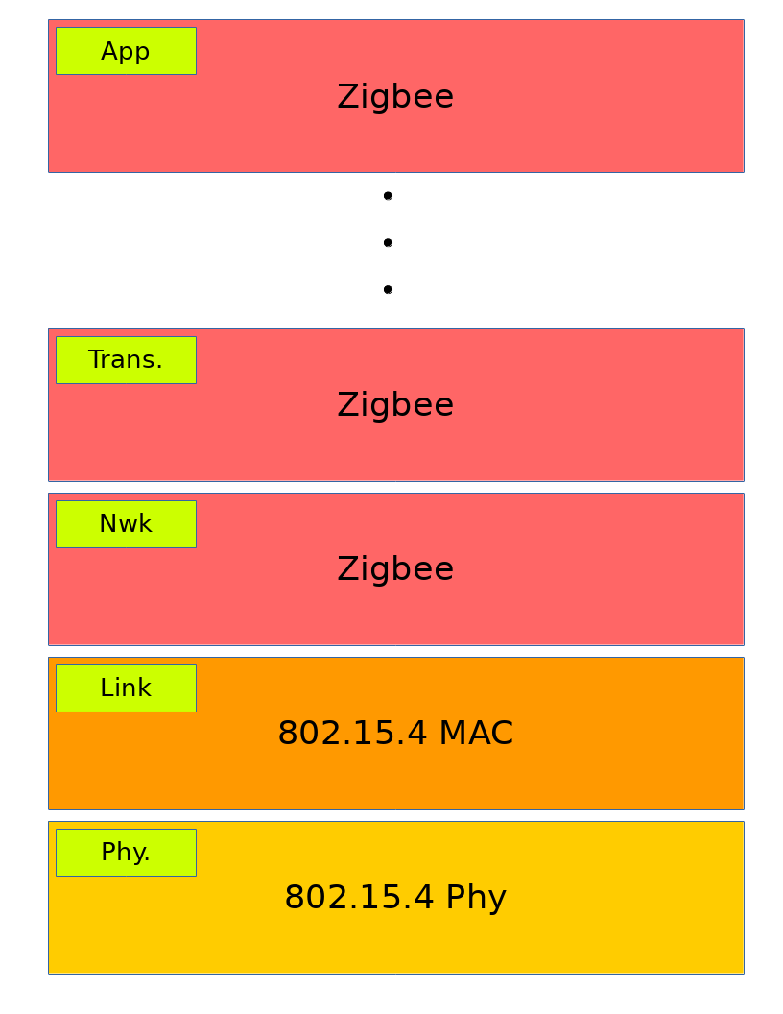
Zigbee : what is it ?
Notes:
Complete stack over 802.15.4

Slide 7
Zigbee stack details : AP

Slide 8
Sources
[1]

