Slide 1

Image/Video capture with V4L2
Meetup Linux Embarqué Toulouse, 05/12/2018

Slide 2

Who am I
Alexis Lothoré, embedded software engineer
  2016 to 2018 : Smile ECS, Toulouse
  2018 to now : Somfy Protect By Myfox, Toulouse
Main work fields :
  Complete linux firmwares for embedded systems
  Connected alarm systems : video streaming, connected systems, embedded security
https://github.com/Tropicao

Slide 3
Summary
What is V4L2
Using V4L2 for video capture : initialization, stream loop
Going further : encoding a raw image for image, for video

Slide 4




What is V4L2
A standardized kernel ↔ userspace API, started from kernel 2.1.X for v1, then dropped and replaced by v2 in v2.5.x
Originally supports various captures support (webcams, TV tuners, radio)
Now supports a large set of features : input/output for audio/video, tuners, modulators, extended user controls, M2M, etc.
This presentation focuses on video capture

Slide 5





Why should I use V4L2 ?
One code base to rull them all !
Can adapt to each platform at runtime (e.g. capabilities detection)
But : you need proper V4L2 support (kernel and drivers)

Slide 6
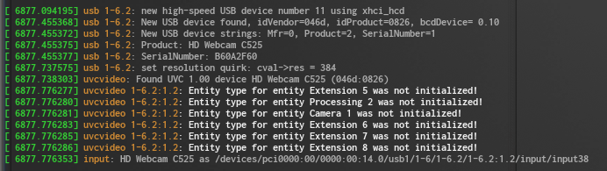
What do you need to begin
Obviously, a video capture device
A V4L2 capable linux-kernel
Proper V4L2 driver for used device

Slide 7
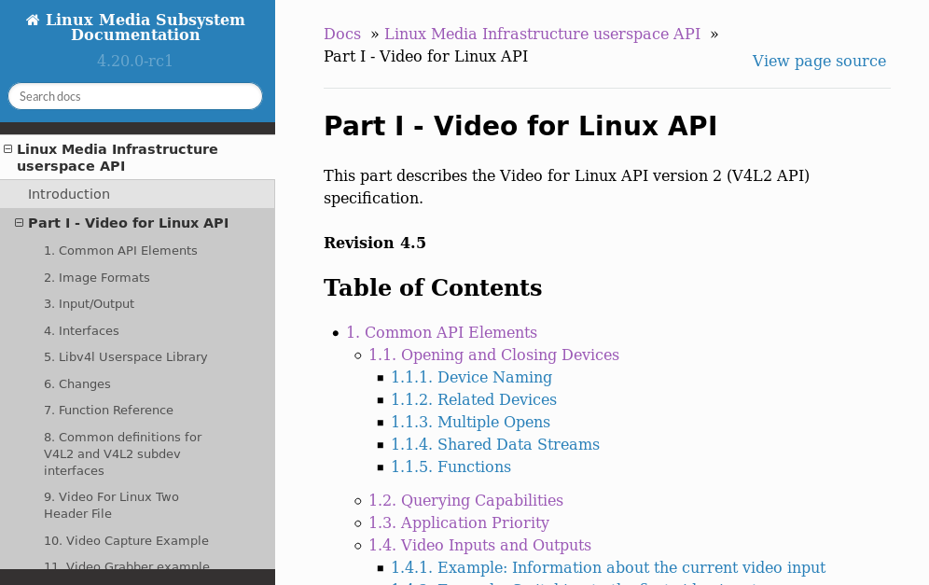
Your new friend : the official V4L2 doc
Can be used as an API documentation
Can be used as a guide
Userspace API, but also kernel API
The rest of the slides are heavily relying on this documentation
https://linuxtv.org/downloads/v4l-dvb-apis/uapi/v4l/v4l2.html

Slide 8
Discovering your device
struct v4l2_capability cap ;
dev_fd = open("/dev/video0", O_RDWR, 0) ;
if(ioctl(dev_fd, VIDIOC_QUERYCAP, &cap) == -1)
fprintf(stderr, "Cannot fetch devices capabilities") ;
if (!(cap.capabilities & V4L2_CAP_VIDEO_CAPTURE))
fprintf(stderr, "Selected device cannot capture video") ;

Slide 9
Configuring your device input
setting the application priority : VIDIOC_S_PRIORITY
querying / setting video input : VIDIOC_ENUMINPUT, VIDIOC_S_INPUT
querying / setting video standards : VIDIOC_ENUMSTD
cropping : VIDIOC_S_SELECTION
setting streaming parameters VIDIOC_S_PARM
and more...

Slide 10
User controls on image
A driver can expose many image controls (brightness, saturation, …)
We can enumerate and expose those controls : VIDIOC_QUERYCTRL, VIDIOC_QUERY_EXT_CTRL
Some controls can be menus : VIDIOC_QUERYMENU
/!\ VIDIOC_QUERY_EXT_CTRL added later, check if supported by your kernel/driver !

Slide 11
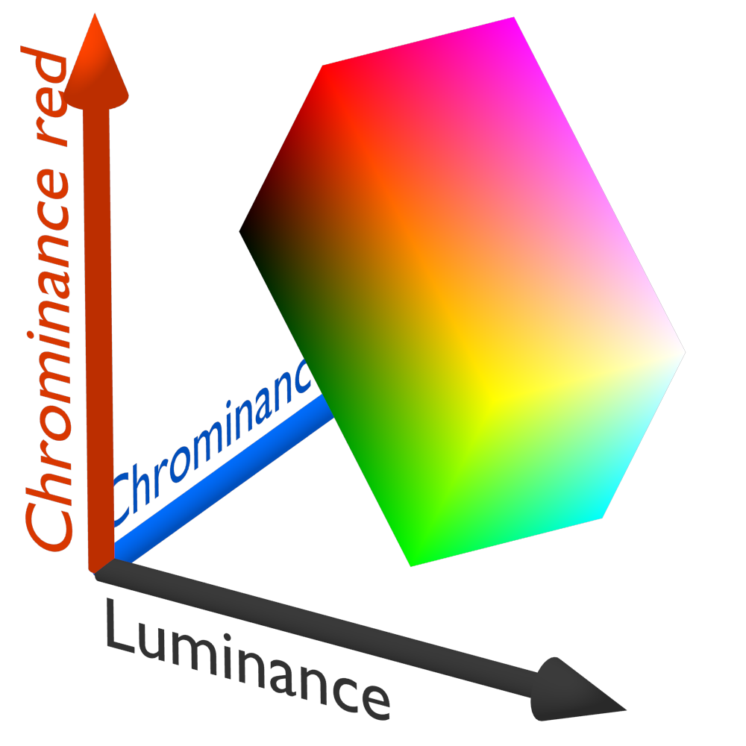

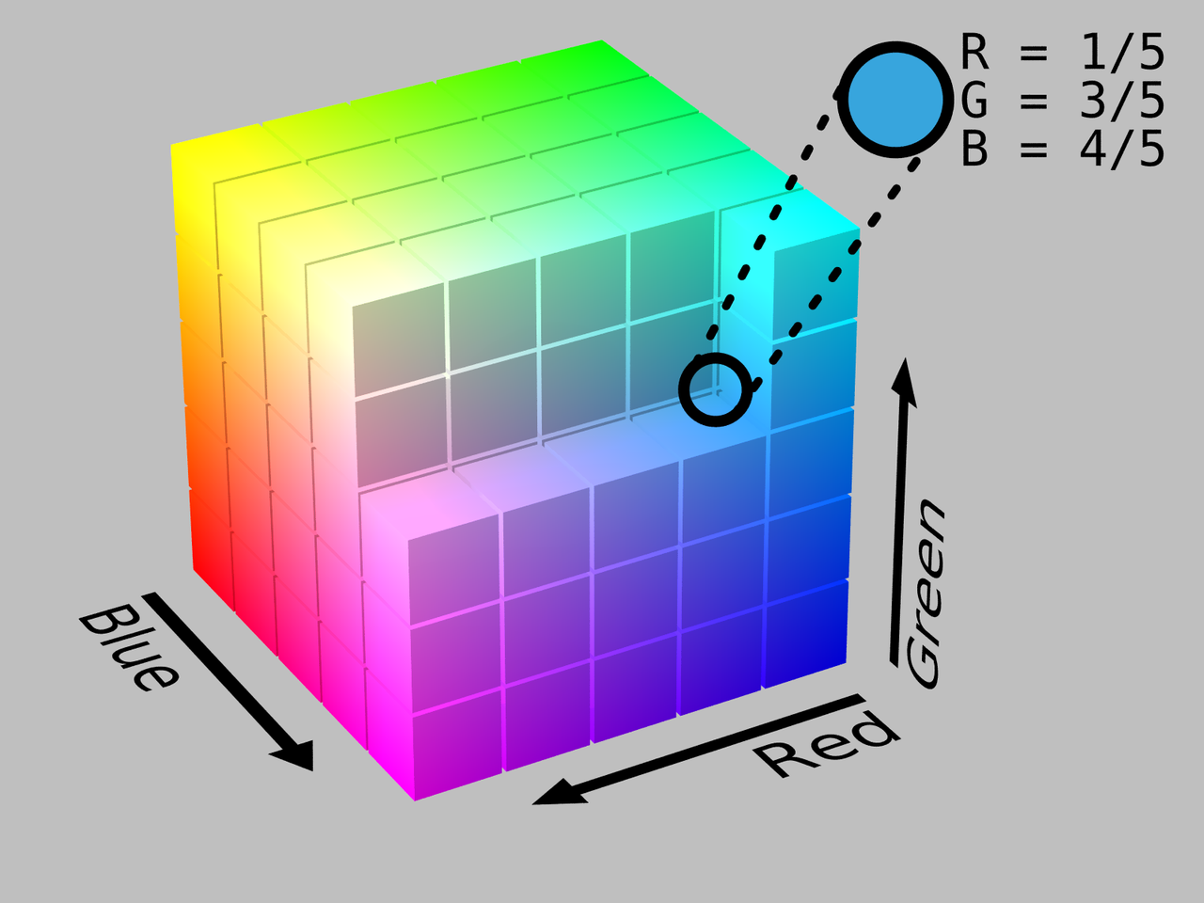
The pixel format : quick summary
Many different image formats are available, depends on drivers :
  different colorspaces : RGB, HSL, YCbCr…
  single plane or multi plane format
  indexed formats
  etc
Each format is represented with a FourCC code
RGB format
YCbCr format
HSL format

Slide 12
Image format example : Bayer RGB
FourCC code : ‘B’ ‘A’ ‘8’ ’1’
Raw frame size : width * height
Why more G than B and R ? Because human eye is more sensible to green !
B
G
B
G
B
G
B
G
...
...
G
R
G
R
G
R
G
R

Slide 13
Image format example : YUV422, or YUY2
FourCC code : ‘Y’ ‘U’ ‘Y’ ’V’
Raw frame size : width * height * 2
Why more Y than U and V ? Because most of the image information is in Luma !
Y
U
Y
V
Y
U
Y
V
...

Slide 14
Image format example : NV12, or YUV420SP
FourCC code : ‘N’ ‘V’ ‘1’ ’2’
Raw frame size : width * height * 3/2
Y
Y
Y
Y
Y
Y
Y
Y
U
V
Y
Y
Y
Y
Y
Y
Y
Y
Y
Y
Y
Y
Y
Y
Y
Y
Y
Y
Y
Y
U
V
U
V
U
V
Y
Y
Y
Y

Slide 15
Negotiating image format
Asking driver format capabilities : VIDIOC_ENUM_FMT
Each format as a unique code, represented with 4 letters : FourCC code
Selecting a format : VIDIOC_S_FMT
  fill the v4l2_format structure according to your needs
  format is not expressed the same way between APIs (single vs multiplanar)
  remember to check what the driver has really taken !

Slide 16
Choosing a capture method
Three way of retrieving raw frames :
  basic I/O : read/write directly from/to device (remember to check for device capabilities : V4L2_CAP_READWRITE !)
  streaming (needs V4L2_CAP_STREAMING !) :
    memory mapping : request, mmap, enqueue and dequeue buffers
    user pointers
    DMA buffers (to export data between devices)

Slide 17
Focusing on MMAP buffers
Allocate buffers on driver side( set number of buffers, and type V4L2_MEMORY_MMAP
For each buffer, query length and location
mmap the buffer
VIDIOC_REQBUFS
VIDIOC_QUERYBUF
VIDIOC_QUERYBUF
VIDIOC_QUERYBUF
mmap()
mmap()
mmap()
=> How many buffers do I need ???

Slide 18
The capture loop
VIDIOC_QBUF
VIDIOC_STREAMON
want frames ?
VIDIOC_DQBUF
process_buffer
VIDIOC_STREAMOFF
VIDIOC_QBUF

Slide 19
Using raw images in real world ?
Displaying raw images
http://www.rawpixels.net/
Encoding images :
we can pass raw RGB or YUV images to a JPEG encoder (software encoder, like jpeglib, or even a hardware JPEG encoder)

Slide 20
Exploiting raw frames for video
frame.aac
frame.raw
frame.h264
vid.mp4
Userspace
x264
libmp4v2
Kernel
V4L2
driver

Slide 21
Exploiting raw frames for video
frame.aac
frame.raw
frame.h264
vid.mp4
Userspace
libmp4v2
Kernel
V4L2
driver
Hardware
codec

Slide 22

Summary
( )
Let’s face it : it was quite fastidious, just to get images…
And we have just reinvented part of the wheel : see v4l2-ctl, v4l2ucp
see also : libv4lconvert, libv4l, libv4l2
libcamera, made to replace V4L2 ?
Notes:
ffmpeg -f video4linux2 -i /dev/video1 -vframes 1 test.jpeg

Slide 23
Summary
Having proper kernel support is sometimes a big assumption
Unimplemented ioctls ?
Unexpected behavior ?
But we have a generic code which can run on multiple platforms !
We have only discussed a very little part of the framework !

Slide 24
Sources
https://fr.wikipedia.org/wiki/Video4Linux
http://www.latelierducable.com/tv-televiseur/yuv-420-ycbcr-422-rgb-444-cest-quoi-le-chroma-subsampling/
https://linuxtv.org/downloads/v4l-dvb-apis/uapi/v4l/v4l2.html
http://linuxgizmos.com/libcamera-successor-to-v4l2-hopes-to-ease-embedded-linux-camera-headaches/

