Slide 1
Music Genres Classification
Di Feng Yaoyu He Peijun Xu

Slide 2
catalogue
1. Problem Settings
2. Previous Method
3. Feature Extraction
4. Convolution Network Structures
5. Temporal Result
6. Approvement

Slide 3
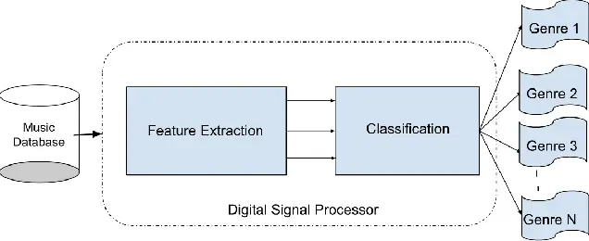
Problem Settings
Genre classification plays a crucial role in music recommendation systems and we aim to design a network that, by extracting certain features of a song, categorizes the song into its respective genre.

Slide 4
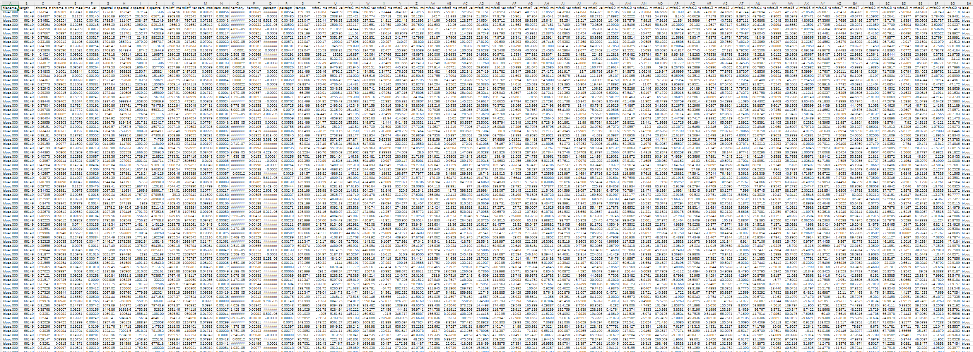
Previous Method
KNN
Multiple graphs…

Slide 5
Previous Method
Weaknesses:
1.Limitations of the KNN Algorithm: KNN struggles with large datasets or tasks that require capturing complex patterns. It is also sensitive to high dimensional data, which can lead to the curse of dimensionality.
2.Performance and Efficiency Issues: KNN needs to compute the distance between the test sample and all training samples for classification, which can be time-consuming for large datasets.
3.Lack of Model Representation Power: Compared to deep learning models, KNN has weaker capabilities in representing complex patterns and relationships.

Slide 6
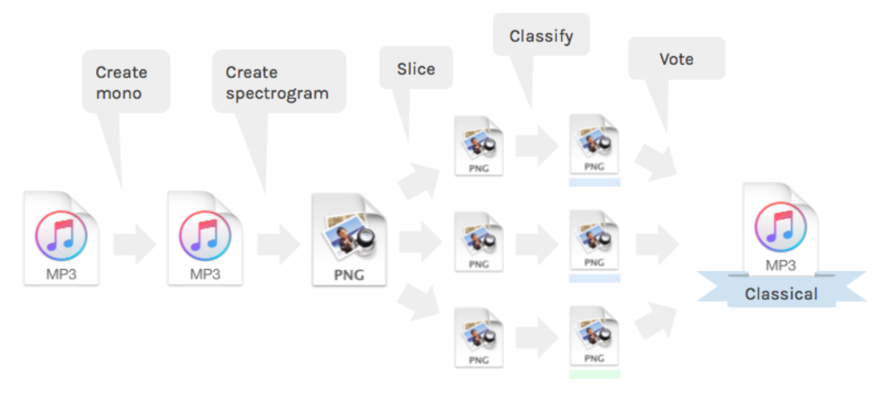
Previous Method
The way to CNN:
A project on github: DeepAudioClassification
However

Slide 7
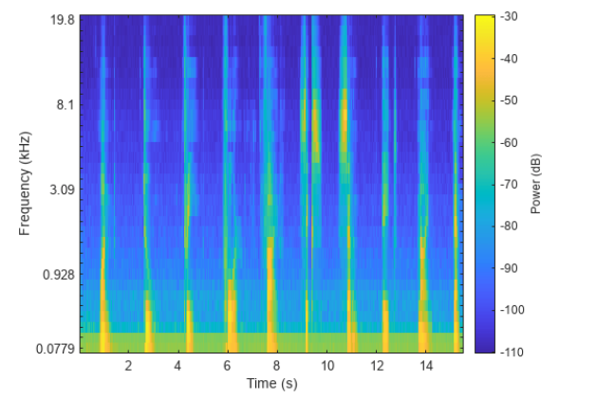

Feature Extraction
1. Mel Spectrogram
This feature represents the power spectrum of a sound, mapped onto the Mel scale, which is a perceptual scale of pitches judged by listeners to be equal in distance from one another.
A classic formula to convert f hertz into m mels
Mel Spectrogram

Slide 8
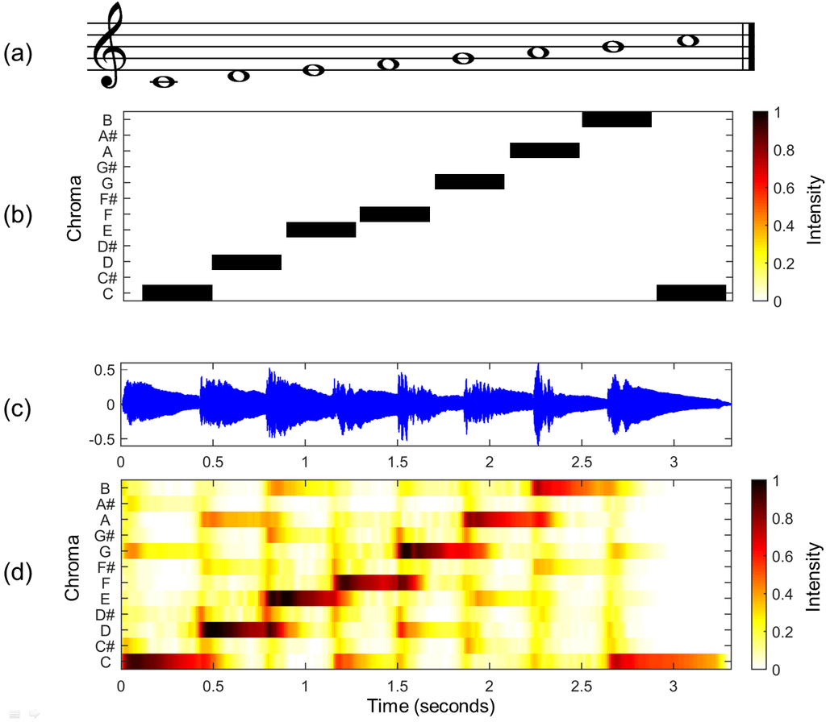
Feature Extraction
2. Chroma Features
Chroma features represent the energy content of a signal in each of the 12 different pitch classes. They capture the harmonic and melodic characteristics of music, making them particularly useful for tasks like chord detection and music similarity.
(a) Musical score of a C-major scale.
(b) Chromagram obtained from the score.
(c) Visual representation (Sonogram) of an audio recording of the C-major scale played on a piano.
(d) Chromagram obtained from the audio recording.

Slide 9
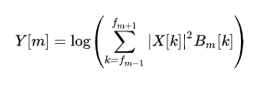

Feature Extraction
3. MFCC (Mel Frequency Cepstral Coefficients)
MFCCs are coefficients that collectively make up an MFC (Mel-Frequency Cepstrum).
MFCCs are highly used in voice recognition and other audio-related fields because they efficiently represent the shape of the sound's spectral envelope.
Formula to convert MFCC

Slide 10
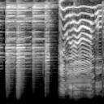
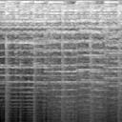
Convolution Network Structures
The Mel Spectrograms，Chroma Features and MFCCs exhibit distinct variations across different types of music in details.
Not enough kernels: Can’t sufficiently extract usable features.
Too many kernels: Extract worthless features(noise).
Blues
Country

Slide 11
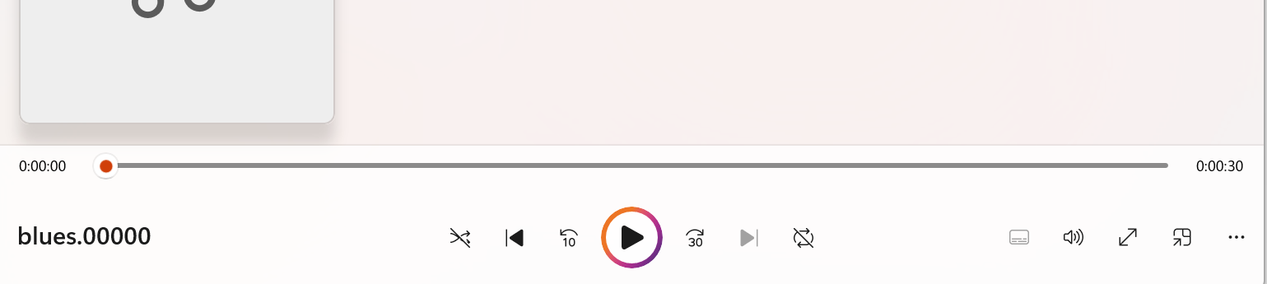
Convolution Network Structures
- Input:
A thirty-second audio file.
- Output:
The class of the music.
- Preprocessing:
1.Mel Spectrogram
2.Chroma Features
3.MFCC

Slide 12
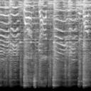
Convolution Network Structures
Mel
Chroma
Mfcc

Slide 13
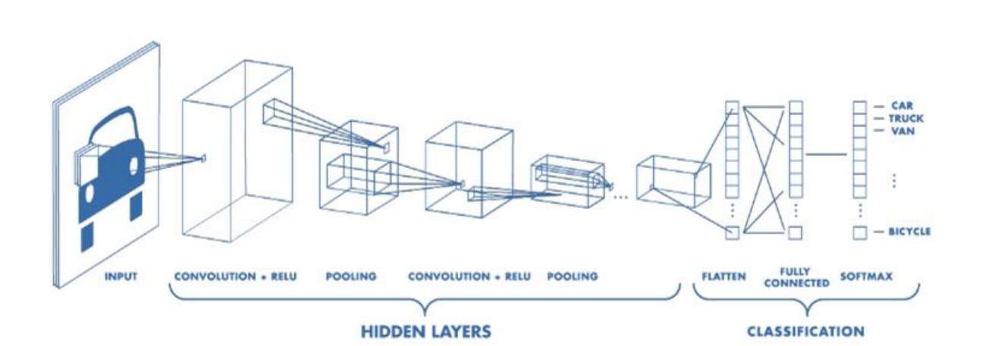
Convolution Network Structures
Similar to traditional CNN…
Stolen from course ppts

Slide 14
Temporal Result
Accuracy: 73%
All the pop music are correctly classified.
About 40% other music* are classified to pop musics.
Because of the diversity of the spectrum in pop music.
*Based on popular music players(Apple Music, QQ Music...)

Slide 15
Approvement
1. PCA (Principal component analysis)
The Chroma feature vector is 12-dimensional, the Mel feature vector is 128-dimensional, and for the MFCC, we only take the first five dimensions.
Therefore, we hope to try performing PCA (Principal Component Analysis) dimensionality reduction on the Mel and Chroma vectors.
2.Data Augmentation:
Adding Background Noise
Echo and Reverberation Effects
Random Cropping and Padding

Slide 16
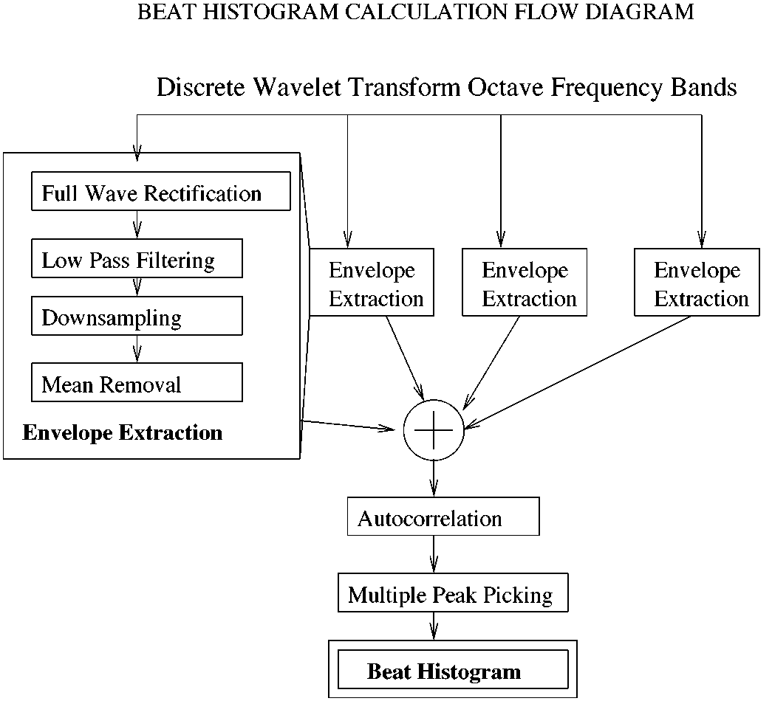




Approvement
3. Beat Historgram
Full Wave Recitification:
Low Pass Filtering:
Downsampling:
Mean Removal:
Autocorrelation:

Slide 17
Thanks

