Slide 1
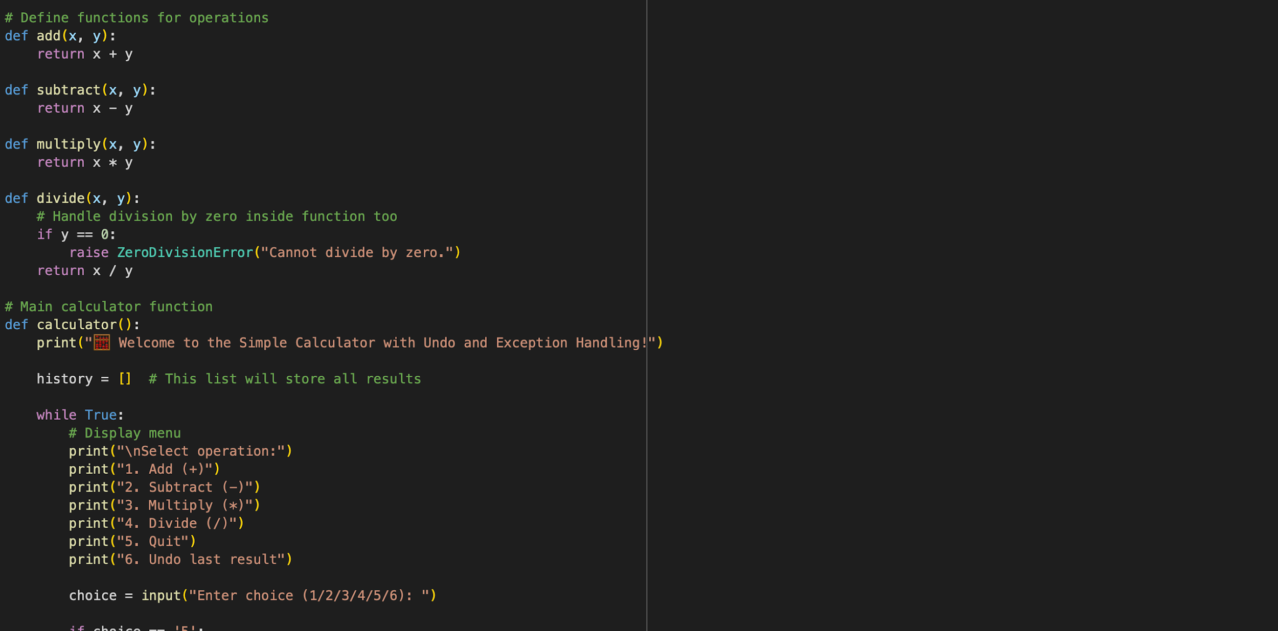
calculator
By: Aiden white

Slide 2

overview
Python calculator for +, −, ×, ÷
Includes Undo feature and error handling
Uses functions, lists, and control structures
This line creates a list called history, which stores all the results of previous calculations and allows the Undo feature to remove the last result.

Slide 3
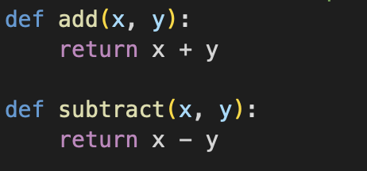
Why is it Useful?
Real-world Python example
Practices functions lists, if/else, loop
Simple, interactive expandable
These are functions that perform addition and subtraction. Functions make the code reusable, and they clearly separate each operation.

Slide 4
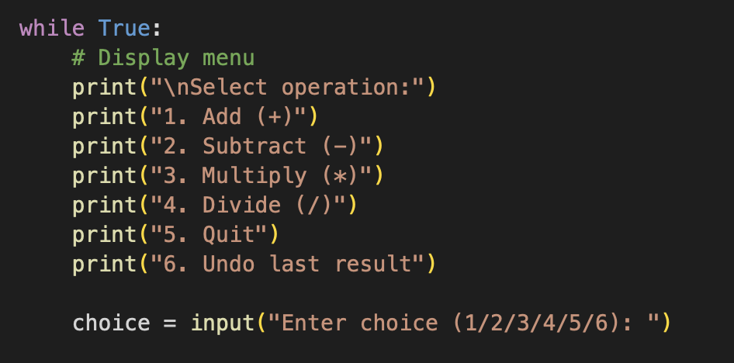
How it Works
User selects operation from menu
Enters 2 numbers
Result is stored in history
Undo removes last result
Errors handled with try/except
This is the main menu shown to the user in a while loop. The loop keeps the program running until the user chooses Exit.

Slide 5
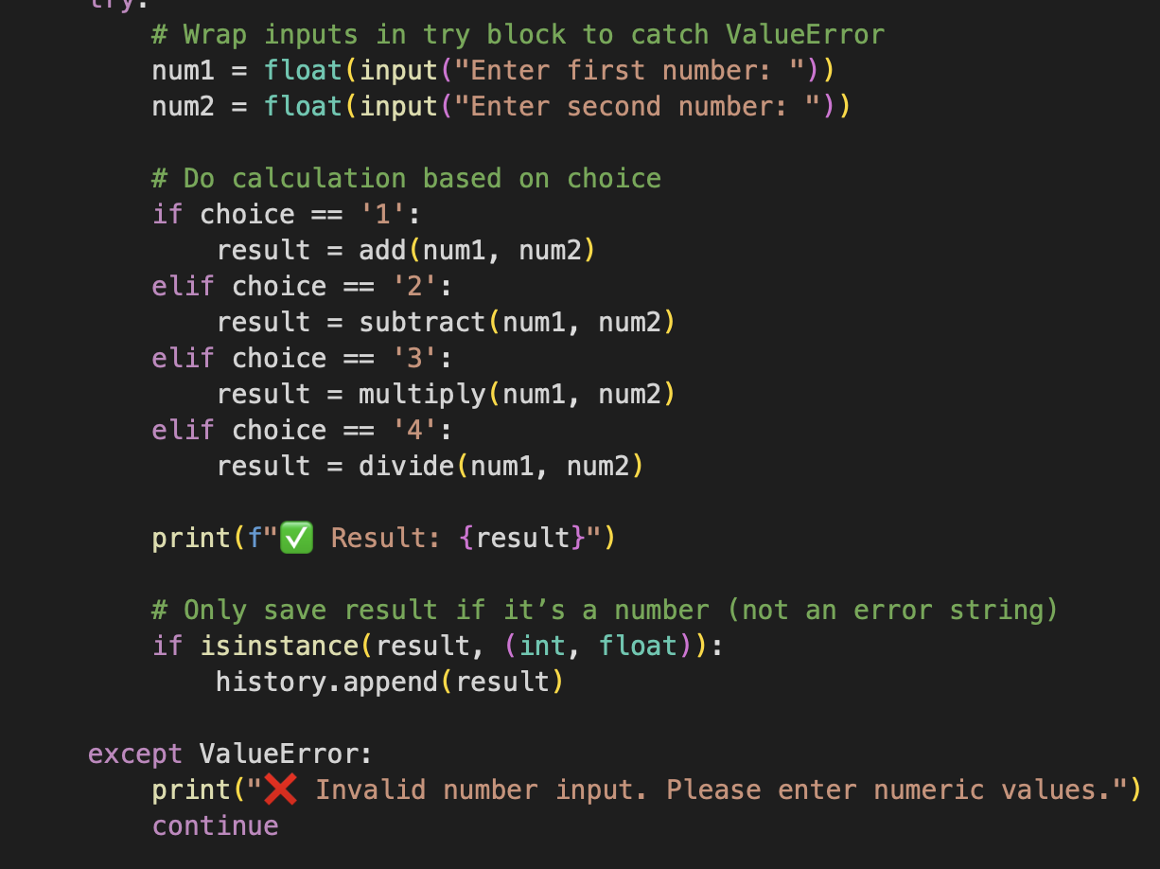
Key features
Functions for operations
List to store history
Loop + if/else for control
Exception handling for safe input
This code shows the logic of the calculator. The program takes two user inputs, performs the chosen calculation using functions, and prints the result. If the result is valid, it is stored in the history list for possible undoing later.

Slide 6
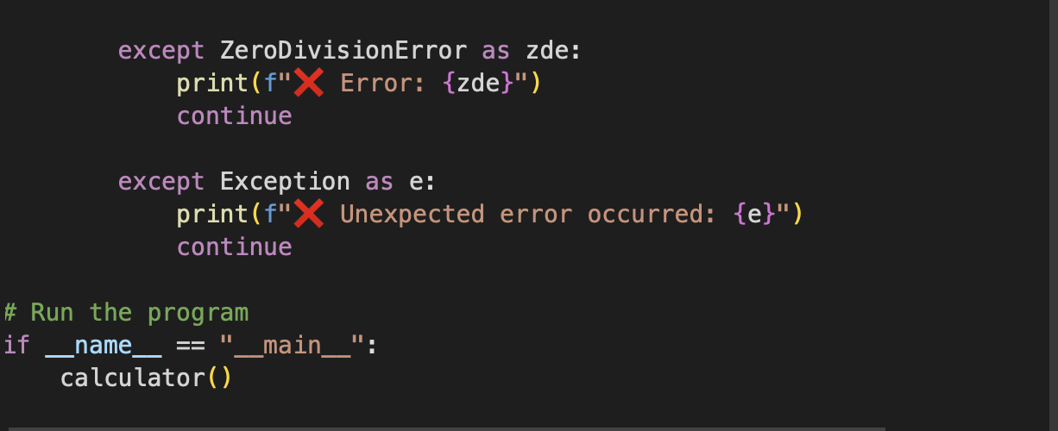
conclusion
Fully working calculator with Undo
Clear, functional code
Used functions, lists, loops, error handling
Learned skills for larger projects
This part of the code show the division by zero error when the user attempts to divide any number by zero

