Slide 1
Fan-map of potential NBA rookies
Team B
Junming Zhang
Yixuan Xu
Zenze Zeng
Ying Luo
Yinghan Peng

Slide 2
01
Collect data
Collect the technical statistics of NBA players
First season statistics of rookies from 2004~2016
Full statistics of all players from 2000~2017
Use Twitter API to collect data of followers
Twitter ID
Location

Slide 3
02
Process Data
01
Analyze the format of location information
02
Use pandas to clean the data
Generate a state file to select America’s states and cities
Generate a country file to select the country

Slide 4
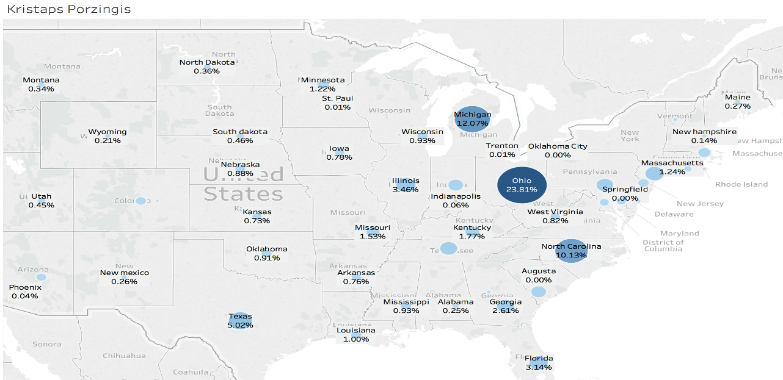
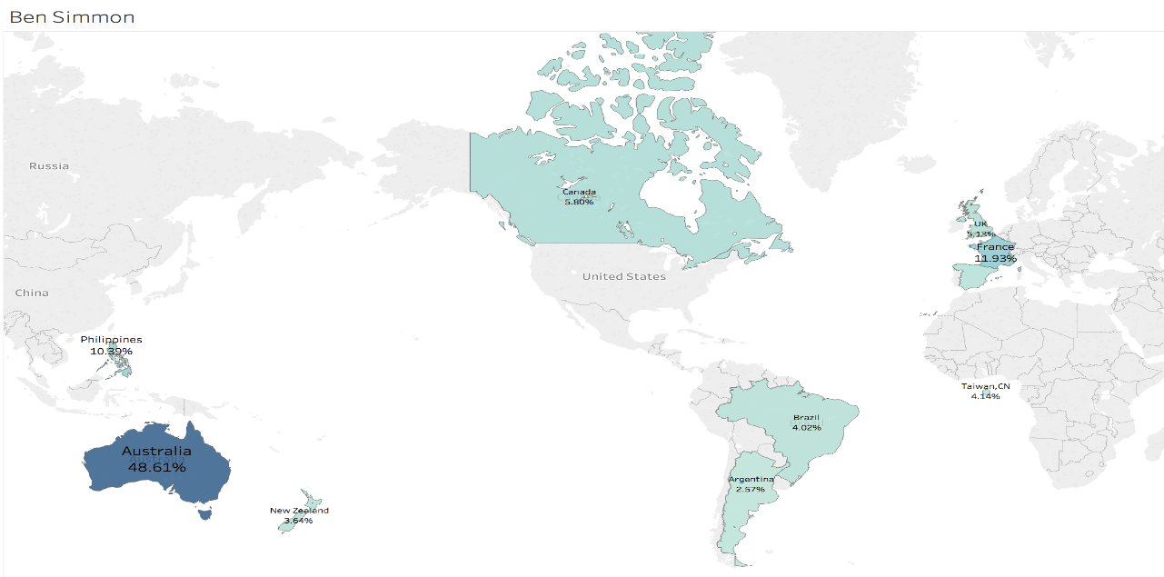
03
Plot data
Tableau
American State & city map
Import longitude and latitude
Country map(Except America)

Slide 5
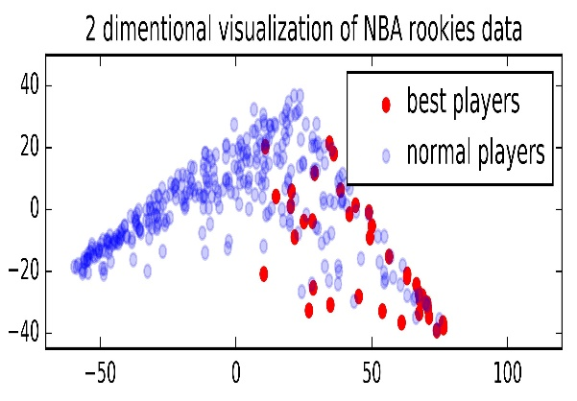
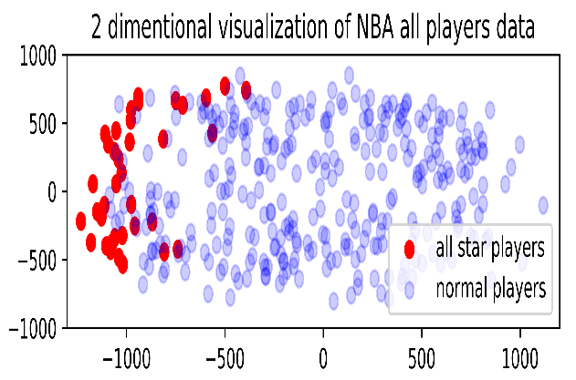
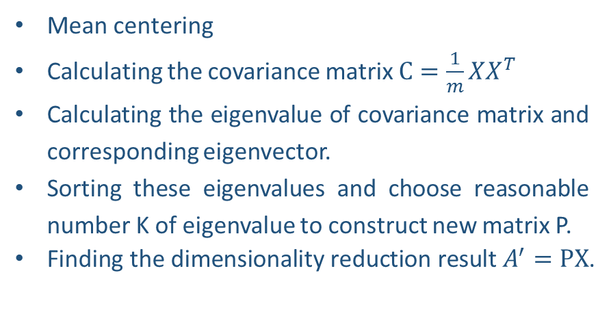
04
Prediction
STEP 01
Principal components analysis
Mean centering
Calculating the covariance matrix $C=\frac{1}{m}XX^{T}$
Calculating the eigenvalue of covariance matrix and corresponding eigenvector.
Sorting these eigenvalues and choose reasonable number K of eigenvalue to construct new matrix P.
Finding the dimensionality reduction result $A^{′}=PX$.

Slide 6
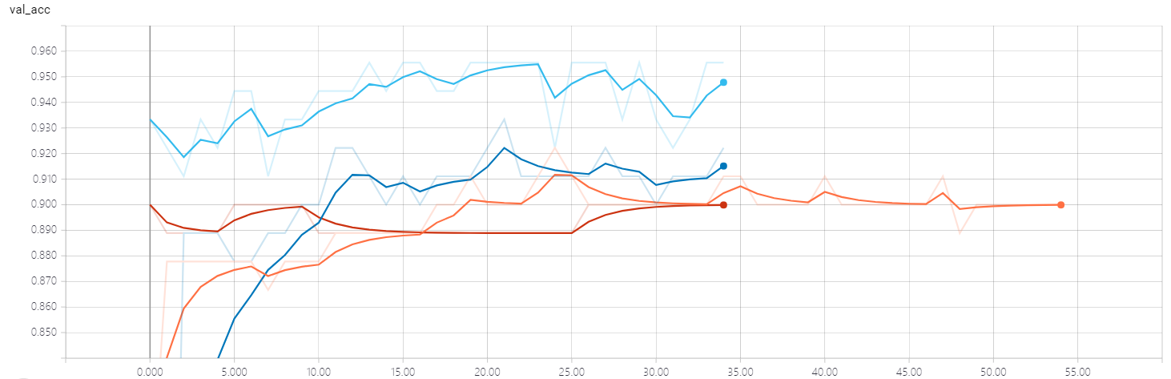
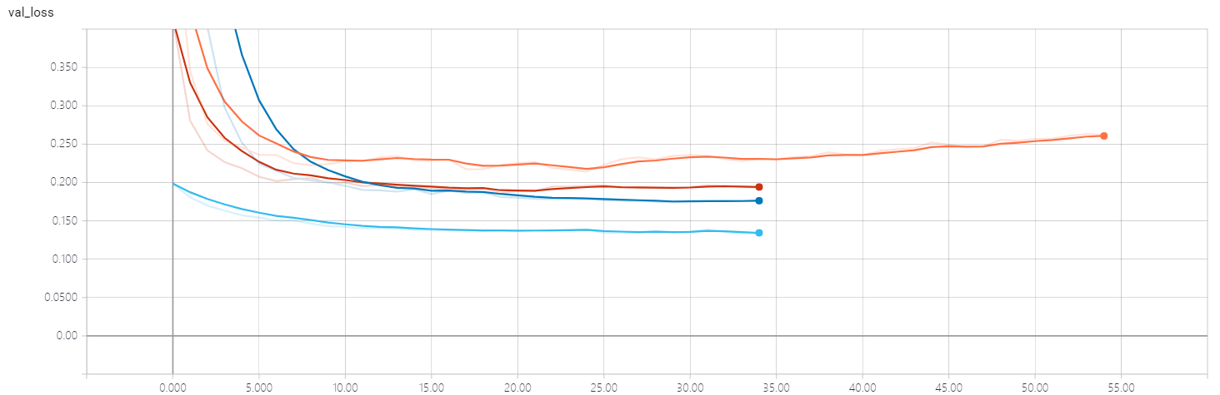
04
Prediction
STEP 02
Neural network building
Keras is a high-level neural networks API with TensorFlow as backend, it provides a convenient frame to build and run neural networks.
The Sequential model API
Neural network structure:
1. Input layer
2. Dense choose
3. Activate function choose
4. Dropout choose
5. Compile: loss, optimizer and metrics choose
6. Validation, epochs and batch size choose
Shuffle training dataset
Recode the training result by tensorboard

Slide 7
05
Result
The list of players the model predicts
2015-2017 NBA Rookie Players All-Star List
2015 | Karl-Anthony Towns | Kristaps Porzingis | Willie Trill Cauley-Stein
2016 | None
>>
2017-2018 NBA Rookie Team
Ben Simmon | Donovan Mitchell | Dennis Cliff Smith | Lauri Markkanen
Lonzo Balle | Jayson Christopher Tatum | Dillon Brooks
>>

Slide 8
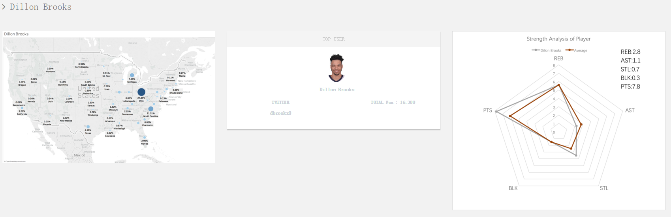
06
Data visualization
Web application

Slide 9
THANKS

