Slide 1

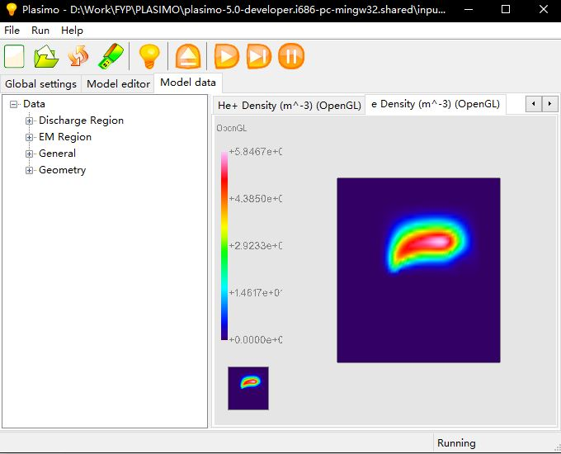
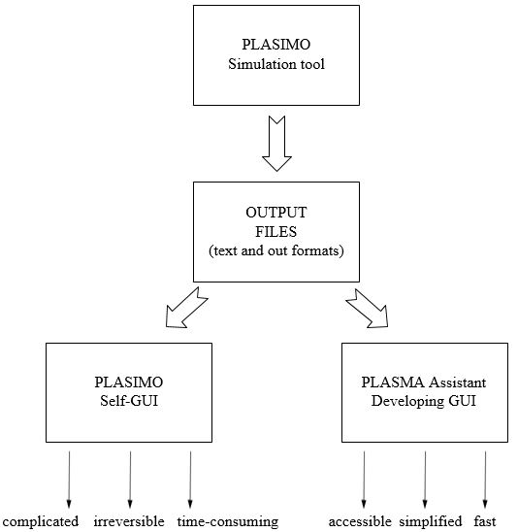
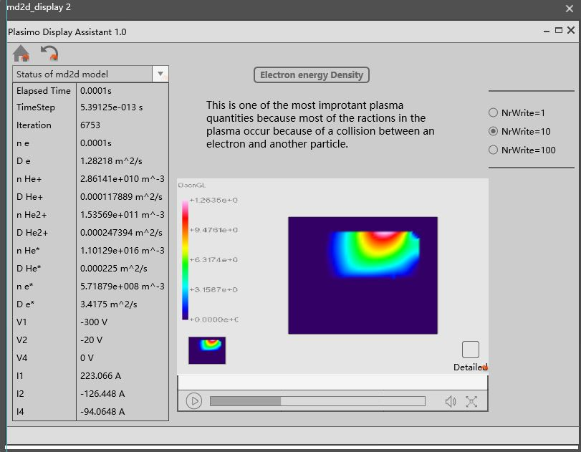
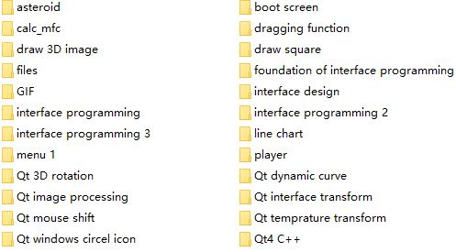
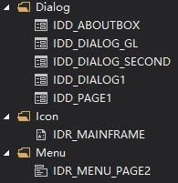
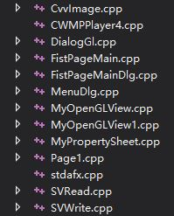
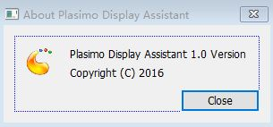
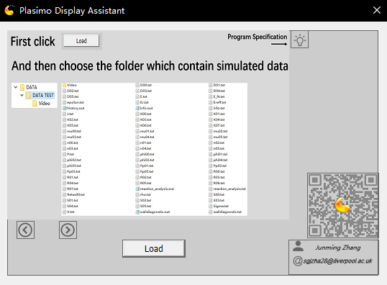
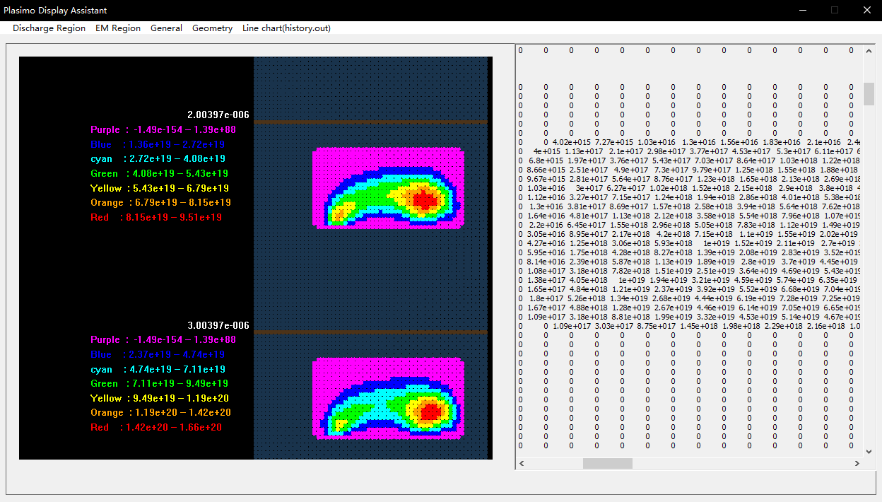
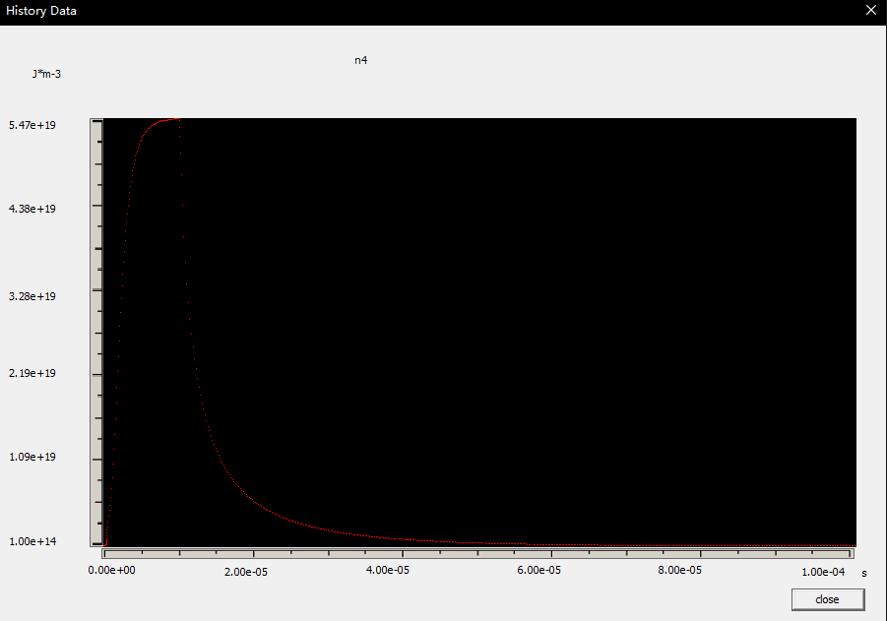
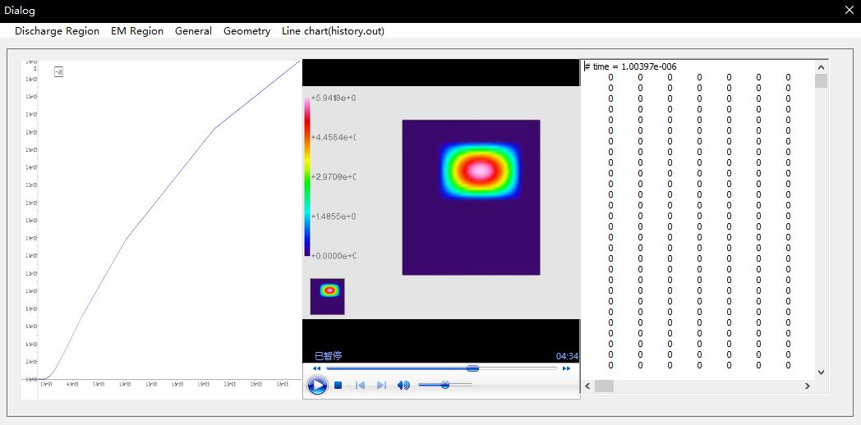
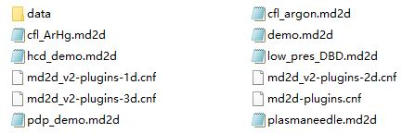
Development of a C++-based user-interface for a plasma simulation tool
Junming Zhang
Band F
Supervisor: Dr Mark Bowden
Assessor: Dr Kirsty McKay
Introduction
Methodology
Plasimo
Prototype Design
Learning OpenGL and MFC
Programming
The Plasimo code is a toolbox that provides support for the numerical simulation of plasma sources of various degrees of equilibrium.
Tool: Mockplus
Tool: Visual Studio 2015
Tool: Visual Studio 2015
Prototype Design is the critical first step because it helps me to understand the real requirement of users.
And then repeating amend design to get better understand of this project.
As an EEE student, the foundation of C++ already learned in year 1. However, this project needs more knowledge especially using MFC and OpenGL to build and generate the program.
Step 1: Build home page and operation dialog
Step 2: Match properties and text files
Step 3: Read and display data in text files
Step 4: Draw 2D graph and line chart based on data
Objective
The aim of this project is to develop a user-friendly interface that effectively displays the simulation output from Plasimo.
Result
Experience
Software name:
Plasimo Display Assistant
Home page
2D image and Data display
Line chart
This project has an abandoned version which is using video and image to show the output data from Plasimo.
The Second version is not perfect either.
The running speed will slow down with the increasing number of data and there are not an effective way to locate particular time.
Quick instruction
Open user guide
Open Google Blog
Contact information.
All data in one period will be divide into 7 parts and represented by 7 different colors.
Data in history.out will be used to generate line chart as a function of time to help users to do research
Operating environment:
Only for Windows users
It’s inapplicable because it needs lots of time to record videos.
Supported Format:
Only for micro discharge 2D model in Plasimo
Keep learning to solve unfamiliar problems are the big challenge but also the most exciting thing in the project.

