Slide 1
PLASIMO DISPLAY ASSISTANT
Junming Zhang
Supervisor: Dr Mark Bowden
Assessor: Dr Kirsty McKay

Slide 2


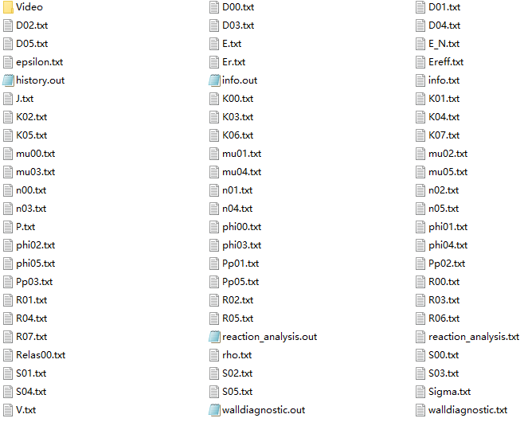
First click
Program Specification
And then choose the folder which contain simulated data

Slide 3
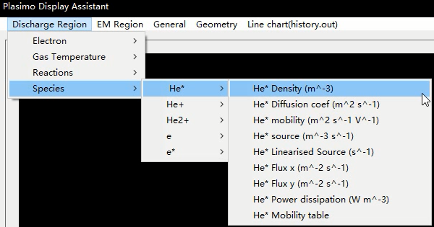
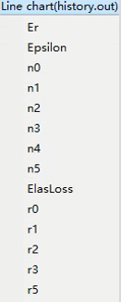
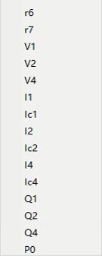
Program Specification
Now, you can check
different properties of plasma
Observe the line chart
generated by history.out
If there are any misunderstanding, please click
for more instruction

