Slide 1

Body Fat Prediction STAT 628, Module 2
Group 3: zheng ni, jingpeng weizhou, zifeng wang, Ke chen
Date: oct 10, 2019

Slide 2
Outline
Introduction
Data Preprocessing
Model selection
Model diagnostics
Conclusion

Slide 3




Introduction
Background (Body Fat Percentage)
A crucial index for describing health condition
Previous calculation methods are costly
Goal
To provide a simple and accurate rule-of-thumb method
To provide a model only require available clinical data (costless measurement)

Slide 4
Introduction
Data Overview
252 men’s clinical measurement data
Available features
AGE | WEIGHT | HEIGHT | ADIPOSITY | NECK | CHEST | ABDOMEN | HIP | THIHG | KNEE | ANKLE | BICEPS | FOREARM | WRIST
years | lbs | inches | bmi | cm | cm | cm | cm | cm | cm | cm | cm | cm | cm

Slide 5
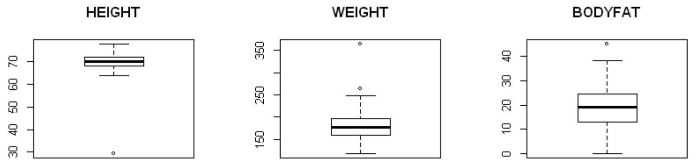
Data Preprocessing
Outliers Detection
Boxplot
Graph1: Examples of Boxplots

Slide 6
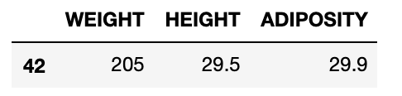
Data Preprocessing
For Measurement Error
Impute by BMI function (BMI = WEIGHT/(HEIGHT^2) * 703)
e.g. The height of No.42 is too short while the other measurement data seem normal → Inverse BMI: Height = (Weight/703*BMI)^{0.5}
Impute by regression method
Build a regression model for wrist first (Wrist~Ankle+Knee+Age)
Impute the value for the outlier
For Extreme value (not due to measurement error)
Drop these records (39, 41, 216)

Slide 7
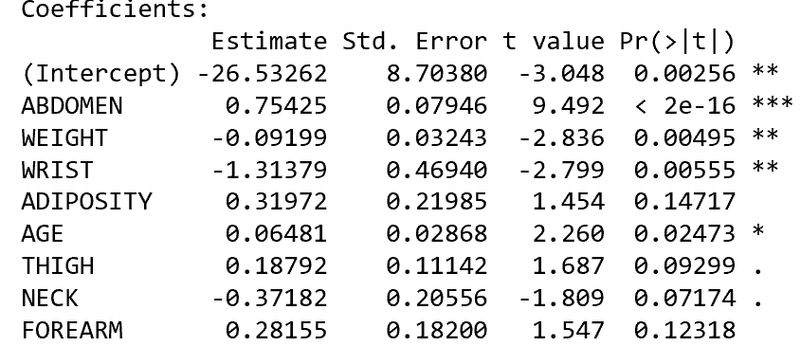
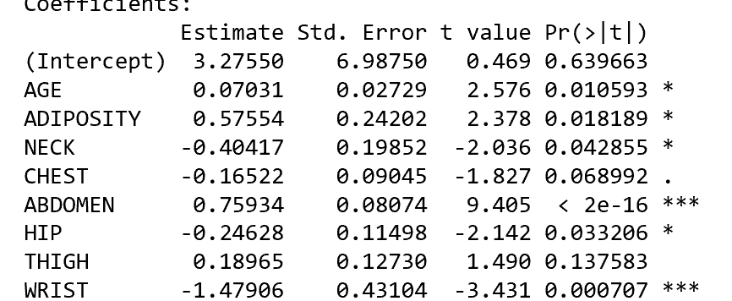
Model Selection
Forward regression
ABDOMEN, WEIGHT and WRIST are significant variables in forward regression
Backward regression
ABDOMEN, WRIST are significant variables in backward regression

Slide 8
Model Selection
Model comparing.
In order to make model simple and easy to understand, we would only select two variable from the result of stepwise model. Comparing the two following models:
BodyFat = ABDOMEN + WEIGHT
BodyFat = ABDOMEN + WRIST
According to the R square and p=value of each variables, we select model with variable ABDOMEN and WEIGHT as final model.

