Slide 1
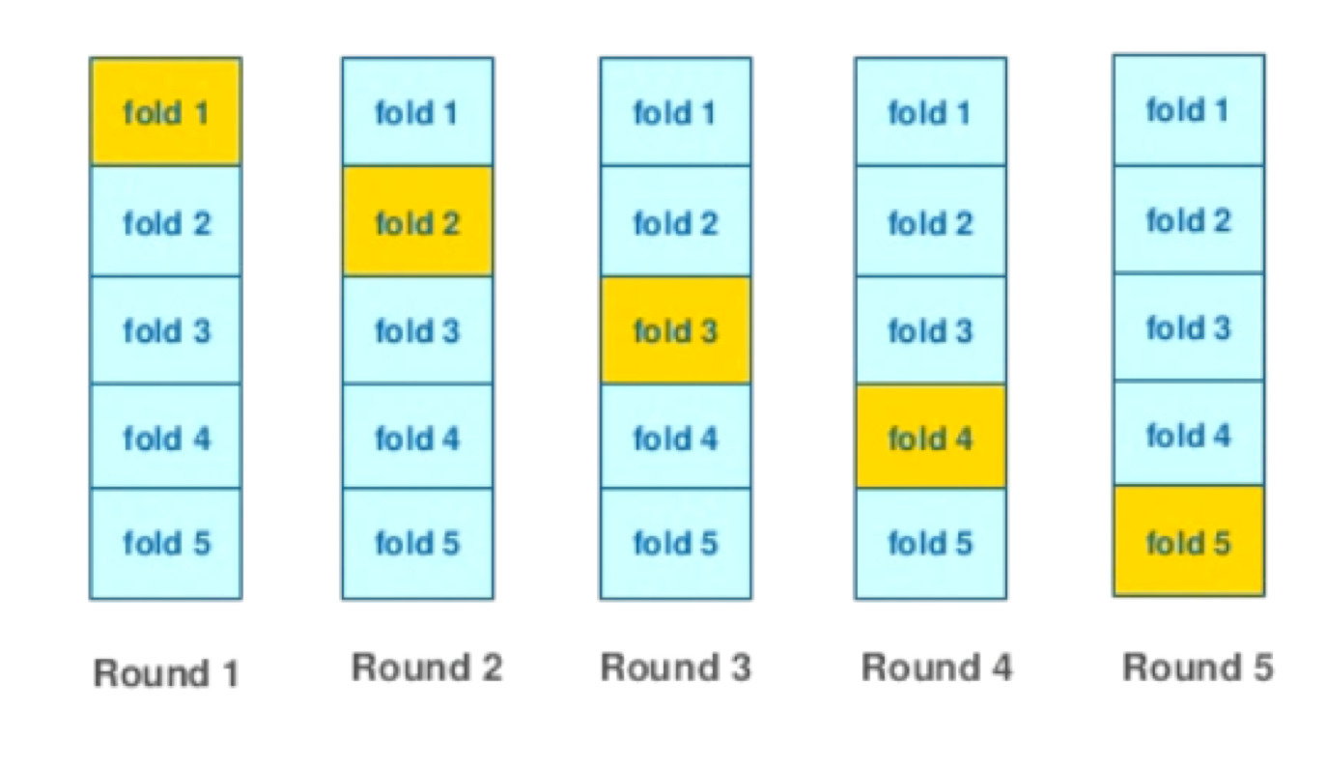
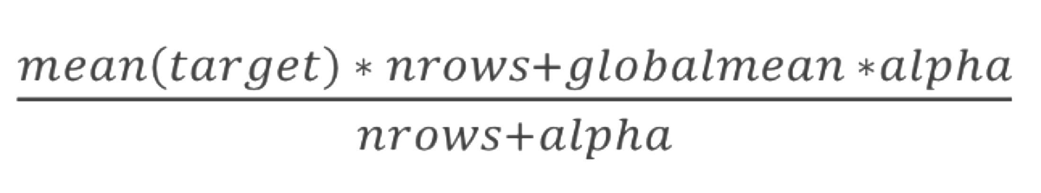
Regularization
【Regularization】
「mean encoding 」はそのまま、使用できないことが以前のビデオで分かったので、このビデオではRegularization(正則化)についてを学ぶ。
正則化は以下の4つの方法を実施していく。
１．交差検証
２．スムージング(平滑化)
３．ノイズを加える
４．Expanding mean
CV loop inside training data;
Smoothing;
Adding random noise;
Sorting and calculating expanding mean.
1.
2.
Notes:
In the previous video we realized that mean encodings can not be used as is and require some kind of regularization on training part of data.
Now, we will cover 4 different methods of regularization. Namely, doing a cross-validation loop to construct mean encodings, then smoothing based on the size of category, then adding random noise and, finally, calculating expanding mean on some permutation of data.
We will go trough all of these methods one by one.

Slide 2
Regularization. CV loop
１．交差検証
データを4～5分割して、学習データとテストデータとして、評価する。各回で測定した精度の平均をとる。
・直感的で堅牢な方法
・データを4～5つに分割する。
・LOO(Leave-One-Out)一個抜き法を使用する際は注意が必要
※データが少ないときに使用
サンプル一個を学習データ、残りをテストデータとする。
<ホールドアウト法>
データを学習データとテストデータに分割して評価する方法
Robust and intuitive
Usually decent results with 4-5 folds across different datasets
Need to be careful with extreme situations like LOO
KFold scheme
Notes:
Lets start with CV loop regularization. It’s a very intuitive and robust method. For a given data point we don’t want to use target variable of that data point. So we separate the data into K (klarge) non-intersecting subsets, or in other words, folds. To get mean encoding value for some subset, we don’t use data points from that subset and estimate the encoding only on the rest of subsets. We iteratively walk through all the data subsets. Usually 4 or 5 folds are enough to get decent results, you don’t need to tune this number.
It may seem that we have completely avoided leakage from target variable. Unfortunately, it’s not true. It will become apparent if we perform leave-one-out scheme to separate the data. I’ll return to it a little later. At first lets learn how to apply that method in practice.

Slide 3
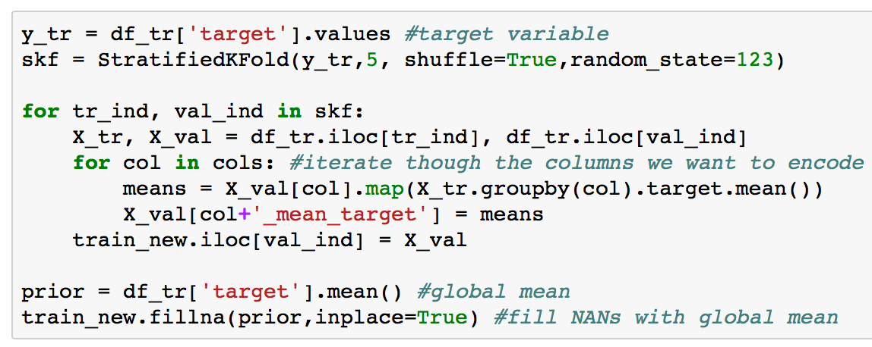
Regularization. CV loop
コード例：
Notes:
Suppose that our training data is in df_tr DataFrame. We will add mean encoded features into another train_new DataFrame.
In the outer loop we iterate through StratifiedKFold iterator in order to separate training data into chunks. X_tr is used to estimate the encoding. X_val is used to apply estimated encoding.
After that we iterate through all the columns and map estimated encodings to X_val DataFrame. At the end of the outer loop we fill train_new DataFrame with the result.
Finally, some rare categories may be present only in a single fold, so we don’t have the data to estimate target mean for them. Thats why we end up with NANs. We can fill them with global mean.
As you can see, the whole process is very simple.

Slide 4
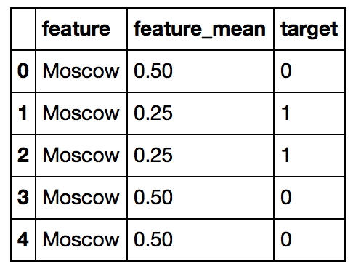
Regularization. CV loop
Perfect feature for LOO scheme
Target variable leakage is still present even for KFold scheme
１．交差検証
・ LOO(Leave-One-Out)一個抜き法のための完璧な特徴量
・Kfoldを使用したとしても、目的変数が漏れてしまうことがある
leakage：テストデータの中にあるべき変数が学習（訓練）データに漏れて(leak)しまっていること
Leave-one-out
Notes:
Now lets return to the question of whether we leak information about target variable or not. Consider the following example. Here we want to encode Moscow via leave-one-out scheme. For the first row we get 0.5, because there are 2 ones and 2 zeros in rest of rows. Similarly, for the second row we get 0.25 and so on. But look closely at the resulting feature: it perfectly splits the data! Rows with feature_mean equal or greater than 0.5 have target 0 and the rest of rows have target 1.
We didn't explicitly use target variable, but our encoding is biased. Furthermore, this effect remains valid even for KFold scheme, just milder.
So it this type of regularization useless? Definitely not. In practice, if you have enough data and use 4 or 5 folds, mean encodings will work fine with this regularization strategy. Just be careful and use correct validation.

Slide 5
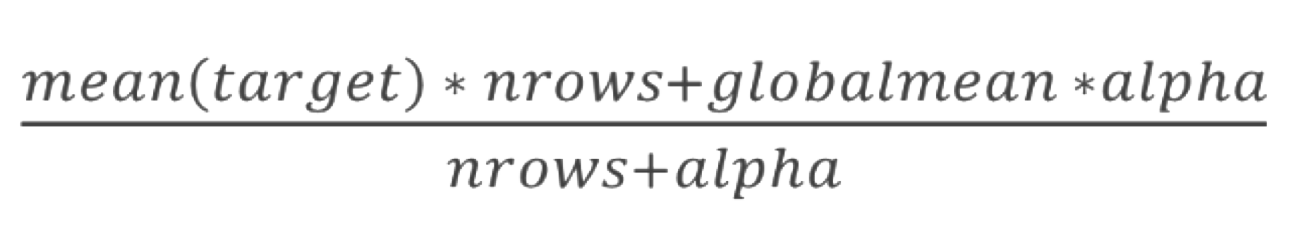
Regularization.Smoothing
Alpha controls the amount of regularization
Only works together with some other regularization method
２．スムージング(平滑化)
・アルファは正則化の量を制御します
・他の正則化方法としか動作しない(交差検証と組み合わせたりできる)
出現頻度が0にならないようにアルファを加算する。
アルファが0の場合、正則化は実施されず、無限に近づくと、globalmeanとなる。
Notes:
Another regularization method is smoothing. It’s based on the following idea. If category is big, has a lot data points, then we can trust the estimated encoding. But if category is rare, it’s the opposite. Formula on the slide uses this idea. It has hyper parameter alpha that controls the amount of regularization. When alpha is zero, we have no regularization and when alpha approaches infinity, everything turns into global mean.
In some sense, alpha is equal to the category size we can trust.
It’s also possible to use some other formula. Basically, anything that punishes encodings of rare categories can be considered smoothing.
Smoothing obviously won’t work on it’s own, but we can combine it with CV loop.

Slide 6
Regularization. Noise
Noise degrades the quality of encoding
How much noise should we add?
Usually used together with LOO
３．ノイズを加える
・ノイズはencodeの品質を下げる
・どれくらいノイズを加えるべきか？
・たいていLOO(Leave-One-Out)一個抜き法と一緒に使用する。
ノイズが多すぎるとモデルとしてよくない。ノイズが少なすぎると正則化がうまくいかない。
Notes:
Another way to regularize mean encodings is to add some noise. Without regularization mean encodings have better quality for the train data than for the test data. By adding noise we simply degrade the quality of encoding on training data.
This method is pretty unstable, it’s hard to make it work. The main problem is the amount of noise we need to add. Too much noise will turn the feature into garbage, while too little noise means worse regularization.
This method is usually used together with leave-one-out regularization. You need to diligently fine tune it, so it’s probably not the best option if you don’t have a lot of time.

Slide 7
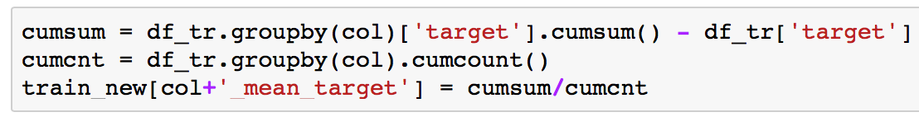
Regularization. Expanding mean
Least amount of leakage
No hyper parameters
Irregular encoding quality
Built - in in CatBoost
４．Expanding mean
・漏れがすくなくなる
・ハイパーパラメータを使用しなくてもよい
・不規則なencodingに対しても質が高い
・CatBoostに組み込まれている
Notes:
The last regularization method I am going to cover is based on expanding mean. The idea is very simple: we fix some sorting order of our data and use only rows from 0 to N-1 to calculate encoding for row N.
You can check simple pandas implementation in the code snippet. ‘cumsum’ stores cumulative sum of target variable up to the given row and ‘cumcnt’ stores cumulative count.
This method introduces the least amount of leakage from target variable and requires no hyper parameter tuning. The only downside is that feature quality is not uniform, but it’s not a big deal. We can average models fitted on encodings calculated from different data permutations.
It’s also worth noting that it is expanding mean method that is used in cat boost gradient boosting trees library, which proves to perform magnificently on datasets with categorical features.

Slide 8
Regularization. Conclusion
There are a lot ways to regularize mean encodings
Unending battle with target variable leakage
CV loop or Expanding mean for practical tasks
<まとめ>
・「 mean encodings 」にはたくさんの正規化方法があります。
・目的変数の漏れをなくしてくれる
・交差検証もしくは「 Expanding mean」が実用的
Notes:
Ok, lets summarize what we’ve discussed in this video. We covered 4 different types of regularization. Each of them has it’s own advantages and disadvantages. Sometimes unintuitively, we introduce target variable leakage, but in practice, we can bear with it. Personally, I recommend CV loop or Expanding mean methods for practical tasks: they are the most robust and easy to tune.
This is it with regularization! In the next video I will tell you about various extensions and practical applications of mean encodings.

