Slide 1
Fundamentals of Object Oriented Programming
Lunch and Learn – Wednesday, March 1, 2017
Notes:
Hey everyone, I'd like to welcome you to today's Lunch and Learn. Today we're going to be covering a concept called Object Oriented Programming, which is one of the first and most common coding patterns that you'll encounter in your day-to-day routine.

Slide 2
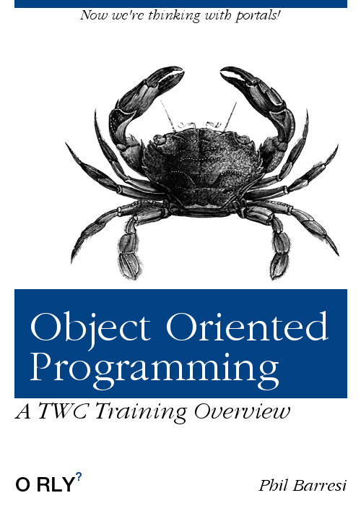

Slide 3
Basic OOP: Abstraction and Encapsulation
Notes:
There's a great deal to Object Oriented Programming, generally split into 4 major tenets that we'll see momentarily. Today, we're going to focus on the most basic concepts of OOP: Abstraction and Encapsulation.
Everything we do today falls under the umbrella of conveying intent with our programming. So with every line of code you read, think in terms of "what is the intent of that?". When you go to write code, think in terms of: "what is the intent of my current function?"

Slide 4
What is Object Oriented Programming?
OOP is the practice of developing code in a manner where the focus is on the data, and the methods that it can perform.
Each object only cares about itself and how it interacts with itself, and other objects.
Objects are generally noun-like; for example, Pigeon or Dog.
Even non-physical things and concepts can be represented in an OOP manner:
Lists are a representation of any ordered set of things
Sets are a representation of any unique set of things
Tweets are a representation of not-funny quips people say and images they post of their food.

Slide 5
What are the fundamentals of OOP?
Abstraction: grouping and representing meaningful data together
Encapsulation: hiding internal logic that the outside world does not care about
Inheritance: objects can be based off other objects
Polymorphism: we can have many ways of doing the same method on a class.

Slide 6
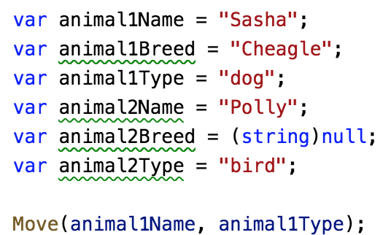
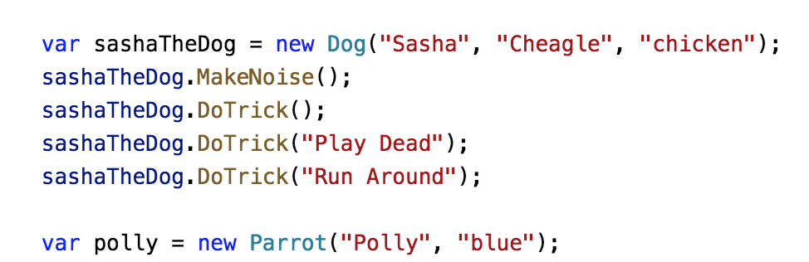
What is abstraction?
Abstraction is the concept of taking your procedures and grouping them together in a reasonable fashion.
On top, we see a procedural way of writing code without classes or objects. We just see a line by line description of what our program is supposed to do – it is very limited to the current intent of the program, and not very expandable.
Below, we see a grouping based on commonality. We make animals, of different types, by constructing new classes.
Let’s take a look at IAnimal.cs in order to see how we’d define an interface for our animal.

Slide 7
Classes and Objects in C#
In C#, we can practice Object Oriented programming by writing classes and making objects.
Classes are a blueprint for a complex piece of data. Classes themselves are types just like integers and booleans, and don’t actually have any data of their own (with the exception of static data). Instead, they have properties and methods which describe data that instances of your objects will contain and functions they will perform.
If you look in your classes folder, you’ll see all our classes for different types of animals!
While classes are blueprints, we make new instances of the classes (see Program.cs). You can tell you are making an instance of a class by the use of the new keyword, followed by the constructor function of a class.
These instances are self contained objects that have all the data and methods of that class. You can get or set the properties of that class instance and not affect other instances of that class.

Slide 8
What is encapsulation?
Encapsulation is the process of hiding internal data and logic from the outside. It can be seen as part of DOING the abstraction
Real world example: you don't need to know how a dog's body works to know that when you feed your dog a steak, they eat the steak and digest it. (See dog.js Eat method for an abstraction of that!)
Real world example: You also don't know how the parrot will decide to speak, but it will emulate something spoken to. You just want to get the result of it speaking.
This is useful because it allows us to focus on making objects that are self-contained: they perform what is expected of them, and we don't need to know how they do that.

Slide 9
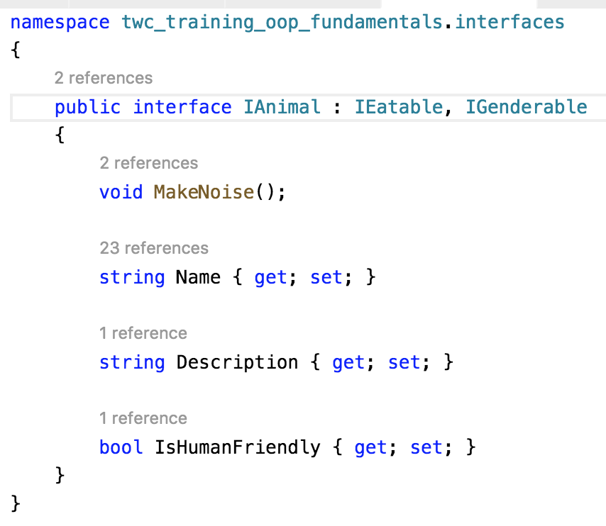
What is an interface?
An interface is a contract that describes what a class has and how it is expected to behave.
When we make animals, they would implement IAnimal, which means they would have all the properties and methods defined in IAnimal.
Interfaces can implement other interfaces, as well!

Slide 10
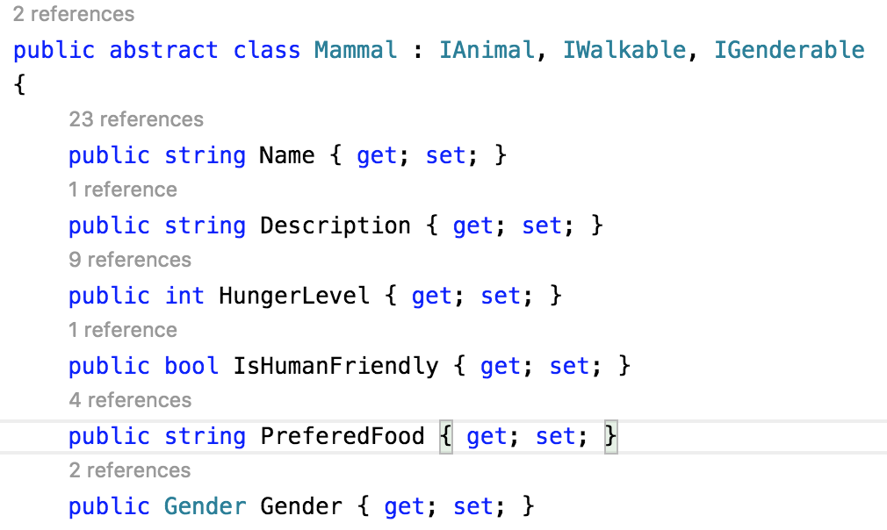
How do we implement an interface in C#?
Implementation is a fulfillment of an interface; to implement an interface, your class needs to have all the properties and methods defined in the interface.
Our Mammal class is going to implement 3 interfaces:
IAnimal
IGenderable
IWalkable
As such, it must implement all methods and all properties from all those interfaces.

Slide 11
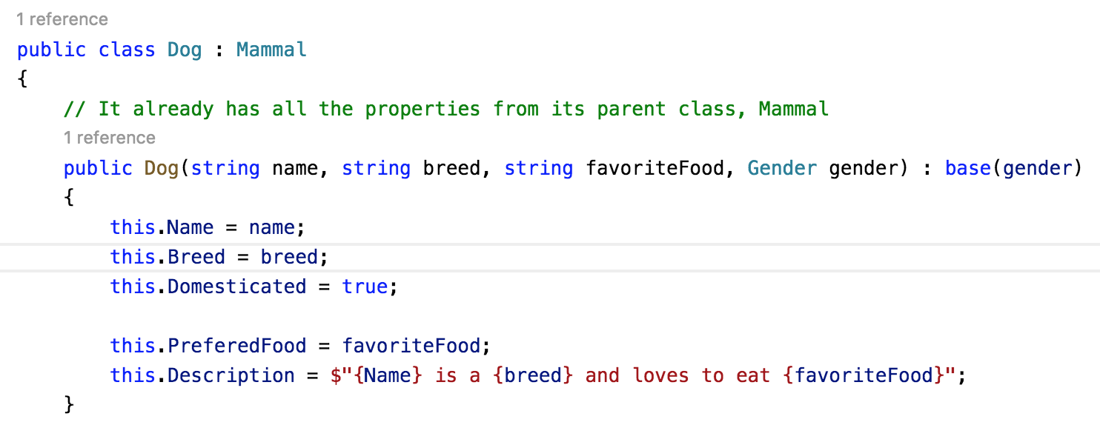
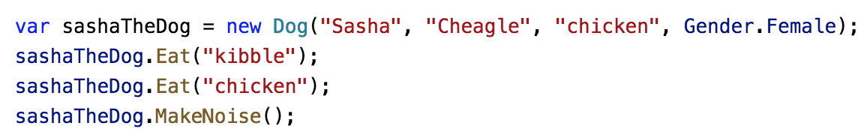
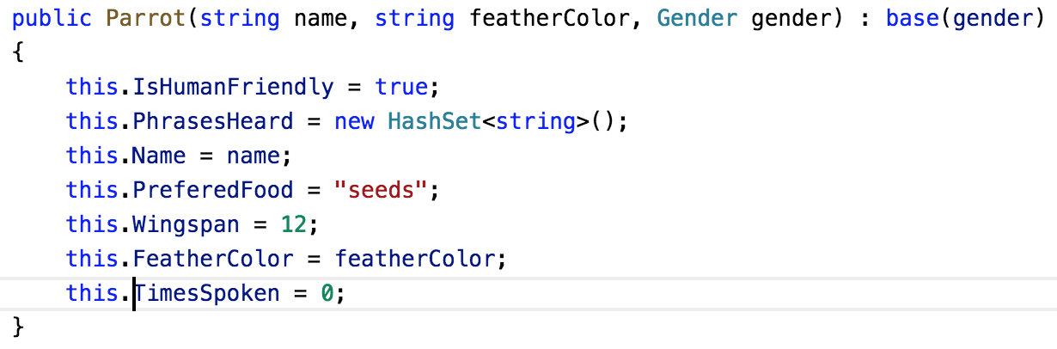
Constructors and initialization
When creating a class, we create special methods call constructors that are called when we make a new instance of the class. The constructor method name is the same as the class name.
Constructors are extremely important, as they allow you to setup all the data for each instance of the class.
We often pass data about the instance of that class into the constructor, so that we can setup that instance with relevant data.
Here, we see that the Dog has a constructor method that takes the dog’s name, breed, favorite food, and gender and sets up the properties of that class instance based on those parameters.
Constructors also allow us to initialize data that does not come from the parameters, such as setting the parrot’s PhrasesHeader property to a brand new hash set at the time of construction.

Slide 12
Practical: Abstraction and Encapsulation
You will make an interface, IPerson.cs, which implements IGenderable, IWalkable, and IEatable
Properties in IPerson:
Name: String
Age: int
Hobbies: HashSet<string>()
Methods in IPerson:
void Talk(): If the person does not have a hobby, it will print to the console: I don’t have anything to talk about; if the person has hobbies, it will talk about one of the hobbies
void AddHobby(string hobby): will add an entry to the set of hobbies
You will then write Person.cs, which will implement IPerson!

Slide 13
Advanced OOP: Inheritance and Polymorphism

Slide 14
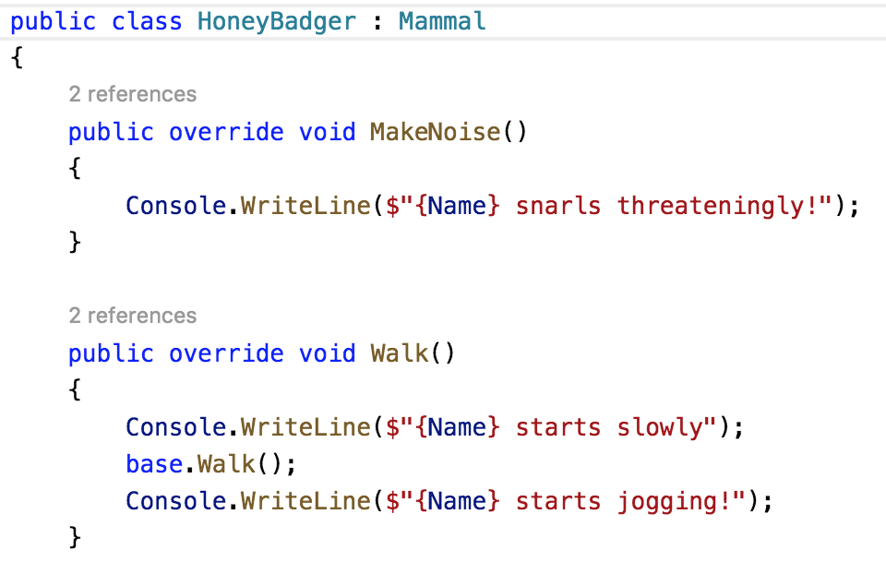
What is inheritance?
Inheritance is the concept of allowing classes to be created that exist "on top" of other classes.
For example, we can make a class for mammals, and have dogs inherit from that class. Often, we will inherit from abstract classes.
It is often useful to make an abstract class, which is an ”incomplete class", or to use virtual methods when making a class that will act as a parent class. You can't make a new instance of an abstract class since it's incomplete, but you can inherit from them and build on top of them.
Our Mammal class was an abstract class, and our HoneyBadger class inherits the Mammal class and finishes it up.

Slide 15
Multiple Inheritance
Interfaces and classes can both inherit from multiple interfaces at a time. This allows us to create small interfaces that describe a very reusable slice of functionality.
For example, our animals all can move! But they all move in different ways.
Rather than declare that all our animals follow the interface rules of IWalkable, or IFlyable, we have each particular abstract class define inherit from IAnimal and whichever movement patterns describe them best.
Mammal inherits from IWalkable and IAnimal
Avian inherits from IWalkable, IFlyable, and IAnimal
This can be extended to a school of thought known as composition over inheritance
https://en.wikipedia.org/wiki/Composition_over_inheritance

Slide 16
What is polymorphism?
Polymorphism is the concept of your classes using the same name to represent the same action occurring, but in different ways. This comes in two forms: overriding, and overloading

Slide 17
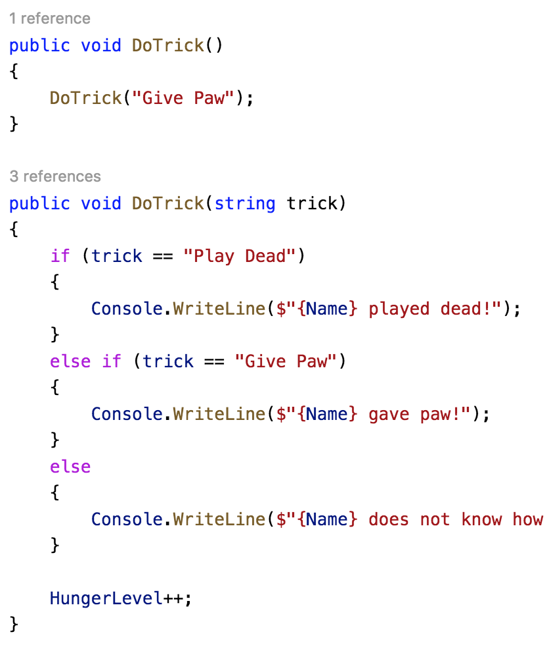
Overloading
Overloading is when a class has a method with the same signature and return type, but different parameters. It is common to see overloads calling other overloads with different parameters.
Here, we see how a Dog has two DoTrick overloads: one of them has no particular trick specified, while one of them allows you to specify which trick to have the dog perform.

Slide 18
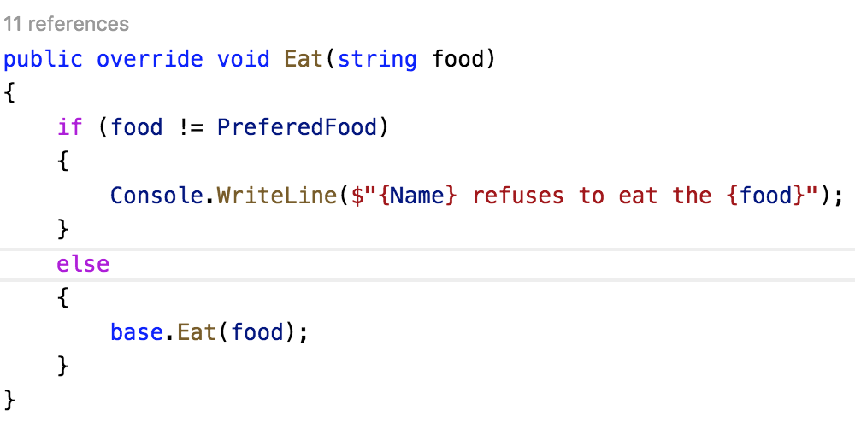
Overriding
Overriding is when a child class makes a method that overrides a parent class's version of the same method.
Even if we override a method on our child class, inside of our class we can actually still call our parent methods by using the base reference.
We see this in most of our animals. This demonstration can be found in Parrot.cs, where the Parrot will only eat if it’s their prefered food.

Slide 19
Abstract and virtual methods
Abstract methods are when methods are described in a class, but not defined; it's allowing a class to describe the thing that it will need.
Virtual methods are "suggestions" that a class can follow. They can be overridden, or they can be used by their children.

Slide 20
Practical: Putting it all together
Make a new animal, Cat, that inherits from Mammal.
Cats should have a private readonly property called HumanTolerance, which describes how many times it can stand being told to speak before it stops talking and prints the message: "{CATNAME} is bored and does not want to speak"; after being fed, this human toleration is set to the value provided at time of construction
Making the cat class is an example of abstraction
Making the cat class have a readonly property called HumanTolerance that it uses internally is encapsulation.
Having cat inherit from Mammal is inheritance.
Having the cat override speak and call the parent’s speak method internally is polymorphism.

